Slide 1


Space cataloguing and intelligence: the potential disclosed by MATER algorithm and by the East-West branch
Final Meeting
Martedì 30 Giugno – Giovedì 02 Luglio
OAC - Osservatorio Astrofisico di Arcetri
M.F. Montaruli

Slide 2
OUTLINE
01
02
03
04
05
06
MATER algorithm
Operational implementation
Ambiguity solving through East-West branch
Radar IOD
Fragmentation campaigns (CZ-6A, Starlink 34343, ZQ-2E R/B)
Conclusions
Missione 4 • Istruzione e Ricerca
Missione 4 • Istruzione e Ricerca

Slide 3
OUTLINE
01
02
03
04
05
06
MATER algorithm
Operational implementation
Ambiguity solving through East-West branch
Radar IOD
Fragmentation campaigns (CZ-6A, Starlink 34343, ZQ-2E R/B)
Conclusions
Missione 4 • Istruzione e Ricerca
Missione 4 • Istruzione e Ricerca

Slide 4
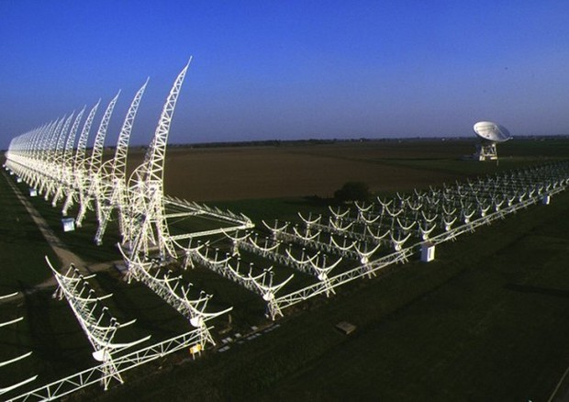
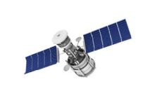
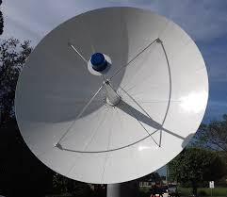
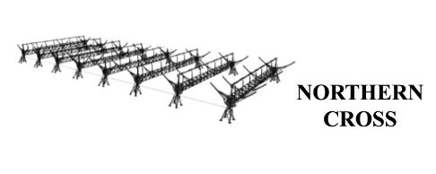
BIstatic Radar for Leo Survey (BIRALES)
Angular profile
Slant Range
Northern Cross
Doppler Shift
RFT
Northern Cross
(Bologna)
RFT
(Sardinia)
Missione 4 • Istruzione e Ricerca
Missione 4 • Istruzione e Ricerca

Slide 5
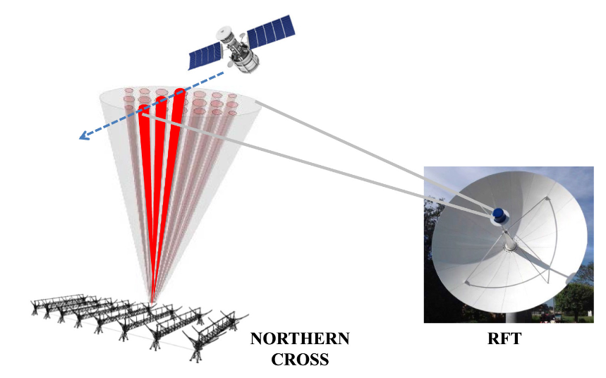
BIRALES: Multibeam Approach
Angular profile
Disadvantage: both main lobes and grating lobes appear in sensor FoV
Static beamforming ^{[1]}
Beam 2
Beam 1
Medicina
(Bologna)
Salto di Quirra
(Sardinia)
M. Losacco, et al., Initial orbit determination with the multibeam radar sensor BIRALES, 2020
Missione 4 • Istruzione e Ricerca
Missione 4 • Istruzione e Ricerca

Slide 6
BIRALES: Multibeam Approach
Angular profile
Disadvantage: both main lobes and grating lobes appear in sensor FoV
Static beamforming ^{[1]}
Beam 2
Beam 1
Medicina
(Bologna)
Salto di Quirra
(Sardinia)
M. Losacco, et al., Initial orbit determination with the multibeam radar sensor BIRALES, 2020
Missione 4 • Istruzione e Ricerca
Missione 4 • Istruzione e Ricerca

Slide 7
BIRALES: Multibeam Approach
Angular profile
Disadvantage: both main lobes and grating lobes appear in sensor FoV
Static beamforming ^{[1]}
Beam 2
Beam 1
Medicina
(Bologna)
Salto di Quirra
(Sardinia)
M. Losacco, et al., Initial orbit determination with the multibeam radar sensor BIRALES, 2020
Missione 4 • Istruzione e Ricerca
Missione 4 • Istruzione e Ricerca

Slide 8
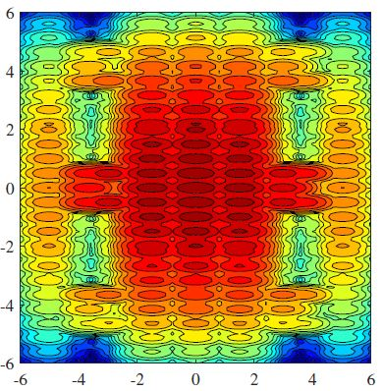
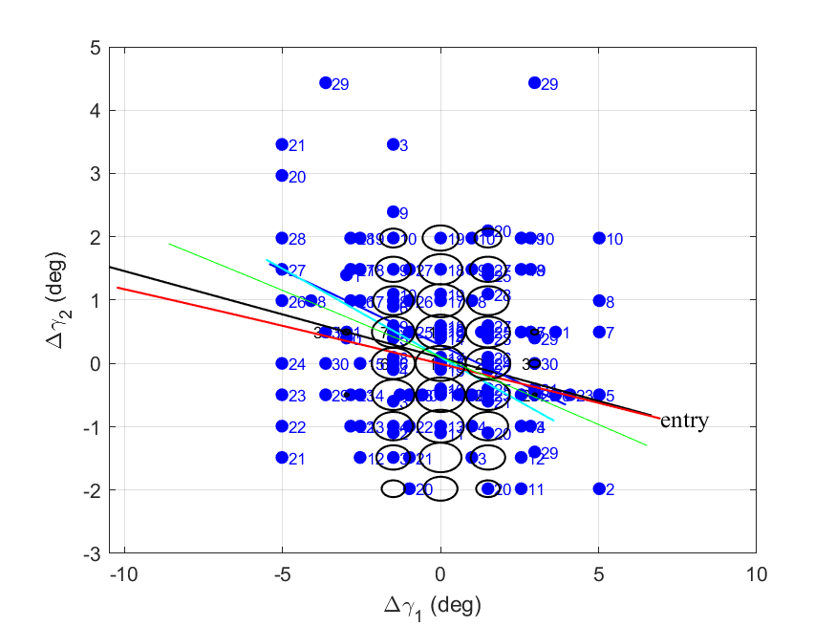
BIRALES: Multibeam Approach
Static beamforming ^{[1]}
Medicina
(Bologna)
Salto di Quirra
(Sardinia)
M. Losacco, et al., Initial orbit determination with the multibeam radar sensor BIRALES, 2020
Missione 4 • Istruzione e Ricerca
Missione 4 • Istruzione e Ricerca

Slide 9
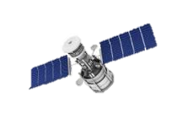

BIRALES: Multibeam Approach
Adaptive beamforming
Medicina
(Bologna)
Salto di Quirra
(Sardinia)
R. Schmidt et al., IEEE Transactions on Antennas and Propagation, 1986
Missione 4 • Istruzione e Ricerca
Missione 4 • Istruzione e Ricerca

Slide 10
BIRALES: Adaptive Beamforming Approach
MUSIC - MUltiple SIgnal Classification ^{[2]}
Raw signal
Covariance matrix
MUSIC ^{[2]}
DOA estimation
R. Schmidt et al., IEEE Transactions on Antennas and Propagation, 1986
Missione 4 • Istruzione e Ricerca
Missione 4 • Istruzione e Ricerca

Slide 11
BIRALES: Adaptive Beamforming Approach
MUSIC - MUltiple SIgnal Classification ^{[2]}
Raw signal
Direction of Arrival (DOA)
Covariance matrix
MUSIC ^{[2]}
DOA estimation
Angular track
R. Schmidt et al., IEEE Transactions on Antennas and Propagation, 1986
Missione 4 • Istruzione e Ricerca
Missione 4 • Istruzione e Ricerca

Slide 12
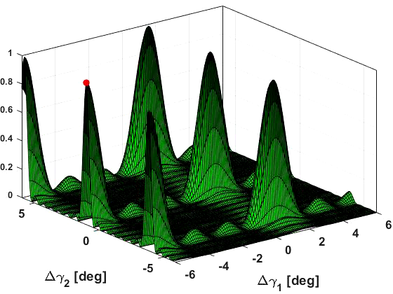
Music Approach for Track Estimate and Refinement (MATER)
Signal Correlation Matrix
0.73 m
Estimate signal Direction of Arrival
Solve angular track ambiguities
5.67 m
10 m
M.F. Montaruli, et al., Adaptive track estimation on a radar array system for space surveillance, Acta Astronautica, 2022
M.F. Montaruli, et al., Adaptive track approach for multiple sources scenario in space surveillance applications, Aerospace Science and Technologies, 2024
M.F. Montaruli, et al., Delta-k approach for space surveillance multireceiver radars. Astrodynamics, 2024
Missione 4 • Istruzione e Ricerca
Missione 4 • Istruzione e Ricerca

Slide 13
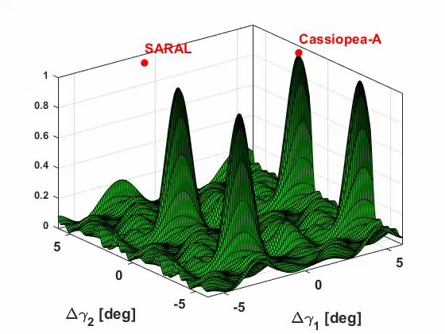
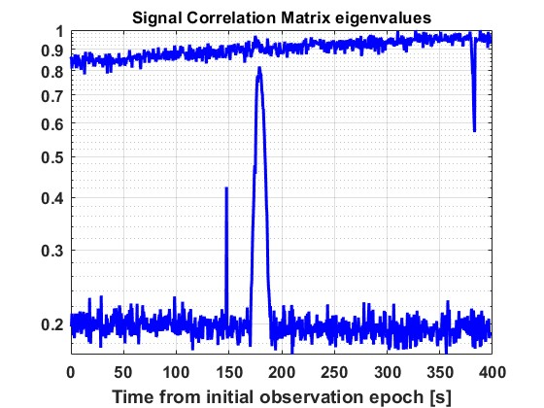

Real data processing - channelisation
December 2°, 2022
Target: SARAL (norad ID 39086)
Radiosource: Cassiopea-A
SARAL transit
Cassiopea-A
SARAL
Missione 4 • Istruzione e Ricerca
Missione 4 • Istruzione e Ricerca

Slide 14
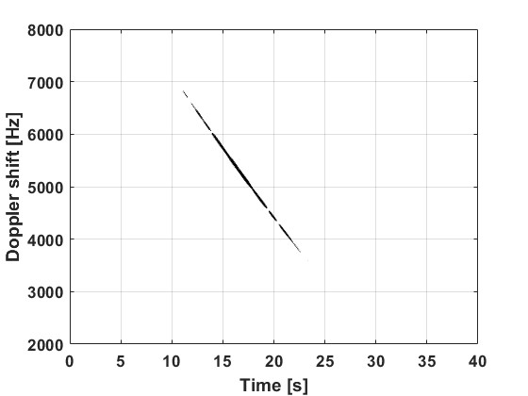
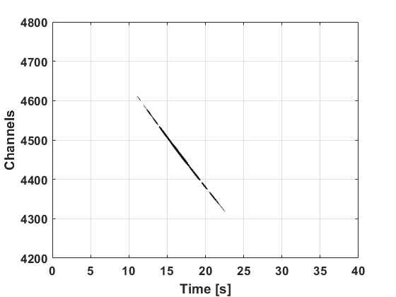



Real data processing - channelisation
8192 channels
Detection block
Channel selected
Correlate
$$BW_{RX} \sim 85000 Hz$$
Angular track accuracy
$$BW_{RX} \sim 10 Hz$$
Detection rate
$$SNR∝\frac{1}{BW_{RX}}$$
Multiple sources scenario
M.F. Montaruli, et al., Operational angular track reconstruction in survey radars through an adaptive beamforming approach, MDPI Aerospace, 2024
Missione 4 • Istruzione e Ricerca
Missione 4 • Istruzione e Ricerca

Slide 15
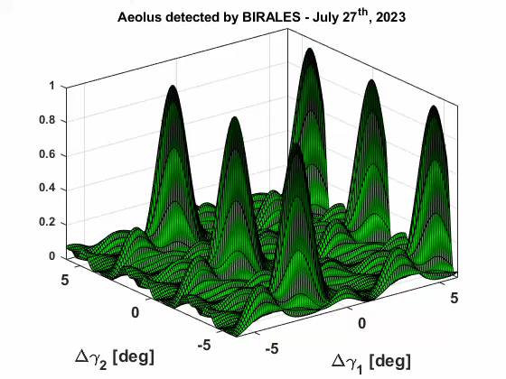
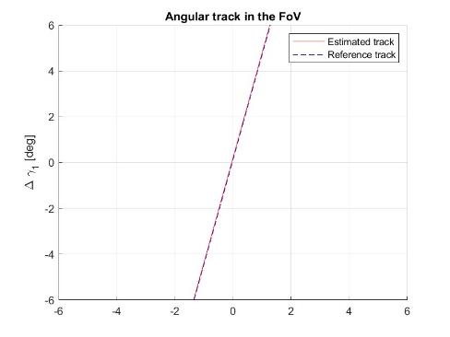
Real data processing - channelisation
July 24°-28°, 2023
The target was maneuvering during the observation
Uncatalogued case
Aeolus re-entry campaign
Missione 4 • Istruzione e Ricerca
Missione 4 • Istruzione e Ricerca

Slide 16
OUTLINE
01
02
03
04
05
06
MATER algorithm
Operational implementation
Ambiguity solving through East-West branch
Radar IOD
Fragmentation campaigns (CZ-6A, Starlink 34343, ZQ-2E R/B)
Conclusions
Missione 4 • Istruzione e Ricerca
Missione 4 • Istruzione e Ricerca

Slide 17
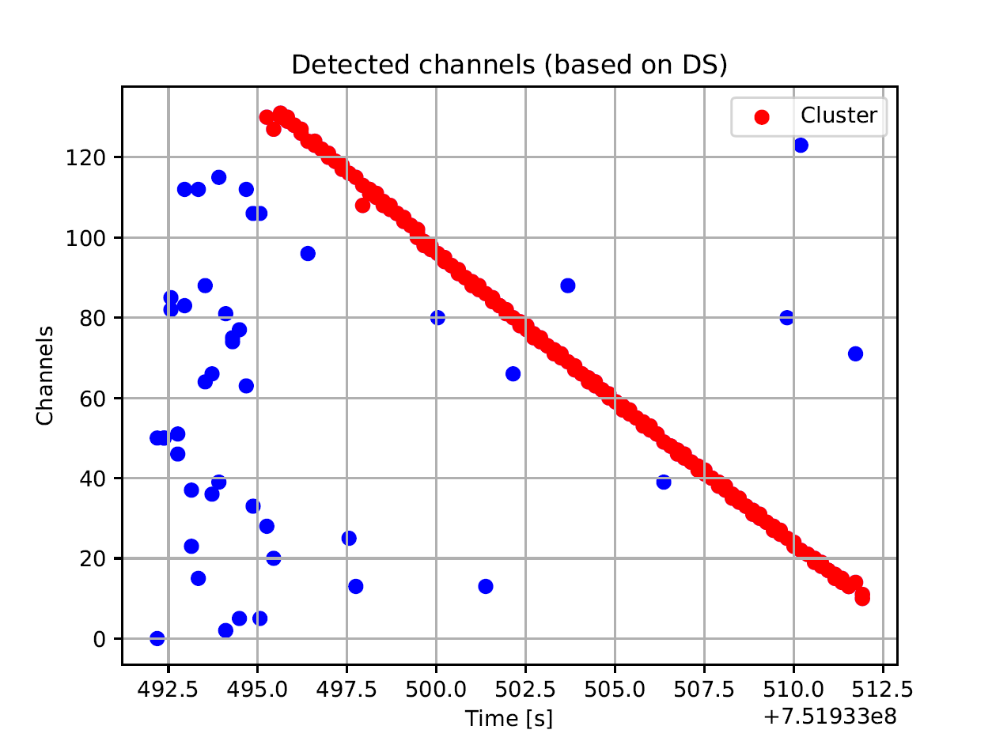
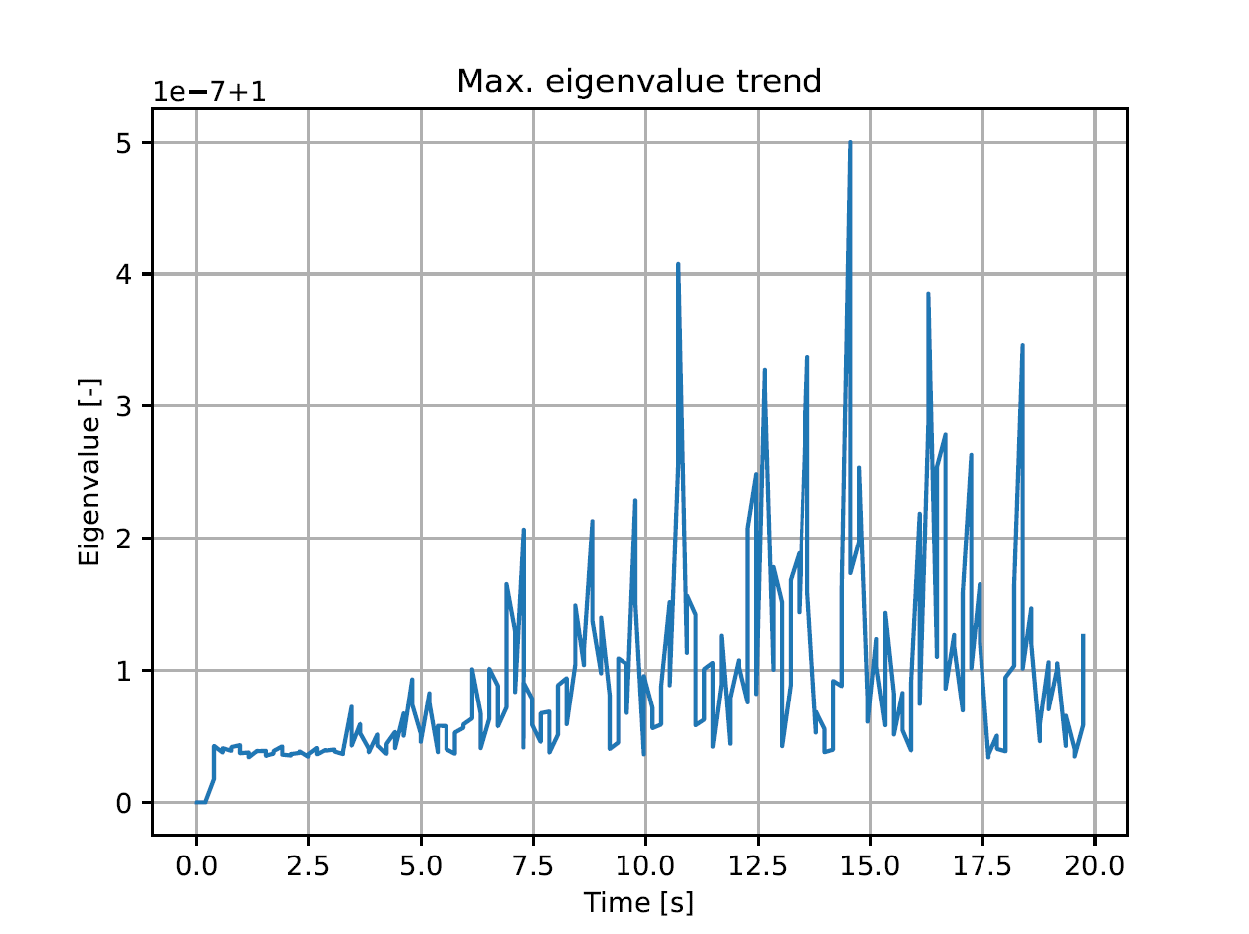
Input
MATER
CM calibration
Remove outliers
Signal power cut
Signal Correlation Matrix
Detection epochs
Detection channels
Other data
Missione 4 • Istruzione e Ricerca
Missione 4 • Istruzione e Ricerca

Slide 18
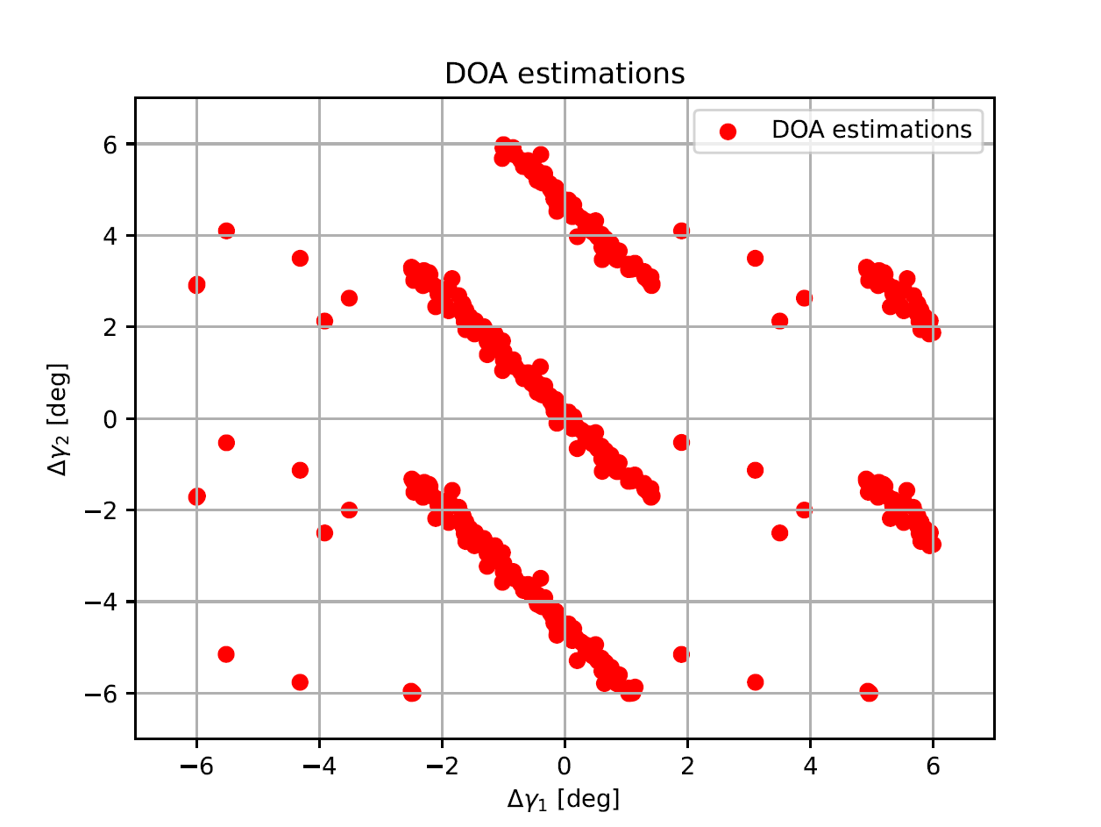
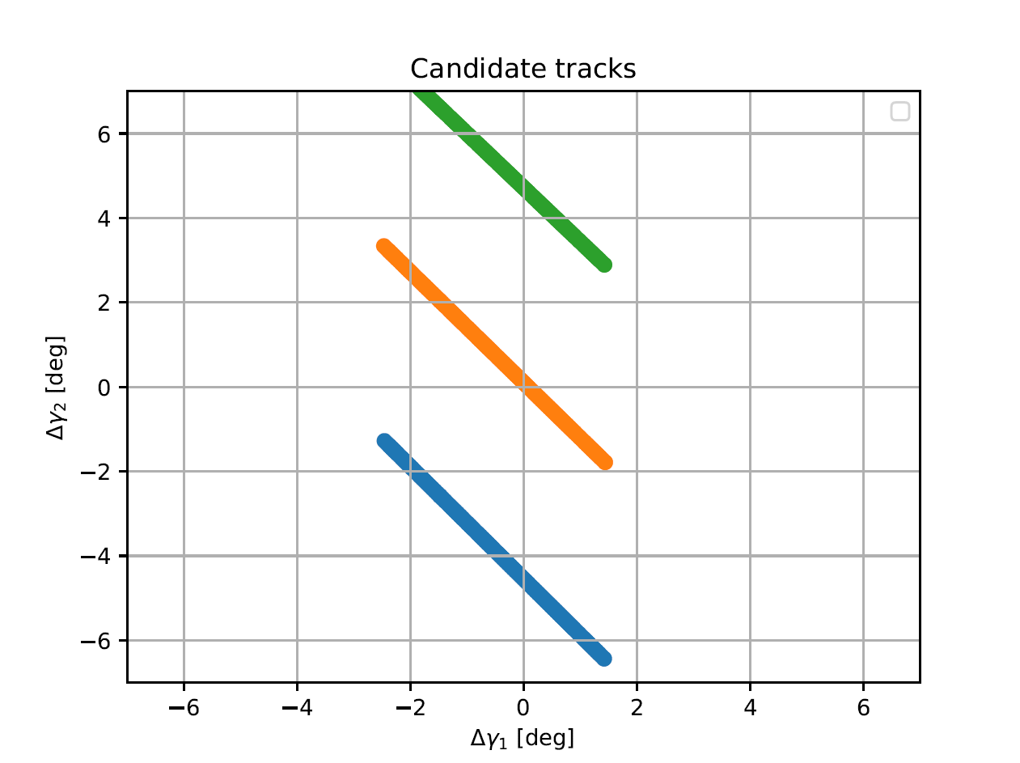
Input
MATER
CM calibration
Remove outliers
Signal power cut
Signal Correlation Matrix
Compute angular track candidates
Cluster solutions
Estimate signal Direction of Arrival
Detection epochs
Detection channels
Other data
Missione 4 • Istruzione e Ricerca
Missione 4 • Istruzione e Ricerca

Slide 19
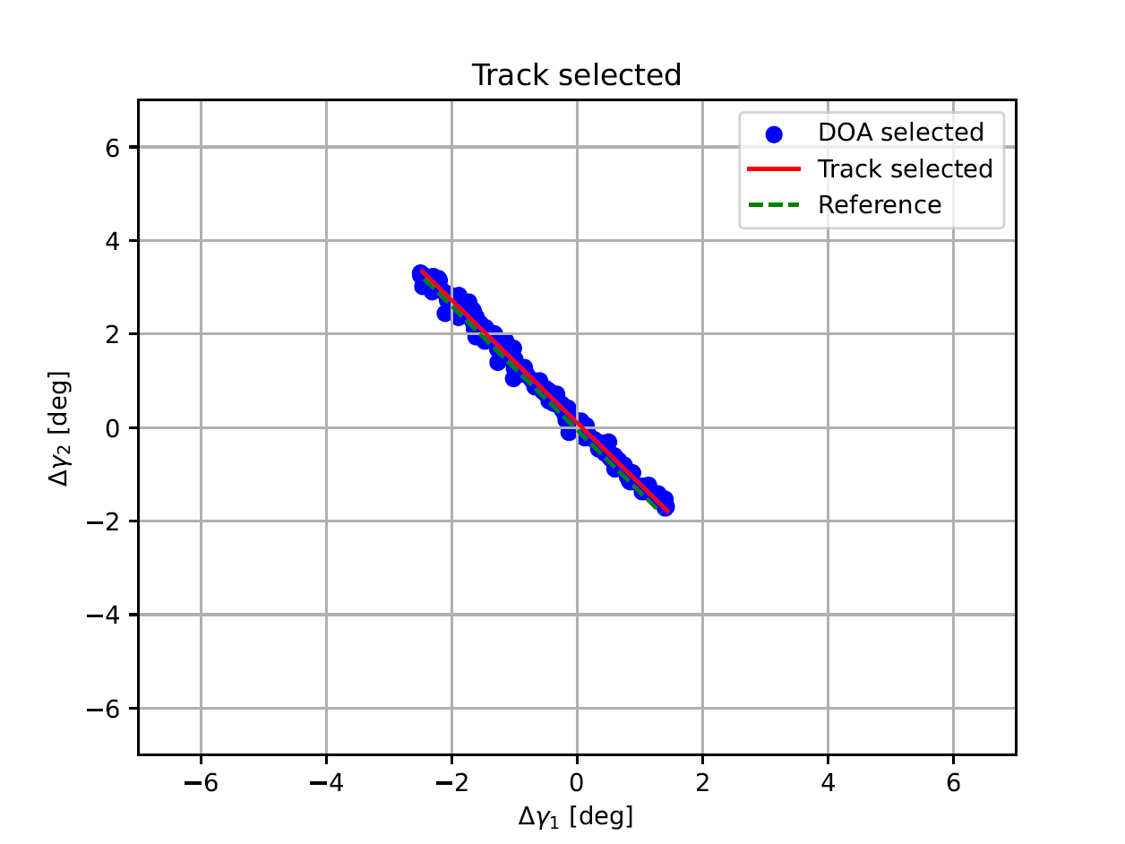
Input
MATER
CM calibration
Remove outliers
Signal power cut
Signal Correlation Matrix
Compute angular track candidates
Cluster solutions
Estimate signal Direction of Arrival
Detection epochs
Track-to-orbit correlation
Detection channels
Select the track best correlating
Other data
Missione 4 • Istruzione e Ricerca
Missione 4 • Istruzione e Ricerca

Slide 20
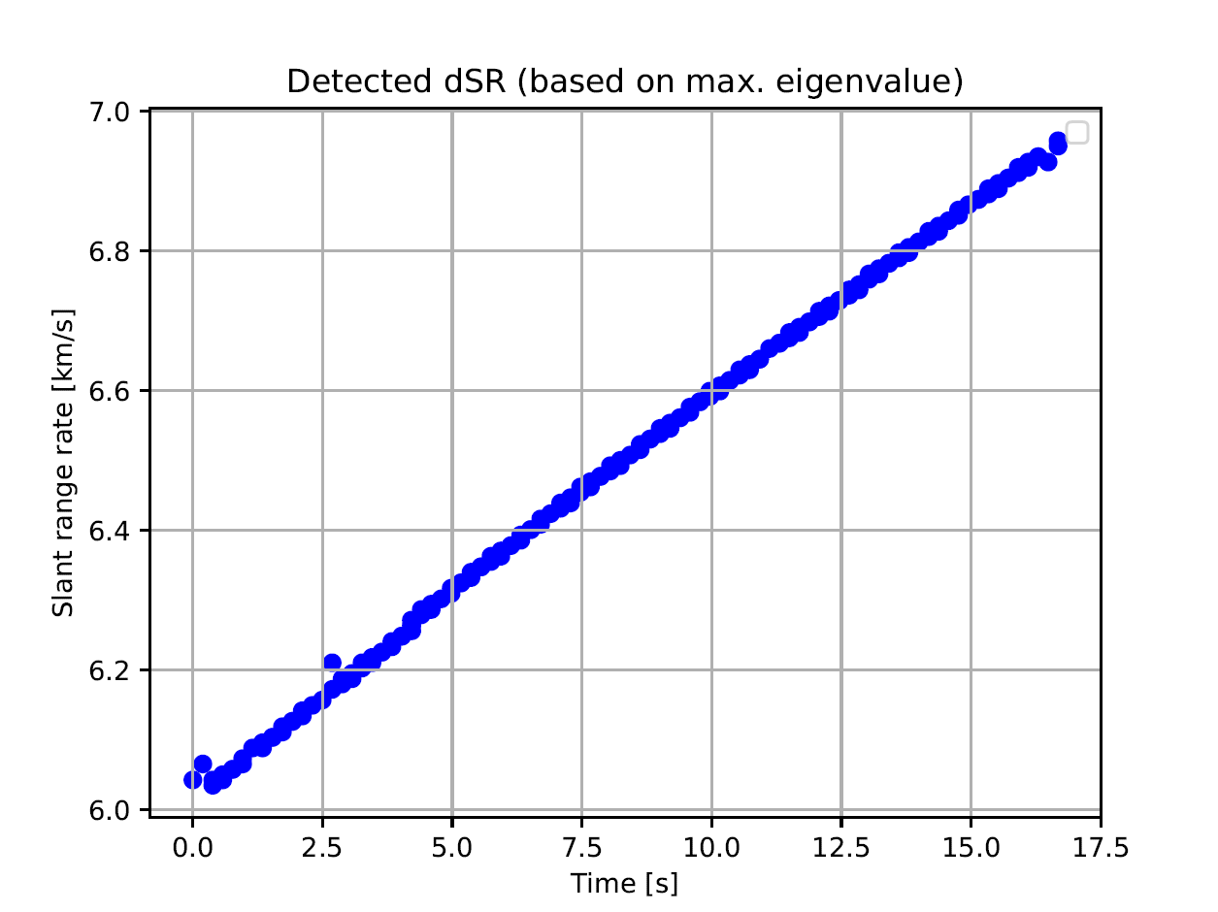
Input
MATER
CM calibration
Remove outliers
Signal power cut
Signal Correlation Matrix
Compute angular track candidates
Cluster solutions
Estimate signal Direction of Arrival
Detection epochs
Track-to-orbit correlation
Detection channels
Select the track best correlating
Other data
Possible integration with slant range measurement
Write TDM
Missione 4 • Istruzione e Ricerca
Missione 4 • Istruzione e Ricerca

Slide 21
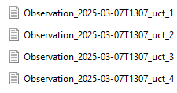
Input
MATER
CM calibration
Remove outliers
Signal power cut
Signal Correlation Matrix
Compute angular track candidates
Cluster solutions
Estimate signal Direction of Arrival
Detection epochs
Track-to-orbit correlation
Detection channels
Select the track best correlating
Keep all the track candidates as UCTs
Other data
Possible integration with slant range measurement
Write TDM
Write TDMs
Missione 4 • Istruzione e Ricerca
Missione 4 • Istruzione e Ricerca

Slide 22
Input
MATER
TDM(s)
CM calibration
Remove outliers
Signal power cut
Signal Correlation Matrix
Angular track
Compute angular track candidates
Cluster solutions
Estimate signal Direction of Arrival
Detection epochs
Doppler shift
Track-to-orbit correlation
Detection channels
Select the track best correlating
Keep all the track candidates as UCTs
Slant range
Other data
Possible integration with slant range measurement
Write TDM
Write TDMs
Missione 4 • Istruzione e Ricerca
Missione 4 • Istruzione e Ricerca

Slide 23
Input
MATER
TDM(s)
CM calibration
Remove outliers
Signal power cut
Signal Correlation Matrix
Angular track
  Python: 3.7 or higher.
  Compatibility with data provided by the detection module (University of Malta).
  TDMs generated both for catalogued and uncatalogued objects.
  Computational time: about 1 minute to process 20 s track.
  Report generated: graphs and measurement residuals.
Compute angular track candidates
Cluster solutions
Estimate signal Direction of Arrival
Detection epochs
✓
Doppler shift
✓
Track-to-orbit correlation
Detection channels
✓
Select the track best correlating
Keep all the track candidates as UCTs
Slant range
Other data
Possible integration with slant range measurement
Write TDM
Write TDMs
Missione 4 • Istruzione e Ricerca
Missione 4 • Istruzione e Ricerca

Slide 24
OUTLINE
01
02
03
04
05
06
MATER algorithm
Operational implementation
Ambiguity solving through East-West branch
Radar IOD
Fragmentation campaigns (CZ-6A, Starlink 34343, ZQ-2E R/B)
Conclusions
Missione 4 • Istruzione e Ricerca
Missione 4 • Istruzione e Ricerca

Slide 25


Ambiguity solving through East-West branch
Correct
Ambiguous
North-south branch
0.73 m
$$δ_{1}$$
Correct
Ambiguous
$$δ_{1}$$
5.67 m
10 m
10 m
5.67 m
Missione 4 • Istruzione e Ricerca
Missione 4 • Istruzione e Ricerca

Slide 26

Ambiguity solving through East-West branch
Correct
Ambiguous
North-south branch
0.73 m
$$δ_{1}$$
Correct
Ambiguous
$$δ_{2}$$
East-west branch
5.67 m
b
a
10 m
10 m
5.67 m
Missione 4 • Istruzione e Ricerca
Missione 4 • Istruzione e Ricerca

Slide 27
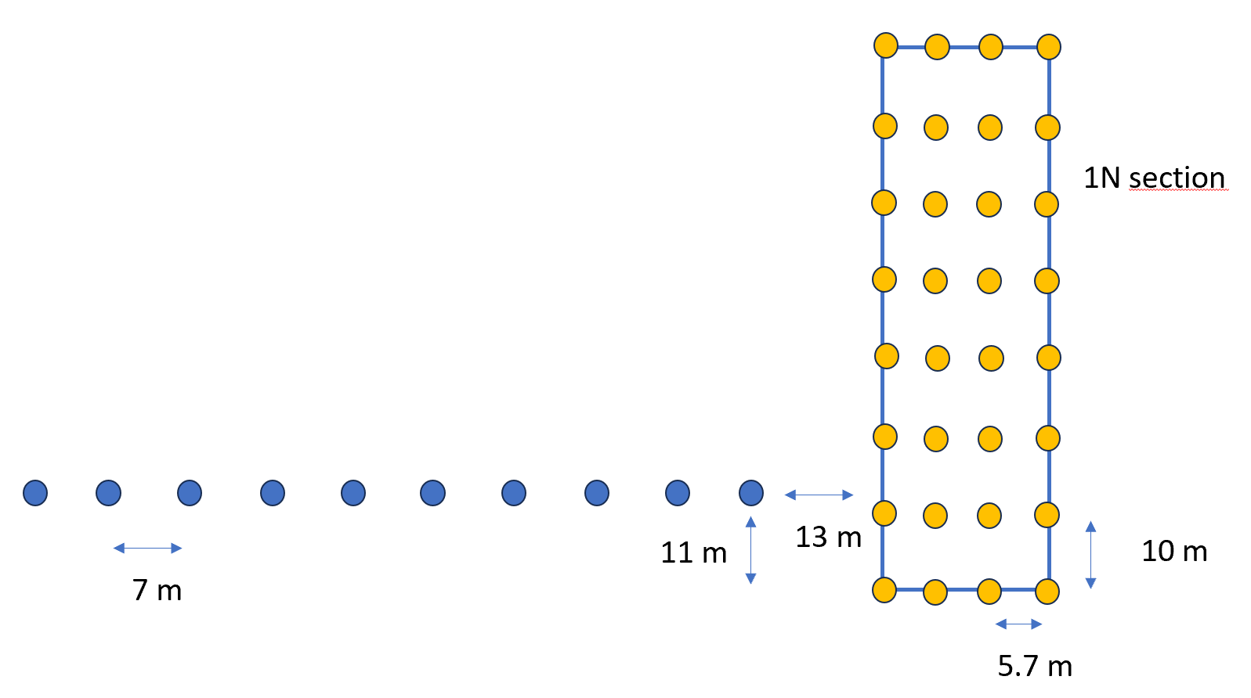
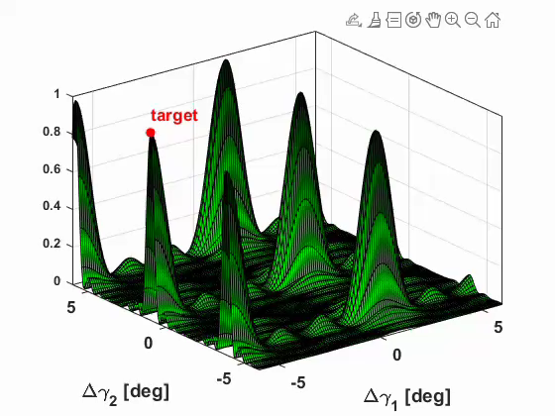
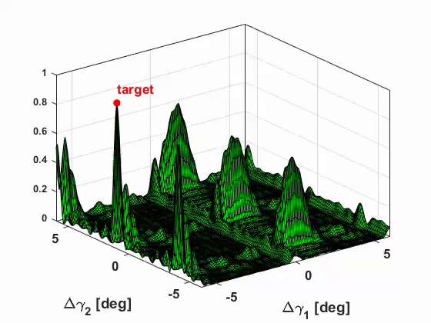
Ambiguity solving through East-West branch
1N section
1N section + EW branch
E-W branch: 10 receivers (out of 416) are considered
Improved resolution in E-W direction.
The N-S shift between the 1N section and the E-W branch depends on the E-W pointing direction.
  Performance partially change
Missione 4 • Istruzione e Ricerca
Missione 4 • Istruzione e Ricerca

Slide 28
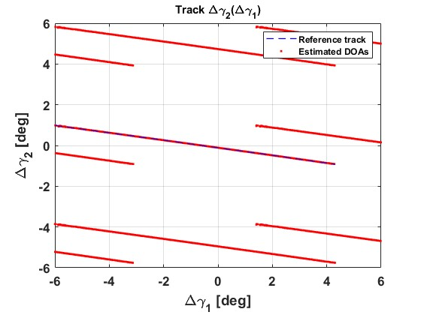
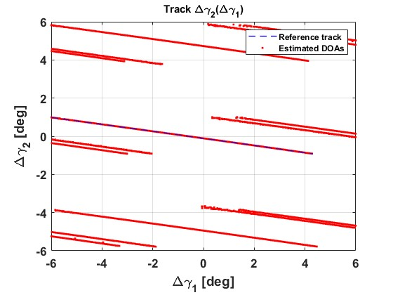
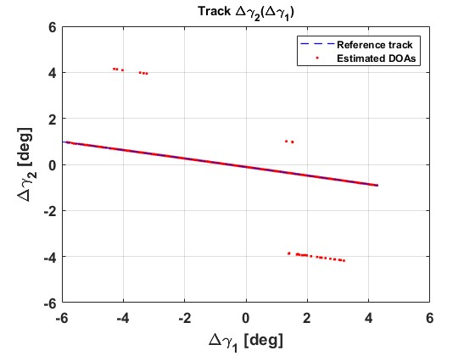
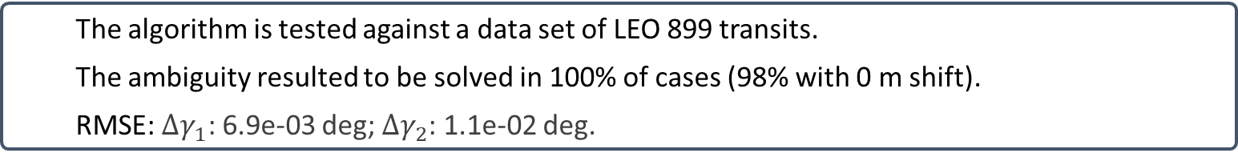
Ambiguity solving through East-West branch
1N section
1N section
EW branch
Most fixed solution
Operationally
  The algorithm is tested against a data set of LEO 899 transits.
  The ambiguity resulted to be solved in 100% of cases (98% with 0 m shift).
  RMSE: $Δγ_{1}$: 6.9e-03 deg; $Δγ_{2}$: 1.1e-02 deg.
No need of track-to-orbit correlation:
Improves reliability.
Solve the ambiguity in the UCT case.
✓
✓
Missione 4 • Istruzione e Ricerca
Missione 4 • Istruzione e Ricerca

Slide 29
OUTLINE
01
02
03
04
05
06
MATER algorithm
Operational implementation
Ambiguity solving through East-West branch
Radar IOD
Fragmentation campaigns (CZ-6A, Starlink 34343, ZQ-2E R/B)
Conclusions
Missione 4 • Istruzione e Ricerca
Missione 4 • Istruzione e Ricerca

Slide 30
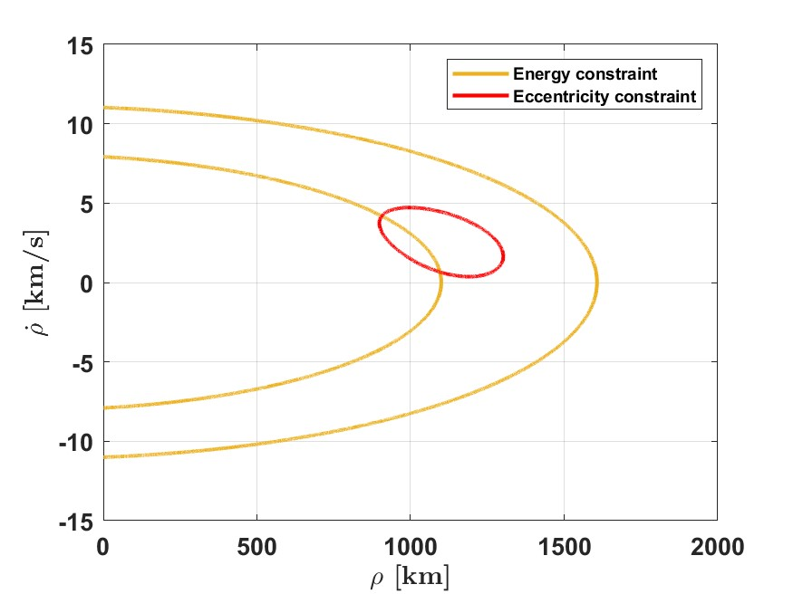
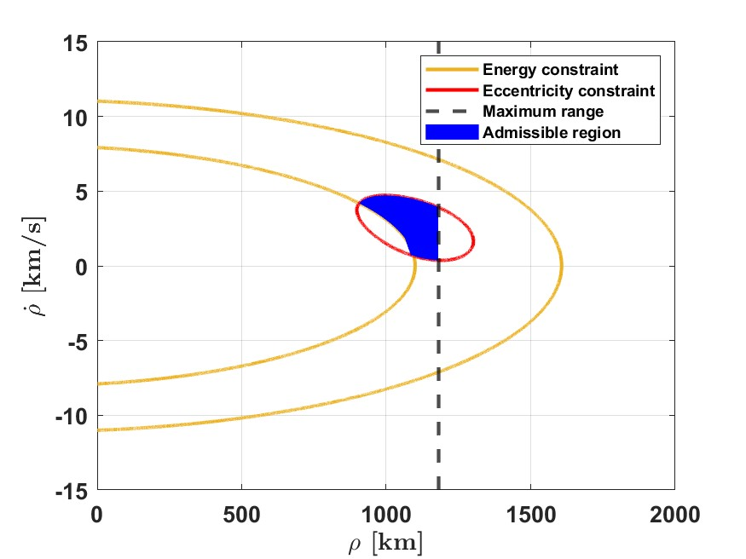
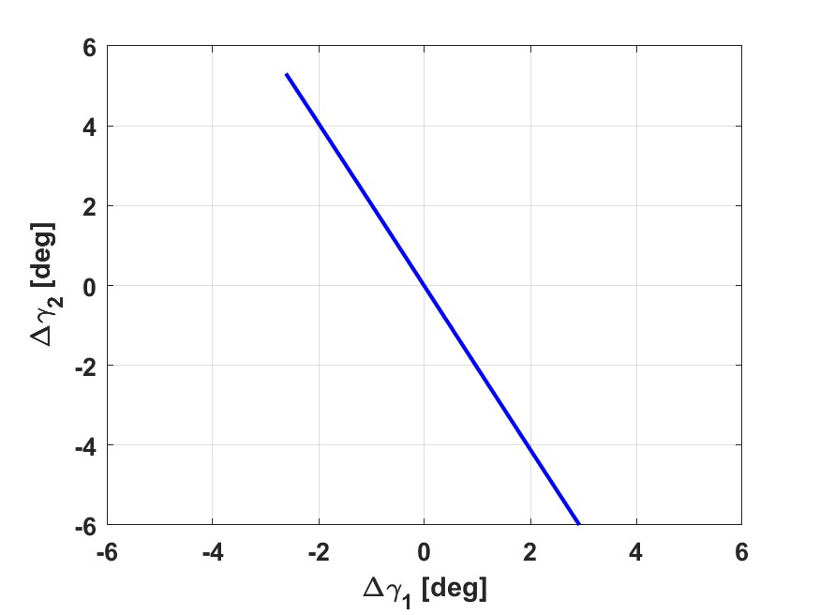
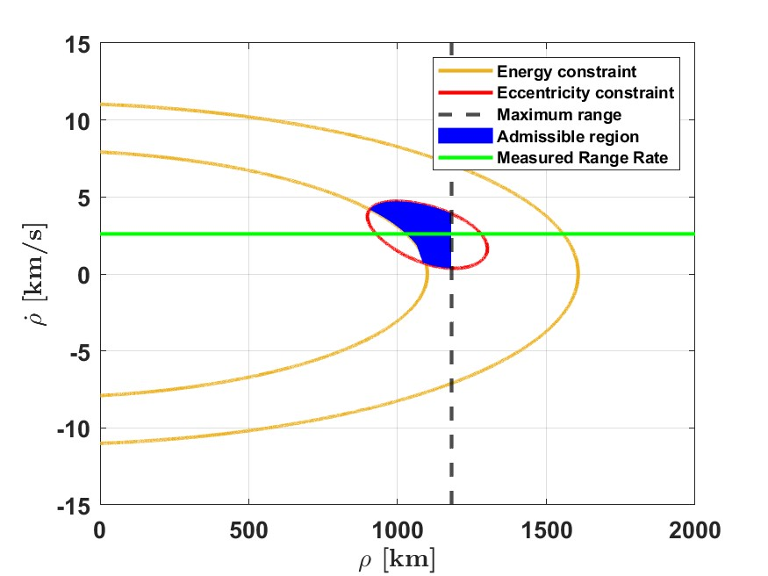
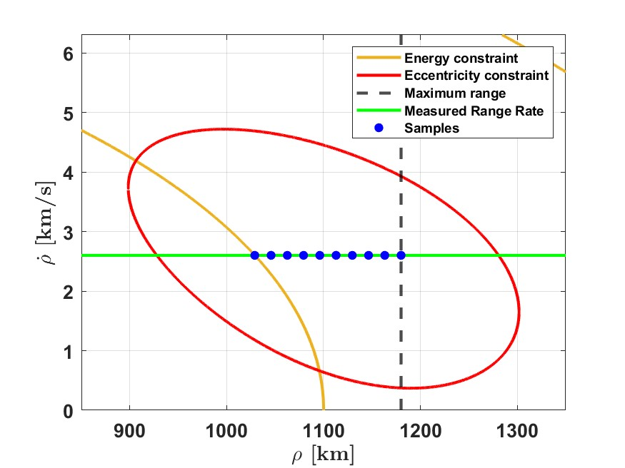


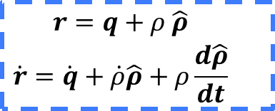
IOD angles and DS
$$\begin{matrix}r=q+ρ \hat{ρ} \\ \dot{r}=\dot{q}+\dot{ρ}\hat{ρ}+ρ\frac{d\hat{ρ}}{dt}\end{matrix}$$
Angular track compression
Optical admissible region
Add radar constraints
Orbital states candidates
A. Milani, et al., Orbit determination with very short arcs. I admissible regions, Celestial Mechanics and Dynamical Astronomy, 2004
M.F. Montaruli, Radar initial orbit determination method from angular track and Doppler shift measurements, Astrodynamics, 2025
Missione 4 • Istruzione e Ricerca
Missione 4 • Istruzione e Ricerca

Slide 31
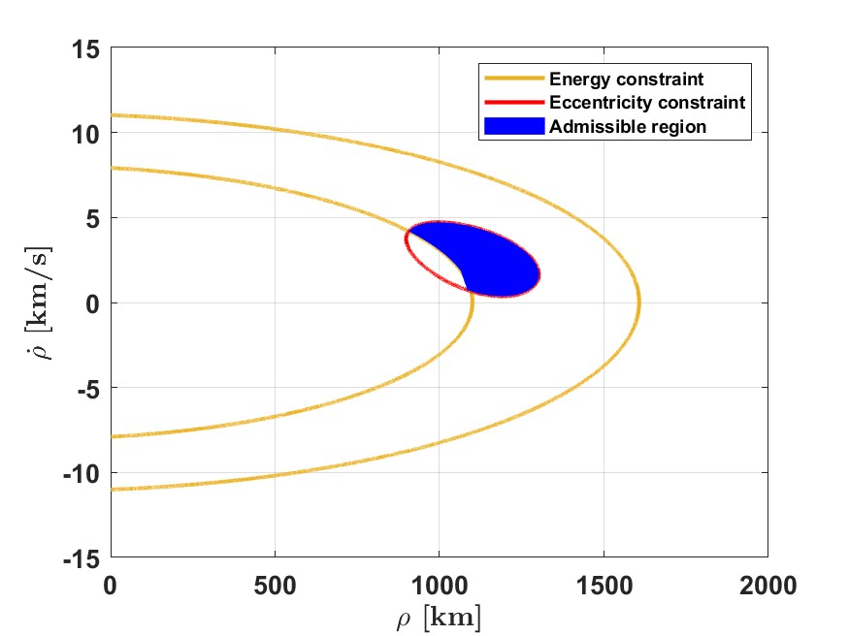
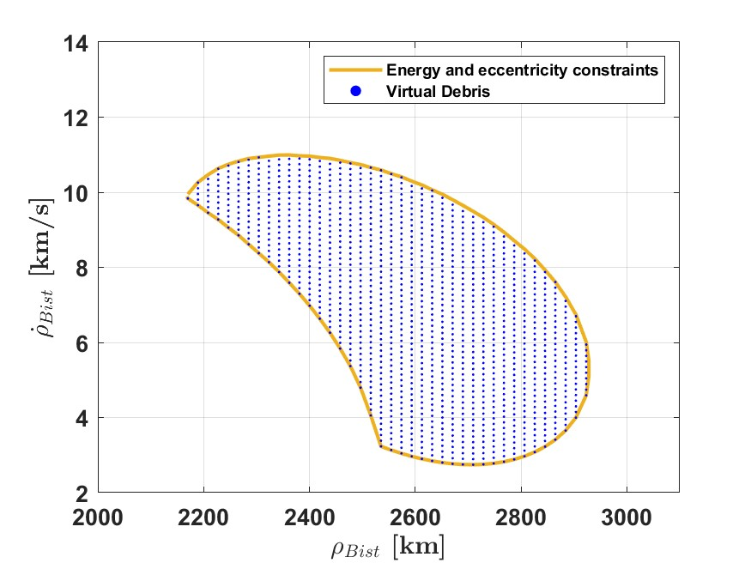
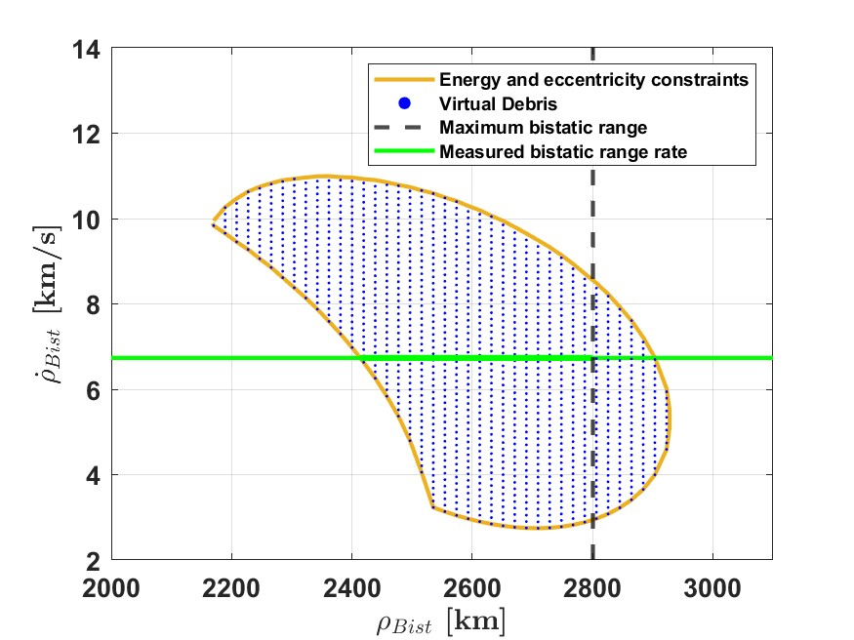
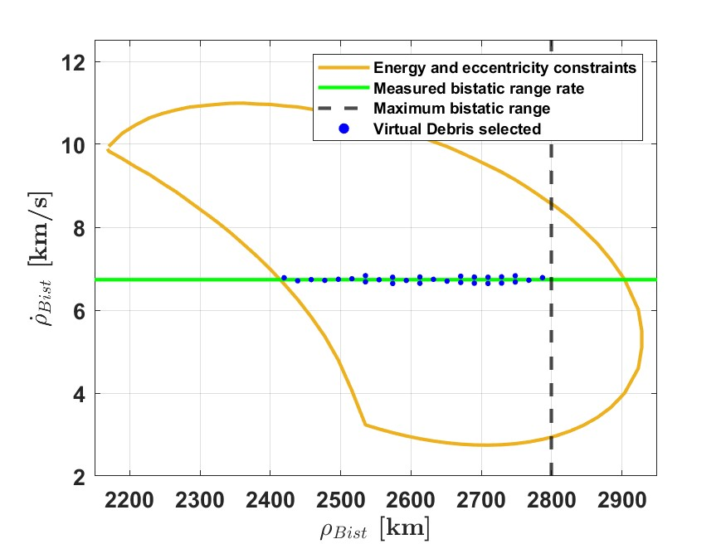
IOD angles and DS
$$\begin{matrix}r=q+ρ \hat{ρ} \\ \dot{r}=\dot{q}+\dot{ρ}\hat{ρ}+ρ\frac{d\hat{ρ}}{dt}\end{matrix}$$
Angular track compression
Optical admissible region
Bistatic case
Project VDs in the bistatic plane
Add radar constraints
Orbital states candidates
A. Milani, et al., Orbit determination with very short arcs. I admissible regions, Celestial Mechanics and Dynamical Astronomy, 2004
M.F. Montaruli, Radar initial orbit determination method from angular track and Doppler shift measurements, Astrodynamics, 2025
Missione 4 • Istruzione e Ricerca
Missione 4 • Istruzione e Ricerca

Slide 32
IOD angles and DS
$$\begin{matrix}r=q+ρ \hat{ρ} \\ \dot{r}=\dot{q}+\dot{ρ}\hat{ρ}+ρ\frac{d\hat{ρ}}{dt}\end{matrix}$$
Monostatic case
Bistatic case
Angular track compression
Optical admissible region
Bistatic case
Project VDs in the bistatic plane
Add radar constraints
Select the candidate with the minimum eccentricity
Run a batch filter
Orbital states candidates
A. Milani, et al., Orbit determination with very short arcs. I admissible regions, Celestial Mechanics and Dynamical Astronomy, 2004
M.F. Montaruli, Radar initial orbit determination method from angular track and Doppler shift measurements, Astrodynamics, 2025
Missione 4 • Istruzione e Ricerca
Missione 4 • Istruzione e Ricerca

Slide 33
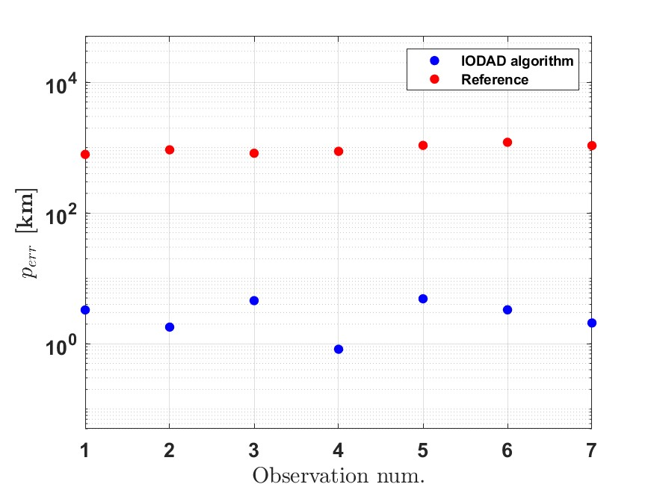
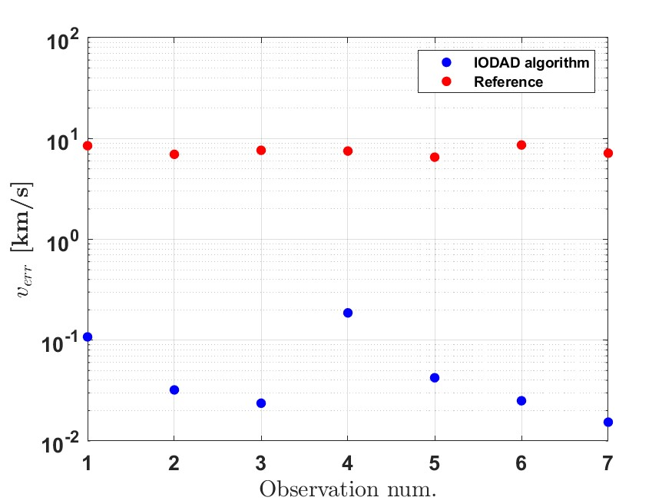
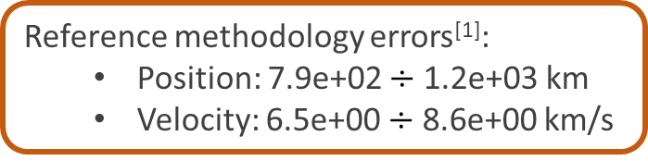
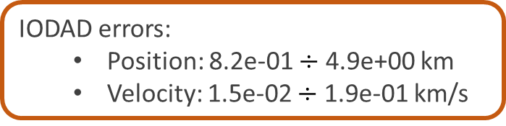
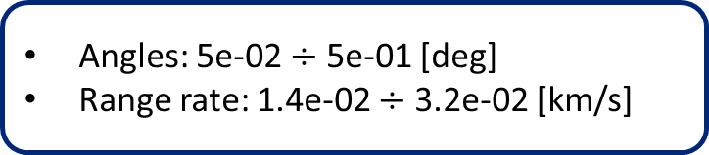
IOD angles and DS
Measurements accuracy
Angles: 5e-02 $÷$ 5e-01 [deg]
Range rate: 1.4e-02 $÷$ 3.2e-02 [km/s]
Duration: 20 s ÷ 45 s
IODAD errors:
  Position: 8.2e-01 $÷$ 4.9e+00 km
  Velocity: 1.5e-02 $÷$ 1.9e-01 km/s
Reference methodology errors^{[1]}:
  Position: 7.9e+02 $÷$ 1.2e+03 km
  Velocity: 6.5e+00 $÷$ 8.6e+00 km/s
  Remarkably improvement with respect the state of the art
  Cataloguing capability from UCTs wihout range
✓
✓
C. Yanez, et al., A Novel Initial Orbit Determination Algorithm from Doppler and Angular Observations, 2017
Missione 4 • Istruzione e Ricerca
Missione 4 • Istruzione e Ricerca

Slide 34
OUTLINE
01
02
03
04
05
06
MATER algorithm
Operational implementation
Ambiguity solving through East-West branch
Radar IOD
Fragmentation campaigns (CZ-6A, Starlink 34343, ZQ-2E R/B)
Conclusions
Missione 4 • Istruzione e Ricerca
Missione 4 • Istruzione e Ricerca

Slide 35
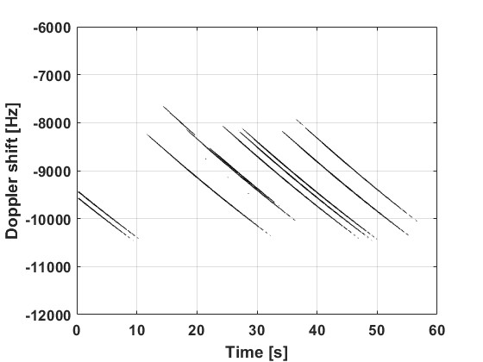
Fragmentation CZ-6A
September 3°, 2024
Target: CZ-6A DEB (norad id 60649)
Critical clustering
August 7°, 2024: break-up of the launcher carrying QIANFAN constellation satellites
QIANFAN constellation detected by 1N and 2N
Signal transmitted: 60% CHIRP + 40% CW
Missione 4 • Istruzione e Ricerca
Missione 4 • Istruzione e Ricerca

Slide 36
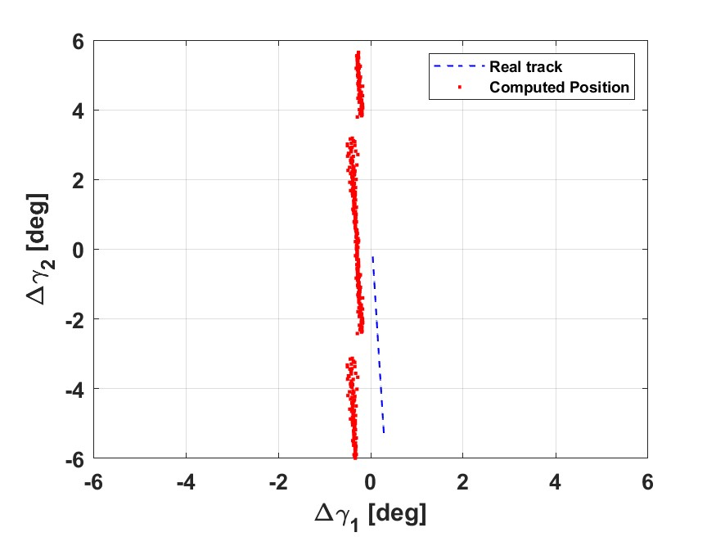
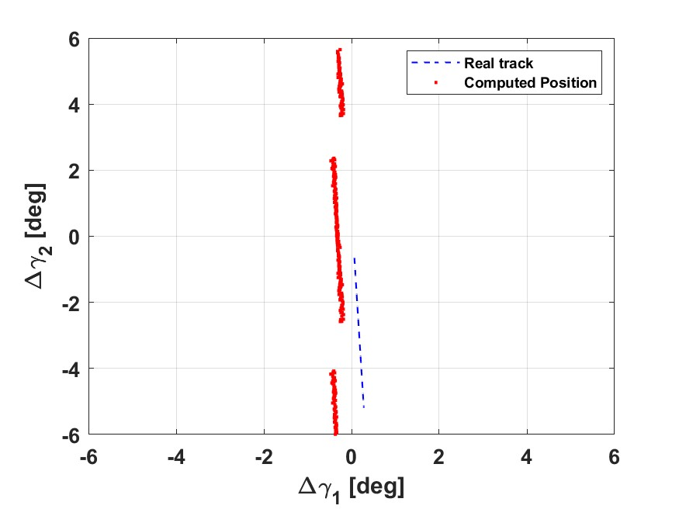
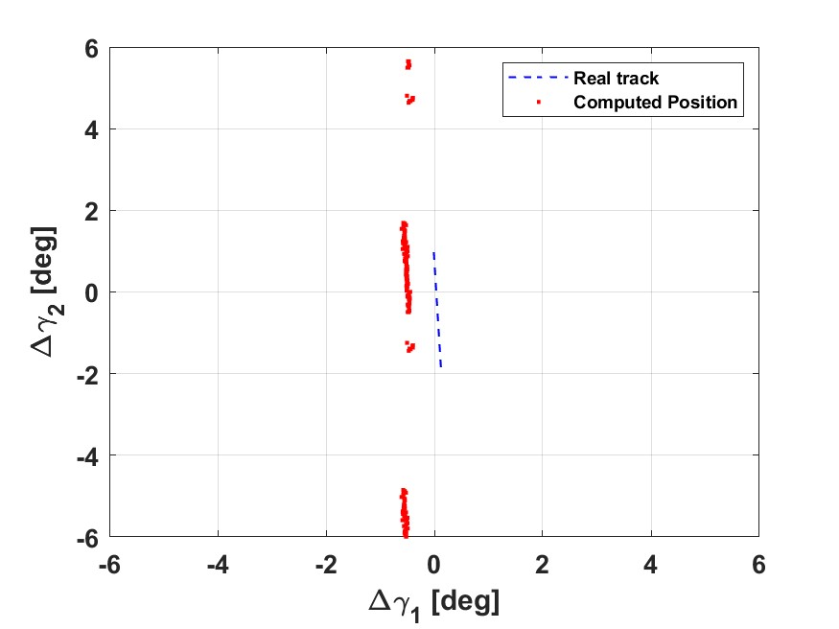
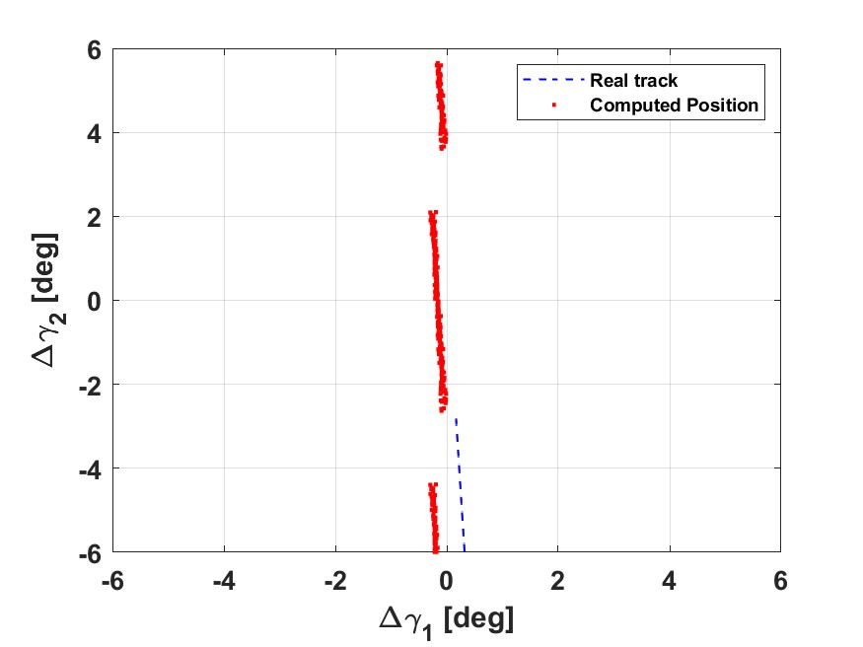






Fragmentation CZ-6A
Red dots: signal direction of arrival detected.
Dashed blue line: target prediction.
Missione 4 • Istruzione e Ricerca
Missione 4 • Istruzione e Ricerca

Slide 37
Fragmentation CZ-6A
2 fragments detected
 |  | TDM A | TDM B | TDM C | TDM D | TDM E | TDM F | TDM G | TDM H | TDM I | TDM L
QIANFAN-1 | 60379 |  |  |  |  |  |  | 0.38
QIANFAN-5 | 60383 |  |  |  |  |  | 0.31
QIANFAN-6 | 60384 |  |  |  | 0.35 | 10.35
QIANFAN-7 | 60385 |  |  | 0.84 |  |  |  |  |  | 1.06
QIANFAN-8 | 60386 | 1.36 | 0.49
QIANFAN-9 | 60387 | 15.53 | 5.59 |  |  | 0.36
QIANFAN-11 | 60389 |  |  | 0.29 |  |  |  |  | 0.29 | 0.5
QIANFAN-12 | 60390 |  |  |  |  |  |  |  | 0.37 |  | 4.73
QIANFAN-13 | 60391 |  |  |  |  |  |  |  | 2.78 |  | 0.34
QIANFAN-14 | 60392 |  |  |  |  | 5.58
CZ-6A DEB | 60649 |  |  | 13.61 |  |  |  |  |  | 12.23
CZ-6A DEB | 60800 |  |  |  |  |  |  |  |  |  | 18.9
Missione 4 • Istruzione e Ricerca
Missione 4 • Istruzione e Ricerca

Slide 38
Fragmentation CZ-6A
We keep one track per target and one track per target
 |  | TDM A | TDM B | TDM C | TDM D | TDM E | TDM F | TDM G | TDM H | TDM I | TDM L
QIANFAN-1 | 60379 |  |  |  |  |  |  | 0.38
QIANFAN-5 | 60383 |  |  |  |  |  | 0.31
QIANFAN-6 | 60384 |  |  |  | 0.35 | 10.35
QIANFAN-7 | 60385 |  |  | 0.84 |  |  |  |  |  | 1.06
QIANFAN-8 | 60386 | 1.36 | 0.49
QIANFAN-9 | 60387 | 15.53 | 5.59 |  |  | 0.36
QIANFAN-11 | 60389 |  |  | 0.29 |  |  |  |  | 0.29 | 0.5
QIANFAN-12 | 60390 |  |  |  |  |  |  |  | 0.37 |  | 4.73
QIANFAN-13 | 60391 |  |  |  |  |  |  |  | 2.78 |  | 0.34
QIANFAN-14 | 60392 |  |  |  |  | 5.58
CZ-6A DEB | 60649 |  |  | 13.61 |  |  |  |  |  | 12.23
CZ-6A DEB | 60800 |  |  |  |  |  |  |  |  |  | 18.9
Missione 4 • Istruzione e Ricerca
Missione 4 • Istruzione e Ricerca

Slide 39
Fragmentation CZ-6A
TDM A remains not correlated. Possible fragment?
 |  | TDM A | TDM B | TDM C | TDM D | TDM E | TDM F | TDM G | TDM H | TDM I | TDM L
QIANFAN-1 | 60379 |  |  |  |  |  |  | 0.38
QIANFAN-5 | 60383 |  |  |  |  |  | 0.31
QIANFAN-6 | 60384 |  |  |  | 0.35
QIANFAN-7 | 60385 |  |  |  |  |  |  |  |  | 1.06
QIANFAN-8 | 60386 |  | 0.49
QIANFAN-9 | 60387 |  |  |  |  | 0.36
QIANFAN-11 | 60389 |  |  | 0.29
QIANFAN-12 | 60390 |  |  |  |  |  |  |  | 0.37
QIANFAN-13 | 60391 |  |  |  |  |  |  |  |  |  | 0.34
QIANFAN-14 | 60392
CZ-6A DEB | 60649
CZ-6A DEB | 60800
Missione 4 • Istruzione e Ricerca
Missione 4 • Istruzione e Ricerca

Slide 40


Fragmentation Starlink 34343
Fragmentation epoch: around 2026-03-29T19:30:00.000
Parent orbit geometry
Computation of pointing
Two visibility intervals of ~10 minutes per day
Visibility constraints
Orbital plane scanning
Meridian crossing
+
Missione 4 • Istruzione e Ricerca
Missione 4 • Istruzione e Ricerca

Slide 41

Fragmentation Starlink 34343
Fragmentation epoch: around 2026-03-29T19:30:00.000
BIRALES detection from 02/04/2026 – h. 19:38 UTC
Missione 4 • Istruzione e Ricerca
Missione 4 • Istruzione e Ricerca

Slide 42

Fragmentation Starlink 34343
BIRALES detection from 02/04/2026 – h. 19:38 UTC
Virtual debris
Missione 4 • Istruzione e Ricerca
Missione 4 • Istruzione e Ricerca

Slide 43



Fragmentation Starlink 34343
Fragmentation forensic analysis
Measurement space
(no IOD result exploited)
Orbital space
(based on IOD result)
FRED: Fragmentation Epoch Detector
Compatible cluster with Space-track alert
M.F. Montaruli, et al., A stochastic approach to detect fragmentation epoch from a single fragment orbit determination, Advances in Space Research, 2023
Space-track website: https://www.space-track.org/
P. Grattagliano, et al. Early stage characterization of on-orbit fragmentation events, Acta Astronautica, 2025
P. Grattagliano, et al., Advanced techniques for the stochastic fragmentation event characterization from a single fragment orbital state, Advances in Space Research, 2026
Missione 4 • Istruzione e Ricerca
Missione 4 • Istruzione e Ricerca

Slide 44

Fragmentation Starlink 34343
BIRALES detection from 02/04/2026 – h. 19:38 UTC
Starlink 33924
(Norad ID 64149)
Virtual debris
Missione 4 • Istruzione e Ricerca
Missione 4 • Istruzione e Ricerca

Slide 45
Fragmentation Starlink 34343
BIRALES detection from 02/04/2026 – h. 19:38 UTC
And the others?
Starlink 33924
(Norad ID 64149)
Virtual debris
Missione 4 • Istruzione e Ricerca
Missione 4 • Istruzione e Ricerca

Slide 46









Fragmentation Starlink 34343
STARLINK-4147 (norad ID 53256)
Uncatalogued, but not associated to the events.
Starlinks not yet in the catalogue?
Missione 4 • Istruzione e Ricerca
Missione 4 • Istruzione e Ricerca

Slide 47
Fragmentation ZQ-2E R/B
Fragmentation epoch: around 2026-06-09T08:47:00.000
2026-06-20T03:33:31.603 | +/- 5 minutes | ✓
2026-06-20T10:00:07.230 | +/- 5 minutes
2026-06-21T09:38:03.110 | +/- 5 minutes
2026-06-22T02:36:11.689 | +/- 5 minutes
2026-06-22T09:08:09.316 | +/- 5 minutes
2026-06-23T02:08:42.894 | +/- 5 minutes | ✓
2026-06-23T08:34:03.196 | +/- 5 minutes
Missione 4 • Istruzione e Ricerca
Missione 4 • Istruzione e Ricerca

Slide 48



Fragmentation ZQ-2E R/B
Fragmentation epoch: around 2026-06-09T08:47:00.000
Numerical simulation
Analogic system
Detection of both parent object (the target) and a catalogued fragment.
The old system correlated the catalogued fragment to a Starlink-31342 (Norad Id 59166).
Validation of the observation strategy.
The orbital plane based strategy remains robust for several days.
Is the fragment tumbling?
Parent object (Norad id 69537)
Parent object (Norad id 69537)
Catalogued fragment
(Norad id 69629)
Importance of migrating to the new operational system
Catalogued fragment
(Norad id 69629)
Missione 4 • Istruzione e Ricerca
Missione 4 • Istruzione e Ricerca

Slide 49
OUTLINE
01
02
03
04
05
06
MATER algorithm
Operational implementation
Ambiguity solving through East-West branch
Radar IOD
Fragmentation campaigns (CZ-6A, Starlink 34343, ZQ-2E R/B)
Conclusions
Missione 4 • Istruzione e Ricerca
Missione 4 • Istruzione e Ricerca

Slide 50
Conclusions
✓
MATER algorithm operationally implemented
Potential of E-W branch contribution to solve the angular track ambiguity
No ambiguous tracks for uncorrelated tracks
Radar Initial Orbit Determination from angles and Doppler shift
Capability to determine the target orbital state even if the range is not present
Effectiveness in fragmentation campaigns
Dedicated observation strategy validated
Criticalities posed by mega-constellations
Uncorrelated tracks detected
✓
✓
✓
Missione 4 • Istruzione e Ricerca
Missione 4 • Istruzione e Ricerca

Slide 51
Thank you
Final Meeting
Martedì 30 Giugno – Giovedì 02 Luglio
OAC - Osservatorio Astrofisico di Arcetri
M.F. Montaruli

