Slide 1



L’evoluzione della stazione radioastronomica di Noto
Final Meeting
Martedì 30 Giugno – Giovedì 02 Luglio
OAC - Osservatorio Astrofisico di Arcetri

Slide 2
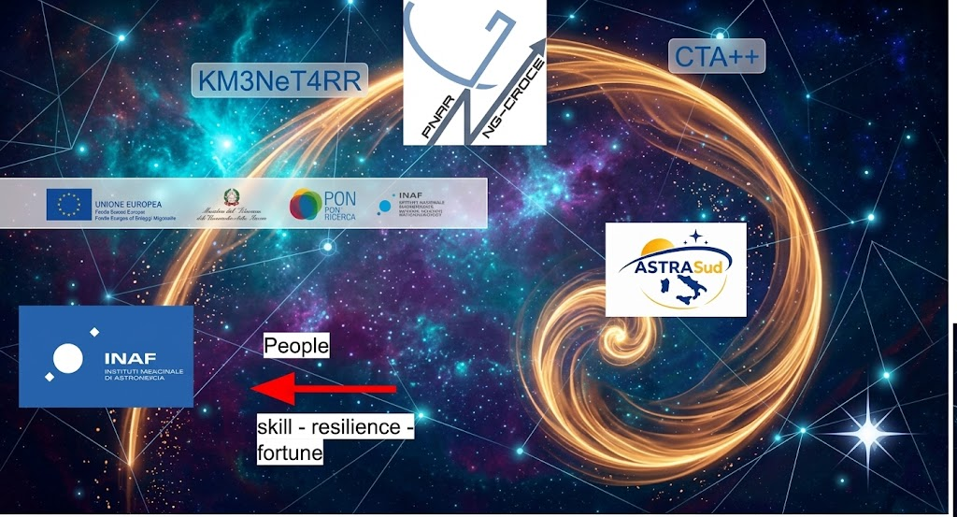
Key Takeaway
Missione 4 • Istruzione e Ricerca
Missione 4 • Istruzione e Ricerca

Slide 3
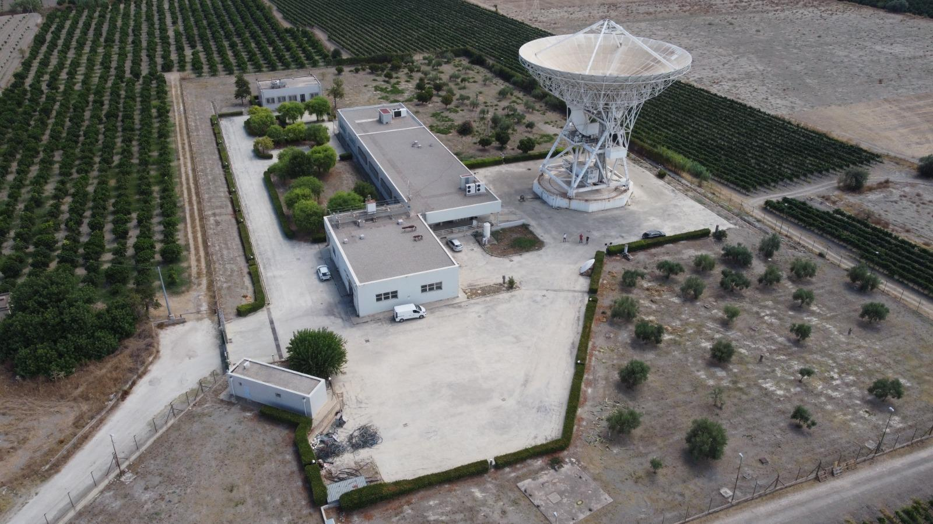
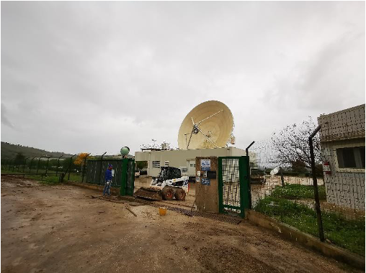
Where we started
Mid 2018 to mid 2023: reports and funding requests
Main building ceiling water leaks
Non-compliant electrical system
Leaking AC pipes
Flooding
H-Maser hydrogen refill issues
Unsafe guardhouse
Missione 4 • Istruzione e Ricerca
Missione 4 • Istruzione e Ricerca

Slide 4
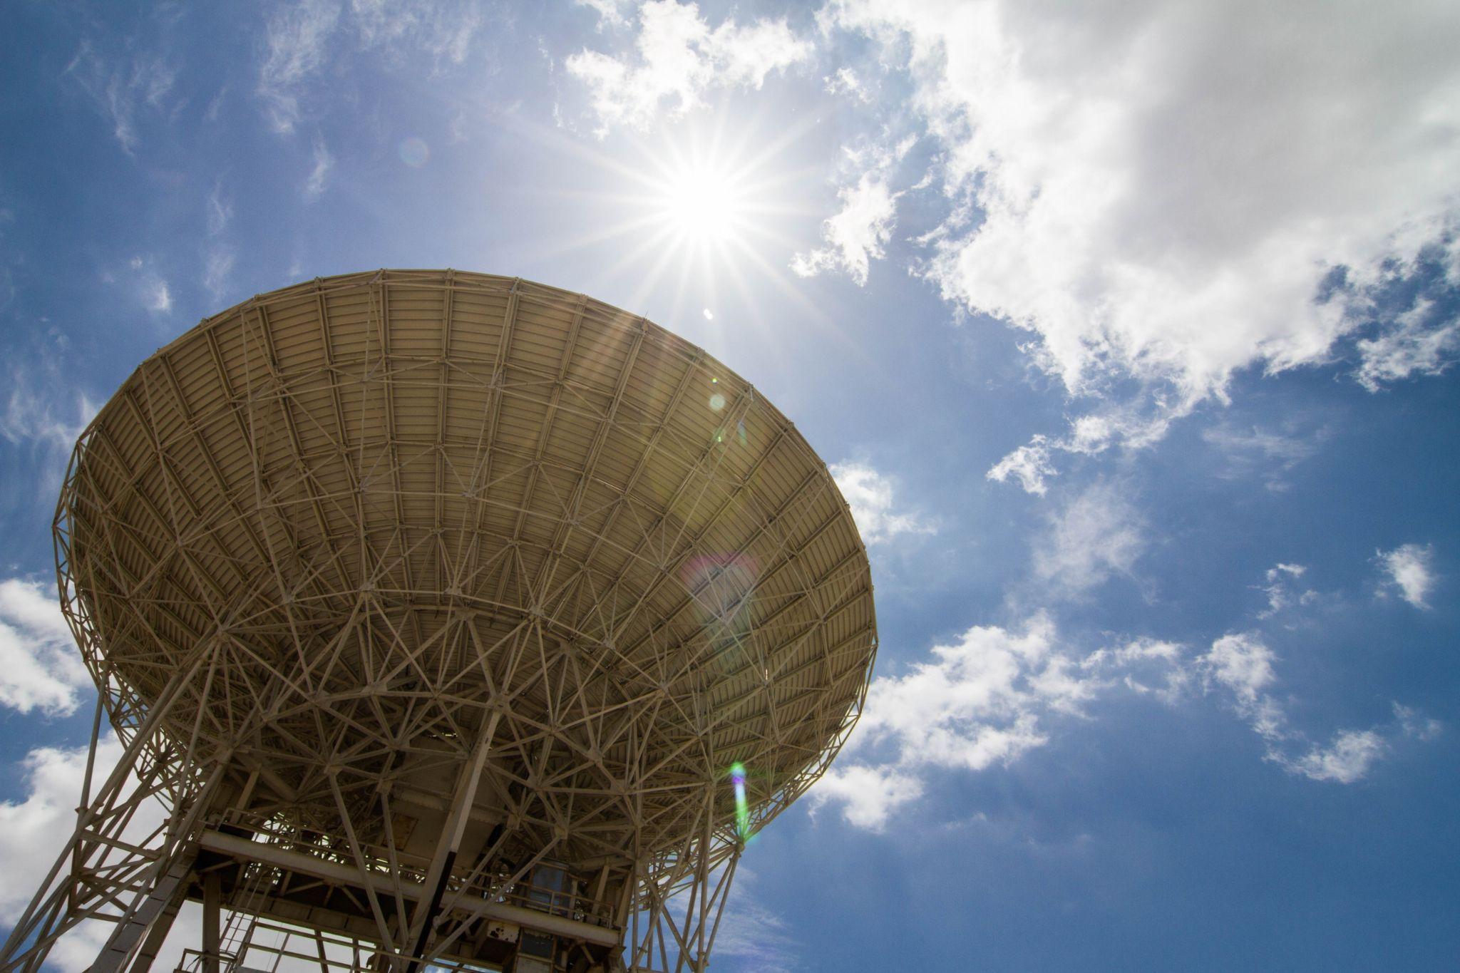
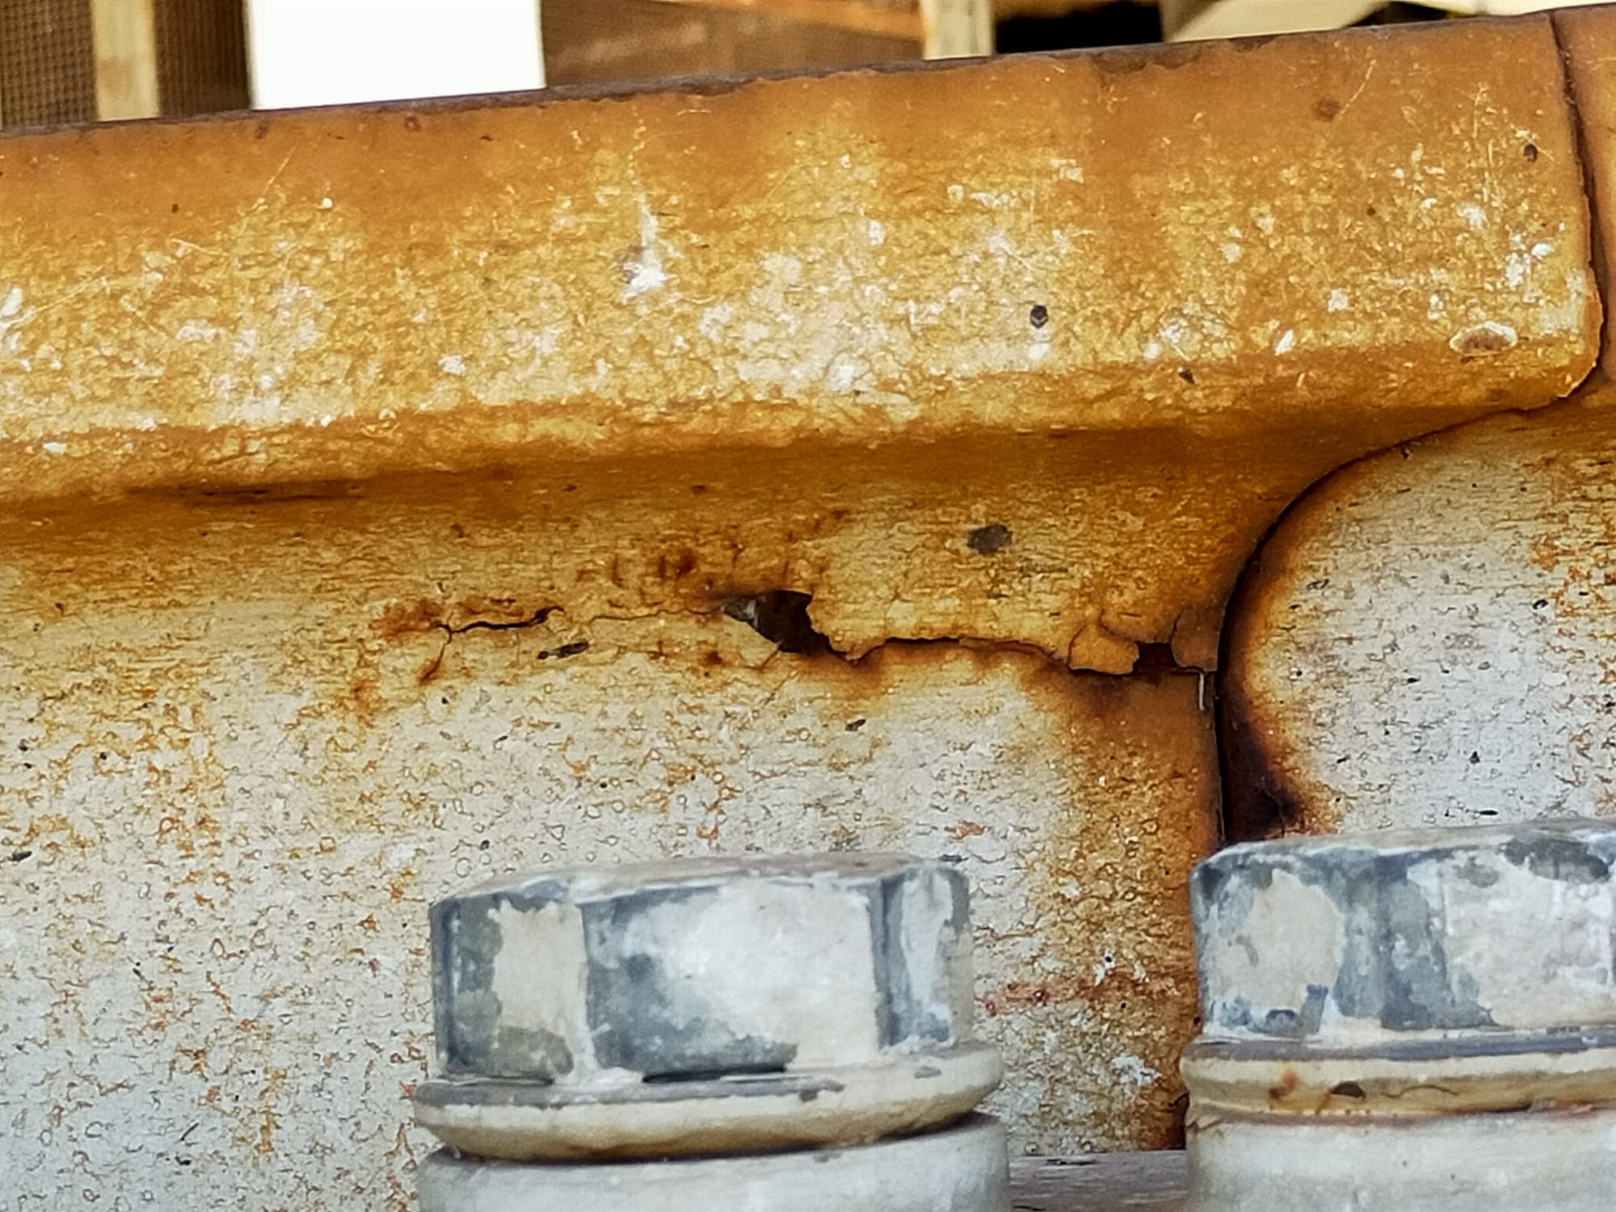
Where we started
Faulty S-X-L- receiver
5cm and 1.3cm receiver issues
Secondary drive system jamming
Drive system obsolescence and spare parts procurement issues
Secondary mirror unsuitable for high frequencies
Primary mirror repainting and treatment required
Azimuth track structural issues
Elevation rack wear and tear
Severe corrosion on active surface actuators
Radio telescope structure needs repainting
Missione 4 • Istruzione e Ricerca
Missione 4 • Istruzione e Ricerca

Slide 5
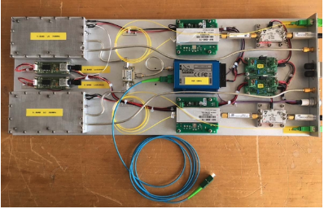
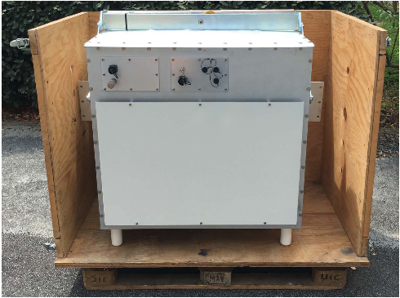
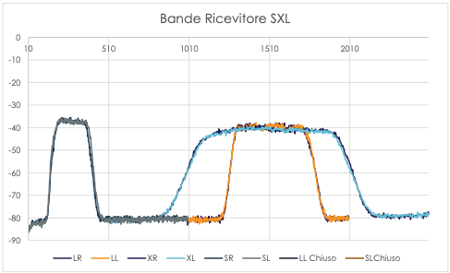
S-X-L-Receiver
2019
Banda L (1316 MHz - 1722 MHz)
Tsys (LCP): 71° K Tsys (RCP): 77° K
DFPU (LCP): 0,10 K/Jy DFPU (RCP): 0,10 K/Jy
Banda S
(2213 MHZ - 2389 MHz)
Banda X (8205 MHz - (938 MHz)
Tsys (LCP): 88° K Tsys (RCP): 93° K
DFPU (LCP): 0,103 K/Jy DFPU (RCP): 0,108 K/Jy
Missione 4 • Istruzione e Ricerca
Missione 4 • Istruzione e Ricerca

Slide 6
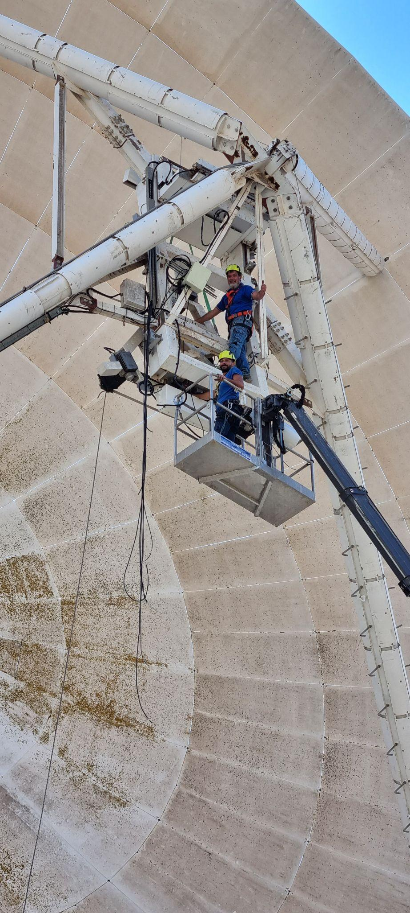
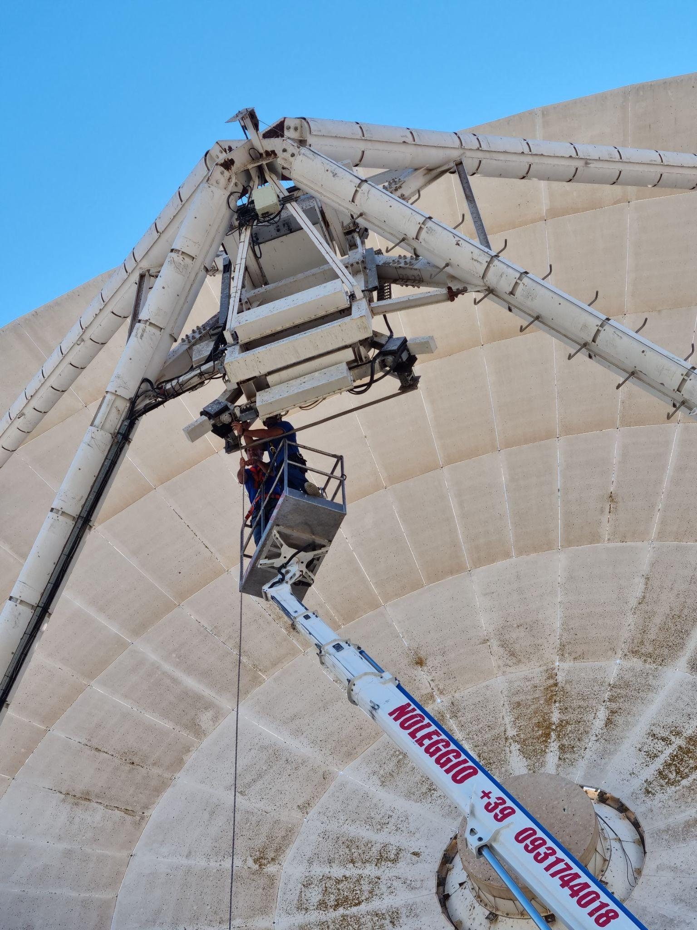
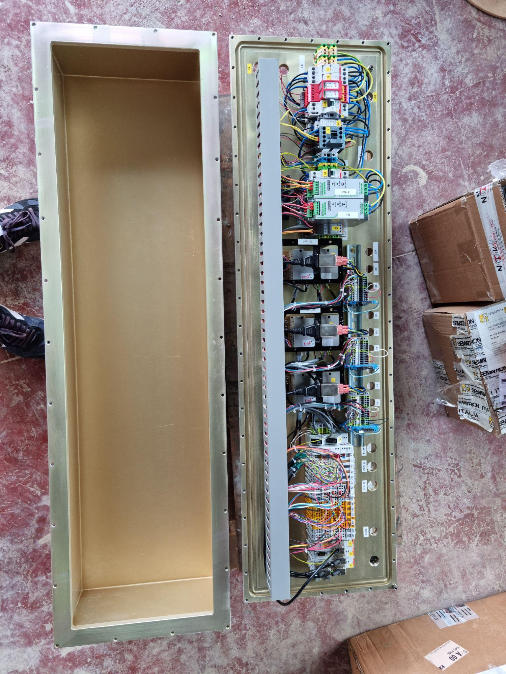
Secondary mirror servo system
2021
7-axis positioning system (5 for the sub-reflector and 2 for the prime-focus receiver)
implemented using a Beckhoff PLC
ultra-compact Elmo drives
Brushless motors.
Missione 4 • Istruzione e Ricerca
Missione 4 • Istruzione e Ricerca

Slide 7

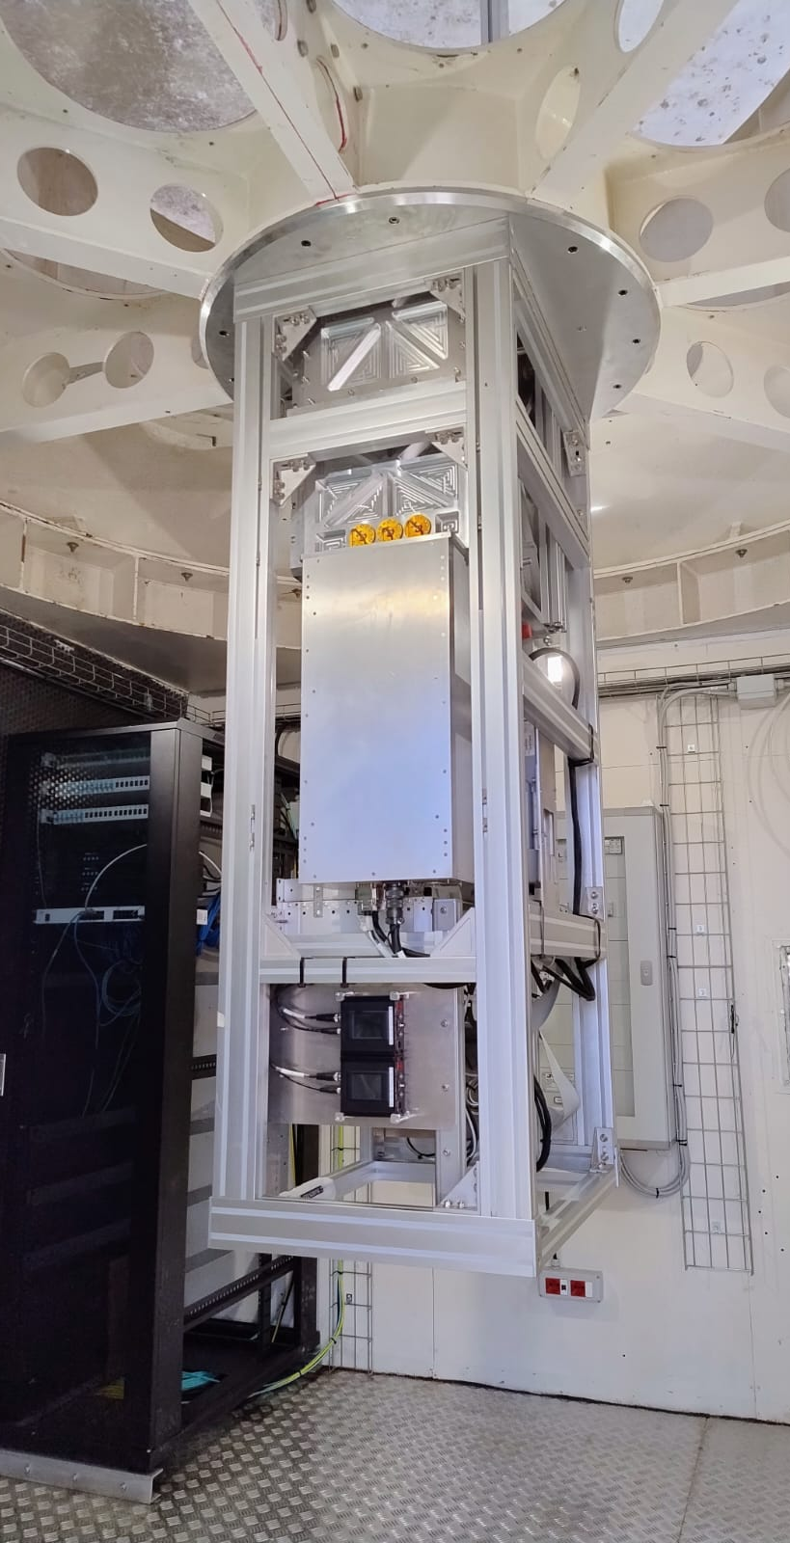
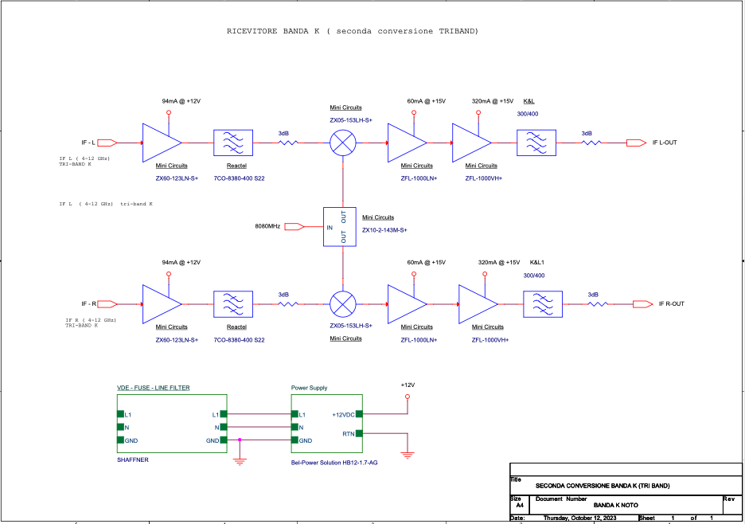
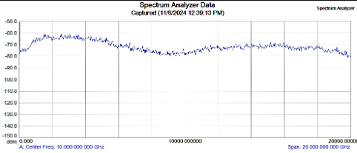
CTR - Compact Triband Receiver
2022
Receiver assembled and tested.
  Gain hole in Q-band Channel B. Solved.
  Same condensation problem as Medicina CTR. Solved.
Installed in dec ‘24, ready for commissioning and first light. But a severe issue with driver of the servo system halted telescope operations.
Missione 4 • Istruzione e Ricerca
Missione 4 • Istruzione e Ricerca

Slide 8
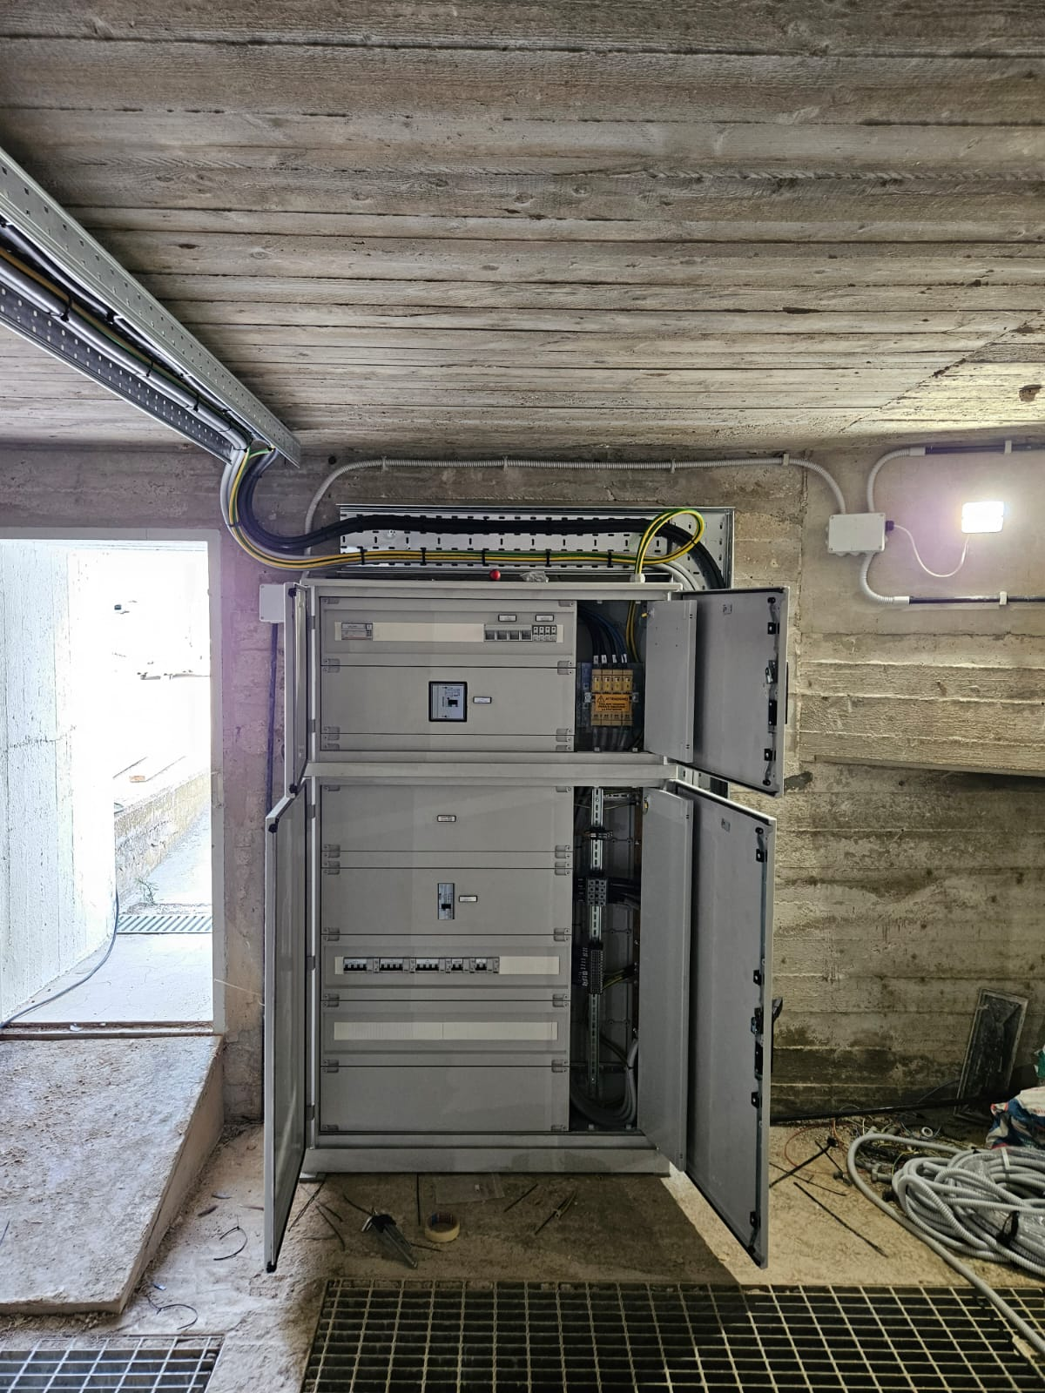
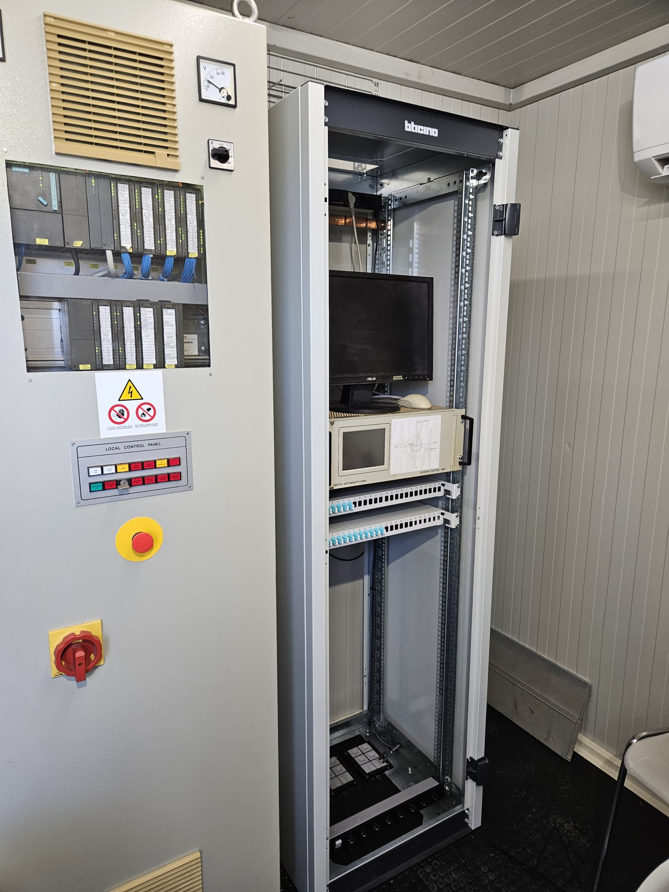
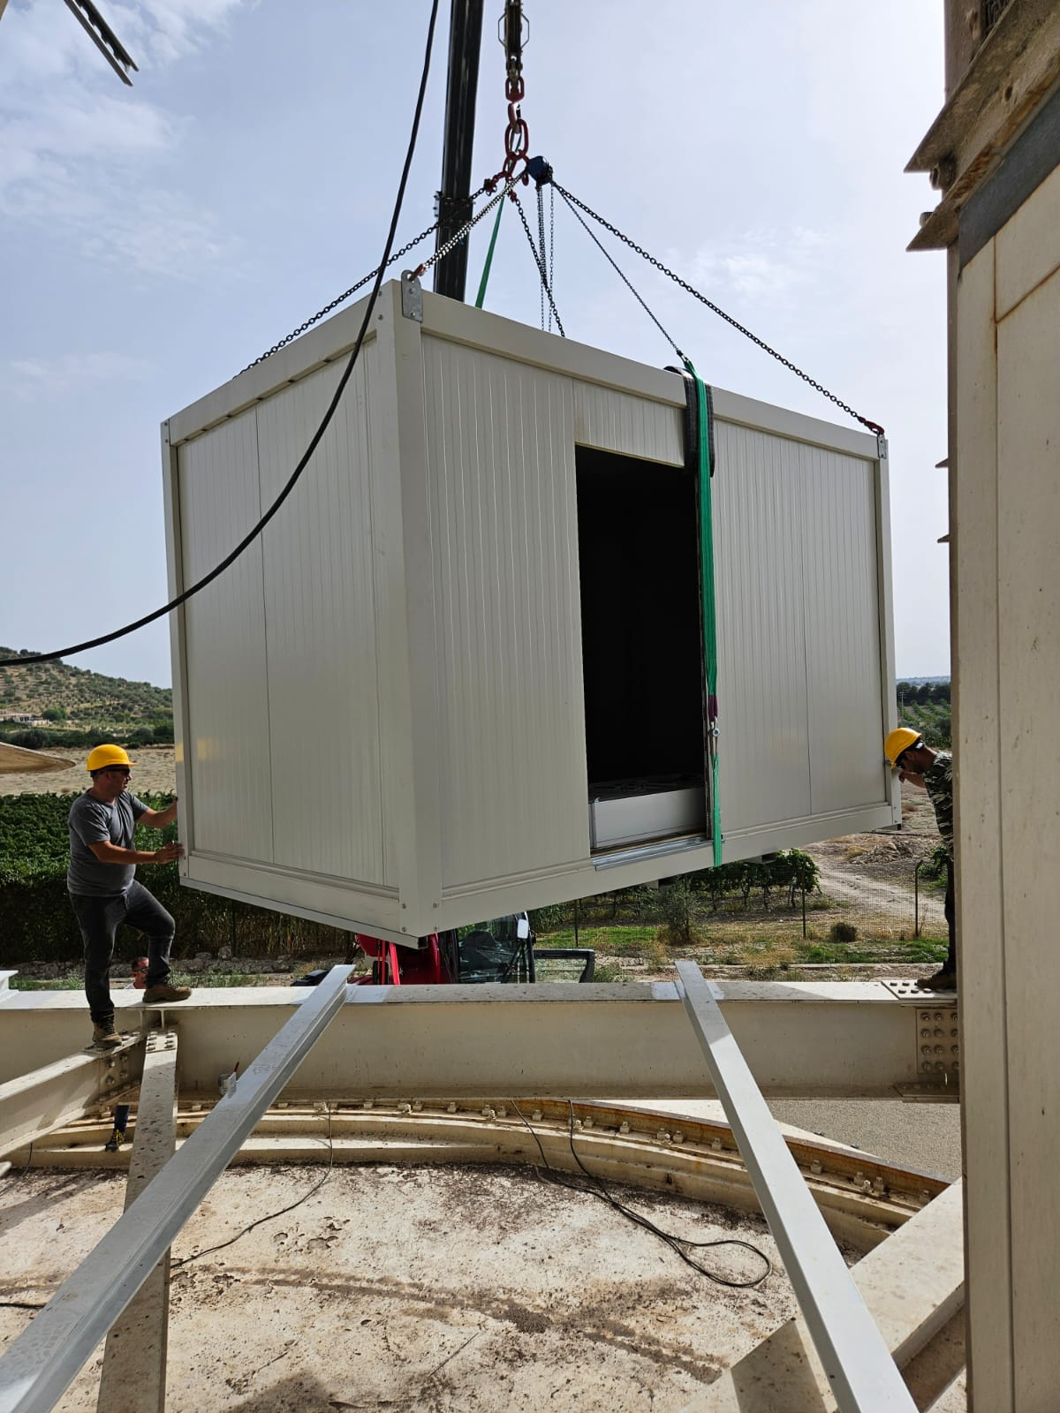
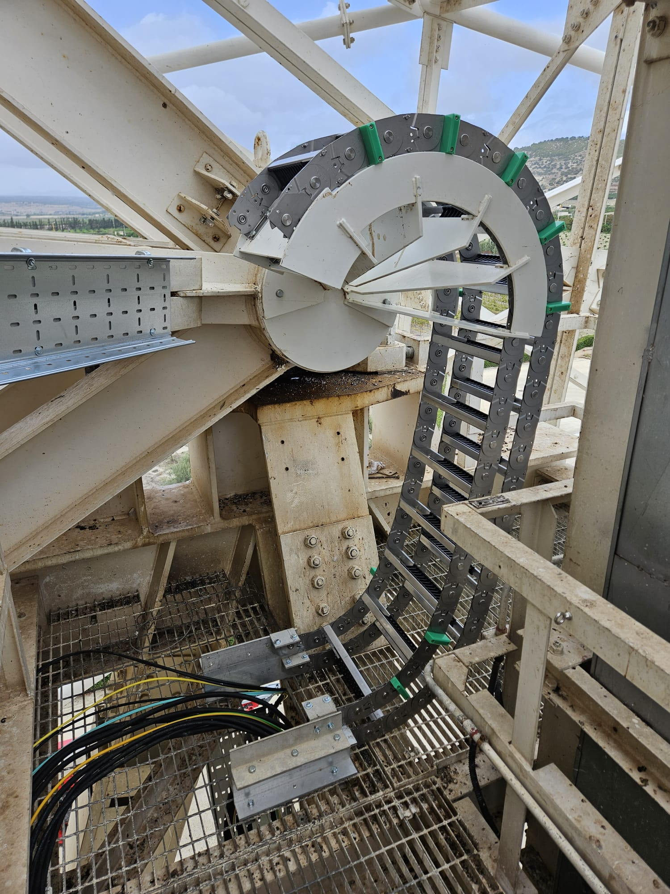
Telescope infrastructure refurbishment
2023-2024
New power distribution system.
New elium lines serving the Vertex room.
New air cooling system for the Vertex Room
New cryogenic compressor room.
Optical Fiber cabling
Elevation cable wrap
New Servo System Room
Missione 4 • Istruzione e Ricerca
Missione 4 • Istruzione e Ricerca

Slide 9
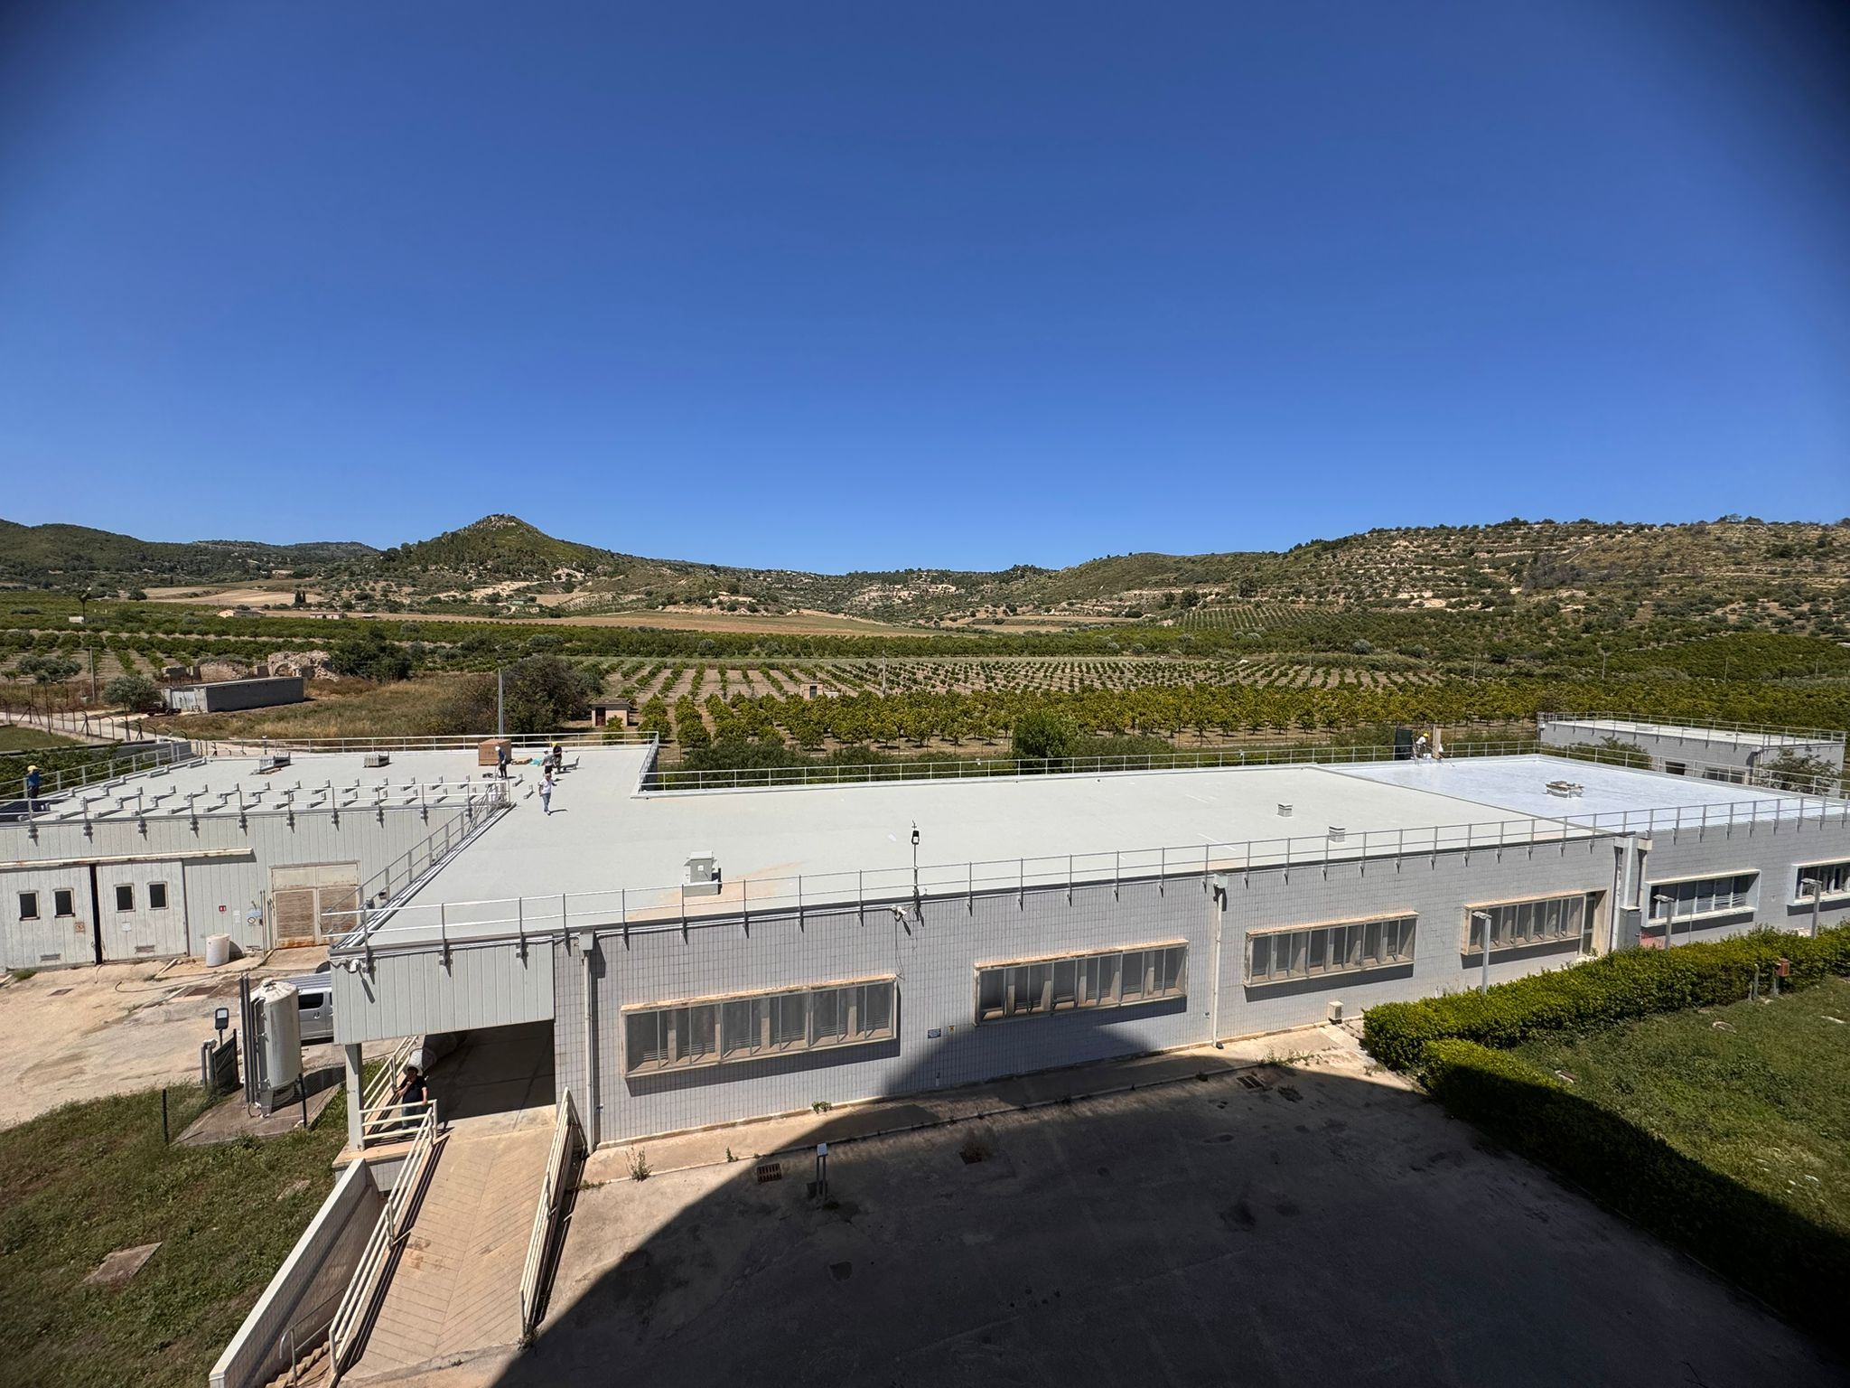
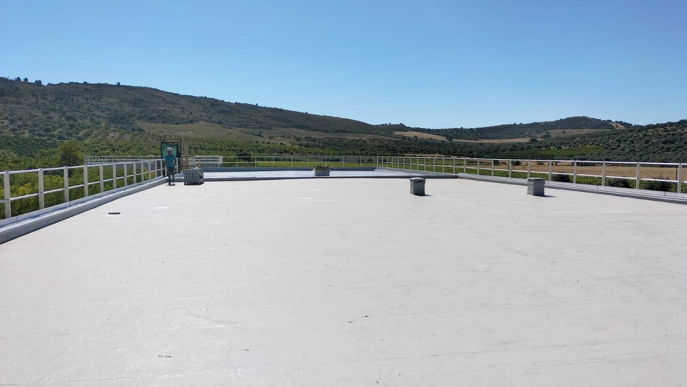
Main building ceiling
2025
Missione 4 • Istruzione e Ricerca
Missione 4 • Istruzione e Ricerca

Slide 10
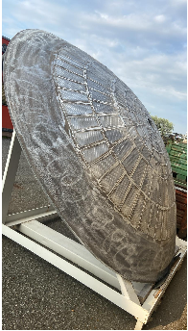
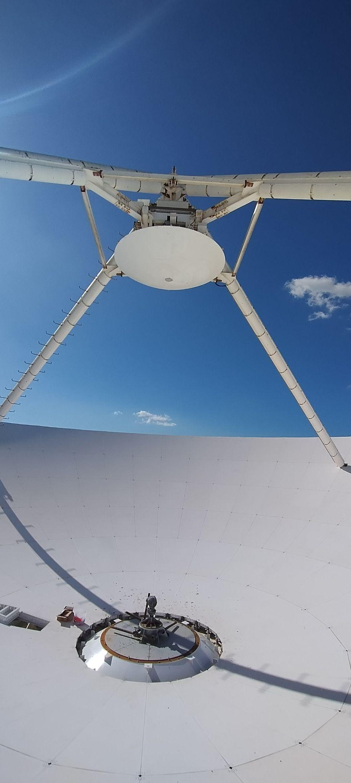
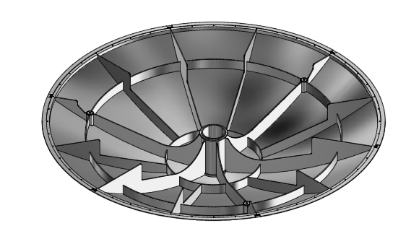

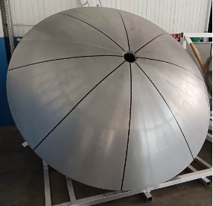
Increased high frequency capabilities
INAF-OACT
2023-2025
KM3Net to follow-up neutrino sources(High Frequency). Exploiting capabilities of CTR receiver.
Juri Roda
    New digital backend and data acquisition system based on SKARAB Boards.
    New, 50-microns-RMS, secondary mirror (subreflector)
Missione 4 • Istruzione e Ricerca
Missione 4 • Istruzione e Ricerca

Slide 11

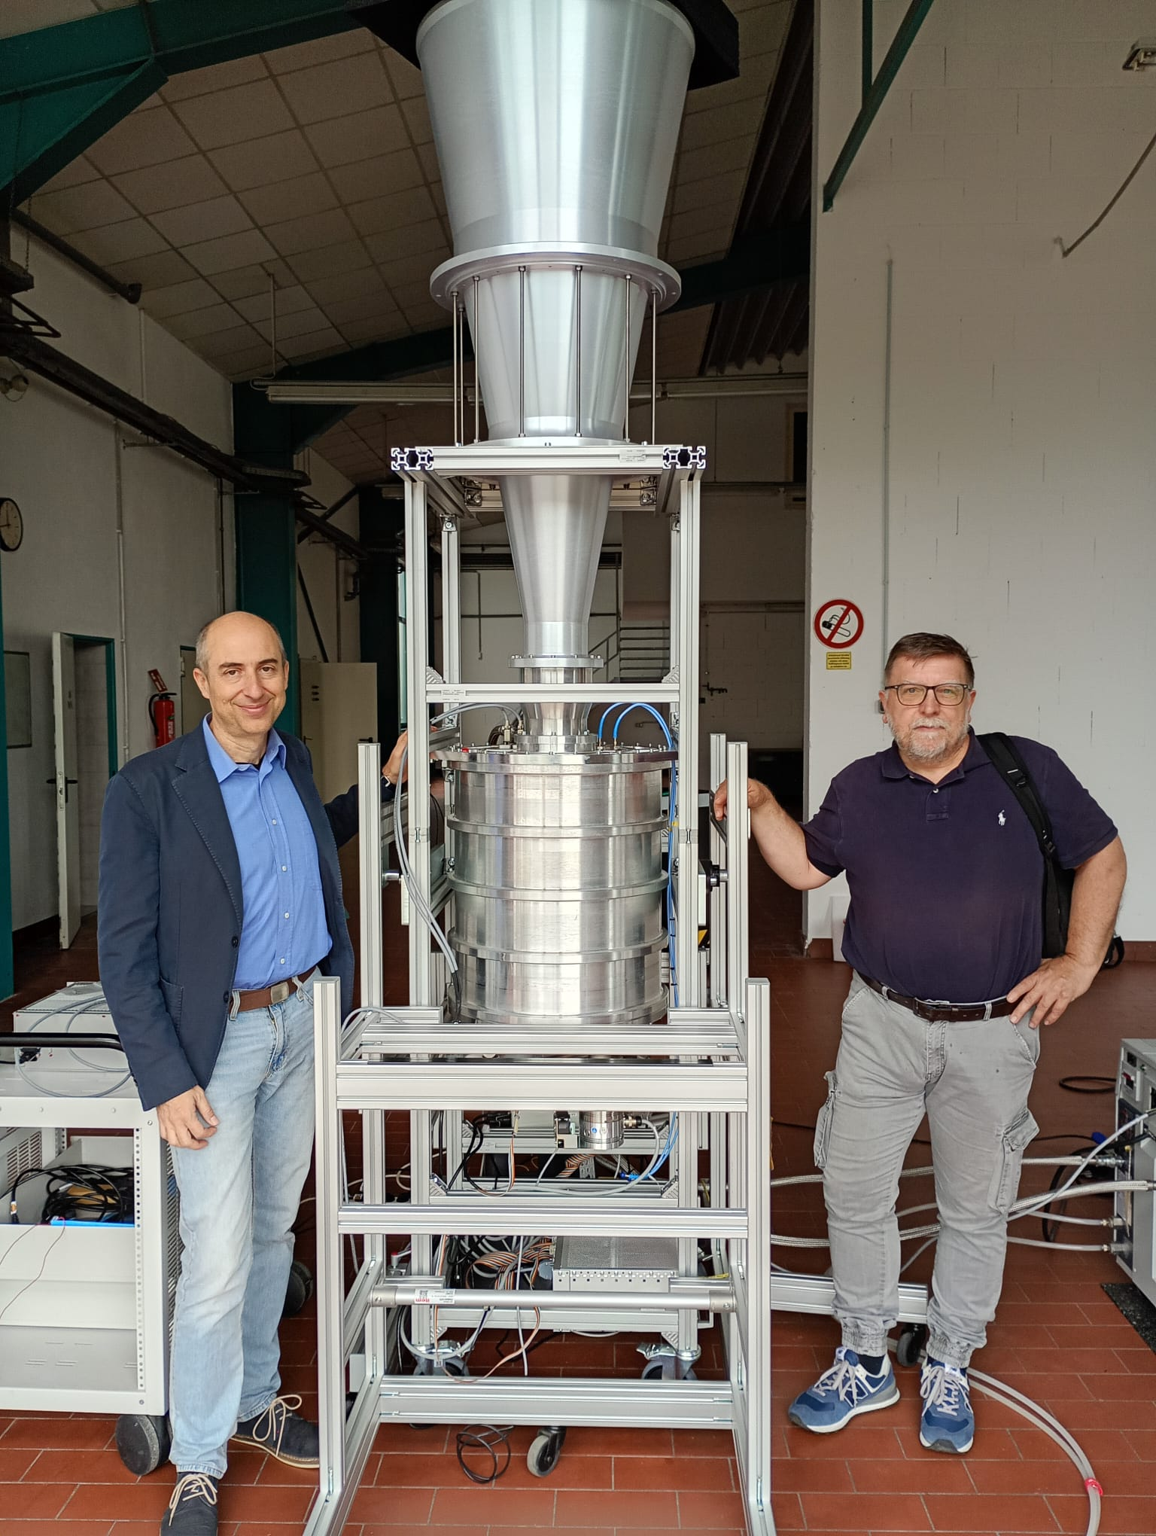
New C-X- Receiver
Cryogenic
Tric is 8K
Sky frequency 4.0-9.0 GHz
4 IFs 0.1-2.4 GHz bandwidth
Full linear polarization.
2026
Missione 4 • Istruzione e Ricerca
Missione 4 • Istruzione e Ricerca

Slide 12
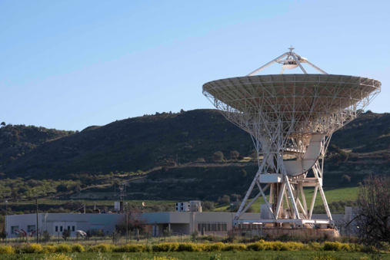
WP4 - Upgrade of Noto observatory
Goal
  Enable Noto radio telescope for SST monitoring and for FRBs observations
Synergies
  KM3Net to follow-up neutrino sources(High Frequency).
  All science activities of the facility (EVN, IVS, etc.)
Budget
  4.1M€
Improve availability and reliability of the facility “at-large”
Add scientific instrumentation (receiver, backend) to enable the cooperation and the synergies with the Northen-Cross
2023-2026
Missione 4 • Istruzione e Ricerca
Missione 4 • Istruzione e Ricerca

Slide 13
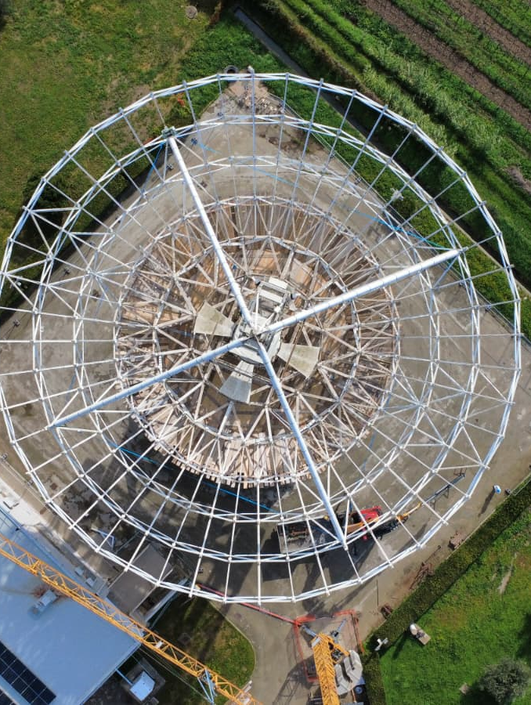
Station and Radio Telescope tasks
Station Refurbishment
  Air cooling system
  Power distribution
  Green energy
  Time & Frequency - new H-maser
Radio Telescope
  Elevation rack
  Azimuth rail
  Replacement of mechanical parts of the Active Surface Actuators
  Primary mirror repainting
  P-Band receiver
Missione 4 • Istruzione e Ricerca
Missione 4 • Istruzione e Ricerca

Slide 14
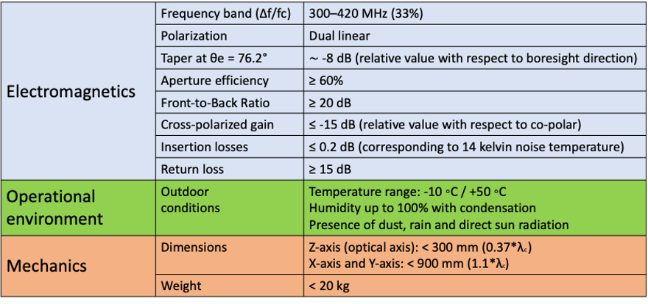
P-band receiver data sheet
Missione 4 • Istruzione e Ricerca
Missione 4 • Istruzione e Ricerca

Slide 15
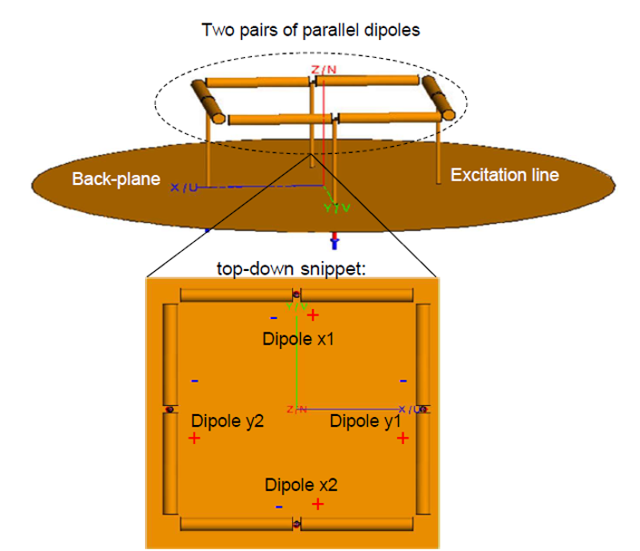
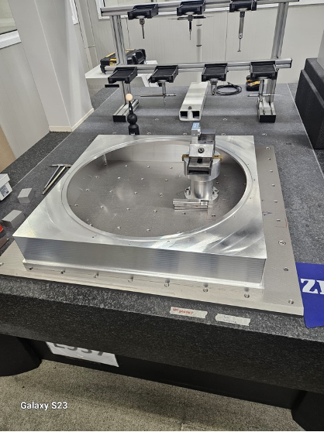
P-band receiver design
Missione 4 • Istruzione e Ricerca
Missione 4 • Istruzione e Ricerca

Slide 16
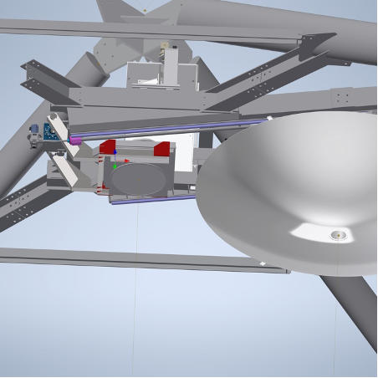
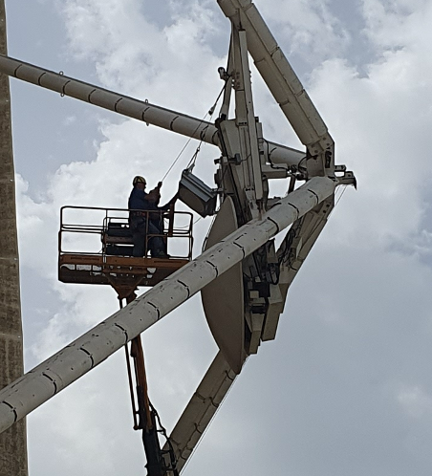
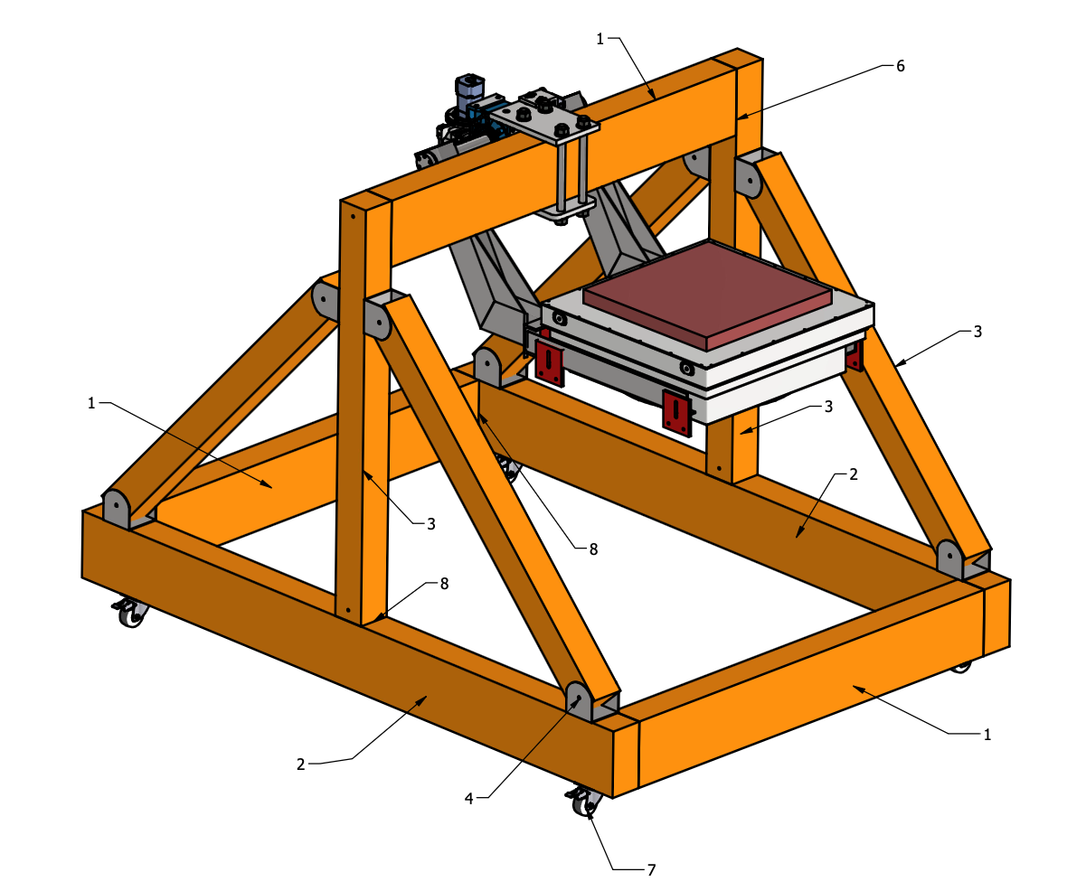
P-band receiver on primary focus
Missione 4 • Istruzione e Ricerca
Missione 4 • Istruzione e Ricerca

Slide 17
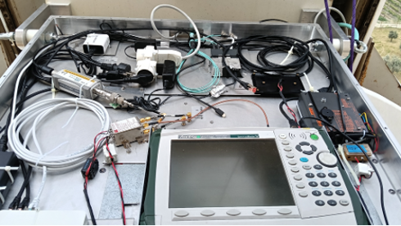
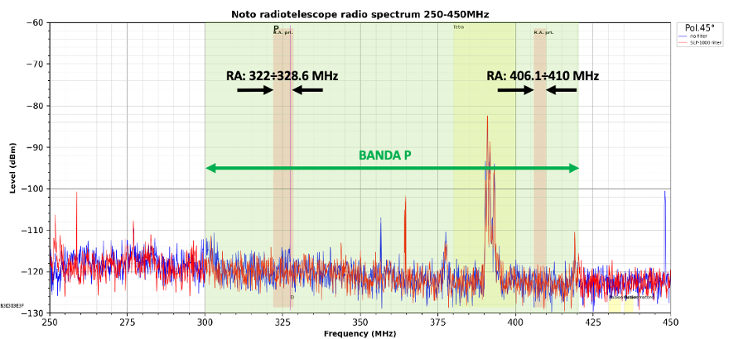
P-band preliminary results - RFI
Missione 4 • Istruzione e Ricerca
Missione 4 • Istruzione e Ricerca

Slide 18
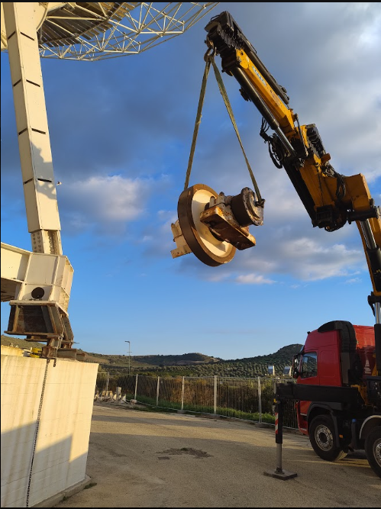
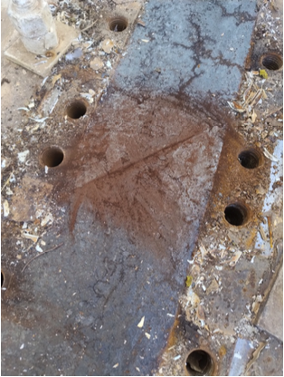
Azimuth Rail and Wheel Replacement
The Rail: It has a nominal diameter of 18.3 meters. It is divided into 12 high-precision machined steel sectors, weighing approximately 420 kg each.
Fastening: The anchoring to the annular foundation plate is achieved through a robust bolted wedge system, technically called "pizzicotti" (pinchers).
Structural Support: The weight of the entire mobile radio telescope structure (32 meters) is supported by four wheel groups.
Traction System: Two "drive wheel groups" are connected to reducer-motor-brake systems for rotation. The remaining two are "idler wheel groups" dedicated exclusively to support and sliding.
Missione 4 • Istruzione e Ricerca
Missione 4 • Istruzione e Ricerca

Slide 19









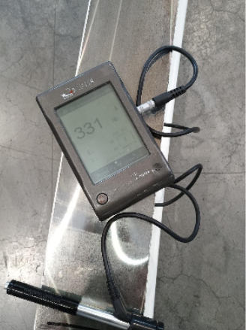
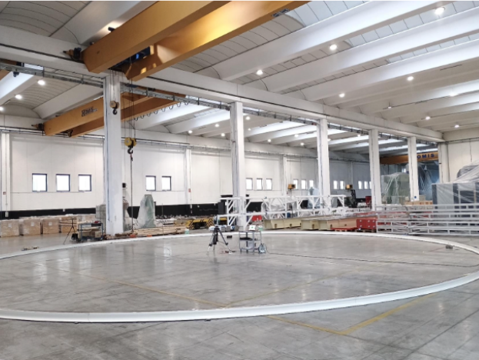
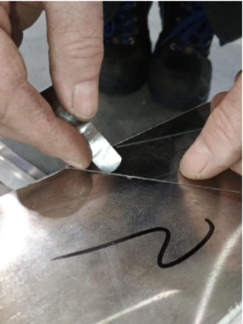
Quality checks and measurements
Hardness Test
Dimensional Accuracy
Joint Coupling
Post-machining measurements were performed using a SAUTER hardness tester. The recorded values (327-331 HB) are perfectly compliant with the strict technical design specifications (321-388 HB)
A Laser Tracker certified a diameter of Ø18288 ±6 mm (well within the ±10 mm tolerance). Parallelism between faces showed minimal deviations (maximum 0.03 mm over 100 mm).
Empirical test performed with Johnson gauge blocks and a 0.05 mm feeler gauge. The tool did not pass through any of the joints, certifying perfect alignment and the absence of gaps ("lights").
Missione 4 • Istruzione e Ricerca
Missione 4 • Istruzione e Ricerca

Slide 20
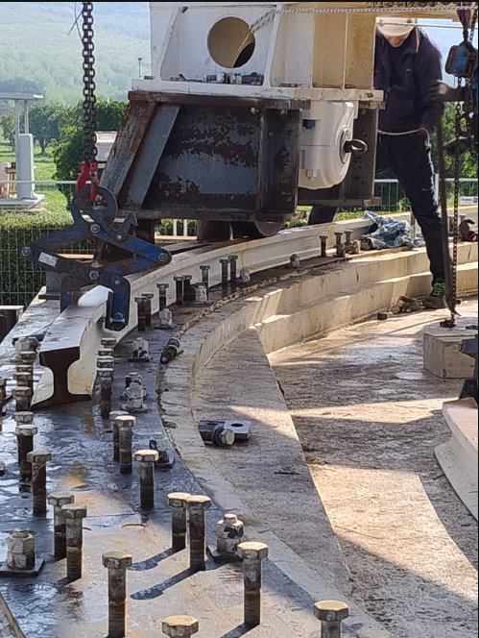
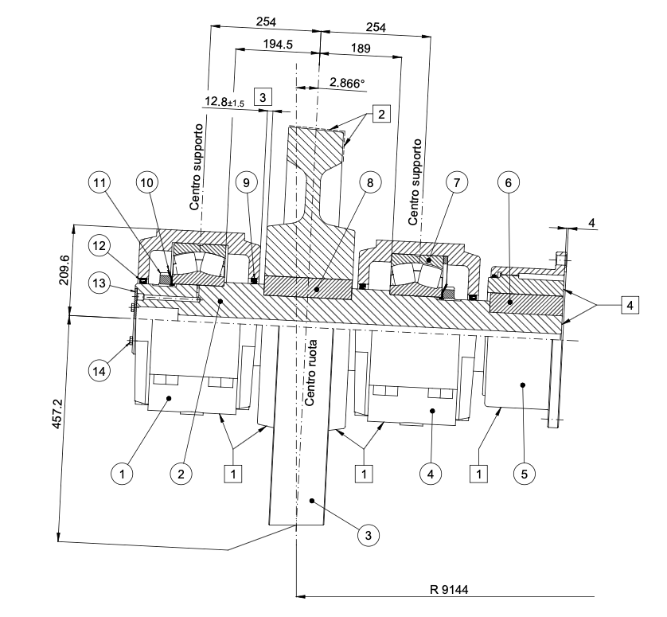
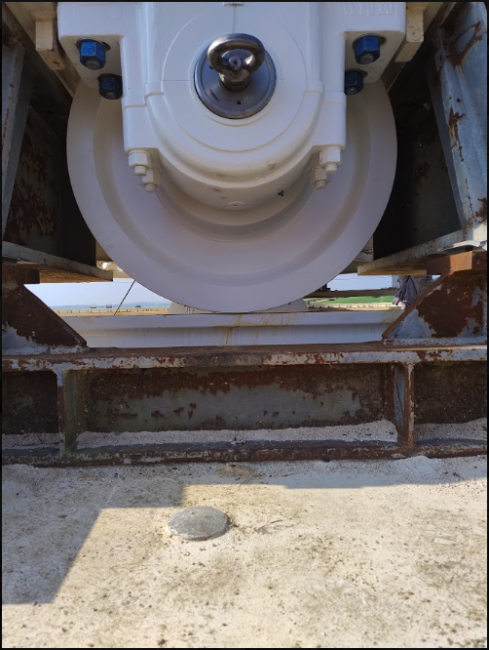
Installation and metrology
During the assembly process, the metrological measurements were crucial. Performed using precision instruments, they were necessary to establish the physical axis of the parabola, ensure the correct positioning of the 12 track sectors, and guarantee the proper tilt of the wheels.
Missione 4 • Istruzione e Ricerca
Missione 4 • Istruzione e Ricerca

Slide 21
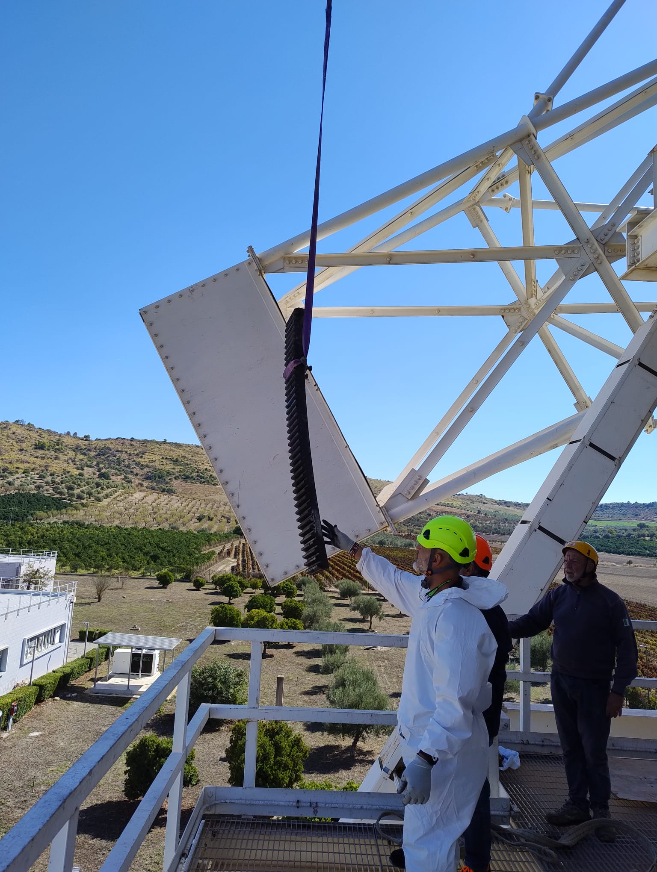
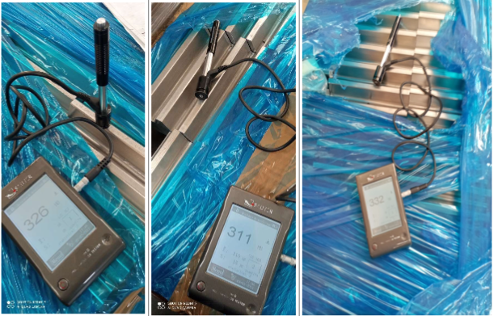
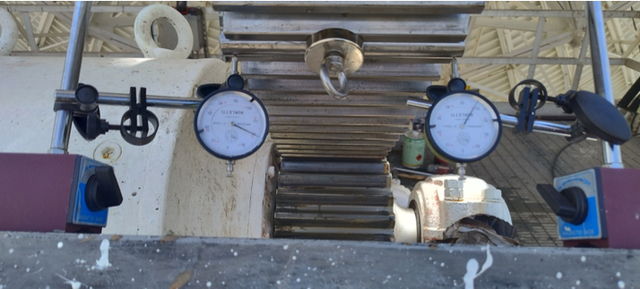
Rack & Pinion Replacement and Quality Control
Component Replacement Complete replacement of 7 geared rack sectors and drive pinions due to historical lamination and wear.
Hardness Testing Achieved rigorous specifications: ~60 HRC on the pinions and 311-326 HB on the rack, validated via portable instruments.
Dimensional Accuracy Theoretical curvature verified; maximum radius deviation remained strictly under 0.09mm across all sectors.
Pitch Consistency Joint gaps were measured and validated sequentially, maintaining an exact tooth pitch between 39.91mm and 39.96mm.
Alignement The mechanical backlash between the pinion and rack teeth was registered to a strict tolerance of exactly 0.2mm to 0.4mm.
Missione 4 • Istruzione e Ricerca
Missione 4 • Istruzione e Ricerca

Slide 22
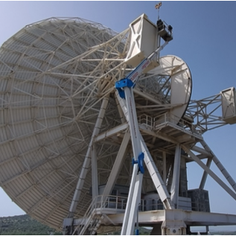
Structural Balancing
Counterweight Restoration
Over the years, structural additions—such as the Active Surface installed in 2001—shifted the optimal "positive balance" to a negative state. This imbalance placed undue stress on the elevation mechanisms and degraded the original concrete and metal counterweights.
To restore equilibrium, a new heavy-duty steel framework was installed directly onto the existing counterweight boxes. Using precise torque measurements, steel plates are iteratively added to the structure until perfect positive balance is achieved.
Missione 4 • Istruzione e Ricerca
Missione 4 • Istruzione e Ricerca

Slide 23
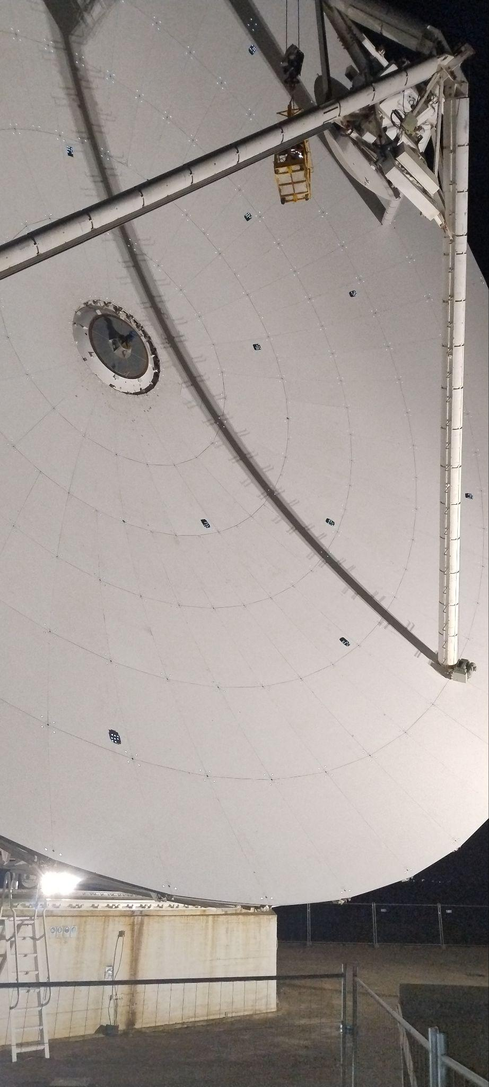
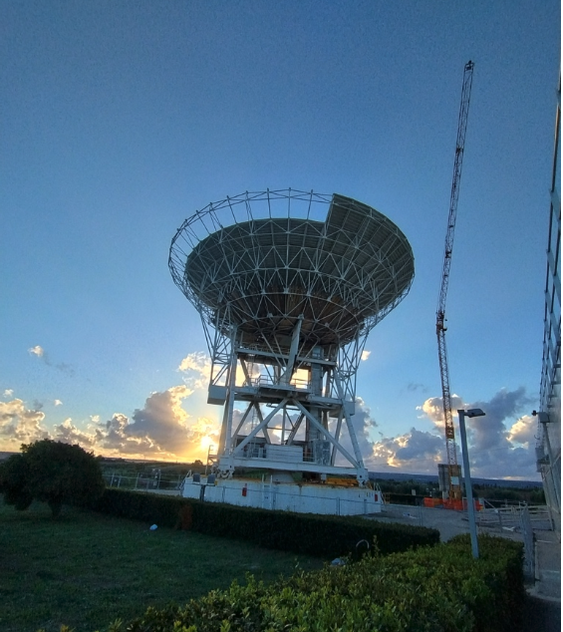
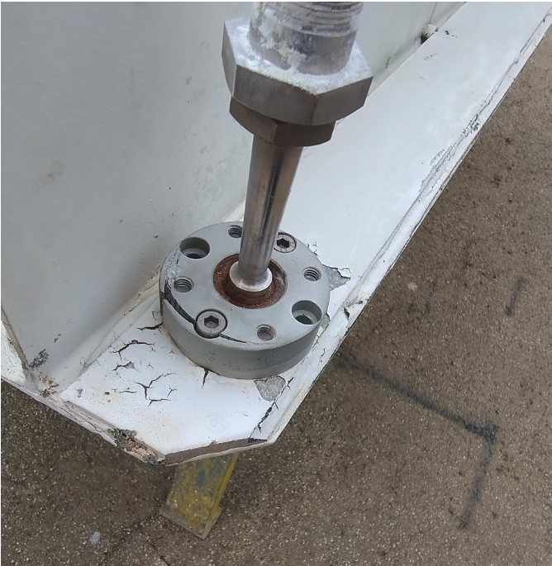

Active Surface Refurbishment
  Prolonged environmental exposure caused severe corrosion on the aluminum alloy components of the primary mirror's support system, necessitating immediate intervention.
  Instead of removing the 244 actuators completely, a targeted replacements of damaged sub-components (adjustment tubes, locking rings, spherical joints).
  Also all aluminum panels were cleaned a painted with with Goldstone 7 Series Low Gloss White to optimize thermal reflectance and structural longevity
Missione 4 • Istruzione e Ricerca
Missione 4 • Istruzione e Ricerca

Slide 24

Metrology
  1. Laser Tracker Measurements: Utilizing a column-mounted Leica instrument in the Vertex room and special retro-reflective spheres (Corner Cubes), the position of the Secondary Mirror M2 relative to the Primary Mirror M1 was determined at various elevation angles (from 3° to 90°). This activity was conducted during the night to minimize thermal distortions.
  2. Close Range Photogrammetry: Photogrammetric survey of the deformations sustained by the support grid (BUS - Back-Up Structure) under the effect of gravity. This operation requires applying approximately 1000 retro-reflective targets on the corners of the 240 panels of the primary mirror, as well as utilizing an aerial platform capable of lifting operators 60 meters above the ground to take high-resolution photographs at various elevations. The data analysis, processed using "bundle adjustment" software, guarantees sub-millimeter precision (less than 0.25 mm), which is essential for updating the system's corrective tables. As of the date of this report, the final results from the analysis of the collected data have not yet been delivered.
Missione 4 • Istruzione e Ricerca
Missione 4 • Istruzione e Ricerca

Slide 25

Photogrammetry preliminary results
Missione 4 • Istruzione e Ricerca
Missione 4 • Istruzione e Ricerca

Slide 26

Photogrammetry preliminary results
Missione 4 • Istruzione e Ricerca
Missione 4 • Istruzione e Ricerca

