Slide 1
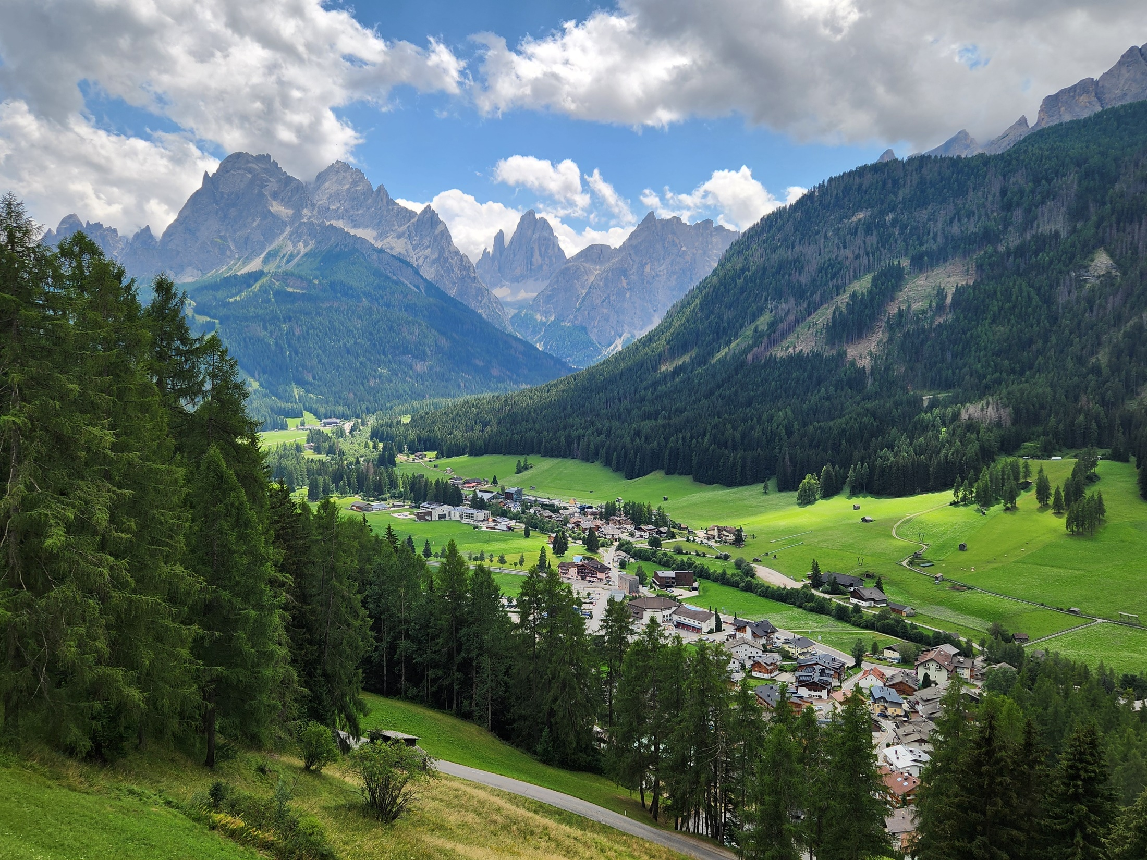



Extragalactic (VHE) Gamma-Ray Sources and Hadronic Models
0
Markus Böttcher,
North-West University
Potchefstroom
South Africa

Slide 2
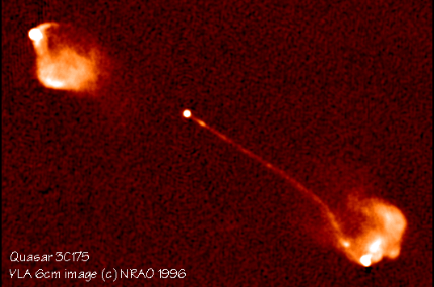
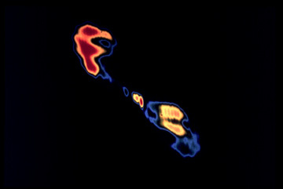
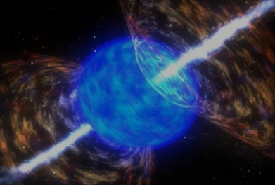
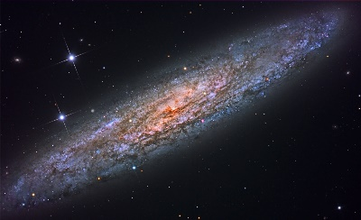
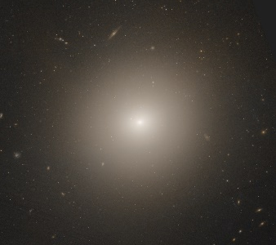
Extragalactic VHE Gamma-Ray Sources
Blazars
  Most numerous source class, promising neutrino sources → Focus of this talk
Radio galaxies
  6 detected; probably same physics as blazars → Not covered separately.
Gamma-ray bursts
  5 detected so far (incl. the BOAT, GRB 221009A); no coincidences with neutrino events so far → No compelling evidence of prominent hadronic interactions.
Starburst galaxies
  2 detected (M82, NGC 253). Most likely hadronic cosmic-ray interactions.
  Not covered here due to lack of time.
Low-Luminosity AGN (LLAGN)
  Only NGC 4278 → Giulia Migliori’s talk Monday

Slide 3
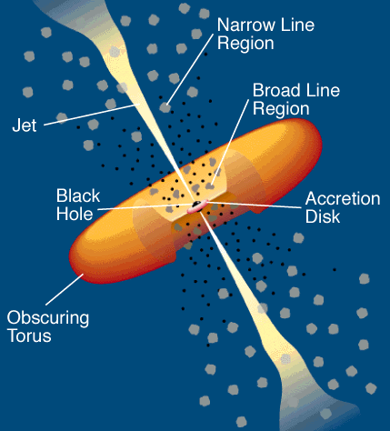

Leptonic Blazar Model
0
Synchrotron emission
Injection, acceleration of ultrarelativistic electrons
Relativistic jet outflow with Γ ≈ 10
$$δ= \frac{1}{Γ (1 − βcosθ)}$$
νF_{ν}
Q_{e} (γ,t)
γ^{-q}
ν
γ₁
γ₂
γ
Compton emission
Radiative cooling ↔ escape =>
νF_{ν}
γ^{-q} or γ⁻²
Q_{e} (γ,t)
ν
γ^{-(q+1)}
Seed photons:
Synchrotron (within same region [SSC] or external sources, e.g., accretion disk, BLR, dust torus (EC = External Compton)
γ₁
γ_{b}
γ₂
γ
γ_{b}:
τ_{cool}(γ_{b}) = τ_{esc}
γ_{b}
γ₁
γ₂

Slide 4
Hadronic Blazar Models
0
Injection, acceleration of ultrarelativistic electrons and protons
Proton-induced radiation mechanisms:
Relativistic jet outflow with Γ ≈ 10
$$δ= \frac{1}{Γ (1 − βcosθ)}$$
νF_{ν}
γ^{-q}
ν
Q_{e,p} (γ,t)
Proton synchrotron
γ₁
γ₂
γ
pγ → pπ⁰ π⁰ → 2γ
Synchrotron emission of primary e⁻
pγ → nπ⁺ ; π⁺ → μ⁺ν_{μ}
μ⁺ → e⁺ν_{e}ν_{μ}
νF_{ν}
→ secondary μ-, e-synchrotron
ν
Cascades …

Slide 5
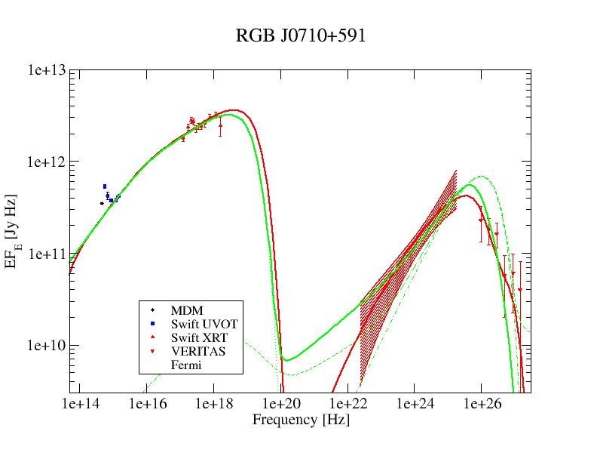
Lepto-Hadronic Model Fits to Blazar SEDs
(HBL)
Red = leptonic
Green = lepto-hadronic
In many cases, leptonic and hadronic models can produce equally good fits to the SEDs.
Possible Diagnostics to distinguish:
Neutrinos
Polarization
Variability

Slide 6
Origin of IceCube-Detected Neutrinos
(Buson et al. 2022)
Significant correlation of IceCube neutrinos with γ-ray (Fermi-LAT) blazars (chance coincidence probability p = 6∙10⁻⁷)
– but can not be responsible for all IceCube neutrinos (e.g., Murase et al. 2018)

Slide 7
Origin of IceCube-Detected Neutrinos
(Plavin et al. 2022)
(Buson et al. 2022)
Also: Correlation with radio-loud blazars
(chance-coincidence probability of p = 3∙10⁻⁴)
(Plavin et al. 2020, 2021, 2022)

Slide 8
Basic ingredients of hadronic jet multi-messenger emission models
Particle acceleration/injection (usually modelled as instantaneous injection; 2nd-order [stochastic] acceleration included in some models/codes)
Particle interaction / radiation modules (synchrotron, SSC, EC standard, but differences in pγ interactions and cascades)
Secondary particle (pions, muons, neutronos, electron-positron pair) production (MC vs. semi-analytical templates)
Radiative transport (emission / absorption / scattering) (geometry-dependent in multi-zone / extended jet models; polarization?)
Evolution of particle distributions (re-acceleration / cooling / escape) (usually through solutions to Fokker-Planck equations)

Slide 9
Basics of Neutrino Production
p + p (N) → p + p/n + n₀π⁰ + n₊π⁺ + n₋π⁻
p + γ → p + π⁰ (2/3)
or n + π⁺ (1/3)
π⁰ → 2γ
π⁺ → μ⁺ + ν_{μ} τ = 2.55×10⁻⁸ s
π⁻ → μ⁻ + ν_{μ}
μ⁺ → e⁺ + ν_{μ} + ν_{e} τ = 2.2×10⁻⁶ s
μ⁻ → e⁻ + ν_{μ} + ν_{e}
(σ_{pp} ~ 0.1 mb)
(σ_{pγ} ~ 0.6 mb)

Slide 10
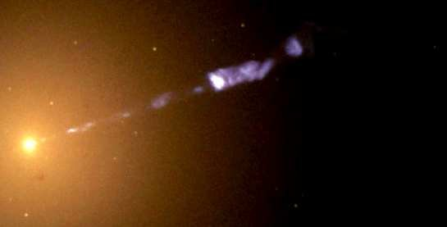
Neutrino Production in AGN Jets

Slide 11
Photo-Pion Production Cross Section
Δ⁺ resonance (1232 MeV)
σ(pγ→pπ⁰) : σ(pγ→nπ⁺) = 2:1
(Morejon et al. 2019)

Slide 12
Photo-Pion Production
Δ⁺ resonance
(1232 MeV)
Spectral index (n[ε] ~ ε^{−α}) of target photon field
Interaction Probability
(Mücke et al. 1999)
Center-of-Momentum energy
For realistic target photon fields, most interactions occur near threshold (at Δ⁺ resonance).

Slide 13

Phohto-pion induced neutrino production in relativistic jets
pγ → p π⁰
n π⁺
θ
Earth
$$δ= \frac{1}{Γ (1 − β cosθ)}$$
Γ
E_{obs} = δ E’

Slide 14
Photo-pion production - Energetics
p-γ threshold: ~ 10¹⁷ eV E_{t,eV}⁻¹
At Δ⁺ resonance:
s = E_{p}’ E_{t}’ (1 – β_{p}’ μ) = E_{Δ+}² = (1232 MeV)²
Each neutrino takes about ~ 5 % of the proton’s energy
To produce IceCube neutrinos (~ 100 TeV → E_{ν} = 10¹⁴ E₁₄ eV):
Need protons with E’_{p} ~ 200 E₁₄ δ₁⁻¹ TeV
and target photons with E’_{t} ~ 1.6 E₁₄⁻¹ δ₁ keV

Slide 15
Photo-pion production –
Origin of Target Photons
To produce IceCube neutrinos (~ 100 TeV → E_{ν} = 10¹⁴ E₁₄ eV):
Need protons with E’_{p} ~ 200 E₁₄ δ₁⁻¹ TeV
and target photons with E’_{t} ~ 1.6 E₁₄⁻¹ δ₁ keV
=> X-rays!
(At least) two possible scenarios:
Target photons co-moving with the emission region
E_{t}^{obs} ~ 16 E₁₄⁻¹ δ₁²/(1+z) keV
Observed as Doppler-boosted hard X-rays
Tightly constrained by observed hard X-ray flux -> Energetics constraints.
Target photons stationary in the AGN frame
E_{t}^{obs} ~ 160 E₁₄⁻¹/(1+z) eV
Observed as UV / soft X-rays, Doppler boosted into the emission-region frame
Much more relaxed energetics constraints.

Slide 16
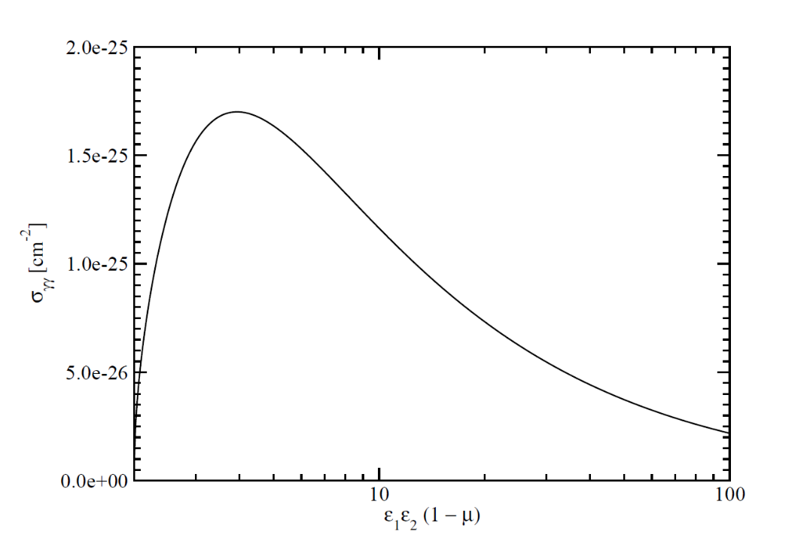
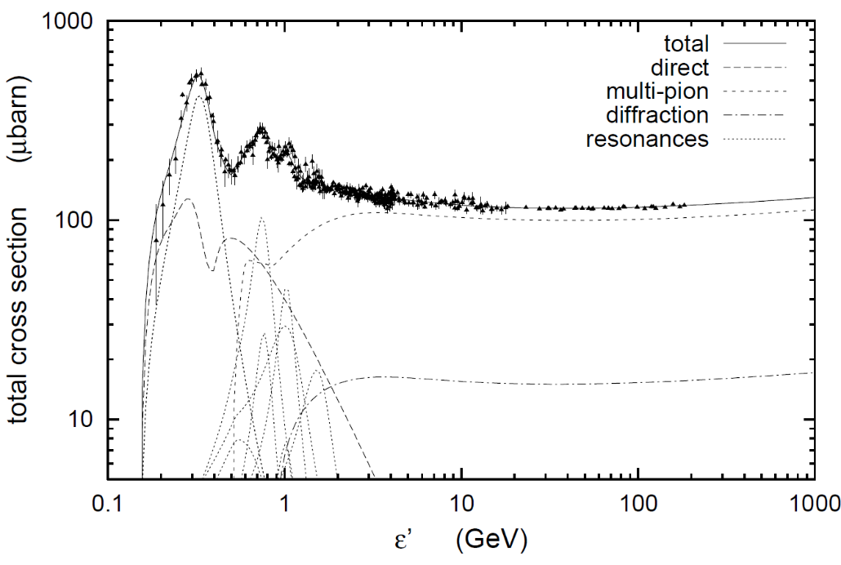
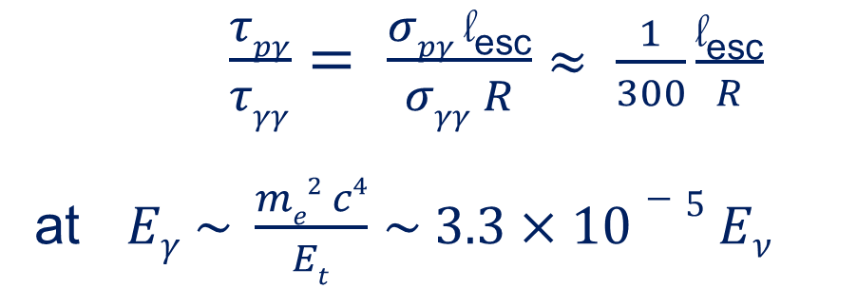
The pγ Efficiency Problem
Efficiency for protons to undergo pγ interaction ~ τ_{pγ} = l_{esc} σ_{pγ} n_{ph}
Likelihood of γ-ray photons to be absorbed ~ τ_{γγ} = R σ_{γγ} n_{ph}
Efficient neutrino production sites are likely to be optically thick to gamma-rays
Expect no correlation between GeV – TeV gamma-ray and neutrino activity!
Cascades! → Expect correlation with X-ray / soft (MeV) γ-ray and possibly multi-TeV gamma-ray activity!
Promising targets for ASTRI / SSTs
σ_{pγ}
σ_{γγ}
$\frac{τpγ}{τγγ}= \frac{σpγ \text{l}\text{esc}}{σγγ R}$ $≈ \frac{1}{300}\frac{\text{l}\text{esc}}{R}$
at $Eγ \sim \frac{me2 c4}{Et}$ $\sim 3.3×10−5 Eν$
l_{esc} = average length travelled by protons until escape
~ few to tens of
GeV γ-rays

Slide 17
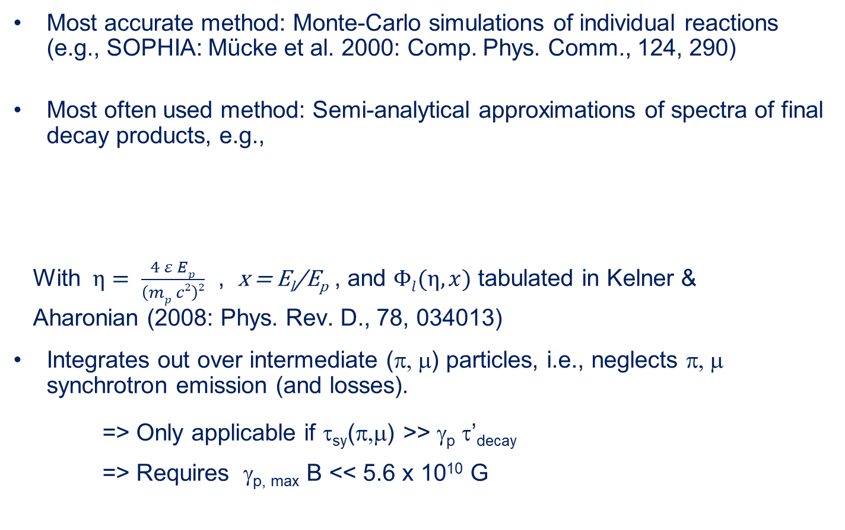
Modeling Multi-messenger Emissions from photo-pion production
Most accurate method: Monte-Carlo simulations of individual reactions (e.g., SOPHIA: Mücke et al. 2000: Comp. Phys. Comm., 124, 290)
Most often used method: Semi-analytical approximations of spectra of final decay products, e.g.,
With $η= \frac{4 ε Ep}{\left(mp c2\right)2}$ , x = E_{l}/E_{p} , and $Φl(η,x)$ tabulated in Kelner &
Aharonian (2008: Phys. Rev. D., 78, 034013)
Integrates out over intermediate (π, μ) particles, i.e., neglects π, μ synchrotron emission (and losses).
=> Only applicable if τ_{sy}(π,μ) >> γ_{p} τ’_{decay}
=> Requires γ_{p, max} B << 5.6 x 10¹⁰ G

Slide 18
Modeling Multi-messenger Emissions from photo-pion production
More generally applicable method: Production (injection) rates of pions Q_{π}(E_{π}) based on semi-analytical templates from Hümmer et al. (2010: ApJ, 721, 630)
Solve coupled Fokker-Planck equations for the evolution of all particle species, e.g.,
π
Radiative (synchrotron) losses
Pion production
Escape
Stochastic acceleration
Pion decay: π⁺ → Q_{μ}(E_{μ})
π⁰ → Q_{γ}(E_{γ})
(e.g., Diltz et al. 2016, Zacharias et al. 2019, 2021)

Slide 19
(Lepto-)Hadronic codes “on the market”
AM³ (Gao et al. 2017; Klinger et al. 2024)
Atheνa (Mastichiadis & Kirk 1995; Mastichiadis et al. 2005; Dimitrakoudis et al. 2012; Petropoulou et al. 2014)
B13 (Böttcher et al. 2013)
LeHa-Paris (Cerruti et al. 2015)
LeHaMoC (Stathopoulos et al. 2024)
OneHaLe (Zacharias et al. 2019, 2021)
(Cerruti et al. 2026: Hadronic code comparison project)

Slide 20
(Lepto-)Hadronic codes “on the market”
Various codes agree with each other to within a few %.
(Cerruti et al. 2026: Hadronic code comparison project)

Slide 21
Recent candidate neutrino blazar modelling results
Large body of publications on candidate neutrino blazar modelling using various codes.
Arguably most comprehensive: Rodrigues et al. (2024): Systematic modelling (AM³) of the SEDs of 324 bright blazars :
  In most cases, leptonic-dominated models suffice;
  only ~ 33 % benefit from an additional hadronic component.
Blazars may produce ~ 20 %
of the diffuse IceCube
neutrino flux, in
agreement with
stacking limits.
(Rodrigues et al. 2024)

Slide 22
Neutrino detection potential from bright blazar flares
Using OneHaLe for hadronically-dominated modelling of SEDs and light curves of the 20 brightest Fermi-LAT blazar flares studied by Kreter et al. (2020) with a simple calorimetric method (neutrino output proportional to bolometric high-energy flux).
(Robinson & Böttcher 2024)

Slide 23
Neutrino detection potential from bright blazar flares
Even the brightest blazar flares expected to yield < 0.1 neutrinos even for KM3NeT design configuration.
Calorimetric approximation tends to over-estimate neutrino expectations by about an order of magnitude.
(Robinson & Böttcher 2024)

Slide 24
Dedicated SED modelling of 4 neutrino blazas
Bharathan et al. (2026): Selected 4 recent blazar-neutrino coincidences with good broadband coverage:
  PKS 0446+112 (z = 2.153; IC 240105)
  TXS 0506+056 (z = 0.3365; IC170922A)
  PKS 1424-418 (z = 1.522; IC 121204)
  PKS 1502+106 (z = 1.8378; IC 190730A)
Selected 3 different states for each source:
  E1: quiescent
  E2: around neutrino alert
  E3: bright γ-ray flare
Lepto-hadronic
modelling with
Böttcher et al. (2013)
code.
(Bharathan et al. 2026)

Slide 25
Dedicated SED modelling of 4 neutrino blazars
Most SEDs well fitted with purely leptonic models; hadronically (pγ) dominated models excluded by hard X-ray spectra.
2 exceptions where
leptonic models fail:
  PKS 0446+112
  during neutrino
  detection, but pγ
  cascade component
  still sub-dominant
  (see also Khatoon
  et al. 2026)
  PKS 1502+106
  during neutrino
  detection.
PKS 0446+112
E1 (qu.)
E2 (ν)
E3 (γ)
E2 (lh)
(Bharathan et al. 2026)

Slide 26

Summary
0
Association of IceCube neutrinos with γ-ray and radio bright blazars becomes more and more significant.
Energetics constraints prefer external target radiation fields for pγ interactions.
SED modeling of blazars generally prefers leptonically dominated broadband emission with at most a sub-dominant contribution of hadronic processes to X-ray – γ-ray emission.
Even the brightest γ-ray flares of blazars are unlikely to yield a neutrino detection probability of > 10 % even for KM3NeT design sensitivity.

Slide 27
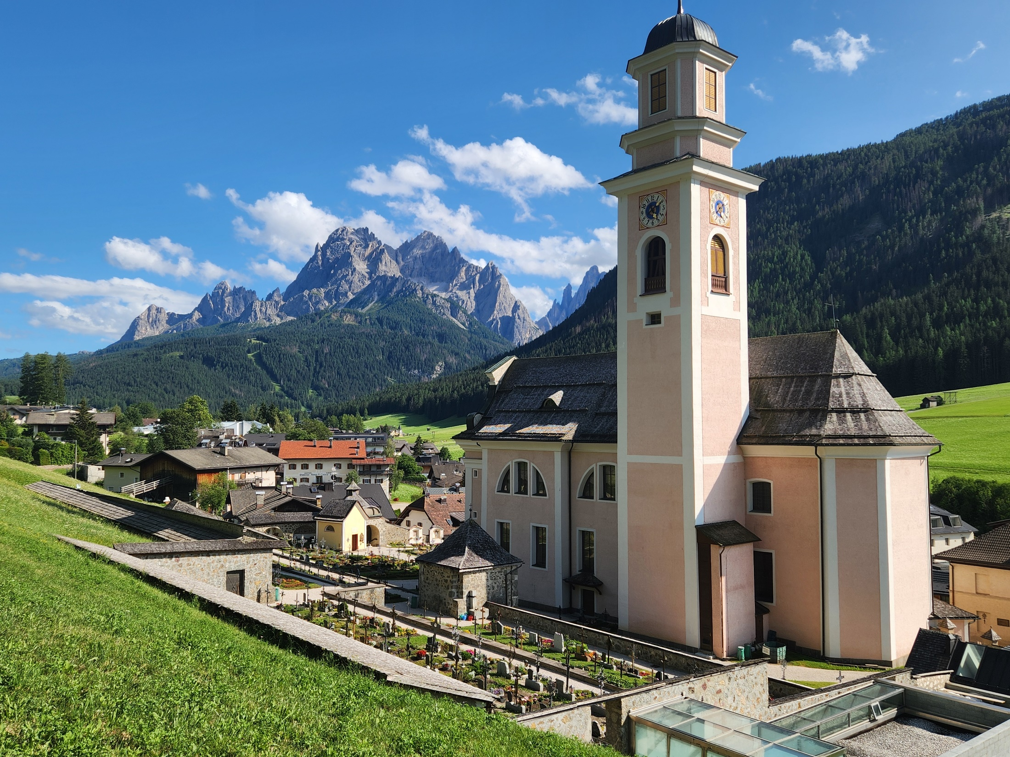
Thank you!

Slide 28
Backup

Slide 29
Blazars
0
Class of AGN consisting of BL Lac objects and gamma-ray bright quasars with relativistic jets pointing close to our line of sight
Rapidly (often intra-day) variable
Strong gamma-ray sources
Radio knots often with superluminal motion
Radio and optical (and X-ray) polarization

Slide 30
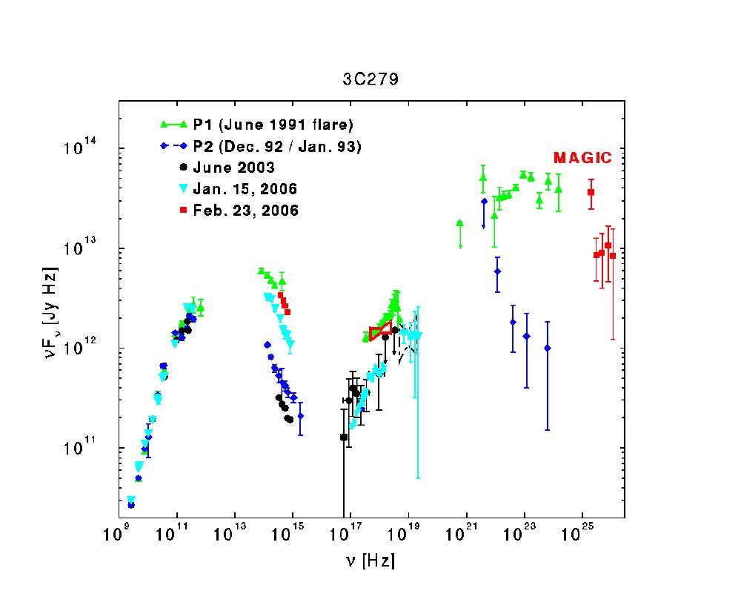
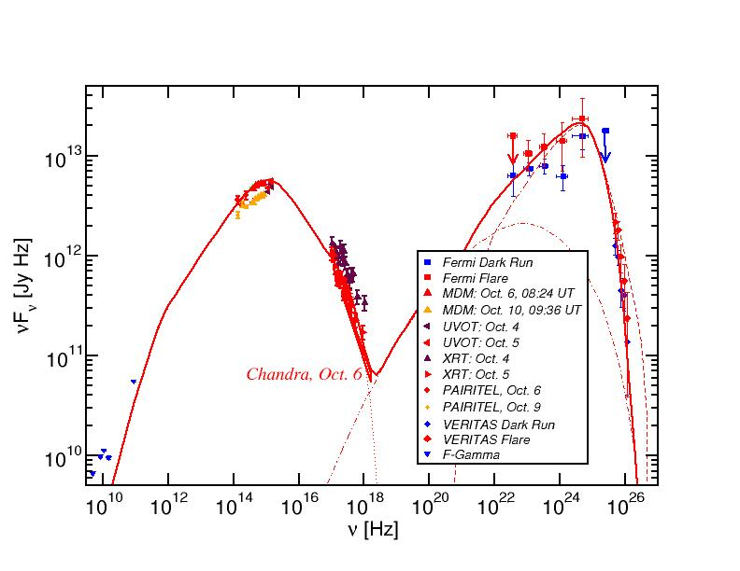
Blazar Spectral Energy Distributions (SEDs)
3C66A
Non-thermal spectra with two broad bumps:
Low-energy (probably synchrotron):
radio-IR-optical(-UV-X-rays)
High-energy (X-ray – γ-rays)

Slide 31
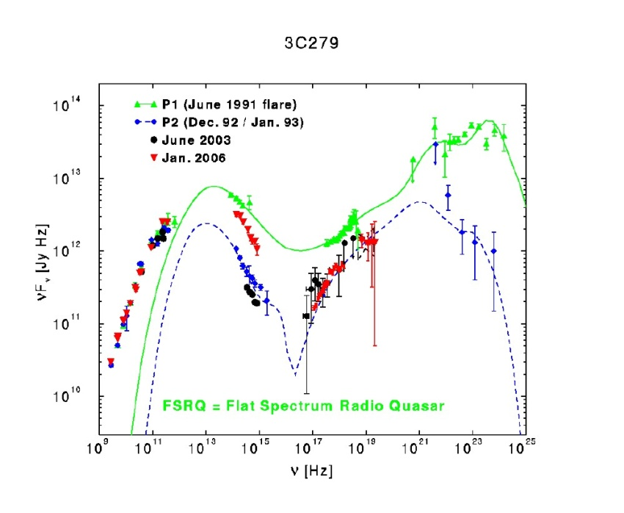
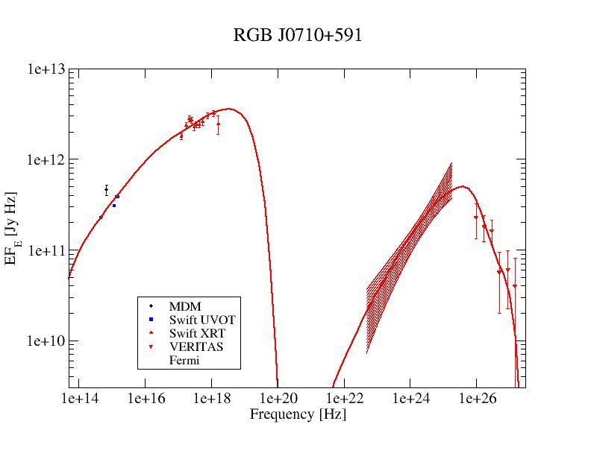
Blazar Classification
0
3C66A
(Abdo et al. 2011)
(Acciari et al. 2009)
(Hartman et al. 2000)
High-Synchrotron Peaked (HSP): High-frequency peaked BL Lacs (HBLs):
Low-frequency component from radio to UV/X-rays,
ν_{sy} > 10¹⁵ Hz
often dominating the total power
High-frequency component from hard X-rays to high-energy gamma-rays
Low-Synchrotron Peaked (LSP): Quasars (FSRQs)/ Low-frequency peaked BL Lac Objects (LBLs)
Low-frequency component from radio to optical/UV,
ν_{sy} ≤ 10¹⁴ Hz
High-frequency component from X-rays to γ-rays, often dominating total power
Intermediate-Synchrotron Peaked (ISP): Intermediate BL Lacs (IBLs):
Peak frequencies at IR/Optical and GeV gamma-rays,
10¹⁴ Hz < ν_{sy} ≤ 10¹⁵ Hz
Intermediate overall luminosity
Sometimes γ-ray dominated

Slide 32
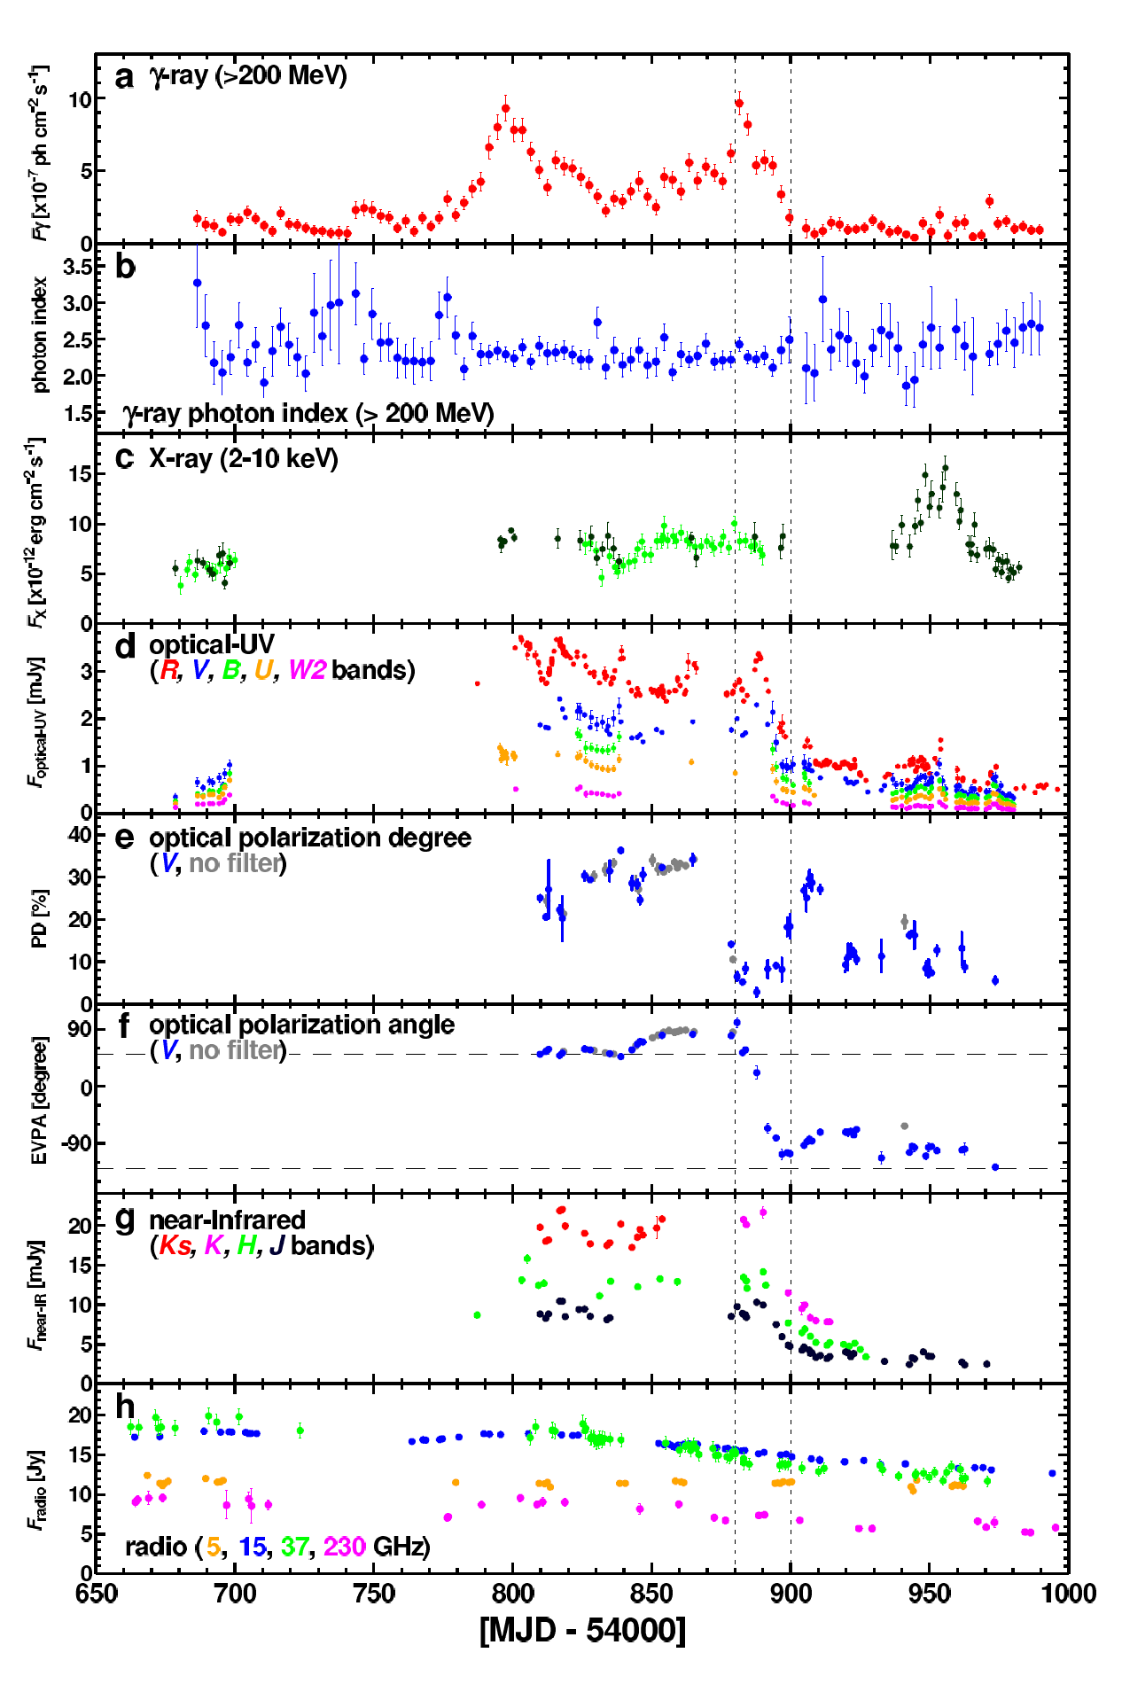
Flux and Polarization Variability
Multi-wavelength variability on various time scales (months – minutes)
Sometimes correlated, sometimes not
Observed optical polarization degrees
Π_{opt} <~ 30 %
Both degree of polarization and polarization angles vary.
(3C279: Abdo et al. 2010)

Slide 33
The IceCube Neutrino Detector at the South Pole
Fully operational since 2010.

Slide 34
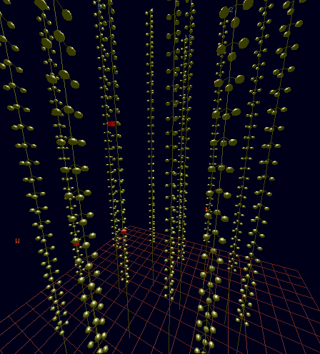
High-Energy Neutrino Detectors
IceCube:
E_{ν} ∼ 100 TeV – few PeV
ν-matter scattering, followed by particle cascades in ice/water → Cherenkov light detection.

Slide 35
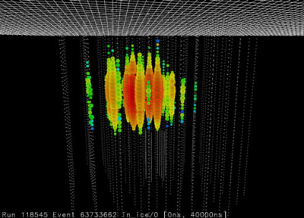
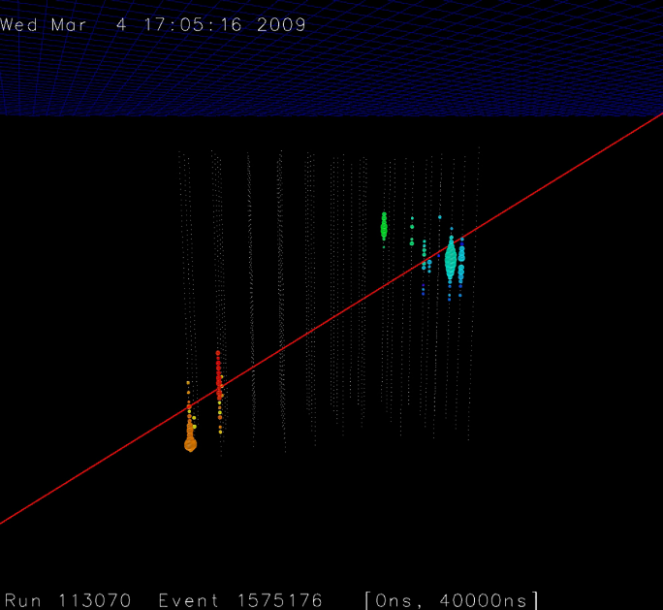
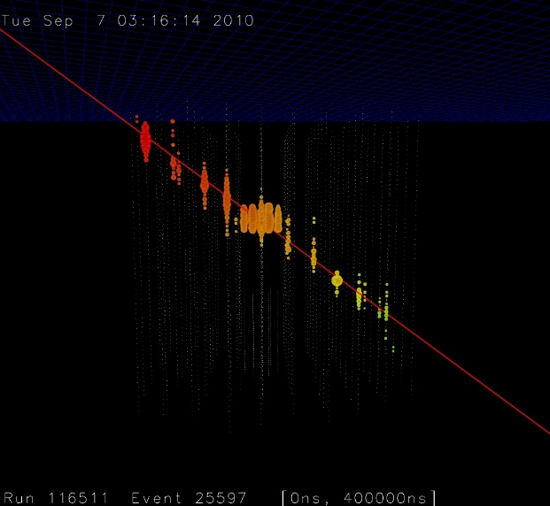
Neutrino Event Types
Tracks ← ν_{μ}
ν_{μ} interaction produces a muon
→ Long track
→ Localization down
to ~ 0.4º.
Cascades ← ν_{e}
ν_{e} interaction produces an electron
→ loses energy quickly in a blob-like cascade.
Localization to ~ 8º.
Double Bang ← ν_{τ}
ν_{τ} interaction produces a tau lepton
→ 2 cascades: One at tau production, one at tau decay.

Slide 36
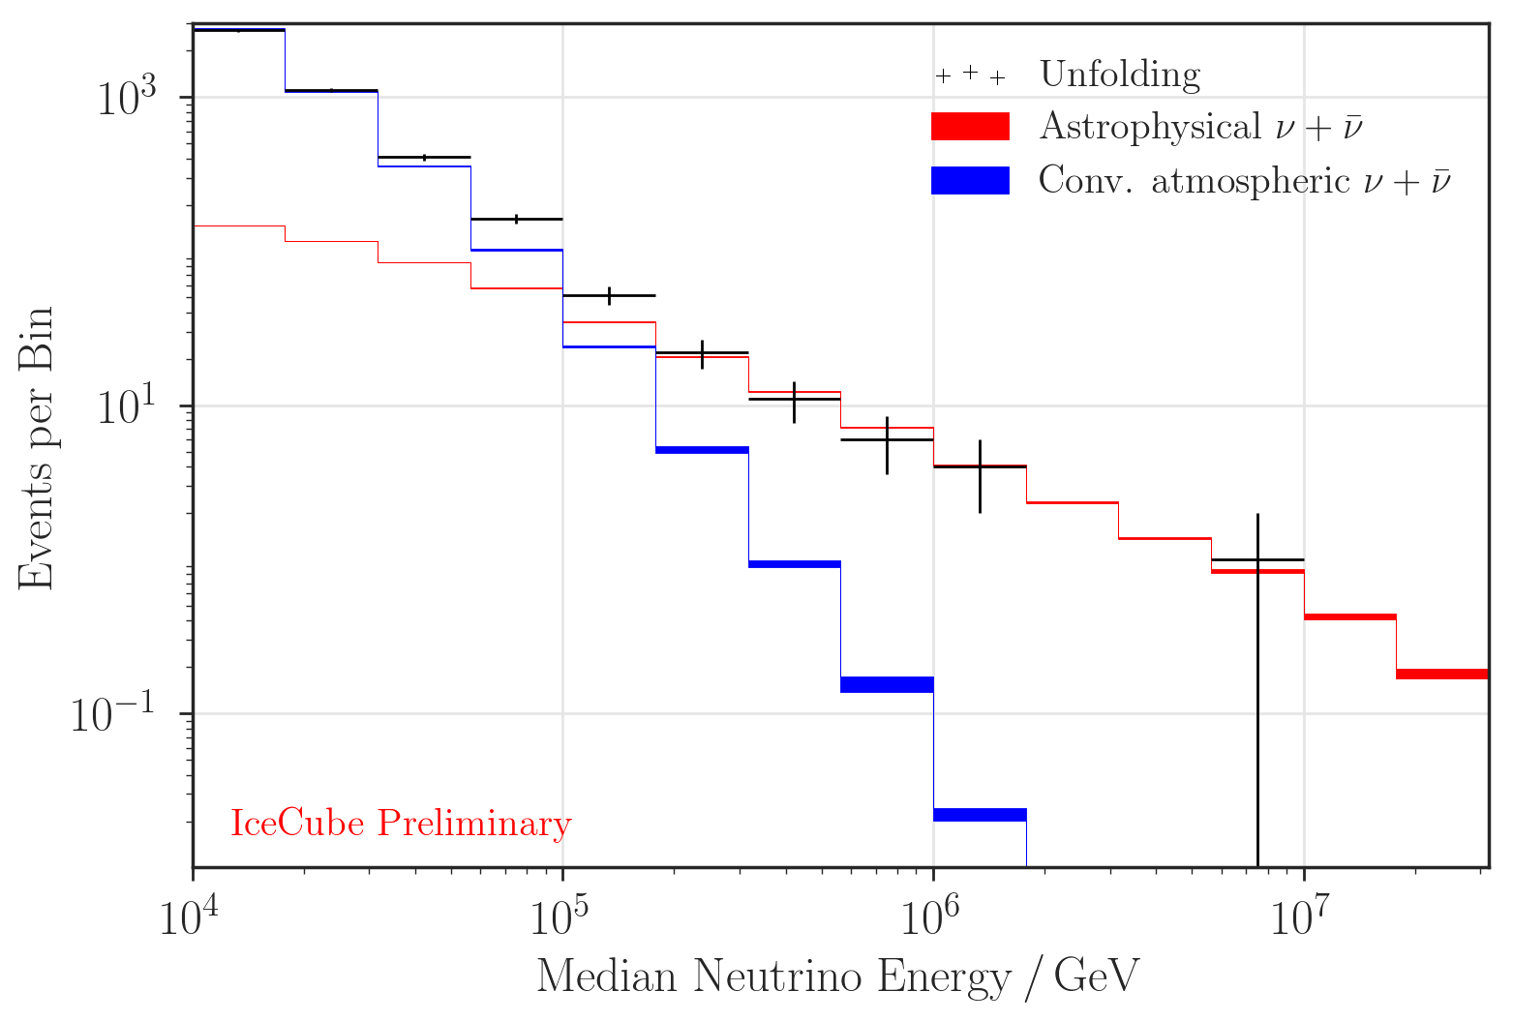
The IceCube Neutrino Spectrum
E_{ν} >> 100 TeV => Likely of astrophysical origin
Large background of atmospheric neutrinos from cosmic-ray interactions with the atmosphere.
First evidence for astrophysical neutrinos published in 2013.

Slide 37
Origin of IceCube-Detected Neutrinos
(Buson et al. 2022)
Significant correlation of IceCube neutrinos with γ-ray (Fermi-LAT) blazars (chance coincidence probability p = 6∙10⁻⁷)
– but can not be responsible for all IceCube neutrinos (e.g., Murase et al. 2018)

Slide 38
Origin of IceCube-Detected Neutrinos
(Plavin et al. 2022)
(Buson et al. 2022)
Also: Correlation with radio-loud blazars
(chance-coincidence probability of p = 3∙10⁻⁴)
(Plavin et al. 2020, 2021, 2022)

Slide 39
The Eddington Bias
Most modelled blazar – neutrino coincidences based on 1 single neutrino.
~ 100 other blazar sources with similar properties (same neutrino flux?)
Models only need to produce ~ 0.01 neutrinos from any individual source! (Strotjohann et al. 2019)

Slide 40
IceCube-170922A
Tentative Associations of IceCube Neutrinos with Blazars
(IceCube et al. 2018a)
Sept. 22, 2017: neutrino-induced muon track with E_{ν} ~ 290 TeV
~ 50 % probability of being astrophysical

Slide 41
IceCube-170922A and TXS 0506+056
(IceCube et al. 2018a)
Position consistent with BL Lac object TXS 0506+056
(z = 0.3365) during a ~ 4 weeks long γ-ray high state
(~ 3 σ probability of association)

Slide 42
IceCube-170922A and TXS 0506+056
(IceCube et al. 2018a)
Position consistent with BL Lac object TXS 0506+056 (z = 0.3365) during a ~ 4 weeks long γ-ray high state.
Flare detection by MAGIC several days after neutrino

Slide 43
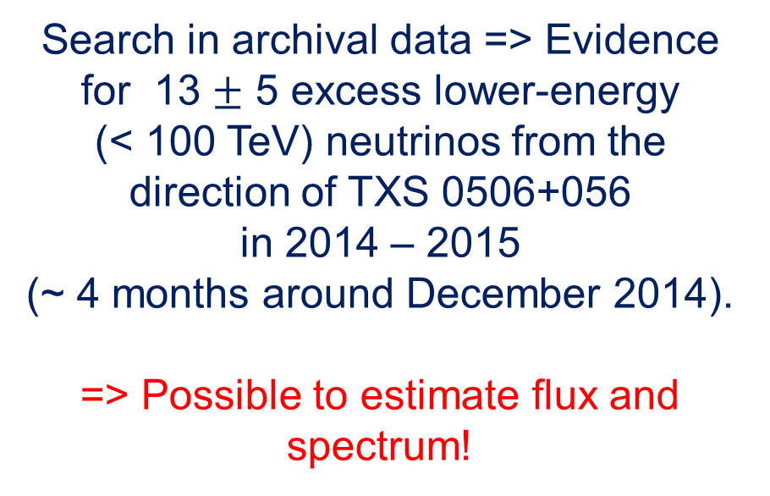
The Neutrino Flare from TXS 0506+056
(IceCube et al. 2018b)
Search in archival data => Evidence for 13 $±$ 5 excess lower-energy
(< 100 TeV) neutrinos from the direction of TXS 0506+056
in 2014 – 2015
(~ 4 months around December 2014).
=> Possible to estimate flux and spectrum!
No γ-ray activity!

