Slide 1

Exploring the Milky Way with
LHAASO and LACT
Ruizhi Yang
on behalf of LHAASO/LACT Collaborations

Slide 2
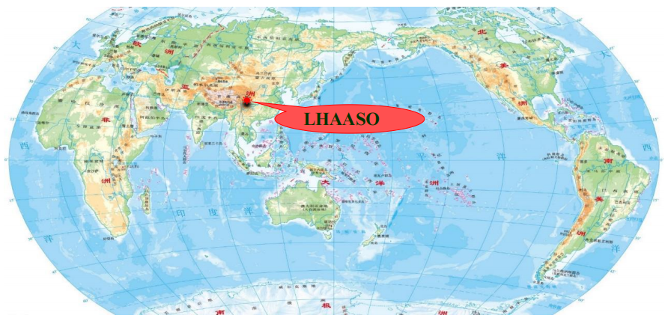
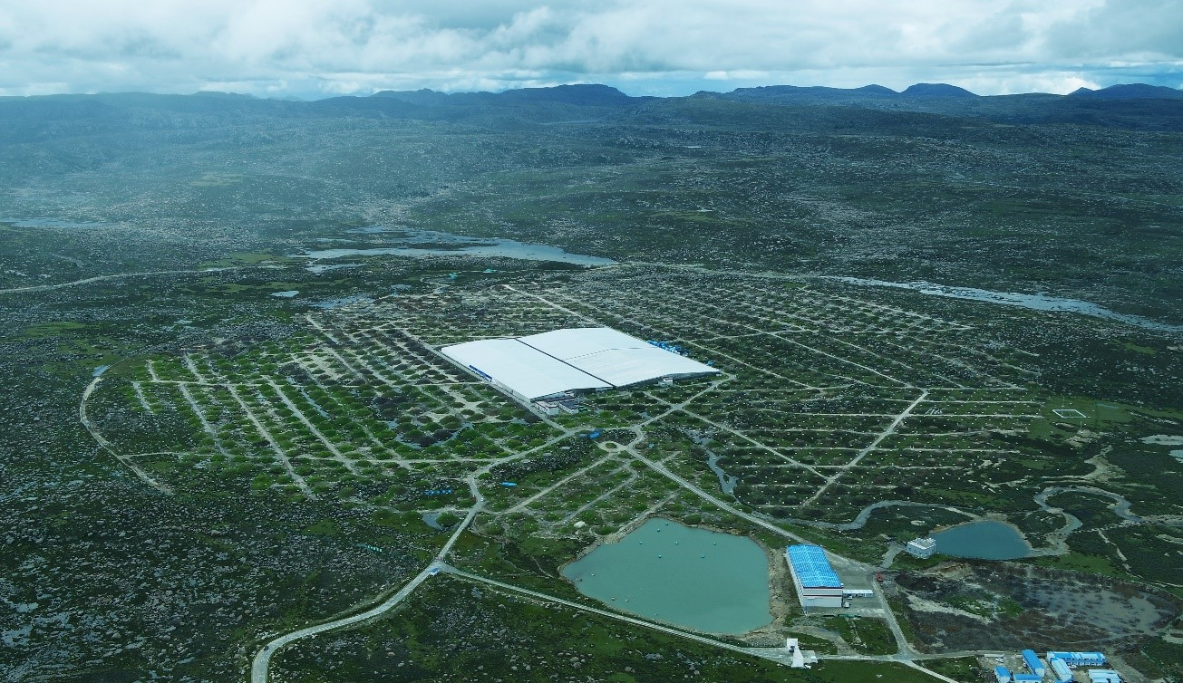
LHAASO: Large High Altitude Air Shower Observatory
Haizi mountain, Sichuan, China, 4410 m above the sea level
LHAASO uses hybrid detector arrays: the square kilometer array (KM2A), the water Cherenkov detector array (WCDA), and the wide field-of-view Cherenkov telescope array (WFCTA)
Full operation since July 2021
2

Slide 3
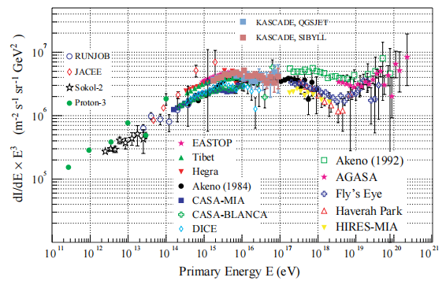
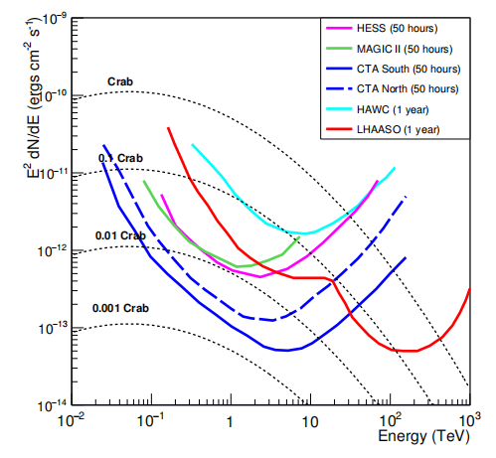
Objectives of LHAASO
Kampert + (2004)
Probe the origin of CRs, via precise measurements of spectra and anisotropies
Study the ultra-high-energy gamma-ray sky with unprecedented sensitivity
Search for new physics
3

Slide 4
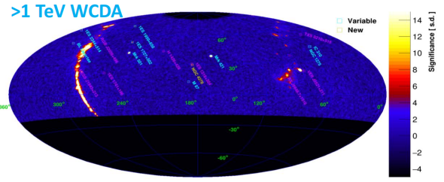
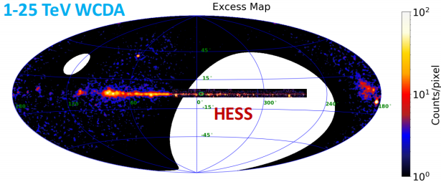
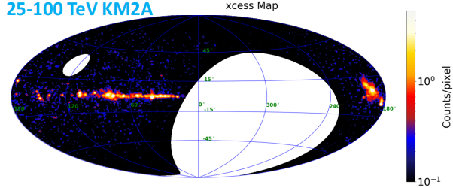
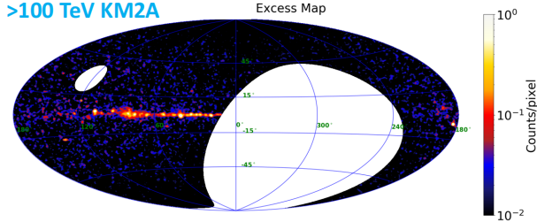
LHAASO catalog of VHE-UHE sources
LHAASO (2024, ApJS)
90 sources as of Sep. 2022, 32 newly reported, 43 with >100 TeV emission
77% by WCDA, 83% by KM2A, 61% by both
4

Slide 5
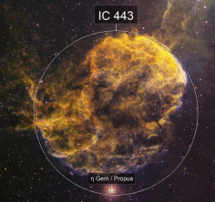
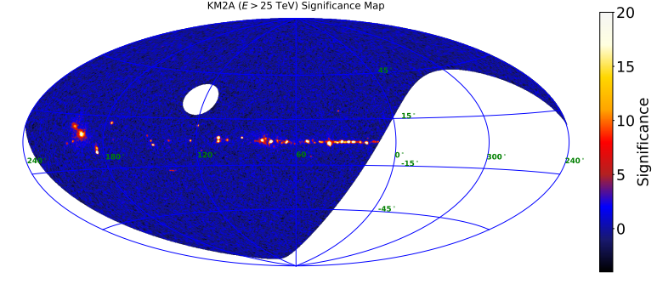
Supernova remnants
Cas A
Gamma Cygni
G150.3+4.7
W51C
W44
5

Slide 6
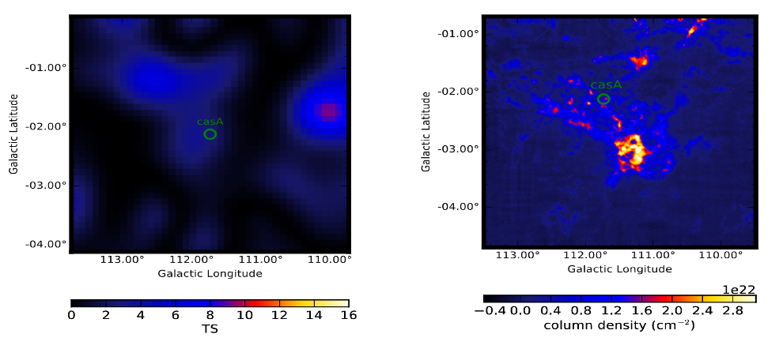
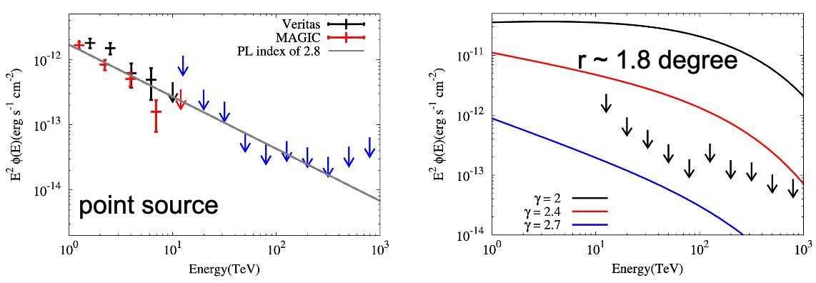
LHAASO KM2A ON Cas A
Stringent upper limit was set for the total VHE CRs injected by Cas A since explosion
hints for other candidates of PeVatrons
6

Slide 7
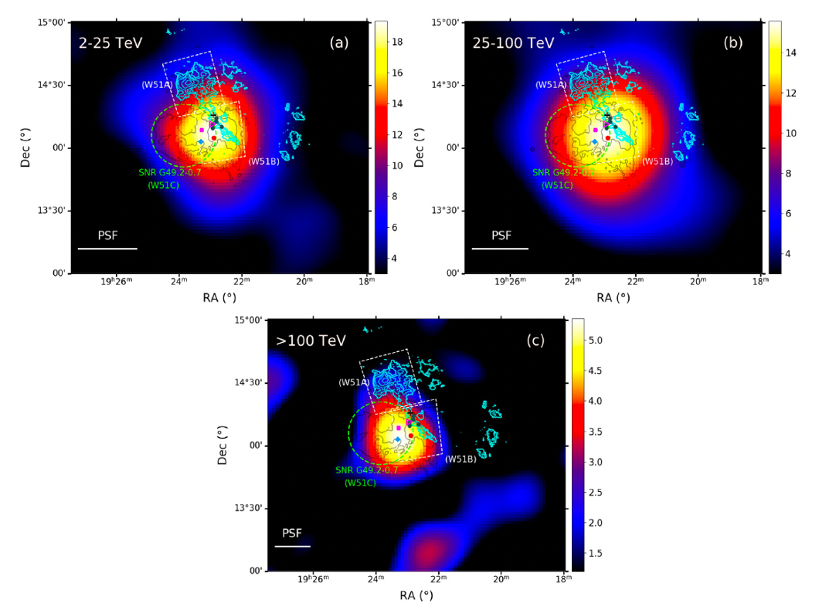
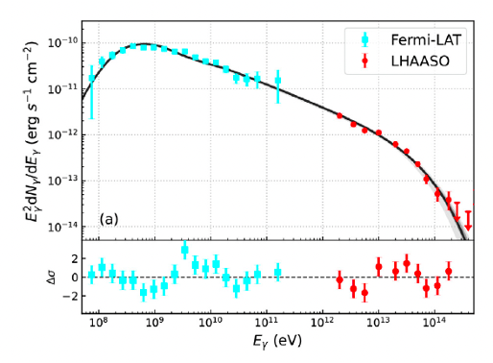
LHAASO ON MID-AGED snrS W51C
•Wp ~ 1e50 erg
•Index ~2.5
•Break at ~ 300 TeV for CRp
•Escaped CRs accelerated in earlier stage
7

Slide 8
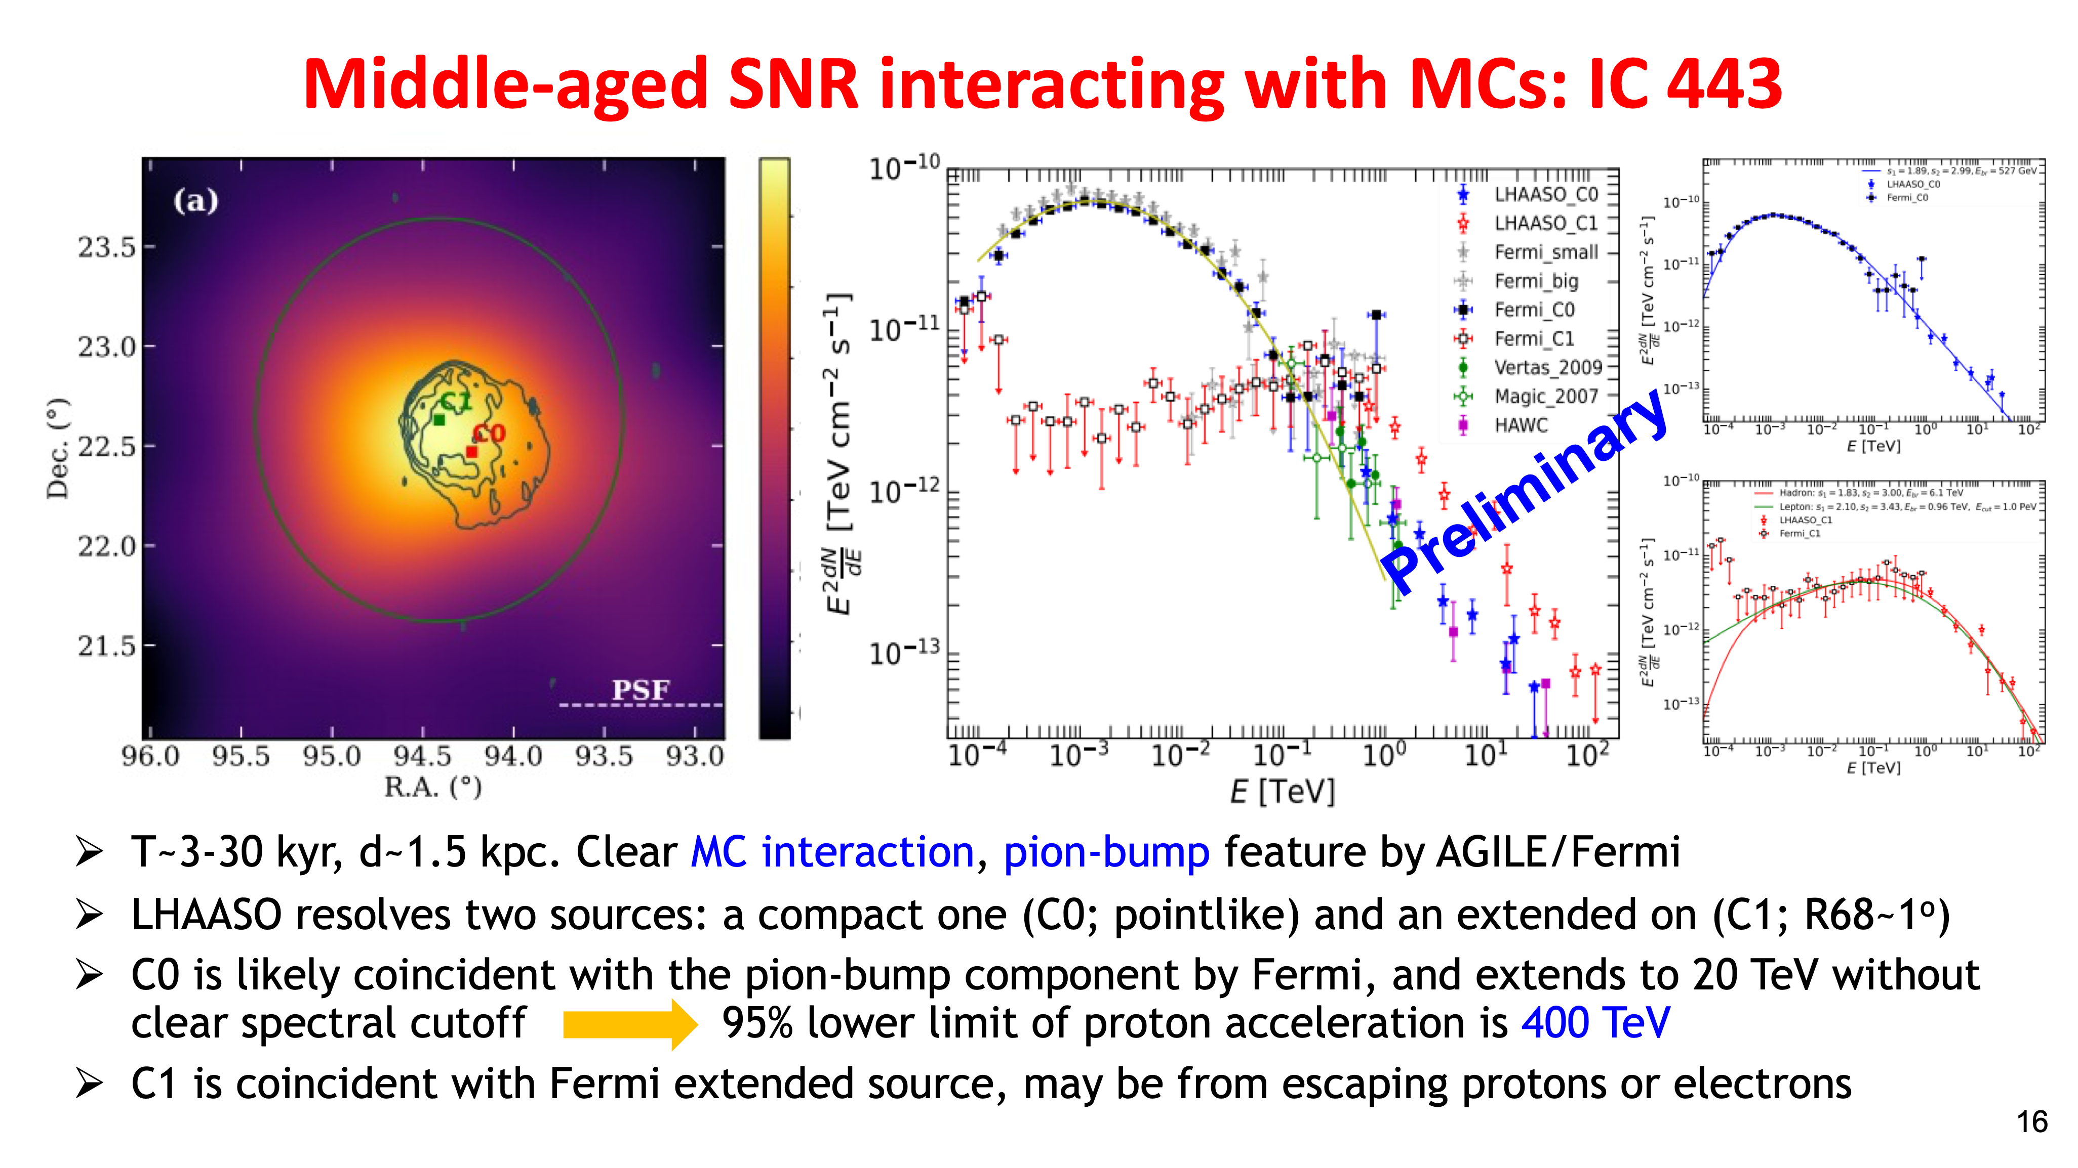
8

Slide 9
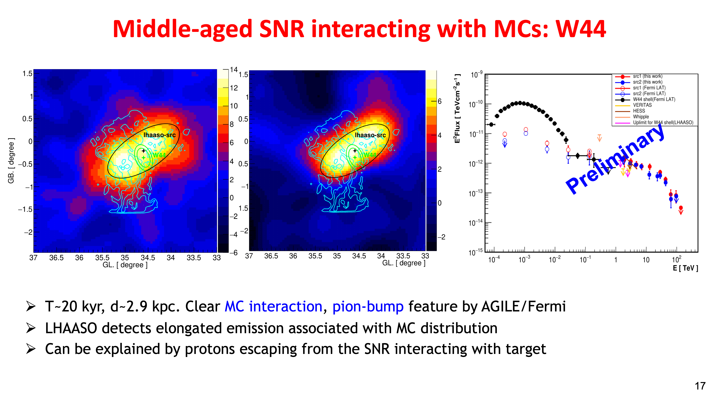
9

Slide 10
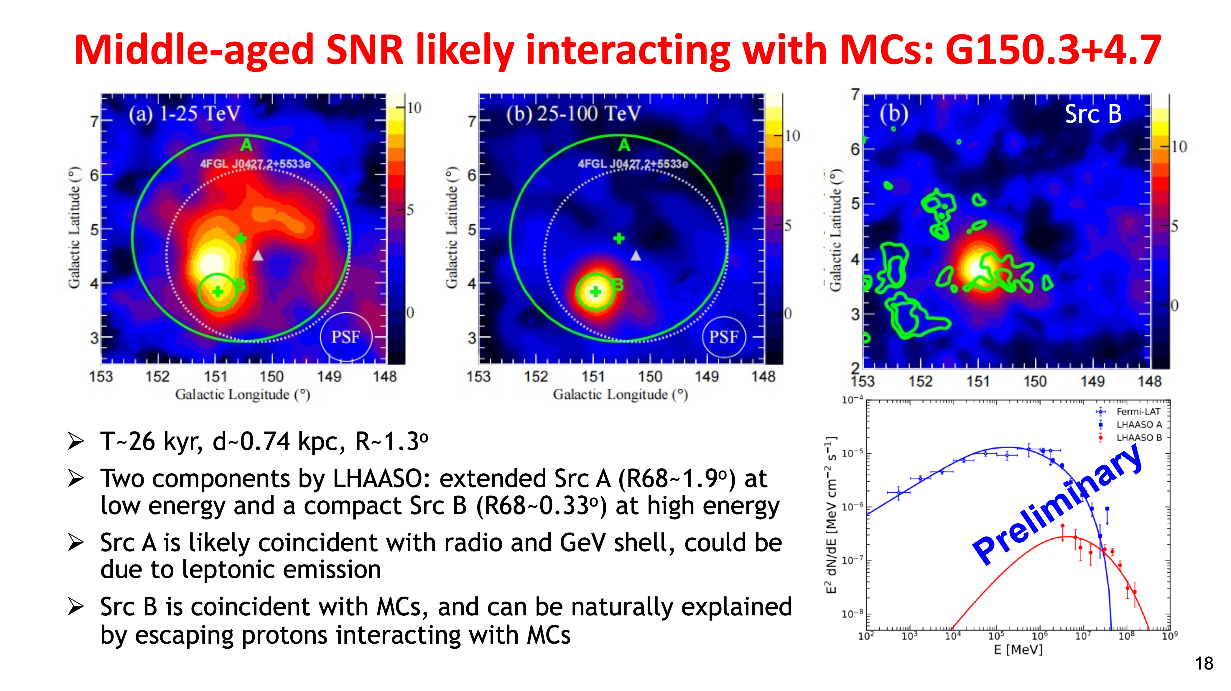
10

Slide 11
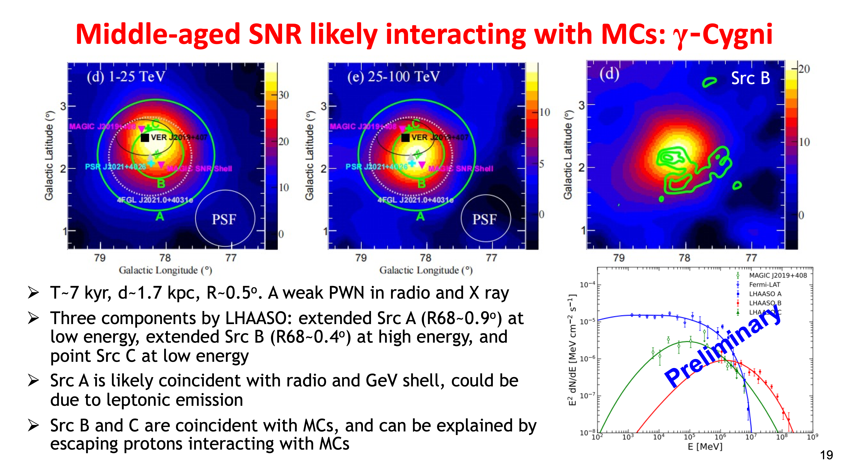
11

Slide 12
summary on snrs
LHAASO detects a number of SNRs with emission up to 100 TeV, most of which show complicated morphologies and spectra
Compelling evidence of hadronic emission with likely association with MCs has been obtained, and indicating that SNRs can at least accelerate protons to sub-PeV energies
Proton spectral cutoff of hundred TeV is shown for some sources, suggesting that they may not major contributor to CRs above the knee
12

Slide 13
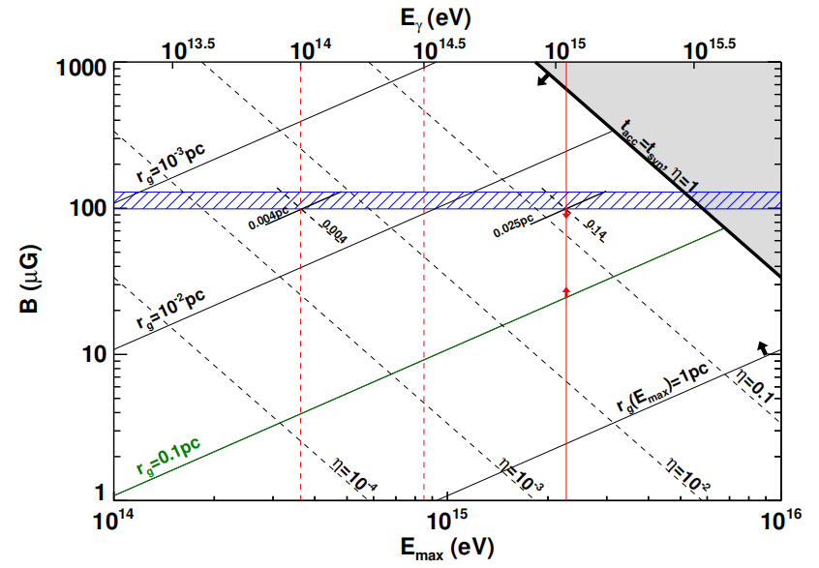
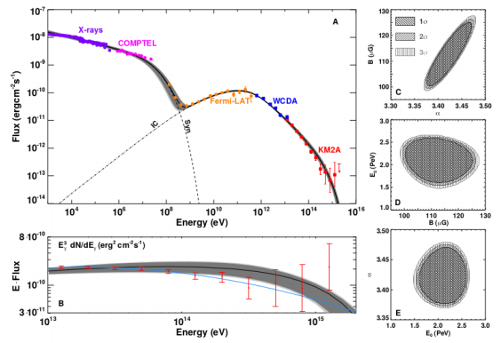


Young PWN: crab nebula
LHAASO (2021, Science)
13

Slide 14
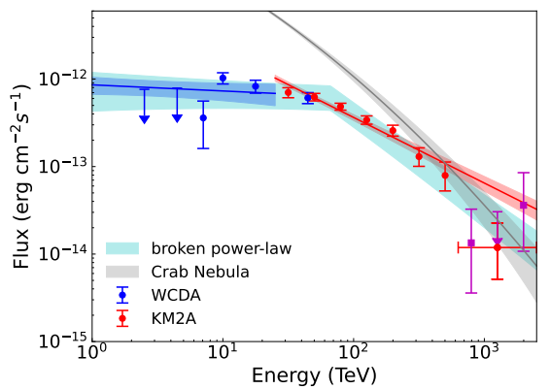
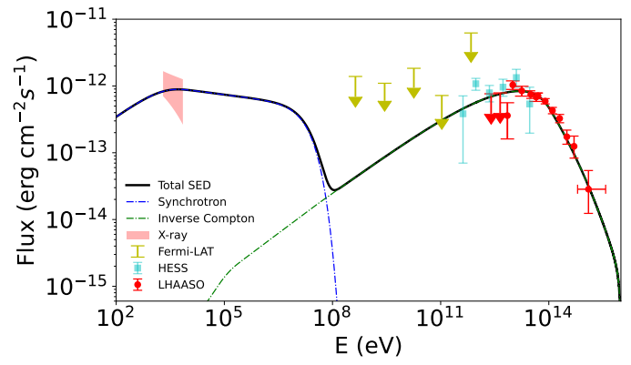
PSR J1849-0001: extreme accelerator
T~43 kyr, d~7 kpc, L~10³⁷ erg/s
Most energetic photon has an energy of ~2 PeV maximum electron energy ~3.7 PeV
Very extreme particle acceleration with η>1, challenging the particle acceleration in PWN
LHAASO (2026, NA)
14

Slide 15
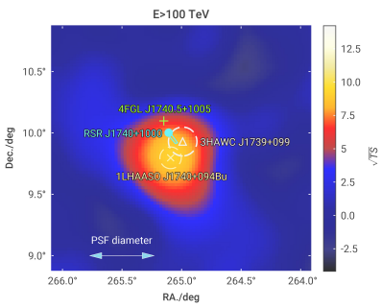
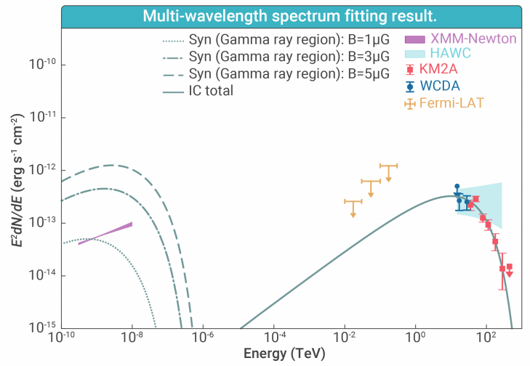
LHAASO J1740+0948: bow-shock PWN
Kargaltsev + (2008)
LHAASO (2025, The Innovation)
T~114 kyr, d~1.4 kpc, L~2×10³⁵ erg/s
Emission offset by ~0.2^{O} from the pulsar, located at the extension of X-ray tail
Emission may originate from reaccelerated electrons advected away from the bow shock tail
15

Slide 16
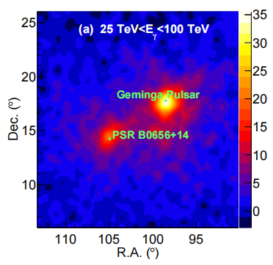
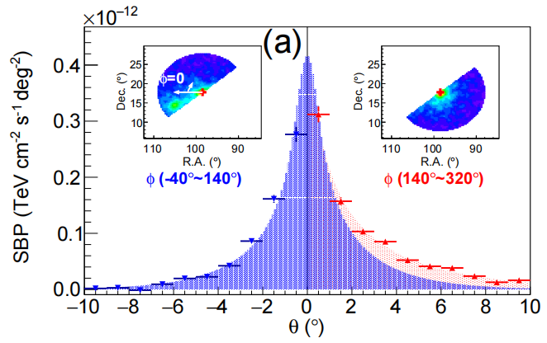
Middle-aged pulsar halos
Preliminary
Asymmetric morphology of pulsar halos suggesting inhomogeneous/anisotropic diffusion in the vicinity of pulsars
16

Slide 17
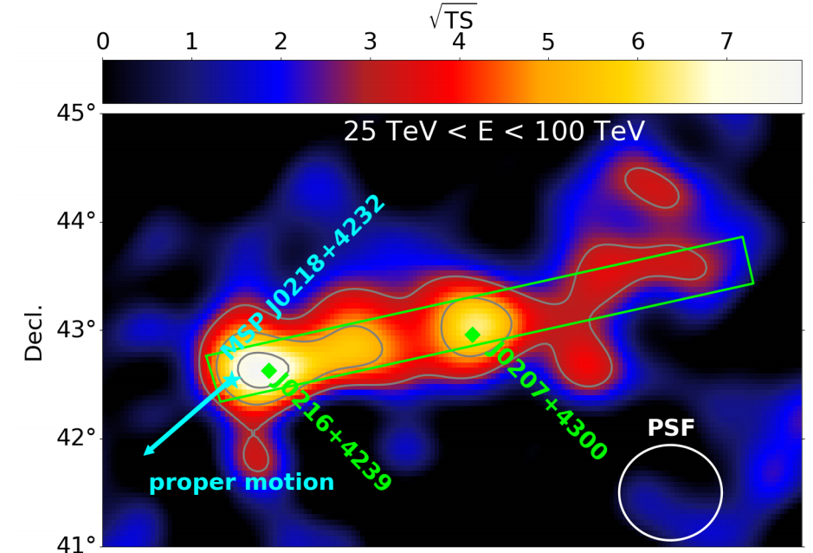
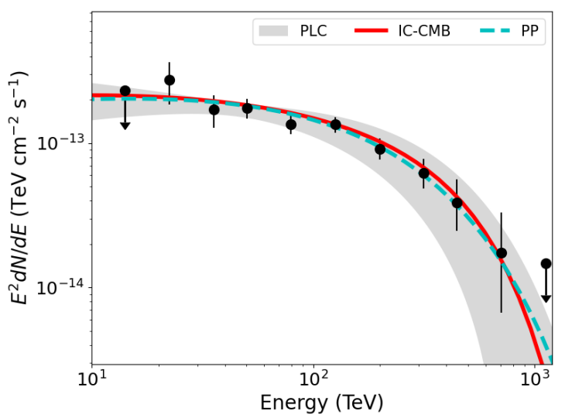
PEANUT possibly associated with an MSP
Preliminary
P=2.3 ms, T<0.5 Gyr, d~3 kpc, L~2.4×10³⁵ erg/s
LHAASO detects peanut-shape emission (250 pc×25 pc), with highest energy photon of 740 TeV
The morphology may indicate electron diffusion along large-scale magnetic fields
17

Slide 18
Short summary on PWN and pulsar halos
PWN and pulsar halos are found to be a major class of sources emitting UHE gamma-ray radiation
Very high acceleration efficiency is revealed in young PWN
Asymmetric morphologies for Geminga and Monogem halos have been found, indicating inhomogeneous or anisotropic diffusion of particles
PEANUT shape emission possibly associated with an MSP indicates interesting particle propagation in the ISM
18

Slide 19
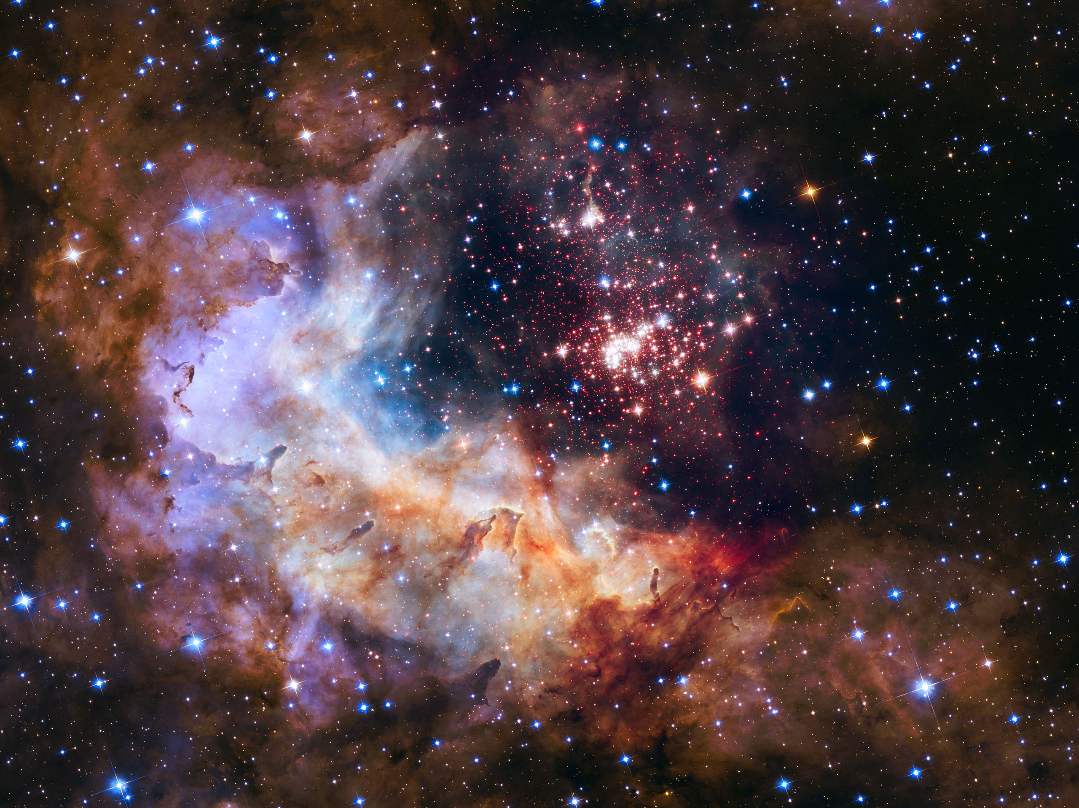
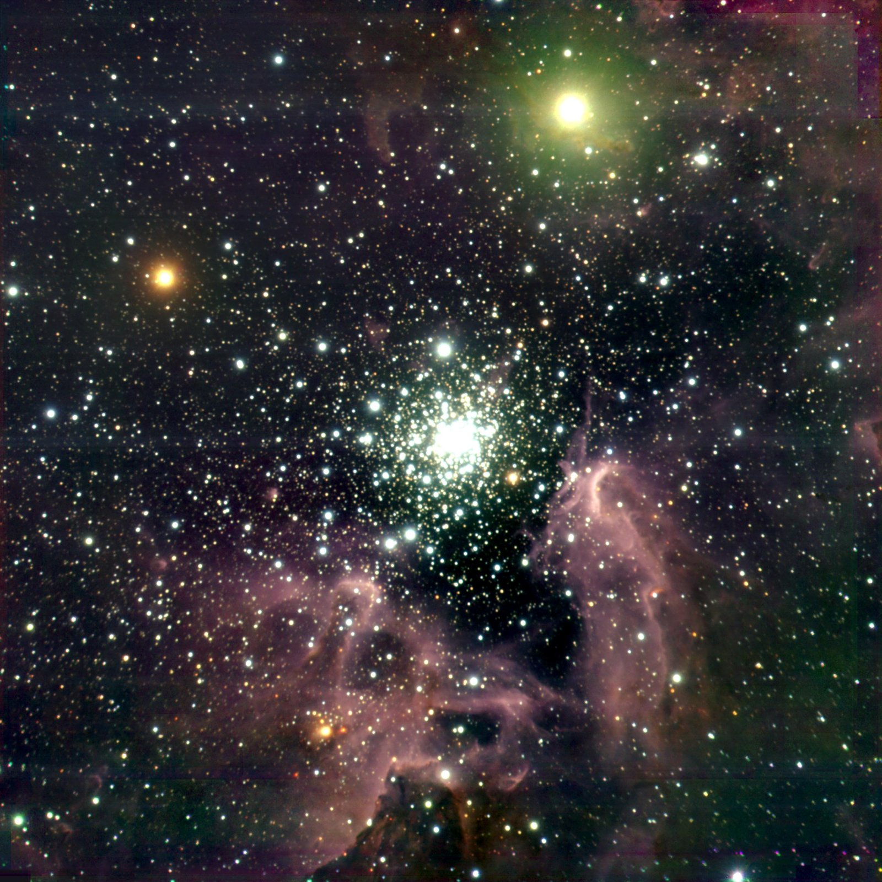
YMCS
Westerlund 2 (HST image)
NGC 3603 (VLT image)
More than dozens of OB stars and WRs
Compact structures ( ~ pc)
19

Slide 20
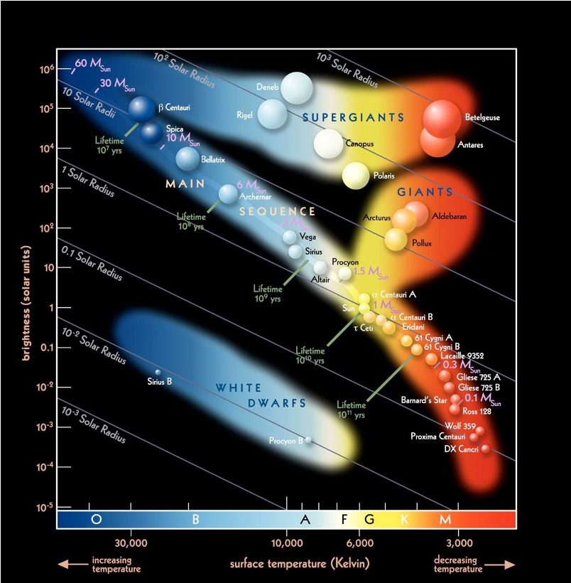
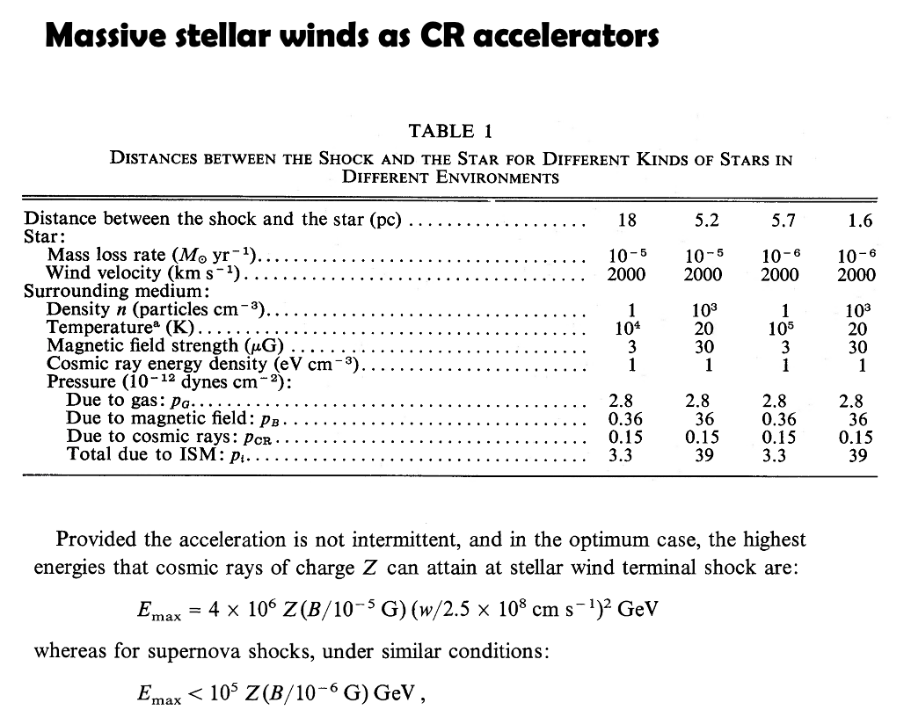



YMCs can potentially accelerate crS
20

Slide 21
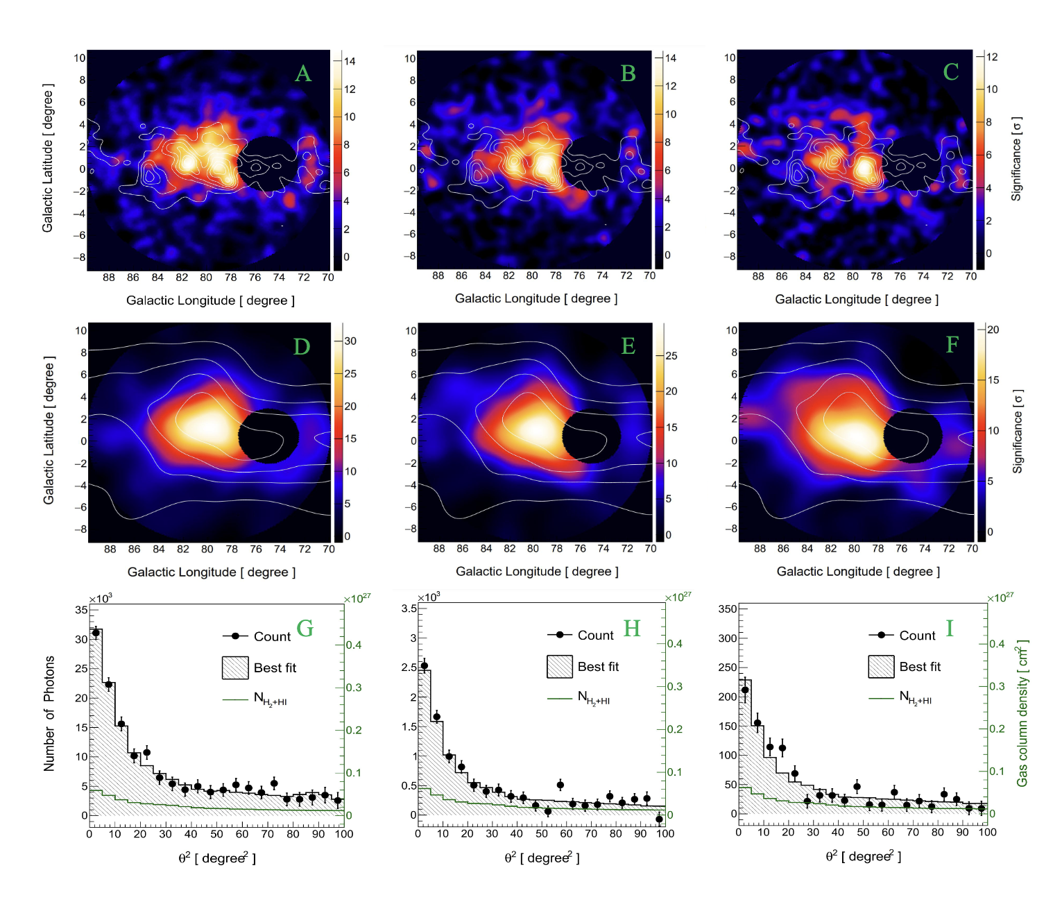
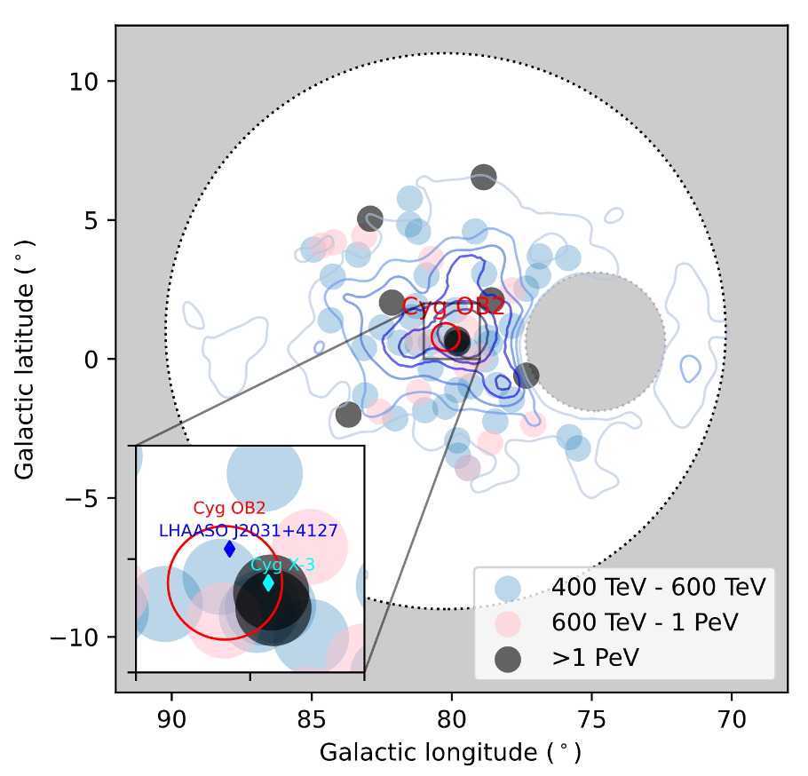
Cygnus bubble: super PeVatron
LHAASO (2024, Sci. Bull.)
8 PeV events, highest energy of 2.5 PeV
21

Slide 22
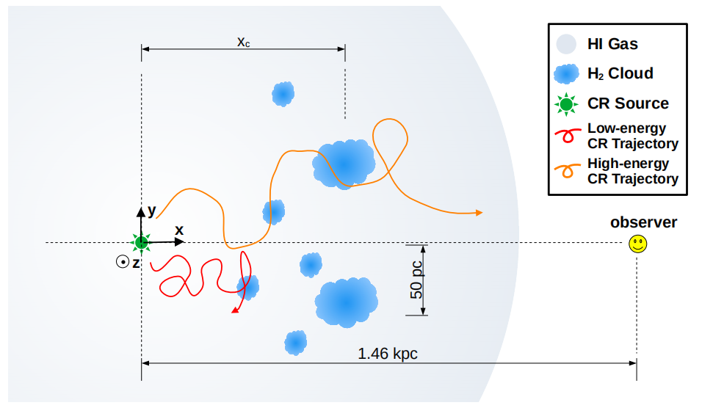
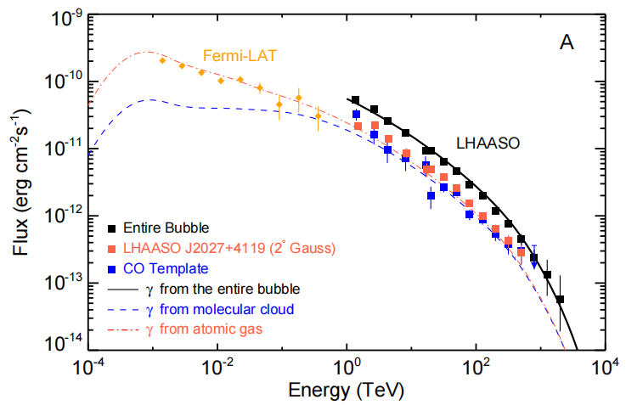
Cygnus bubble: super PeVatron
LHAASO (2024, Sci. Bull.)
Morphological and spectral decomposition: extended bubble w HI gas + hot spots w MCs
22

Slide 23
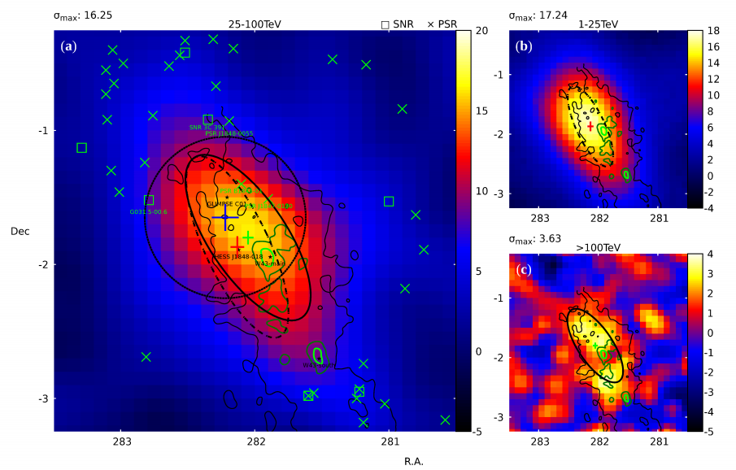
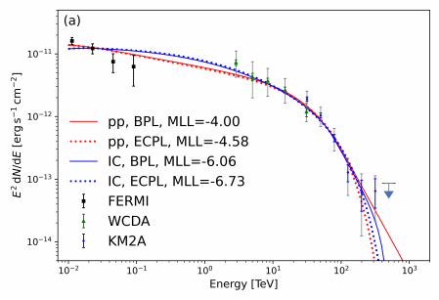
W43: Galactic mini-starburst
UHE gamma-ray emission reveal good correlation with dense gas
Spectrum up to 400 TeV, with cutoff at ~30 TeV
W43 can likely accelerate hadronic CRs to PeV energies
LHAASO (2025, SCPMA)
23

Slide 24
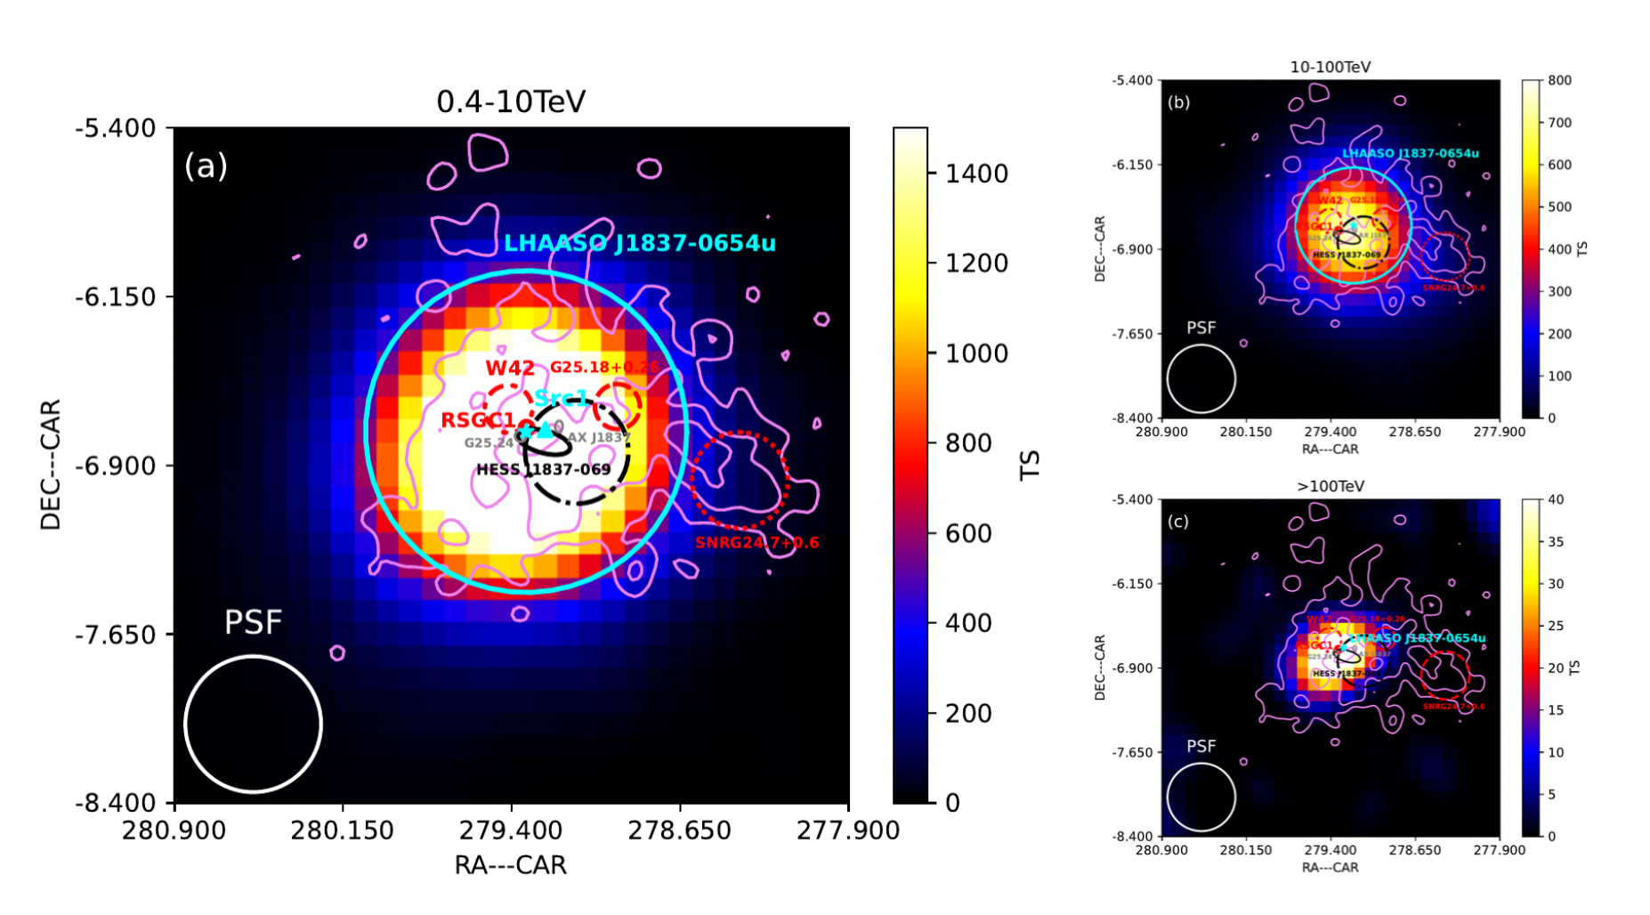
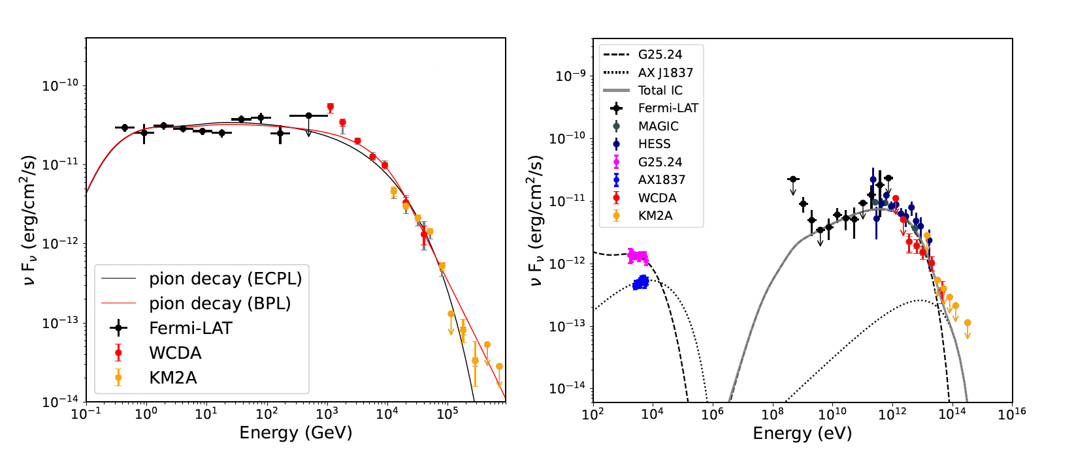
G25: star forming region/YMC
Compact central source in association with PWN
Extended emission injected by old SNR in RSGC1 or On-going acceleration by YMC W42
LHAASO (2026, submitted)
24

Slide 25
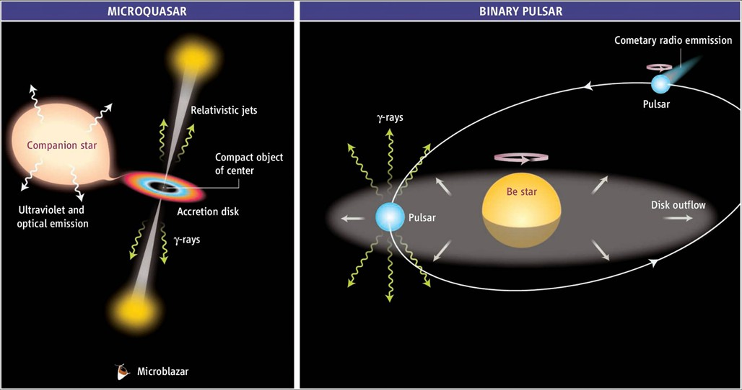
Gamma-ray binaries
Accretion, particle acceleration and radiation in extreme environments
25

Slide 26
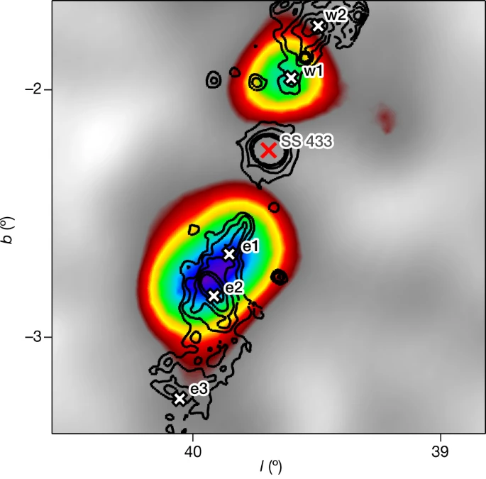
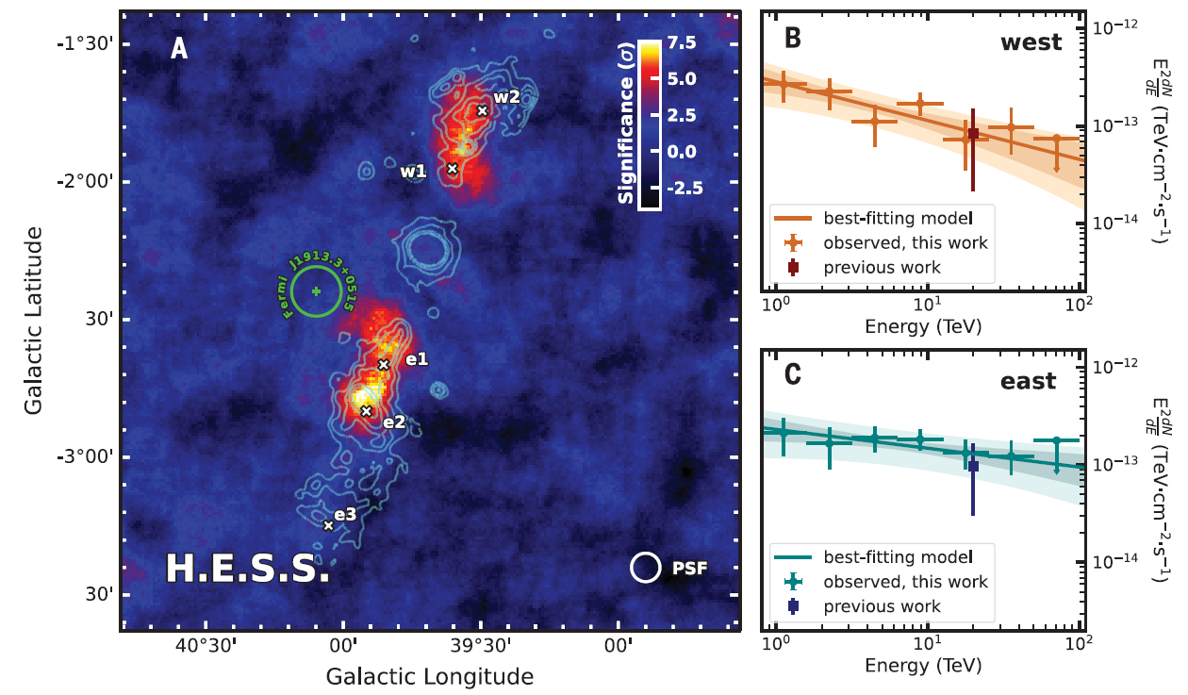
SS 433
TeV emission from jet lobes of SS 433 by HAWC (Abeysekara+ 2018)
Shift of position of TeV with energy reported by HESS (HESS Collaboration 2024)
26

Slide 27

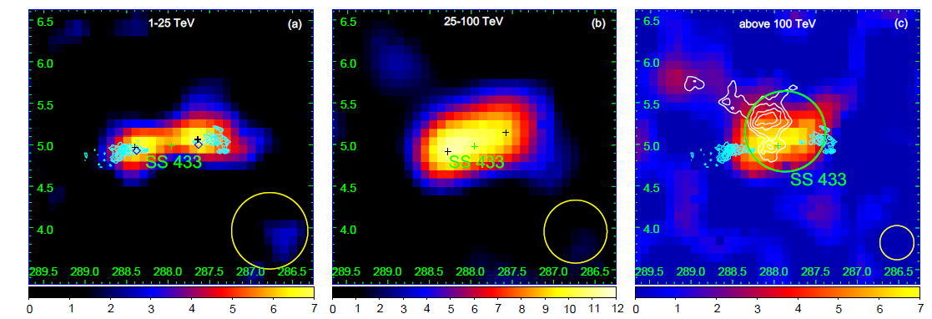
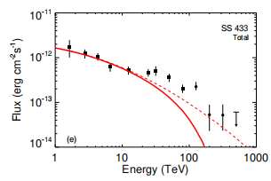
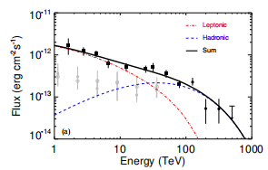
SS 433
Detection of >100 TeV gamma-ray emission with significance >5σ by LHAASO
The UHE emission is partly overlapped with HI cloud at the same distance, may hint for a hadronic origin
LHAASO (NSR, 2025)
27

Slide 28
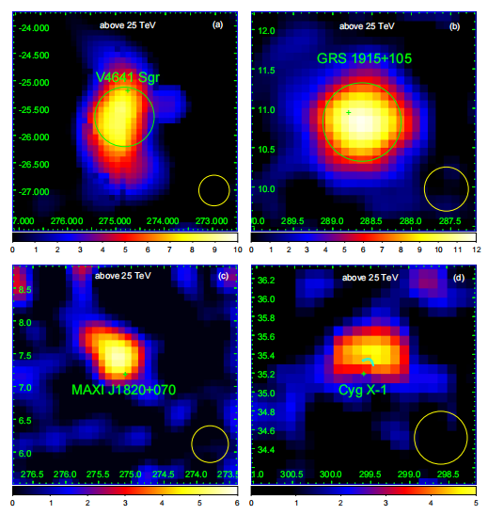
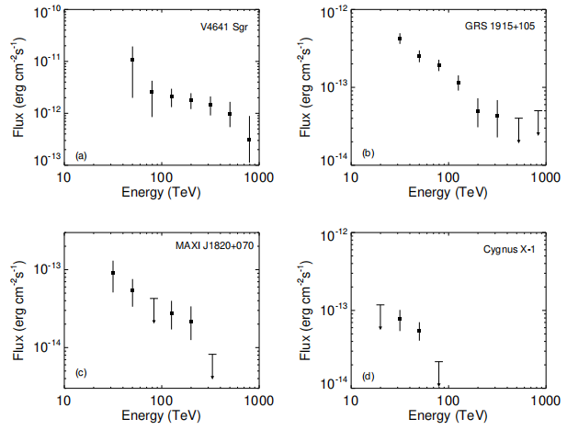
Other microquasars
colliding-wind binary system
LHAASO (NSR, 2025)
28

Slide 29
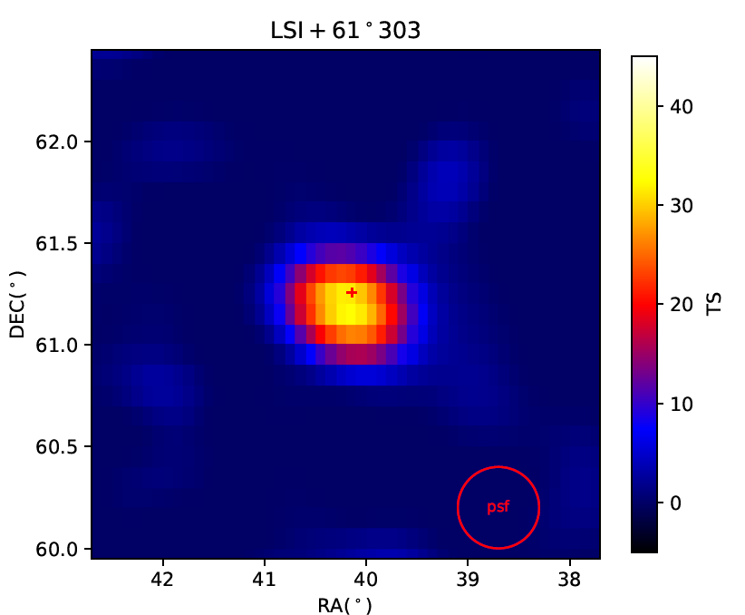
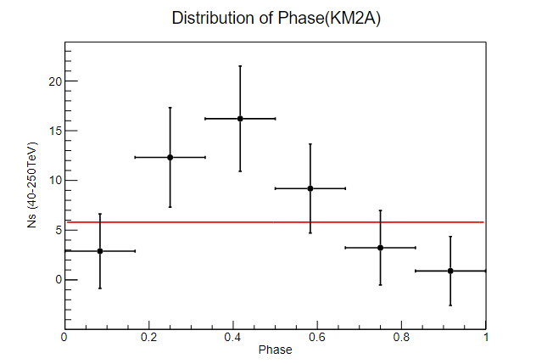
LSI + 61º303
Be companian, compact object with unknown origin
Orbital period: 26.4960 days
About 6σ detection above 25 TeV
Maximum photon energy ~200 TeV
Hint of orbital modulation
LHAASO (PRL, 2026)
29

Slide 30




Cyg X-3
First variable UHE source
Above 100 TeV, significant detection and strong hint for orbital modulation
Pgamma as the only plausible explanation, require > 10 PeV protons , Wp ~1e38 erg/s
30

Slide 31




Microquasars as PEV cr FACTORY
Lp(1PeV)~1e38 erg/s from the SED model for SS433 /Cyg X-3
the total number of BH X-ray binaries in Milky Way is expected to be about 1000, with a dozen of them probably boasting X-ray luminosity exceeding 10³⁹erg/s
31

Slide 32

Cyg X-3 to power Cygnus bubble
Harer et.al 25
Cygnus OB may have problems in accelerating PeV protons (too loose, no collective effects)
PeV protons provided by Cyg X-3
physical size of bubble > 500 pc
Energetic feasible, age unknown
32

Slide 33


Cyg X-3 to power Cygnus bubble
Shi et al. 26 In prep
Can explain the morphology and spectrum above 100 TeV (considering realistic gas distributions )
Energetic feasible when age > 10^5 years
33

Slide 34

Diffuse Gamma-ray emission (DGE)
KM2A: 29.1σ; WCDA: 24.6σ
KM2A: 12.7σ; WCDA: 9.1σ
LHAASO (2025, PRL)
34

Slide 35



LHAASO diffuse results
LHAASO (2025, PRL)
LHAASO gives the first detection from the outer Galactic plane (125º<l<235º)
A spectral break around 30 TeV is revealed in the inner Galactic plane
Measured fluxes are higher than predictions (local CR×gas column×cross section)
35

Slide 36


Giant Molecular clouds (stacking analysis)
First detection of TeV gamma-rays from GMCs
Independent measurement of CR spectrum in the vicinity of solar system
36

Slide 37
Large array of Cherenkov telescopes
(lact)

Slide 38

LACT
32 telescopes in LHAASO sites
6m Davis-Cotten type telescope
Synergy with LHAASO
38

Slide 39


mOTIVATIONS
ﬁrst LHAASO catalog
• 90 VHE/UHE gamma-ray sources
• The number of UHE gamma-ray sources increased to 43，most are extended
• Associate with supernova remnants, pulsar wind nebulae, pulsar clouds, and massive star clusters and so on
Half of them unidentified
39

Slide 40


mOTIVATIONS
Limited angular resolution of LHAASO hinder morphological studies and identifications
IACTs are natural solutions
Effective synergy require similar sensitivities with LHAASO
40

Slide 41


site
LHAASO site: good infrastructures (road, electricity, computing…)
Reasonable NSB rate: ~0.25 ph/m2/ns/deg2
Good weather in winter, annual exposure ~ 1400 hours
41

Slide 42


array layout
32 (8 X 4) telescopes in more than 1km^2 (in the gaps of KM2A MDs)
Flexible grouping for different observing mode
42

Slide 43

TELESCOPE
Davies-Cotton mirror
Alt-azimuth mount
SiPM camera
Readout electronics system
Slow control system
Data acquisition system
Calibration system
43

Slide 44


mIRRORS
•Consist of 54 hexagonal spherical mirror facets
•Diameter：~6 m
•Effect area：~24 ㎡
•Spot （80% energy）： <25.8 mm
•Curvature radius of facet: 16 m
Honeycomb sandwich structure mirror facet
44

Slide 45





CAMERA
Number of pixels | 1616
Pixels size | $\sim$0.2°
FoV | $\sim 8$°
SiPM output pulse width | FWHM$<3$0 ns
Dynamic range of each pixel | 3.2 orders of magnitude
Moon night observation capability | Yes
SiPM and Winstone cone sub-array
Optical filter and performance
45

Slide 46


Muon information from LHAASO
Science 373, 425 (2021)
46

Slide 47


Muon information from LHAASO
The joint reconstruction of LACT and LHAASO muon detector array can increase the sensitivity of LACT by 1.6 times, especially for extended sources and long exposure time.
Results for 8 telescopes at 20 degree zenith angle, for extended sources
MD can also be used for LZA mode (on going work)!
47
Zhang, et al., Journal of High Energy Astrophysics 43 (2024) 280–285

Slide 48


LACT first telescope (prototype)
The first telescope (without camera) was installed in April, 2025
48

Slide 49


LACT first telescope (prototype)
Frist camera
  Performance was measured in the lab before being shipped to the LHAASO site.
  Being shipped to the LHAASO site on January 21, 2026
  and began observations on January 26, 2026.
49

Slide 50



LACT first telescope (prototype)
Tracking Crab
50

Slide 51


Gamma-like event
Source: Crab
×
Scintillator detector
muon detector
51

Slide 52


Cosmic ray like event
Source: Crab
×
muon detector
Scintillator detector
52

Slide 53


LACT second telescope（ Design-finalized telescope ）
Assembly started on January 28, 2026, at the Tianfu Cosmic-Ray Research Center
Shipment to LHAASO site is finished in April 2026
The second telescope will begin participating in the observations in September 2026

Slide 54
Summaries on LACT
Next generation IACT: Large Array of Cherenkov Telescopes（LACT）
  32 telescopes in the LHAASO site
  LACT angular resolution: < 0.05° @ > 10 TeV
  Muon information from LHAASO： Joint reconstruction
  LZA mode: significant advantage in high altitude
Construction on-going
5 telescopes will be completed by 2026, other 18 in 2027, and the full array will be completed by 2028

Slide 55


LACT expectation： Microquasar V4641
V4641
Binary system
Zenith angle：55° - 75°
2026.9 – 2027.6：279 h
  2026.10.02 - 2026.11.01
  2027.02.20 - 2027.05.30
LACT
LHAASO
Black hole
Massive star
LACT expectation：4 tels, 1y (279 h)
LHAASO measurement
(~3.4 y)
3 TeV ~ 30 TeV
30 TeV ~ 100 TeV
> 100 TeV
55

Slide 56


Performance of LACT on GC
Significant improvement of sensitivities
~100 hours exposure each year

Slide 57



LACT simulation on GC
Zhipeng Zhang
Postdoc in ICRR
Following the results in HESS 2018 paper
Three Point Source: G0.9+0.1, HESS J1745-290, HESS J1746-285
Three Diffuse Components: Dense Gas Components, Large Scale Components, Central Components

Slide 58


LACT simulation on GC
Can significantly detect the Cutoff position with ~ 100 hours

Slide 59



https://doi.org/10.1093/mnras/stag589
LACT potential on SS433
Zhen Xie
PhD student in USTC
We simulated LACT observations of SS 433 and analyzed the expected detection significance and spatial resolving power for its TeV emission.
For SS 433, LACT can:
resolve the east and west jet regions;
distinguish the possible central hadronic component suggested by the LHAASO results;
1

Slide 60
Conclusion
LHAASO keeps producing interesting results
LACT under construction, will strengthen the PeVatron research

Slide 61

LACT first telescope and KM2A coincident events
About 20,000 coincident events were recorded on January 26, 2026.
Continued data collection and in-depth analysis are underway.
LACT first telescope
Shower core location distribution
61

Slide 62


OptimIzation of PSF
Unavoidable downgrade of angular resolution in Large offset due to the DC type optical
Using likelihood method (freePact framework) to improve
62

Slide 63




OBSERVATION MODE
(zenith<50°) observations for lower energy thresholds
Collection area: 1 km² @ 10TeV
Angular resolution:
<0.06° @ >1TeV
Threshold Energy: ~200GeV
1
2
3
120-200m
4
6
5
350-450m
8
7
Sensitivity of point source
1.6 km²
Zhang et.al.
Chinese Physics C,
49, 3,035001
63

Slide 64




OBSERVATION MODE (large zenith angle)
(zenith>50°) observations for high energy band.
Collection area: 3 km² @ 10TeV
Angular resolution:
<0.06° @ >1TeV
Threshold Energy: ~1 TeV
8 telescopes: LACT has four sets of eight telescopes that can simultaneously observe four UHE sources
3 km²
Zhang et.al.
Chinese Physics C,
49, 3,035001
64

Slide 65

OBSERVATION MODE (large zenith angle)
Extend the FOV to include the most interesting sources
65

