Slide 1
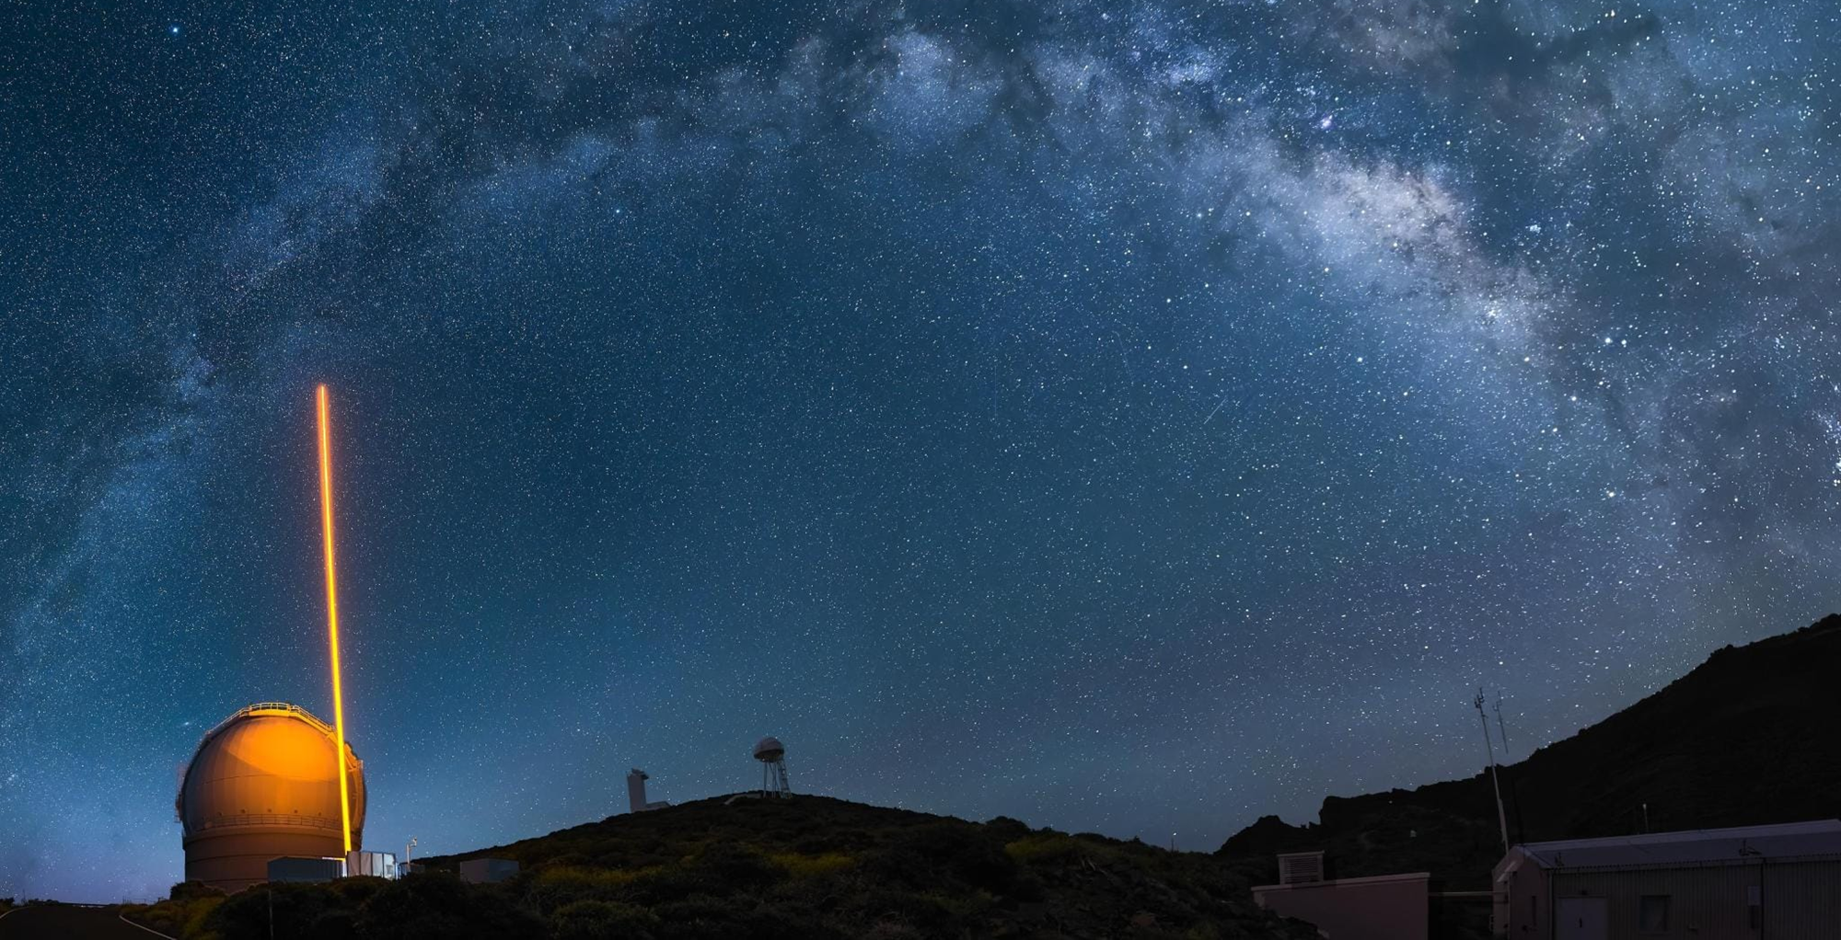
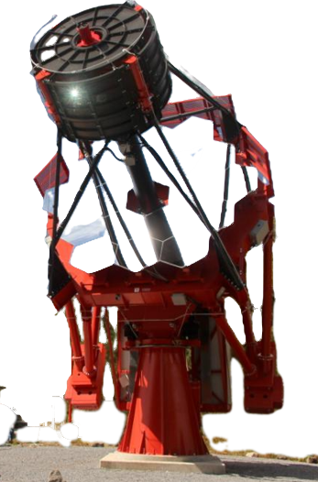
Beyond ASTRI: the CTA++/ASTRI-10 and Wi-FI SuperCAT projects air-Cherenkov telescopes inspiring applications different from just gamma-ray astronomy
Giovanni Pareschi (INAF/ Brera Observatory)
Notes:
JUST A SIMPLE REMINDER:
WITH OUR LASERS WE EXCITE SODIUM ATOMS AT ABOUT 90 KM ALTITUDE AND CREATE A REFERENCE STAR FOR TELESCOPES.
In this Picture, the SODIUM LASER in PROPAGATION from ESO-INAF laser facility @ ORM.
Actually, we are using it for astronomical purposes, as multiple laser guide stars using a single source, but not only.
_____________________________________________________________________________

Slide 2


Slide 3

CTA++ ➔ PN-RIC $$$$
“Strengthening public Research Infrastructures (RI) operating in the S3 sector to advance companies’ technology

Slide 4
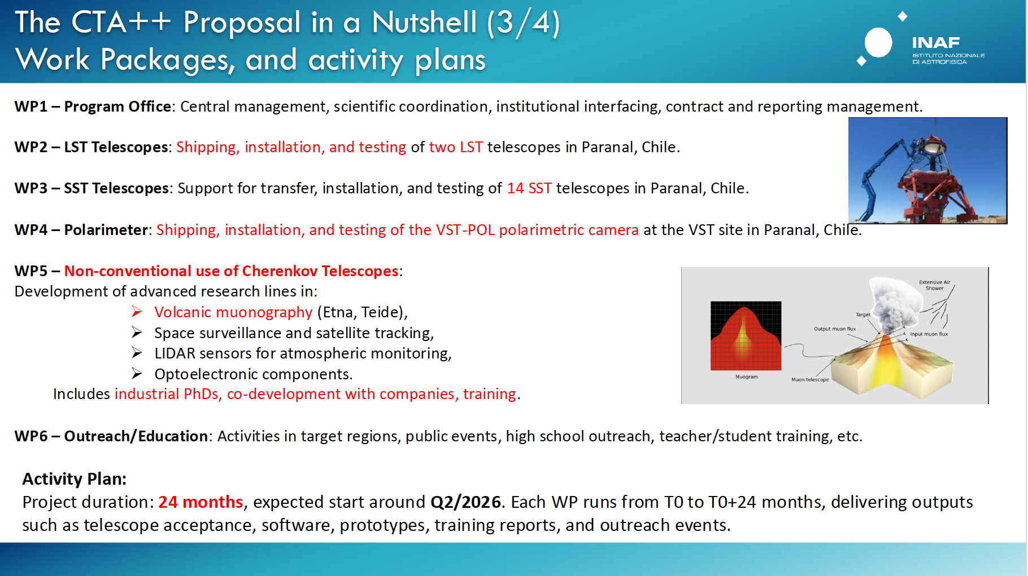
CTA++ Proposal (From Cappi, 2025)
Principal Investigator: Max Cappi
KOM: Jun 1st, 2026

Slide 5
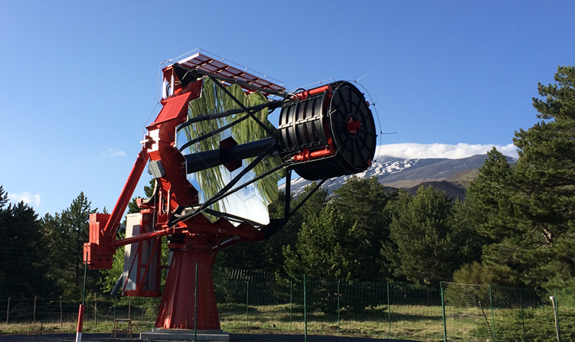
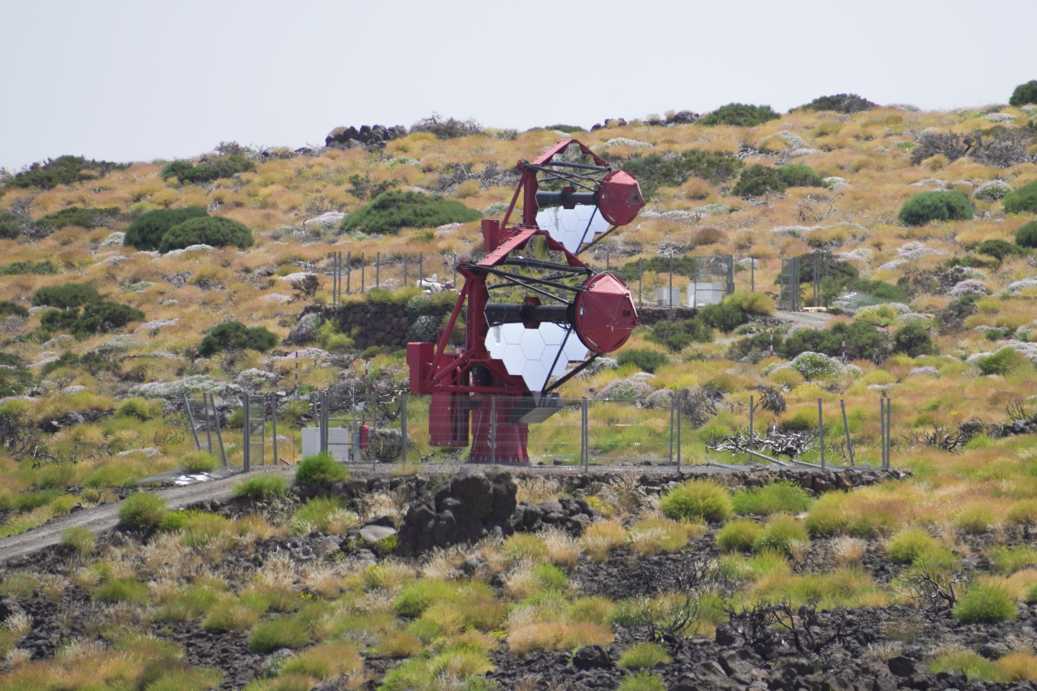
The mini-array @Teide: the science adventure starting!
ASTRI-Horn Prototype
INAF-led Project funded by Italian Ministry of Research
End-to-end prototype installed and operational on Mount Etna volcano (Sicily, Italy)
First detection of a gamma-ray source (Crab Nebula) above 5σ with a dual-mirror, Schwarzschild-Couder Chrenkov telescope (Lombardi et al., 2020)
Mini-Array of 9 ASTRI telescopes
INAF-led Project with international partners: Univ. of Sao Paulo/FPESP (Brazil), North-West Univ. (S. Africa), IAC (Spain), FGG, ASI/SSDC, Univ. of Padova, Perugia and INFN
Being deployed at the Observatorio del Teide (Spain) in collaboration with IAC and FGG-INAF.
Next 4 yr → Core Science, following 4 yr → Observatory Science. Science operation → Q2 2026
5

Slide 6
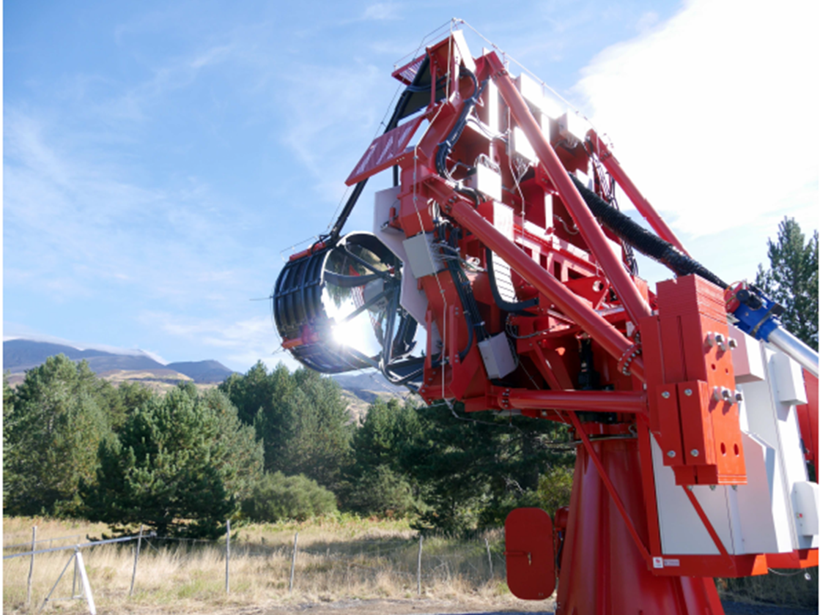

Slide 7
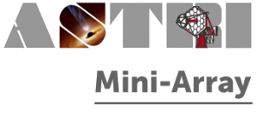
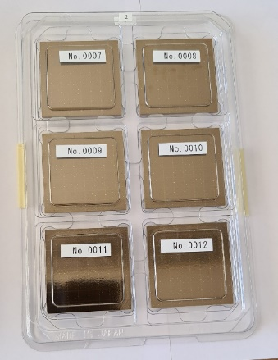
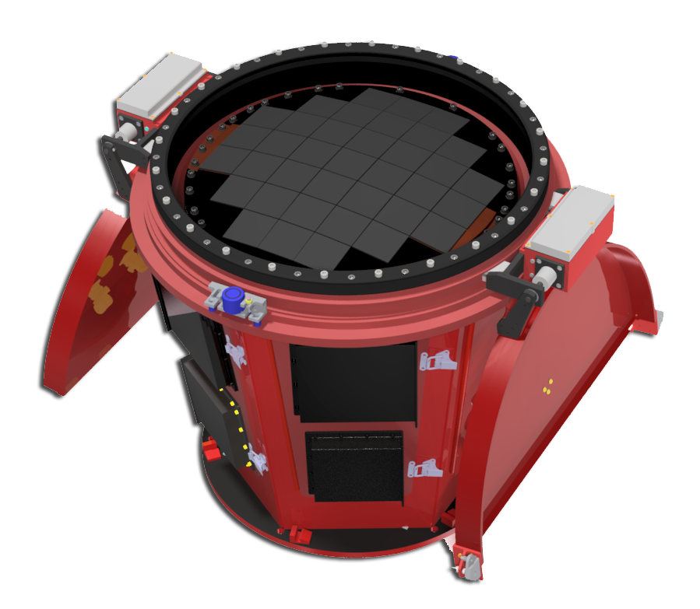
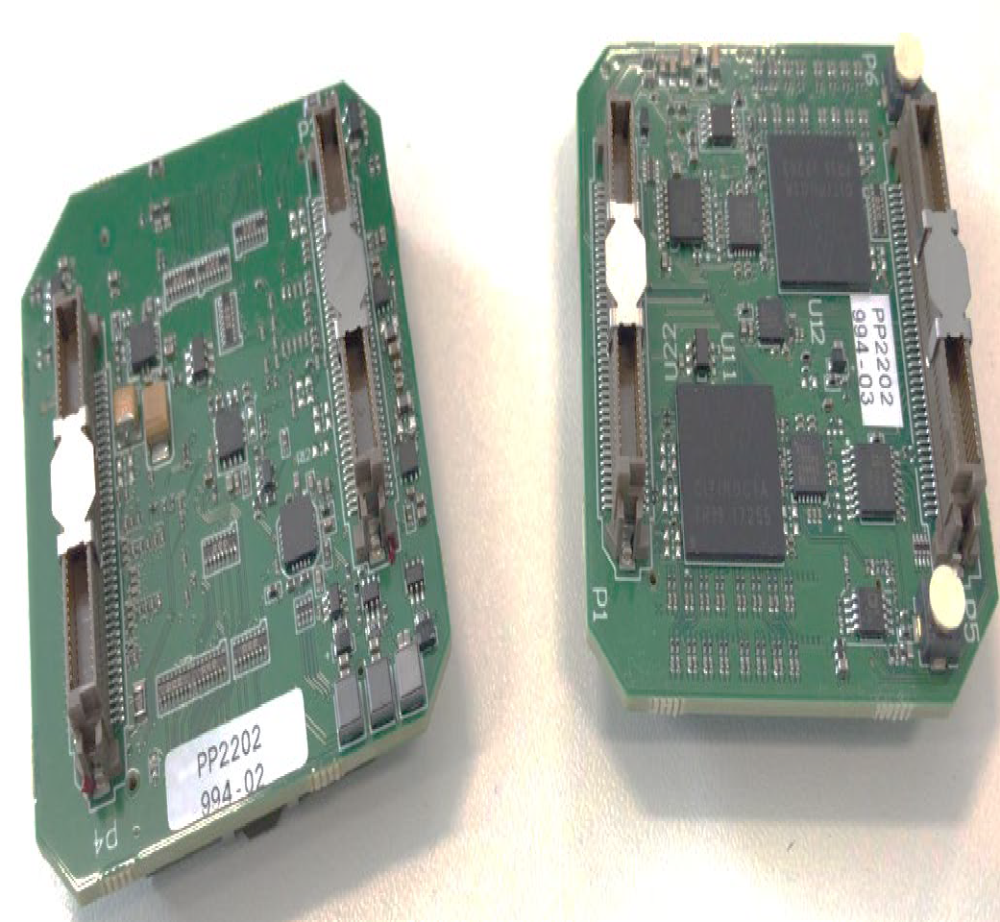
ASTRI Camera
The SiPM produced by Hamamatsu photonics (7x7 mm²) grouped in matrices of 8x8 pixels
37 matrices are arranged to adapt to the curved focal plane of the telescope.
innovative electronics for peak detection(CITIROC ASICS , WEEROC-INAF) ⇒ smalls mount of data
Interferential filter as front window (Romeo et al. (2018) and Catalano et al. (2018)) that allows to reduce the contribution from the night sky background at wavelengths greater than 550 nm where the sensitivity of SiPM detector is still high.
FIELD OF VIEW OF 10.5 Deg IN DIAMETER
SiPM matrices
ASIC board

Slide 8
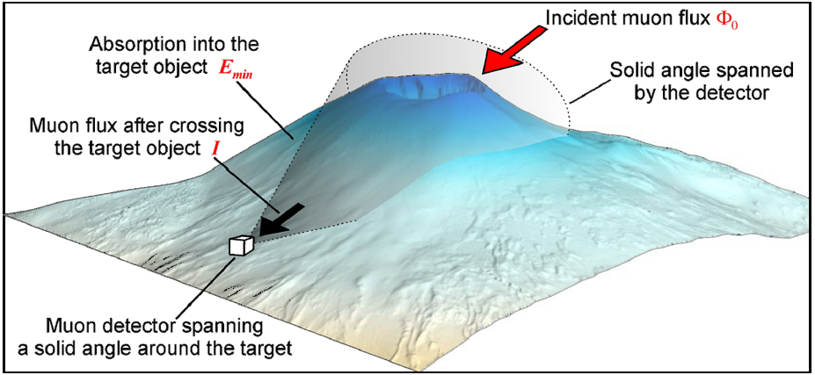

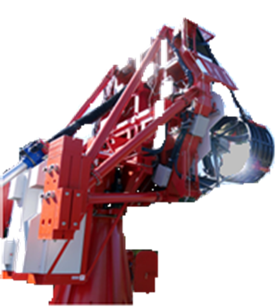
Principles of muon imaging
The density distribution of the interior of a volcano can be determined by measuring the differential attenuation of the muon flux as a function of the amount of rock crossed along different directions. Any muon flux variation translates in a difference in the opacity (X) which is defined as:
where ρ is the density and ξ is the spatial coordinate measured along the trajectory L.
MUON RADIOGRAPHY
Measuring differential attenuation of the cosmic-ray muon flux as a function of the
amount of rock crossed along different directions, it is possible to determine
the density distribution of the interior of a volcano.

Slide 9
“Muongraphy” with ASTRI-Horn
The feasibility of muography is currently being investigated with ASTRI Horn exploiting the fortunate coincidence of the proximity of the telescope to the ETNA volcano.
ETNA VOLCANO
ASTRI Horn
The quantitative understanding of the inner structure of a massive target, as a volcano, is a key-point to monitor the stages of the volcano activity, to forecast the eruptive style and mitigate volcanic hazards.
Fracastoro observatory - Serra la Nave (Monte Etna) : Altitude 1735 m a.s.l.
Longitude: +14º 58'4'‘ : Latitude +37º41'5''

Slide 10
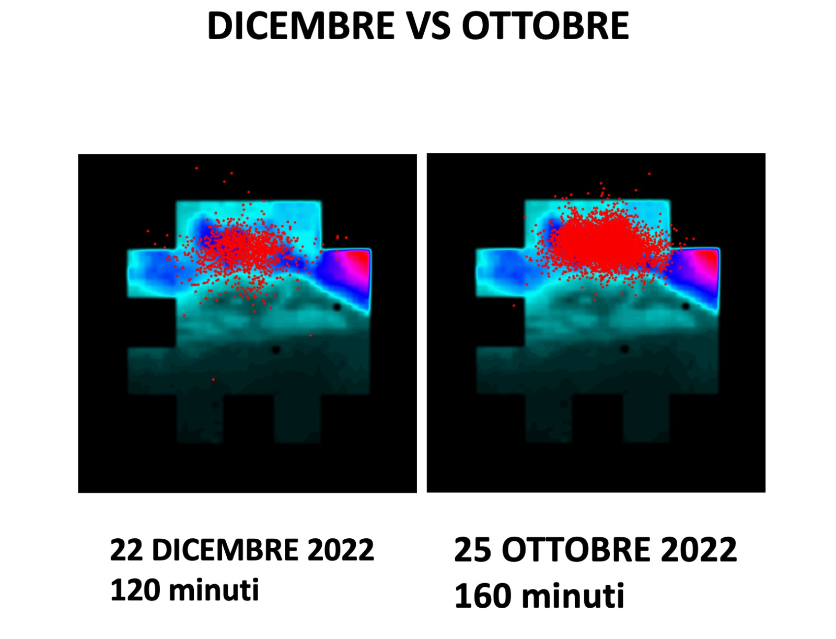
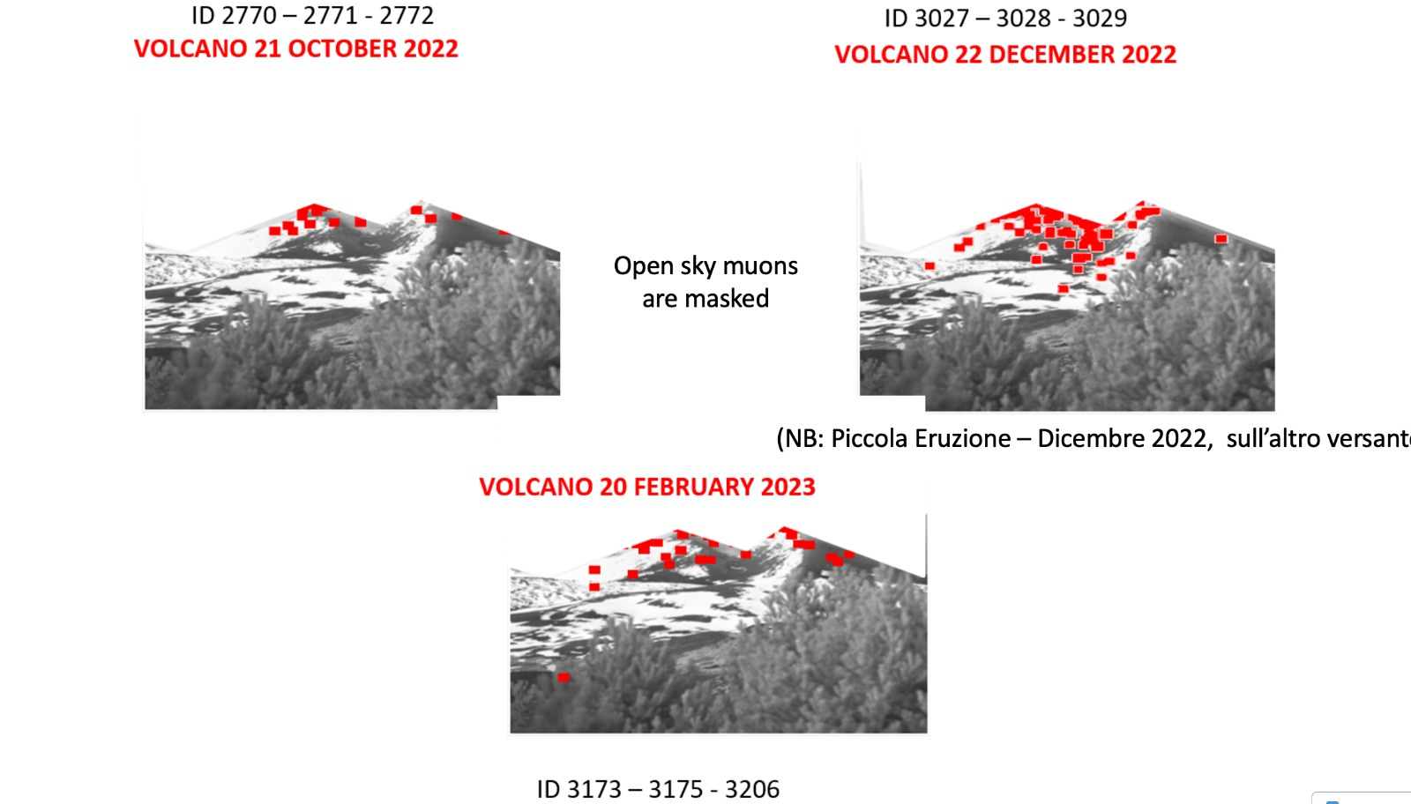

Slide 11
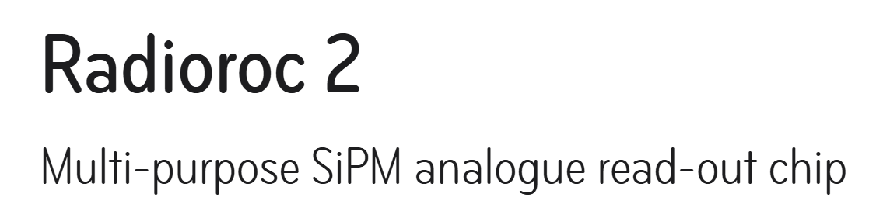
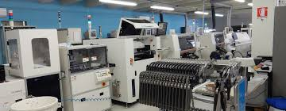
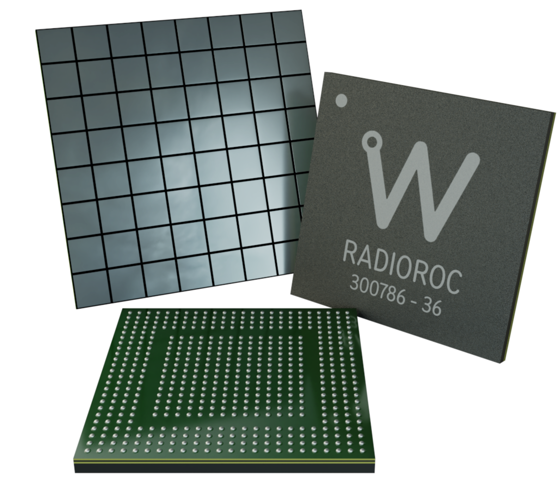
SiPMs represent a versatile and constantly evolving technology, with applications ranging from medicine to fundamental physics, thanks to their unique characteristics of sensitivity, compactness and robustness.
Radioroc e’ a TRL 5
Interazione ricerca industria per
Aumentare i TRL
Lesson learned from PNRR – Controlli di qualità rapidi e ad altissima precisione nella catena di produzione
Elettronica ad alta velocità (∼1ns) per applicazioni di ricerca ed industriali (fisica medica, automotive)
Credits: WEEROC, France

Slide 12
Why RADIOROC
Trigger timing is critical for muon ring detection in the presence of a Night Sky Background (NSB).
RADIOROC, with a trigger timing of ~3 ns and a double-pulse resolution of ~5 ns, significantly reduces accidental coincidences caused by NSB.
CITIROC, with a Fast Shaper of ~20 ns and a double-pulse resolution of ~50 ns, requires a much larger increase in the trigger threshold to maintain an acceptable accidental trigger rate.
RADIOROC's advantage is not in increasing the muon signal but in preserving it by maintaining a sufficiently low trigger threshold even under high NSB conditions.

Slide 13

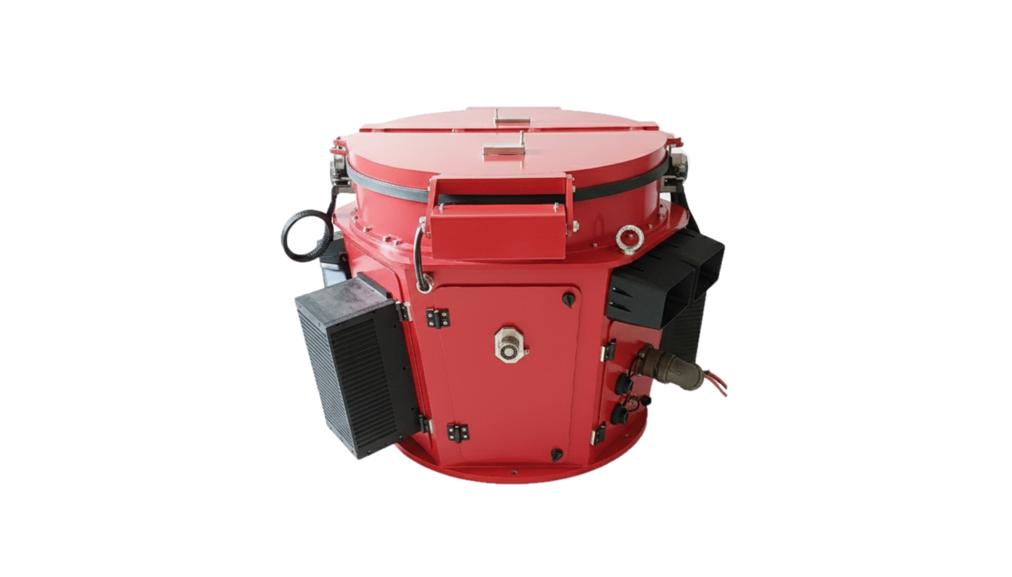
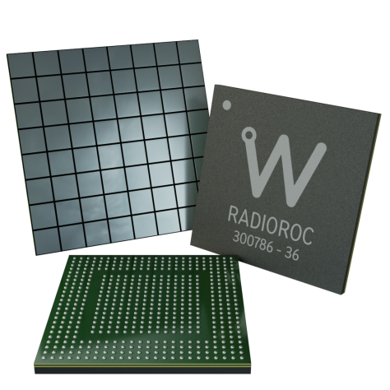
RADIOROC CTA ++
+
RADIOROC limits the rate of accidental triggers as the NSB increases by increasing the thresholdby just over 1 pe. CITIROC requires larger increases.
For CITIROC the threshold must be significantly increased to have a muon signal detectable over the NSB, resulting in a loss of efficiency. As RADIOROC requires only a small increase in the threshold, the detection efficiency for muon rings remains nearly constant even as the NSB increases.

Slide 14

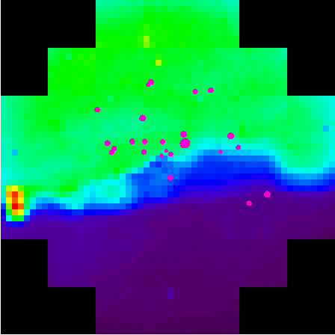
Muons @Teide with ASTRI1
Teide
The figure shows muons emerging from Teide in 3 minutes of operation. Unfortunately, ambient light prevented us from increasing the run time.
A conservative estimate,, yields a number of muons emerging from the mountain of 1,500/2,500 in 8 hours of operation using RADIOROC. In a month, 60,000 muons would be available, thanks to RADIOROC's constant detection efficiency.

Slide 15
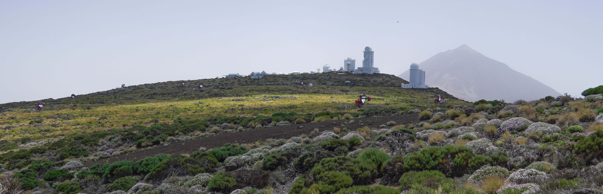
Distribution with ASTRI Mini-Array

Slide 16
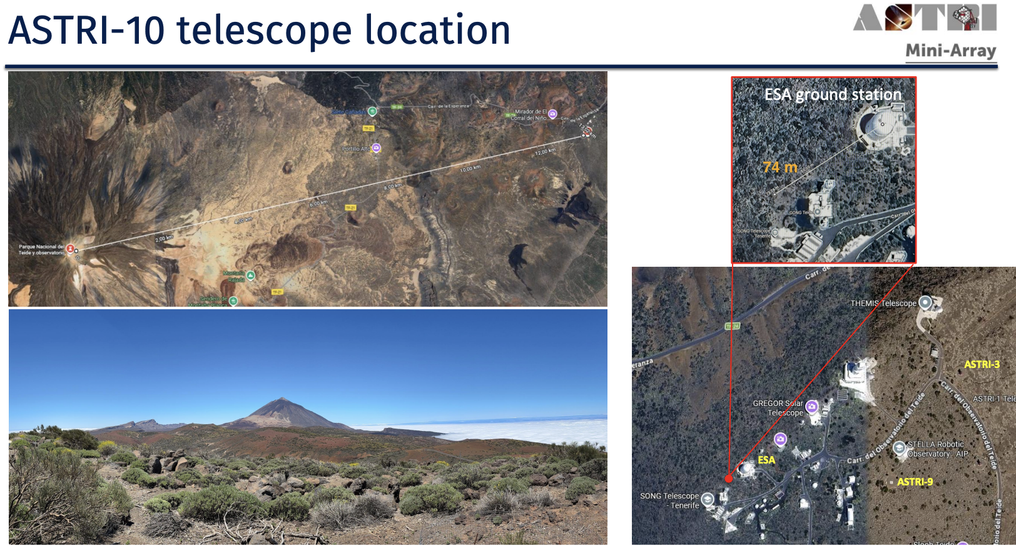
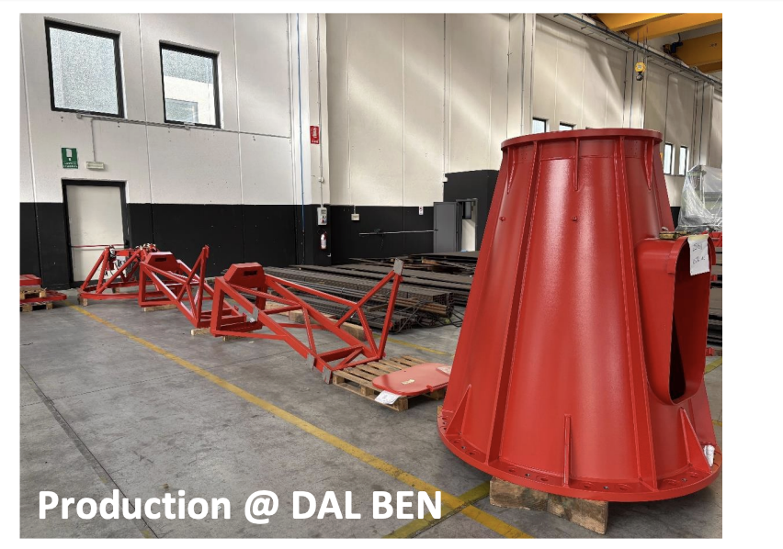

Slide 17
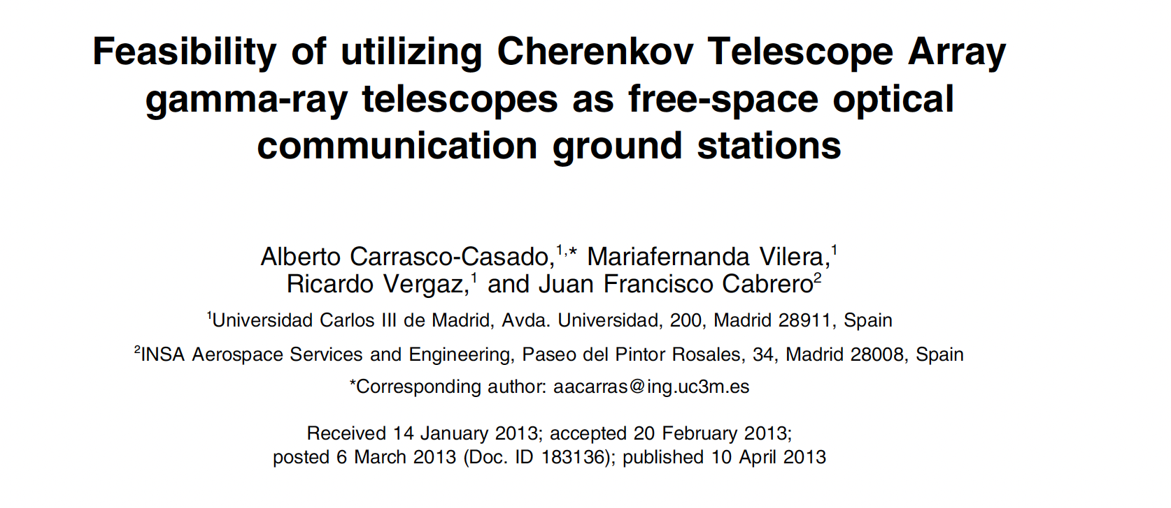

Slide 18
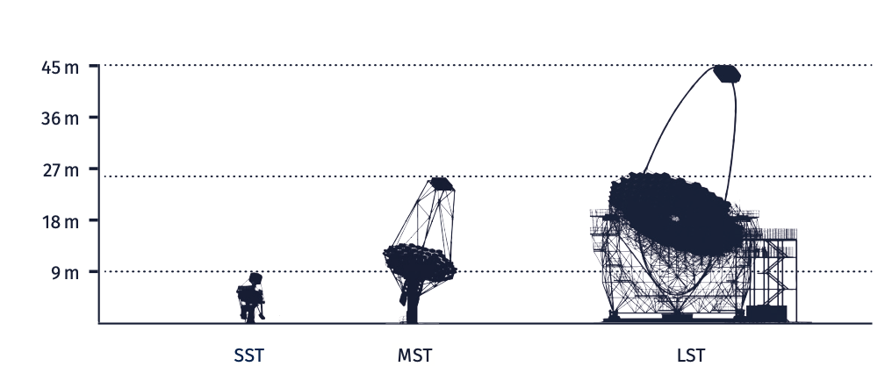






Three telescope designs
2-mirror Schwarzschild-Couder
optical design
4.3 m ⊘ primary reflective
surface
SiPM camera: 2048 pixels (0.16 ∘)
8.8∘ FoV
17.5 tonne
Davies-Cotton optical design
12 m ⊘ reflective surface
PMT camera – 2 designs:
  NectarCam: 1855 pixels
  FlashCam: 1764 pixels
~7∘ FoV
82 tonne
Parabolic optical design
23 m ⊘ reflective surface
PMT camera: 1855 pixels (0.1∘)
4.3∘ FoV
100 tonne
Large-Sized Telescopes
(LST)
Medium-Sized Telescopes
(MST)
Parabolic design
23 m ⊘ reflective surface
PMT camera
4.3∘ FoV
17 tonne
Small-Sized Telescopes
(SST)
Davies-Cotton optical design
12 m ⊘ reflective surface
PMT camera
~7∘ FoV
82 tonne
Sc
4 m ⊘ primary mirror
SiPM camera
8∘ FoV
17 tonne
2 different MST
camera designs:
NectarCam
Pos
FlashCam
Small-Sized Telescope
Medium-Sized Telescope
Large-Sized Telescope
300 TeV
5 TeV
200 GeV
20 GeV
ENERGY

Slide 19
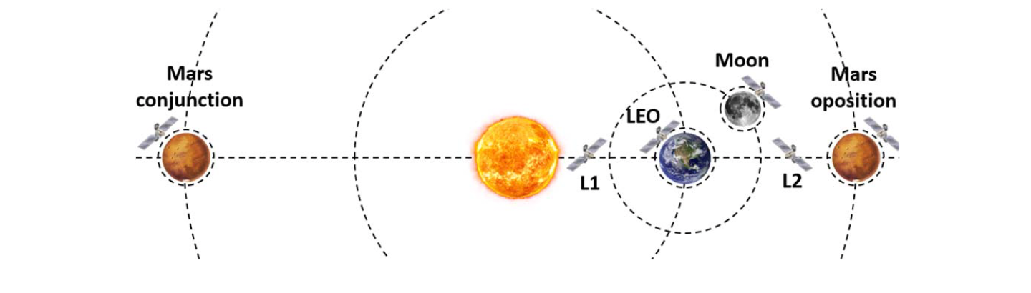
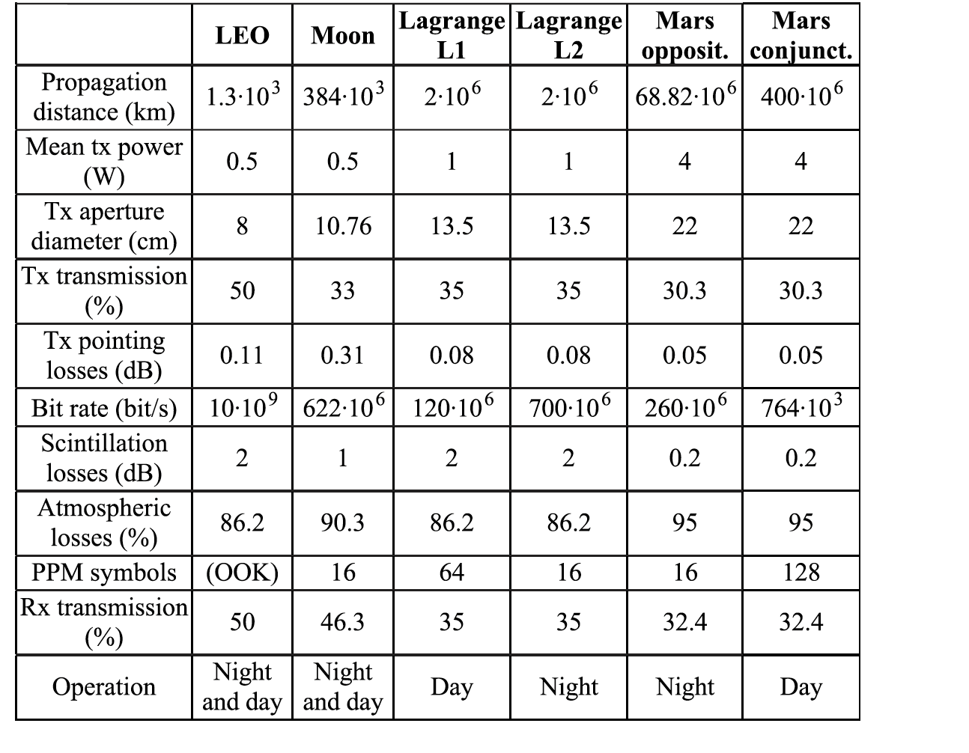
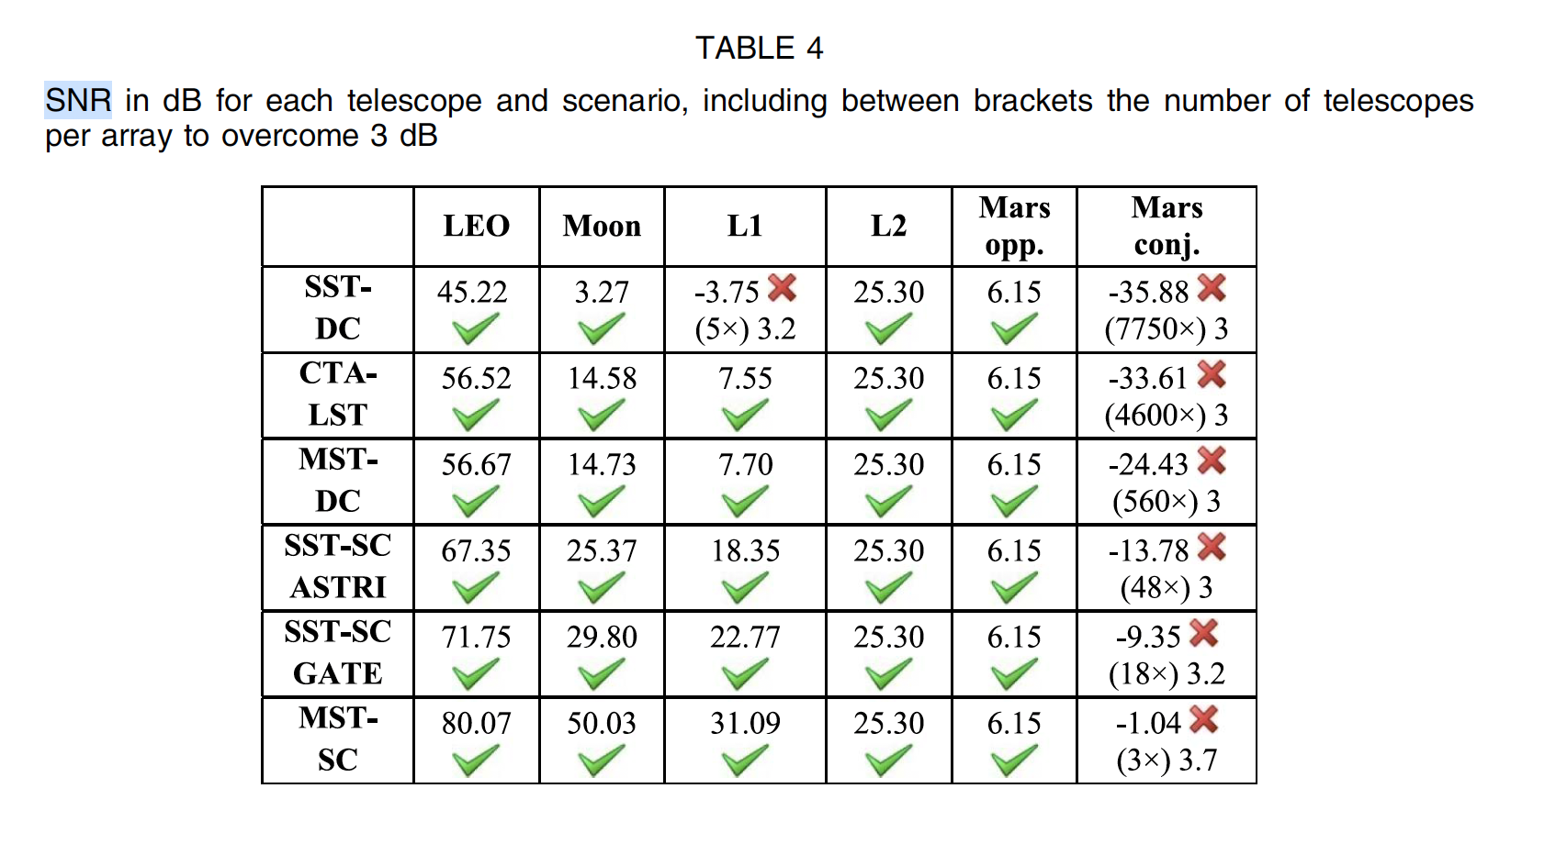
Possible scenarios
Credits: Carrasco-Casado et al.

Slide 20
ASTRI as OptComm receiver experiment within CTA++
Test plan (M. Centrone, INAF Roma)
  Calibrate the relative sensitivity of the camera on ALASCA and the camera on ASTRI, either using a known astronomic source or a 1064 beacon on Teide (cable car upper station)
  Use ALASCA at OGS to lock the satellite beacon transmitter, which will so emulate the ‘far filed optical transmitter’
  Acquire the beacon images both with the ALASCA equipment at OGS and the camera mounted on ASTRI
    Measure the field strength on both receivers, weighting by the means of the calibration
    Measure the PSF so that we can evaluate the level of correction that would be needed to efficiently feed the beam into a fiber core or small detector (APD SPAD/SNSPD)

Slide 21
ASTRI as OptComm receiver experiment
Straw-man design
  The beam radius of the Alphasat beacon on the earth is ~300m; for this reason, when Alphasat ‘locks’ on the OGS, it will illuminate evenly also ASTRI, which is just 40m far away from the OGS
  The ASTRI receiver shall be temporarily replaced by a NIR camera
    Considering a C-RED 2 camera and adopting the existing ASTRI M1-M2 configuration, we achieve a pixel scale of 1.44”/pixel
    This is NOT OPTIMAL considering the diffraction limit of the telescope ~ 6 arcsec, thus a ~20x magnifier is needed to achieve a good tradeoff between resolution and FoV
    The optical design shall also include a narrowband 1064nm filter to allow daytime operation. This is necessary because Alphasat cannot operate during daytime

Slide 22
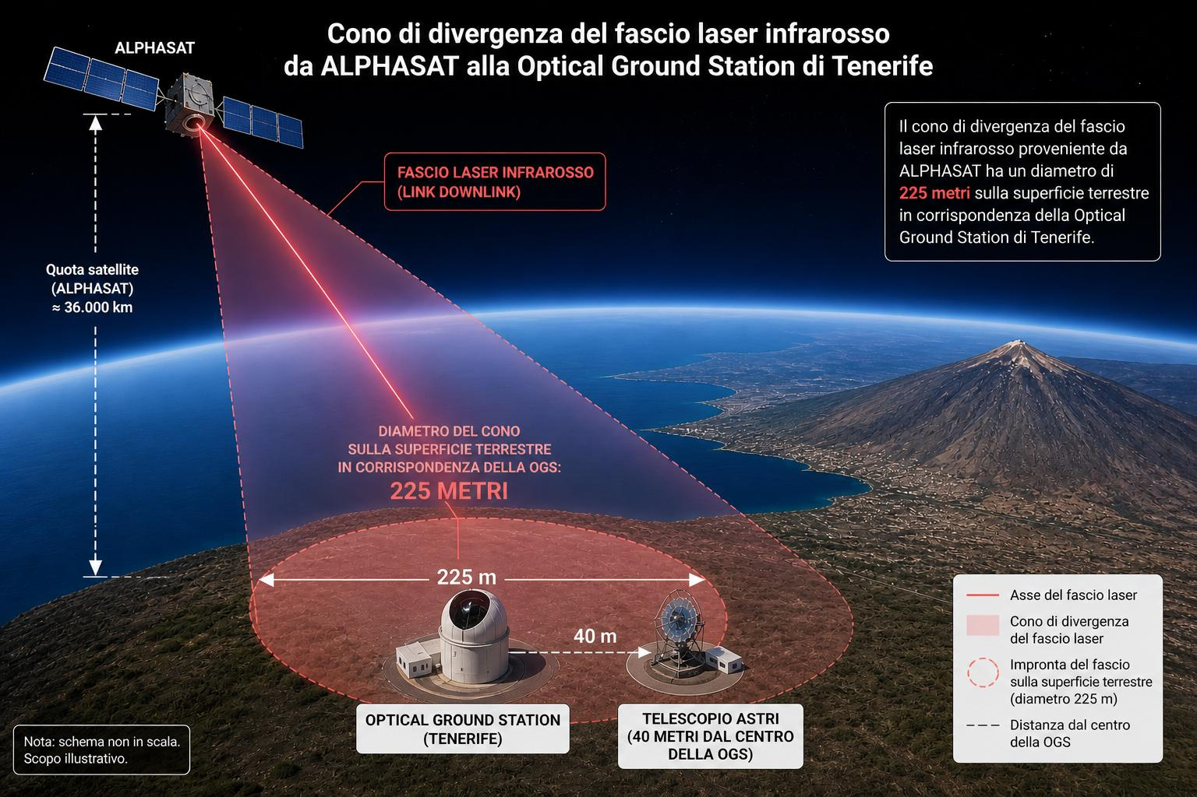





Slide 23
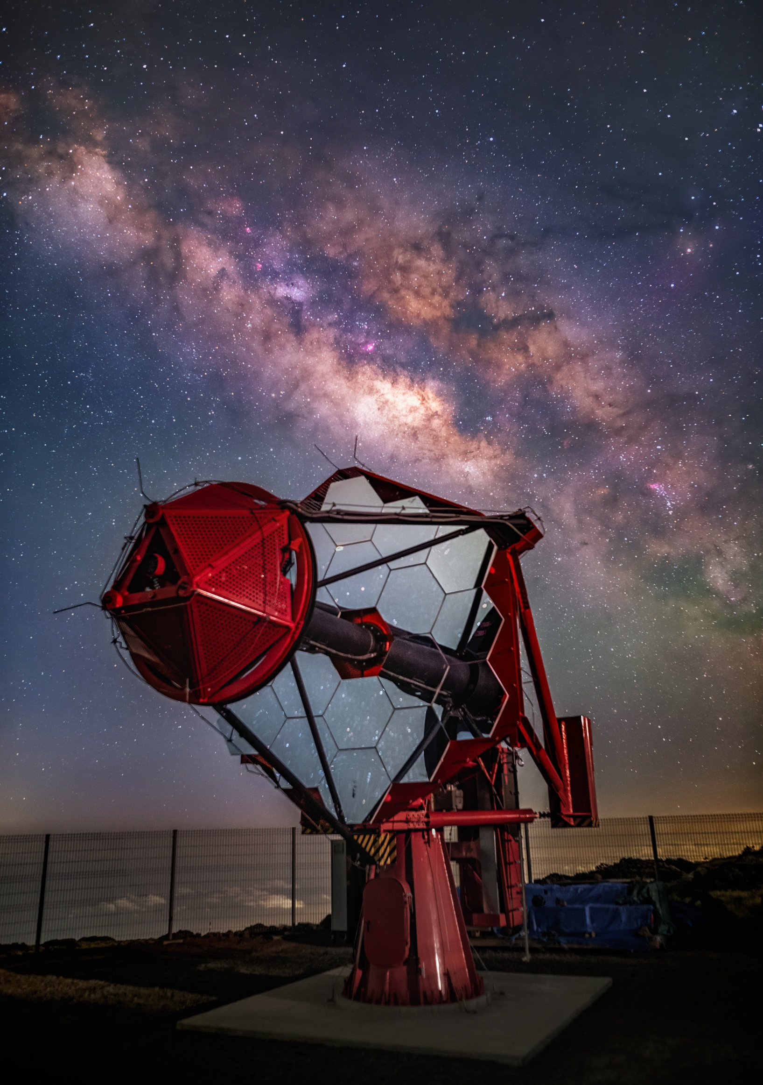
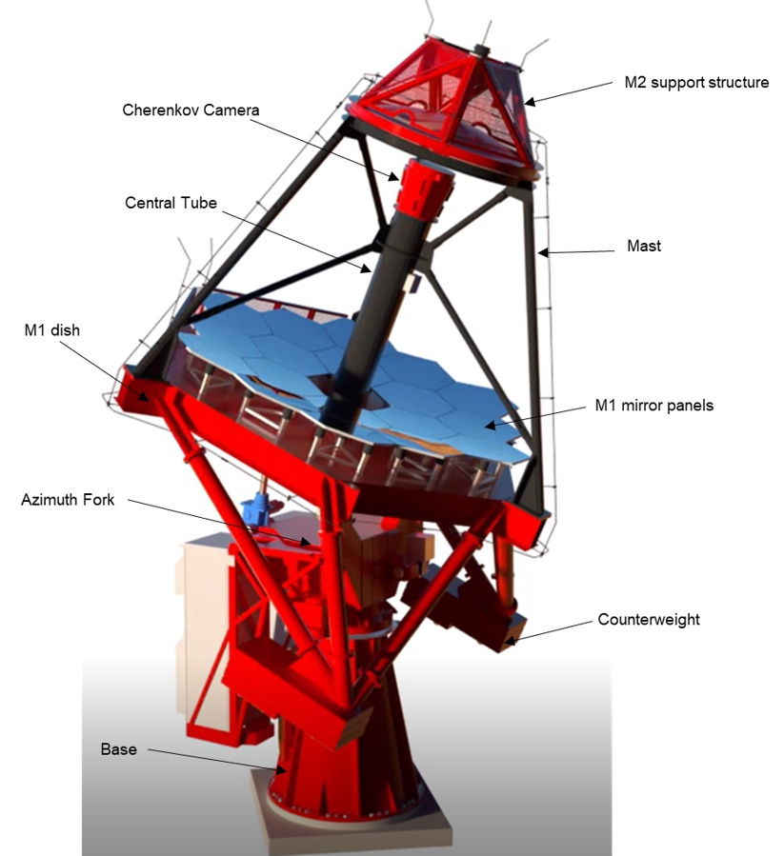
ASTRI Mini-Array telescopes
Contribution to opto-mechanics design and production from several companies:
DAL BEN SpA, EIE Group Srl, Media Lario Srl, Flabeg, Vetrolamp, Cilas, ZAOT
Pointing Monitoring Camera
Alt-azimuthal mount
Total weight: 17.5 tons
Dimensions: 8.6 m pointing at zenith, 7.5 m pointing at the horizon
Modified Schwarzschild-Couder configuration
Primary Mirror: 4.3 m (18 segments)
Secondary Mirror: 1.8 m (monolithic)
Average effective area > 5.0 m²
F-number: 0.5
Daniel Lopez/IAC
G. Tosti - From nine to forty: the SST telescopes and gamma-ray science with ASTRI and CTAO-2026

Slide 24

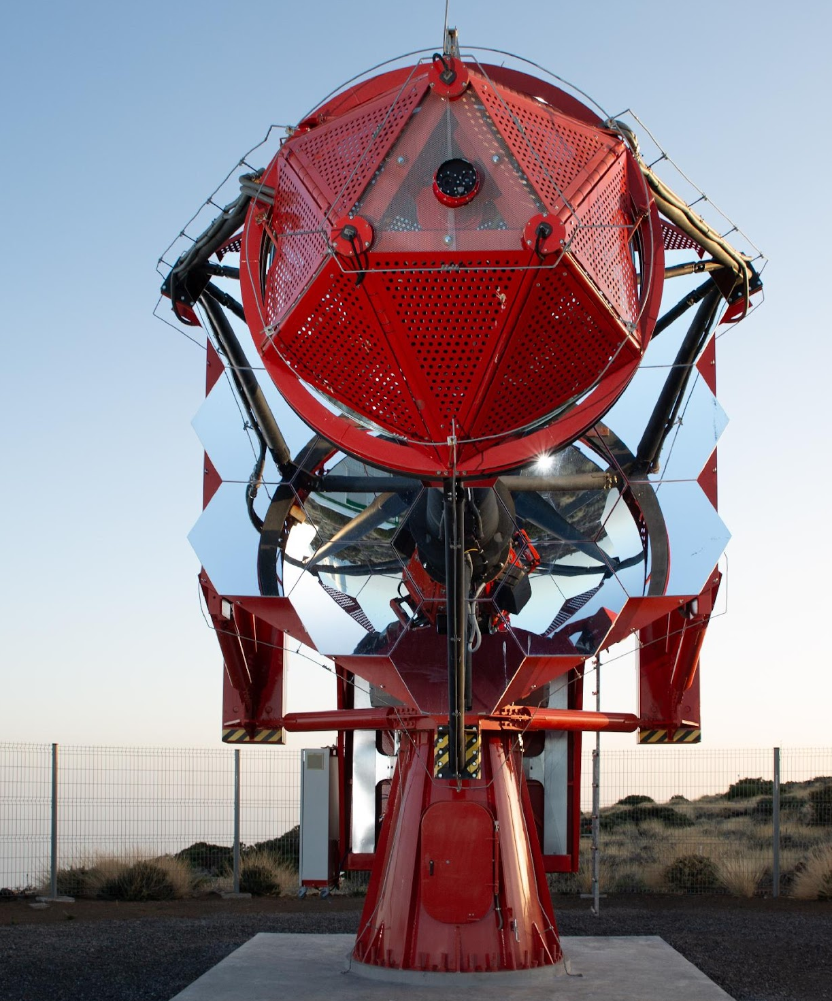
ASTRI Telescopes
The current ASTRI telescopes are an evolution of the ASTRI-Horn prototype telescope
The electromechanical structure was optimized in terms of mass, functionality and maintainability (mass has been reduced by 30% ).
Dual-mirror optical layout (Schwarzschild-Couder)
Wide FOV (~10)
Optimal PSF across the entire FoV
ASTRI Silicon photomultipliers camera
37 (8x8) matrices are arranged to adapt to the curved focal plane of the telescope.
Small pixel size (0.19°)
2368 pixels
No external cooling
Citiroc ASIC by Weeroc /INAF
Work also with moonlight

Slide 25

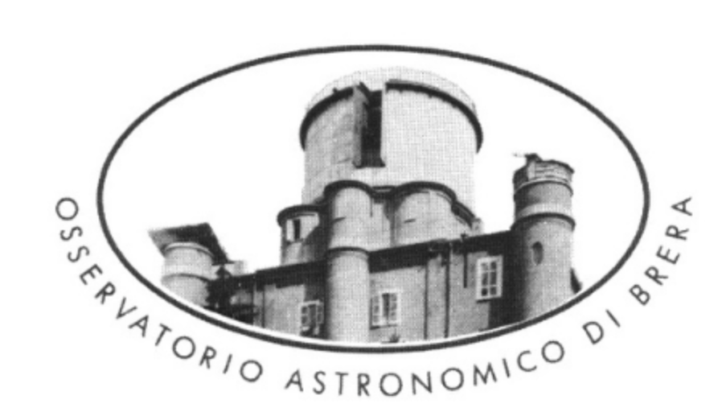

Wi-Fi SuperCAT (Wide-Field Super Compact Aplanatic Telescope)
A new very wide field concept being developed @ INAF – Brera inpired by the ASTRI experience

Slide 26
Wide-field telescopes for space surveillance and time-domain astronomy
Wide-field optical telescopes are fundamental to modern astrophysics, enabling space surveillance (asteroids and space debris) and the study of the "transient" Universe (GW, GRB, XRT…).
Internationally, in the Northern Hemisphere, only the Zwicky Transient Facility (ZTF) at the Palomar site in California is currently operational. It is equipped with a wide-field Schmidt camera with a field of view of 47 square degrees.
Italy, with the support of ASI and ESA, and with the support of INAF, is developing the FLYEYE/NEOSTED prototype in Matera, with a planned transfer to Sicily, plus 4 other telescopes to be distributed around the globe for large sky coverage ➔ 47 – 35 square degrees
Drawbacks:
high cost,
large number of optical elements (for Fly Eye),
just equatorial mount ➔ large volume and high power consumption
no derotation,
no fast repointing

Slide 27
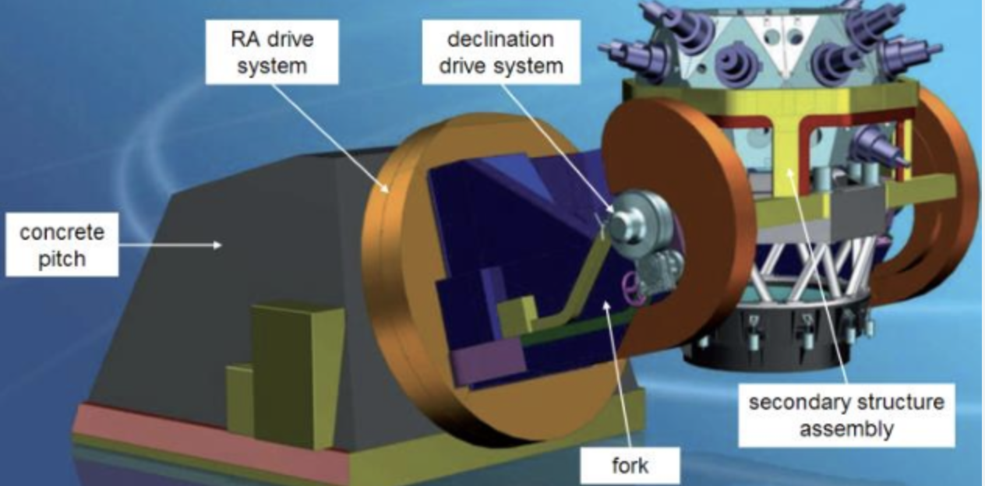
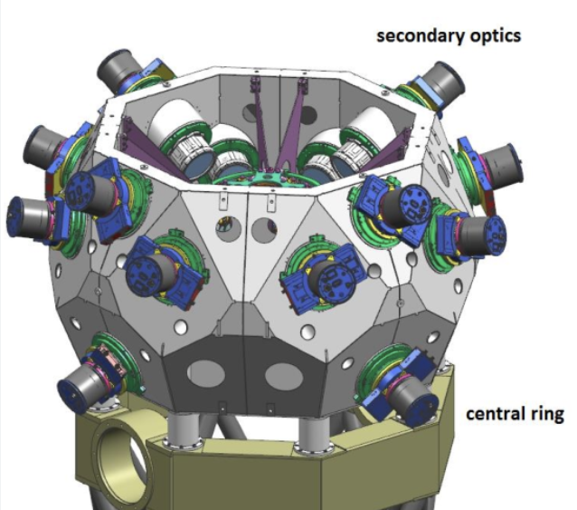
Fly-Eye Concept
Design concept by R. Ragazzoni and P. Salinari
ASI – ESA are developing 5 telescopes for Space Surveillance to be distributed around the globe. OHB Italia

Slide 28
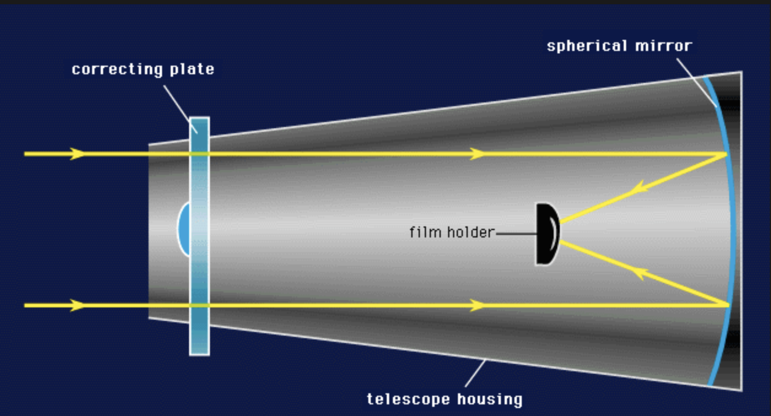
Schmidt Concept

Slide 29
A posiible change of perspective
CMOS technologies already available:
  Small pixels (2–10 microns)
  Large arrays (10k x 10k pixels per camera)
Very compact aplanatic telescopes (F# 1 or less)
AZ mount
  Reduced space requirements
  Fast re-pointing
Single camera (possibly mosaic)
  Small Vignetting and uniform PSF across the entire field
  Low Power reduction

Slide 30
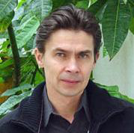
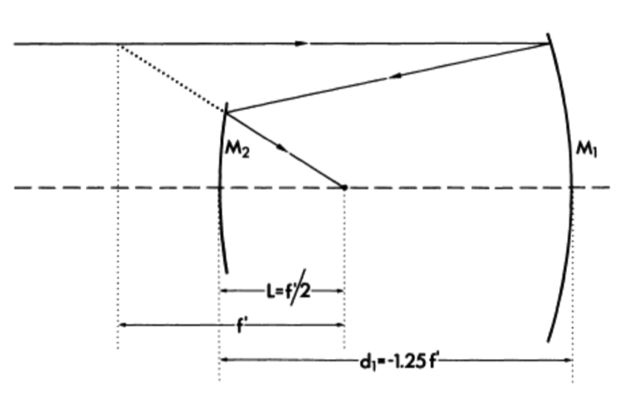
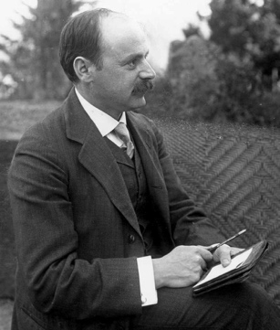
The Schwarzschild Aplanatic Telescope
1905: Karl Schwarzschild solved the Seidel ‘s equations for spherical aberration and coma finding a relation between parameters capable to make a telescope aplanatic. (Couder 1926 ➔ also correction of astigmatism with curved focal plane)
“For any geometry, 2 aspheric mirrors allow the correction of SI and SII to give an aplanatic telescope”
Vladimir Vassiliev, UCLA
Schwarzschild telescope
KS: f/3.0
b_{S1}= -13.5 (Hyperbola)
b_{S2}= 1.963 (Spheroid)
FoV:2.8 deg
RMS_{edge}~12’’
Technological challenge: Aspherical Optics manufacturing + large secondary mirror
30

Slide 31
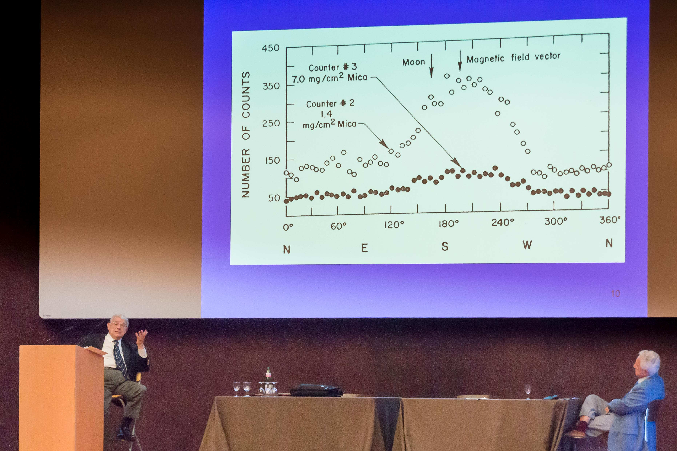
X-ray Astronomy: towards the next 50 years!
Conference in Riccardo’s honor, Milano 1- 5 Oct 2012

Slide 32
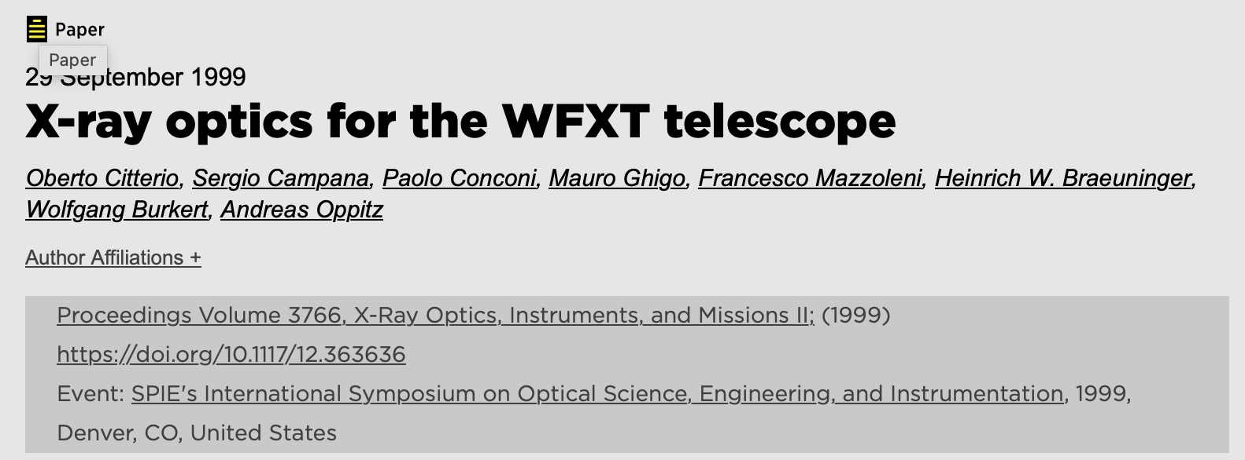
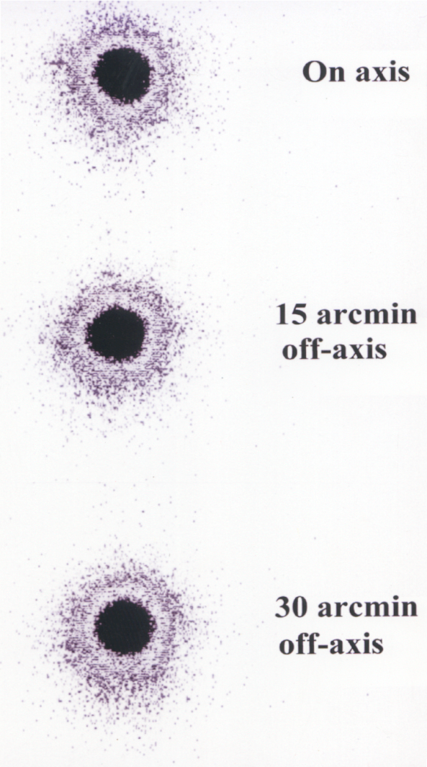
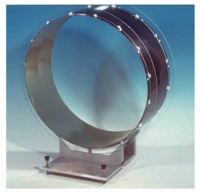
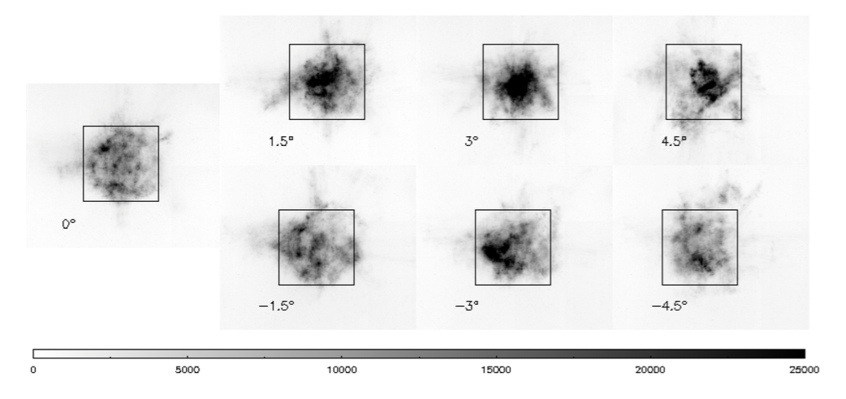
X-ray and Cherenkov Aplanatic Polynomyal Telescopes
SAME OPTICAL DESIGNER (Paolo Conconi, INAF Brera)

Slide 33
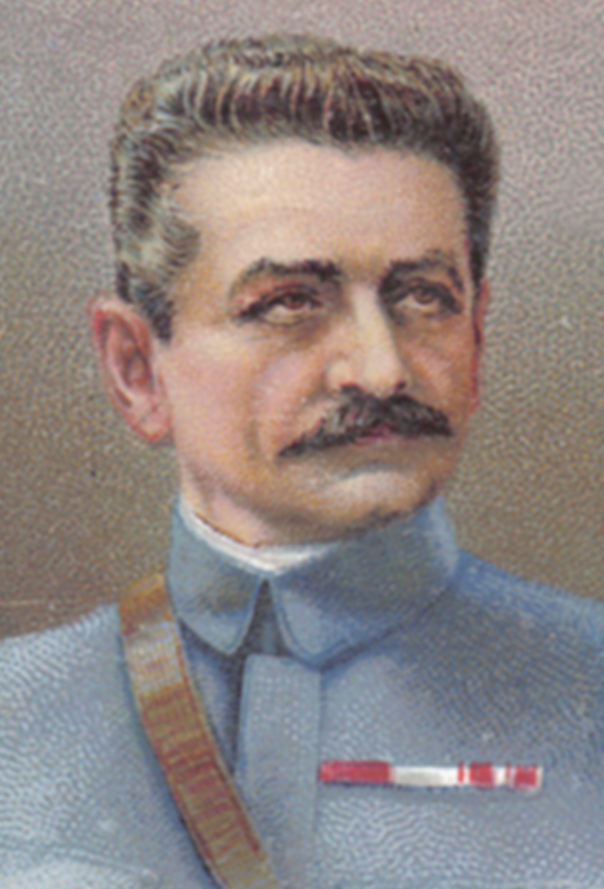
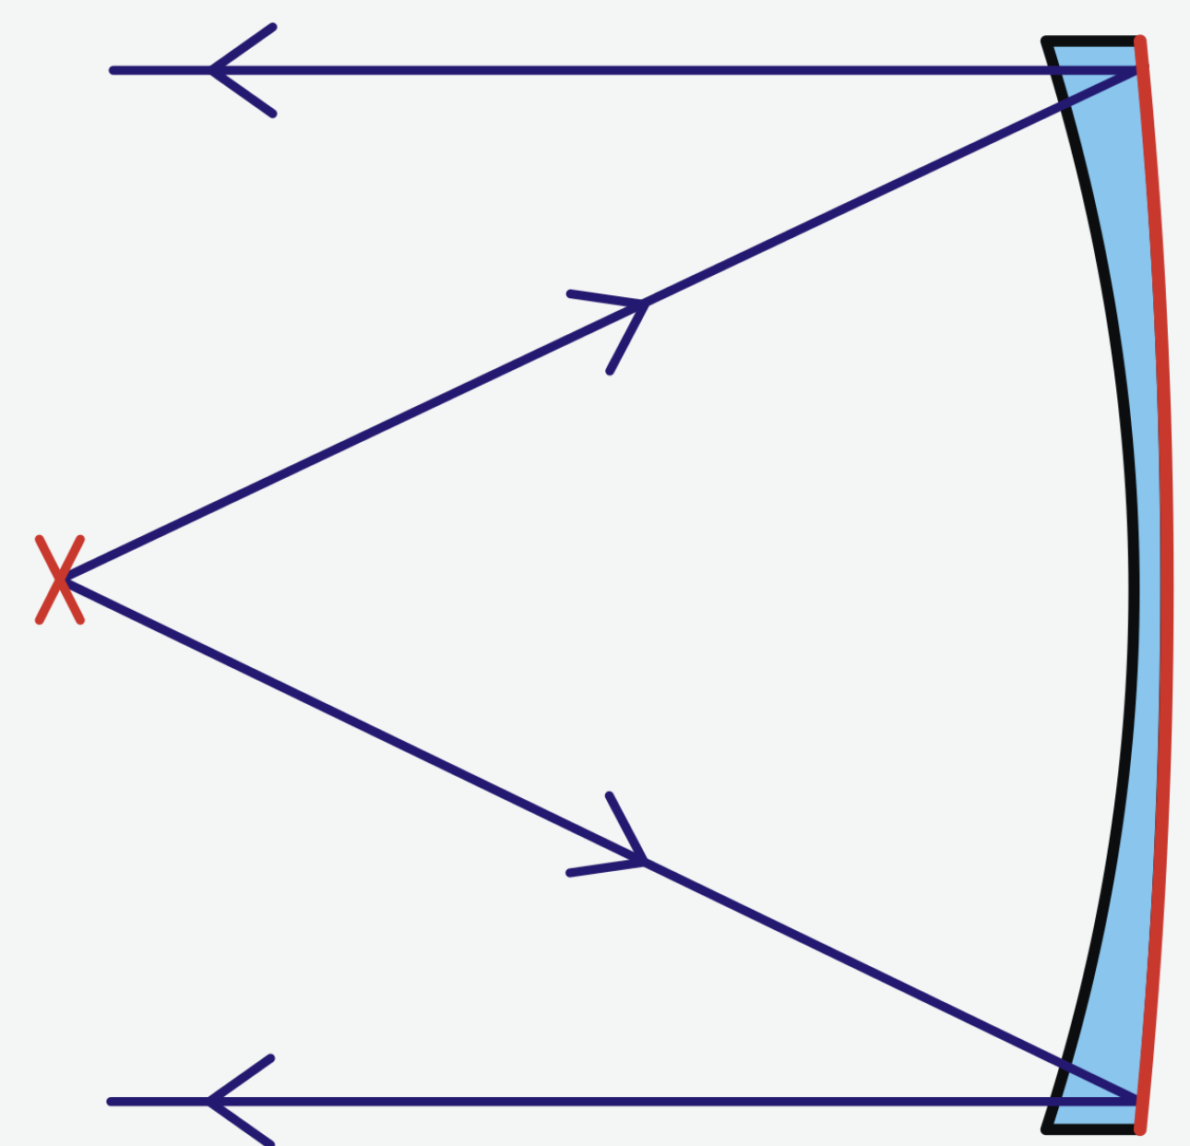
Mangin Mirror – invented in 1874
Alphonse Mangin

Slide 34
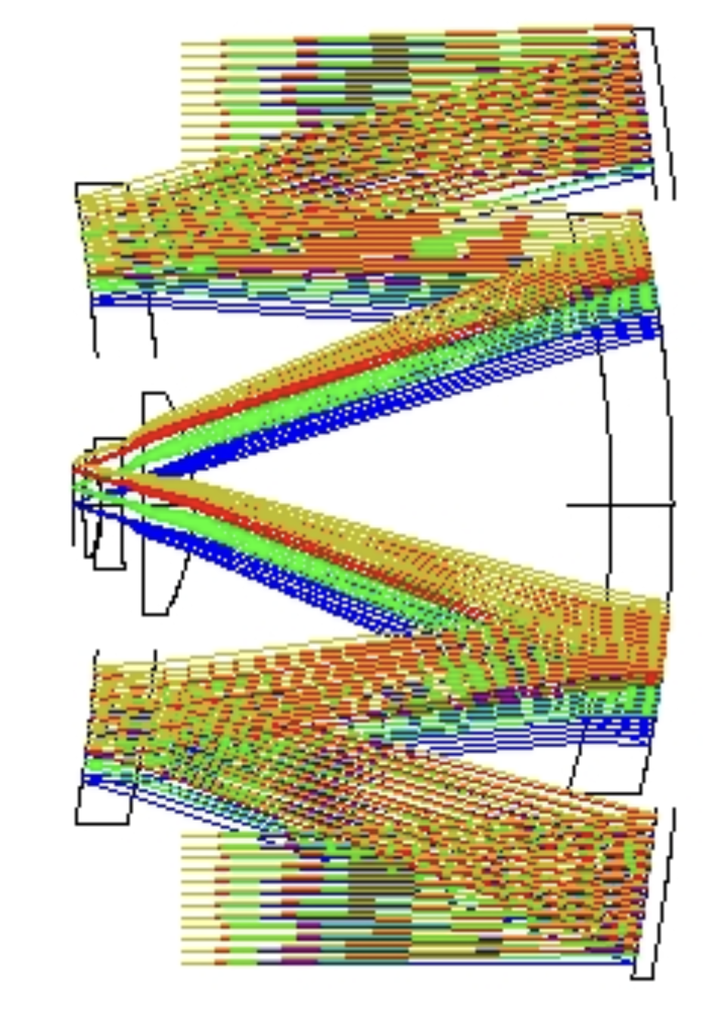
An extremely compact system (homothetic)
Primary
Secondary - Mangin
COMPATIBLE WITH HIGH-SPEED ROBOTIC AZ MOUNT
Triplert of lenses
Tertiary - Mangin

Slide 35
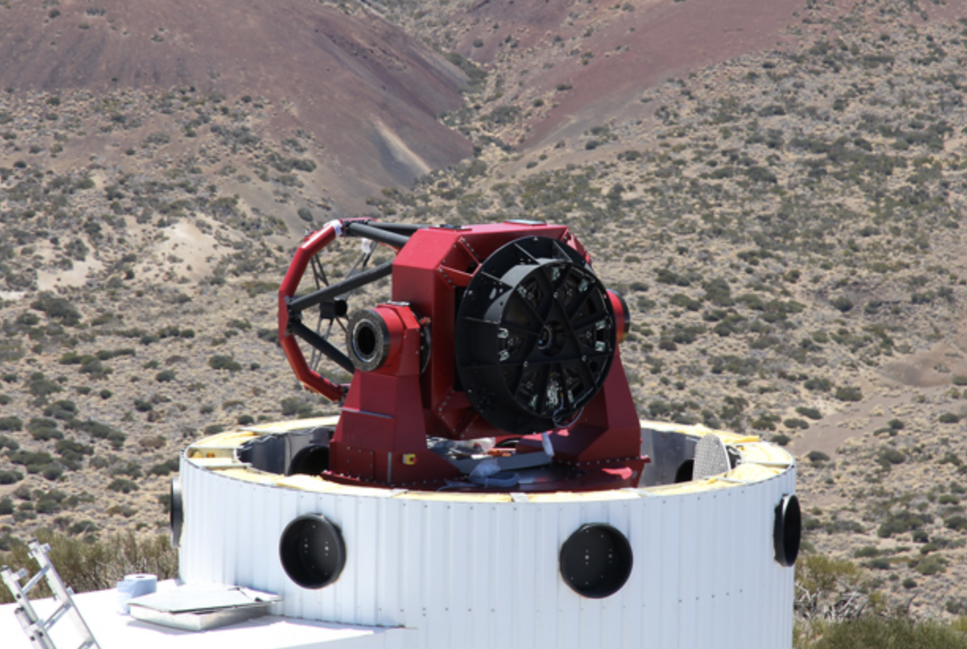
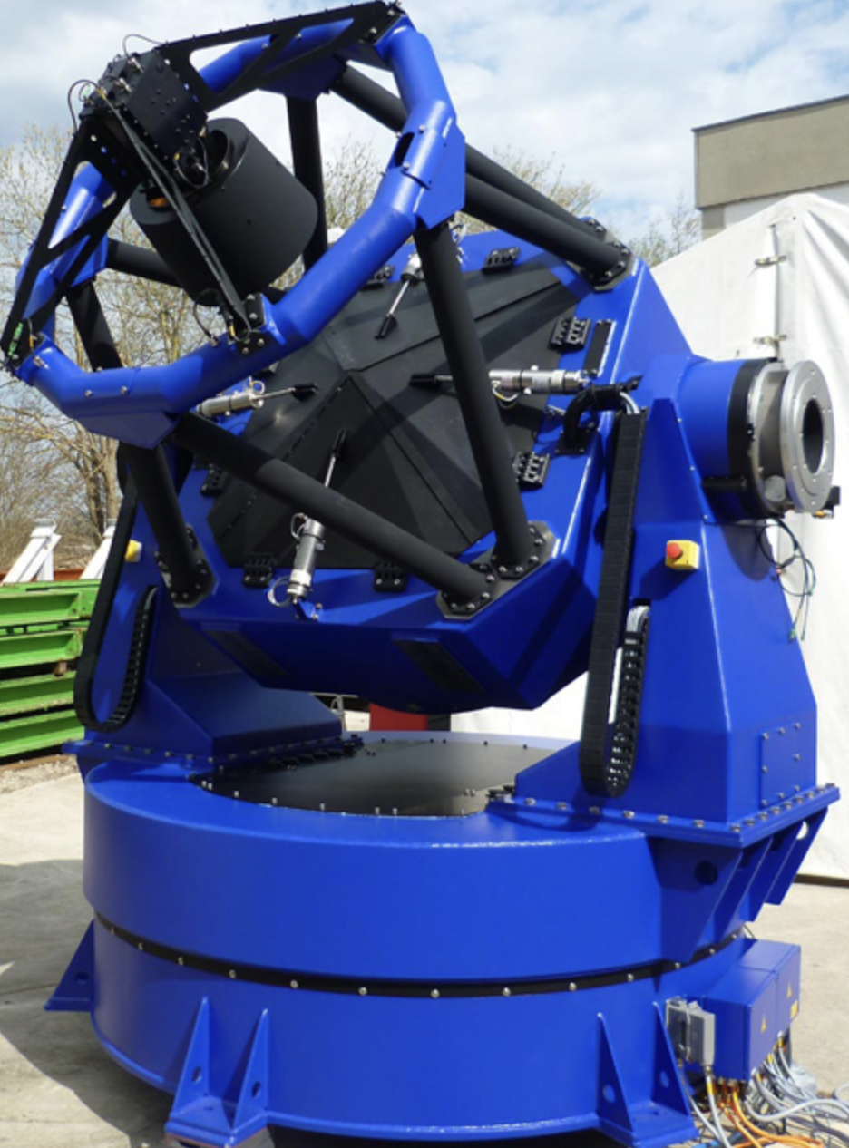
AZ Robotic Mount
https://www.astelco.com/products.htm

Slide 36

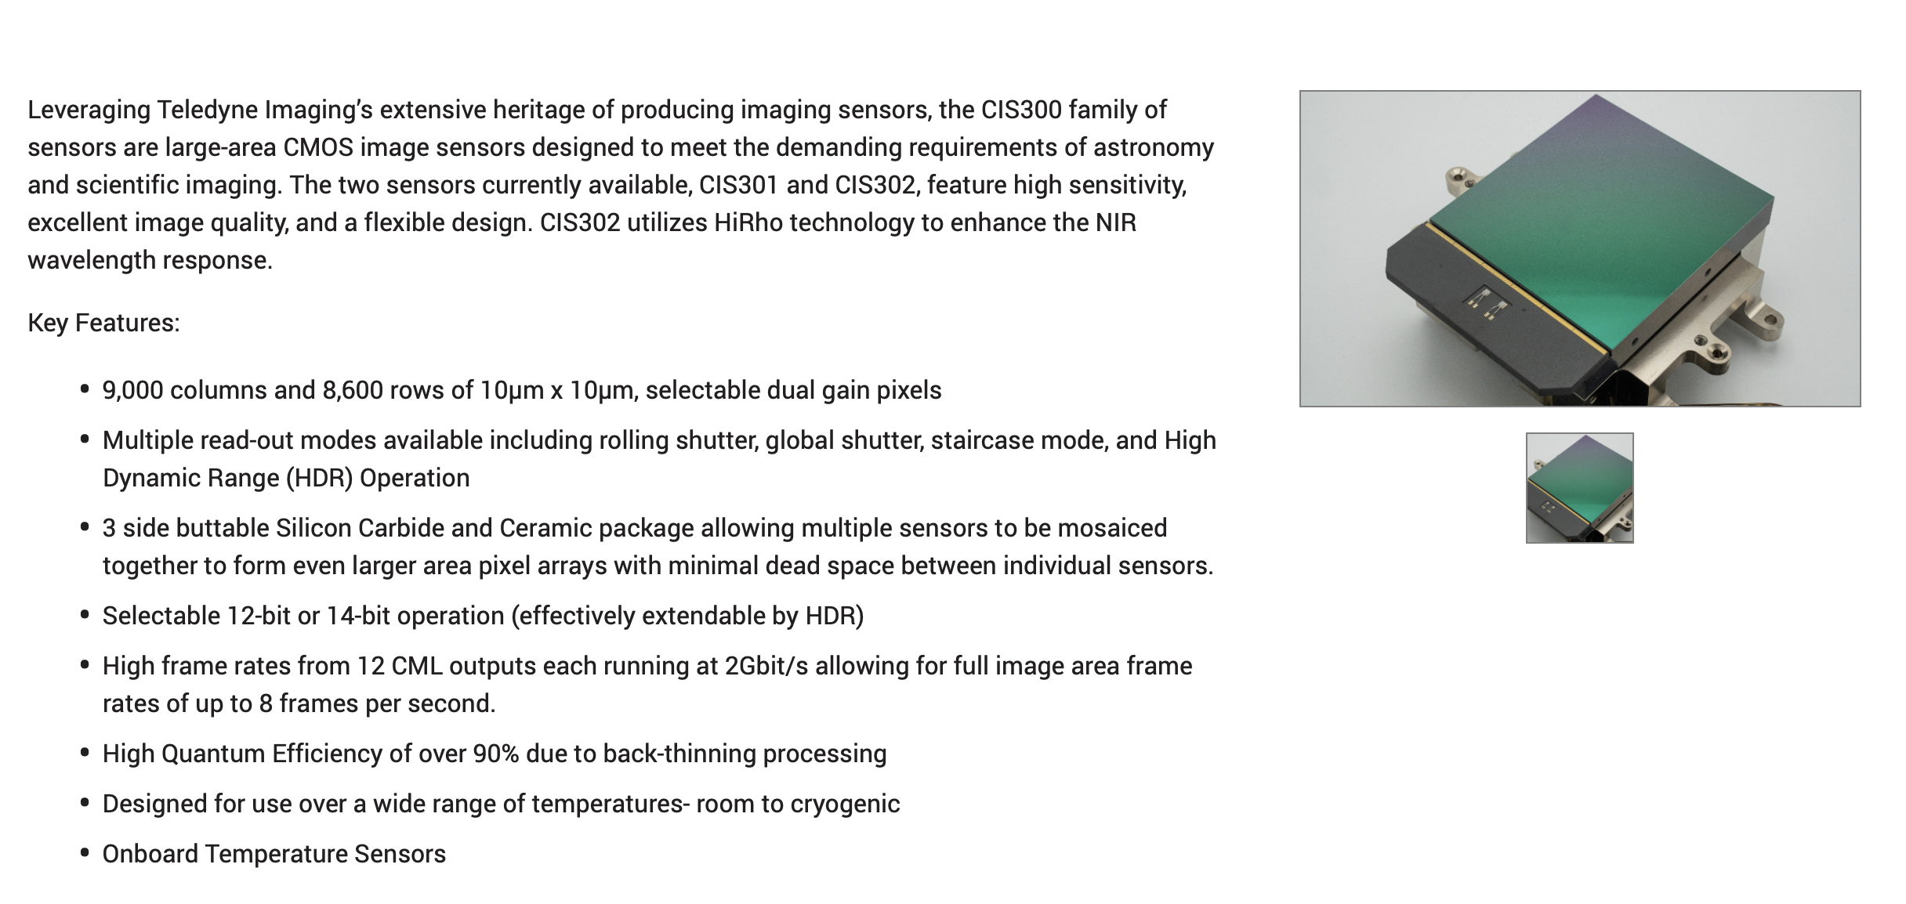
Mosaic of large form at, small pixels CMOS arrays

Slide 37
WI-FI S-CAT Vs. telescopi attuali

Slide 38
Conclusions
Air-Cherenkov telescopes may inspire applications beyond gamma-ray astronomy
CTA++ (WP5) will investigate and develop a few of these applications, including air-Cherenkov volcanic muonography and free-space communications
The ASTRI10 telescope will be added to the ASTRI Mini-Array
The Wi-Fi SuperCAT telescope, inspired by ASTRI, is being developed as a very wide-field, fast-repointing system for time-domain astronomy and space surveillance

