Slide 1

Some Interesting Aspects of the IACT Design,
Also Relevant for Stellar II
Razmik Mirzoyan
Max-Planck-Institute for Physics, Garching by Munich, Germany
National Academy of Sciences of Armenia, Yerevan, Armenia

Slide 2
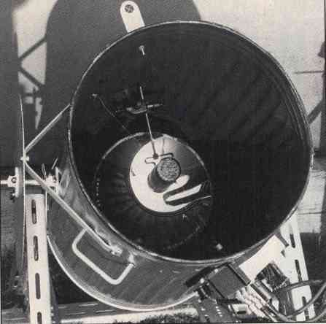
Galbraith & Jelley‘s pioneering discovery of Cherenkov light pulses from extensive air showers
This tiny telescope was based on a 25cm diameter parabolic mirror, fixed inside a dustbin and a single 2 inch PMT in its focus.
They pointed this simple telescope at the night sky and patiently waited. Soon they observed rare pulses coming from the sky.
This discovery, published in 1953, laid the foundation of the atmospheric Cherenkov light detection technique (Galbraith, Jelley, 1953).

Slide 3
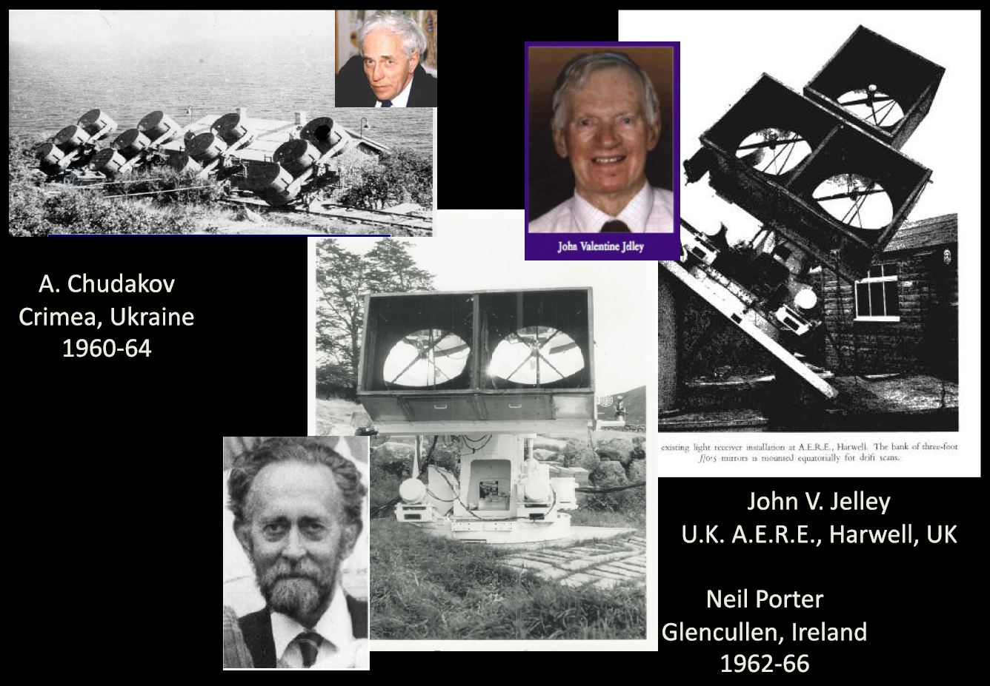

Slide 4
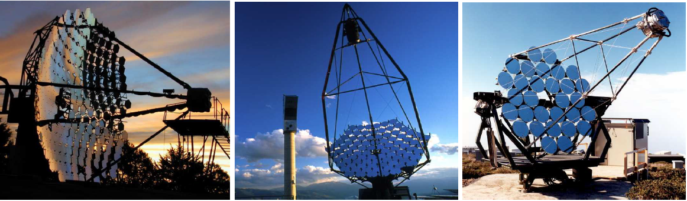
10m Ø Whipple, 5m Ø French CAT and
one of the HEGRA 4m Ø telescopes

Slide 5
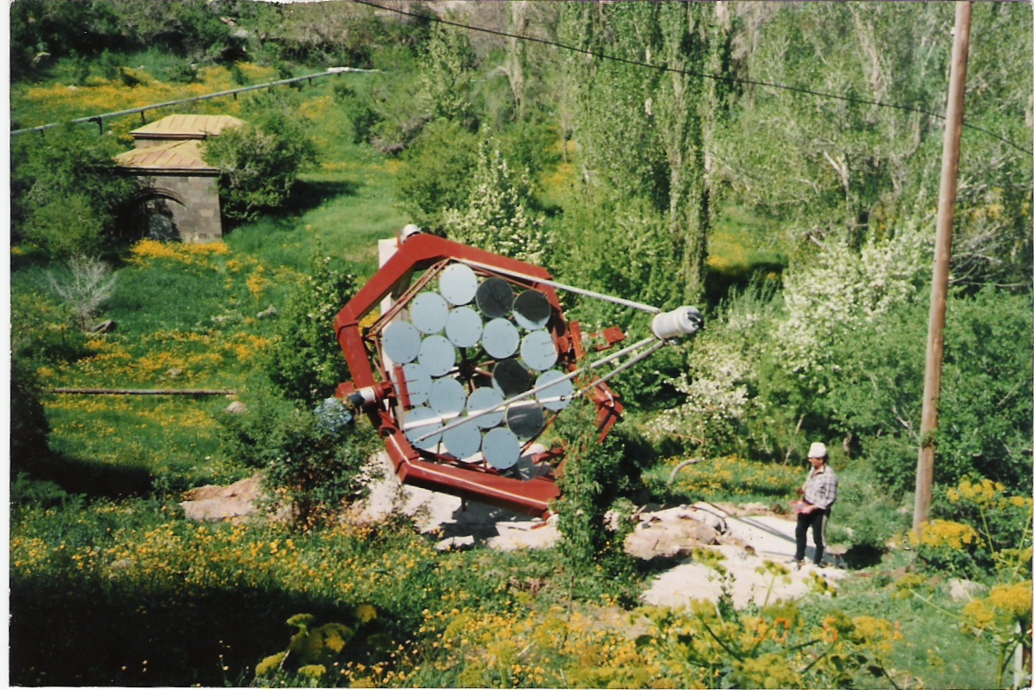
The 1st telescope (of 5 planned) we´ve built: 1989
Nor Amberd cosmic ray
Station, mount Aragats,
2000 m a.s.l., Armenia

Slide 6
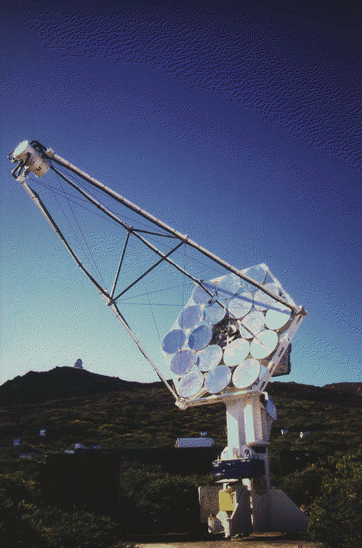
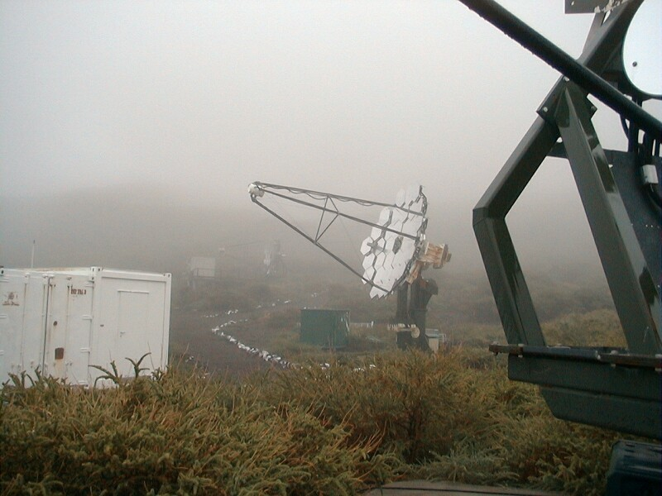
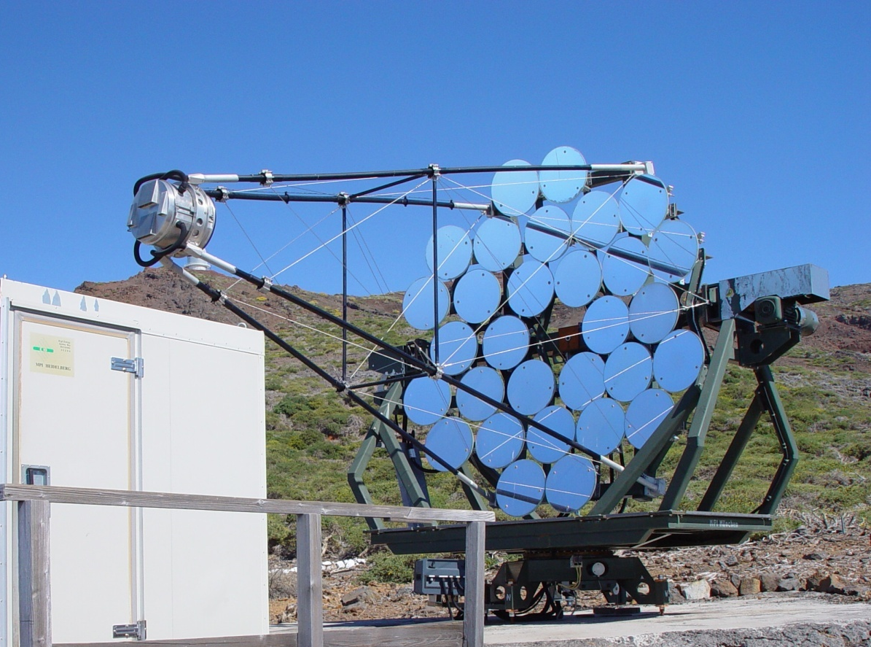
1st confirmation of γ‘s from Crab Nebula in fall 1992
CT2 – CT6 (4,2m ᴓ): 5 telescopes built till 1997
Weight: 2,2 T
Mechanical mount cost (MPP): 36.-k€
2 x larger reflector, 1997
The 1st telescope of HEGRA, the CT1, (installed in spring 1992)
Started collecting data in August 1992

Slide 7
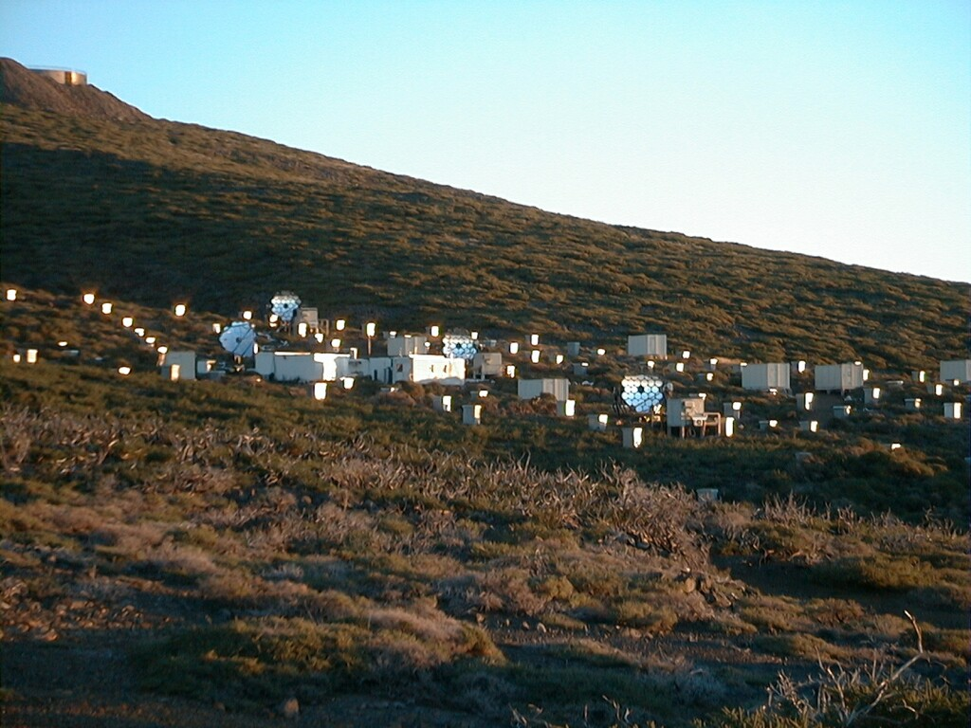
The HEGRA detector, including
6 air Cherenkov imaging telescopes
Location: ORM @ La Palma
Operation 1992 - 2002
CT6
CT3
CT1
CT4

Slide 8
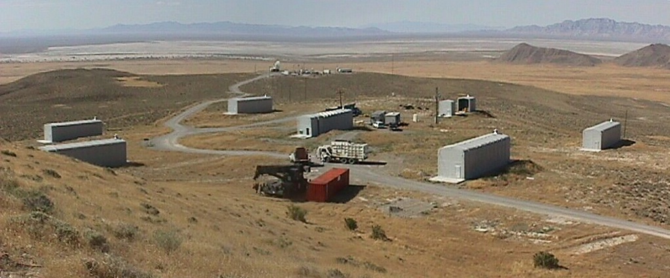
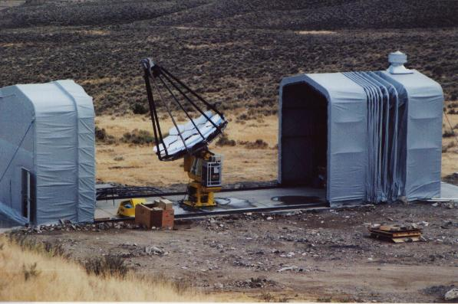
Japanese 7-telescope array
The 7-Telescope Array was planned to include two big arrays of 127 imaging telescopes, operating in coincidence (Teshima, et al., 1992). A single telescope had a 3m diameter tessellated reflector and a 256-pixel imaging camera. In 1996-1997, three out of ready seven telescopes were installed in Dugway proving grounds, Utah, USA. The telescopes started taking data on the flaring MKN-501 and 1ES1959 in 1997. Unexpectedly, a missile launched by the military at the Dugway test-site lost its target position and mistakenly hit the telescopes' data acquisition containers. Luckily the rocket was unarmed and there was nobody in the test container, which of course was completely destroyed. This unusual event forced operations to cease at the end of 1997.

Slide 9

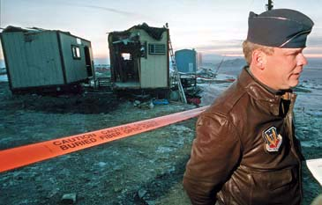
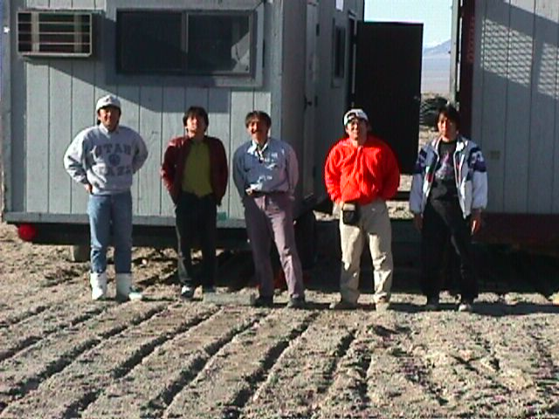
What remained of 7 telescope-array after the missile strike?

Slide 10
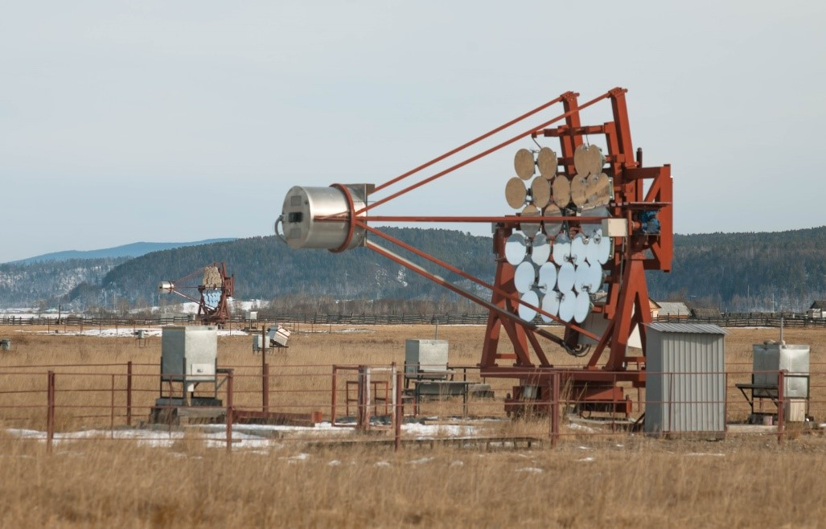
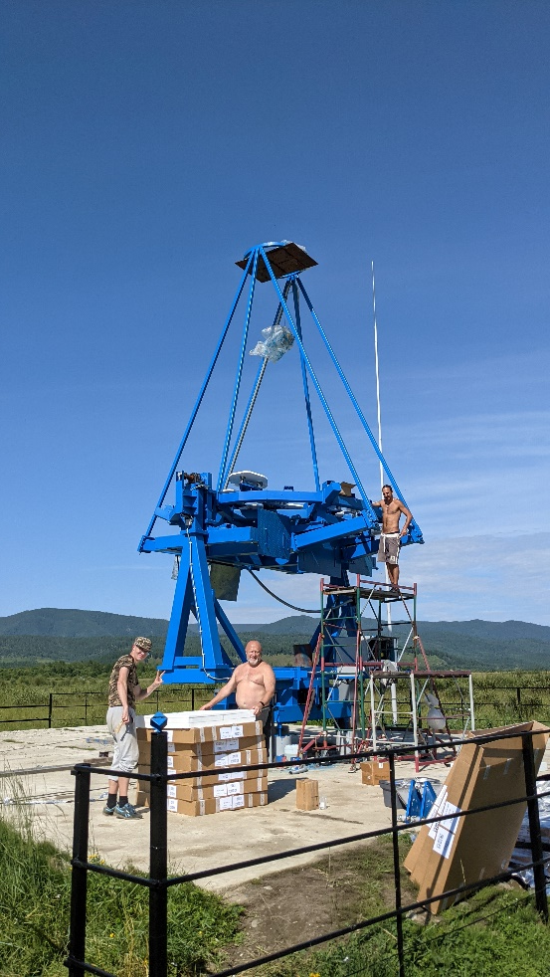
3 TAIGA IACTs in Tunka valley near lake Baikal, Russia
Imaging camera aperture 9.6°
560 PMT pixels of 0.36° size;
Special design allows operation under -35° C;
Mechanical mount is a modified version of HEGRA;
Telescope #4 is ready camera under const.

Slide 11
Veritas at Base-Camp of the Harvard-Smithsonian Center for Astrophysics near Tucson, Arizona, USA
4 x 12m Ø IACTs

Slide 12
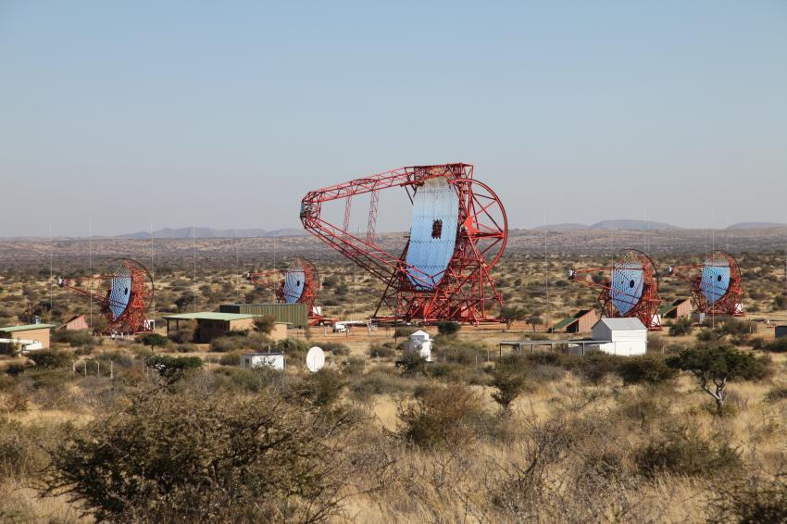
H.E.S.S. near Gamsberg, Namibia
4 x 12m + 24x28m big telescope in the center

Slide 13
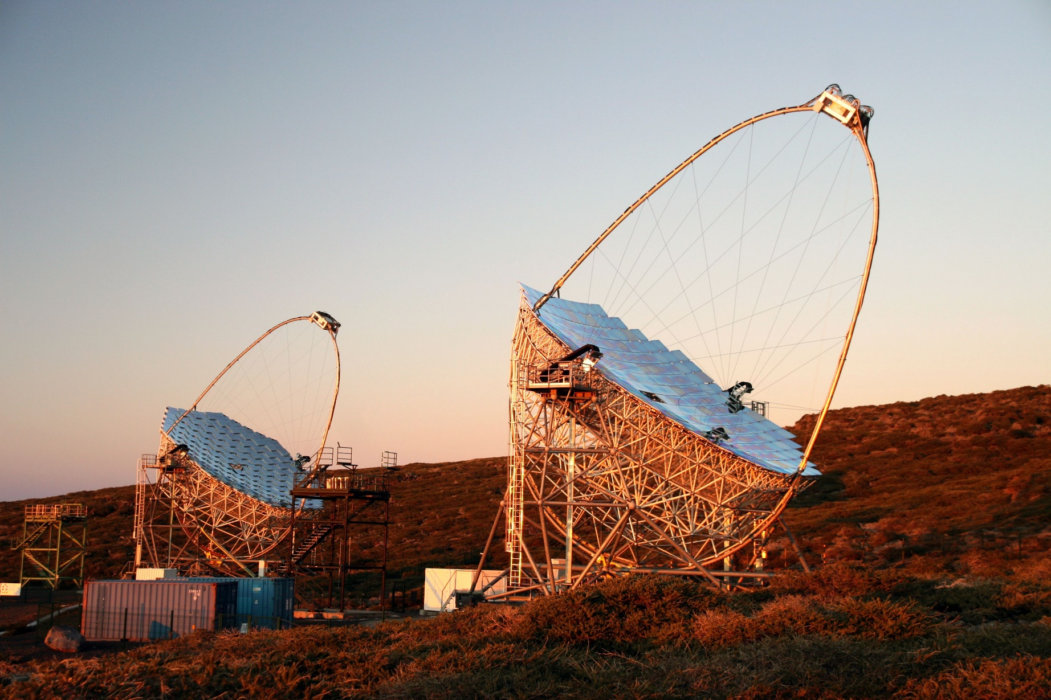
MAGIC at Roque de los Muchachos EU North Observatory on the Canary Island of La Palma

Slide 14
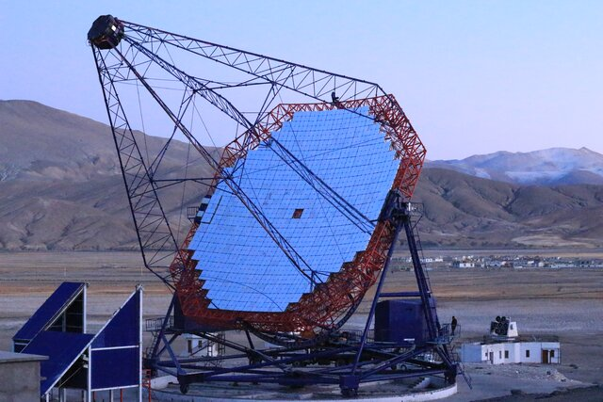
The 21m diameter MACE IACT in India, Hanle, 4270m a.s.l. (not surprisingly, looks similar to MAGIC)
Reflector: 340 m²
356 mirror panels with 1424 mirrors of 49cm x 49cm size
Camera weight: 1200 kg
Weight: 180 Ton
6 wheels, moving on 27m diameter rail
Camera: 1088 PMT pixels of 0.125° size
FoV: 4.0° x 4.3°
Threshold: 20 GeV

Slide 15
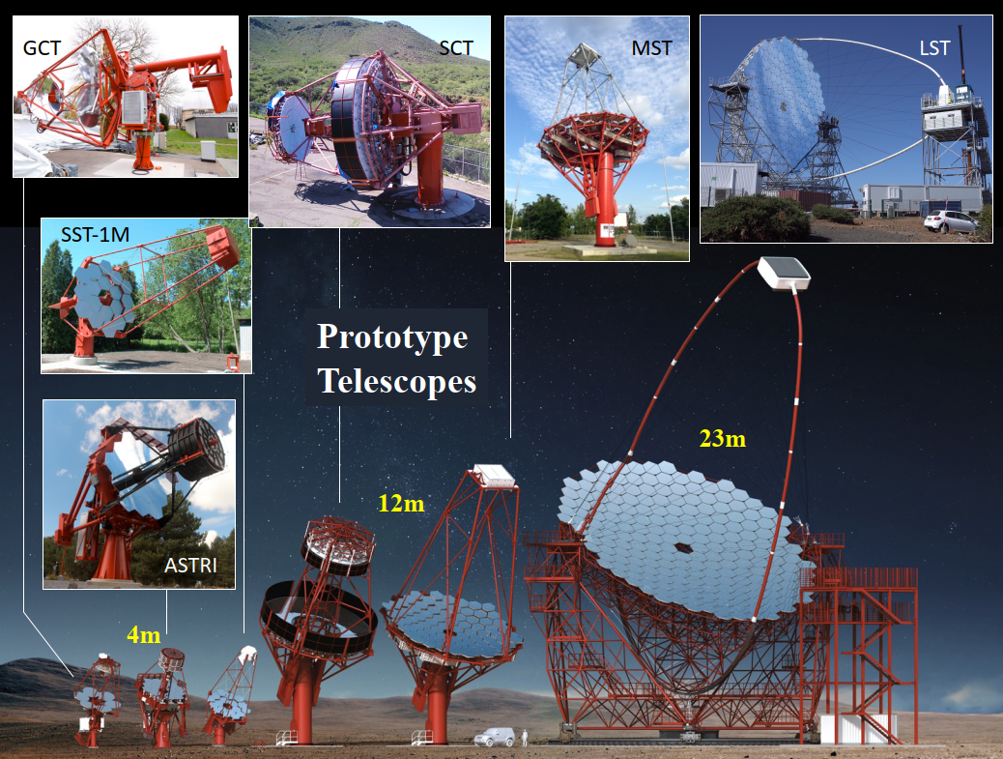
CTA IACT designs, some more successful than the others
(majority did not survive)

Slide 16
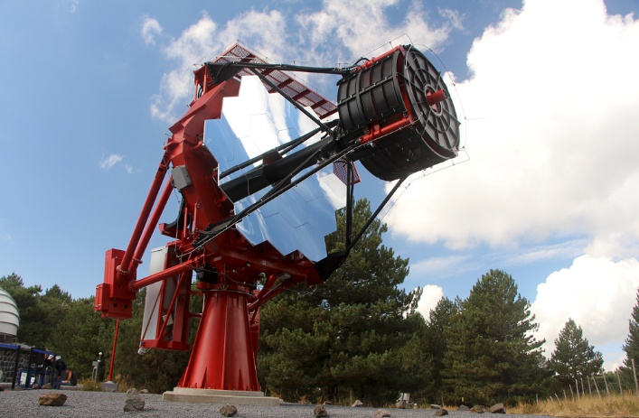
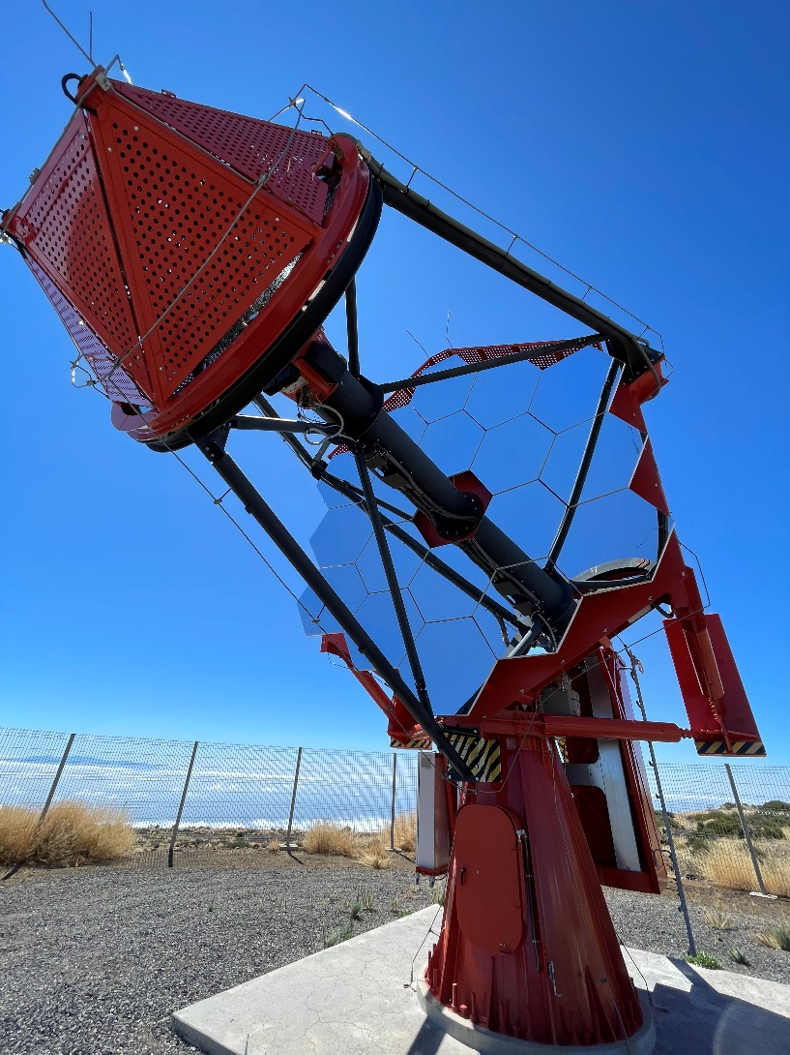
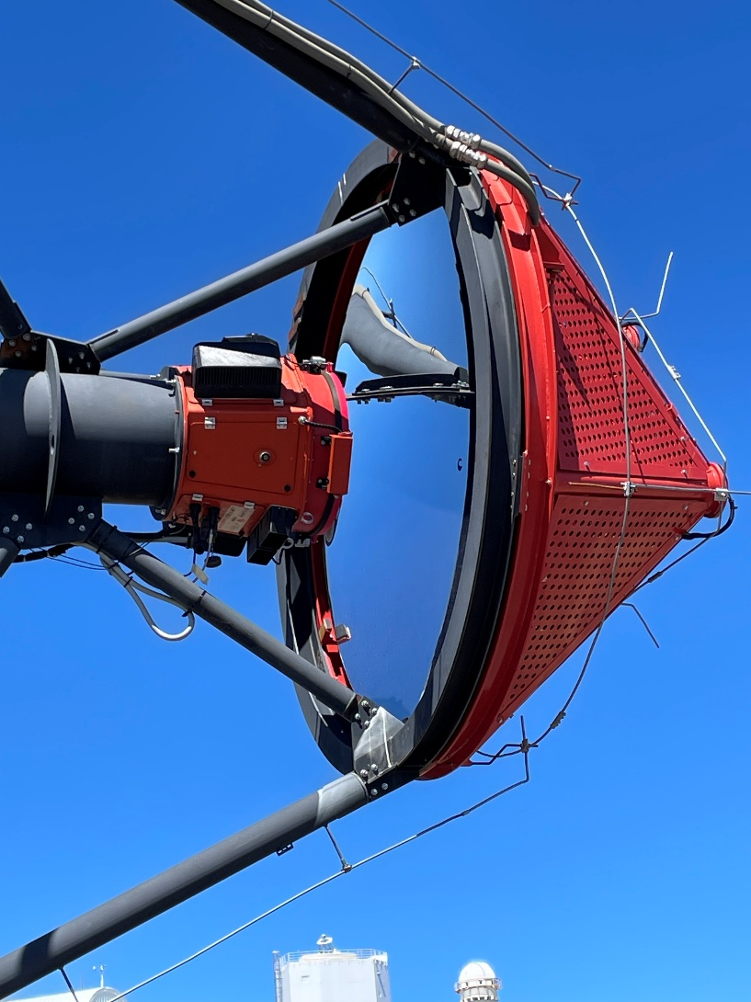
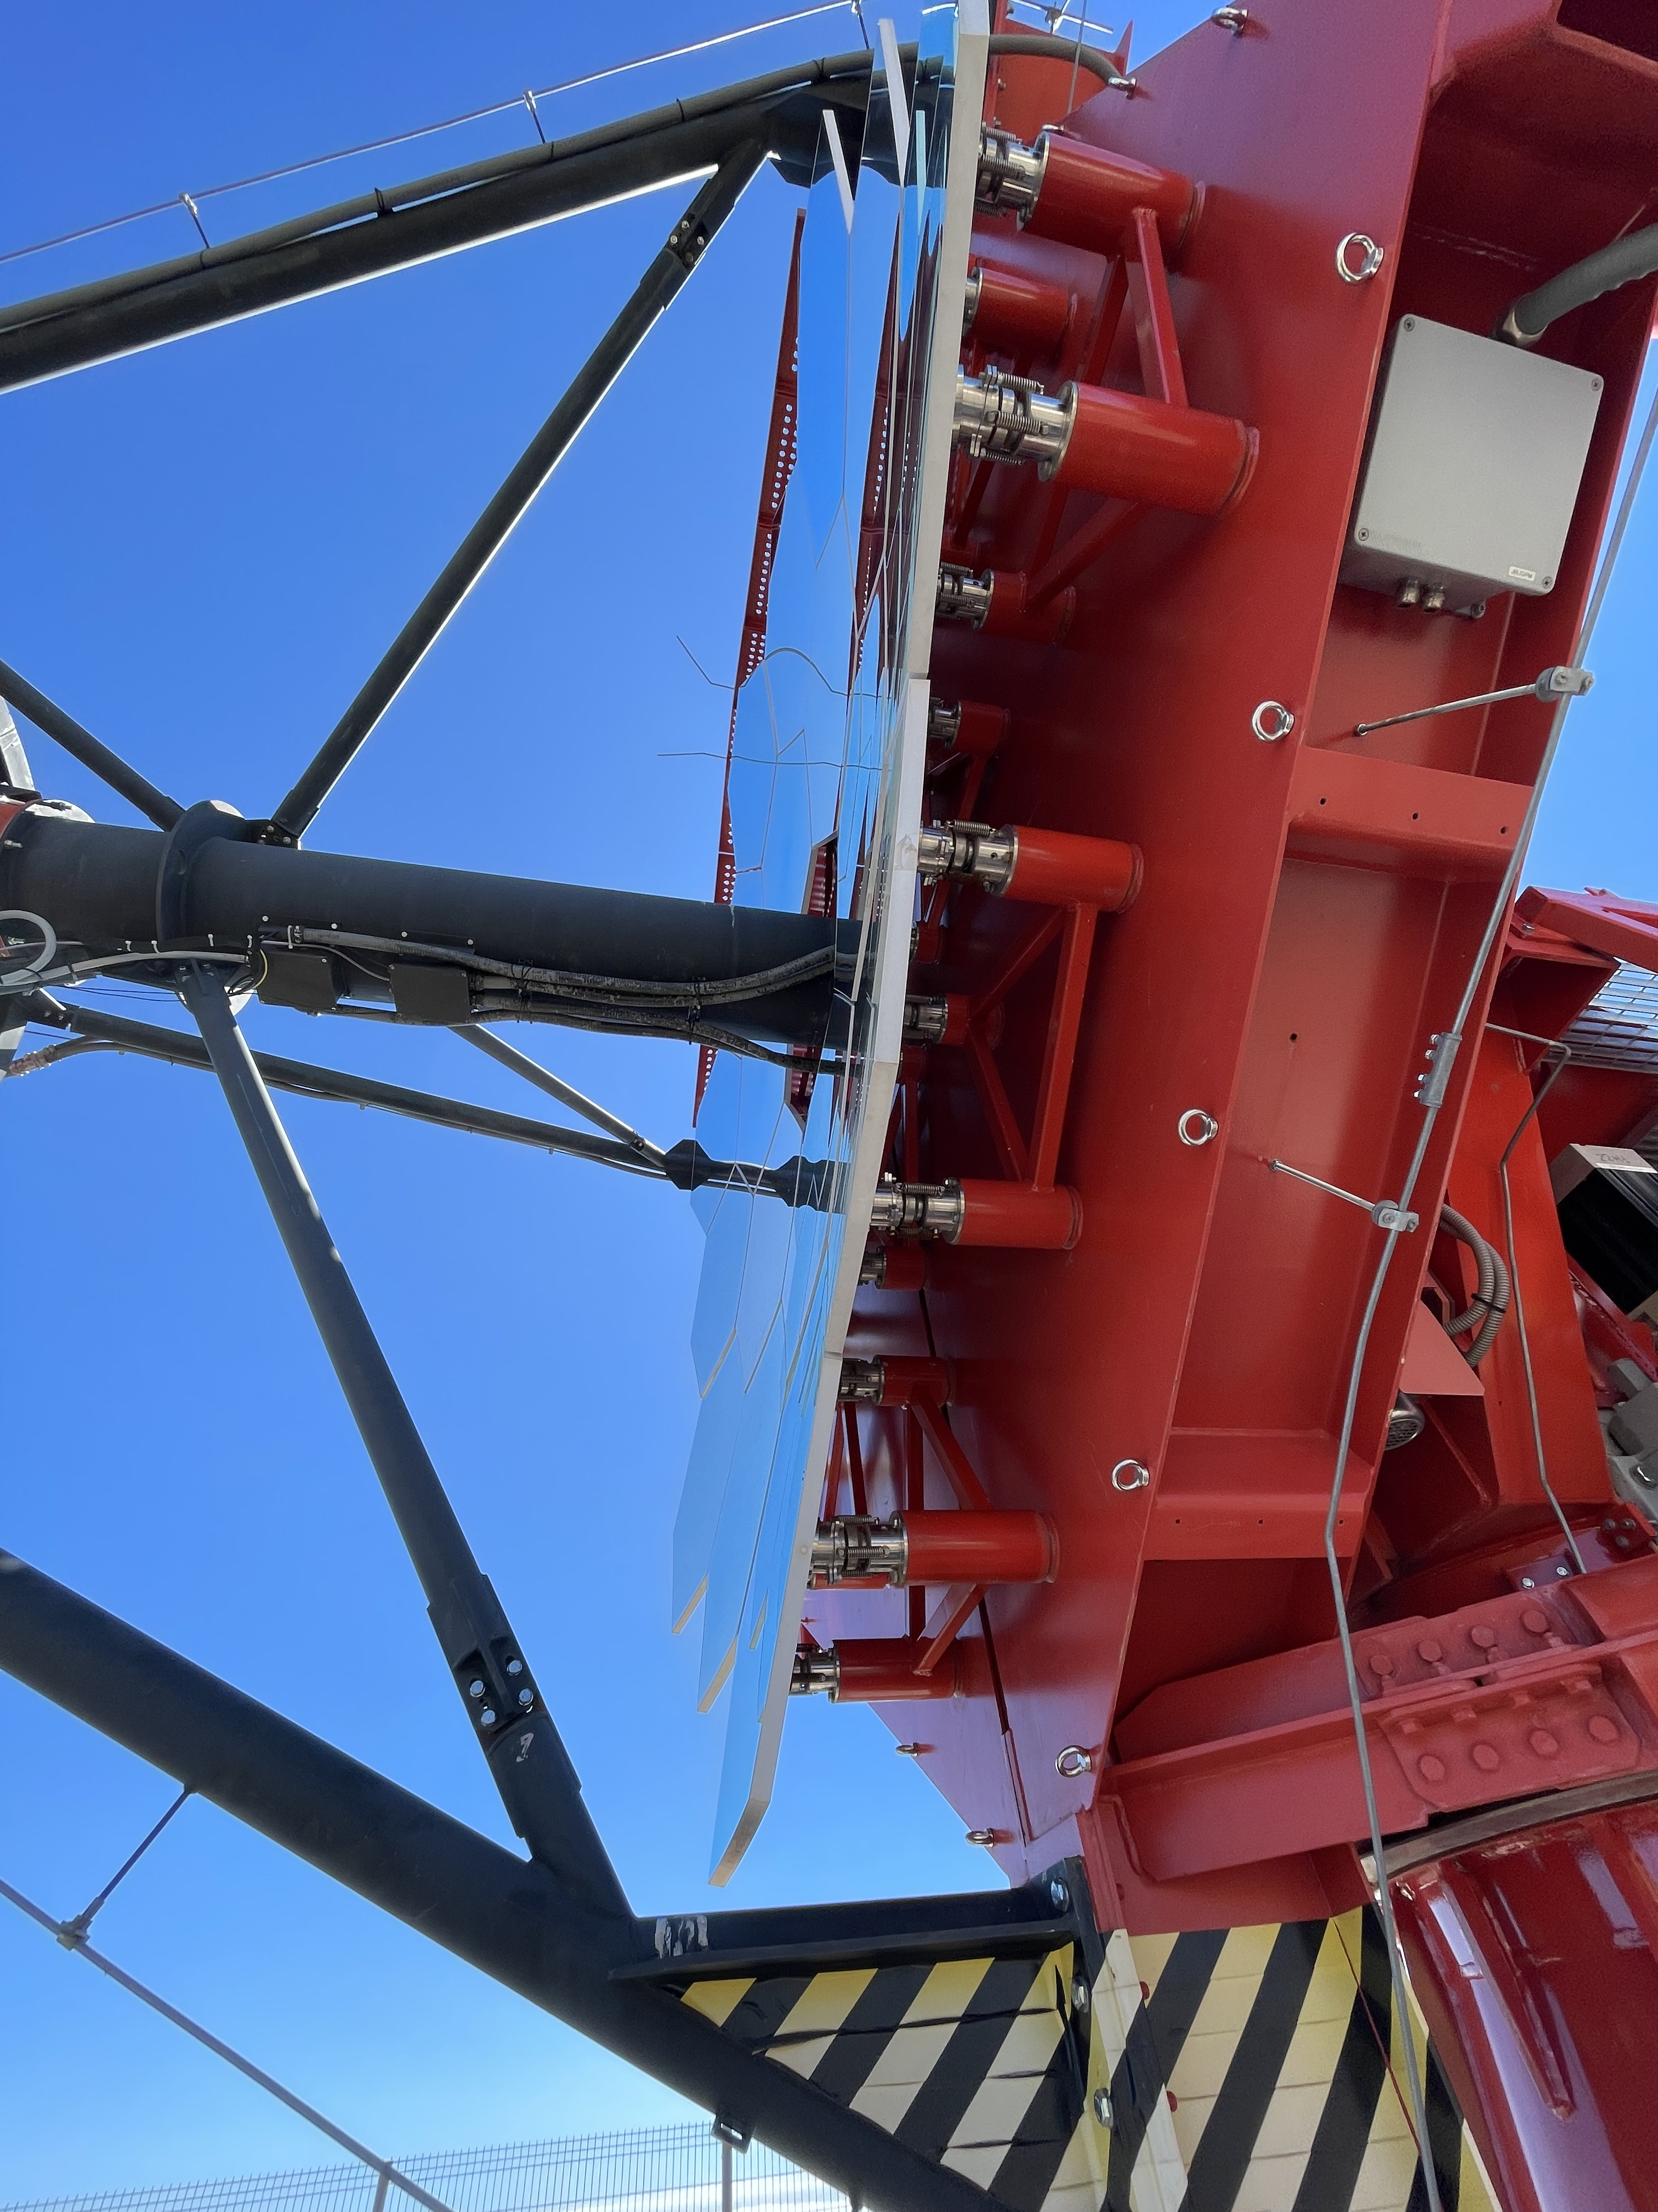
Dual-mirror design ASTRI telescopes from Italy
Now 9 (+1) telescope array is under completion at Isania observatory on the Canary island Tenerife

Slide 17
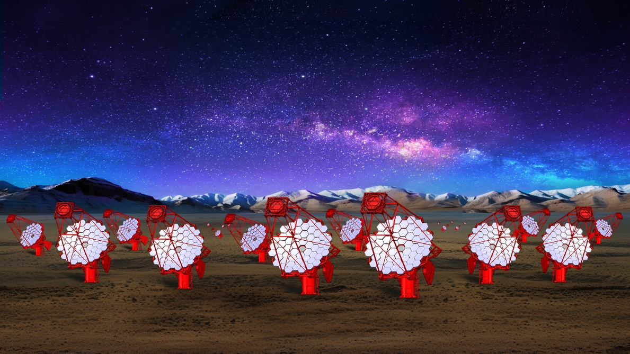
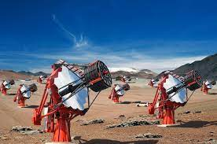
SST arrays that are going to strongly impact contemporary astrophysics
LACT: large array of 32 (+4) IACTs of 6m diameter, f/1.33 at LHAASO site, 4400m a.s.l., largest distance ~ 1.3 km
ASTRI mini-array of 9 (+1) telescopes, SCT, double mirror (4.3m & 1.8m) design, on mount Teide on Tenerife on the Canary islands
Plus the array of 37 (+5) ASTRI-like SSTs under the construction for the CTAO Southern location in Chile

Slide 18
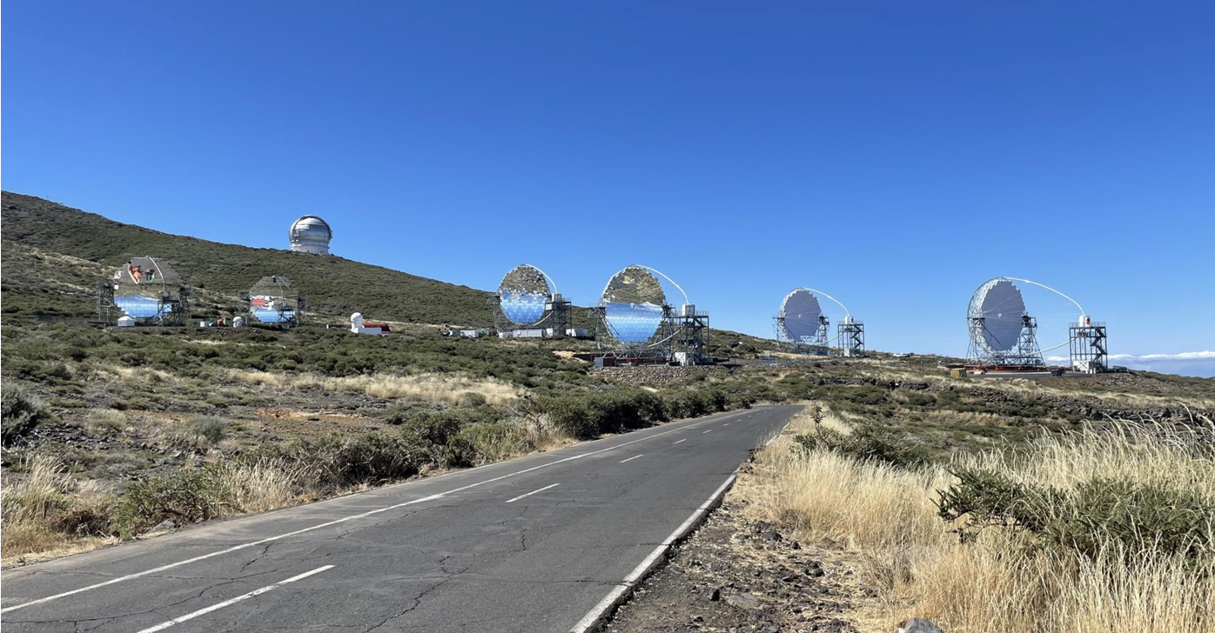
4 CTAO LSTs in La Palma; will be inaugurated on October 14-15 2026 . On the left one can see the 2 MAGICs

Slide 19
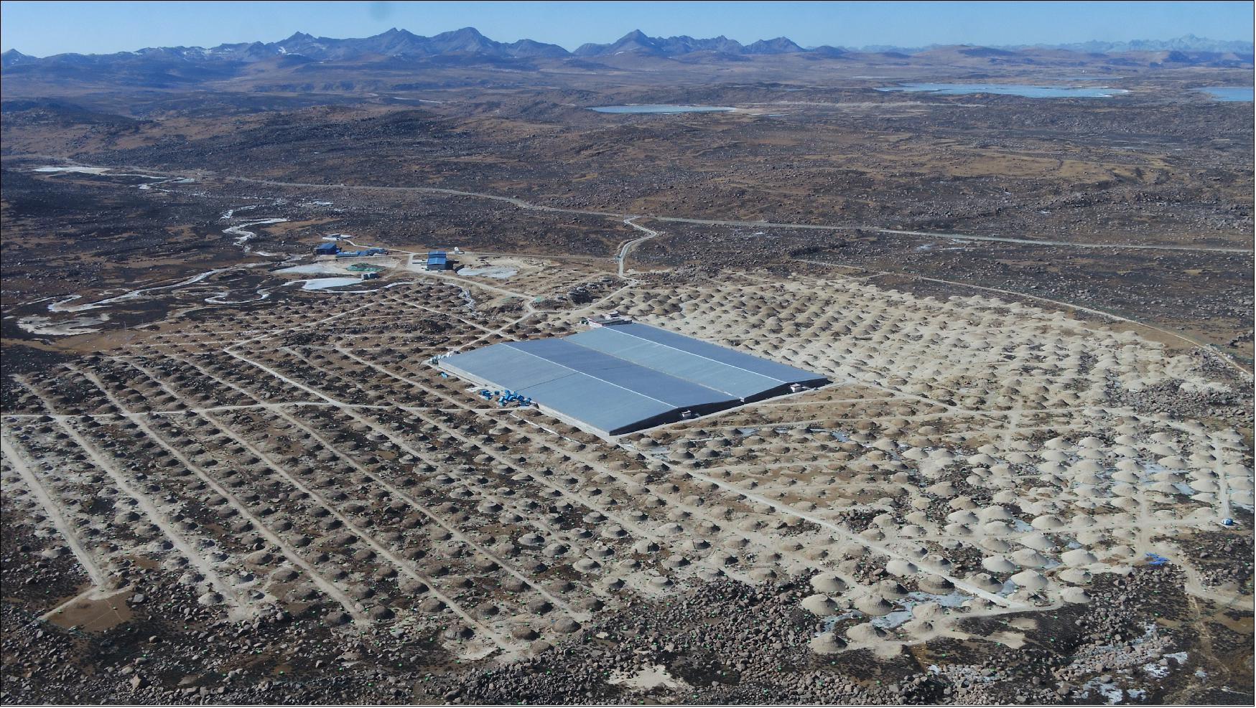
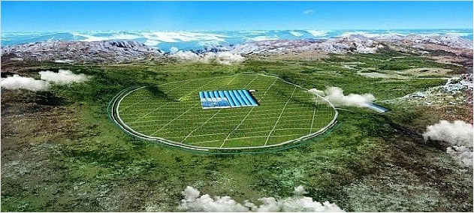
Near Future Plans of LHAASO
Array of 32 (+4) IACTs of 6m ø

Slide 20
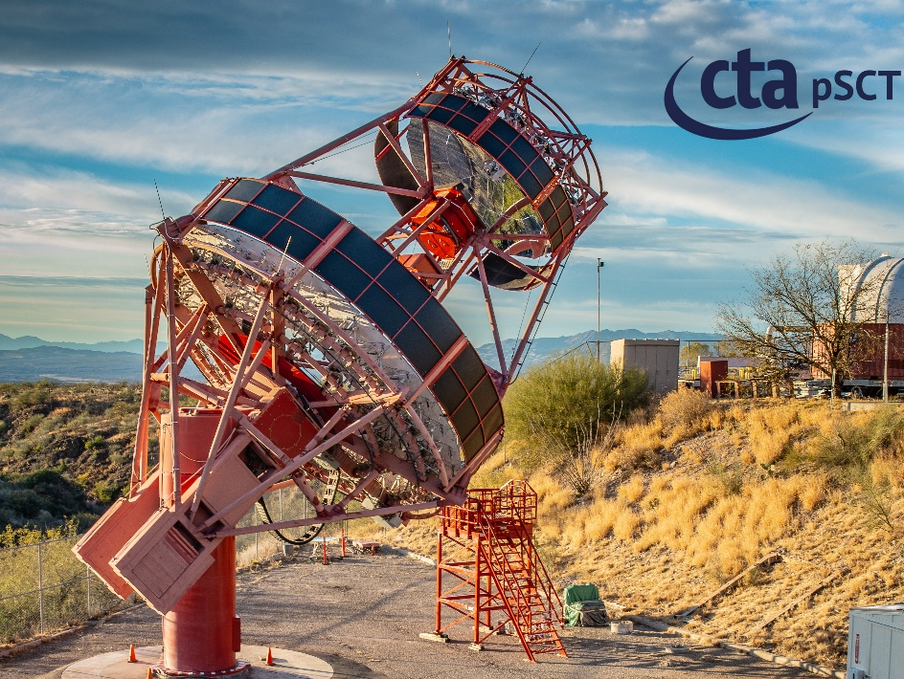
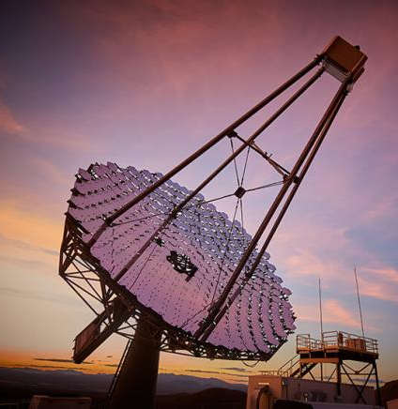
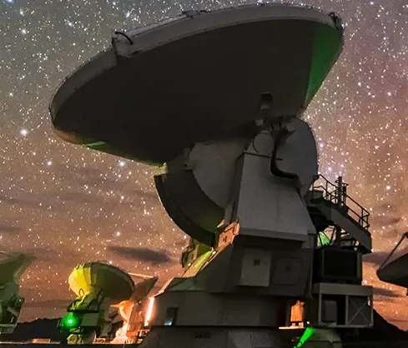
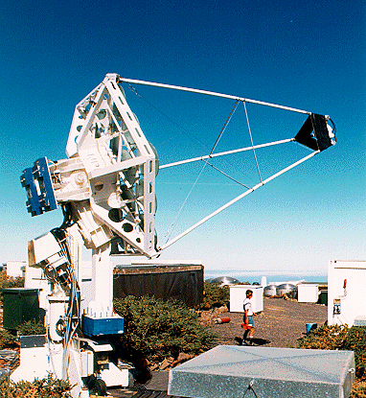
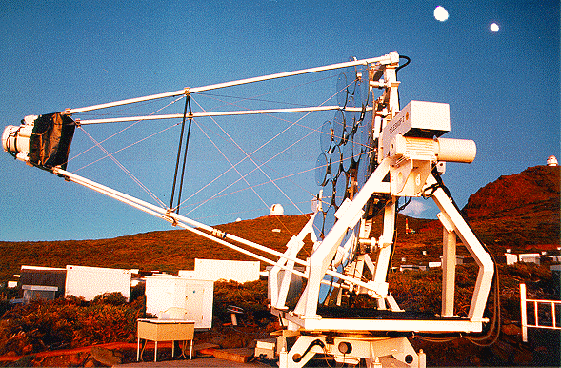
For an optimal weight of the telescope and for reduced counterweights it is important to properly choose the position of the elevation axis
The VERITAS, MST, ASTRI, LACT drive designs are compact but require use of large counterweights.

Slide 21
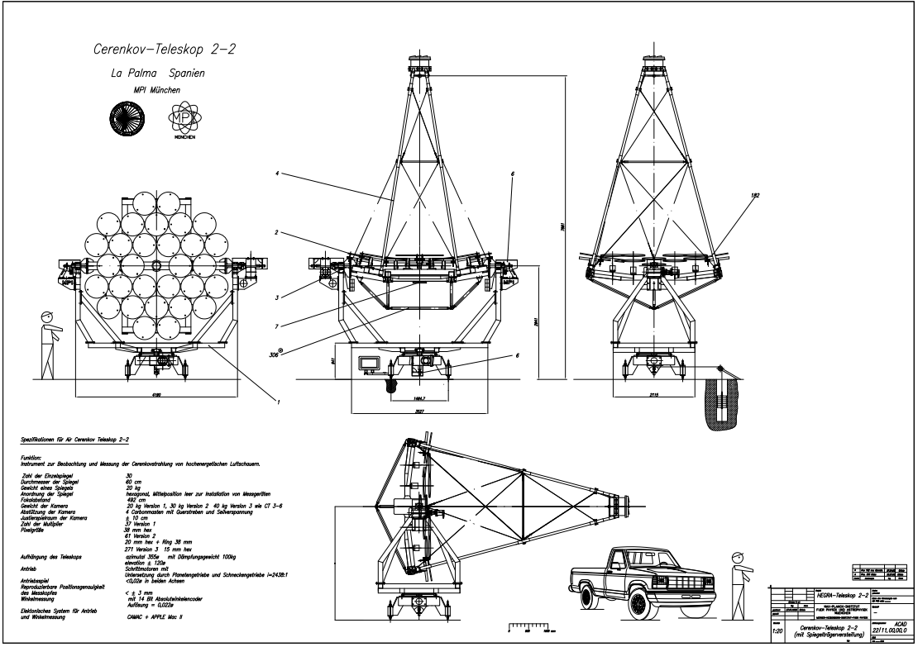
HEGRA telescopes had a lightweight design of weighing only ~2.2 T
HEGRA CT2-CT6
counterweight had a negligible weight.
This was possible by the proper choice of the horizontal rotation (elevation angle) axis.
It allowed to balance the reflector frame with the mirrors on the rear side by the camera and mast system in the front side (reflector played the role of the counterweight)

Slide 22
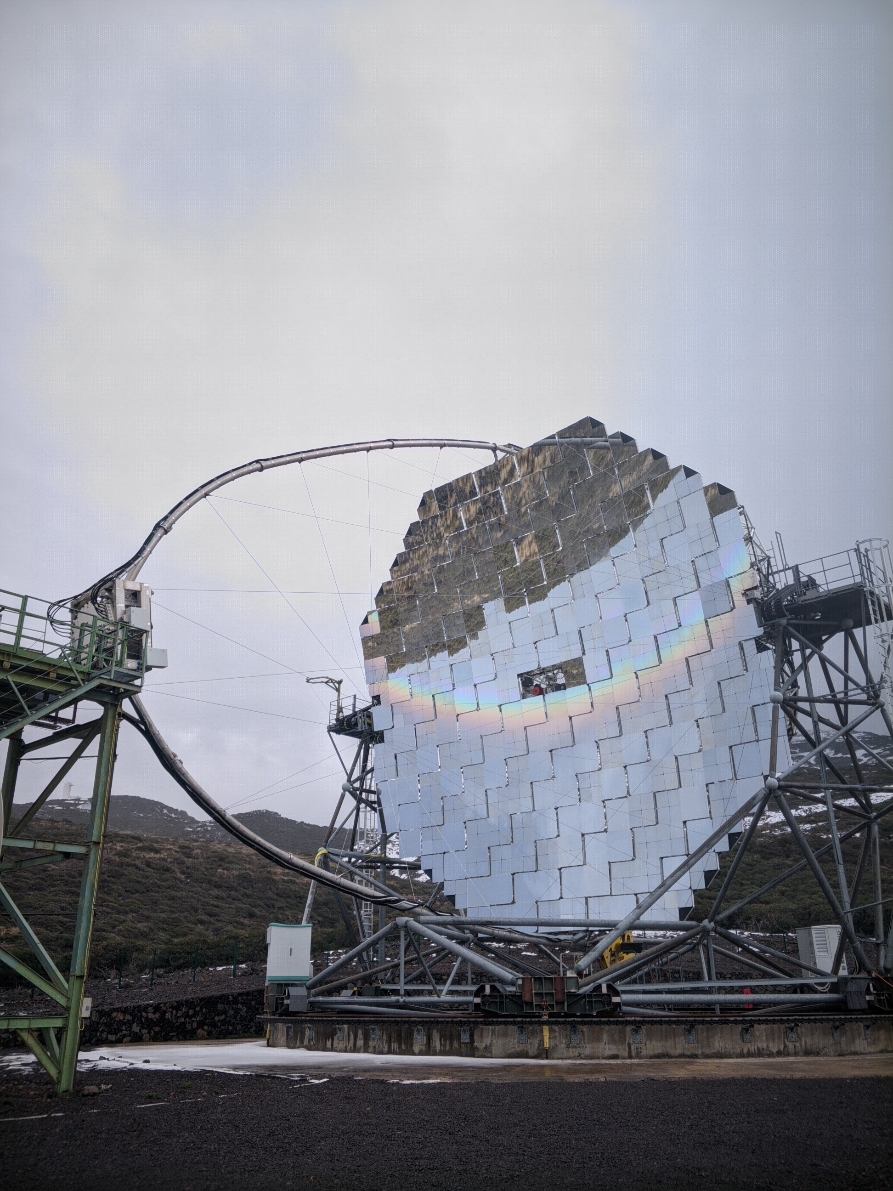
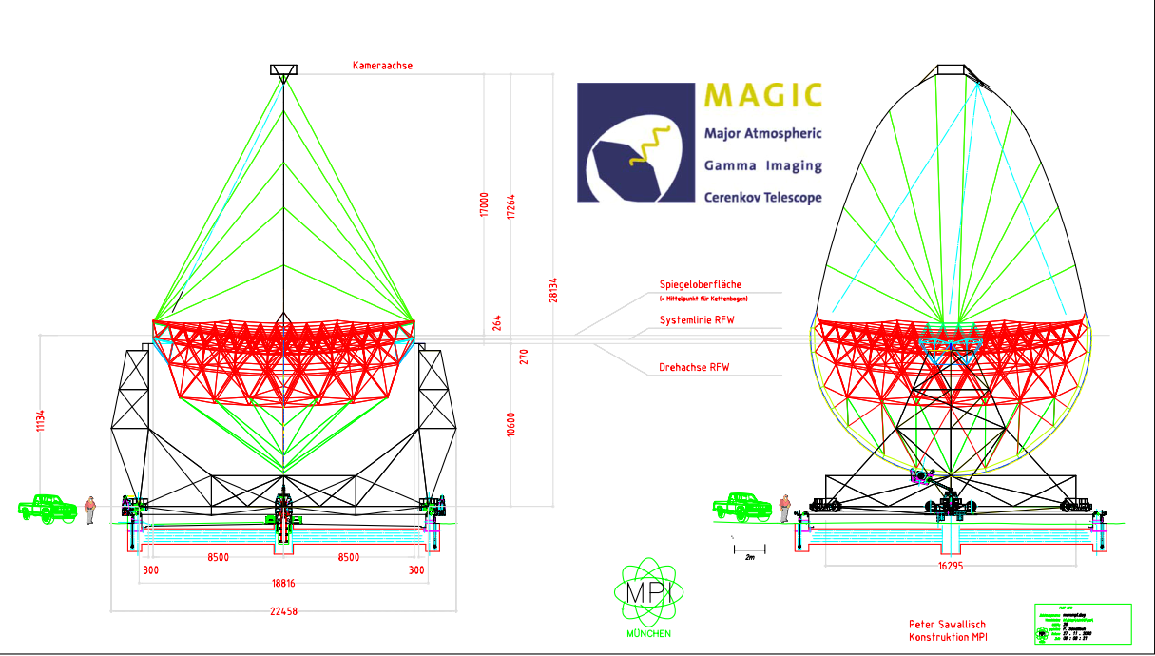
The counterweight of MAGICs is ≤ 2T
With increasing diameter of the telescope one can move to a design where the motion in the azmuth plane is provided either by a chain fixed to the rail system and motors with toothed wheels attached to the rotating structure of the telescope or by directly driving the wheels on the rail

Slide 23
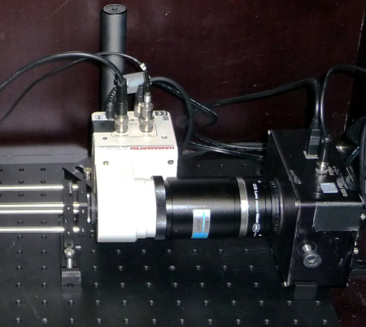
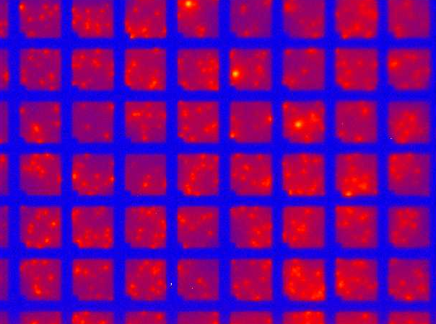
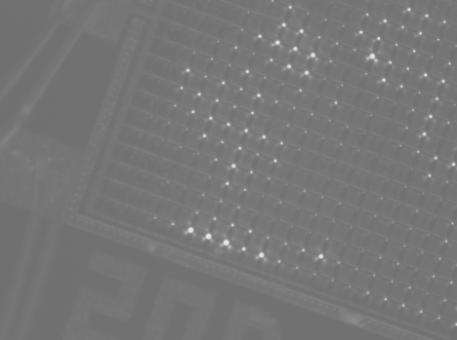
Light Emission Microscopy (LEM) is a powerful diagnostic method for SiPM sensors, revealing cell-substructures, defects and diverse hidden details – below I show part of our setup to measure light emission from different SiPM chips
Knötig, Hose, Mirzoyan, IEEE TNS 2014
Gated
Image
Intens.
CCD
Relay lense

Slide 24
SiPM Light emission spectrum
Amplitude spectrum from a SiPM & SiPM + mirror on
a short distance
Mirzoyan, Kosyra, Moser, 2009
Wavelength range | 450 – 1600 nm | < 1117 nm
This measurement | 3.86 x 10⁻⁵ ph/e | 1.69 x 10⁻⁵ ph/e
Lacaita, et al., 93 |  | 2.9 x 10⁻⁵ ph/e

Slide 25
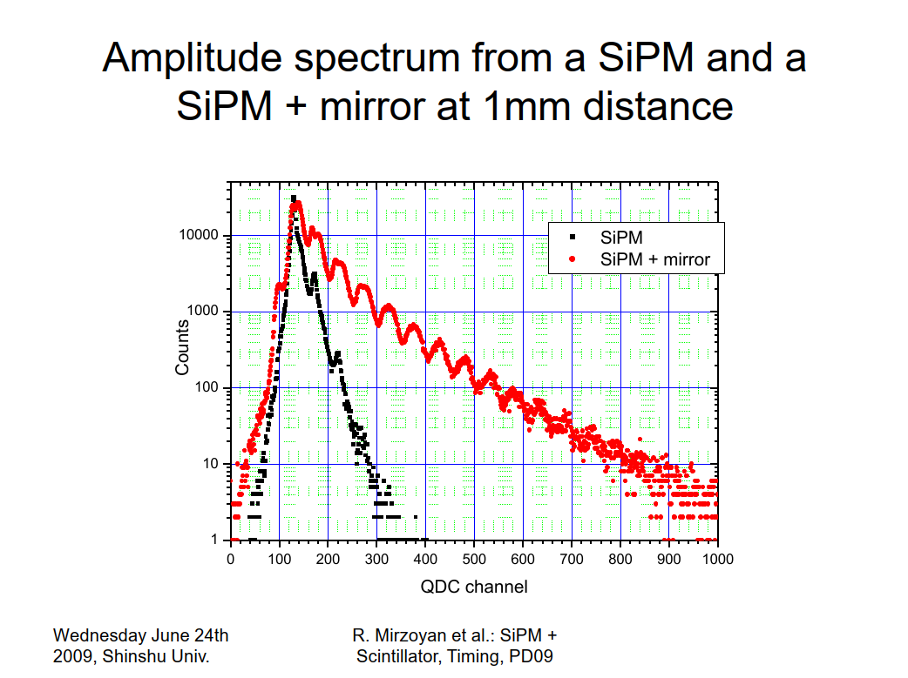
Mazzilo, et al., IEEE Sensors J. 17 (13) (2017); Hahn, Mirzoyan et al, 2024
I showed this study at the New Photon Detectors Conference-09 held in Shinshu University, Matsumoto, Japan, June 2009
The black curve shows the amplitude spectrum of a SiPM with strong suppression of X-talk
The red curve shows the spectrum when a small mirror was held a short distance in front of the SiPM: own emitted light is reflected back and triggers avalanches, thereby distorting the amplitude resolution and the spectrum.
This can happen when using a LoNS absorption filter in front of a SiPM.
If, for example, an interference filter with a passband of 300-550 nm is used, all other wavelengths outside that band are reflected with an efficiency of ~100%.
Light emission from SiPMs is mainly in the infrared; it is therefore unclear whether a filter is more beneficial or detrimental.

Slide 26
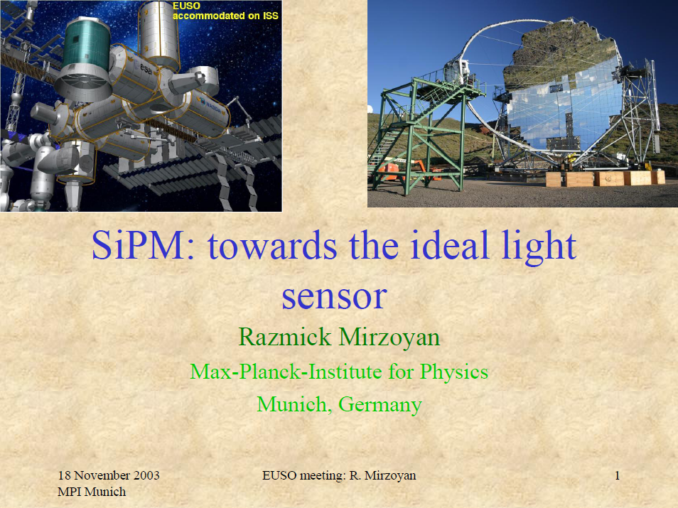
1st Mention of Using SiPM in Astro-Particle
Physics and Space Applications in 2003

Slide 27
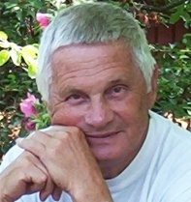
Silicon Photo Multiplier (SiPM)
I had the good fortune to collaborate with Prof. Boris Dolgoshein (one of the "fathers" of SiPMs) and his team at MEPhI from 2002 to 2010.
Multiple basic features of SiPM were developed during this time – already in 2011 we developed and demonstrated custom-made samples of SiPM with peak PDE of (50-60) % at a X-talk level of a 3-5 % (thanks to 4-fold X-talk suppression), T° sensitivity 0.5%/°C, see [Dolgoshein et al, 2012]
I was next to Boris Dolgoshein when he coined the term Silicon Photo Multiplier – SiPM
However, it took nearly 20 years for me to grasp the true significance of this. In practice, SiPMs are generally used as a kind of semiconductor-based alternative to conventional PMTs. As with PMTs, we typically amplify the output signals—which are in the millivolt range—subject them to discrimination, and finally use an ADC system to digitize the amplitude. Since the dimensions of an SiPM are far smaller than those of a PMT, multiple SiPMs must be employed to cover an area equivalent to that of the photocathode—a factor that can drive up costs.
Still one needs to calibrate the system by using some calibration method for deriving the number of measured ph.e.s

Slide 28
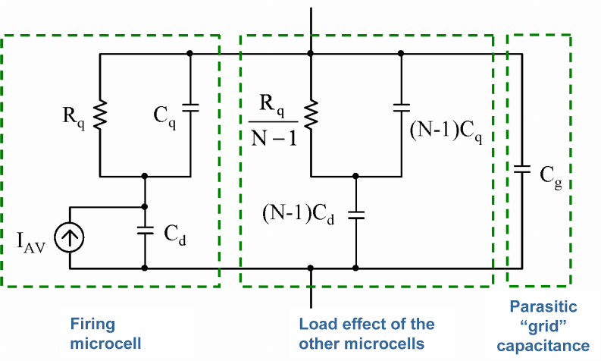
Silicon Photo Multiplier (SiPM)
The SiPM's inherent digital characteristic (a Geiger avalanche produces the same saturated amplitude—i.e., a digital "1") is lost "during translation" when the analog amplitude of avalanches are summed at the anode.
A single triggered SPAD is producing a relatively large amplitude of at least several hundreds of mV (for example, a 20 x 20 µm² SPAD will tipically produce an amplitude of 150-200 mV)
This means that there is no readout noise, as is the case with CMOS or CCD cameras, which makes the SPAD a noise-free device.

Slide 29
Use a plurality of SPADs to profit from their real digital feature
Imagine an array of individual SPADS closely laid out on a semiconductor chip
Each SPAD operates independent on others
When a (Geiger mode) avalanche happens, a SPAD produces a „digital 1“
An electronic scheme counts the number of fired SPADs, i.e. the number of detected photons
One needs no amplifier, no ADC, no X-talk of small amplitudes due to the electronic pick-up from closely-packed neighbouring readout channels
Hence from the very first moment going digital
Providing one can invent a very fast digital readout, this will be the „Non Plus Ultra“ light sensor of future – one can still improve the SPAD sensitivity (and eventually one may improve the counting speed of the electronics by moving from Si to „faster“ semiconductors)
These sensors can provide an incredible dynamic range
One can calculate the time of flight for every photon, images can provide accurate 3D information.
~10 ps time resoluton does not seem to be a fantastic feature, not anymore

Slide 30
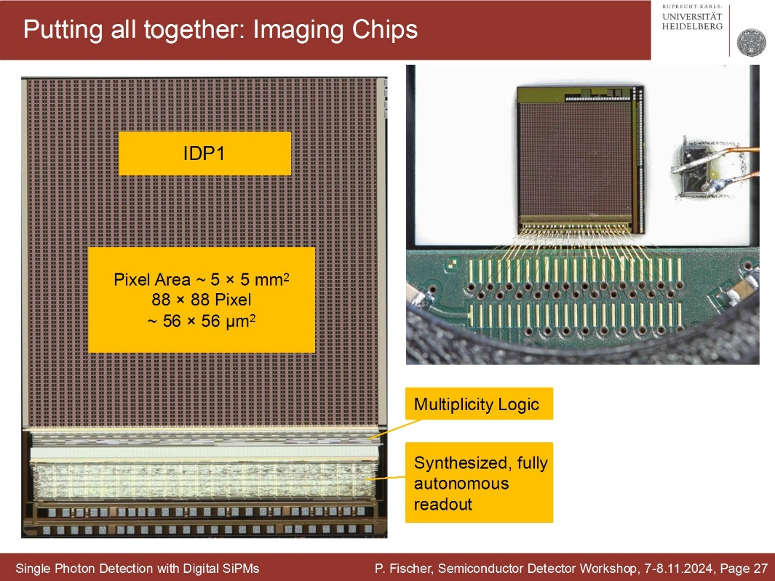
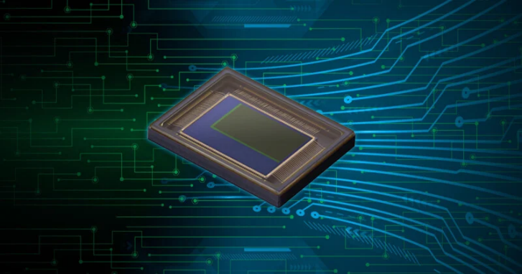
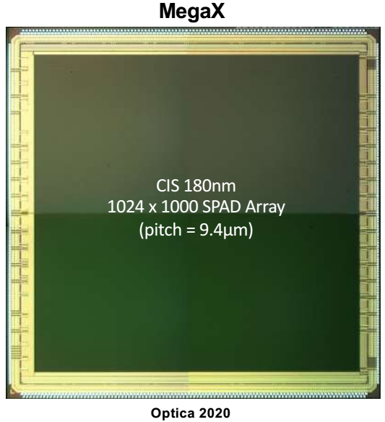
The SPAD arrays with different readout principles are being intensively developed by many groups worldwide, to name just a few
P. Fischer, U. Heidelberg, Semicond. Det. Work.
Multiple developments from
Edoardo Charbon, SPAD Array,
Swiss CTA Day, 2020
SPAD matrix from Canon

Slide 31
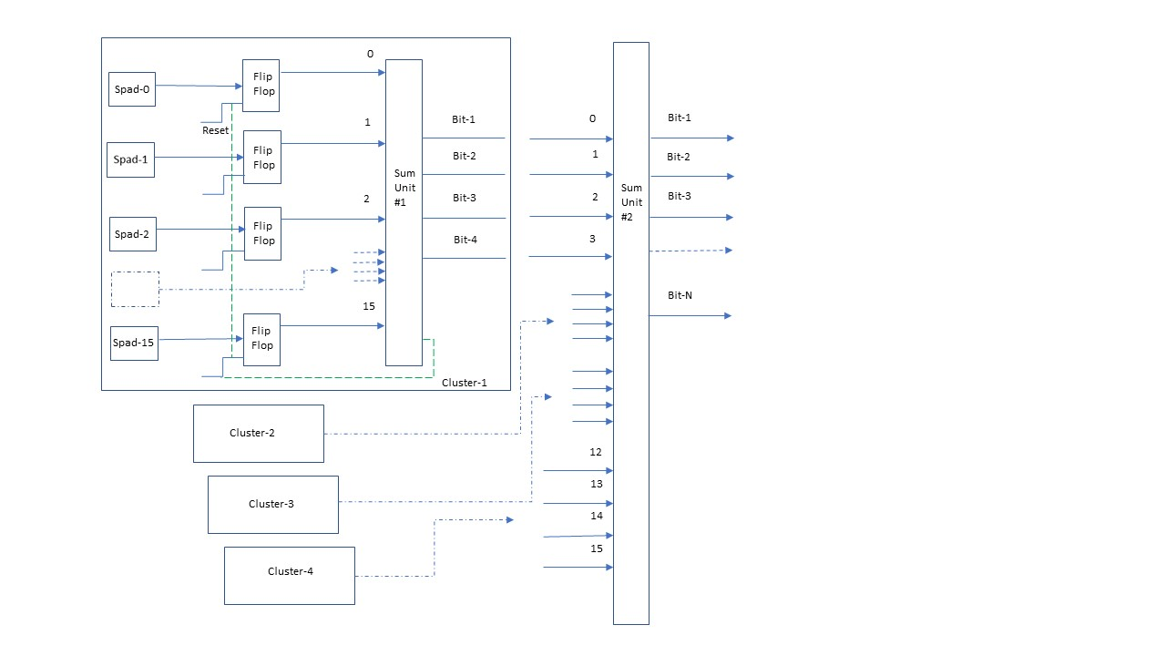
One may ask: and what the novelty is? These have been under development in many labs and for a long time
What's new is that we've also joined the "club" - we think that we have an interesting idea for how to readout a SPAD array very quickly and efficiently.
We started developing an ASIC, initially a simple one, just for counting signals from a small matrix of SPADs, see a toy model-principle of summing up the signals

Slide 32

The SPAD arrays with different readout principles are being intensively developed by many groups worldwide
We are hoping that the matching matrix of SPADs could be developed by
the Semiconductor Institute of the Max-Planck Society (former HLL lab), who would integrate the ASIC with the sensor array
Of course, as all the good things, also these will take time
Meanwhile, wonderful sensor developments are taking place elsewhere, from which our entire community (and far beyond) benefits.
I am afraid that these could soon send the SiPM into “retirement” :-)

Slide 33
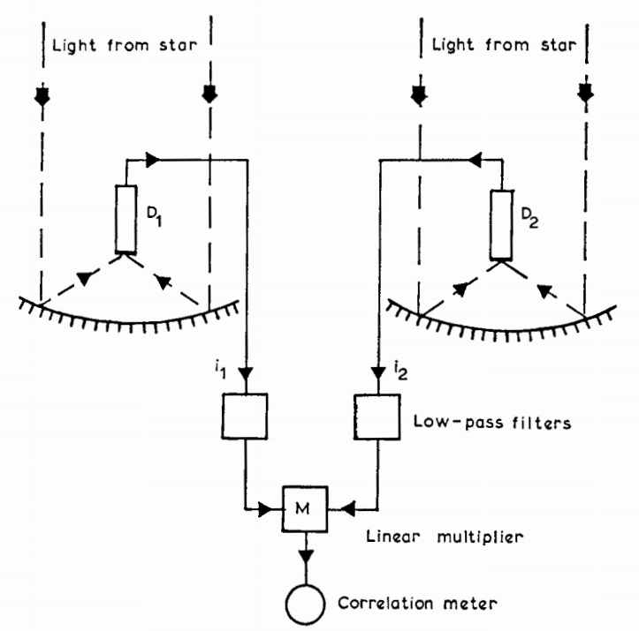
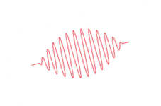
Intensity Interferometer
Light from a star is collected on two separated photo-detectors, D1, D2 and produces currents I₁, I₂.
These currents fluctuate and we may assume that these are partially correlated.
The main component of the fluctuations is the classical shot (random, Poissonian) noise, which is not correlated.
There is an additional smaller component, called wave noise, which corresponds to the fluctuations in the intensity of the light wave. One can think of this as the envelope of the light wave rectified by the photo-detector

Slide 34
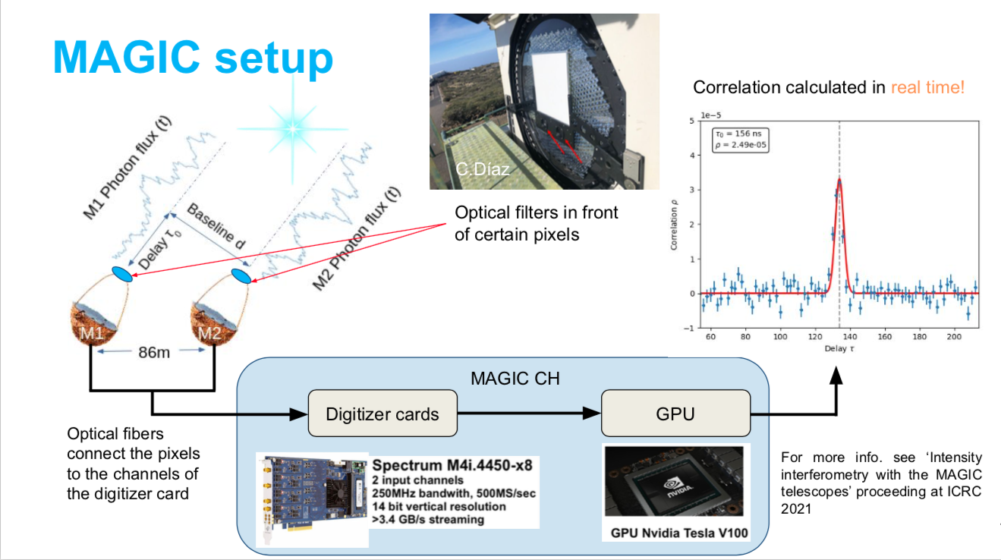
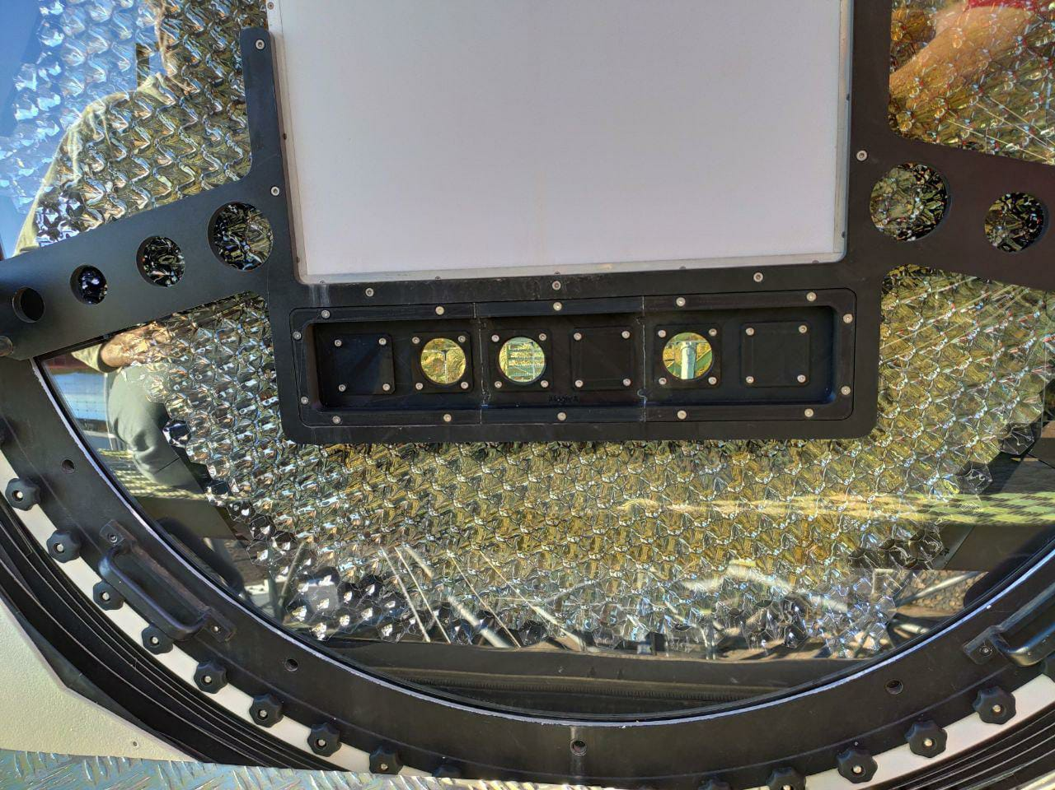
MAGIC interferometry setup

Slide 35
The Sensitivity of an Intensity Interferometer
Angular resolution ∝ 1/d
d-is the baseline
Sensitivity ∝ S_{mirror} ∙ QE_{pixel} ∙ F_{pixel}⁻¹ ∙ N_{telescopes} ∙ √Bandwidth ∙
Mirror area
Quantum efficiency of photodetector
1/ sqrt(Photodetector Time resolution)
Number of telescopes

Slide 36


And a few words on the heterodyne SII
Heterodyne interferometry shines a laser signal into a photo sensor and down-converts optical-frequency oscillations at (n x 10¹⁴) Hz into signals in the GHz (10⁹ Hz) domain, where mature detection and processing technologies from the technique of radio telescopes exist.
Using the periodic spectrum of the frequency comb (Nobel Prize 2005), one can split the electromagnetic spectrum into narrow measuring channels, each with its own local oscillator.
The sensitivity of the heterodyne technique will be proportional to the square root from the number of channels; it is estimated to be by one order of magnitude better compared to “conventional” SII, approaching objects of 15th magnitude with modest size telescopes.
A laser frequency comb
Photonic Integrated Circuit (PIC)

Slide 37
Interesting questions
Does it make sense to design the future IACTs so that they can also serve as telescopes for intentisty interferometry?
This will require to seriously improve the optics of IACTs for achieving a tiny PSF (< 1mm), at least in the center of the field of view
The role of LoNS integration on top of the signal will be further reduced
The time resolution of the telescope will become ~ 10 – 20 ps; does it have the promise to significantly improve the background suppression power of an IACT ?
Given a time resolution of ~10 ps one can „trace the motion of photons“, i.e. one can obtain a full 3D picture of impinging photons

Slide 38


Observations of strongly inclined EAS with IACT systems open a range of possibilities for cosmic-ray background-free γ-ray astronomy above 100 TeV and provide a possibility for the measurement of composition of the cosmic-ray flux in the energy range up to UHECR. This is due to the fact that a sizable fraction of light is due to very high number of muons (a distinct halo or tail component of the EAS image). This is well distinguishable from the electromagnetic component of the image.
Such observations could suppress hadron initiated EAS with an efficiency of ~10⁵, while discarding only a tiny fraction (approximately ≲10⁻³) of γ-rays (or alternatively, one can select those hadrons)
A wide-angle IACT should sample the EAS on a timescale of 0.1–1 μs when deployed for zenith angles between 70° and 90° (this is in contrast to the conventionally used timescale of 1–10 ns).

Slide 39
Conclusions: the prospects are simply great
4 LSTs will be inaugurated in October 2026 in La Palma. Commissioning will probably take another 1.5 – 2 years time
Number of 9 (+1) ASTRI telescopes are already taking coincident data
9 Middle Size Telescopes are supposed to come to La Palma
14 MSTs will go to Chili, the CTA South location near 4xVLT and ELT telescopes
2 LSTs will be installed in the CTAO South location, likely in 2027
37 (+5) SSTs are planned for the Southern location
The 32 (+4) LACTs will make LHAASO the a versatile instrument for studying the Universe in gamma and cosmic rays in a very wide energy range
SWGO site is selected and the construction underway in the south

Slide 40
Backup

Slide 41
The first, Non-Imaging Generation of Atmospheric Cherenkov Telescopes
The first generation experiments were based on counting the number of excess events from the ON source and selected OFF source regions. Fluctuations of Light of Night Sky (LoNS) have direct impact on photo sensor signals in telescopes. The instantaneous positive fluctuation of LoNS can add up with a genuine weak signal from a given shower and produce a trigger. It is natural that the ON- and selected OFF-source regions in the sky will have different LoNS intensity. These differences can cause a positive or negative excess in a counting rate experiment. Researchers learned to counteract differences in brightness in the ON and OFF regions by setting a weak light source as for example, a miniature light bulb, near the input window of a PMT and built an electronic circuit to keep constant the sum light from the “bulb plus LoNS” system (Chudakov, et al., 1964).
But whether the achieved accuracy was sufficient for long-term observations is another question. It should be kept in mind that those telescopes did not produce images, so it was not trivial to verify off-line the results of performed observations. The researchers understood the underlying problems and improved the technique. That paved the way for the next generation of telescopes.

Slide 42
Short Summary of the 1st Generation Atmospheric Cherenkov Telescopes
Many first generation telescopes occasionally reported "signals" measured from a number of sources, even from pulsars. It can be assumed that sometimes some then unknown light phenomena in the upper layers of the atmosphere could cause a short-term sporadic excess. But in the case of pulsars, the likely cause was incorrect statistical and systematic data processing (see, for example, (Grindlay, 1972)). Later it became clear that those reports did not stand up to serious scrutiny. This can be understood when one considers the strong desire of small, enthusiastic groups of researchers to reinterpret small, minor, and/or sporadic excesses in observations as indicating the desired signal from sources.
By then, the unspoken rule of "fashion" encouraged researchers to report source discoveries at conferences. By the end of the 1980s, the number of such source reports reached its apogee (see (Chadwick, McComb and Turver, 1990)).
The impact of these vague reports from the early days proved important, as they underlined interest in the discipline and belief in the bright future of ground-based gamma-ray astronomy.

Slide 43
2nd Generation, Imaging Atmospheric Cherenkov Telescopes (IACT)
In 1967, Giovanni Fazio and colleagues began construction of a 10 m diameter, F/0.7 telescope on Mount Hopkins at the Whipple Observatory (2300 m a.s.l.) (Fazio, et al., 1968a). As one can imagine, the large telescope provided a relatively low detection threshold for EAS. It began operating in 1968, at first with a single 5" PMT in focus, but later the number of PMTs was gradually increased to two and then to ten. These enabled simultaneous ON-source and OFF-source observations. In 1968, Fazio together with colleagues, including young Trevor Weekes, published a paper on the observations of 13 candidate gamma-ray sources. The Crab Nebula was prominently in the paper, along with M87, M82, IC443 (Fazio, et al., 1968b). Flux limits above the ~2 TeV threshold have been reported. Today we know that the listed candidates are very interesting sources of gamma-rays.
Michael Hillas proposed at the ICRC in La Jolla in 1985 to parameterize the focal plane images by using the seconds moments of the measured charge distribution (Hillas, 1985). This turned out to be a real milestone in the development of the technique. Using this formalism, the Whipple team published in 1989 the result of the famous 9s signal from the Crab Nebula (Weekes, et al., 1989).
This is considered as the birthday of the ground-based VHE gamma-ray astrophysics.
The scientific intuition and perseverance of Trevor Weekes and the small team around him paid off after about 20 years of effort and spawned a new branch of science.

Slide 44
3rd Generation IACTs
The 3rd generation telescopes were designed before the potential of the second generation telescopes was fully exploited. Already in 1995 the first presentations on the concept of a 17m diameter IACT were made (Bradbury, et al., 1995),(Lorenz, et al., 1995). These were followed by the VERITAS letter of intent in fall 1996 and in the next year by H.E.S.S. Both VERITAS and H.E.S.S. were following the goal of doing astrophysics with a stereo system of 10 m diameter telescopes, based on well-known, proven technologies. These were well-known thanks to the Whipple and HEGRA telescopes. Instead, the design of MAGIC was aimed at measuring in the energy range below 100 GeV, down to 20-30 GeV, in "terra incognita". The latter task was more demanding and challenging, several novel techniques and technologies were necessary for making it possible.
When HEGRA ceased operation in 2002, the collaboration split into two parts. One part together with the scientists from Germany and France, formed the core H.E.S.S. and built their instrument in Namibia. The other part stayed in La Palma; the scientists from Germany, Spain and Italy founded the MAGIC collaboration.
The Veritas, H.E.S.S. and MAGIC telescopes have literally revolutionized astrophysics and made TeV measurements indispensable for the assessment and interpretation of the astrophysical sources. A large number of different types of sources have been discovered and studied in minute detail that it is impossible to give a compact description. The interested reader is advised to visit the (TeVCat) catalog.

Slide 45
4th Generation IACT arrays
The seven workshops “Towards a Major Atmospheric Cherenkov Detector”, along with the first similar workshop that took place in 1989 in Crimea, former USSR (this could be considered as the workshop number “0”), and the last one in Palaiseau (France) in 2005, served their purpose. In 2006 the researchers decided to unify the efforts of the entire community for building one major instrument, dubbed as CTA (Cherenkov Telescope Array). Today it counts over ~1500 researchers worldwide, working with the Atmospheric Cherenkov Technique. Advanced prototypes of the CTA telescopes were manufactured and tested, allowing the transition to the construction phase. Originally about 100 telescopes of 23m (Large Size Telescope - LST), 12m (Middle Size Telescope – MST) and 4m (Small Size Telescope – SST) sizes were planned to be built in the southern and northern observatories, covering the energy range from 10 GeV to more than 100 TeV (Acciari, et al., 2013), (The CTA Consortium, 2017). This is going to be the major ground-based instrument for doing astrophysics by means of gamma rays for the next few decades.

