Slide 1
CTAO: The Upcoming VHE γ-ray Observatory
Dr. David Green, CTAO Deputy Project Scientist
Prof. Michele Doro, CTAO Deputy Project Scientist (on loan from U Padova)
Dr. Ivana Batkovic, Coordinator of the Gamma-Ray Joint Centre of Expertise
Dr. Roberta Zanin, CTAO Project Scientist

Slide 2
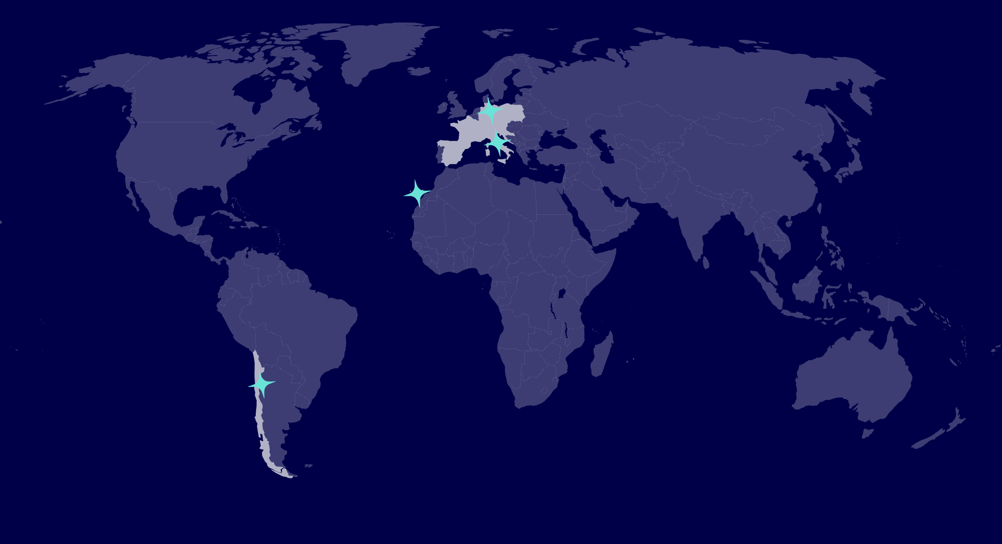
What is CTAO?
Beyond Telescopes
A facility with 4 sites
  Headquarters in Bologna (IT)
  Science data Management Centre in Zeuthen (DE)
  2 Observation Stations
CTAO is an ERIC (European Research and Innovation Consortium)
Funded by 9 EU member states, Switzerland, ESO, and Japan
  Australia, Brazil and USA are in talks
    Acting as contributing parties
CTAO Northern Array
4 LSTs
9 MSTs
CTAO Southern Array
14 MSTs
37 SSTs

Slide 3
A Proposal Driven Observatory
Bulk Archive
Temporary Storage
Science Archive
All science proposals will be evaluated by the CTAO Time Allocation Committee (TAC) purely on scientific merit
Science Ready data is processed and delivered to PI within one month after observations
Data will have a proprietary period of 1 year after the last observation in an Observing Period
  After which the data will be public
Observatory lifetime is is 30 years
SUSS
DPPS
ACADA
Off-site ICT
On-Site ICT & Clock
CTAO Northern Array
4 LSTs
9 MSTs
SOSS

Slide 4
A Proposal Driven Observatory
Integrated over 10 Years
AO (Announcement of Opportunity) Calls regularly issued
  Occurs once every observing period (13 lunar cycles ~1 year)
  To request Open Time and most of the Host Guaranteed time
  Issued by CTAO several months before the observing period begins on the CTAO Science Portal
8% of time is for any scientist either through DDT or ICOT
HGT = Host Guarantee Time (CCI, Spain, Chile, ESO)
DDT = Director’s Discretionary Time
KSP = Key Science Projects Time
ICOT = International Community Open Time
For Illustration Purposes Only
Available Observing Time
Observing Time Category
KSP time
Observing Periods

Slide 5
Key Science Projects
Large and Long Proposals
Key Science Projects (KSPs) are observing projects requiring more than 300 hours of CTAO observing time allocated over more than one observing period with the aim of delivering legacy datasets, science data products and gamma-ray catalogues, which are produced in a coherent fashion, on key science cases promising major breakthroughs
Systematic Analysis
Well defined research case
Scientific Comm.
Dedicated KSP call to submit KSP proposals
Must be submitted through the CTAO Science Collaboration
  Up to 10% of external scientists for each KSP proposal

Slide 6
Key Science Projects
KSP Proposal
Science Objective #1
Science Objective #2
Science Objective #3
Science Objective #N
Team Expertise
Team Expertise
Team Expertise
Team Expertise
Scientific Comm.
KSP Proposals are made up of several Science Objectives
Each having their own team PIs and experts

Slide 7
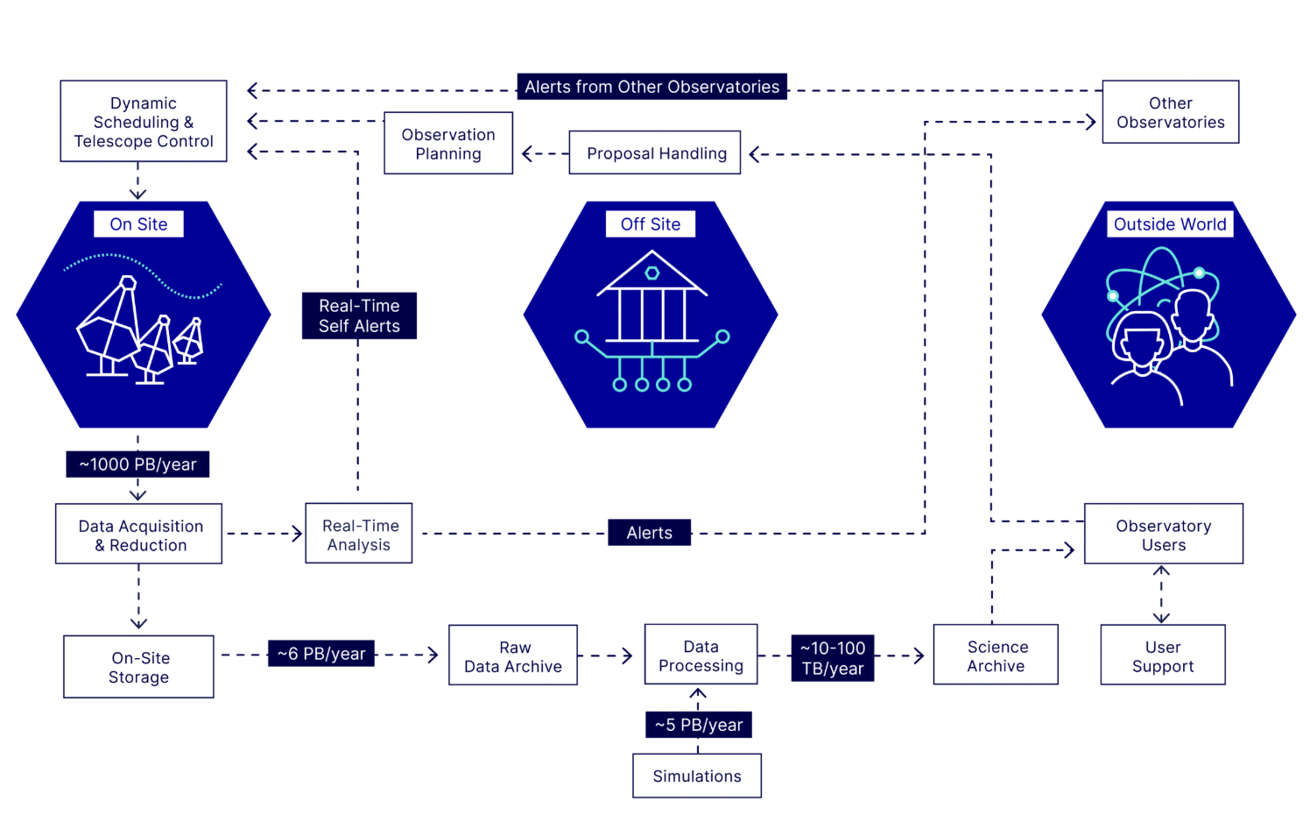
A Cornerstone of MM/MWL Astronomy
CTAO will have dynamic scheduling and fast repointing (30 seconds) via the LSTs
Automatic and manual alert generation configurable via proposals
Building Transient Handlers to use all types of external alerts:
  Neutrinos, optical, x-rays, radio, other gamma-ray instruments
Internal Alerts
  Self triggers from monitoring of sources
  Serendipitous discoveries
External Alerts (<50s)
Real-time Analysis
Internal Alerts (30s)

Slide 8
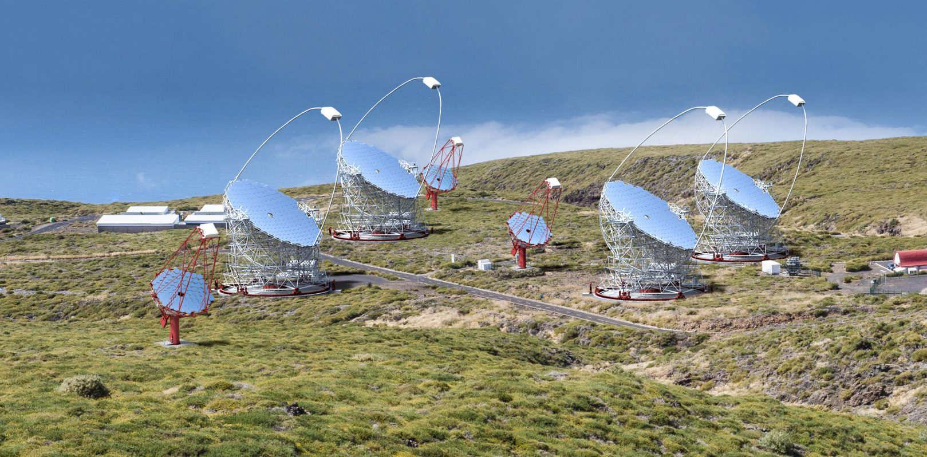
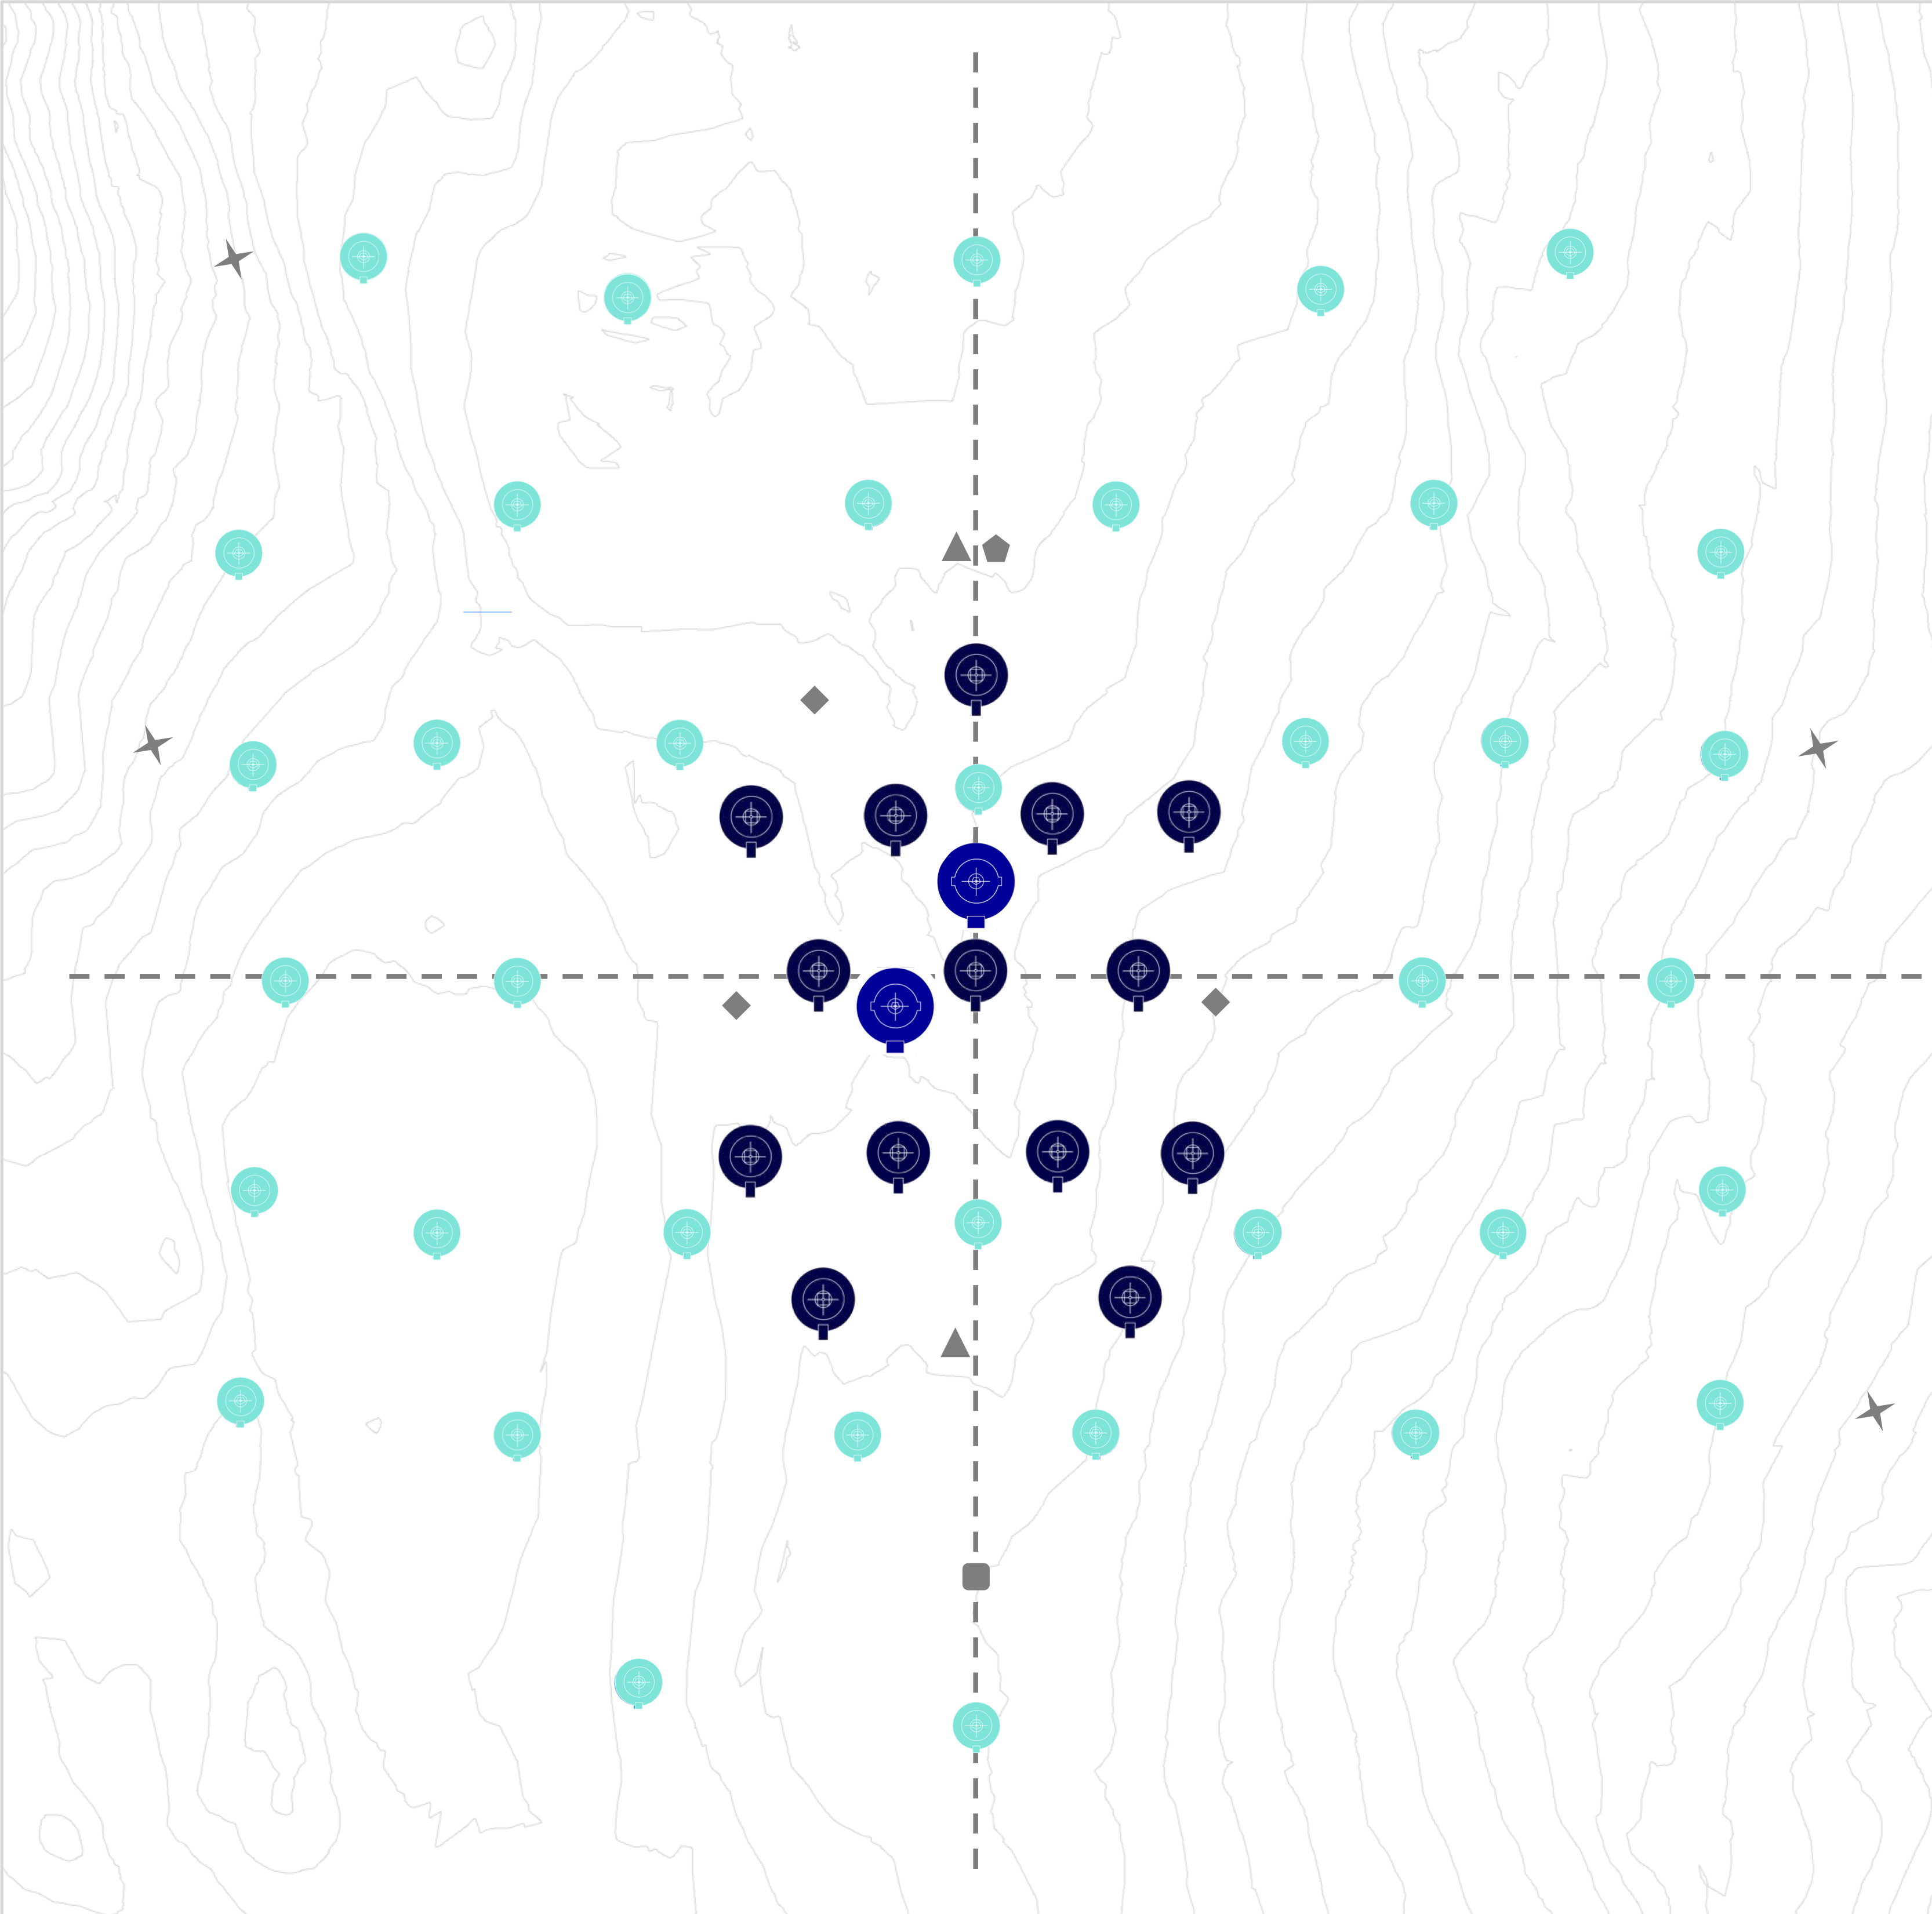
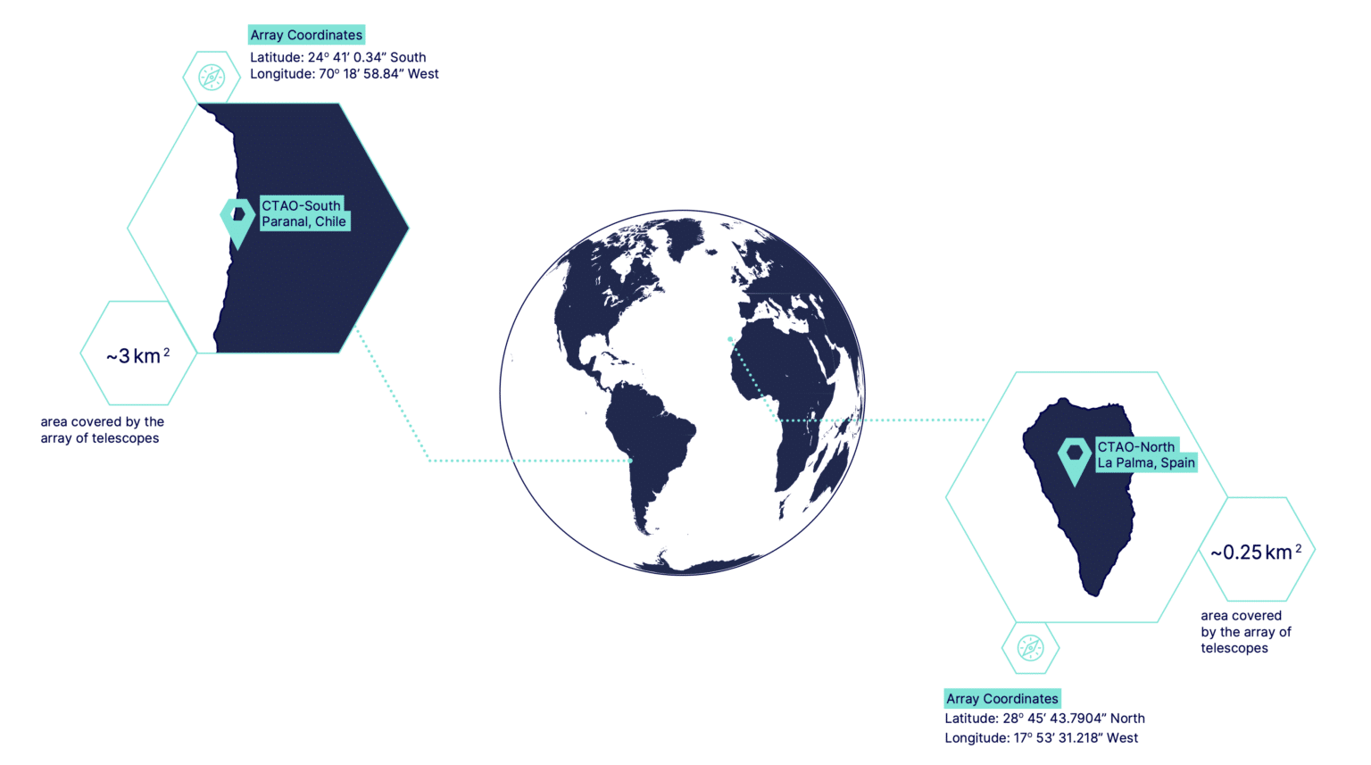
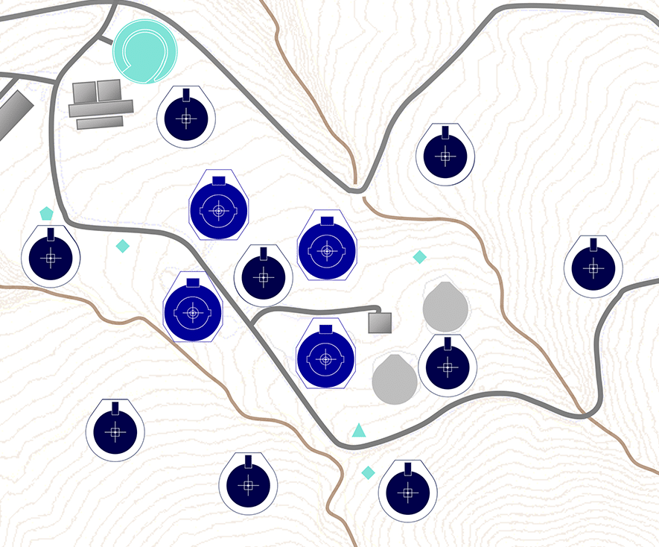
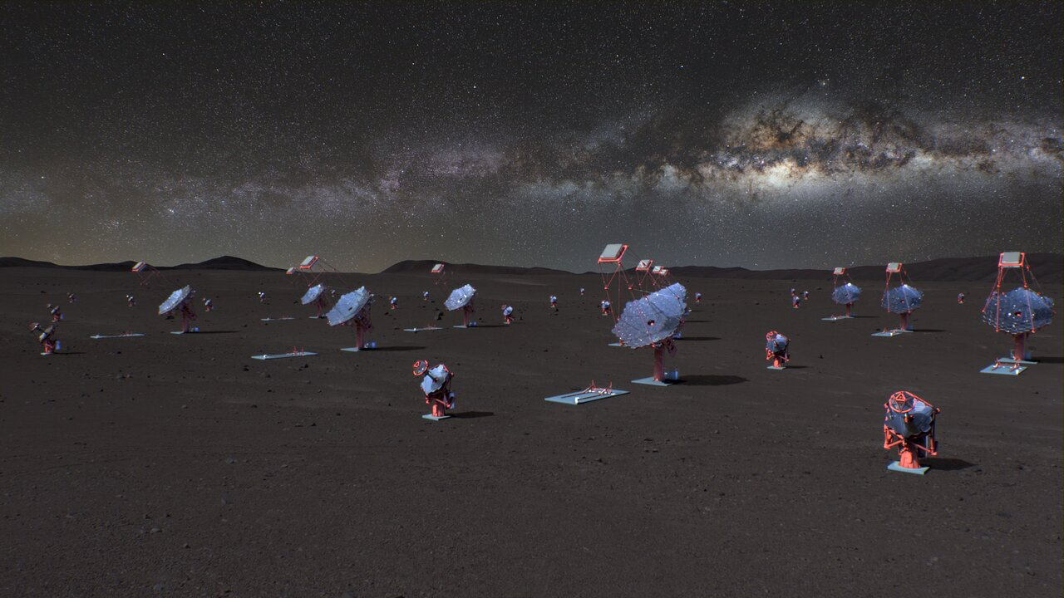
One Observatory, Two Stations
Beta Configuration
CTAO Northern Array
4 LSTs
9 MSTs
CTAO Southern Array
14 MSTs
37 SSTs

Slide 9
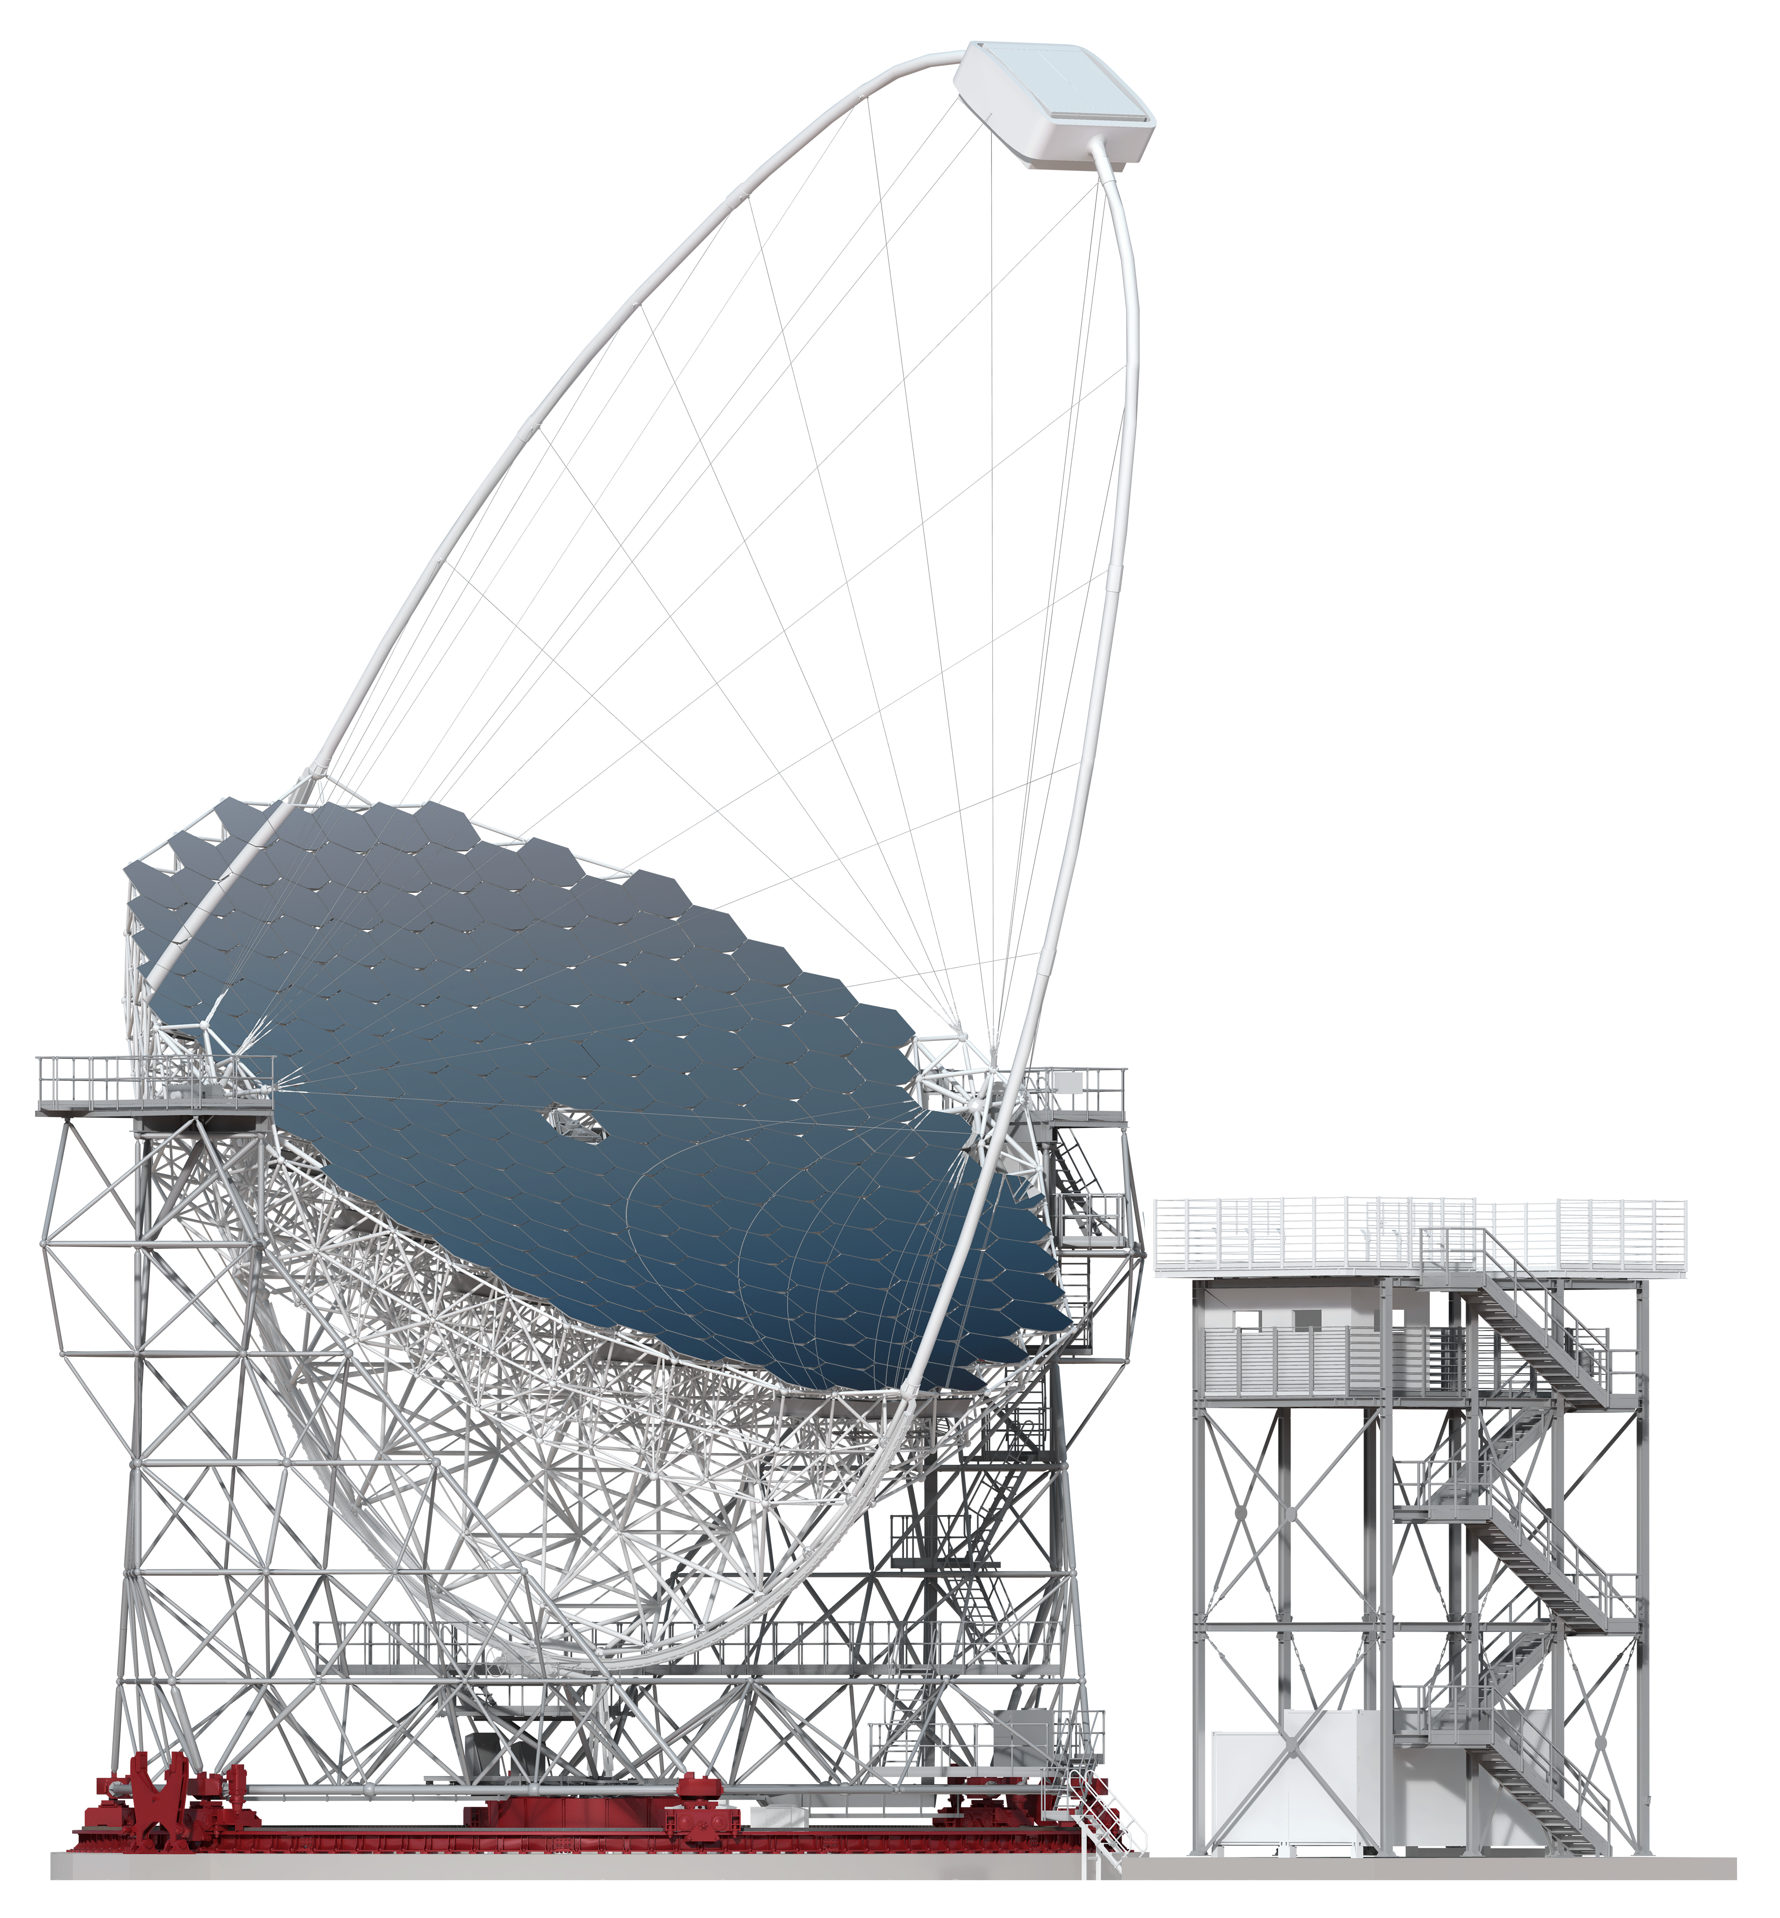
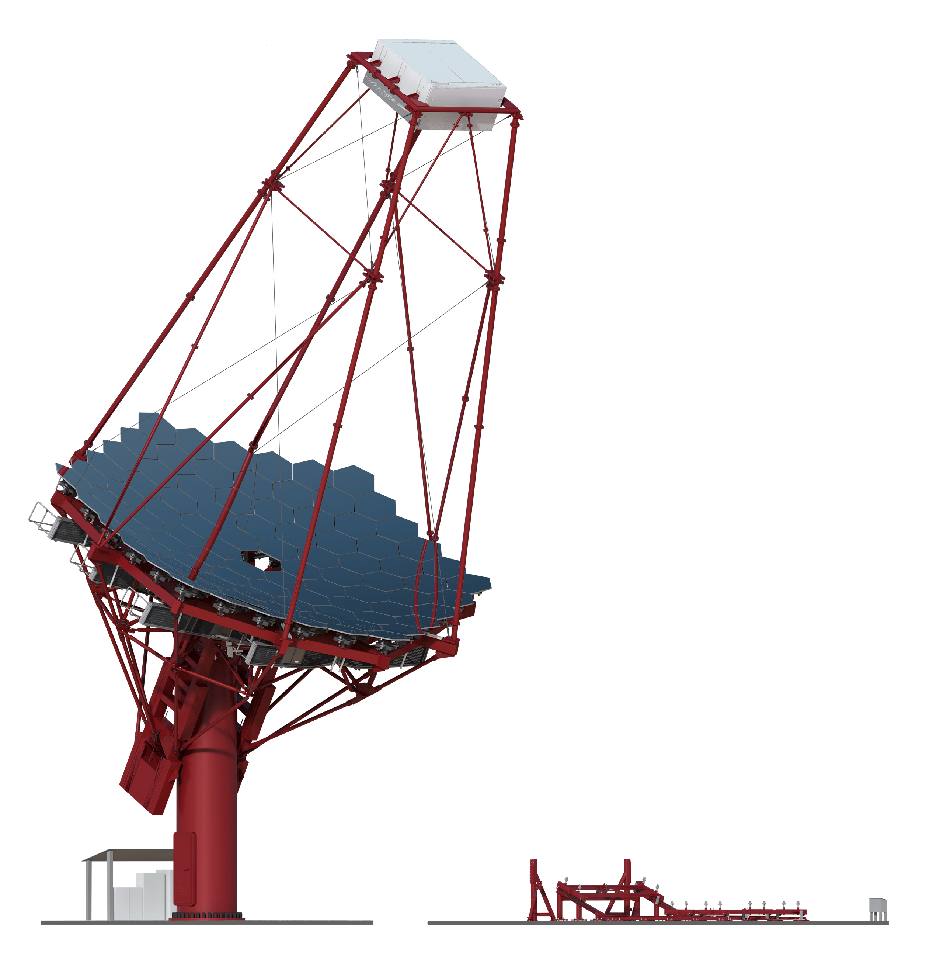
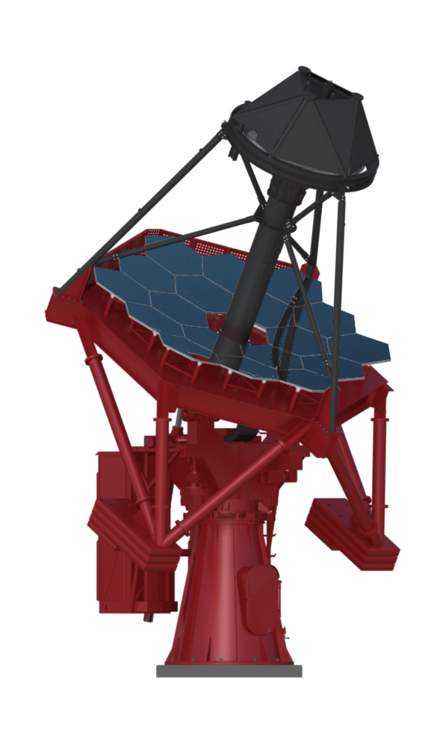
Telescopes
Large-Sized Telescopes:
- 4 North
- 2 South
- 4.5° FoV
- 20 GeV – 3 TeV
Medium-Sized Telescopes:
- 9 North
- 14 South
- 8° FoV
- 80 GeV – 50 TeV
Small-Sized Telescopes:
- 37 South
- 9.6° FoV
- 2 TeV – 300 TeV

Slide 10
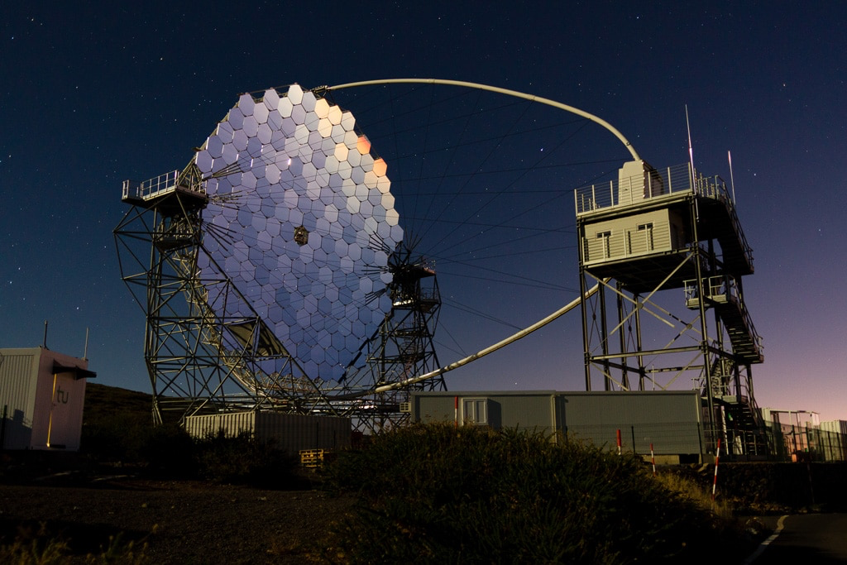
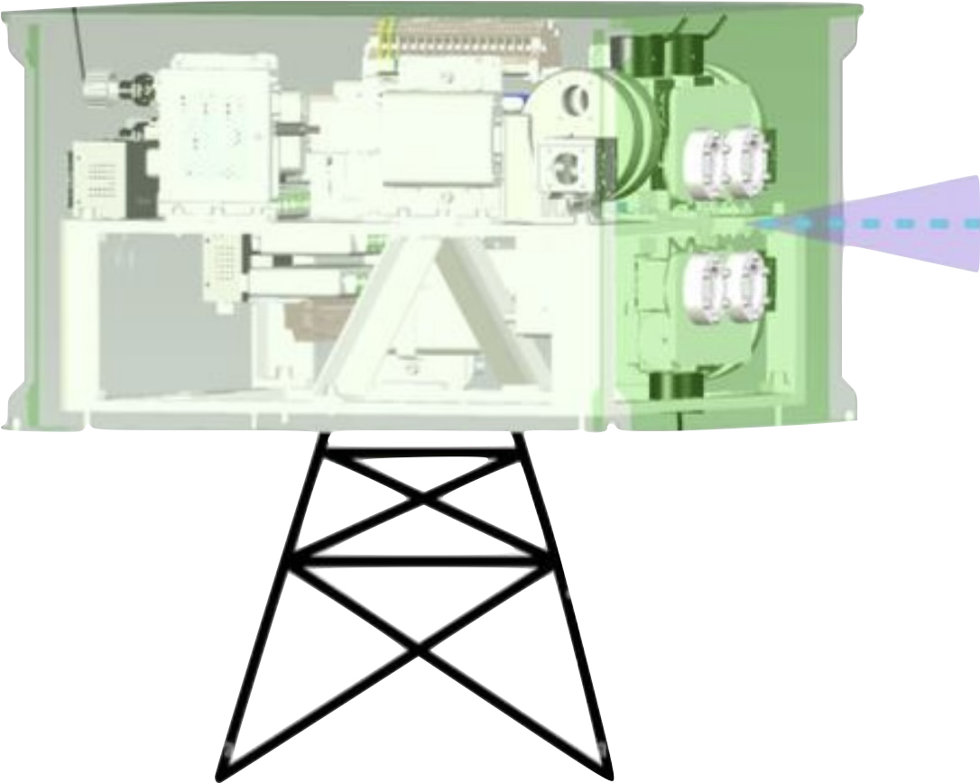
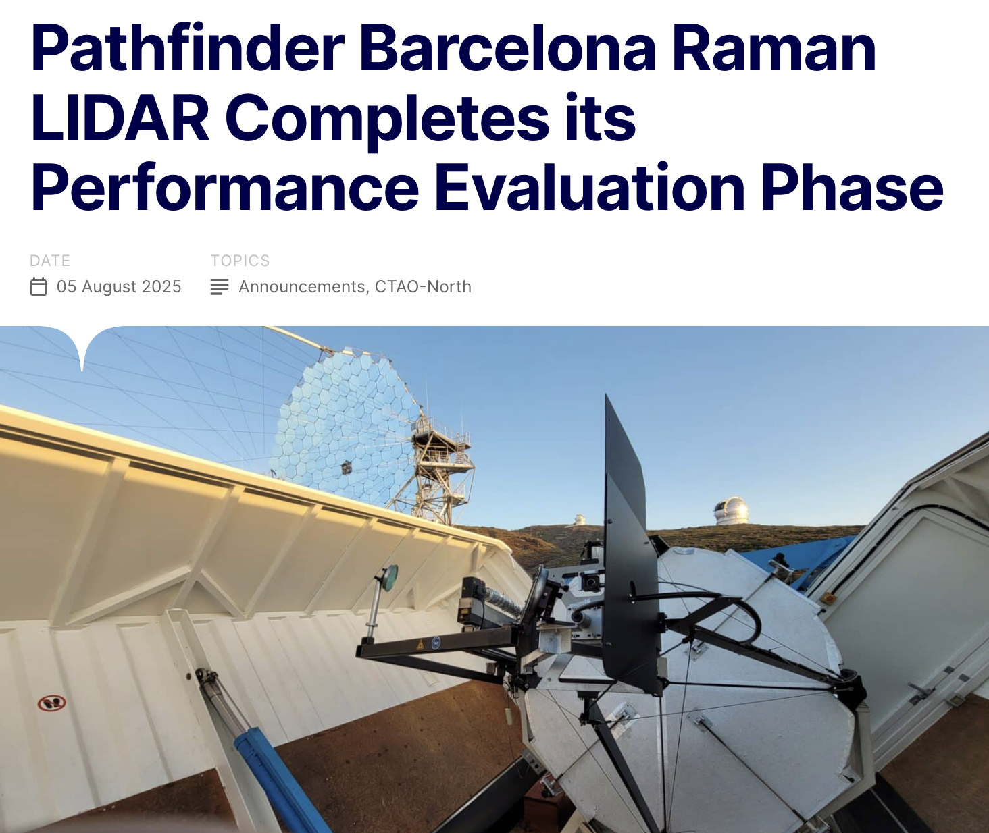
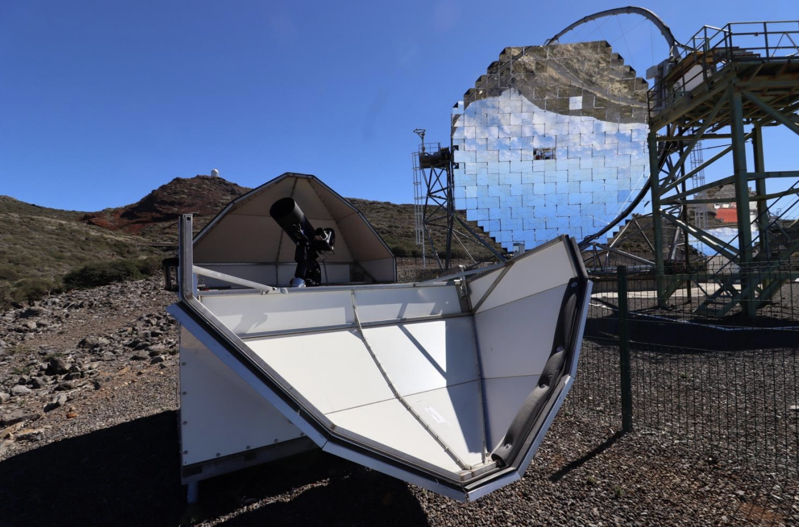
Array Common Elements
Illuminators (not to scale)
Ensure that CTAO meets all science performance requirements
  Under telescope aging
  Under all atmospheric conditions
Ensure that CTAO site environment is sufficiently characterized to
  Allow efficient protection of humans and instruments
  Maximize the science output duty cycle
This is done through LIDARs, FRAMs, Weather stations, and illuminators
Needed to characterize the systematic uncertainties of the array
FRAM

Slide 11
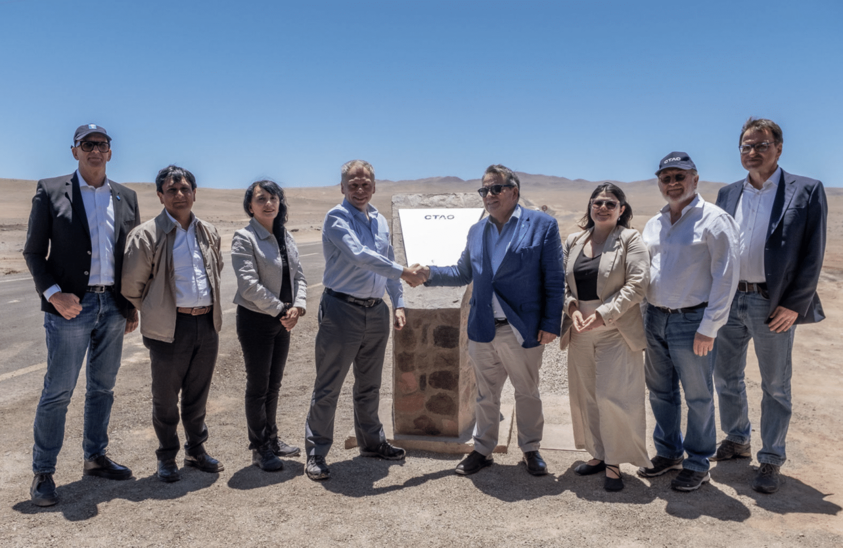
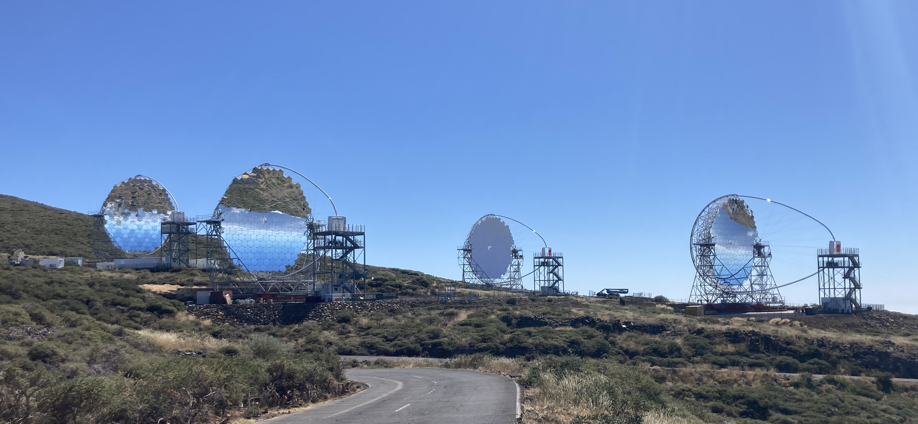
Construction
July 2025
CTAO Construction has already begun!
CTAO South Groundbreaking
December 2025
CTAO North Progress
September 2025

Slide 12
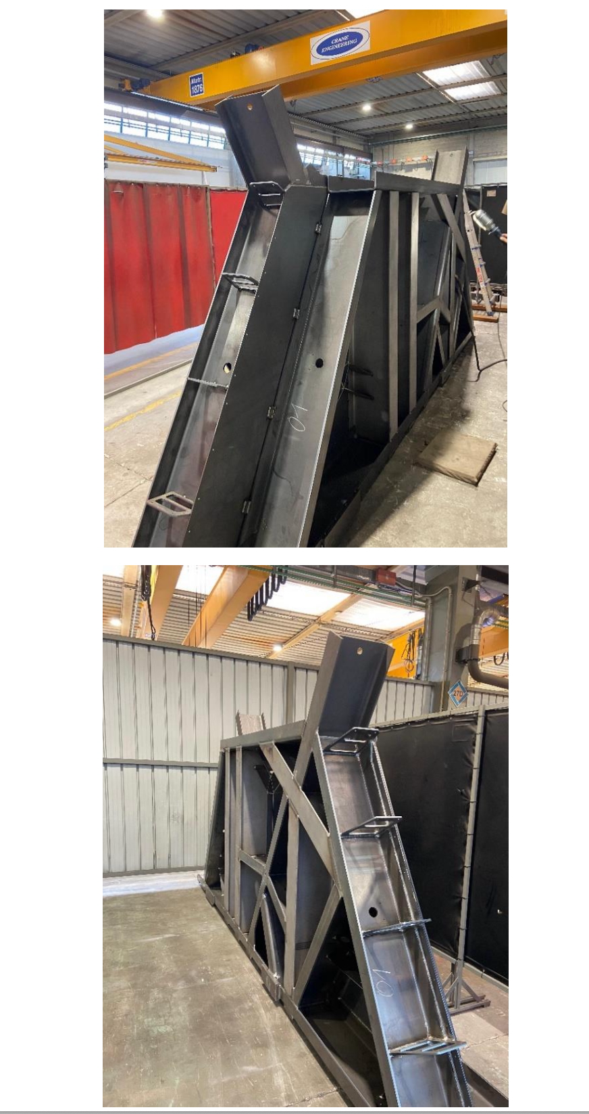
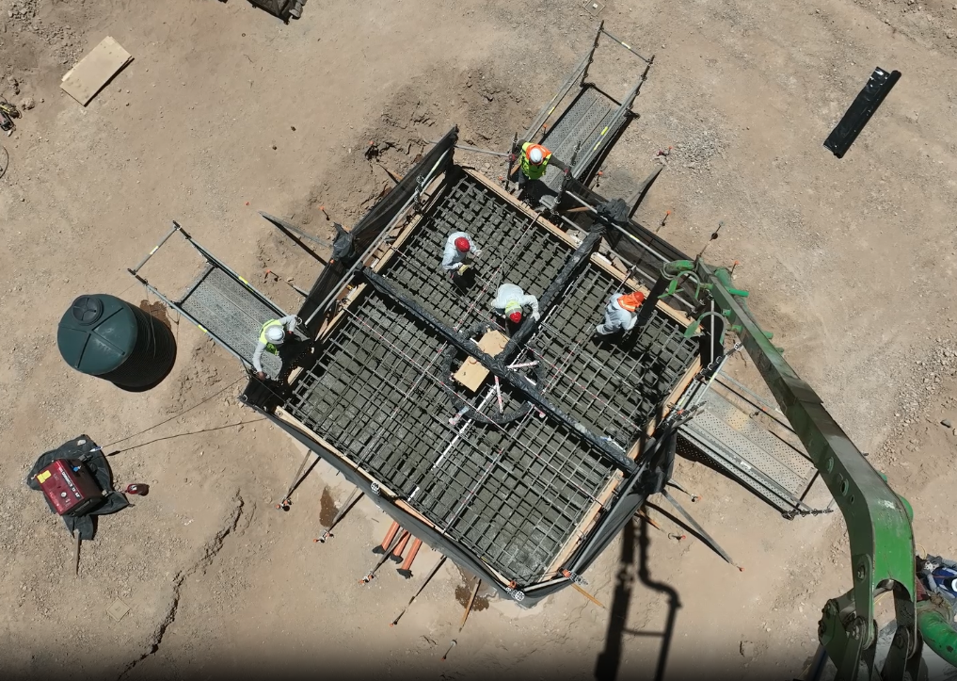
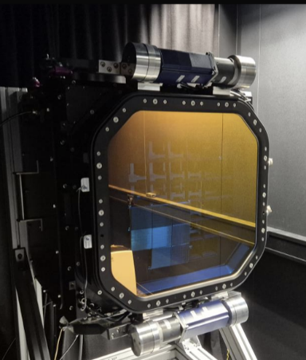
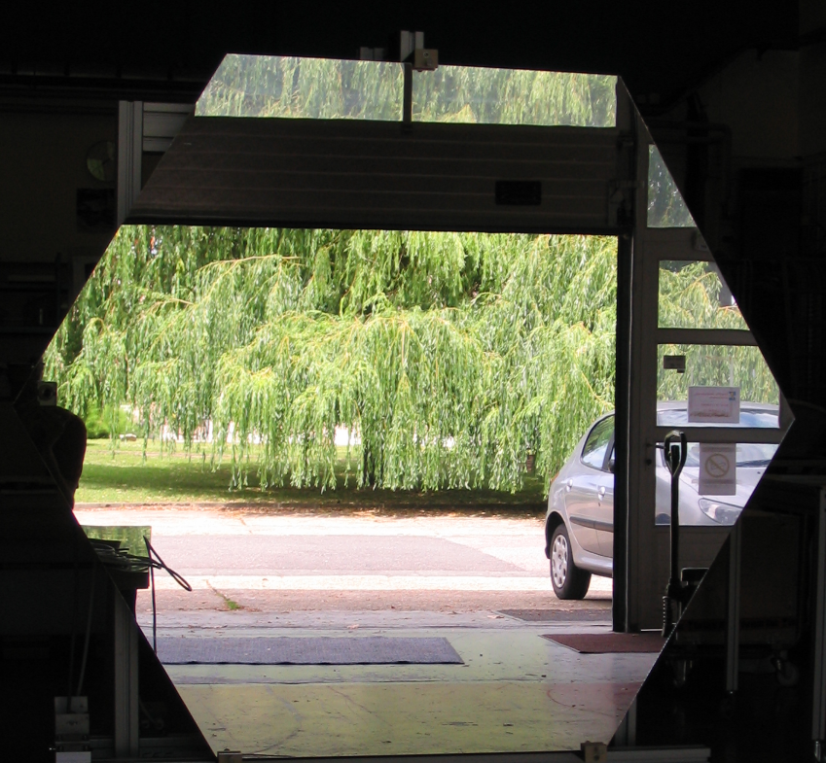
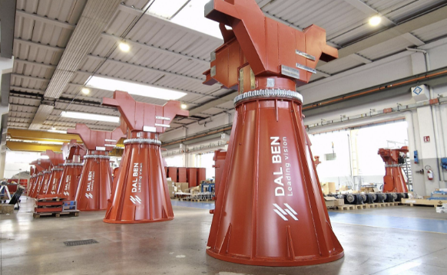
SST Foundation (Paranal)
July 2025
SST Camera
MST Structure
Under Construction
MST Mirror
SST Structure

Slide 13
CTAO Timeline

Slide 14
CTAO Sensitivity
CTAO Sensitivity
Beta Configuration Coming Soon!
Based on Prod5 Simulations
Full array sensitivity
Prod6 expected in the upcoming months
14

Slide 15
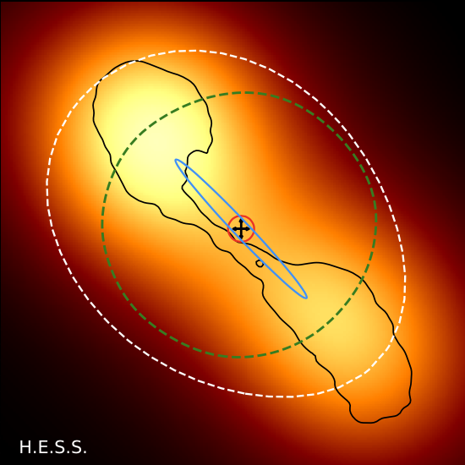
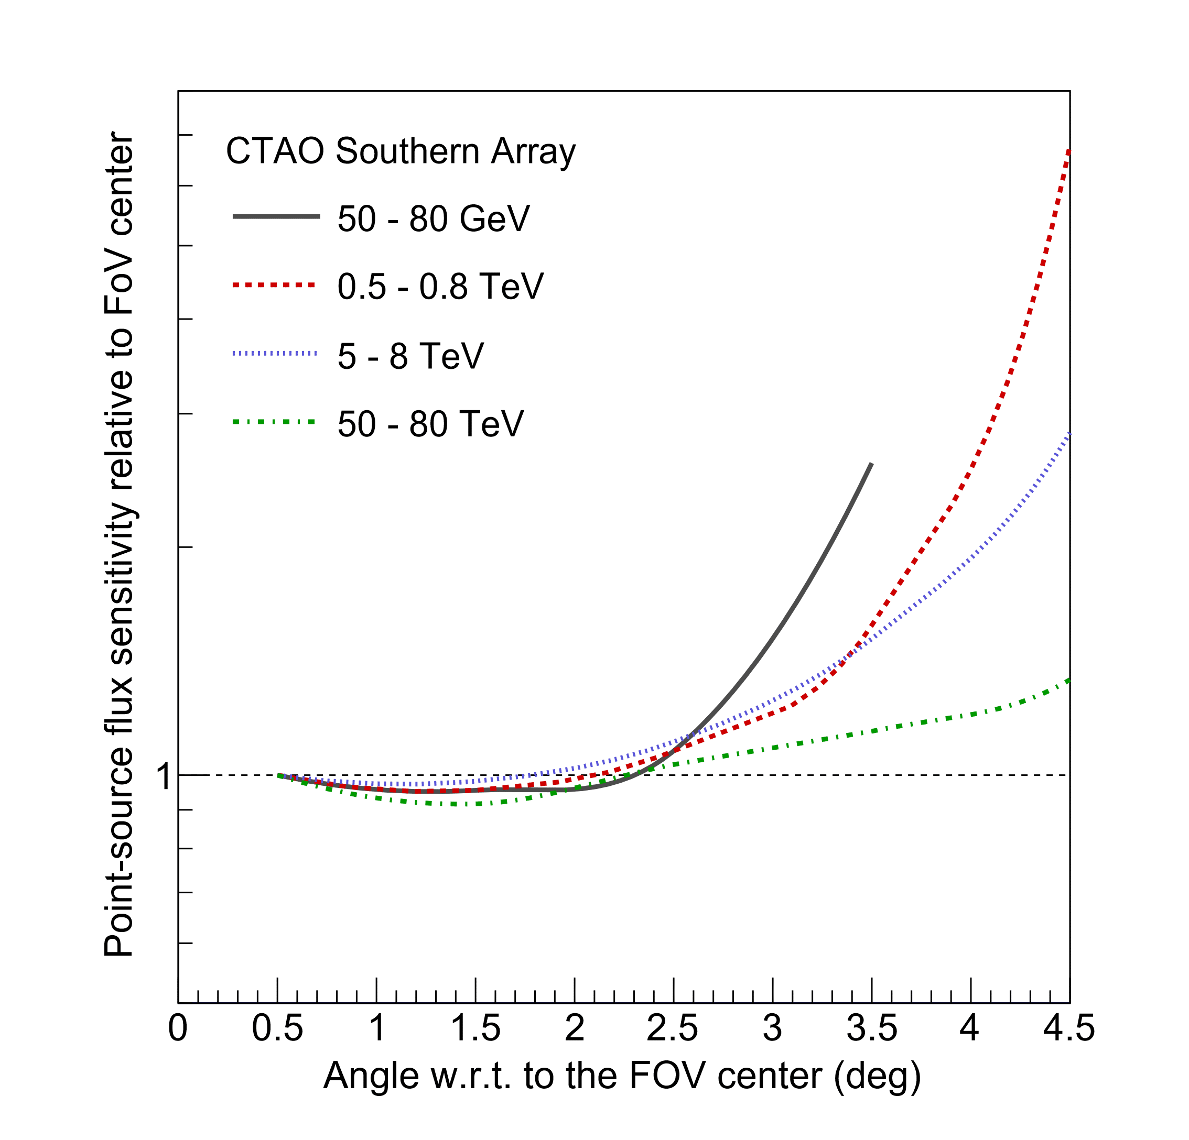
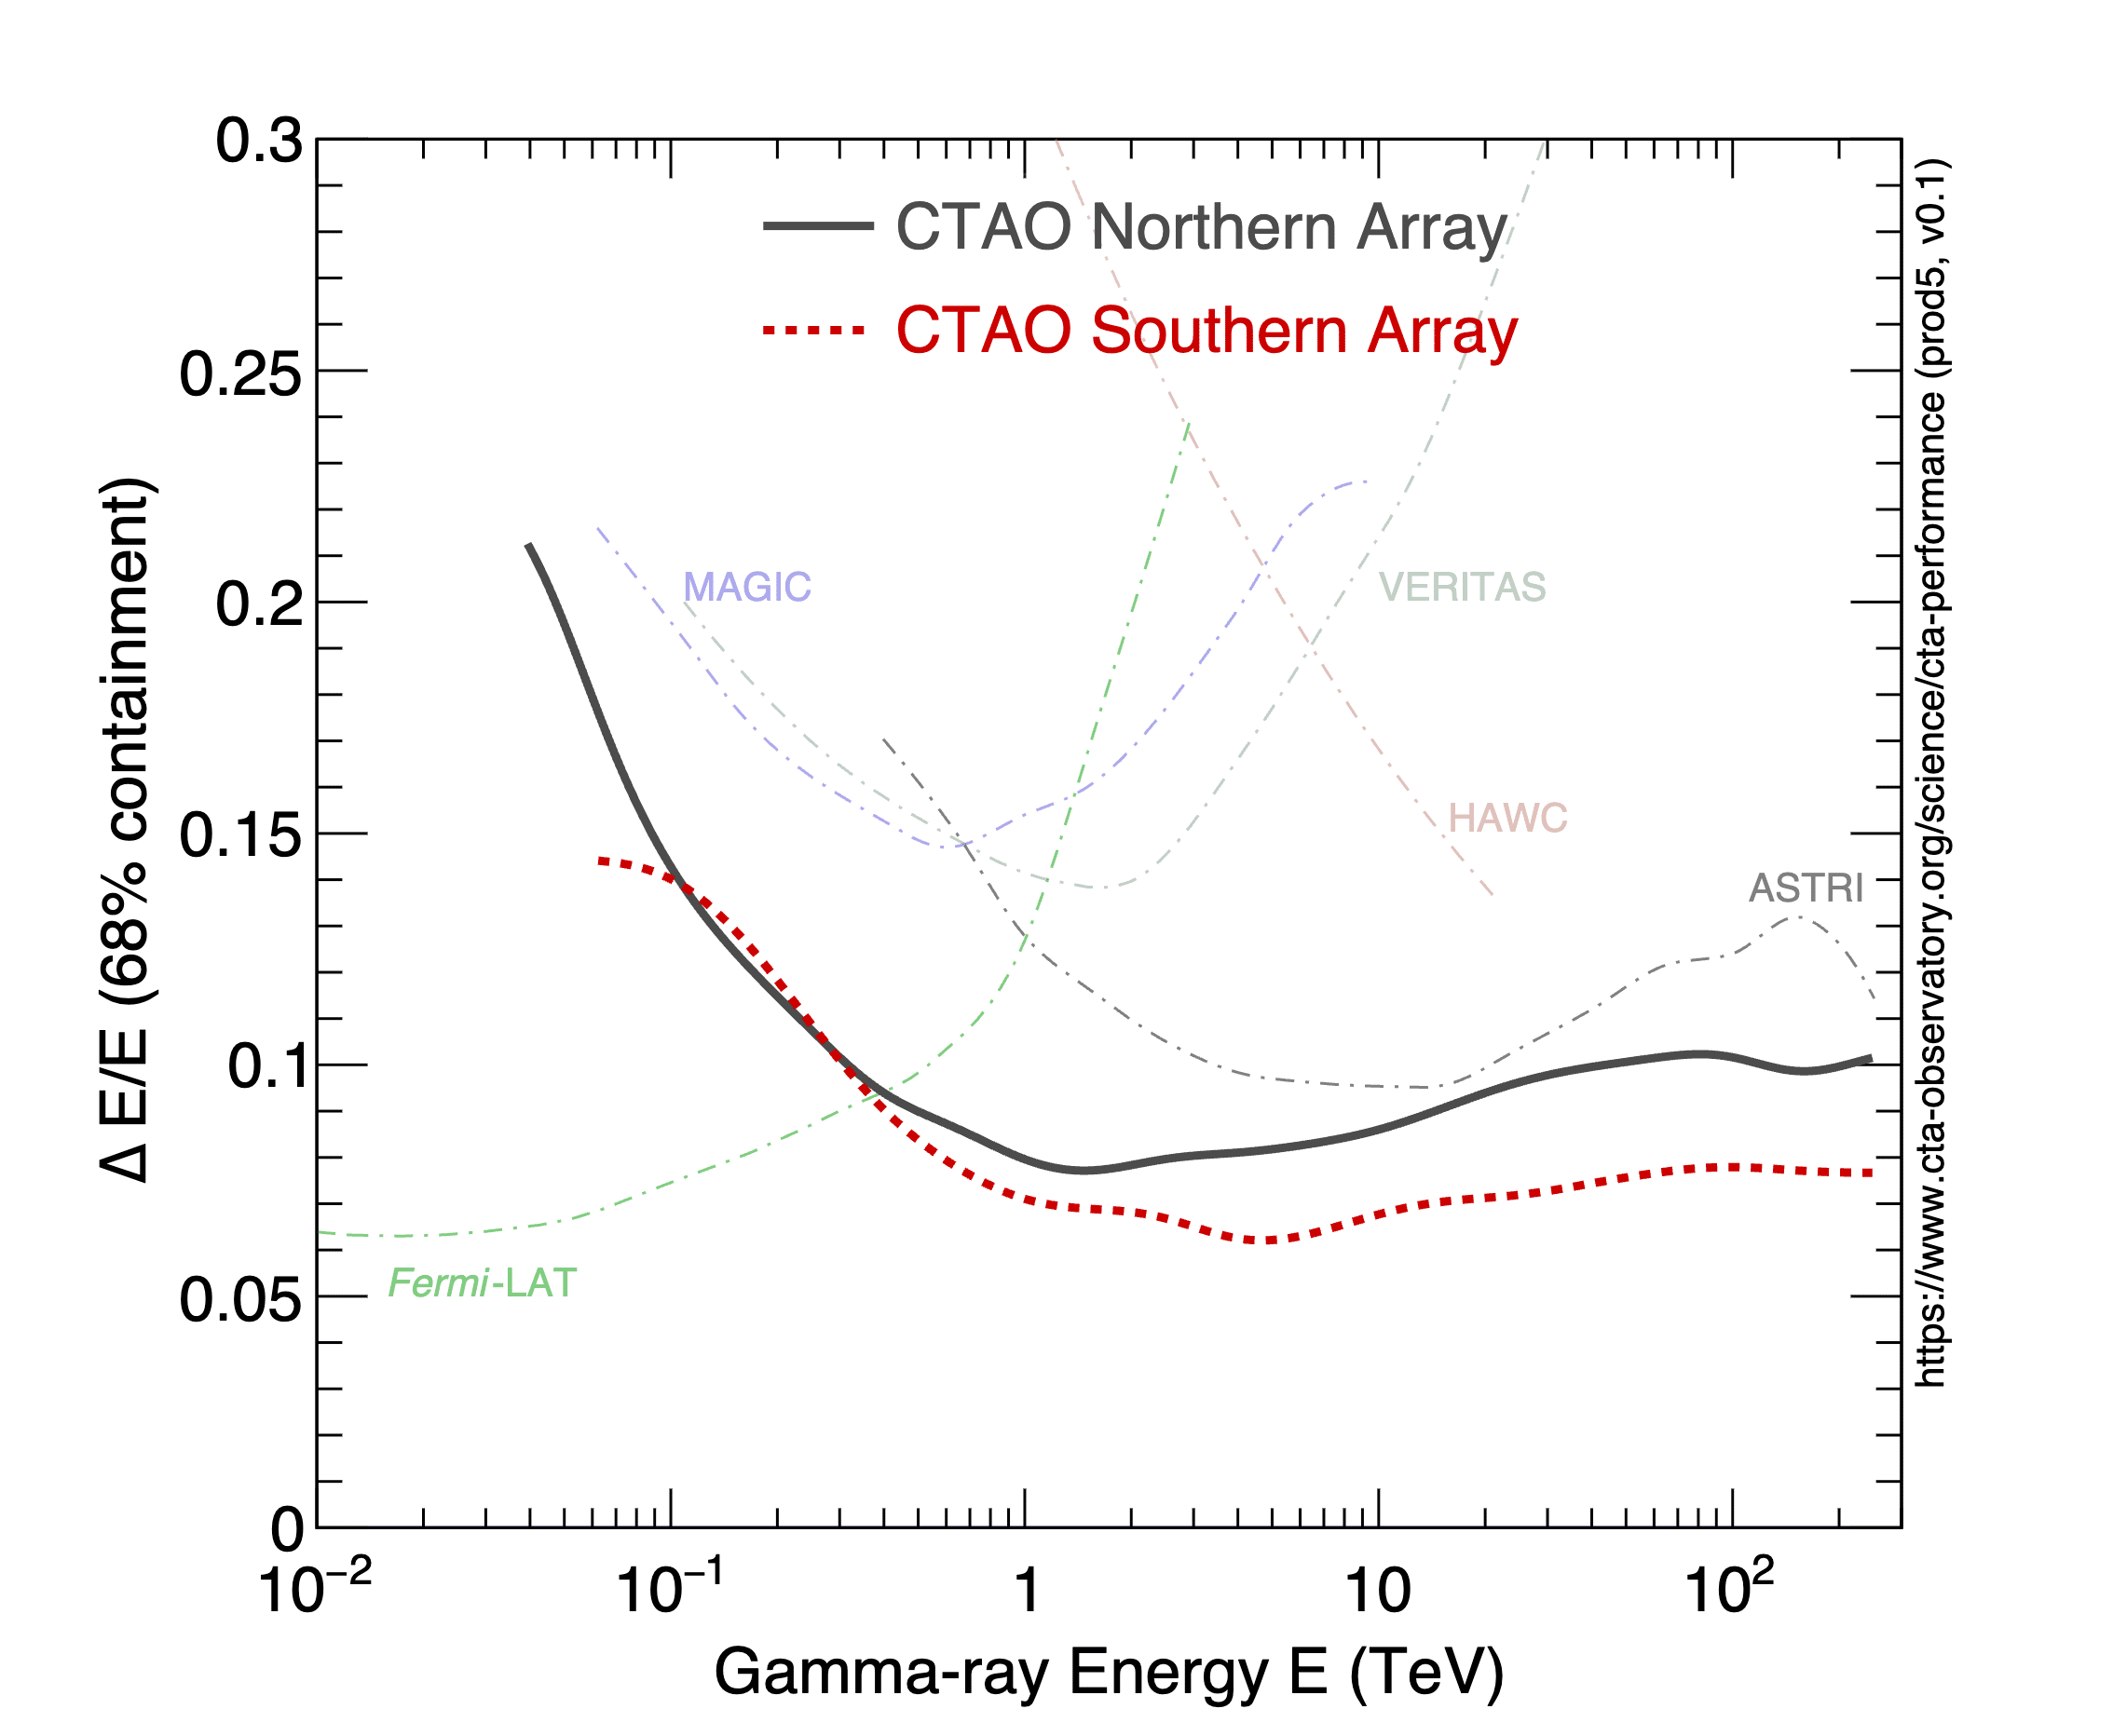
Beyond Sensitivity
15-30” localization
x
ASTRI
10 TeV
CTAO
2 TeV
Observational Functionalities
- Surveys and Deep Observations
- Fixed ICRS and fixed Horizon (i.e. drift scan)
- Sub-array configurations
- Parallel and Divergent (under investigation)
LAT @10GeV
HAWC
@10TeV
LHAASO
@30 TeV
SWGO
@10TeV
7% Energy Resolution
15

Slide 16
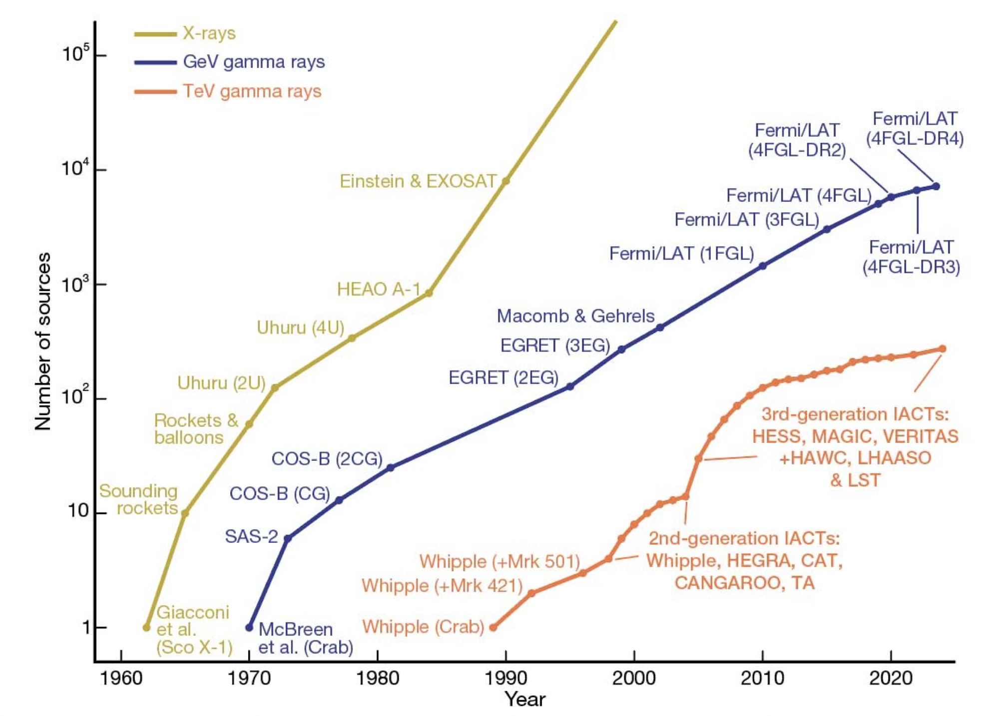
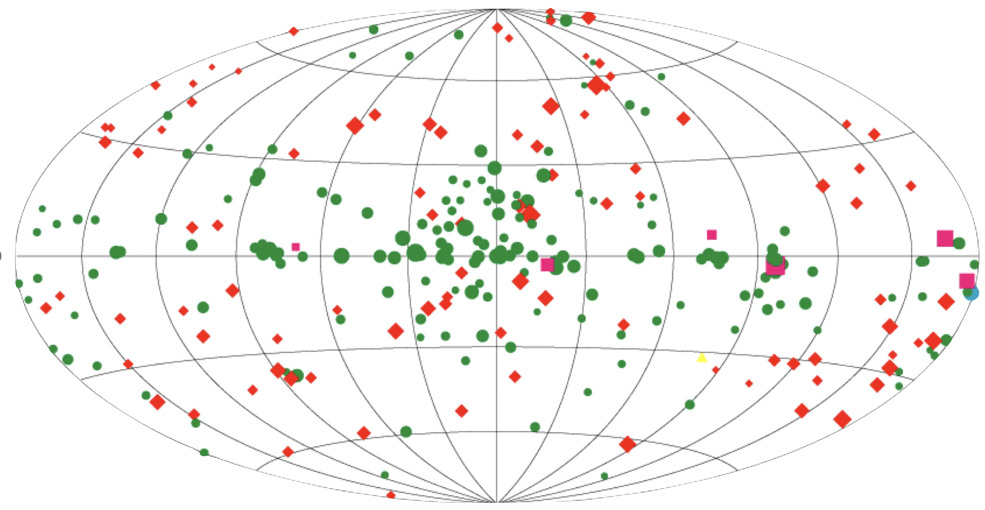
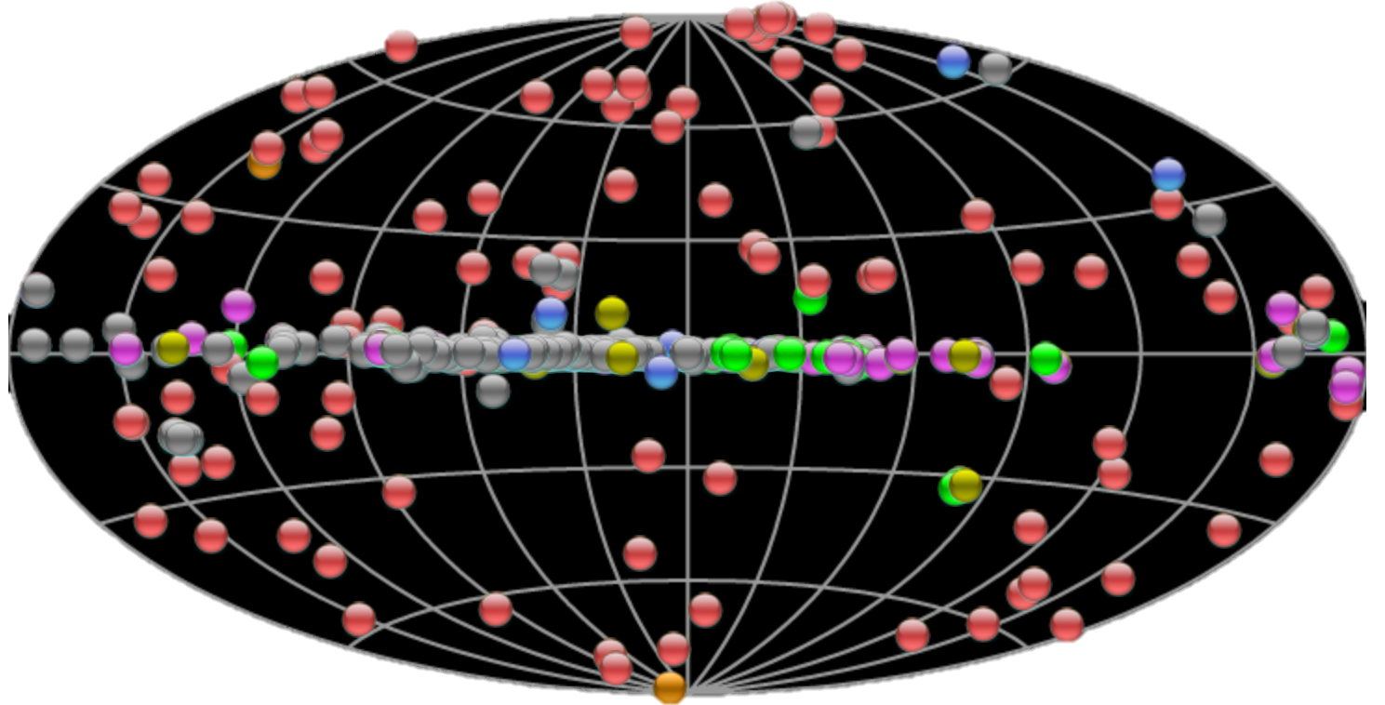
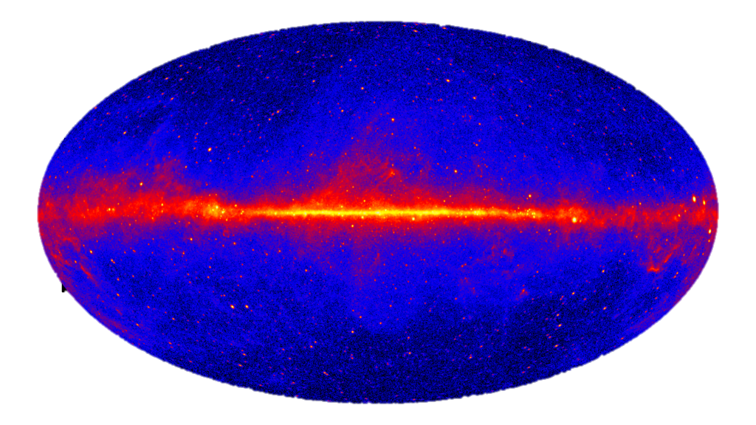
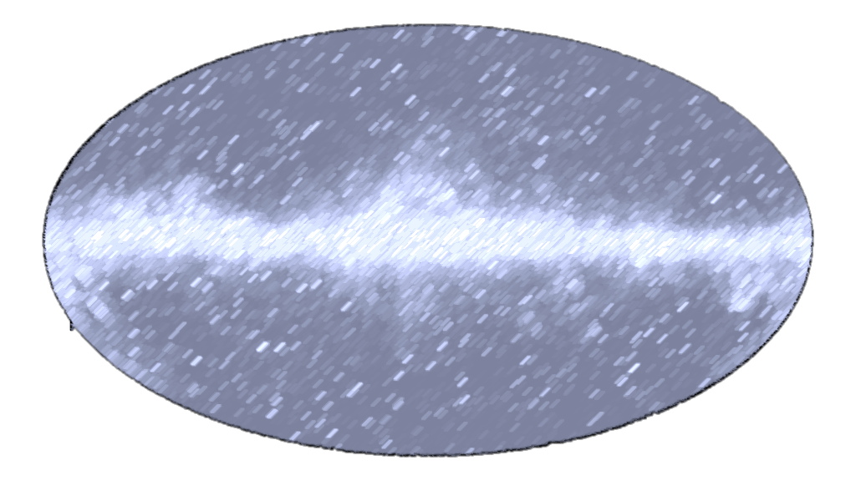
CTAO Science
High Energy (>100 MeV)
Very High Energy (>100 GeV)
EGRET
Fermi-LAT
MAGIC
H.E.S.S.
VERITAS
CTAO
188
7194
CTAO
Kifune Plot

Slide 17
CTAO Science
Theme 1: Origin and role of Cosmic-rays in the Universe
Galactic PeVatrons
Identify sources capable of accelerating cosmic rays to PeV energies.
Key targets: Galactic Center, SNRs, PWNe, mircoquasars.
Binary Systems
Investigate particle acceleration in compact binaries, microquasars.
Pulsar Wind Nebulae (PWNe)
Examine leptonic acceleration, cooling, and nebular structure.
SNRs and the Origin of Cosmic Rays
Study acceleration, diffusion, and escape of particles.
Combine CTAO data with Fermi-LAT, radio, and X-ray observations.
Star-forming Systems
Explore collective acceleration in starburst regions and OB associations.
Cosmic-Ray Diffusion and Propagation
Probe cosmic-ray transport through molecular clouds and diffuse emission.

Slide 18
CTAO Science
Theme 2: Probing Extreme Environments
Clusters of Galaxies
Probe cosmic-ray confinement, cluster energetics and intracluster medium heating.
Gamma-Ray Bursts (GRBs)
Explore prompt and afterglow VHE emission; Lorentz factor limits; new physics.
The Galactic Center Environment as a whole
Study diffuse gamma-ray emission, potential PeVatron, and dark matter.
Pulsars and Magnetospheres
Search for VHE pulsed emission; constrain emission zones.
Radio Galaxies and Misaligned AGN
Test jet models and large-scale VHE emission.
Active Galactic Nuclei (AGN)
Study particle acceleration, jet formation, B-field and variability.
Transient and multi-wavelength/multi-messenger program

Slide 19
CTAO Science
Theme 3: Exploring Frontiers in Physics
Cosmology and Intergalactic Magnetic Fields (IGMF)
  Hubble Constant via EBL
Study pair cascades and delayed emission to probe IGMF strength
Lorentz Invariance Violation (LIV)
Use GRBs and AGN flares to test quantum-gravity effects through time-delay and threshold effects
Axion-like Particles (ALPs)
Search for photon–ALP mixing through irregularities in spectra and photon-recovery.
Extragalactic Background Light (EBL)
Constrain EBL density through attenuation of AGN and GRB spectra.
Dark Matter Searches
WIMP annihilation/decay from Galactic Center, dwarf spheroidals, galaxy clusters.
Cosmic-Ray Electron Spectrum and Anisotropy
Measure local spectrum up to tens of TeV to test nearby sources.
Expected performance in heavier CRs

Slide 20
Some Personal Highlights
Pulsars
Microquasars
YMSC
Novae

Slide 21
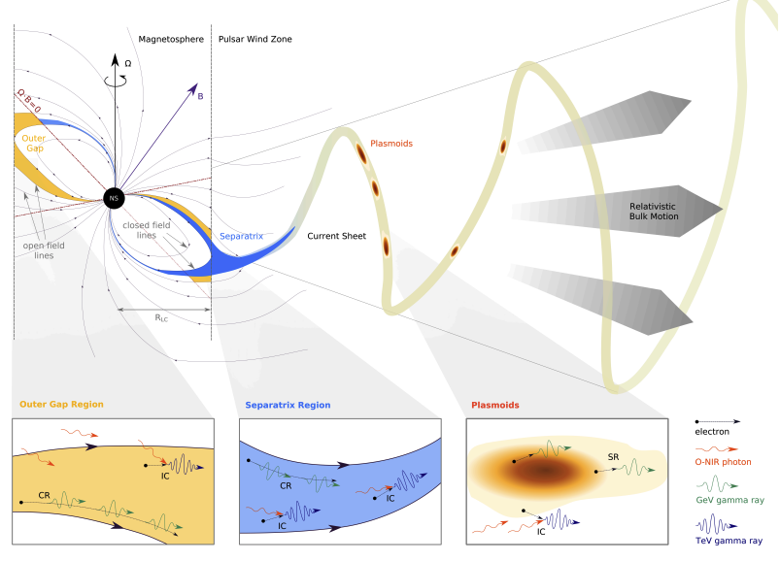
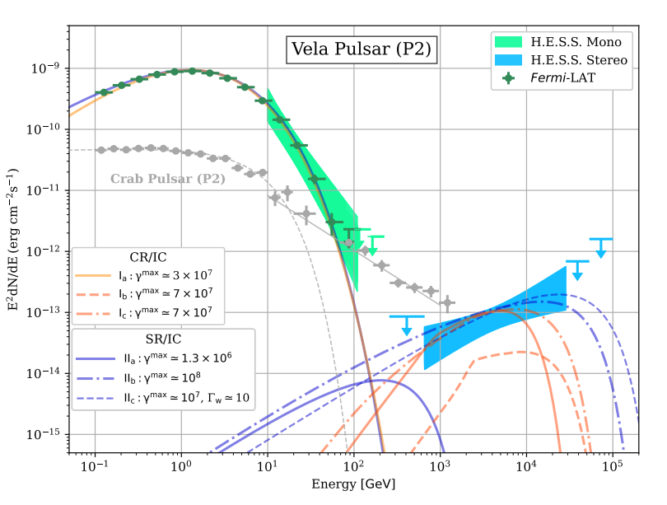
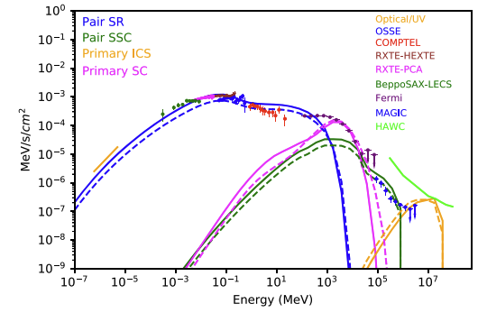
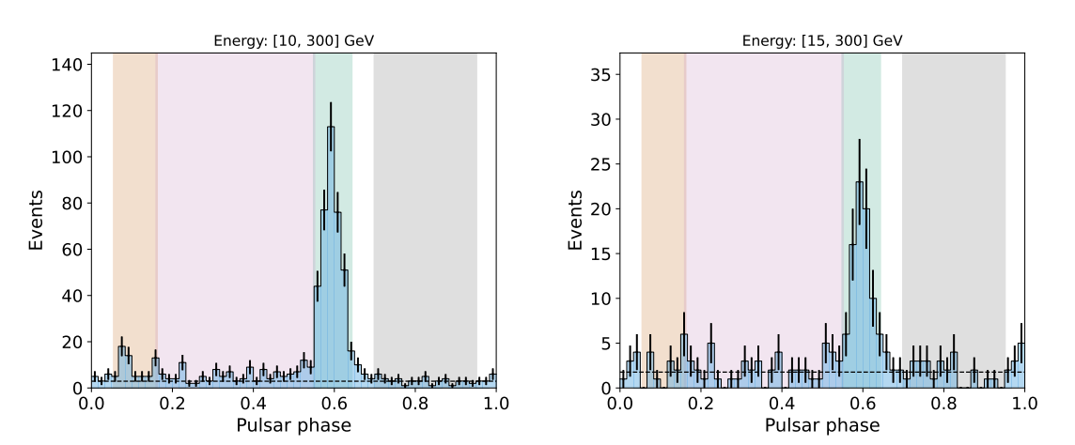
Pulsars
Nature Astronomy, Vol 7, p. 1341-1350
What does the primary spectrum look like: Simple cutoffs vs extra components
How many other pulsars have an IC peak?
How many more VHE pulsars
More targets mean more constraints on theory
Extreme e+- accelerators -> Understand positron fraction
ApJ 923, 2, id.194, 17 pp.
Crab Pulsar (P1 + P2)
A&A, 698, A283.

Slide 22
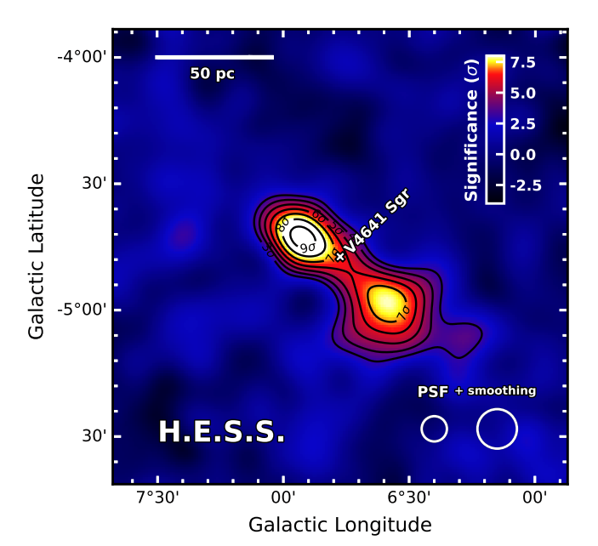
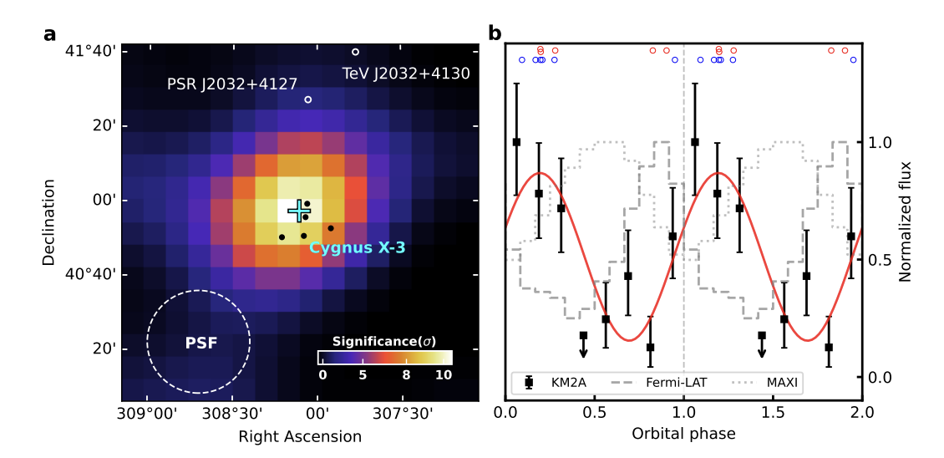
Microquasars
A&A, Vol 706, id.A8, 23 pp.
What is the maximum energy from these sources:
  LHAASO says 100s TeV Requires high power (~Ledd) and high magnetic fields
V4641 Sgr has been radio quiet but gamma-ray bright
What determines whether a microquasar is gamma-ray bright?
  No clear correlation between average power
  Only small sample size!
CTAO sensitivity, FoV, and PSF can determine:
  Emission mechanisms,
  Maximum Energy
  New microquasars
https://arxiv.org/abs/2512.16638

Slide 23
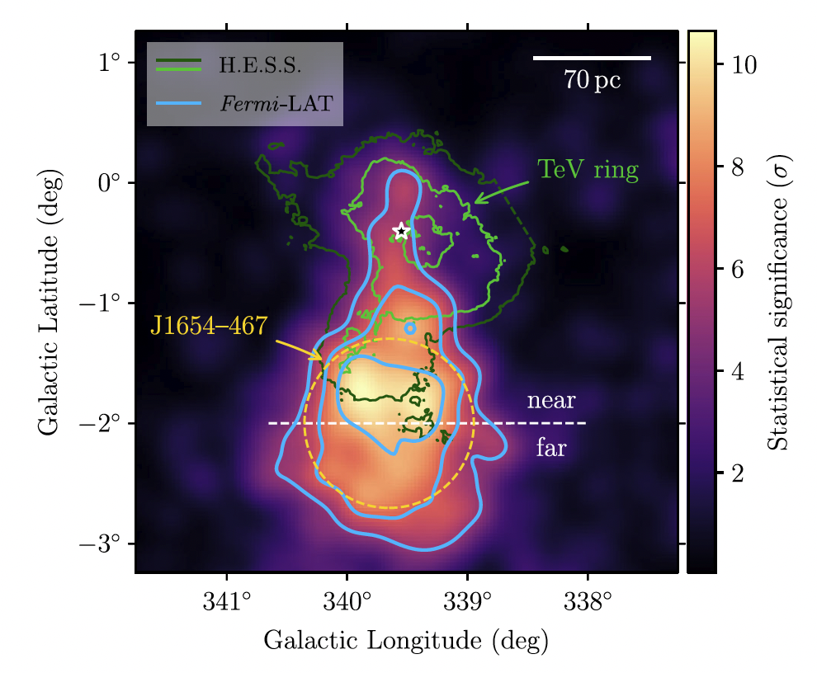
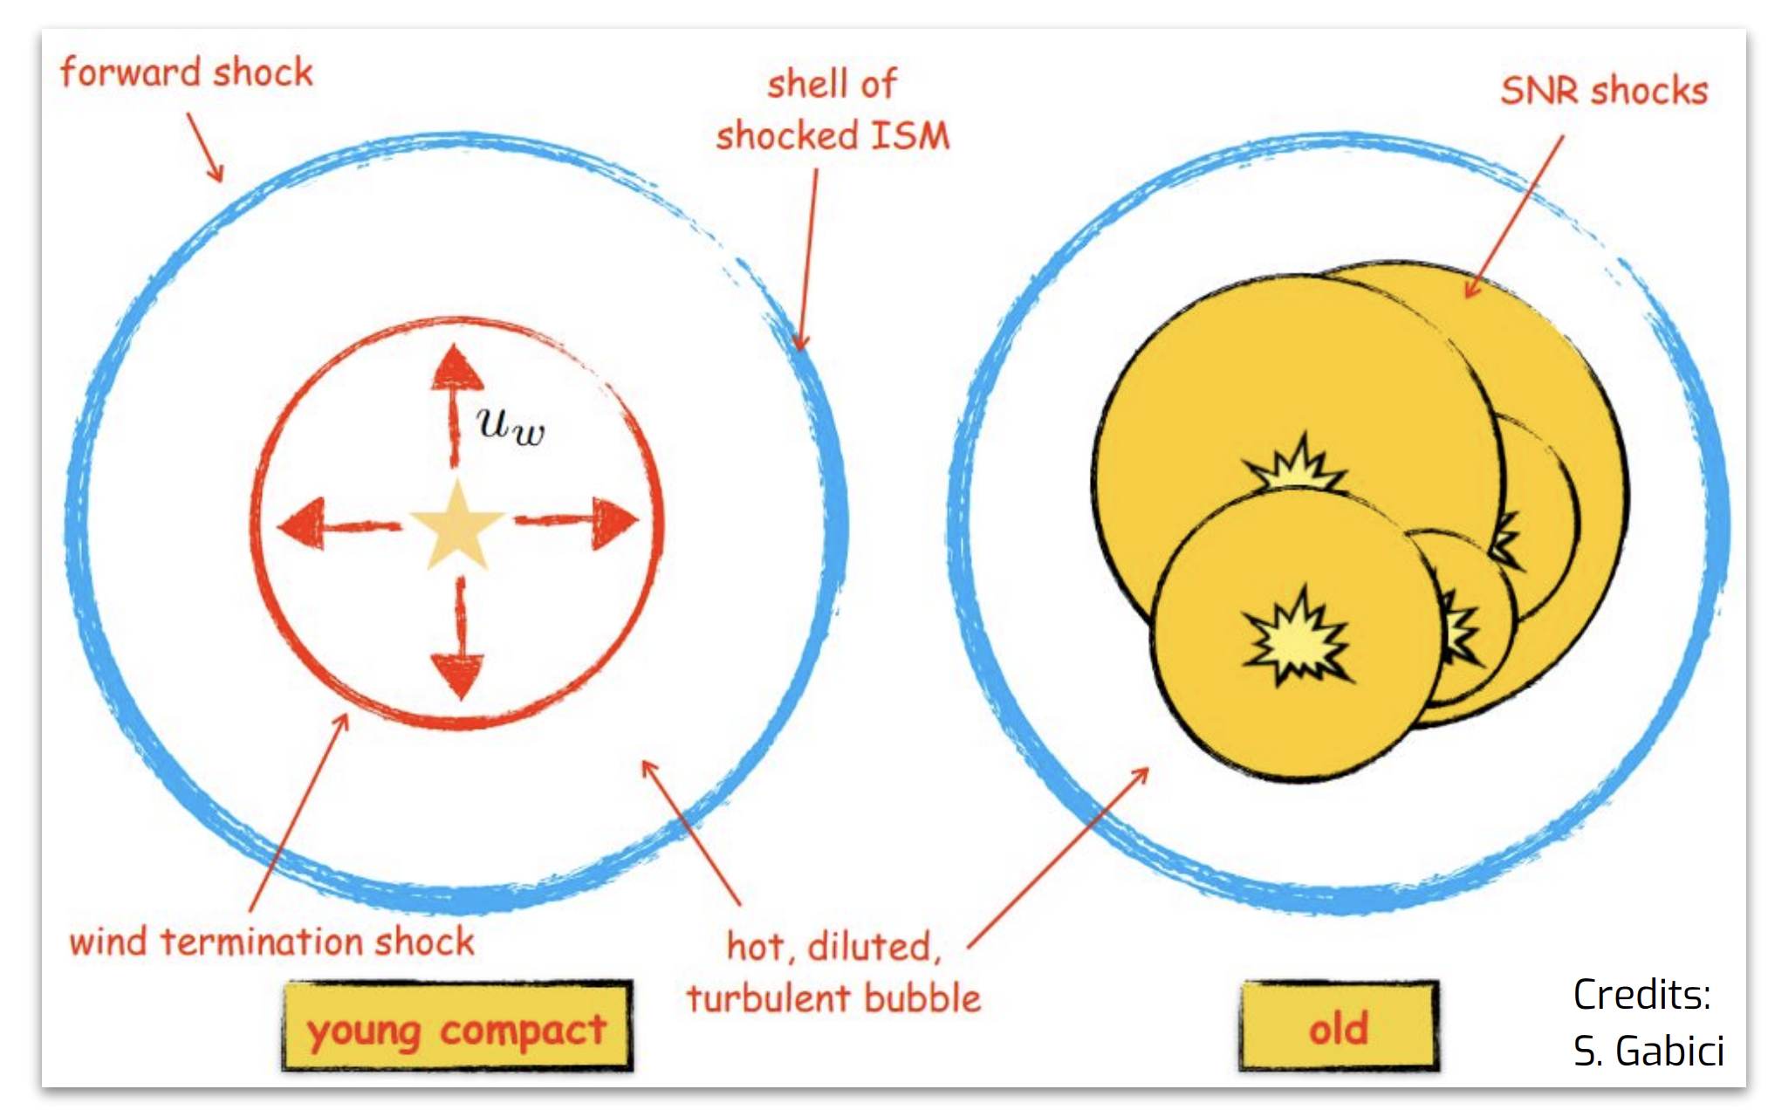
YMSC
Increasingly promising sources for CRs
Show clear 100s TeV to PeV emission
Multiple components and energy dependent morphologies
  What is the maximum energy and where in the YMSC is it emitted?
  What is the role of escaping CRs?
How much to YMSC contribute to overall CR population?
Only a few detected currently, CTAO will increase by 10x
Nature Communications 16: 10820 (2025)

Slide 24
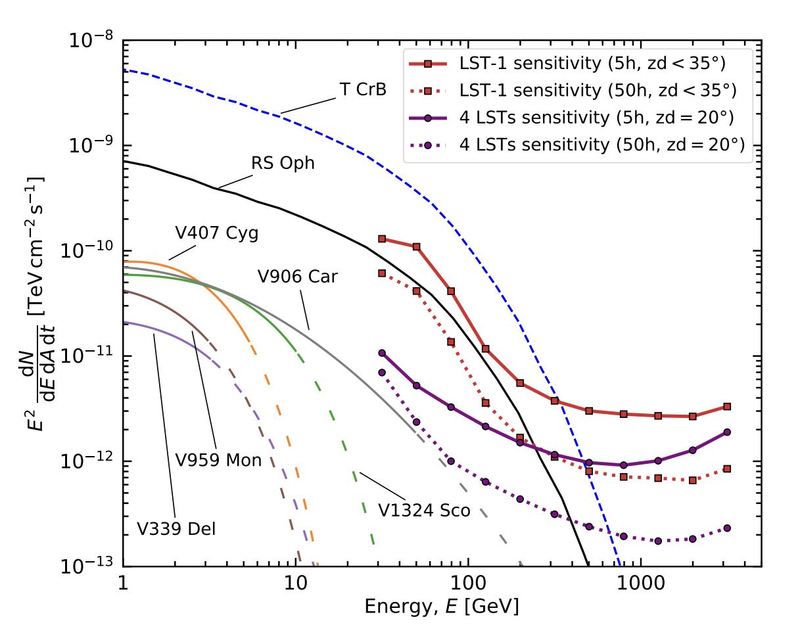
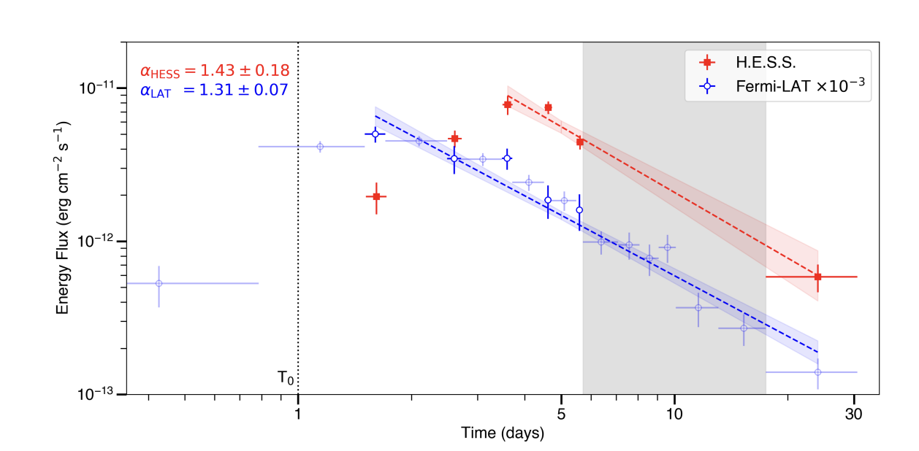
Novae
Abe, K., et al.: A&A, 695, A152 (2025)
Only one nova has been detected in VHE
  RS Oph – Symbiotic Novae
  Dozens in HE
What does the role of the donor environment play?
  What about classical novae?
Deeper temporal observations are needed
  Both long term and immediate follow up (< 1 day after optical outburst)
Next RS Oph outburst is ~2035
Science, 376,6588, pp. 77-80 (2022).

Slide 25
Science Data Challenge
Fully open and blind!
Seven years of simulated CTAO observations provided as science-ready datasets
Goals:
  Allow the scientific community to explore CTAO Scientific capabilities
  Allow users to become familiar with the technicalities of the analysis as well with the CTAO SAT/Gammapy
  Good opportunity to learn Gammapy
Release of Science Data Challenge Q4 2026

Slide 26
Conclusions
VHE gamma-ray astronomy is a key discipline within the broader field of astrophysics
CTAO will be the first proposal driven open astronomy observatory in the field of VHE astronomy
The scientific community will have the possibility to request observing time and to access the data (after a one year of proprietary period)
CTAO is set to become a cornerstone of mutli-messenger and mutli-wavelength (MM/MWL) astronomy
The construction of the CTAO project has already started! First data is coming soon.

Slide 27
Backup Slides

Slide 28
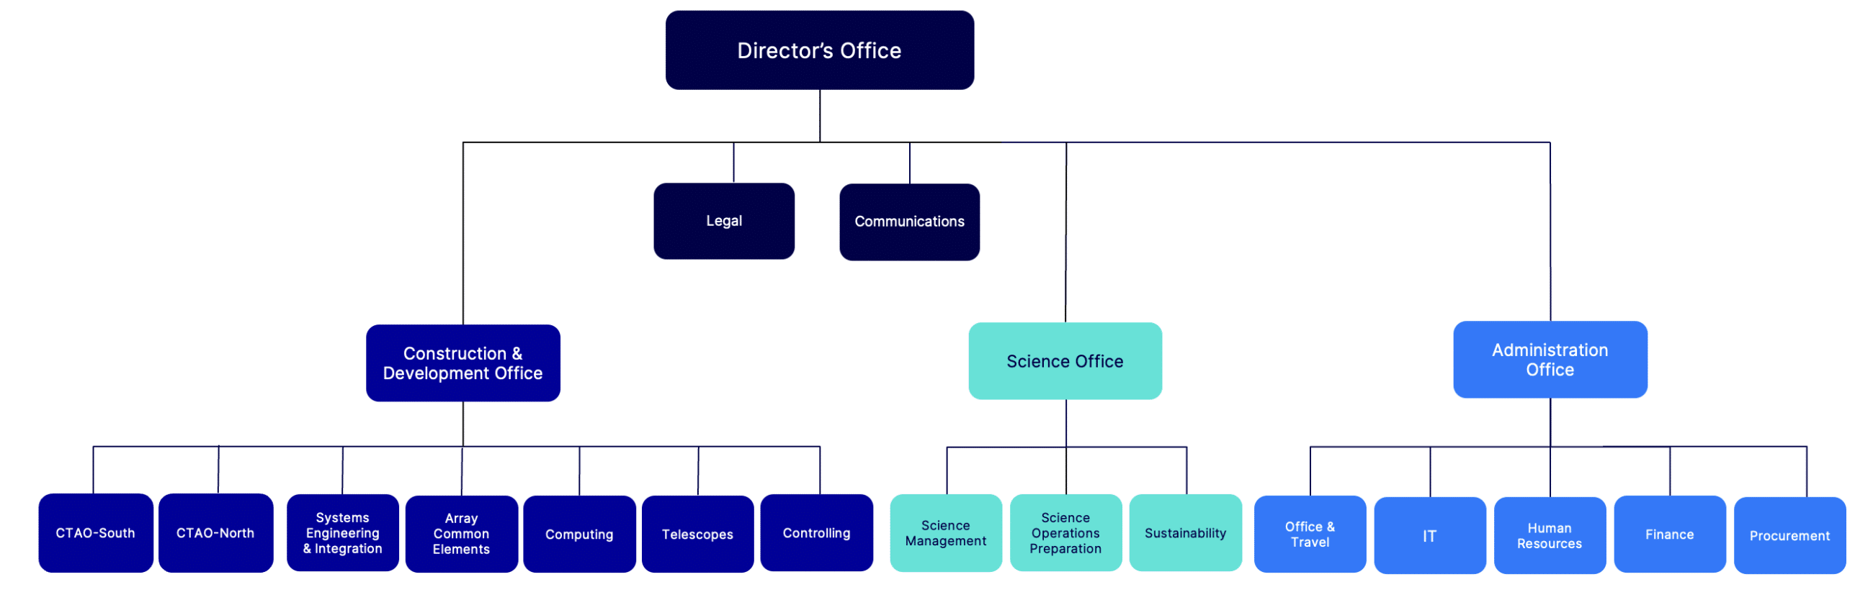
Who is the CTAO ERIC?
Beyond Telescopes
Stuart McMuldroch
Nadia
Defrancesco
Volker Heinz
Roberta Zanin
CTAO Southern Array
14 MSTs
37 SSTs
More information on the CTAO team: https://www.ctao.org/it/organisation/team/

Slide 29
Data Categories
CAT-A data
Realtime analysis
CAT-B data
On-site analysis
CAT-C data
Off-site analysis
Latency | Within the same observing night | Next day (before the start of the next observing night) | Within 1 month of observation
Goal | Issue Scientific alerts and follow-up observations | Data quality and check of CAT-A results | Delivery of best quality data for scientific analysis == used in publications
Performance Requirements in terms of systematic uncertainties

Slide 30
Data Levels
  CTAO will offer a storage service on selected DL5/6 data (e.g., skymaps, catalogs)
R0
Telescope
Raw data
R1
Standard Raw data
DL0
Archived Raw data
DL1
Calibrated data
DL2
Reconst. Air showers
DL3
Science Ready data
DL4
Binned Science Data
DL5
Advanced Science Data
DL6
Advanced Science
Collection
Structure
Produced by:
Users with SAT
  User-contributed data products
CTAO with standardized pipeline
  Observatory data products for quick-look results
Preserved Data
Distributed to the Scientific Community

Slide 31
Towards first CTAO data
Intermediate array configurations
Incremental array configurations that become progressively available to community
  Telescopes and array elements fully integrated with the intermediate release of software packages
  Array elements include telescopes but also calibration devices and atmospheric characterization instruments
Mid-period plan (~3 years) based on the construction and acceptance schedule
  Built accounting for the inputs of the in-kind contribution teams

Slide 32
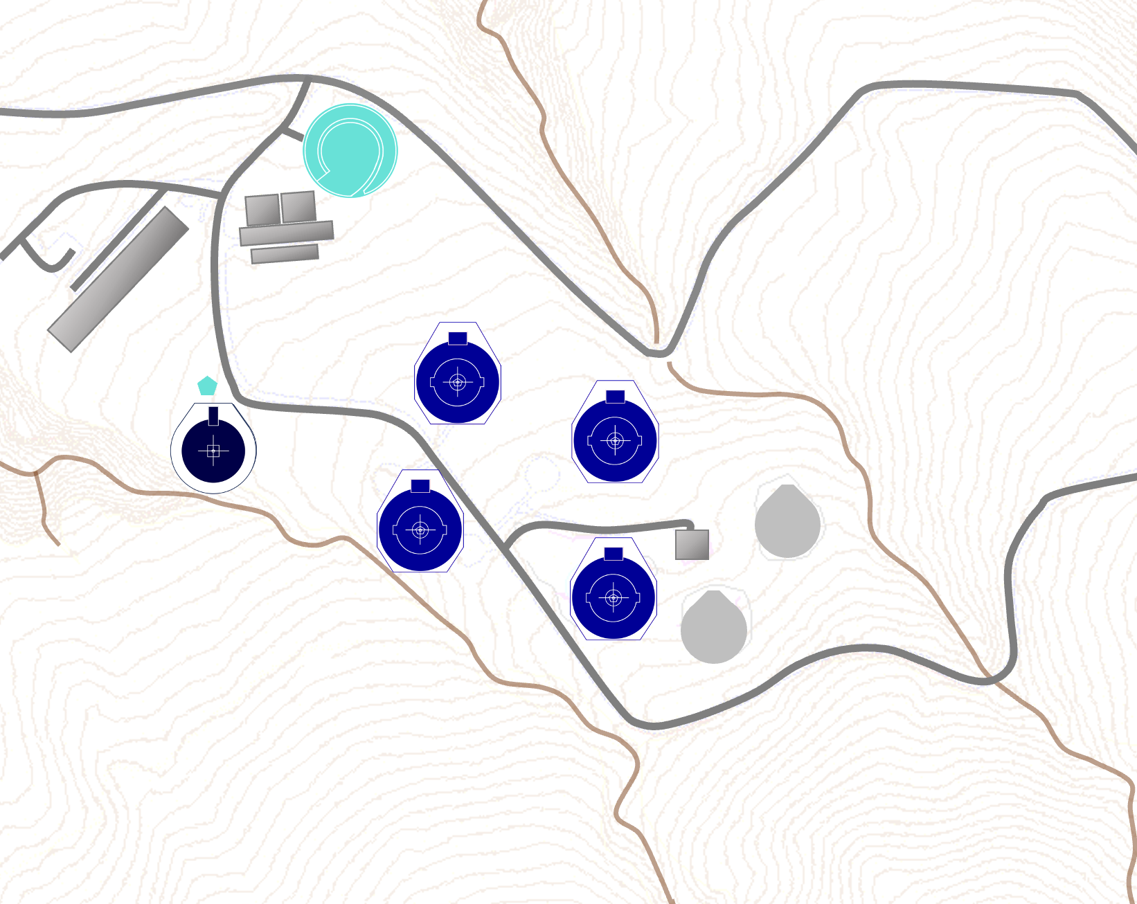
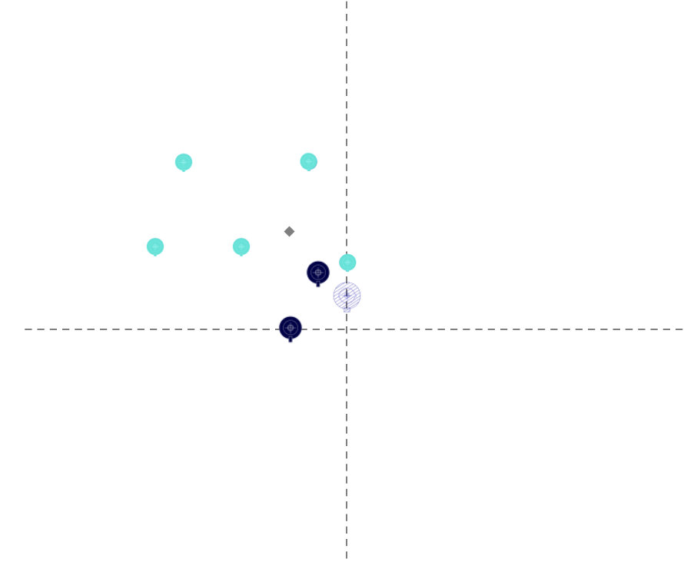
1st Intermediate Arrays
3 years from today
CTAO-North
CTAO-South

Slide 33
1st Intermediate Arrays
Intermediate array configurations should be available in 2029
  CTAO Central Office is working closely with IKC teams
CTAO-North -> 4 LST + 1 MST
CTAO-South -> 2 MST + 5 SST
CTAO-North
CTAO-South

Slide 34
Public Early Science Timeline

Slide 35
Public Early Science
Goals: Get data to community, get community ready for CTAO
Best effort Announcement of Opportunity
CTAO guarantees the performance of the intermediate configuration prior to the start of the Public Early Science Observing Period
  Done after science validation and verification
Stay tuned for more information!

