Slide 1



Status of ALMA proposal preparation
Rahul Rana (Chalmers Team)
Chalmers University of Technology
This work is supported by the ERC grant RECAP under grant agreement No 101166930

Slide 2
Potential proposals
[OIII] 88 µm from [CII]-detected galaxies at z = 6–7 [Rahul+]
Kinematics as a tracer of LyC emission [Aniket+]
LyC leakers: [OIII]/[CII] [Antonio+]

Slide 3
[OIII] 88 emission
Characterize the multi-phase ISM by comparing tracers of ionized gas ([OIII]) and neutral PDR gas ([CII]).
Compare spatial distribution of ionized and and neutral gas
Quantify the obscured fraction of star formation by combining JWST UV measurements (SFR_UV) with ALMA FIR measurements (SFR_IR).

Slide 4
Feasiblity Check
ID_UCE | ALMA_source_name | z_spec | Info | OIII expected (mJy) | RMS (mJy) | B8 (time)
COSMOSweb25-60120 | WMH13 | 5.992 | L_CII=8.56 (L24) | 2.49 mJy at 485.269 | 0.5 mJy | 1.5days
COSMOSweb25-464316 | 20521 / COSMOS20521 | 6.36 | L_CII<7.7 (3sigma; L24) | <0.11 so go for 0.10 mJy at 461.0062 | 0.07mJy | Not feasible
COSMOSweb25-474402 | COSMOS24108 | 6.629 | L_CII=8.04 (L24) | 0.649 mJy at 444.7511 | 0.13mJy | Not feasible
COSMOSweb25-664333 | COS-2987030247 /COS2987 | 6.8076 | S_158 < 0.02mJy & S_88 <0.19 (3sigma; M24); L_CII=8.56 (L24) | 2.069 mJy at 434.5773 | 0.41mJy | Already done
COSMOSweb25-671610 | COS-3018555981 | 6.854 | S_158 < 0.04mJy (3sigma; M24) L_CII=8.67 (L24) | 2.639 mJy at 432.0099 | 0.53mJy | Already done
COSMOSweb25-358243 | UVISTA-Y-004 / REBELS-27 | 7.09 | L_CII=8.79 (L24) Continuum detection (B22) | 3.315 mJy at 419.4074 | 0.66mJy | 2.7h
COSMOSweb25-639392 | COSMOS13679 | 7.145 | L_CII=7.85 (L24) | 0.376 mJy at 416.5753 | 0.10mJy | Not feasible

Slide 5
Kinematics as a tracer of LyC: ALMA archive coverage
Use resolved [CII] and/or [OIII] to detect outflows, turbulence, and disturbed kinematics
Source ID | RA (deg) | Dec (deg) | Spec_z | CII158 | CI 370 | OI145 | NII 205 | Bands obs.
JADES-GS+53.13002-27.77839 | 53.13005 | -27.77839 | 5.56616 | – | – | – | – | 3, 4, 6
JADES-GS+53.17655-27.77111 | 53.17654 | -27.77111 | 5.88979 | – | – | – | ✓ | 3, 6
JADES-GS+53.15407-27.76607 | 53.15407 | -27.76608 | 5.79912 | – | – | – | ✓ | 3, 6
JADES-GS+53.18343-27.79097 | 53.18343 | -27.79098 | 7.43173 | ✓ | ✓ | ✓ | – | 3, 6
JADES-GS+53.11572-27.77495 | 53.11572 | -27.77496 | 5.50411 | – | – | – | – | 3, 6
JADES-GS+53.18374-27.79390 | 53.18375 | -27.79389 | 7.26270 | ✓ | ✓ | – | – | 3, 6

Slide 6
Coverage Check for [CII] 158µm and [OIII] 88µm
Source ID | RA (deg) | Dec (deg) | Spec_z | CII | OIII
JADES-GS+53.13002-27.77839 | 53.13005 | -27.77839 | 5.56616 | B7 | Not covered
JADES-GS+53.17655-27.77111 | 53.17654 | -27.77111 | 5.88979 | B7 | B8
JADES-GS+53.15407-27.76607 | 53.15407 | -27.76608 | 5.79912 | B7 | B8
JADES-GS+53.18343-27.79097 | 53.18343 | -27.79098 | 7.43173 | B6 | B8
JADES-GS+53.11572-27.77495 | 53.11572 | -27.77496 | 5.50411 | B7 | Not covered
JADES-GS+53.18374-27.79390 | 53.18375 | -27.79389 | 7.26270 | B6 | B8

Slide 7
LyC Leakers [OIII] / [CII]
[OII] 88µm, difficult to observe (band 10 or 9), time expensive. Strategy now: science case [CII] and dust. If successful, later expand to other lines.
ID | RA | Dec | z | Log(mstar) | SFR | CII_exp (GHz) | Band CII
GS14633 | 53.193584 | -27.843512 | 2.003 | 9.23 | 5.49 | 632.8671284455276 | 9
GS35257 | 53.103874 | -27.74767 | 2.107 | 9.37 | 6.02 | 611.683273628934 | 9
F336W-1013 | 53.173527 | -27.773691 | 2.98 | 8.5 | NaN | 477.512560525671 | 8
4010 | 3.57519 | 3.60033 | 2.998 | 7.88 | 8.52 | 475.36269245308574 | 8
LACES 104037 | 334.278 | 0.3592 | 3.0646 | 9.26 | 11.01 | 467.573686040635 | 8
1181371 | 53.1358 | -27.7955 | 3.08 | 8.0 | 17.99 | 465.80883223980237 | 8
19863a | 53.1699 | -27.7684 | 3.088 | 9.0 | 7.999 | 464.89722643627937 | 8
Q1549-C25 | 238.02528 | 19.191214 | 3.15 | 9.9 | 6.0 | 457.95179670513573 | 8
Ion2 | 53.01355 | -27.75519 | 3.212 | 9.2 | 15.6 | 451.2108376530192 | 8
11806 | -30.40735 | -30.38675 | 3.236 | 7.50 | 20.309 | 448.654384470328 | 8
J0121+0025 | 20.4837 | 0.4223 | 3.244 | 9.9 | 981.000 | 447.8086754926484 | 8
109004028 | 53.0994 | -27.8392 | 3.27 | 8.85 | 11.000 | 445.081969201233 | 8
F336W-1041 | 53.16962 | -27.7726 | 3.329 | 9.46 | NaN | 439.0159394027981 | 8
3052076 | 53.1679 | -27.798 | 3.46 | 9.29 | 58.000 | 426.1210725885137 | 8
F336W-189 | 53.167904 | -27.797922 | 3.46 | 9.31 | 23.399 | 426.1210725885137 | 8
J1316+2614 | 199.1234 | 26.2353 | 3.613 | 9.7 | 499.99 | 411.9878678897459 | 8
122021111 | 53.1389 | -27.8354 | 3.79 | 9.21 | 15.00 | 396.7640950178182 | 8
Ion1 | 53.069412 | -27.714743 | 3.794 | 9.2 | 10.0 | 396.4330684304139 | 8
126049137 | 53.2042 | -27.8172 | 4.43 | 9.19 | 257.0000 | 350.00001106472996 | 7

Slide 8
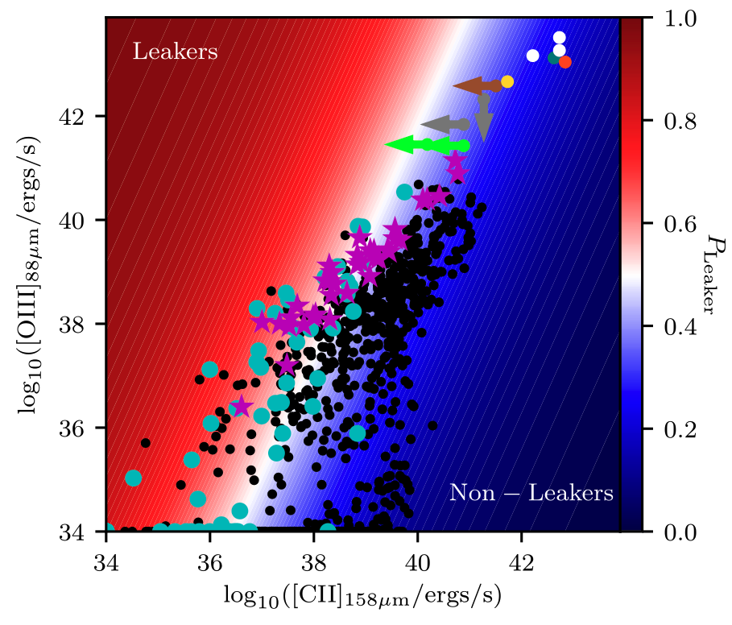
Using [CII] and [OIII] as a tracer of potential LyC Leakers
First focus on [CII] and dust, possibly later on [OIII]
Katz et al. 2020

Slide 9
LyC Leakers [OIII] /[CII]
Test whether LyC leakers have porous / patchy neutral ISM
Test feedback-driven escape via [CII] kinematics
[CII] Deficit → Density-Bounded ISM ?

Slide 10
Other Proposal Ideas
ALMA proposal 4: [OIII] observations of z>6 QSO that are not already covered by C+ or other lines Leader: Vale / Kirsten
ALMA proposal 5: Proposal of QSO with unidentified absorbers (from JWST) to detect some lines (which ??) tracing the neutral gas Leader: Vale/Kirsten
ALMA proposal 6: Dust and continuum observations of mergers Leader: Louise

Slide 11
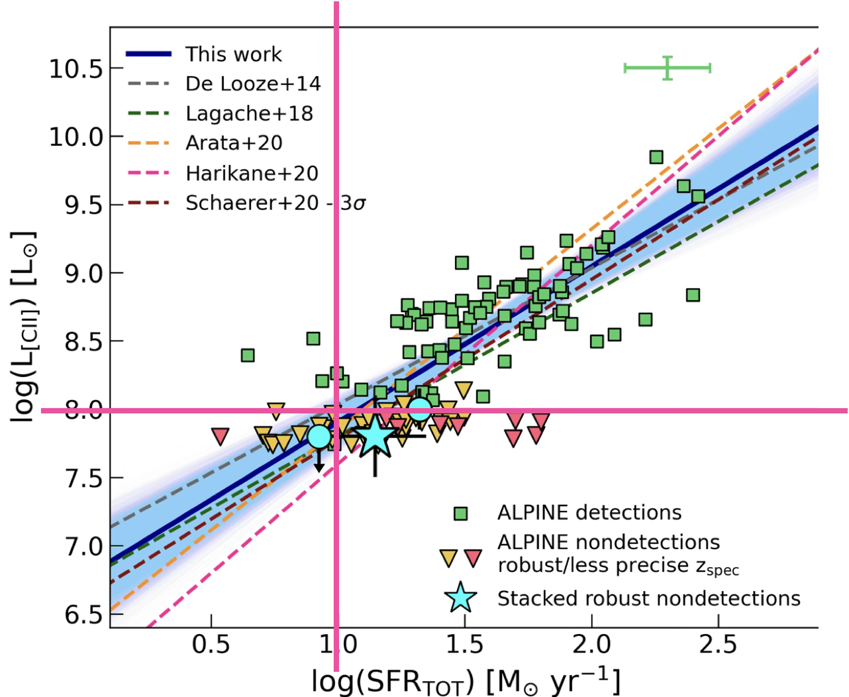
Status: ALMA proposal on interactions at z > 4 (Louise)
Sample: galaxies in different interactions/merger stages
Selected 40 galaxy pairs (r_sep = 0-30 kpc) in COSMOS-Web at z>4, from which 1 member has spec-z
(To do) Combine with merger sample of Laura, Antonello et al.
Observations: dust continuum + [CII] line with ALMA Band 7
Scientific questions:
Do interactions affect high-z star formation activity?
Probe the “duty cycle” of mergers that is found in SPICE, with bursts of SF and emission lines (would need more details about that)
How does the ISM respond to these interactions?
(Are these real pairs?)
From Romano+ 2022; from the ALPINE survey
including stacking results of none-detections.

