Slide 1
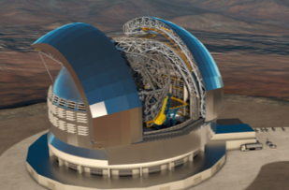
STILES
"Dalle Stalle alle Stelle":
The New INAF Infrastructures for Concurrent Design and Multi-Wavelength Control Systems
Christian Eredia, Enrico Cascone, Liana De Filippis, Vincenzo Cianniello, Andrea Baruffolo
17/03/2026

Slide 2
Concurrent Design Facility
Activity | Name | Activity Leader
3201 | ConcurrentDesignFacility_PrimaryNodeOACN | Enrico Cascone
3202 | ConcurrentDesignFacility_AncillaryNodeOABR | Marco Riva
Control Software Infrastructure
Activity | Name | Activity Leader
3401 | CtrlSWInfra_OAAb | Matteo Canzari
3402 | CtrlSWInfra_OAA_ | Carlo Baffa
3403 | CtrlSWInfra_OACt | Simone Riggi
3404 | CtrlSWInfra_OACN | Giulio Capasso
3405 | CtrlSWInfra_OAPd | Andrea Baruffolo
3406 | CtrlSWInfra_OATs | Paolo Di Marcantonio

Slide 3
3200 – Infrastructures for Concurrent Design in INAF
“Systematic approach to integrated multi‐disciplinary system development that emphasises the response to customer expectations and embodies team values of co‐operation, trust and sharing in such a manner that decision making is by consensus, involving all perspectives in parallel from the beginning of the system life‐cycle”
Definition of concurrent design according to
ECSS-E-TM-E-10-25A - Engineering design model data exchange – CDF

Slide 4

Concurrent design
Co-location of all the actors involved in a project (from system engineering to project management, from subsystem experts to customers and end users)
Busy week sessions divided into iterations to define a model of the system
All stakeholders (including final users/customers) can follow the design process as it develops, optimising interactions and convergence of results
“Systematic approach to integrated multi‐disciplinary system development that emphasises the response to customer expectations and embodies team values of co‐operation, trust and sharing in such a manner that decision making is by consensus, involving all perspectives in parallel from the beginning of the system life‐cycle”
ECSS-E-TM-E-10-25A - Engineering design model data exchange – CDF

Slide 5
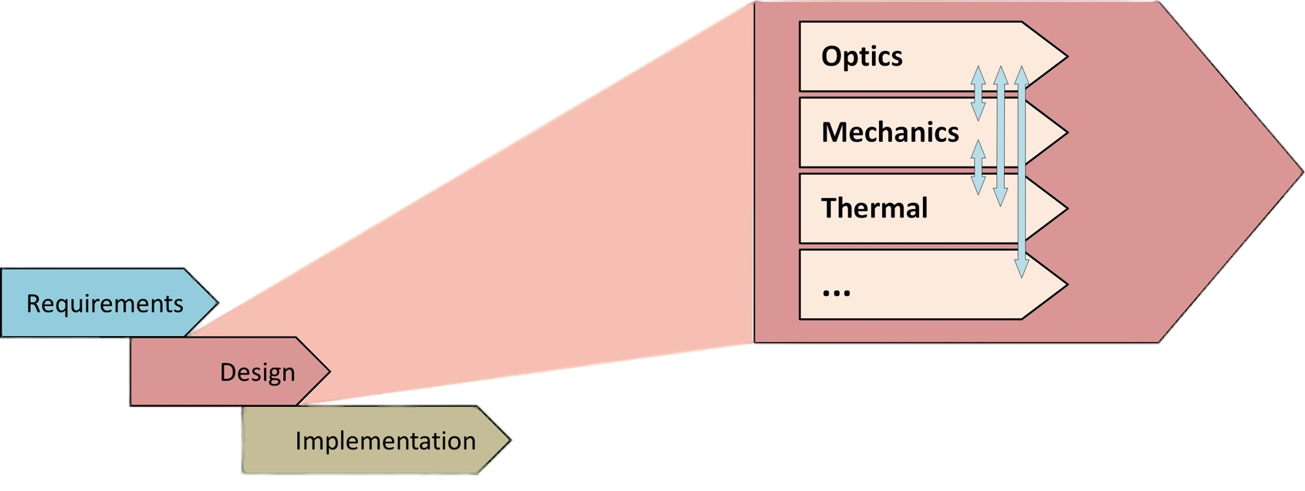
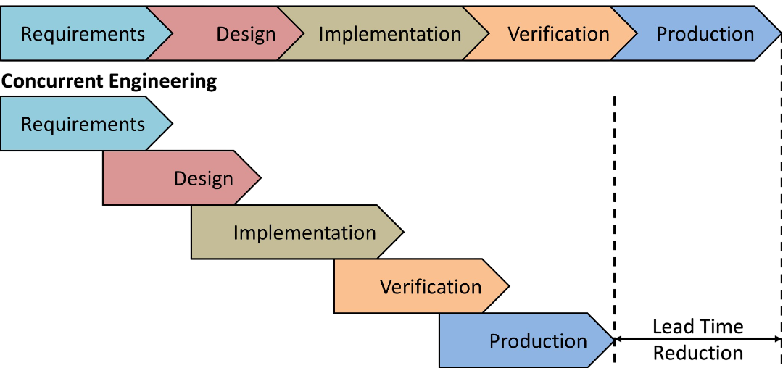
Concurrent design
The aim is to surpass the sequential structure of both phases and interactions, gaining in development time and overall quality of teamwork.

Slide 6
Concurrent design – A timeline
1998
The first Concurrent Design Facility (CDF) is built by the European Space Agency
2000 - …
Various facilities built by companies and research institutes following the ESA model
2010
Model based data exchange standard (ECSS-E-TM-E-10-25A) for concurrent design is published
2022
Start on work to define a new concurrent design paradigm for ground based instrumentation in INAF
2026
Inauguration of the INAF OACN CDF

Slide 7
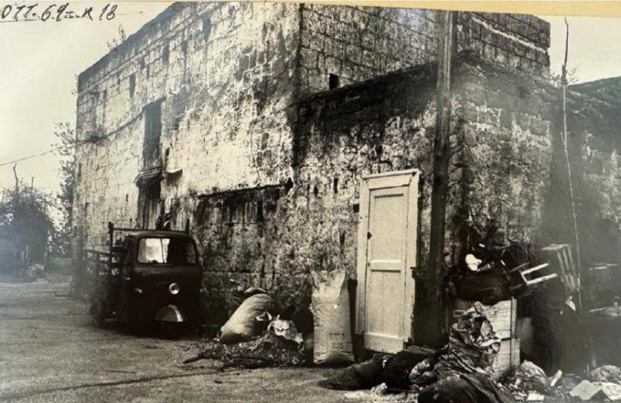
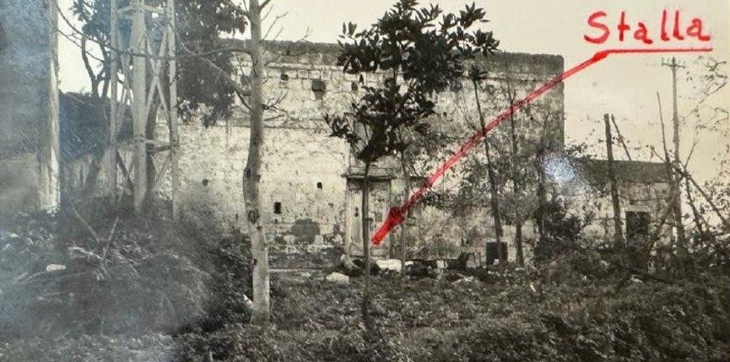
The INAF OACN Concurrent Design Facility
Dalle stalle…
1969-1970

Slide 8
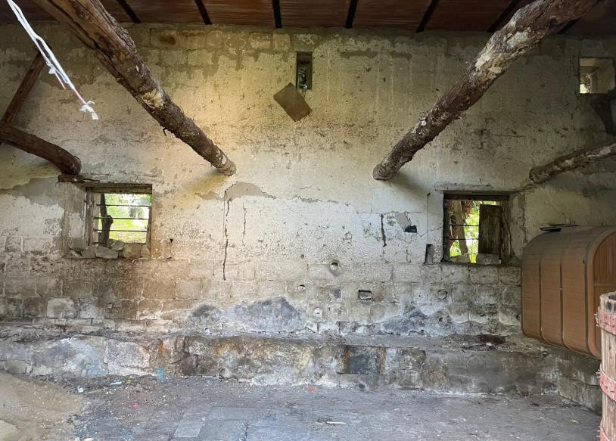
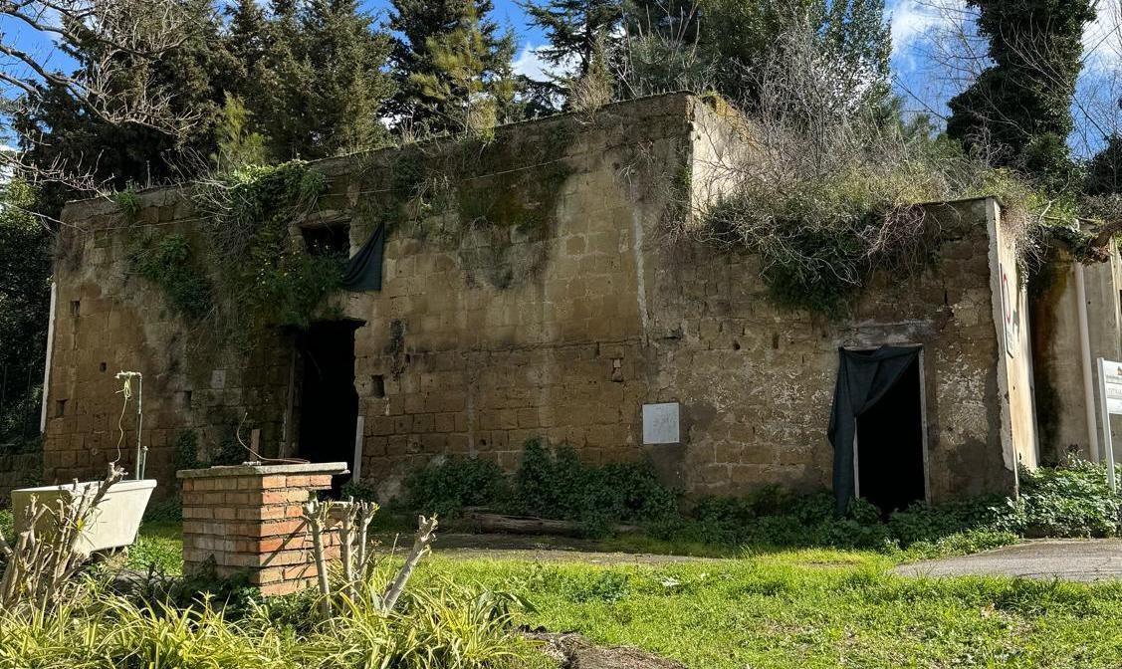
The INAF OACN Concurrent Design Facility
Dalle stalle…
2022 – Before STILES

Slide 9
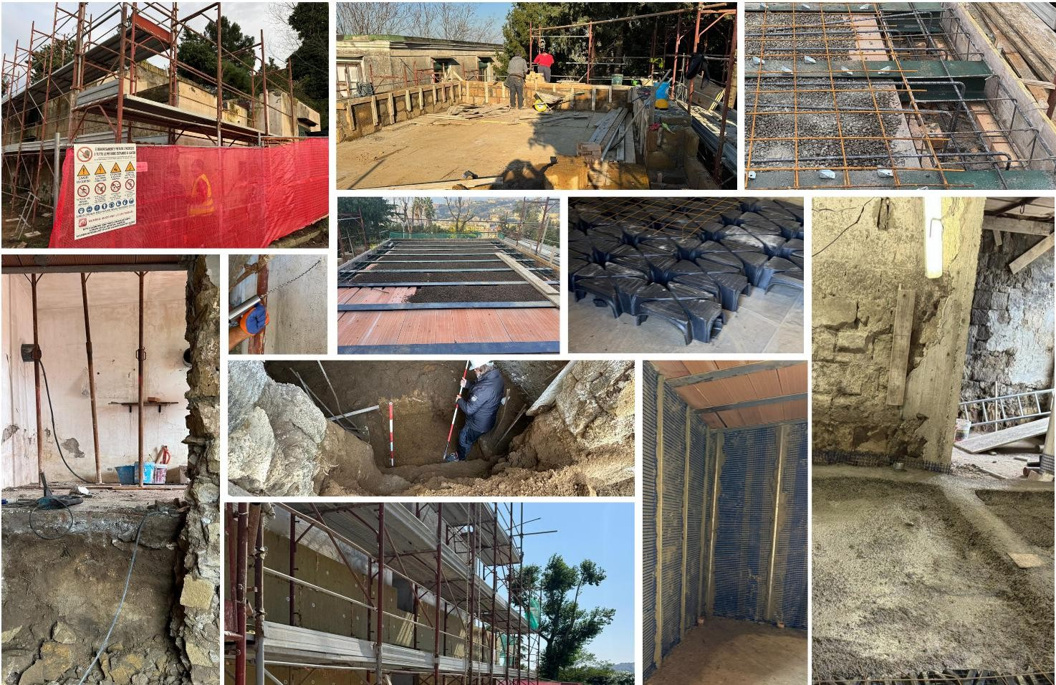
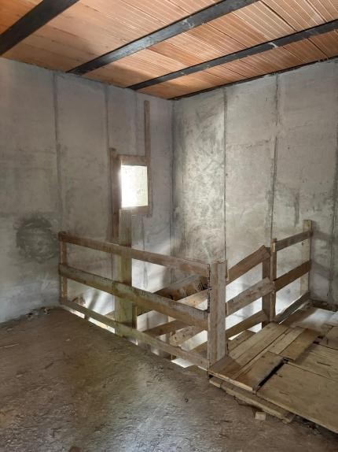
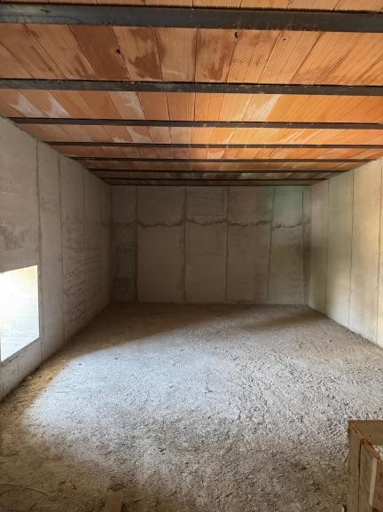
The INAF OACN Concurrent Design Facility
…alle stelle
Restoration work at the facility (2024-2025)

Slide 10
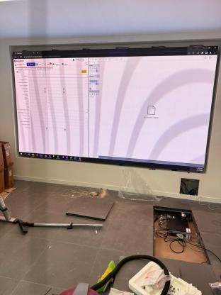
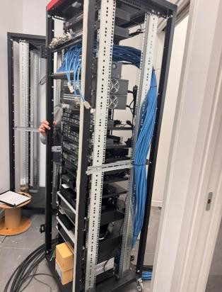
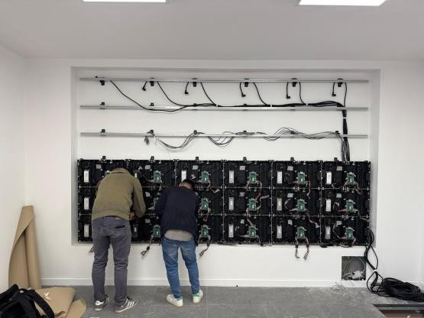
The INAF OACN Concurrent Design Facility
…alle stelle
Technical installation at the facility (2025)

Slide 11
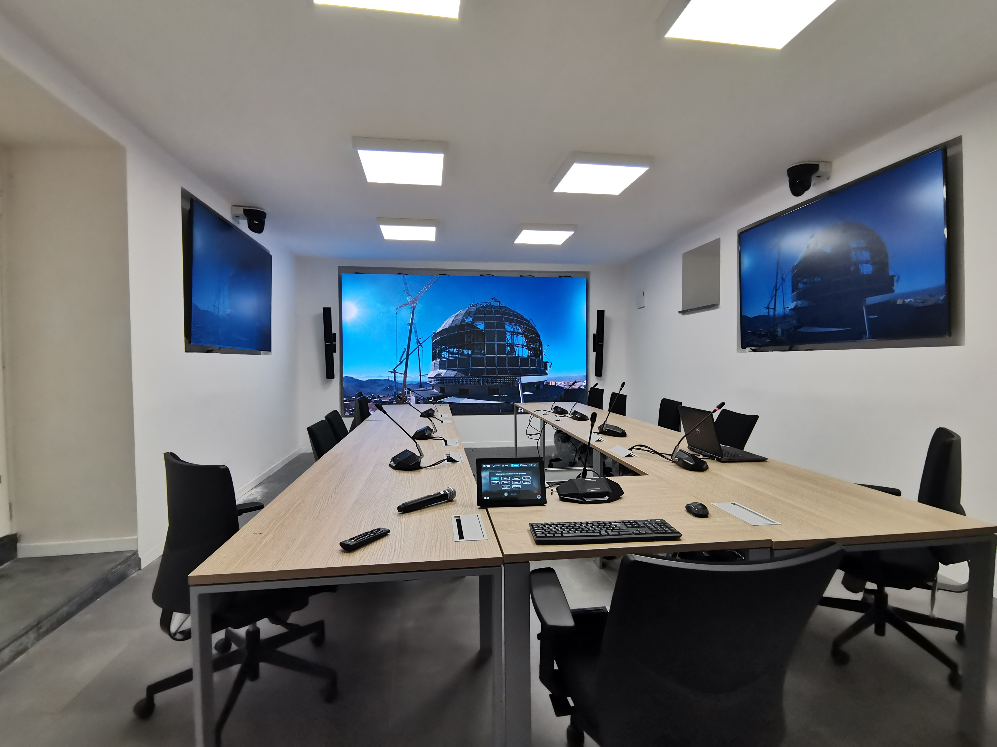
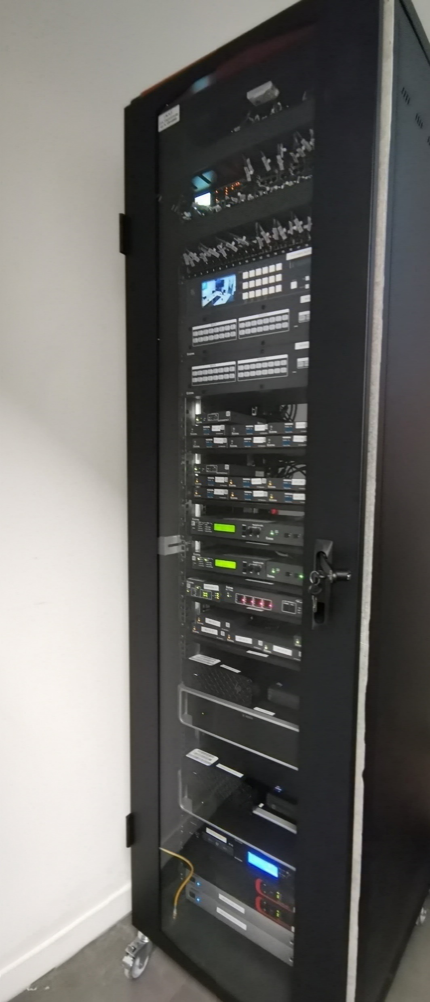
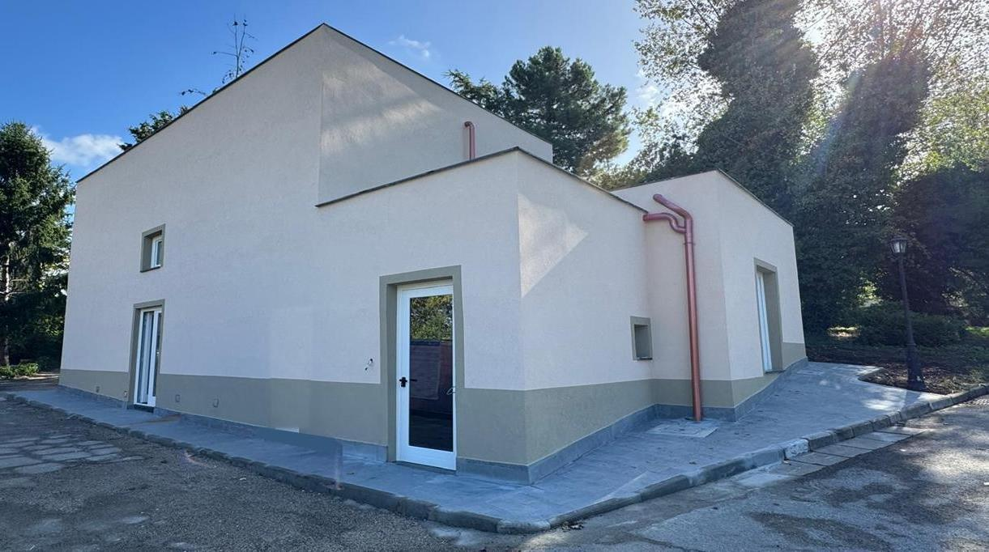
The INAF OACN Concurrent Design Facility
…alle stelle
The finished INAF OACN CDF (2026)

Slide 12
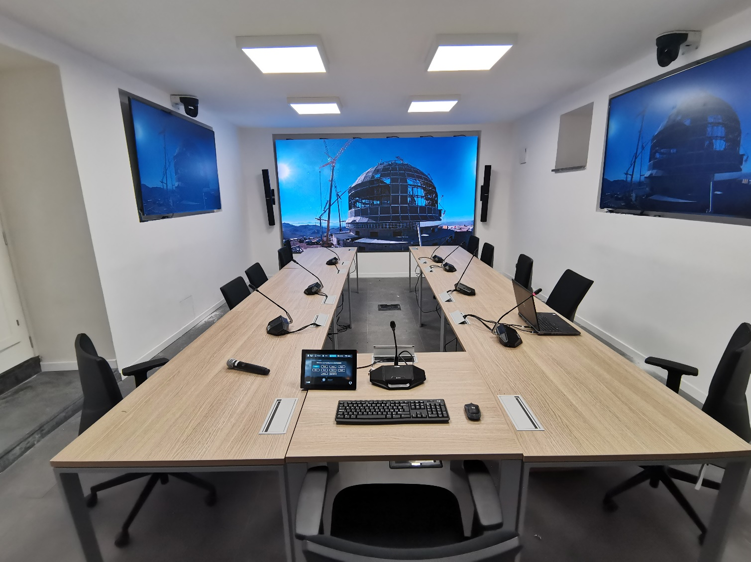
The INAF OACN Concurrent Design Facility
Audio-video infrastructure to support content sharing between members of the team.
Two rooms that can work independently or together
13 seats per room (6 domains of expertise + concurrent design facilitator)
Smartboard for brainstorming in early sessions.
Front and lateral screens can be used by any participant to share their work and to present.
Supporting labs for better understanding and visualisation of the model (additive manufacturing, virtual reality).
Videoconference system allows for hybrid sessions with people connecting from remote (or other facilities).

Slide 13




INAF Concurrent Design Facilities
Networks of facilities that can work independently or together:
OA Capodimonte Primary Node (STILES – 3201)
OA Brera Ancillary Node (STILES – 3202)
OA Cagliari Ancillary Node (STILEMI - coming soon…)
Exchange of data to facilities outside of INAF is possible thanks to ECSS-E-TM-E-10-25A - Engineering design model data exchange – CDF standard

Slide 14

Software tool for concurrent design
The concurrent design software is a model-based system engineering (MBSE) tool where the model is built and traced during the engineering session.
It is also the main point of data exchange between all participants to the sessions.
ESA and INAF facilities employ CDP-4 COMET from Starion.
The concurrent design software does NOT replace the specific domain tools.

Slide 15
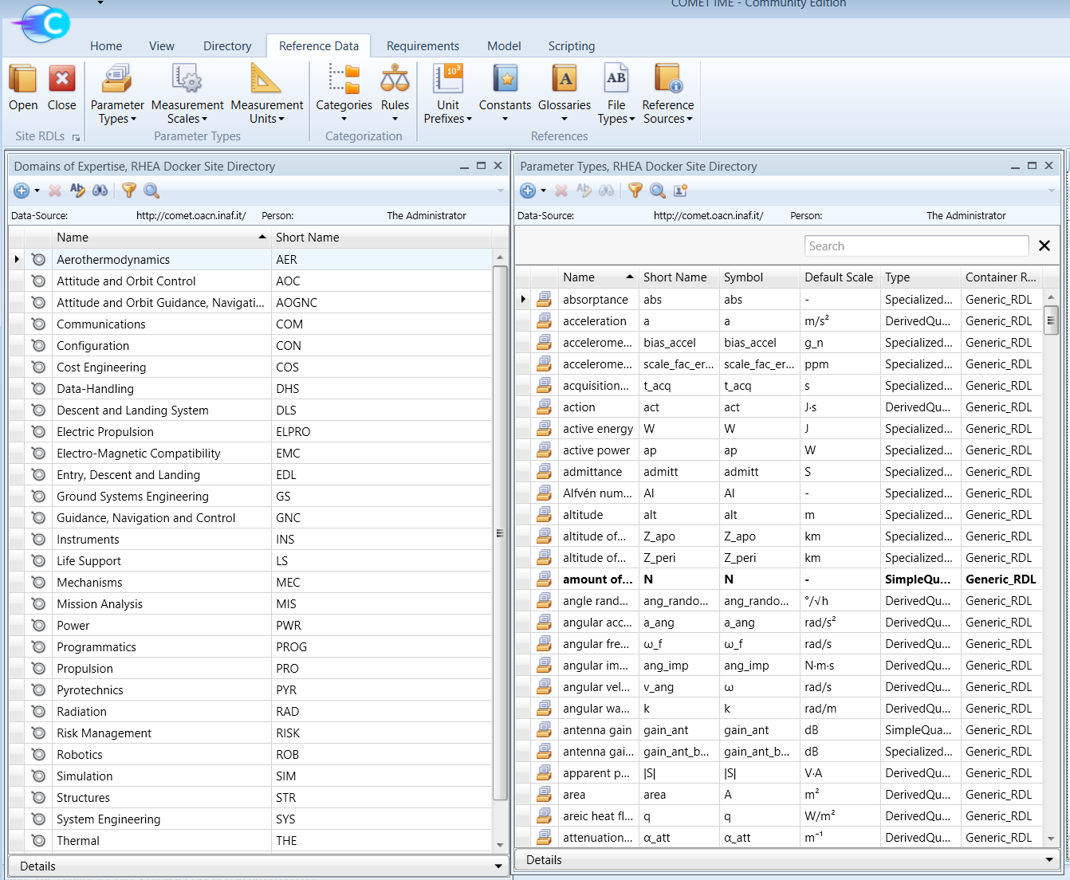
Software tool for concurrent design
CDP-4 COMET is an open source software.
It allows, among other things, the definition of:
Participants to the concurrent design session and roles with different access rights to the model
Requirements
Domains of expertise
Elements (the bricks of the model)
Parameters that characterise the elements and define the interdependencies between the domains
A reference data library for space applications (according to the ECSS standard) is already implemented. The library can be expanded for any application.
The COMET Integrated Modelling Environment application User Interface

Slide 16
Concurrent design - Phases
Interactions between domain experts and other stakeholders
Publishing of updated parameters for each discipline
Presentations by domain experts
Closing of iteration
Start of work from current model
Preparation
First definition of model and participants
Updated model
Convergence of parameters between all domains
Final report and conclusion
Concurrent design session

Slide 17

Concurrent design – The INAF way
The concurrent design approach has been clearly defined and described in the years for space related applications.
A concurrent engineering paradigm for the design of ground-based instrumentation cannot be, however, a simple copy and paste of the space applications standard, as we have also realised through our interactions with ESA and the wider concurrent design world (including participation to the ESA concurrent design challenge and to the Systems & Concurrent Engineering for Space Applications Conference in 2024).
The INAF STILES team’s objective is twofold: create both the physical facility to do concurrent design, and define a new standard for ground-based astronomical instrumentation.
The new paradigm will be tested and refined as case studies are managed in the INAF CDF.
New COMET reference libraries, dedicated to ground-based applications, will also be created as part of this work, to be used for future studies.

Slide 18
Concurrent Engineering
Traditional step-by-step approach
Based on strict collaboration between all involved parties
Faster, in terms of development time
More cost effective
Mistakes and/or criticalities are identified in early design phases
Improved quality of interactions
More coordinated definition of technical specifications and design constraints
Better traceability of the design steps
Based on a sequential process among different disciplines
Separation of work, system engineers have to interact with each designer and coordinate them separately
Longer times to flow down design choices to all work groups
Higher chance of independent design choices not being compliant with design phase shifts
Increase of costs due to the criticalities listed above
The concurrent engineering approach is versatile: it is useful for early concept definition, but also in later phases, to guide any aspect of the design and trade-off processes.

Slide 19
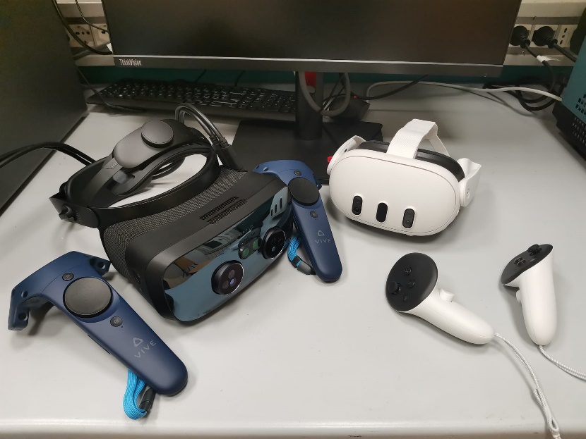
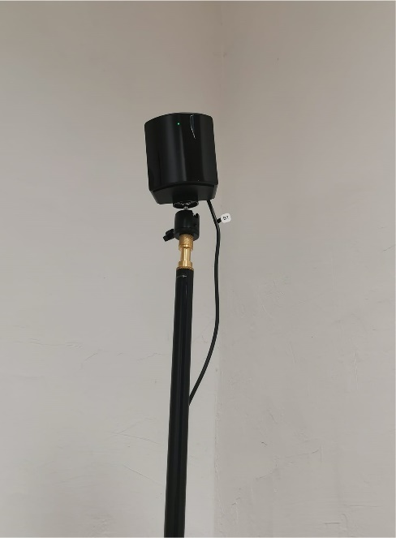
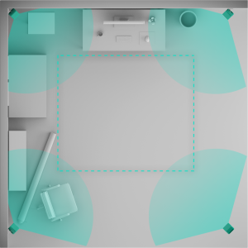
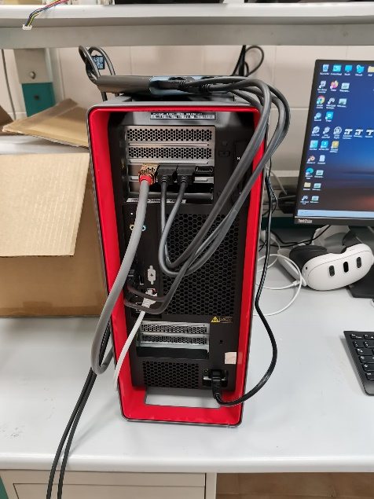
eXtended Reality laboratory
Headsets
Cabled and stand-alone, for both MR and VR applications, with integrated hand-tracking.
Tracking system
Four base stations to be put in the corners of the room.
2x Workstation
3D rendering of the environments

Slide 20
WP 3400 - Control Software Infrastructure
Aim: consolidation and expansion of the infrastructure for prototyping, development, test and validation of control software for astronomical telescopes and instruments in the radio and optical domains.
Main focus: SKA & ELT
Six activities, reference INAF sites:
3401 OA Abruzzo
3402 OA Arcetri
3403 OA Catania
3404 OA Capodimonte
3405 OA Padova
3406 OA Trieste

Slide 21
WP 3400 - Control Software Infrastructure
Total funding: ~700K€
Acquired hardware:
Multi-processors, multi-cores severs with and w/o GPUs for algorithms prototyping and development
Servers for provisioning of Virtual Machines and SW containers
Hardware controllers (e.g. PLC) and laboratory equipment (Master Clock, Test Benches, …)
Auxiliary components (storage, network switches, …)
Personnel: 1 CTER (activity 3406)
For more details, see dedicated posters.

Slide 22


Next steps
INAF OACN Concurrent Design Facility ready to use for new studies
Potential first projects to exploit the CDF:
SHARP - near-IR multi-mode spectrograph for the next generation ELTs
Concept studies within the "Piccola Missione scientifica italiana“ call
STILEMI - Strumenti, Tecnologie e Infrastrutture di Laboratorio per Esperimenti e Misure Innovative
Upgrade of the INAF Concurrent Design Facilities and creation of the INAF OA Cagliari Ancillary Node
Hiring of 2 resources:
Technical management of the facilities, of their upgrade, and of the synergy between the OACN CDF and the Auditorium Nazionale
Development of the INAF methodology for the concurrent design of ground-based astronomical instrumentation

Slide 23

THANK YOU!
Contact points:
christian.eredia@inaf.it
vincenzo.cianniello@inaf.it
enrico.cascone@inaf.it

