Slide 1
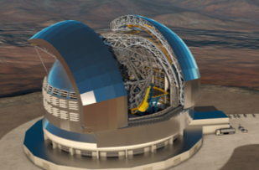
STILES 5401
DATT
Detector Advanced Test Track
Roberto Piazzesi
Fernando Pedichini
17/03/2026

Slide 2
5401-DATT: Detector Advanced Test Track
PNRR has funded 1.156k€
F. Pedichini WP responsible
R. Piazzesi deputy
DATT laboratory
  Dark clean room with optical bench
  Control room
  Enriched opto-mechanical inventory
Measurement bench
  Interferometer
  Spectroscope
Updated workshop
  Machinery
  Enriched tools inventory
Bridge crane | € 74.420
Control computers | € 8.326
Turbulence Injector | € 195.200
Clean room | € 112.445
Supercontinuum LASER | € 10.558
Motorized axes | € 151.493
Optomechanics | € 54.000
Bench, Spectroscope, mirrors | € 91.629
Interferometer | € 95.879
Tools, off-axis parabolas | € 139.787
Sources, DLP & software | € 81.740
Cromatique source & qORCA detector | € 139.920

Slide 3
Concept: simulate telescope conditions to test detector/instrument
Test bench for detectors/instruments
VIS with some IR capabilities
OB concept for test scripts: repeatability and standardization
Easily reconfigured
DATT
Clean environment
Remote operation
(to a point)
Test detector/instrument simulating real-life targets and optical operating conditions

Slide 4
DATT Layout
Control room
Dark Clean Room (ISO 7+)
Several light sources (LED/LASER/ lamps)
Cromatiq Light engine (custom spectra)
Super-K LASER
Cooling fluid
Control station (PC)
Light mixer (fibers and Int. Sphere)
Optical Fiber feeds
Optical bench (air suspended) 3m x 1.5m
Test platform with Hexapod
Bridge crane (150kg)
“Magic box” f#15
Collimator 100+ mm
Projector diff. limited f#15 - DLP-1M target
Turbulence injector (ALPAO-380)
Shack Hartmann WFS
Point-like and/or extended targets

Slide 5
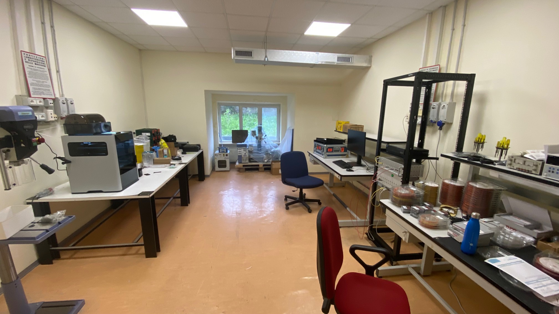
Control Room
Hosts:
Control computer:
  light sources
  clean room motorized axes
  Manage test results and output format
Light sources
Fiber distribution matrix
Workspace and workshop (more on this later…)

Slide 6
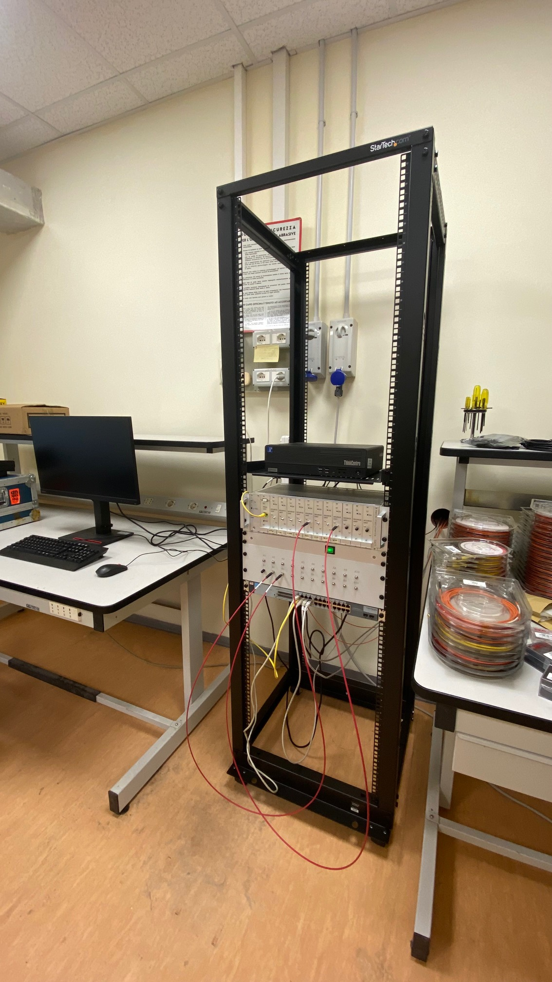
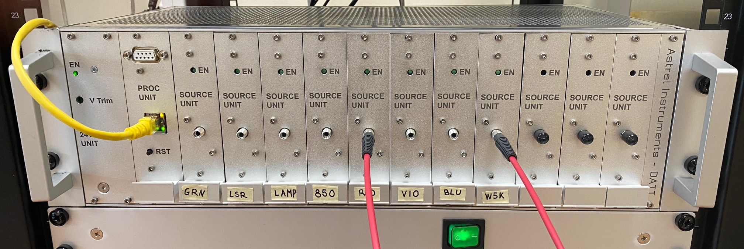
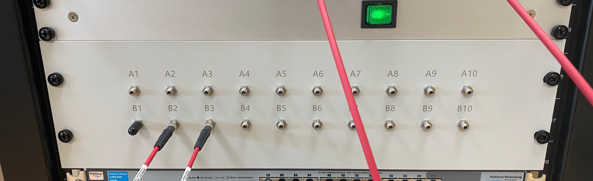
Control Room
Light sources and distribution
Different light sources in rack
Fiber distribution matrix (patch bay) connects control room sources to “Magic box” on optical bench in clean room
Light sources can be split and patched to different outputs on optical bench
LED/LASER/bulbs driver
Fiber matrix and patch bay

Slide 7
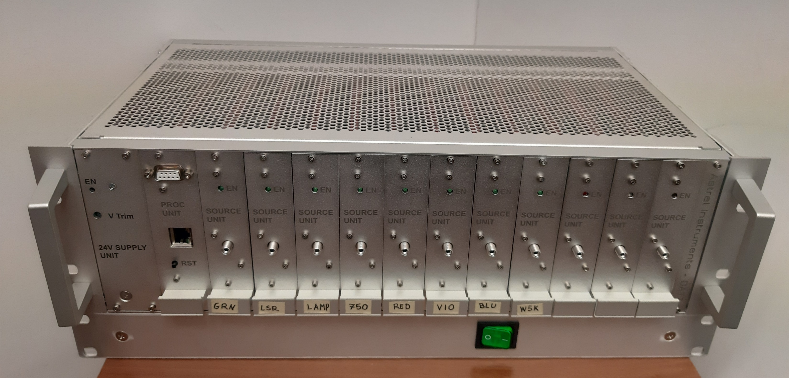
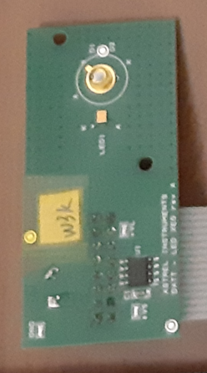
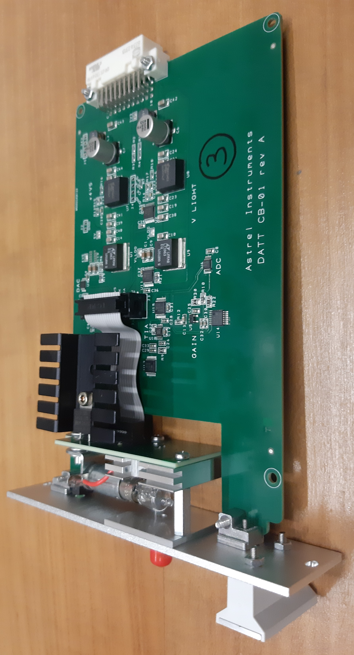
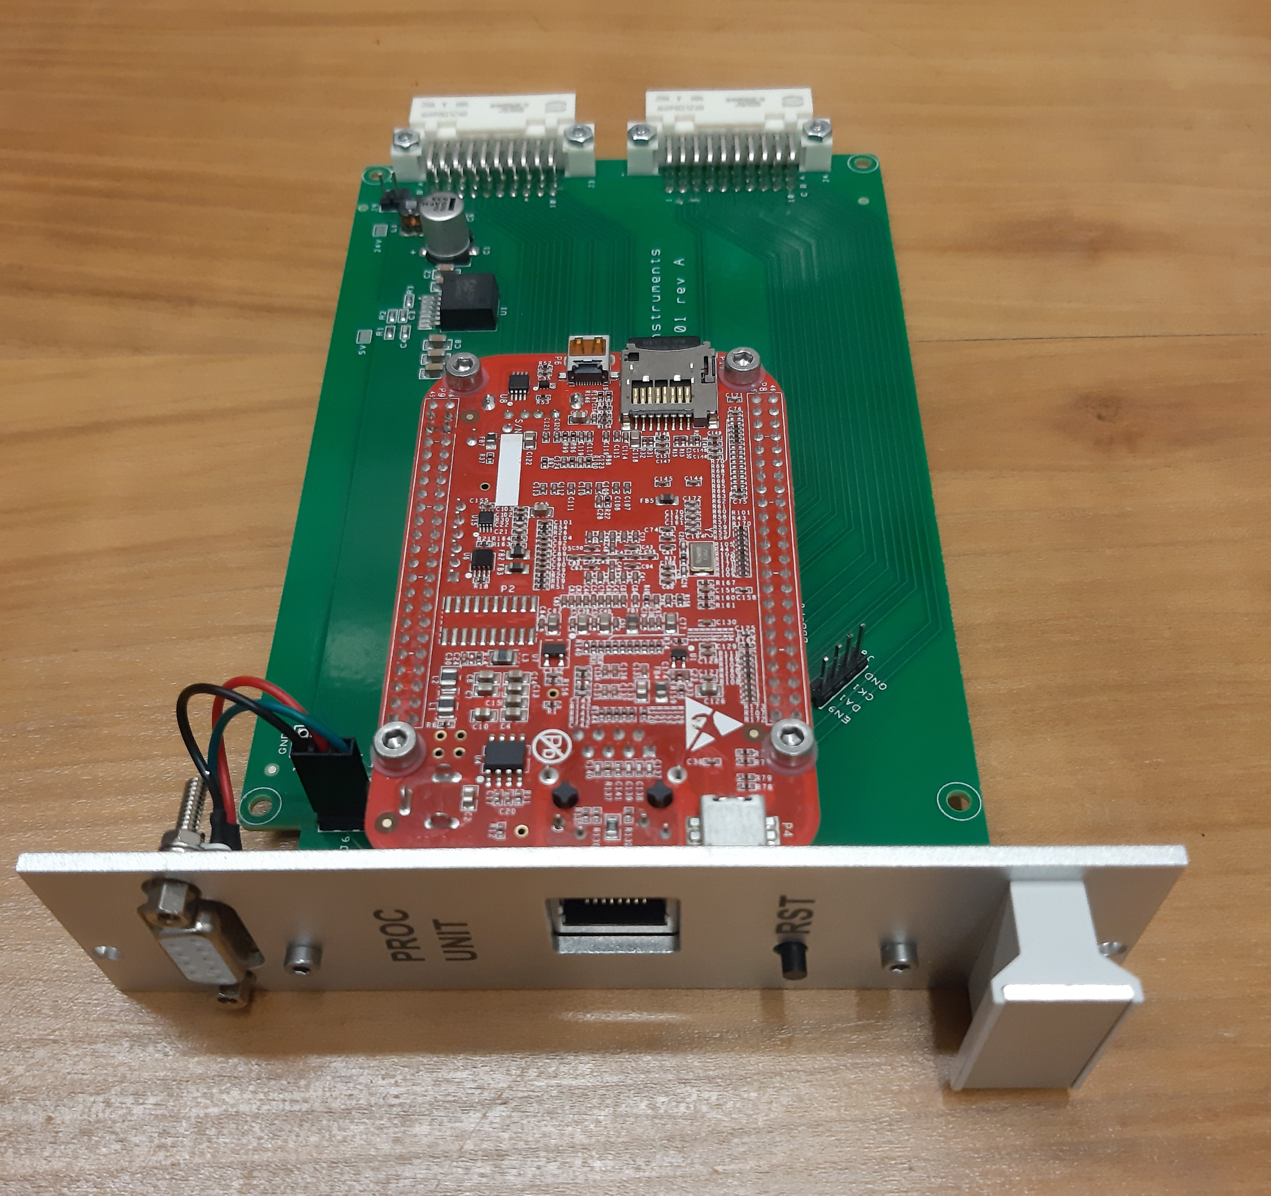

Light sources 1
LEDs/LASERS/Bulbs
TCP/IP control
Drives LEDs, LASERs & bulbs
Closed loop with optical feedback->stability
20bit resolution
SMA optical fiber output
Made by ASTREL & INAF
Light sources rack
BB bulb unit
LED/ssLASER insert with feedback
ETH controller

Slide 8
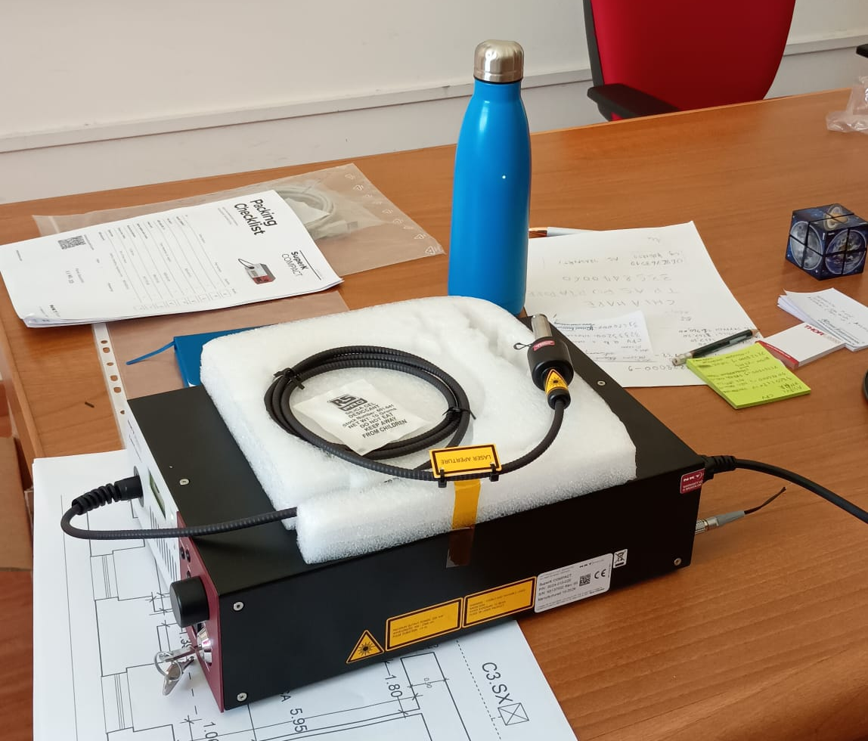
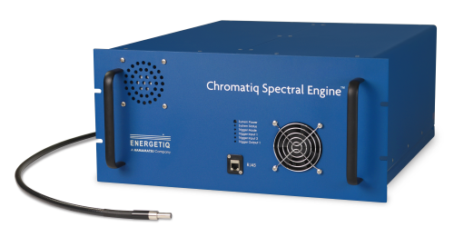
Light sources 2
Super K LASER/Spectral engine
380-800 nm programmable spectrum engine with 3nm resolution by Chromatiq
100mW supercontinuum LASER
Super K LASER
Chromatiq spectral engine

Slide 9
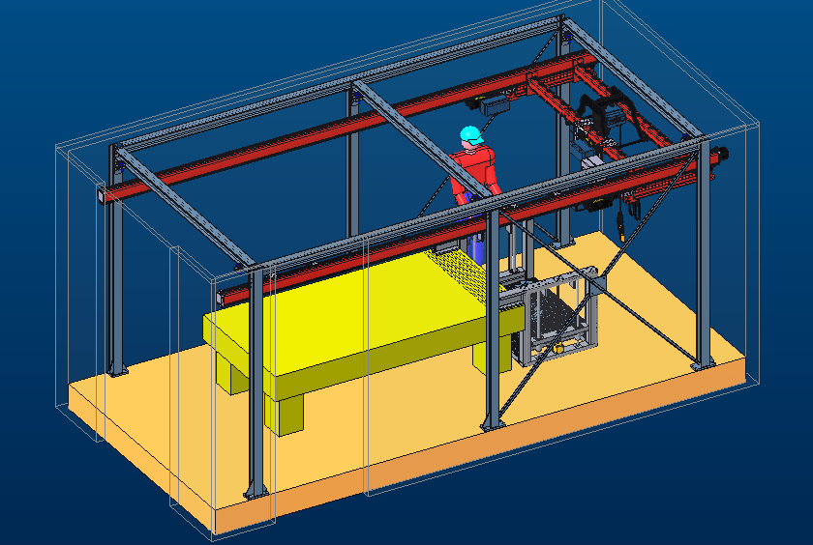
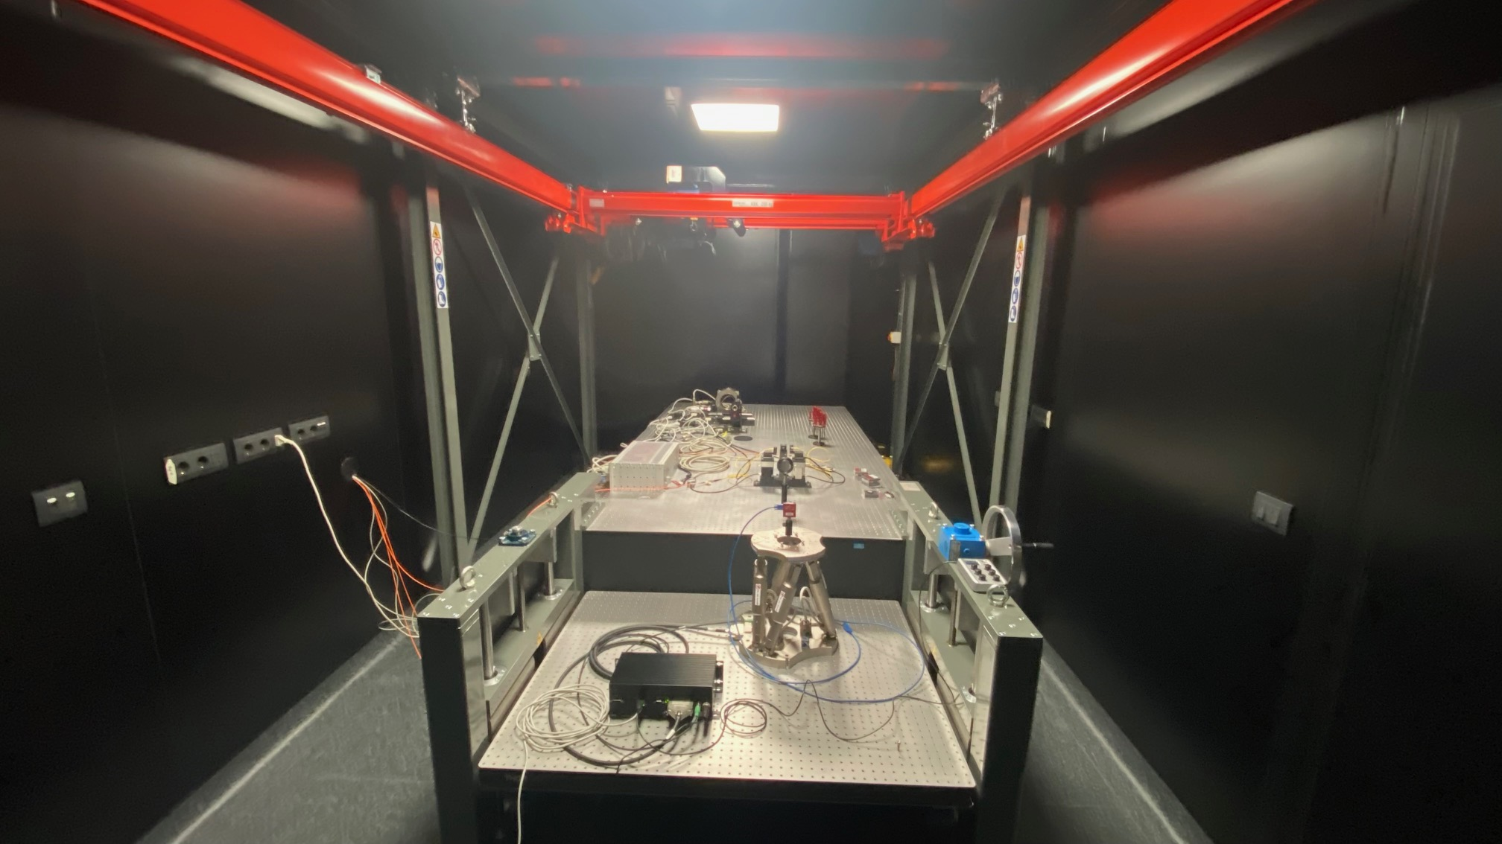
Dark clean room
Bridge crane (200kg) to move equipment and instruments
3m x 1.5m optical bench
Platform with hexapod to host/position detector/instrument

Slide 10
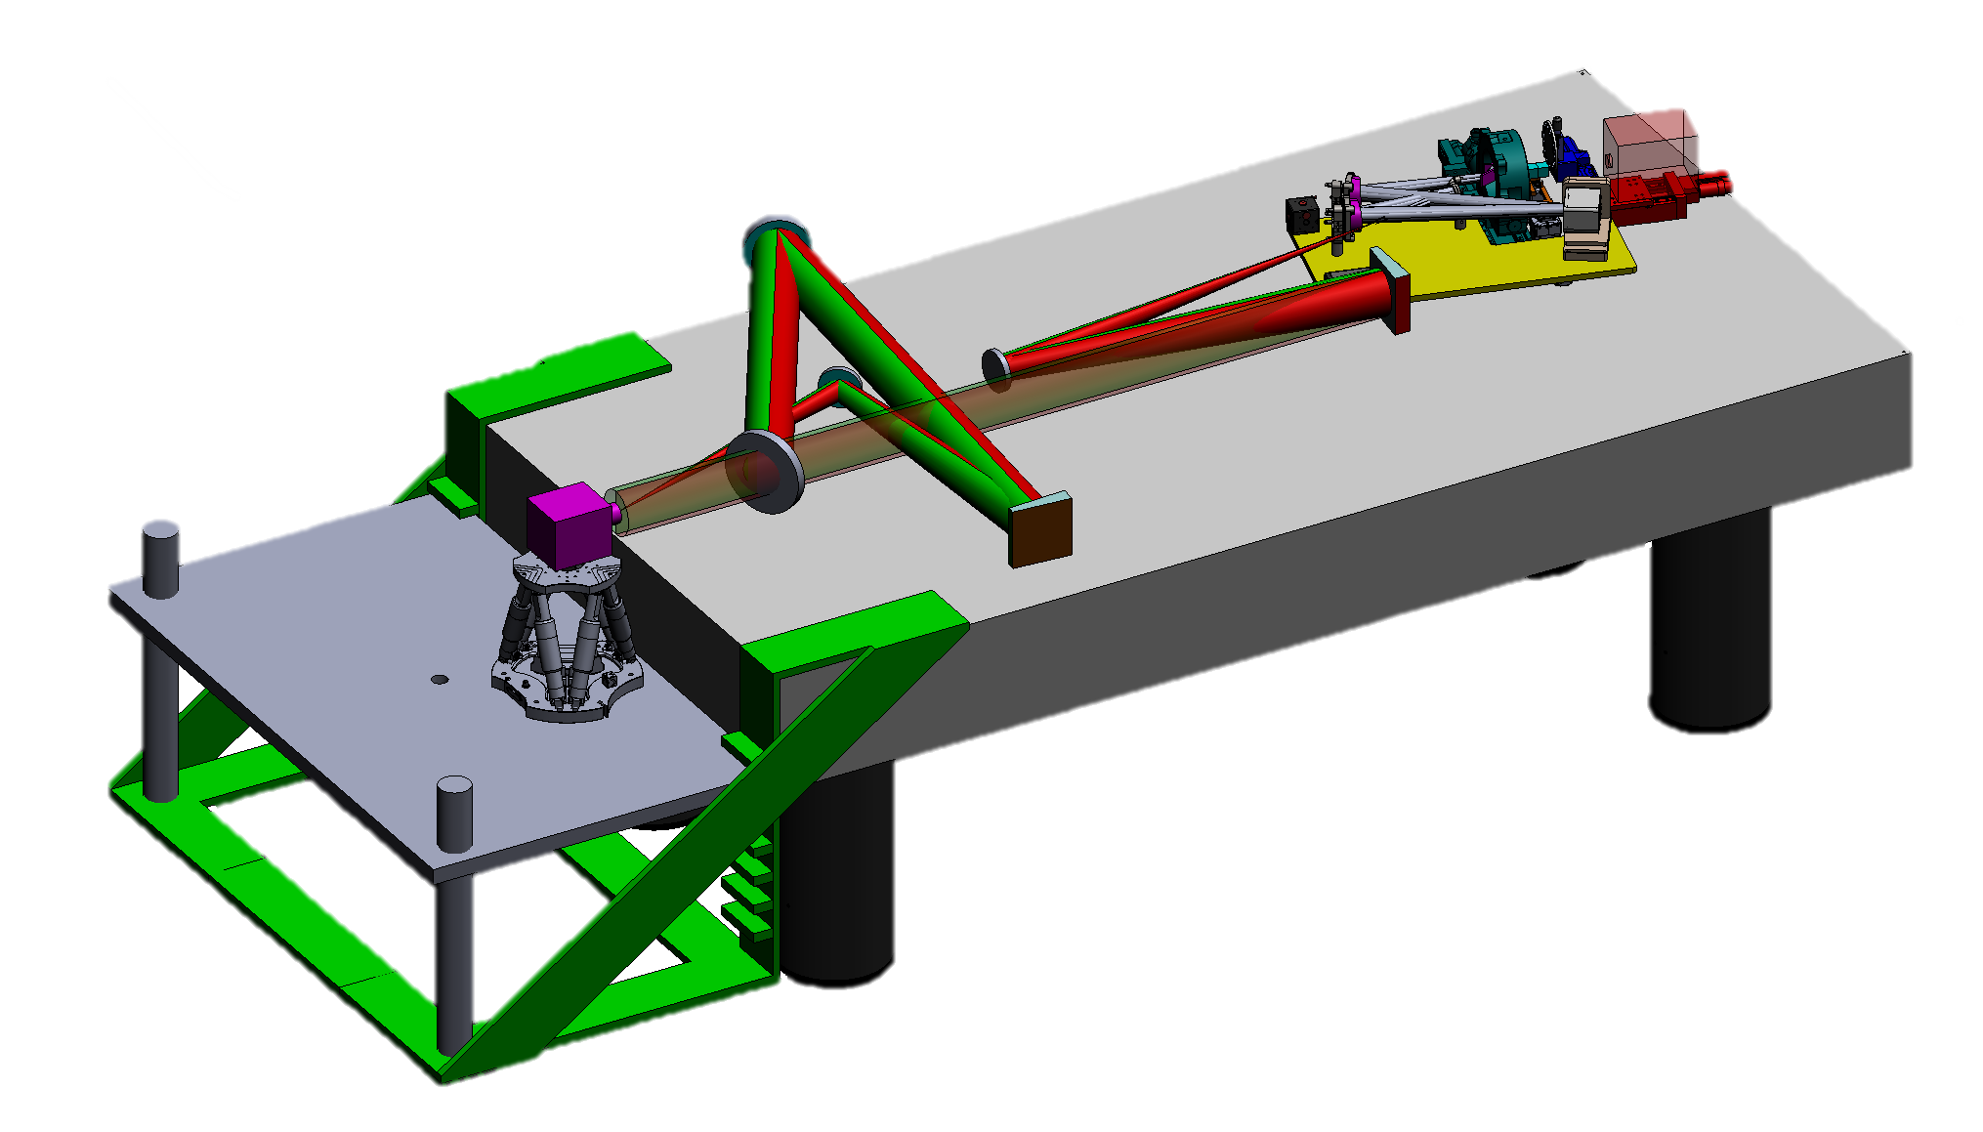
DATT bench layout
Optical relay
Magic box (source):
fiber-fed from Control Room
Turbulence injector
Platform with hexapod
Available:
Collimated beam
Focused beam
Test subject
(detector/instrument)
Movable mirror
(collimated/focused setup)

Slide 11
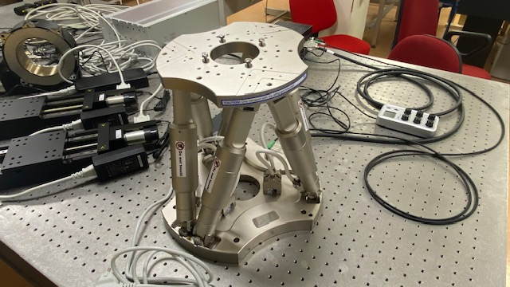
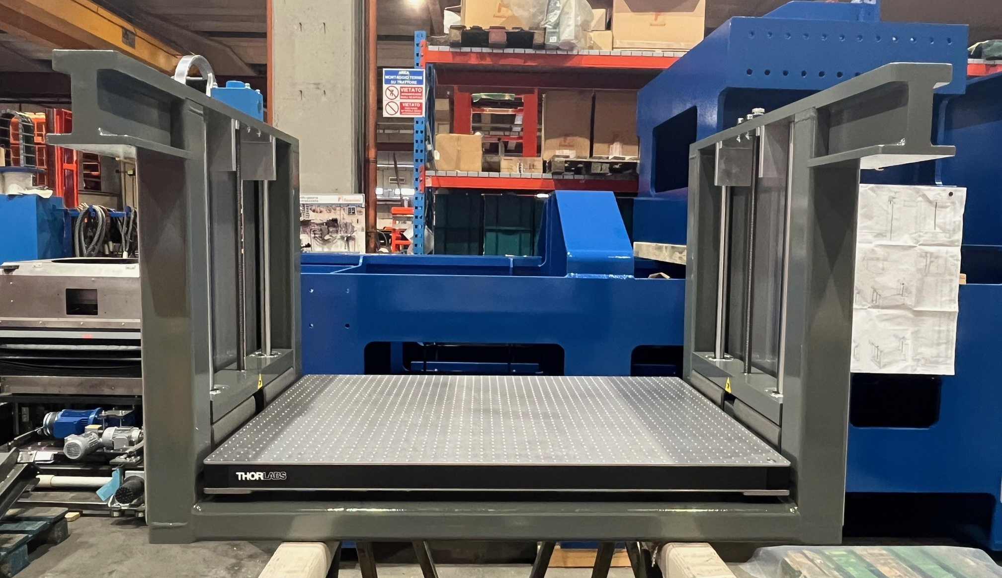
DATT bench layout
Payload Platform + Hexapod (up to 150kg)
800 mm vertical travel
6 DoF
x, y, z: +/- 50mm; 0.3µm steps
r, q, f : +/- 25degrees; 5 µrad steps

Slide 12
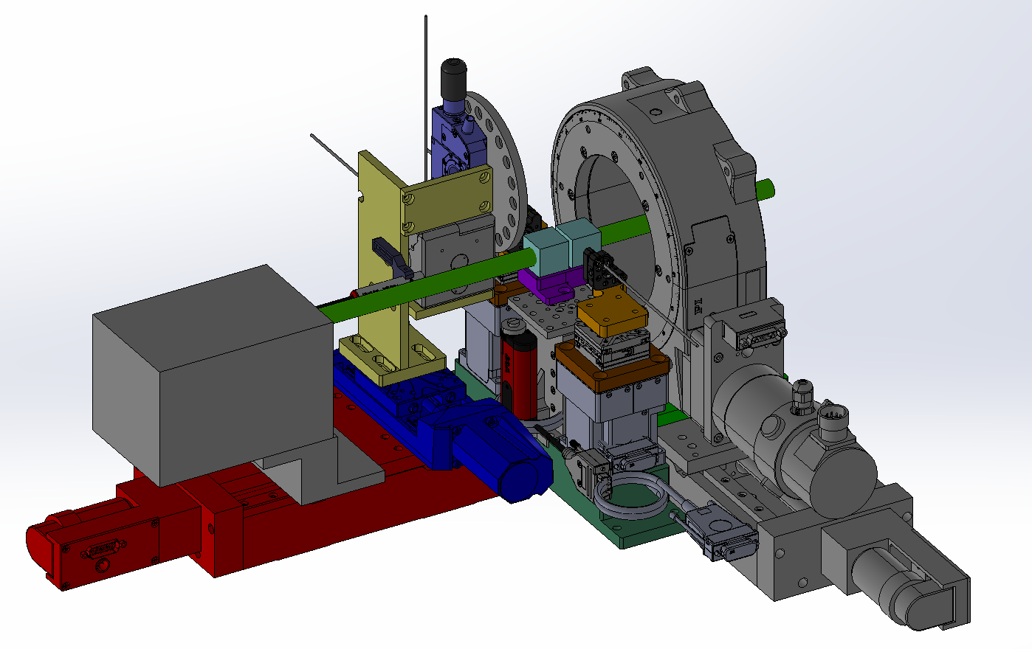
Targets: “magic box”
Fiber-fed by sources in control room
Optically mixes up to 3 sources
  2 point like spots with 3 DoF
  an integrating sphere (sky background) or
  a DLP projector (extended source: SolSys body, galaxy, solar granulation, etc.)
Adds a target/filter wheel
Can rotate the optical field
Can adjust the foci
Has an alignment LASER
Simulates different astronomical targets so detector/instrument can be tested on real life case.

Slide 13
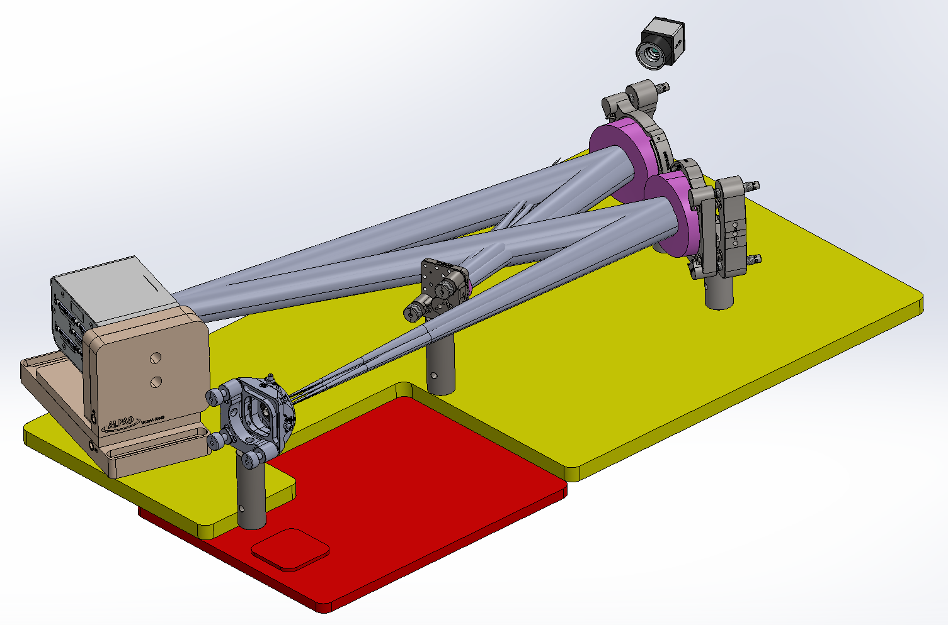
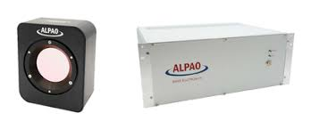
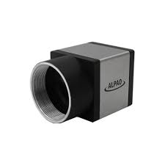
Turbulence injector – ALPAO 380DM
Closed and open loop high-stability operation
Insert atmospheric turbulence
Correct optical bench imperfections
OUT
IN

Slide 14
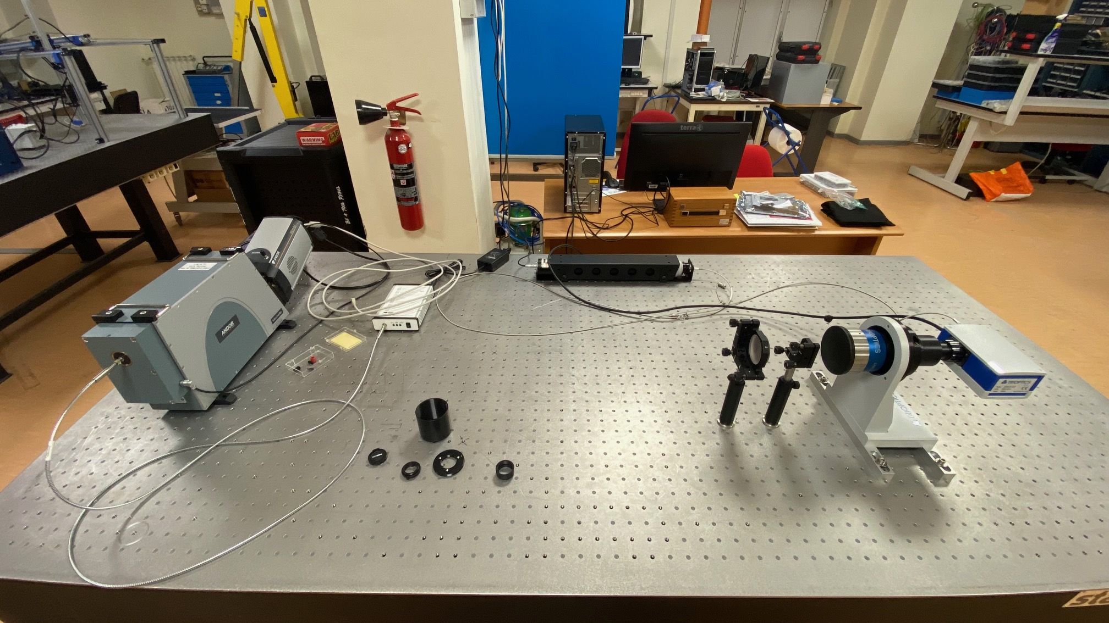
Measurement bench
Spectroscope
ANDOR “Mechelle”
0.2 nm spectral resolution
220-1100 nm bandwidth single-shot
Interferometer
TRIOPTICS Micro Phase 3.3
<1nm WF sensitivity
Easily deployable

Slide 15
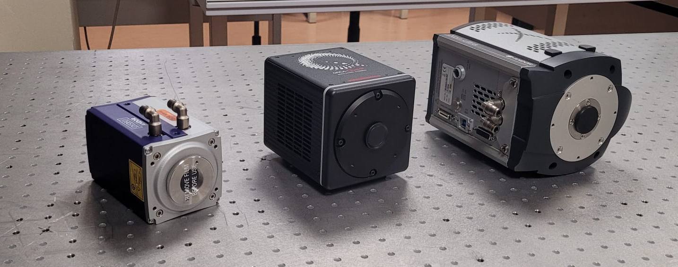
Detectors
Andor Cmos HAMAMATSU qMOS Andor EM-CCDv

Slide 16
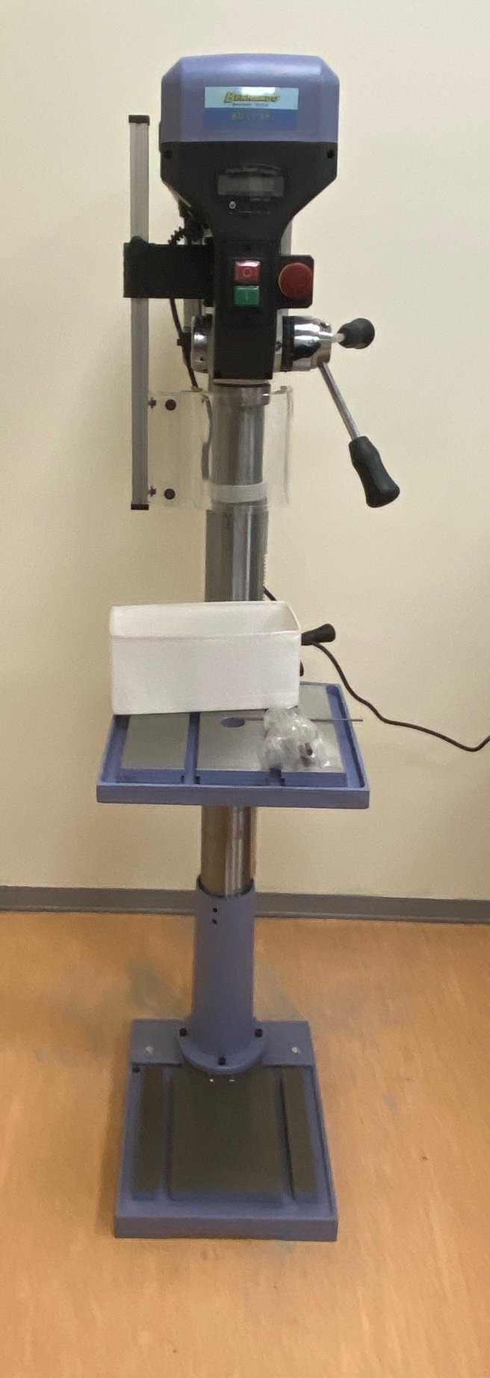
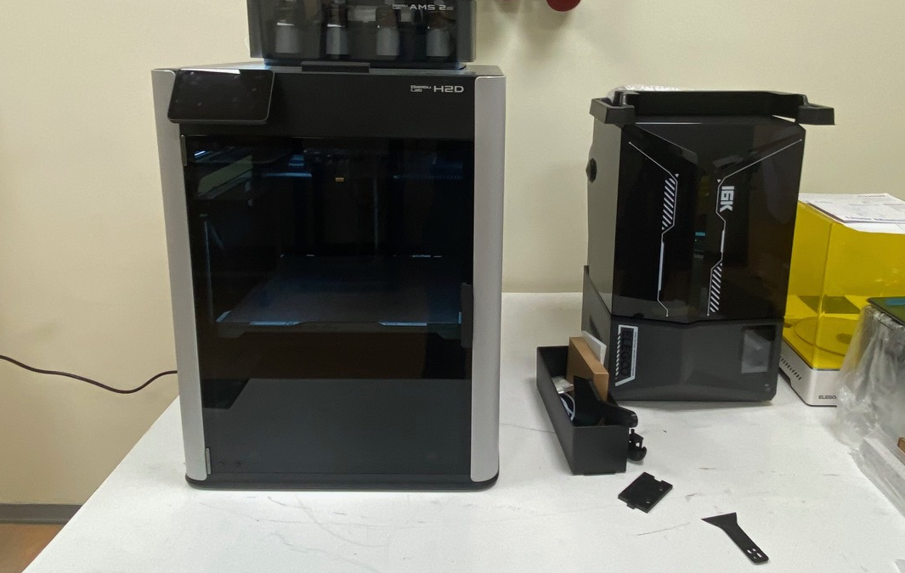
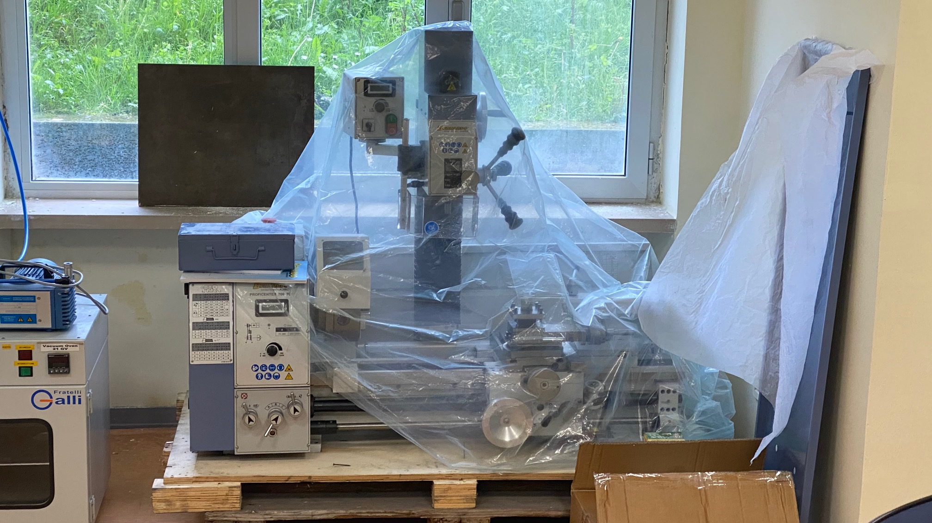
Workshop
Workspace and small workshop on one side of control room
3D printers
Lathe
Vertical drill
Complete assortment of tools
Adaptability of the DATT lab: quick adjustment/manufacture of small components to adapt to sudden needs and reduce down time during tests.

Slide 17
Thank you!

