Slide 1
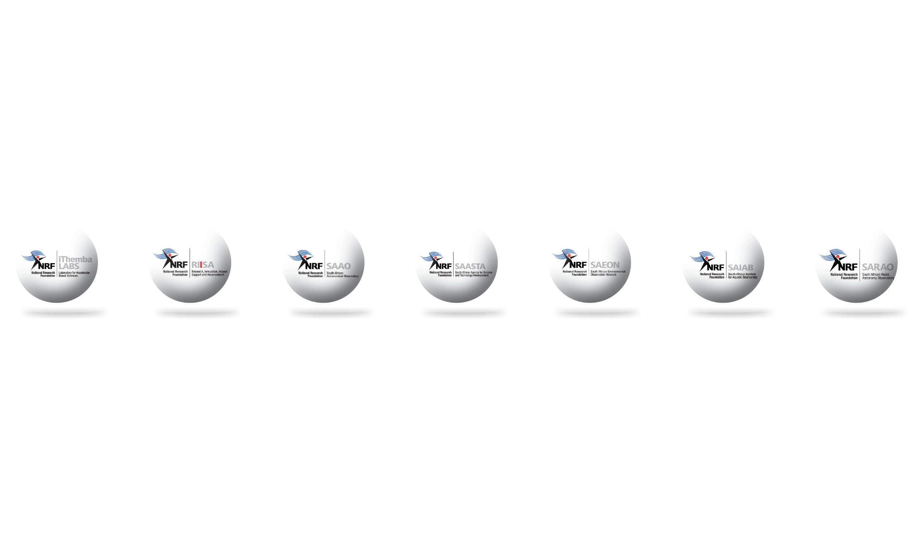
Overview of MeerKAT
STILES workshop
Napoli, Italy
16 March 2026
Sias Malan
Functional Manager: Receiver Systems
SARAO
sias@sarao.ac.za

Slide 2
Talk outline
Overview of SARAO
Introduction to MeerKAT
MeerKAT science
Future plans for MeerKAT
Band 5B capability
MeerKAT extension
Integration with SKAO

Slide 3
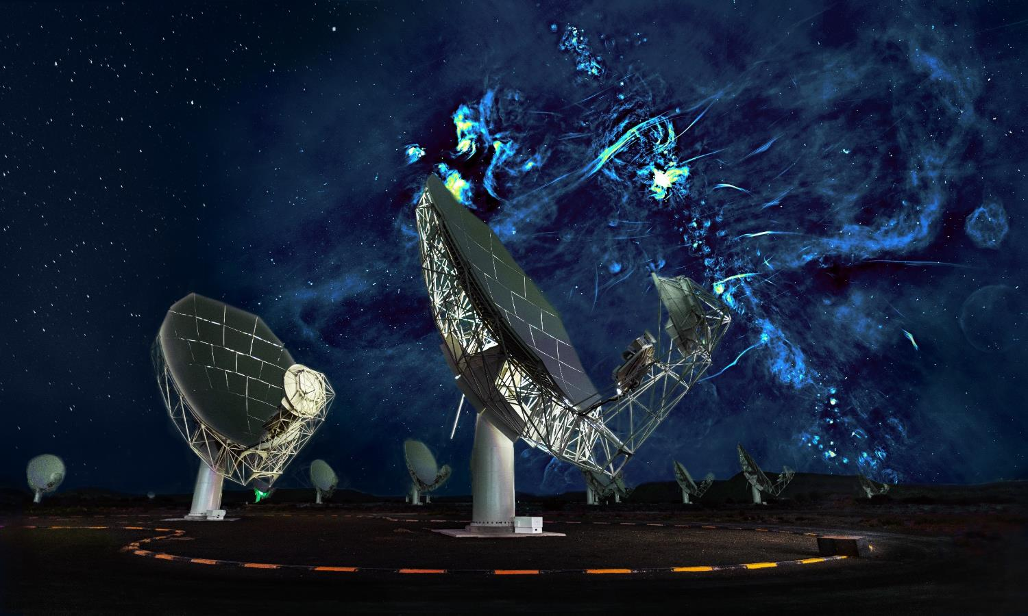
South African Radio Astronomy Observatory (SARAO)
Implements South Africa’s strategic investments in radio astronomy
HartRAO
MeerKAT
SKA
Vision to deliver scientific and technical solutions for astronomy

Slide 4
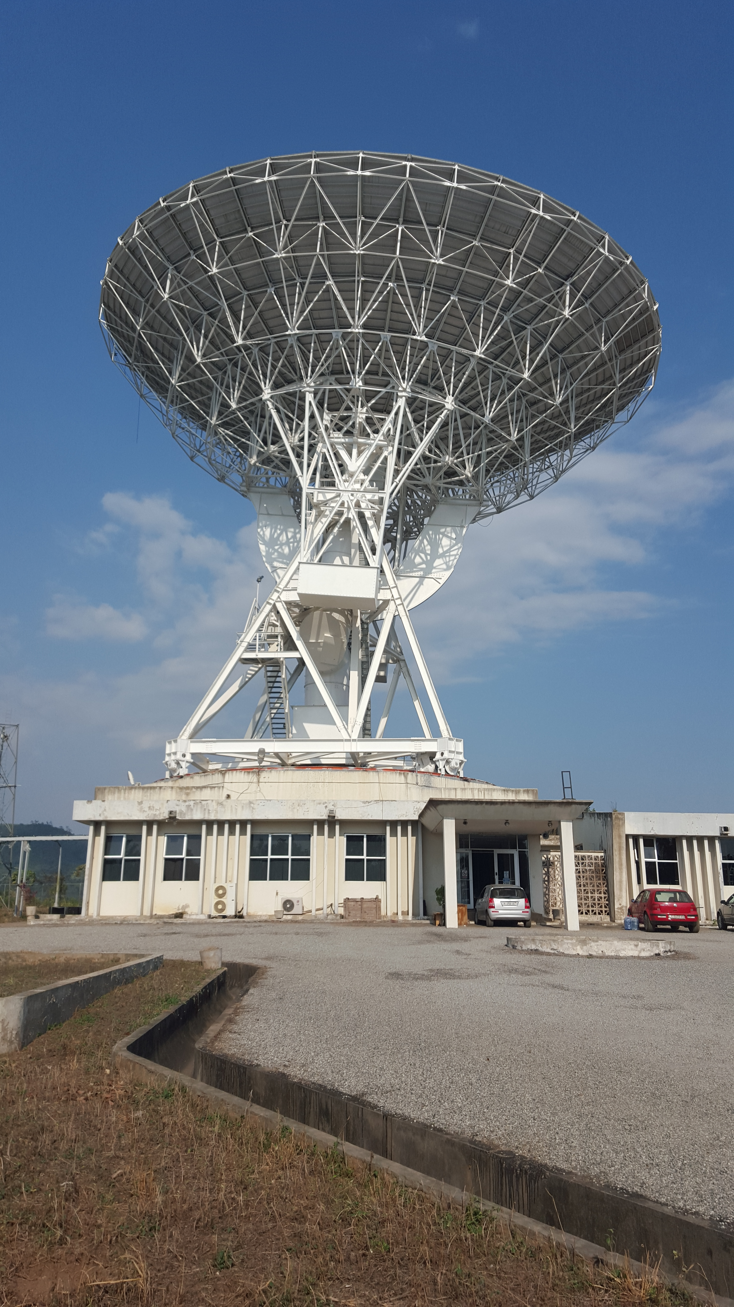
Overview of SARAO
Strategic Activities and Programs
Design, construct and operate radio astronomy facilities
Manage protected areas for hosting radio astronomy facilities
Research and development of astronomy related technologies
Commercialization
Human Capital Development
Communications & Science Engagement
Development of astronomy infrastructure and research capacity in Africa.
Ghana antenna at Kutunse

Slide 5
Overview of SARAO
HCD programme
Established in 2005 in response to the participation of South Africa in SKA
Limited cohort of scientists, and engineers with radio astronomy expertise in South Africa was very small and lacking demographic diversity.
The HCD programme has evolved and is necessarily broad:
(Radio Astronomy) Research Capacity Development
Technical Capacity Development Programme
Strategic Partnerships Programme.
Schools Programme
Notes:
(Radio Astronomy) Research Capacity Development: initiatives at all levels in the academic pipeline – undergraduate, postgraduate, postdoctoral, faculty positions - via three funding instruments: (i) freestanding grants, (ii) research group grants and (iii) research chairs (5: UWC, WITS, UCT, SUN and RU)
-Technical Capacity Development Programme: technical and artisanal qualifications: Bachelors and Diploma in Engineering Technology at universities of technology, and the training of artisans via FET colleges, and training centres such as at NECSA, as well as via SARAO’s ATC in Carnarvon- focused on training in electrical trade
-Strategic Partnerships Programme: radio astronomy skills training in SA and in the 8 SKA partner countries in Africa – via DARA, DARA Big Data, RAAP etc.
-Schools Programme: programmes in schools in the towns close to the SA SKA site in the Karoo, Northern Cape – to enhance Mathematics and Science teaching and Learning – recruitment and secondment of educators, learner bursaries, Maths and Science Camps, Lego Robotics

Slide 6
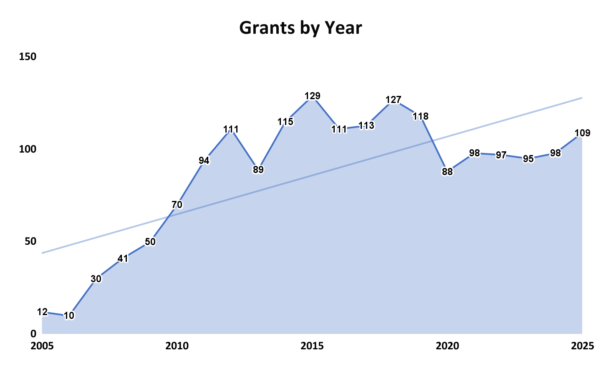
Overview of SARAO
HCD programme
Credit: Kim Anthony, Human Capital Development - SARAO
Notes:
(Radio Astronomy) Research Capacity Development: initiatives at all levels in the academic pipeline – undergraduate, postgraduate, postdoctoral, faculty positions - via three funding instruments: (i) freestanding grants, (ii) research group grants and (iii) research chairs (5: UWC, WITS, UCT, SUN and RU)
-Technical Capacity Development Programme: technical and artisanal qualifications: Bachelors and Diploma in Engineering Technology at universities of technology, and the training of artisans via FET colleges, and training centres such as at NECSA, as well as via SARAO’s ATC in Carnarvon- focused on training in electrical trade
-Strategic Partnerships Programme: radio astronomy skills training in SA and in the 8 SKA partner countries in Africa – via DARA, DARA Big Data, RAAP etc.
-Schools Programme: programmes in schools in the towns close to the SA SKA site in the Karoo, Northern Cape – to enhance Mathematics and Science teaching and Learning – recruitment and secondment of educators, learner bursaries, Maths and Science Camps, Lego Robotics

Slide 7
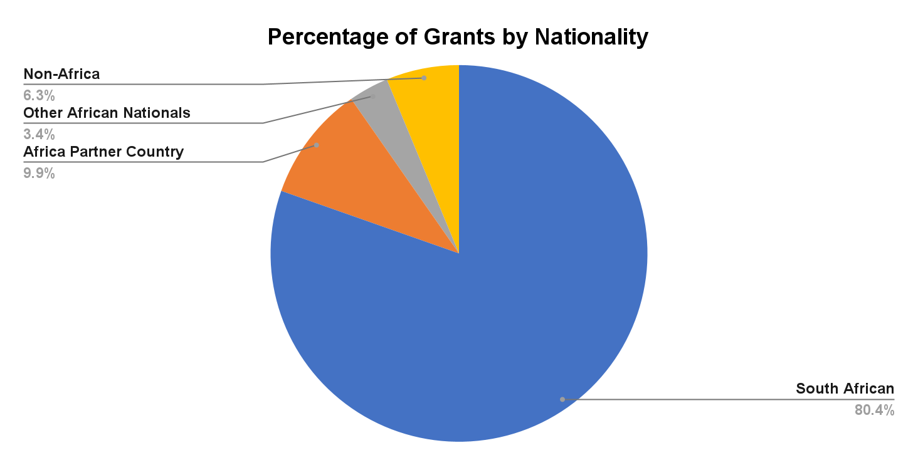
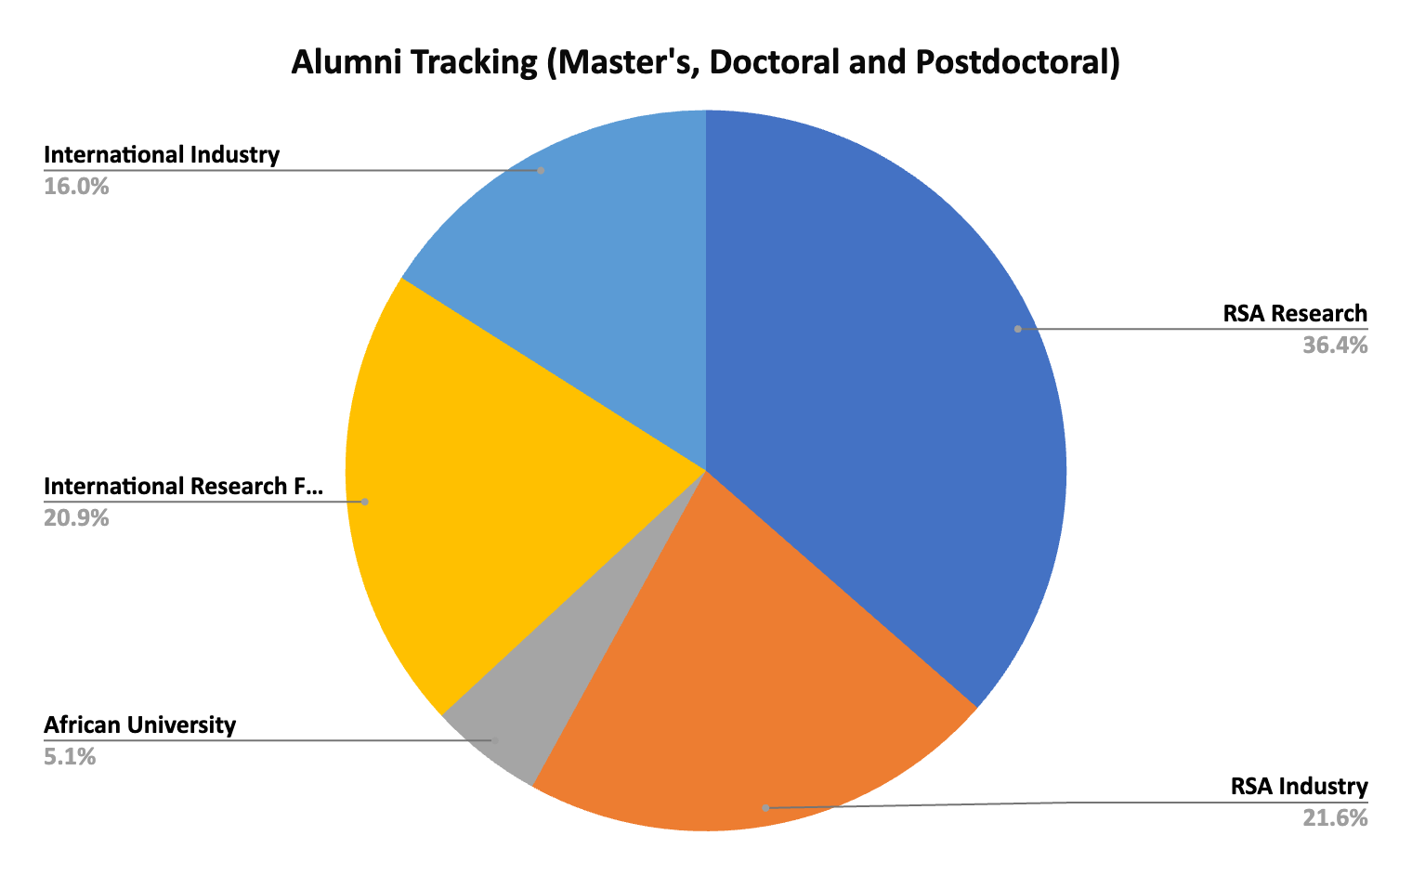
Overview of SARAO
HCD programme
Credit: Kim Anthony, Human Capital Development - SARAO
Notes:
(Radio Astronomy) Research Capacity Development: initiatives at all levels in the academic pipeline – undergraduate, postgraduate, postdoctoral, faculty positions - via three funding instruments: (i) freestanding grants, (ii) research group grants and (iii) research chairs (5: UWC, WITS, UCT, SUN and RU)
-Technical Capacity Development Programme: technical and artisanal qualifications: Bachelors and Diploma in Engineering Technology at universities of technology, and the training of artisans via FET colleges, and training centres such as at NECSA, as well as via SARAO’s ATC in Carnarvon- focused on training in electrical trade
-Strategic Partnerships Programme: radio astronomy skills training in SA and in the 8 SKA partner countries in Africa – via DARA, DARA Big Data, RAAP etc.
-Schools Programme: programmes in schools in the towns close to the SA SKA site in the Karoo, Northern Cape – to enhance Mathematics and Science teaching and Learning – recruitment and secondment of educators, learner bursaries, Maths and Science Camps, Lego Robotics

Slide 8
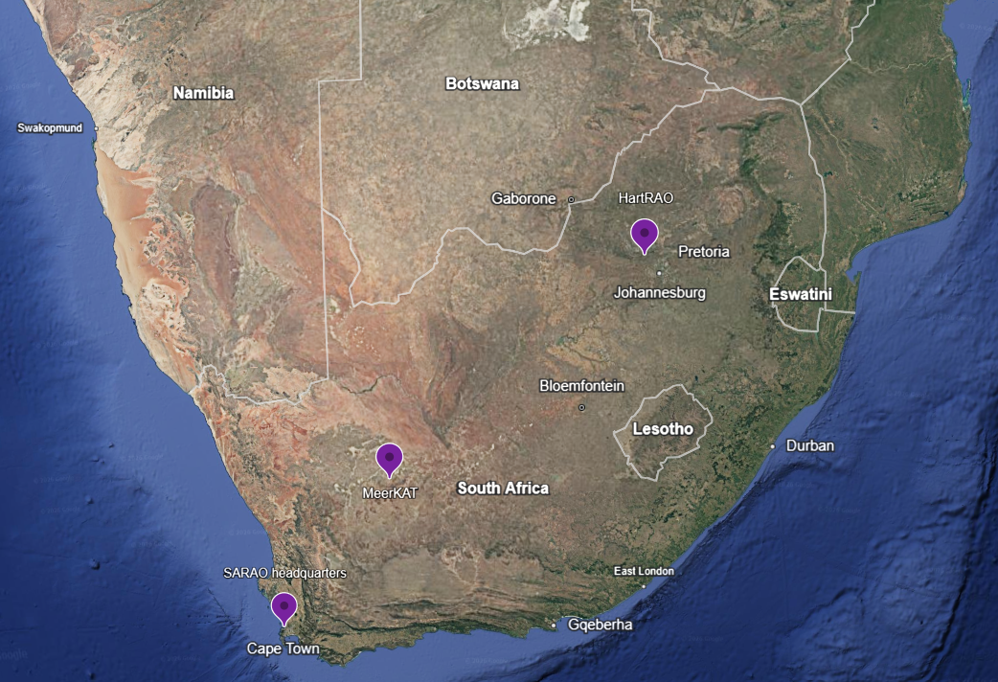
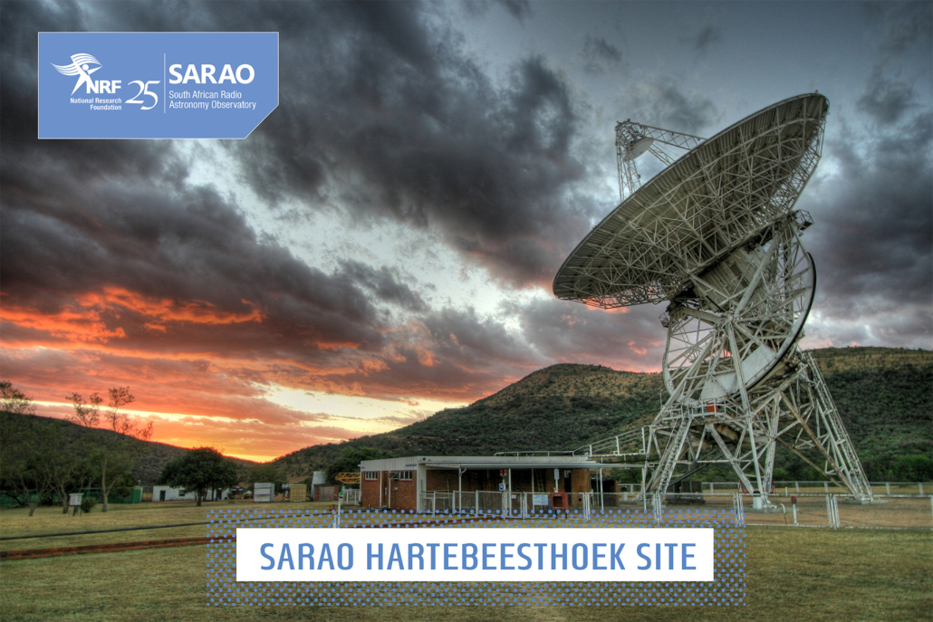
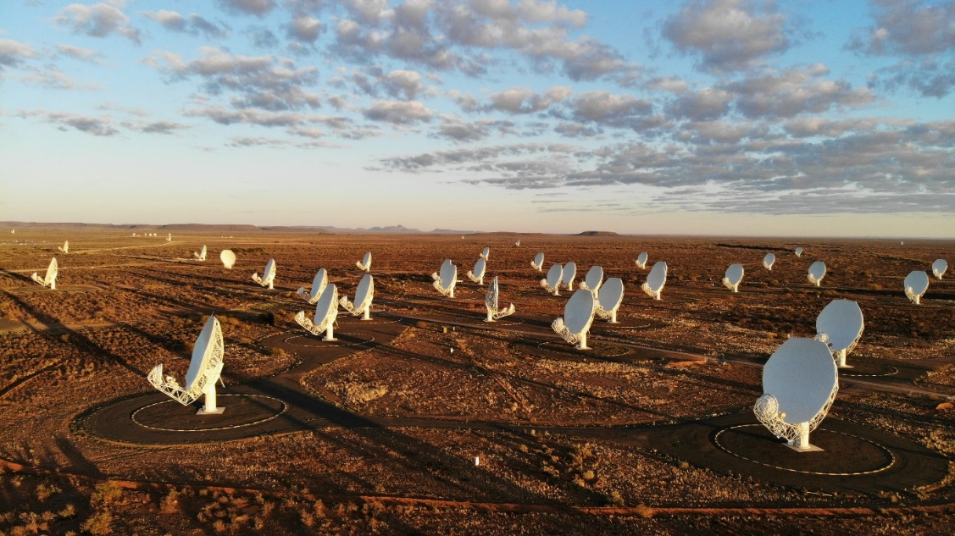
Overview of SARAO

Slide 9
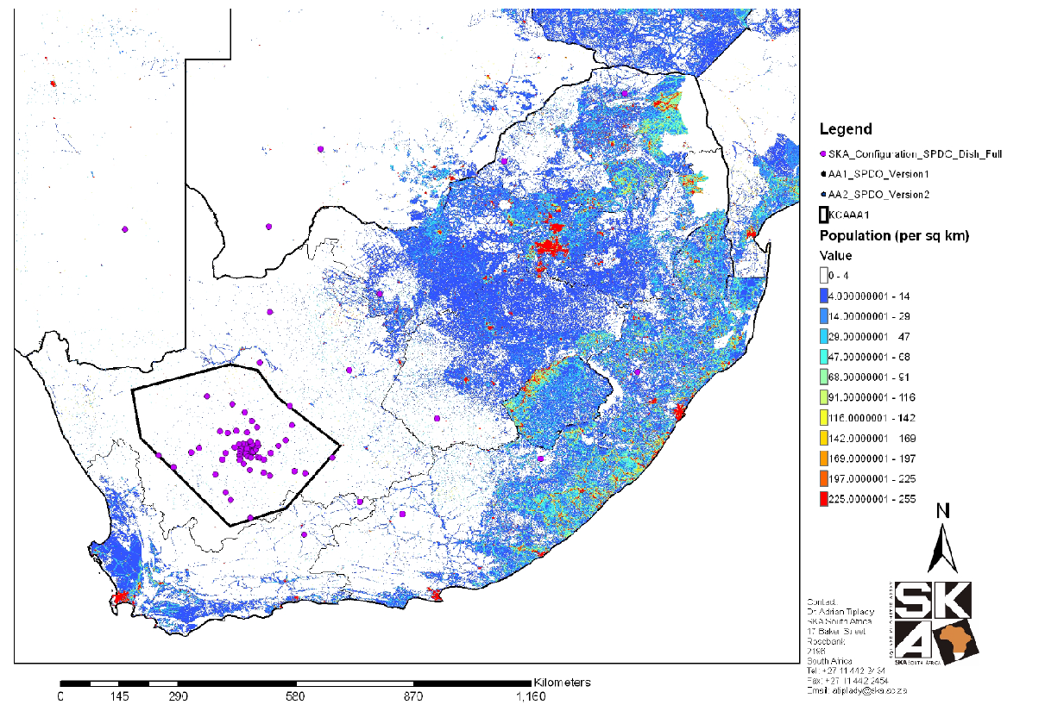
Karoo Site
Geography
Greenfield site in Karoo – arid and sparsely populated region in South Africa
Primarily agricultural economy (sheep farming)
Protection of the Site – Astronomy Geographic Area Advantage Act, 2007
Host MeerKAT, SKA and a number of guest instruments

Slide 10
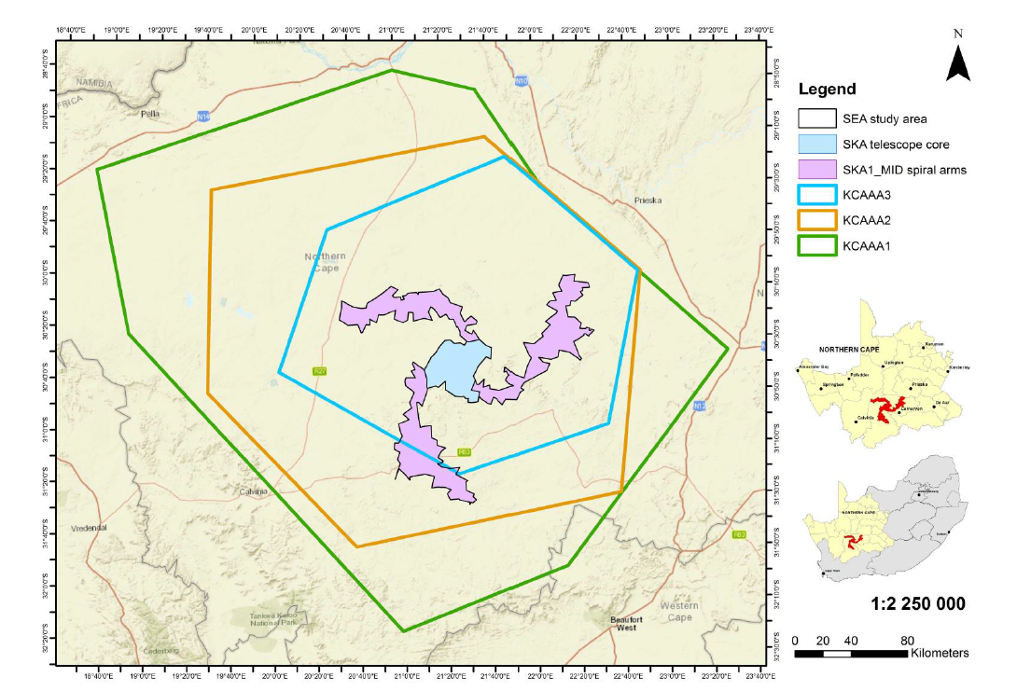
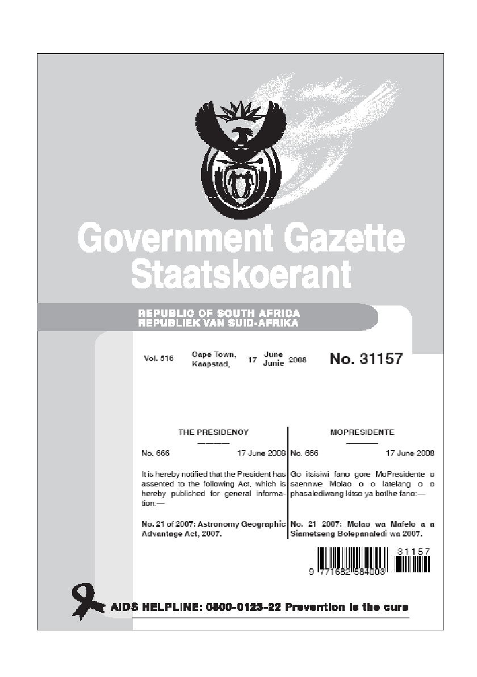
Karoo Site
MeerKAT site is protected in legislation for Astronomy research and instrumentation

Slide 11
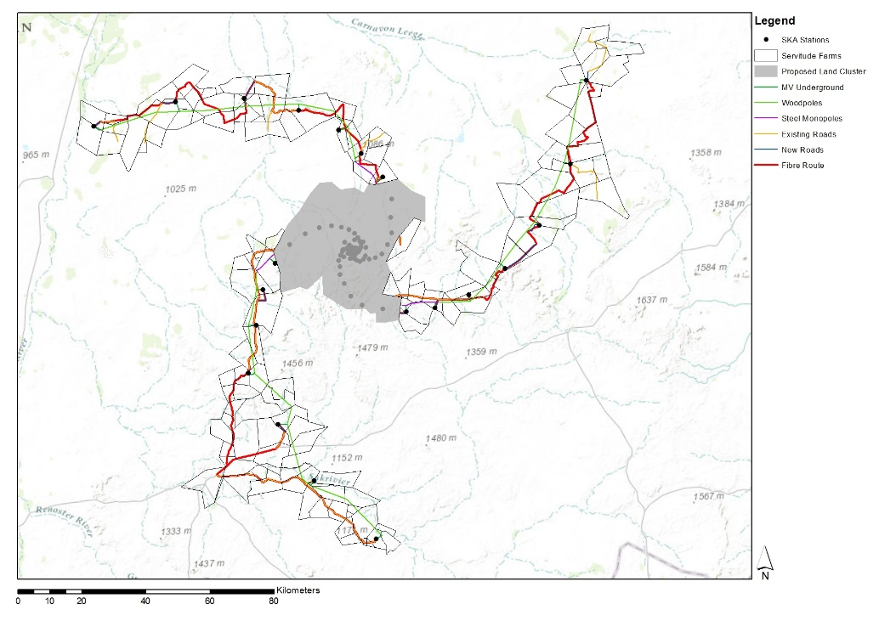

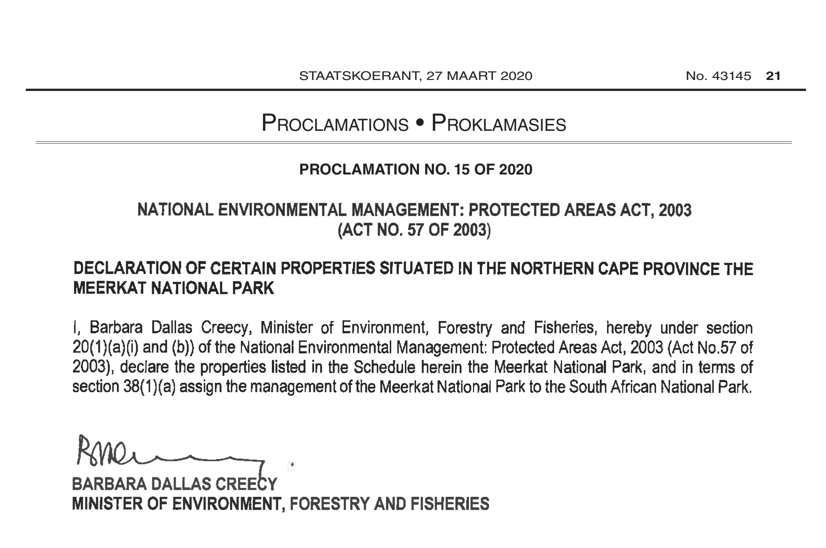
Karoo Site
MeerKAT National Park protecting the sensitive biodiversity
NRF owned land
Servitudes

Slide 12
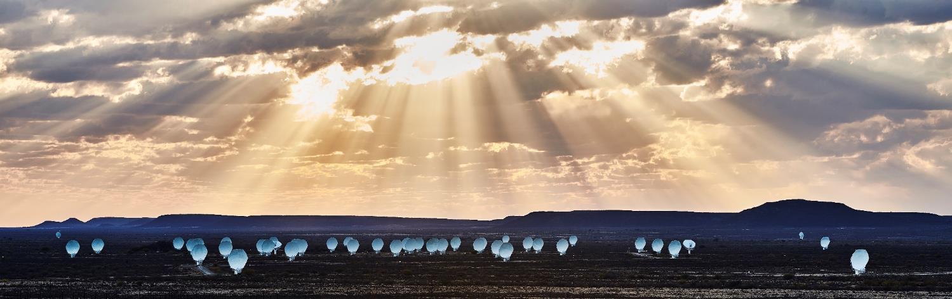
Introduction to MeerKAT
Subheading: Arial, size 18, colour red
Duis aute
Technical summary
Commissioned in 2018
64 x 13.5-metre offset Gregorian dishes
Spread over 8 km (70% within 1 km diameter).
L-band receiver: 0.9–1.67 GHz
UHF-band receiver: 0.58–1.0 GHz
S-band: 0.75–3.5 GHz (supplied by MPIfR)
FX correlator architecture
< 10 ns absolute timing accuracy
Precursor to, and will be integrated with, SKA

Slide 13
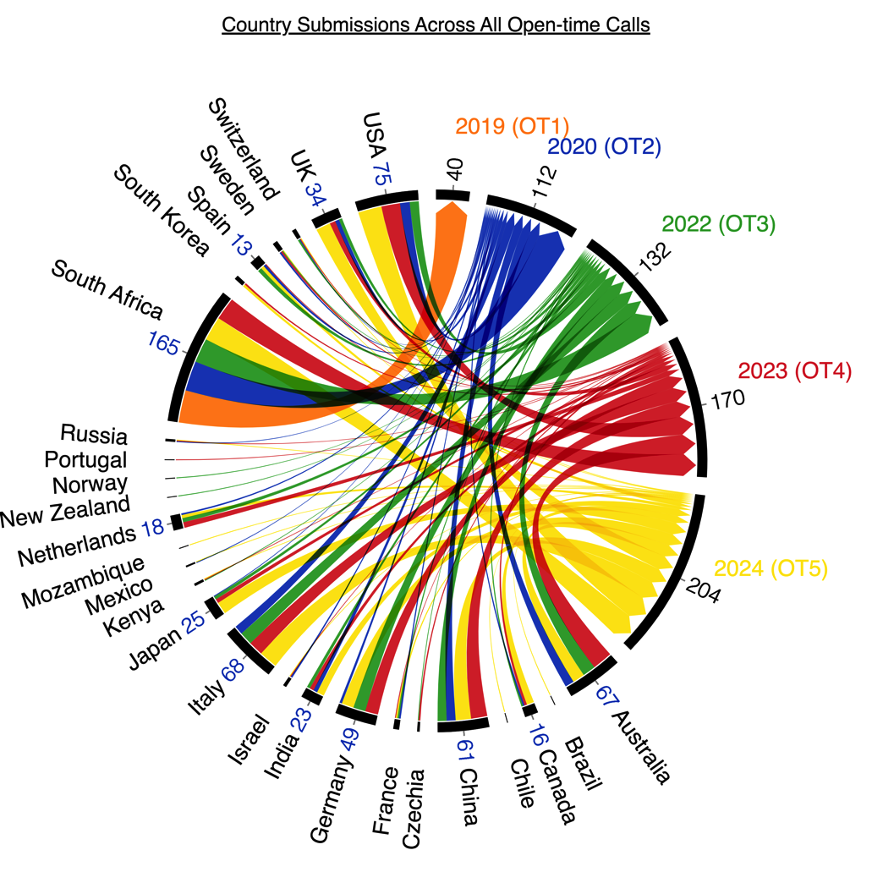
MeerKAT Science
Science by numbers
Telescope inaugurated: July 13, 2018
1st MeerKAT-64 paper: September 2019
>470 articles published since then
3–4x more observing hours requested on telescope than available
A growing world-wide community of users & collaborations: >700 proposals submitted with Principal Investigators in 27 countries

Slide 14
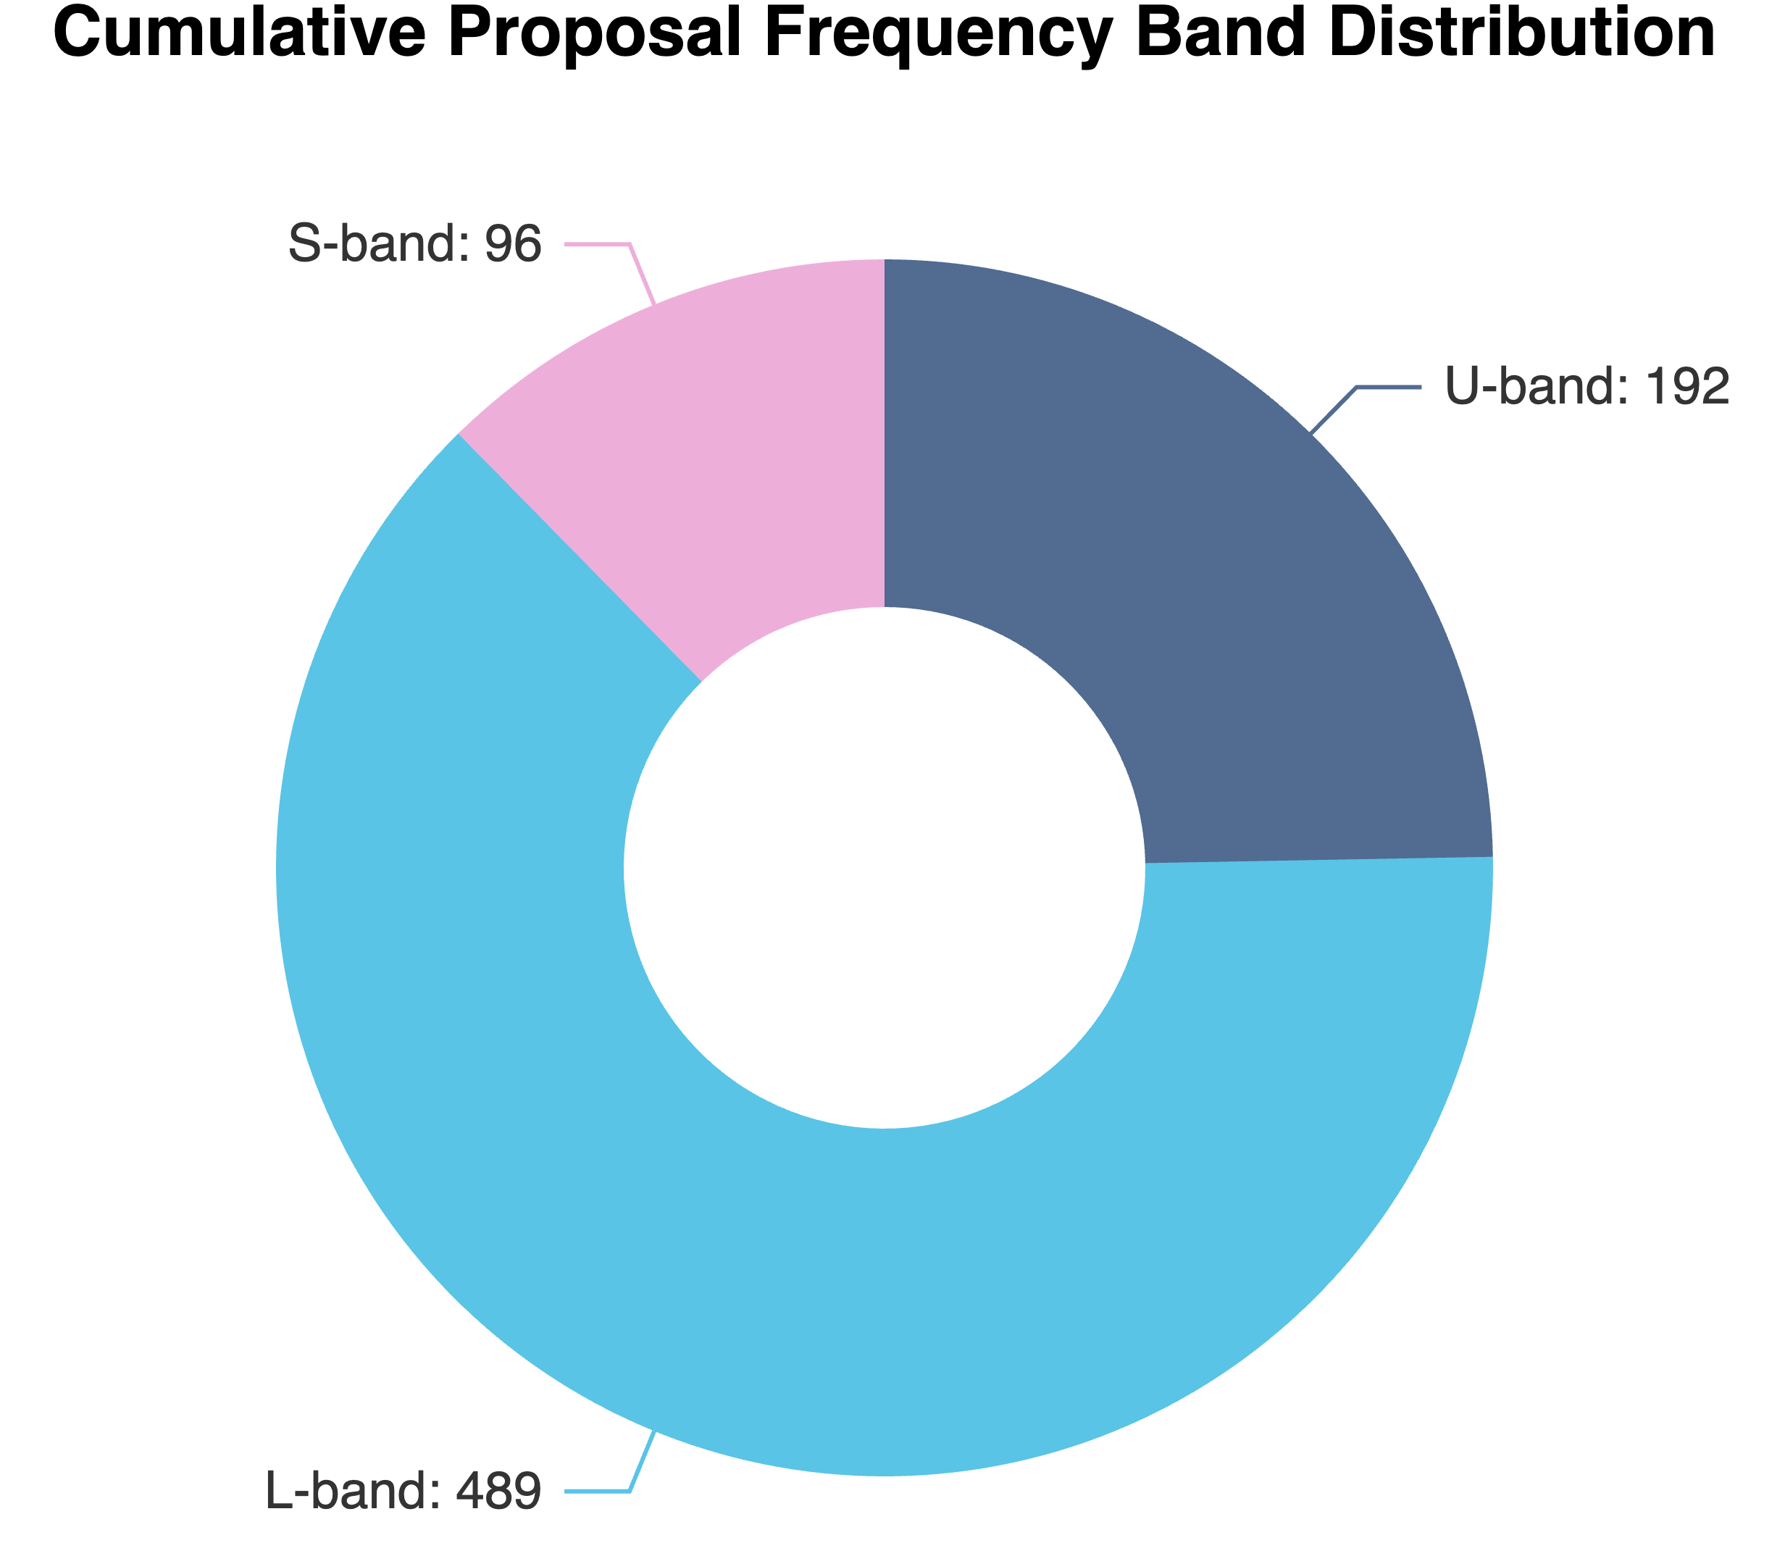
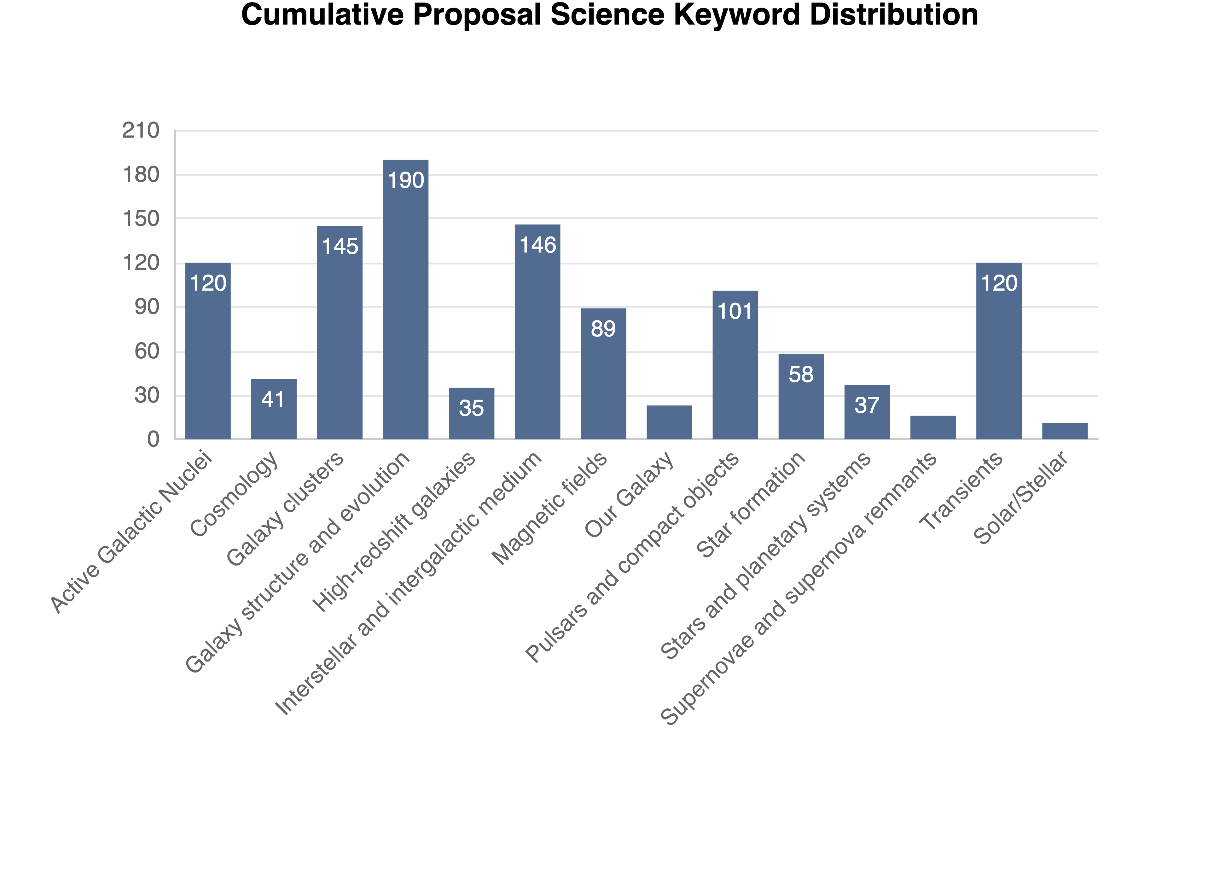
MeerKAT Science
Demand: by science topic & band
L-band available since 2018;
UHF since 2020; S-band since 2022

Slide 15

Heywood et al. 2022
Notes:
Data from inauguration image taken in 2018
Centre of the galaxy showing filaments and bubbles
Two intensity maps
One for bright sources
One for faint sources
Huge dynamic range
Image ended in printed version of the new York times

Slide 16
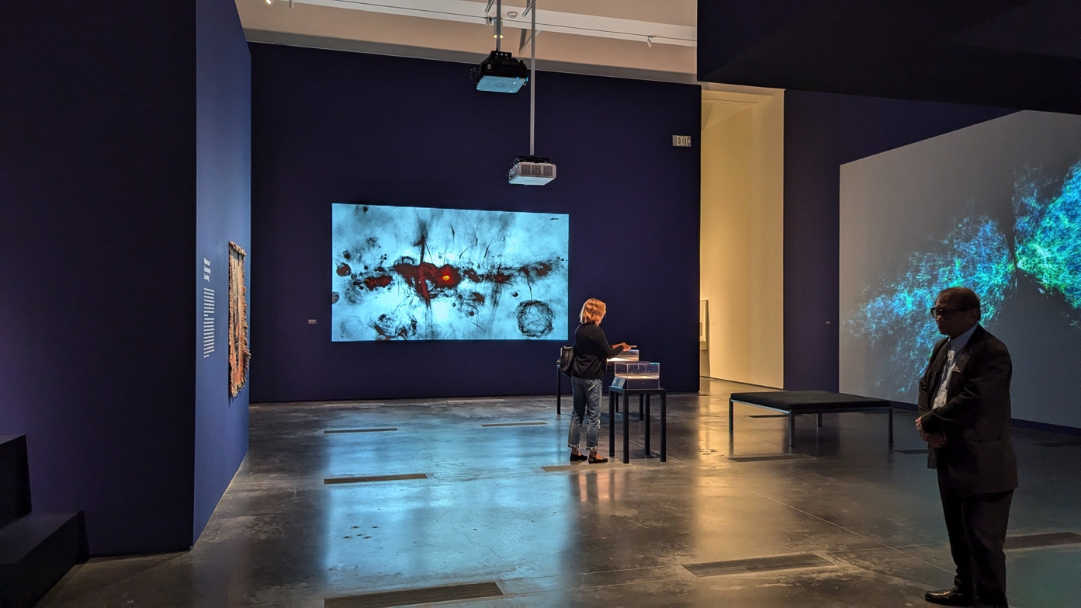
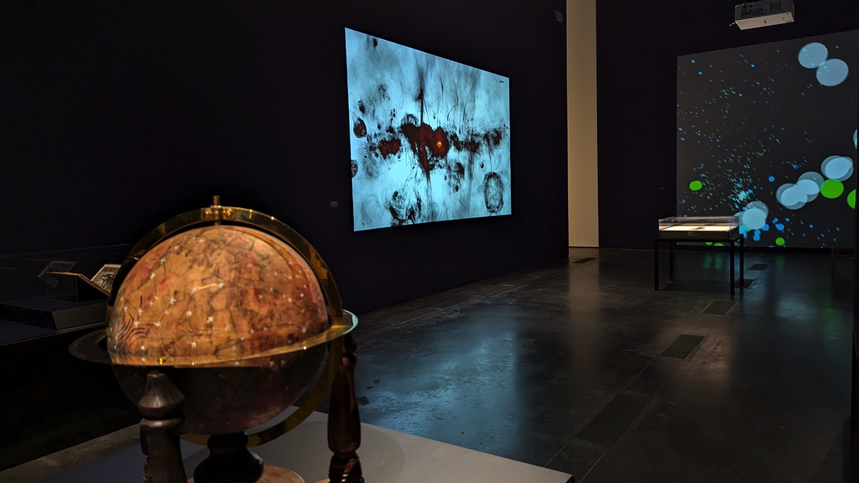
Mapping the Infinite:
Cosmologies Across Cultures
Los Angeles County
Museum of Art (LACMA)
Oct 2024 – Mar 2025
Notes:
Image was displayed in LA county museum of art

Slide 17
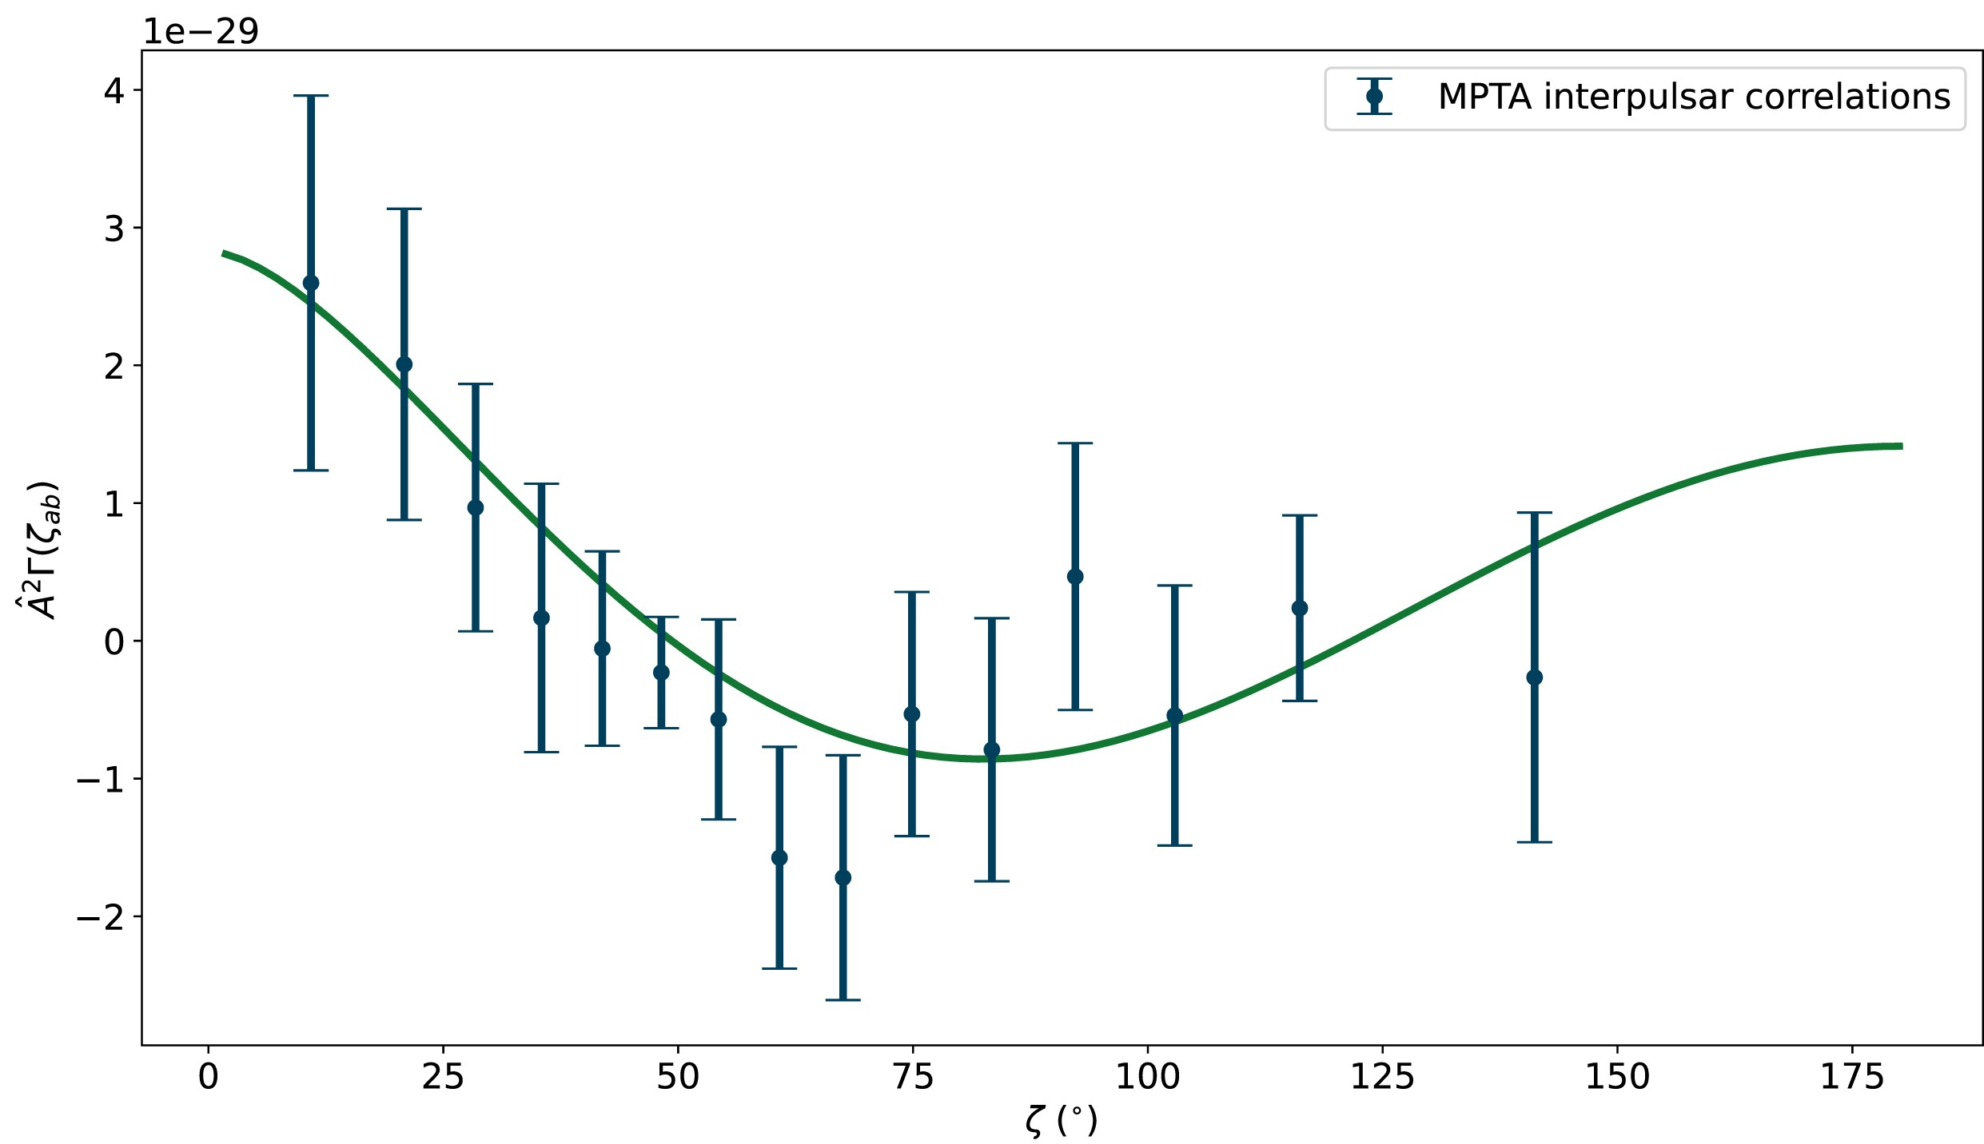

MeerKAT Science
The beauty of high-precision pulsar timing
Credit: Carl Knox (OzGrav) / SARAO
MPTA DR2 (4.5-yr data span on ~80 millisecond pulsars): Searches for a stochastic background of Gravitational Waves with significances comparable to other PTAs despite (much) shorter data sets (Miles et al. 2025)
Notes:
PTA → pulsar timing array
MeerKAT Pulsar Timing Array observing pulsars for 4.5 years
Pulsar observation shows that MeerKAT observation over a relatively short time follows the predicted stochastic background model
Results compare well with other similar global instruments which has been observing the PTA for much longer times

Slide 18
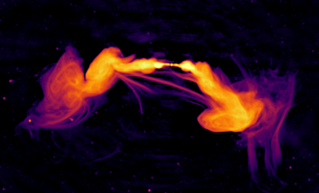
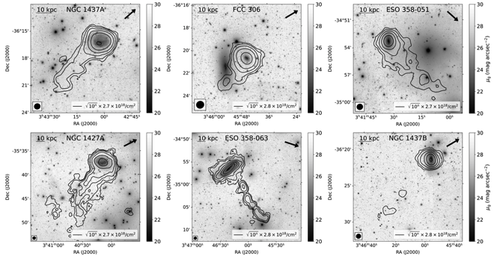
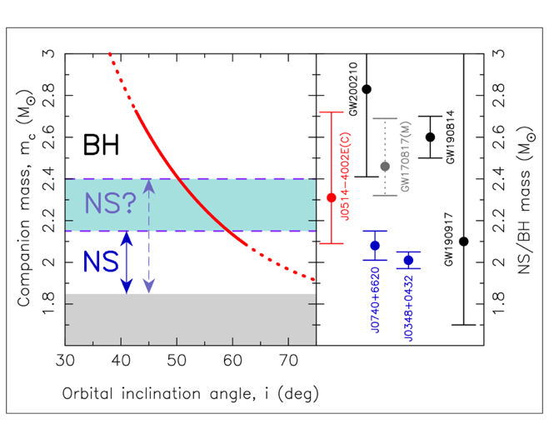
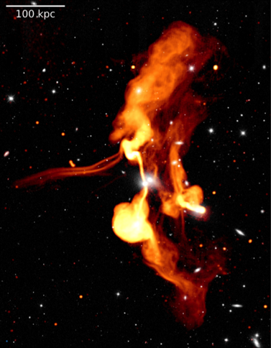

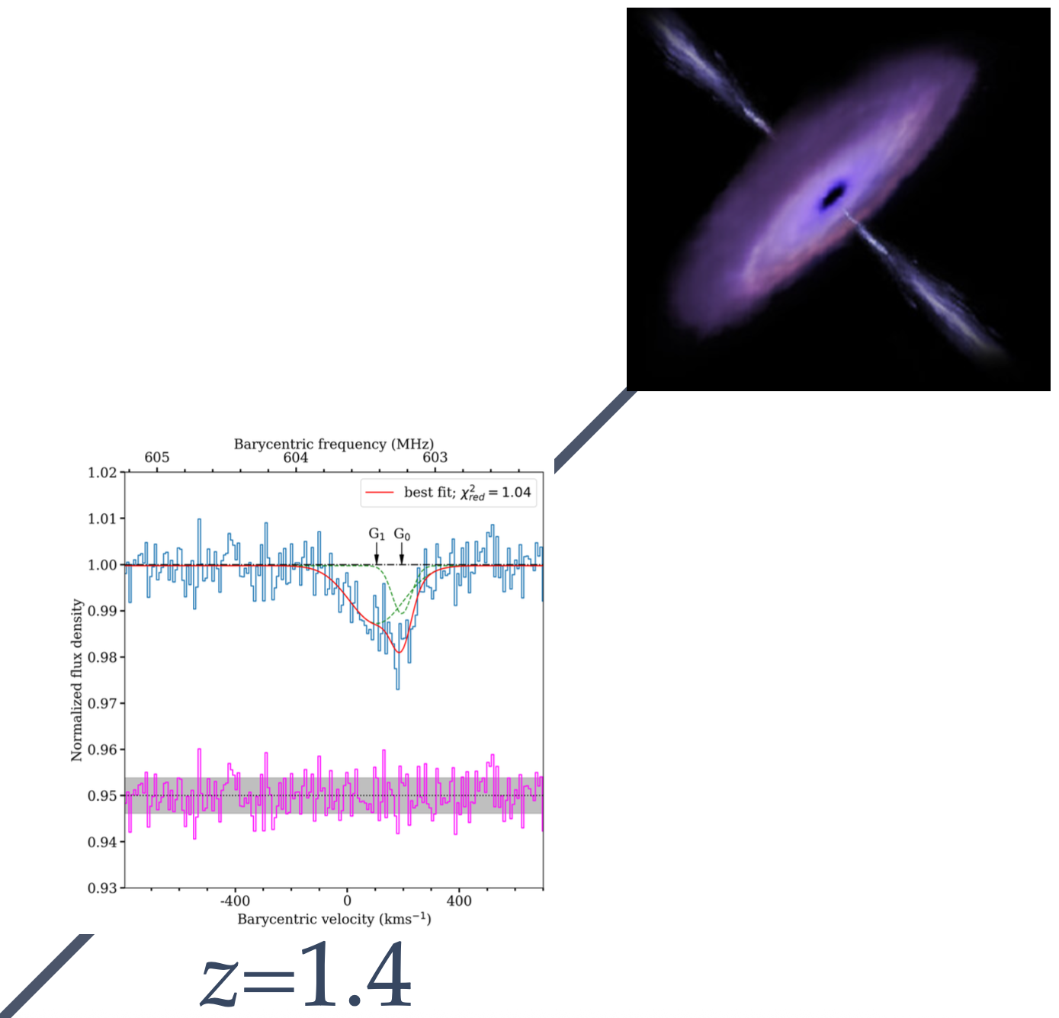
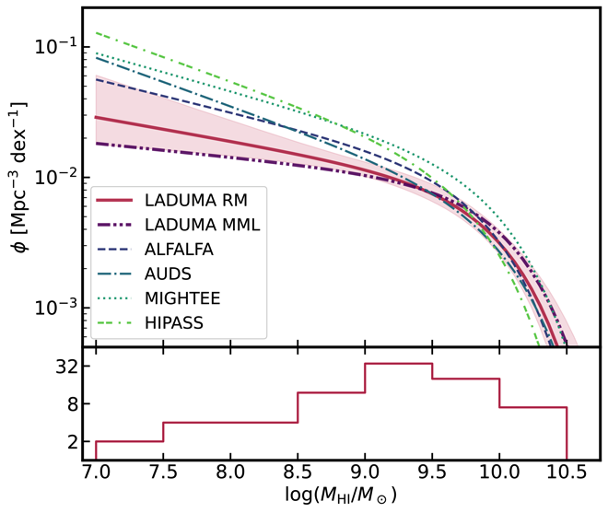
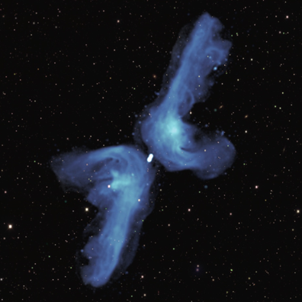
Pulsar searching (TRAPUM)
HI in cluster (Fornax)
Absorption
(MALS)
Galaxies: collimated threads, low surface brightness cocoons
Deep HI (LADUMA)
Deep continuum (MIGHTEE)
HI Intensity Mapping (MeerKLASS)
Notes:
Large survey experiments
Gallaxies images were created while large survey projects were being planned

Slide 19
MeerKAT Band 5B
The aim of the project is to add a Band 5B (8.3–15.4 GHz) science capability to the 64 MeerKAT dishes
In collaboration with INAF who funded majority of the hardware cost
SARAO contracted to deliver
Digitisers
Array Fibre Network
Receptor Fibre Network
Timing and Frequency Reference
Helium and vacuum services expansion
Production of 64 D-Engines for the digitiser completed
Receivers, developed by MPG, already delivered to site
CBF and SDP extensions to start soon

Slide 20
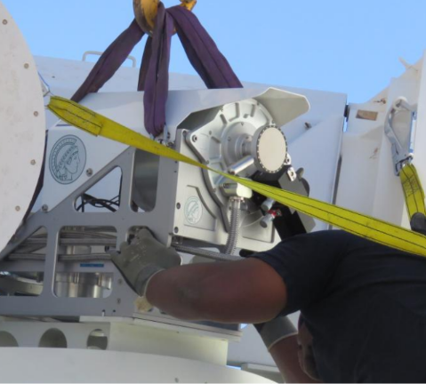
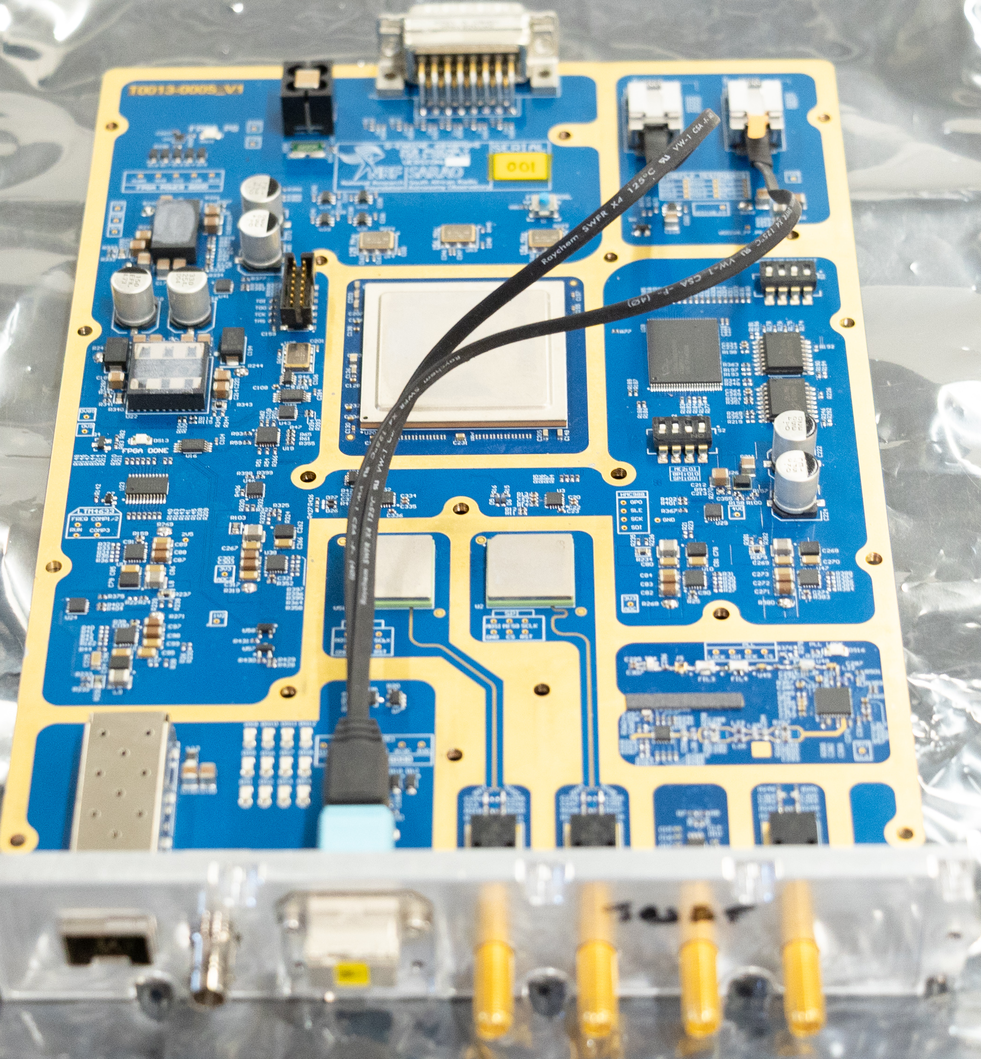
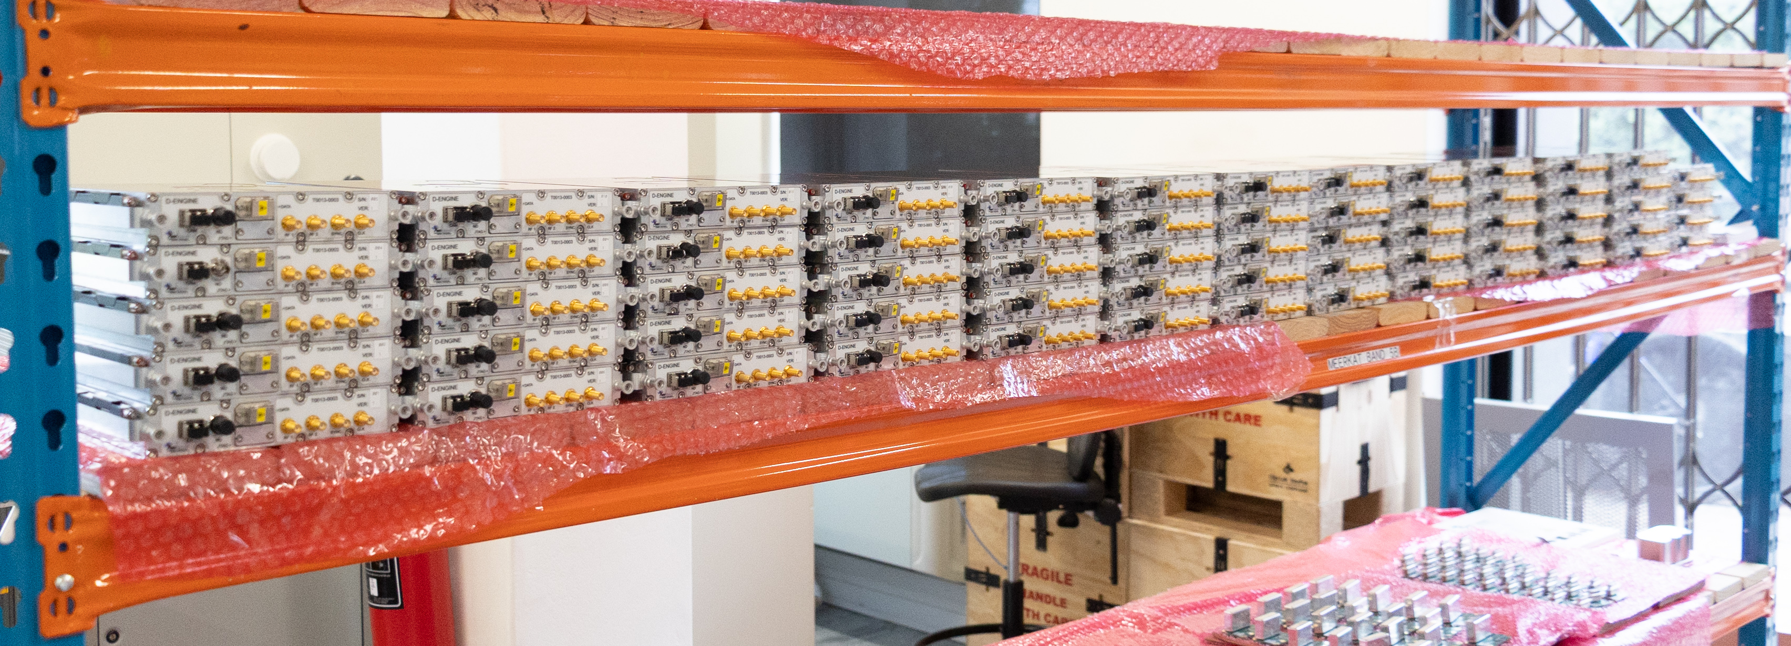
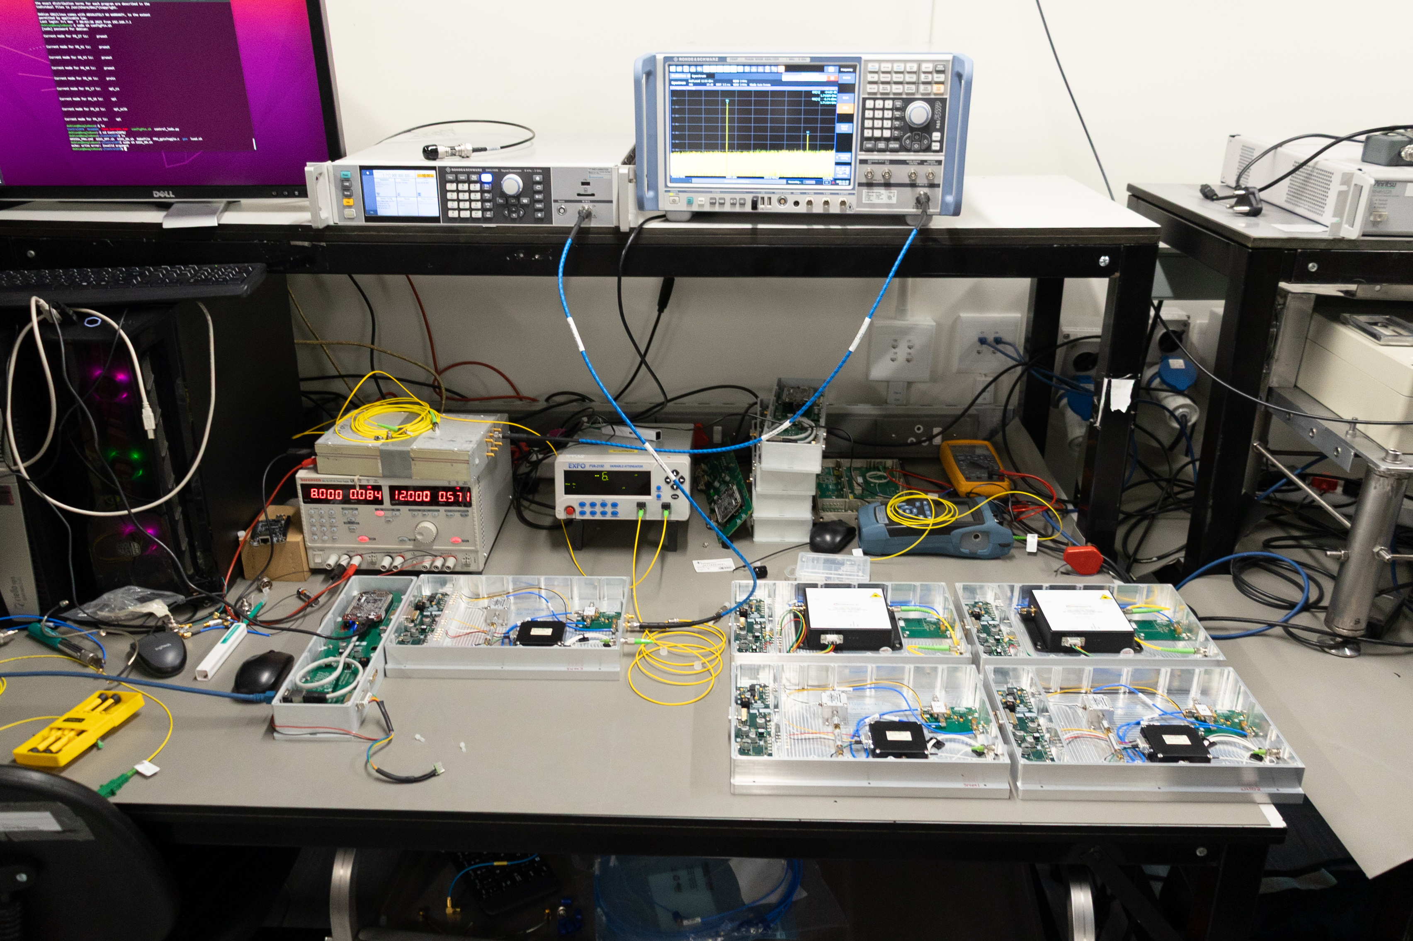
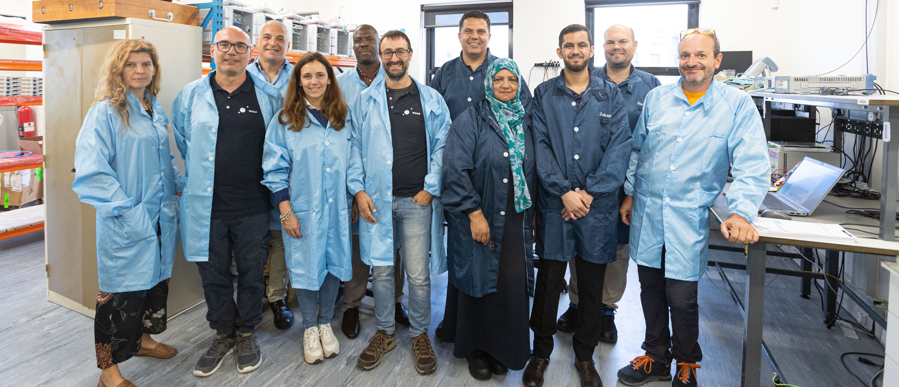
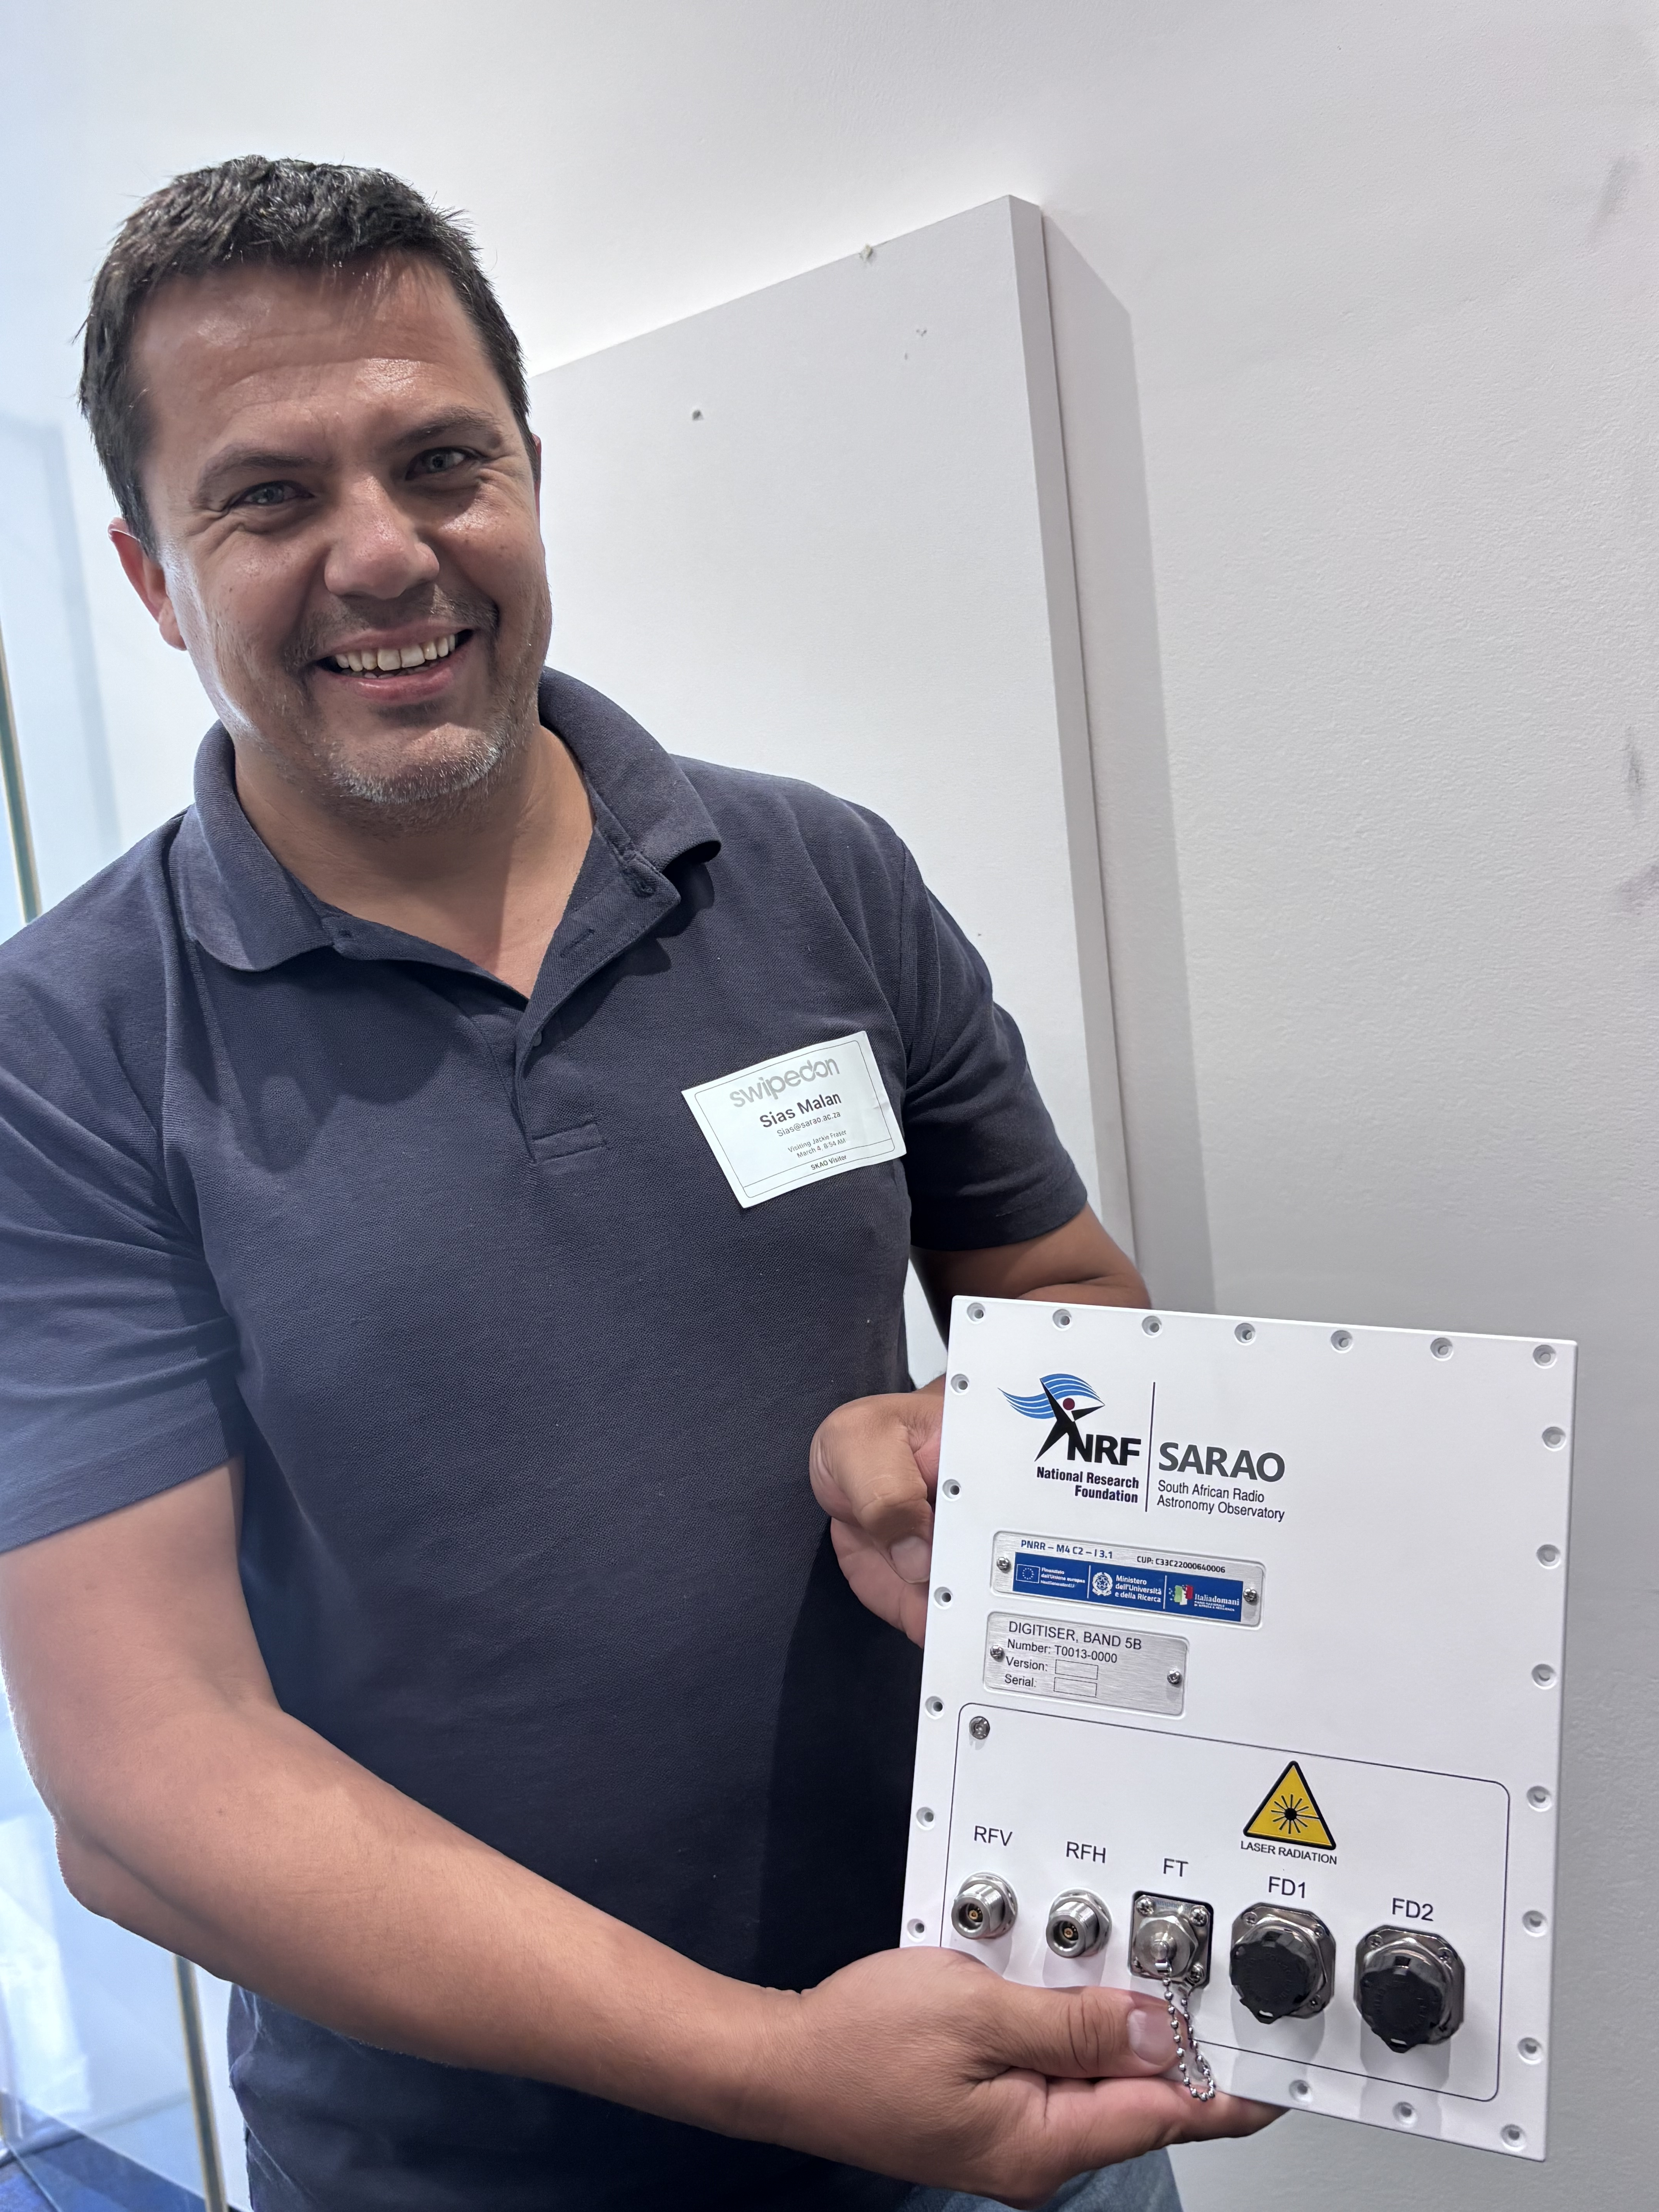
Full scale production
Fitment test of MPI Band 5B Receiver
Band 5B digitization module
TFR component production
Final labels on Digitiser
INAF and SARAO team during acceptance testing

Slide 21
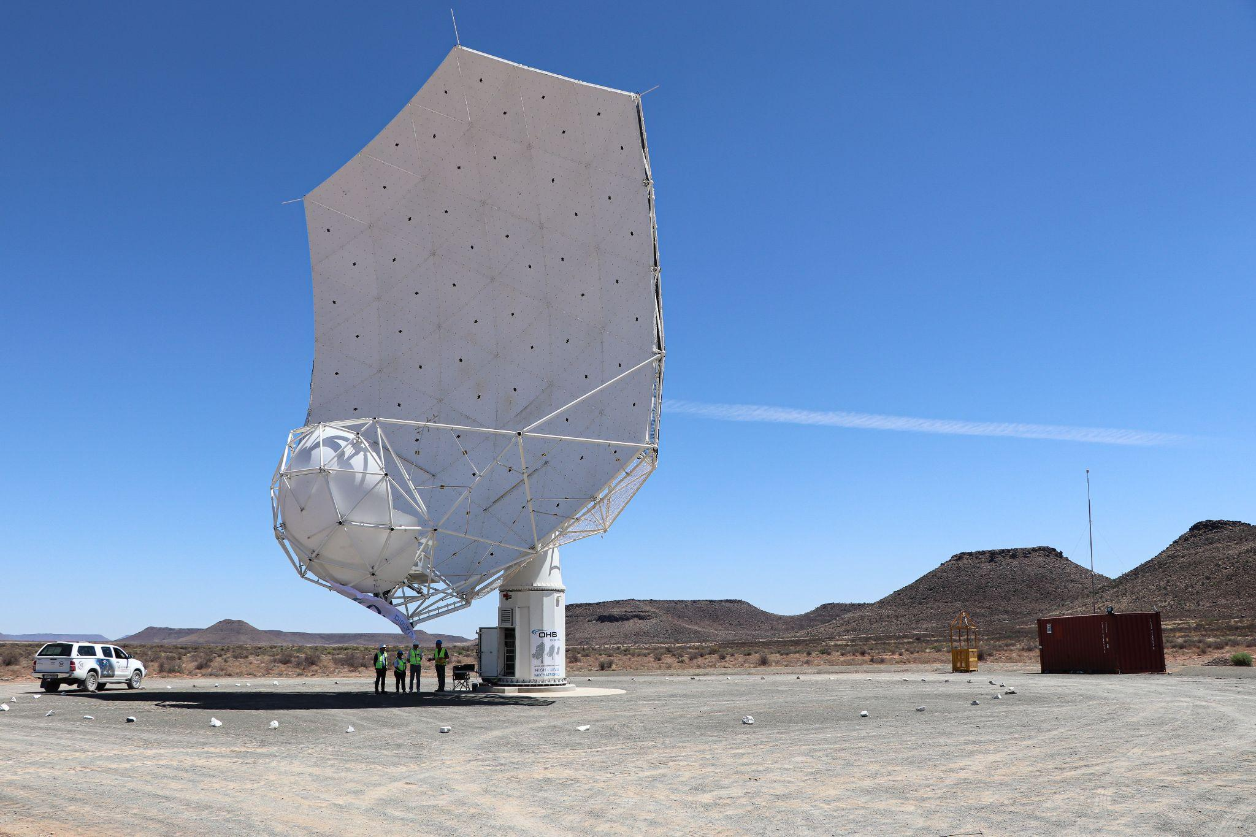
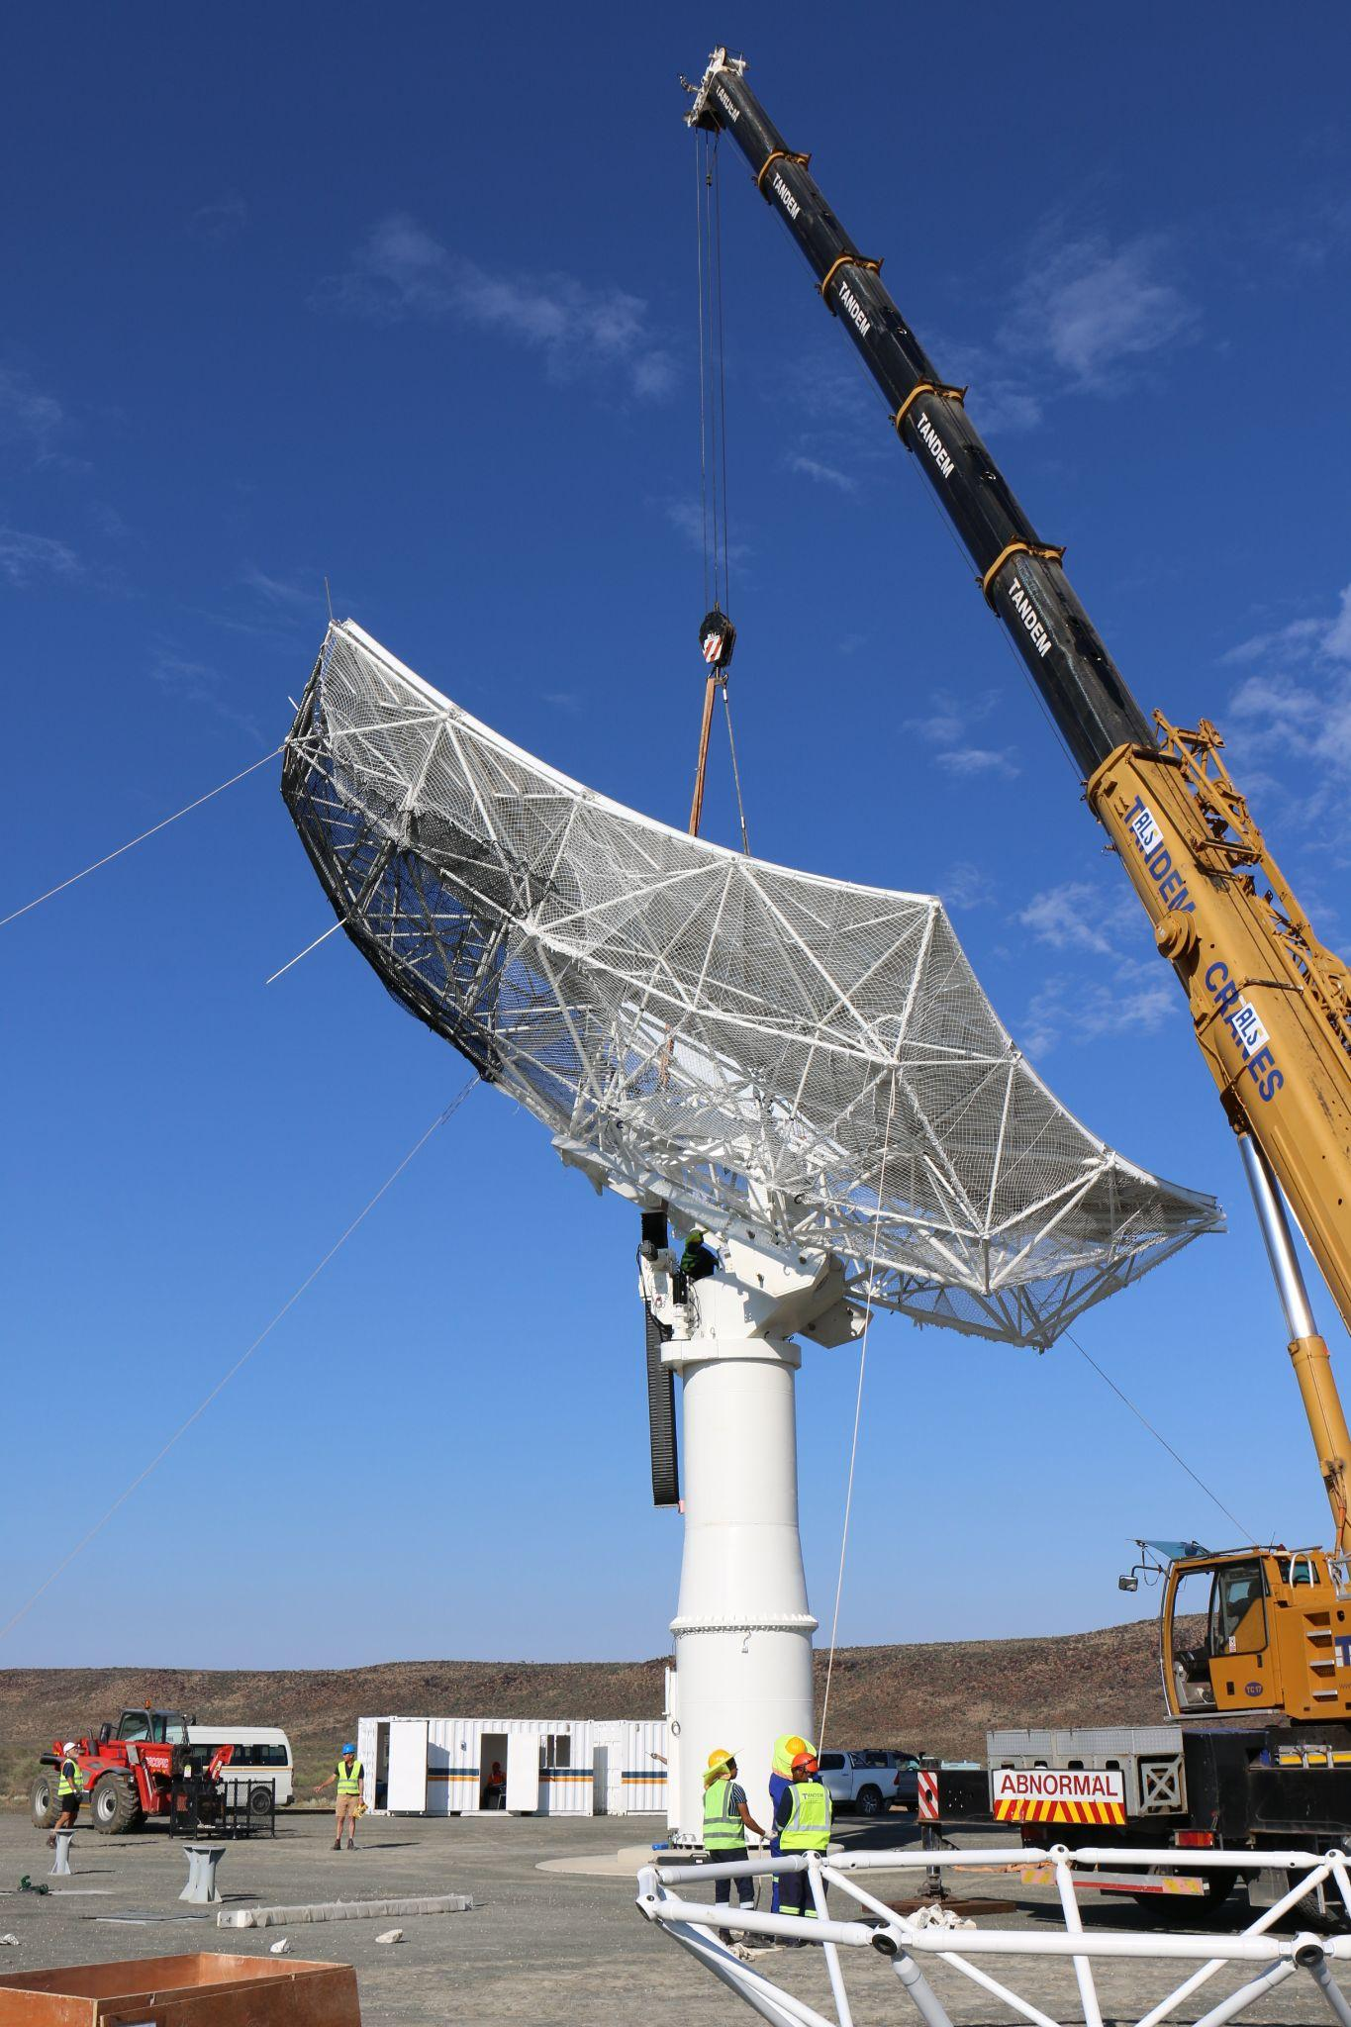
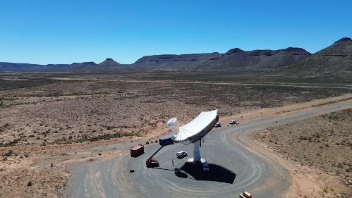
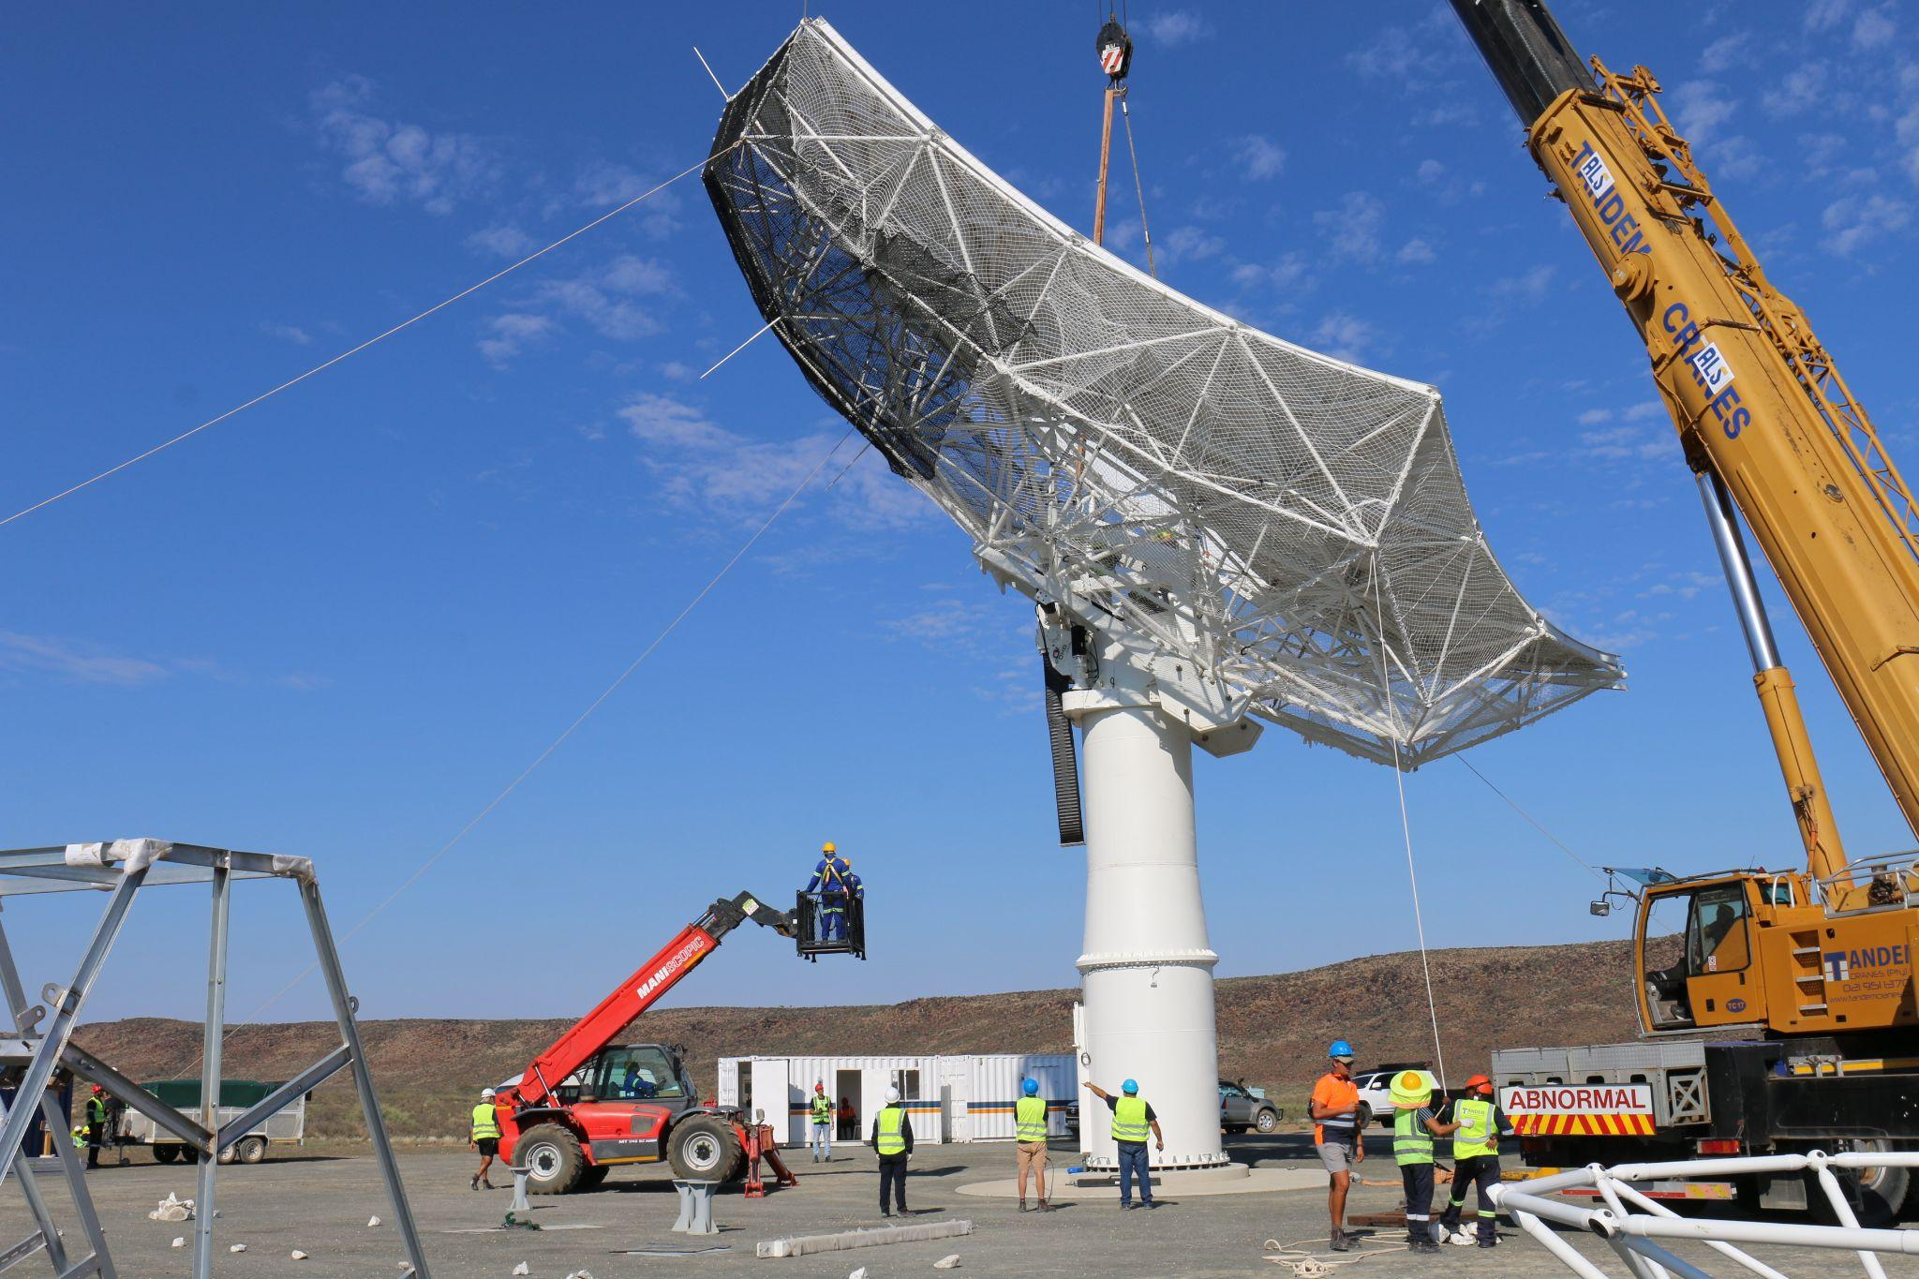
MeerKAT extension (MK+)
One step closer to the SKA
45 million Euro collaboration between Max Planck Society (MPG),SARAO and INAF
14 antennae extension to MeerKAT
15-meter SKA Mid-Dish (~50% more sensitive than MeerKAT)
Longer baselines for higher angular resolution
Approximately 30% increase in array sensitivity

Slide 22
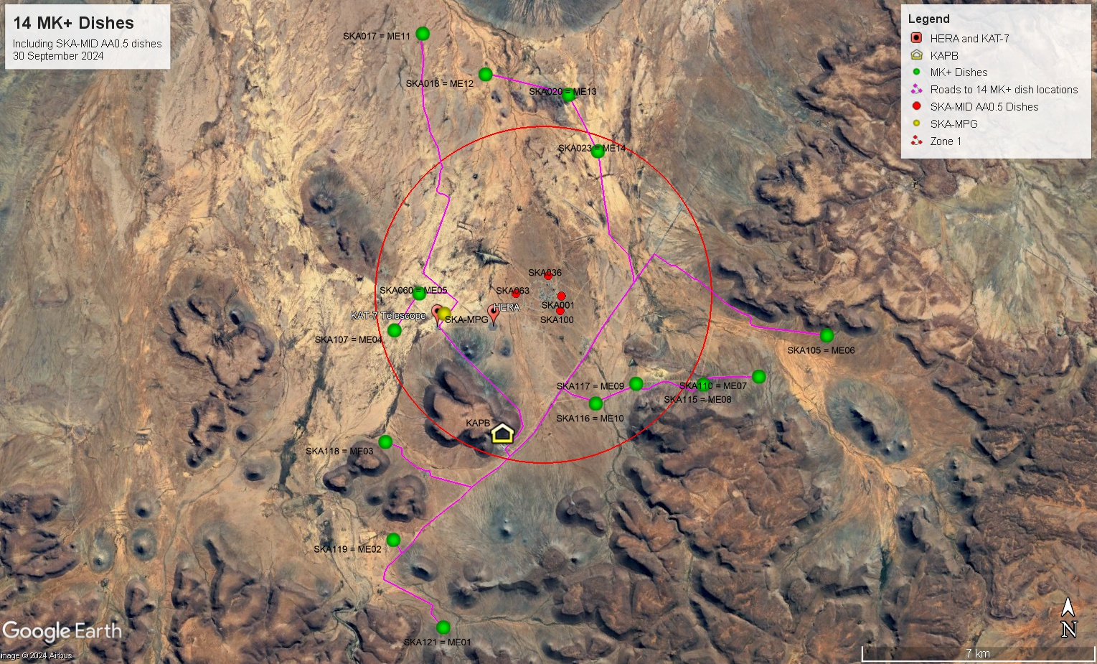
MeerKAT extension (MK+)
Array configuration
MeerKAT extension layout

Slide 23
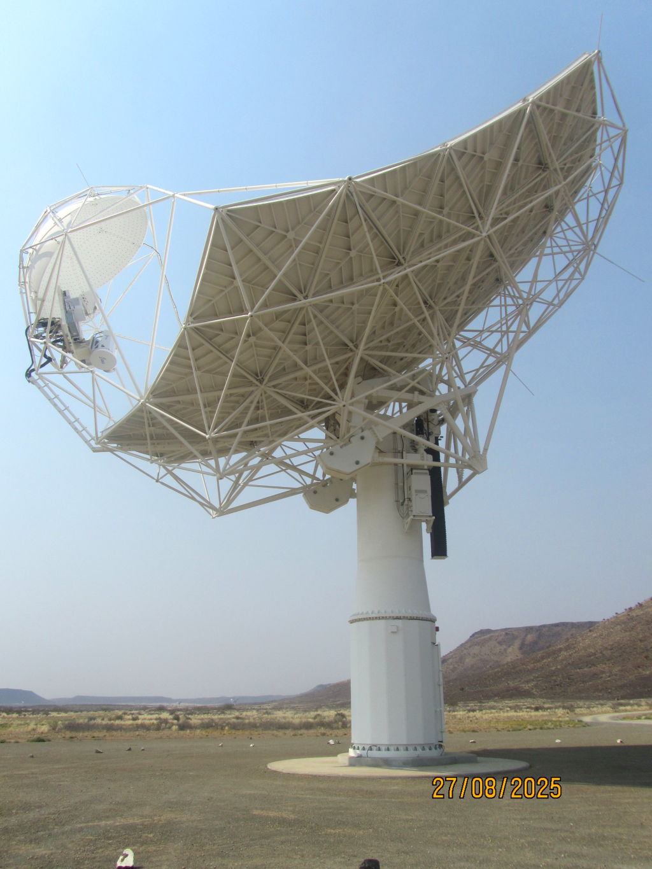
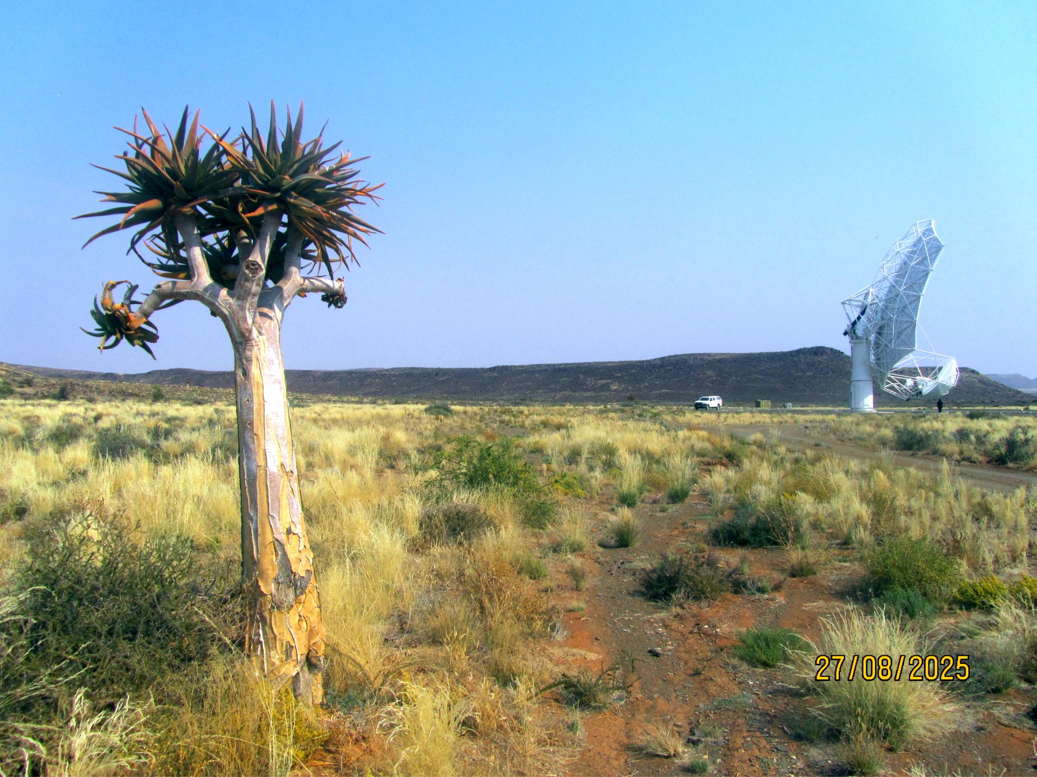
MeerKAT extension (MK+)
Status
Construction of all 14 dish structures complete
Photogrammetry on the 14th dish structure in progress

Slide 24
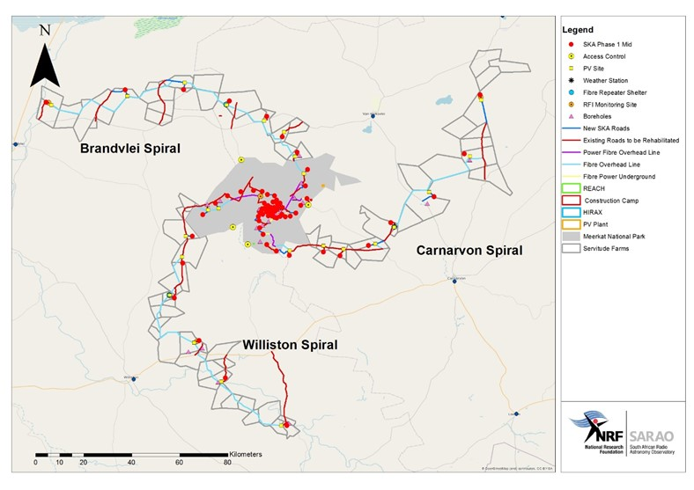
MeerKAT integration into SKA

Slide 25
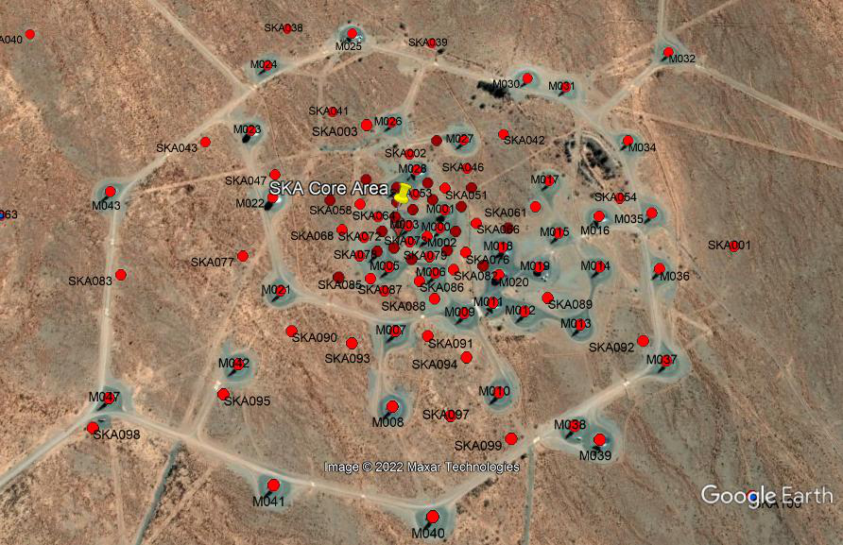
MeerKAT integration into SKA
197 dishes including 64 MeerKAT dishes
Dense central core
3 spiral arms
150 km maximum baseline

Slide 26
Thank you! Any questions?
Sias Malan
Functional Manager: Receiver Systems
SARAO
sias@sarao.ac.za

