Slide 1
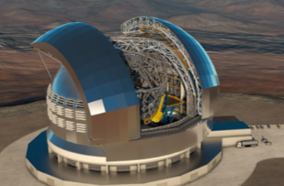
STILES
SKA Observatory –
Status and Perspectives
2026-03-16

Slide 2
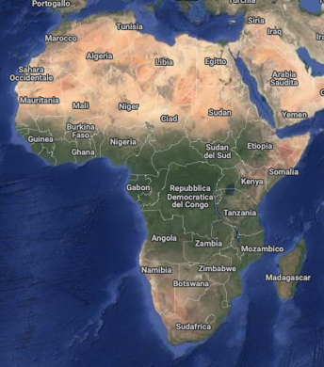
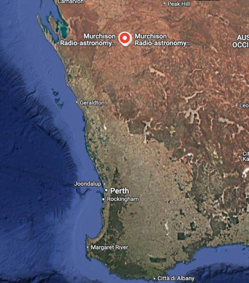
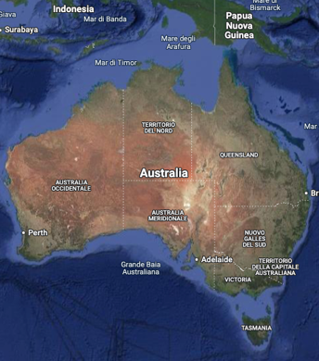
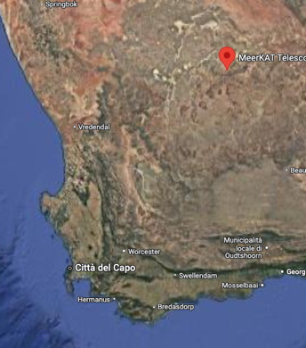
SKA in a Nutshell
SKA is a “high sensitivity, high spatial resolution, large bandwidth radio interferometer”.
SKA consist in two arrays:
SKA-MID for the higher frequency bands (350 - 15,400 MHz) located in the Karoo desert in South Africa,
SKA-LOW for the lower frequencies (50 - 350 MHz) in the Murchison region in Western Australia.
16/03/2026
The SKA Observatory – Status and Perspectives

Slide 3
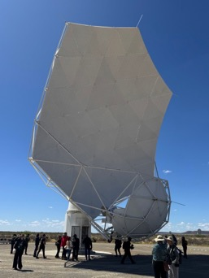
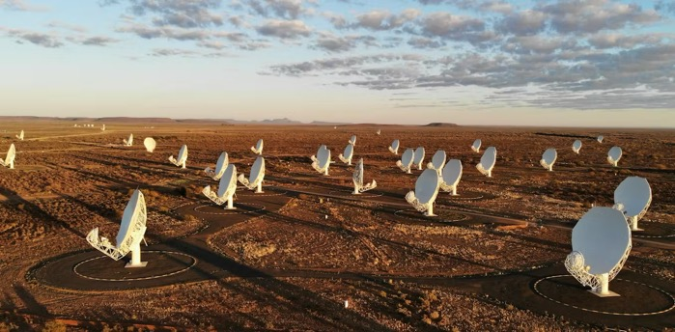
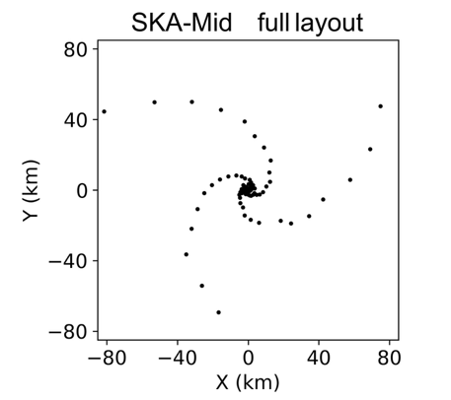
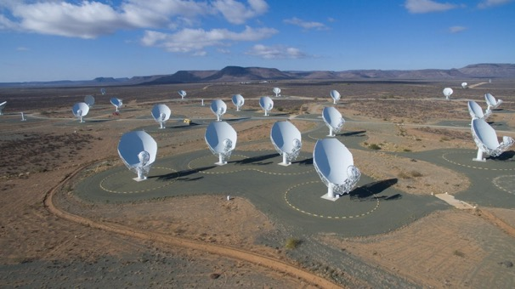
SKA MID
197 steerable dishes 15 mt in diameter (13.5 mt for the MeerKAT incorporated dishes).
Maximum baseline 150 KM.
Randomly populated core 1 Km diameter.
Collecting area 33.000 SQM.
Frequencies 350 MHz-15.4 GHz (goal 24 GHz).
16/03/2026
The SKA Observatory – Status and Perspectives

Slide 4
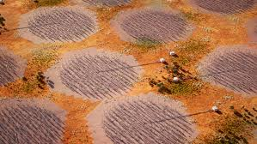
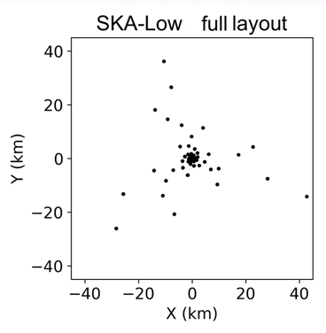
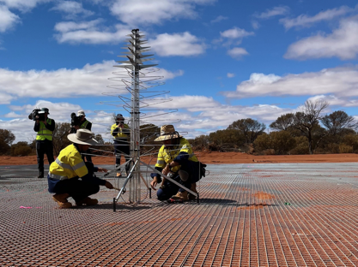
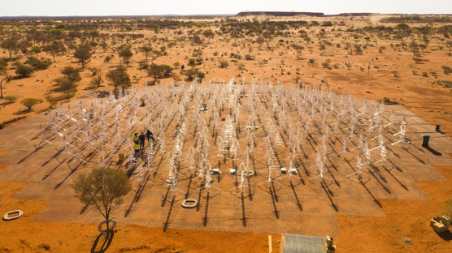
SKA LOW
131072 antennas distributed in 512 stations each with 256 Elements.
Covered frequency range: 50-350 MHz.
Maximum distance between stations: 74 Km
Collecting area: 419.000 SQM.
Single-Element (designed and made in Italy): Log-periodic aluminium..
16/03/2026
The SKA Observatory – Status and Perspectives

Slide 5

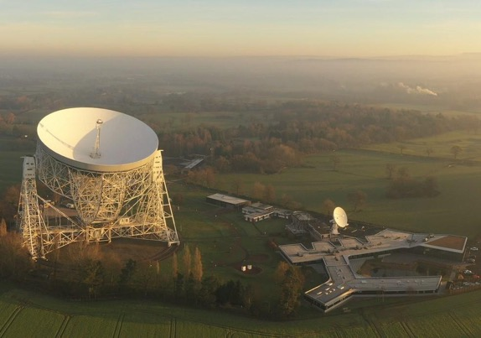
The SKAO (IGO)
The SKA is built and will be operated by the SKAO-IGO.
SKAO is an intergovernmental organisation (IGO) participated by 13 Countries (and 3 observers) of which Italy is a founding member.
Australia, Canada, China, Germany, Italy, India, The Netherlands, Portugal, South Africa, Spain, Sweden, Switzerland, United Kingdom (South Korea, France, Japan)
“The purpose of the SKAO shall be to facilitate and promote a global collaboration in radio astronomy with a view to the delivery of transformational science.”
“The first objective of this global collaboration shall be the implementation of the SKA Project.”
The governing organ of SKAO is the Council. The Global headquarters is at Jodrell Bank, the Greater Manchester area (UK)
16/03/2026
The SKA Observatory – Status and Perspectives

Slide 6
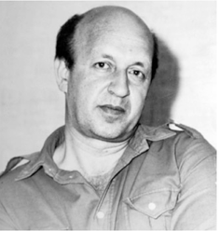

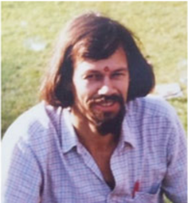
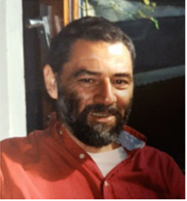


The long Journey – The Early Fathers
The early idea of an SKA occurred in the 70s and 80s independently in India, CCCP, UK and The Netherlands without much communication between the groups.
At the IAU Colloquium 131 at Socorro (NM, USA) in 1990 Noordam (NL), Wilkinson (UK) first discussed the idea of a large collecting area telescope. Later Wilkinson presented a paper “The Hydrogen Array”(1991). This paper is recognized as the starting point of the SKA Journey.
The community remained cool (too much to chew – VLA, upgrades etc.) with the exception of the Netherlands where Braun, Noordam and de Bruyn continued pushing for a “SKA”.
In 1993 in a meeting on “Frontiers for Astronomy” at ESTEC Longair (director of ROE), Ekers (Australia) and Swarup (India) decided the time had come for a collective action.
Yuri Pariskii (CCCP)
1932-2021
Govind Swarup
(India)1929-2020
Ger de Bruyn (NL)
1948-2017
Jan Noordam (NL)
Peter Wilkinson (UK)
Robert Braun (NL)
16/03/2026
The SKA Observatory – Status and Perspectives

Slide 7
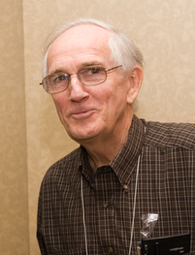

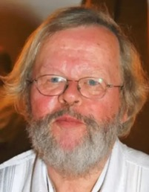
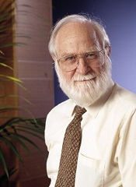
TECHNICAL CHARACTERISTICS
The following decision were taken:
Establish a Working Group
Host it at URSI (International Union of Radio Science) which had a very active Radio Astronomy Commission (unlike the IAU)
At the URSI General Assembly in Kyoto (September 1993) The WG was formed:
Robert Braun (NFRA, Netherlands, chair), Ron Ekers(CSIRO ATNF, Australia), Lloyd Higgs (DRAO, Canada), Yuri Pariiskii (SAO,Russia) Wolfgang Reich (MPIfR, Germany), Wu Shengyin (Beijing Astronomical Observatory, China), Govind Swarup (Tata Institute for Radio Astronomy, India),Dick Thompson (NRAO, USA), Peter Wilkinson (Jodrell Bank Observatory,UK),Francois Viallefond (Meudon Observatory, France)
It is worth noting how the composition of the WG broadly reflects the current SKAO members.
Thompson
Higgs
Reich
Ekers
16/03/2026
The SKA Observatory – Status and Perspectives

Slide 8
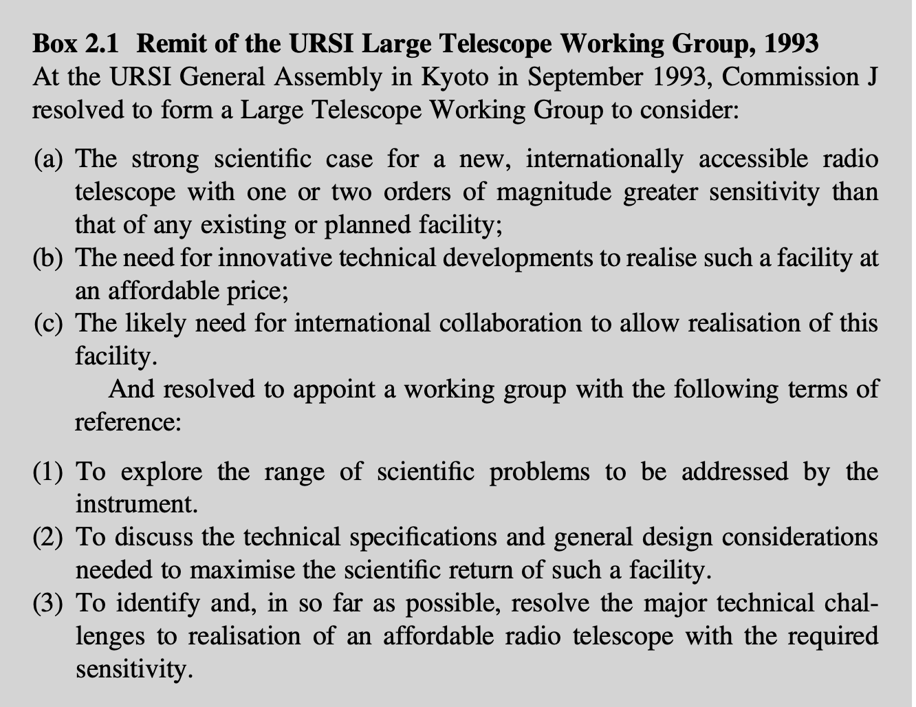
The Manifesto
Internationally accessible
One or two orders of magnitude greater sensitivity of any existing facility
Innovative technologies at an affordable price.
Explore broader science cases.
16/03/2026
The SKA Observatory – Status and Perspectives

Slide 9
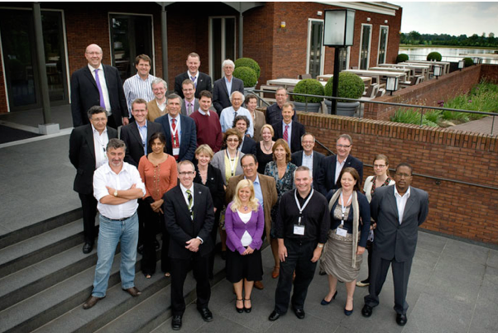
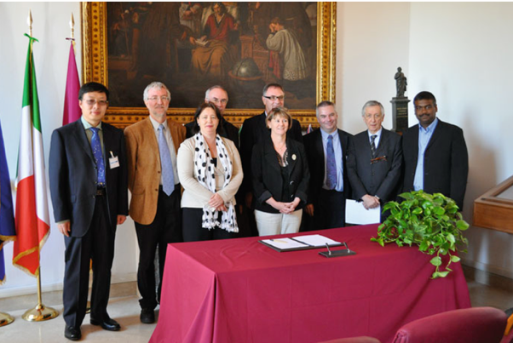
Toward an SKA Observatory
The formation of the WG in 1993 did not influenced the science-technology activities, but activities were undertaken to make the SKA more “visible” – IAU – OECD – other forum.
In 1999 the directors of the institutes involved in SKA decided to join in a Steering Committee to oversee the creation of a reference design, initiate the site-selection process and coordinate the developments.
In 2005 National and international (e.g. EU) funding agencies began to be involved, opening a “transition phase” in the governance (2006-2011) in which 3 leading actors played:
The International SKA Steering Committee (ISSC)
The informal group of funding agencies (Agencies SKA Group – ASG)
The SKA Preparatory Phase (PrepSKA – EU funded 5.5-M€ program) Board
This is the phase in which South Africa and Italy joined the program….. And the USA left after the 2010 decadal survey failure.
ASG
FB
16/03/2026
The SKA Observatory – Status and Perspectives

Slide 10
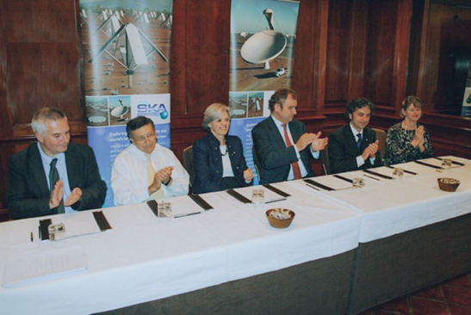
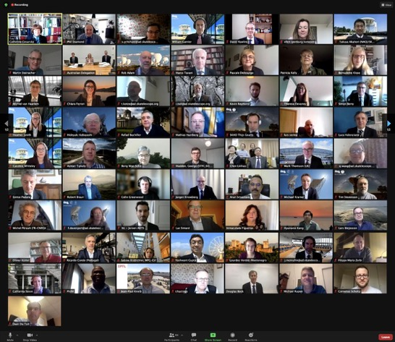
The SKA Organisation
At the end of 2011 the Uk Company SKA Organisation is established as the provisional legal entity to carry out pre-construction activities on the SKA program (including CPTF)
Articles of Association were signed at Heathrow by Australia, China, Italy, the Netherlands, New Zealand, South Africa and the United Kingdom.
One year later Canada and India joined.
At the time of its dissolution in 2021 the SKA organisation had Switzerland, Spain, Germany and France added as members (but it had lost New Zealand).
Form 2021 the governance is moved to the SKAO IGO.
16/03/2026
The SKA Observatory – Status and Perspectives

Slide 11
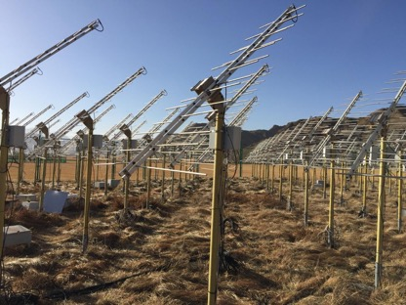
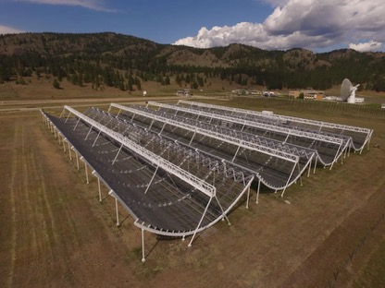
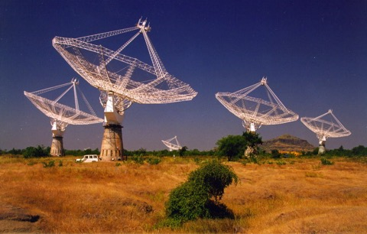
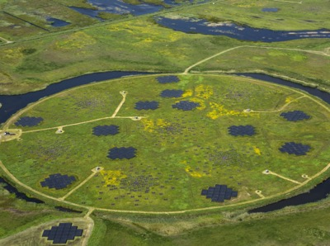



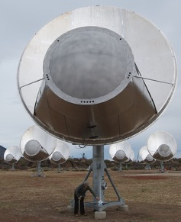
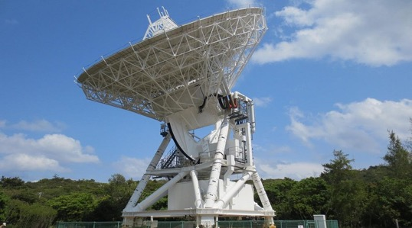
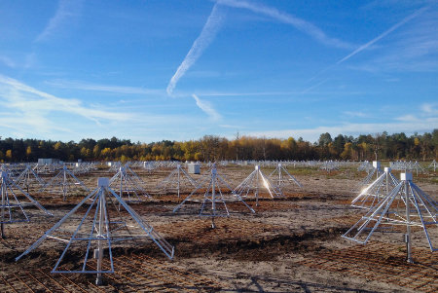
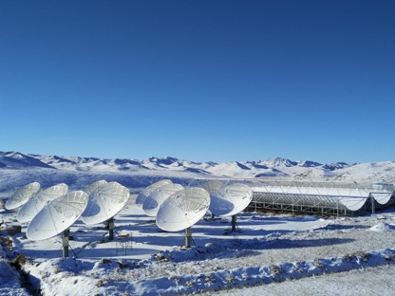



The Pathfinders
21CMA
CHIME
GMRT
LOFAR
ATA
VERA
NenuFAR
TianLai
16/03/2026
The SKA Observatory – Status and Perspectives

Slide 12
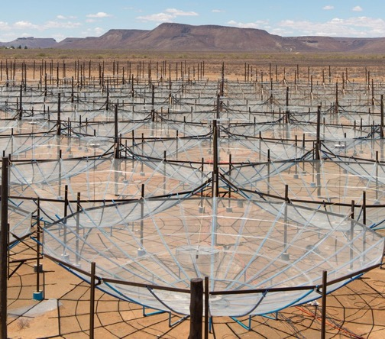
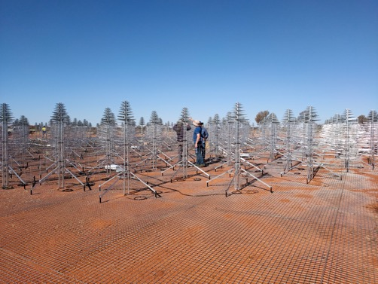
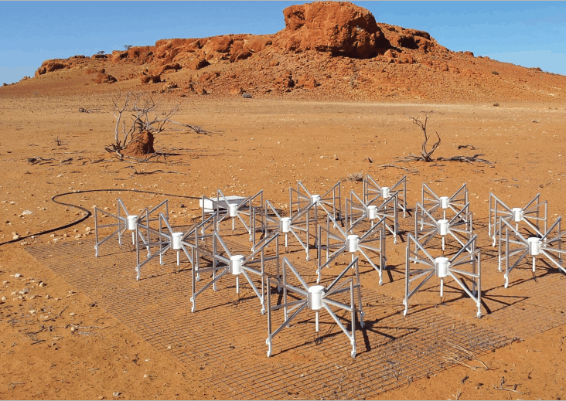
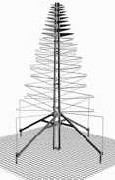


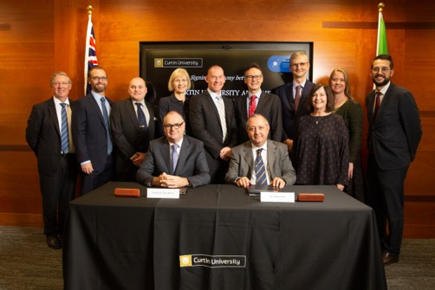

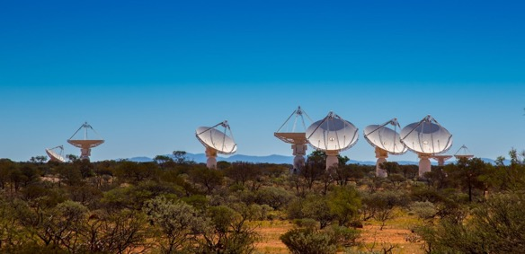
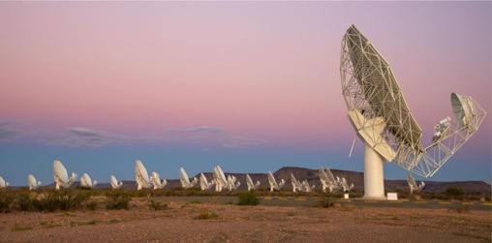
The Precursors
AAVS2.0
MWA
HERA
AAVS2.0
MWA
ASKAP
MeerKAT
16/03/2026
The SKA Observatory – Status and Perspectives

Slide 13
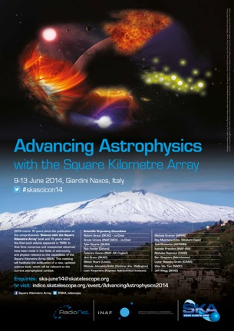
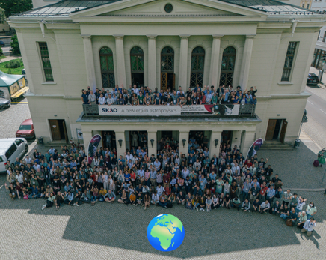
Science with the SKA
Any observing infrastructure is built on a baseline science case that serves for the definition of the top-level science requirements guiding the engineering design and, in some cases, the development of new technologies required to achieve the science goals.
Almost never the infrastructure gains history with any of the science cases described in the baseline.
The reference science case was the result of a community effort photographed at the following milestones:
1999: First detailed science case, edited by Taylor and Braun.
2004: Science with the Square Kilometre Array, book edited by Carilli and Rawlings.
2015 The third edition of the book “advaning Astrophysics” released based on the meeting at Giardini Naxos (2014).
2026 a new version of the book “Advancing Astrophysics” will be edited based on the meeting in Goerlitz (2025).
16/03/2026
The SKA Observatory – Status and Perspectives

Slide 14
Science Cases
Pulsars and related research
Gravitational Waves Astronomy
Pulsar magnetophere
NS Population and census of pulsars
Tomography of magnetoionic medium
Testing Gravity with Pulsars
NS interiors
Magnetism
Jets
MF in nearby galaxies
Large Scale Magnetism
…
General
Continuum observations-survey
OH MASERS
Molecular Spectroscopy
Dark Matter
Cradle of Life
SETI
Protoplanetary disks
Magnetospheres of exoplanets
YSO
Complex organic molecules in protostars
Galactic Star Forming regions
16/03/2026
The SKA Observatory – Status and Perspectives

Slide 15
Science Cases
Synergies
With VLBI
With Vera Rubin
With Euclid
With CMB experiments
With Alma
With the ELTs
With CTAs
….
The Hydrogen Universe
The Transient Universe
The continuum universe
Cosmology
Epoch of Re-ionization
Solar and Heliospheric Physics
….
16/03/2026
The SKA Observatory – Status and Perspectives

Slide 16
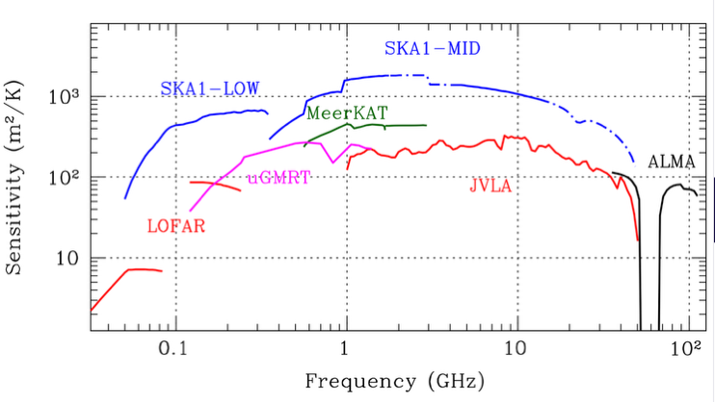
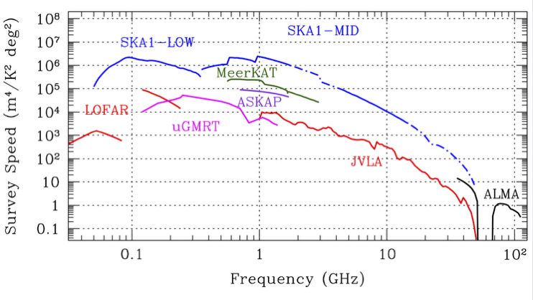
Performance
Expected performance are evaluated with many different metrics. I address you to the SKAO website to find the metric that suits you.
The most common metrics are the sensitivity and the survey Speed.
16/03/2026
The SKA Observatory – Status and Perspectives

Slide 17
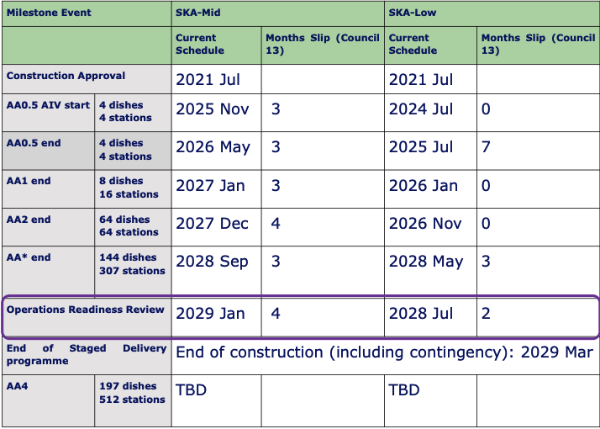
Phased Approach
Both SKA telescopes are multi-element interferometers.
There is no need to conclude the entire array before starting operation (or commissioning or Science Verification).
SKAO adopted a phased approach…
16/03/2026
The SKA Observatory – Status and Perspectives

Slide 18
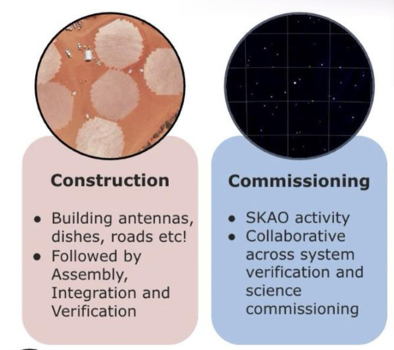
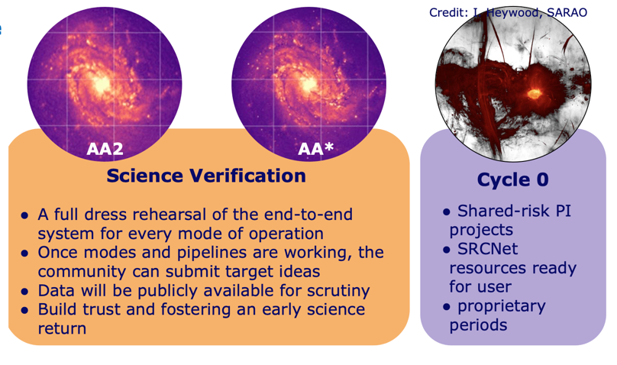
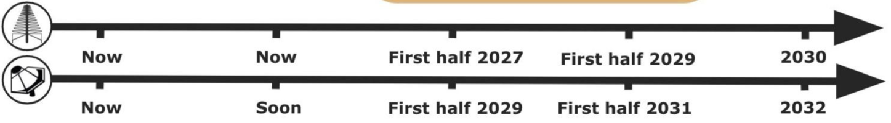
Current Project Timeline
16/03/2026
The SKA Observatory – Status and Perspectives

Slide 19
Troubled Waters
The subprime crisis (2008) – SKA Organisation was established in 2011.
The pandemic emergency (2020) – SKA Observatory was established in 2021 – Constraints in long-distance travelling.
Following the pandemic – a complete revision of almost any cost estimate (especially in Australia).
The war in Ukraine (2022) – Increase in prices of raw materials (steel, aluminium) and components (e.g., FPGA).
The crisis in Iran (2026) – constraints in long-distance travelling, energy costs, etc.
16/03/2026
The SKA Observatory – Status and Perspectives

Slide 20
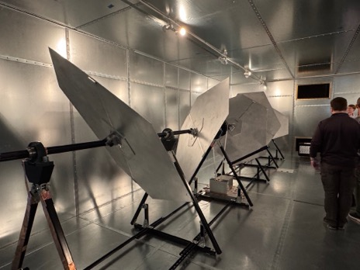
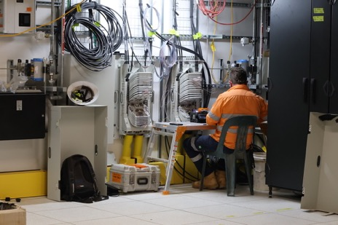





SKA LOW – November 2025
16/03/2026
The SKA Observatory – Status and Perspectives

Slide 21





The peculiarity of MeerKAT
MeerKAT is a fully functional world-class facility (STILES contributes to it).
SKA is building a telescope in the core of an operational telescope in a Super Radio Quiet area.
16/03/2026
The SKA Observatory – Status and Perspectives

Slide 22







SKA MID – November 2024
16/03/2026
The SKA Observatory – Status and Perspectives

Slide 23








G20 - 2025
16/03/2026
The SKA Observatory – Status and Perspectives

Slide 24
THANK YOU
16/03/2026
The SKA Observatory – Status and Perspectives

