Slide 1
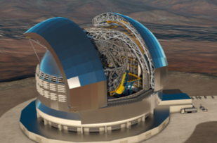
STILES
A scientific roadmap for the
Band5b receiver on MeerKAT
Venturi Tiziana
INAF, Istituto di Radioastronomia
March 17th, 2026

Slide 2
Outline
Science with Band5b
Observational capabilities of the Band5b receiver on MeerKAT
Scientific capabilities of the Band5b receiver and the Italian astrophysical community & next steps
Prospects
Activities 3331-3332-3333
Overview & achievements
Missione 4 • Istruzione e Ricerca

Slide 3
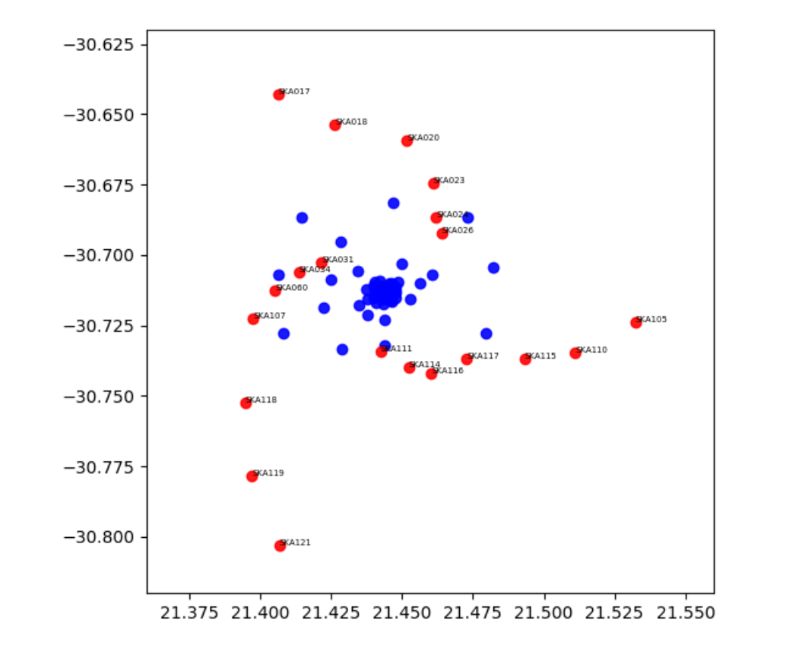
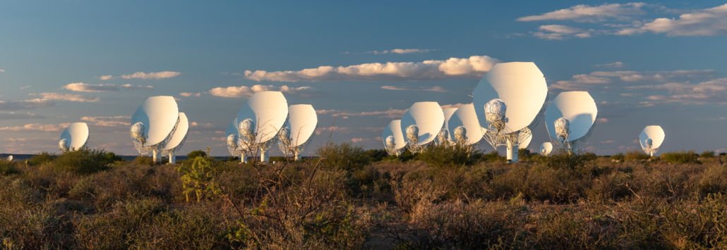
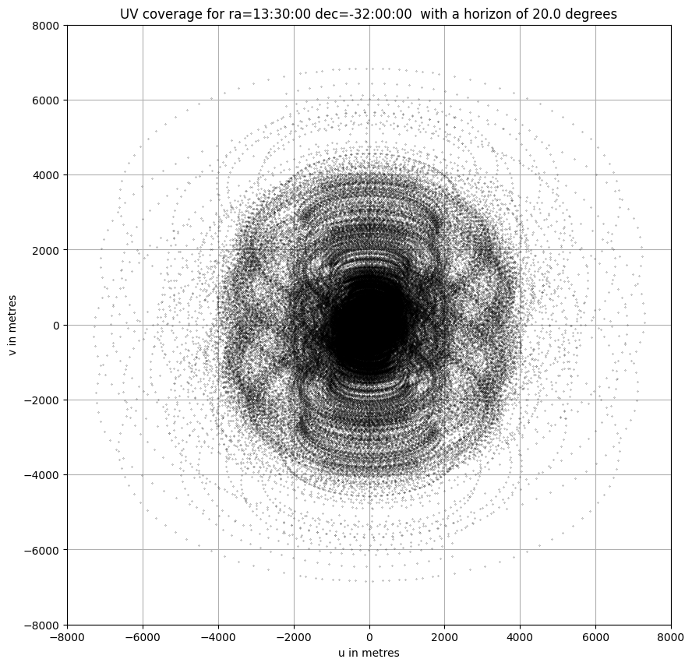
MeerKAT Current performances
MeerKAT
Operated by SARAO
64 dishes with diameter 13.5m in a ‘’random’’ configuration
Maximum baseline 7.7 km
L Band 900-1670 MHz, UHF 580-1015 MHz
S Band 1750-3500 MHz
4k & 32k channels
Pulsar gating
L-band parameters
Angular resolution ∼ 8’’
Image sensitivity ∼ 12𝜇Jy/b/hr
Line sensitivity ∼ 184𝜇Jy/b/hr (209 kHz channel)
SKA1-Mid
Karoo Region South Africa
Dec -30 - 11 hr

Slide 4
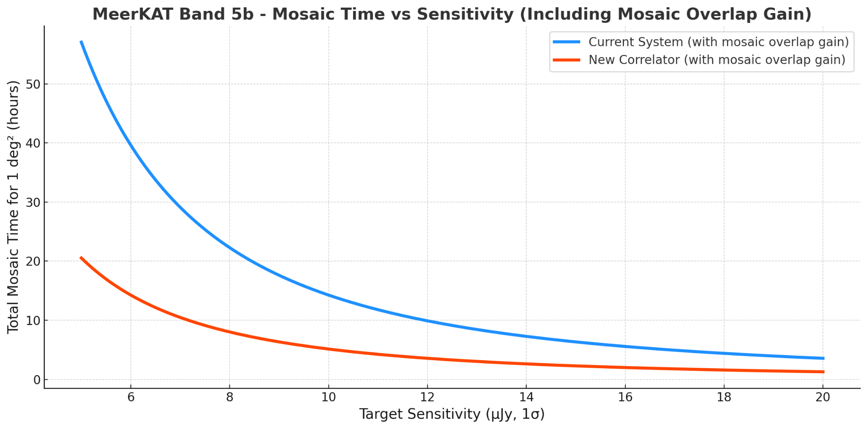
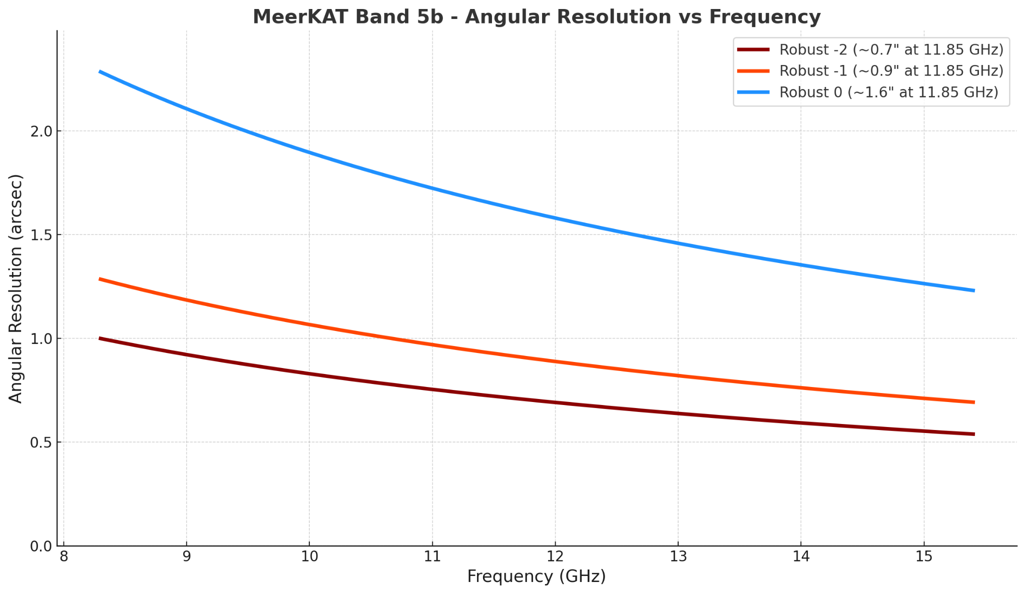
MeerKAT capabilities with the Band5b receiver (2401)
8.3 – 15.4 GHz receiver on all 64 MeerKAT dishes
𝛥𝜈 = 2.5 GHz (tunable anywhere across the band)
𝜃 ∼ 1.2’’ to 0.6’’
FoV ∼ 6.9’
Continuum array sensitivity ∼ 3 𝜇Jy/b (𝛥𝜈=800 MHz and 1 hour integration)
Spectral resolution (no zoom): ∼26.4 kHz (∼1.4 mJy/b) for phase 1; ∼305.2 kHz (∼0.1 mJy/b) for phase 2
Spectral resolution (zoom): ∼1.6-3.3 kHz (∼5.7-4 mJy/b) for phase 1; ∼6..6-13.1 kHz (∼3.3-2 mJy/b) for phase 2
Plots from Cavallaro

Slide 5
MeerKAT capabilities with the Band5b receiver (2401)
8.3 – 15.4 GHz receiver on all 64 MeerKAT dishes
𝛥𝜈 = 2.5 GHz (tunable anywhere across the band)
𝜃 ∼ 1.2’’ to 0.6’’
FoV ∼ 6.9’
Continuum array sensitivity ∼ 3 𝜇Jy/b (𝛥𝜈=800 MHz and 1 hour integration)
Spectral resolution (no zoom): ∼26.4 kHz (∼1.4 mJy/b) for phase 1; ∼305.2 kHz (∼0.1 mJy/b) for phase 2
Spectral resolution (zoom): ∼1.6-3.3 kHz (∼5.7-4 mJy/b) for phase 1; ∼6..6-13.1 kHz (∼3.3-2 mJy/b) for phase 2
Strategic benefits for SKA-mid
Early SKA science with Band5b@MeerKAT before SKA-mid is fully commissioned
Band5b@MeerKAT will considerably improve the SKA image capabilities (more antennas and u-v coverage at short spacings)
Band5b@MeerKAT will support the Italian scientific leadership in high-impact areas
Band5b will considerably boost the scientific potentials
of MeerKAT, as well as the SKA-mid in perspective

Slide 6
The INAF scientific community & Band5b capabilities on MeerKAT
The process to select MeerKAT Band5b scientific highlights & White Book
Consultation with the Italian and South African community through a call for ideas
Broad involvement of INAF
National workshop held in Catania in May 2025 Maximizing MeerKAT’s full potential: the scientific roadmap for Band5b
12 high-impact areas identified
4/12 new (not just for the Italian community)
Editing of the White Book in progress
Scientific highlights | Scientific highlights
Complex organic molecules in the Solar System precursors | Transient science
The Galactic Centre | Synergies with high energy facilities
Pulsars in the Galactic Centre | Radio galaxies
Star formation and census of HII regions | Band5b on MeerKAT and prospects for VLBI
Molecules at high redshift | MeerKAT Band5b spectropolarimetric survey
Nearby galaxies | Galaxy clusters
Negotiation for time allocation in progress with SARAO

Slide 7
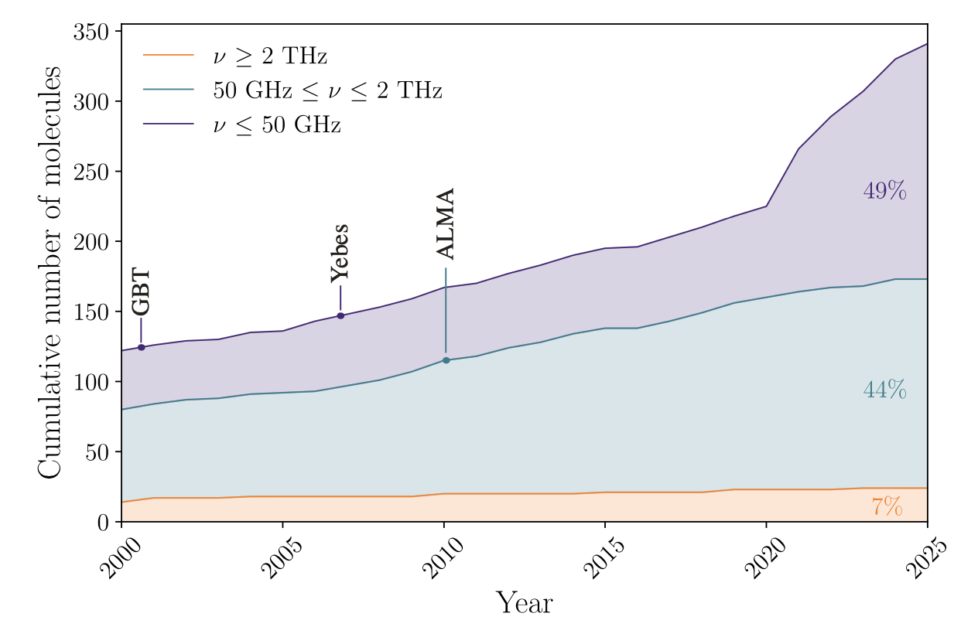
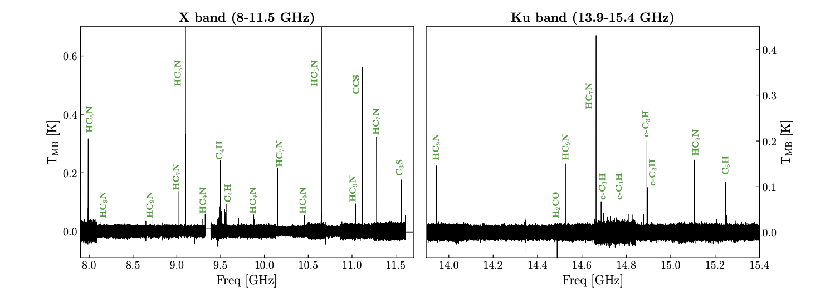
New high-impact area #1 Complex carbon chemistry in Solar System precursors
Need to characterise the initial evolutionary stages in planetary systems – chemical inventory as main tool
Abundance of carbon-bearing species in the radio window
Importance of observations below 50 GHz:
less affected by dust emission
Complex molecules at low temperature peak below 50 GHz
Science cases:
Complex carbon chemistry in prestellar cores
Warm Carbon Chain chemistry in protostars
Carbon chains in accretion streamers
Protostellas shocks
L1544 @ GBT
Slide adapted from E. Bianchi

Slide 8
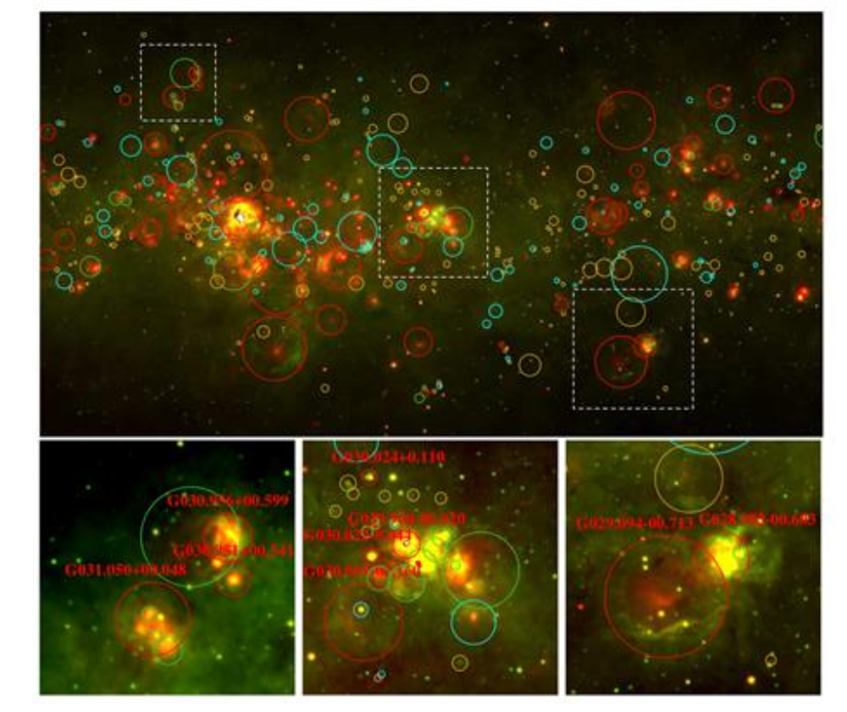
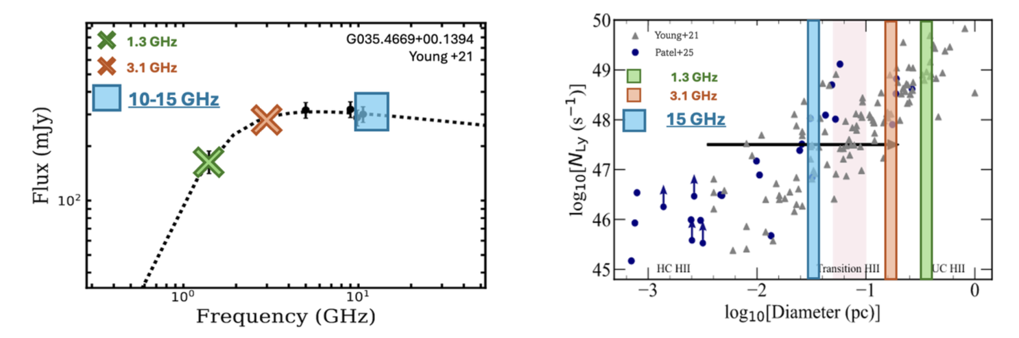
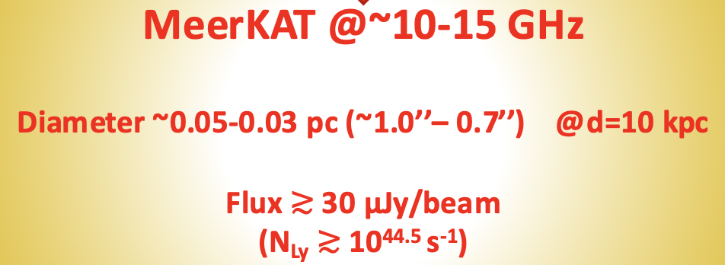
New high-impact area #2 Star formation and census of HII regions
The Band 5b frequency range allows the determination of the SED for the HII regions, which coupled with the angular resolution allows to study their evolution out to ∼10 kpc away from us
Need to disentangle the complex interplay between gravity, turbulence & feedback in the star forming processes
Focus on HII clumps in the Galactic Plane, to complement exisiting surveys
Hyper-compact (HC) and Ultra-compact (UC) HII regions become optically thin at GHz frequencies (1-5 GHz & 5-50 GHz respectively)
Slide adapted from A. Traficante

Slide 9
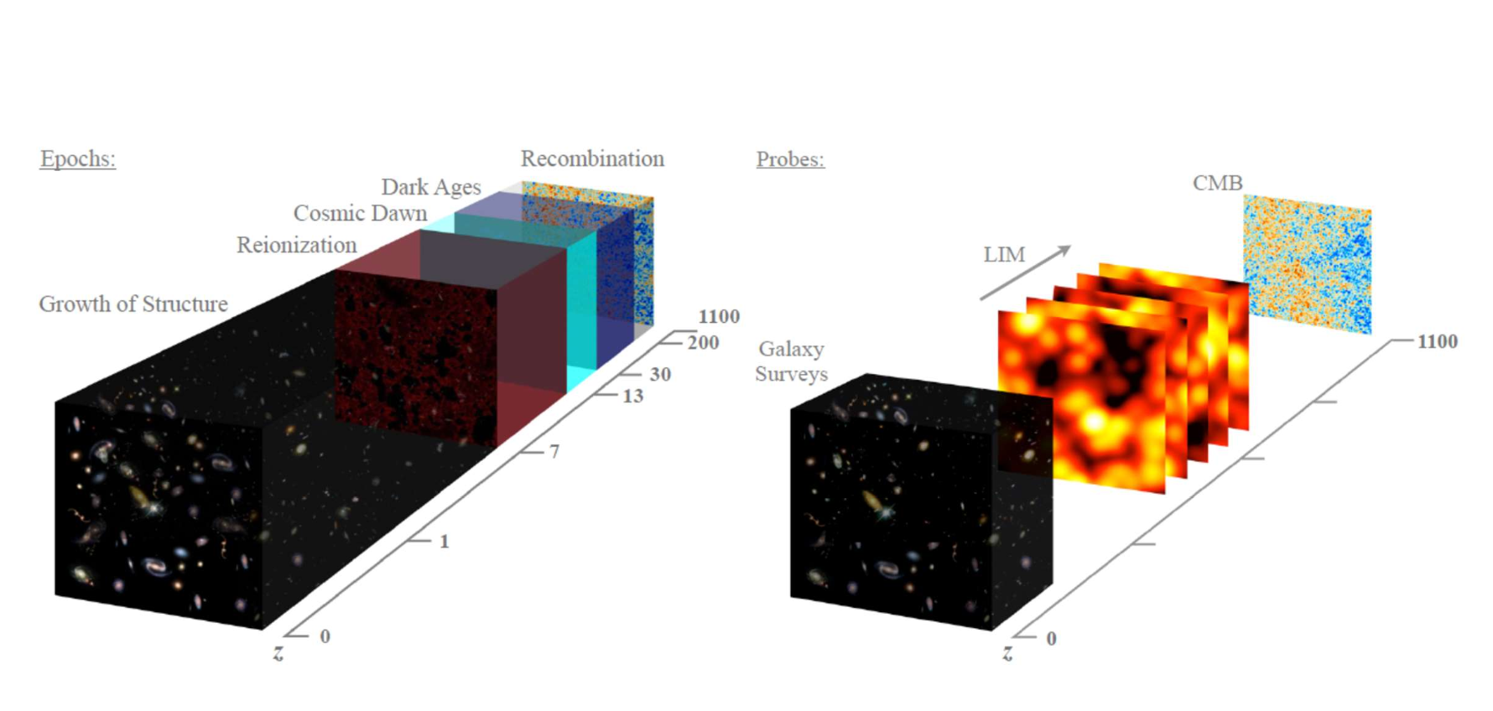
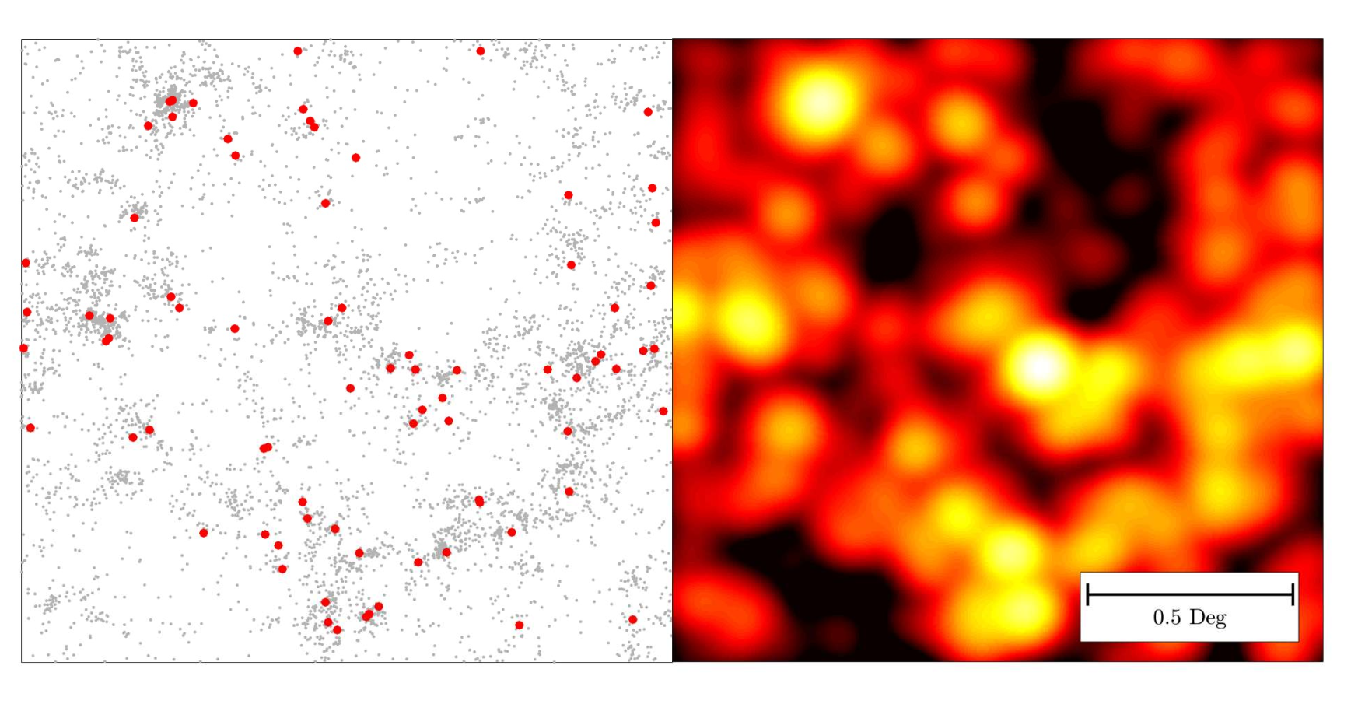
New high-impact area #3 Molecules at high redshift
Cosmic Epoch
Observational tools
CO (1-0) transition falls within Band5b for objects in the range 6.5 < z < 13
Via the intensity mapping technique, CO observations study the formation of the first galaxies through reionization (demanding observations, they require thousands of hours)
No other experiment/observing programme is currently carrying out such observations and nothing is planned in the future
Unique synergies with SKA-low: the only chance to cross-correlate CO and HI intensity mapping observations from the epoch of reionization (z ∼ 6.5)
Observations of redshifted CO in targeted sources can complement the study of cold gas carried out with ALMA
CO intensity mapping forecasts
Slide adapted from G. Bernardi

Slide 10
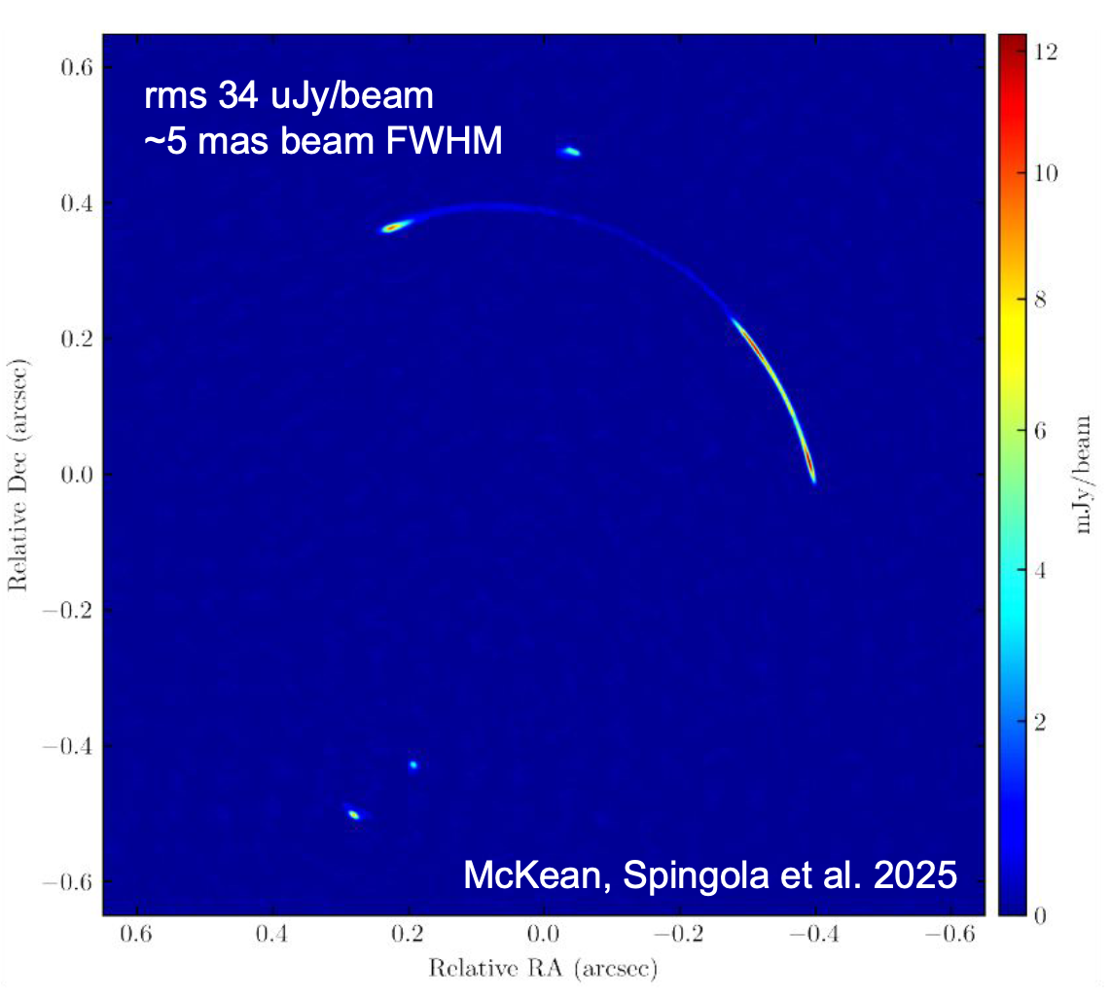
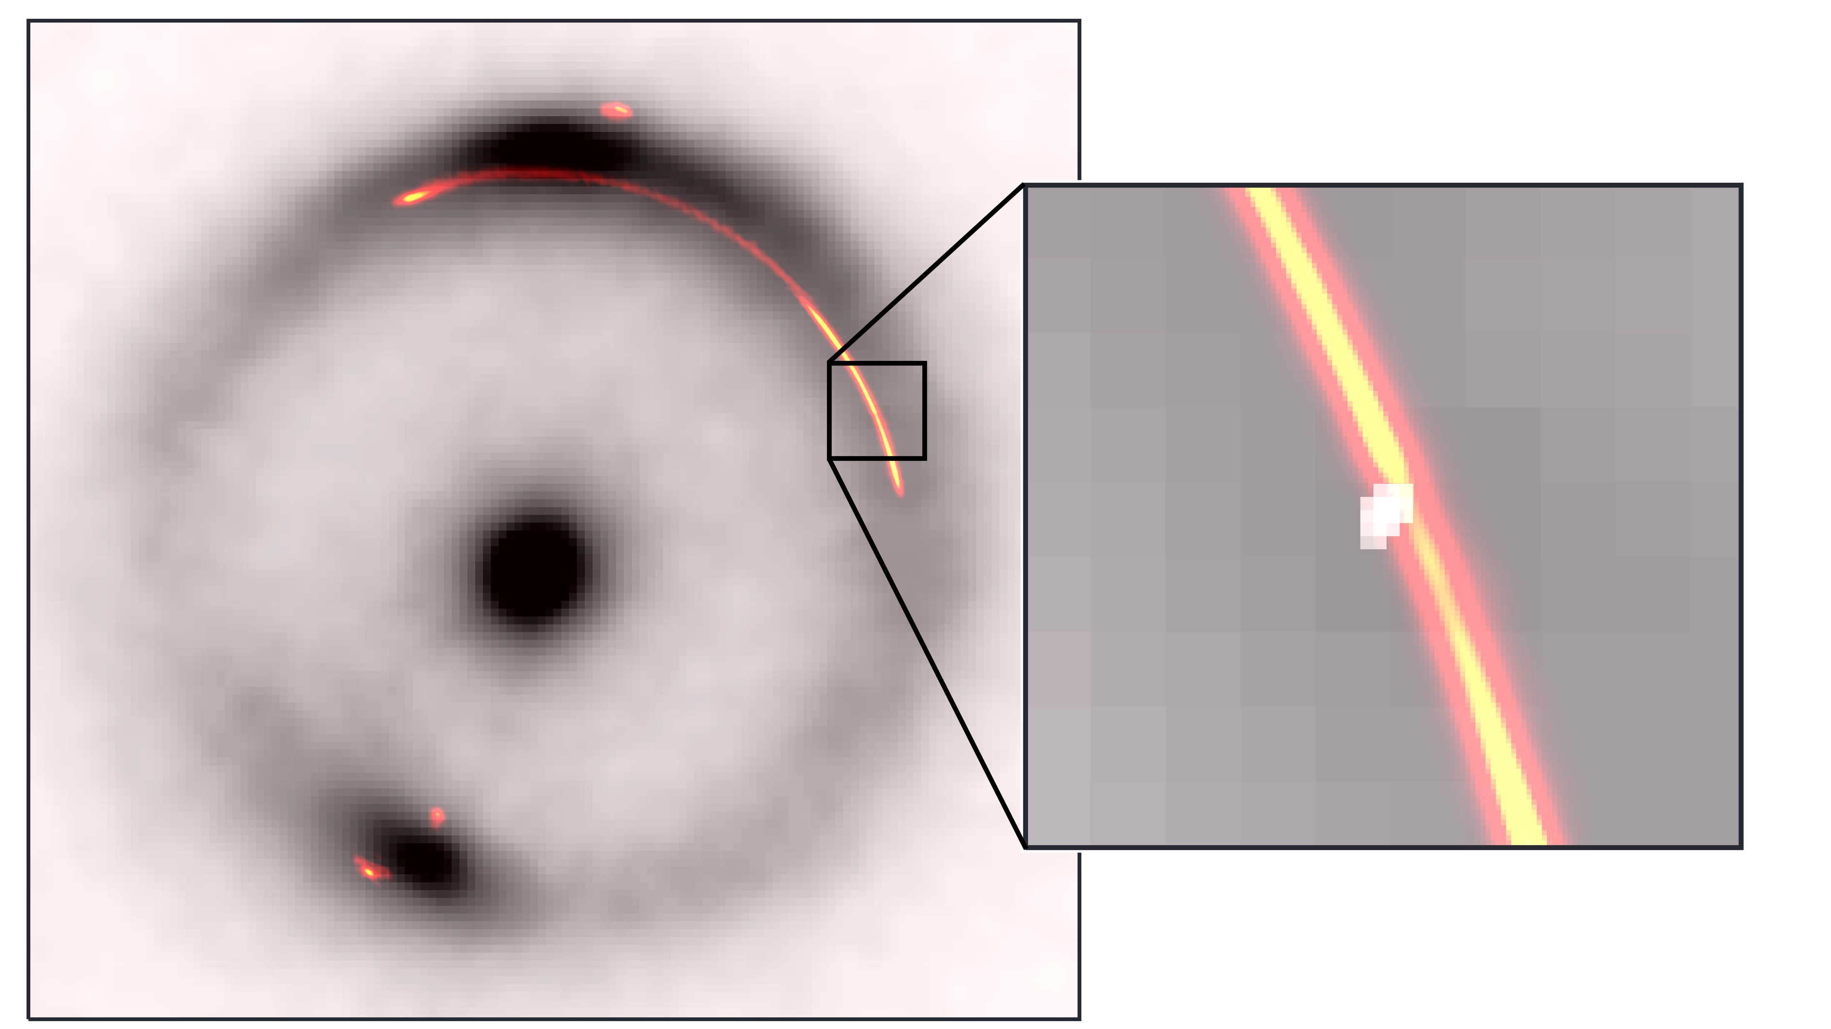
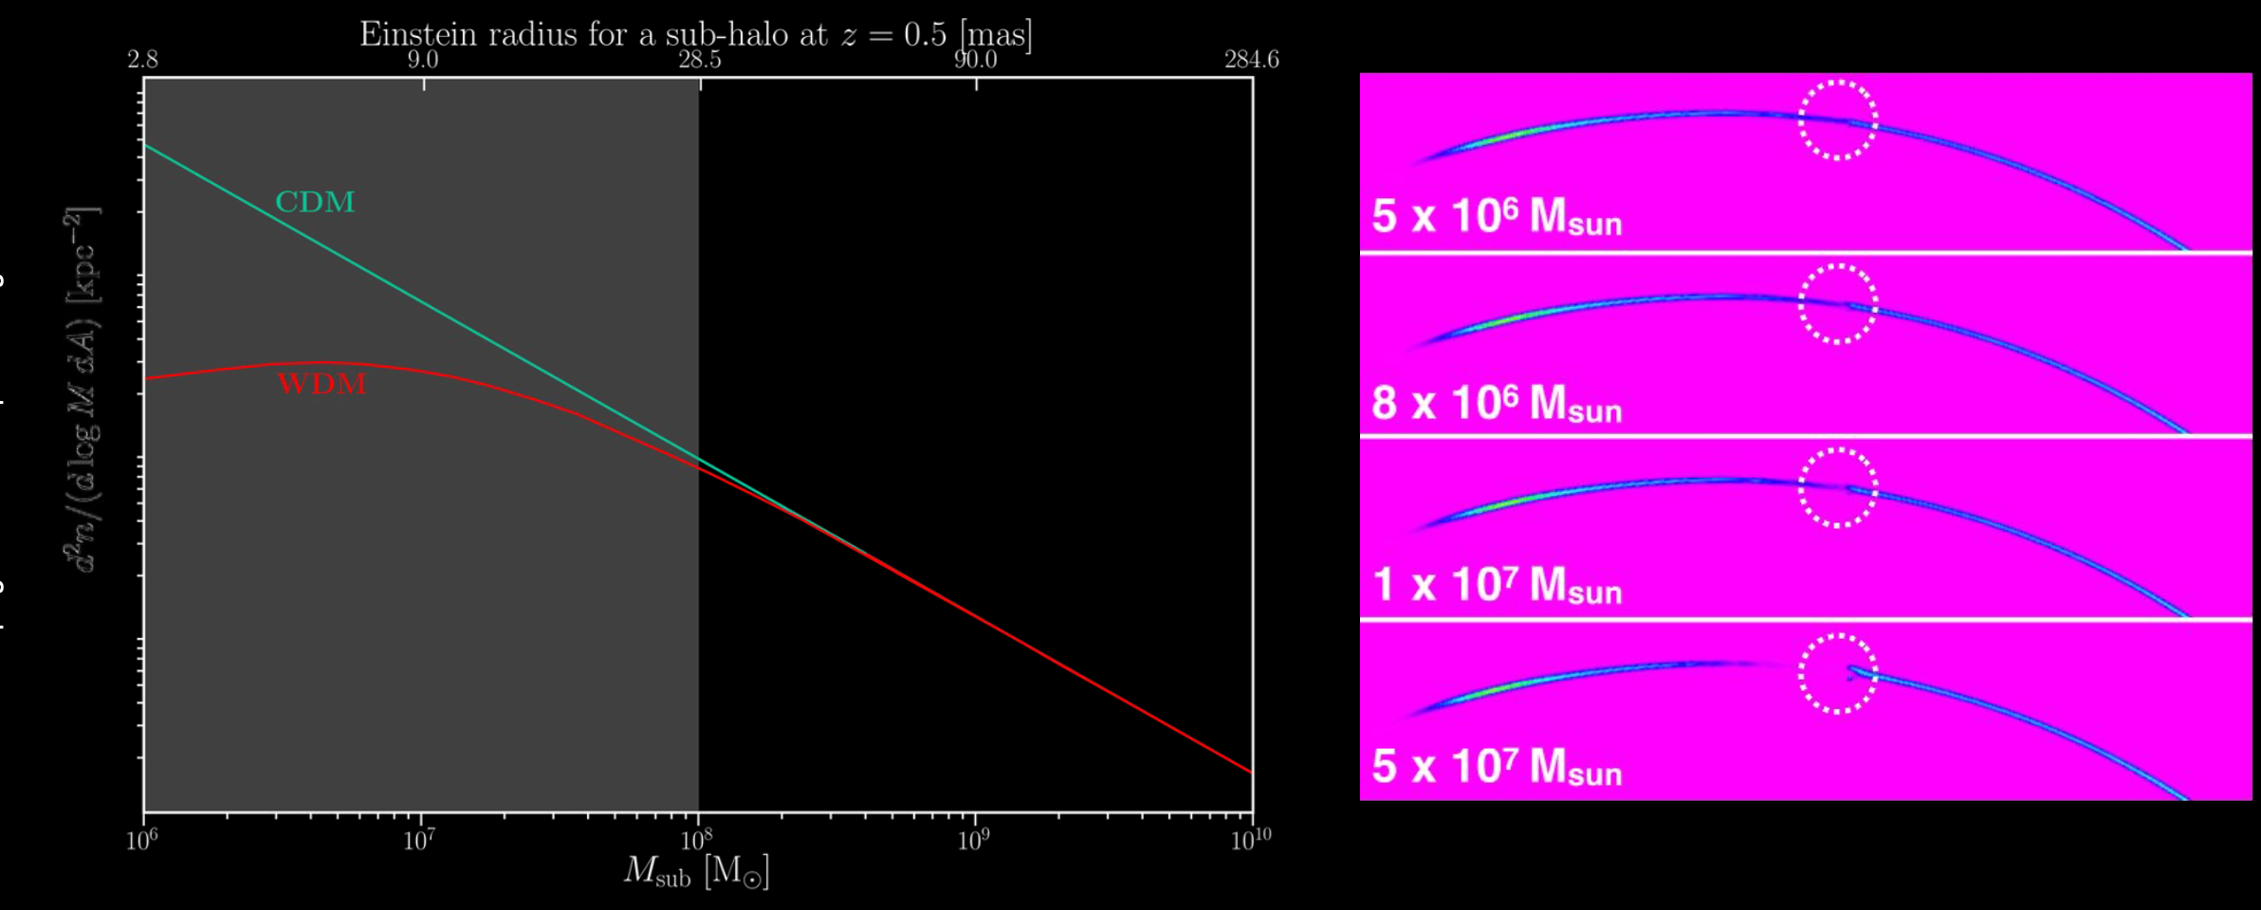
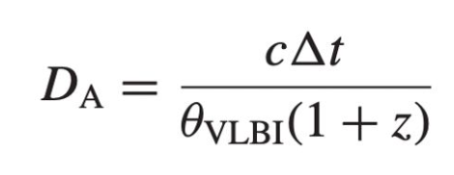
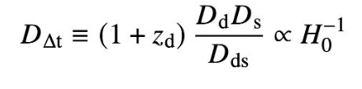
New high-impact area #4 Prospects for VLBI
MeerKAT Band5b provides the resolution and sensitivity to image thin gravitational arcs
Global VLBI @1.65 GHz
As any interferometric array, MeerKAT can be phased-up to act as a single antenna operating in Band5b with joint observations with VLBI arrays (the most relevant for INAF being the European VLBI Network, EVN), to provide substantial contribution to:
Our knowledge of the Milky Way through methanol masers (12 GHz)
Localisation, imaging and multiepoch analysis of transient sources (GRBs, FRB hosts, GW)
High-z AGN & gravitational time delays to infer the cosmological parameters
Imaging of thin gravitational arcs to investigate the nature of dark matter
10⁶ M_{sun}
Powell et al. (incl. Spingola) 2025 Nature Astronomy
Spingola 2021
Slide adapted from C. Spingola
Credits: G. Despali

Slide 11
Activities 3331-3332-3333 General scopes
Need to upgrade computing infrastructure and data storage capabilities for upcoming (Italy-led) surveys exploiting MK Band5b receivers (see activity 2401) and MK+
➔ procurement of new HW and SW best suited for 3 scientific applications:
Extra-galactic HI + radio continuum surveys (activity 3331 – I. Prandoni – IRA)
Time domain observations (activity 3332 – A. Possenti – OA Cagliari)
Full Stokes Galactic radio continuum surveys (activity 3333 - S. Riggi – OA Catania)
Missione 4 • Istruzione e Ricerca
Courtesy of I. Prandoni

Slide 12

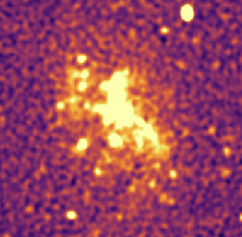
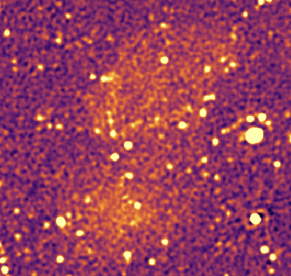
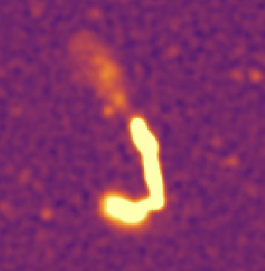
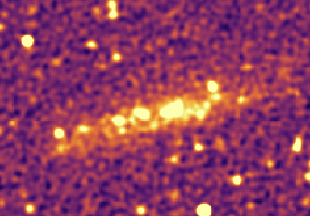
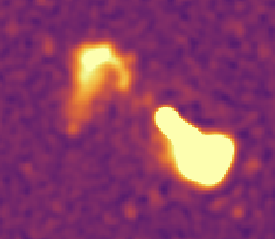
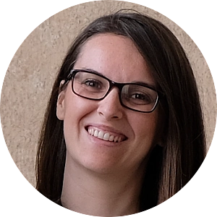
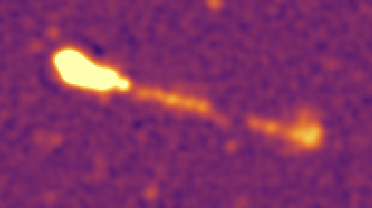
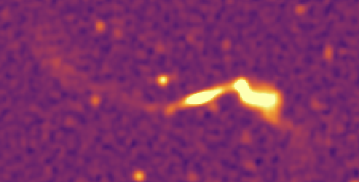
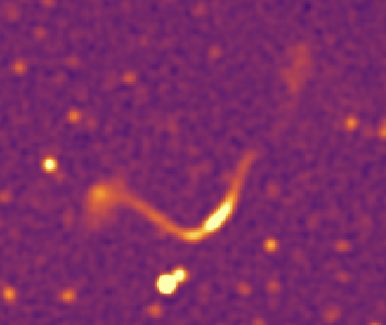
Activity 3331 (163.520,00 Eu)
Procurement (A. Bosi; R. Poerio, G. Solinas, M. Tugnoli):
Computing multi-core Server:
2x32 cores & 2x512 GB RAM
4x20 TB Hard disks (HDD) + 240 GB SSD
Hard Disk SSD 2.5" NVMe PCIe5 12.8TB 3DWPD
Hard Disk SSD 2.5" NVMe PCIe5 7.68TB 1DWPD
HD for 100 Gbit local network upgrade:
N.1 Switch NVIDIA Spectrum SN2100
N.1 RACK installation kit for NVIDIA MELLANOX switch
N.1 NVIDIA MFA1A00-C020 AOC Cable Ethernet 100GbE QSFP 20mt
N.3 NVIDIA MCP1600-C002E30N DAC Cable Ethernet 100GbE QSFP28 2m
N.1 NVIDIA AI Enterprise Support Services Business Standard Support (3 years)
Tape Library (procured by UniNA, Activity 3102)
Server + 20 Tapes (each 18 Tb or 45 Tb compressed)
All HW installed and now operational (IT IRA staff)
NGC 3557
Ruffa+ in prep.
EDFS - Brienza+ in prep.
Hiring: M. Brienza (TD)
Data processing pipelines (in collaboration with OA Cagliari):
OXCAT (radio continuum) & CARACAL (HI) - installed, tested and fine-tuned using computationally-heavy MK datasets:
Wide (23 deg²; 120h) radio continuum mosaic covering the Euclid Deep Field South (M. Brienza)
Wide (23 deg²; 120h) HI mosaic covering the Euclid Deep Field South (A. Bianchetti, F. Maccagni)
Two Deep (25h) HI pointings targeting NGC 3100 and NGC 3557 (F. Maccagni, I. Ruffa)
Courtesy of I. Prandoni

Slide 13
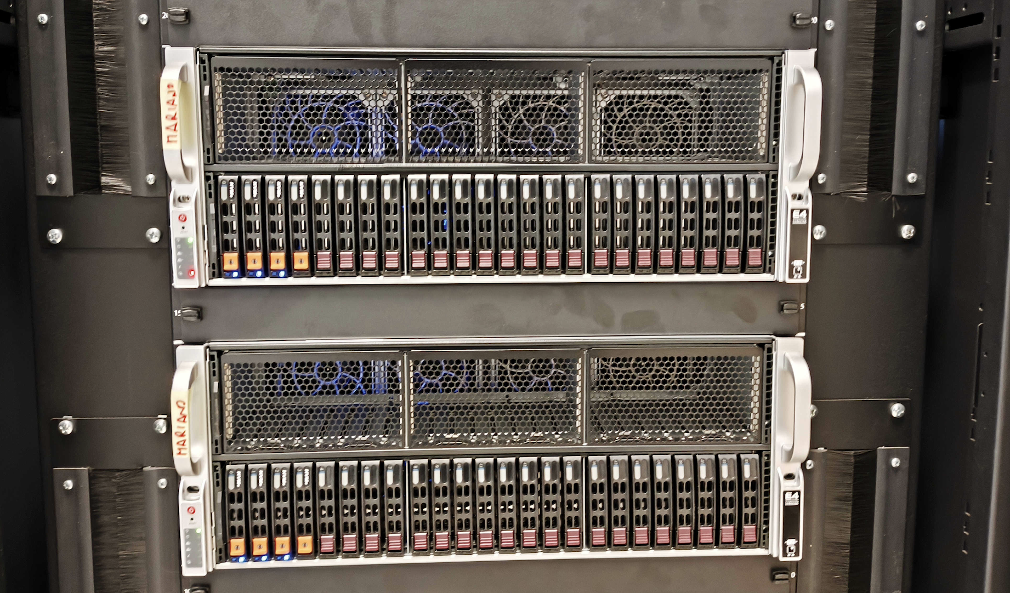

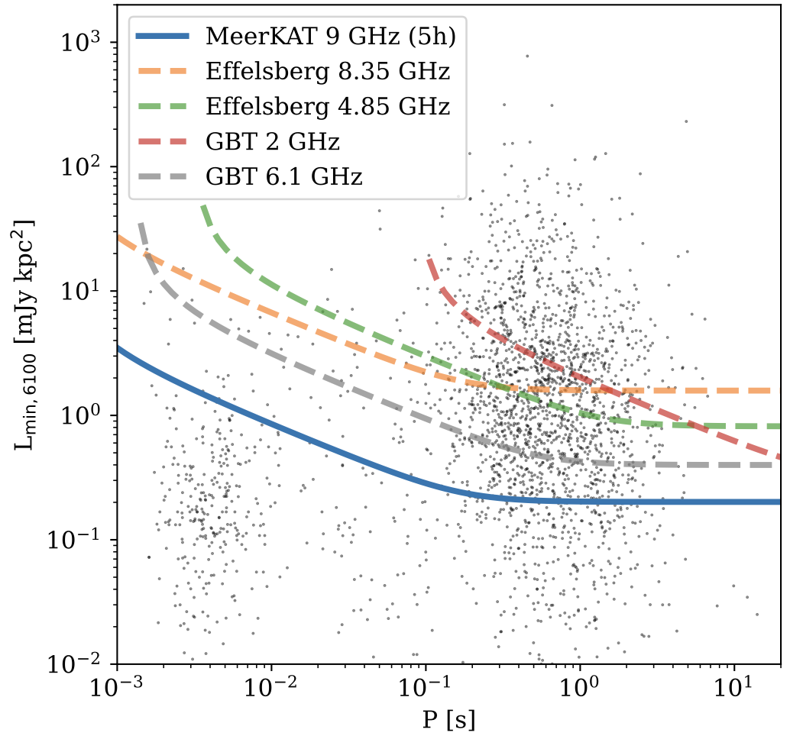
Activity 3332 (174.966,40 Eu)
Procurement (I. Porceddu, A. Mascia):
2 multi-cpu multi-gpu servers:
G434 Server 4U Dual Socket Epyc GPU
2 x 24core-processors AMD Epyc 9224 2 Dischi SATA 480GB con SW RAID 3 Dischi NVMe 15.3TB 4 GPU Active RTX4000 ADA
All HW installed and now operational (IT OAC staff, thanks M. Muscas)
Hiring: F. Abbate (TD)
Hiring: TD F. Abbate
Data processing pipelines
Pipelines to perform searches and timing of pulsars in dense stellar environments – installed
tested and fine-tuned using large MK datasets: e.g.
Globular Cluster NGC 6522: 2 discoveries (F. Abbate, A&A, 12/23 )
Globular Cluster 47Tuc: eclipses of psr O (F. Abbate, A&A, 08/24 )
Galactic Center: rotation measure (F. Abbate, MNRAS, 09/2023)
Galactic Center: review of SKA capabilities (F. Abbate, OJAp, 12/2025)
Comparison of the minimum detectable luminosity of a pulsar in the Galactic Center for past and future MeerKAT/Band5 surveys
Within the central 1 pc, expected
≈1.9 discoveries of a young pulsar in a 10h band5 pointing
predictions for Band5 at Meerkat
Galactic Center: review of MK/Band5 capabilities (F. Abbate, 05/2025, poster here 03/2026)
≈1.7 discoveries of a millisecond pulsar in a 10h band5 pointing
Courtesy of A. Possenti
That would be a scientific breakthrough

Slide 14
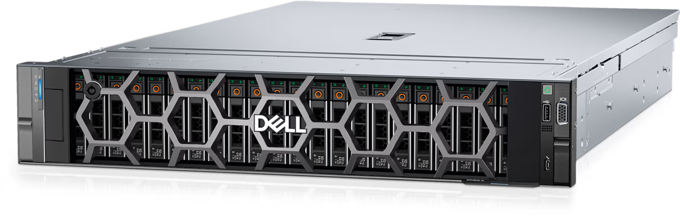
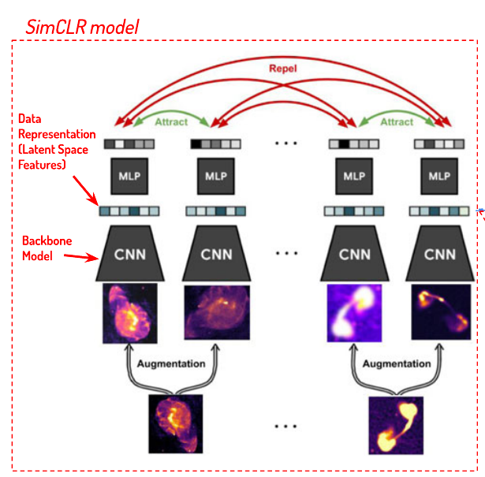
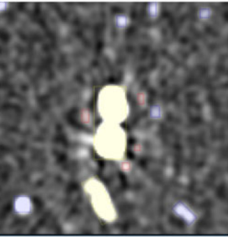
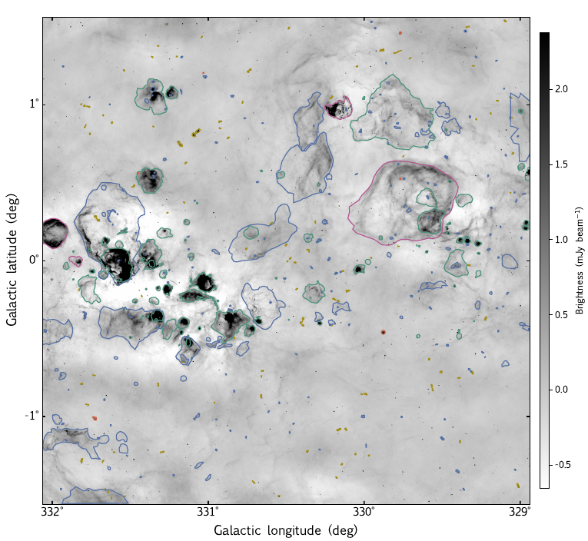
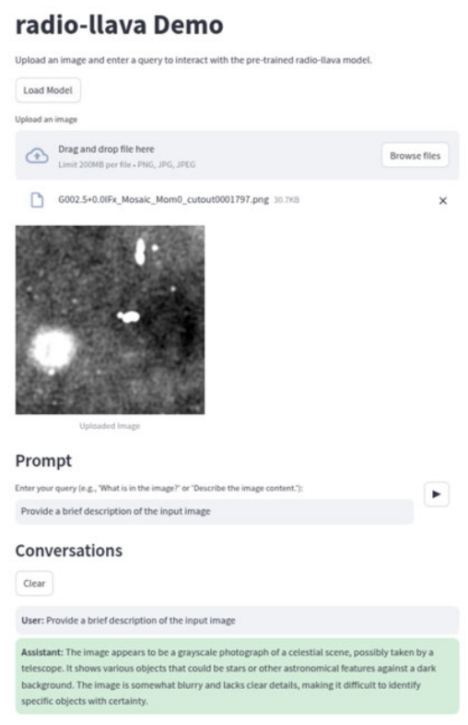
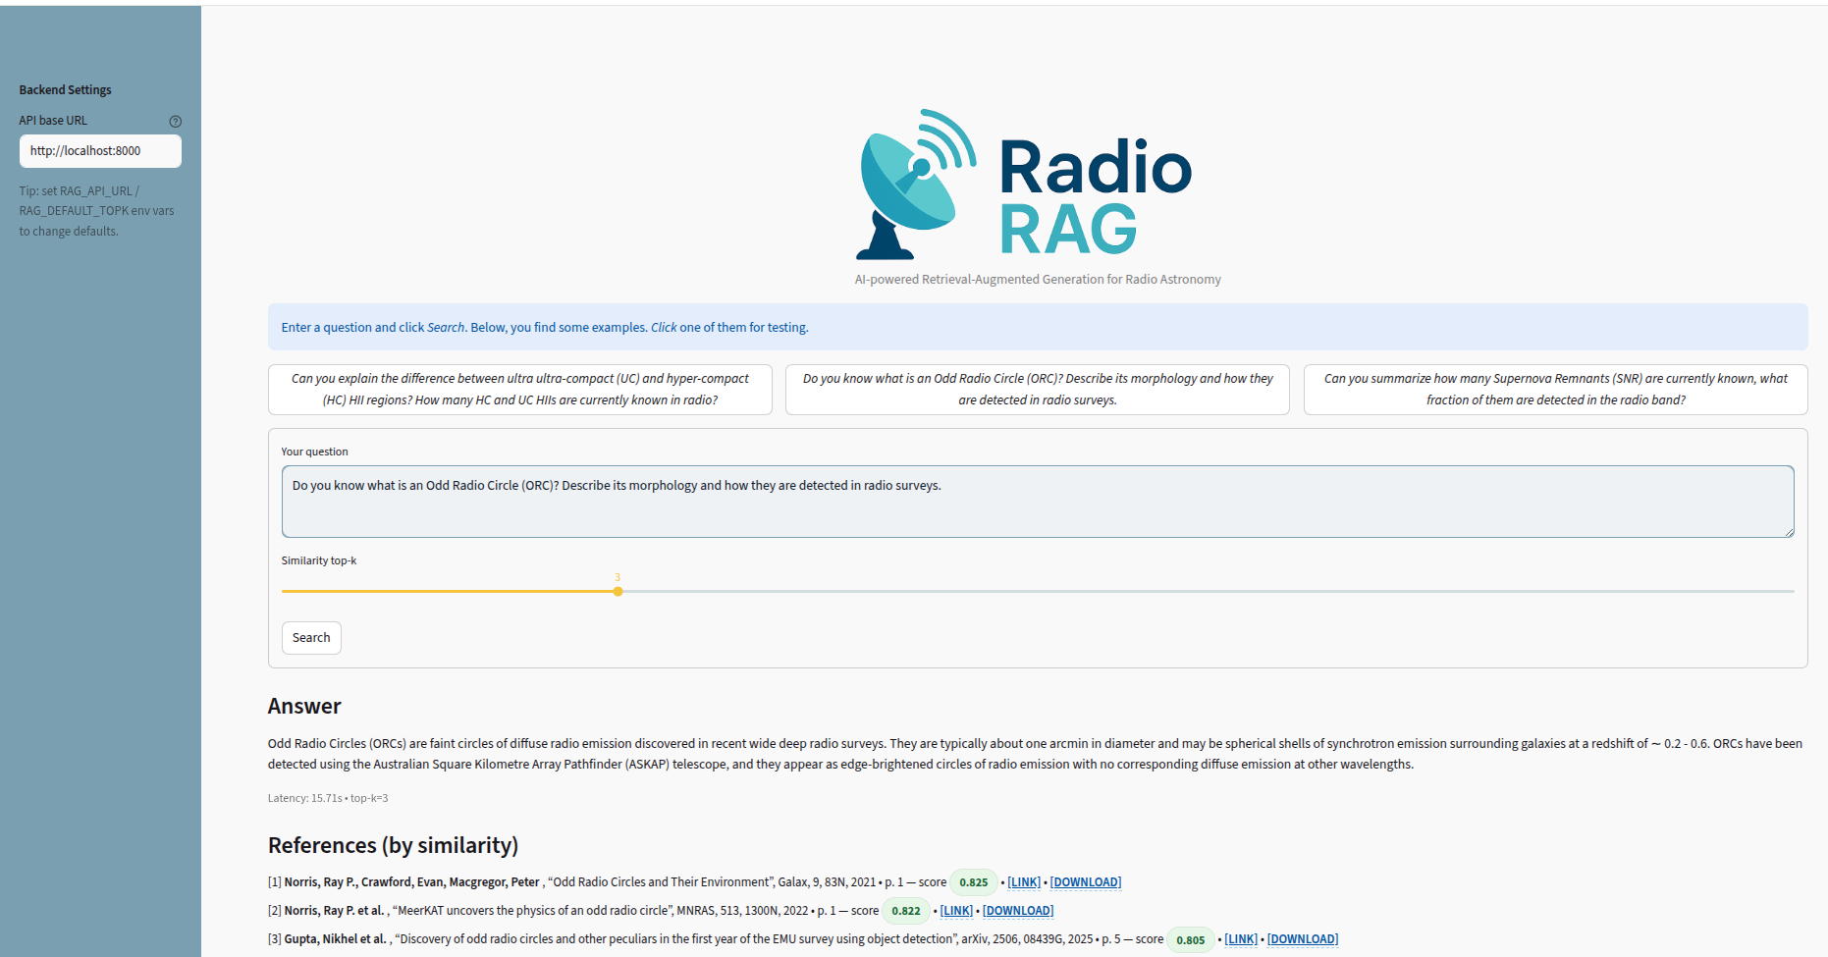
Activity 3333 (25.000 Eu)
Procurement (Riggi, Grillo Buttaccio, Fallica, Li Volsi):
1 computing server for the analysis of continuum data for MeerKAT and MeerKAT+
2 x Intel Xeon Silver 4410Y 2G, 12C/24T
256 GB RAM, 3.5 TB SSD SAS (scratch)
1 x NVIDIA Ampere A30 GPU (24 GB mem)
Procured resources
- 1 GPU Server (DELL PowerEdge R760)
- Direct purchase, merged with activity 3403 CtrlSWInfra_OACt
- Deployed @ OACT Computing Center in Feb 2024
ML for radio source detection, classification & anomaly detection
Extended source catalogue in the Galactic Plane
Generative AI for radio astronomy
a.
b.
c.
Peculiar radio source discovery
Radio source (compact/extended), artefact and filament detection
Transformer-based models for radio source morphological classification
Radio foundational models with self-supervised learning
Catalog of 16,534 extended/diffuse sources in the SARAO MeerKAT Galactic Place Survey in L-band
~24% known Galactic sources
~33% extragalactic
~43% unclassified, some selected for follow-up studies
Benchmarking & fine-tuning vision-language models for radio data analysis
LLM-powered radio literature information retrieval
Radio data analysis with AI agents
Usage
- Produce radio source catalogues and datasets
- Prototype ML applications on radio data
- Support radio data analysis services
Riggi+24, 10.1017/pasa.2024.84; Cecconello+24, arXiv:2411.14078;
Riggi+25, 10.26624/JTVC6453
Bordiu+25, 10.1051/0004-6361/202450356
Riggi+25, 10.1017/pasa.2025.10082
Riggi+26, arXiv.2602.07469
Courtesy of S. Riggi

Slide 15
THANK YOU FOR YOUR ATTENTION

