Slide 1
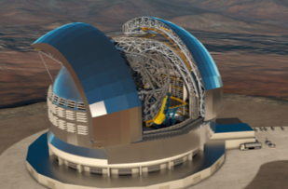
STILES
6k @ CT (6301 and 6601)
Giuseppe Leto, Matteo Munari
Napoli 16-18 3 2026

Slide 2
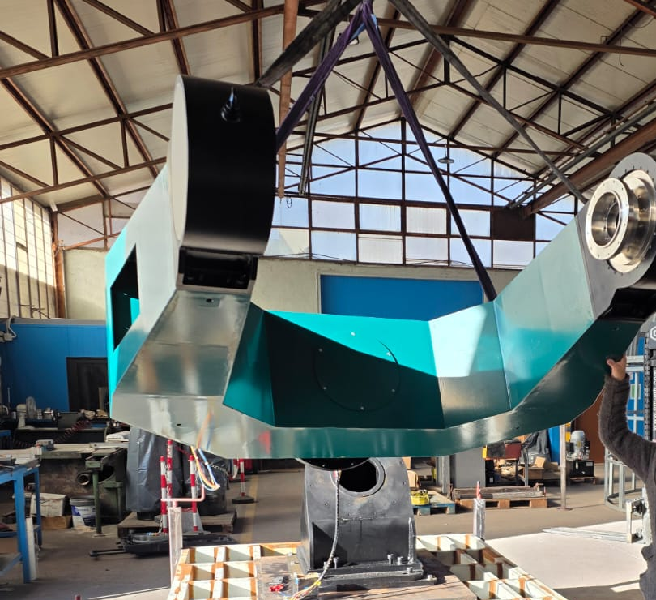
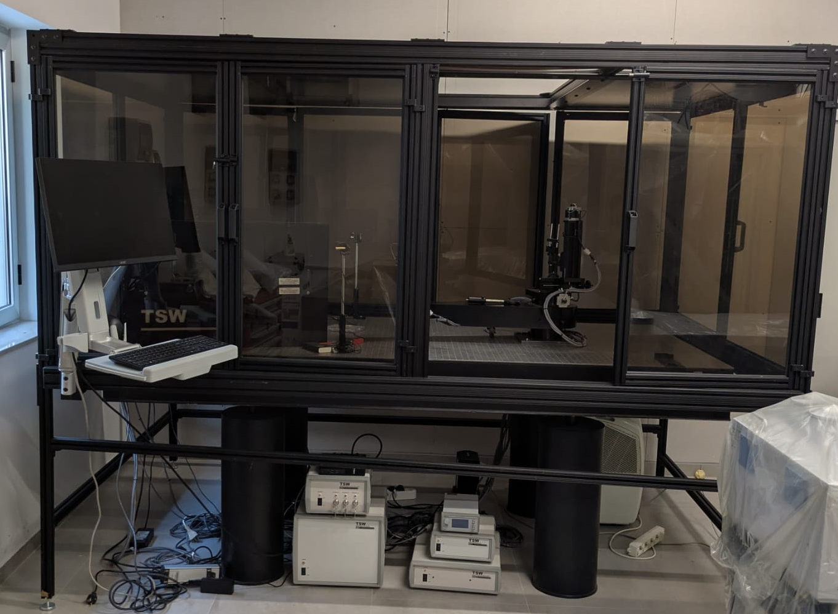
6k @ CT = 6301 & 6601 both in Catania
6301: Inertial platform (G.Leto)
6601: Scatterometer (M.Munari)

Slide 3
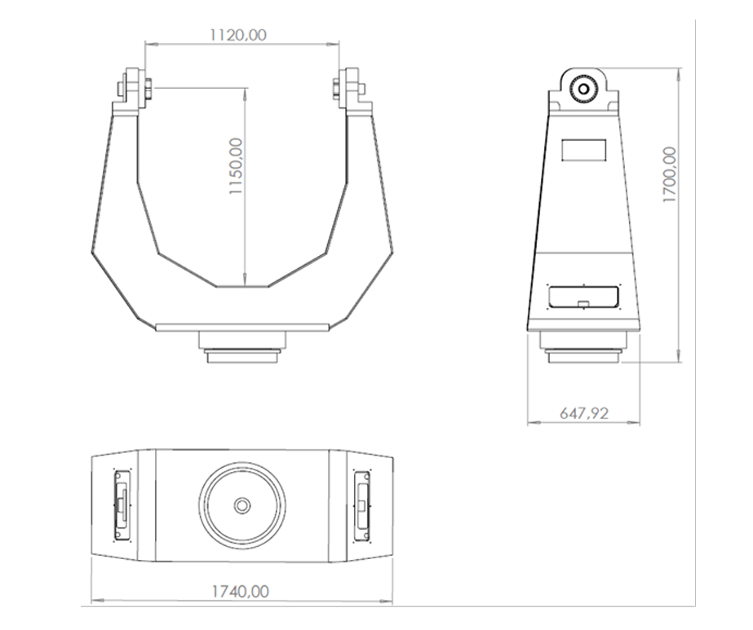
6301: Inertial Platform - What is It
Custom Platform (Mounting + Optical Bench) for large field optical systems
Some requirements:
Mounting must allow the use of instrumentation up to 300kg weight
And allow the use of to 80 cm telescope
Using specific interfaces, must allow the mounting of the optical bench
The system must be ASCOM compliant

Slide 4
6301: Inertial Platform Completed activities
Mount mechanics has been assembled (Astro Alliance S.r.l)
Electronic and control has been implemented
Lab tests done
According to manufacturer report the system fulfill the requirements

Slide 5
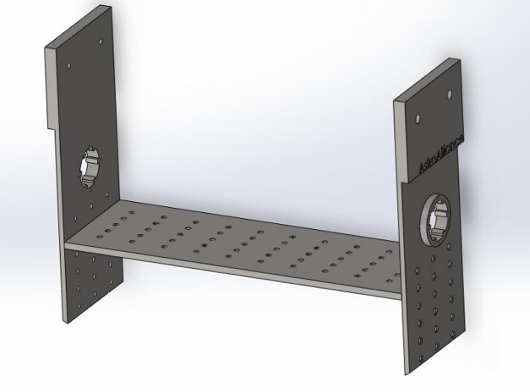
6301: Inertial Platform Remaining activities
Optical bench final implementation
‘Field tests’ : pointing and tracking of an astronomical object
DNSH
After these operations, the platform will be officially accepted and paid
Ancillary activities completed

Slide 6
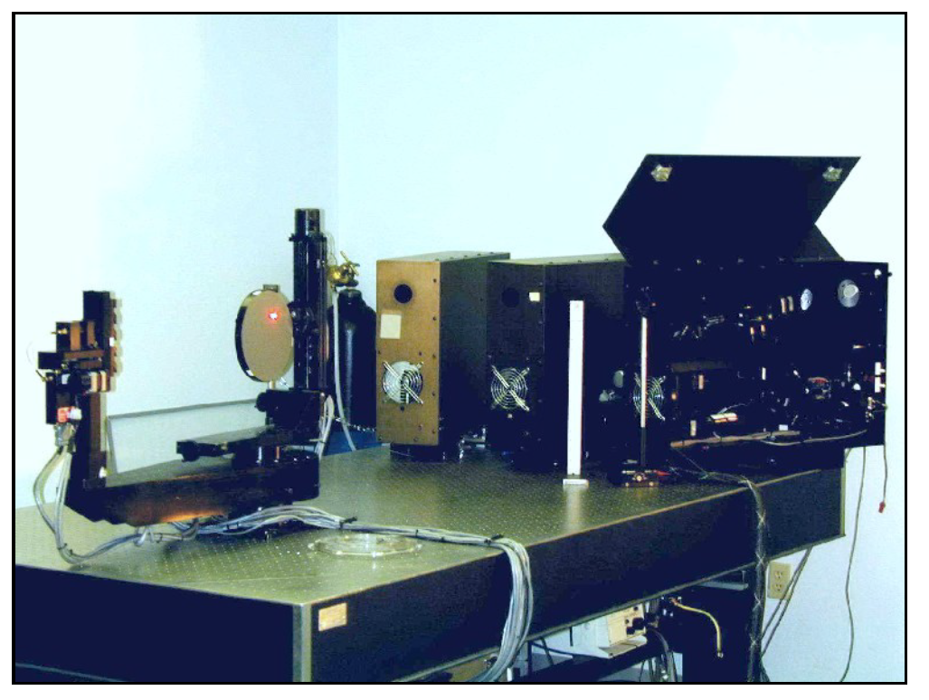
6601: Scatterometer- What is It
Instrument to measure scattering properties of sourfaces (samples)
CASI scatterometer by TheScatterWorks
It measures : BRDF, BTDF, transmittance and reflectance (samples)
Monochromatic (HeNe)
Accuracy 5%
Sample : 15cm size, 2 kg weight (in vertical)
AoI: 0-85 deg
Mesurement angle : 360°

Slide 7
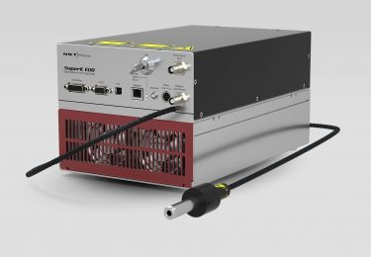
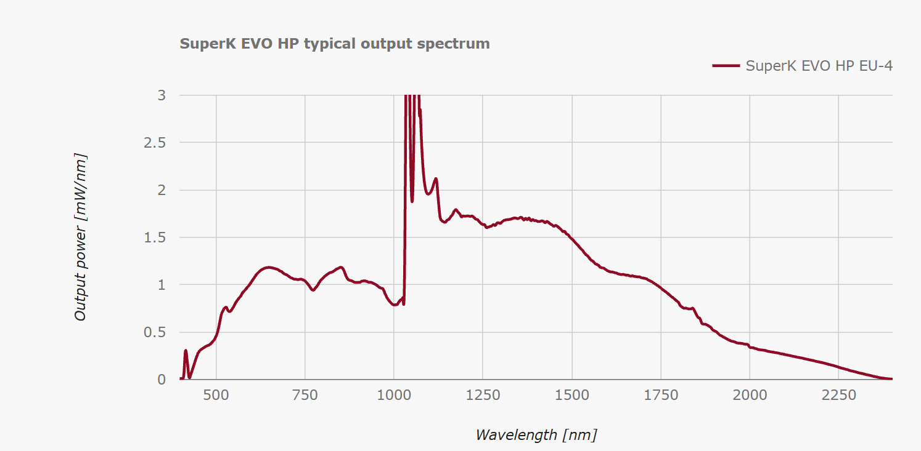
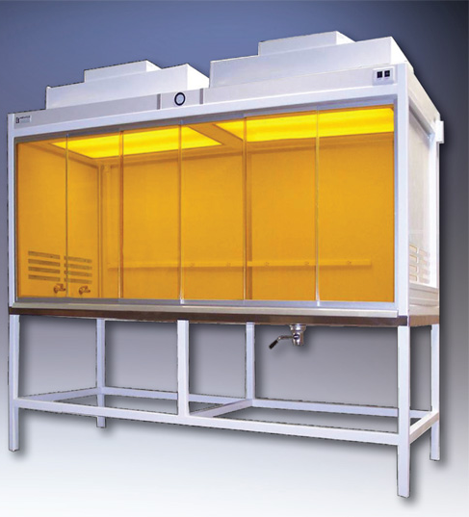
6601: Scatterometer- What is It- Upgrade
Hepa filter → BRDF down to 5e-8 /sr (lambertian white: 1/pi /sr)
Super continuum White laser, tuneable filters and IR detector → form 415 to 2000nm
Polarimetric module

Slide 8
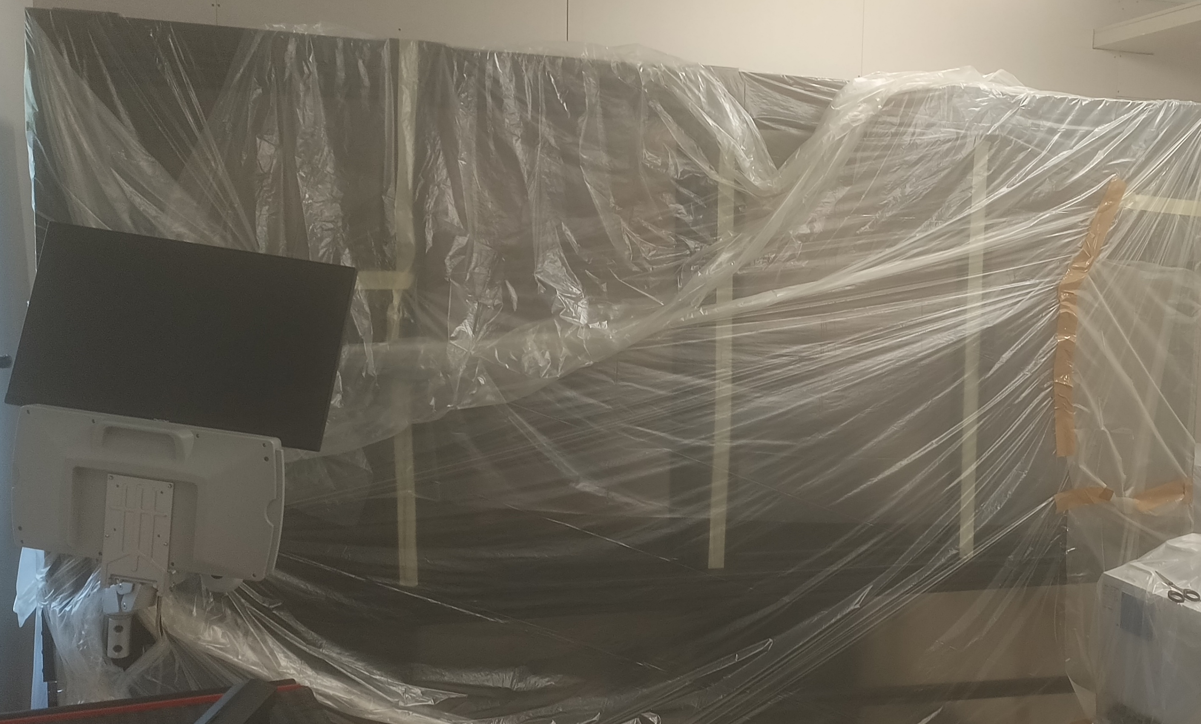
6601: Scatterometer- Status
Both standard system and upgrade
Delivered, tested and installed in Dec 25
Training from TheScatterWorks
Lab room ‘upgrading’ just ended

Slide 9
6601: Scatterometer- Status
Both standard system and upgrade
Delivered, tested and installed in Dec 25
Training from TheScatterWorks
Lab room ‘upgrading’ just ended

Slide 10
6601: Scatterometer- Future
Let’s use it!
The instrument is a ‘standard’ but needs some operator training and practice
Cross-testing
‘Bulk’ characterization of mechanical and optical surfaces
Asset to be shared in INAF and in international projects

