Slide 1

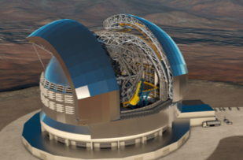
STILES
Efficient AI for
Big Data in Astrophysics
Massimo Brescia

Slide 2
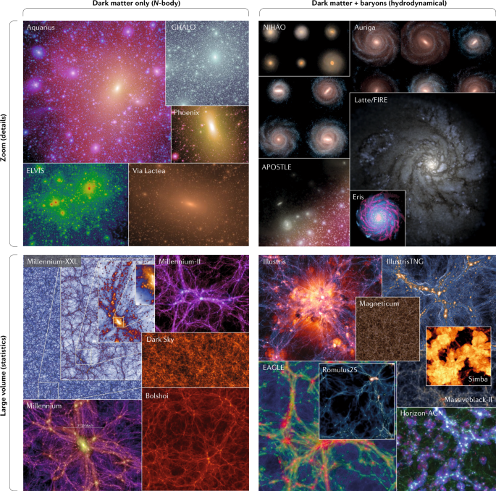
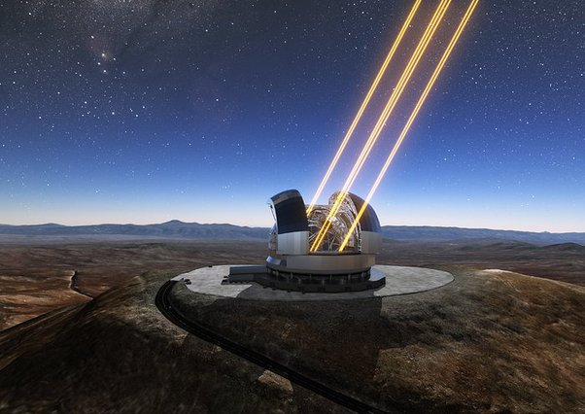
Big Data in Astrophysics:
the 4th paradigm
Big Data is a stable presence in science.
The volume and rate of data produced in many scientific disciplines in some cases could
exceed our ability to effectively treat and analyze them.
cosmological simulations
Modern Astrophysics is driven by data more than by hypotheses
data from telescopes
Already 14 years ago, we publicly claimed: move code instead data!
Cavuoti, Brescia et al. 2012
17/03/2026
M. Brescia – Department of Physics «E. Pancini», University Federico II

Slide 3
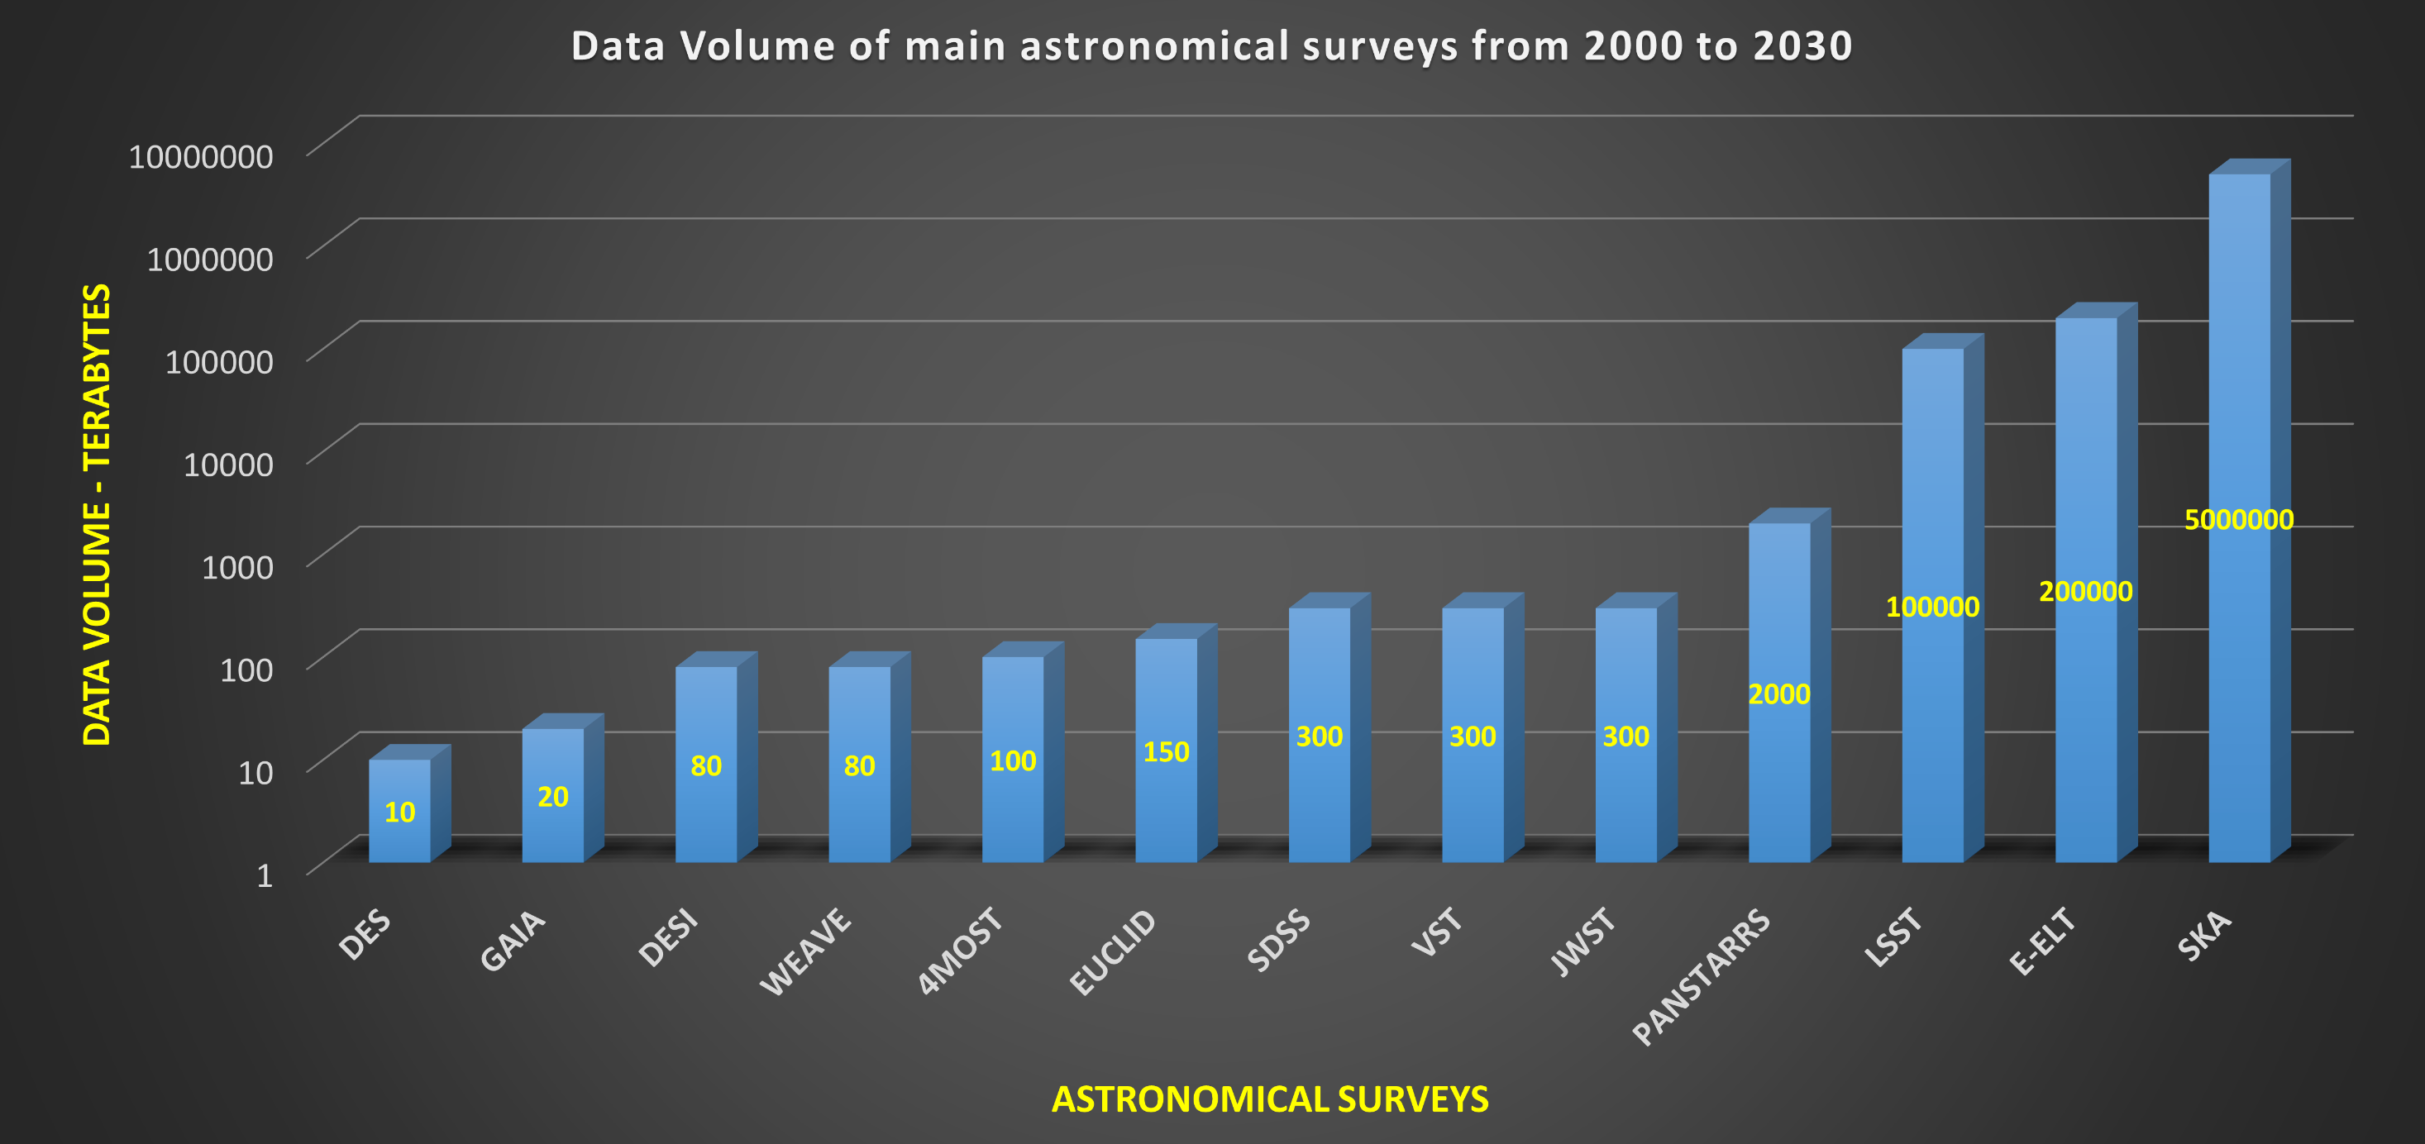

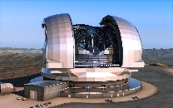


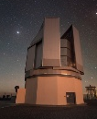
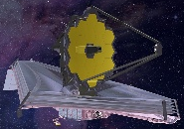

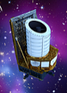

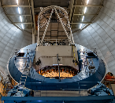


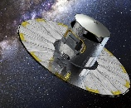
ExaByte
PetaByte
17/03/2026
M. Brescia – Department of Physics «E. Pancini», University Federico II

Slide 4
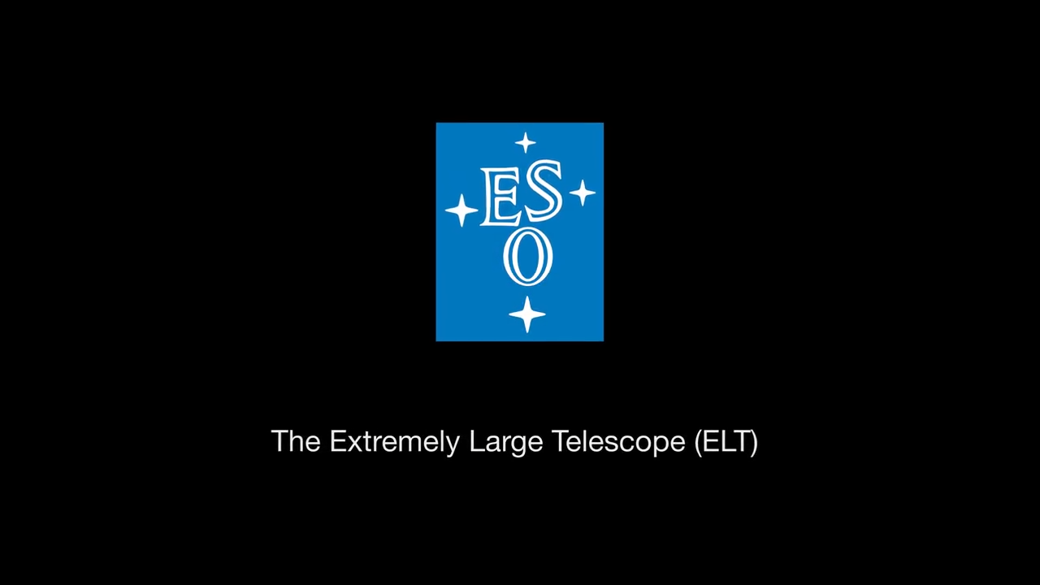
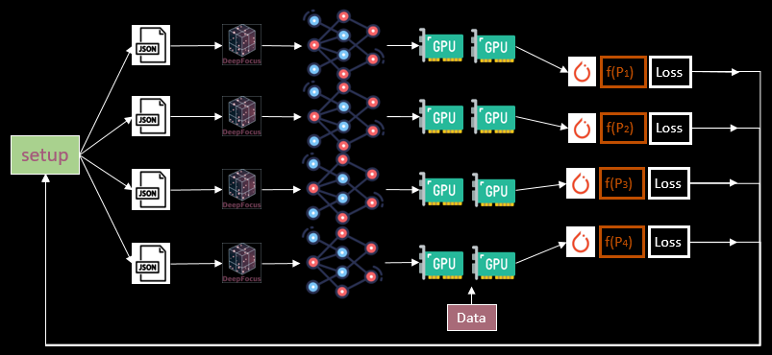
Classification and characterization of sources from images and catalogs (both in the time domain and at different scales, from the solar system to large-scale structures), including specialized methods (e.g. Machine/Deep Learning)
Multi-GPU computing strategy for training on ~100K image cutouts with deep learning models
Synergies with large N-Body cosmological hydrodynamic simulations for combined exploitation of aggregated data.
Cross-correlation with legacy multi-wavelength data, coordination of follow-up groups.
Cross-matching between catalogs with voluminous parameter spaces.
0.3 PFlops required for cross-matching between 2PB sized (150-columns) catalogues
17/03/2026
M. Brescia – Department of Physics «E. Pancini», University Federico II

Slide 5
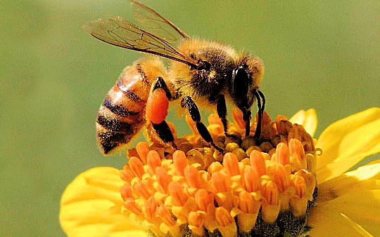
Big Data require a new perspective of doing Science
Data fusion
All sciences in the 21st century is becoming cyber-science (aka e-science) and this change imposes the need for a new scientific methodology.
Data exploration & experiments
The challenge we are tackling:
management of large, complex, distributed data
data exploration → new knowledge
these challenges are universal!
a virtuous synergy between domain science and data-driven science
Data-driven science
Hypothesis/theory
Data analysis
Understanding
17/03/2026
M. Brescia – Department of Physics «E. Pancini», University Federico II

Slide 6
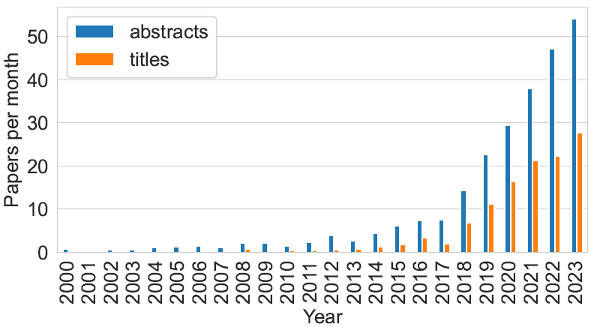
AI & Astrophysics
Huppenkothen et al. 2023
As AI is becoming a standard approach in Astrophysics, there is an increasing and urgent need for best practices on how to build and implement well-posed solutions, how to apply them and report their results.
At least, four main criteria should be followed by an AI approach in Astrophysics:
Reproducibility: results should be invariant w.r.t. data training/prediction choice and code/data made publicly accessible
Interpretability: methods should be explainable and transparent in terms of both pipeline and data flow process
Accuracy: methods should provide accurate results, i.e. unbiased, uniform and rigorous in terms of their validation
Flexibility: methods should demonstrate usefulness and non-ambiguous advantages w.r.t. traditional approaches
M. Brescia – Department of Physics «E. Pancini», University Federico II

Slide 7
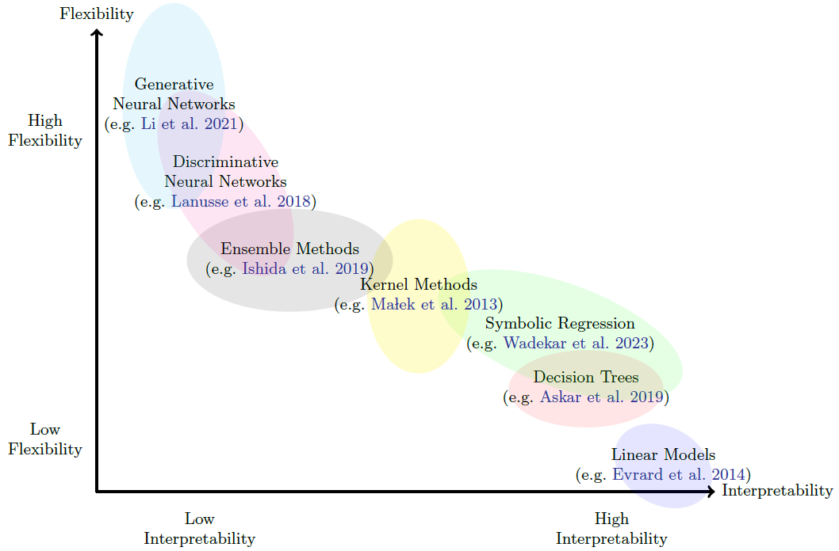
Interpretability & Flexibility
High model flexibility would permit to solve complex problems at the expense of clarity and linearity of its internal mechanisms, together with overfitting occurrence on simpler problems.
The best trade-off practice could be to follow two main rules:
be data-driven, i.e. carry out a deep analysis of data and parameter space, letting data themselves guide the solution choice;
be Nature’s inspired, by emulating the typical approach adopted by Nature: starting from simpler solutions and gradually increasing the model complexity (if needed).
A high model interpretability would imply a simpler approach, unable to be adapted to solve highly complex problems.
M. Brescia – Department of Physics «E. Pancini», University Federico II

Slide 8
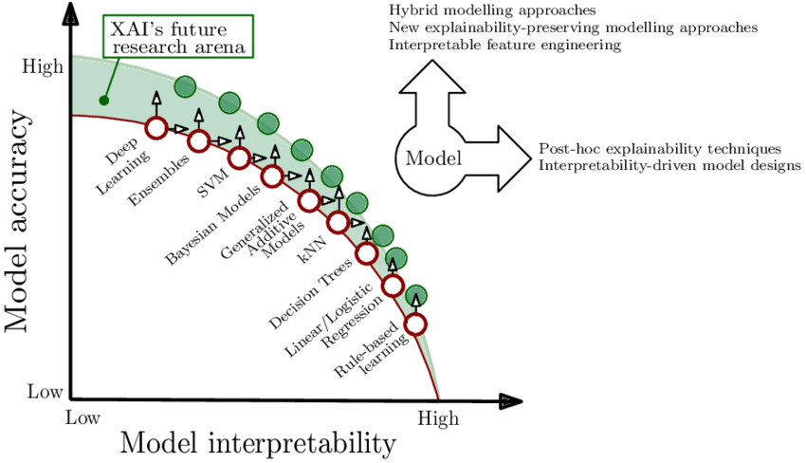
Interpretability & Accuracy
The ethics of generative AI is taking place in the discussions at all levels. We know that these methods are powerful, we know that they can provide very accurate solutions in many complex tasks of real world…
…but they suffer of low Explainability and Transparency
Consequently, a new data science field emerged: XAI (eXplainable Artificial Intelligence), which could aim to produce algorithms that are both powerful and explainable.
Its use should be enhanced in Astrophysics with AI!
Arrieta et al. 2019
17/03/2026
M. Brescia – Department of Physics «E. Pancini», University Federico II

Slide 9
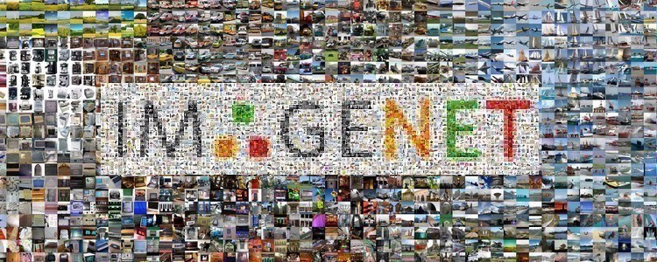
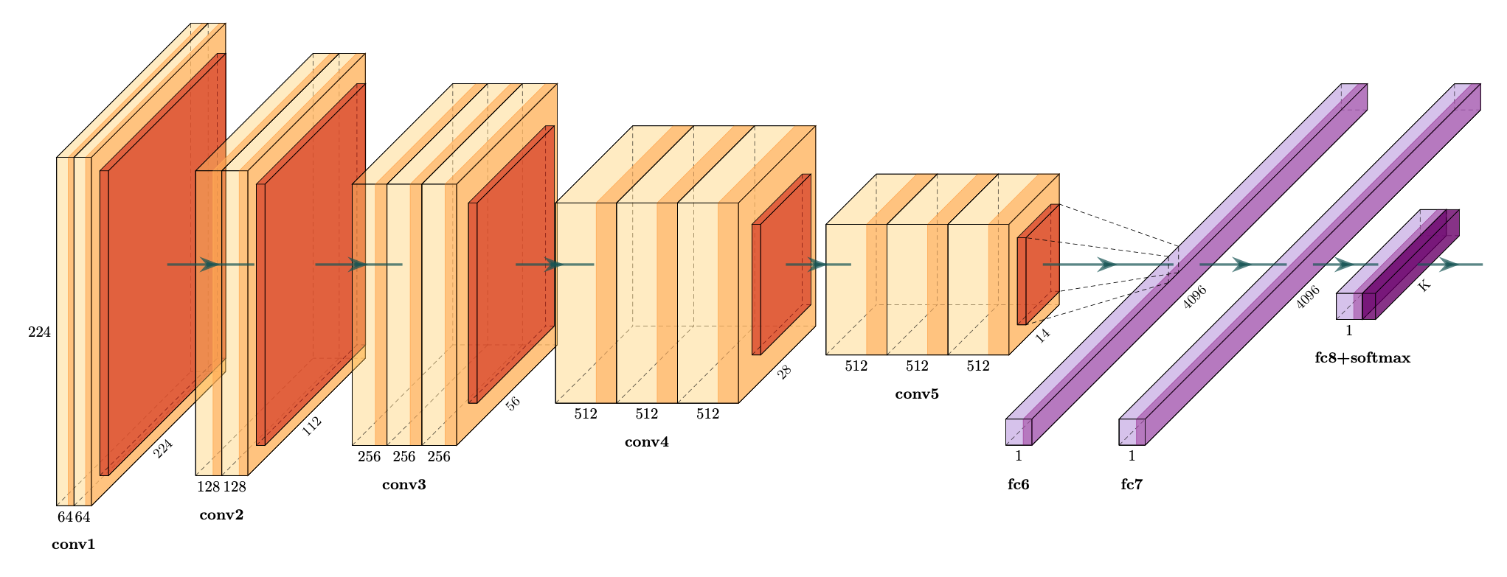

Accuracy & Flexibility
Nowadays, AI is mostly associated to Big Data.
IMAGENET, ChatGPT are typical examples of successful AI on heterogeneous Big image/text Data
But AI also aims to search for “Poor” data, i.e. where few data are available on the objective (e.g. solving a specific problem) and, at the same time, there is a lot of available data on general problems.
TRANSFER LEARNING (TL) is a technique very helpful on these contexts
ImageNet (pre-trained model)
1.2 Million objects (randomly from web)
1000 categories (animals, cars, houses, food…)
The features extraction part of ImageNet
( pre-trained CNN) may be reused on specific science-domain problems.
Particularly efficient in anomaly detection.
Reuse on “Small” data
Feature extractor
(pre-trained on Big Data)
Classifier
17/03/2026
M. Brescia – Department of Physics «E. Pancini», University Federico II

Slide 10

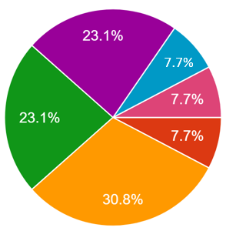
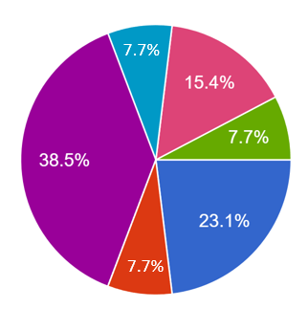
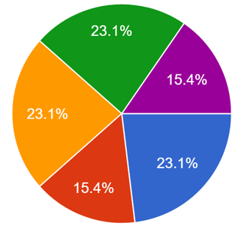
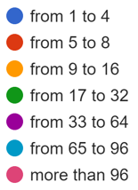
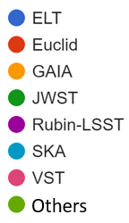
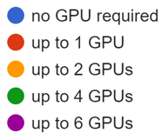
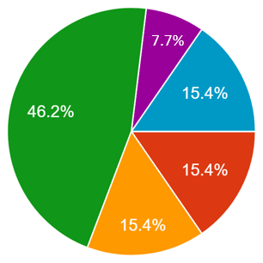
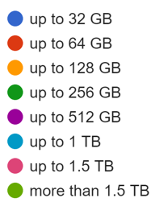
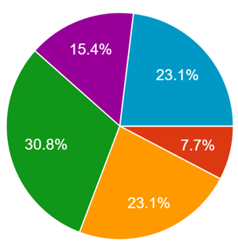
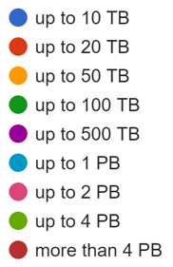
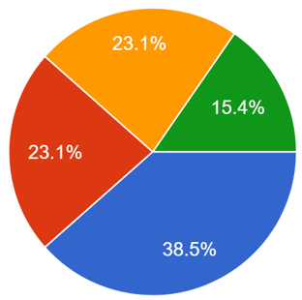
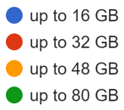
Nr. of CPU’s cores requested
Primary projects involved
Nr. of GPUs requested
M. Brescia
User Survey (15 research
groups)
RAM requested
Storage requested
GPU’s RAM requested
M. Brescia – Department of Physics «E. Pancini», University Federico II

Slide 11



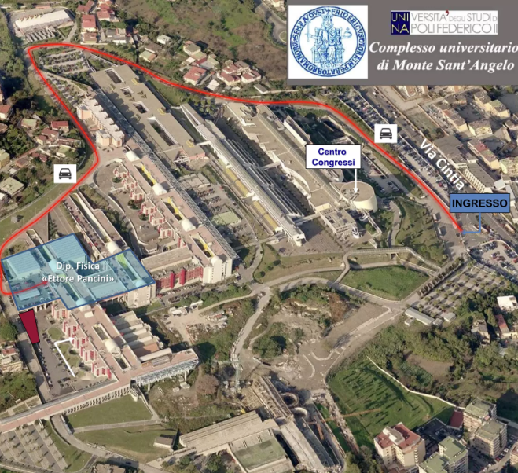
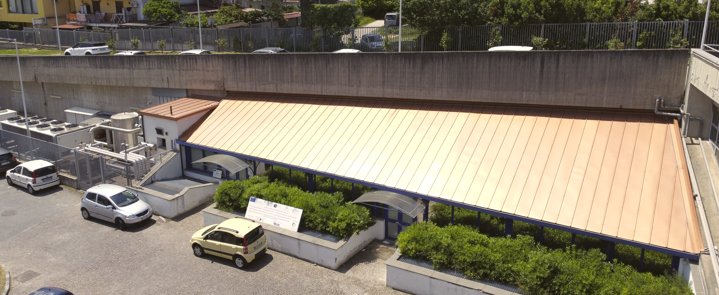
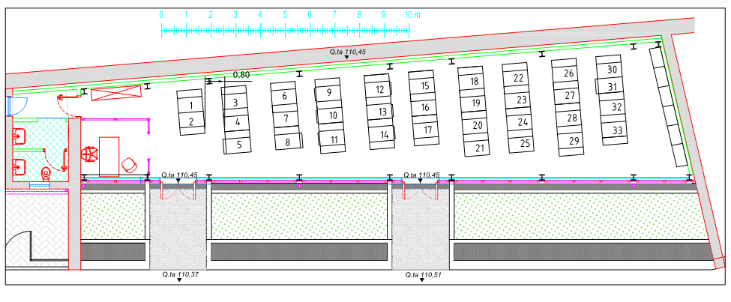
AD HOC
Our ICT @
M. Brescia
Astrophysical Data HPC Operation Center
Designed, developed and hosted by Dept. of Physics
Regulated by a next MoA between INAF and Dept.
Director: G. Russo (M. Brescia since Nov 1, 2024)
Data/processing Science services:
bio- geo- astro- informatics
Data/processing services for astrophysics:
ELT, SKA, VST, ALMA, Rubin-LSST
GARR
Project duration:
Jan 2023 – March 2026
TIER II - 2 Pflops capability
Funded by NextGenerationEU (∼ 7 M€)
17/03/2026
M. Brescia – Department of Physics «E. Pancini», University Federico II

Slide 12
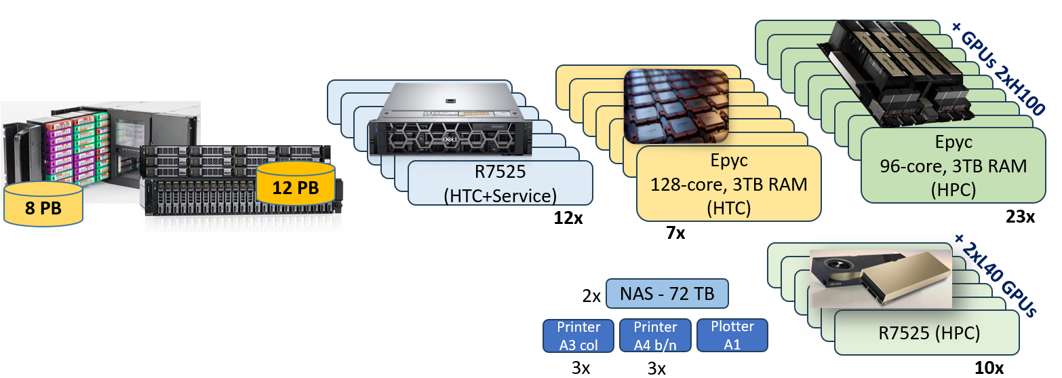
20 PB of Data Storage (raw)
52 HPC/HTC multi-core servers
46 GPUs H100 (80 GB/device)
20 GPUs L40 (48 GB/device)
AD HOC
M. Brescia
Astrophysical Data HPC Operation Center
6PB @ Bologna
2PB @ Napoli
17/03/2026
M. Brescia – Department of Physics «E. Pancini», University Federico II

Slide 13
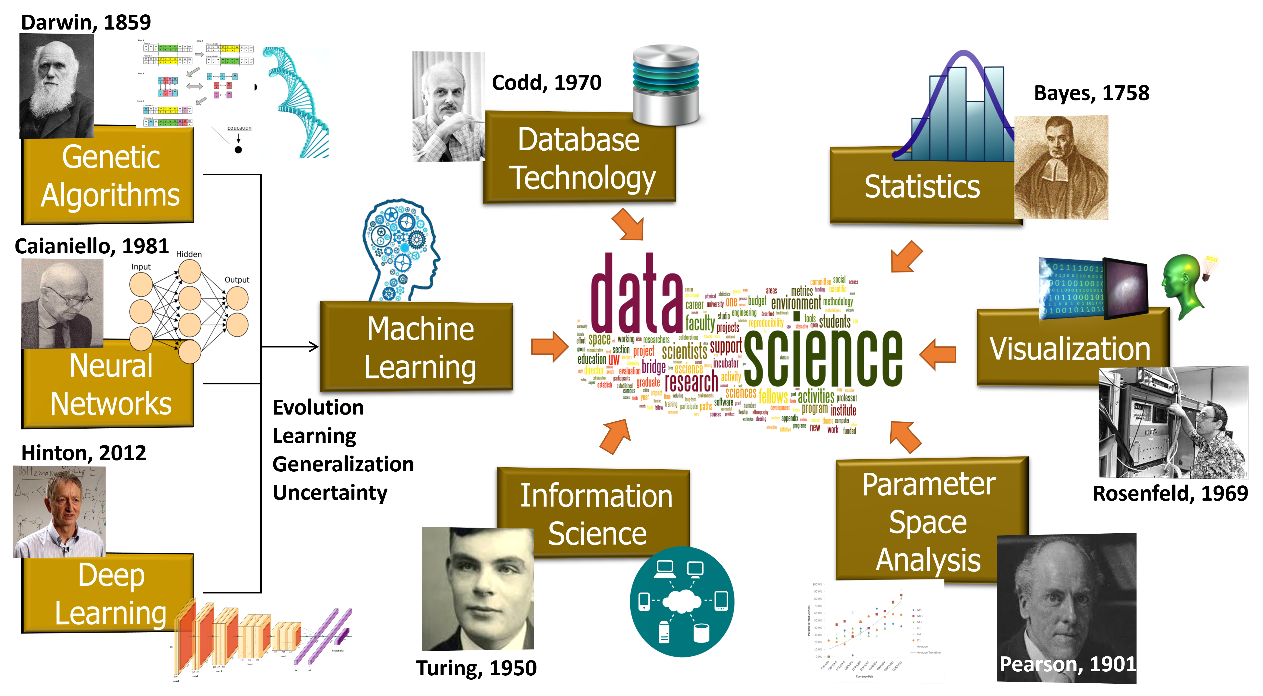
Data Driven Science: interdisciplinary synergy
17/03/2026
M. Brescia – Department of Physics «E. Pancini», University Federico II

Slide 14
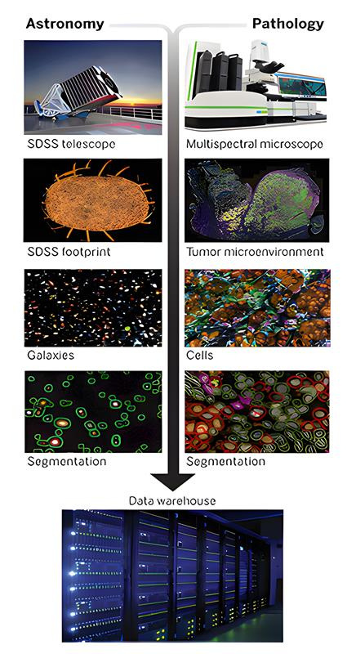
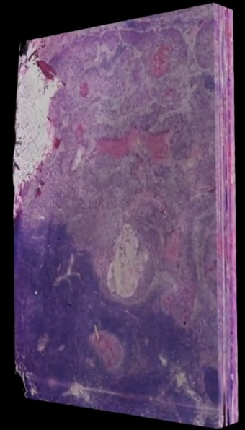
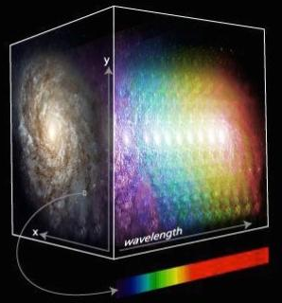
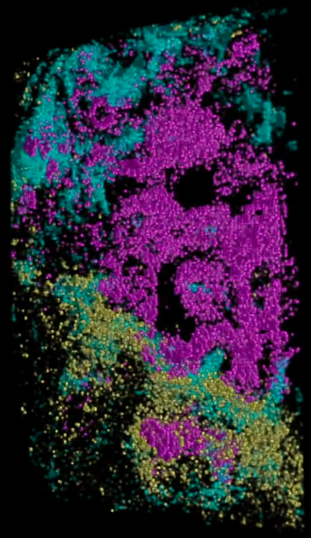
Infinitely small ←→ infinitely big
different science but same approach
Biology:
evolution of the living being
Classification of cells
DATA:
Multi-resolution, multi-epoch, multi-band microscope images, catalogues, measures of gene expressions, DNA sequencing, …
Astrophysics:
evolution of the Universe
Classification of celestial objects
DATA:
Multi-resolution, multi-epoch, multi-band telescope images, catalogues, measures of brightness, distance, …
17/03/2026
M. Brescia – Department of Physics «E. Pancini», University Federico II

Slide 15
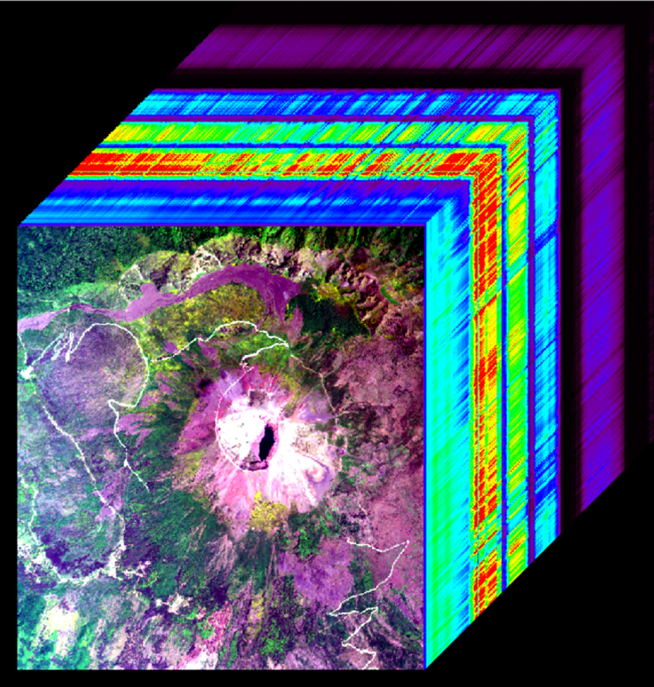
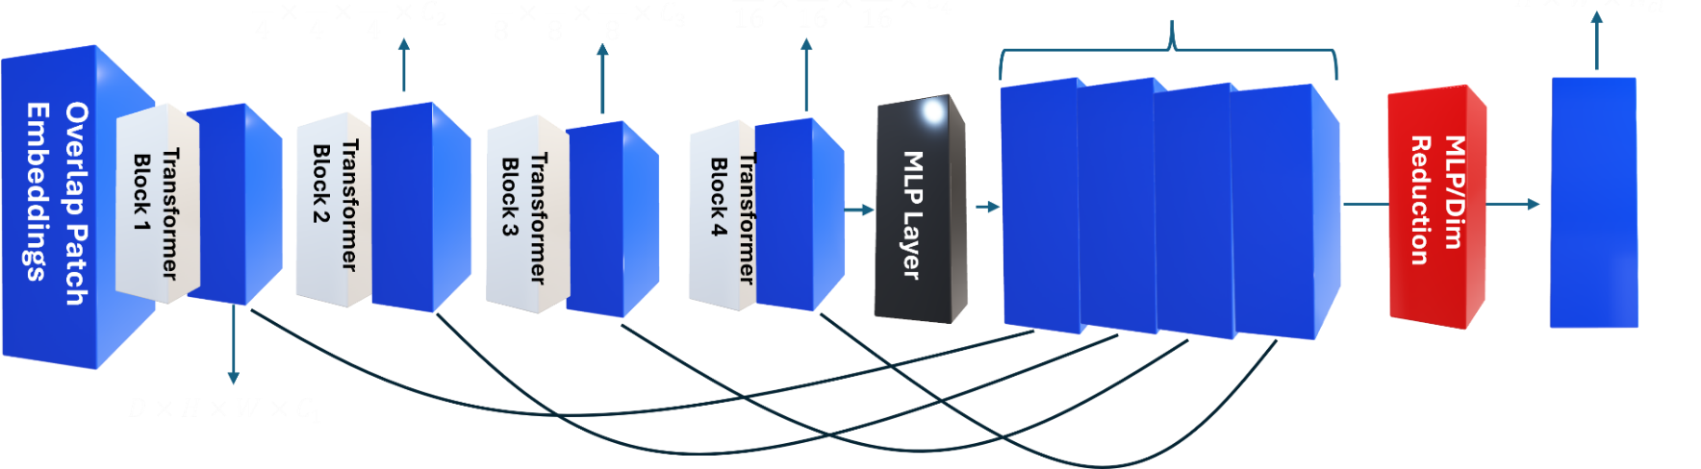
Infinitely small ←→ infinitely big
different science but same approach
Astrophysics:
Integral Field Spectroscopy
DATA:
spatially-resolved spectral images, position and energy of single photons, deep source reconstruction and morphology
Geophysics:
Earth/planets remote sensing
DATA:
spatially-resolved spectral images, details of object’s composition, deep region reconstruction and morphology
A ViT may capture features at multiple scales and incorporates 3D attention matrix to process hyperspectral images, preserving spectral and spatial dimensions.
ViTs demonstrate strong generalization across different types of multi-band images.
17/03/2026
M. Brescia – Department of Physics «E. Pancini», University Federico II

Slide 16

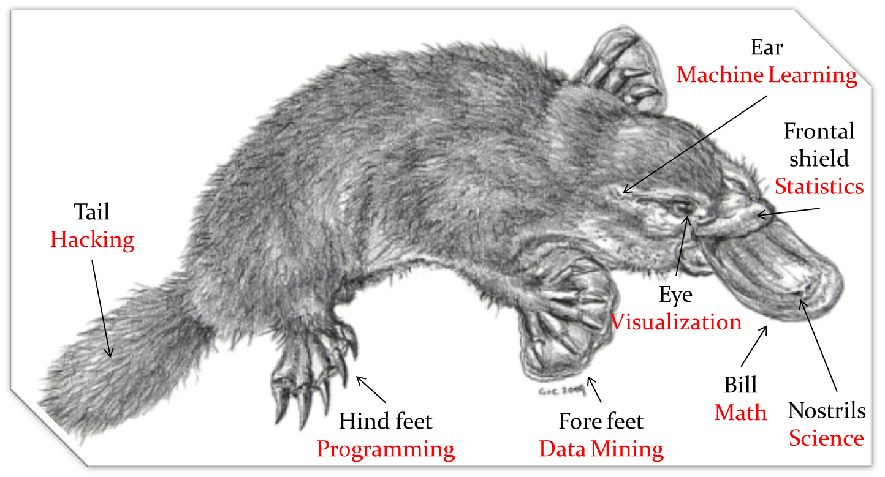
DATA & ICT
Management System
Modern Scientist should emulate the eclecticism of a platypus, the most hybrid living being of the Planet!
17/03/2026
M. Brescia – Department of Physics «E. Pancini», University Federico II

Slide 17

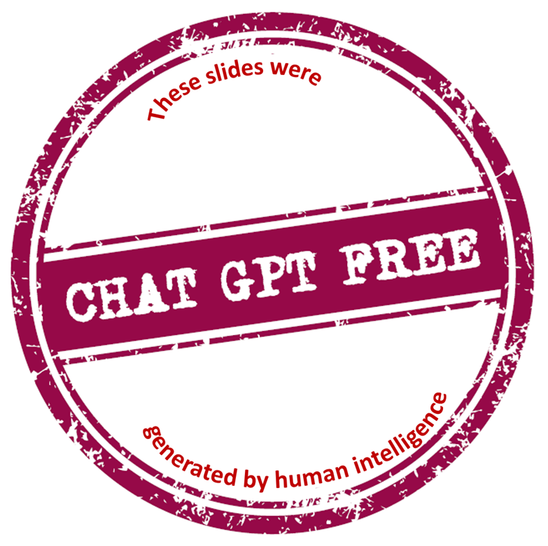

(Part of) The research activities described in these slides were carried out with contribution of the Next Generation EU funds within the National Recovery and Resilience Plan (PNRR).
Mission 4 - Education and Research, Component 2
From Research to Business (M4C2), Investment Line 3.1
Strengthening and creation of Research Infrastructures,
Project IR0000034 – “STILES - Strengthening the Italian Leadership in ELT and SKA”.
The rest of the presented activities are supported by the Opt-NIR UTG-I of the INAF Scientific Direction
17/03/2026
M. Brescia – Department of Physics «E. Pancini», University Federico II

