Slide 1
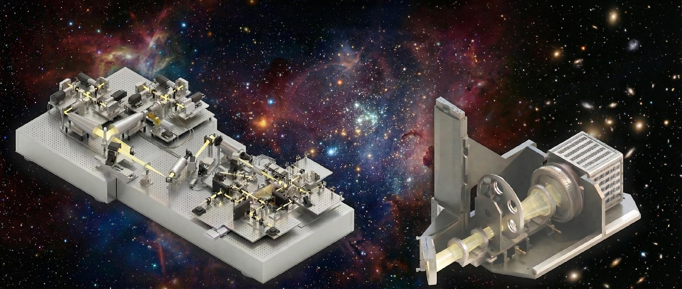

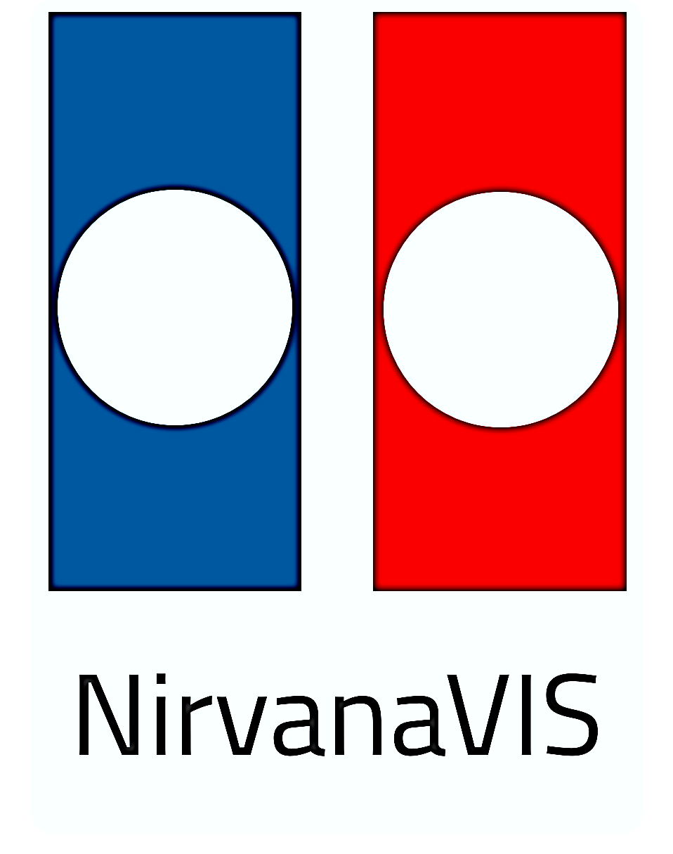
Wide field AO instrumentation and facility
Speaker: Luca Marafatto
on behalf of MATTO and NIRVANA-VIS teams

Slide 2
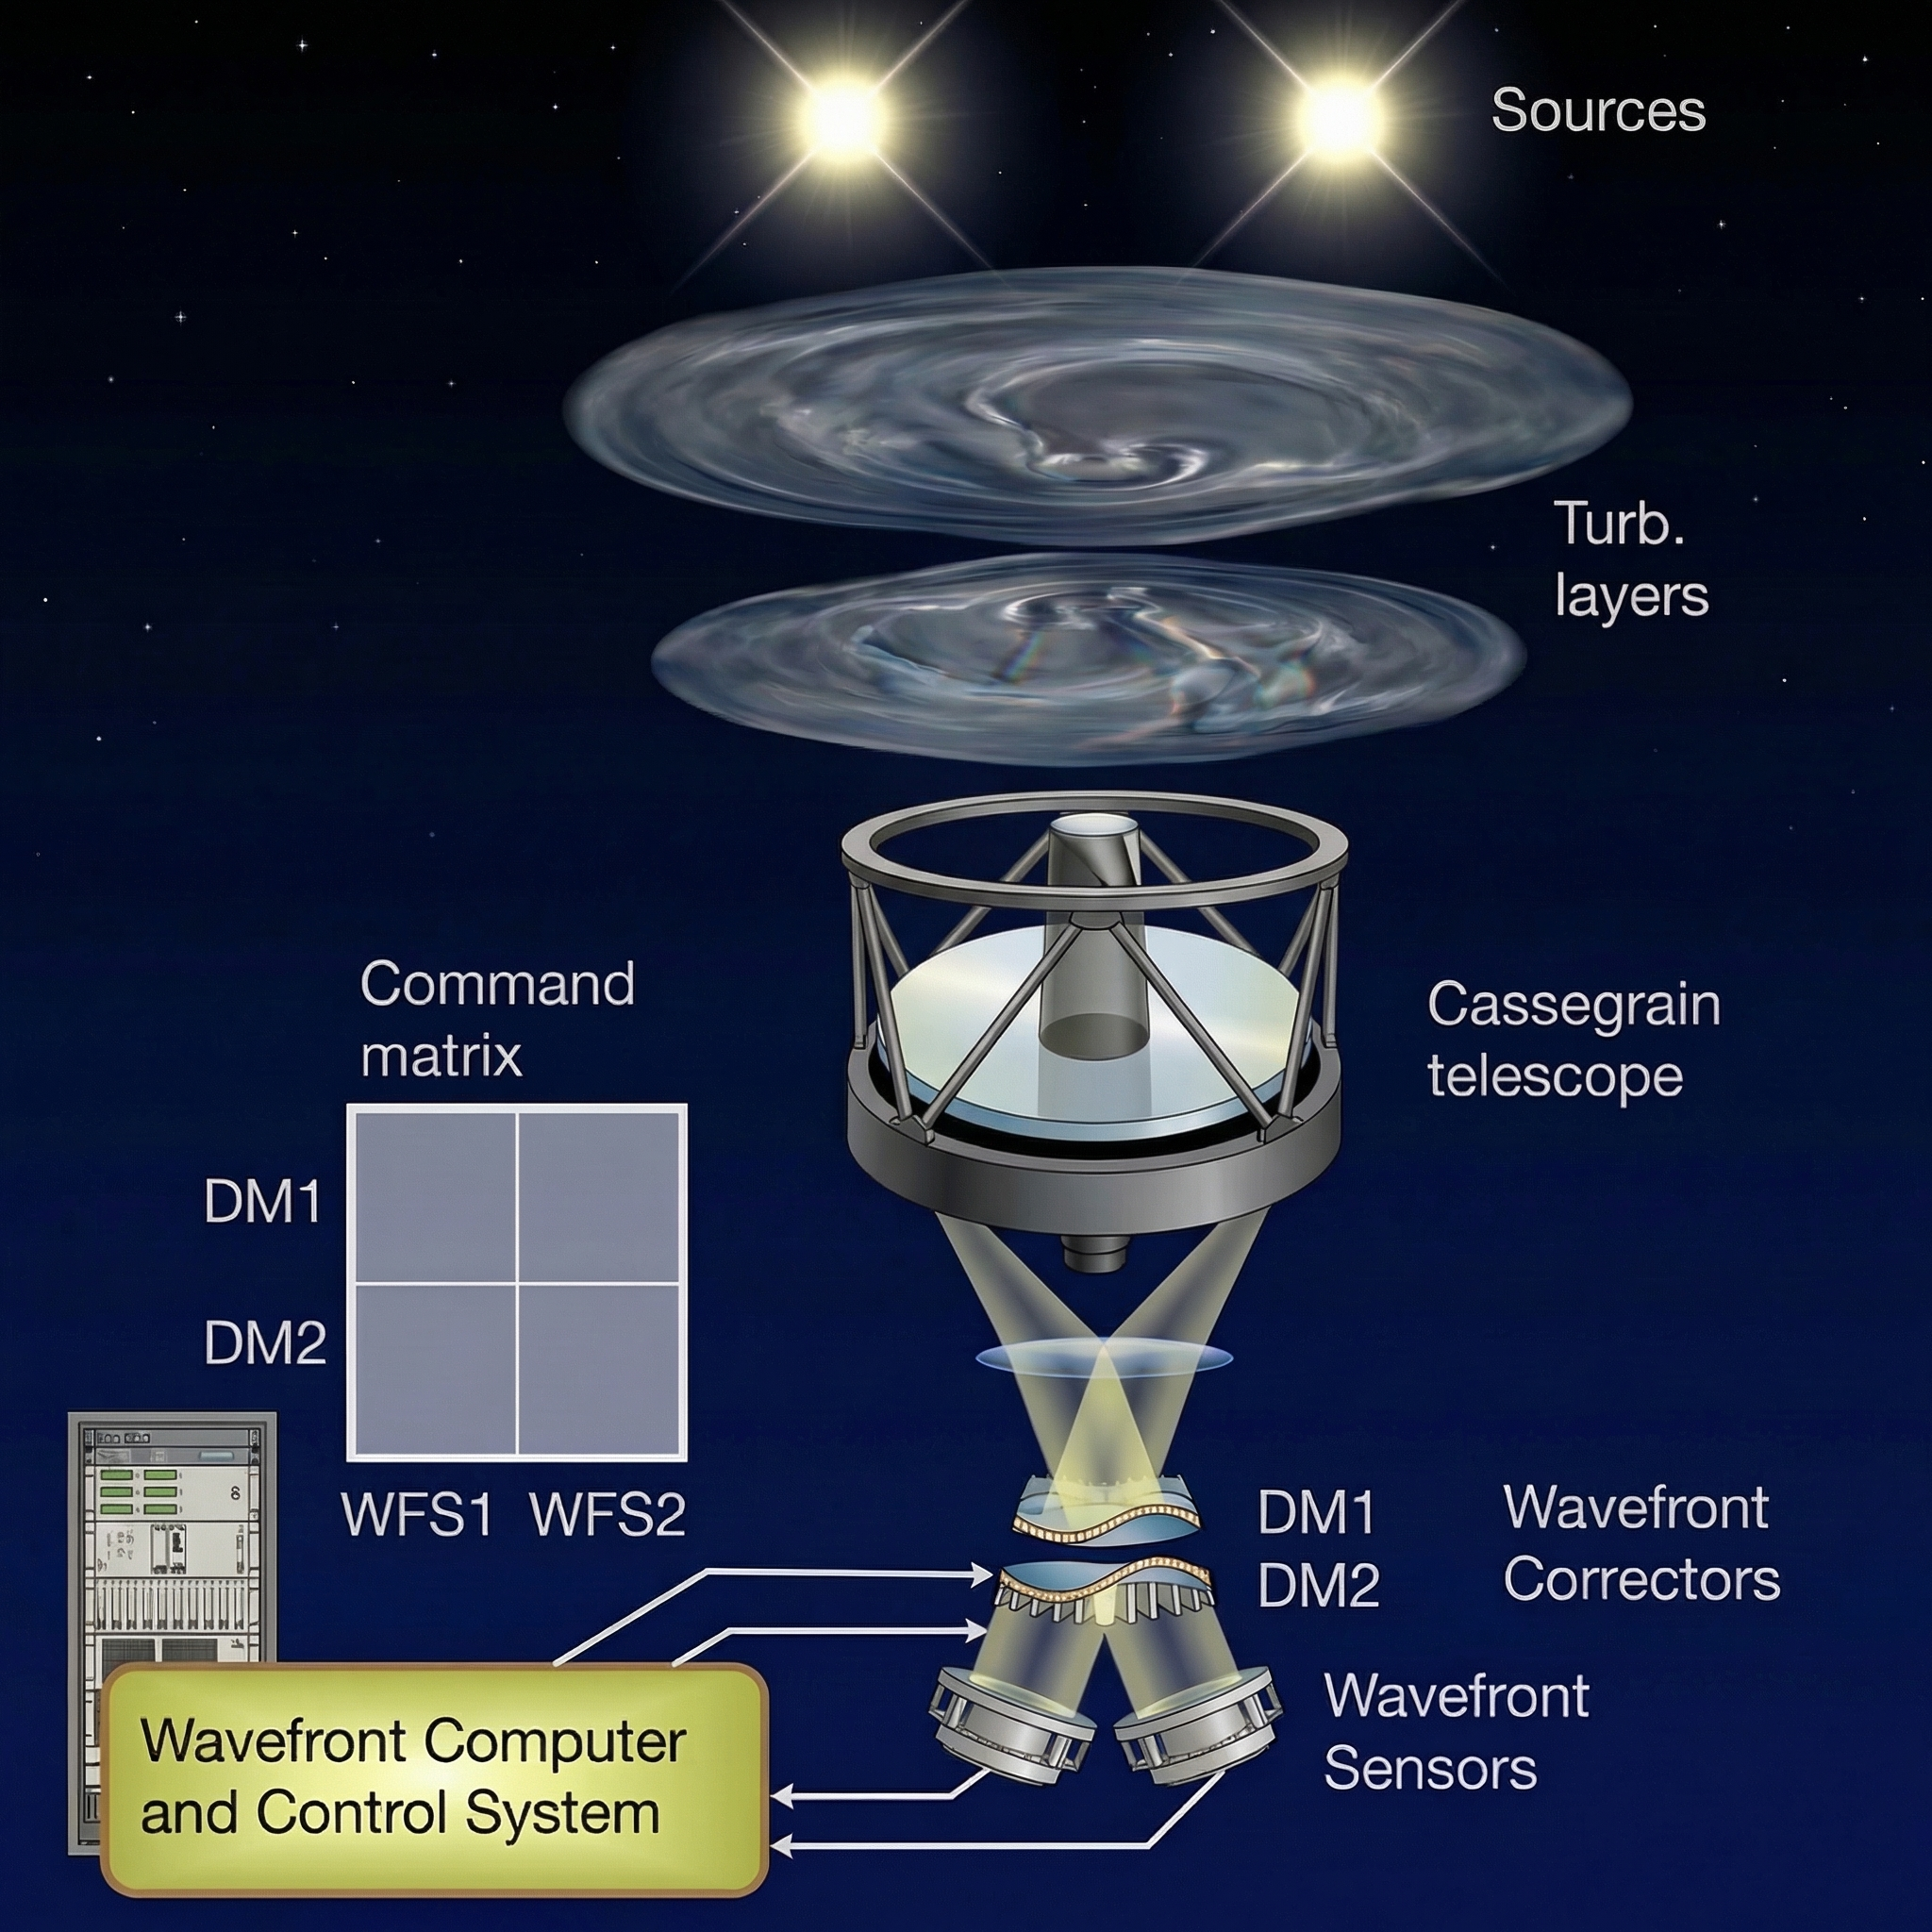
Why MCAO?
Anisoplanatism: in SCAO, we are probing only the effect of turbulence close to our reference star (actually, within a turbulence coherence “isoplanatic” angle)
We want to uniformly correct larger fields of view
Because of the FoV vs thickness rule, we need to sense and compensate the effect of different atmospheric layers -> more WFSs and more WF correctors (e.g. DMs)
To increase the sky coverage, both Laser Guide Stars (LGS) and Natural Guide Stars (NGS) are used.
How MCAO?

Slide 3
SCIENCE NEEDS
PERFORMANCE REQUIREMENTS
AO CONCEPT &
PARAMETERS OPTIMIZATION
# of LGSs & asterism
# of sub-apertures
flux needed
WFS sensitivity (may also depend on the type of reference source)
WFS linearity
To sense the aberration, we aim to:
“see” the full atmospheric volume (tomographic error)
“sample” up to a certain spatial frequency (aliasing error)
“measure” with high signal (SNR of WFS measurements)
To correct the aberration, we aim to:
be able to “compensate” atm. aberration (fitting error)
do it “fast enough” (temporal error)
# of DMs & actuators
loop frequency
MANY parameters to be simulated and tested in different combinations

Slide 4
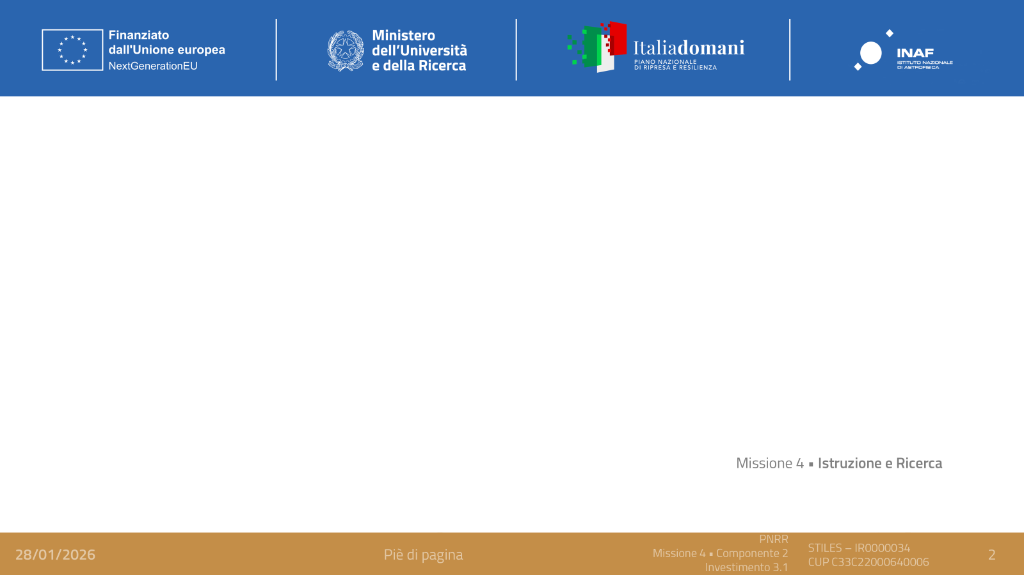
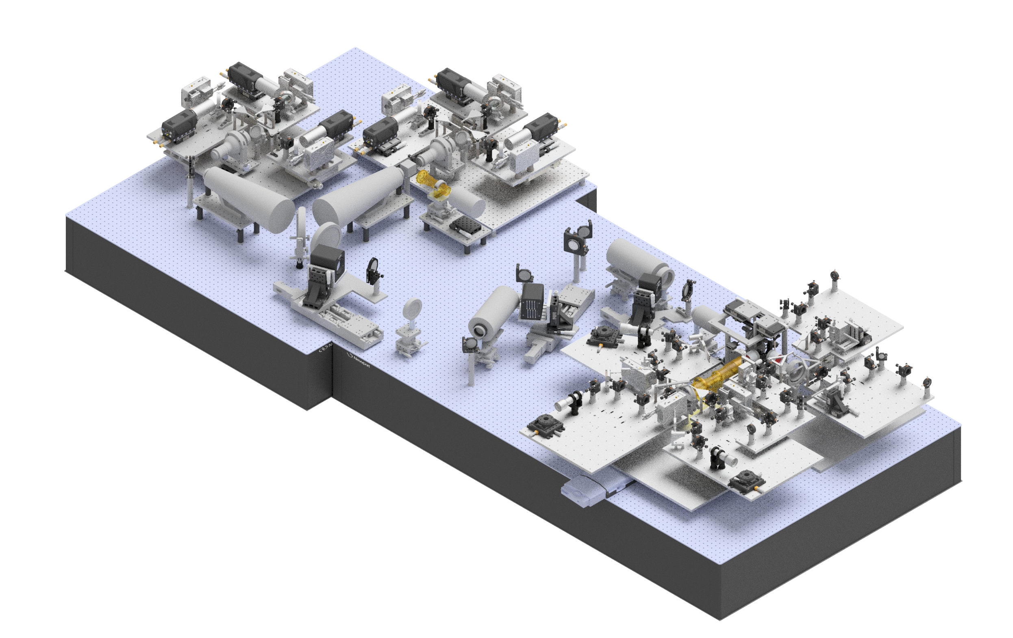
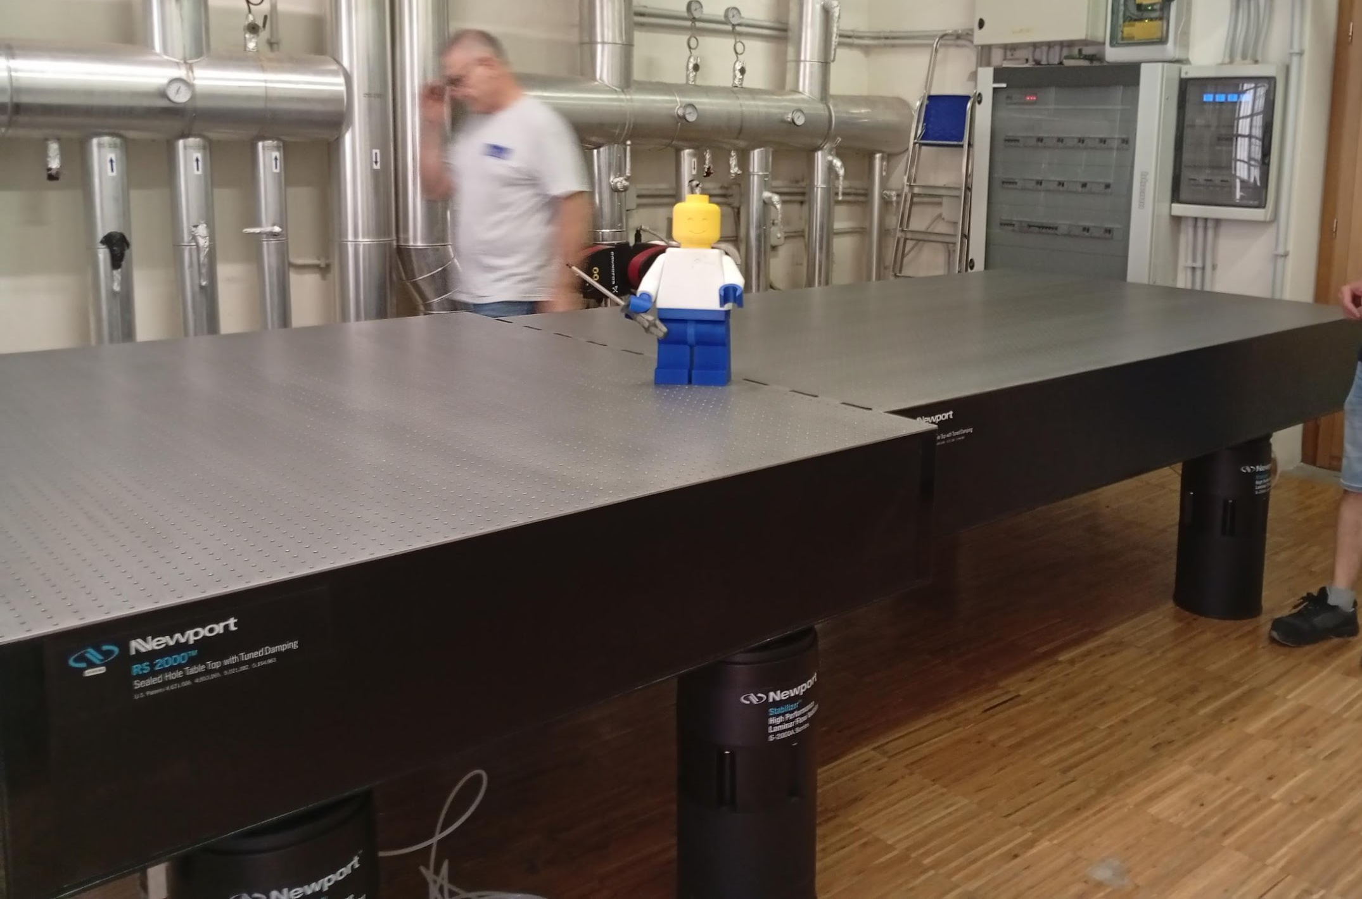
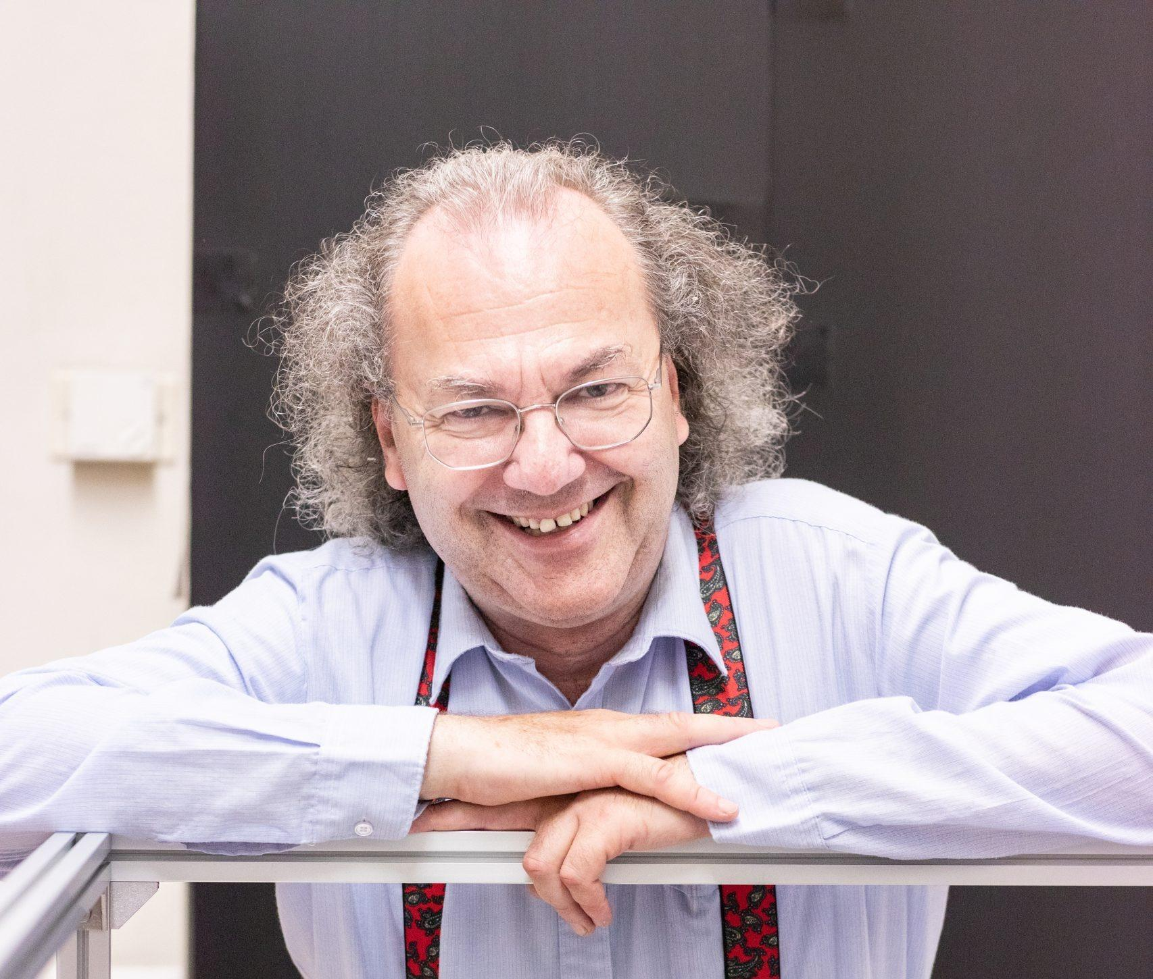
STILES - Att.5301
MATTO Multi-conjugate Adaptive Techniques Test Optics
WFS and science module
Procedure type | Number of procedures | Economic envelope
Call for tender | 1 | 1.037.000,00
Negotiated procedure | 6 | 1.262.225,65
Direct contracting | 4 | 536.981,16
TD personnel | 1 anno | 52.099,13
Wide field test bench facility that can mimic different:
- guide source types, numbers, asterisms
- atmospheric behaviors
- wavefront sensing techniques
- telescope sizes
- new technologies or future upgrades
Telescope simulator
MCAO module
Source module
Benches in the lab

Slide 5
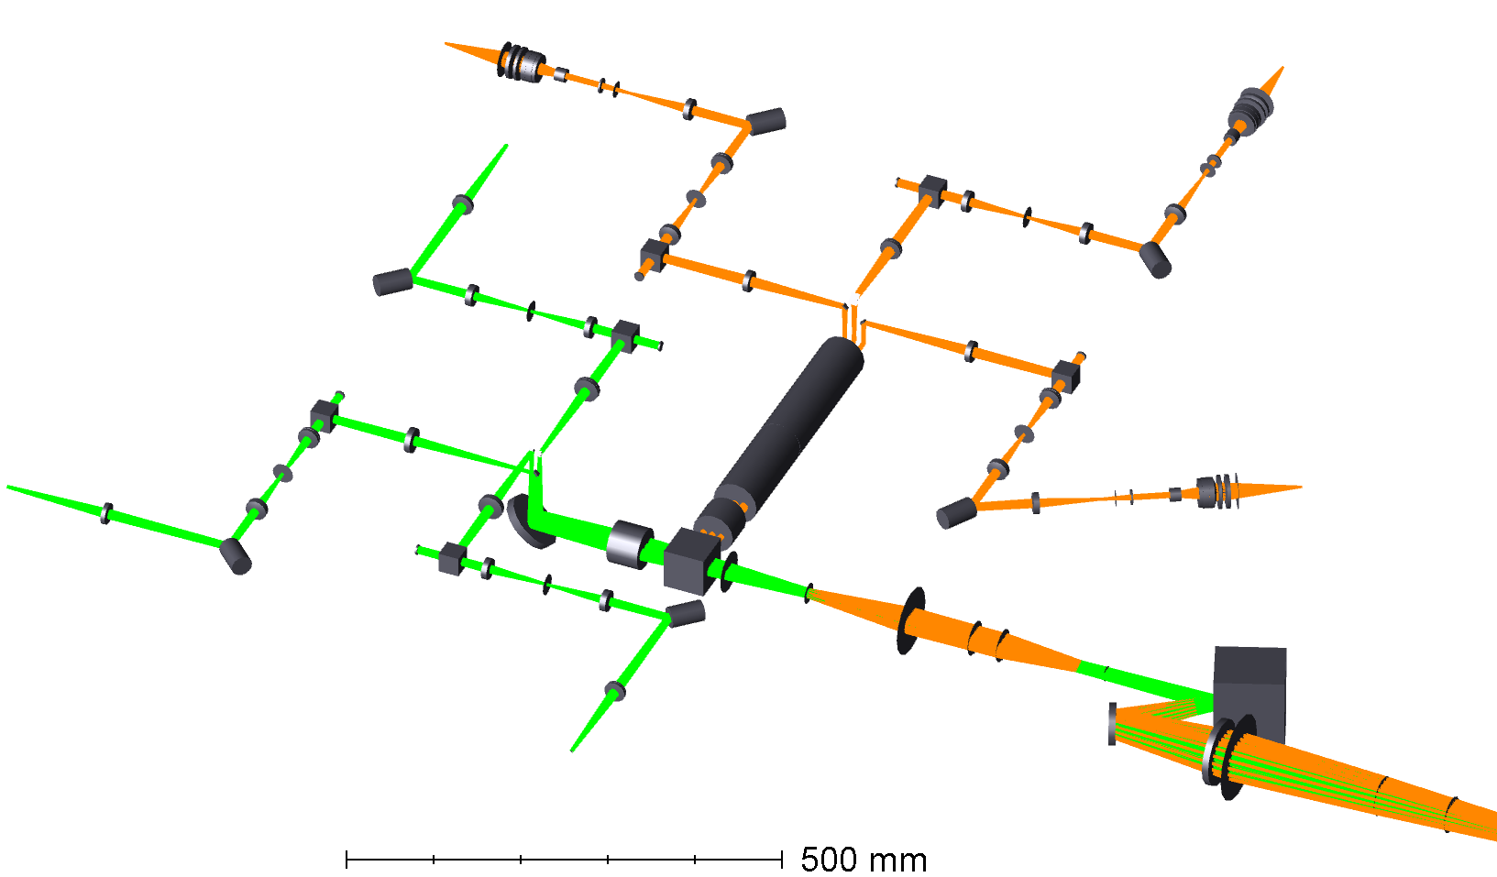
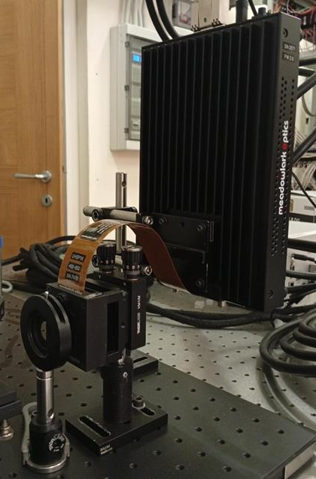
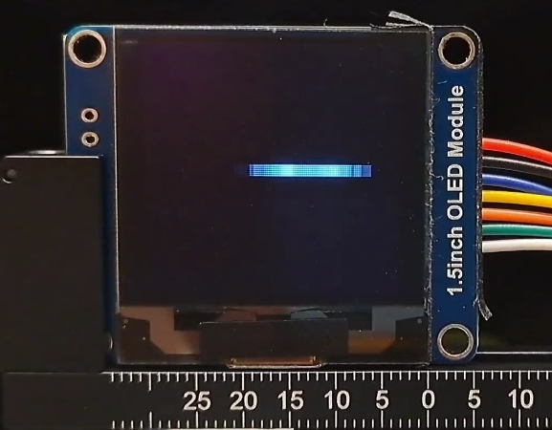
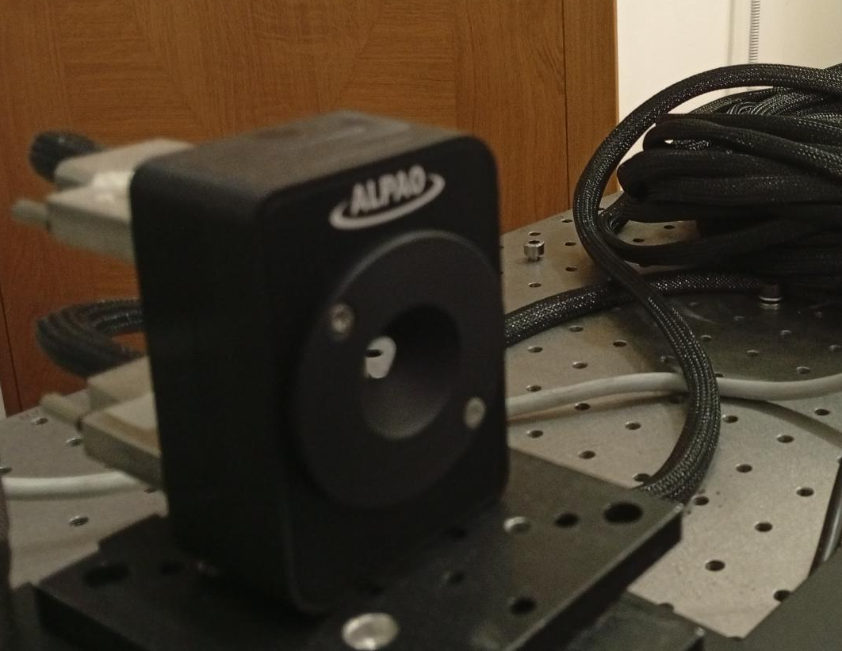
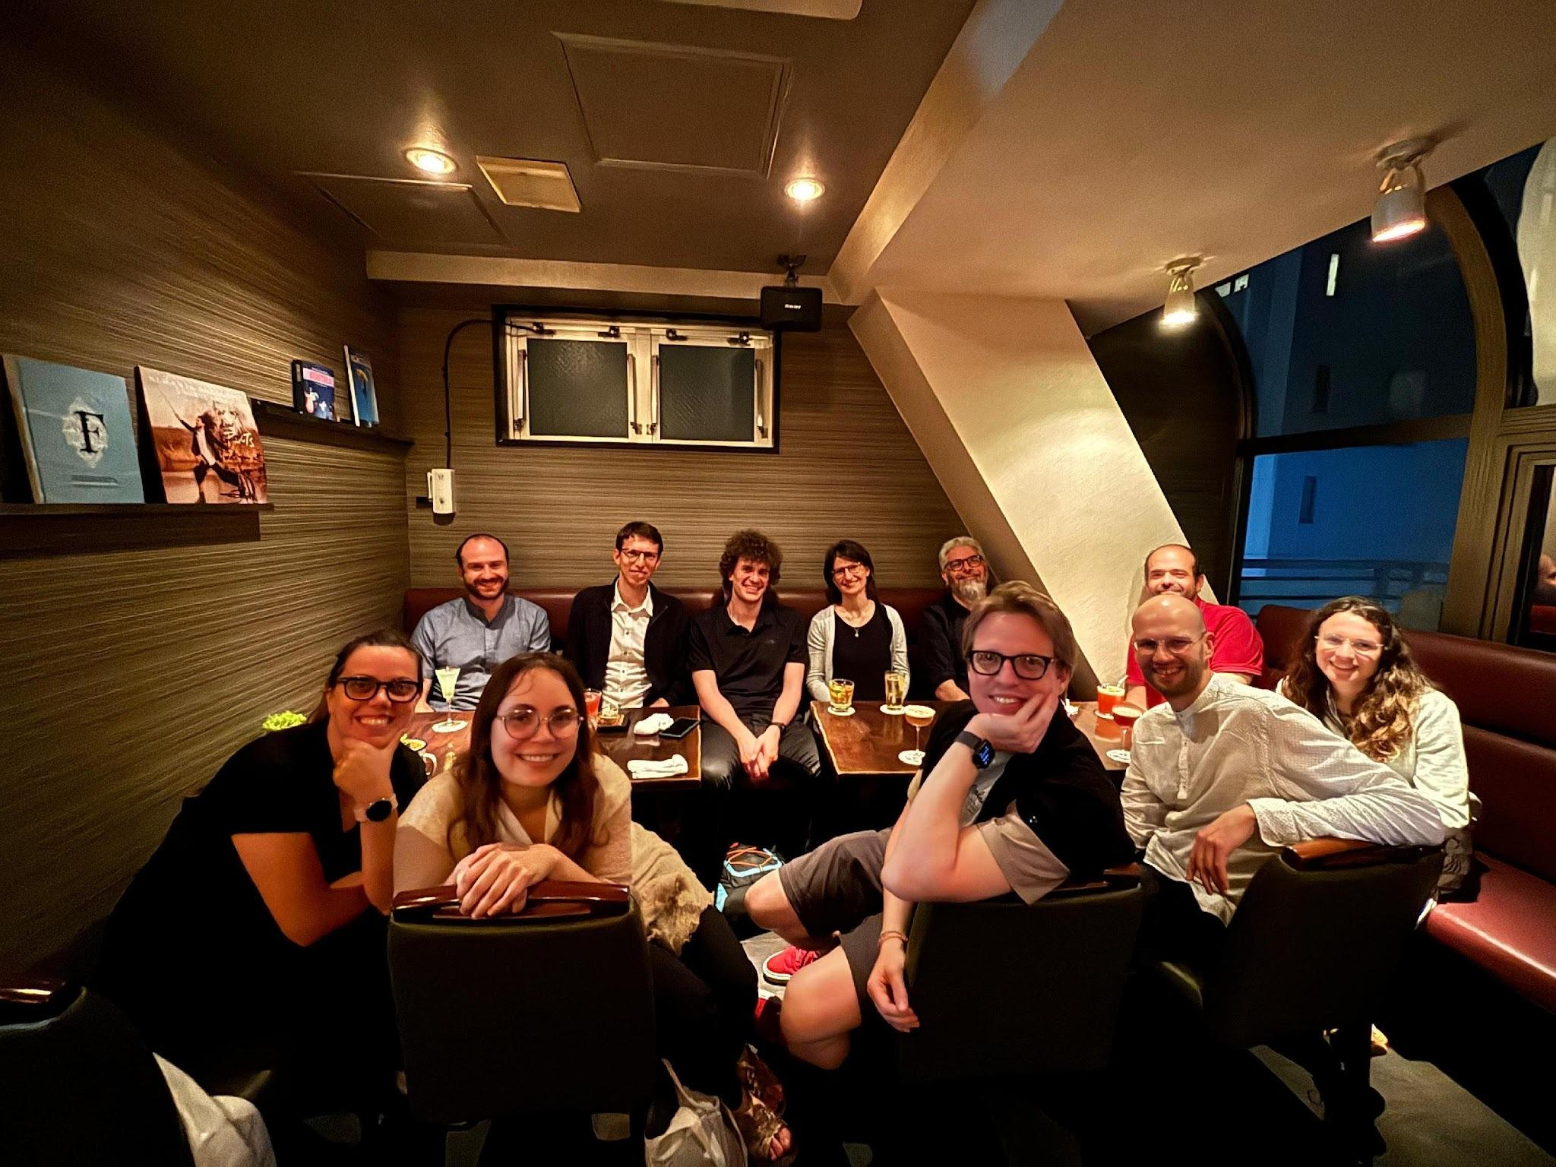
Source module
Atmospheric perturbation simulators (one per each LGS)
3 NGSs and 3 LGSs (the latter simulated with OLED screens to reproduce the source elongation)
Controlled simulated turbulence via:
- 3 Deformable Mirrors (~100 actuators each) for the NGSs
- 3 Tip-Tilt Mirrors + 3 fast Spatial Light Modulators for the LGSs
The LGSs channel can be conjugated at different altitudes via a linear stage
LGS#1
LGS#2
NGS#3
SLM
Atmospheric perturbation simulators (one per each NGS)
1
TTM
DM
LGS
conjugation
NGS#2
LGS#3
To telescope
simulator
NGS#1
OLED screen
Fast SLM
DM97

Slide 6
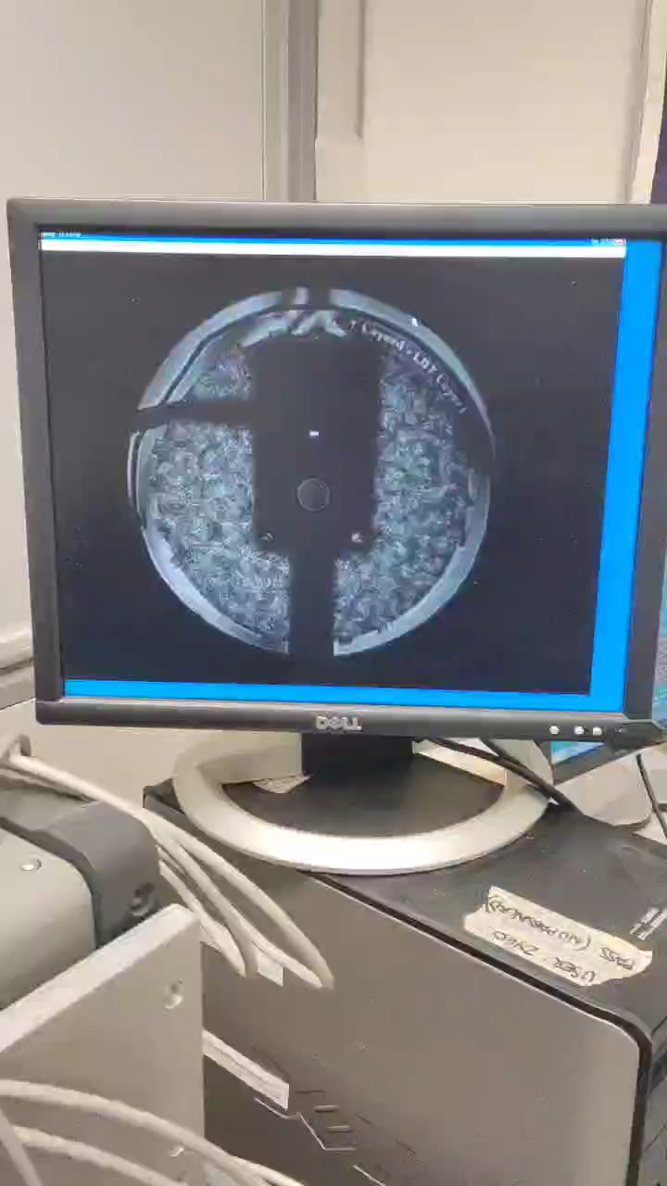
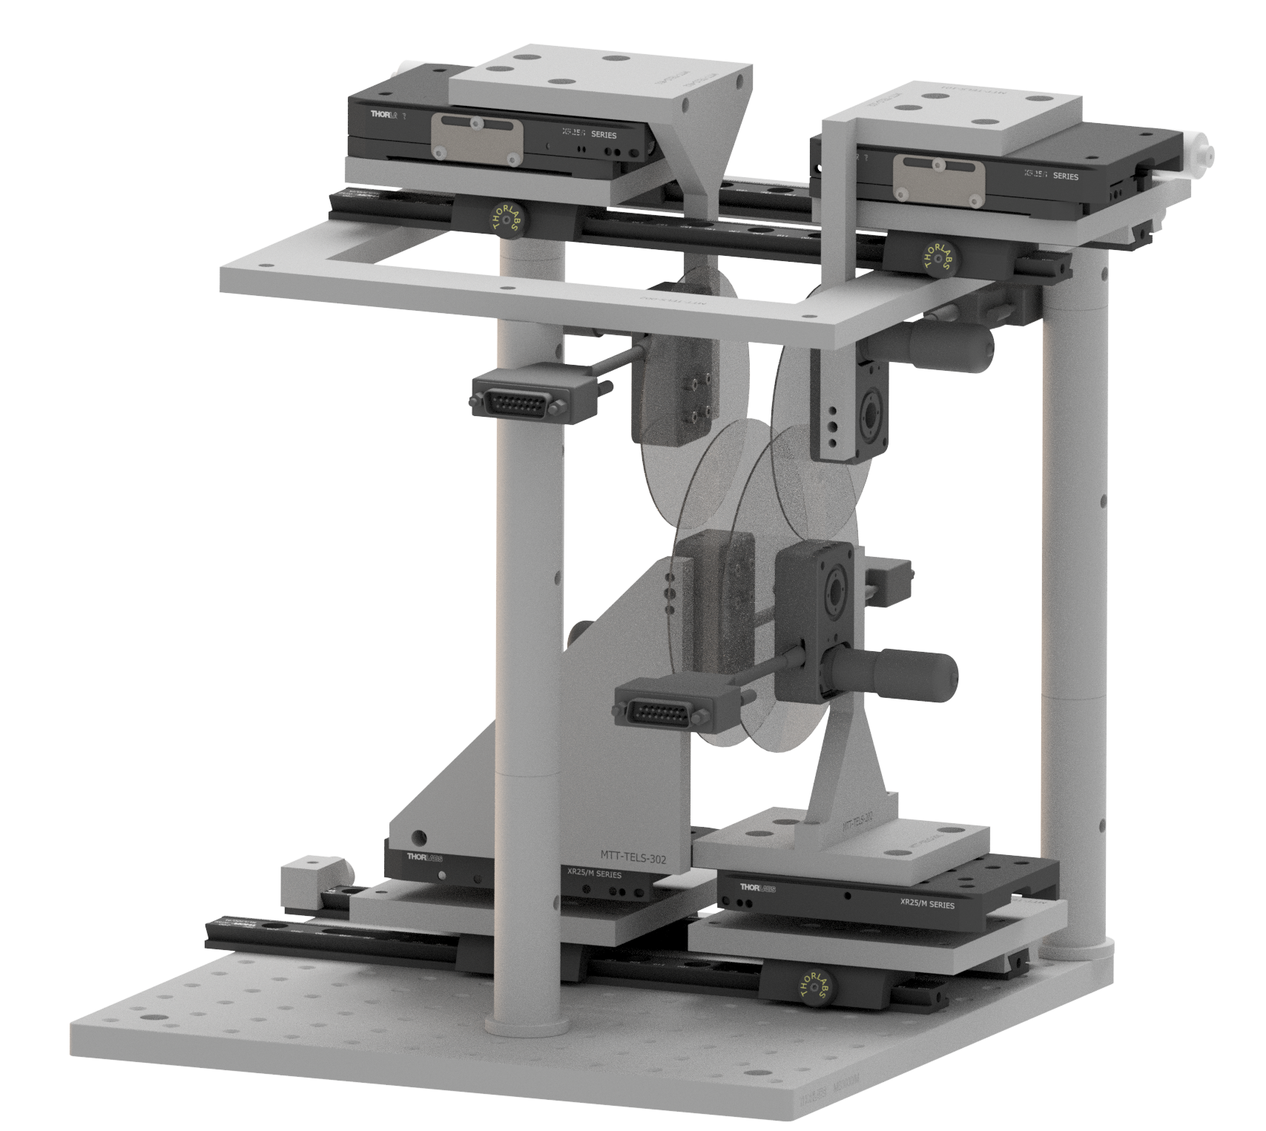
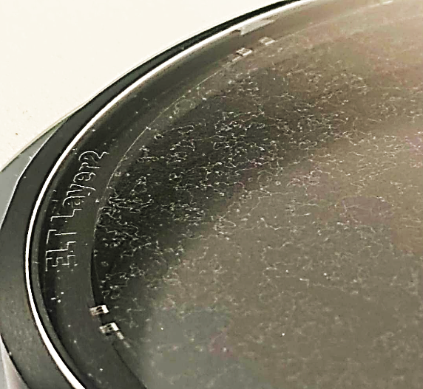
Telescope simulator
3 LGS
3 NGS
Light from NGSs and LGSs is collected, combined and sent to MCAO correction module
Another type of controlled simulated turbulence via:
- 4 thin glass phase screens, with a
photo-lithographicallly etched “turbulence history”
Mounted on rotating stages (simulating very high wind speed) and can translate to inject turbulence at different atmospheric altitudes
LGS
conjugation
2
To MCAO
correction module
turbulence
phase
masks
Phase screen

Slide 7
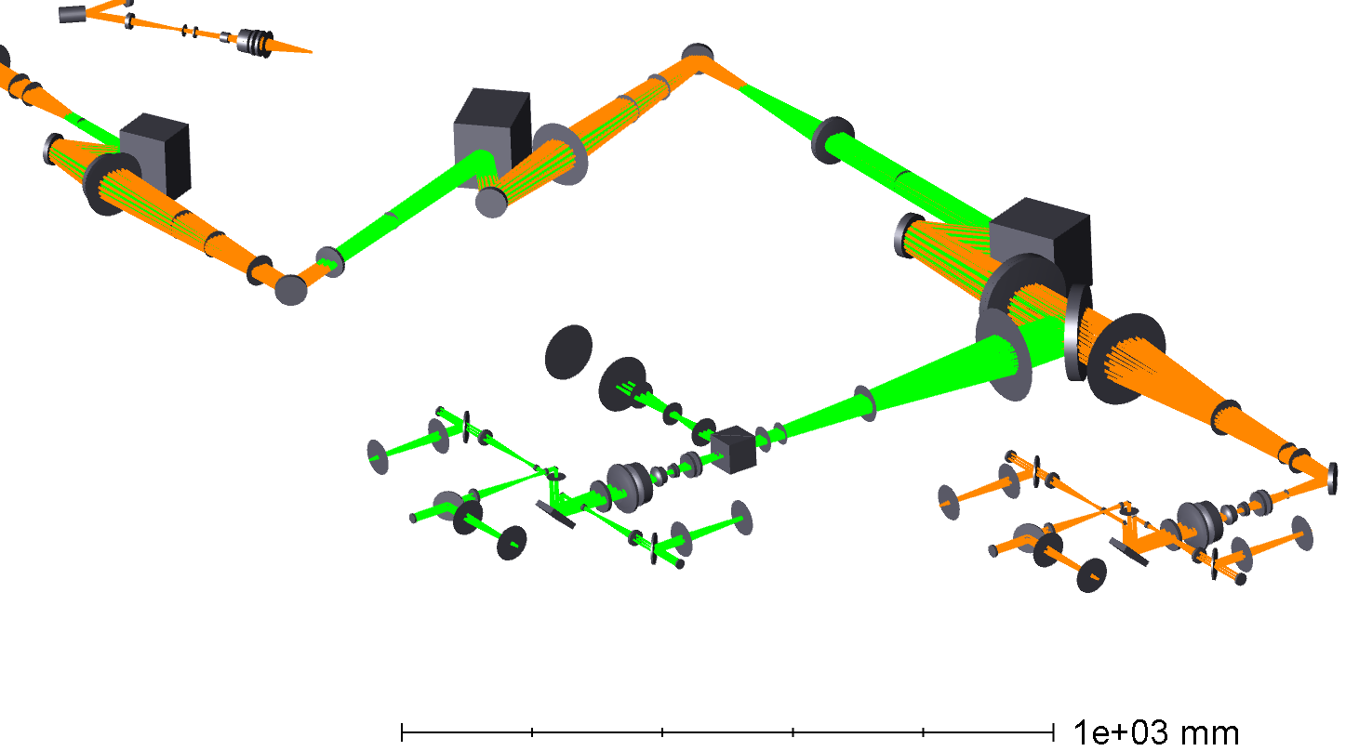
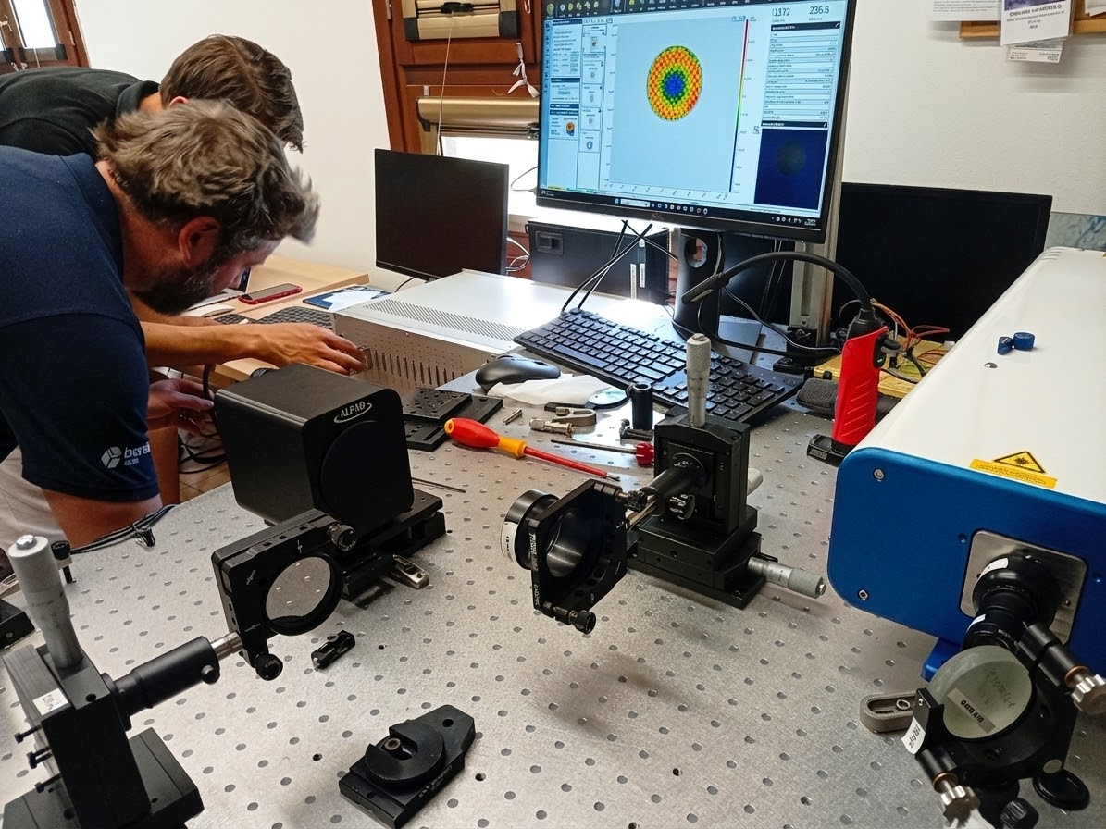
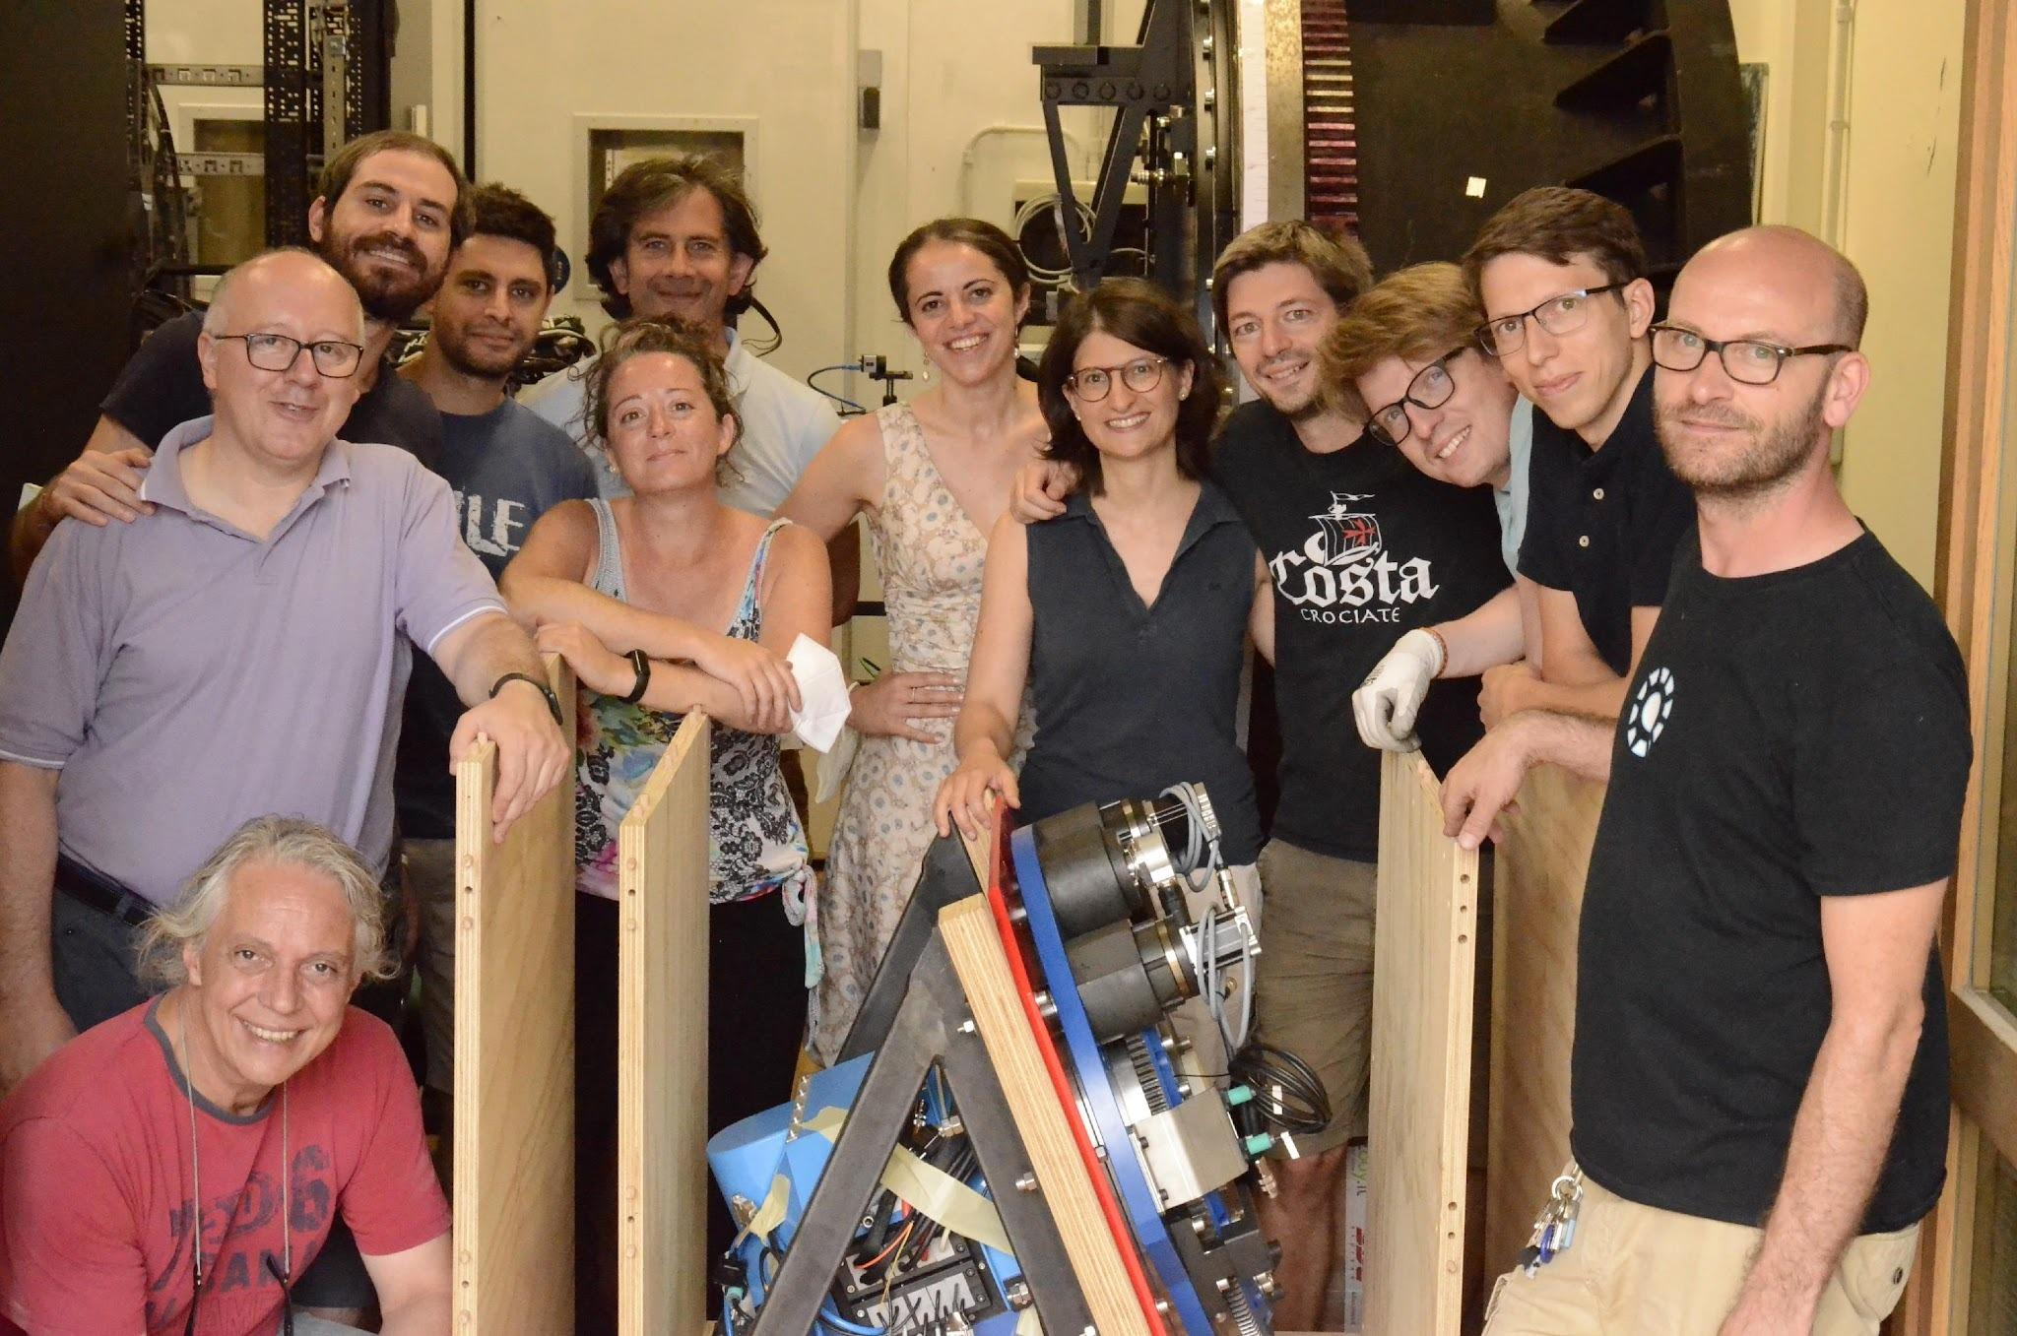
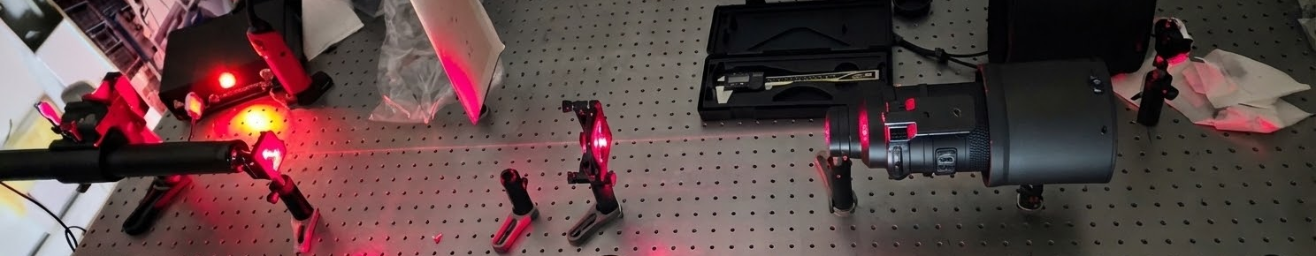
MCAO correction module
From telescope simulator
Mid
Layers DM
3 large Deformable Mirrors for the correction of different atmospheric layers, with adjustable conjugation distance:
- High Atmosphere
(~200 actuators)
- Mid Atmosphere
(~450 actuators)
- Ground Atmosphere
(~800 actuators)
High
Layers
DM
Ground
Layer
DM
To wavefront sensing module (NGS)
To wavefront sensing module (LGS)
‹#›
Turbulence can also be injected via DMs commands
3
DM820 test
Commercial objectives characterization

Slide 8
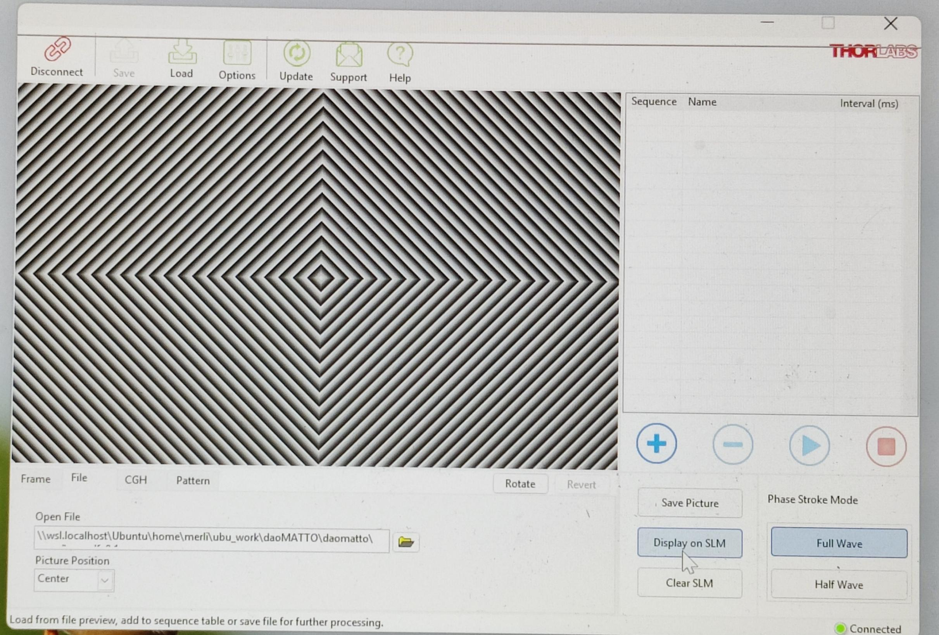
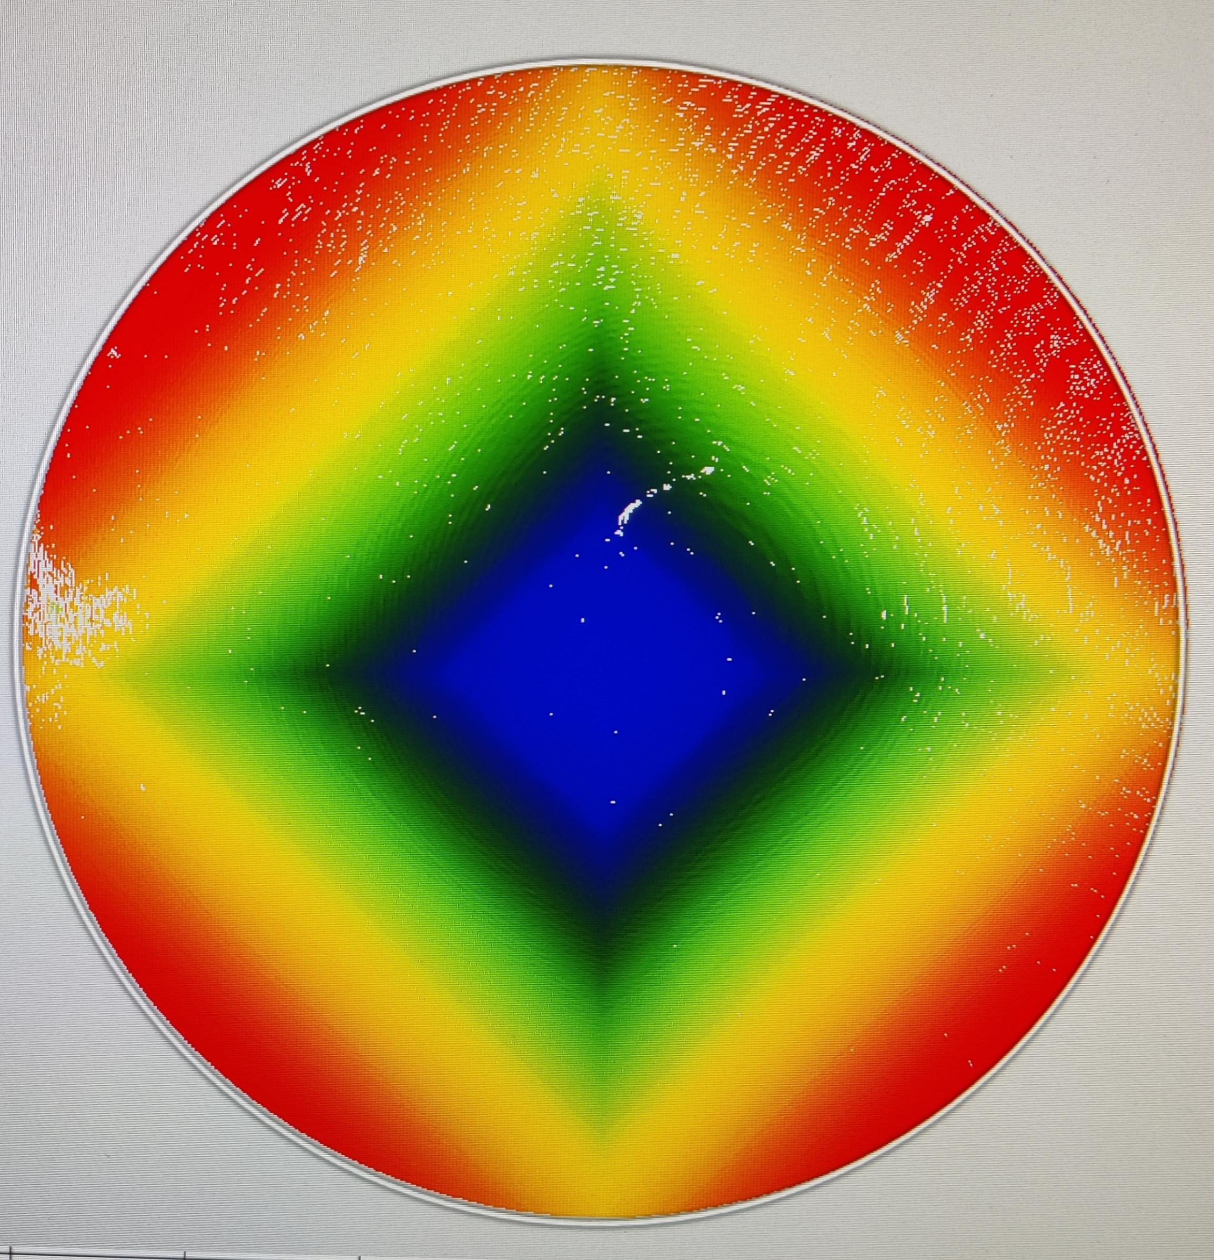
Wavefront sensing module & Science channel
From MCAO correction module
“Scientific” camera
3 + 3 Spatial Light Modulators:
acting as phase masks to mimic different Wavefront Sensors (Shack Hartmann, curvature, Pyramid, Ingot…, new ideas…)
High Layer
DM
To science channel
Ground
Layer
DM
NGS WFSs
Technical camera
To wavefront sensing module (NGS)
LGS WFSs
3 + 3 GigE technical cameras
1 High-Resolution GigE scientific camera
SLM
Pupil plane/
Focal plane
Motorized stages to adapt the conjugation of the LGS channel and to span the Field of View
‹#›
SLM shape stability tests

Slide 9
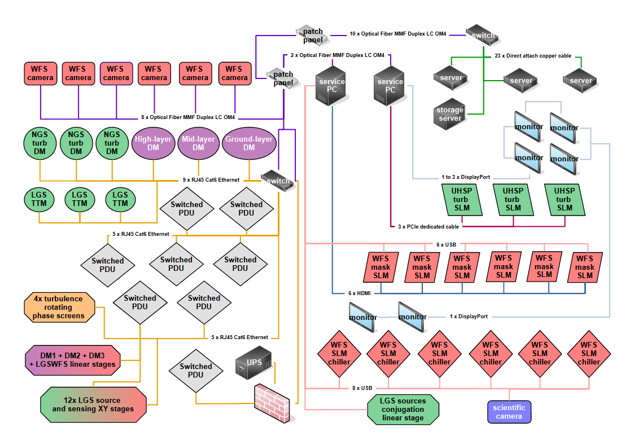
Many devices (DMs, SLMs, cameras,...) to be controlled at high rates.
Real-Time Control
CED
MATTO H-RTC recipe:
3 x servers (OS: Linux) with 6 cutting-edge AMD EPYC 9648X CPUs
1 x storage server
2 x AMD/Intel workstations (OS: Windows) for additional interface
MATTO S-RTC needs:
multi-purpose → needs to adapt to different experiments
facility → long lived, can/will be upgraded with new devices
Again, the magic word is… MODULARITY!
MATTO RTC SW will be based on the DAO (Durham Adaptive Optics) RTC package (in collaboration with CfAI

Slide 10
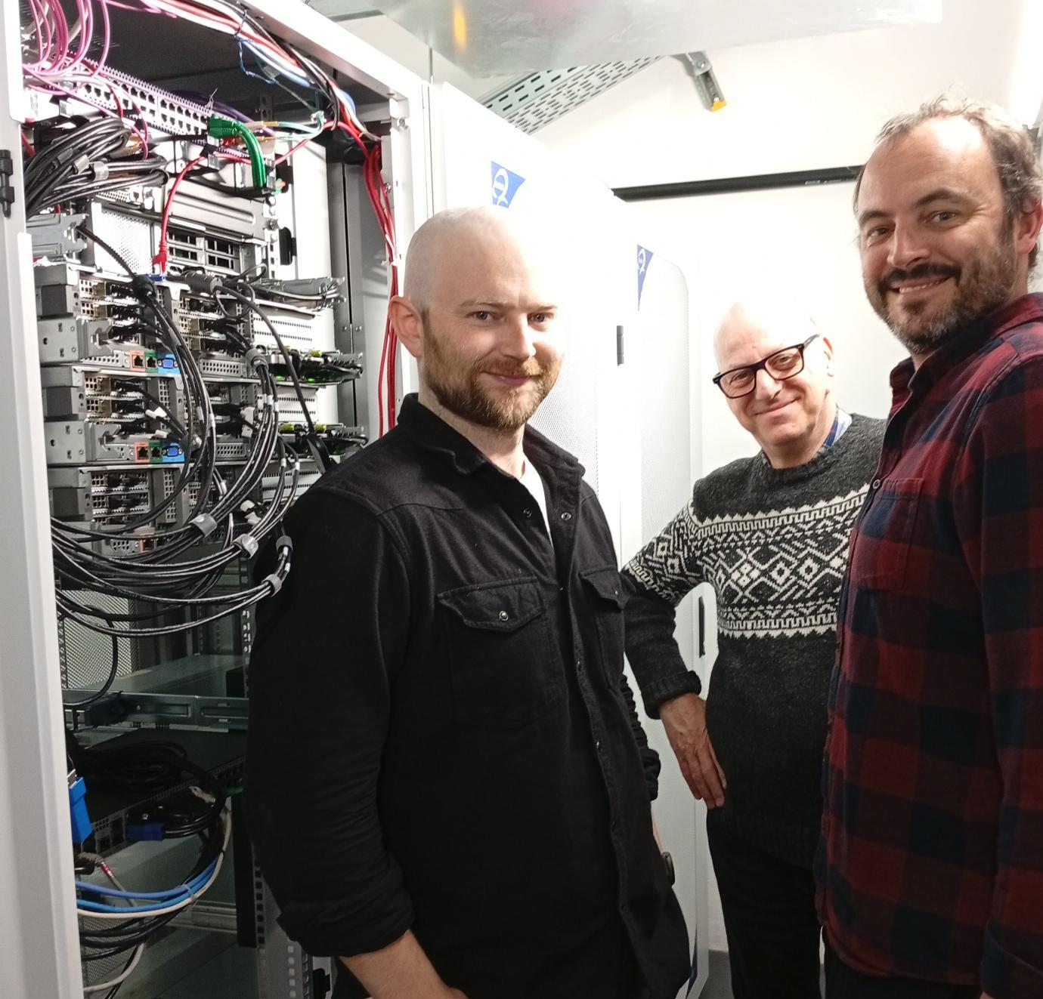
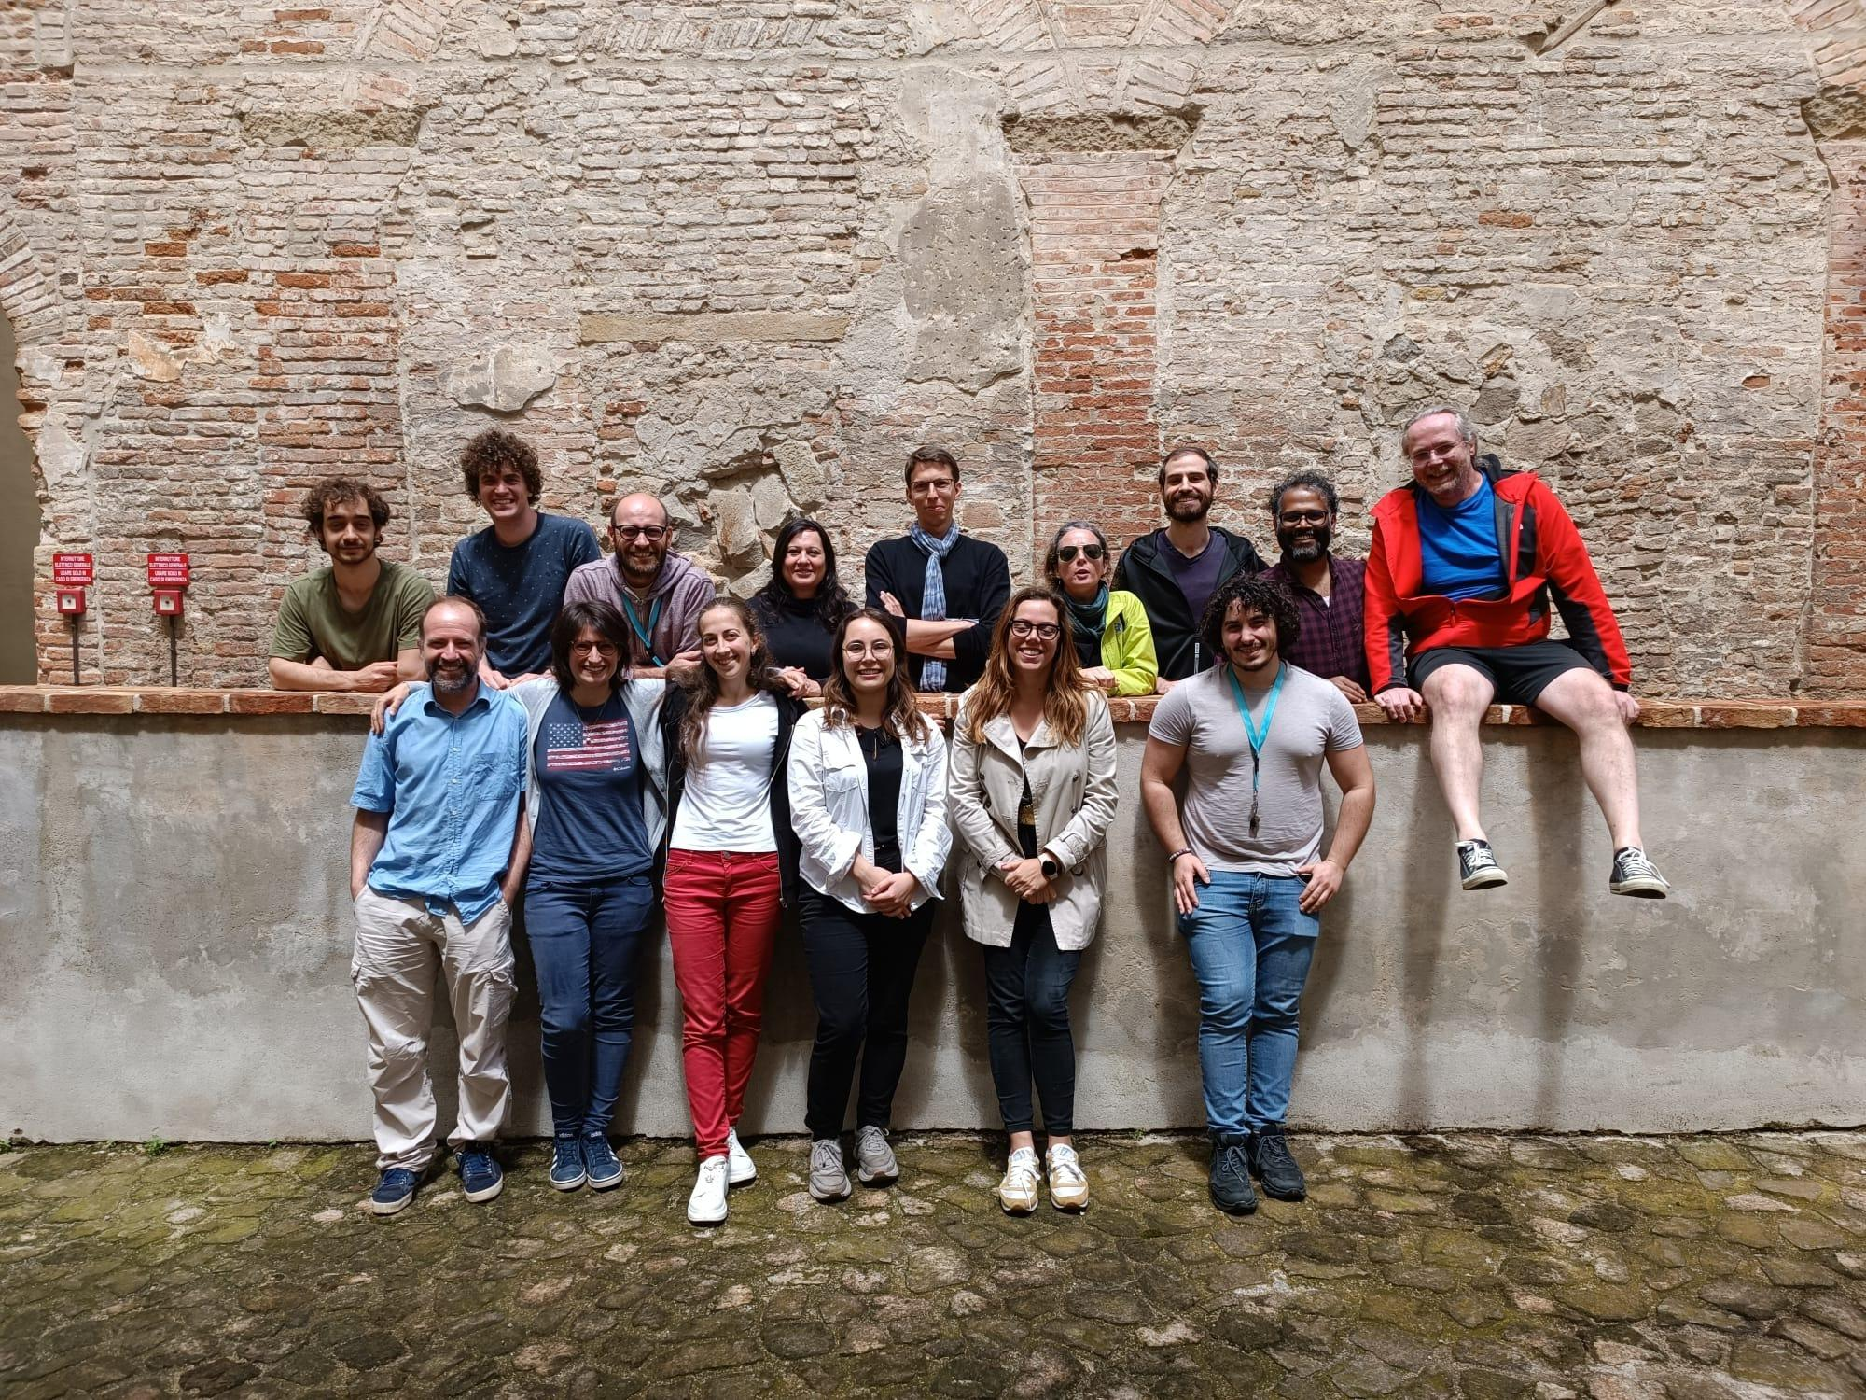
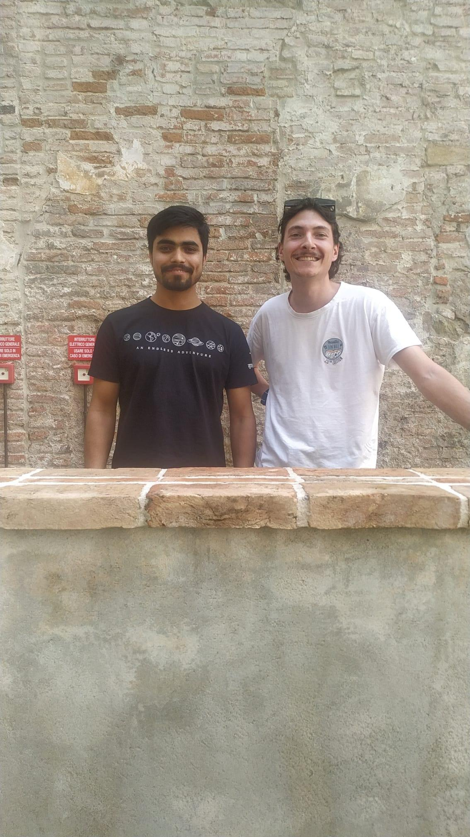
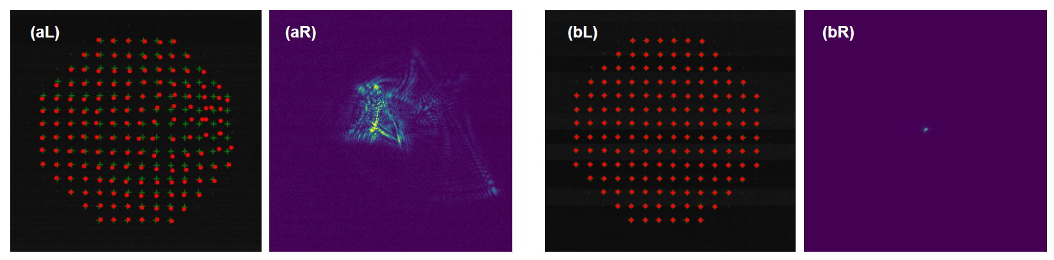
Real-Time Control
MATTO H-RTC recipe:
3 x servers (OS: Linux) with 6 cutting-edge AMD EPYC 9648X CPUs
1 x storage server
2 x AMD/Intel workstations (OS: Windows) for additional interface
MATTO S-RTC needs:
multi-purpose → needs to adapt to different experiments
facility → long lived, can/will be upgraded with new devices
Again, the magic word is… MODULARITY!
MATTO RTC SW will be based on the DAO (Durham Adaptive Optics) RTC package (in collaboration with CfAI
DAO team (+ Danilo)
First tests on real world S-H

Slide 11

Timeline
Oct ‘25 Jan ‘26 Apr ‘26 Jul ‘26 Oct ‘26 Jan ‘27
Procurement
Components characterization
OAPd Labs civil works (impacting also MATTO lab)
Mini-MATTO
(slightly reduced to fit in another lab)
MATTO

Slide 12
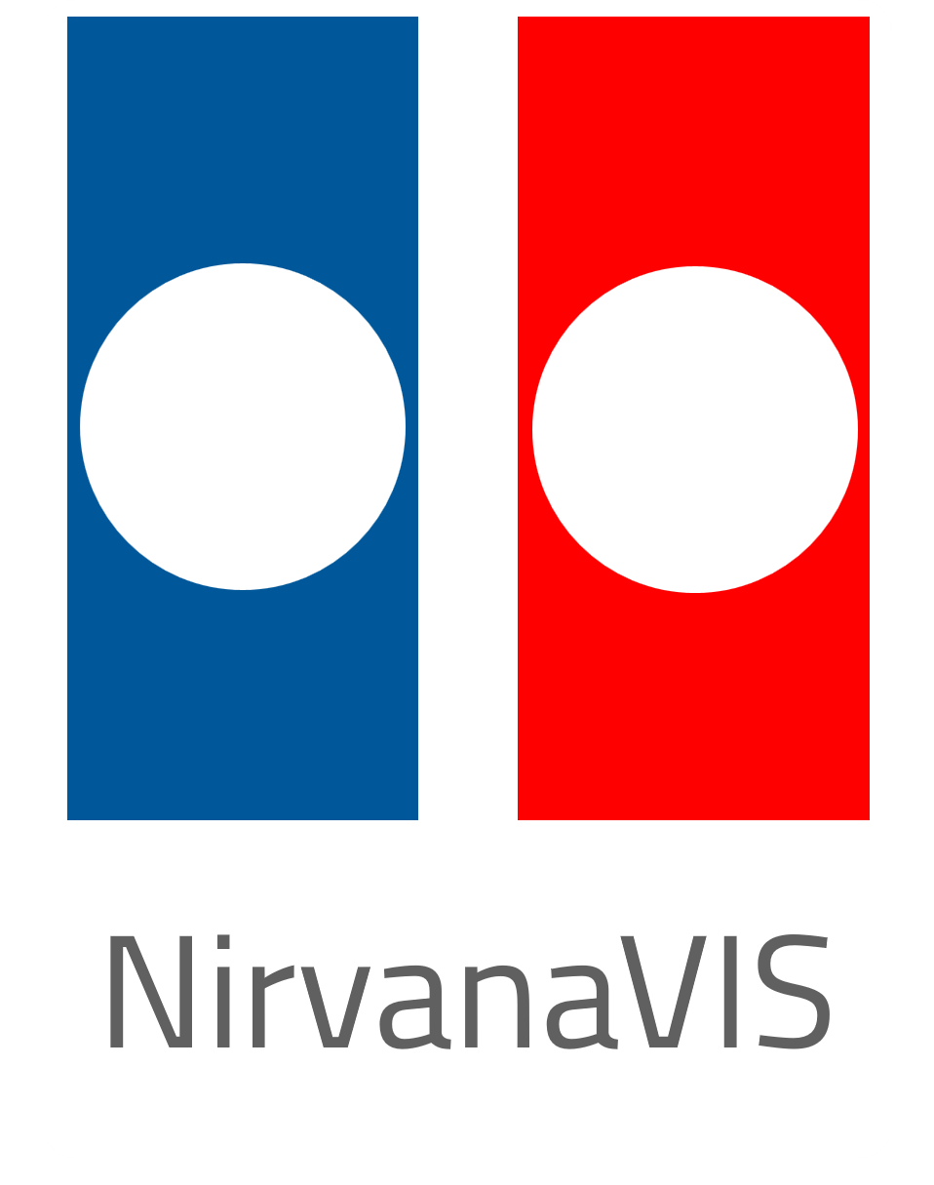
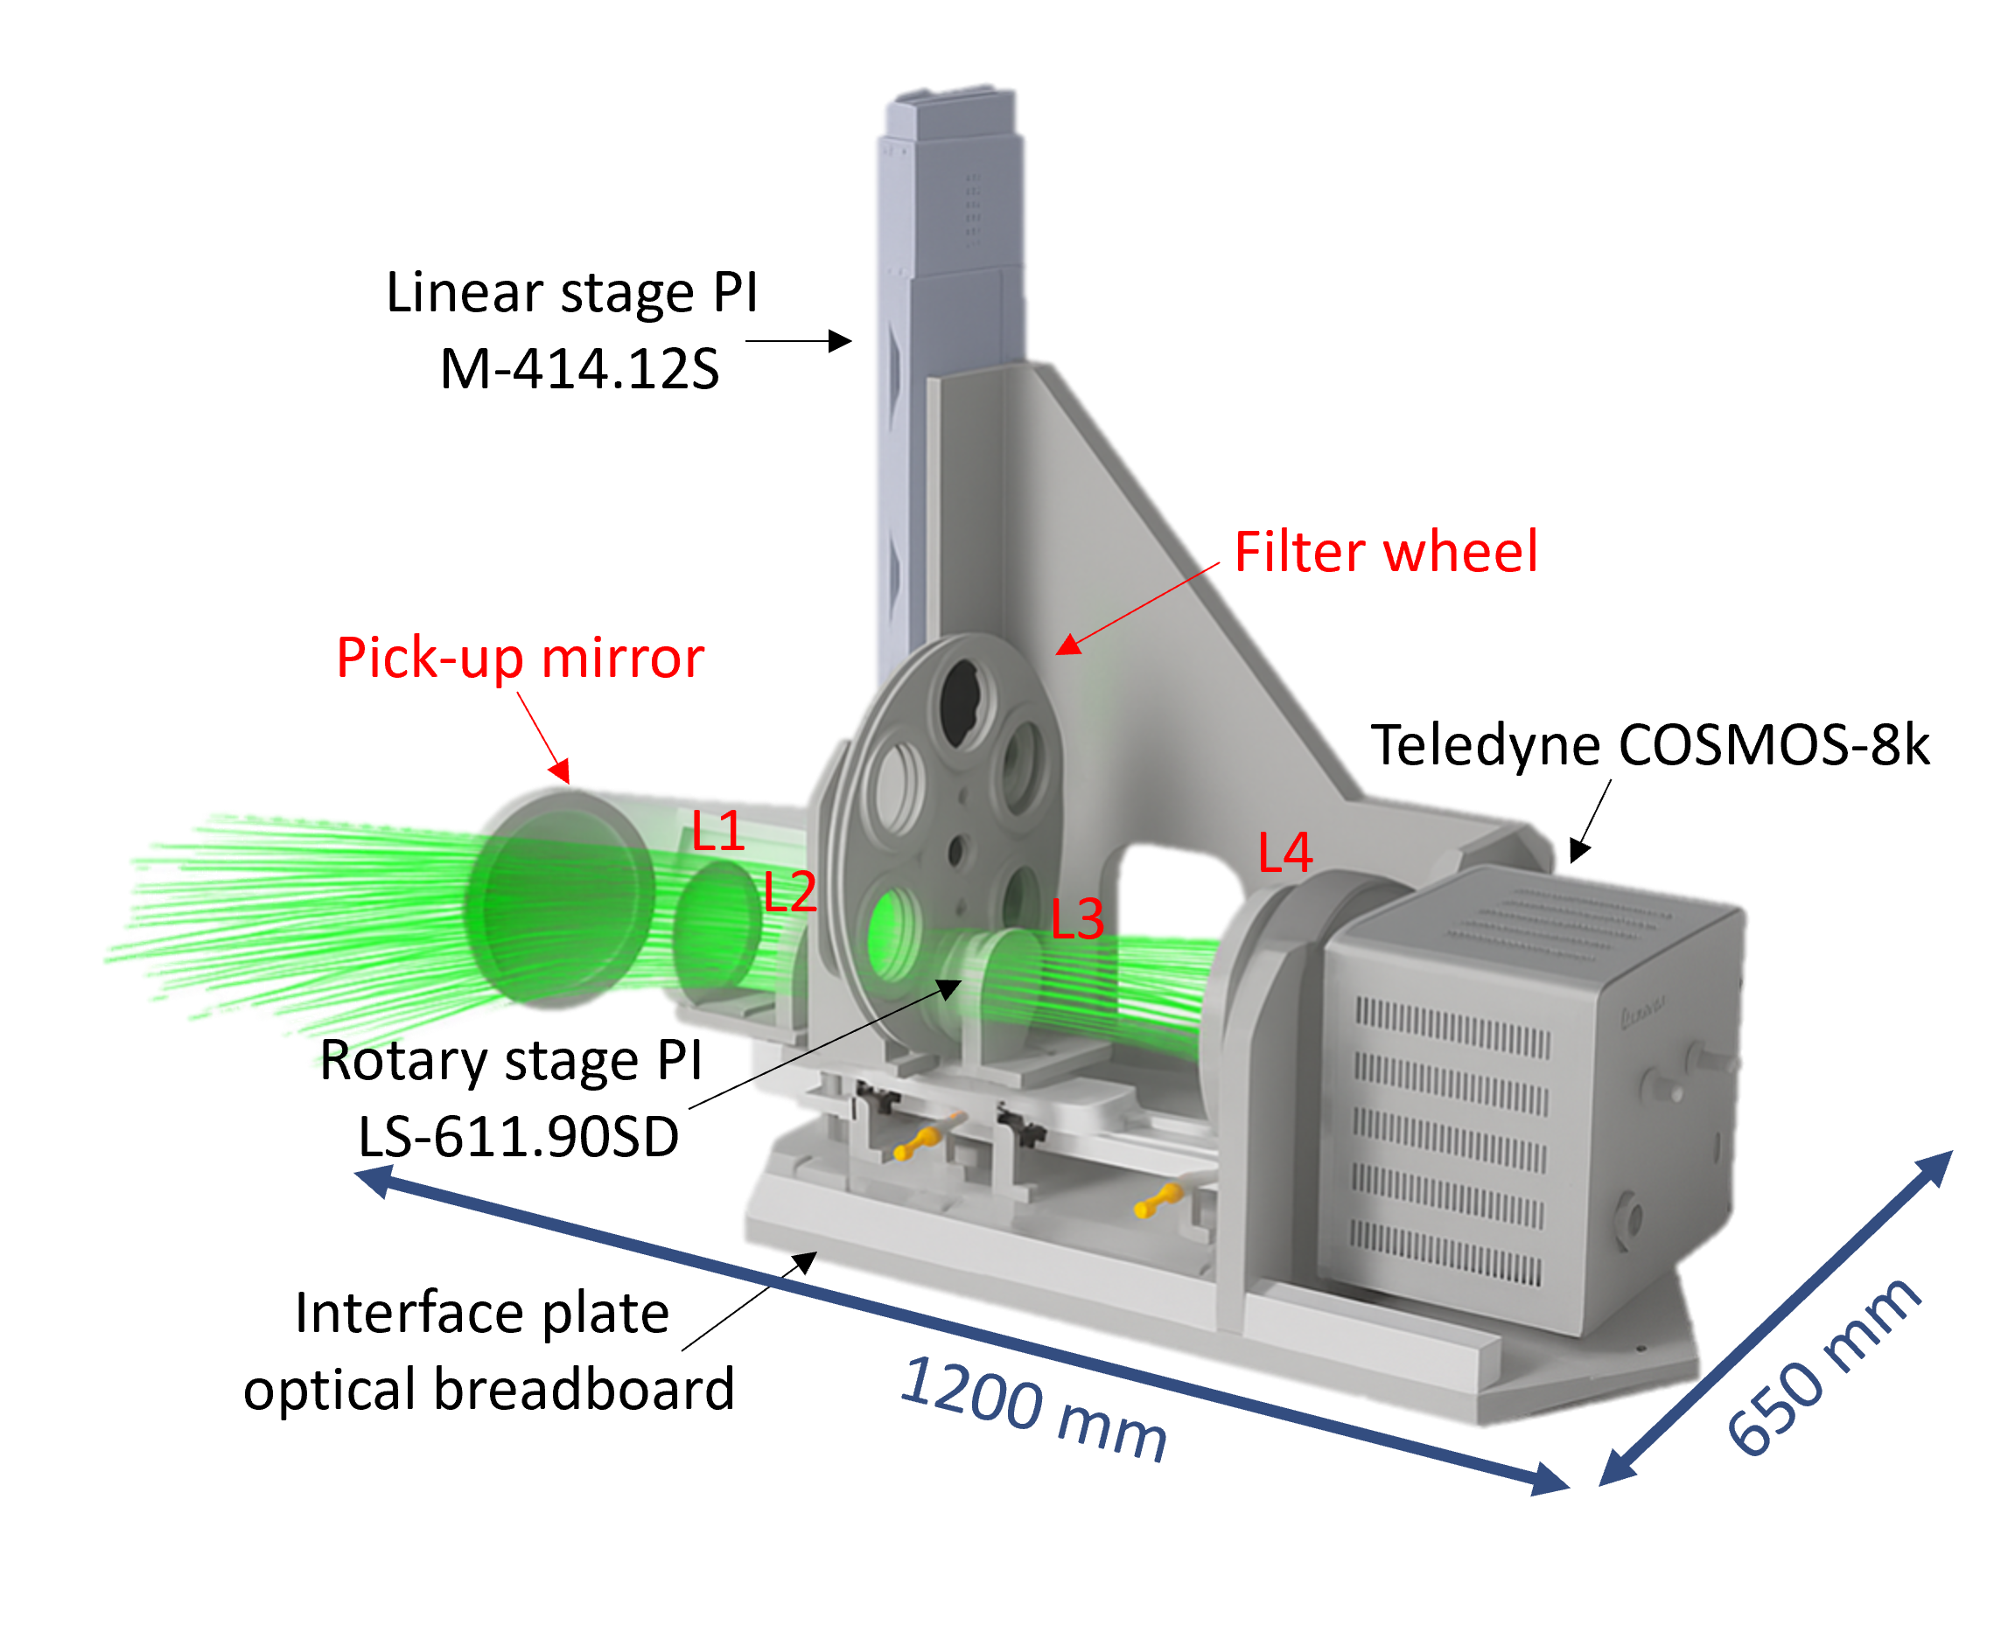
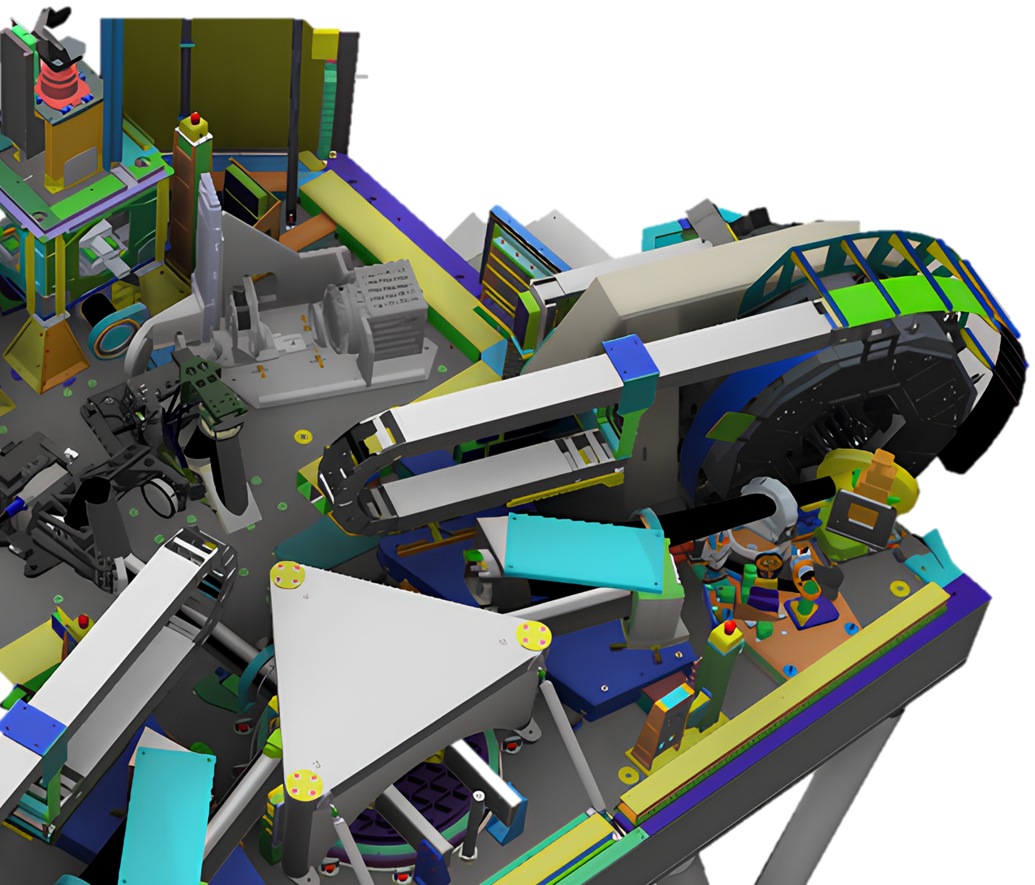
NirvanaVIS – Att. 2201
Upgrade of an existing instrument LINC-NIRVANA @LBT
Conceived to exploit the sensitivity correction granted by LN GLAO onto a 2 arcmin FoV in the visible regime (600-1000 nm), about a factor 2, leaving LN fully operative.
FoV: 52’’ x 52’’ for speckle holography, plate-scale 6.5 mas/pixel 🡪 diffraction limited (19 mas H alpha)
Approx 100 Kg
Missione 4 • Istruzione e Ricerca
Only on SX side
16-18/03/26
Workshop STILES - Risultati e prospettive future
NIRVANA-VIS

Slide 13
NirvanaVIS Bureaucracy
Main people involved in PNRR work @OaPd (Bureaucracy and design): Bergomi, Marafatto, Van Gaalen (PhD), Arcidiacono, Di Rosa, Dima, Greggio, Radhakrishnan
Modello procedura | Numero procedure | Oggetto | Inviluppo economico | RUP, DEC | Supporto Amministrativo
Gara Aperta | 1 | Camera scientifica Teledyne COSMOS 8K | 487.757,65 € | Bergomi, Marafatto | Carraro; Rotondo
Affidamenti diretti | 5+1(Shared with Att.5301) | Workstations & storage Slitte Motorizzate Meccanica Ottiche Filtri scientifici Utensili lab | 215.634,8 € | Bergomi, Petrella(1) | Filippone (1), Panizzolo (2), Carraro (2)
Workshop STILES - Risultati e prospettive future
NIRVANA-VIS

Slide 14
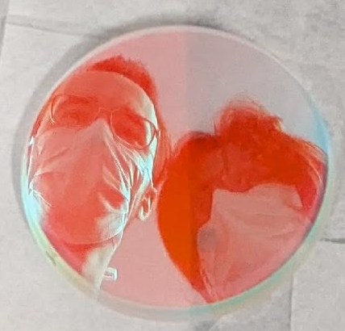
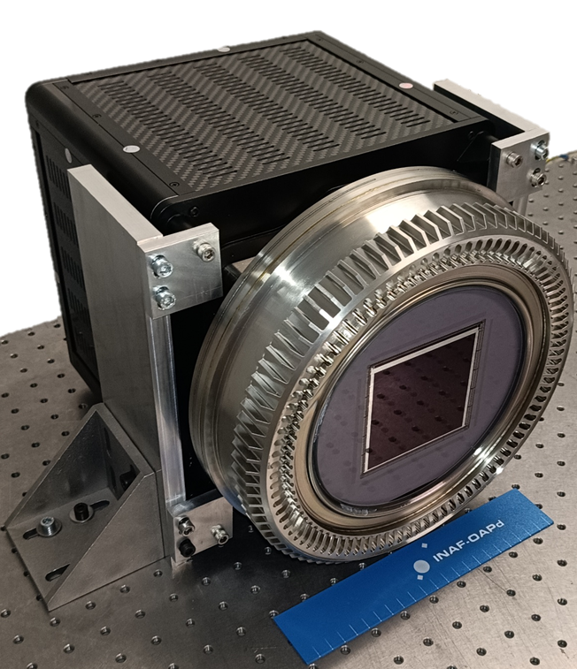
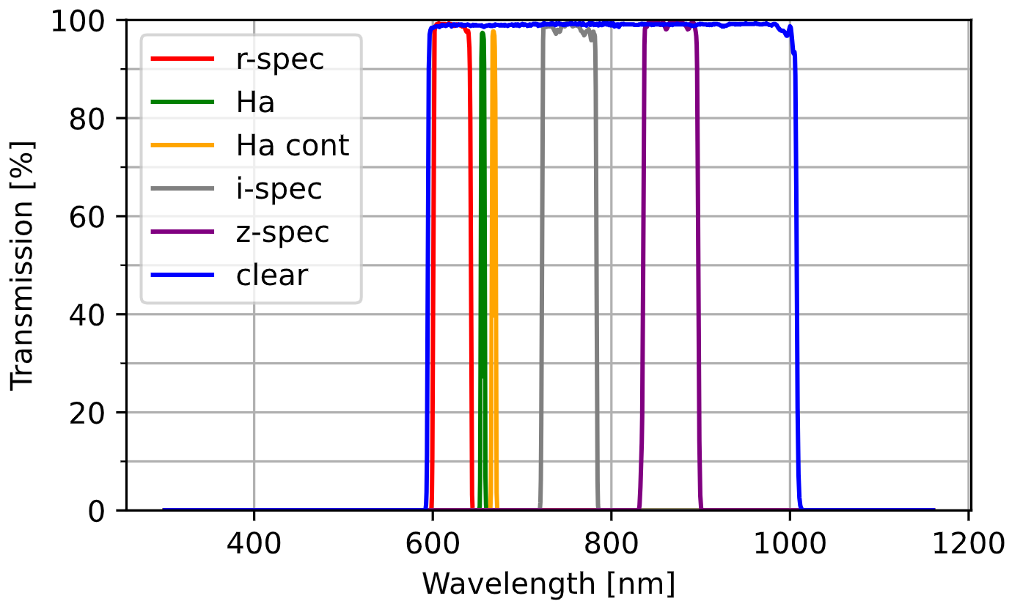
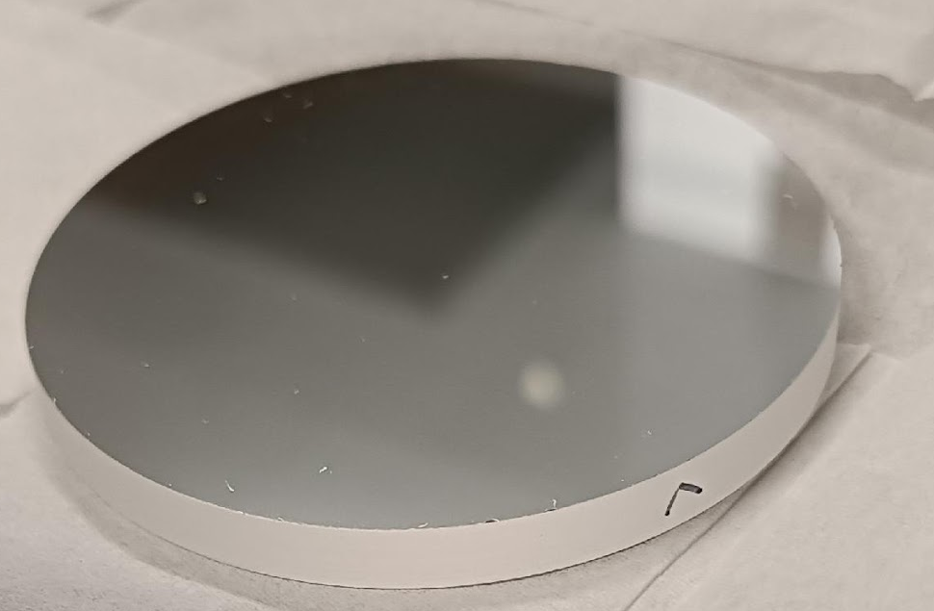
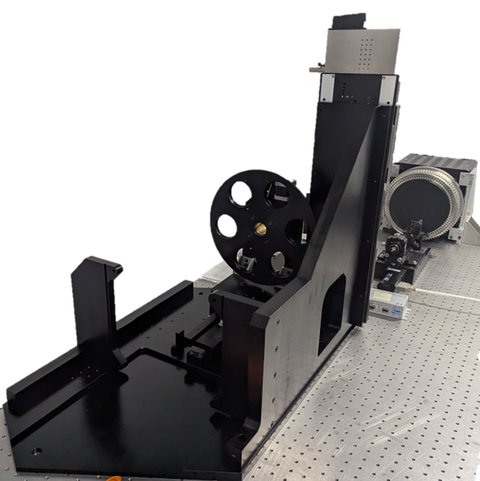
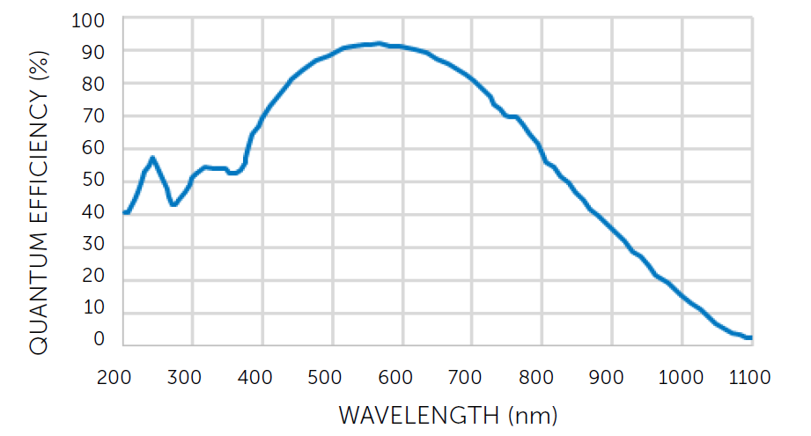
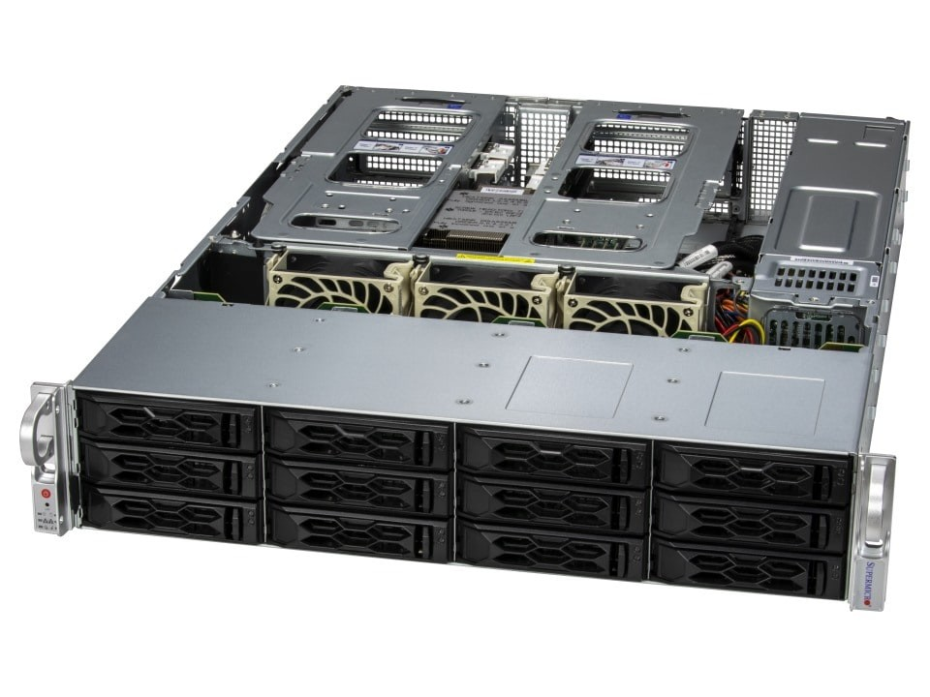
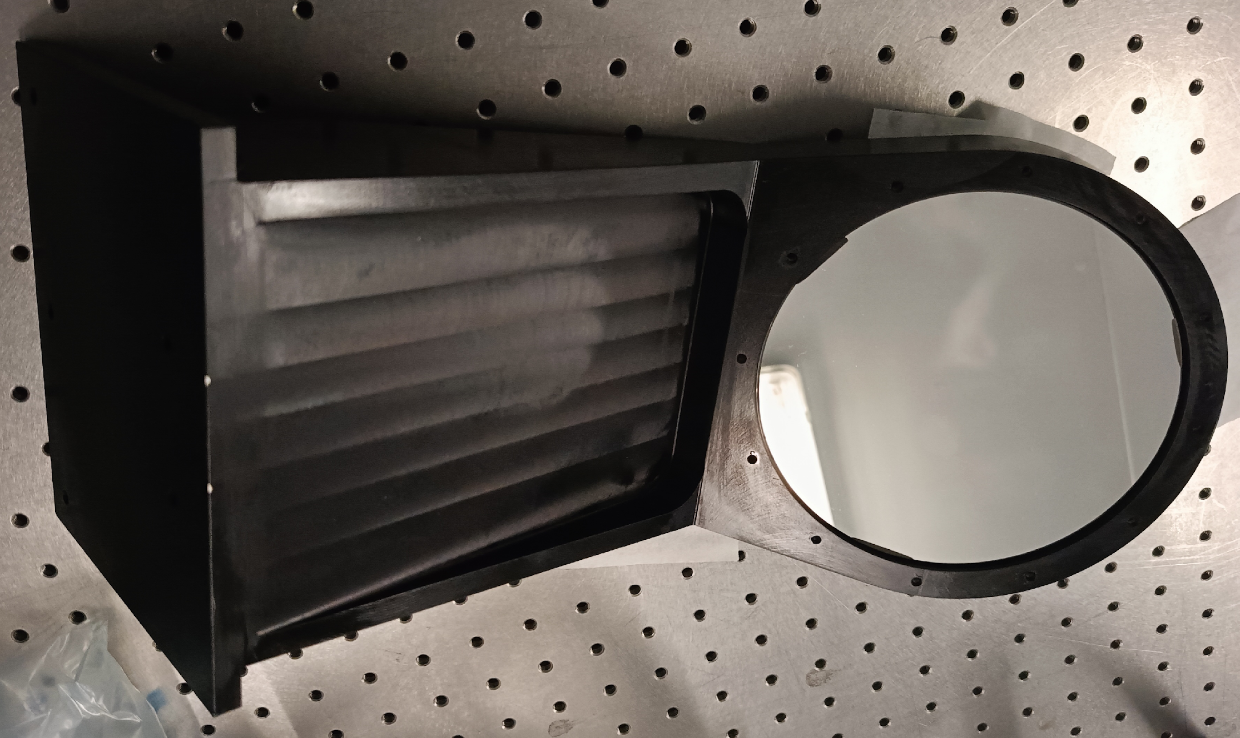
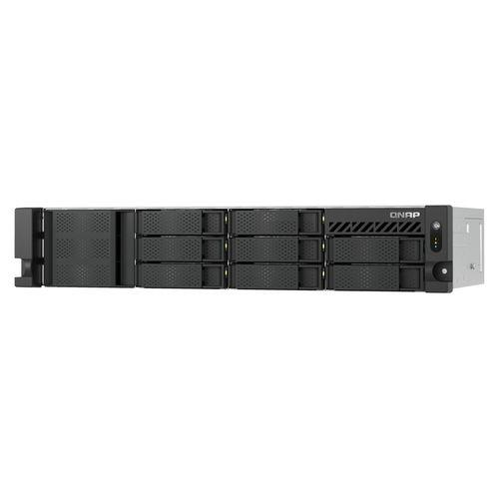
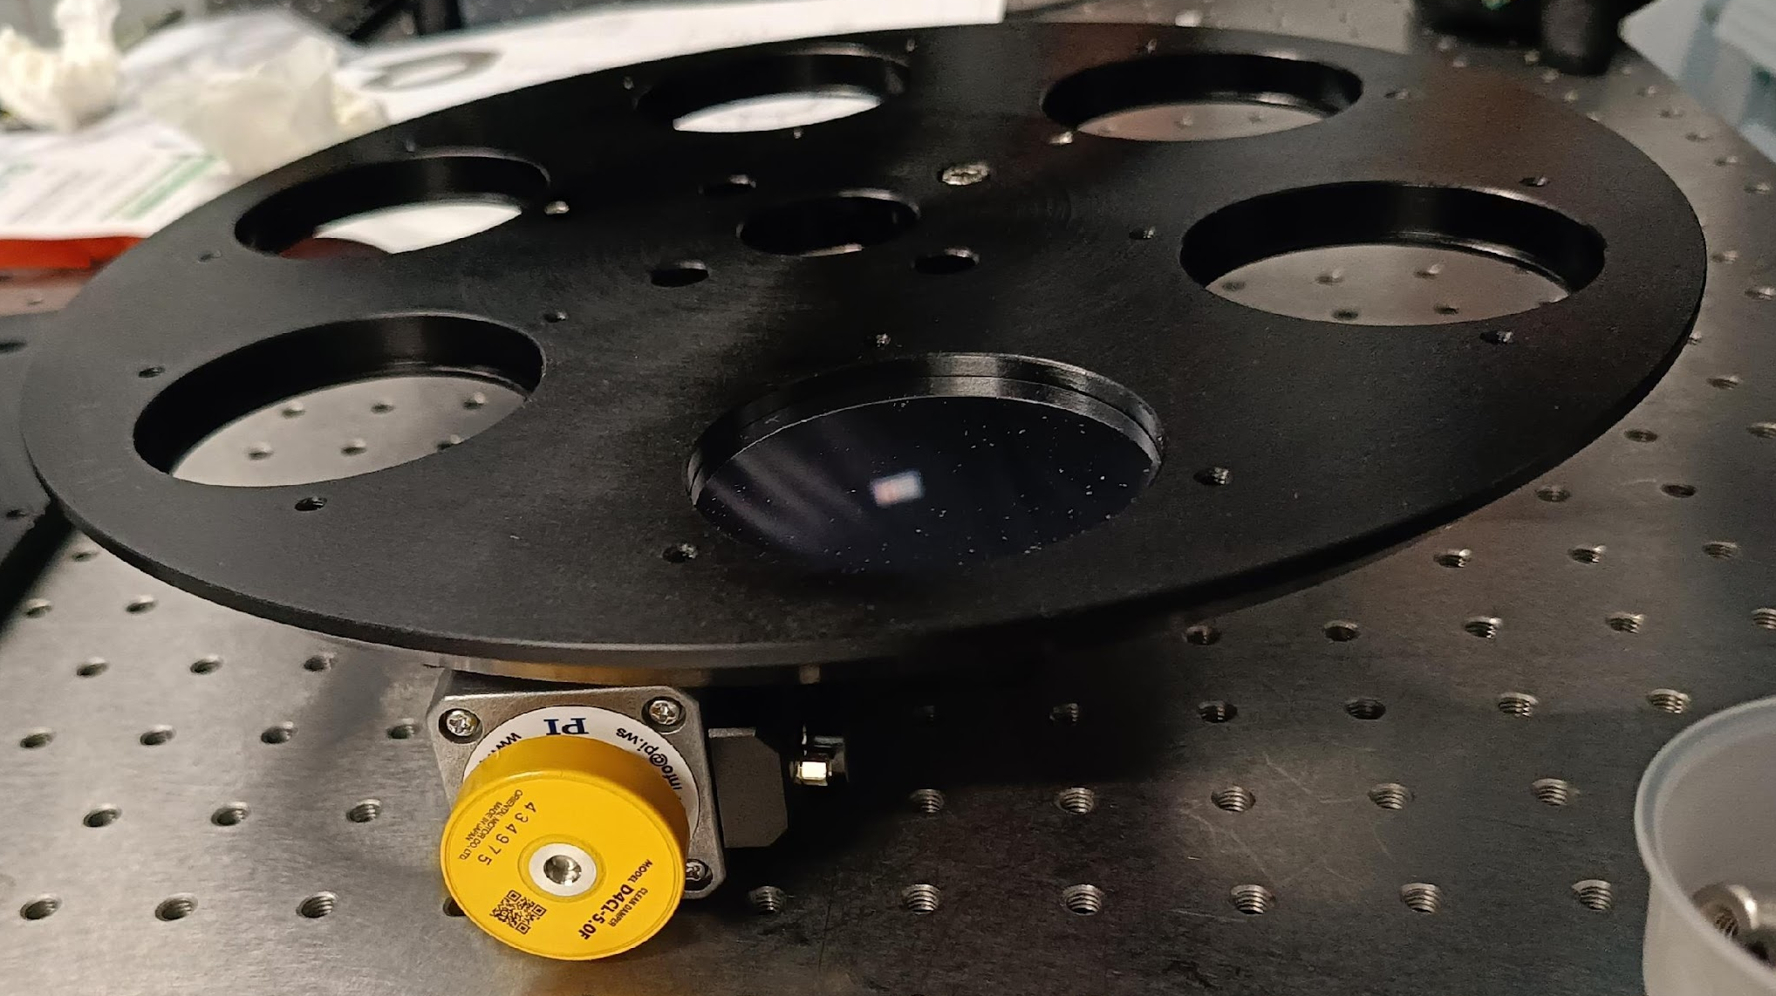
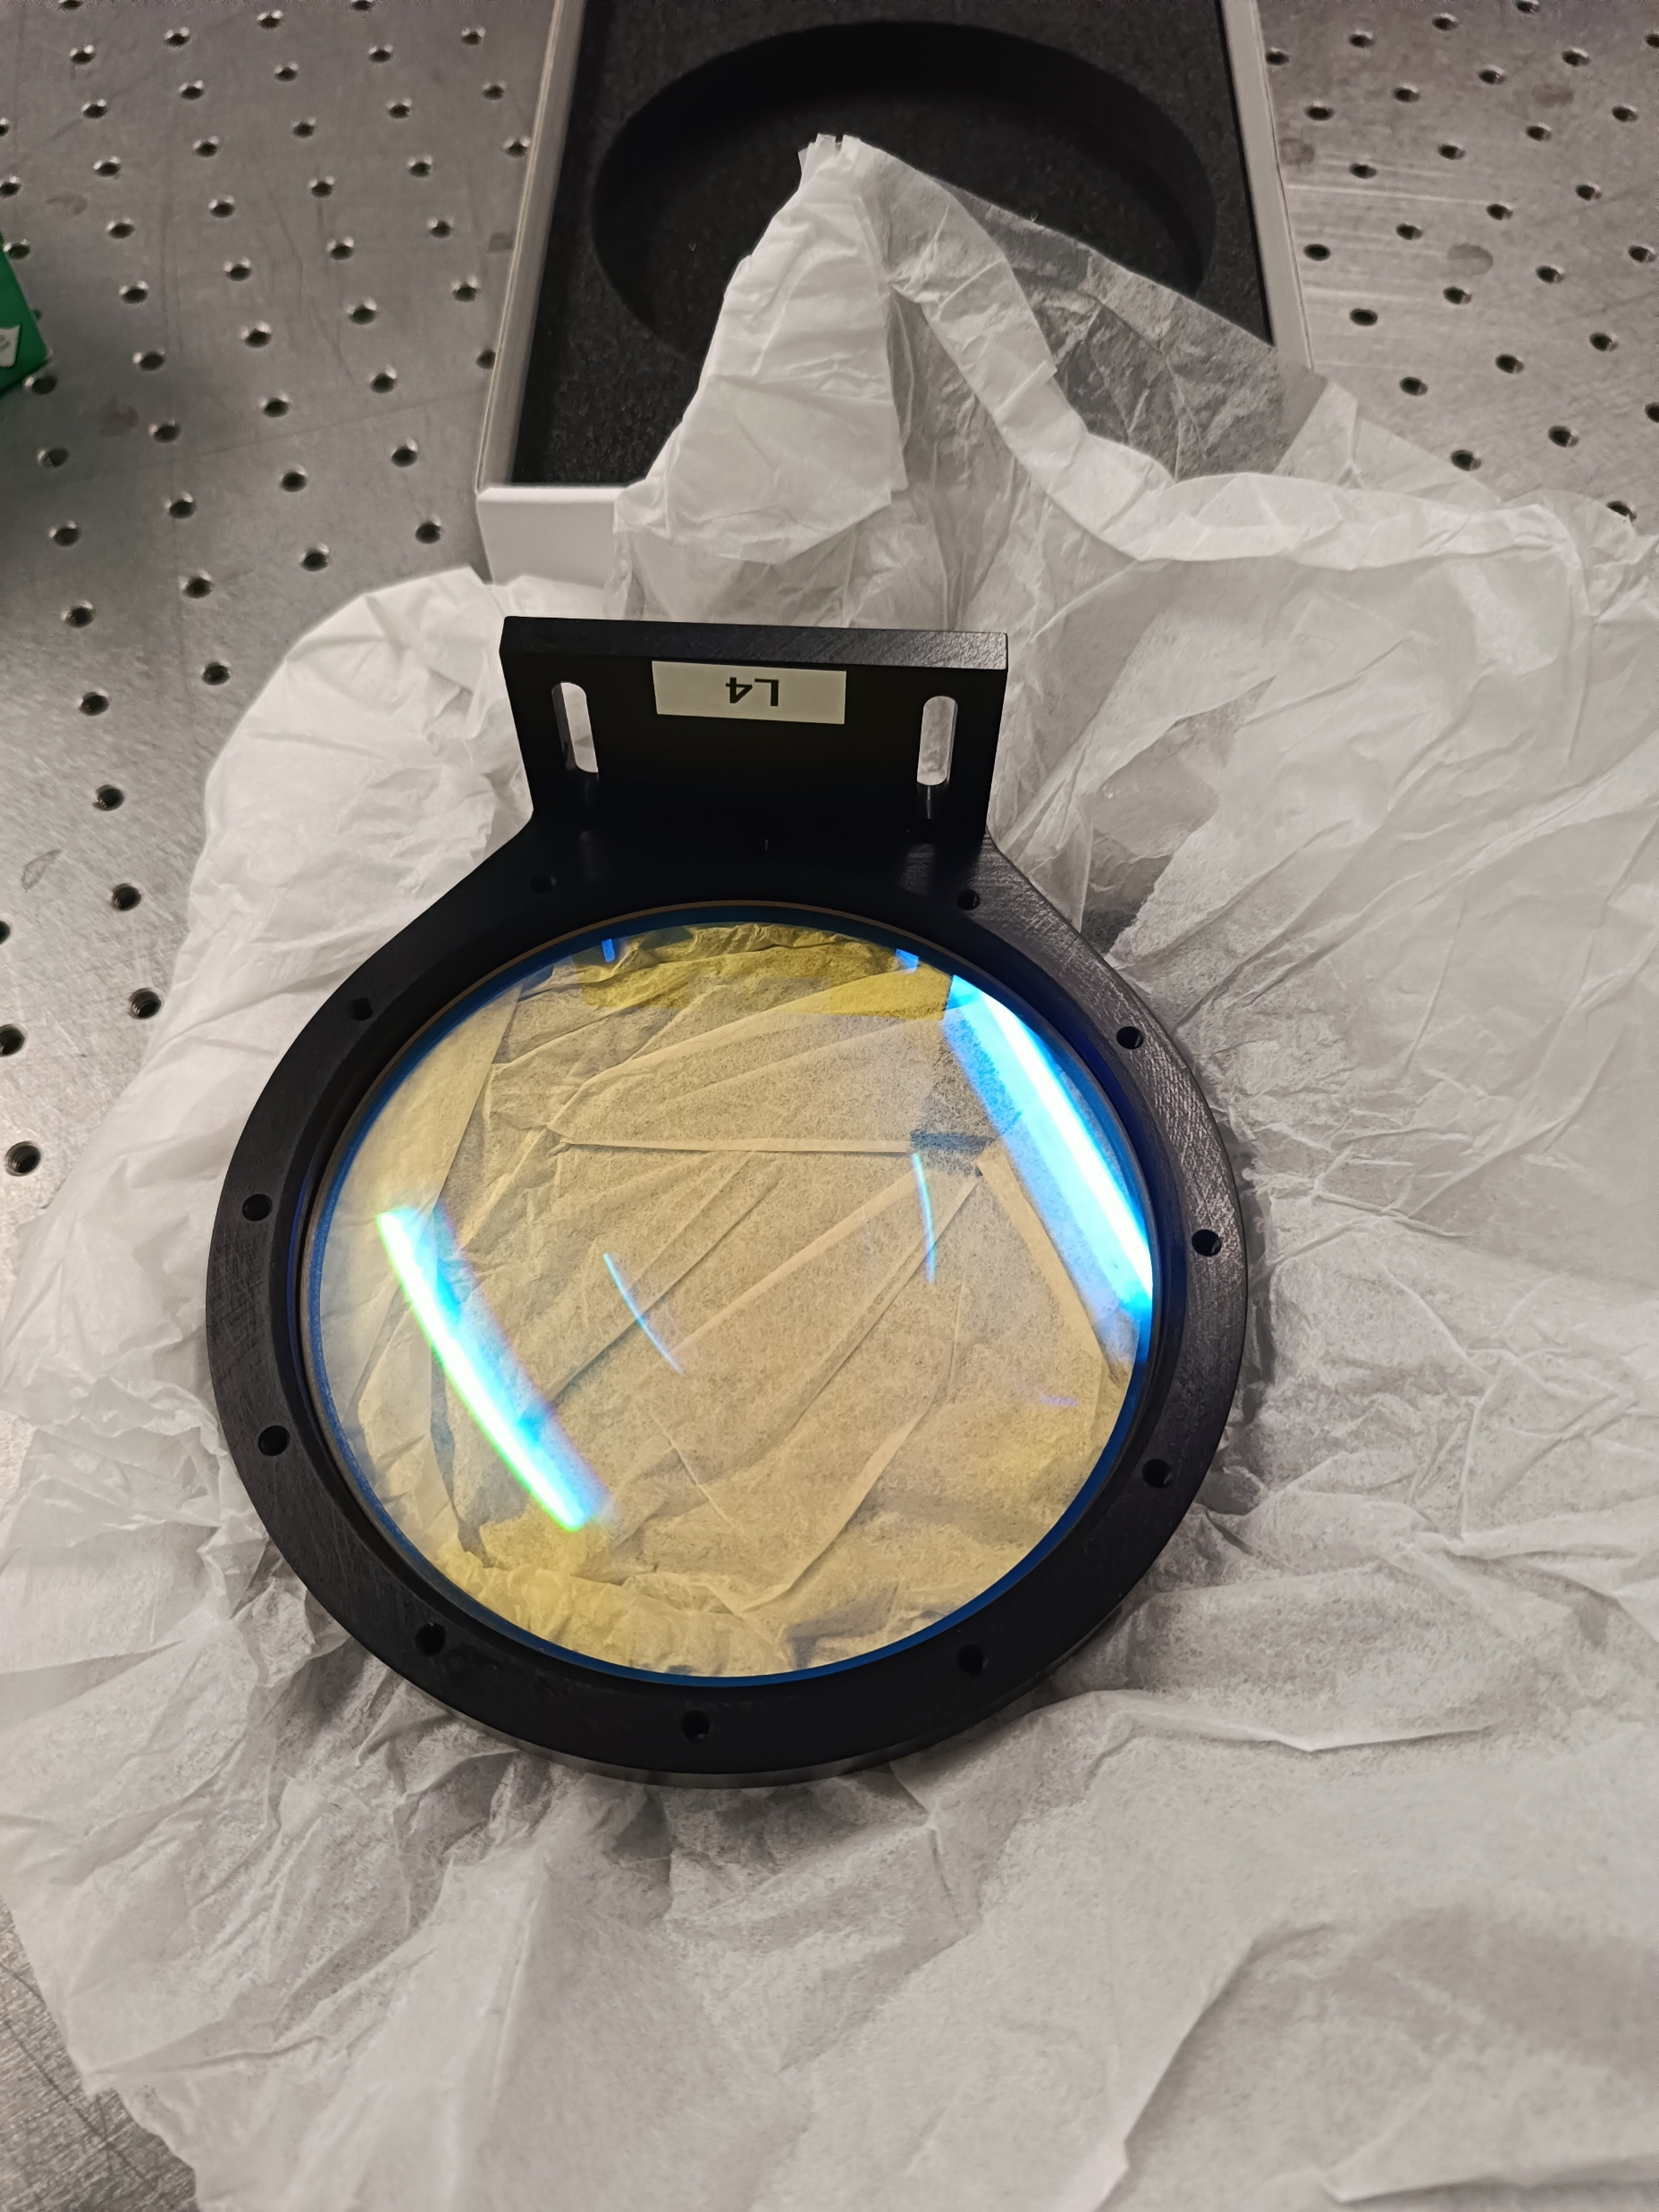
NirvanaVIS Hardware purchased with STILES fundings
Customized 4° AoI
Scientific filters
All in OAPD labs
by December 2025
Teledyne COSMOS 66B (8K) camera
Opto-mechanics
(4 customized lenses + anodized aluminum customized mechanics +
PI motorized stages)
2 servers Supermicro
3x30,72 TB - Padova
6x30.72 TB - LBT
+ NAS (140 TB) for long-term storage
+ Lab equipment for alignment and testing
16-18/03/26
Workshop STILES - Risultati e prospettive future
NIRVANA-VIS

Slide 15
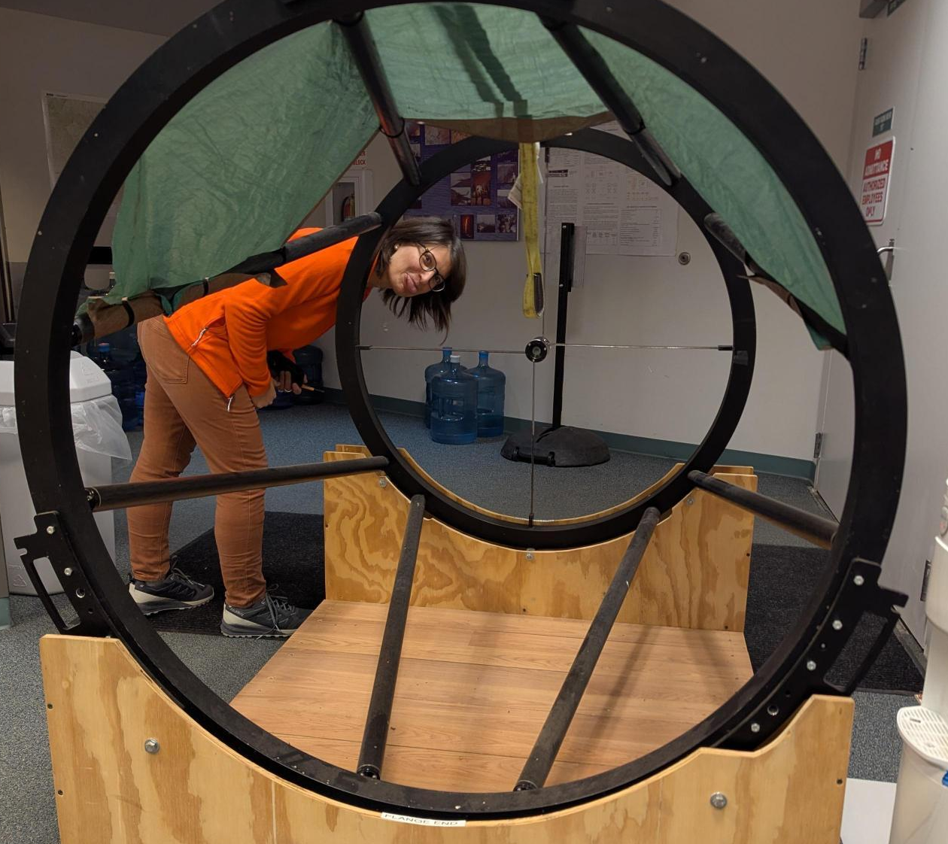
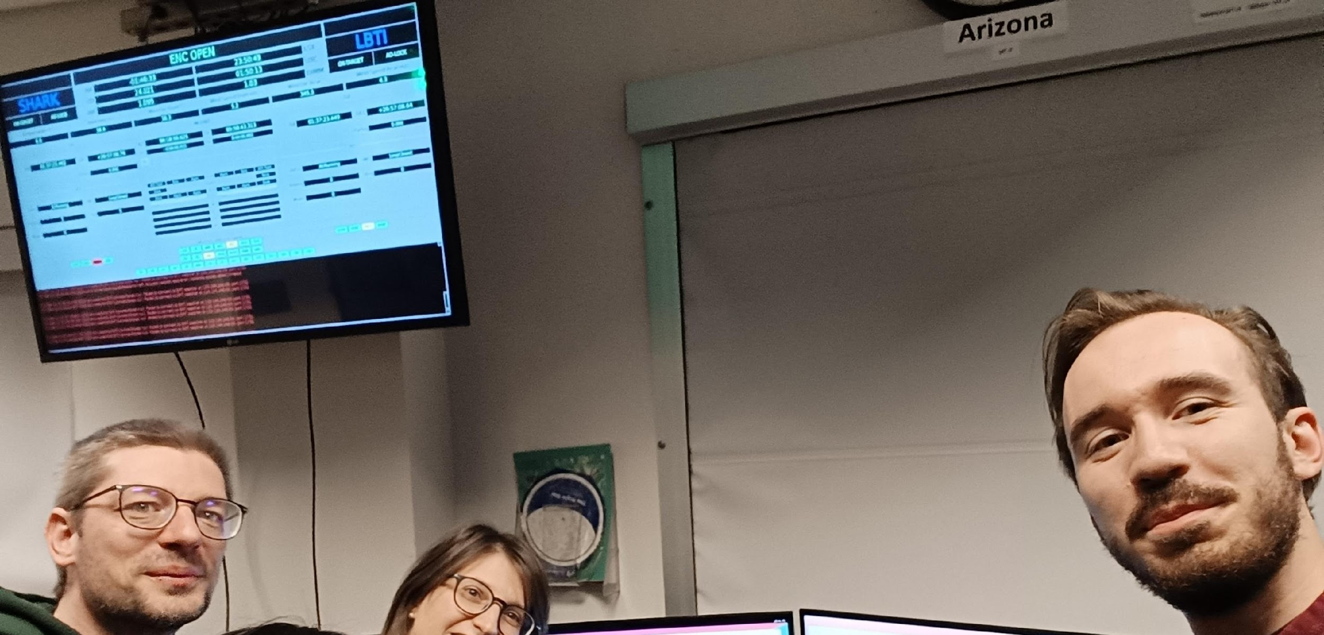
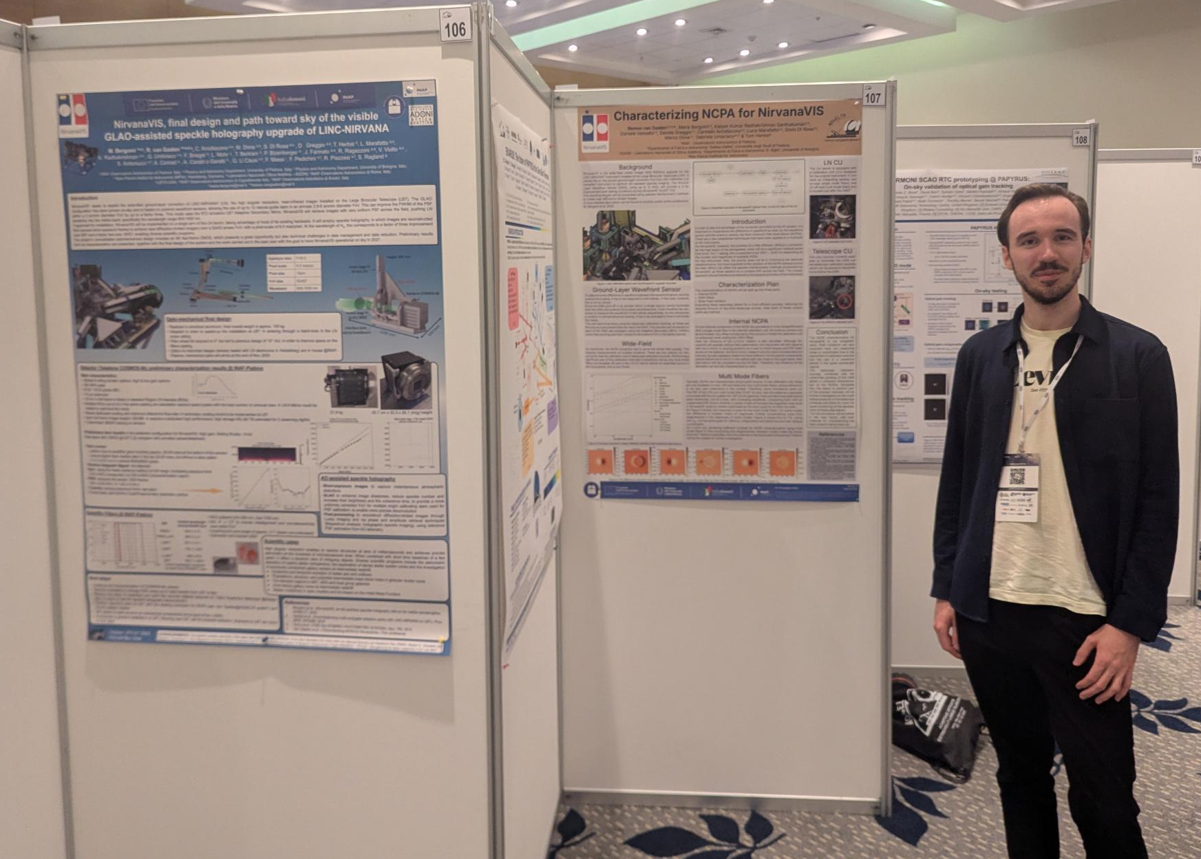
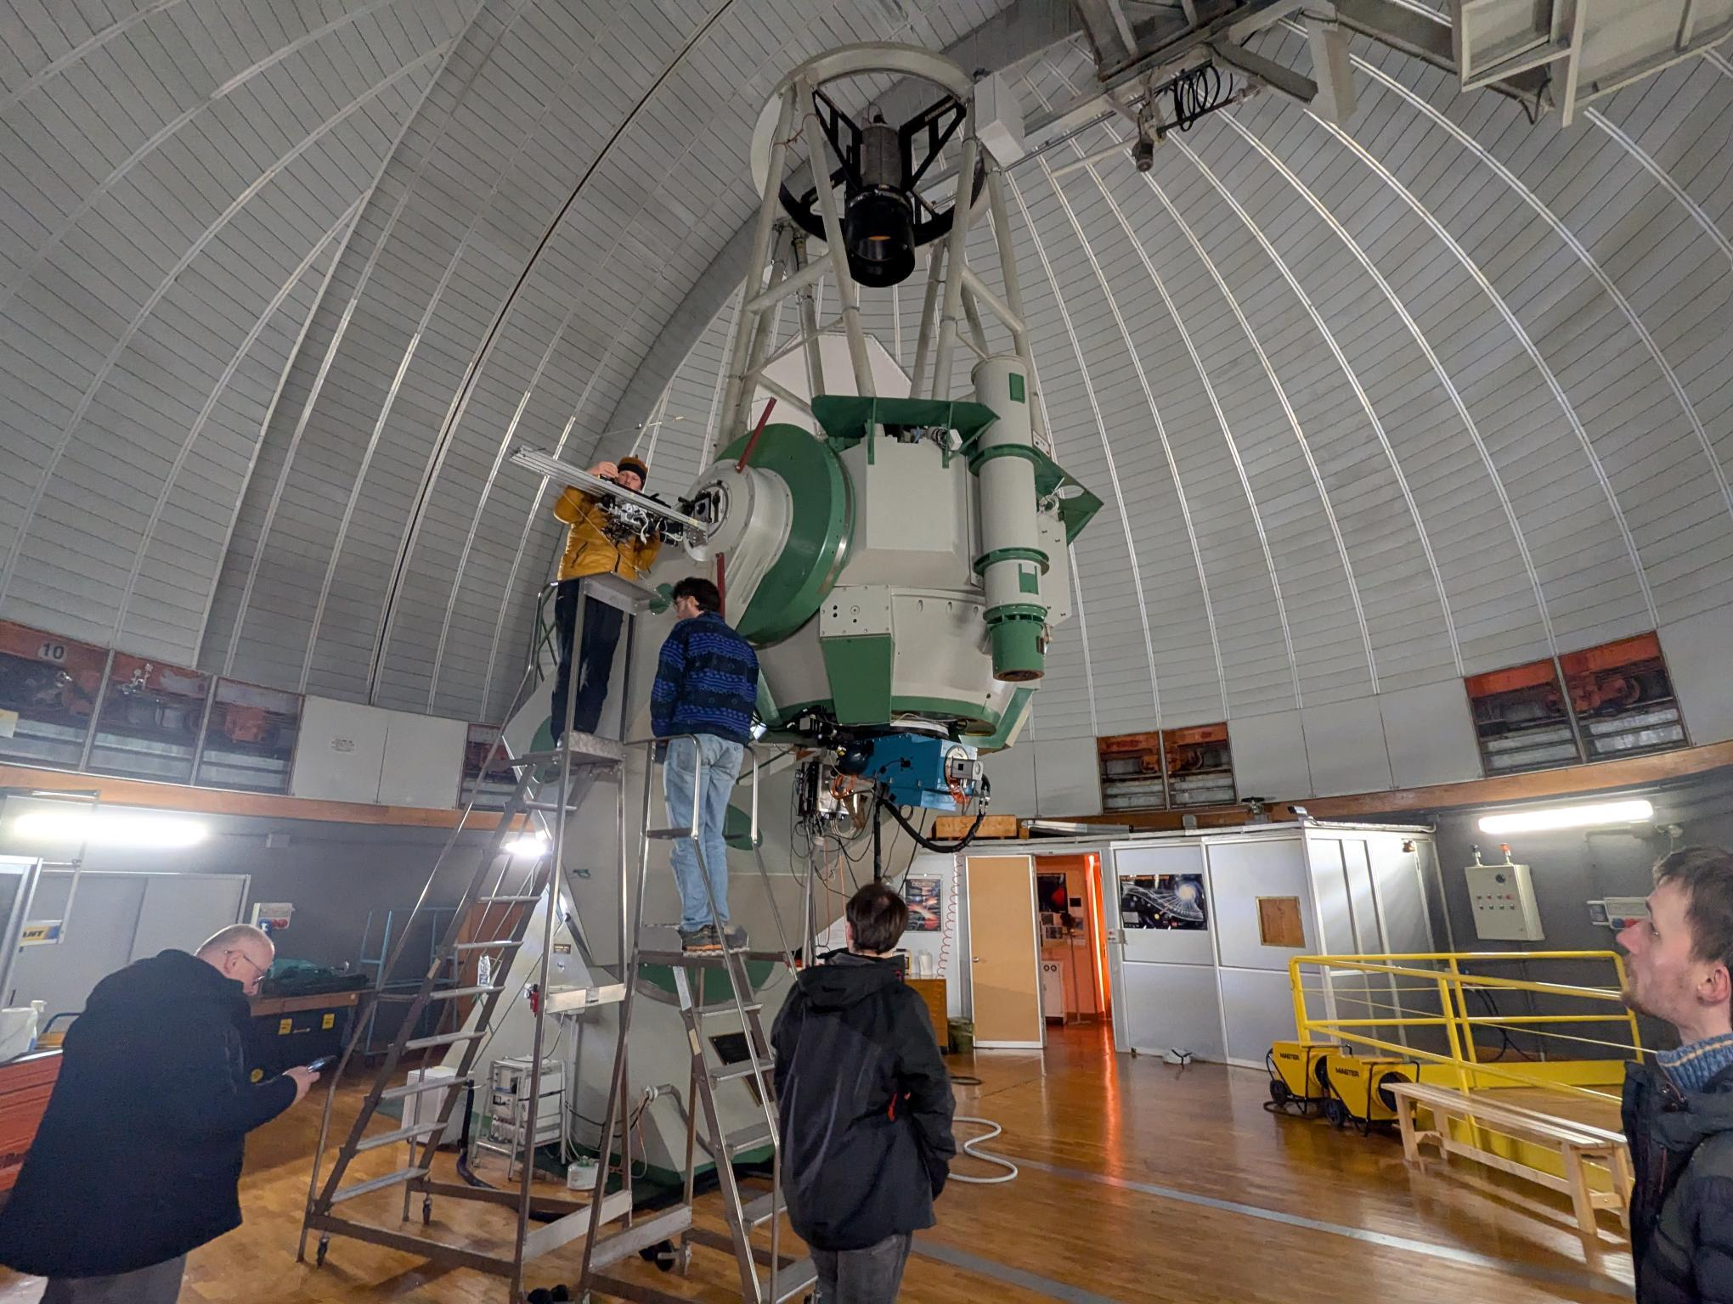
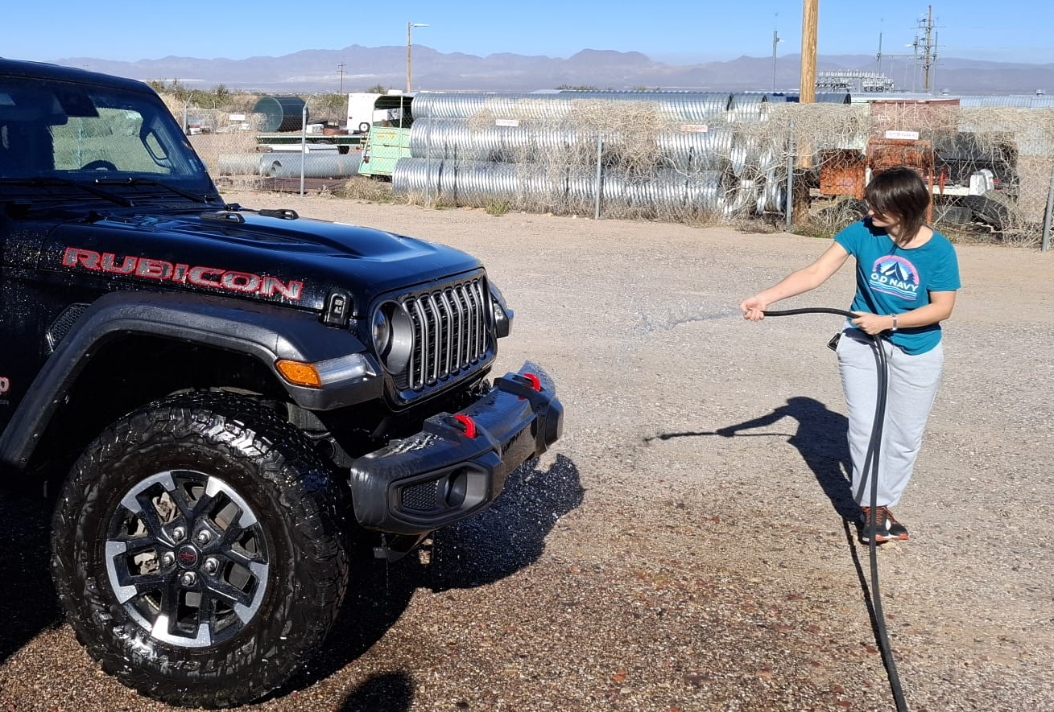
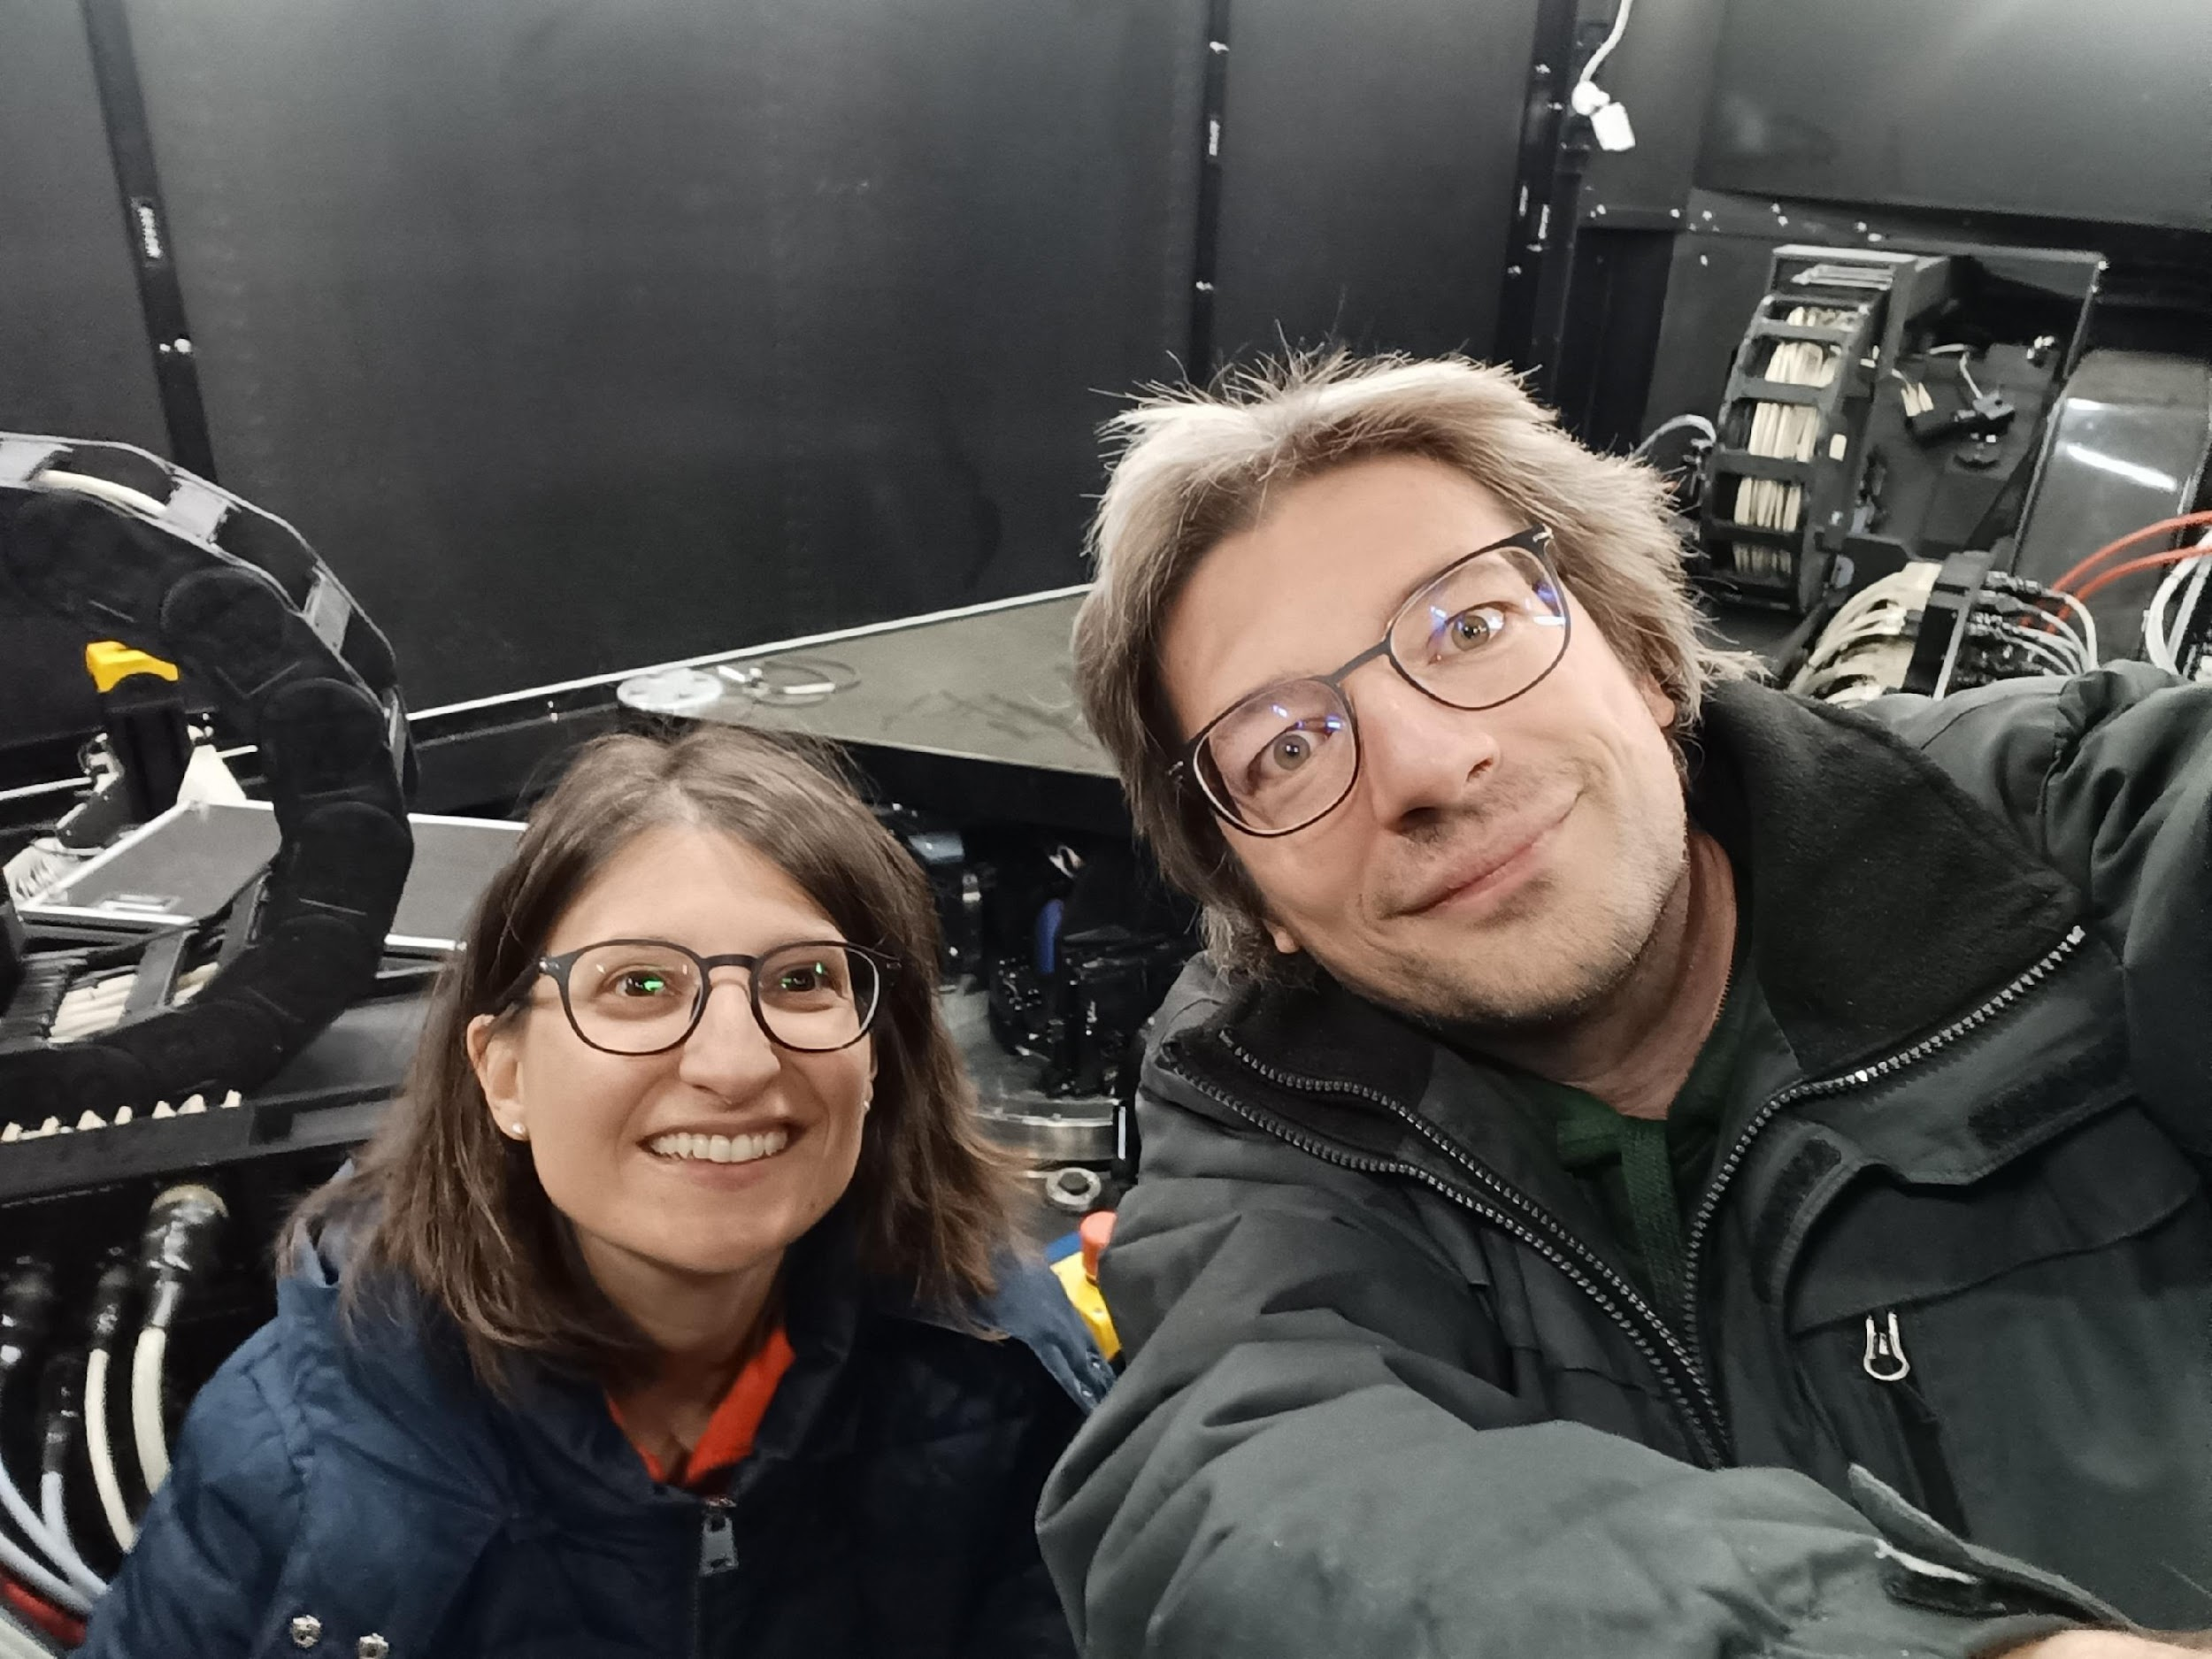
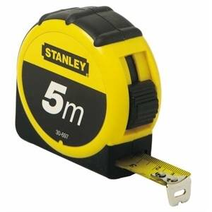
NirvanaVIS travels at LBT with STILES funding
Activities took place in 2024 and 2025 in order to:
Take actual measurements at LBT in order to consolidate a mechanical design to allow reduced time for installation
Perform daytime GLAO tests at LBT installing a light-source into the retro-reflector structure
Speckle imaging testing at Asiago with an Halpha filter and use of dedicated routines for PSF reconstruction
Participation to conferences to present NirvanaVIS
16-18/03/26
Workshop STILES - Risultati e prospettive future
NIRVANA-VIS

Slide 16
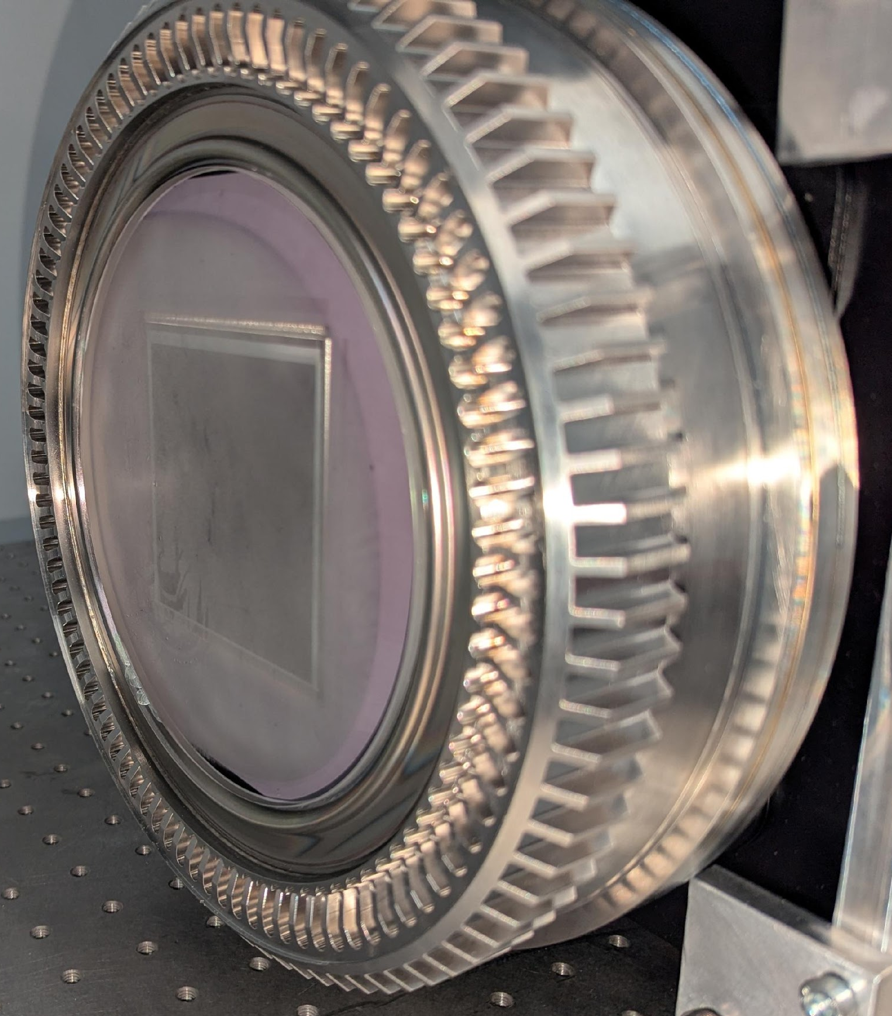
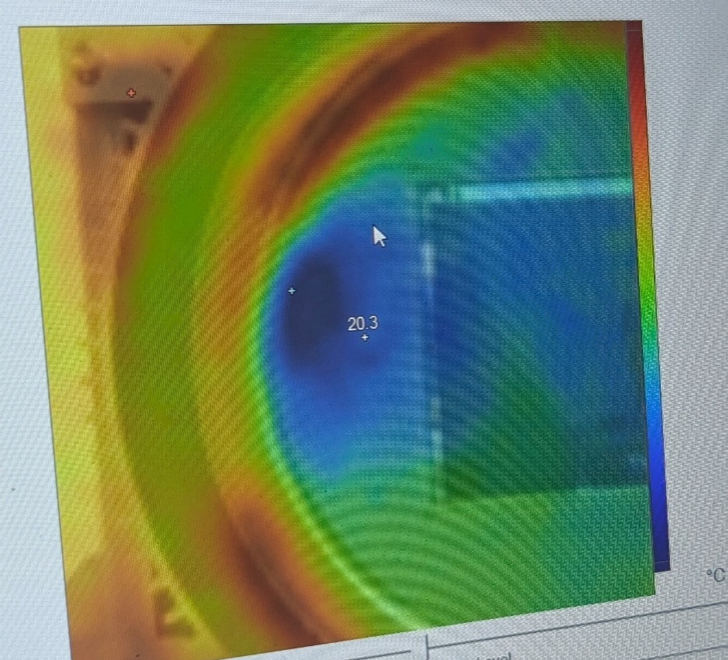
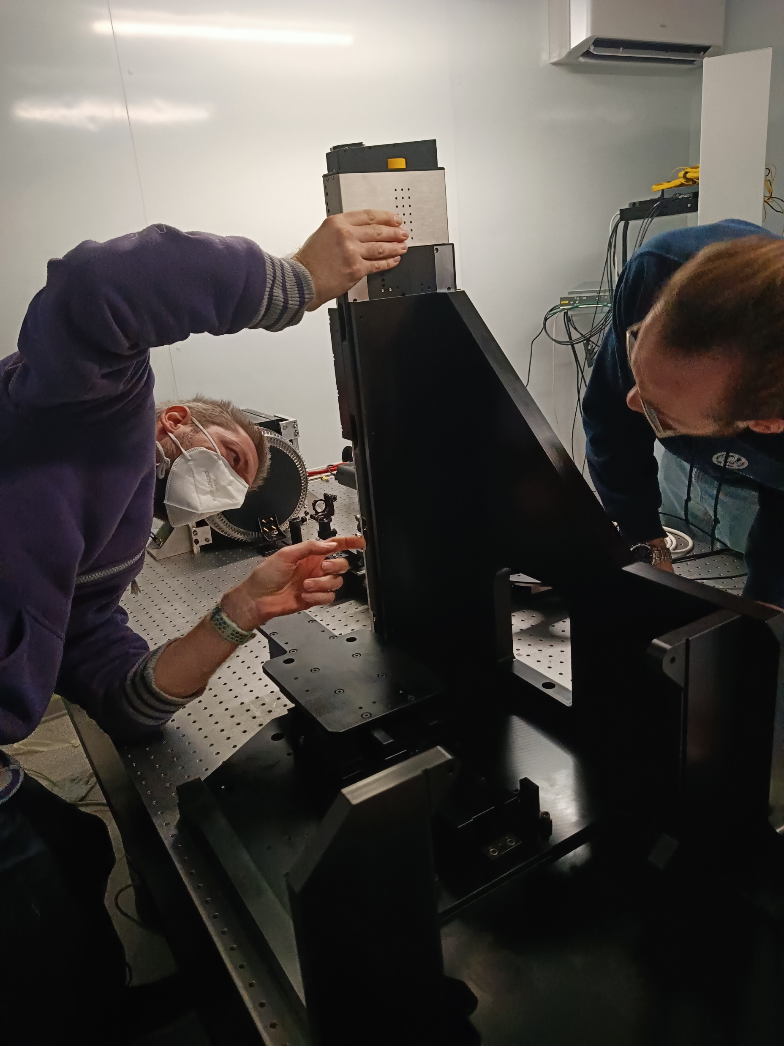


NirvanaVIS main activities
Consolidation of the opto-mechanical design, including required simulations, ahead of procurement
Preparation of a dedicate NirvanaVIS proposal for upgrades at LBT (August 2024 call)
Thourough detector characterization (camera was sent back for repair, due to vacuum leak causing window condensation):
  Linearity (issues in low ADU regime identified by Layden et al. 2025 confirmed)
  Bad pixels map
  Dark current
  Random telegraph Signal: not detected
  Gain
  RON
Opto-mechanical interface verification
AIV of the opto-mechanics (current phase: alignment of the
components to the optical-axis)
Day-time testing of the LN hardware and of the GLAO system
16-18/03/26
Workshop STILES - Risultati e prospettive future
NIRVANA-VIS

Slide 17


NirvanaVIS next steps
Lab tests: completion of AIV, including flexure tests
LBT tests: further GLAO testing daytime (and possibly night-time) and NCPA
correction strategy implementation
Definition of a review with LBT ahead of shipment
Consolidation of data reduction pipeline and science cases
Adaptation of the LN software to include the use of new hardware
First light estimated in 2027
16-18/03/26
Workshop STILES - Risultati e prospettive future
NIRVANA-VIS

Slide 18

16-18/03/26
Workshop STILES - Risultati e prospettive future
NIRVANA-VIS

Slide 19
Extra slides

Slide 20

NirvanaVIS detector characterization
Thourough detector characterization (camera was sent back for repair, due to vacuum leak causing window condensation):
  Linearity (issues in low ADU regime identified by Layden et al. 2025 confirmed)
  Bad pixels map
  Dark current
  pattern due to amplifier glow involving approx. 20-25 rows at the bottom of the camera
  0.12 ± 0.01 e⁻/s in central 8020x8020 pixels 🡪double when applying linearity corrections
  Random telegraph Signal: not detected
  Gain: using the mean-variance method on full range, increasing exposure time
  1.02 e⁻/ADU (measured) vs 0.85 e⁻/ADU (characterization report)
  RON: temporal std across 1000 frames
  1.60 ± 0.04 ADU 🡪 1.63 ± 0.04 e⁻

Slide 21
NirvanaVIS speckle holography
AO-assisted speckle holography
Short-exposure images to capture instantaneous atmospheric distortions
GLAO to enhance image sharpness​, reduce speckle number and increase their brightness and the coherence time, to provide a more uniformly corrected FoV for multiple bright calibrating stars used for PSF calibration, to enable more precise deconvolution
Post-processing to reconstruct diffraction-limited images through Lucky imaging and via phase and amplitude retrieval techniques (Bispectrum analysis, holographic speckle imaging), using reference PSF estimation from AO telemetry

Slide 22


