Slide 1
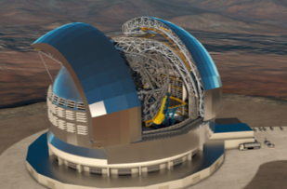
STILES
6801/2-5811
Realization of two new laboratories for acceptance and qualification of analog for low frequency RF systems and the integration of cryogenic high frequency receivers.
16th -18th March 2026
Jader Monari, Manuela Naldi, Germano Bianchi, Federico Perini, Marco Poloni, Alice Bosi, Rosy Poerio, Gianluca Solinas

Slide 2
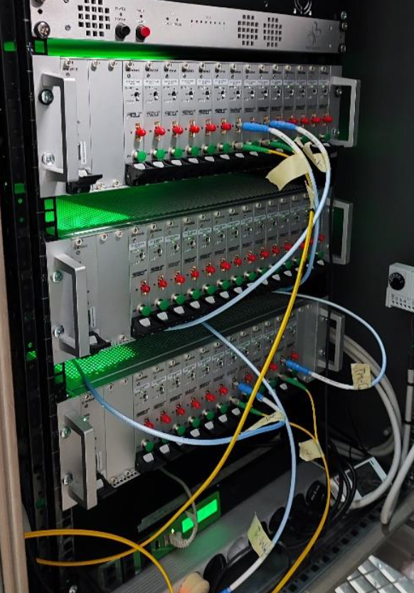
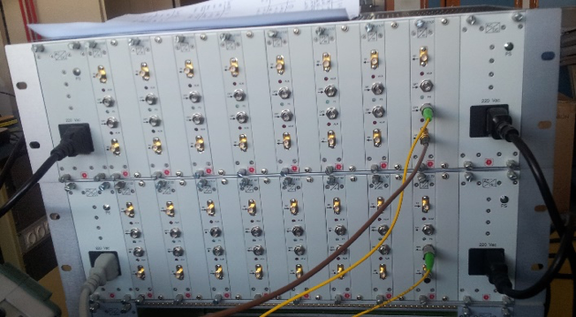
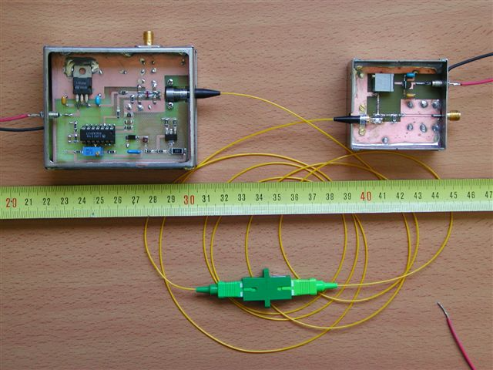
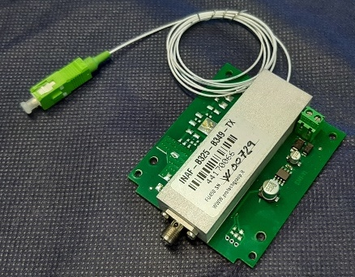
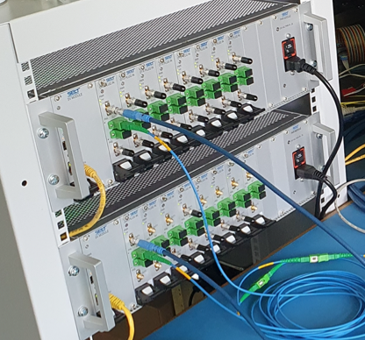
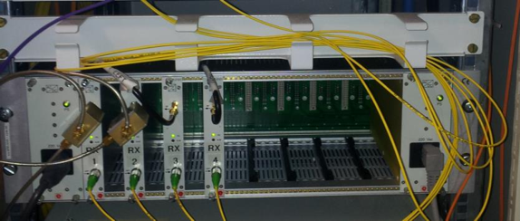
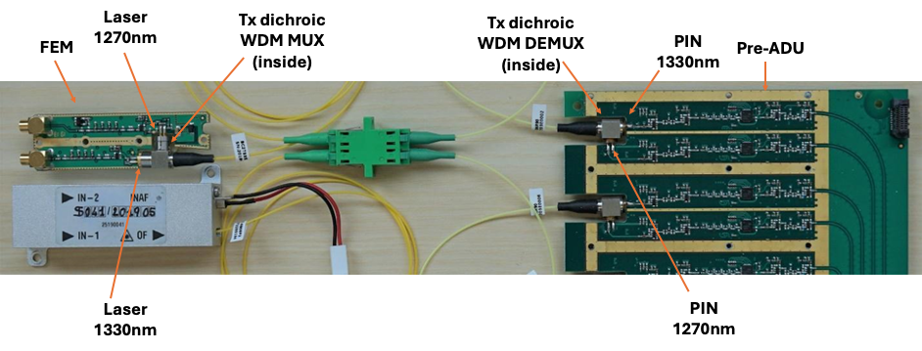
Background – IRA expertise in RFoF → 6802
1st proto Rfof link BEST (2004)
500MHz Northern Cross (2013)
Multifeed K-band (2015)
18GHz –SRT (2025)
SKAlow (2016-today)
4GHz SRT (2022)
2 GHz IF Medicina VLBI Antenna (2013)

Slide 3
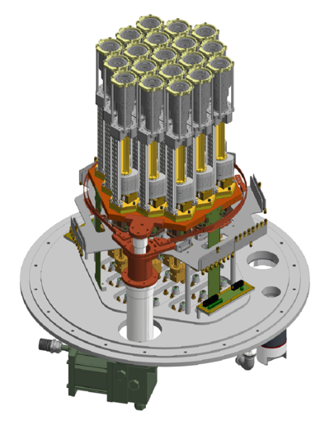
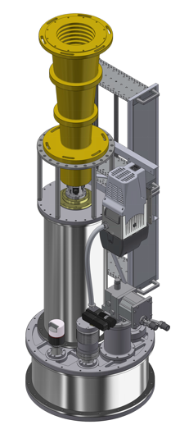
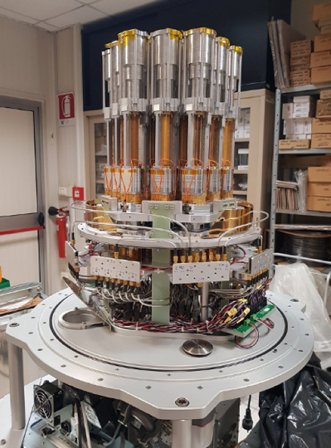
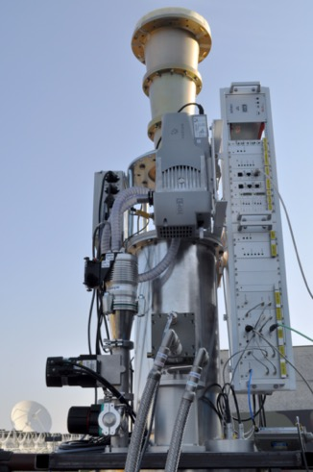
Background – IRA expertise in Cryo-receivers integration → 5811
The staff of the Stazione di Medicina plays a key role in the development of receivers for national and international radio telescopes. Most of the receivers installed also come from Medicina on the Noto dish and on the Sardinia Radio Telescope (SRT).
Ricevitore in banda Q (32 GHz) con 19 feed
Ricevitore in banda C-high (7 GHz) per SRT

Slide 4
Objective of the project
Construction of two technologically advanced laboratories of national relevance and significance. The laboratories will be established at the Medicina Radio Astronomical Station and will be named:
“Laboratory for Acceptance and Qualification of Analog (over fiber and over coax) and Digital Electronics for Low-Frequency RF Systems”
“Integration/Verification Laboratory for High-Frequency Cryogenic Radio Receivers.”
RENOVATION AND ENERGY EFFICIENCY OF THE MECHANICAL, AIR CONDITIONING AND VENTILATION SYSTEMS OF THE MAIN BUILDING

Slide 5
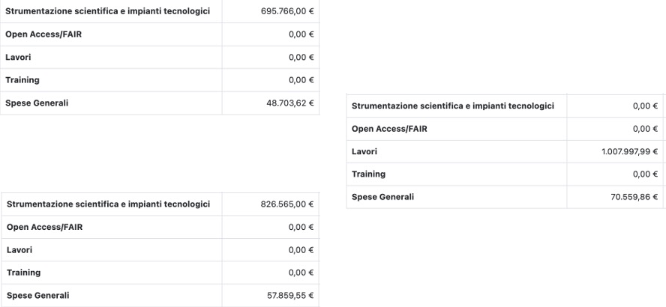
Work Packages
6802
6801
5811

Slide 6
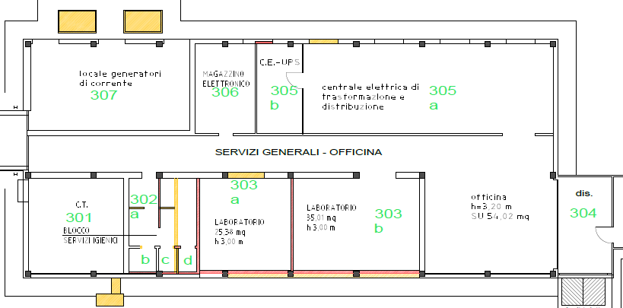
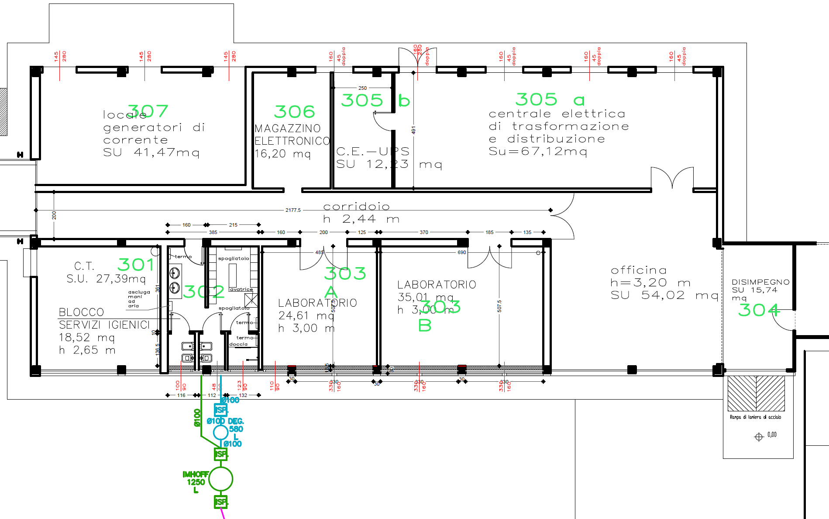
Civil works

Slide 7
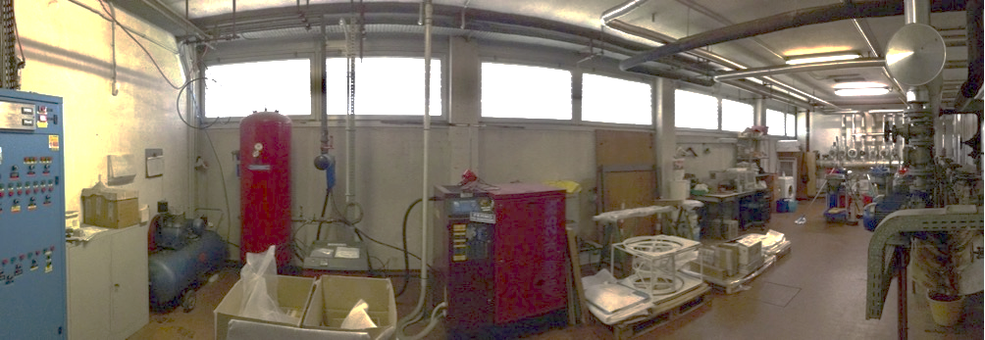
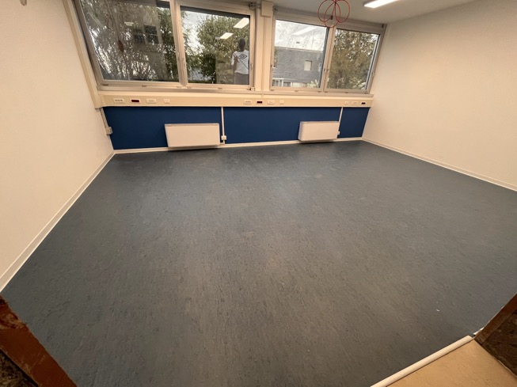
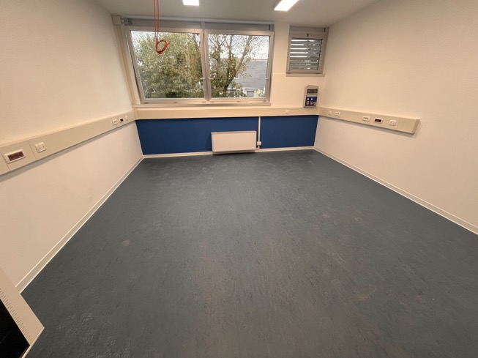
Renovation of the west block
Before
After

Slide 8
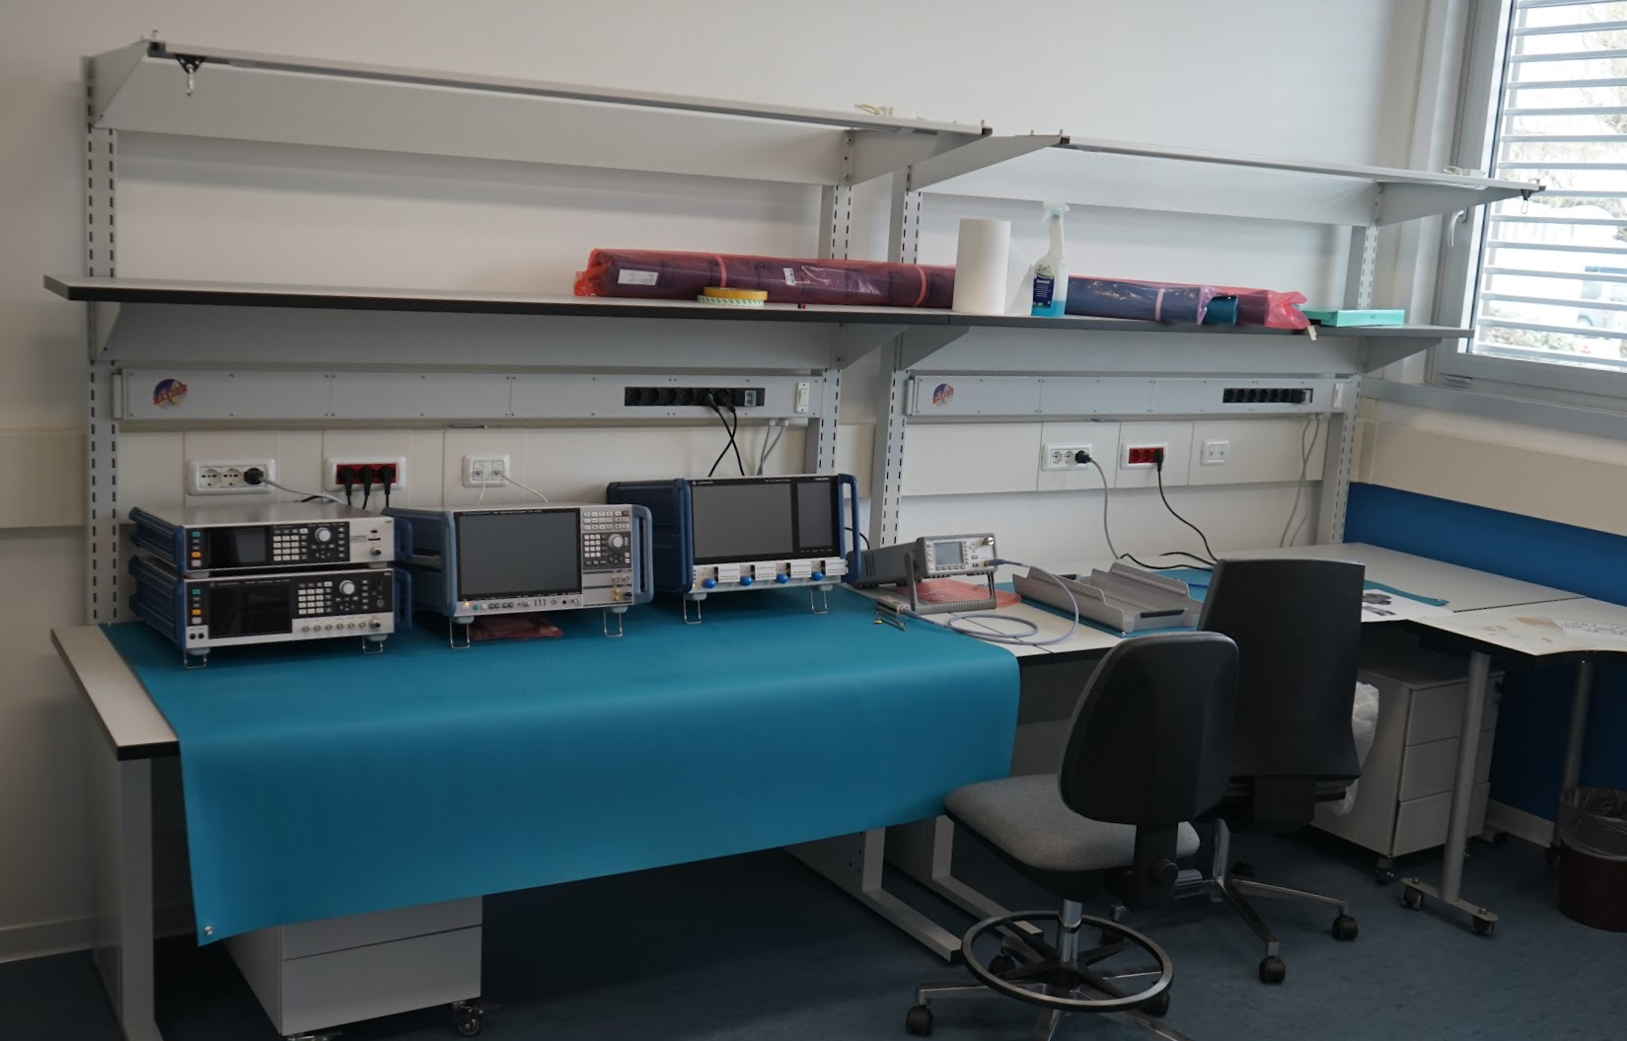
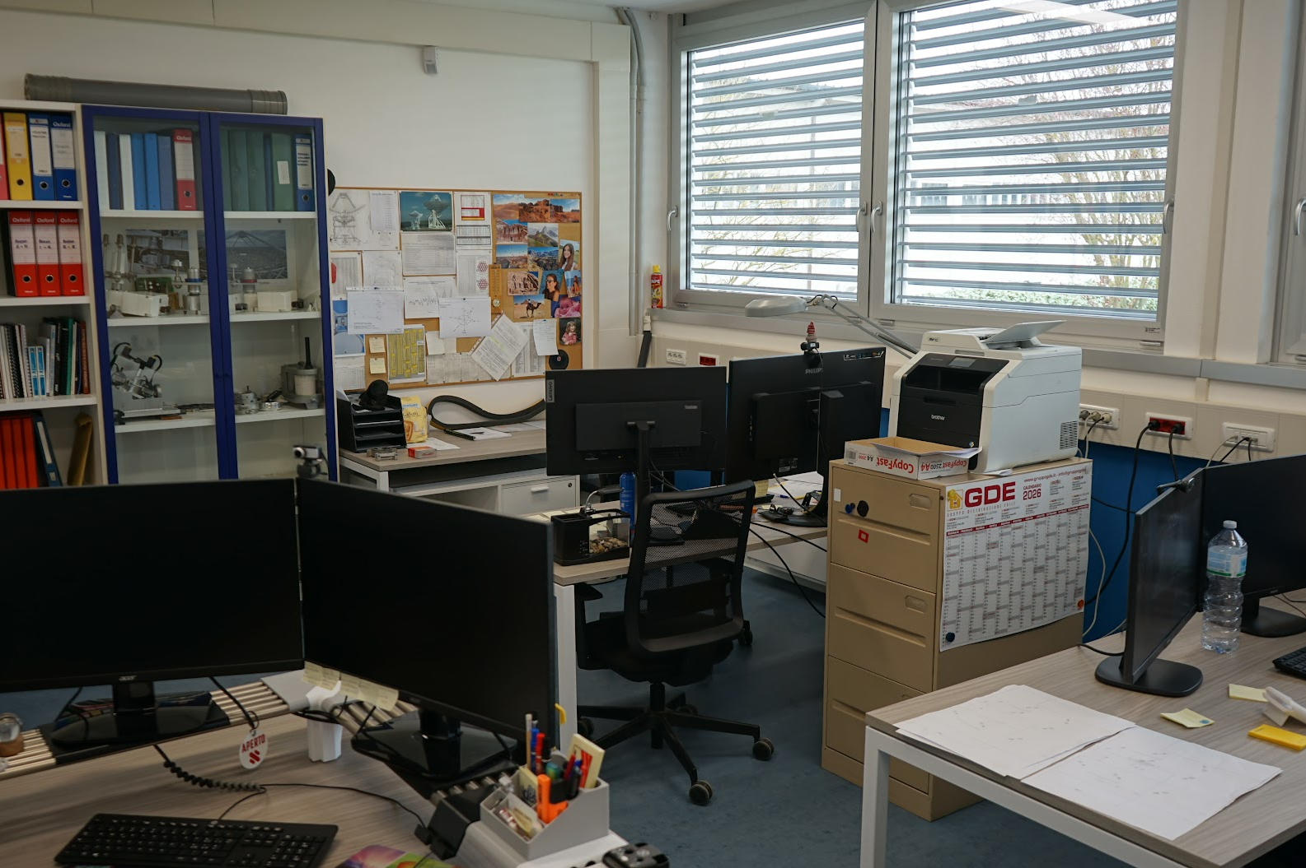
New laboratories

Slide 9
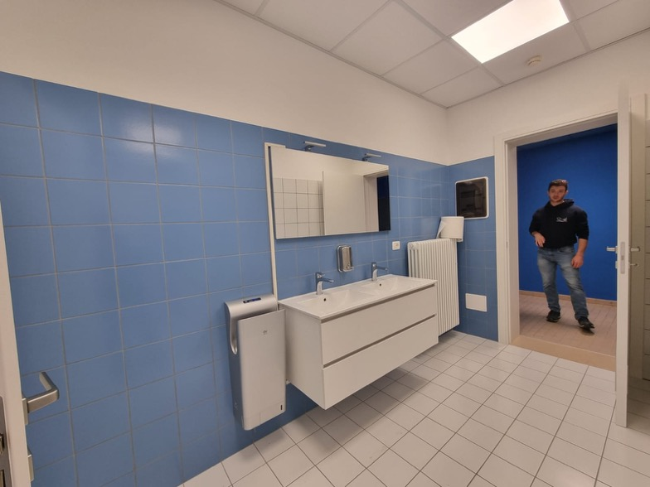
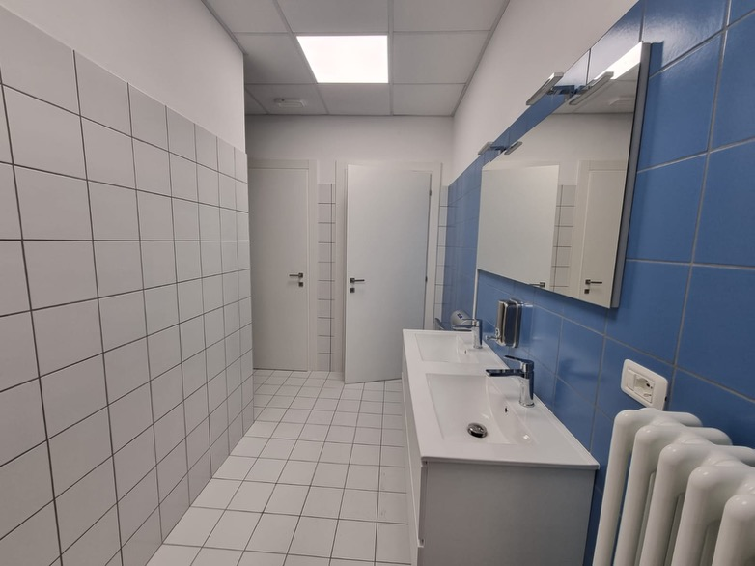
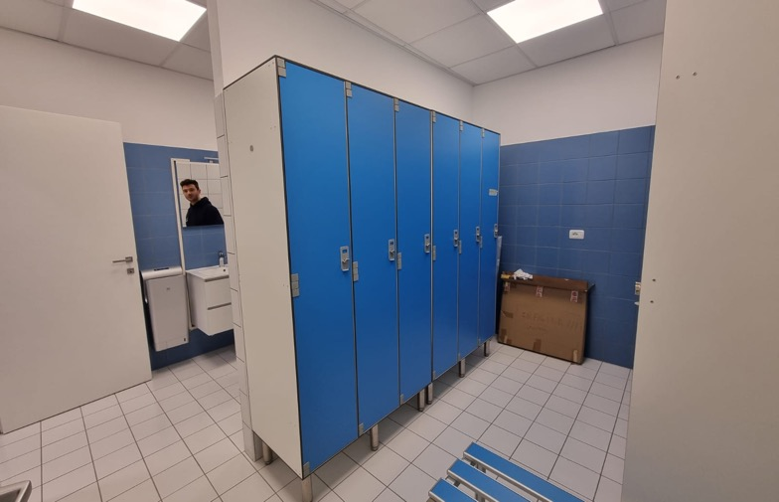
New toilets block C

Slide 10
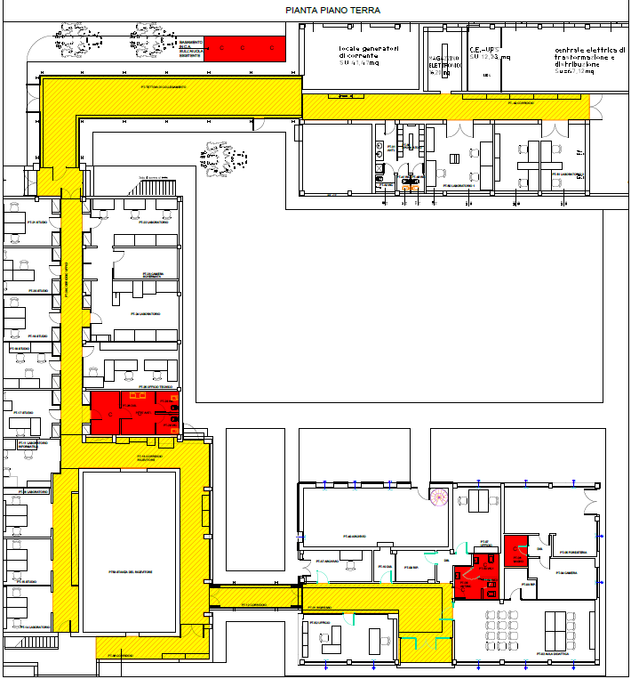
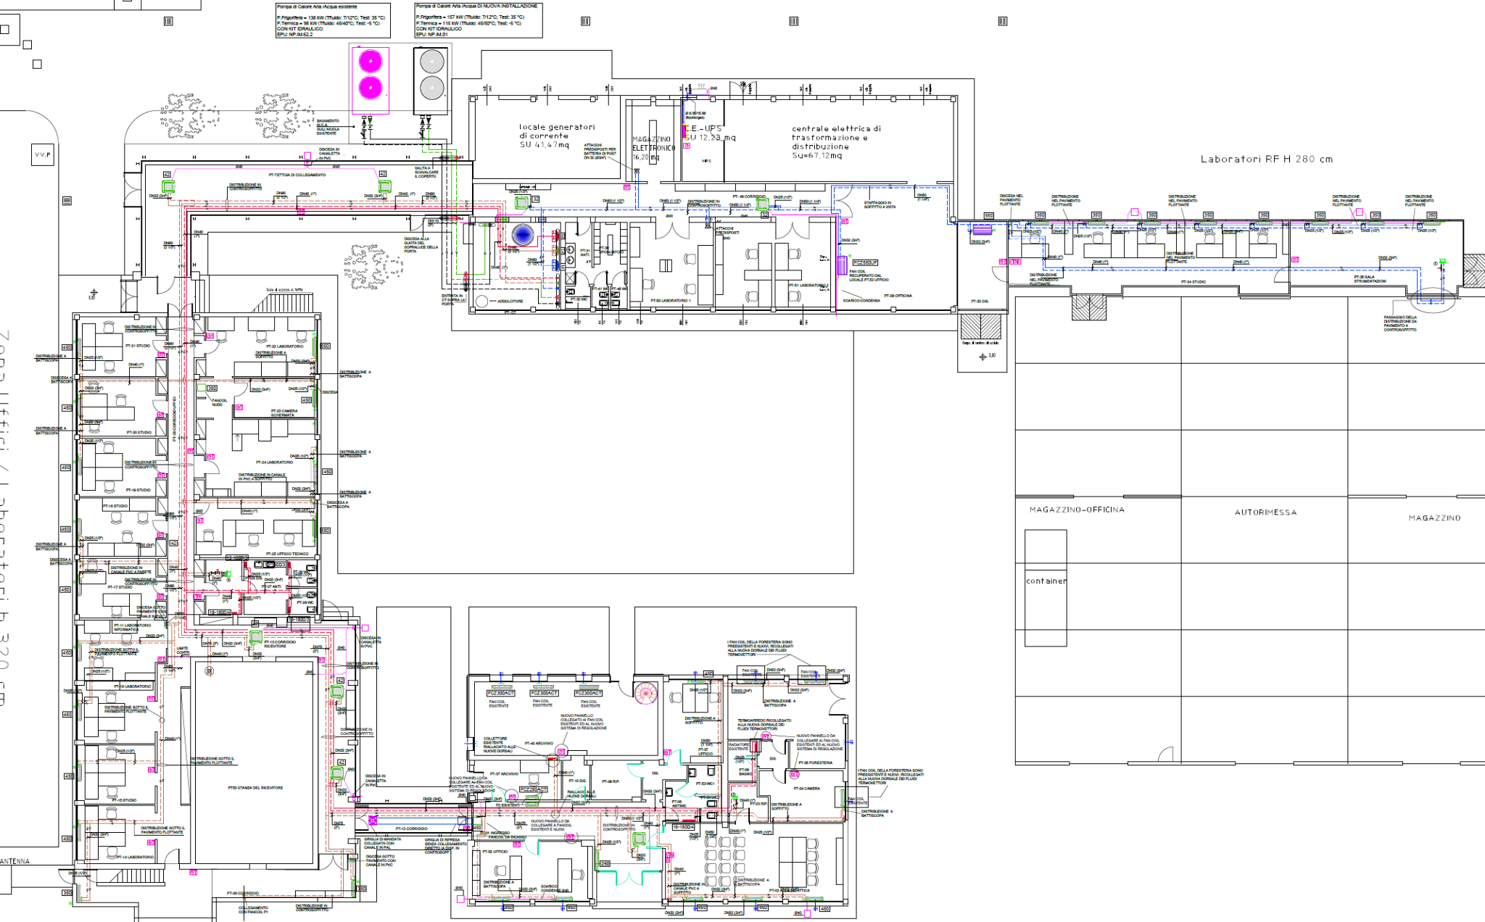
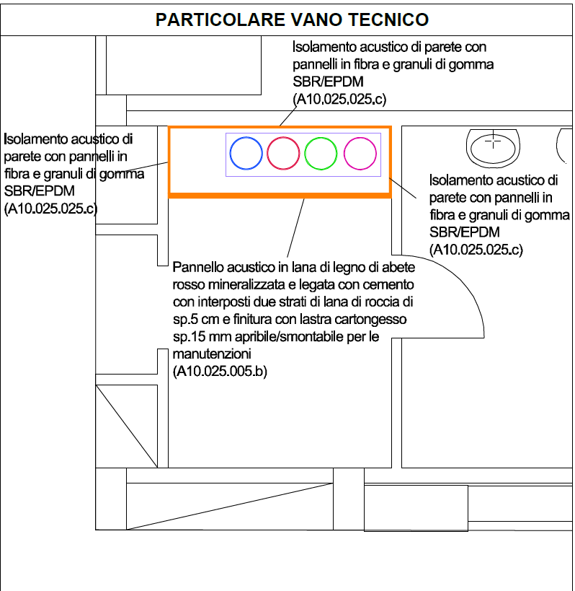
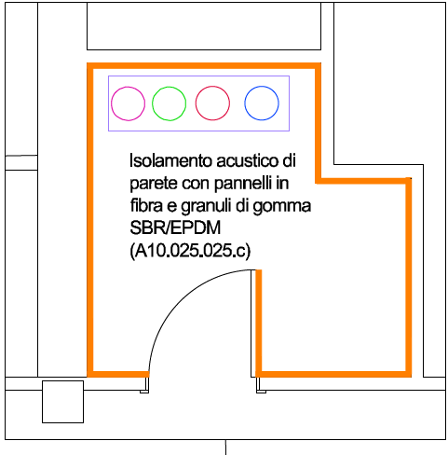
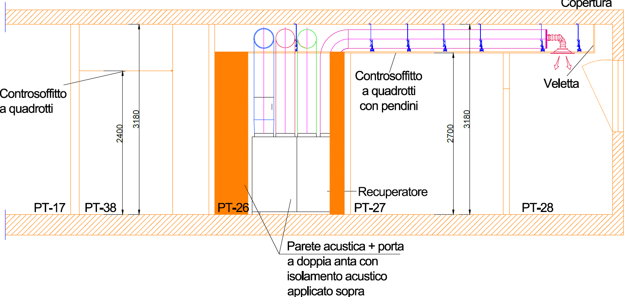
Renovation and energy efficiency of the mechanical, air conditioning and ventilation system of the main building

Slide 11
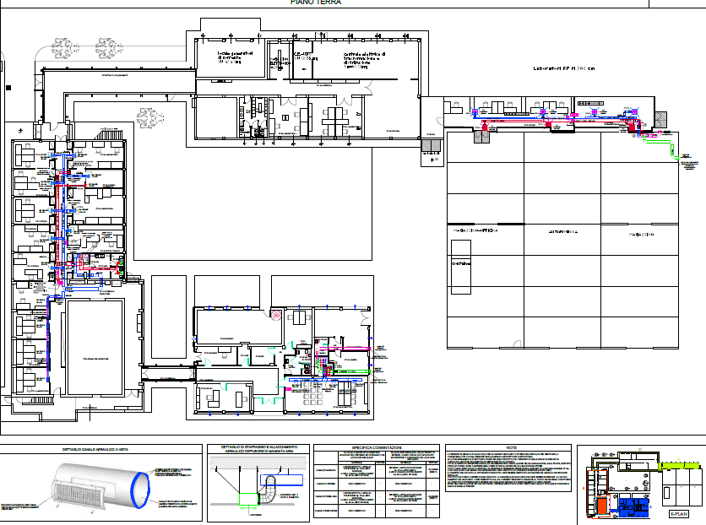

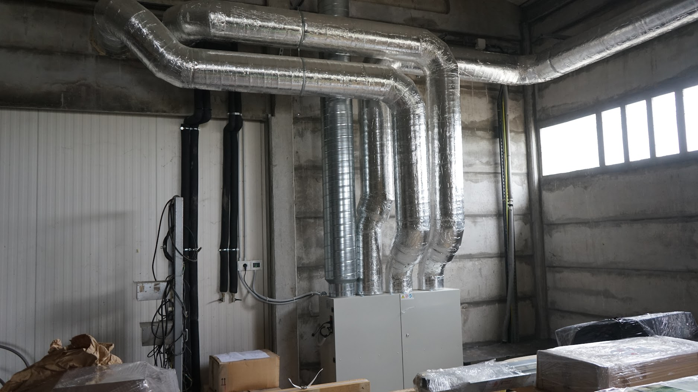
Ventilation system

Slide 12
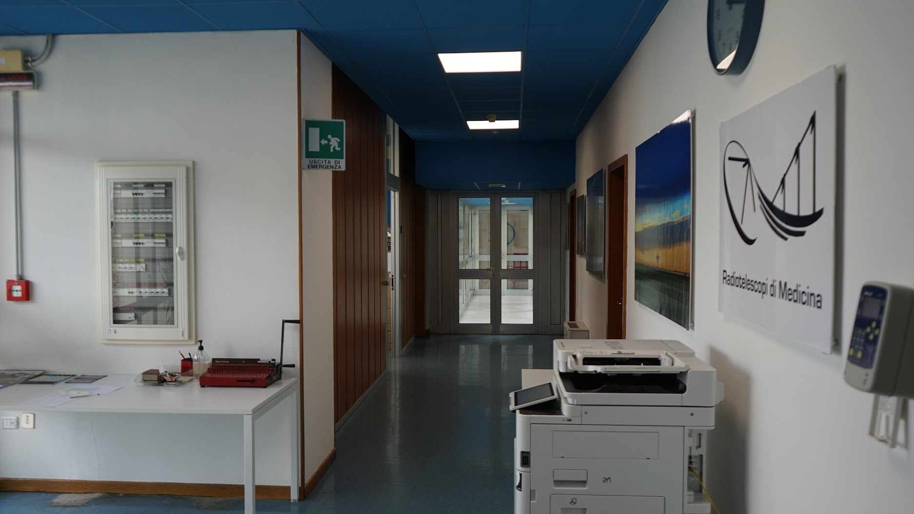
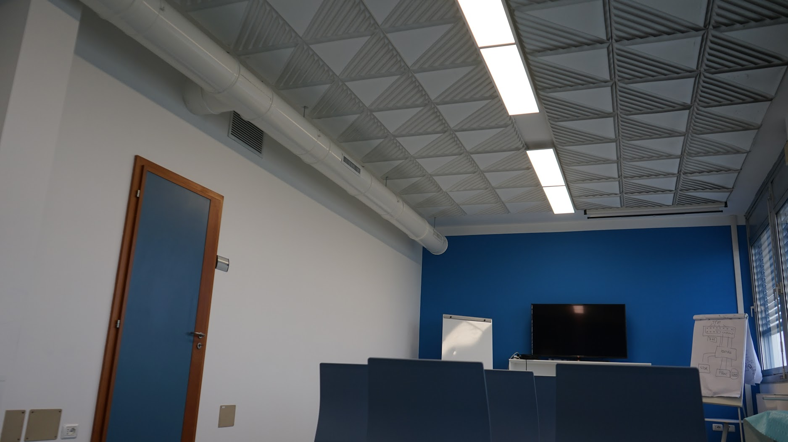
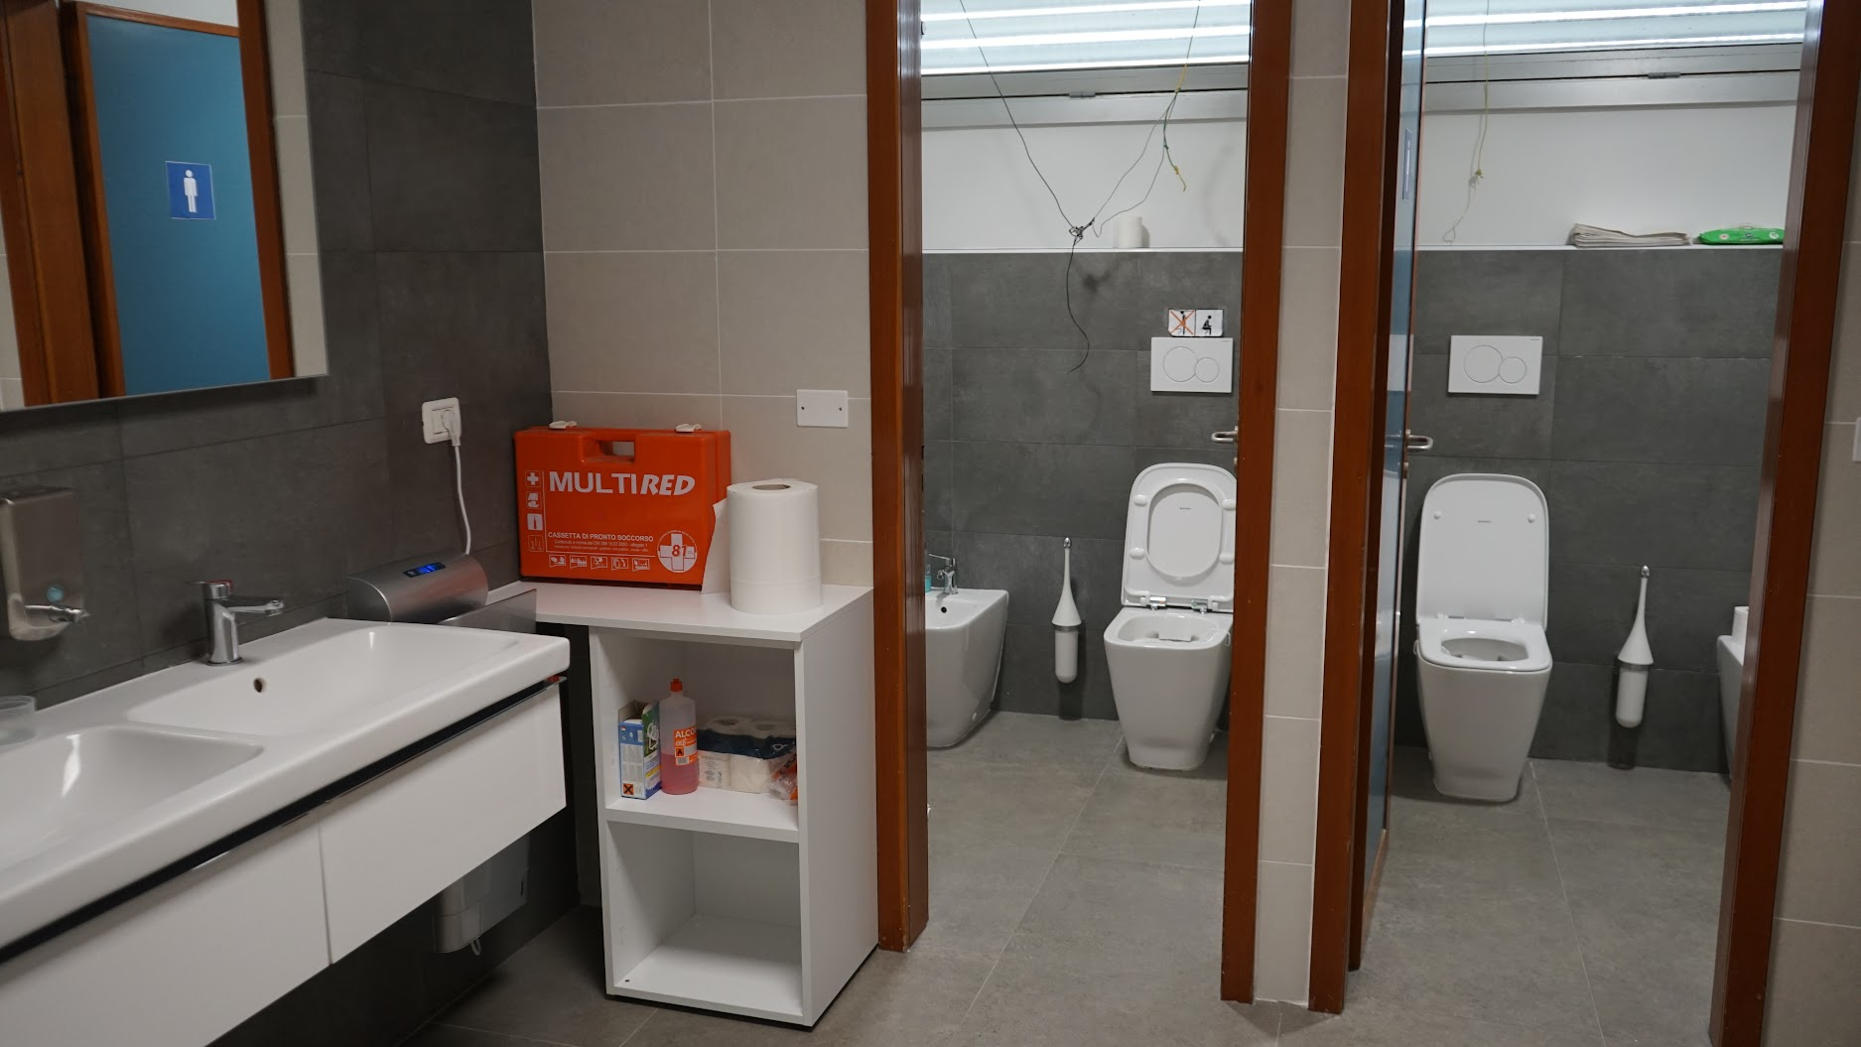
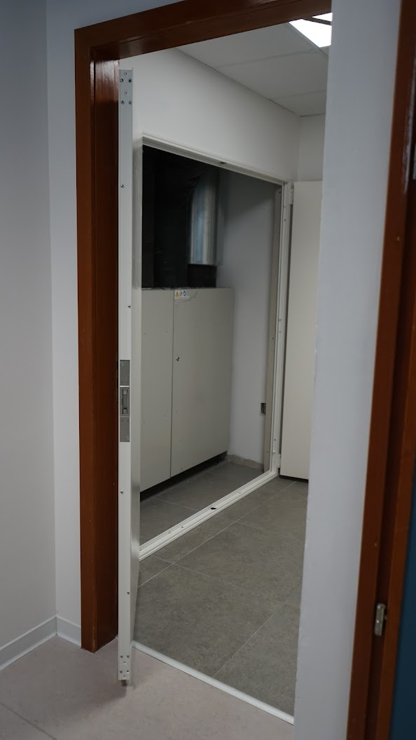
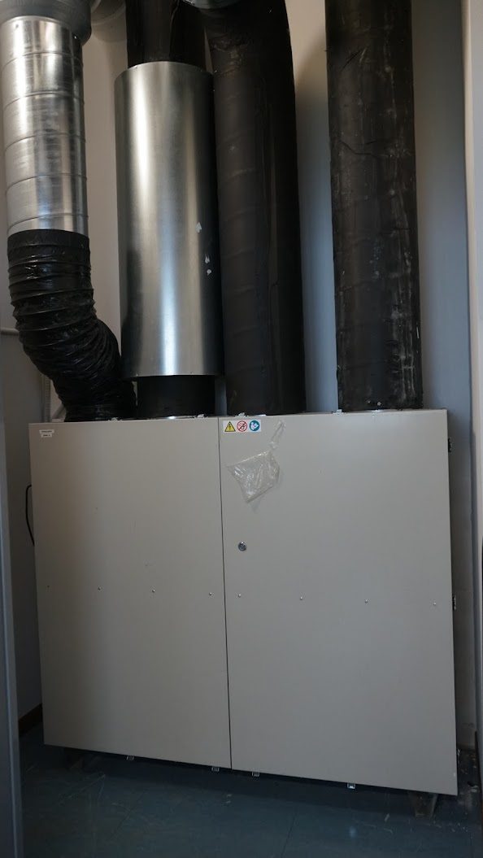

Slide 13
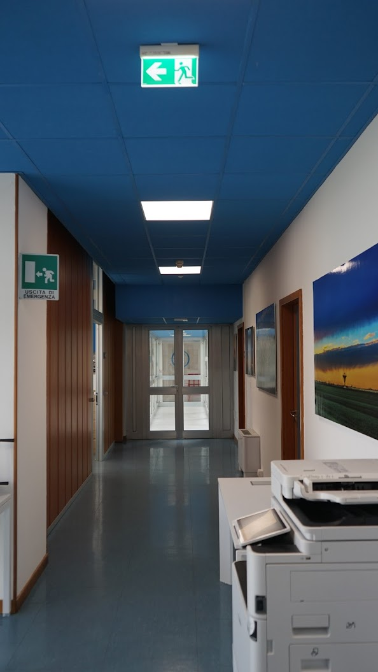
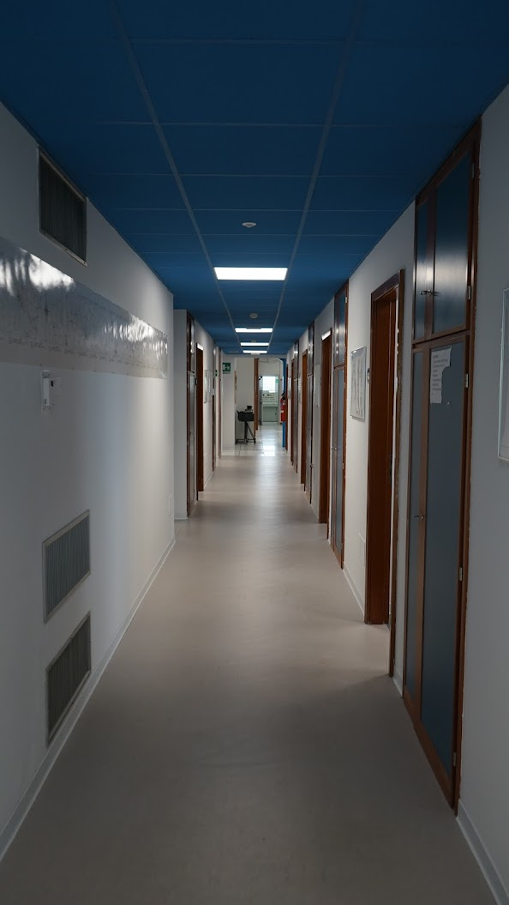
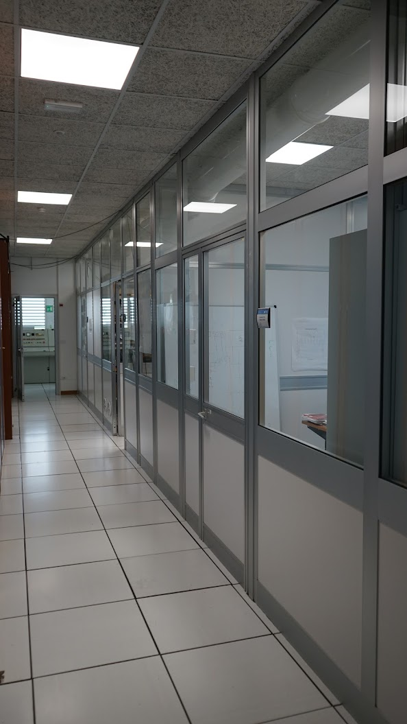
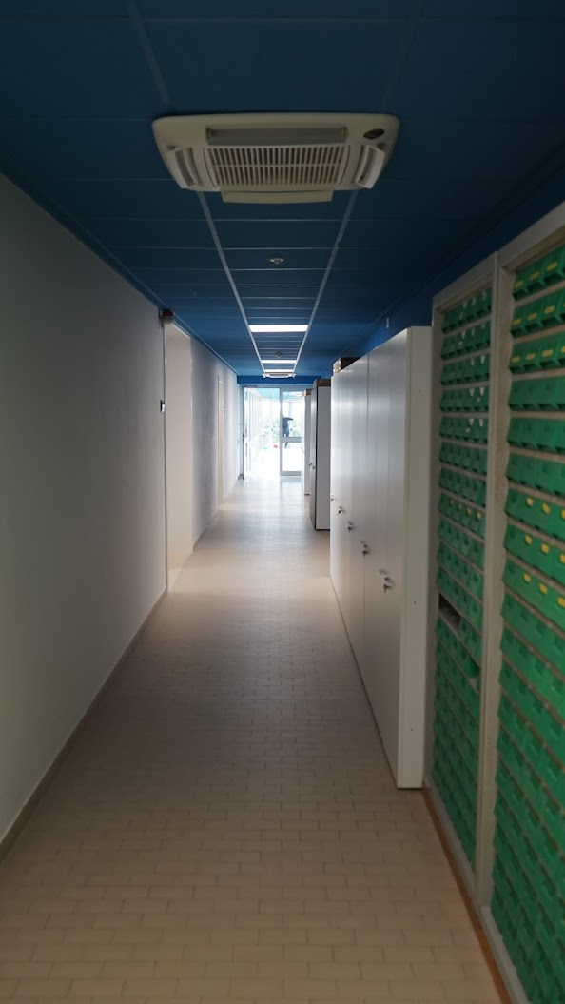
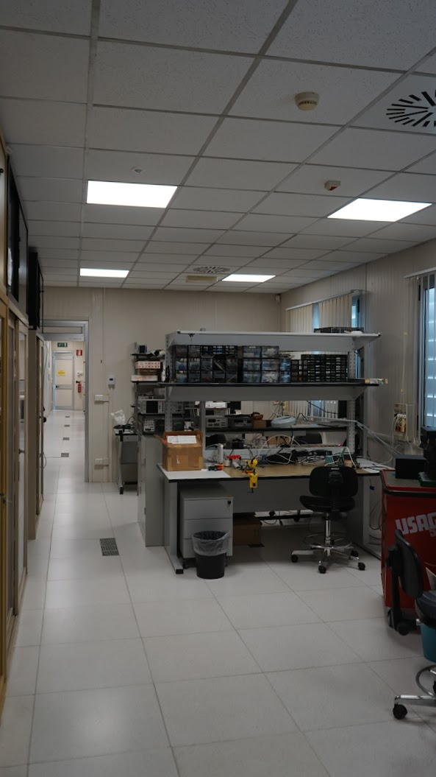
Block A
Block B
Block C
Block D

Slide 14
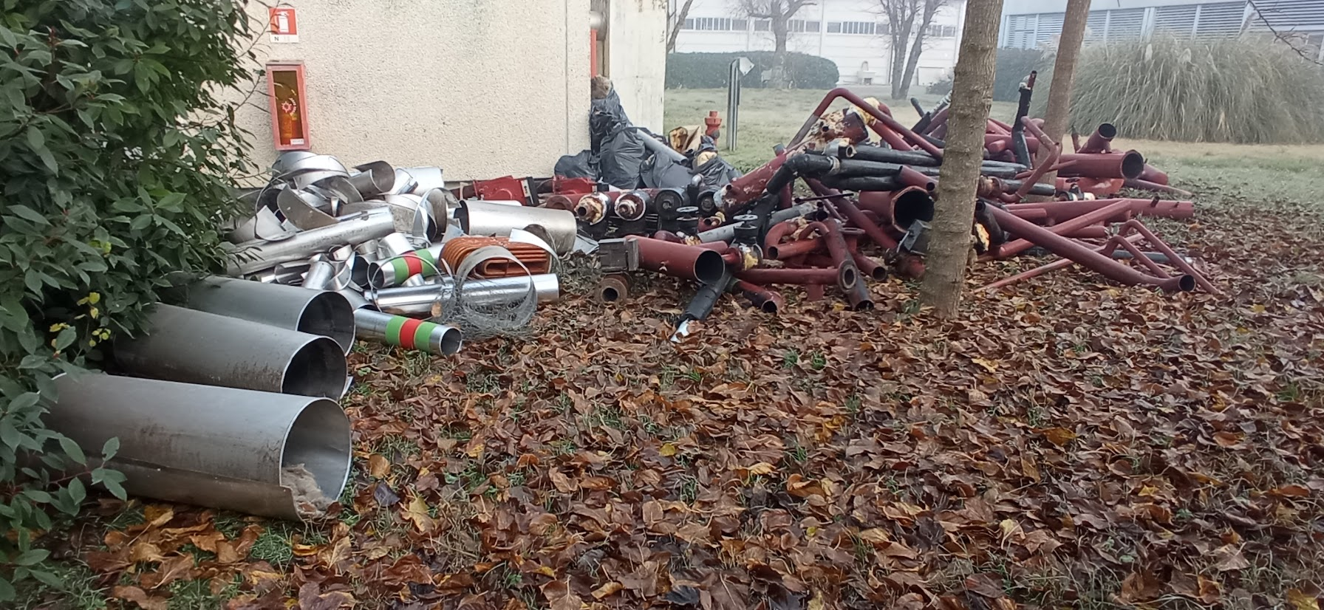
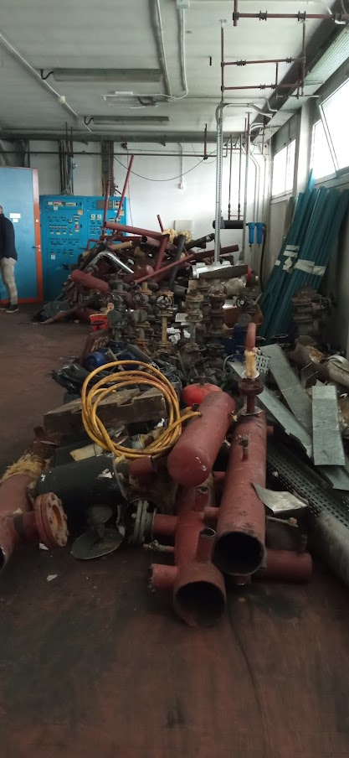
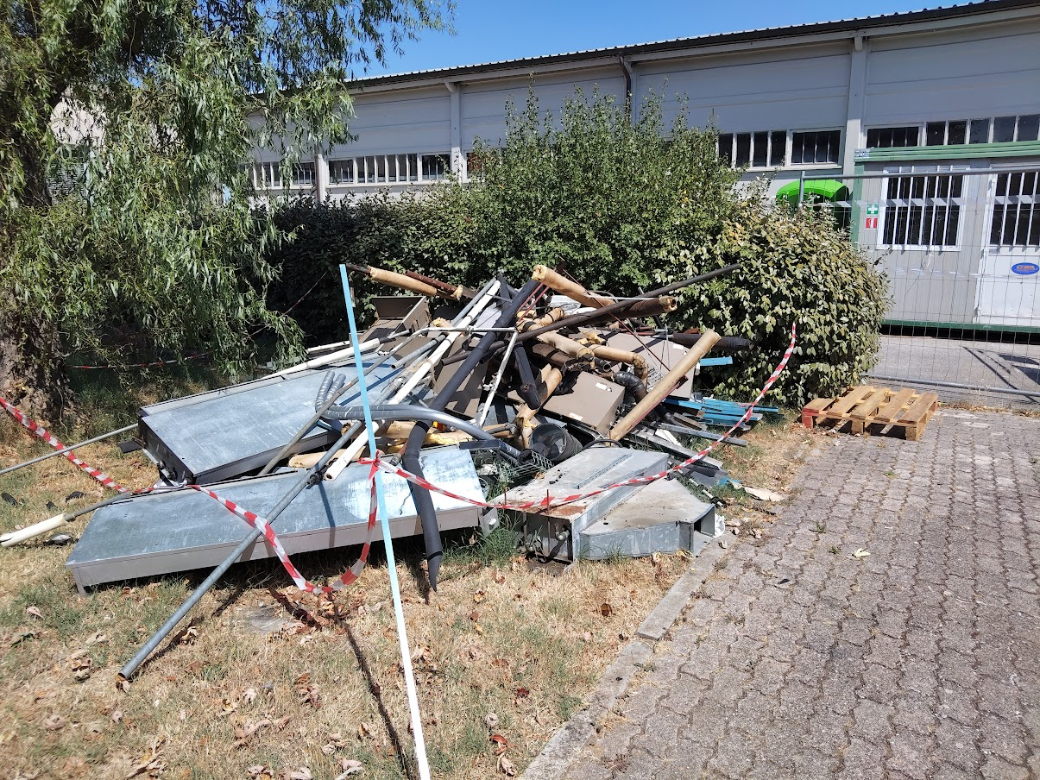
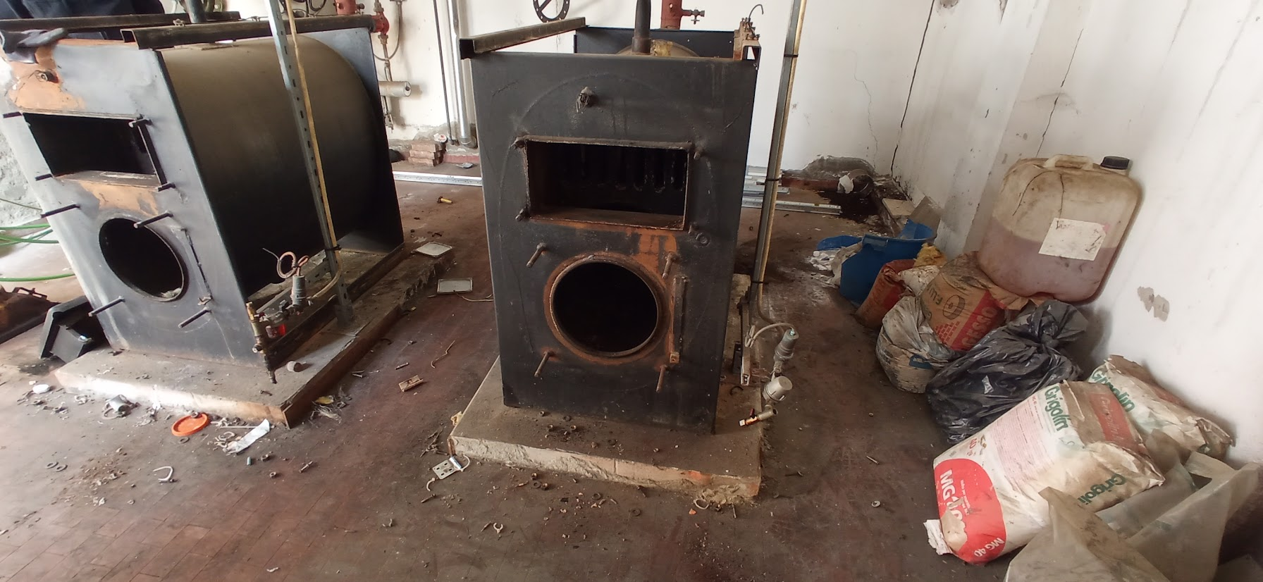
Dismantling operations

Slide 15
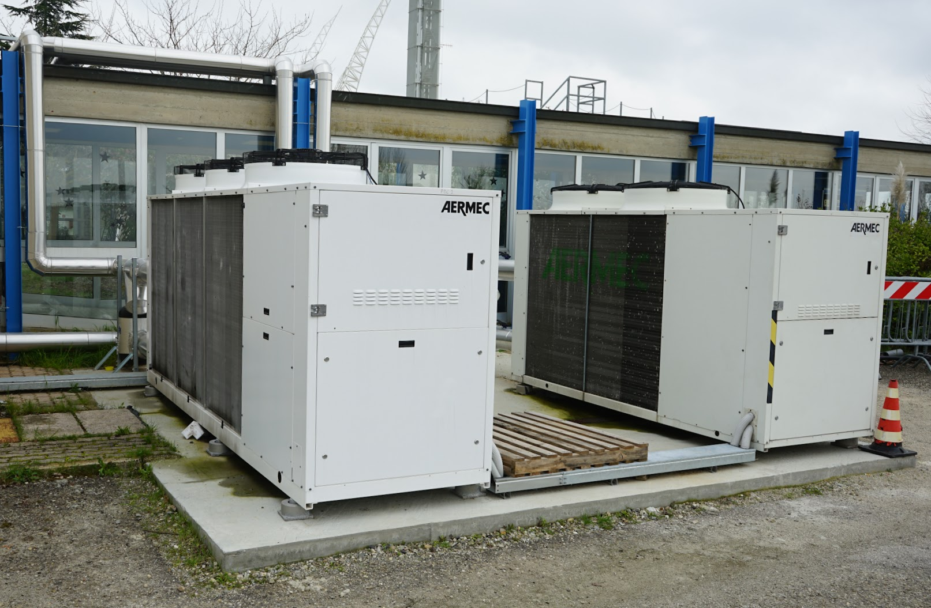
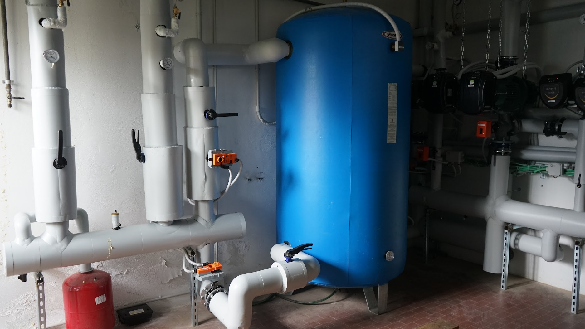
New heat pump / power plant

Slide 16
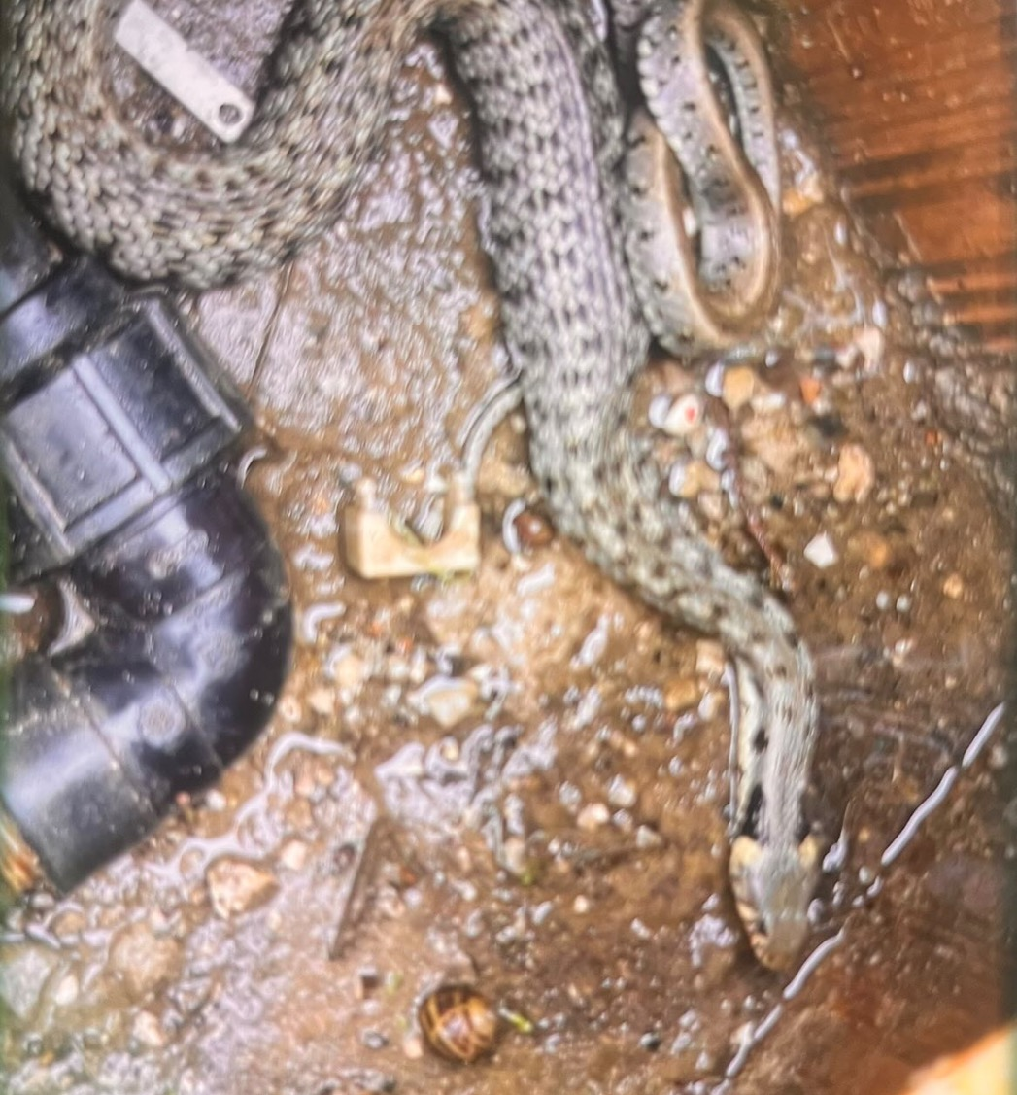
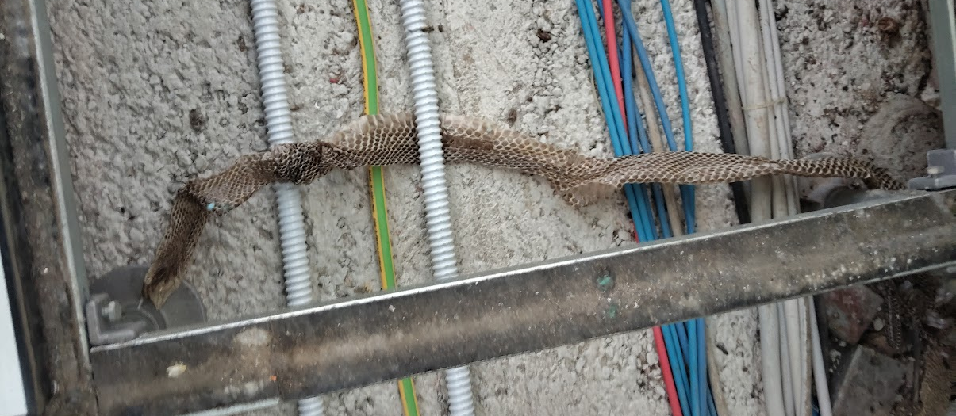
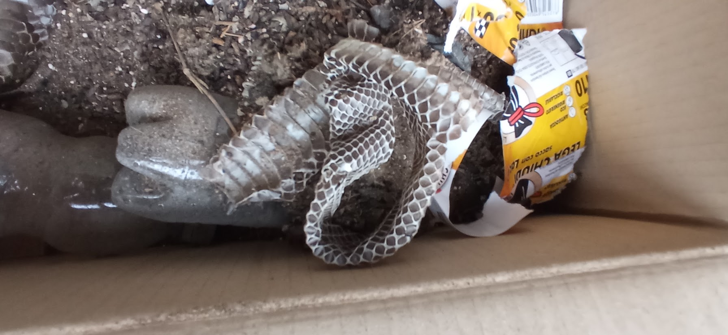
Unexpected ”friends”

Slide 17
Criticalities in the activity 6801
Very tiring start-up, particularly at the initial stage... * There was no planned procedure on civil/construction works and acquisition procedures, which were also subject to the constraints dictated by the PNRR. * Need to acquire the Executive Project essential for the start of tenders and subsequent execution of works and to be aware of the estimated metric calculation and consequently of the amount of the tender amount.--> use of external funds to speed up the timing. * Need for a resource of professional personnel to follow all the phases of the intervention... fortunately Manuela arrived because the Technical Table was leeeento to respond. * Need to find auxiliary contracting authorities because INAF was not qualified -->Agreement with CUC of the NCI for the completion of the calls for tenders ABSOLUTE resource.
During the work even more tiring... * Despite the THREE-phase planning for the renovation, the coexistence and inconveniences were MANY. * Deadlines NEVER respected by companies (at least 4 rescheduling). * Field invasions that have created discontent... But in the end we got there
Today... A renovated and healthy main building * Many details still need to be perfected and some parts damaged as the company did not take enough precautions during the work. * We have a new system, certainly more functional and performing than in the past (previous system now collapsing) even if not yet perfectly tuned in terms of temperature regulation. * The waterproofing of the roof of the body was redone Where there were infiltrations before, the floor of body B was redone (with other bottoms) and almost all the rooms were painted internally

Slide 18
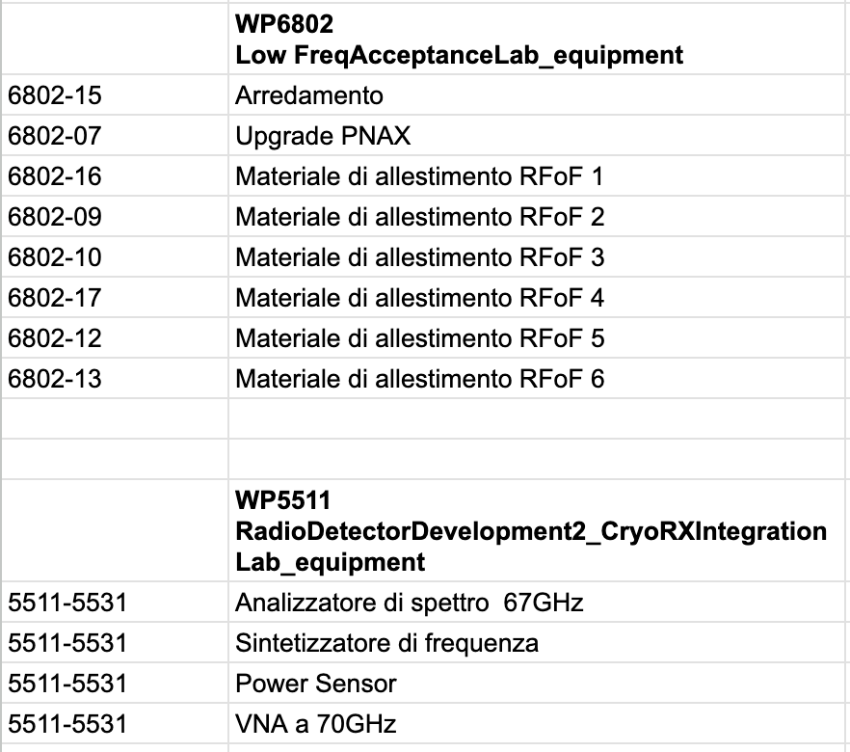
Purchasing instrumentation
Direct order
Merged tender with Catania

Slide 19








Slide 20




Instruments for RFoF laboratory acceptance/testing

Slide 21

Instruments for high frequency receivers integration/verification

Slide 22

Conclusion
To date, the station (which is about 40 years old) has been significantly renovated by redoing all infrastructure main plants and creating new spaces in the west area. The instrument set has also been revitalized in an essential way and in the most efficient way, considering the vision of the needs about 3 years ago.
Would you do it again? Was it worth it? The answers to these questions could be multiple and perhaps contradictory, they have certainly brought benefits, but in general the PNRR has absorbed so many human resources that they have necessarily been diverted from contributing to the main objective of our institution, i.e. research, the loss of opportunities or the << momentum >>on some important projects, including international ones.

