Slide 1
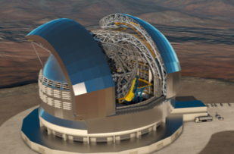
A new facility for AO technologies in the ELTs era
G. Di Rico
INAF - OA Abruzzo
March 18th, 2026
18/03/2026

Slide 2
The Need for a new infrastructure
ACT. 6401-6402: “Establish a national facility to support INAF leadership in international AO projects”
Important contributions in the last years (VLT-ERIS and ELT-MORFEO,…)
Integrated design, analyses, manufacturing and AIT capabilities
Young researchers, established strong INAF synergies, collaborations with many international groups
New challenges arising from current and future projects
Consolidate and enhance expertise & technical skills
Keep the momentum, meeting new technological challenges
for the next decades!
18/03/2026
STILES Workshop
Notes:
successful contributing to important international project

Slide 3
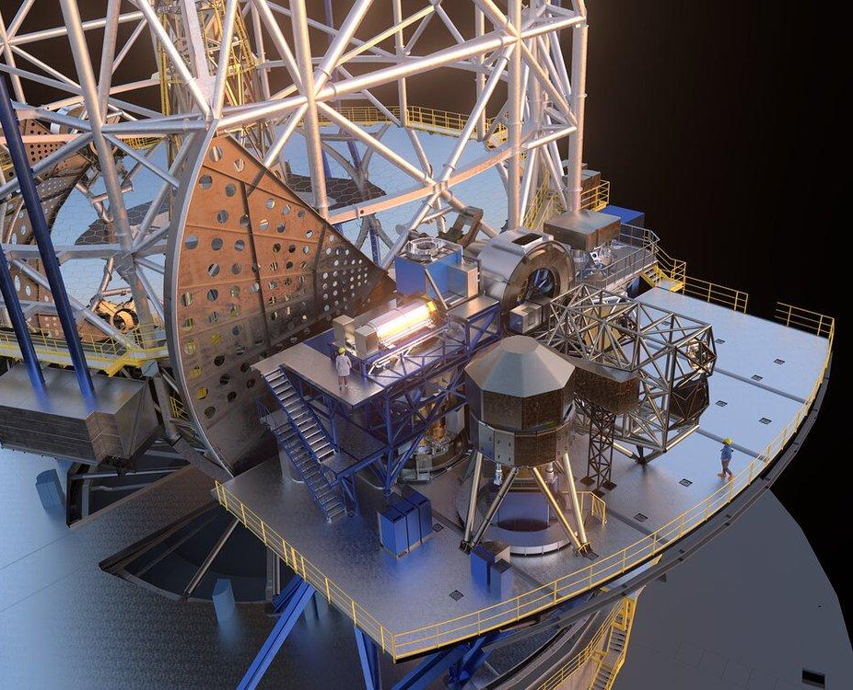
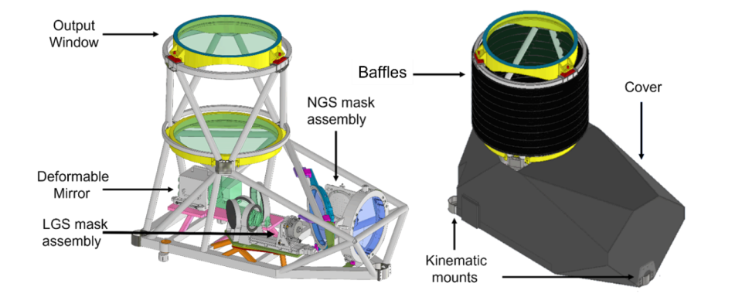
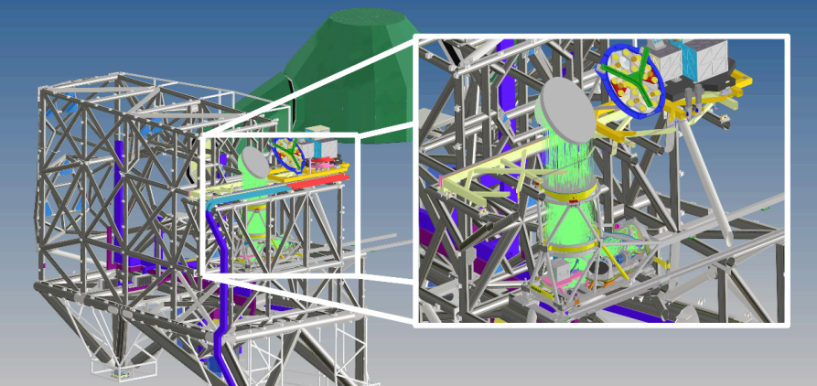
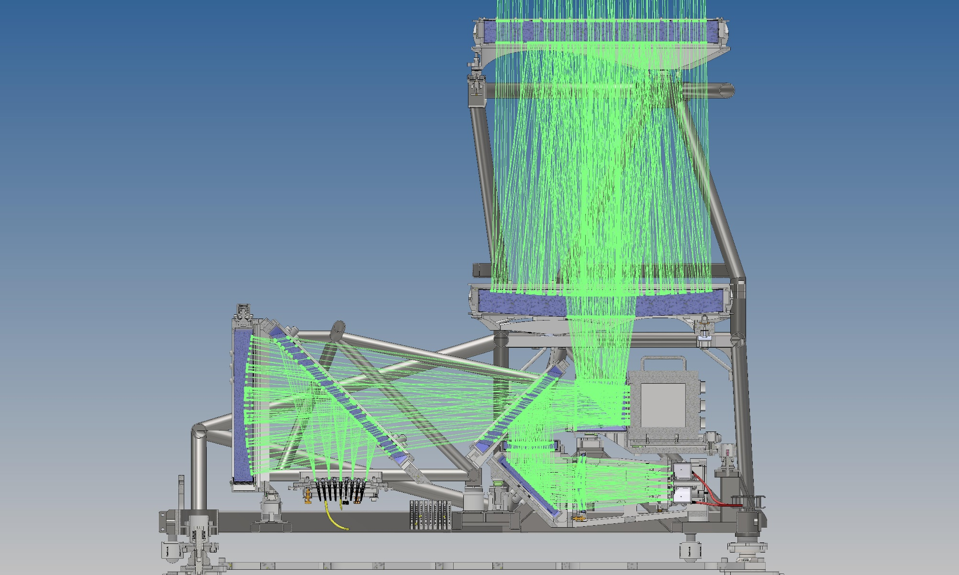

MORFEO - Calibration Unit

Slide 4
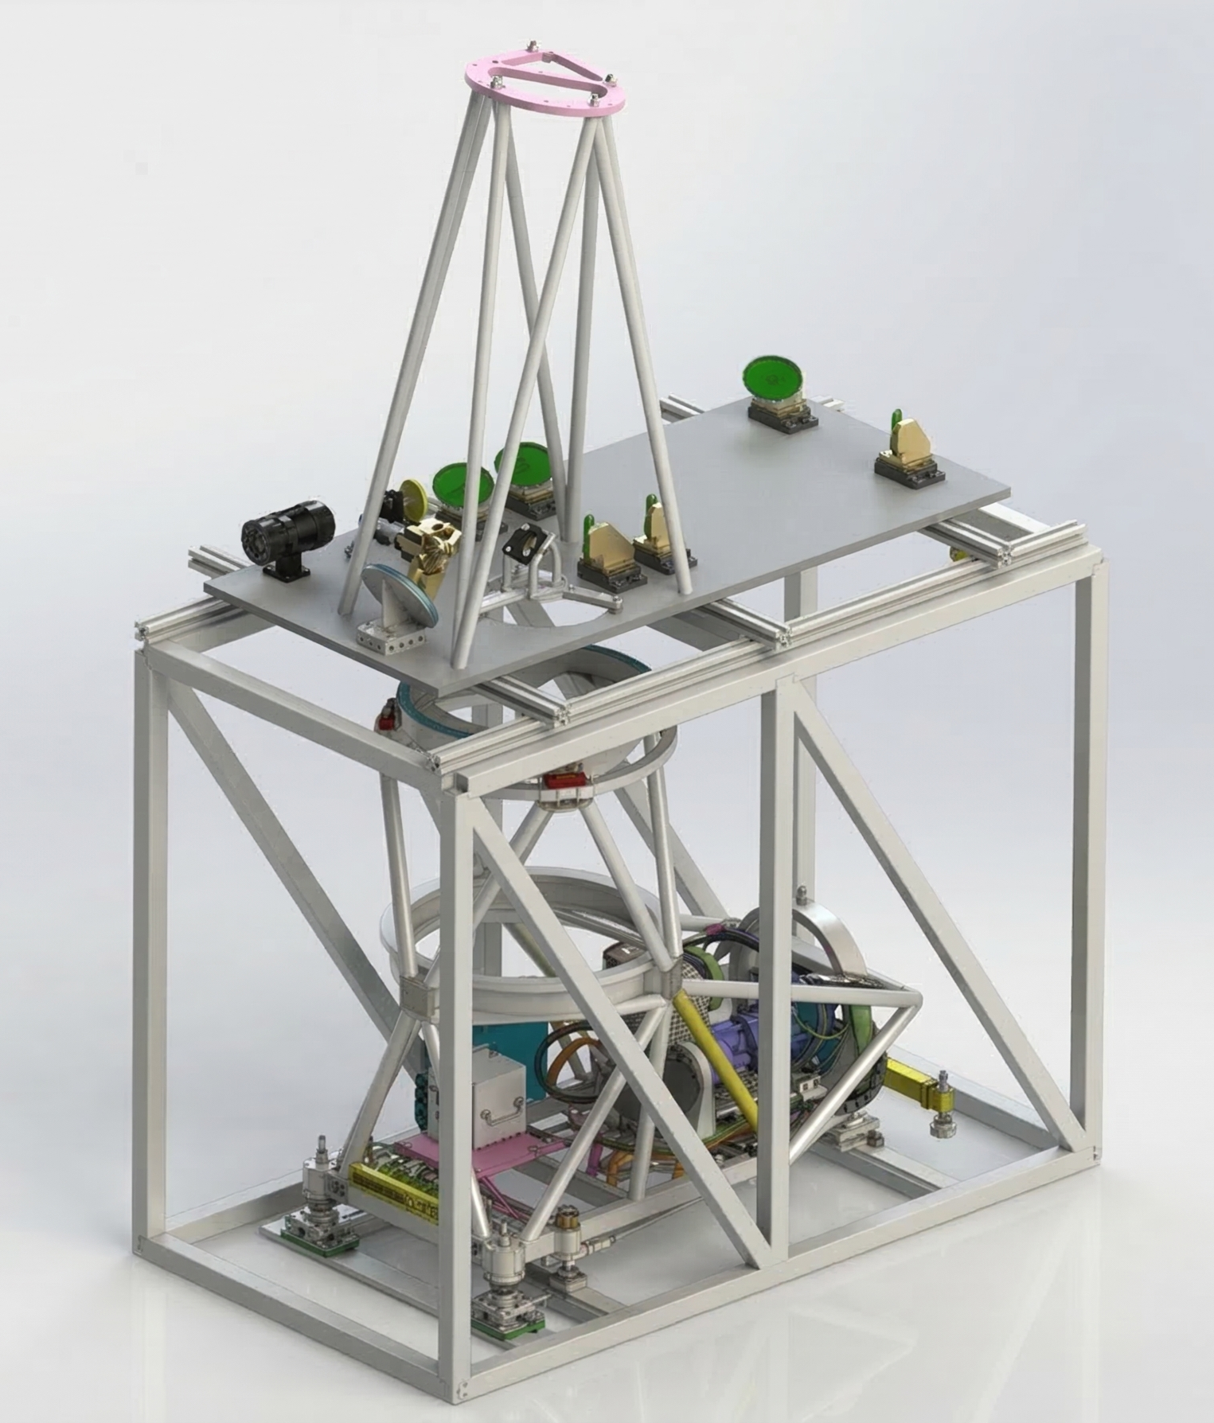
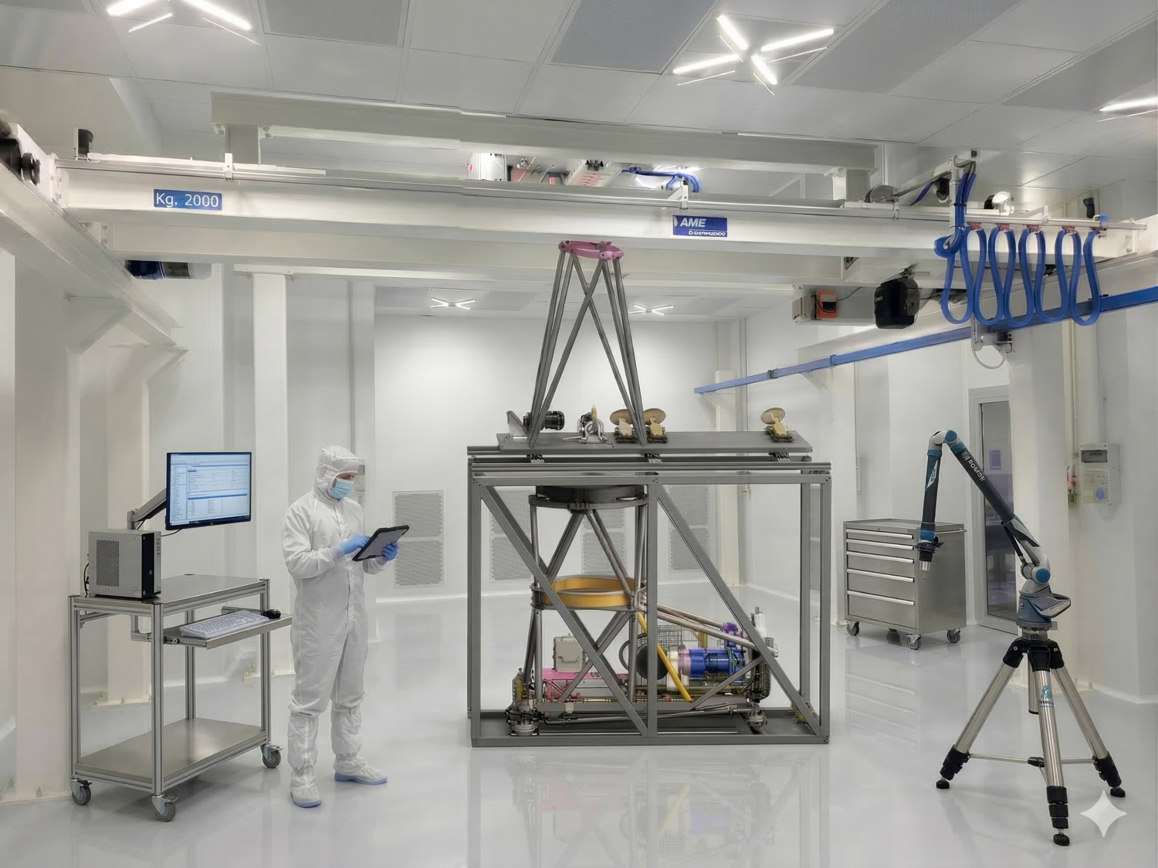
MORFEO-CU Test Equipment and metrology tools (MAIT phase)
CU (400kg) inside Test Equipment
Test Equipment : 2000 mm x 1200 mm x 3500 mm
18/03/2026

Slide 5


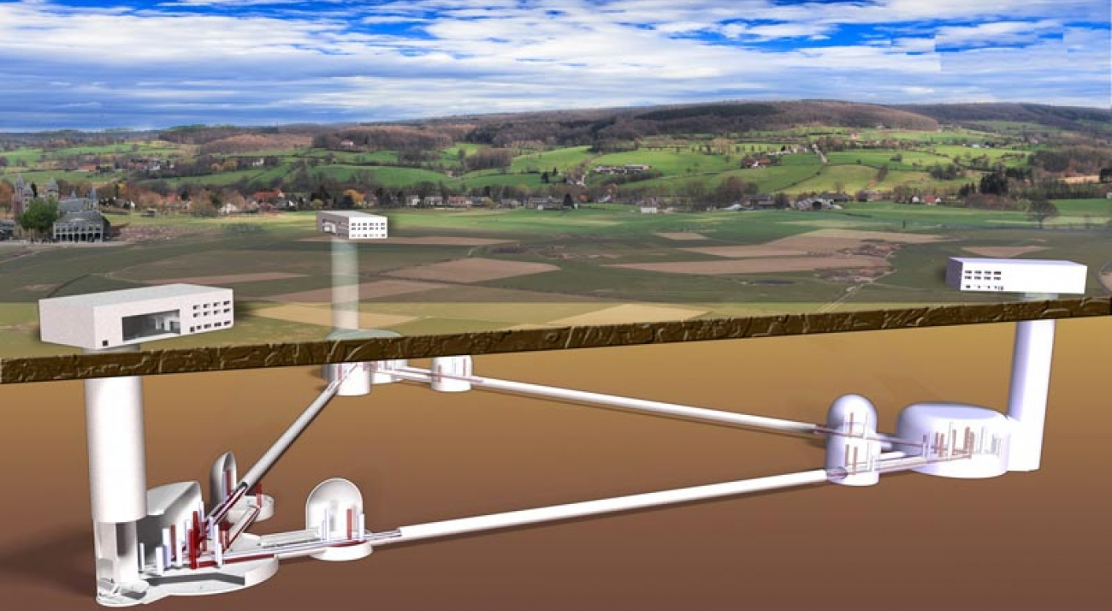



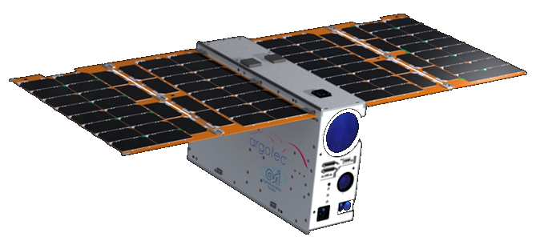

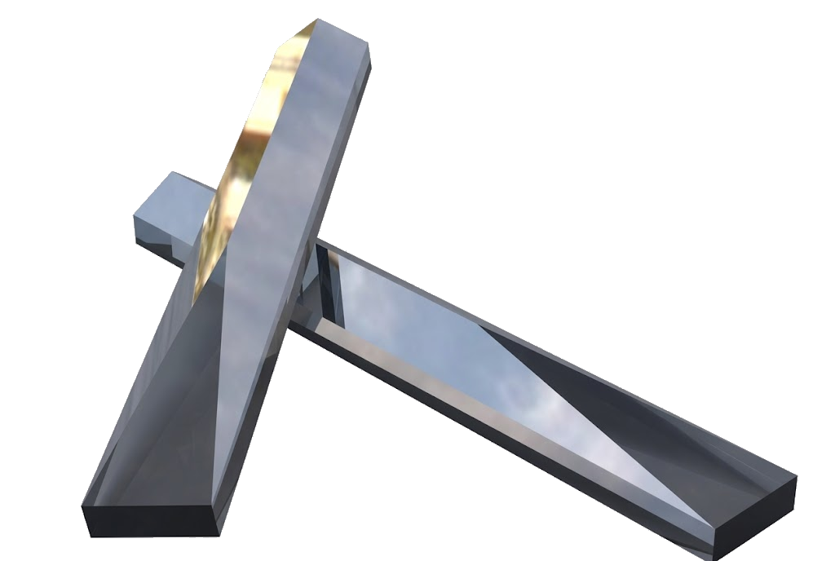

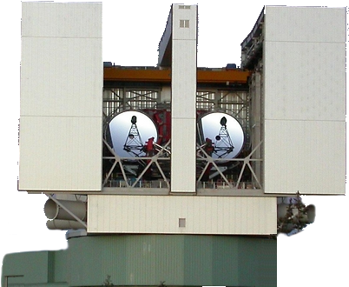
Projects and R&D activities
MASTER
ESO-ELT: MORFEO, PCS
ESO-New Horizon Call: SHARP, …
SKA, LOFAR monitoring & control
Ground Instrumentation, R&D:
ETIC: WFSensing & compensation for ET optics
EKARUS: testbed for AO tech @ INAF-Asiago
FP-WFS (optical fibers + ML)
P-WFS testbench, ML modulated
Ingot LGS-WFS for ELTSs
Space missions R&D :
ORCAS - Orbiting Configurable Artificial Star
LGWA - Lunar Gravitational Wave Antenna
Active mirrors for space telescopes
PCS
CI²RCE
EKARUS
ORCAS
INGOT
18/03/2026
STILES Workshop

Slide 6
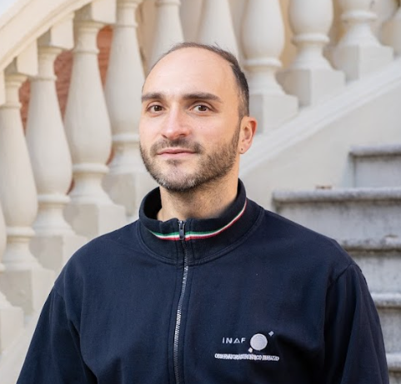
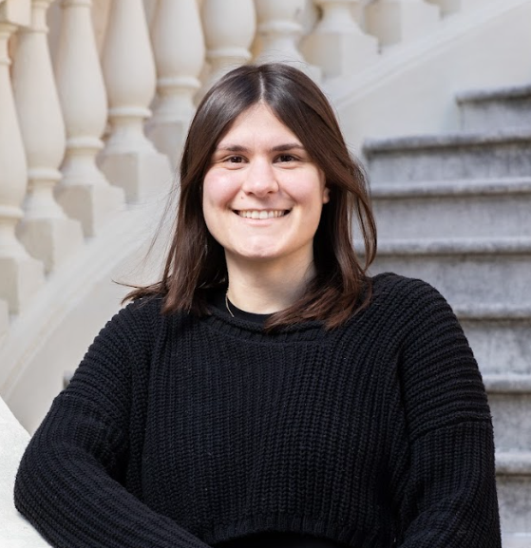



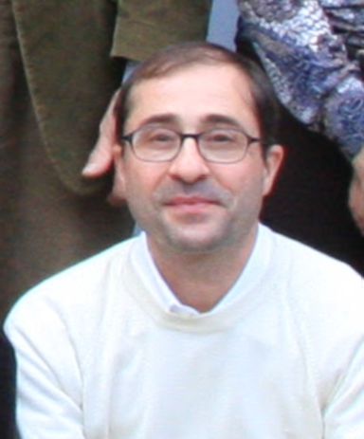

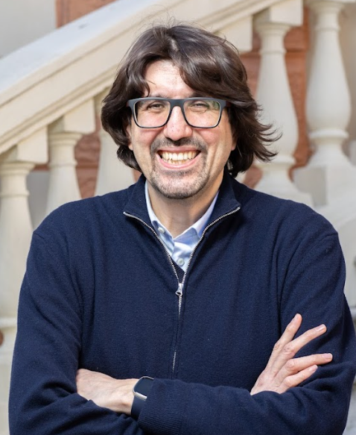
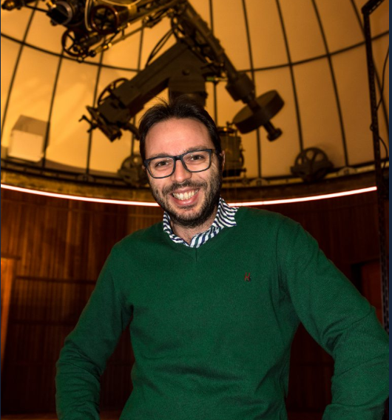
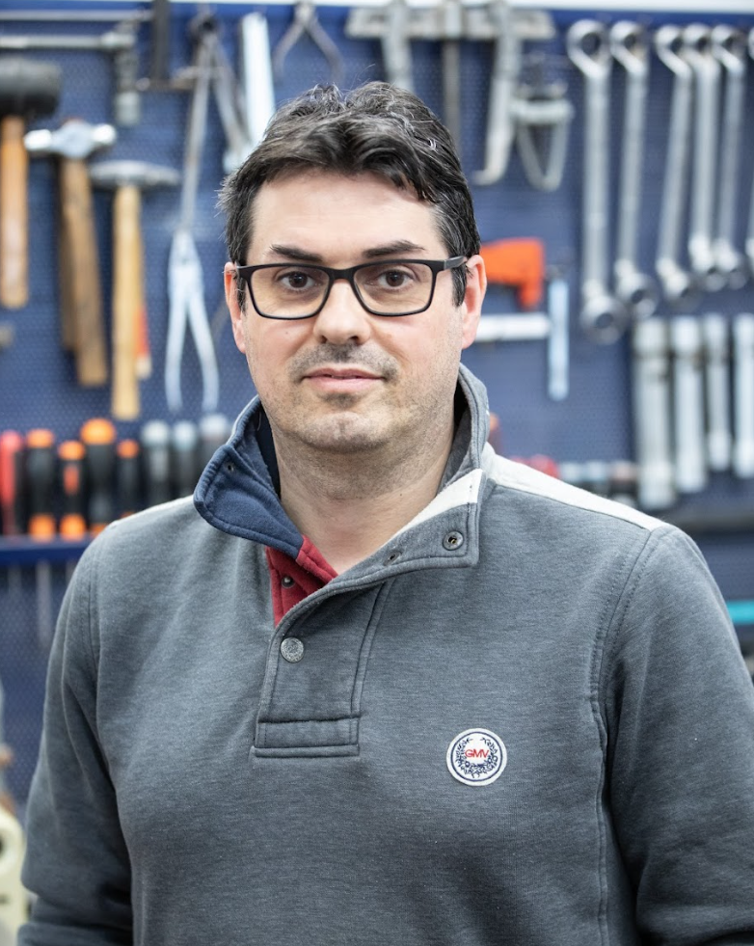
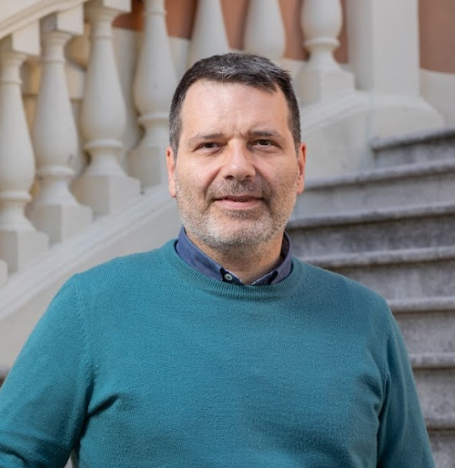
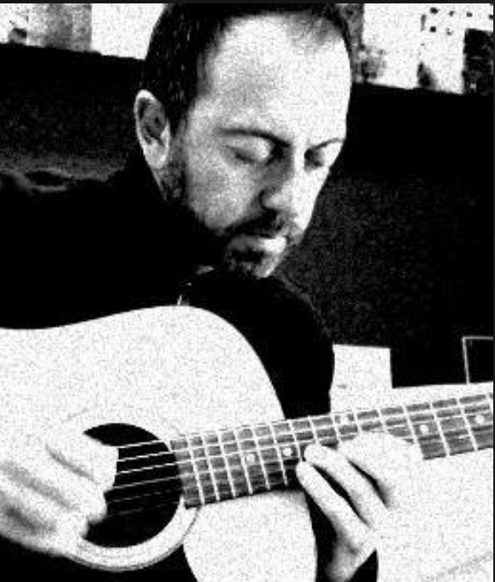

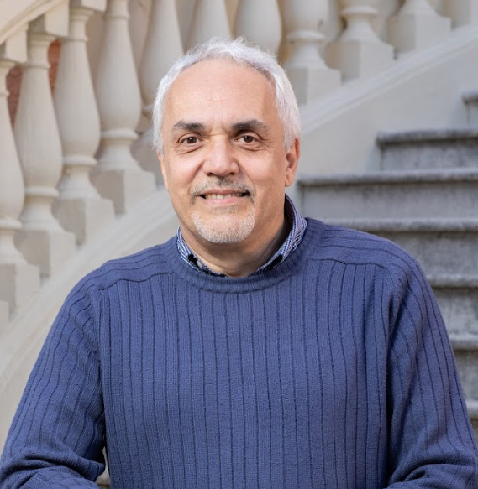
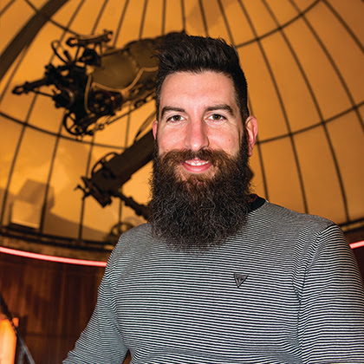
People working to STILES activities
Ivan Di Antonio
Benedetta Di Francesco
Simone Sacquegna
Stefano Di Frischia
Amico Di Cianno
Fabio Di Nicola
Matteo Di Carlo
Elisa Portaluri
Angelo Valentini
Simone Benedetti
Gianluca Di Rico
Fiorella Nusca
Matteo Canzari
Mauro Dolci
18/03/2026
STILES Workshop

Slide 7
Goals of the investment & future expectations
Comprehensive infrastructure to support the entire large project/instrument engineering lifecycle
Acquire accurate metrology tools to improve manufacturing, assembly, test & verification processes
Research & Development, pioneering ideas, exploring new photonic technologies, advanced prototyping
Strategic Objectives
National facility: reference for astrophysics technologies / regional hub in the Central-Southern Adriatic.
Fund-rising & partnerships: accessing to national/international funding channels and industrial partnerships
Attracting researchers & students, expanding collaborations with universities & research institutes.
18/03/2026
STILES Workshop

Slide 8
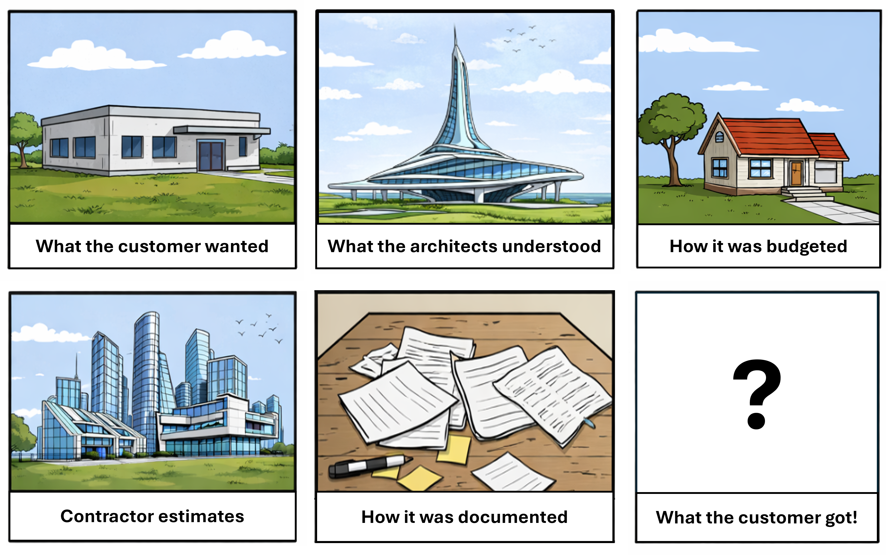
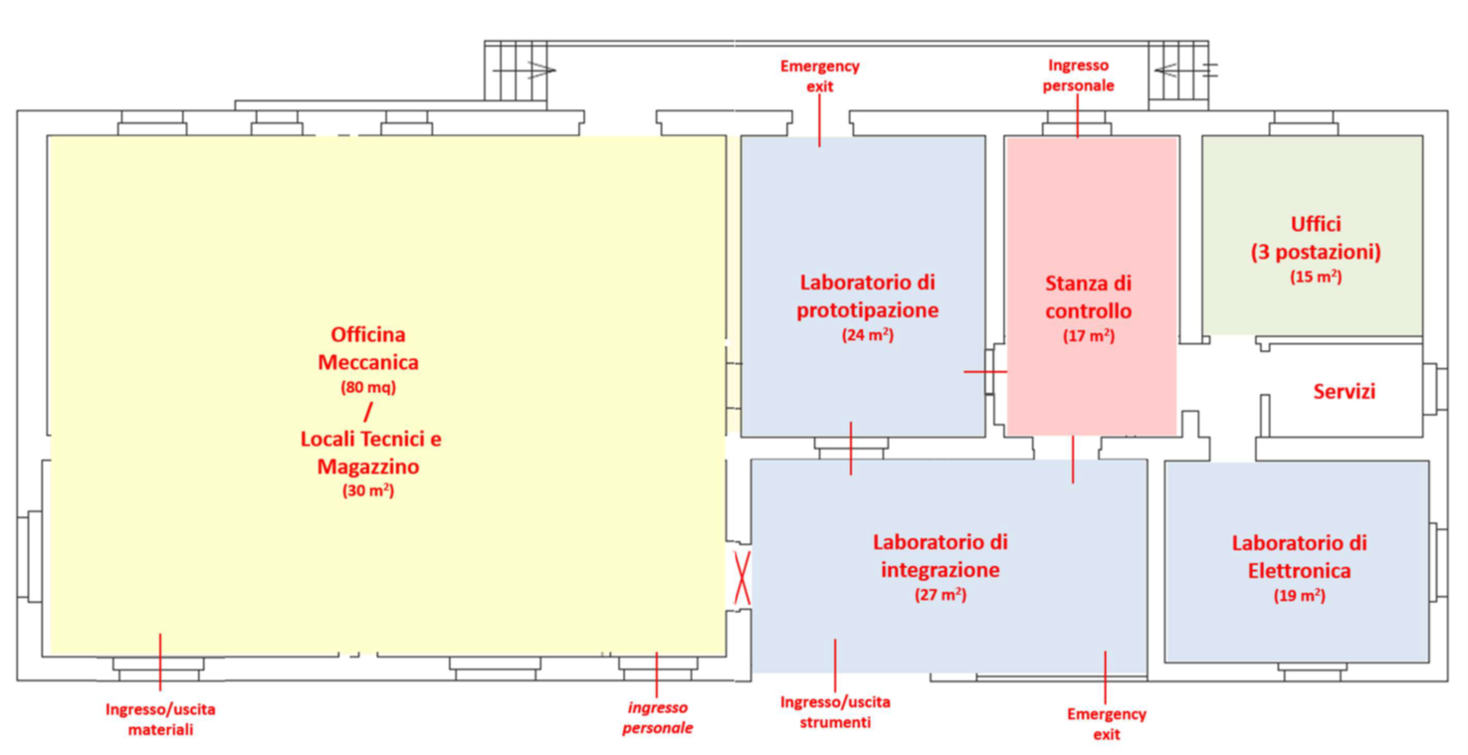
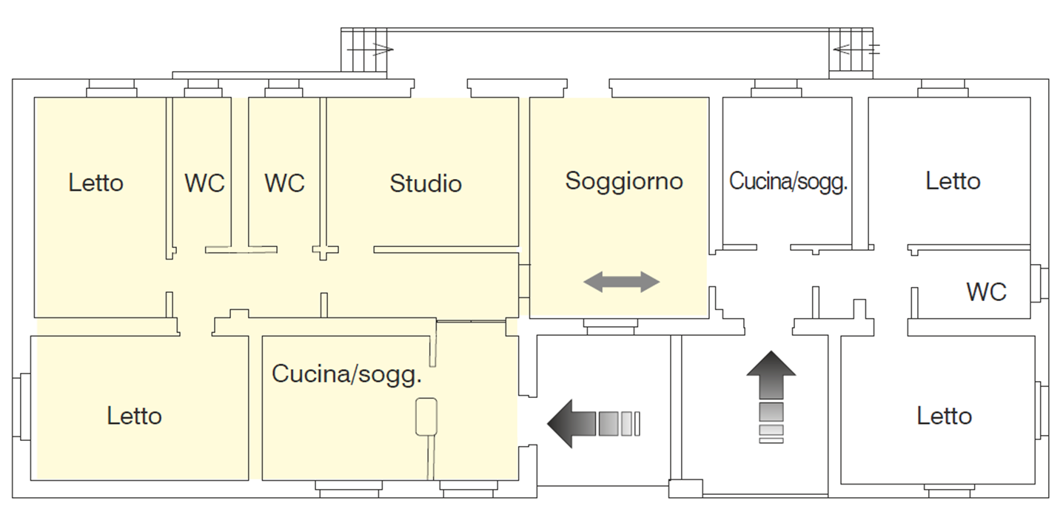
The Project - What We Set Out to Build
Refurbishment of guest houses (Feb 2021)
Masonry structure, requires seismic reinforcement.
Unknown construction techniques and building solutions.
Several undocumented transformations over more than 100 years.
~200 mq / ~600k€

Slide 9
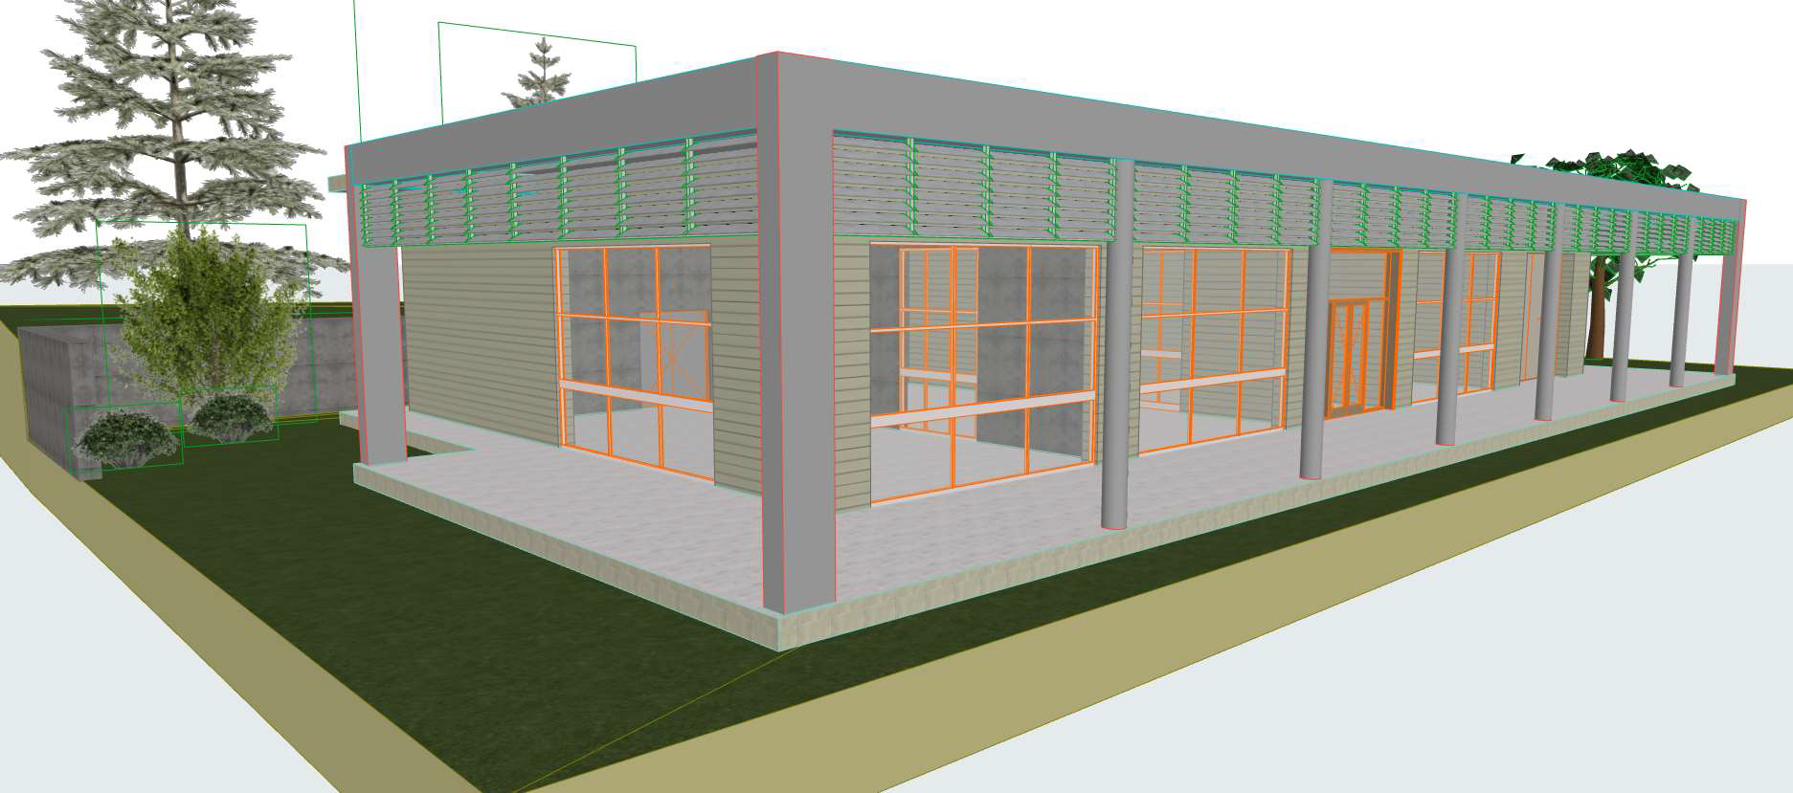
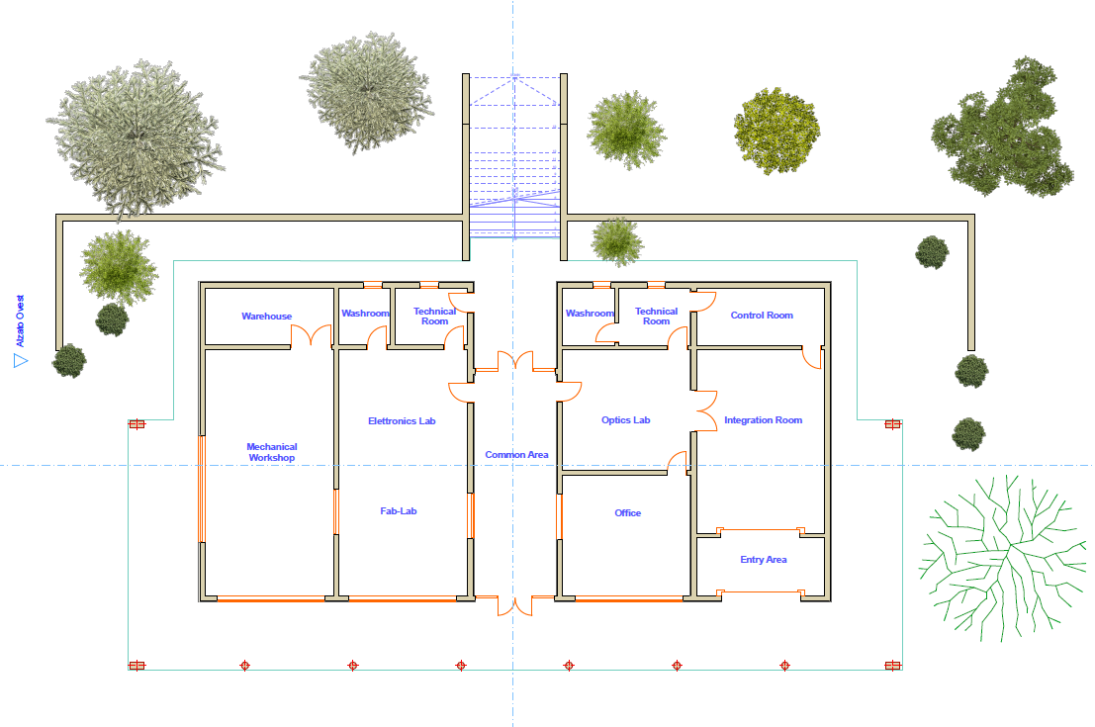
The Project - What We Set Out to Build
Technical and Economical Feasibility Study
(OAAb Technical Office – May 2022)
New building, ground floor layout
~400mq, ~840k€, 30 months
18/03/2026
STILES Workshop

Slide 10
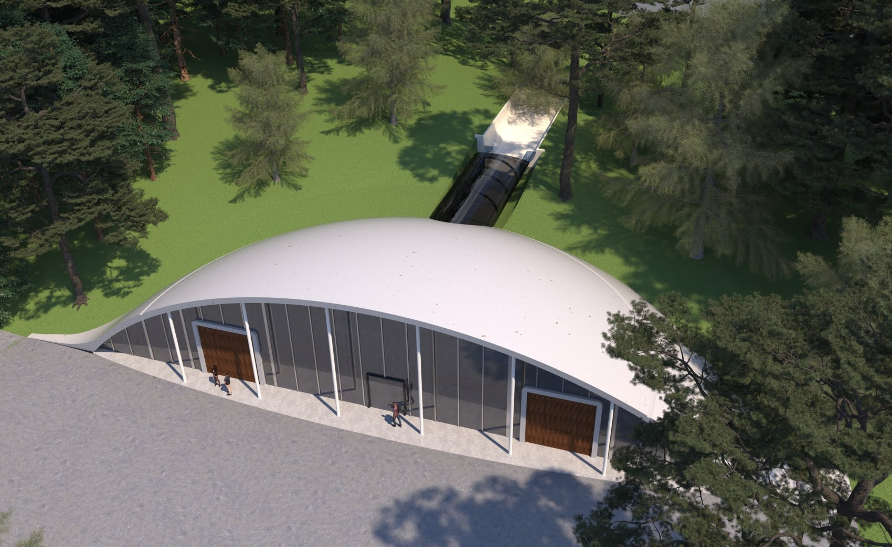

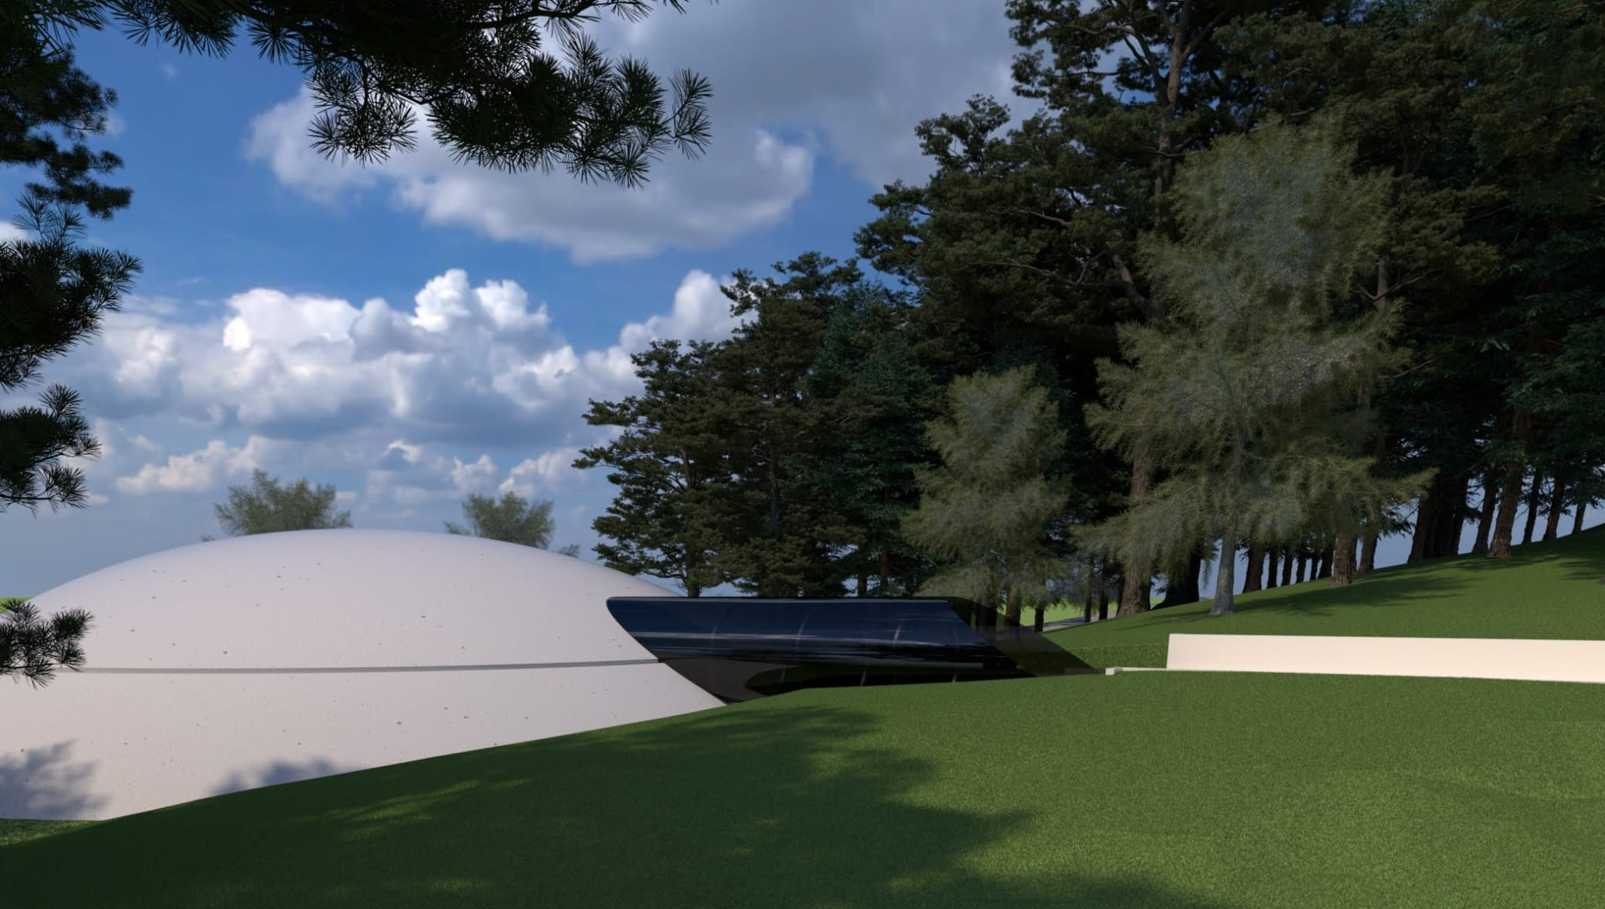
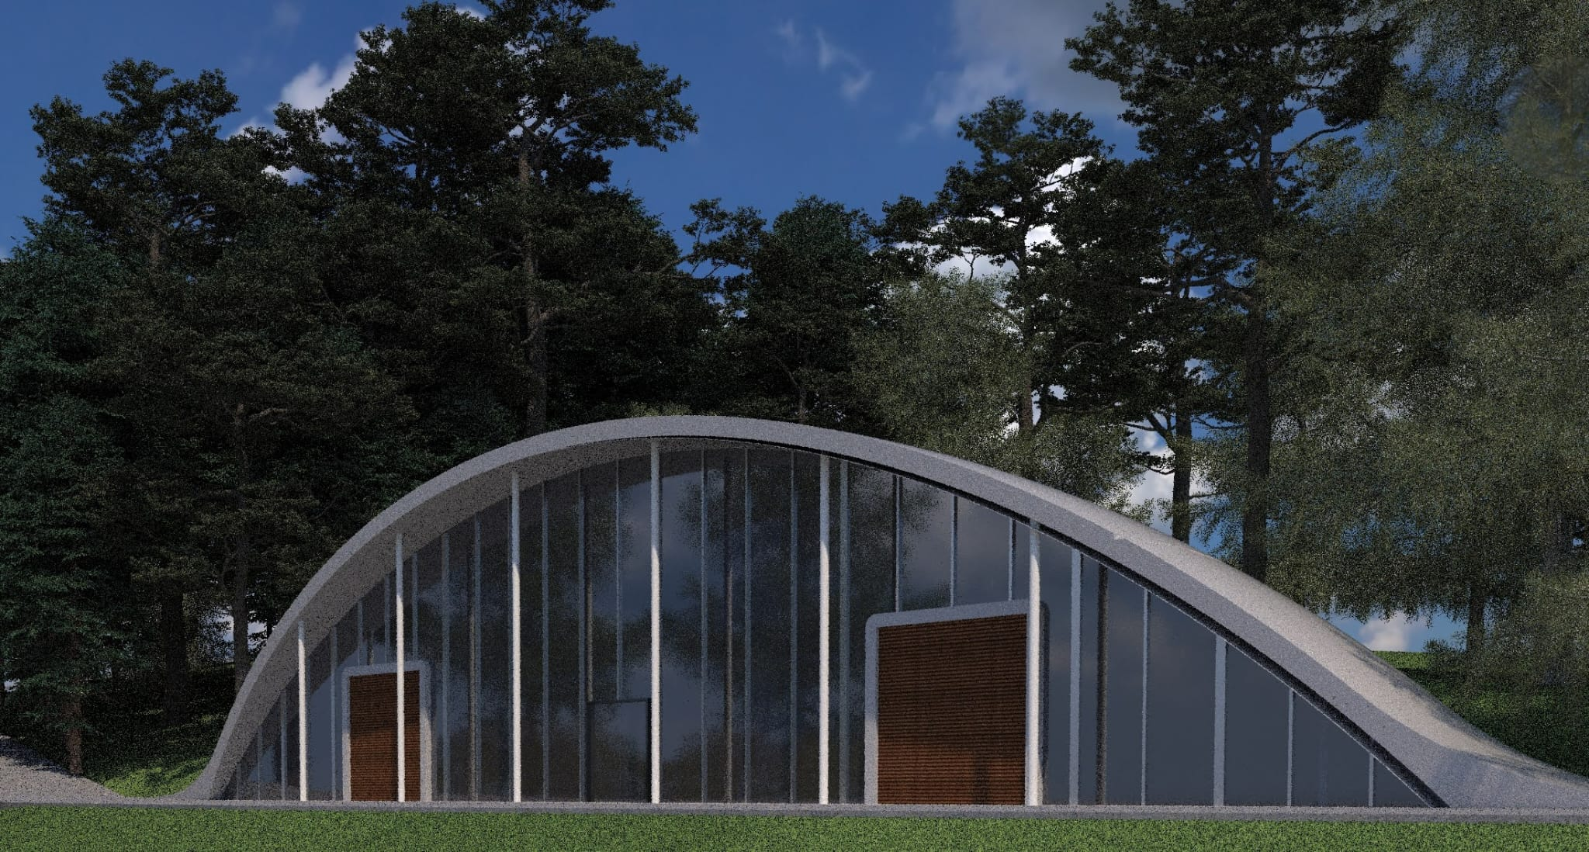
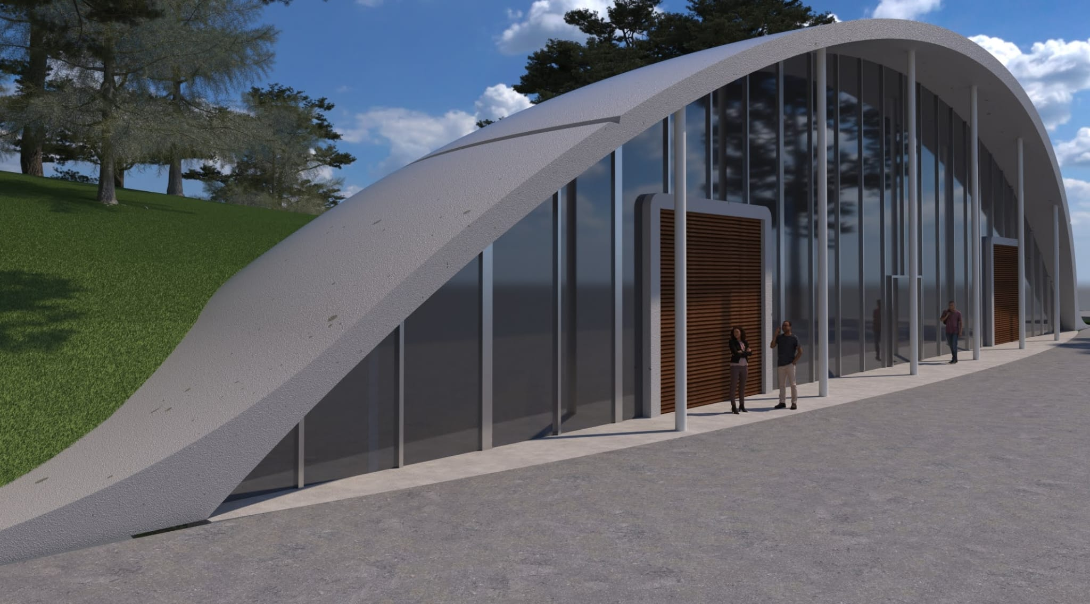
The Project - What architects understood (1st attempt)! €.€€€.€€€
18/03/2026
STILES Workshop

Slide 11
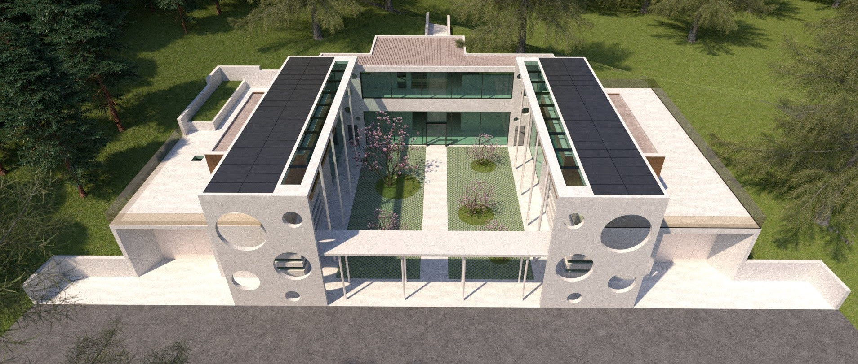
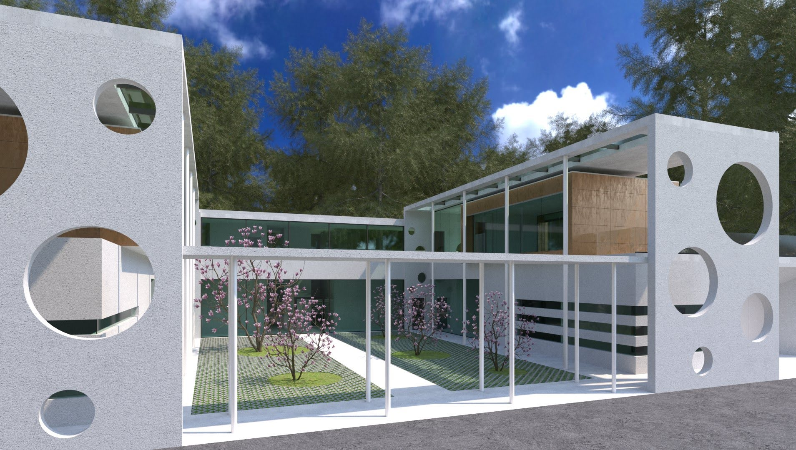
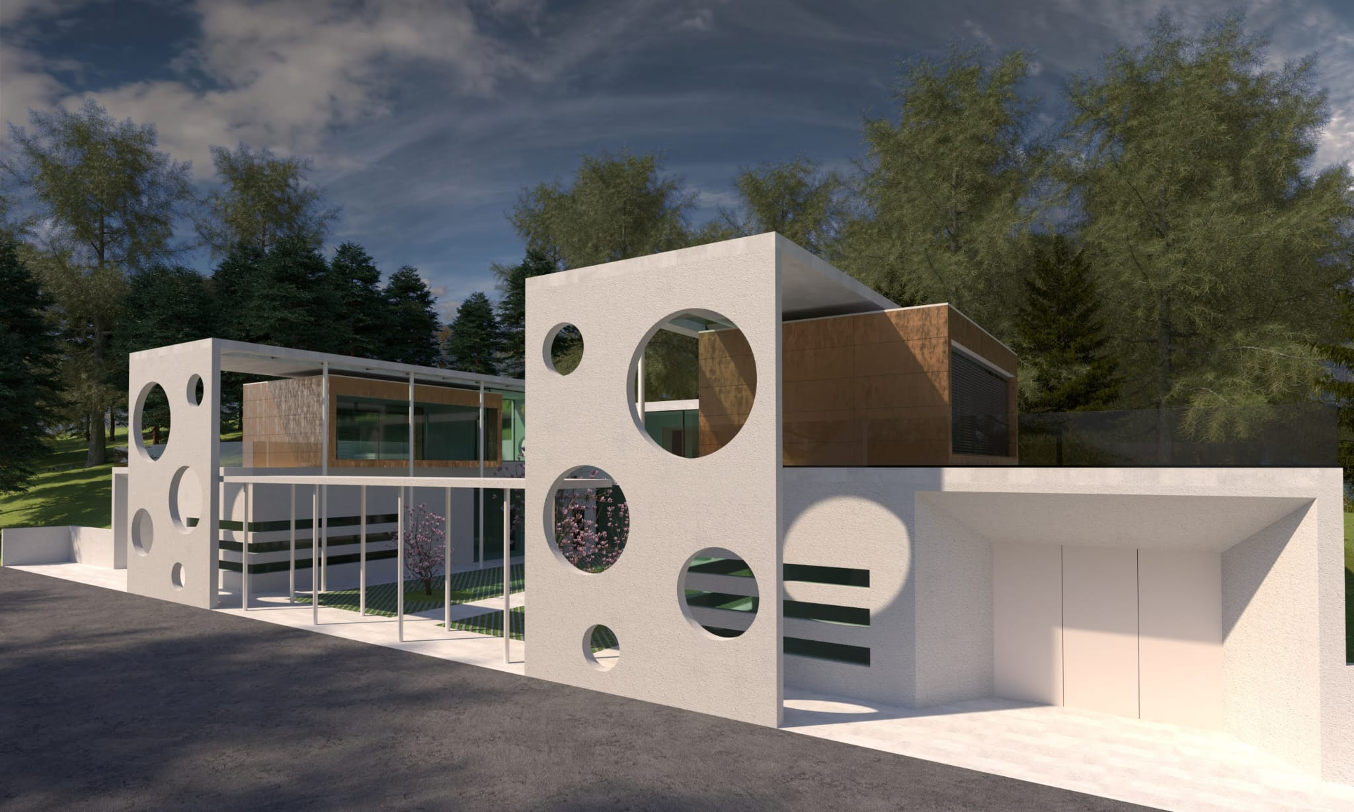
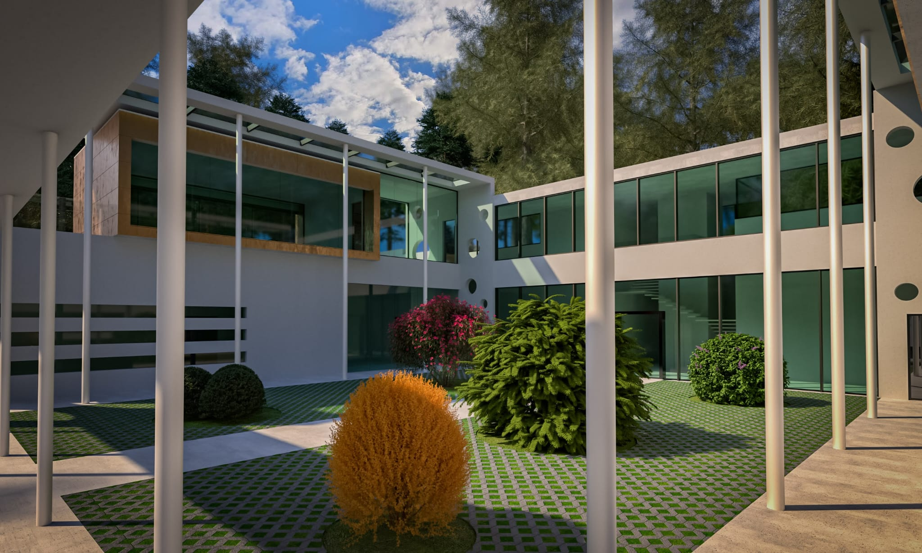
The Project - What architects understood (2nd attempt)! €.€€€.€€€

Slide 12
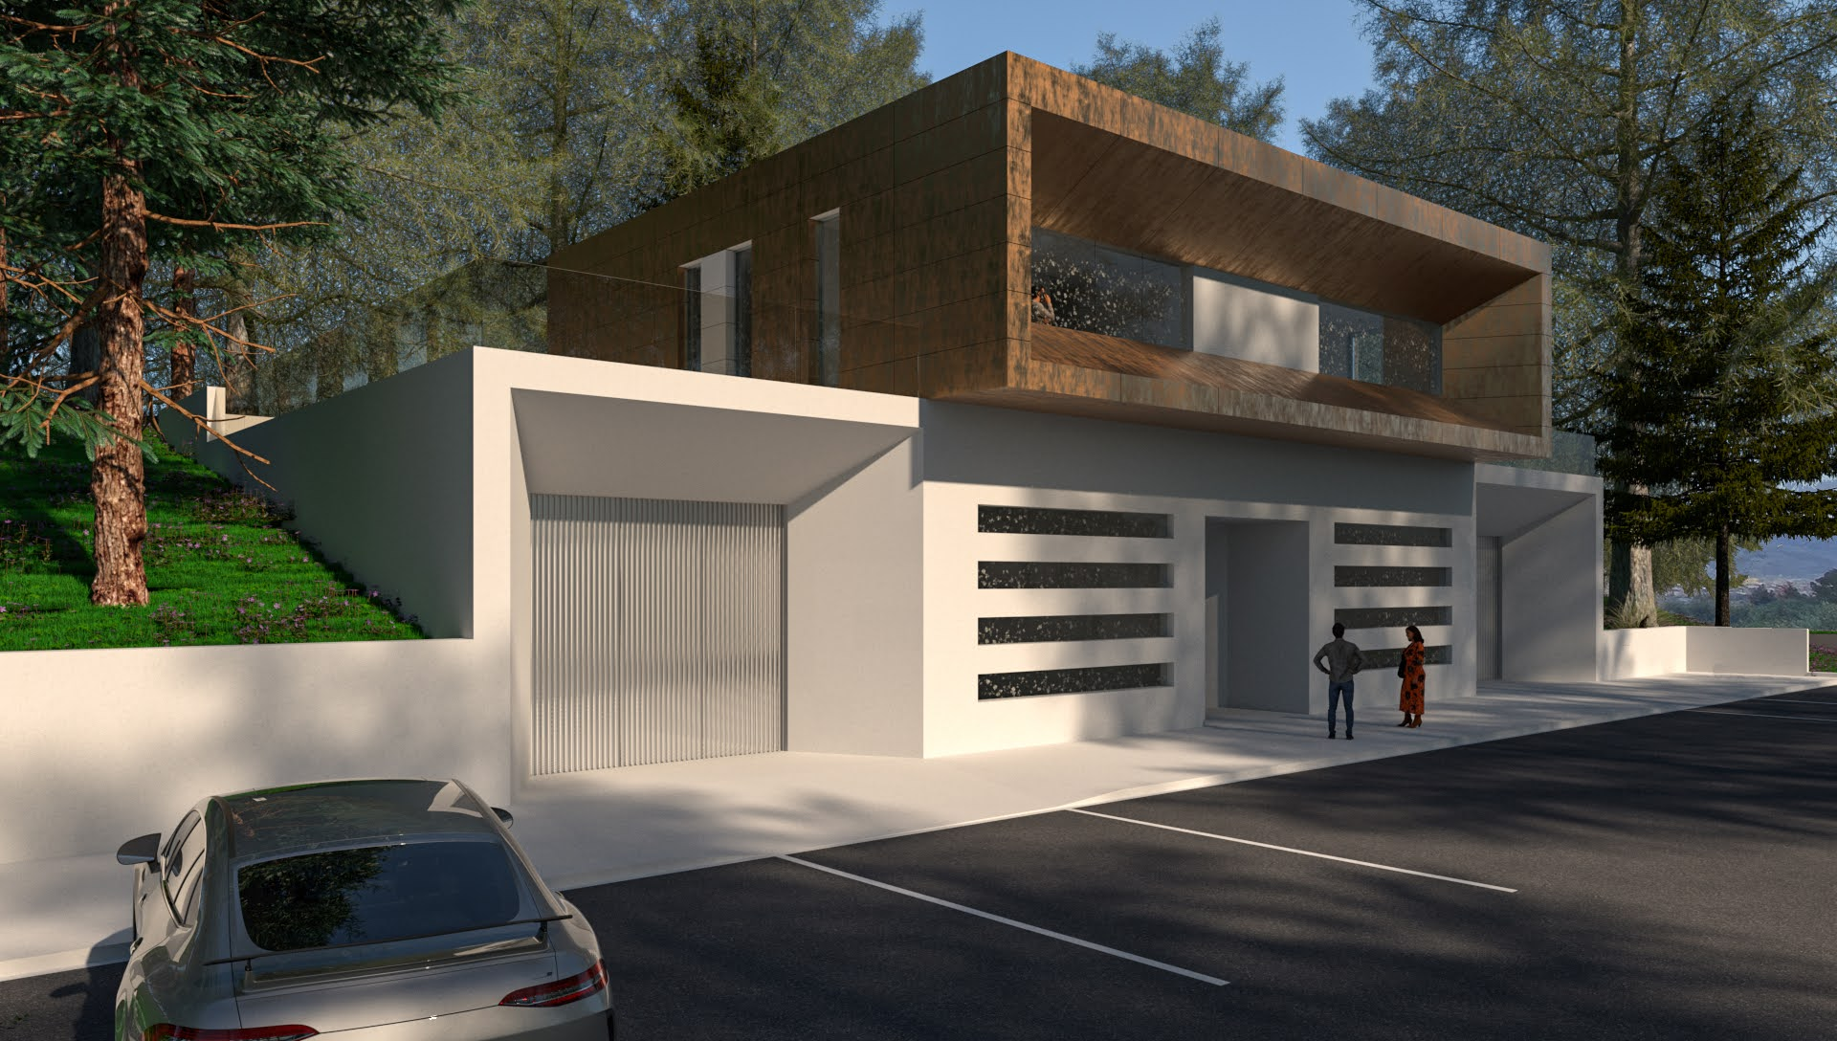
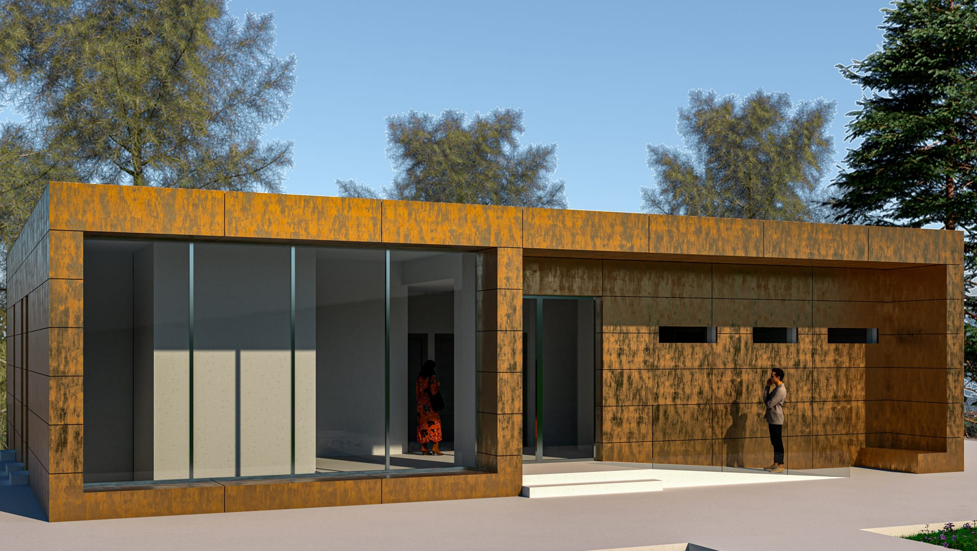
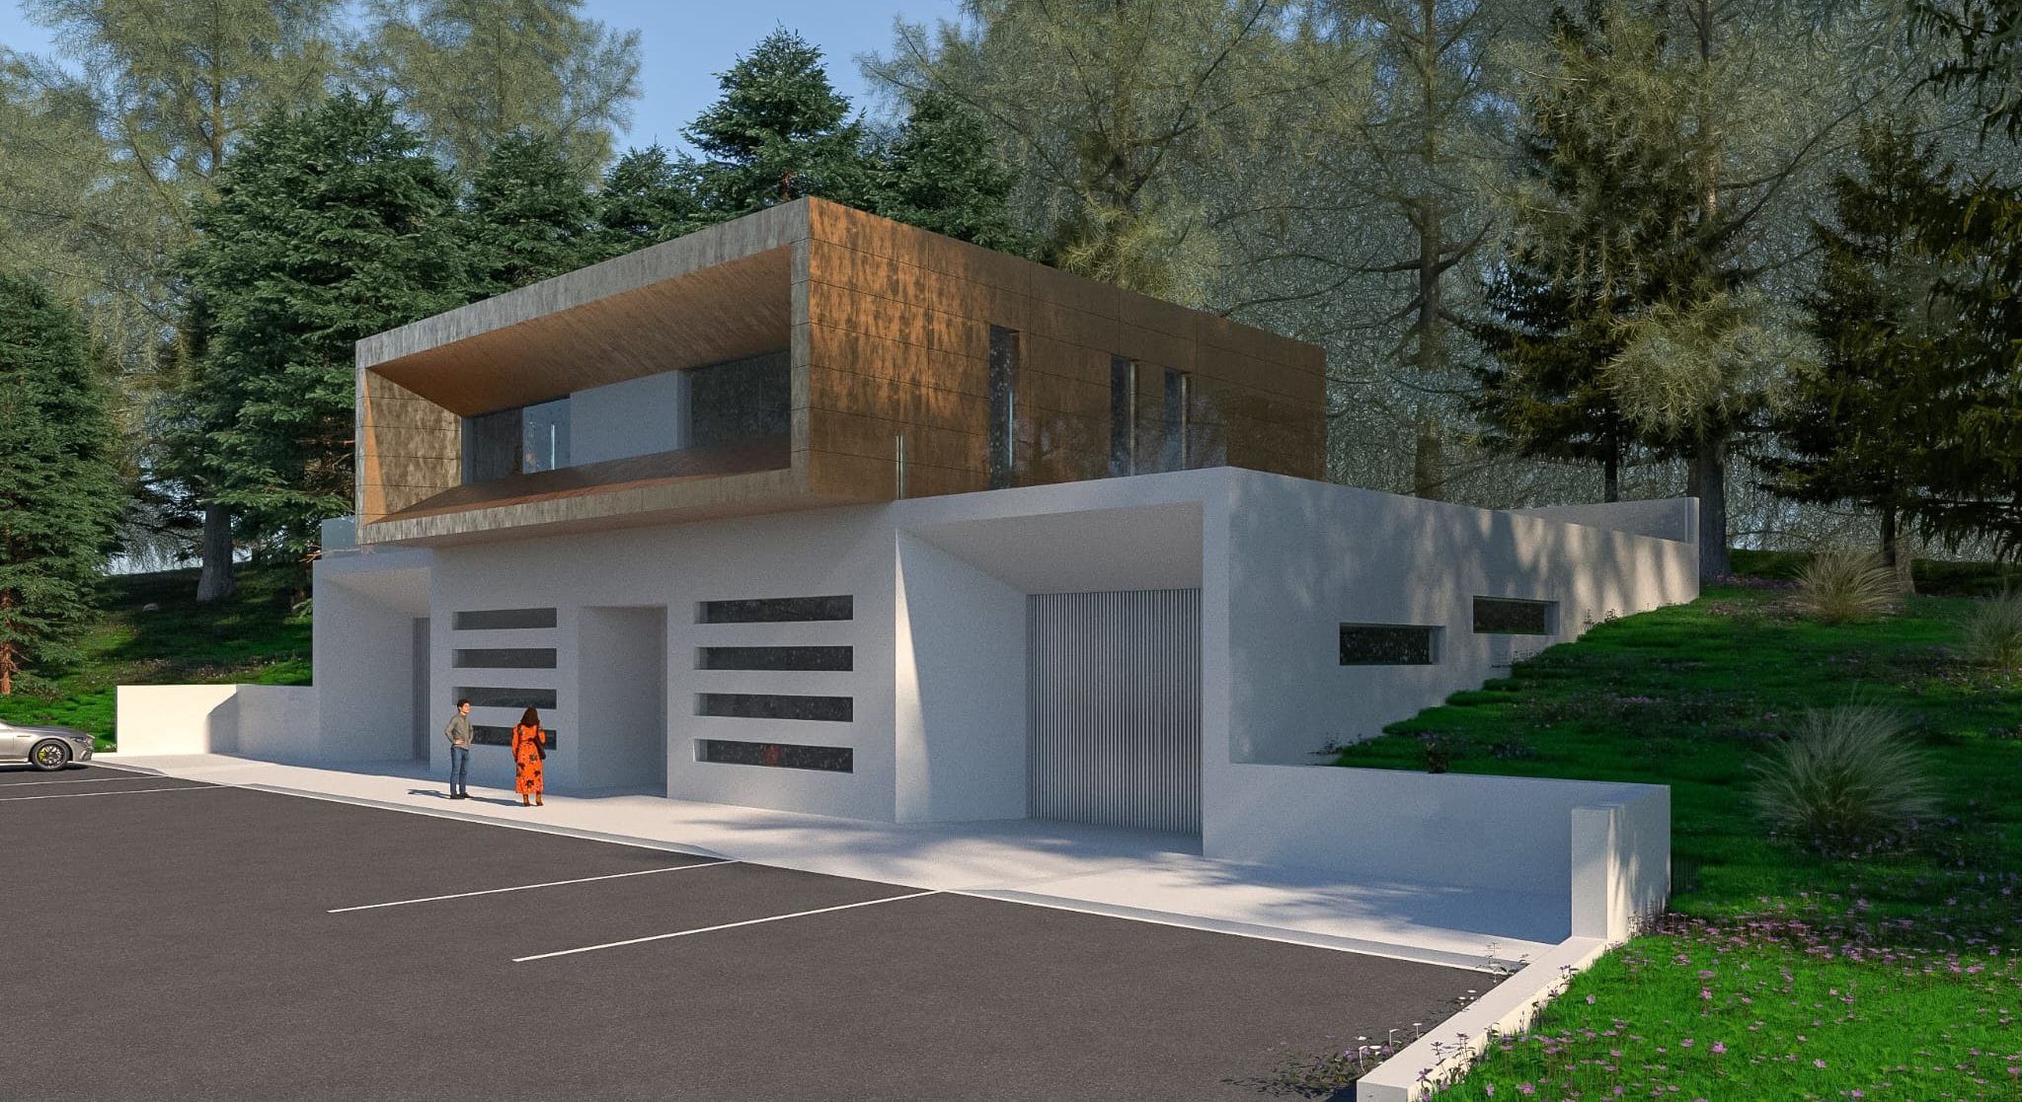
The Project - What we agree to Build ! € 1.460.000
PFTE
(technical-economical feasibility study)
STILES
Design-Build tender
2023
Ground floor (400 sqm):
integration room
laboratories (optics, electronics)
mech. workshop
First floor (150 sqm)
offices
open meeting room
18/03/2026
STILES Workshop

Slide 13
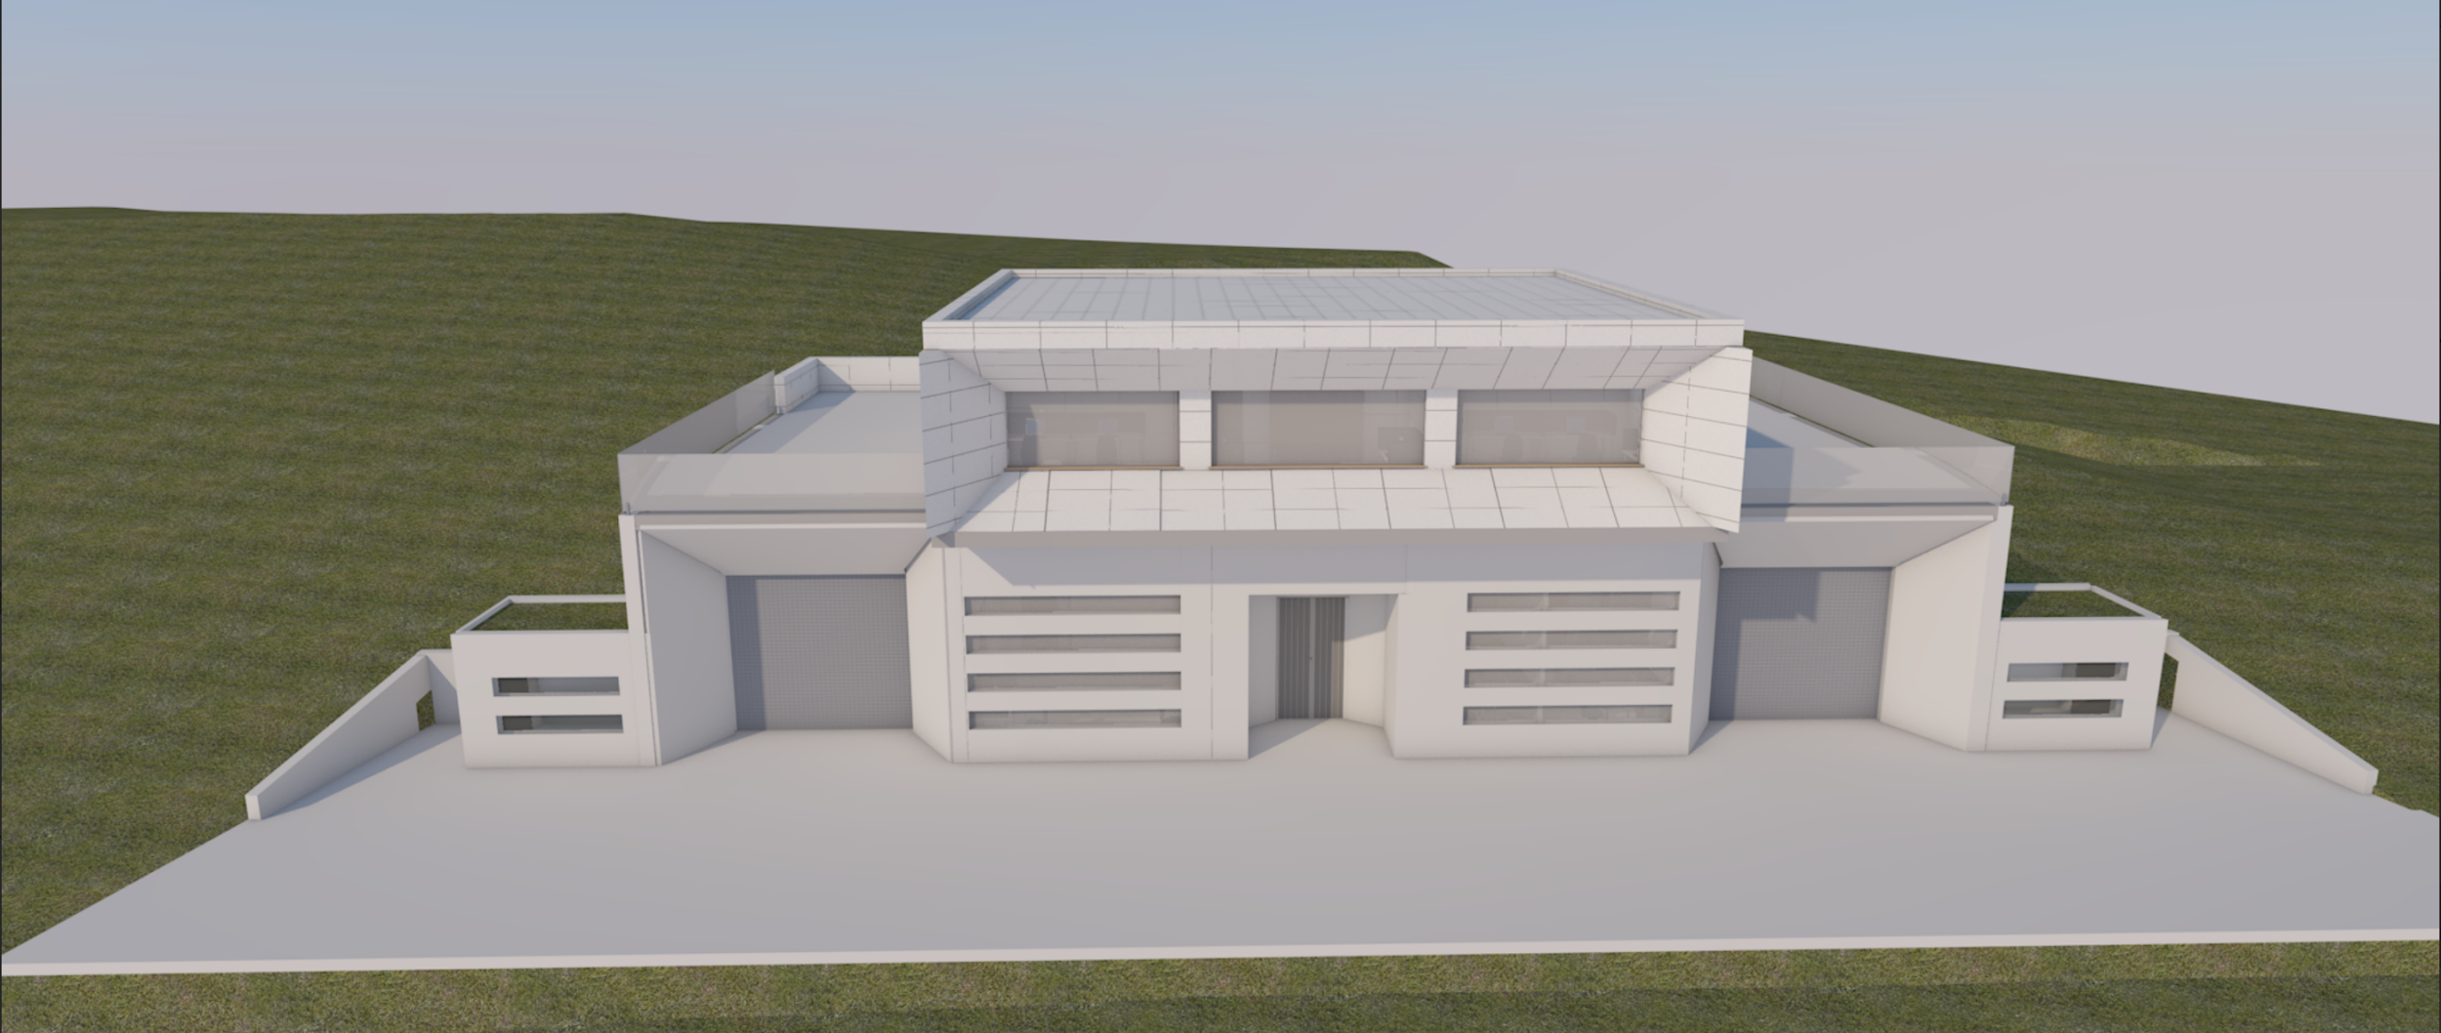
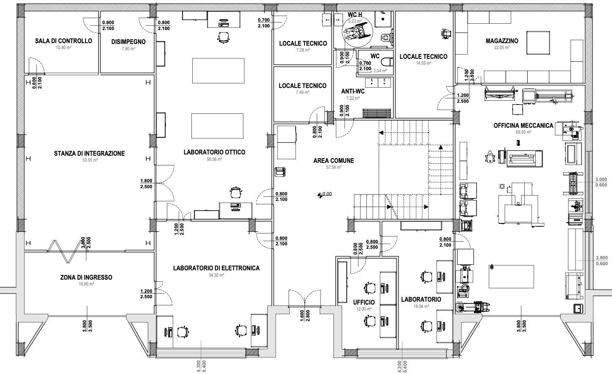
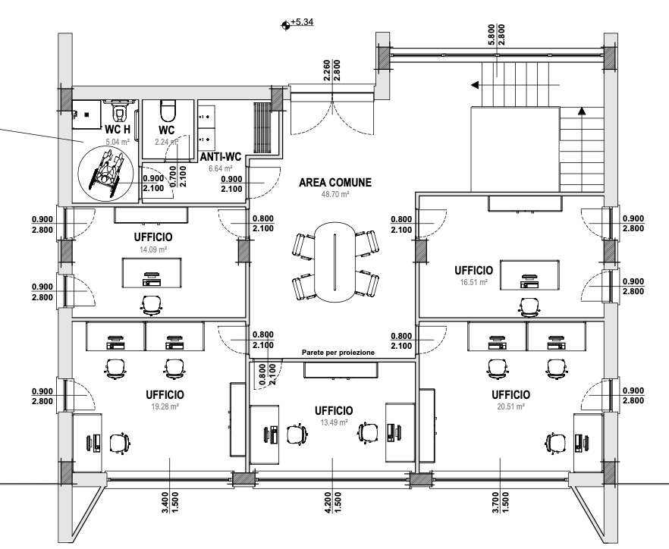
PNRR-STILES (ACT6401/6402)
New facility and metrology tools @ INAF-Abruzzo
workstations and
meeting room.
Ground floor – Laboratory floor
First Floor – Office floor
Optics Lab high-accuracy metrology equipment, experimental test benches
Integration Room clean room (ISO-7) for large instruments integration, test and verification.
Equipped with an overhead crane for handling large components.
Electronics Lab and Fab Lab
control electronics, models and prototypes
Mechanical Workshop Manufacturing & high precision CNC Machining
Office floor
workstations and meeting room for technologists and researchers.

Slide 14
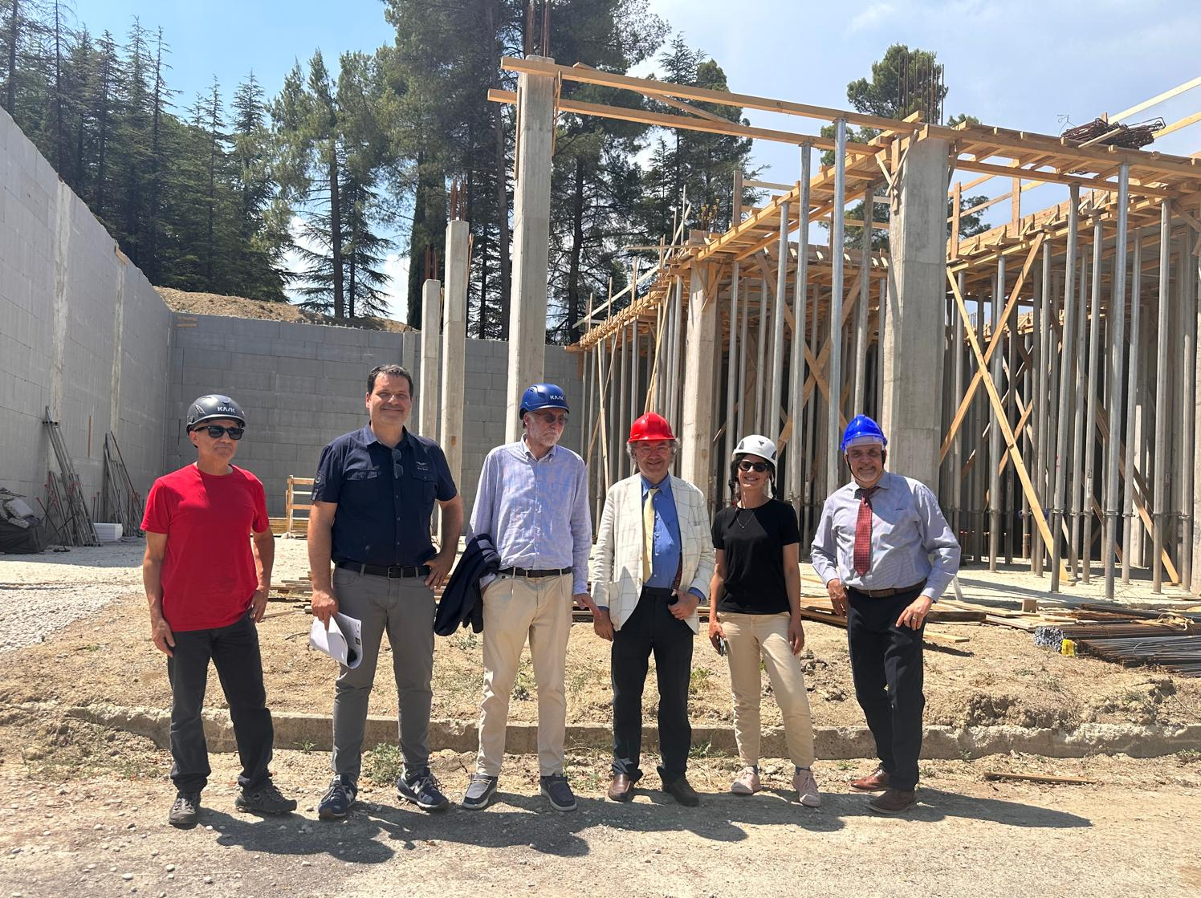
Project Timeline - From concept to building handover
Feasibility Study: 24/05/2023 (INAF funds, no PNRR)
Tender award (Final Design & Construction): 31/12/2023 (WOW!)
Final design (after 3 new design changes!): 26/06/2024
Site handover and start of works: 14/10/2024
Two contract/budget revisions (08/05/2025 and 25/11/2025)
Completion of the works, building handover 20/04/2026
Picture date: July 2025
18/03/2026
STILES Workshop

Slide 15
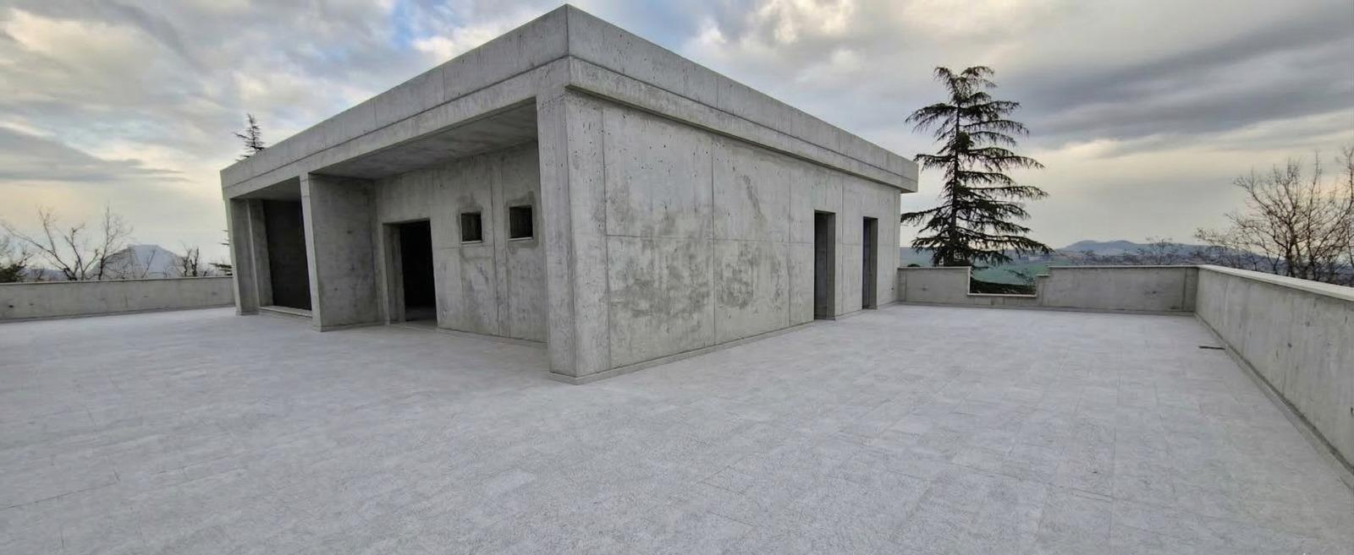
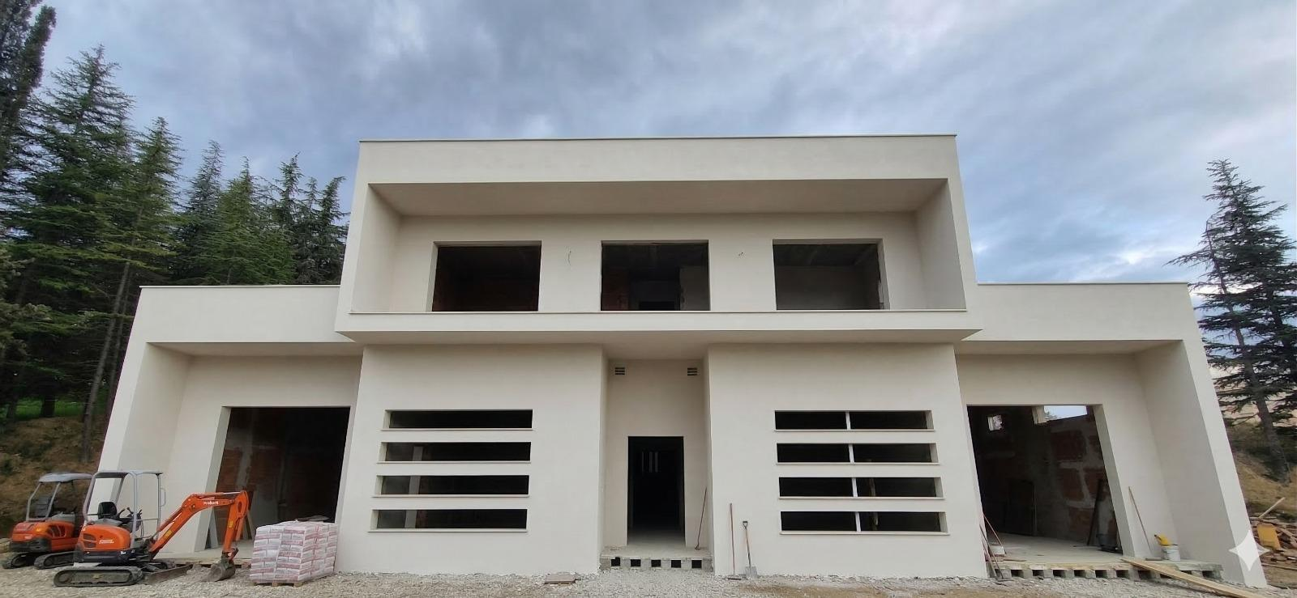
Where We Stand Today - Current Status
Picture date: 12/03/2026
Effective recent speed-up !
3 parallel work crews!
Extending working hours!
Working on Saturday!
This week: doors and frames mounting
Next week: external rendering and painting
4 weeks for MEP systems (mechanical/electrical/plumbing) completion and interior fit-out
18/03/2026
TOTAL cost: €1.629.817,58
STILES Workshop

Slide 16
Lesson learned - Key Lessons for the Future
The Design-Build Model (“Appalto Integrato”) in Public Procurement
Art. 44, D.Lgs. 36/2023 e s.m. Article 44, (“Appalto Integrato”) based on the Technical and Economic Feasibility Study (PFTE).
Promised Benefits (Pros) | Experimented Risks / Challenges (Cons)
Simpler/Fast Procurement: Single tender for both design and construction. | Delayed Timelines: Frequent project changes, re-work and delays, unreliable project scheduling.
Single Point of Responsibility Contractor liability, transfer technical risks to the contractor. | Accountability Gaps/Blame-shifting risks: in temporary Joint Venture contractors may blame each other for design errors, causing delays, higher costs, and conflicts.
Reduced Bureaucracy: Simplified administrative procedures. | Management Complexity: heavier workload to prevent delays and cost overruns
While the Design-Build (“Appalto Integrato”) model appears efficient on paper, it often leads to cost overruns and project stand-stills, require strong constant on-site monitoring and effective/pro-active Works Supervision (Direzione Lavori) !
Notes:
It may seem that….

Slide 17
Lesson learned - Key Lessons for the Future
The choice of a Qualified Contractor Authority:
Agreement signed between the Provveditorato alle Opere Pubbliche (OOPP) and INAF-OAAb
Problem / Challenge | Lesson / Solution
External C.A. → Limited/sporadic presence of Works Supervisor on the construction-site: delays and slow decision-making, coupled with a lack of effective control | Effective Works Supervision Team (outsourced if needed) to ensure constant supervision and proactive coordination.
Poor communication responsiveness between Client (INAF) and Contracting Authority (OOPP) | Use formal and traceable communications, clear channels, regular meetings, and prompt intervention on critical issues.
Critical Overload on Contracting Authority (PNRR, post-earthquake recon., Superbonus 110%). Delays in urgent matters, lack of constant supervision, | Define realistic timelines and clear responsibilities at all levels. Evaluate alternative procurement agencies (Regional Procurement Hubs, Municipalities, Universities).
18/03/2026
STILES Workshop
Notes:
*
- Conflitto di ruoli – il DL interno dipende gerarchicamente dalla stessa PA che prende le decisioni politiche/amministrative, quindi può essere meno indipendente nella gestione tecnica.
- Ritardi e lentezza decisionale – le OOPP devono gestire decine di cantieri (come nel caso STILES), quindi il DL interno non può sempre intervenire tempestivamente.
- Mancanza di controllo reale – senza autonomia, il DL interno può solo “ratificare” decisioni, senza poter imporre modifiche o fermare lavori problematici.
- Rischio maggiore di contenziosi – in caso di problemi progettuali o esecutivi, il DL interno non può tutelare pienamente la PA come farebbe un DL esterno e indipendente.

Slide 18


Lesson learned - Final Remarks!
Not-dedicated Works Supervisor (DL) → poor oversight and slow decision | Always assign a dedicated, independent Works Supervisor (DL) and trusted Inspectors
Design-Build Model (Appalto integrato) → design misalignments, partial executive design | Validate designs early and clearly,
Architectural / structural design misalignment → hidden cost increases for the Client | Ensure strict on-site supervision and constant project monitoring
STILES Workshop

Slide 19
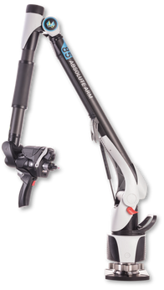
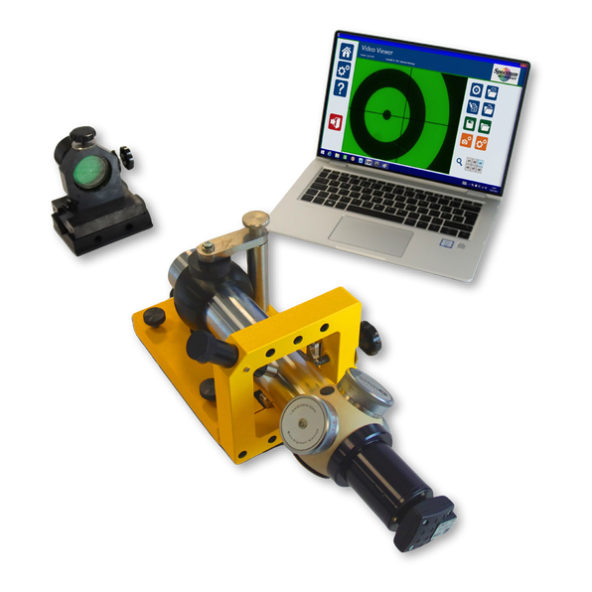
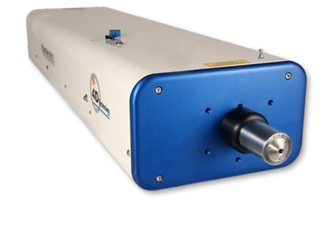
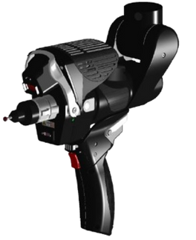
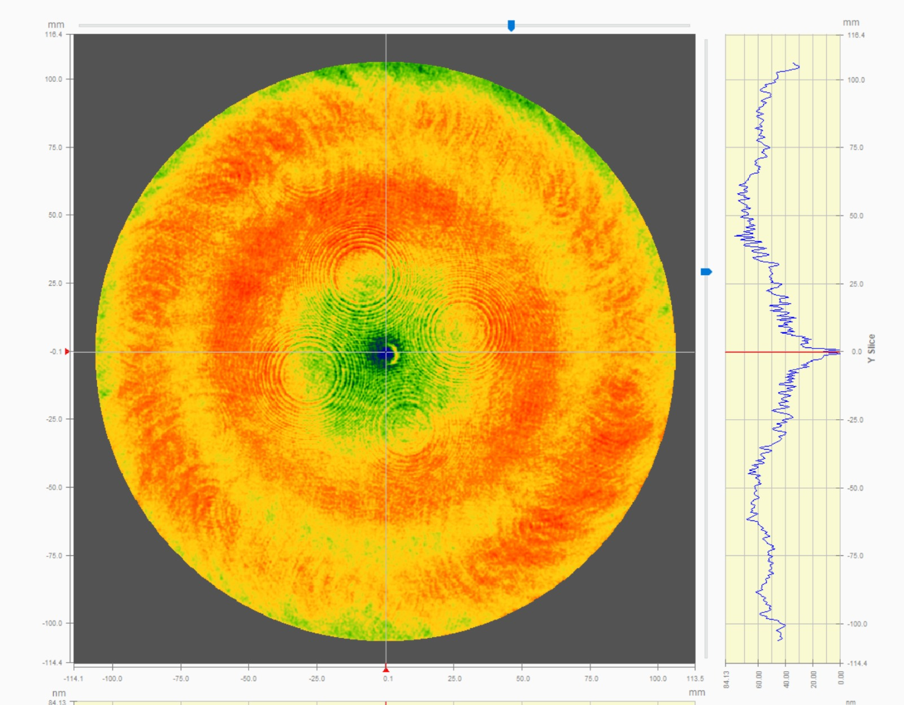
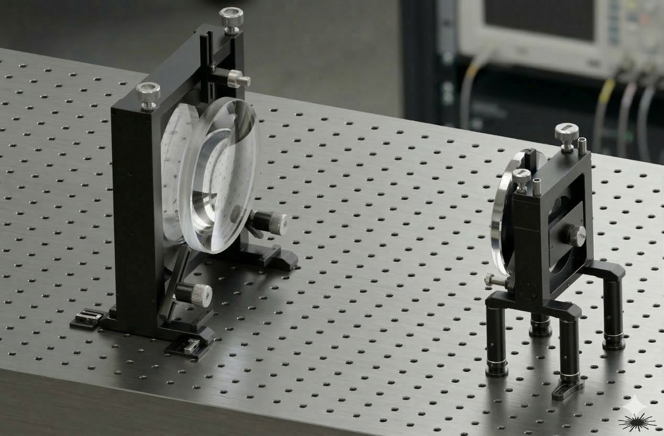
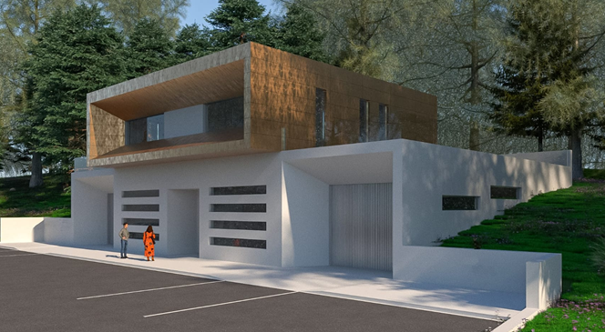
Final Outcomes!
TOTAL cost: € 370.000
Dynamic Laser Interferometer
PHASECAM 4030
Portable Measuring Arm
HEXAGON 8525
Micro-Alignment Telescope
TAYLOR HOBSON M112-2582UC
Procurement of new metrology instruments:
4D Dynamic Interferometer
Hexagon measuring arm + laser scanning head
Taylor-Hobson Mount Alignment Telescope
Custom 21cm beam expander for interferometric metrology of large optical systems (delivered by March)
A new infrastructure for AO technologies in the ELT era!
Beyond the challenges: a goal (dream) pursued for years!
Personnel hired under PNRR funds or in support of the PNRR!
Professional, enthusiastic, high-collaborative!
TOTAL cost: €1.629.818
18/03/2026
STILES Workshop

Slide 20
Acknowledgments
​A unique opportunity we couldn't miss!
Three intense years that have led to results that will last for decades!
PNRR/STILES P.O.: administrative support, effective team working & collaboration! THANKS!
All INAF executives and colleagues that provided their support to our PNRR activities!
THANK YOU!
We hope to see you at the grand opening!
18/03/2026

Slide 21
A new facility for AO technologies in the ELTs era END
G. Di Rico
INAF - OA Abruzzo
18/03/2026
STILES Workshop

