Slide 1
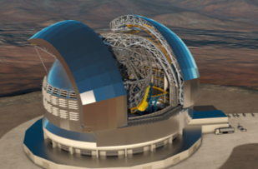
STILES
WP4301- Laboratory Plasma Spectroscopy
@Catania Astrophysical Observatory
Francesco.Leone@inaf.it

Slide 2
GOAL:
The Laboratory for Plasma Spectroscopy @ OACT
Exegesis of astrophysical spectra with attention to ANDES@ELT and NewAthena

Slide 3
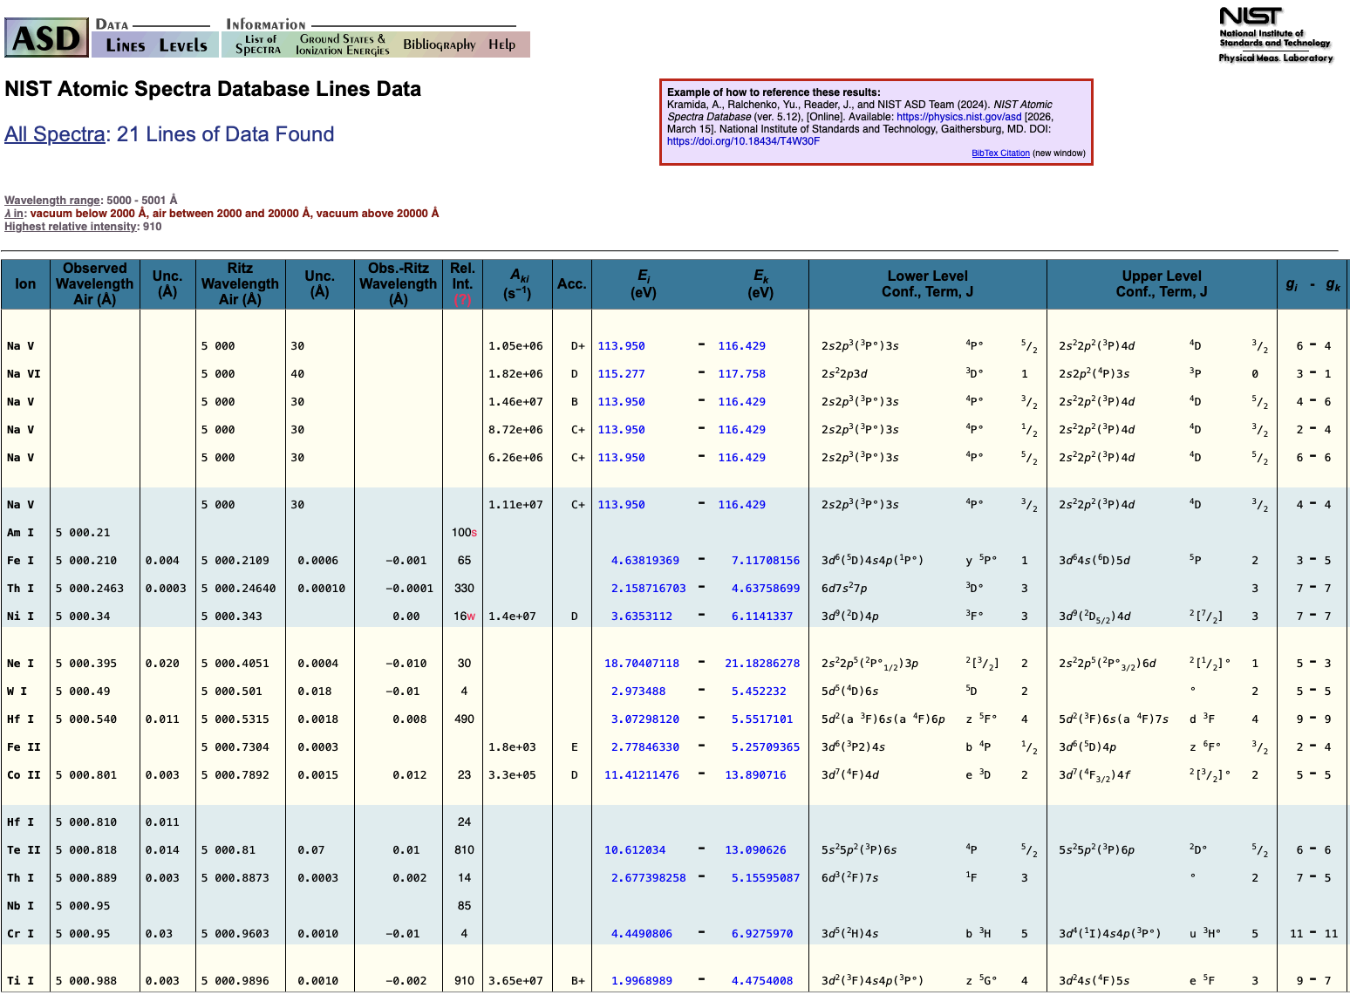
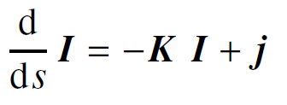


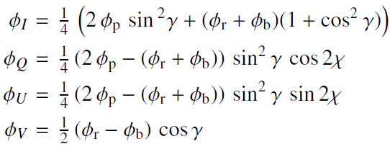

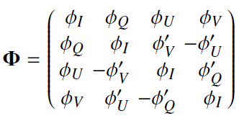
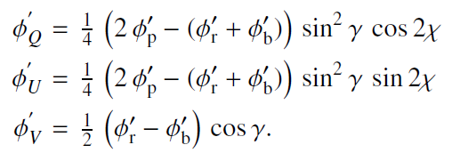
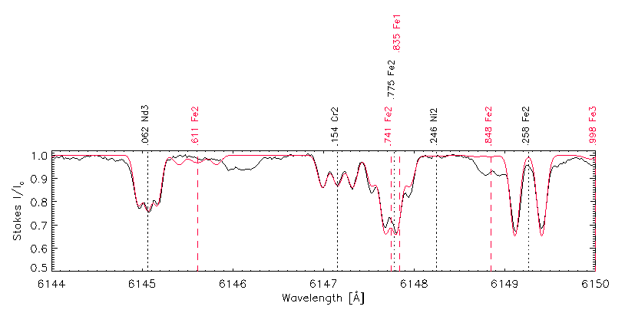
Exegesis of astrophysical spectra
observed
|B|= 5 kG
synthetic

Slide 4
GOAL:
The Laboratory for Plasma Spectroscopy @ OACT
Exegesis of astrophysical spectra with attention to ANDES@ELT and NewAthena
There is a scarcity of experimental atomic data
The differences in wavelengths between ab-initio calculations and experimental values are usually larger than 5%
MOTIVATION:

Slide 5
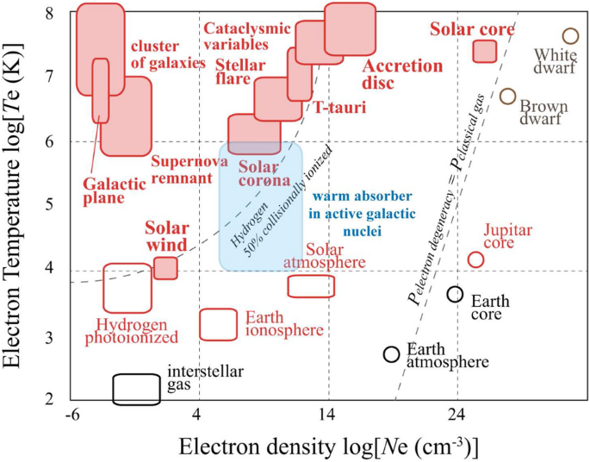
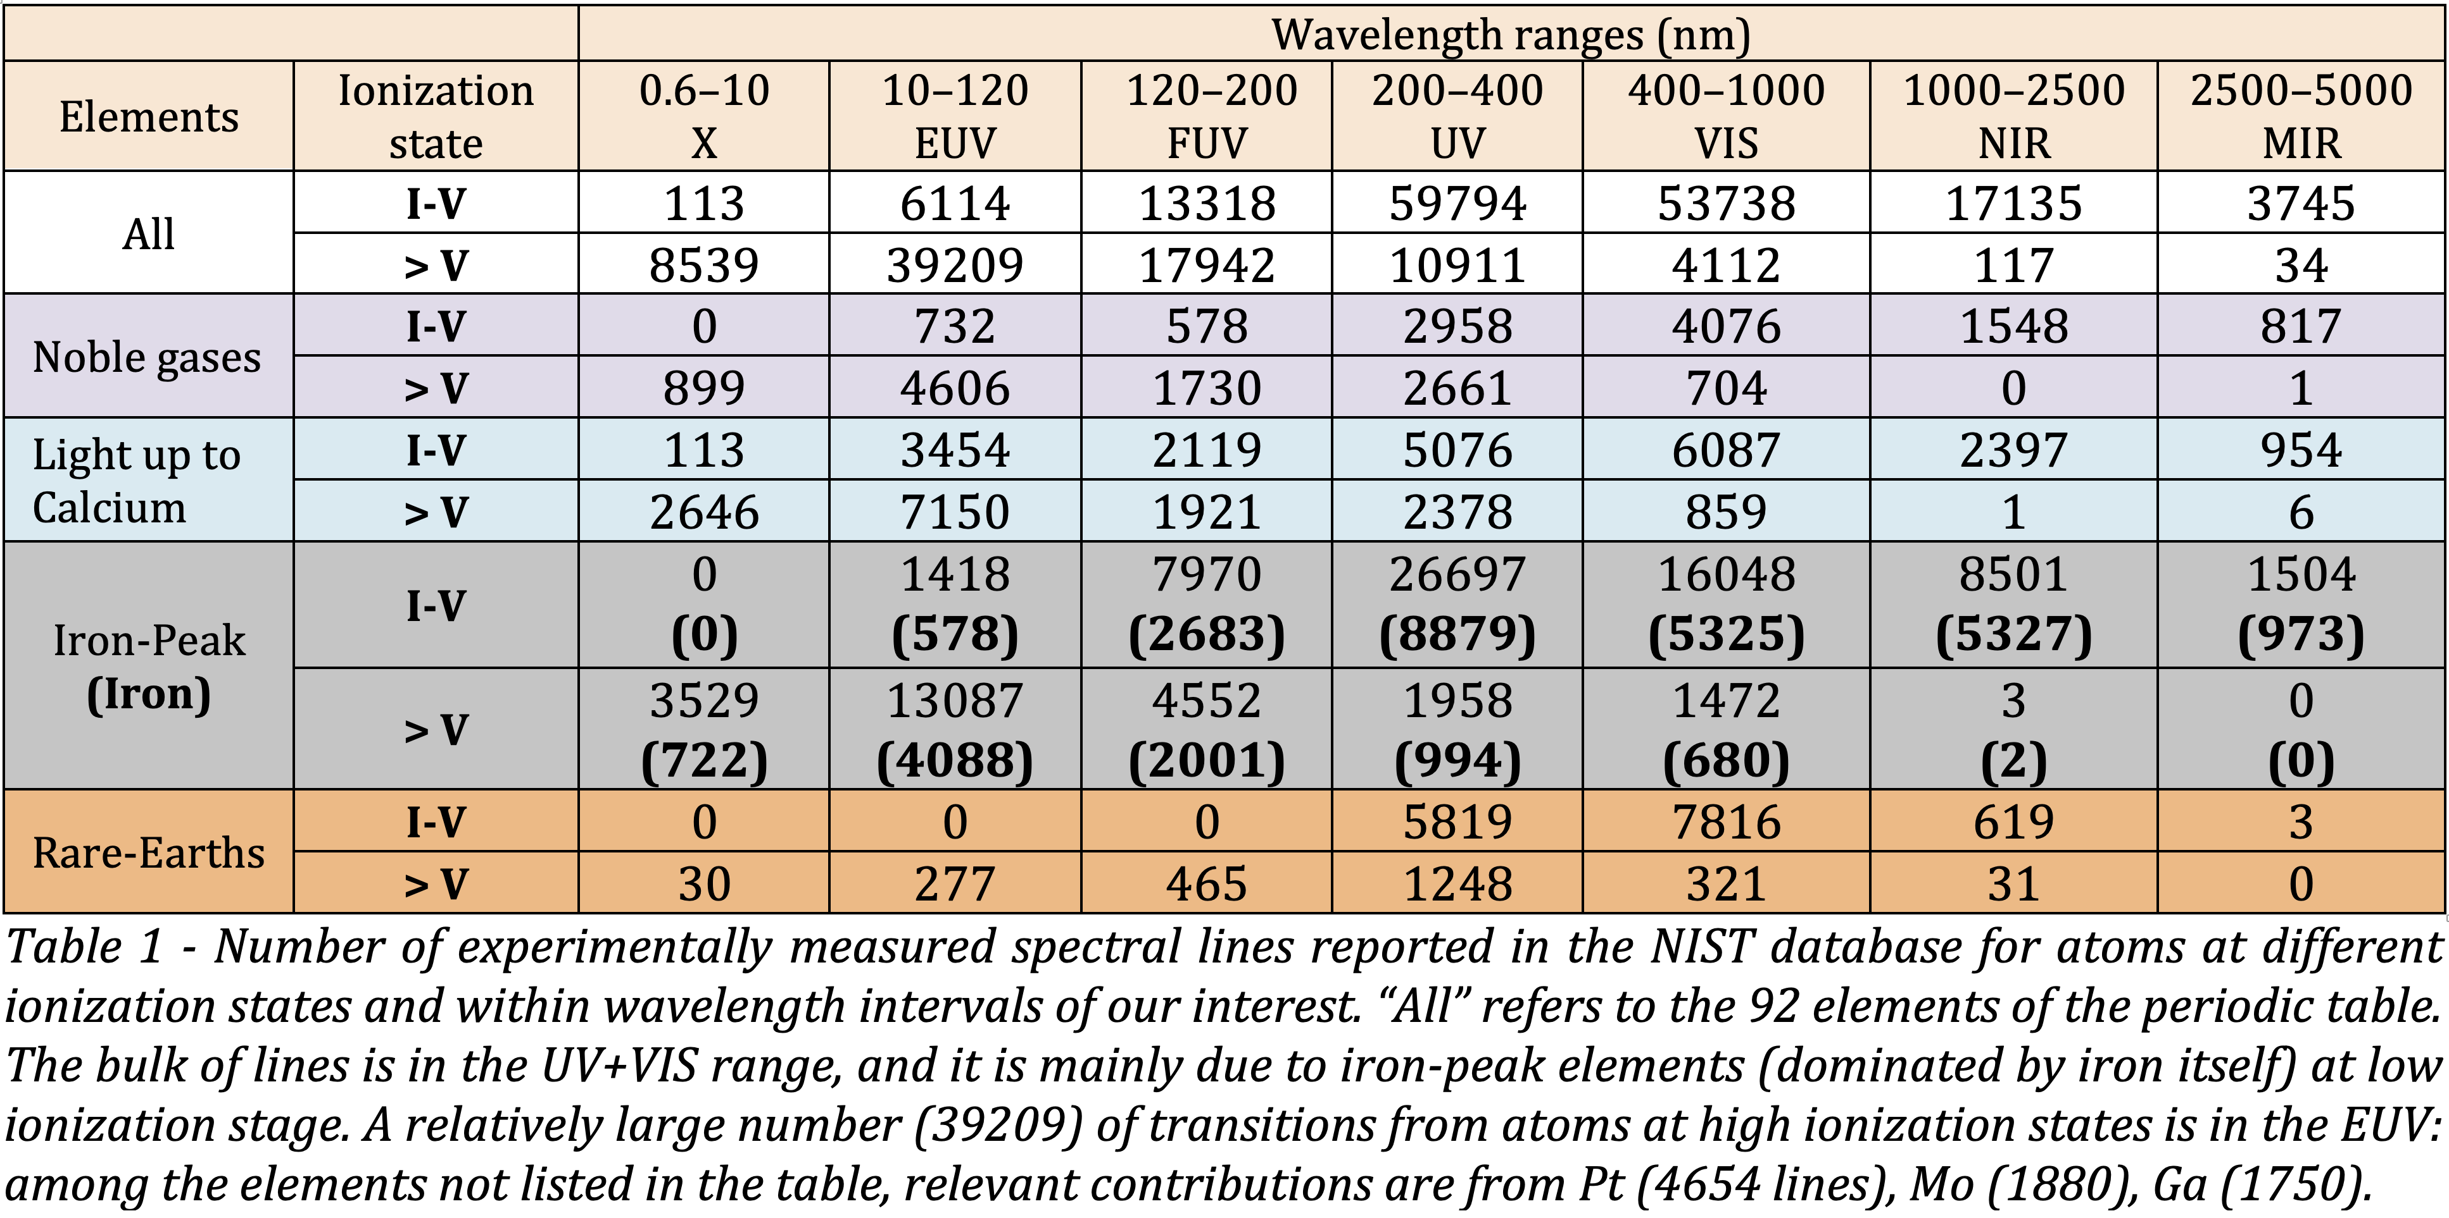
Cast a cold eye on scarcity
Atomic data in Space
In principle, any ion emits an infinite number of spectral lines.
Pls, remined that spectral emission from a
Cold plasma is due to neutral and low-ionised atoms, mainly in the visible range
Hot plasma is due to highly-ionised atoms, mainly at the shortest wavelengths
unknown knowns
at any wavelength
Mining the ‘’National Institute of Standards and Technology’’ database:
Number of experimental spectral lines per species and wavelength
known knowns
in the visible range

Slide 6
GOAL:
The Laboratory for Plasma Spectroscopy @ OACT
Exegesis of astrophysical spectra
There is a scarcity of experimental atomic data
The differences in wavelengths between ab-initio calculations and experimental values are usually larger than 5%
MOTIVATION:
High-resolution spectroscopy of each atomic species, covering all ionisation states, one by one, ideally at any wavelength
METHOD:

Slide 7
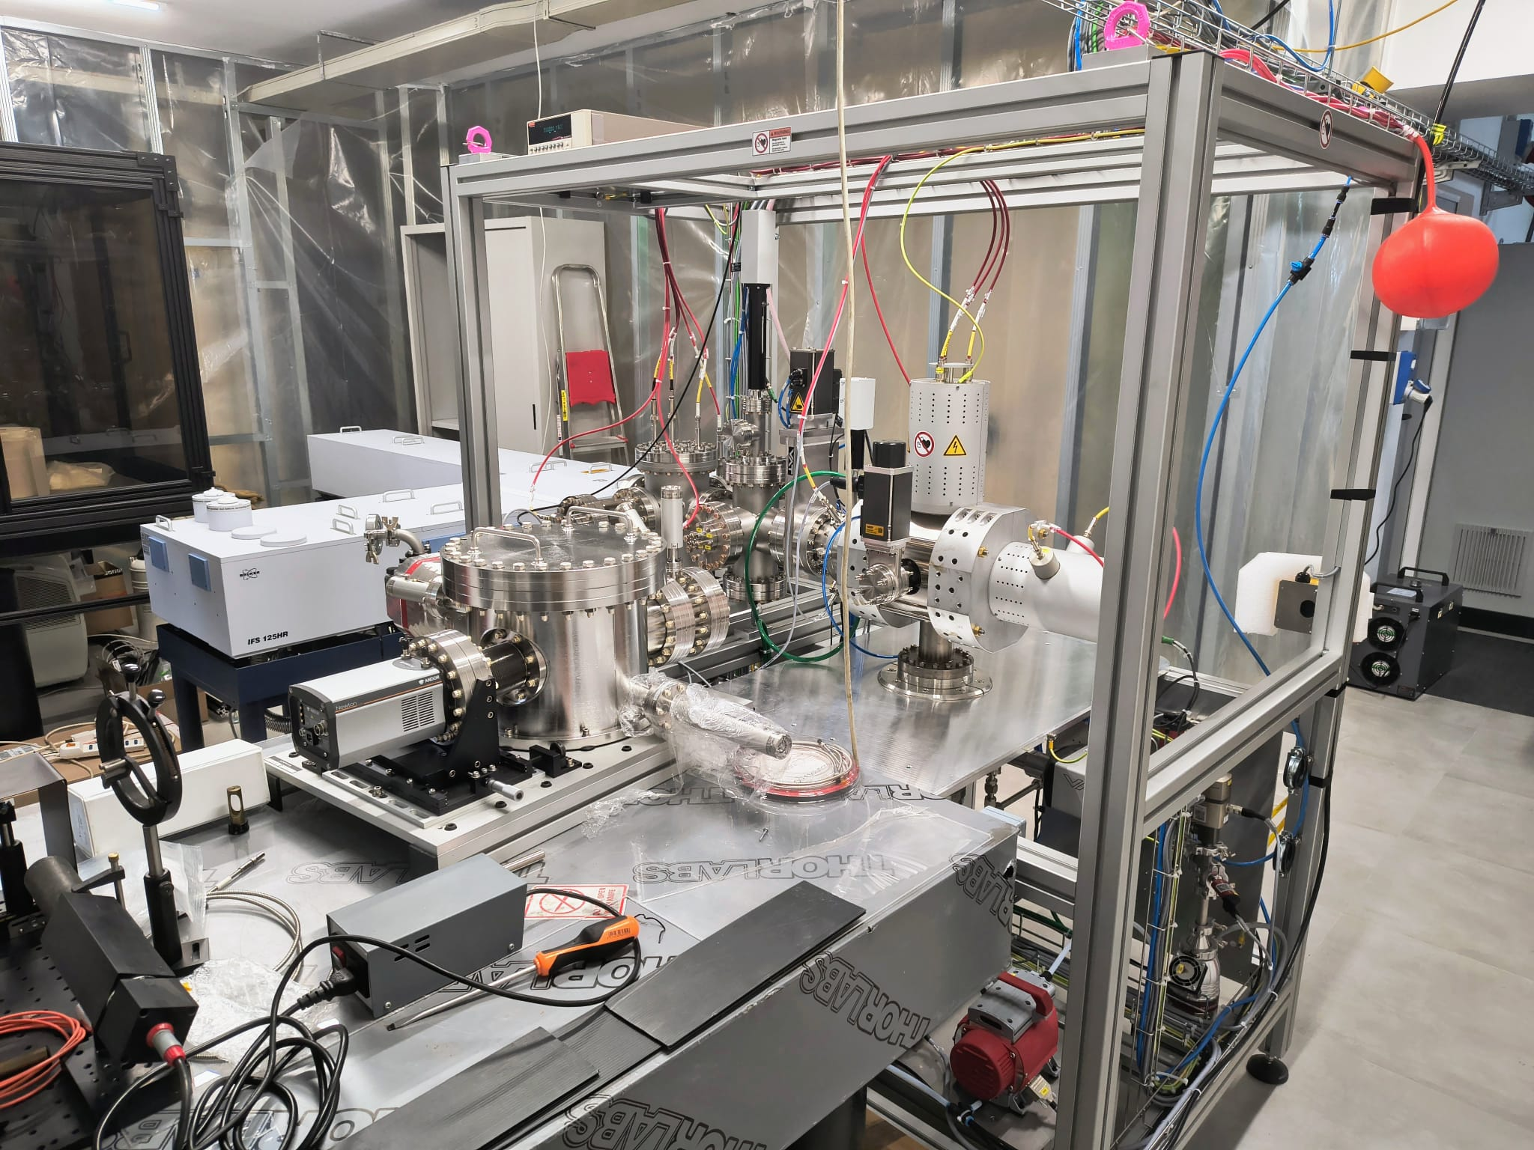
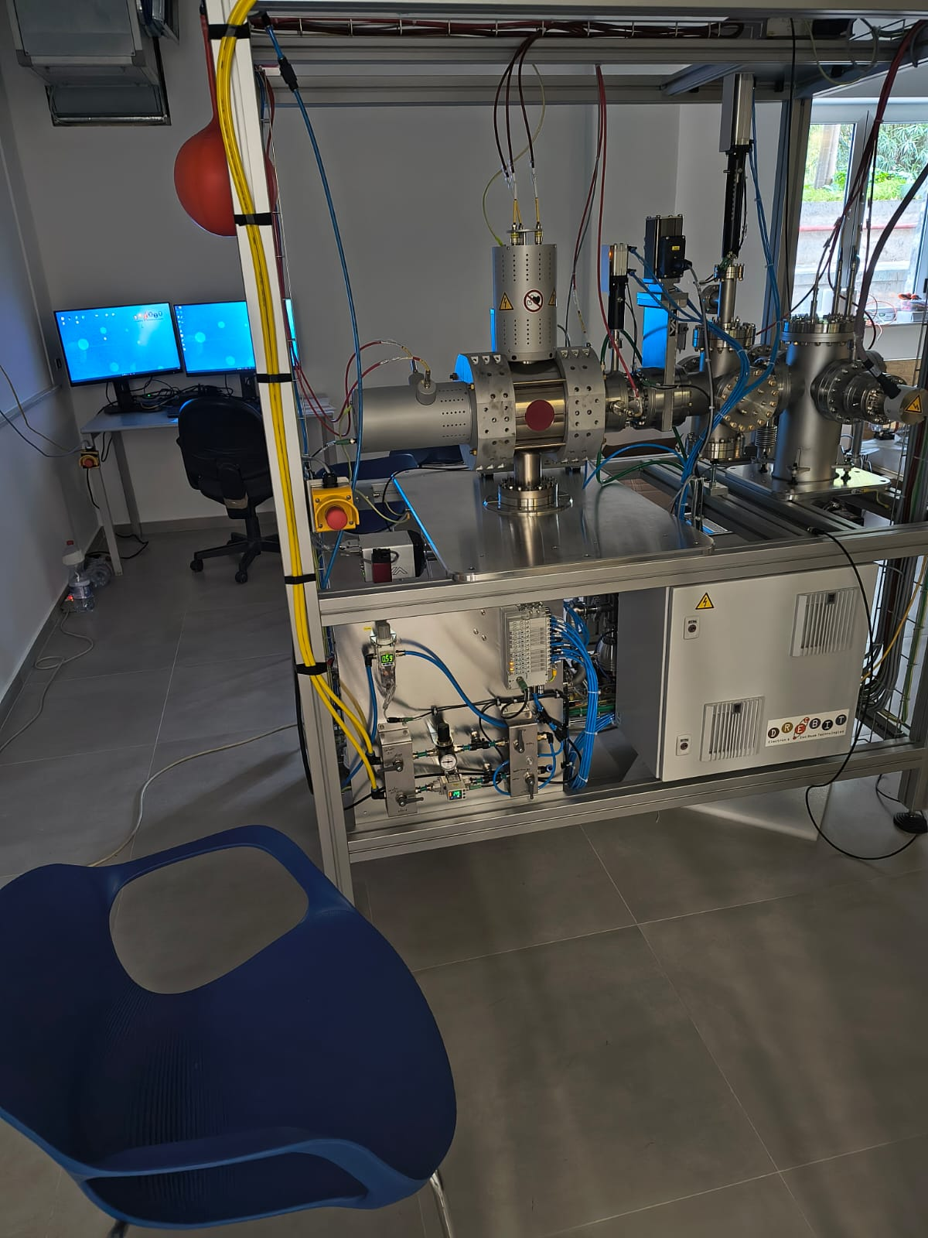
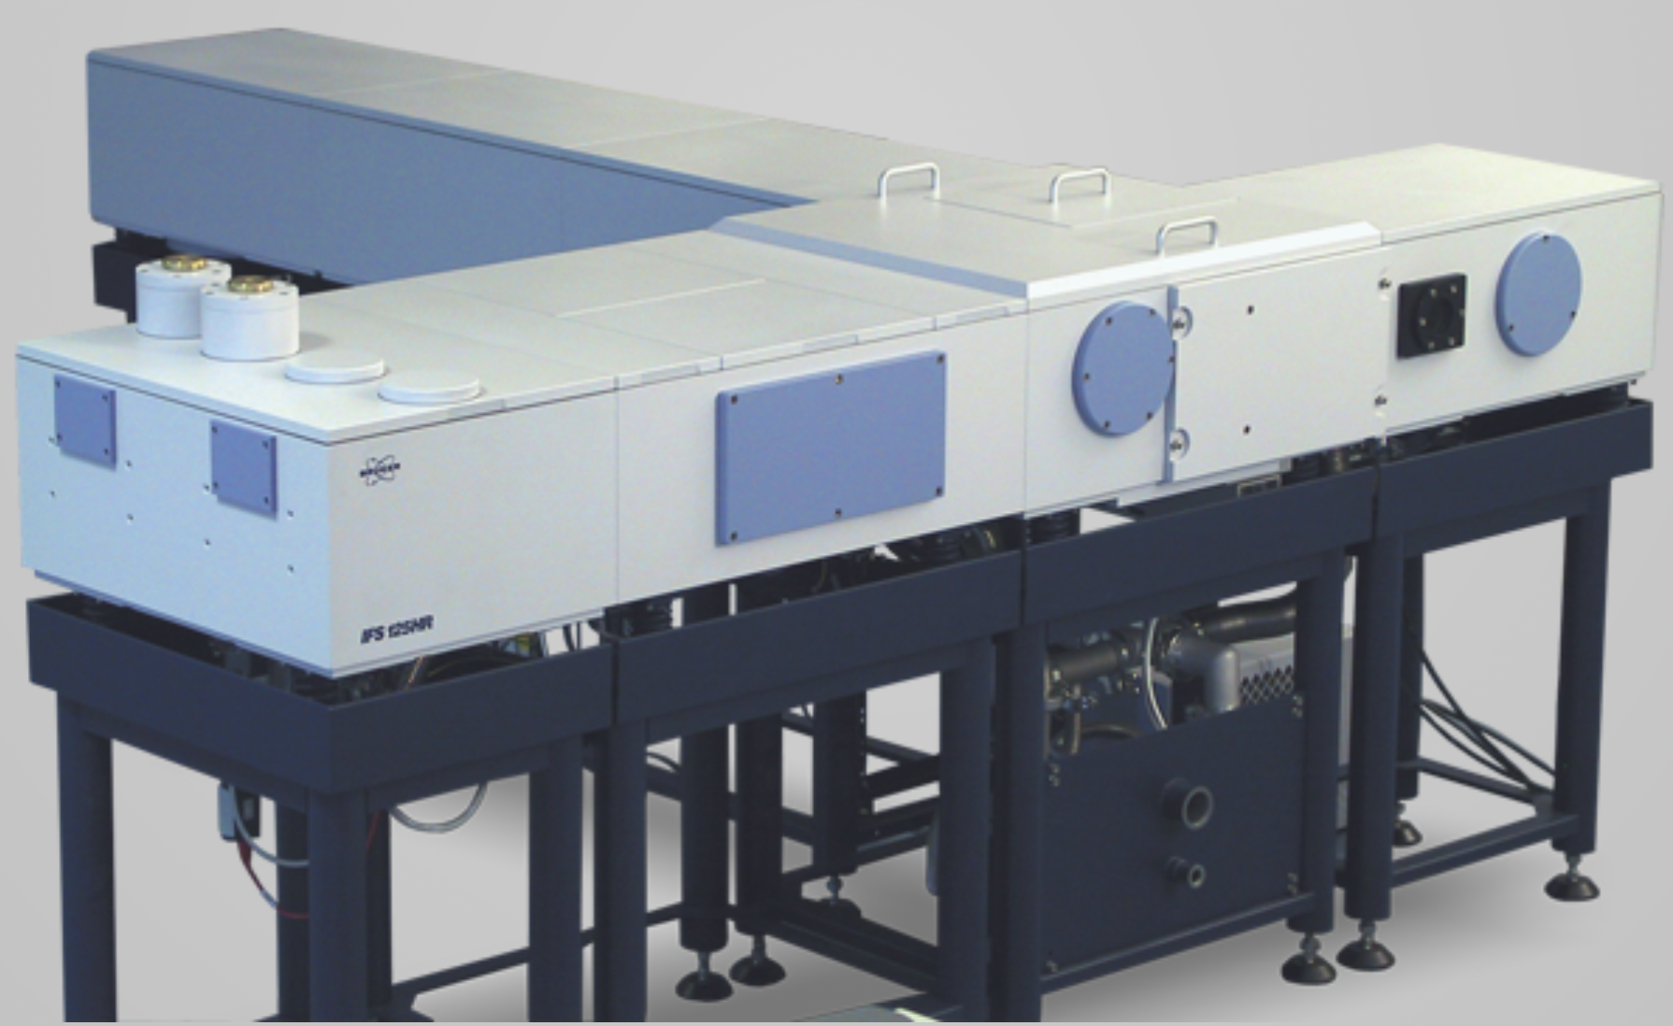
The Plasma Laboratory @ OACT was created to
- ionise atoms in controlled conditions and without risk
- perform high-resolution spectroscopy, at all wavelengths
Laser-Produced Plasma
X-Ray Spectrograph
McPherson 251MX
R_{max}= 700
0.6 - 20 nm range
Fourier Transform Spectrograph
DREEBIT EBIS-A
Plasma Source
Bruker IFS 125 HR
R(500 nm) = 5.7 10⁷
200 nm – 12 μ range

Slide 8
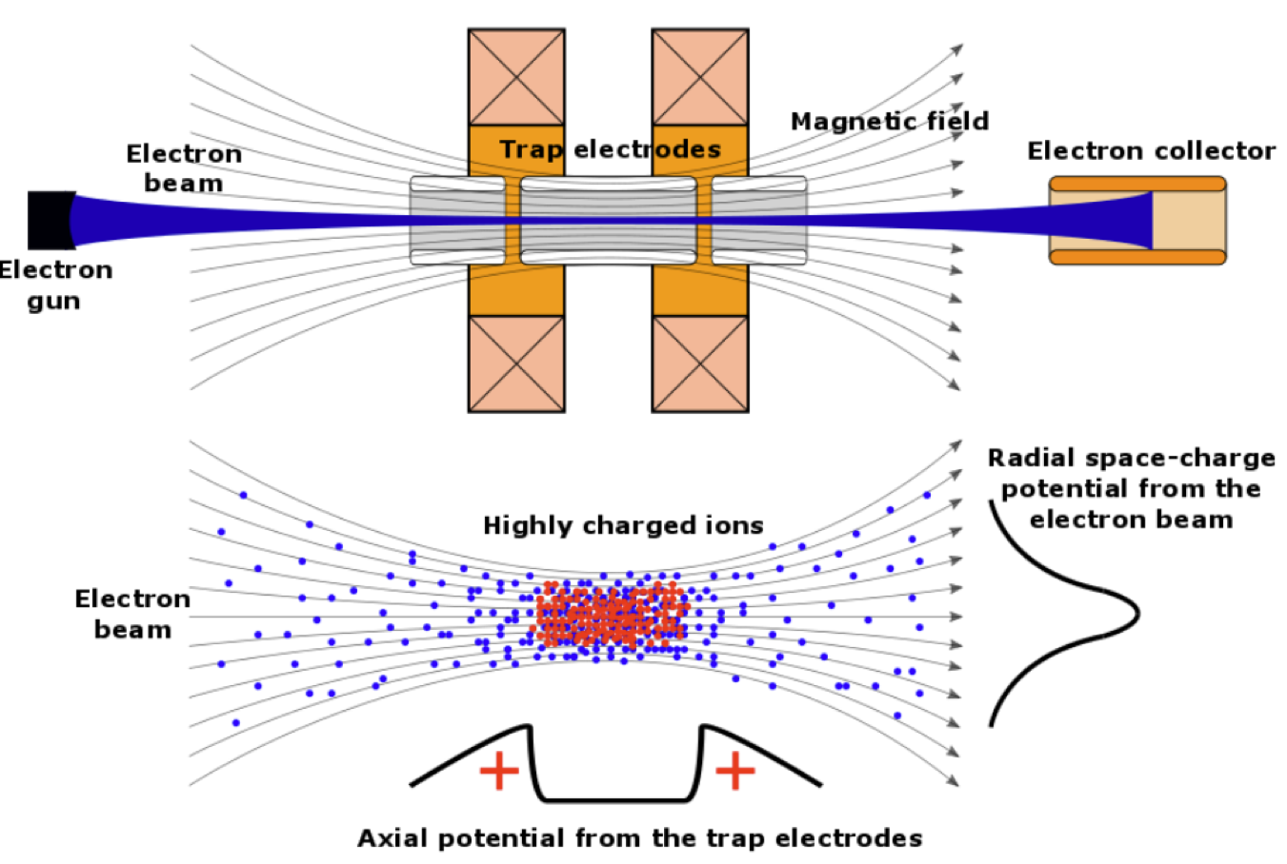
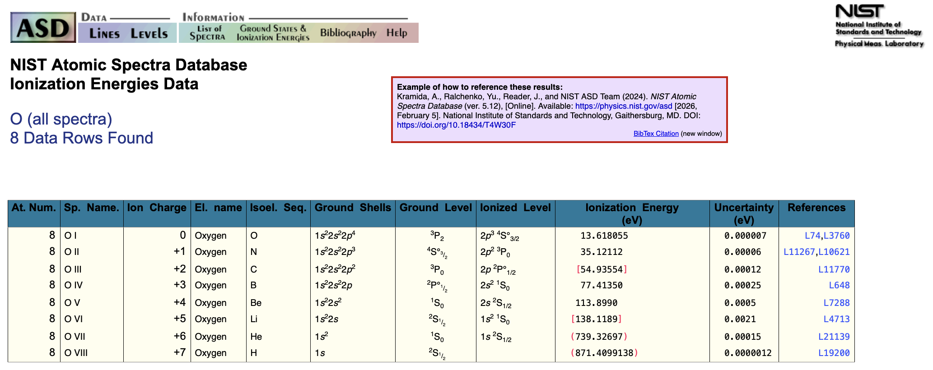
We design the
Plasma Source inspired by NIST
Electron
Beam
Ion
Trap
magnet coils
EBIT mimics million-degree temperatures in safe conditions
T_{ion}[MK]
0.15
0.41
0.64
0.90
1.32
1.60
8.58
10.1

Slide 9

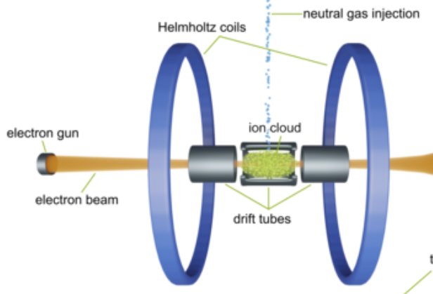
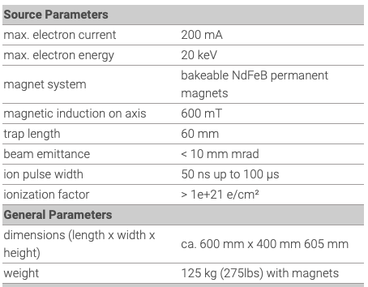
In collaboration with the manufacturing company
We design the Plasma Laboratory based on an
Electron
Beam
Ion
Source
permanent magnets
neutral atoms
electron gun
ion cloud
electron beam
drift tubes

Slide 10
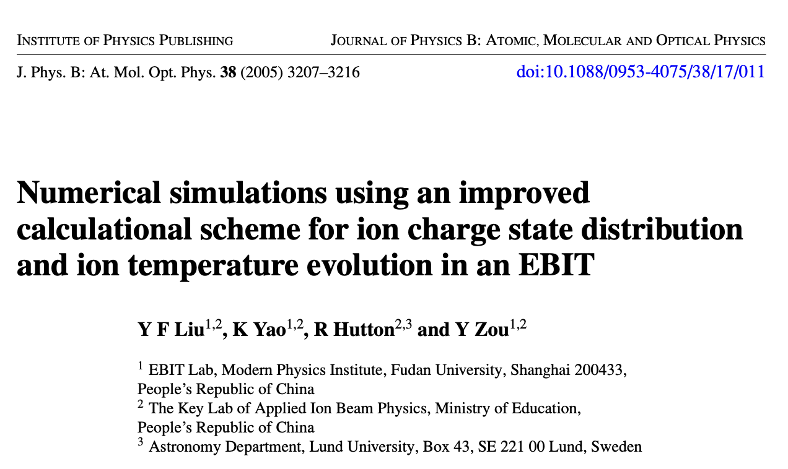
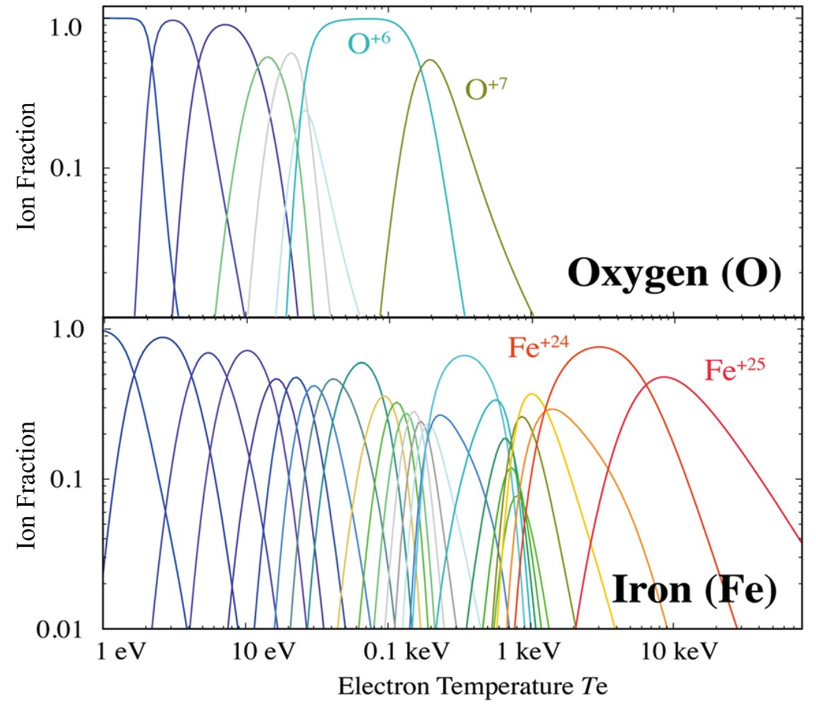
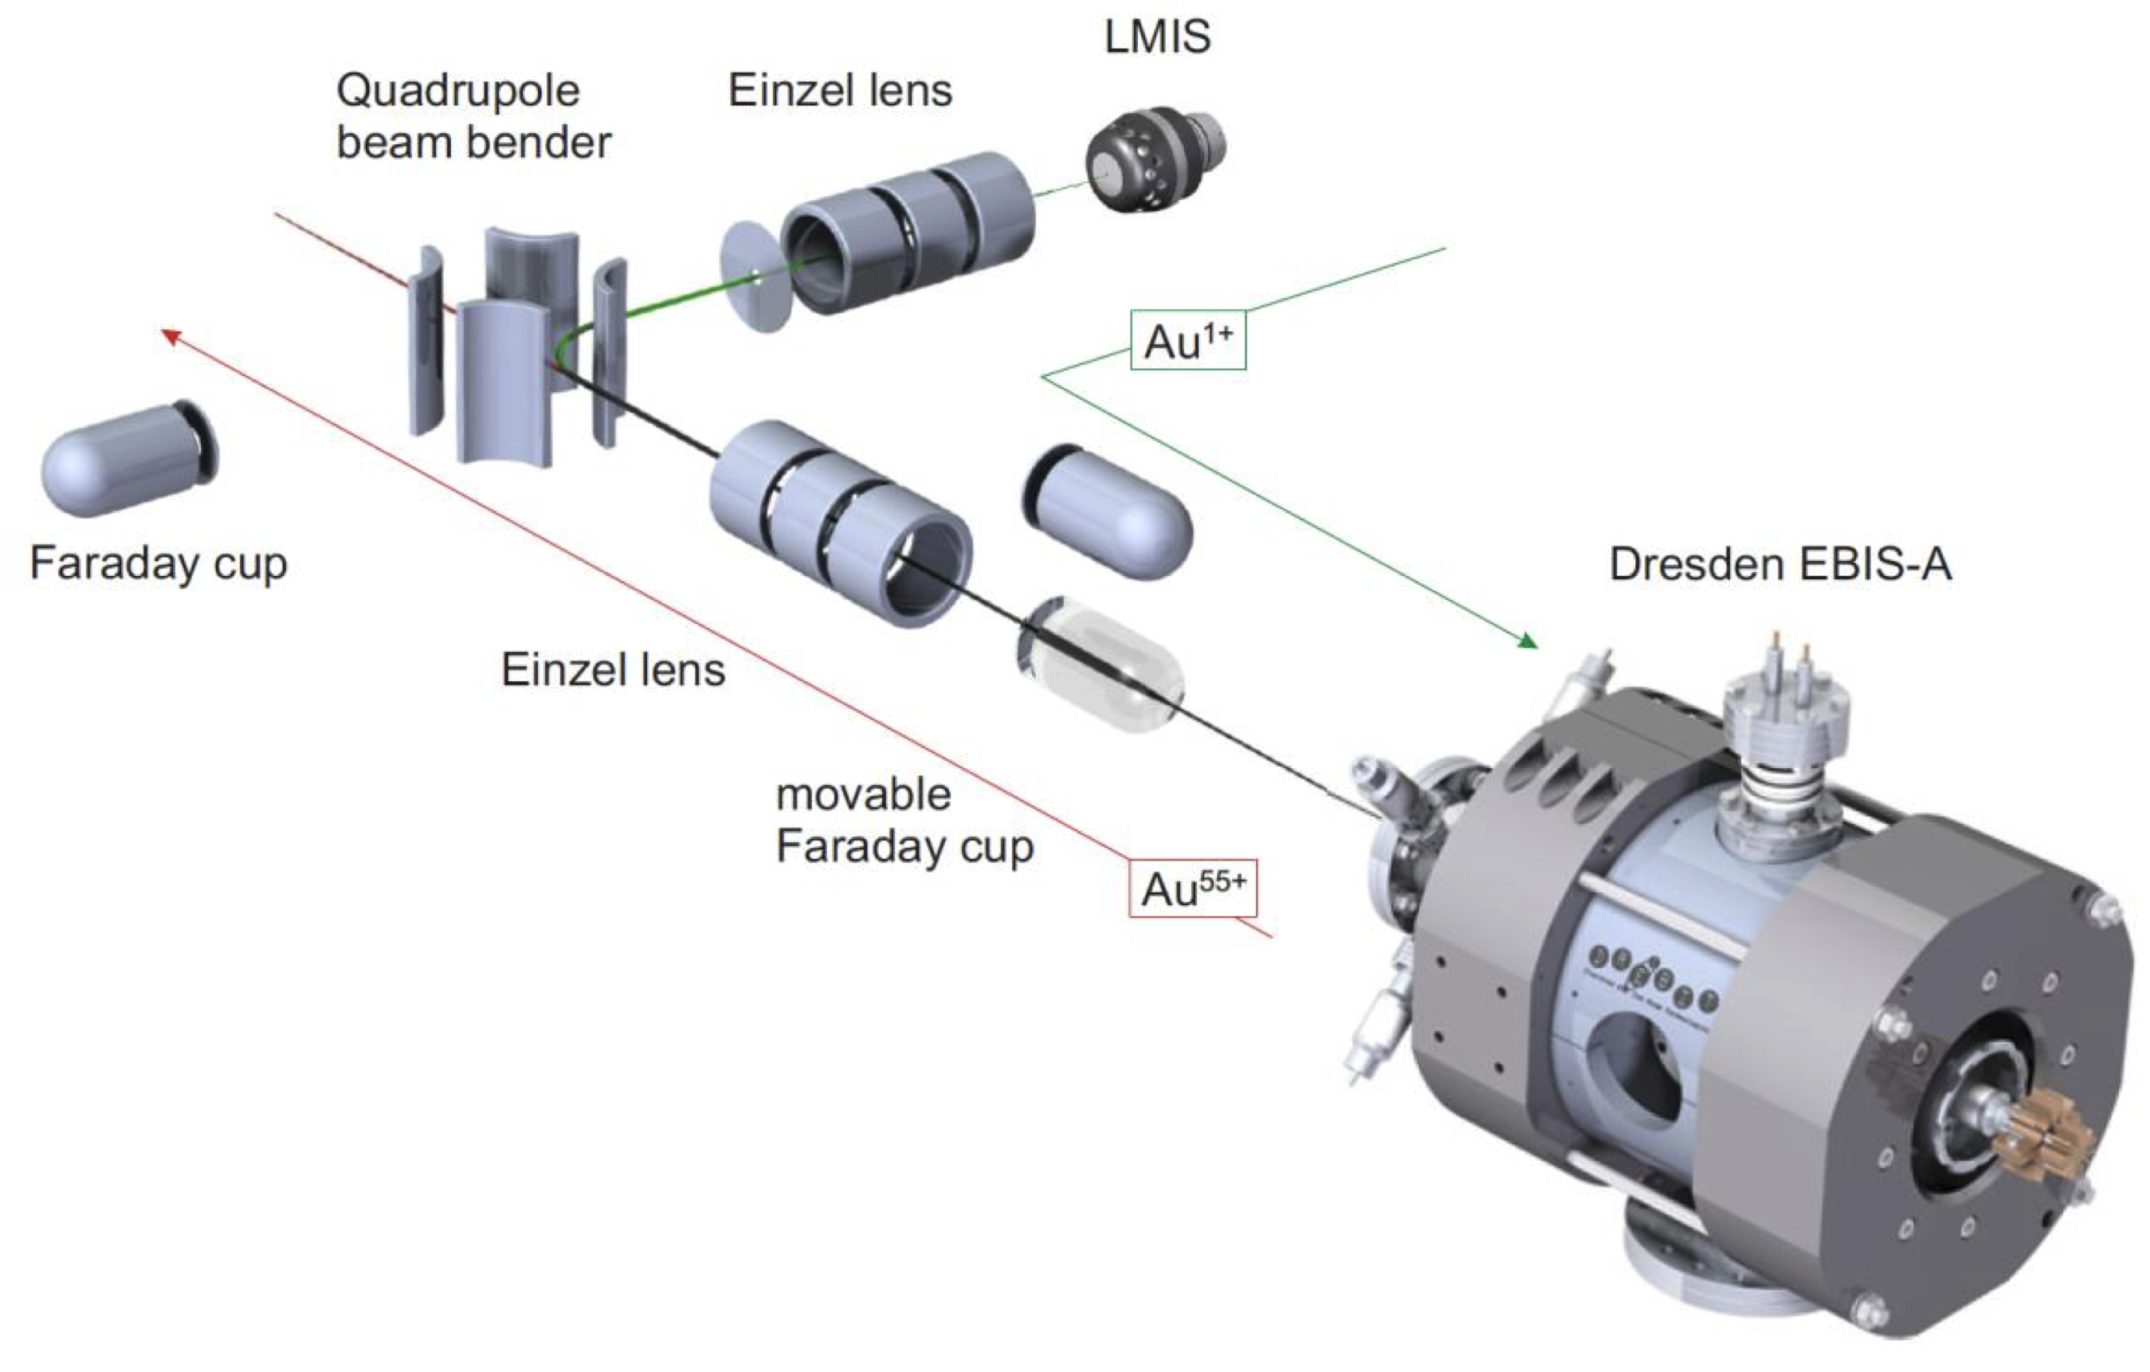
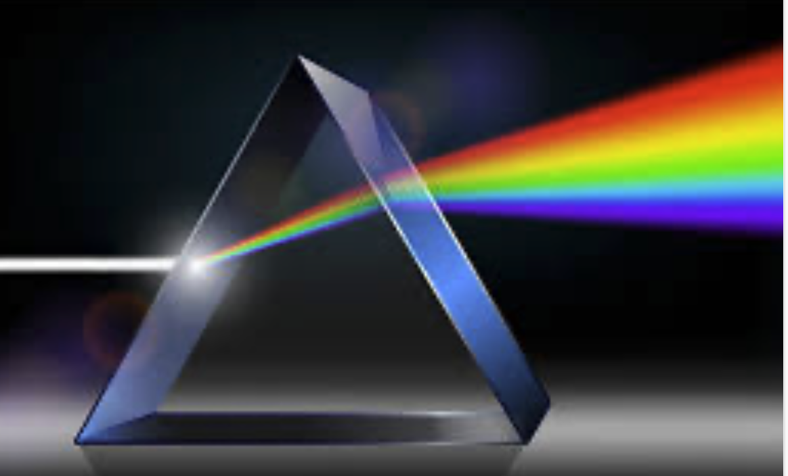
Focused on spectroscopy, instead of an EBIT, we preferred an EBIS from which ions can be extracted
simultaneous
Solution depends on unknown electron impact cross-sections

Slide 11
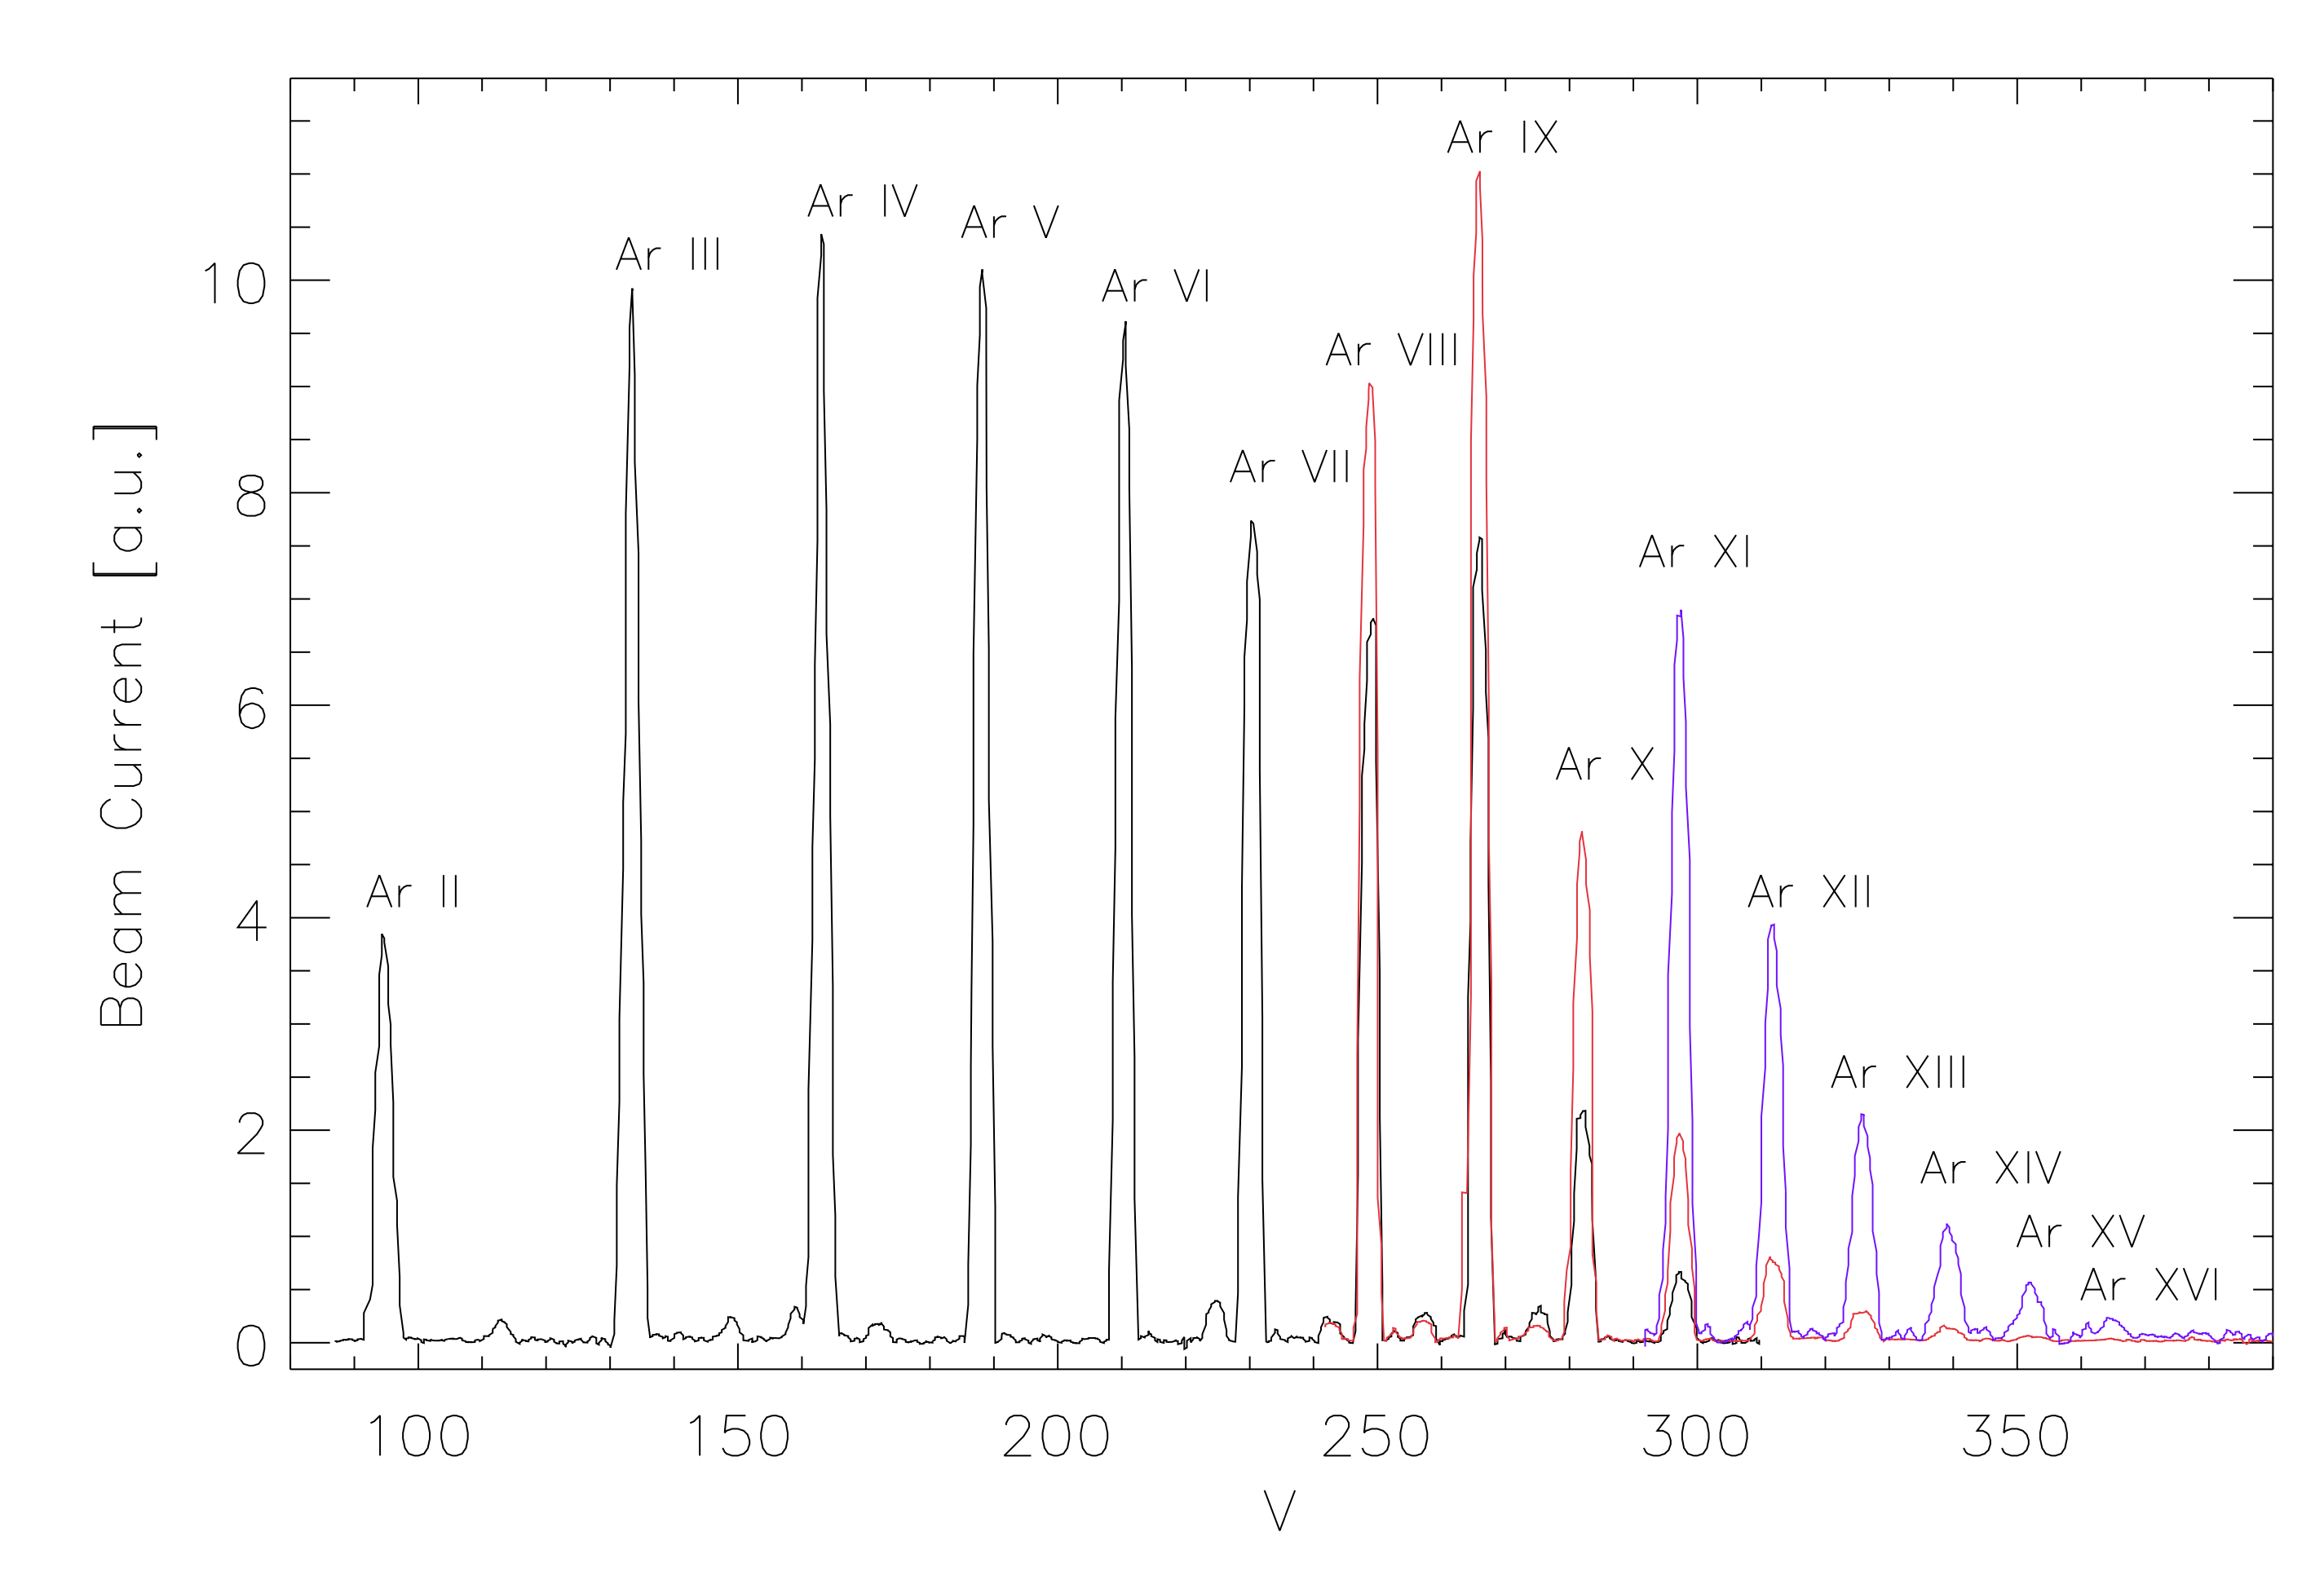
Instead of an EBIT, we preferred an EBIS from which ions can be extracted
equipped with
to measure their
Charge-Distribution
ions
ions
We change the charge-distribution
to uniquely identify the ion responsible for a spectral line

Slide 12
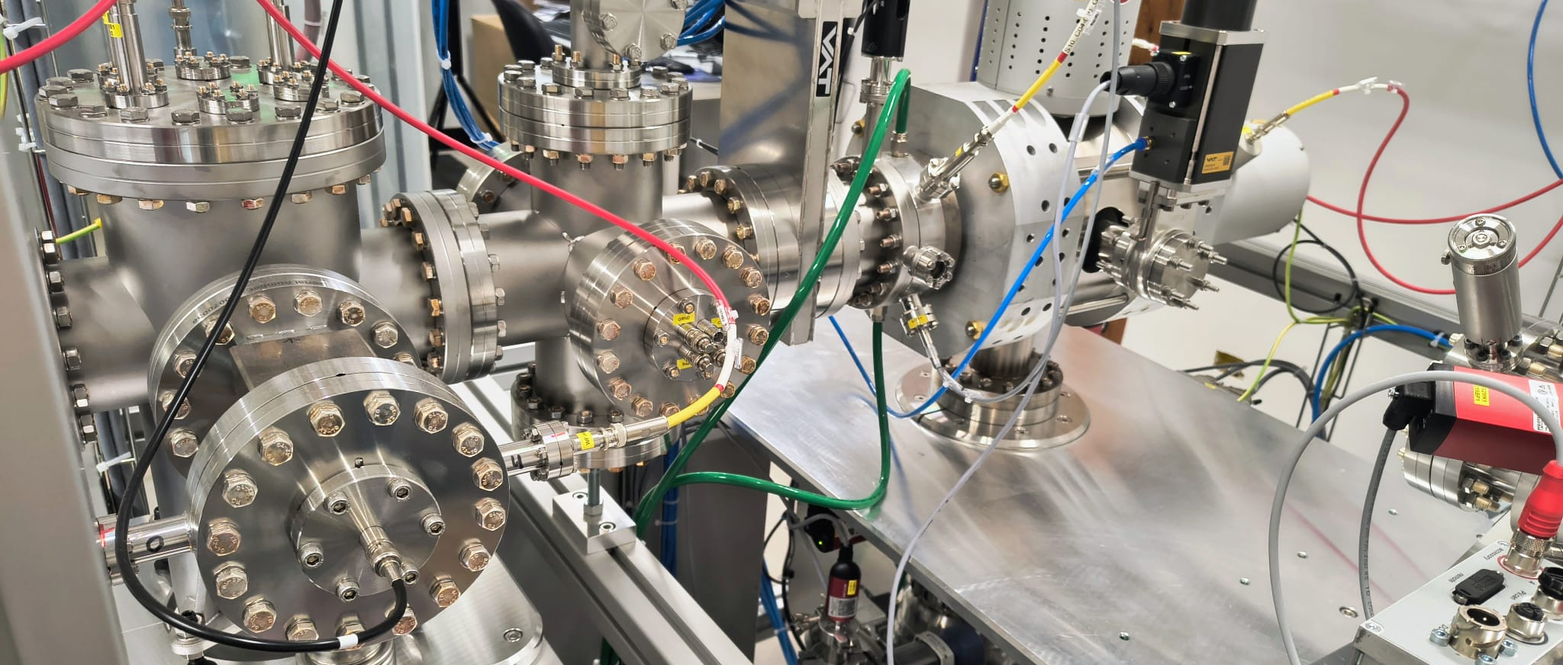

ions
Magnetic Quadrupole
Magnetic Quadrupole
We can directly measure electron impact cross-sections
ions
Charge state analyser

Slide 13
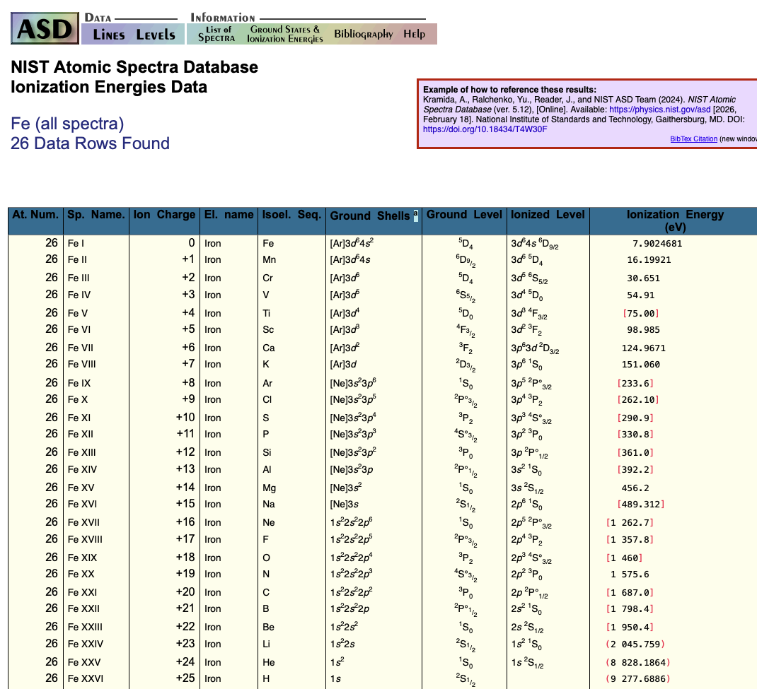
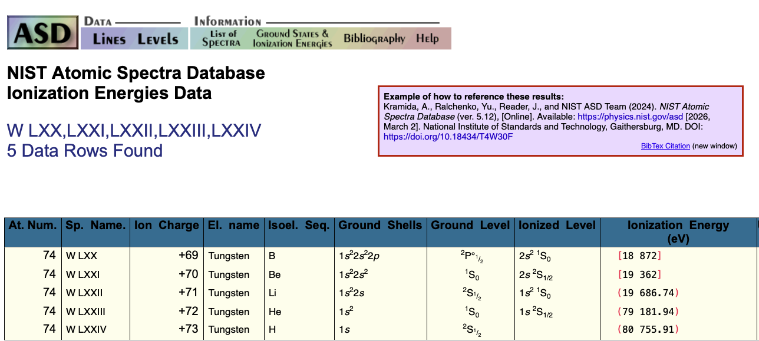
Which ions ??
The 20 keV electron gun
is enough to fully ionise iron
and reduce to He-like configuration all atoms
up to Tungsten

Slide 14
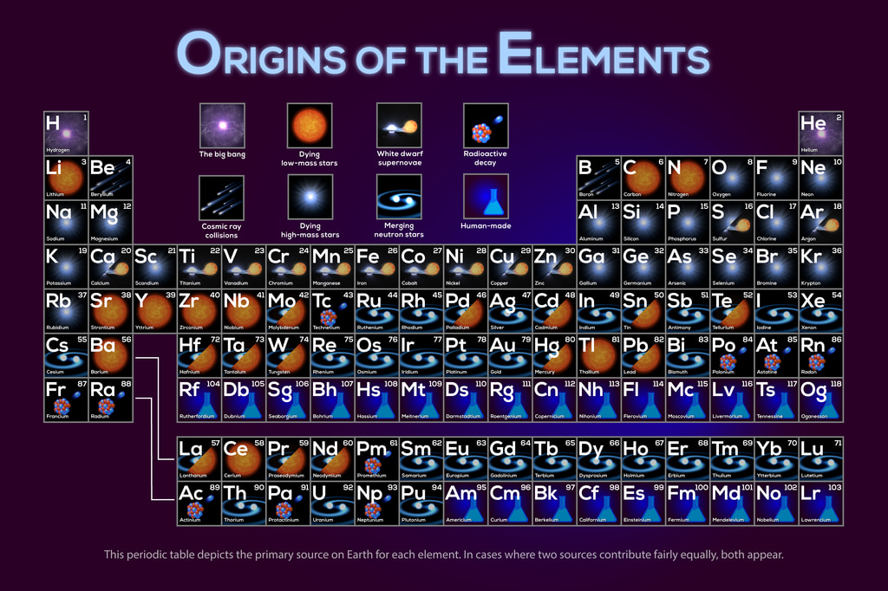
Direct gas injection
Feeding the EBIS:
Which chemical elements can be ionized?

Slide 15
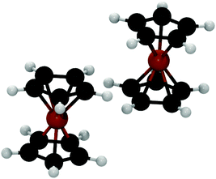
Feeding the EBIS:
MIVOC (Metal Ions from Volatile Compounds)
Liquids and solids sublimating in vacuum at room temperature
Metallocenes
H
H
C
C
MIVOC
C
H
C
C
H
H
H
Fe
H
C
C
H
C
H
C
H
C
H
C
C
C
C
C
H
Iron-peak elements
H
H
C
C
H
C
H
C
C
H
V
H
H
H
C
C
H
Ni
C
H
C
C
H
H
H
C
C
C
H
C
C
H
H
C
C
H
C
H
H
H
C
C
H
Ti
C
C
H
H
H
C
C
H
H
C
C
C
H
C
H
C

Slide 16
Feeding EBIS with the heaviest elements:

Slide 17
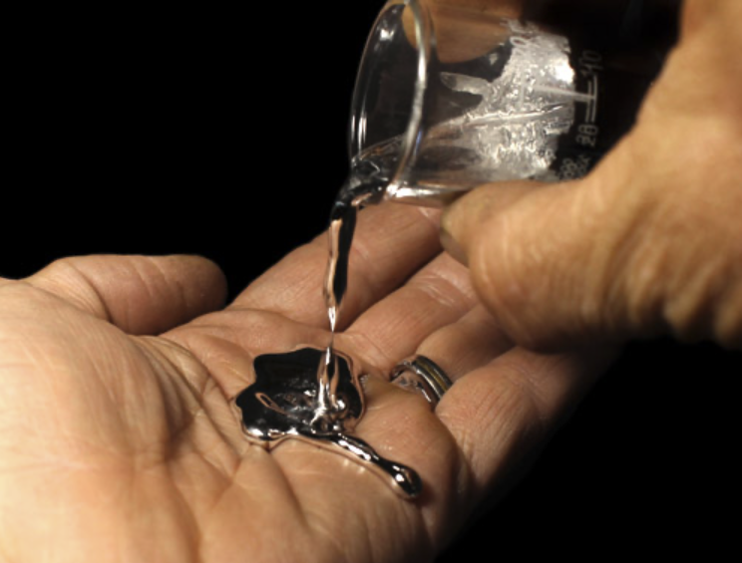

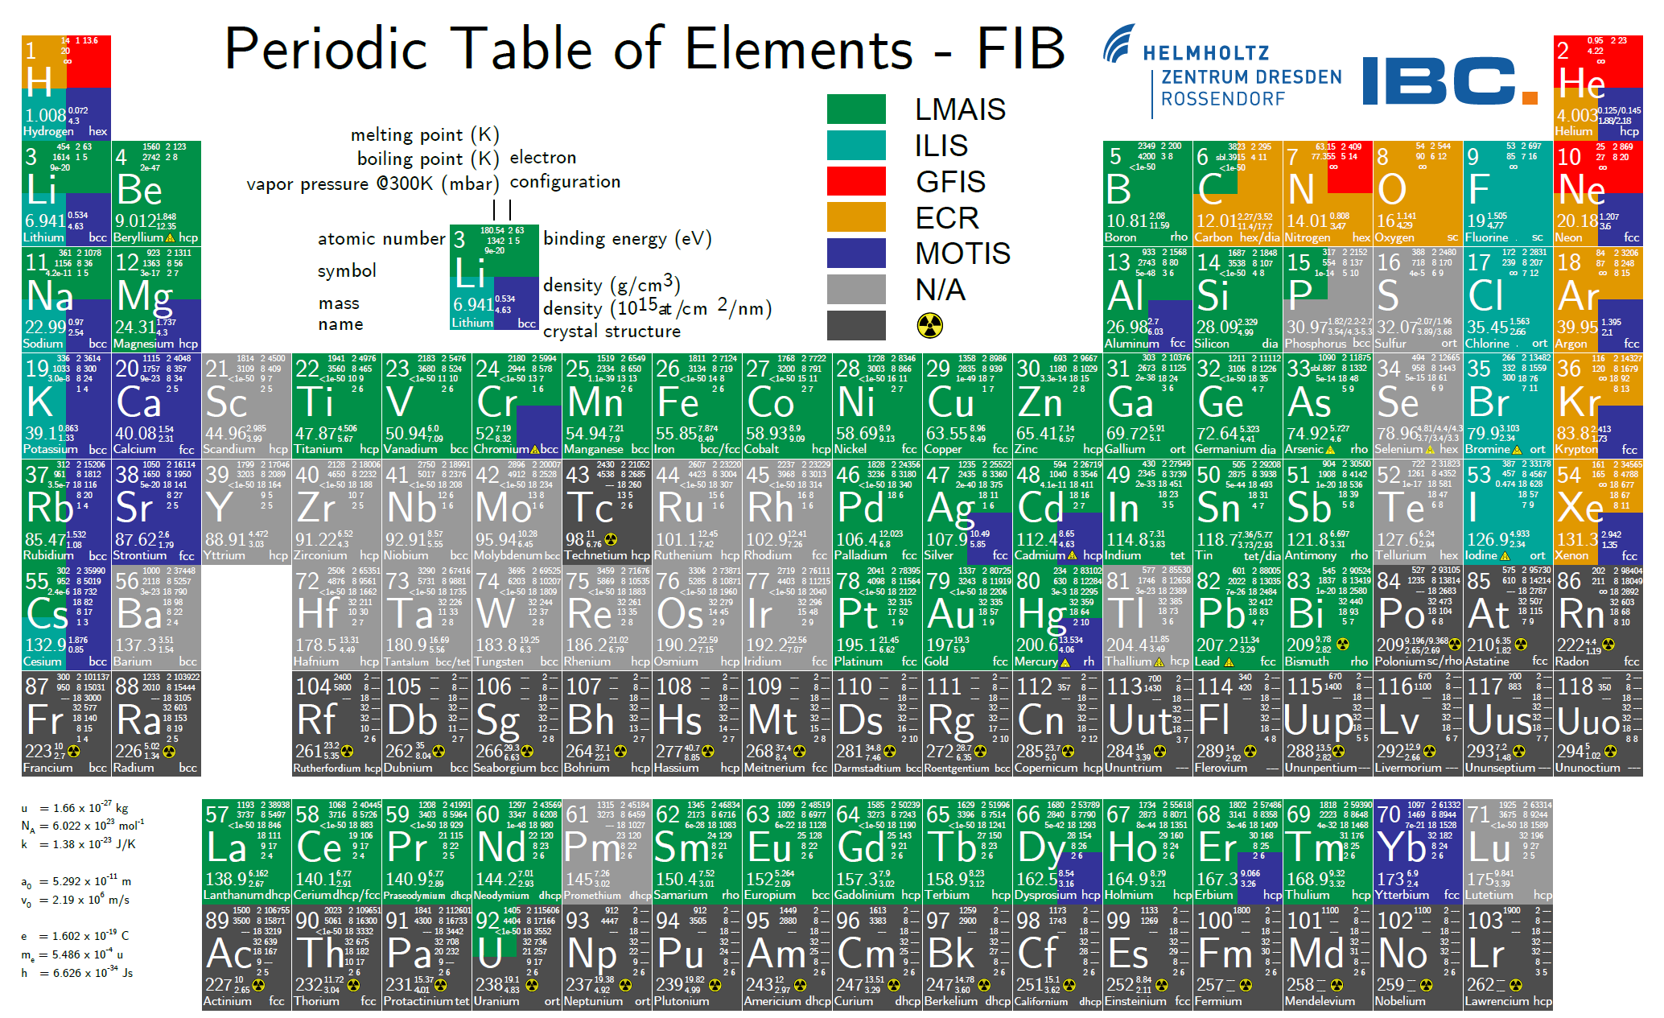
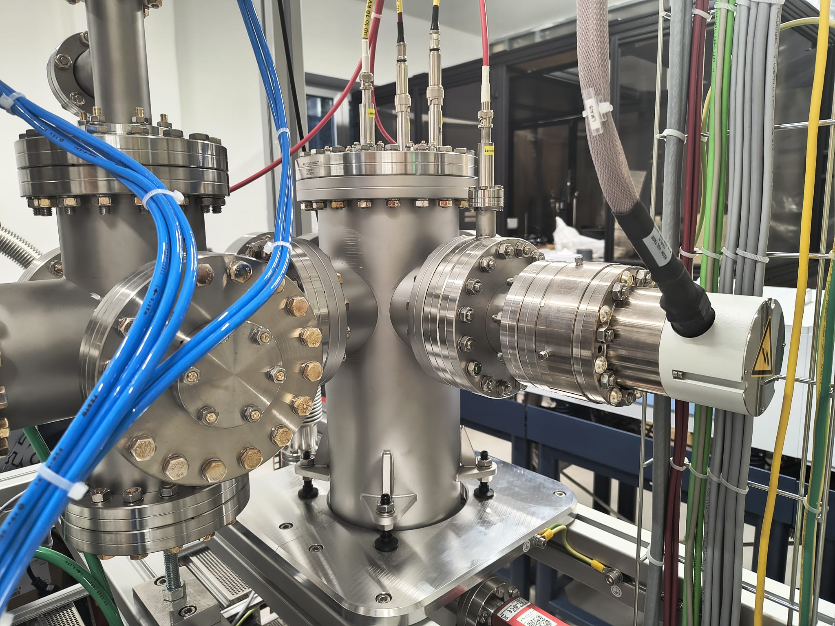
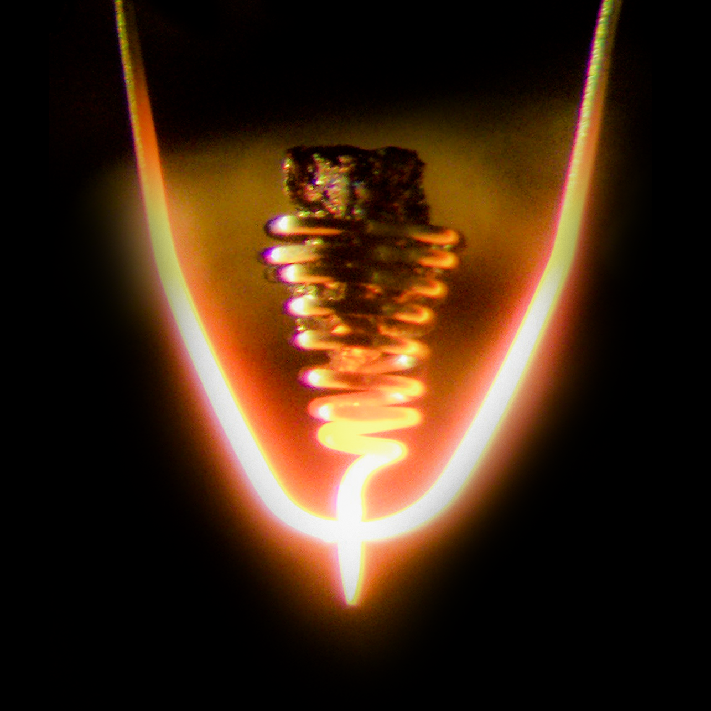
Feeding EBIS with the heaviest elements: LIQUID METAL ALLOY ION SOURCE
the melting temperature of a metal is lowered in alloys
https://www.hzdr.de/db/Cms?pOid=59382&pNid=0
Iow charge ions to be further ionised
Magnetic Quadrupole
Iow charge ions
LMAIS
T = 1500 °C

Slide 18
THE SPECTROGRAPHS

Slide 19
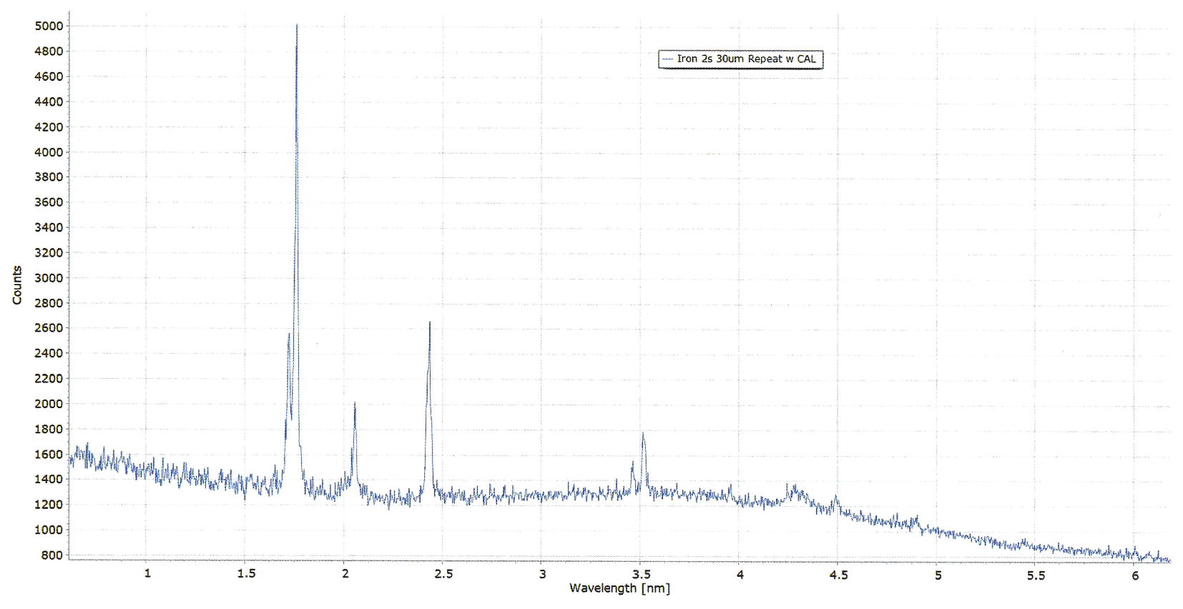
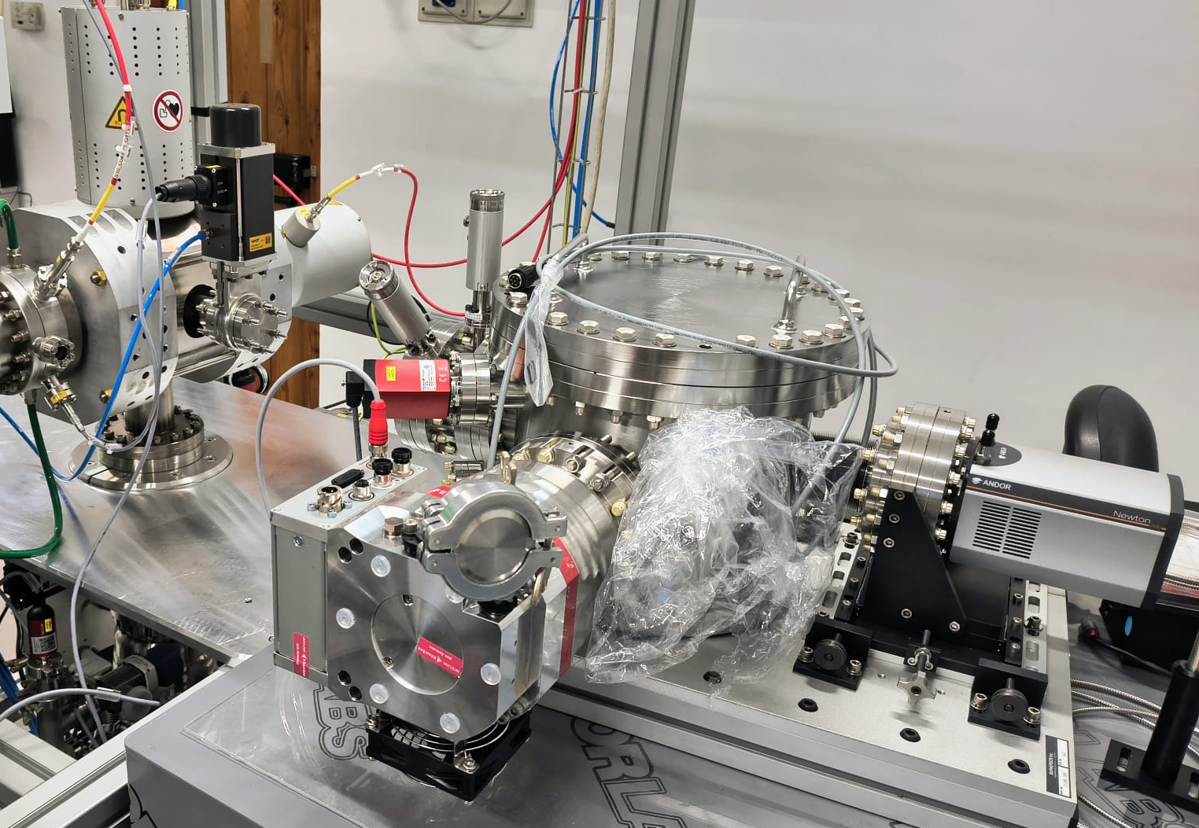
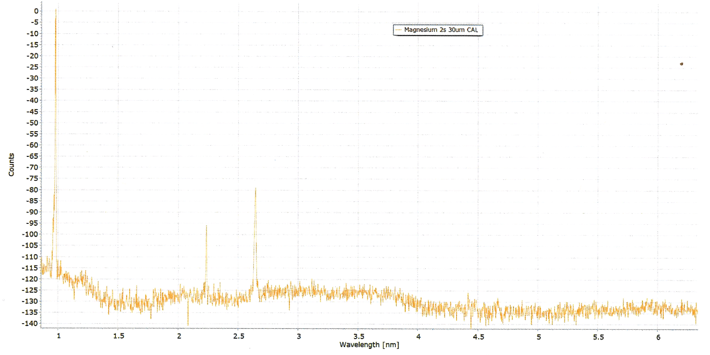
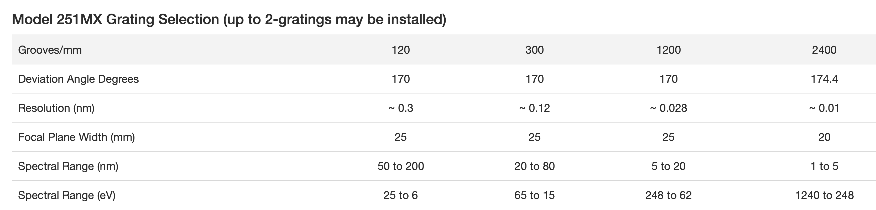
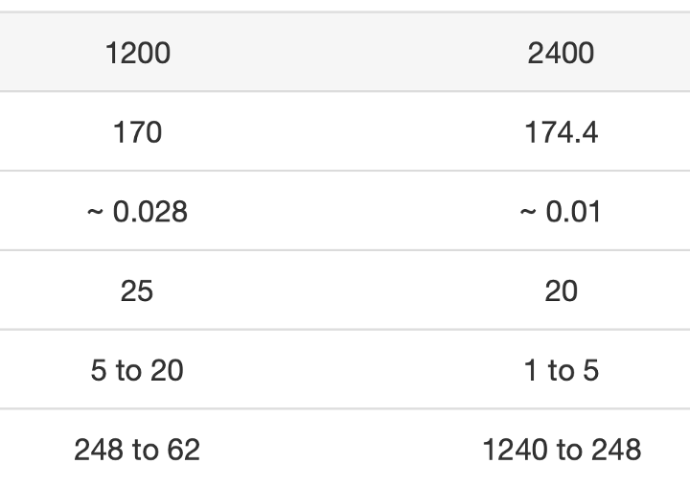
X-Ray Spectrograph
McPherson Model 251MX sharing the Ultra High Vacuum (10⁻¹⁰ mbar) with no port-view λ = 0.6 - 20 nm
Detector: Andor camera
Iron
Magnesium
MOTIVATION
Cross-check vs 251MX@EBIT@CfA
0.6 to 6
2044 to 207

Slide 20
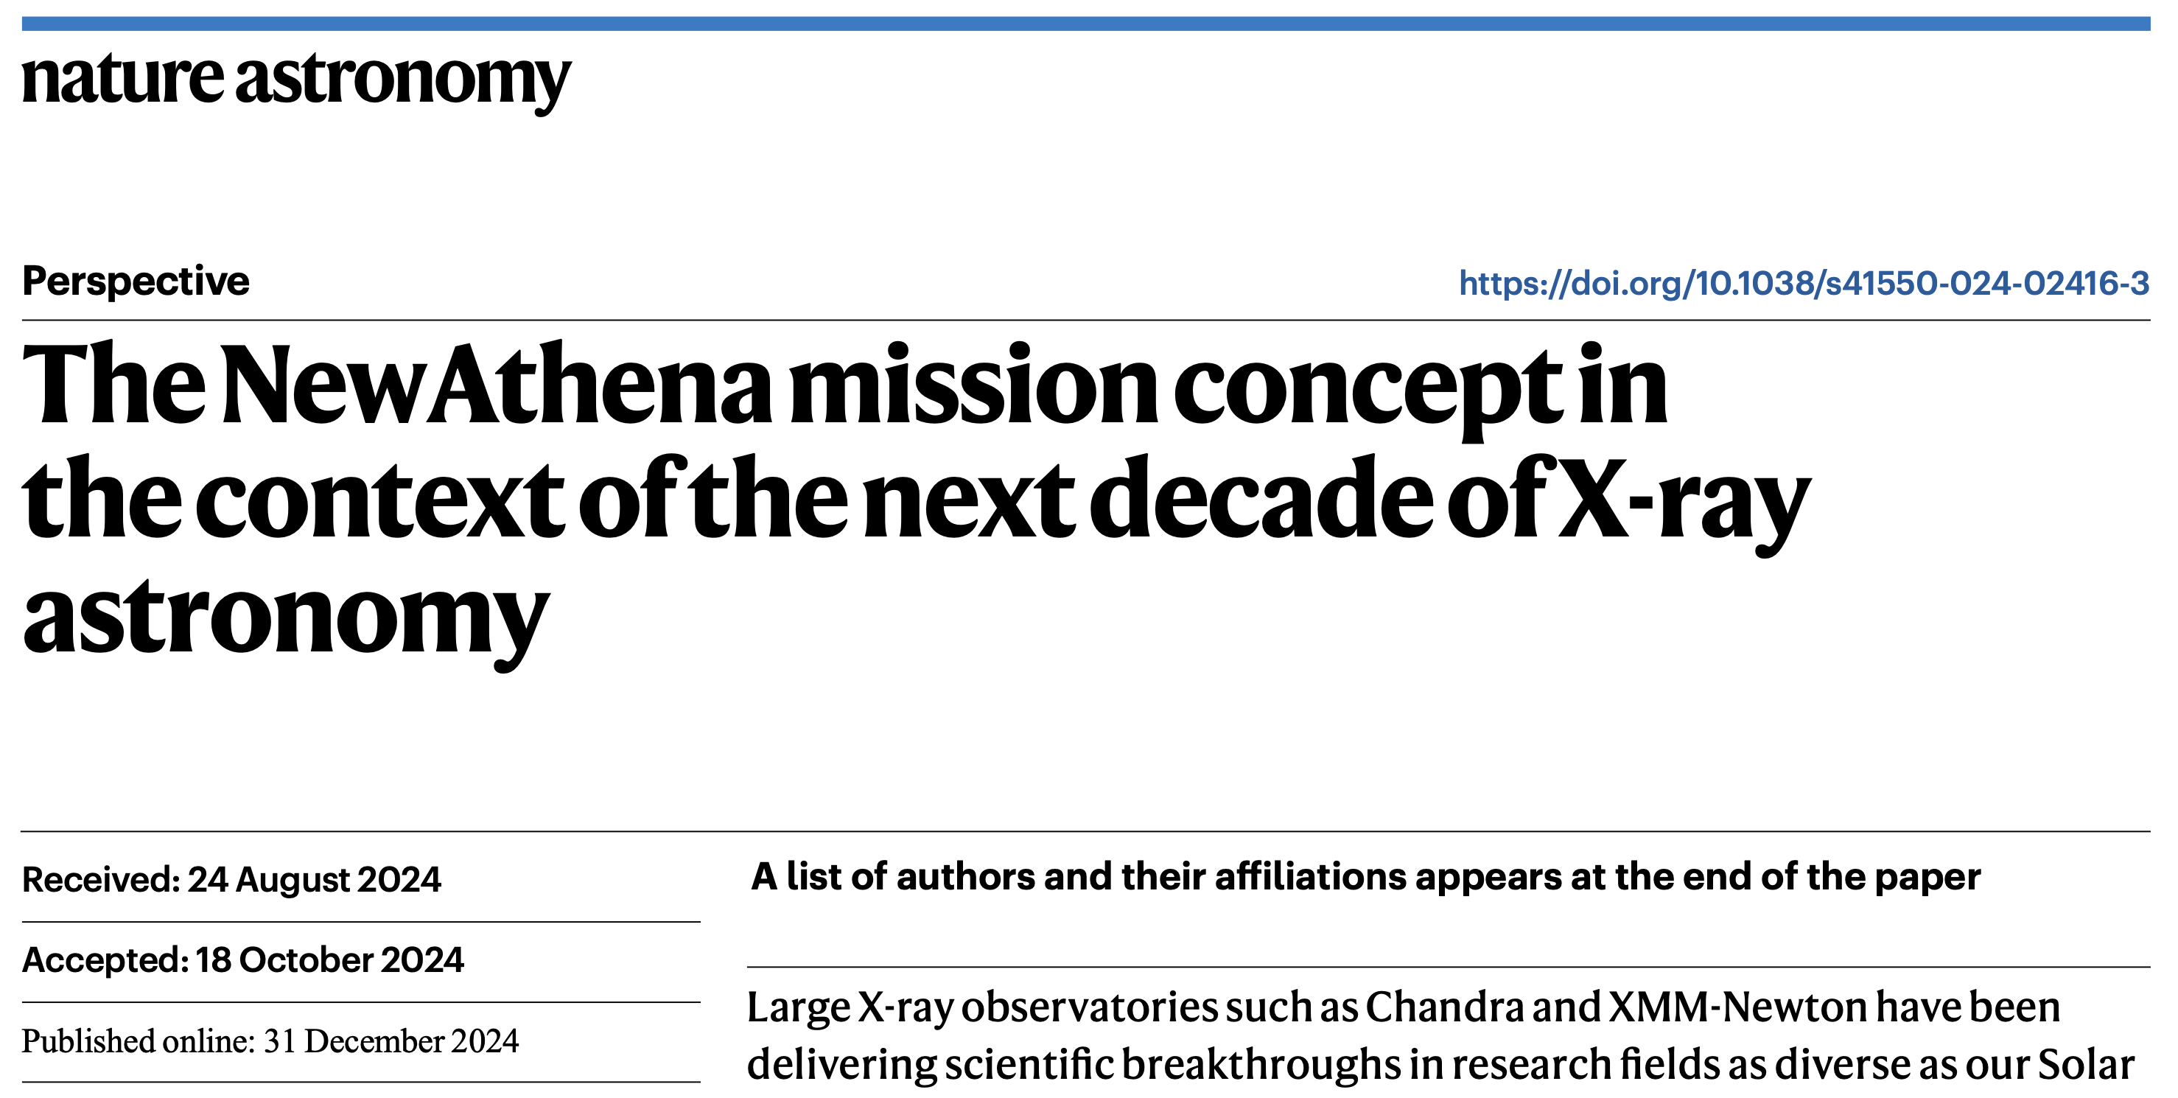
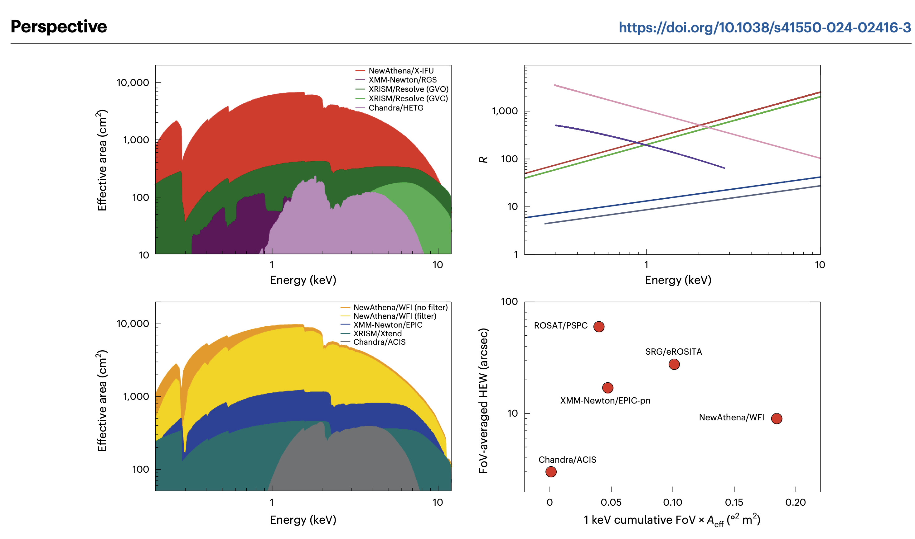
NewAthena/X-IFU
251MX
17/03/26

Slide 21
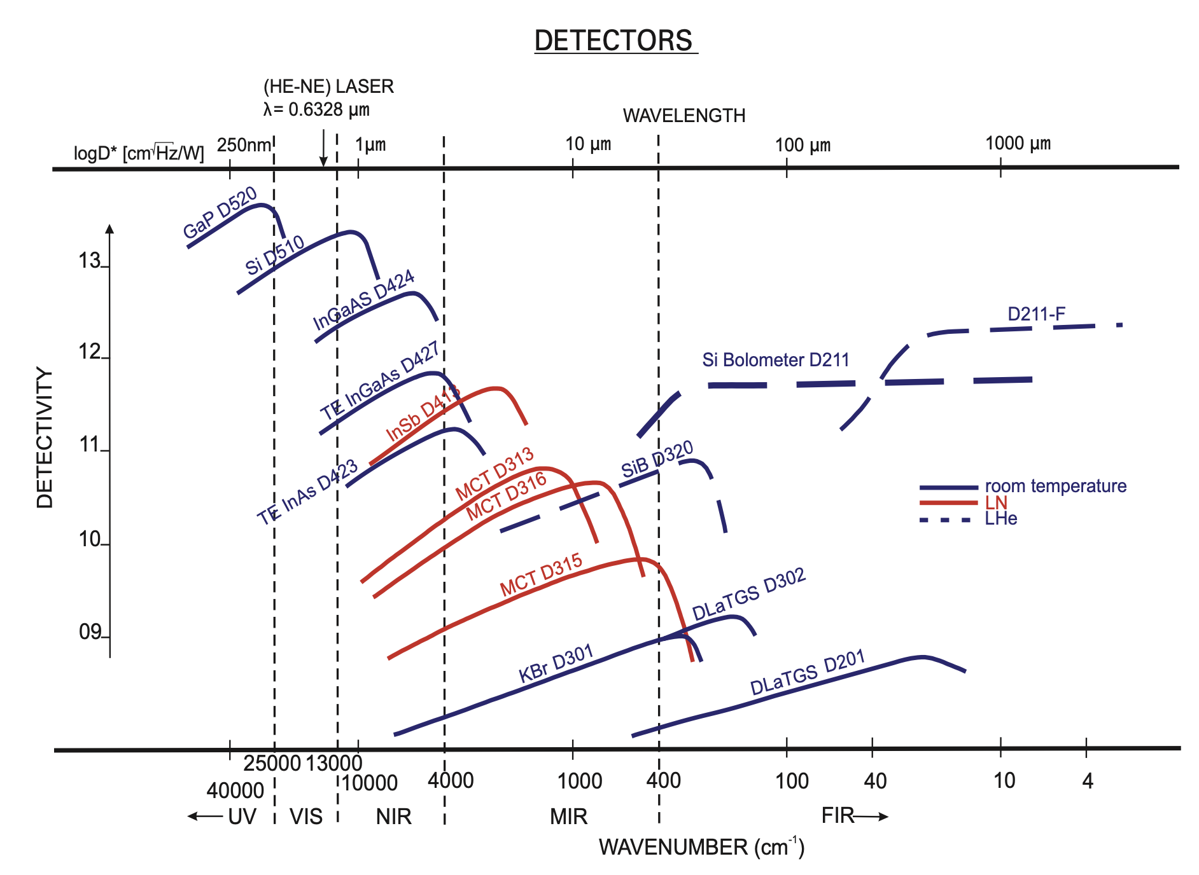

IFS 125 HR from BRUKER
ν = 800 - 50000 cm⁻¹ (= 200 nm – 12 μm)
in vacuum (0.02 mbar)
dν = 0.0035 cm⁻¹
R = ν / dν = 0.115 – 14 x 10⁶

Slide 22
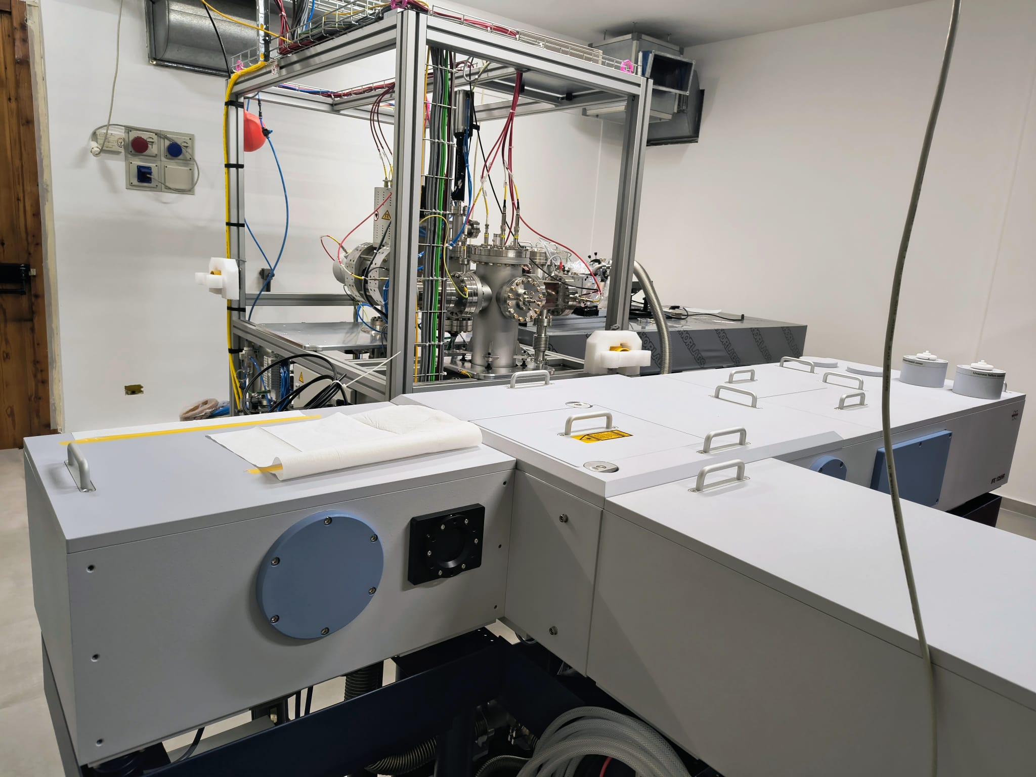
IFS 125 HR from BRUKER
ν = 800 - 50000 cm⁻¹ (= 200 nm – 12 μm)
in vacuum (0.02 mbar)
dν = 0.0035 cm⁻¹
R = ν / dν = 0.115 – 14 x 10⁶
MOTIVATION
Resolving Hyperfine split
The only direct method to measure the Landè g-factors

Slide 23
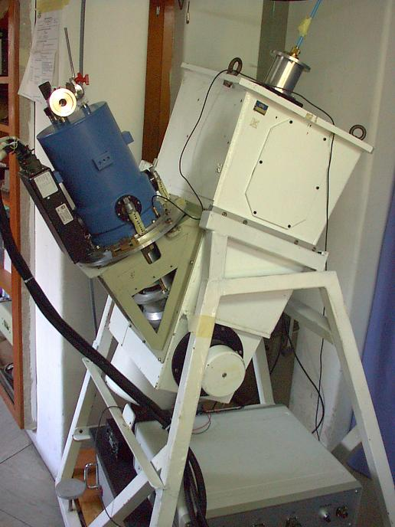
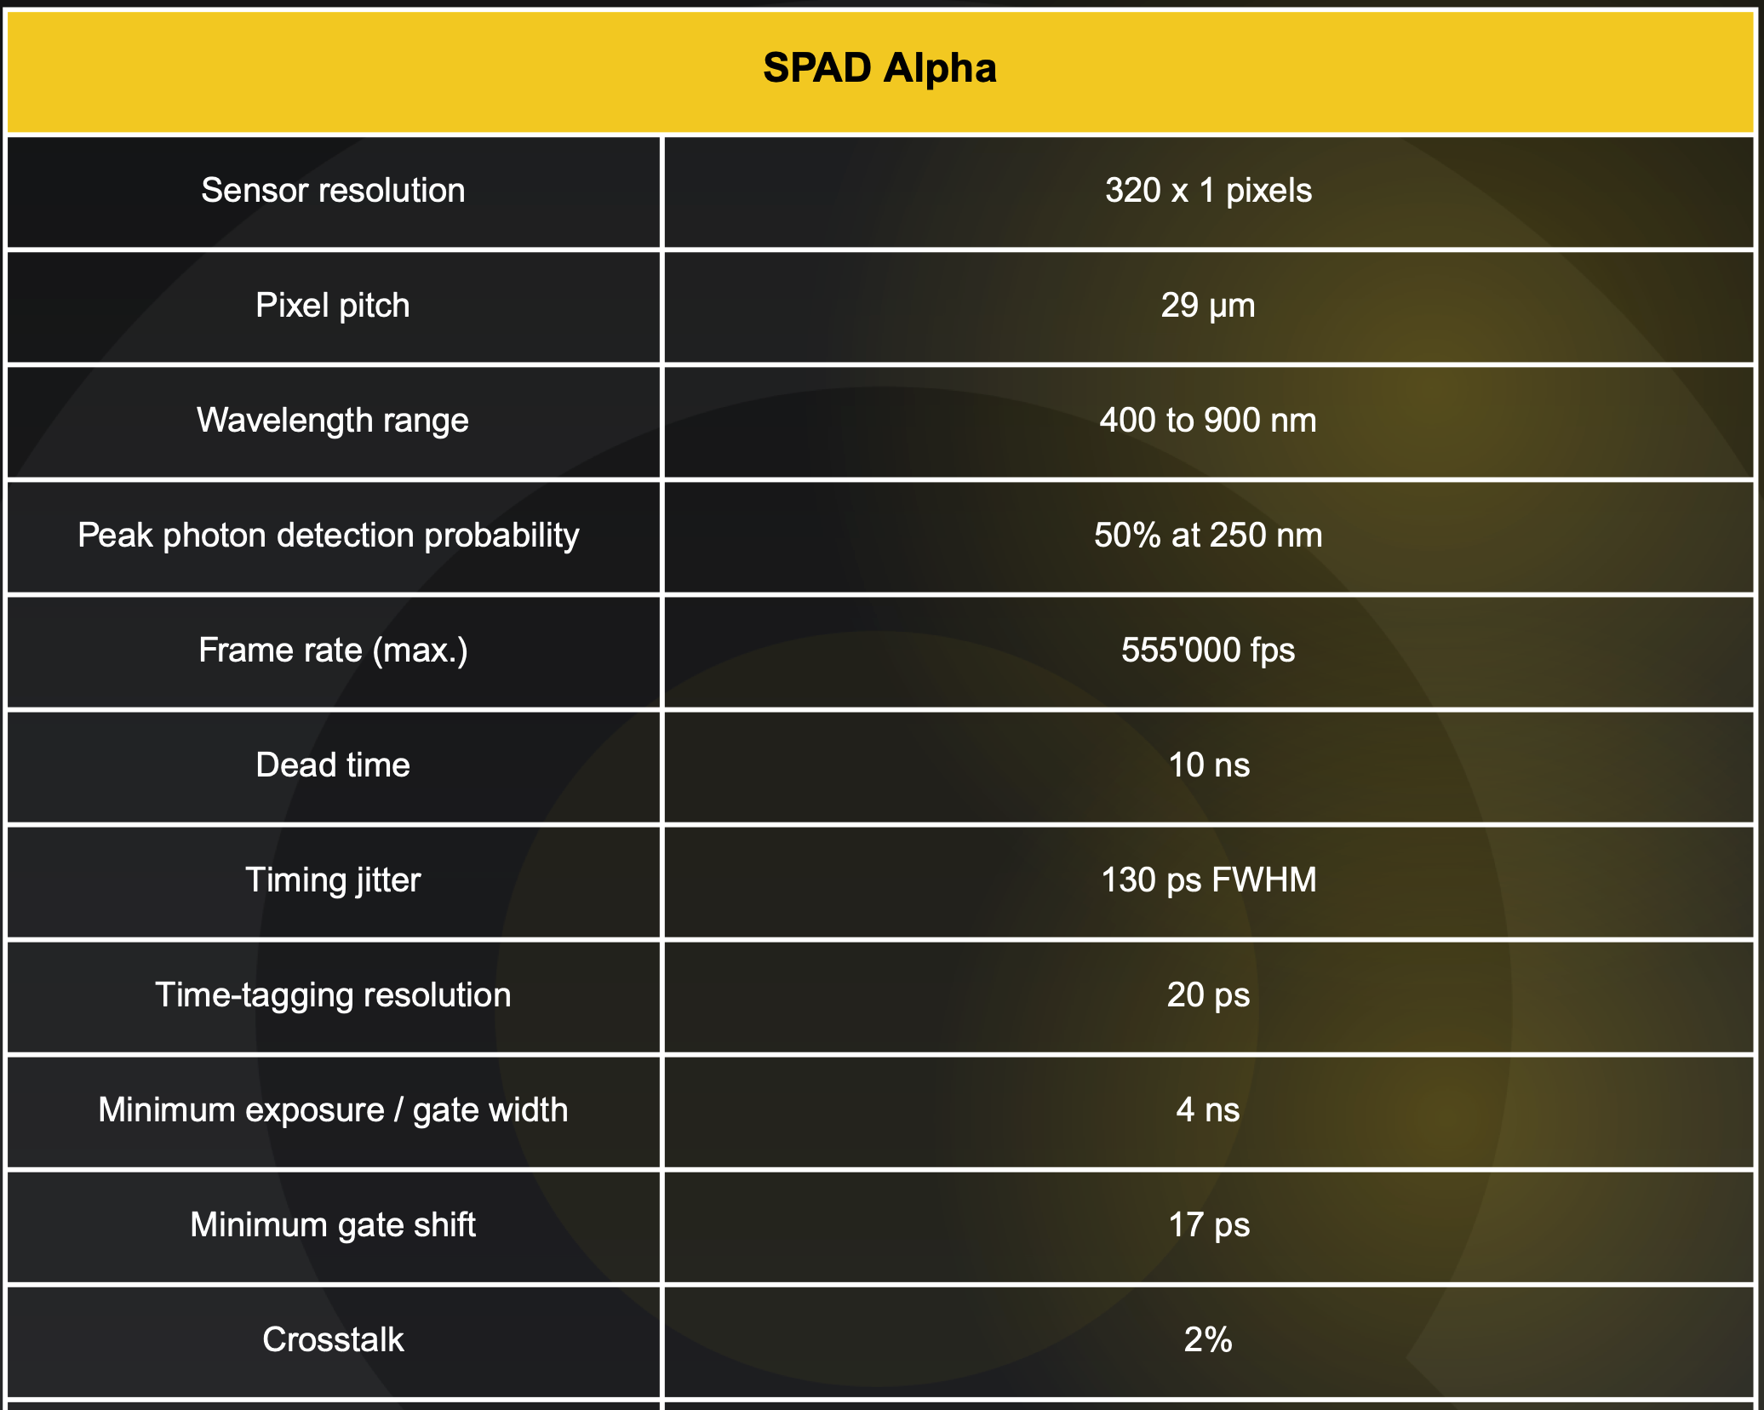

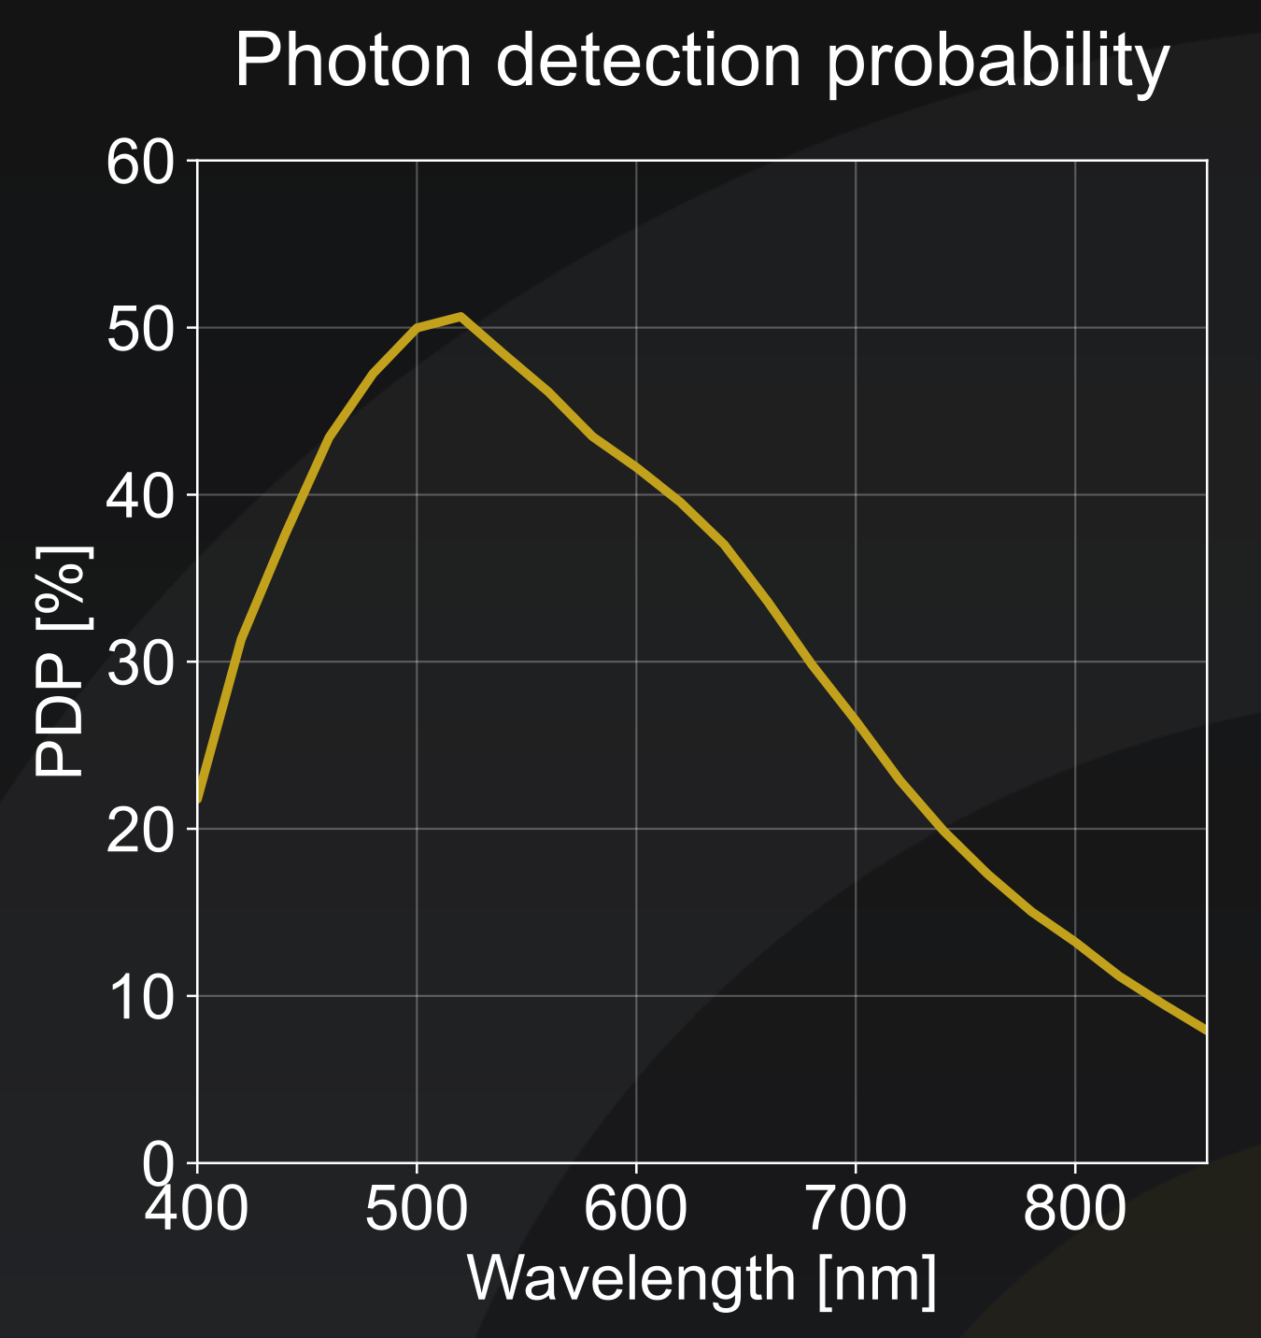
A SPAD linear detector for a direct measure of Einstein coefficients

Slide 24
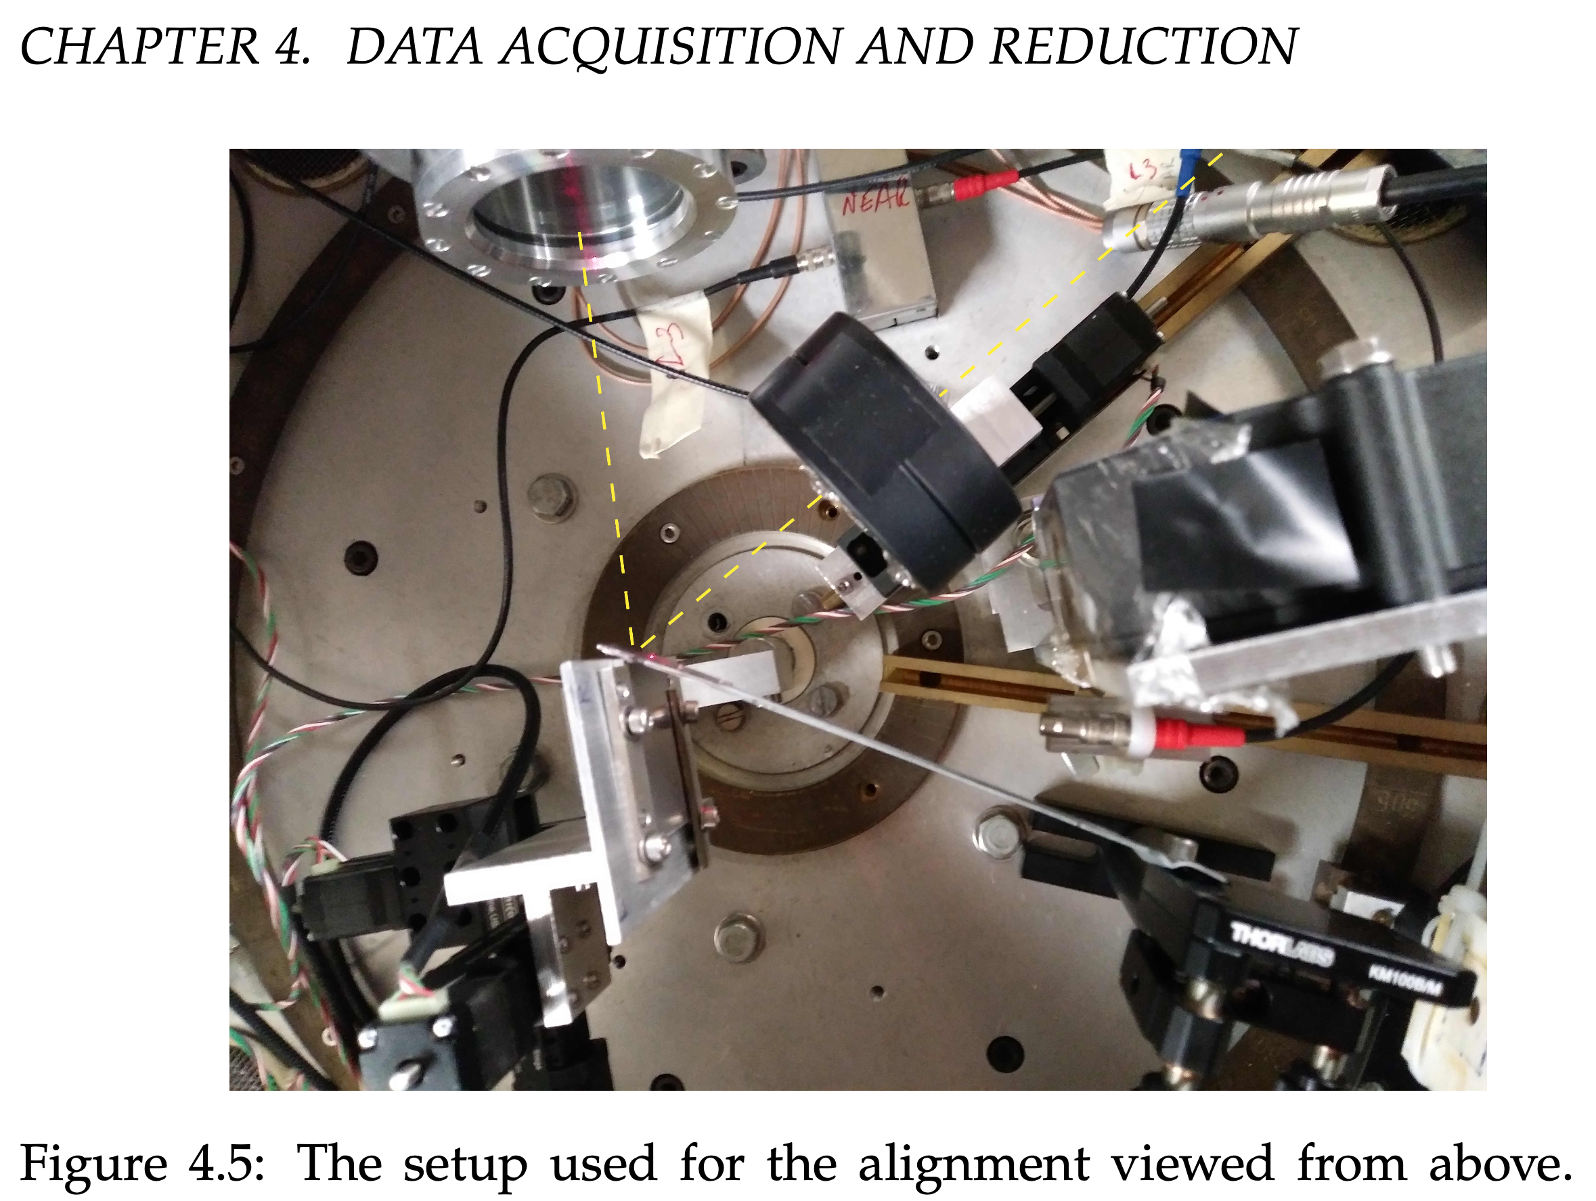
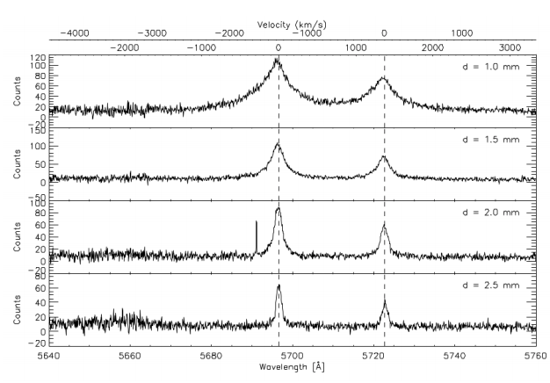

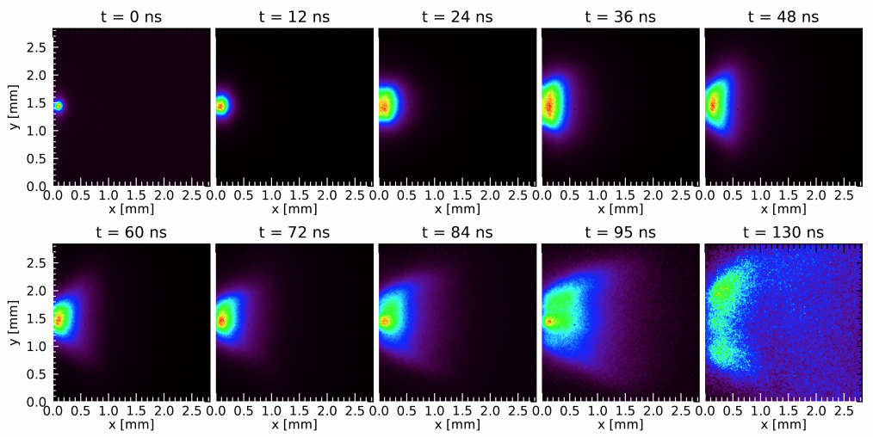
LASER-Produced Plasma
Pulsed Nd:YAG
Q-SMART 850:
850mJ@1064nm,
10Hz,
9mm beam diameter,
6ns pulse duration
MOTIVATION
easy spectroscopy of low-charged ions
expanding plasma

Slide 25
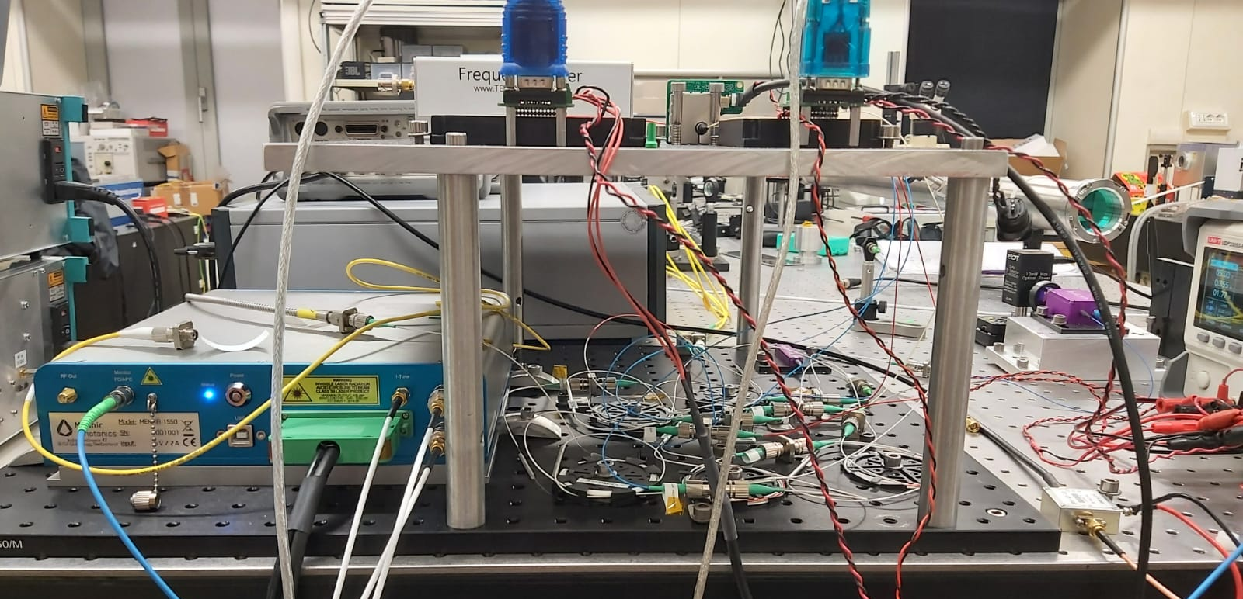
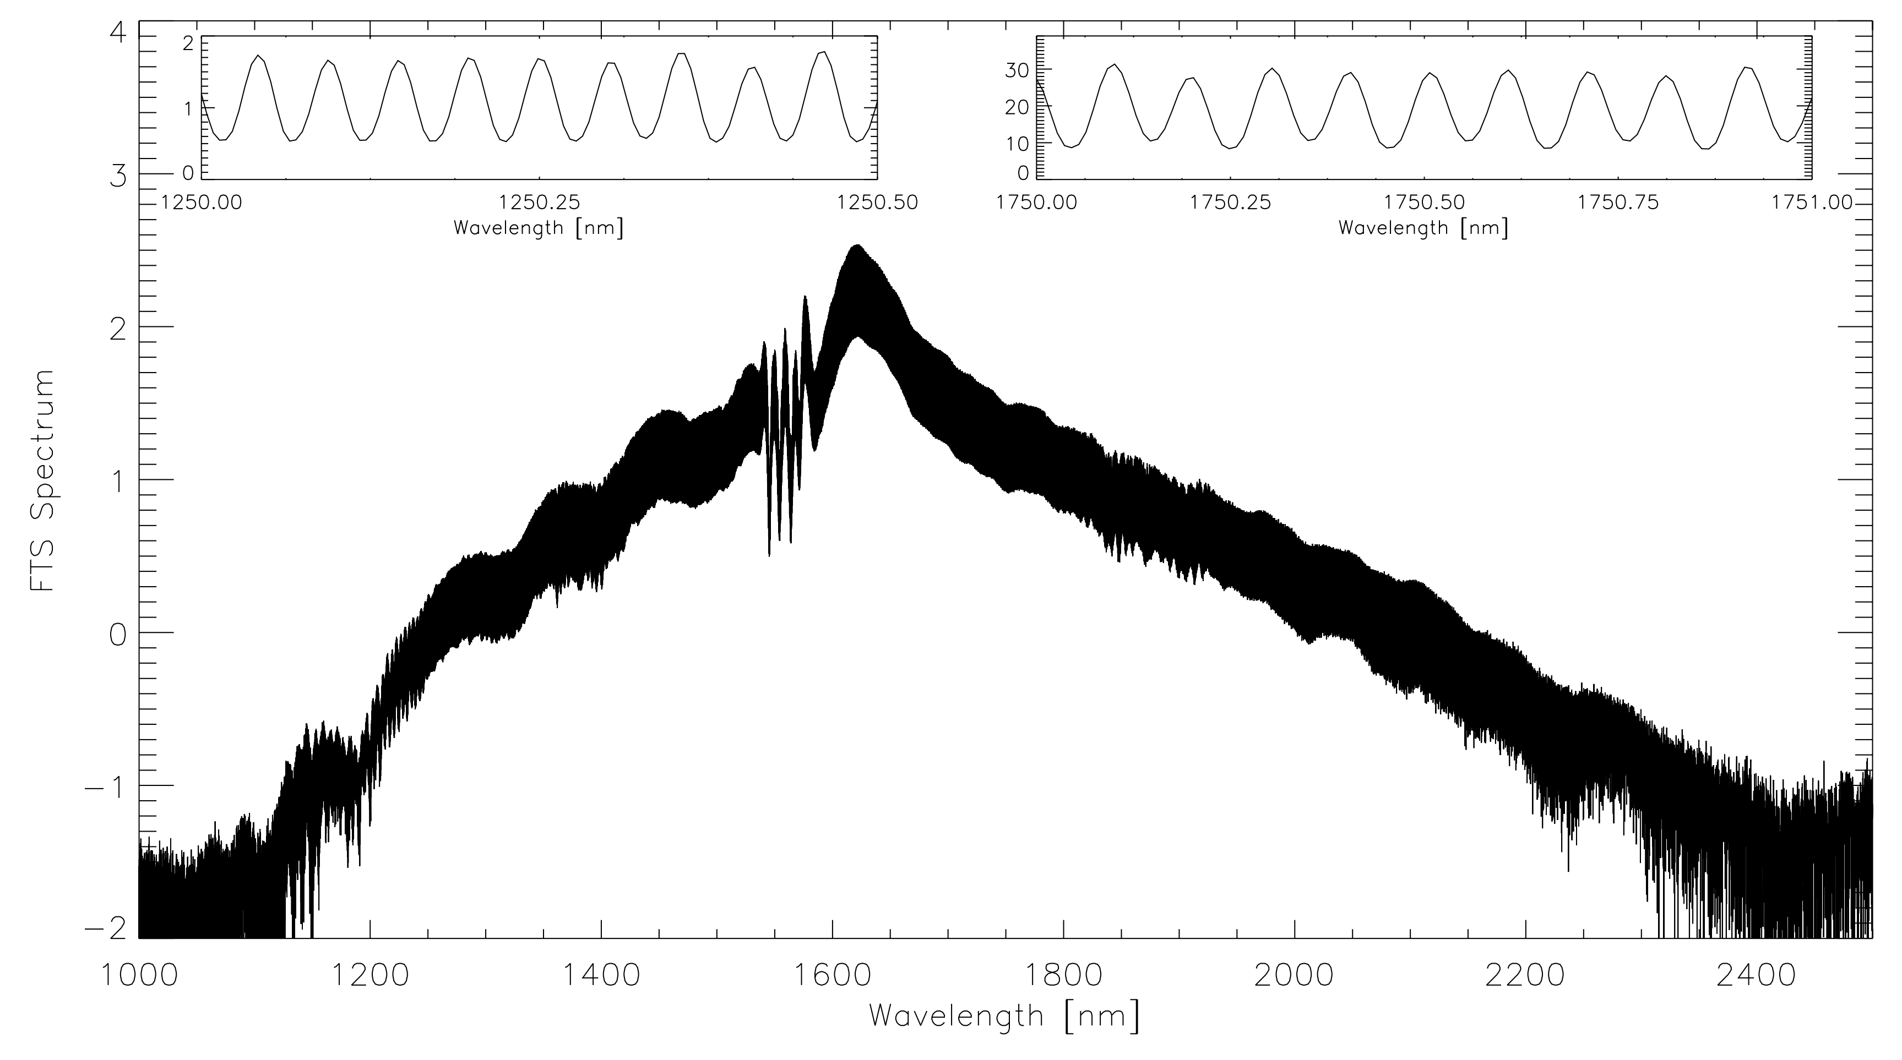

ULTRA-BROAD BAND LASER-COMB for GIANO + HARPSN @ TNG based on a 10GHz pulsated laser
In collaboration with:
Istituto di Fotonica e Nanotecnologie - CNR Milano
Dipartimento di Fisica - Politecnico di Milano
1200 nm
Resolving power was only 25000
Case GIANO

Slide 26
Some few brief considerations on the laboratory
17/03/26
WP4301 – Laboratory Plasma Spectroscopy

Slide 27
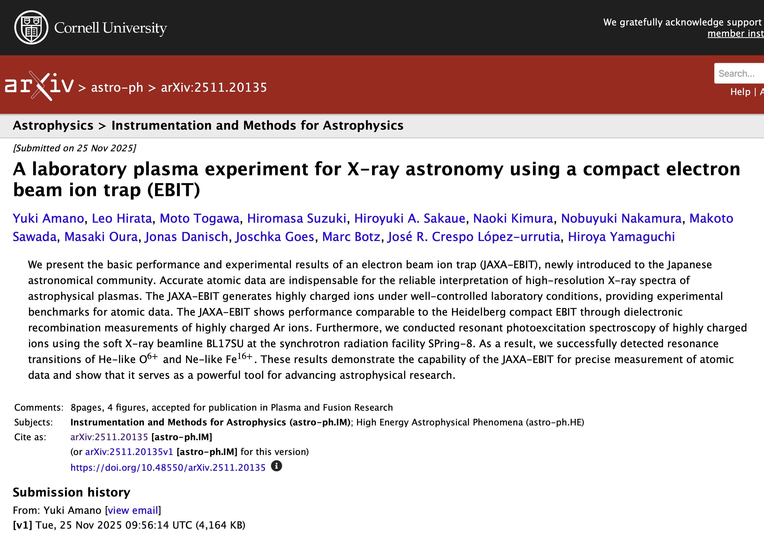
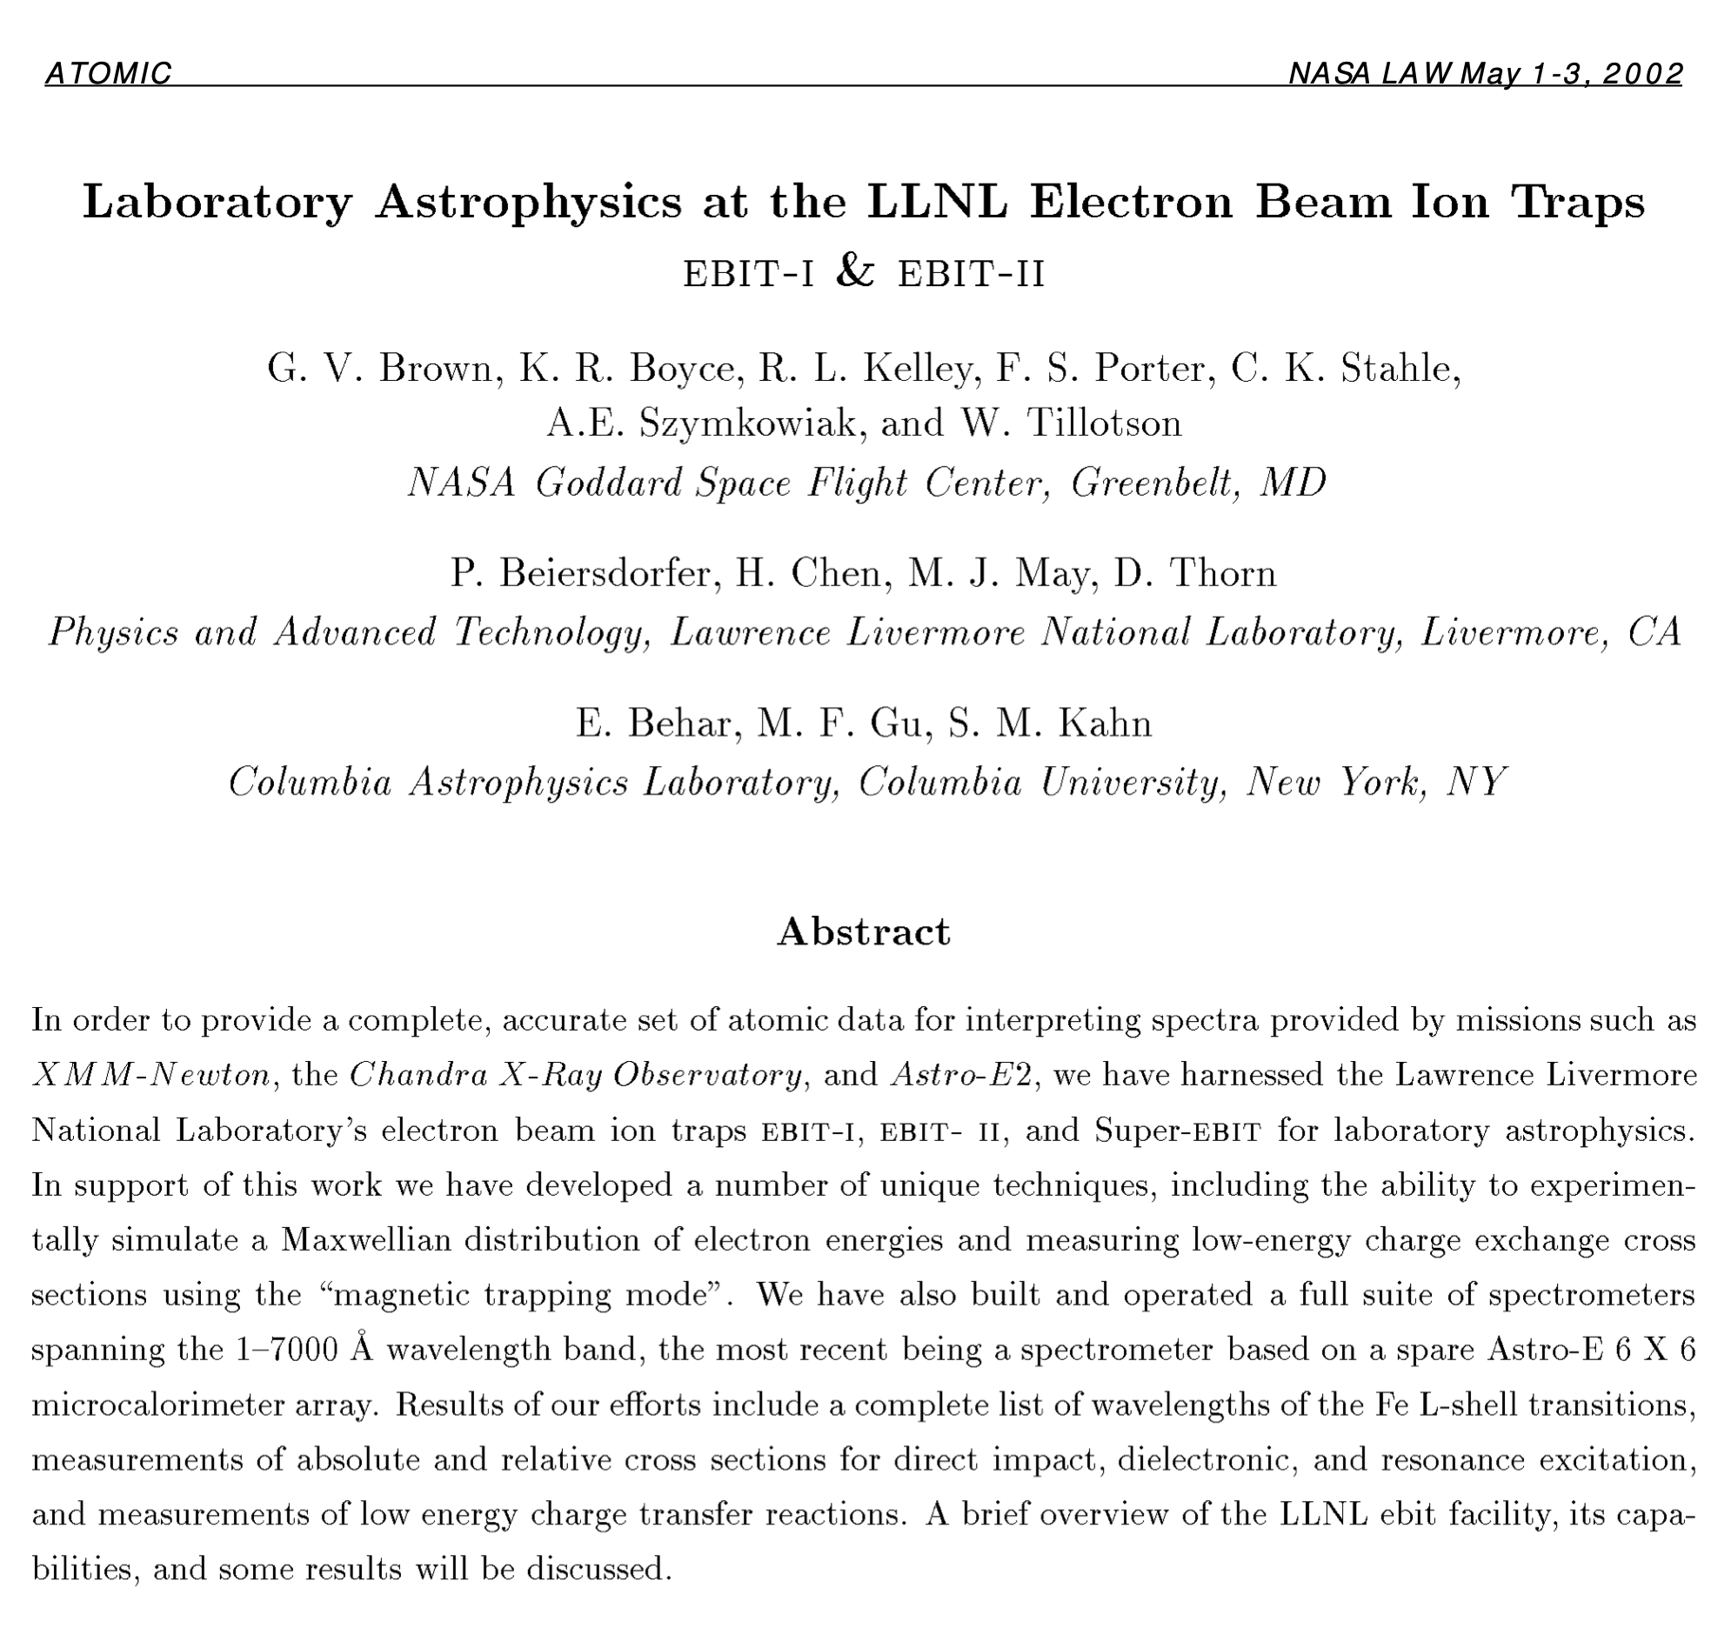
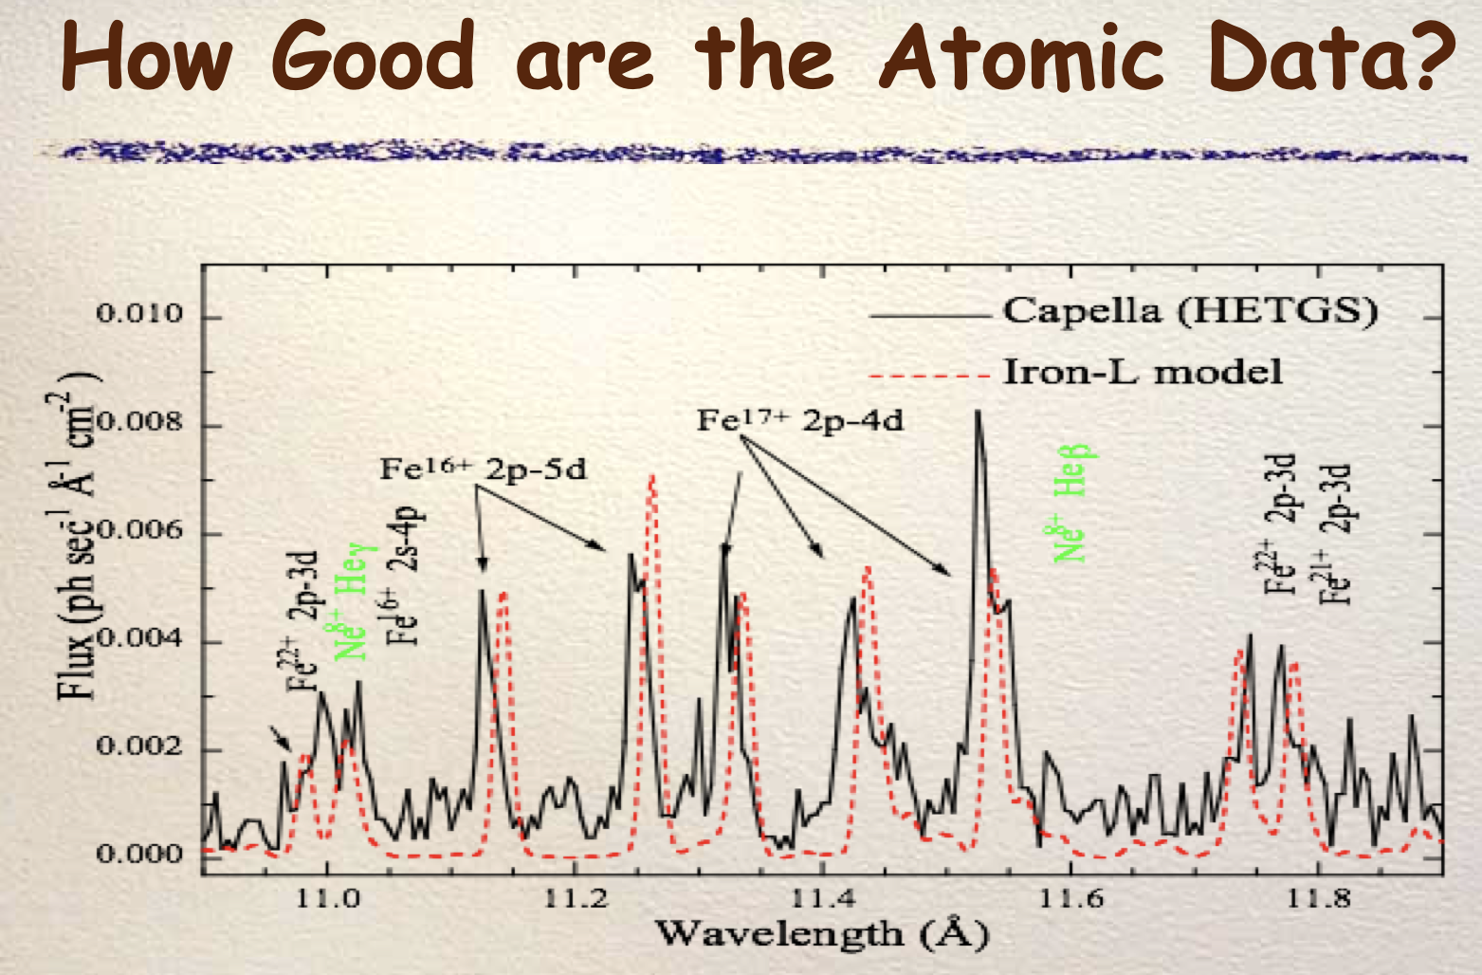
The Laboratory for Plasma Spectroscopy @ OACT
aligns INAF with prominent institutions such as NIST, LLNL, CfA and JAXA
In experimental plasma physics
and, grants autonomy in
- taking measurements of atomic data
- testing our own instrumentation

Slide 28



ANDES@ELT will not provide evidence of r-process in neutron star mergers if we don’t build an atomic database of highly ionised heavy-elements
The Laboratory for Plasma Spectroscopy @ OACT
for the challenges posed by the new high-resolution spectrographs
R=500

Slide 29
The future
The plasma laboratory is an INAF resource and is open to anyone who thinks they could benefit from it.
The Lab is rather complex and fragile: a dedicated researcher and fundings for maintenance are necessary for its operation.

Slide 30
My thanks go to
Adriano, who made all this possible, and Angela for leading the WP.
The entire administrative staff for their help.
I also thank all of you for your time.
If you are interested, write to
francesco.leone@inaf.it
17/03/26
WP4301 – Laboratory Plasma Spectroscopy

