Slide 1
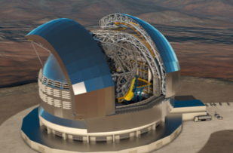
STILES
UPGRADING INAF FACILITIES ACROSS THE
MICROWAVE-SUBMILLIMETER
SPECTRUM
Francesco Cuttaia [OAS] On behalf of WP 5500
Contributions from: Caocci R., Ortu P., Pisanu T., [OAC] , Schillirò F. [OACT], Palmisano G. & the Electronics Group [UniCT]

Slide 2
WP 5500
Laboratories for R&D
Missione 4 • Istruzione e Ricerca

Slide 3
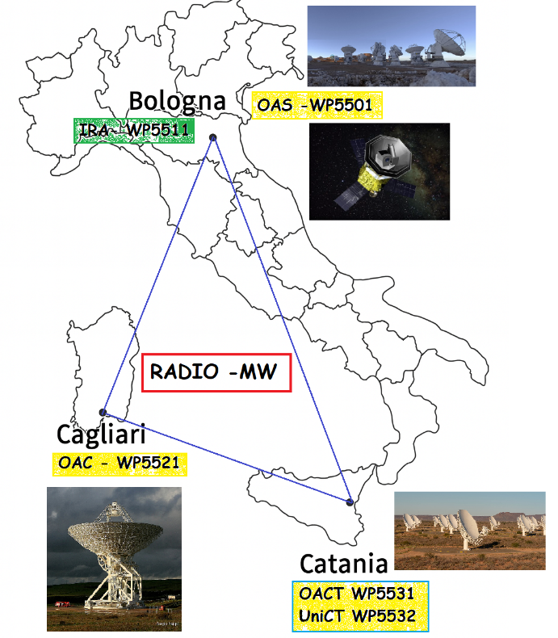
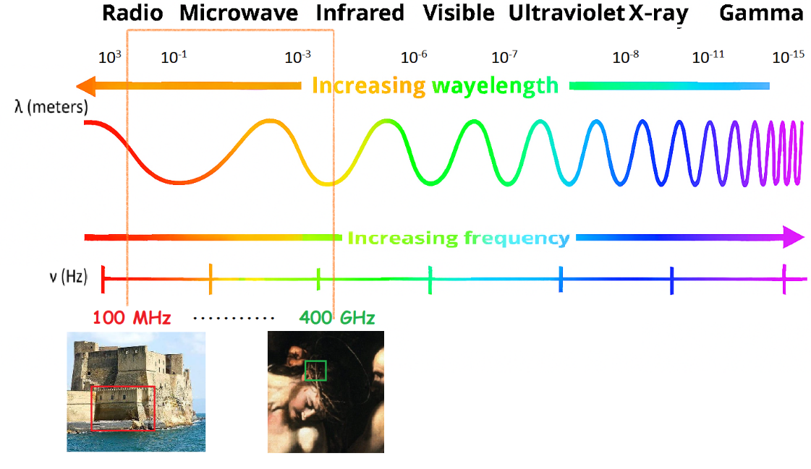
WP 5500
Shared Strategic Objectives
Enhance and unify technological capabilities across all groups
Pool and leverage shared expertise and instrumental assets
Expand groups research reach into domains previously difficult to access
Strengthen INAF’s influence within major national and international projects
Increase INAF competitiveness and readiness for future initiatives
Credits Poppi
Missione 4 • Istruzione e Ricerca

Slide 4

Missione 4 • Istruzione e Ricerca

Slide 5
THE ACTIVITIES
Missione 4 • Istruzione e Ricerca

Slide 6

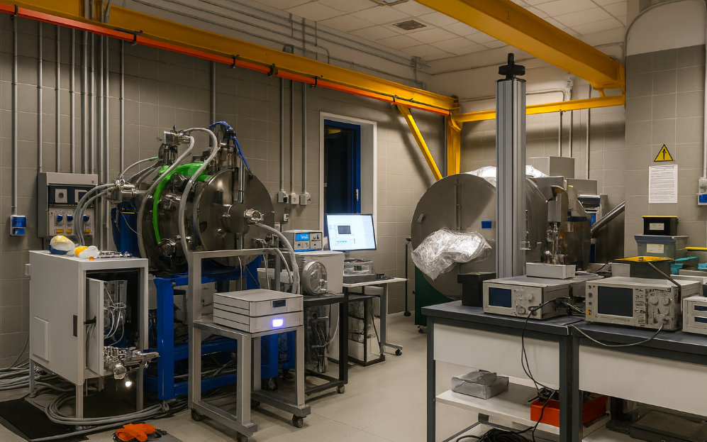
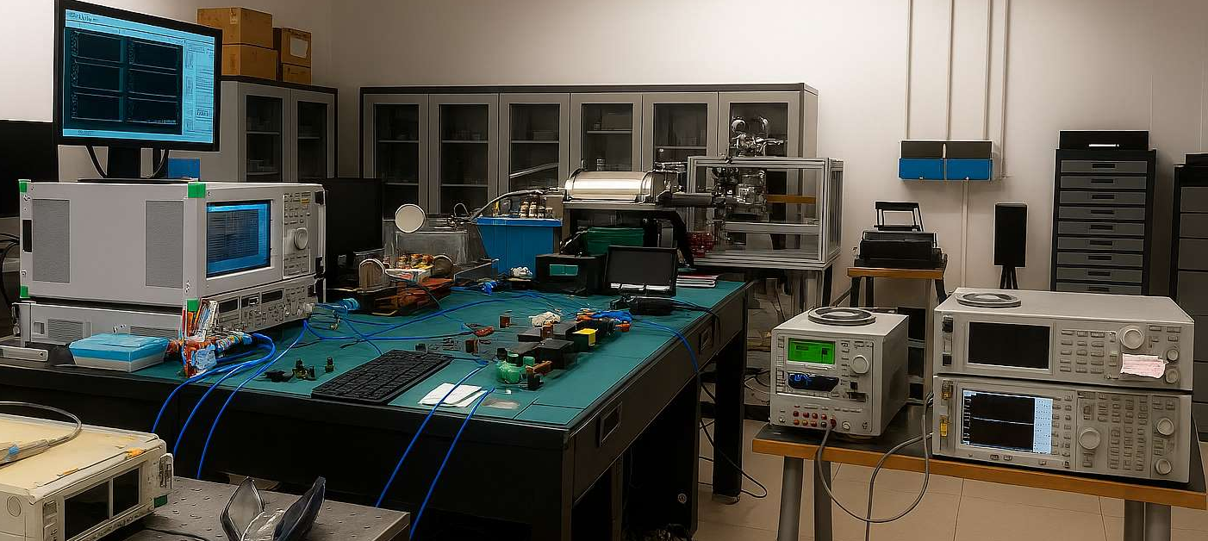
WP 5501 (OAS)
Establish an advanced microwave test facility enabling full‑band characterization of components, subsystems, and integrated systems from 10 GHz to 340 GHz ( current 30–125 GHz discrete‑band coverage).
Missione 4 • Istruzione e Ricerca

Slide 7
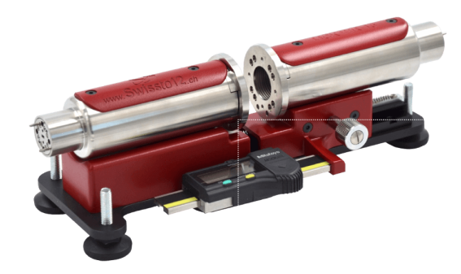
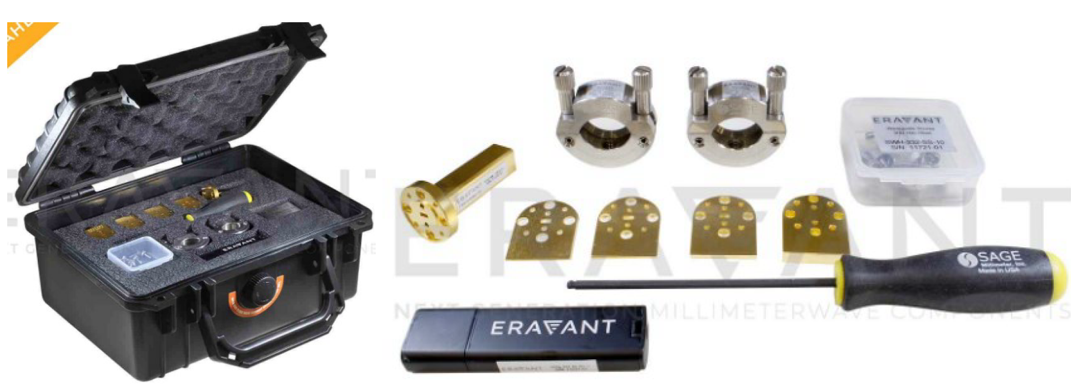
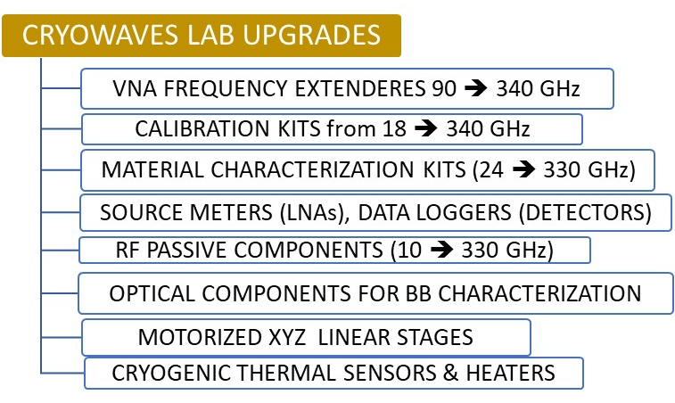

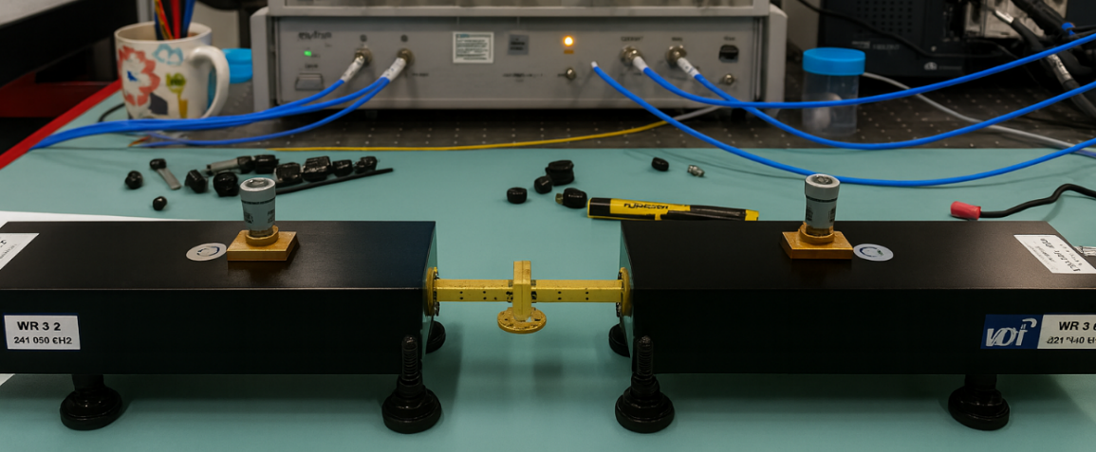
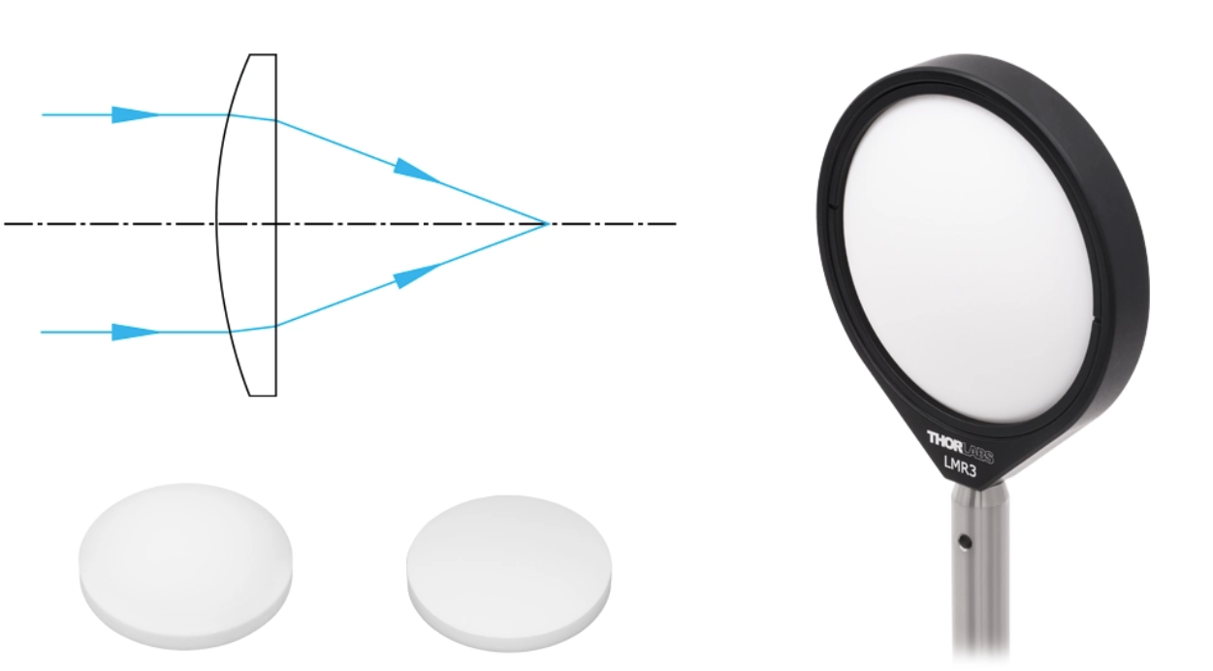
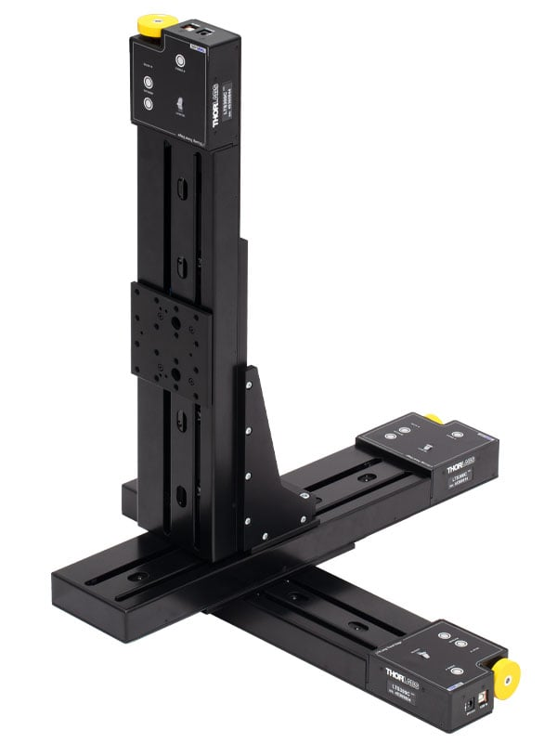
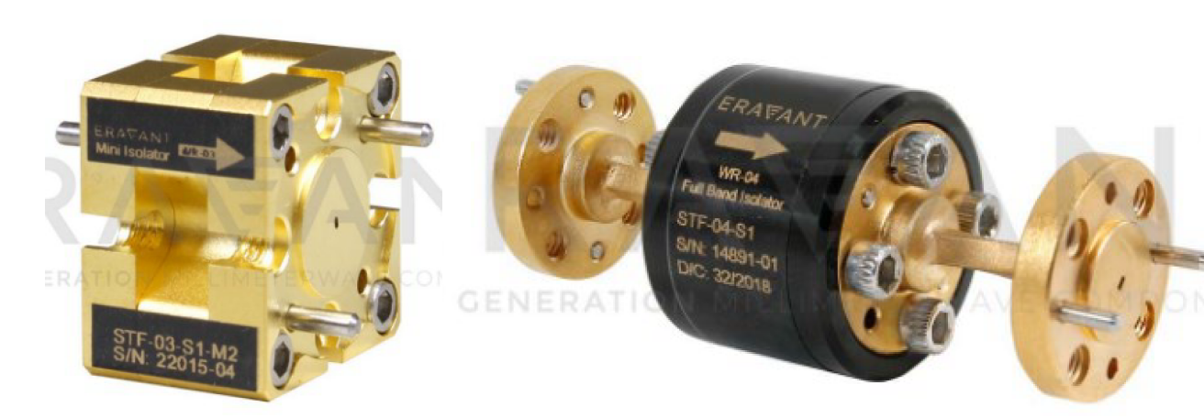
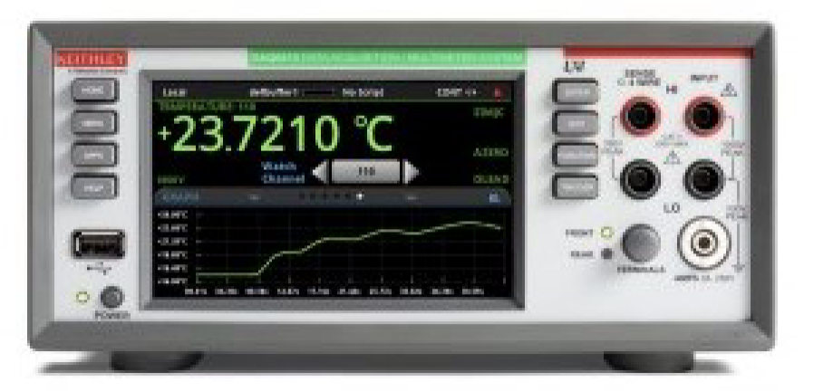
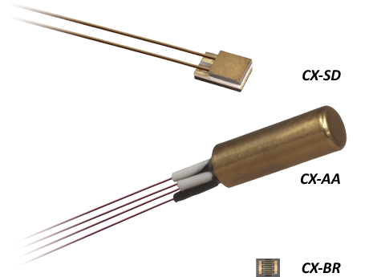
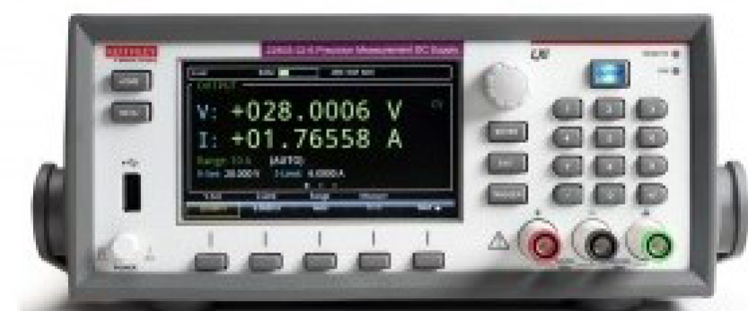
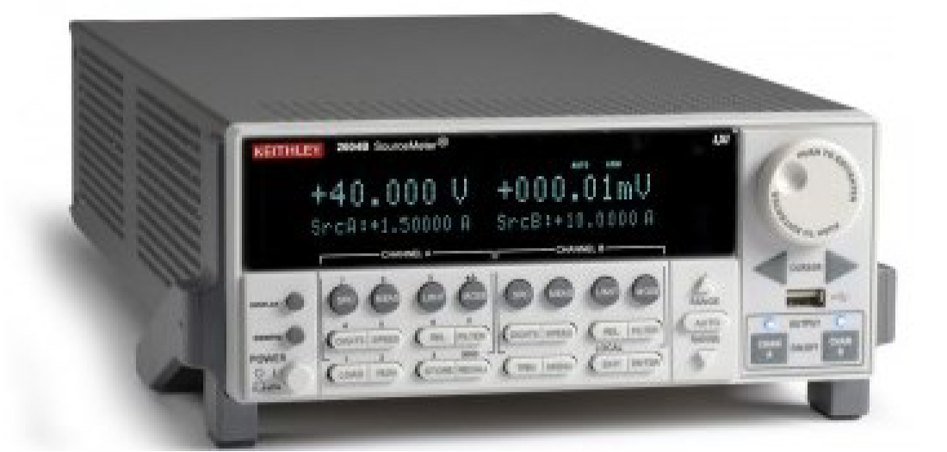
WP 5501 (OAS)
Missione 4 • Istruzione e Ricerca

Slide 8
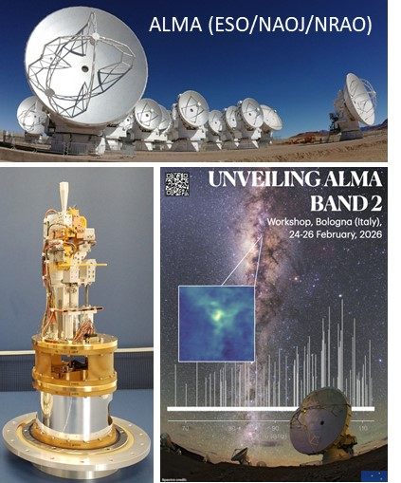
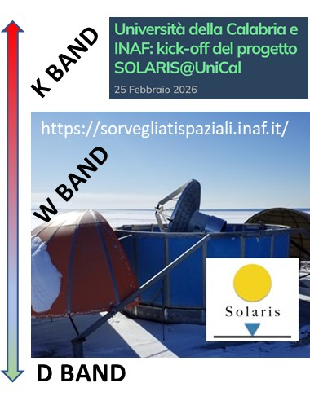
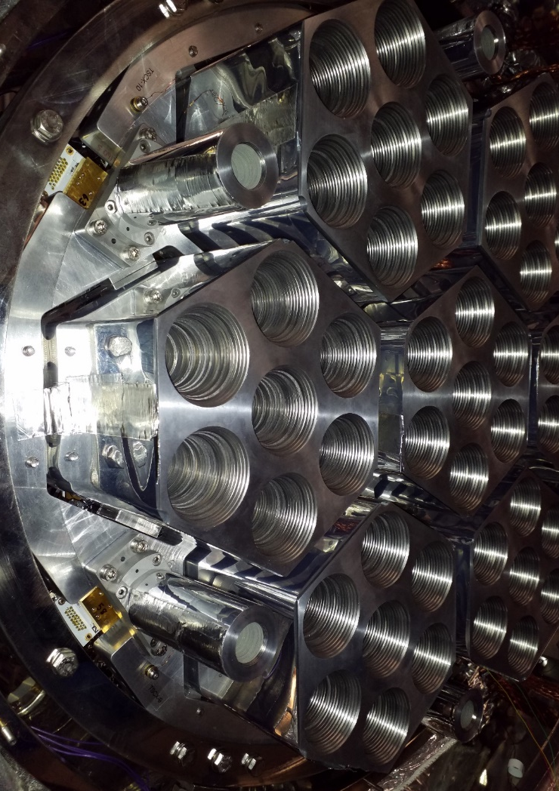



WP 5501 (OAS)
GROUND OBSERVATORIES
Consolidate INAF role across a wide spectrum of scientific and technological projects, Improve the characterization of instruments in ongoing projects & Strengthen contribution to national and international collaborations
ECOGAL agreeement with UNI Bologna to share instruments & students /post doc
BAND4+5
Missione 4 • Istruzione e Ricerca

Slide 9
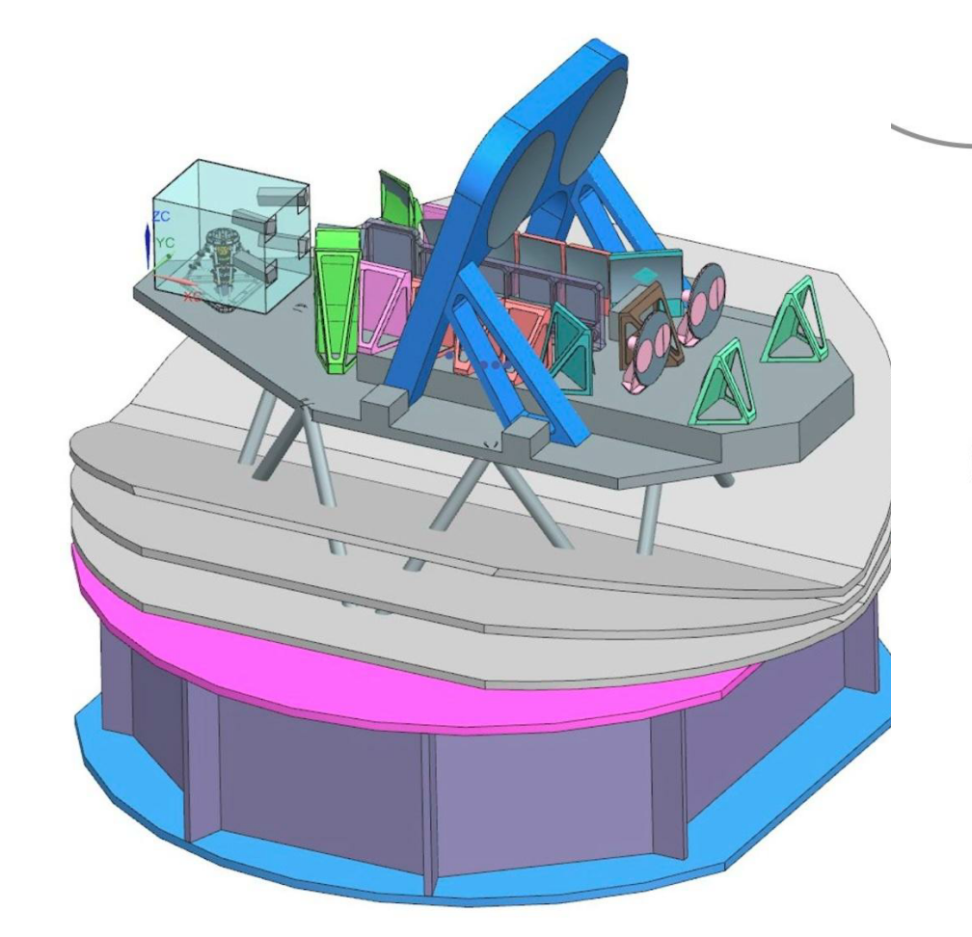
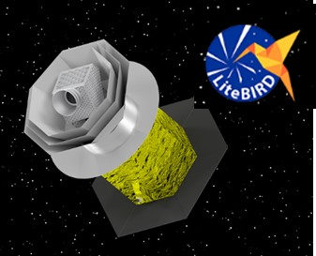
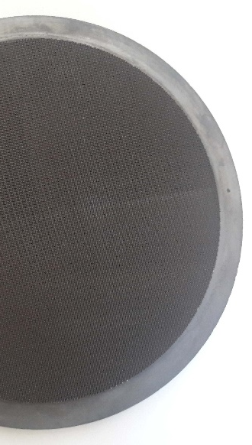
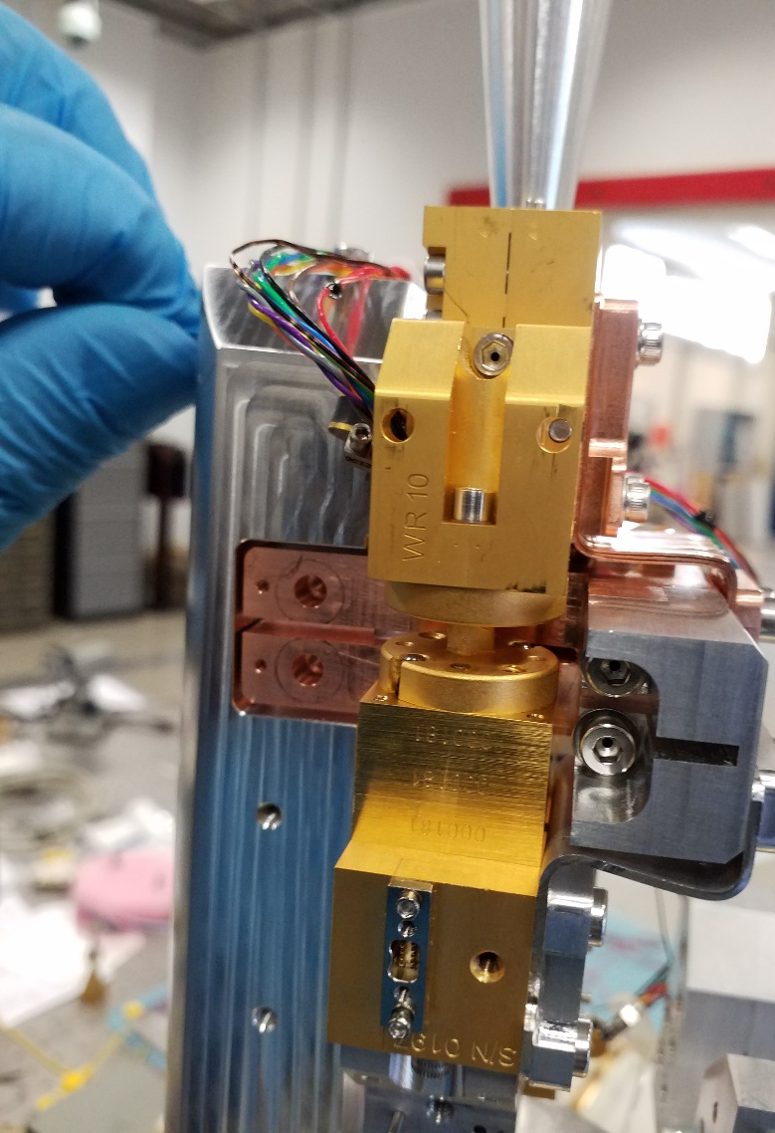
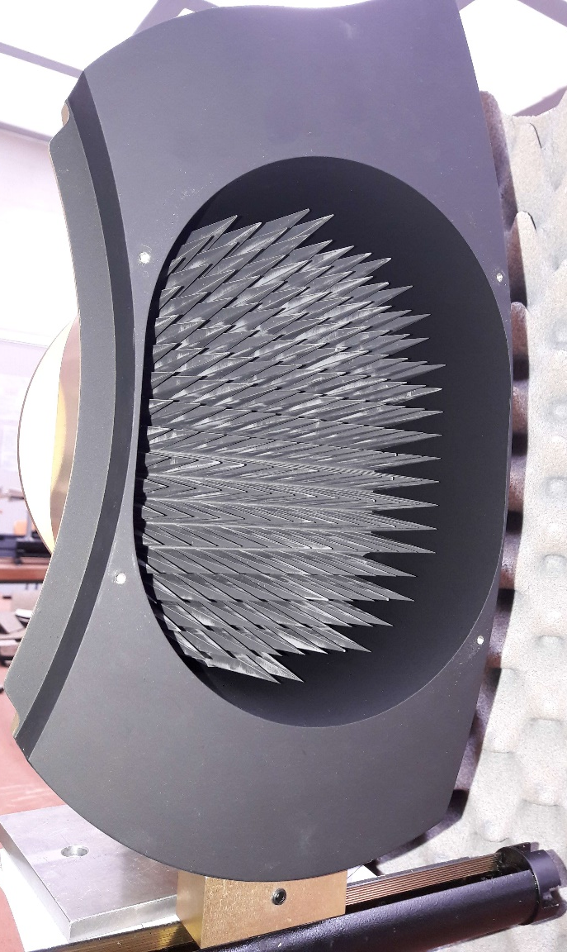
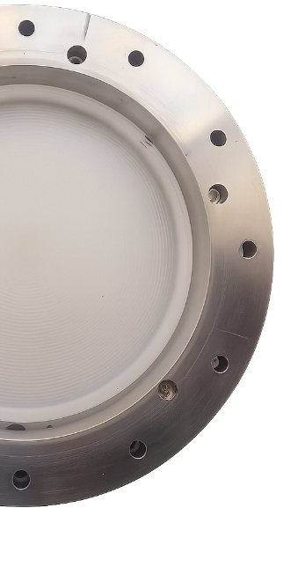

WP 5501 (OAS)
SHAPING THE PRESENT TO THE FUTURE
SPACE OBSERVATORIES
50 GHz : 2 THz
34 -448 GHz
JAXA- ESA –ASI > 2034
M8 – ESA CALL 2039
34 GHz : 448 GHz
Missione 4 • Istruzione e Ricerca

Slide 10

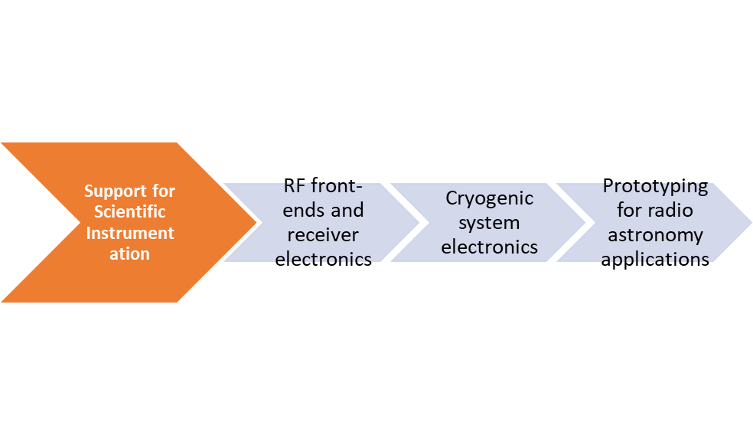
WP 5521 (OAC)
Integrated facility for end‑to‑end design, fabrication, testing of electronic and MW prototype boards.
Enable high‑precision prototyping for next‑generation radio‑astronomy instrumentation, boosting performance, reliability, and technological readiness across INAF projects.
Fully Integrated Production Chain, from layout design to finished PCB: Increased design flexibility and responsiveness & Independence from external suppliers ➔ time saving
Complete In-House PCB Prototyping
Single-layer and multilayer PCB fabrication
Laser structuring and precision milling
Through-hole metallization and lamination
Reflow soldering and assembly
Integration with 3D Printing
Rapid mechanical prototyping
Enclosures, supports, and assembly fixtures
Integrated electronic and mechanical development
Missione 4 • Istruzione e Ricerca

Slide 11
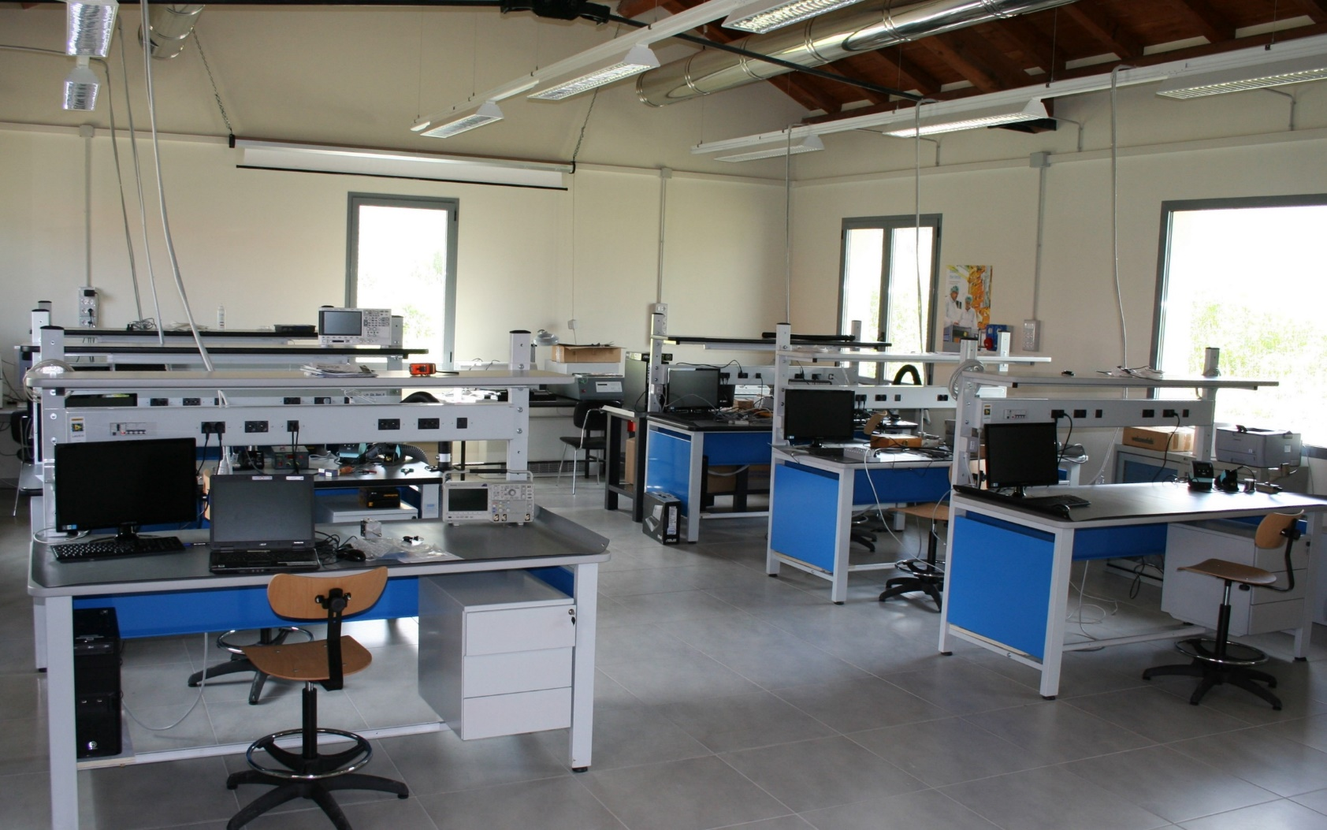
WP 5521 (OAC)
Missione 4 • Istruzione e Ricerca

Slide 12

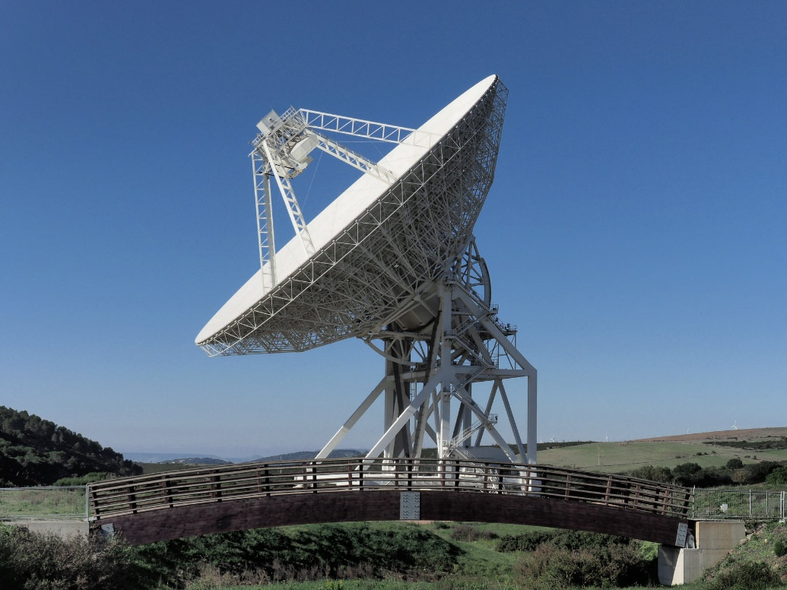
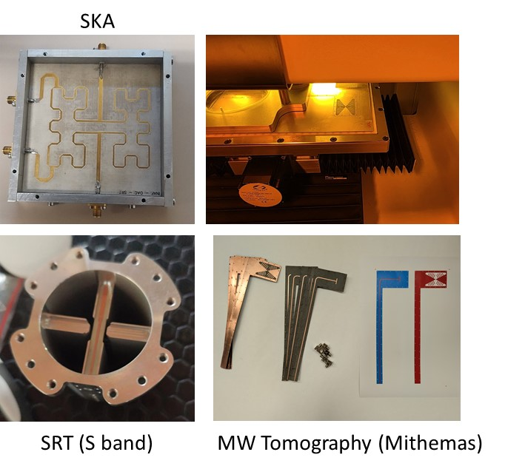


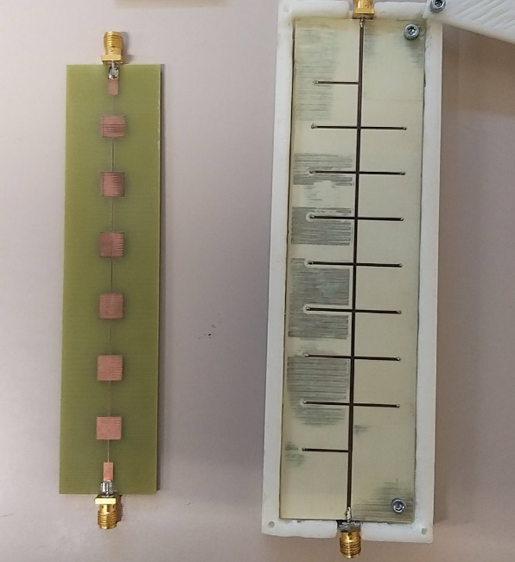

WP 5521 (OAC)
FOLLOW-UP OF BONE HEALING
https://web.unica.it/unica/it/dip_ingelettrica_s2_ss14_1.page
Missione 4 • Istruzione e Ricerca

Slide 13

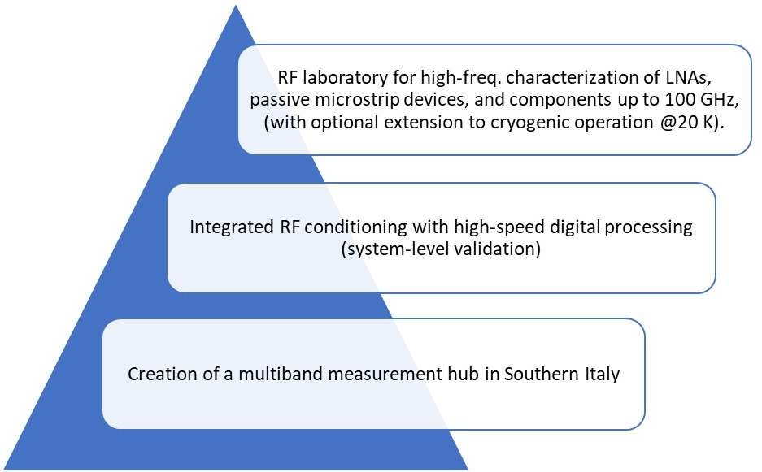
WP 5531 (OACT)
RF-Microwave Cryo Lab for the Design of BAND5@Meerkat
strengthening INAF’s role in major projects
fostering collaboration with universities and high‑tech industries
(WP5532)
High‑Frequency & Cryogenic RF Characterization Hub
WP 5532
Missione 4 • Istruzione e Ricerca

Slide 14

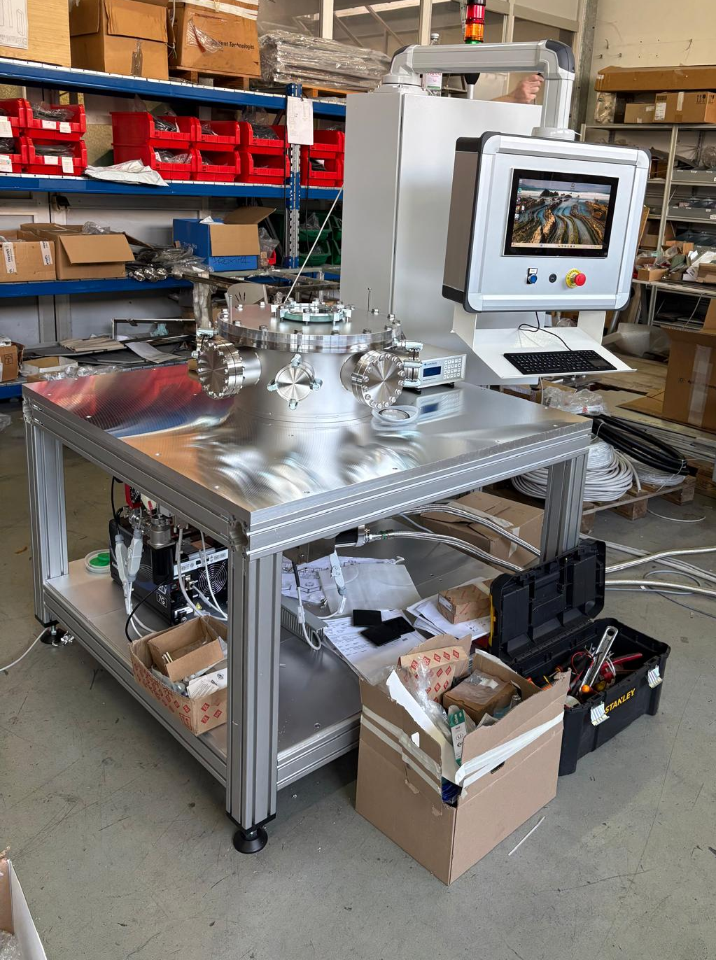
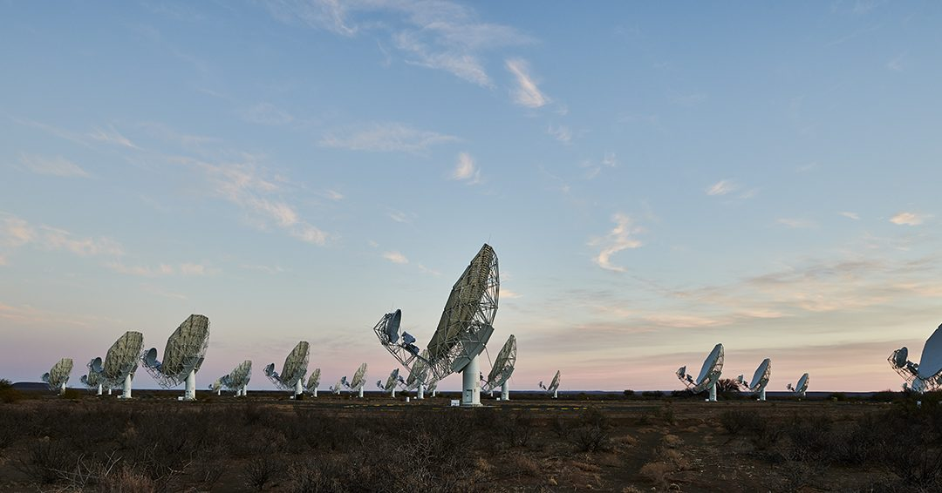
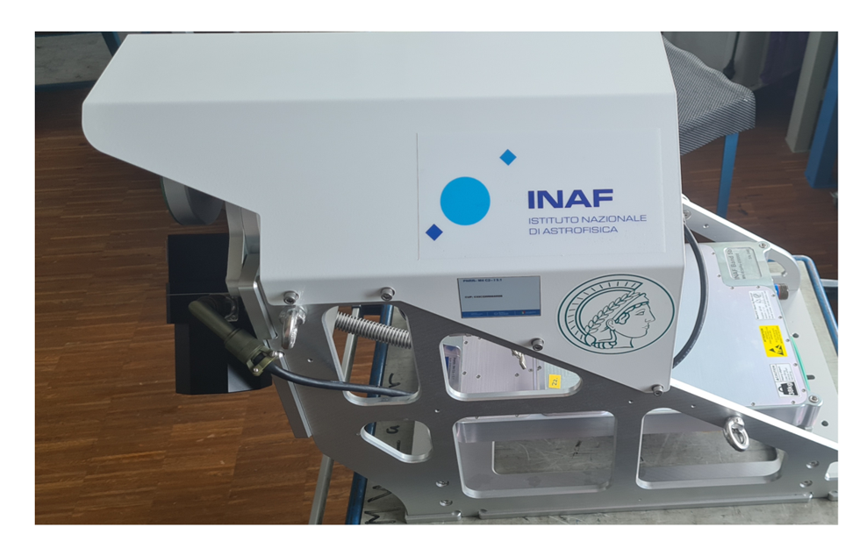
WP 5531 (OACT)
RF LAB UPGRADES
Vector Network Analyzer up to 67 GHz
VNA Tools and equipment
Microwave Spectrum Analyzer up to 67 GHz
2 Microwave Signal Generator u to 67 GHz
Microwave and RF Power Sensor
FS725 - Rubidium Frequency Standard
Portable Microwave Spectrum Analyzer up to 45 GHz
https://www.km3net.org/
MULTIDISCIPLINARITY
MeerKat 5B [8.3 GHz – 15 GHz]
https://www.oact.inaf.it/category/radio/ska/
Credits: E. Sacchetti/Inaf
Missione 4 • Istruzione e Ricerca

Slide 15
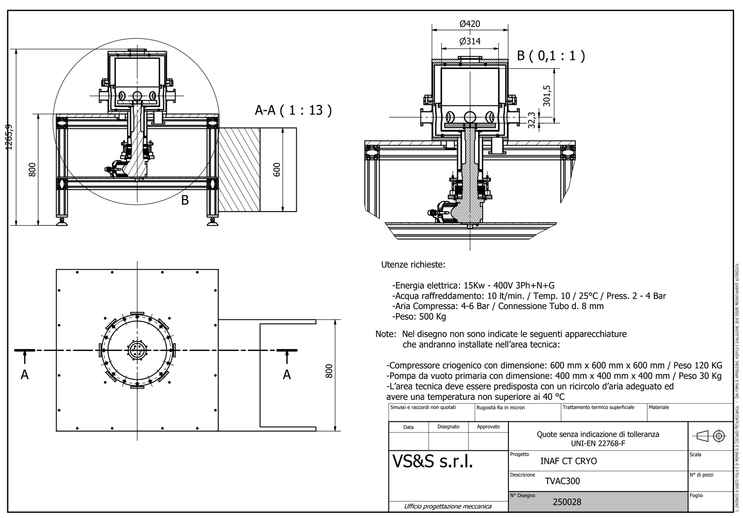
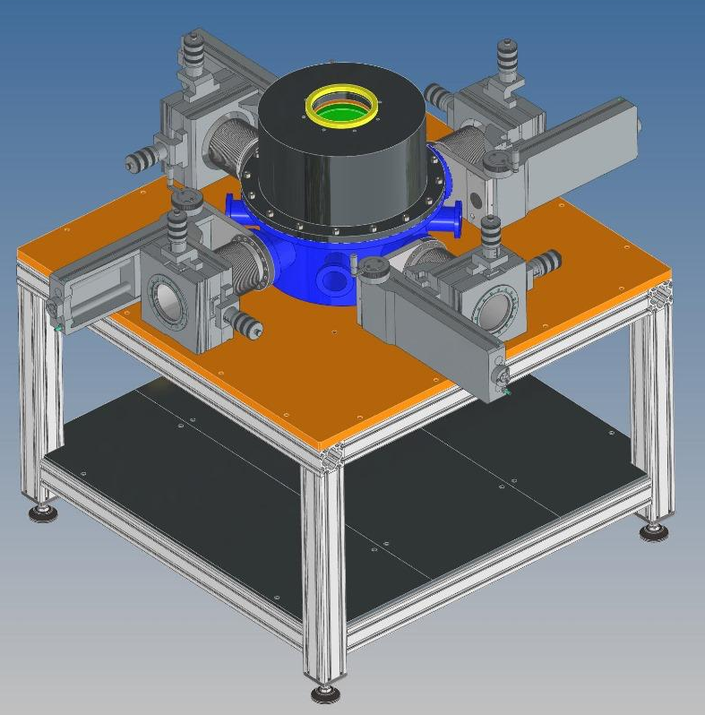
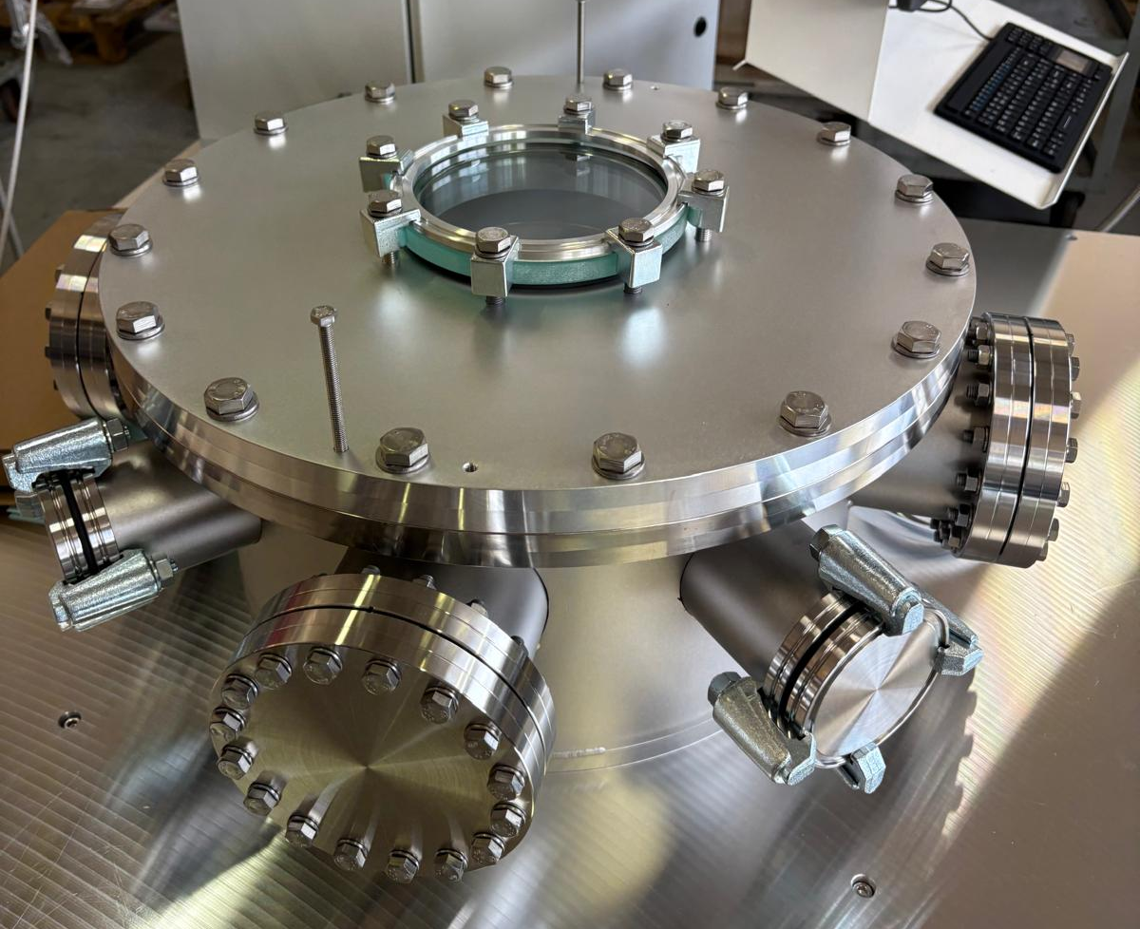
WP 5531 (OACT)
CRYO LAB UPGRADES
CRYO COOLER SYSTEM DOWN TO 4K
INTERFACES WITH RF INSRUMENTS
Missione 4 • Istruzione e Ricerca

Slide 16
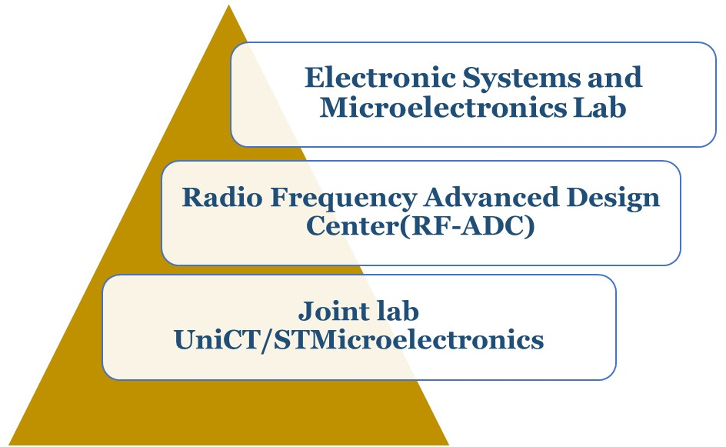
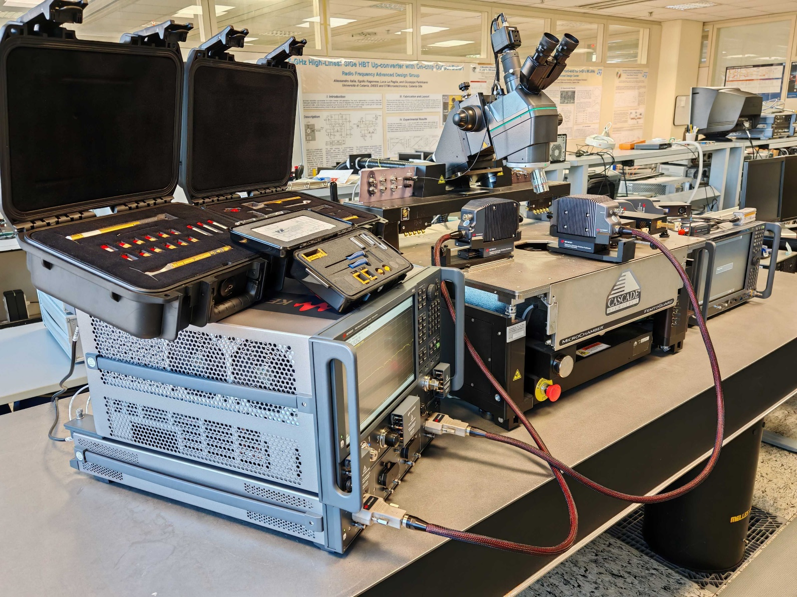
WP 5532 (UniCT)
WP 5532
Strengthening UniCT electronics labs thanks to STILES
Signal Analyzer
Missione 4 • Istruzione e Ricerca

Slide 17
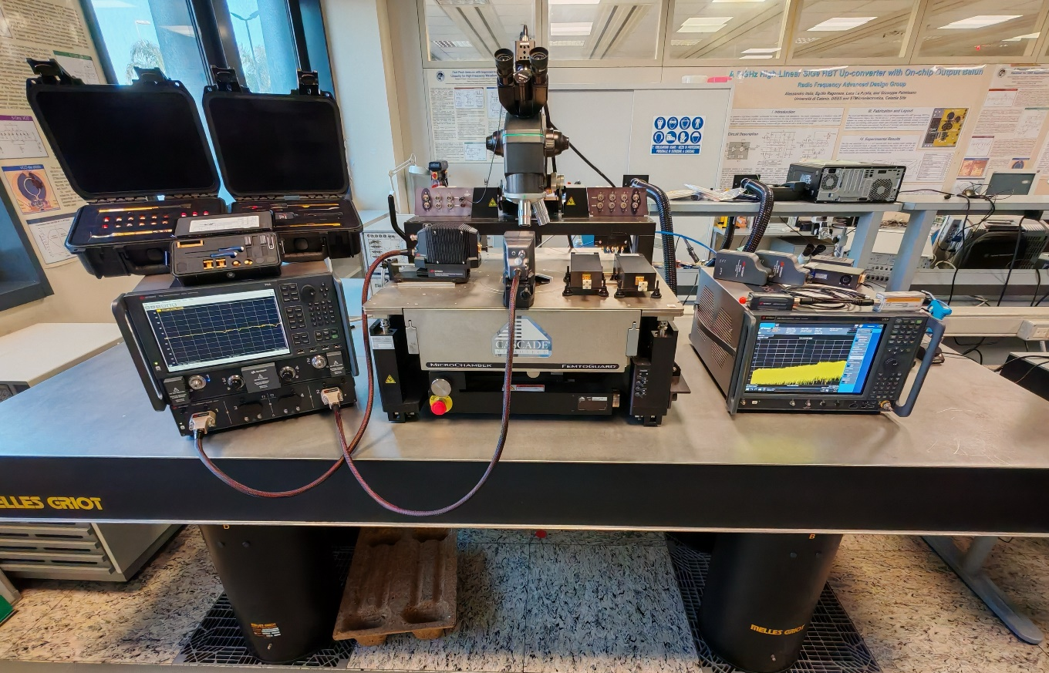
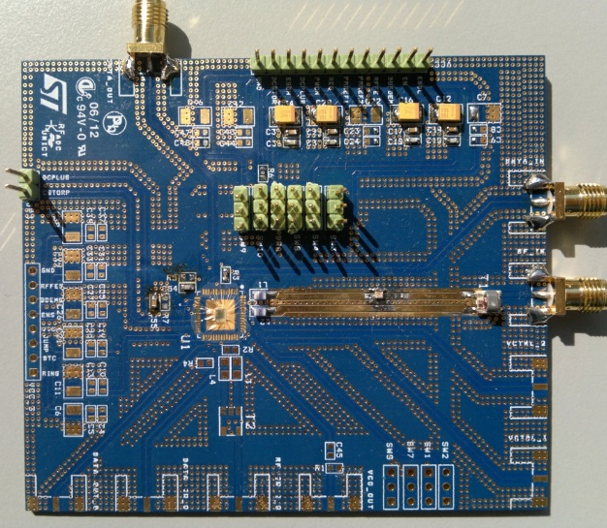
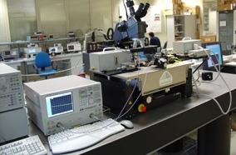
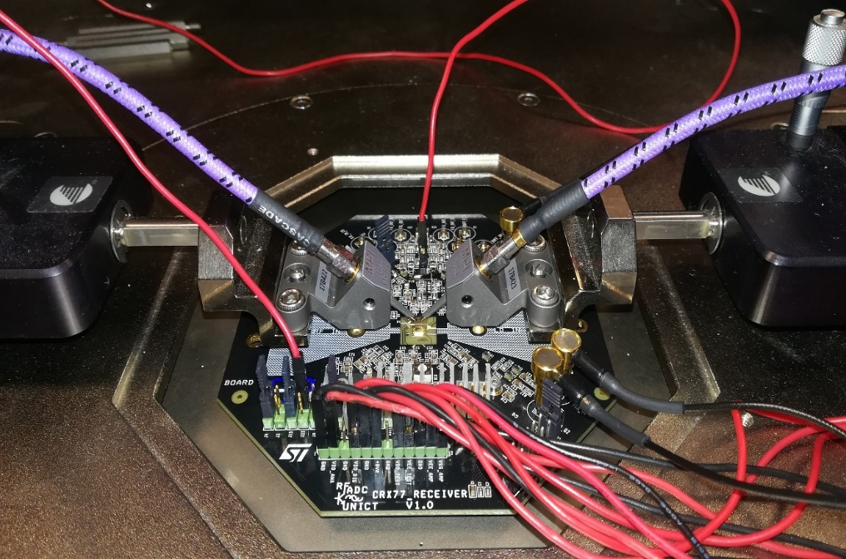
WP 5532 (UniCT)
ELECTRONIC SYSTEMS AND MICROELECTRONICS LAB
Design & characterization
Base-band analog integrated circuits
Digital circuits and systems
Microcontrollers and FPGA-based systems
Network Analyzer
Signal Analyzer
STILES HAS ENHANCED THE LAB CAPABILITIES FOR HIGH PERFORMANCE PROTOTYTPING & BASE-BAND CHARACTERIZATION
Missione 4 • Istruzione e Ricerca

Slide 18
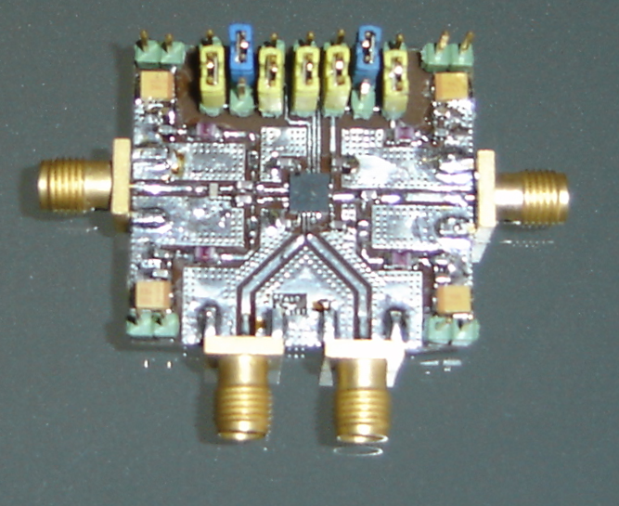
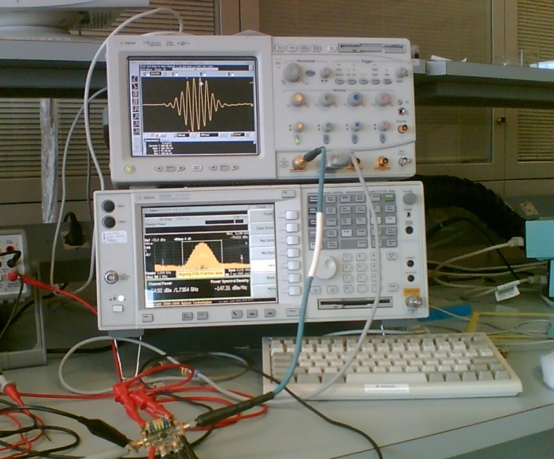
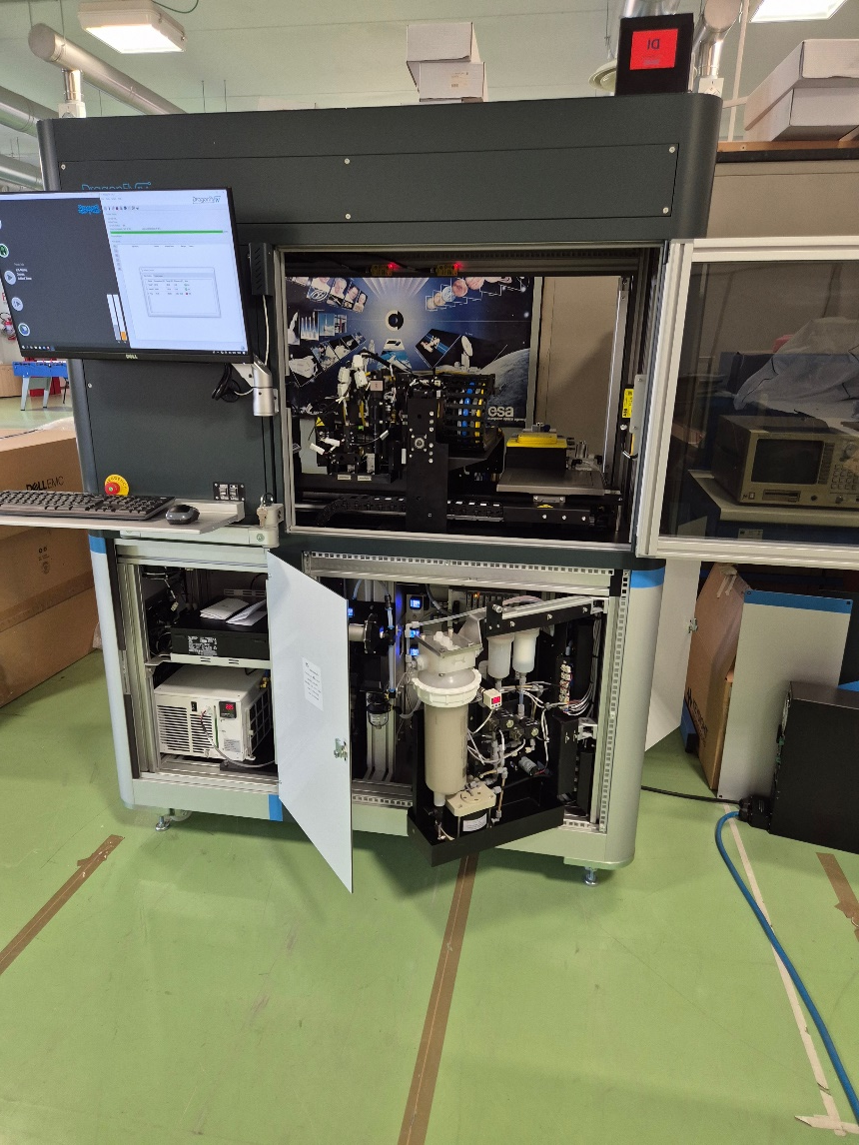
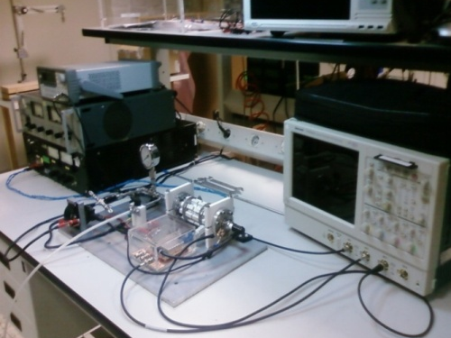
WP 5532 (UniCT)
RF-ADC & JOINT LAB UNICT/STMICROELECTRONICS
ICs for RF & MW applications
Design & characterization
STILES HAS ENHANCED THE LAB TEST CAPABILITIES BY MOVING SIGNAL AND NETWORK ANALYSIS FROM 50 GHZ TO 170 GHZ
(FREQUENCY EXTENDERS)
High-end 3D printer
for electronics
Missione 4 • Istruzione e Ricerca

Slide 19
PROJECT FINANCIAL & PROCEDURAL FRAMEWORK
Missione 4 • Istruzione e Ricerca

Slide 20
 | WP 5501 | WP 5521 | WP 5531 | WP 5532
ISTITUTION | OAS-INAF | OAC-INAF | OACT-INAF | UniCT
CITY | Bologna | Cagliari | Catania | Catania
MANAGER | Francesco Cuttaia | Tonino Pisanu | Francesco Schillirò | Giuseppe Palmisano
CATEGORY WP | Laboratories for R&D | Laboratories for R&D | Laboratories for R&D | Laboratories for R&D
OVERALL BUDGET | 765.457 | 453.482 | 953.555 | 1.555.000
N° OF PROCEDURES | 5 | 1 | 8 | 6
OPEN TENDERS | 1 | 1 (2 lots) | 1 | 2
DIRECT AWARDS | 4 | 0 | 7 | 4
HIRED PERSONNEL | 0 | 1 | 0 | 0
WP 5511 in the next presentation

Slide 21
END

