Slide 1
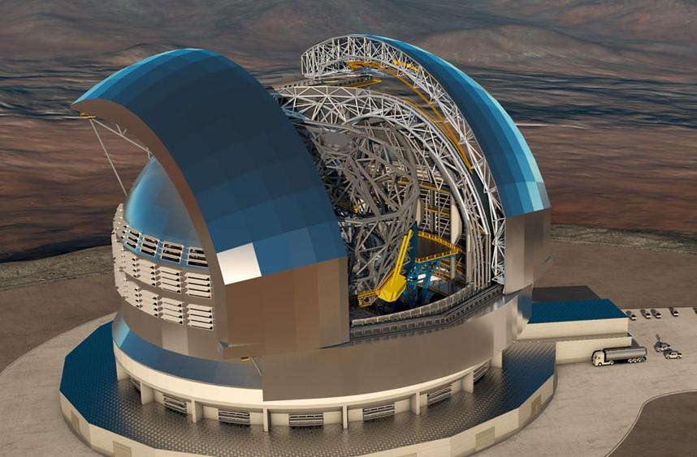
STILES
Anechoic chambers for full range radiation pattern characterization
March 17th, 2026

Slide 2
STILES Proposal: Upgrading Next‑Generation Anechoic Chamber Capabilities
INAF Arcetri Astrophysical Observatory
AI#6201 – Anechoic Chamber
This activity consists in deploying a state-of-the-art anechoic chamber at the Arcetri Astrophysical Observatory (OAA), with operational coverage from VHF/UHF bands up to 110 GHz
Refurbish old disused buildings on the OAA hill
Install a fully operational shielded anechoic chamber (8 m × 4 m × 4 m) to overcome the current ∼2 GHz limitation imposed by the reduced size of the existing chamber
Upgrade the nearby mechanical workshop for in‑house fabrication of custom mechanical components supporting operations
Participants are 2 staff technologists and 1 staff technician
Università degli Studi di Milano
AI#6202 – High Frequency Test Ranges
This activity aims to upgrade the antenna test facilities at the University of Milan (UniMi), extending their operational frequency range from ∼10 GHz up to 750 GHz
Replace the current CATR with a much-improved dual-reflector CATR up to 600 GHz to perform high precision tests on electrically large antennas
Install a thermally-controlled Planar Near-Field antenna measurement system up to 750 GHz
Participants are 1 professor and 2 TD technician

Slide 3
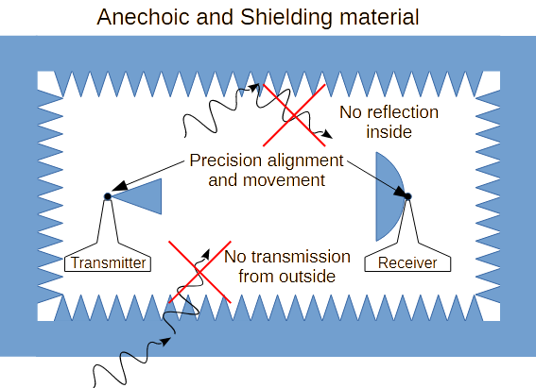
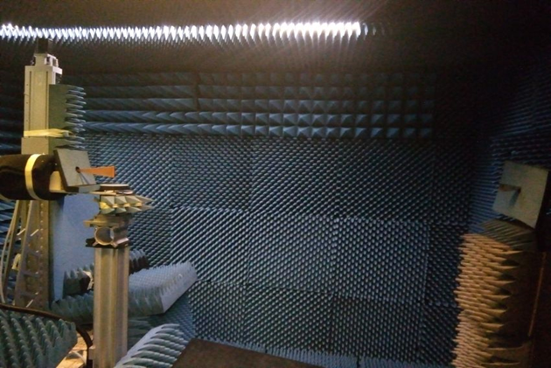
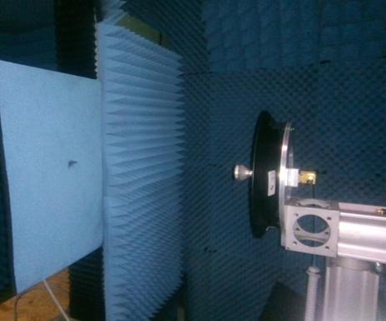
AI#6201 – Anechoic Chamber
Use: Antenna Beam Measurements
Past and future activities
National facilities feed tests: Medicina, Noto, SRT;
International projects: SKA, ALMA;
External Services
What is an anechoic chamber
How it works
Far-Field Measurement
The AUT rotates in azimuth
The test antenna is fixed
Measurement: amplitude
Near-Field Measurement
The AUT is fixed
The test antenna probes the near AUT field
Measurement: amplitude and phase

Slide 4
AI#6201 – Anechoic Chamber
STILES grant CUP C33C22000640006: Budget: 425 k€ (VAT included)
Planned
Description | Original | Variation
Anechoic chamber | 168.500,00 | 168.500,00
Planar Scanner | 42.290,00 | 42.290,00
Computer/Workstation | 3.280,00 | 3.280,00
Accessories (software, cabling, etc.) | 63.180,00 | 63.180,00
Security costs | 3.450,00 | 0,00
Installation and on-site activity | 35.640,00 | 0,00
TOTAL | 316,340,00 | 277.250,00
Payments
Milestones | Payment
Advance Payment | 64.052,35
KM1: Planar Scanner | 62.310,67
KM2: Software + Workstation | 62.310,67
KM3: Anechoic Chamber Shipment | 62.310,67
KM4: Acceptance | 27.800,00
TOTAL | 278.784,36
Notes:
Planned: Include la differenza tra l’offerta economica in risposta al bando di gara (Original) e la Variazione (Variation) dovuta al fatto che l’installazione ed i relativi costi di sicurezza sono stati rimossi a causa della indisponibilità del sito in cui la camera anecoica doveva essere installata
Payments: la tabella descrive le milestone di pagamento. La differenza con il ‘Planned’ (278.784,36 - 277,250,00) è dovuta agli extra costi, principalmente legati agli interessi.

Slide 5
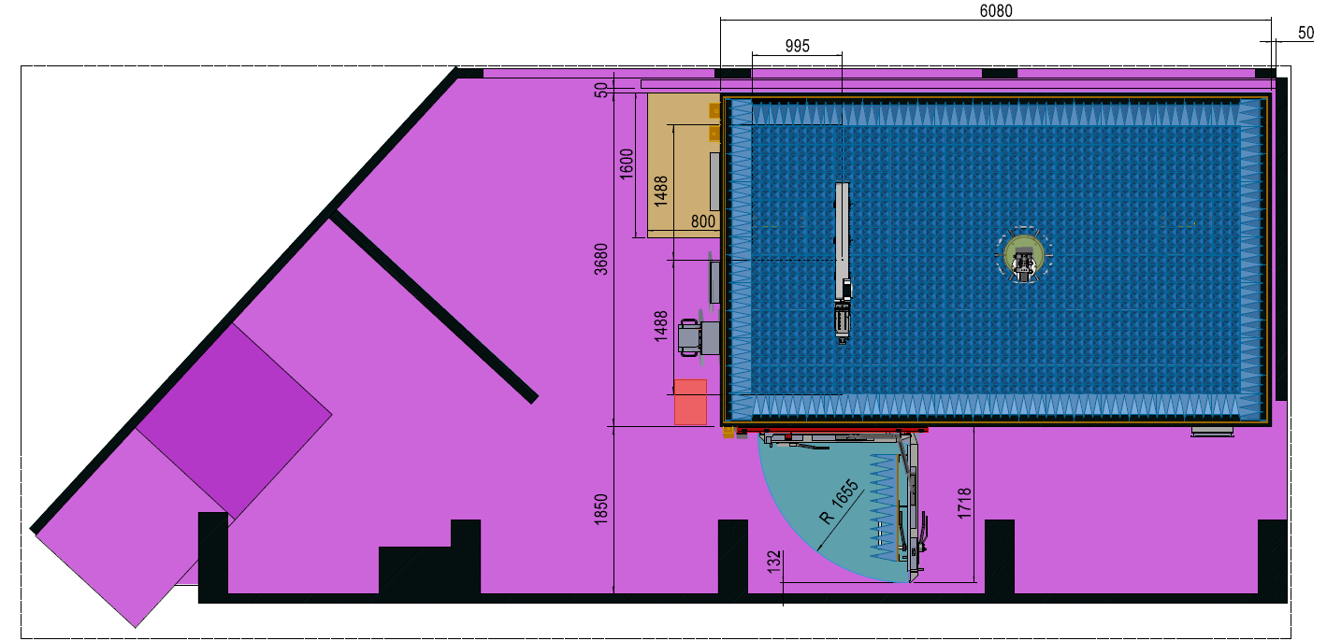
AI#6201 – Anechoic Chamber Design: view inside OAA building (map)
Measurement and control Instrumentation
Planar Scanner
Auxiliary Rotator
Anechoic chamber
Controller
Notes:
Planned: Include la differenza tra l’offerta economica in risposta al bando di gara (Original) e la Variazione (Variation) dovuta al fatto che l’installazione ed i relativi costi di sicurezza sono stati rimossi a causa della indisponibilità del sito in cui la camera anecoica doveva essere installata
Payments: la tabella descrive le milestone di pagamento. La differenza con il ‘Planned’ (278.784,36 - 277,250,00) è dovuta agli extra costi, principalmente legati agli interessi.

Slide 6
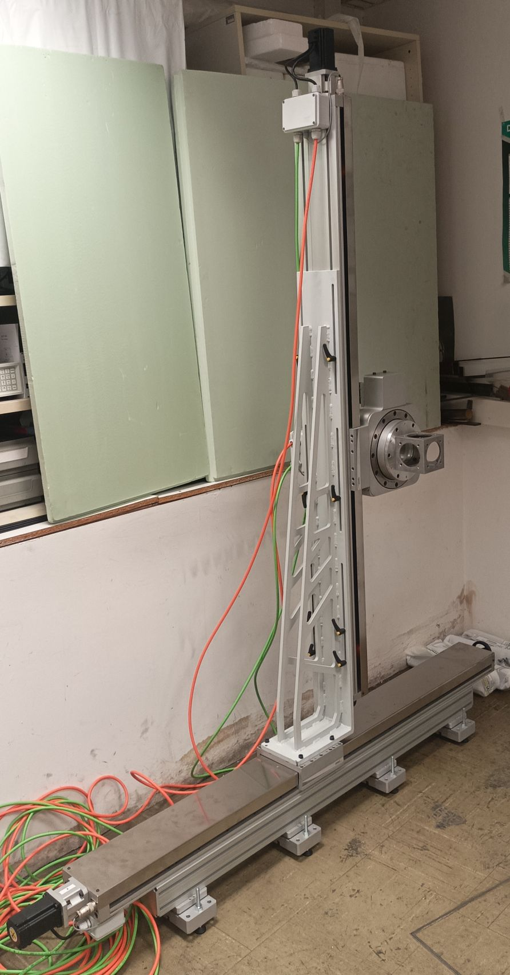
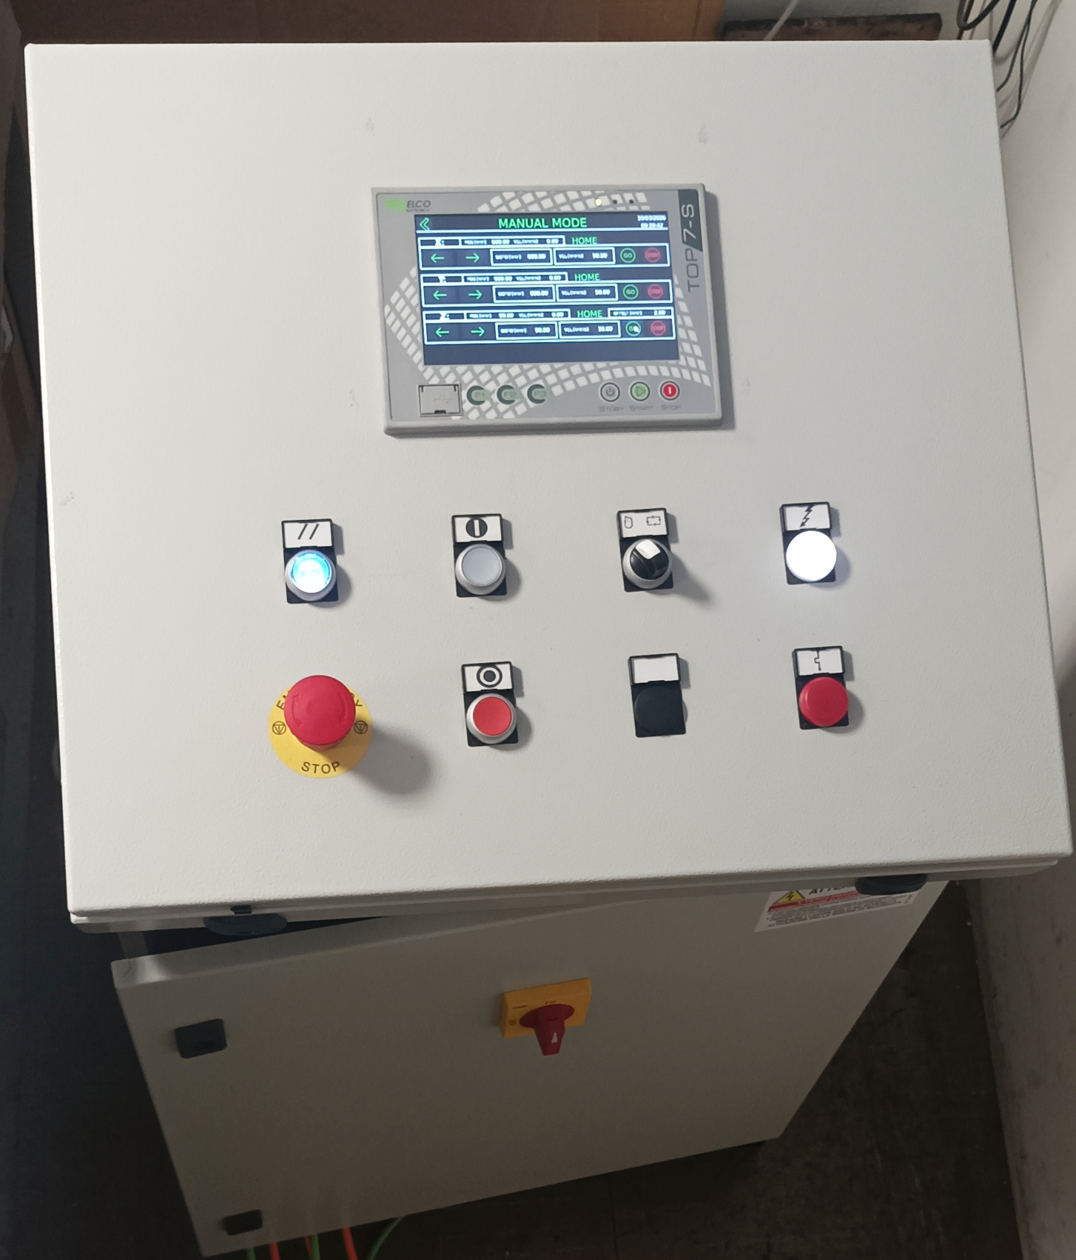
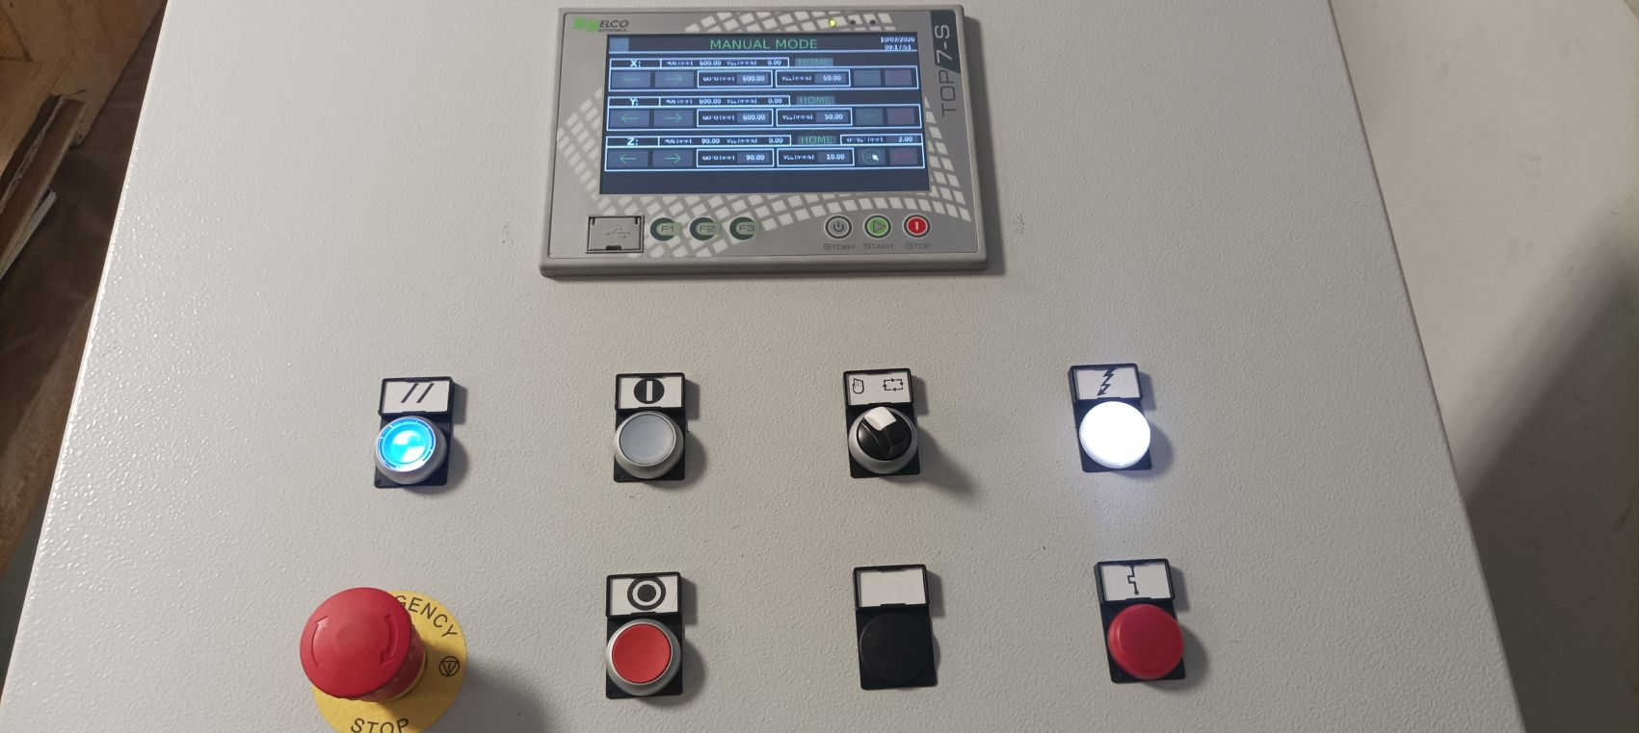
KM1: Planar Scanner Movitec and Controller ELCO
Installation and test: 4 September 2025

Slide 7
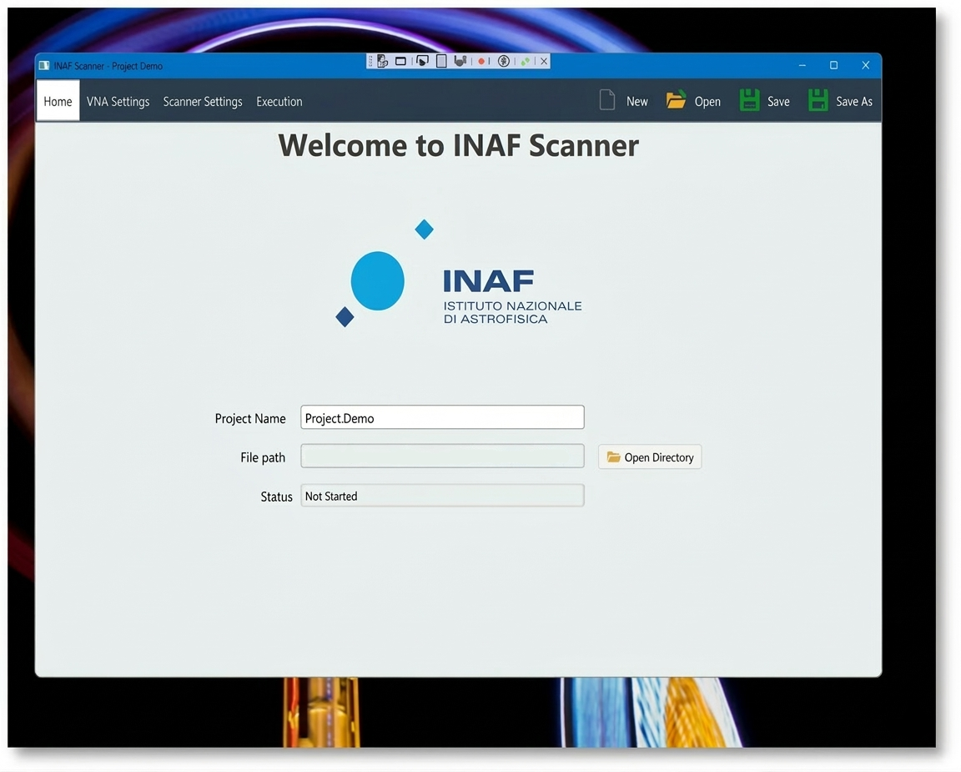
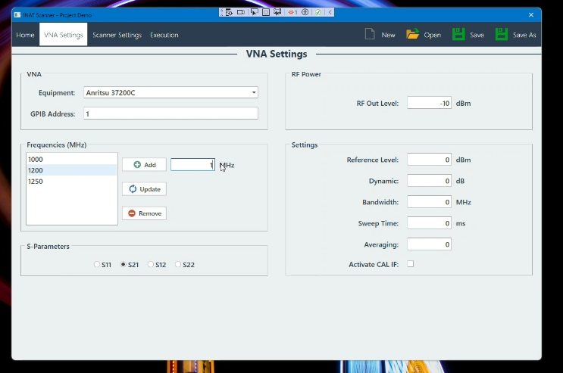
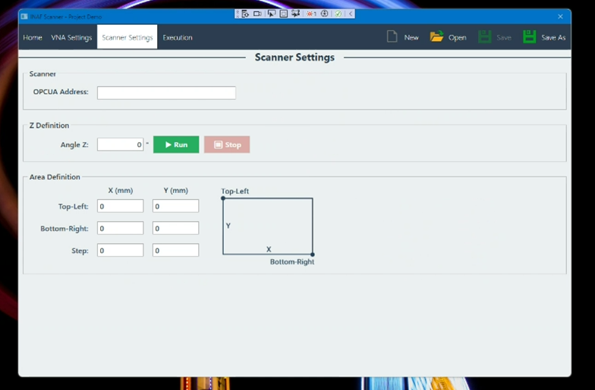
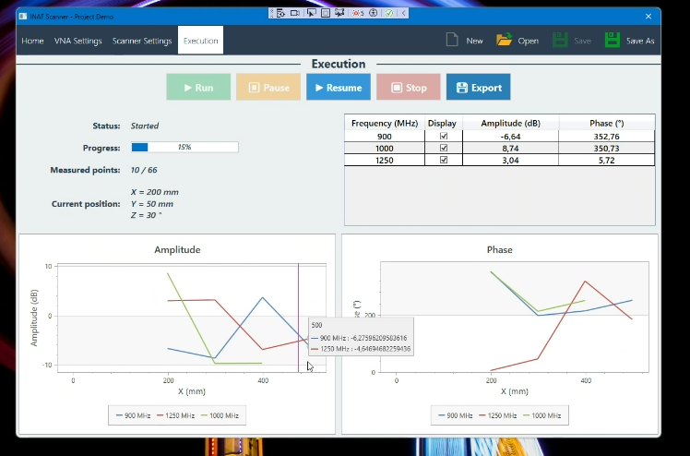
KM2: Software and Workstation
Installation and test:
13, 14 and 15 October 2025

Slide 8
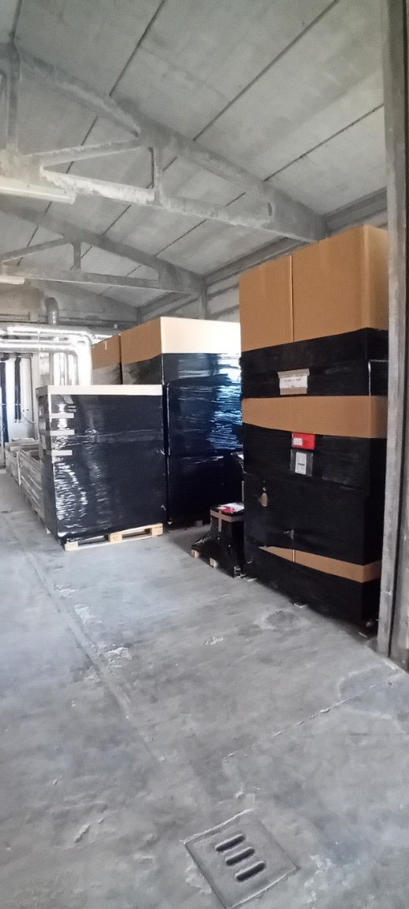
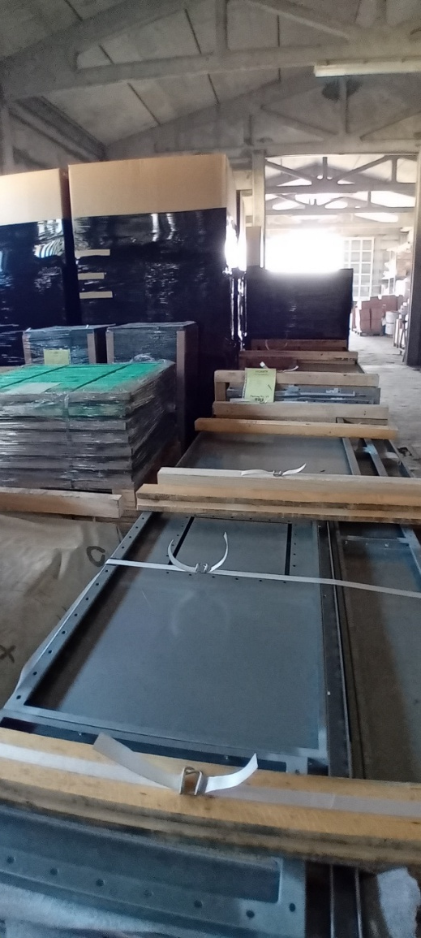
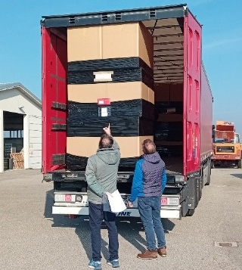
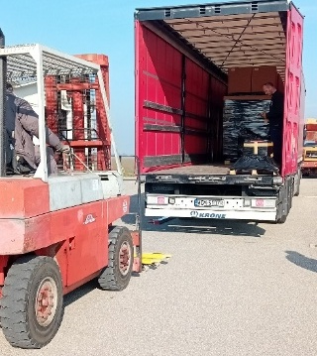
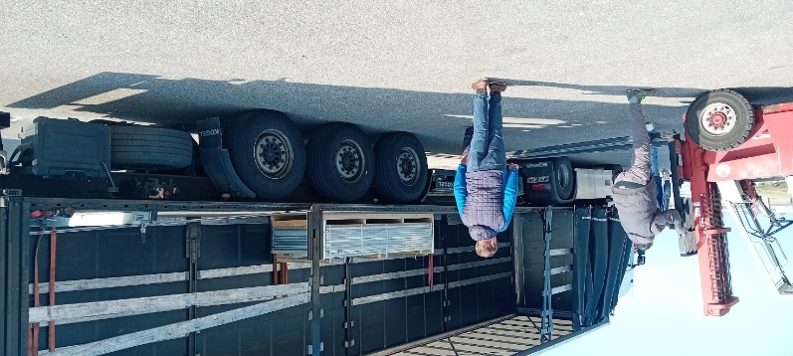
KM3: Anechoic chamber delivery
Delivery at Medicina site:
5 November 2025

Slide 9
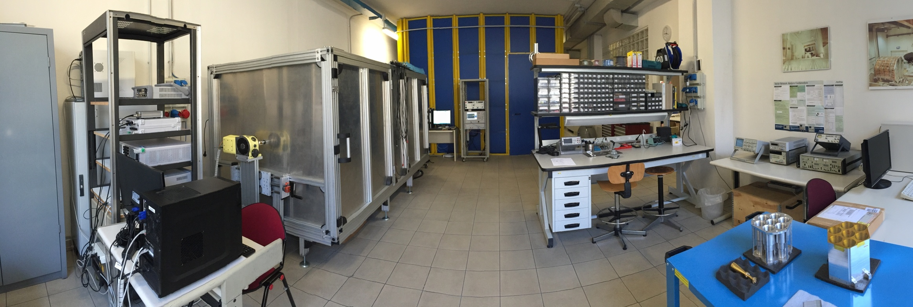

AI#6202 – High Frequency Test Ranges
The big anechoic chamber “Ken”
The small anechoic chamber “Barbie”
Measurements of waveguide components

Slide 10
AI#6202 – High Frequency Test Ranges
20 procedures (total budget 2,149,641.83 € VAT included)
2 procedures for recruiting TD personnel (204.118,13 €)
IR0000034_PRO013 (C. Franceschet)
IR0000034_PRO037 (D. Capelli)
18 procurement procedures for identifying suppliers of goods, services, and works (1.945.523,70 €)
IR0000034_PRO020 75 GHz – 750 GHz VNA extender modules
IR0000034_PRO021 VNA with TestSet
IR0000034_PRO041 Spectrum analyzer
IR0000034_PRO042 Microwave absorber
IR0000034_PRO043 CATR RX positioner
IR0000034_PRO044 Optical table for NF
IR0000034_PRO045 Compact Antenna Test Range (first tender)
IR0000034_PRO199 CATR air‑conditioning and climatic chamber for NF
IR0000034_PRO216 NF positioners
IR0000034_PRO217 Ticra Tools license 2023
IR0000034_PRO218 Ticra Tools license 2024
IR0000034_PRO219 Ticra Tools license 2025
IR0000034_PRO227 CST Studio 2023
IR0000034_PRO228 CST Studio 2024
IR0000034_PRO319 Compact Antenna Test Range
IR0000034_PRO330 Passive components for NF
IR0000034_PRO360 CATR completion
IR0000034_PRO00516 Up/Down conversion system

Slide 11
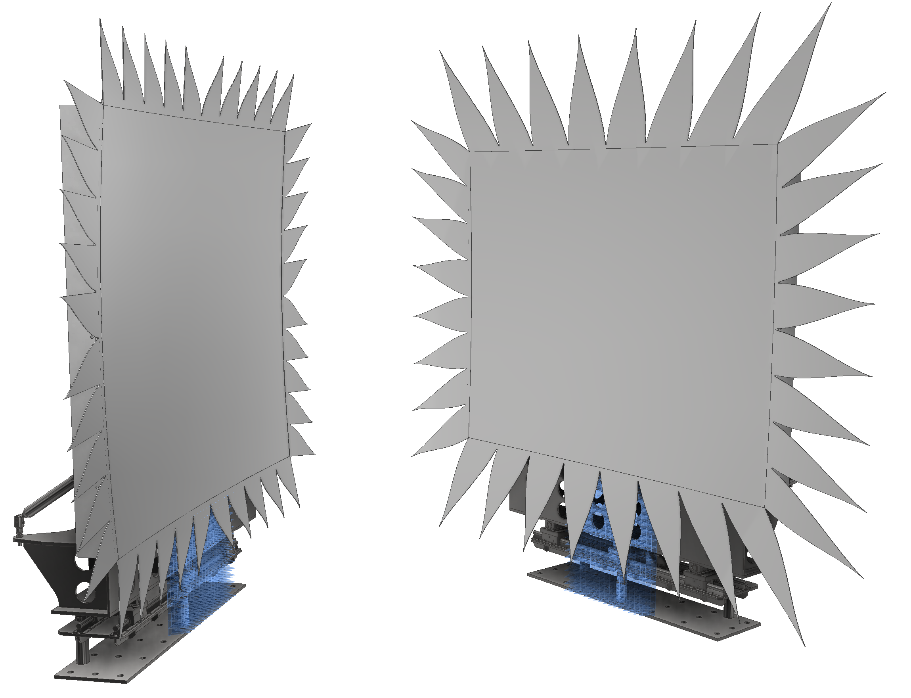

Compact Antenna Test Range
Technical specifications
Monolithic dual-reflector CATR
1.9 m × 1.7 m projected aperture
r.m.s. $∼5 μm$→ $f_{max}∼600 GHz$(λ/100)
X-pol < -45 dB on principal axes
Amplitude/phase ripples @40 GHz: $<0.3 dB_{pp}$ & $<2°_{pp}$
Motion
Azimuth, elevation, polarization, center of phase
Software development
6-axis control & signal acq. and pre-processing (WIP)
Environment
8 m × 4 m × 3.3 m anechoic chamber
Controlled temperature (± 2°C) and RH (< 50%)

Slide 12
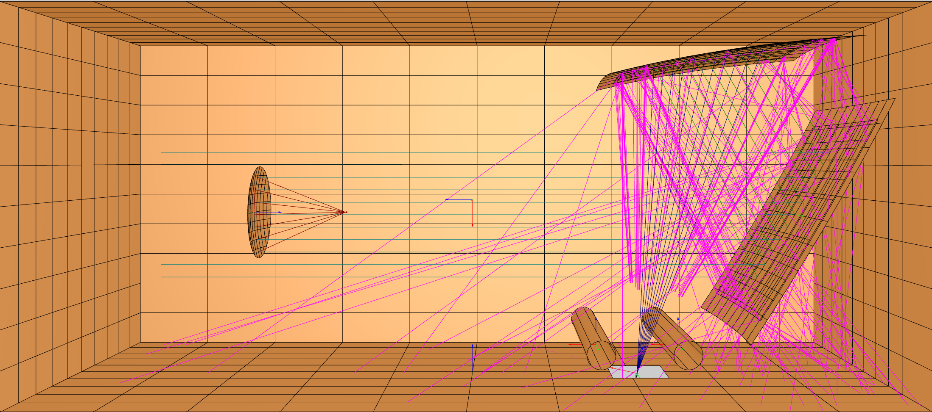
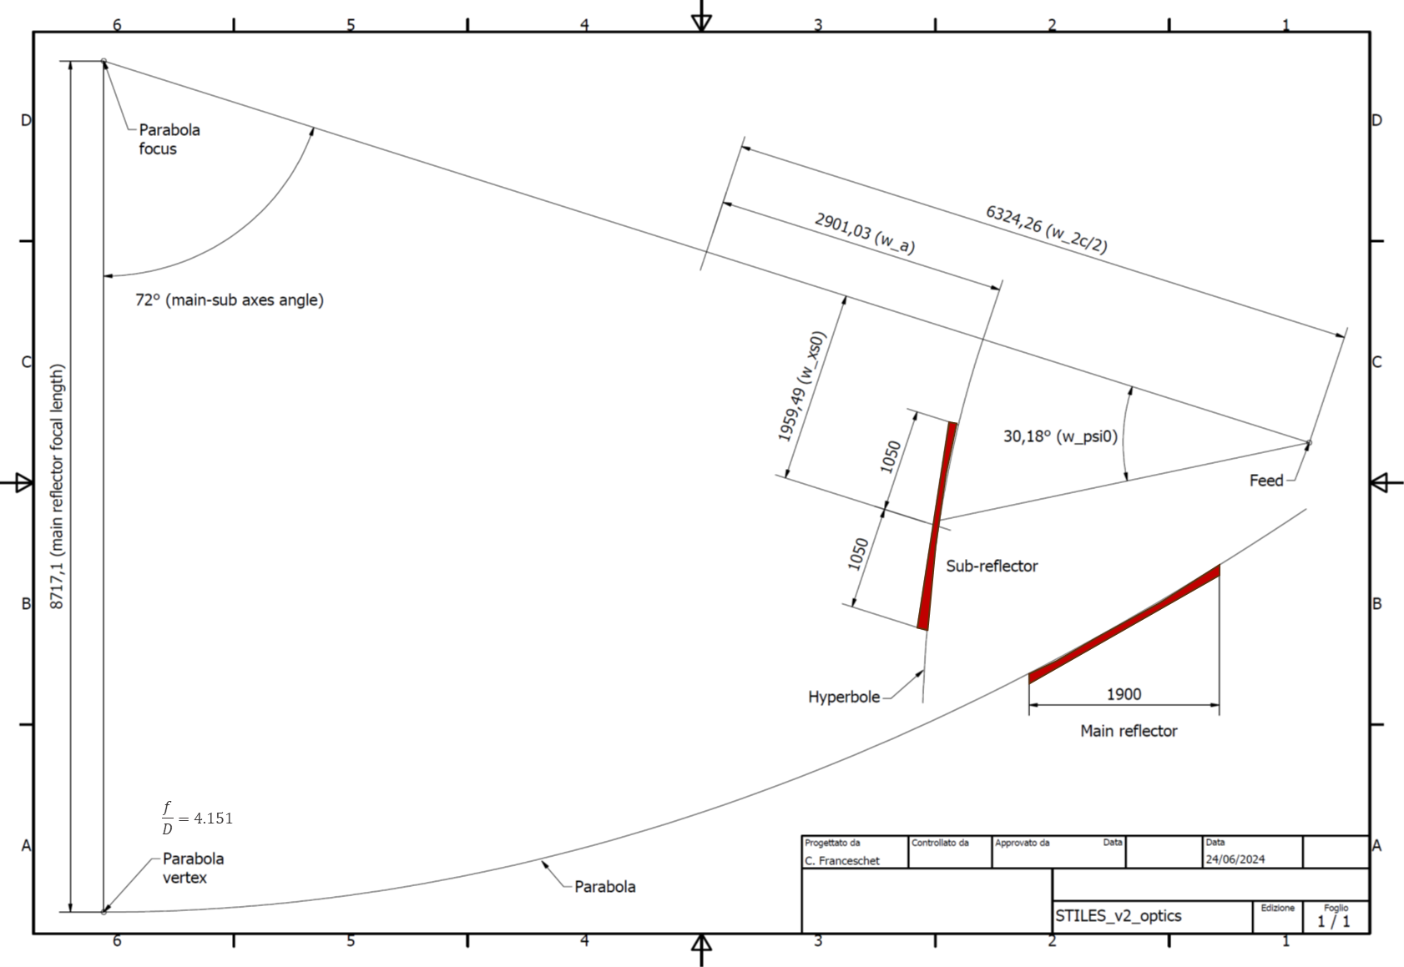
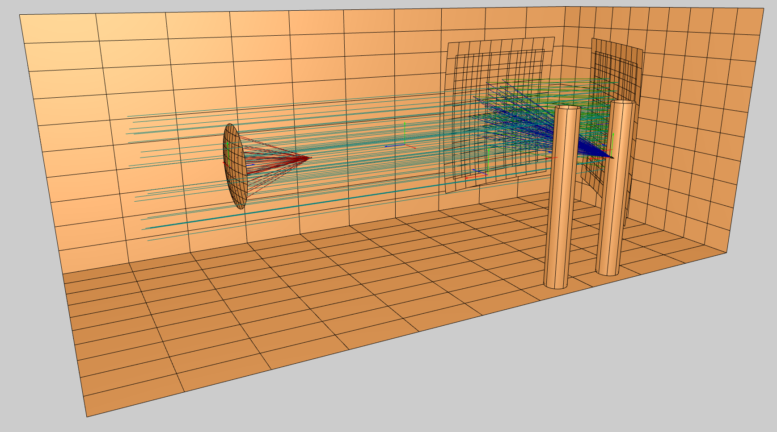
Compact Antenna Test Range
Study of spurious reflections/diffractions inside the anechoic chamber (in progress)
Study of the coupling of the real wavefront with the AUT (post processing – in progress)
Optical design
Side-fed Offset Cassegrain with ∼4.4 m equivalent focal length

Slide 13
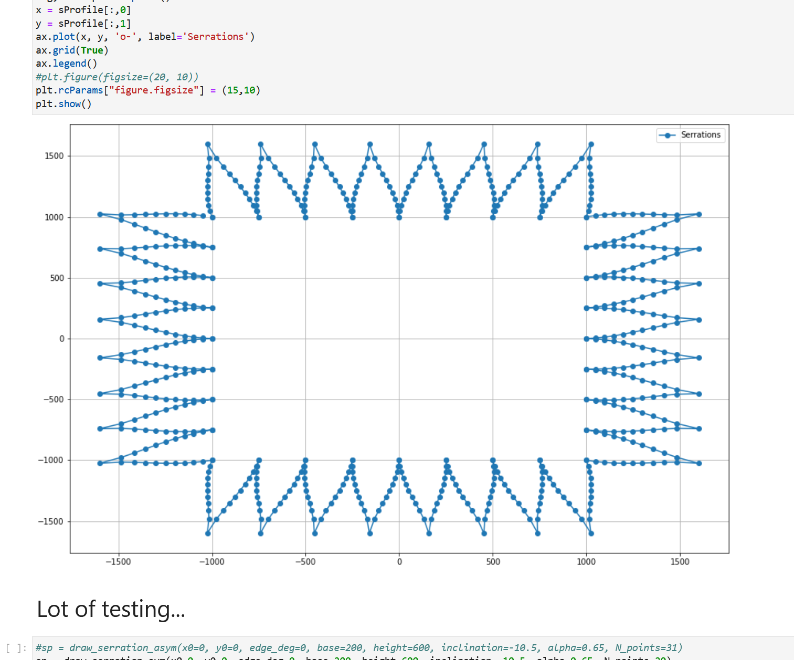
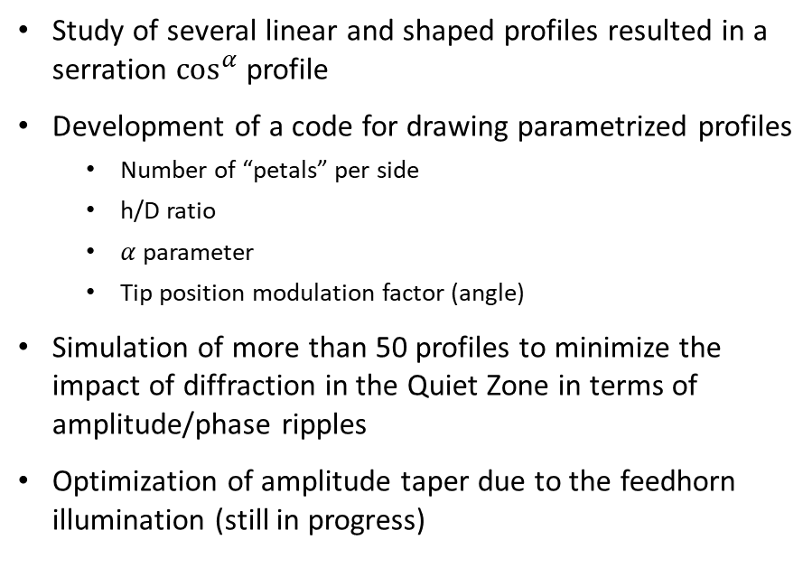
Compact Antenna Test Range
Parametric design of the serrations
Study of several linear and shaped profiles resulted in a serration $\cos^{α}$ profile
Development of a code for drawing parametrized profiles
Number of “petals” per side
h/D ratio
$α$ parameter
Tip position modulation factor (angle)
Simulation of more than 50 profiles to minimize the impact of diffraction in the Quiet Zone in terms of amplitude/phase ripples
Optimization of amplitude taper due to the feedhorn illumination (still in progress)

Slide 14
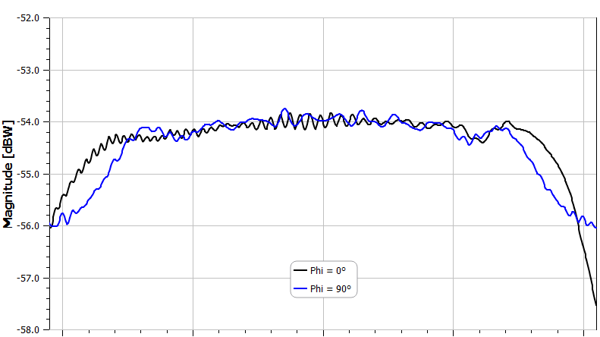
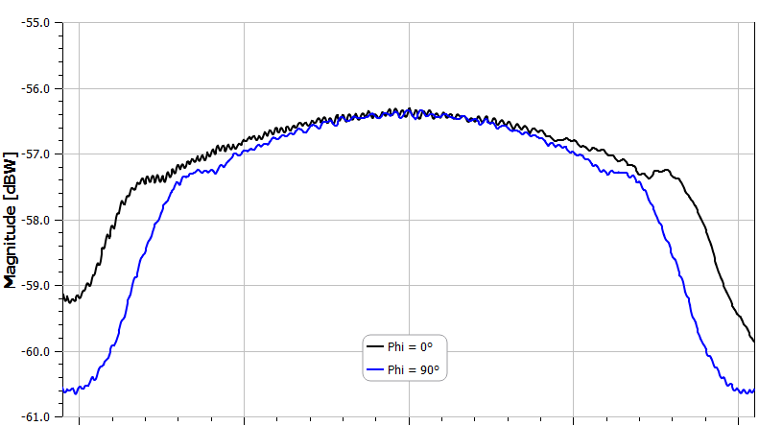
Compact Antenna Test Range
Amplitude cuts in the Quiet Zone at 20.35 GHz & 40 GHz
20.35 GHz
40.0 GHz

Slide 15
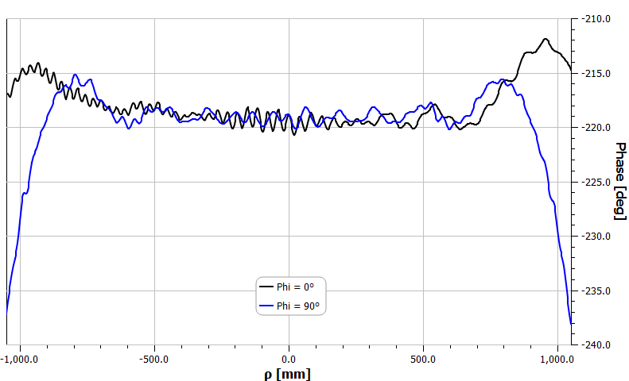
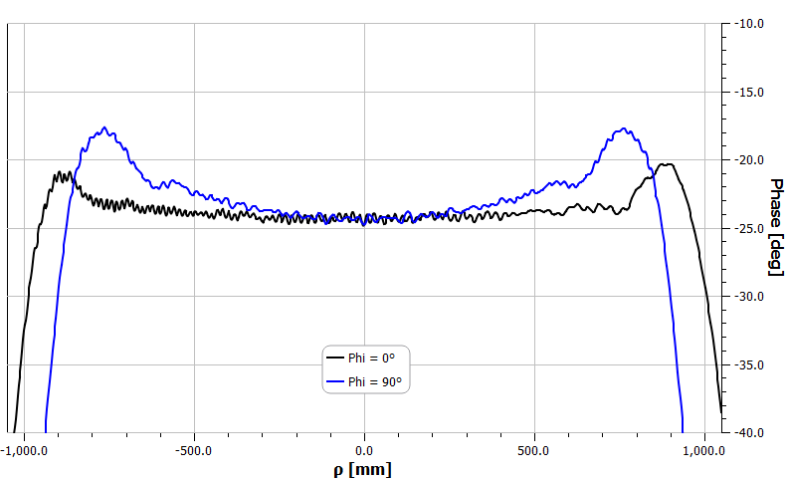
Compact Antenna Test Range
Phase cuts in the Quiet Zone at 20.35 GHz & 40 GHz
20.35 GHz
40.0 GHz

Slide 16
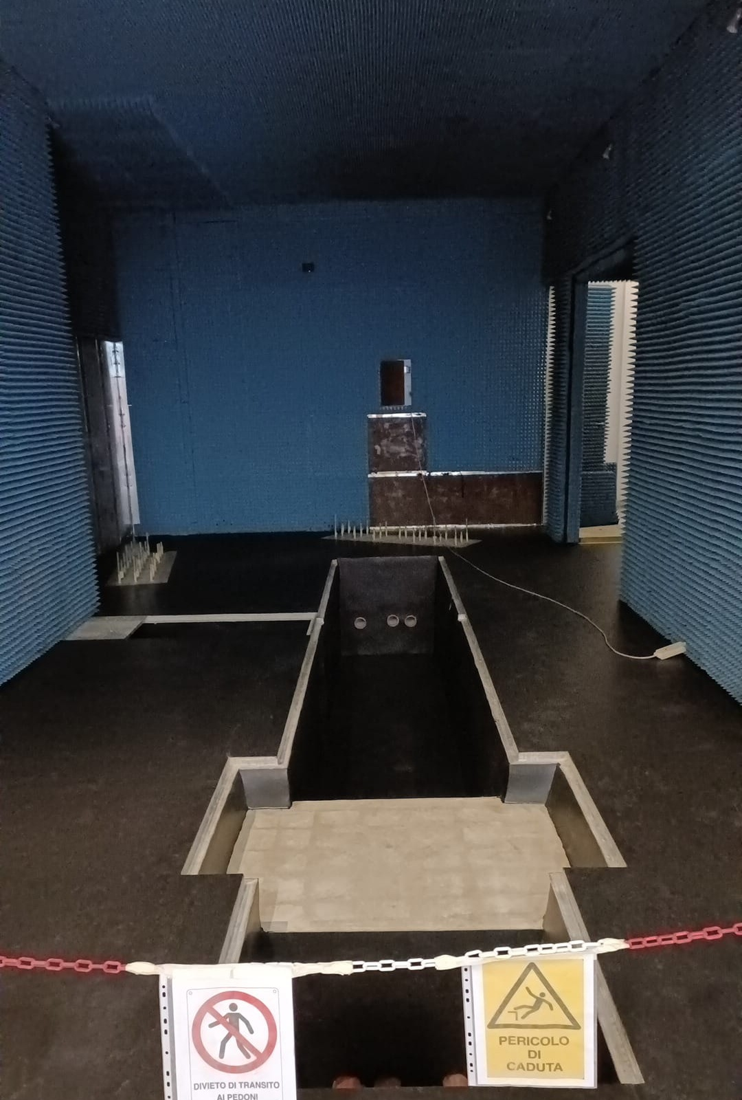
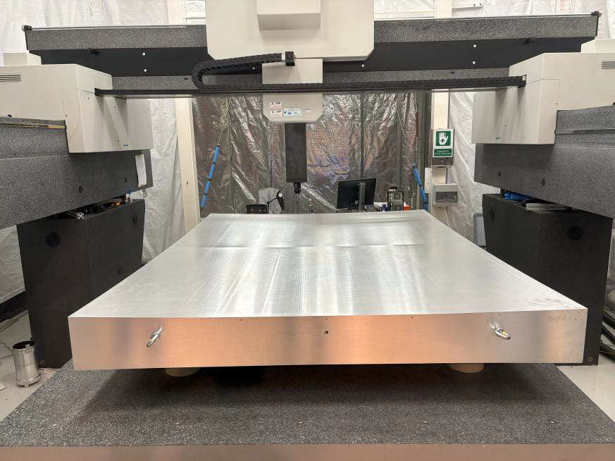
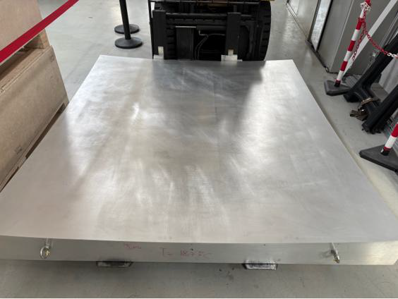
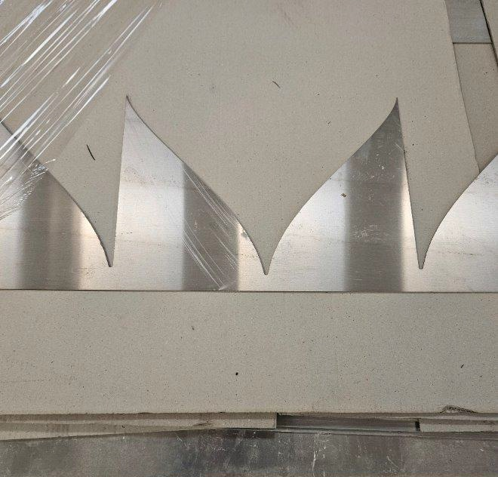
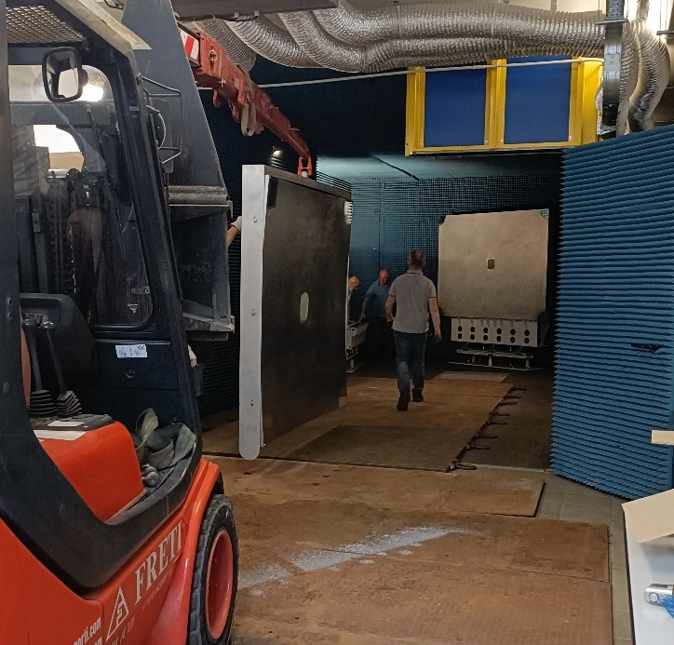


Compact Antenna Test Range
Modified anechoic chamber…
Main reflector…
… and sub-reflector!
Sub-reflector $\cos^{α}$ serrations
CATR installation
Credits: Media Lario S.r.l.

Slide 17
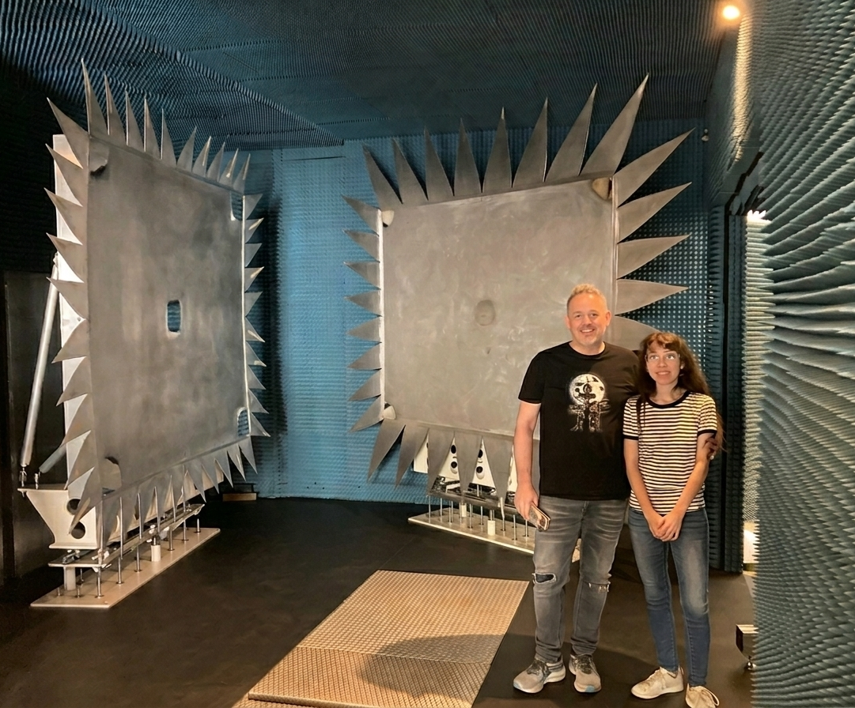
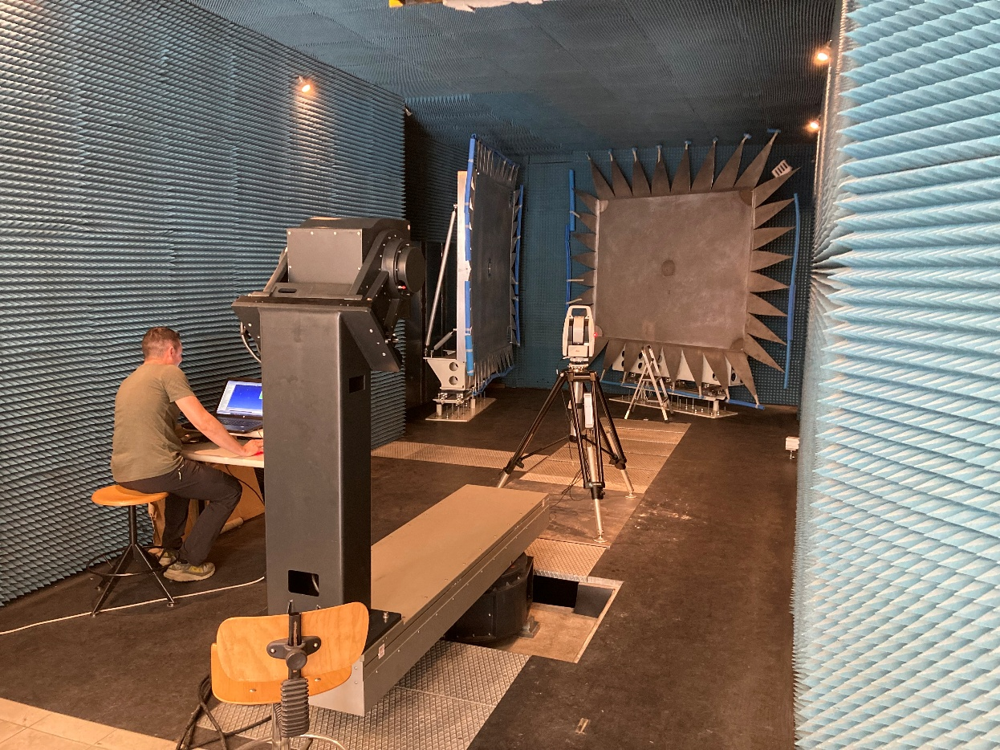
Compact Antenna Test Range

Slide 18
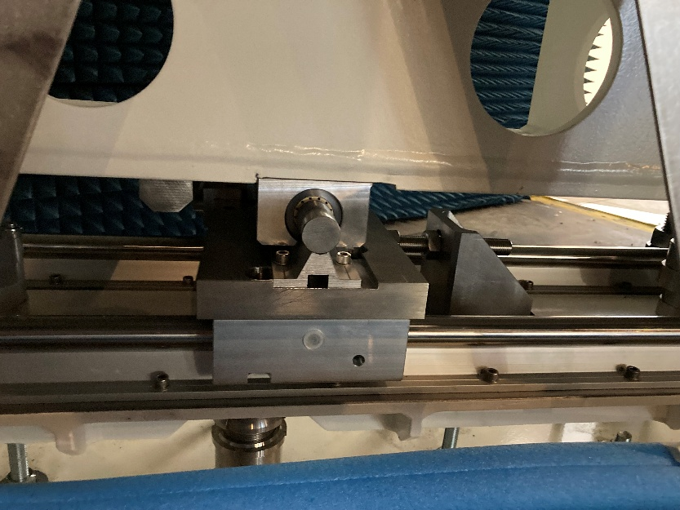
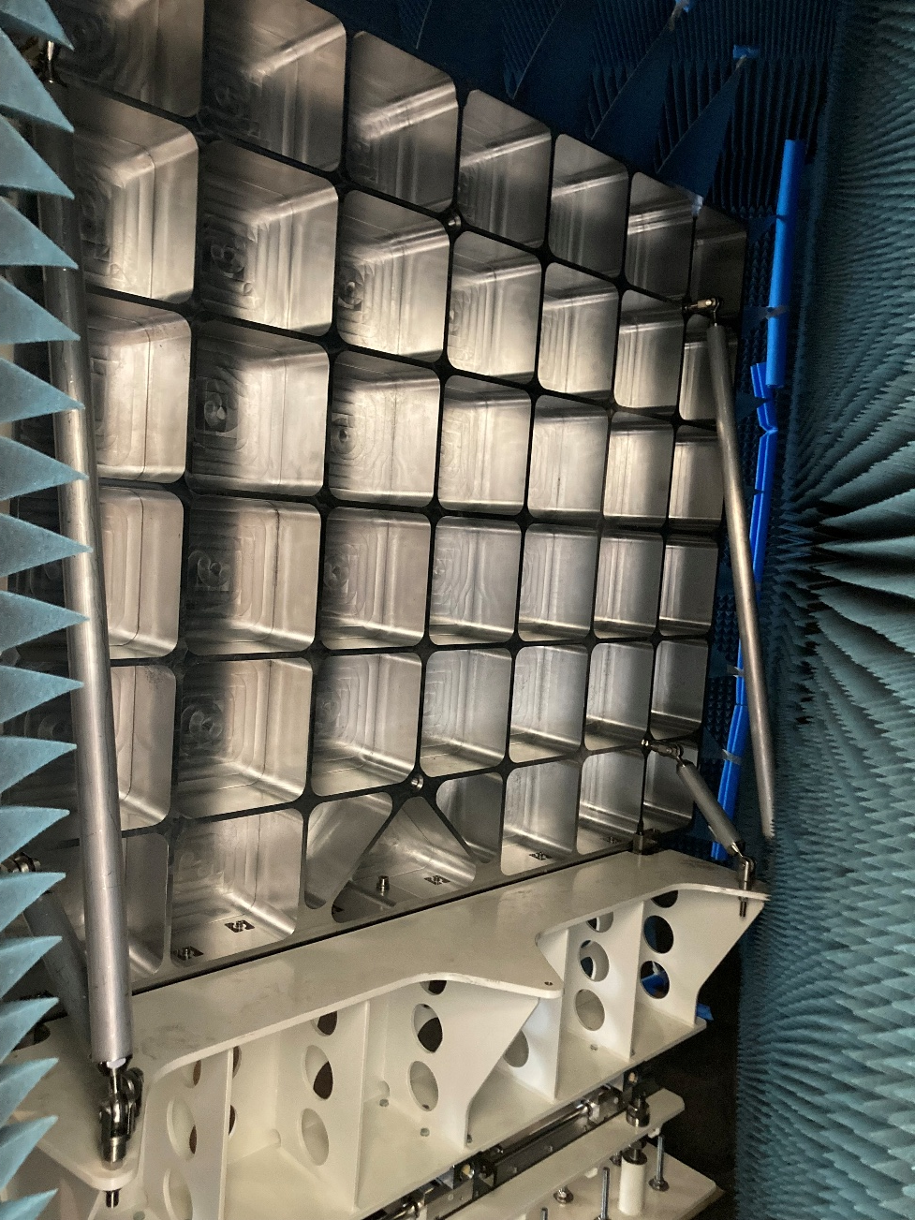
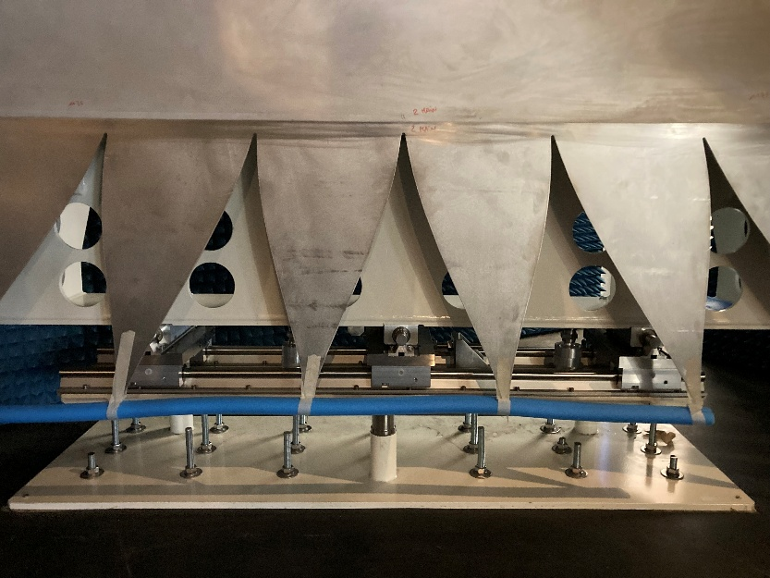
Compact Antenna Test Range
Main reflector fine adjustment
Back of the main reflector
The two reflectors are machined on the back with a mesh pattern for lightweighting
The weight of each reflector including its support structure is ∼800 kg
We built reinforced concrete plinths under the floor to ensure load-bearing capacity and stable alignment over time
Main reflector serrations

Slide 19

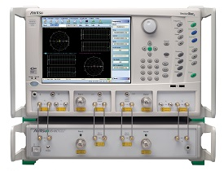
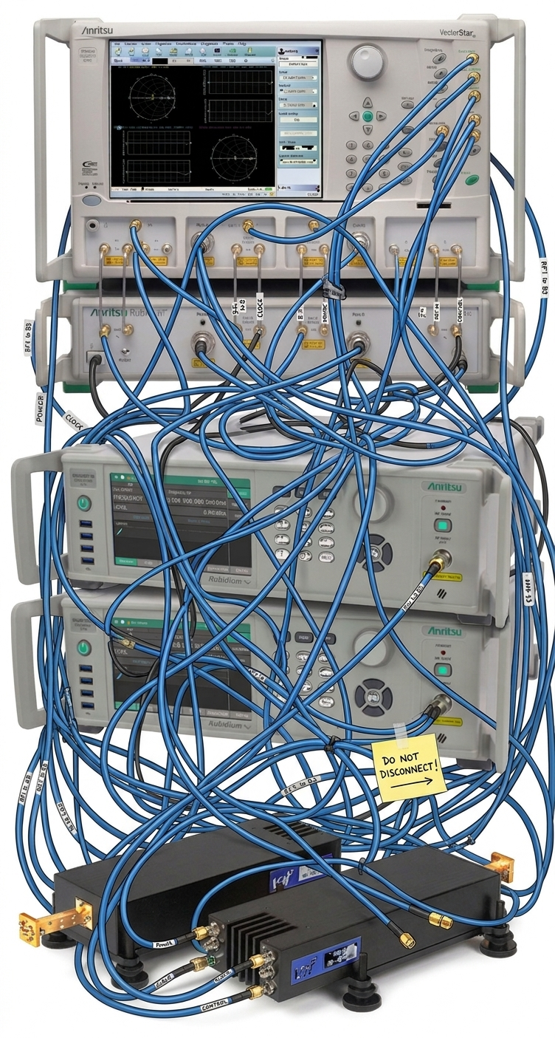
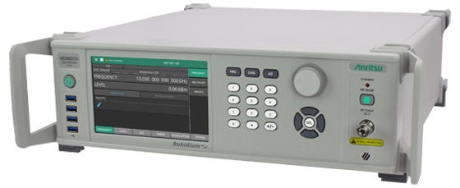
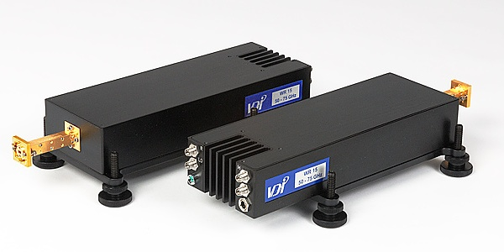
Compact Antenna Test Range
Work to be done before “turning on” the system…
Complete the hardware & software
Conductive gap-filler between reflectors and serrations
Polishing of reflector surface
Cable routing (TX & AUT local oscillators, IF signals, etc.)
Complete the development of launchers/horns
Verification
Dynamic range up to 600 GHz, signal degradation inside chamber, etc.
Mechanical repeatability of positioners
Post processing
Study of antenna pattern correction (APC) techniques from literature and simulation

Slide 20
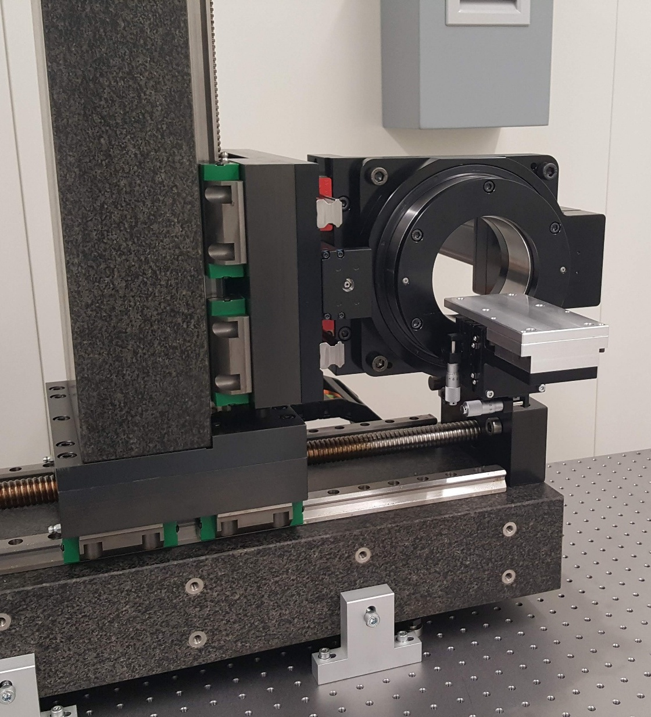
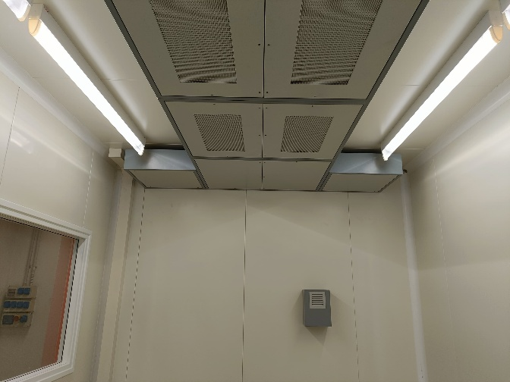
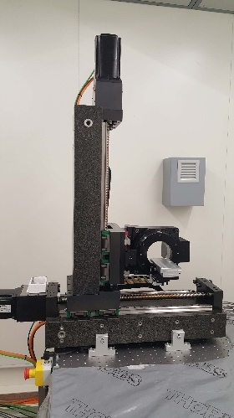
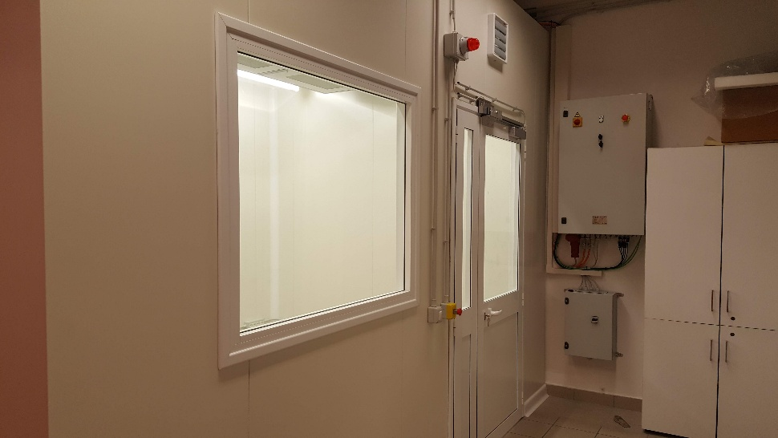

Near-field Measurement System
Technical specifications
400 mm x 400 mm planar scanner
Nominal f_{max} = 400 GHz (λ/50) → 750 GHz (λ/25)
Motion
XY-axes (R.M.S. $\sim 15 μm$)
Z-axis (100 mm travel)
Polarization axis
Software development
NF2FF routines verified at simulation level
Motion/acquisition software integration being completed
Environment
Climatic chamber w/ temperature (±0.3°C) and RH (±5%) control
Possible upgrade to ISO-8
Optical table with passive isolation (2.5 m × 1.2 m)
Near-field Test Range
up to 750 GHz
Near-field climatic chamber

Slide 21
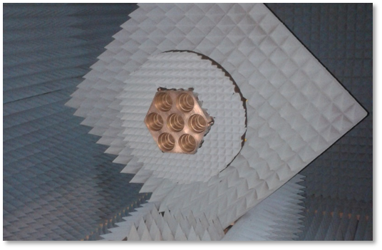
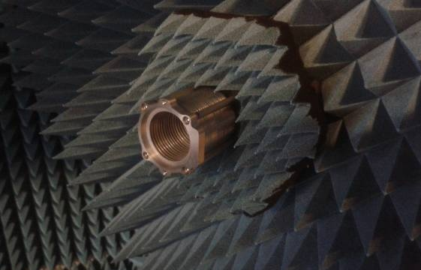



Radiation pattern measurements
LSPE/Strip
Sardinia Radio Telescope
Tenerife Microwave Spectrometer (TMS)
49 radiation patterns at 43 GHz
19 radiation patterns at 41.5 GHz
Co-polar and cross-polar pattern @13 GHz

Slide 22





Radiation pattern measurements
Breadboard model “BB1” of the LiteBIRD MHFT instrument
Frequency band: 90-110 GHz (W-band)
Measurement-simulation agreement at the level of ∼0.1 dB down to near sidelobes
LiteBIRD MHFT BB1, H-plane at 100 GHz

Slide 23



Anechoic chambers for full range radiation pattern characterization
AI#6201 & AI#6202 will operate from 30 MHz to 750 GHz
SKA – Square Kilometre Array
SKA-Low: 50 MHz – 350 MHz
SKA-Mid: 350 MHz – 15.4 GHz
ALMA – Atacama Large Millimeter/submillimeter Array
10 bands in the range 35 – 950 GHz
LiteBIRD
15 bands in the range 30 – 450 GHz
Many other INAF and UniMi projects
Service to industry and institutions

Slide 24
STILES
Anechoic chambers for full range radiation pattern characterization

