Slide 1
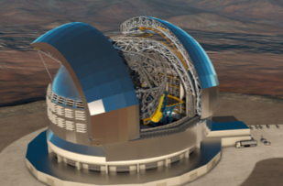
STILES
WP 4101
Exoplanet Atmosphere Laboratory

Slide 2
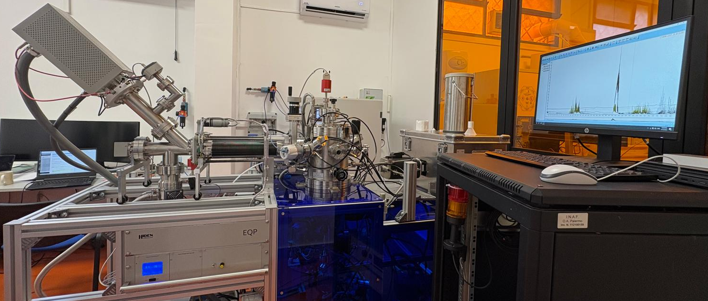
Light Irradiation Facility for Exochemistry & PLAnetary Systems – LIFE+
A. Ciaravella, A. Jimenéz-Escobar, A. Mangione, C. Cecchi-Pestellini
INAF-Osservatorio Astronomico di Palermo
Objective
Design and construction of an atmosphere simulator facility, to study the chemical and physical evolution of a gas mixture “the atmosphere” under highly energetic phenomena (UV, X-rays, Lightening)ing)
Missione 4 • Istruzione e Ricerca

Slide 3
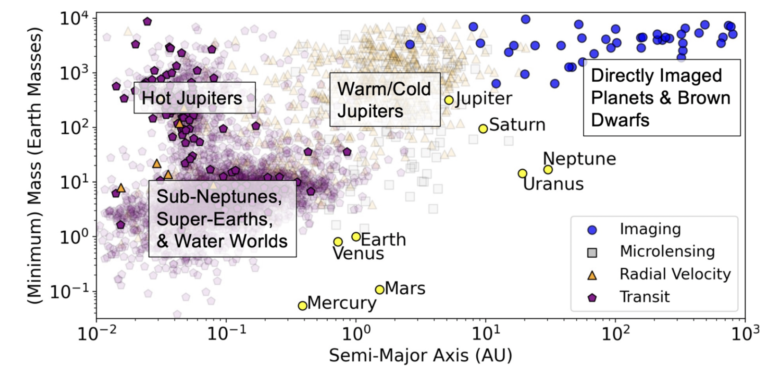

Exoplanets
10000 exoplanets & planet candidates, ~ 6000 confirmed planets
(mostly by Transit & Radial Velocity Techniques)
1995 - 51 Pegasi b, the first planet orbiting a Sun-like star ( radial velocity )
2000 - The first transiting exoplanet was identified, changing the course of exoplanetary science.
Transit Technique has overtaken Radial Velocity as the primary method for discovery.
The transit technique is the only method that allows for Transmission Spectroscopy.
Spectra of the star’s light filtered through the outher layers of planet’s atmosphere provide
aerosols (clouds, hazes) and chemical markers, biosignatures (habitability)
(Klempton & Knutson 2024, Rev. in Min. and Geo.)

Slide 4
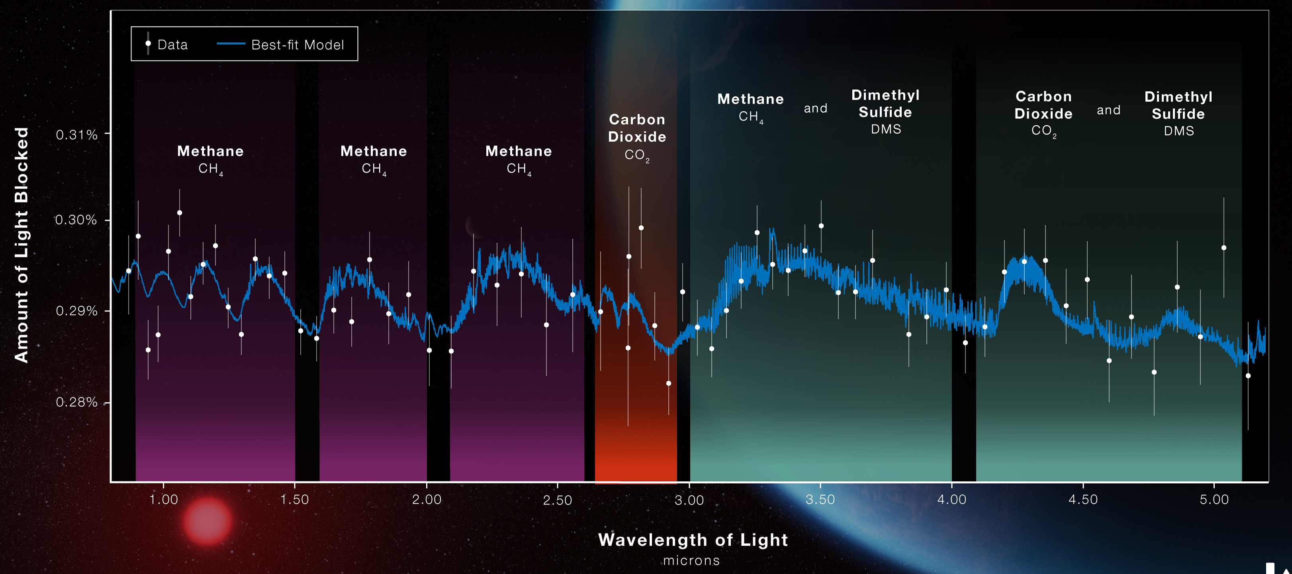
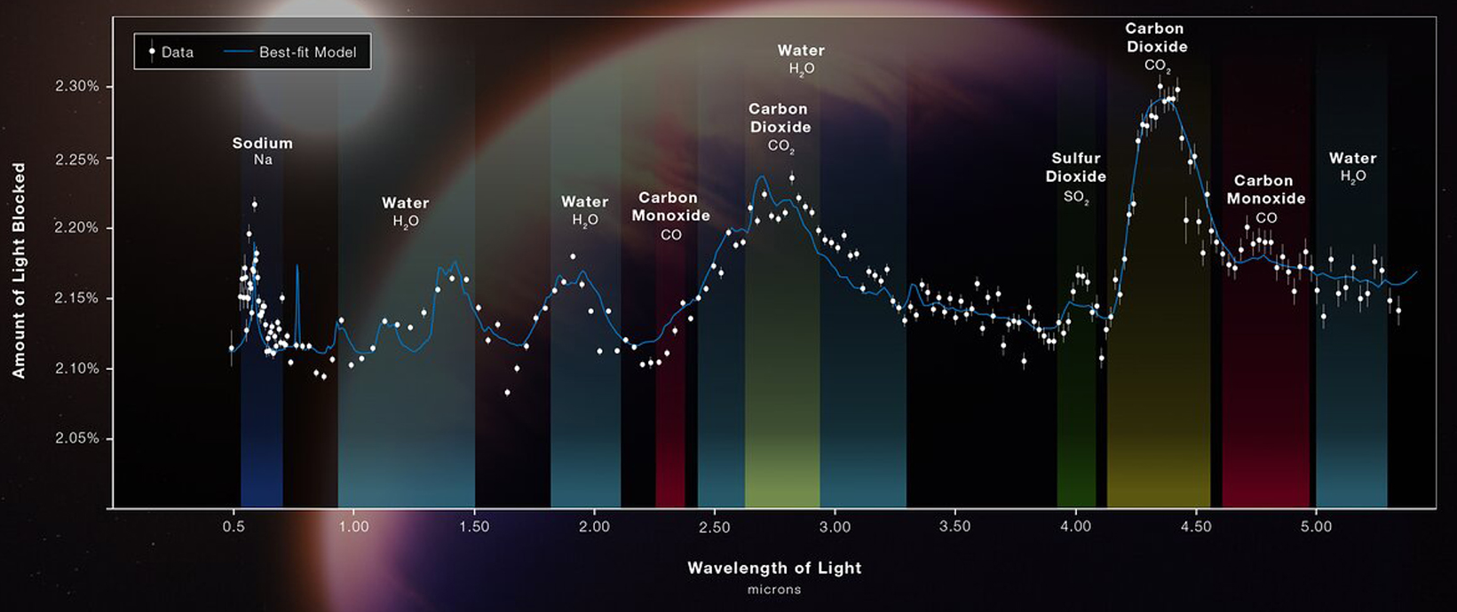
2002 Charbonneau et al: HST the first exoplanet atmosphere was detected HD 209458b, a "Hot Jupiter”.
2010 Bean et al: The first atmospheric spectrum of an object smaller than Neptune (GJ 1214b)
Further studies revealed a thick layer of clouds or haze (Kreidberg et al. 2014) .
JWST Era
Over 100 exoplanets have had their atmospheres characterized.
Atmospheric characterization is now a cornerstone of modern astronomy with present (JWST) and future space (ARIEL) and ground-based (ELT) telescopes
K2 – 18b M=8.6 M⨁ R= 2.6 R⨁
WASP – 39b R= 1.42 R_{jupiter} M= 2.43 M_{Jupiter}

Slide 5
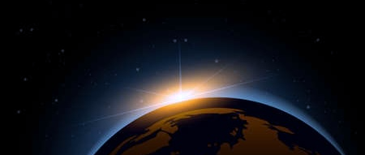
Simulating Atmosphere in a Laboratory
Gas-mixture ”the atmosphere”
Composition, T, P

Slide 6
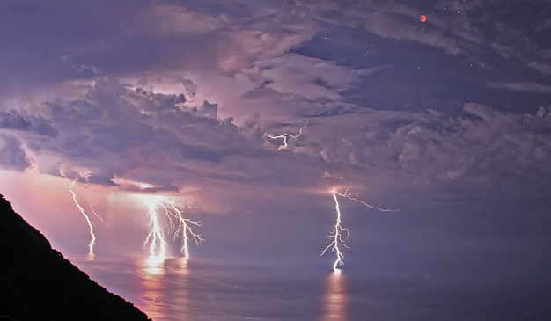
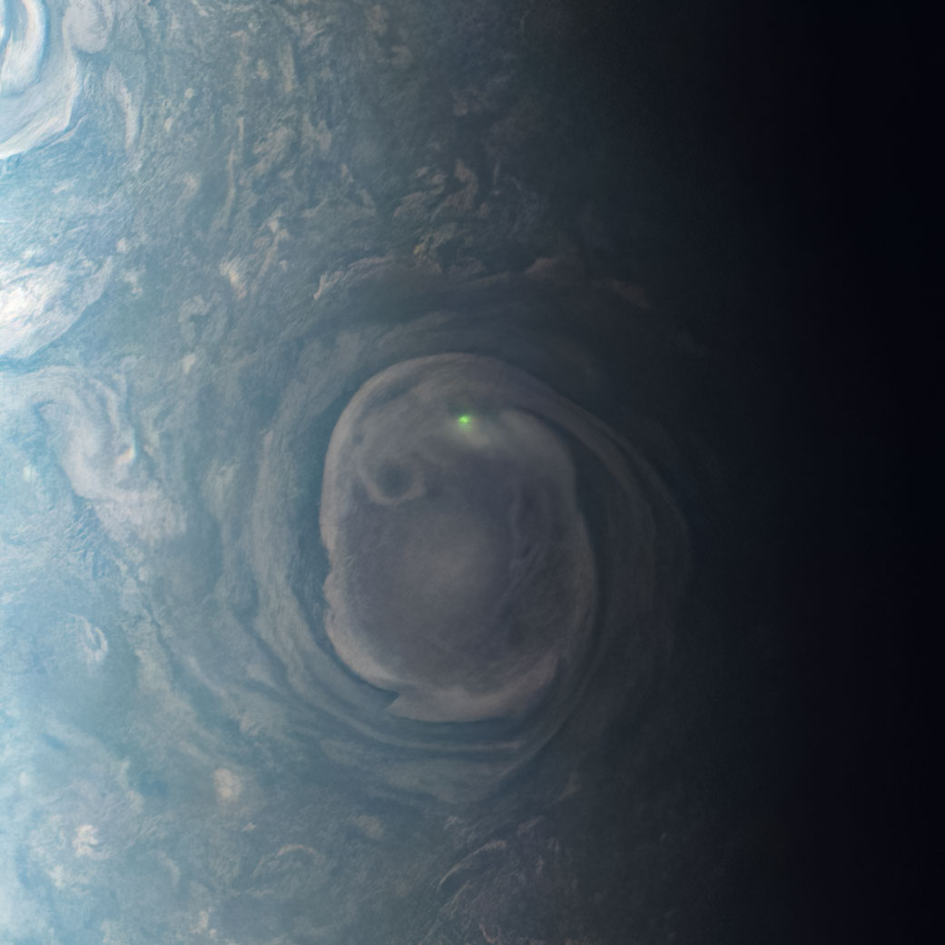
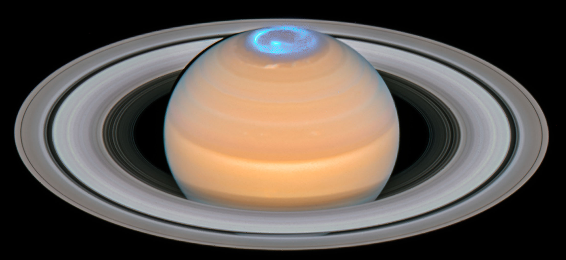
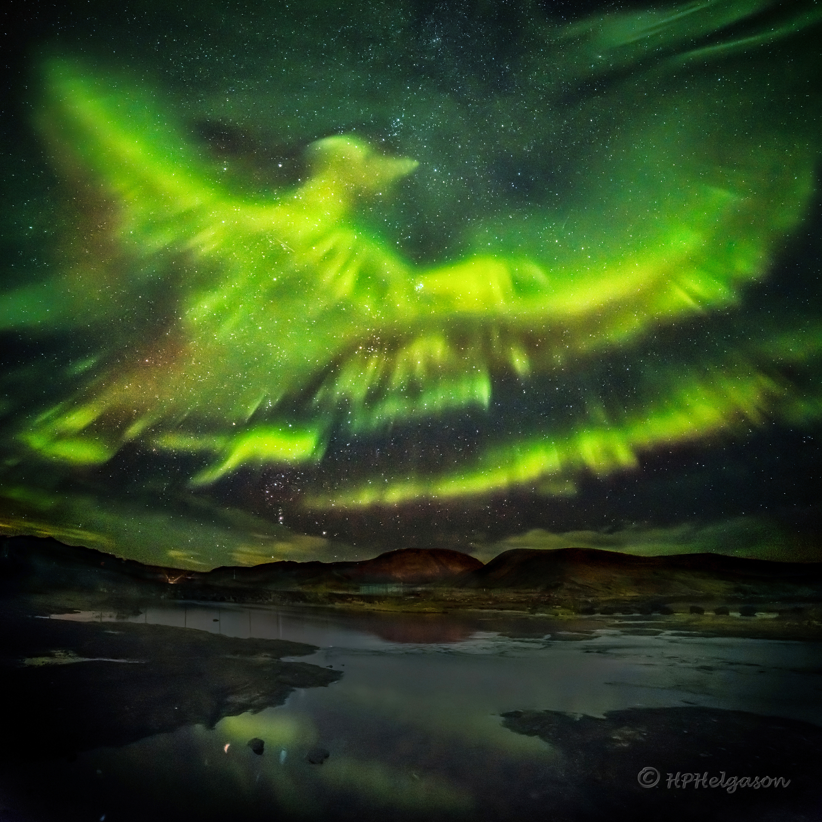
Simulating Atmosphere in a Laboratory
Gas-mixture ”the atmosphere”
Composition, T, P
Processing ”the atmosphere”
radiation, atmospheric phenomena….
NASA, ESA, Hubble, OPAL Program
NASA/MAVEN/Goddard Space Flight Center/CU/LAS

Slide 7
Simulating Atmosphere in a Laboratory
Gas-mixture ”the atmosphere”
Composition, T, P
Processing ”the atmosphere”
radiation, atmospheric phenomena….
NASA, ESA, Hubble, OPAL Program
NASA/MAVEN/Goddard Space Flight Center/CU/LAS
Gas-mixture ”the atmosphere” Chemical evolution
Mass Spectrometry, IR spectra

Slide 8
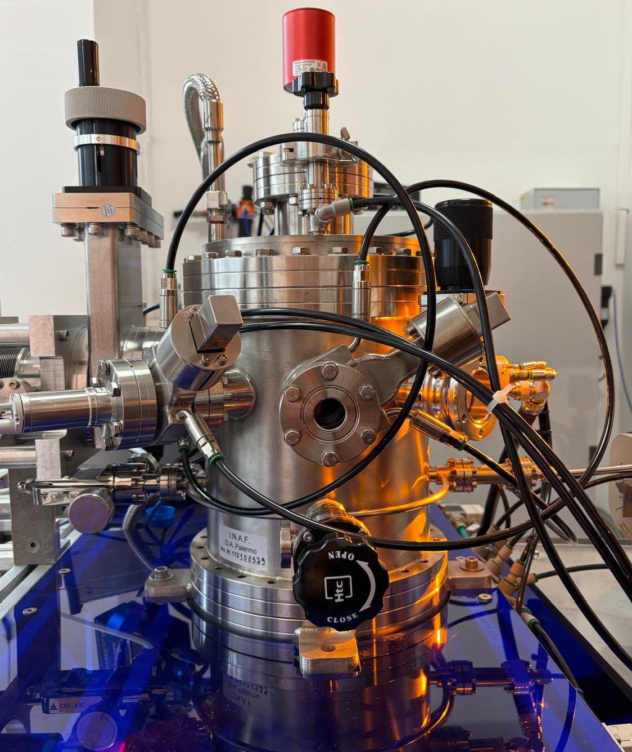
The chamber containing “the atmosphere” , T= -20 to 300 °C P ≦ 1 bar

Slide 9
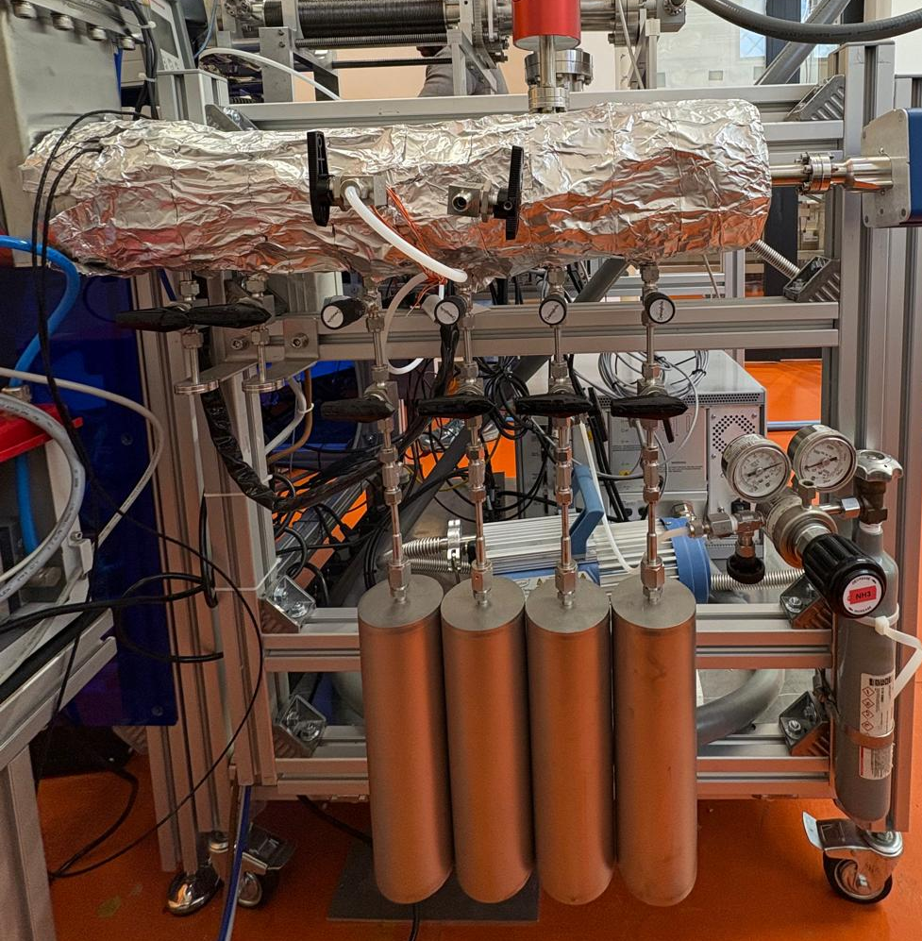
The chamber containing “the atmosphere” , T= -20 to 300 °C P ≦ 1 bar
Mixing chamber to prepare the “atmosphere”

Slide 10
The chamber containing “the atmosphere” , T= -20 to 300 °C P ≦ 1 bar
Mixing chamber to prepare the “atmosphere”
Radiation Sources:
- X-ray source Specs XR-50 X (Al/Cu 1.5/9 keV) ~ 10¹⁰ ph/s
- UV microwave-discharge hydrogen-flow lamp. ~4 × 10¹⁰ ph/cm²/s (no STILES funds)
Sources of atmospheric phenomena:
- arc-discharge generator (lightening)
plasma generator (aurorae)

Slide 11
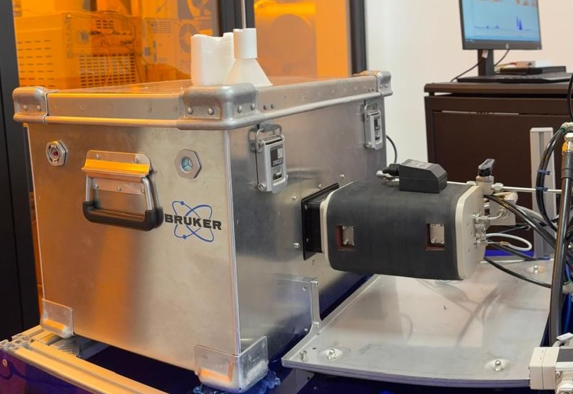
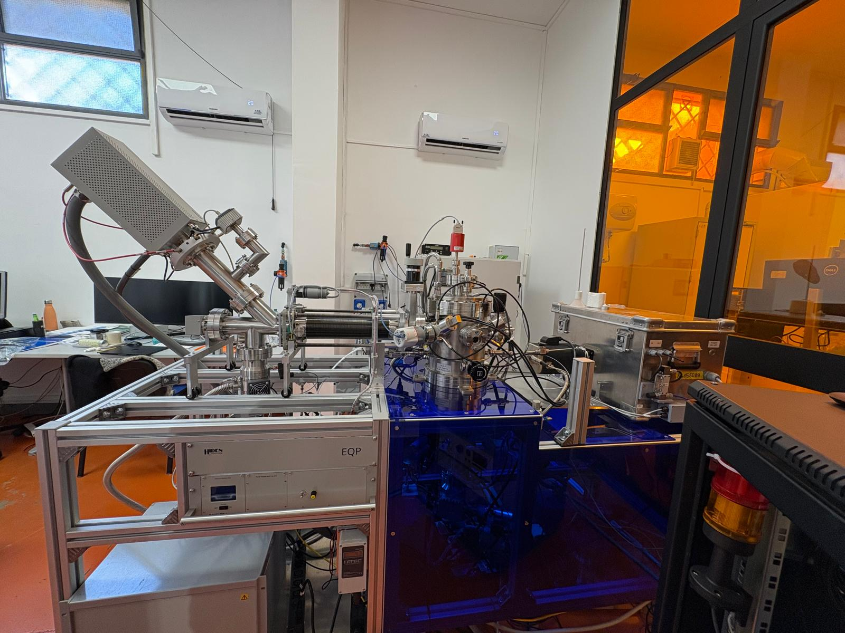
The chamber containing “the atmosphere” , T= -20 to 300 °C P ≦ 1 bar
Mixing chamber to prepare the “atmosphere”
Radiation Sources:
- X-ray source Specs XR-50 X (Al/Cu 1.5/9 keV) ~ 10¹⁰ ph/s
- UV microwave-discharge hydrogen-flow lamp. ~4 × 10¹⁰ ph/cm²/s (no STILES funds)
Sources of atmospheric phenomena:
- arc-discharge generator (lightening)
plasma generator (aurorae)
Dignostic Instruments
- NIR-MIR InfraRed spectrometer with a 5m multi reflection gas cell
- mass spectrometer (up to 300 amu) for of neutrals, radicals and ions.
- VUV spectrometer 100 - 400 nm (no STILES funds)

Slide 12
LIFE+
NIR-MIR InfraRed (1-13𝜇m) spectrometer
with a 5m multi reflection gas cell
mass spectrometer (⋜ 300 amu) for of neutrals, radicals and ions.
Plasma characterization
Master thesis (13.03.2026)
S. Ficano (Ingegneria Aerospaziale)
18/03/26

Slide 13
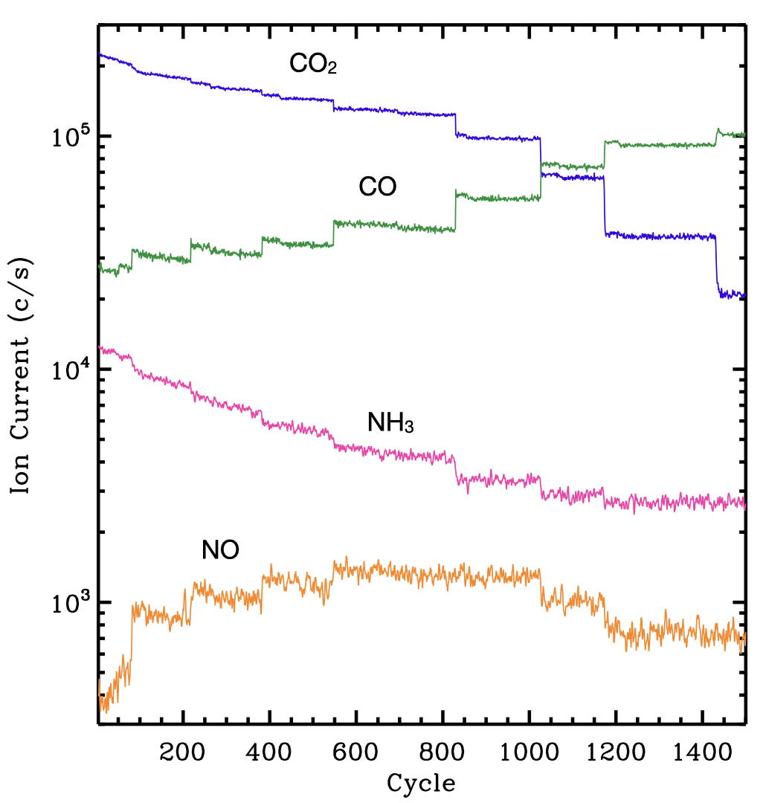
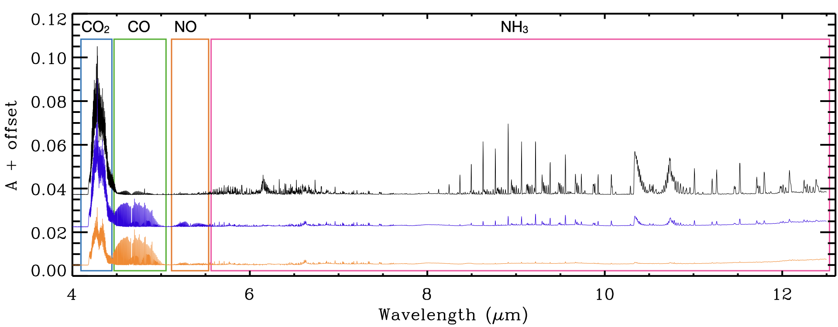
Mixture CO₂:NH₃ (10:1)
P = 5 x 10⁻⁴ bar; T=300 K
t= 0, 5 sec, 60 sec

