Slide 1
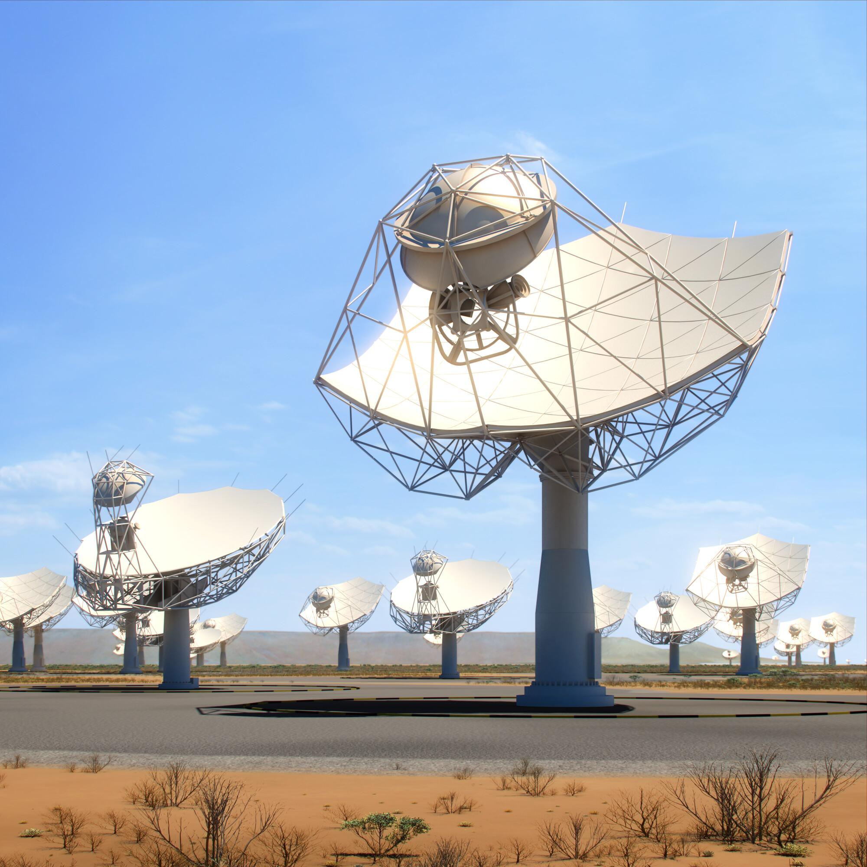
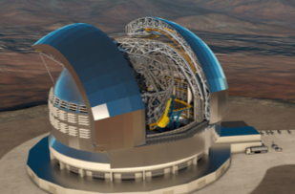
STILES: Goals, results and future endeavours.
Adriano Fontana

Slide 2
It all started on Dec 23, 2021…

Slide 3

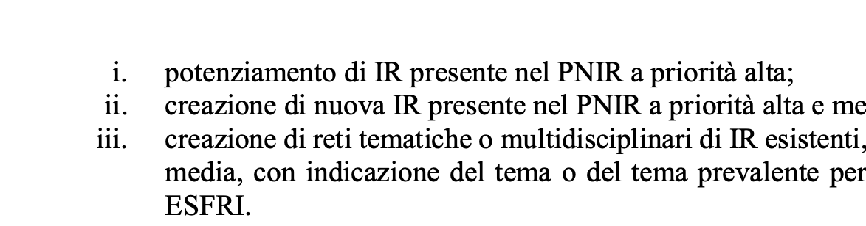
Call came out on Dec 28, 2021…
Keywords:
- Strenghtening of Research Infrastructures
- Expected financial envelope: >50M€
- Stringent time limit: Dec25 (→Apr26)
- 40% in southern regions

Slide 4
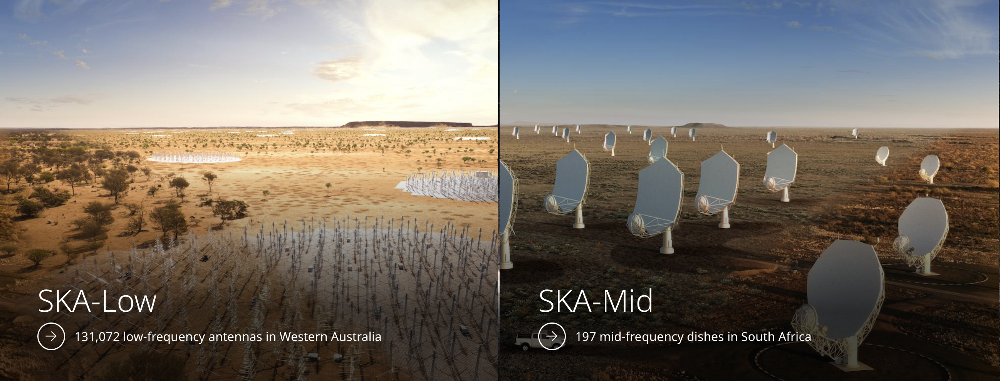
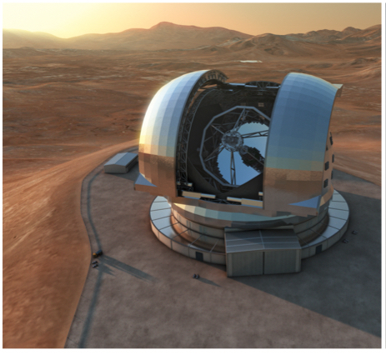
Extremely Large Telescope
Square
Kilometer
Array

Slide 5
ELT and SKA will lead the field for decades…
They will be the subject of an intense development for many decades.

Slide 6
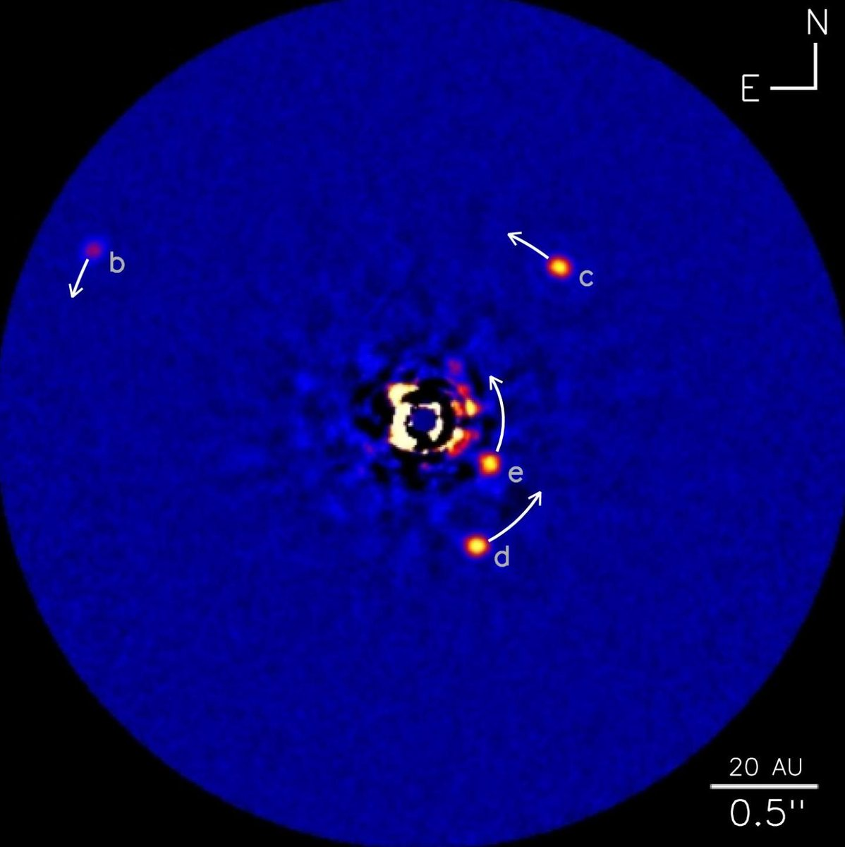
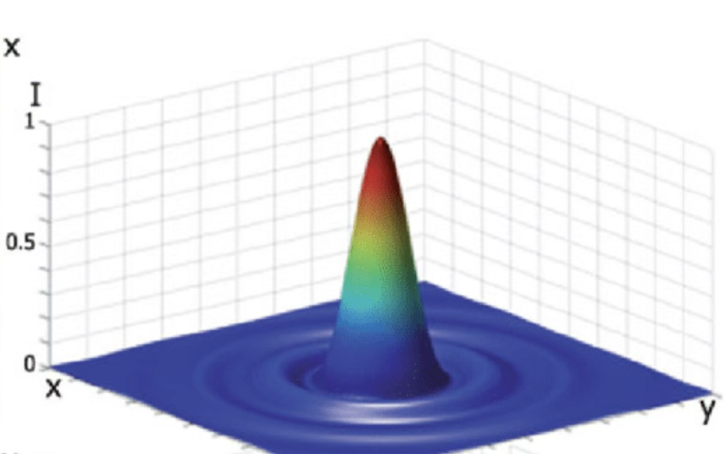
ELT and SKA will lead the field for decades…
They will be the subject of an intense development for many decades.
FWHM = 1.22 λ / D
No instrument currently under construction will approach the ultimate limits.
Understanding the telescope and developing new technologies is mandatory before we can design (e.g.) the exo-planet finder (PCS)

Slide 7

ELT and SKA will lead the field for decades…
They will be the subject of an intense development for many decades.
AA0.5
Low: 2024/07 Mid: 2025/11
AA1
Low: 2026/01 Mid: 2027/01
AA2
Low: 2026/11 Mid: 2027/12
AA*
Low: 2028/05 Mid: 2028/09
AA4
TBD
Phase 2
?
Antenna & LNA
Receiver
Signal Processing
Key future techonologies: - Phased Array Feeds (PAFs)
- Medium Frequency Aperture Arrays (MFAAs)
- Wide Band Single Pixel Feeds (WBSPFs)
- Front End and Analogue/Digital Systems
Tile Processing module, TPM
LNA
RFoF
Spectral filters
Tile Beamforming
Part Station beamforming
Network
e/o
o/e
ADC
e/o
Antenna
structure
Italian contributions to the SKA construction and development
Antenna
Processing Facility

Slide 8
Turning the concept into reality: a bottom-up process
“Editors”
Adriano Fontana
Angela Ciaravella
Isabella Prandoni
Lorella Galliani
Serena Benatti
Ugo Di Giammatteo
Valentina Viotto
Editorial Board
The “Editorial Board”
Adriano Fontana
Federica Govoni
Giovanni Pareschi
Grazia Umana
Isabella Prandoni
Roberto Ragazzoni
Simone Esposito
Editors
59 Activity Leaders
79 Activities
Proposal: 91.5M€, 257 pages… prepared in 50 days!

Slide 9
The final project after approval & negotiation
PI + Project Office
WP Leader
WP Leader
WP Leader
54 Activity Leaders
61 Activities
Accepted: 70M€

Slide 10
STILES: STrengthening the Italian Leadership in ELT & SKA
STILES’ main goals:
Design and procure telescope instrumentation for ELT, SKA and their pathfinders,
Implement a set of facilities and laboratories dedicated to R&D and instrument characterization for optical and radio astronomy,
Train the next generation of researchers and
-Foster technology transfer and industrial collaboration with Italian companies.

Slide 11
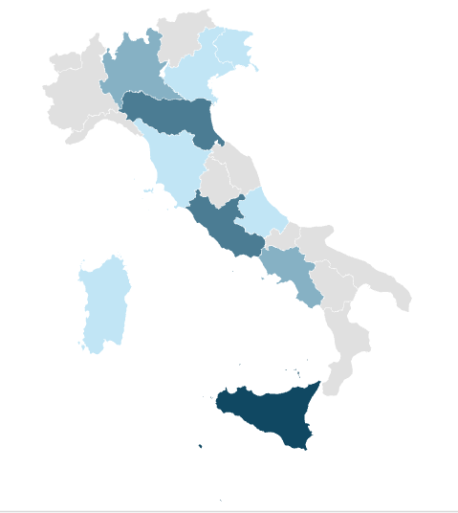

The participants
12 INAF Institutes +
7 Universities
Milano Statale (Radio detectors and instrumentation)
Bologna (Optical lab)
Roma La Sapienza (Machine Learning)
Roma Tor Vergata (Exo Lab)
Napoli Federico II (Computing and machine learning)
Palermo (SW for data analysis)
Catania (Radio Lab)

Slide 12
Telescope instruments
Directly grants scientific return for the Italian community:
New observational capabilities
GTO: ~16 ELT nights, 5% Meerkat time
9.5M€
11.5M€
0.65M€

Slide 13
R&D laboratories
Laboratories for the R&D designed for specific instrument developments.
Essential to develop ELT&SKA instrumentation.
2.9M€

Slide 14
National Testing Facilities
Buildings! + Testing & Characterization facilities of broad usage/impact.
4 M€
2.1 M€

Slide 15
Exo laboratories
Lab simulation of astrophysical environments (exo-planets and high-energy plasma).
Essential also to interpret ELT data

Slide 16
Information Technology
Computing facilities for optical and radio astronomy
6 M€
1.3 M€

Slide 17
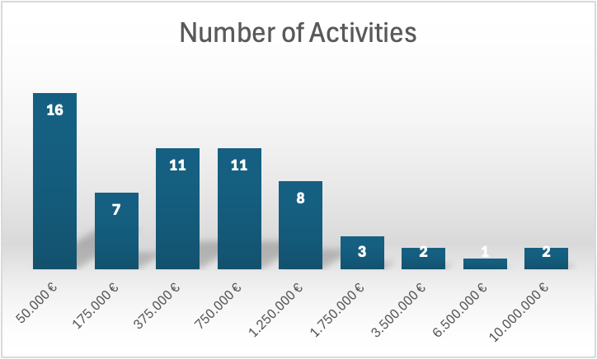
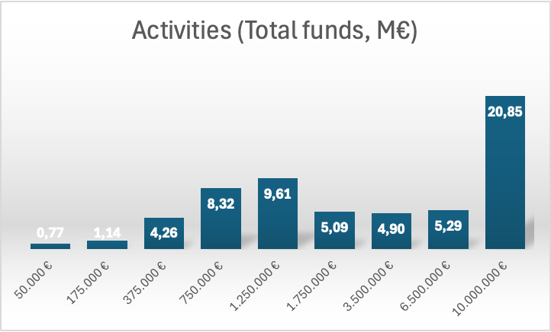
60.224.009€ in Instruments and Laboratories
Most investments are above the scale that can be obtained with standard funding proposal

Slide 18
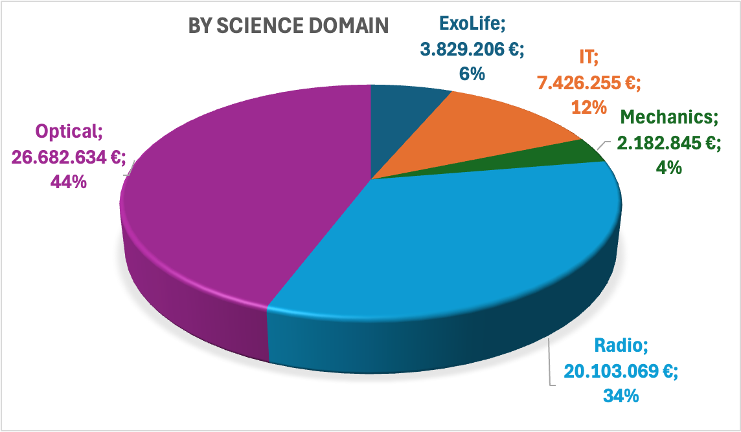
60.224.009€ in Instruments and Laboratories^{(*)}

Slide 19
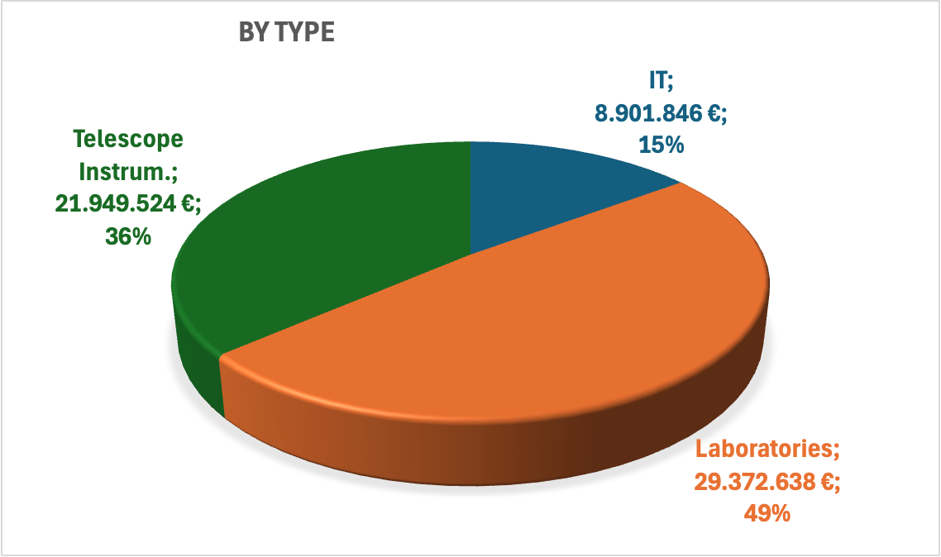
60.224.009€ in Instruments and Laboratories^{(*)}
(*) Values updated at the 3rd project revision

Slide 20
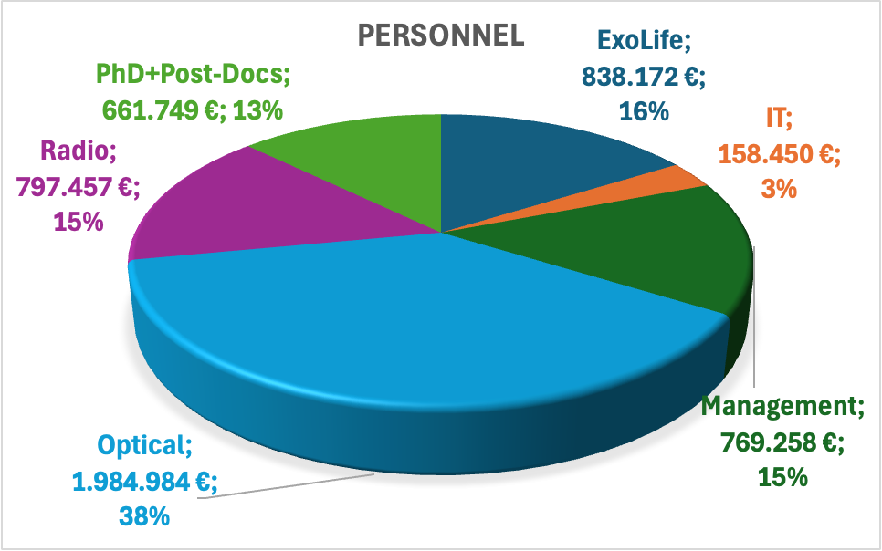
5.219.069€ in Personnel^{(*)}
(*) Values updated at the 3rd project revision

Slide 21

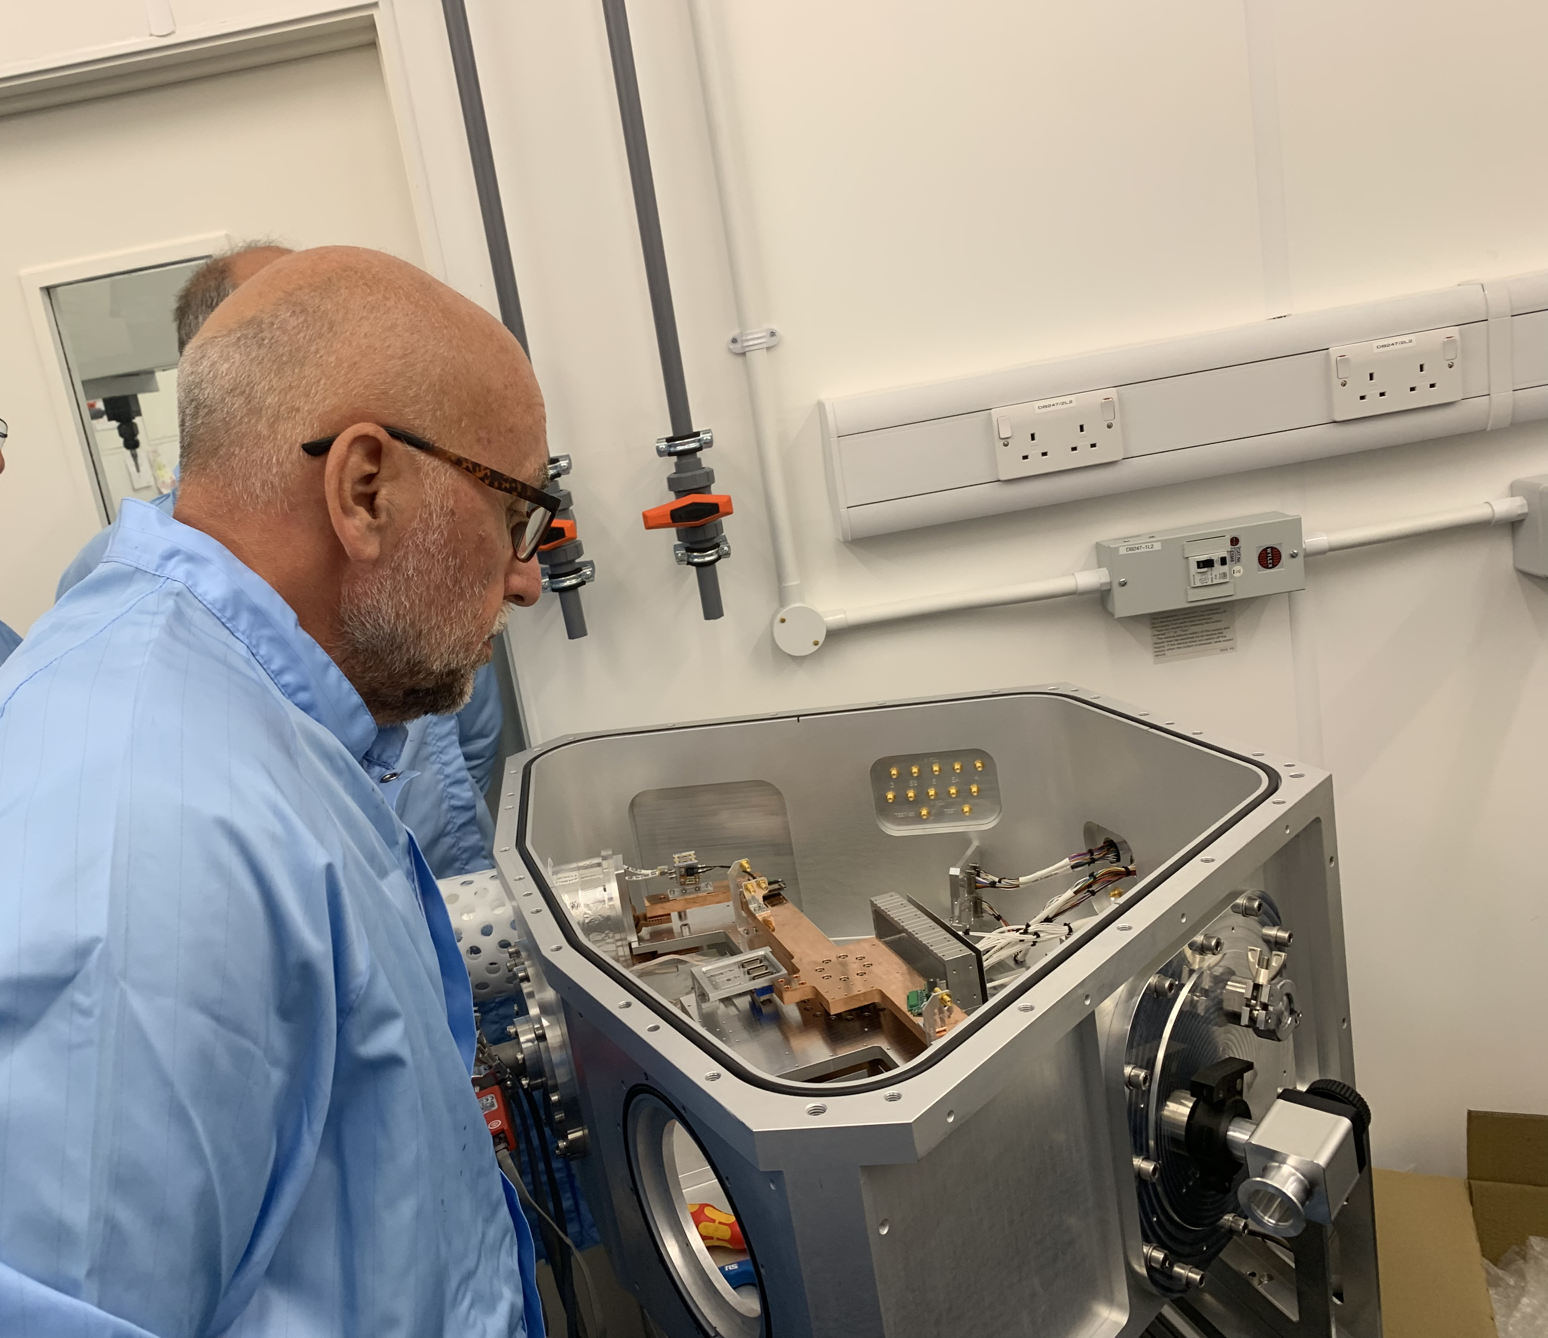
It has been a lot of fun…
……not always…

Slide 22
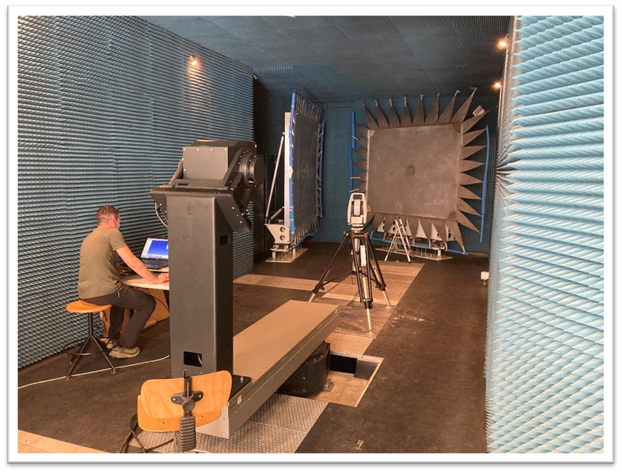
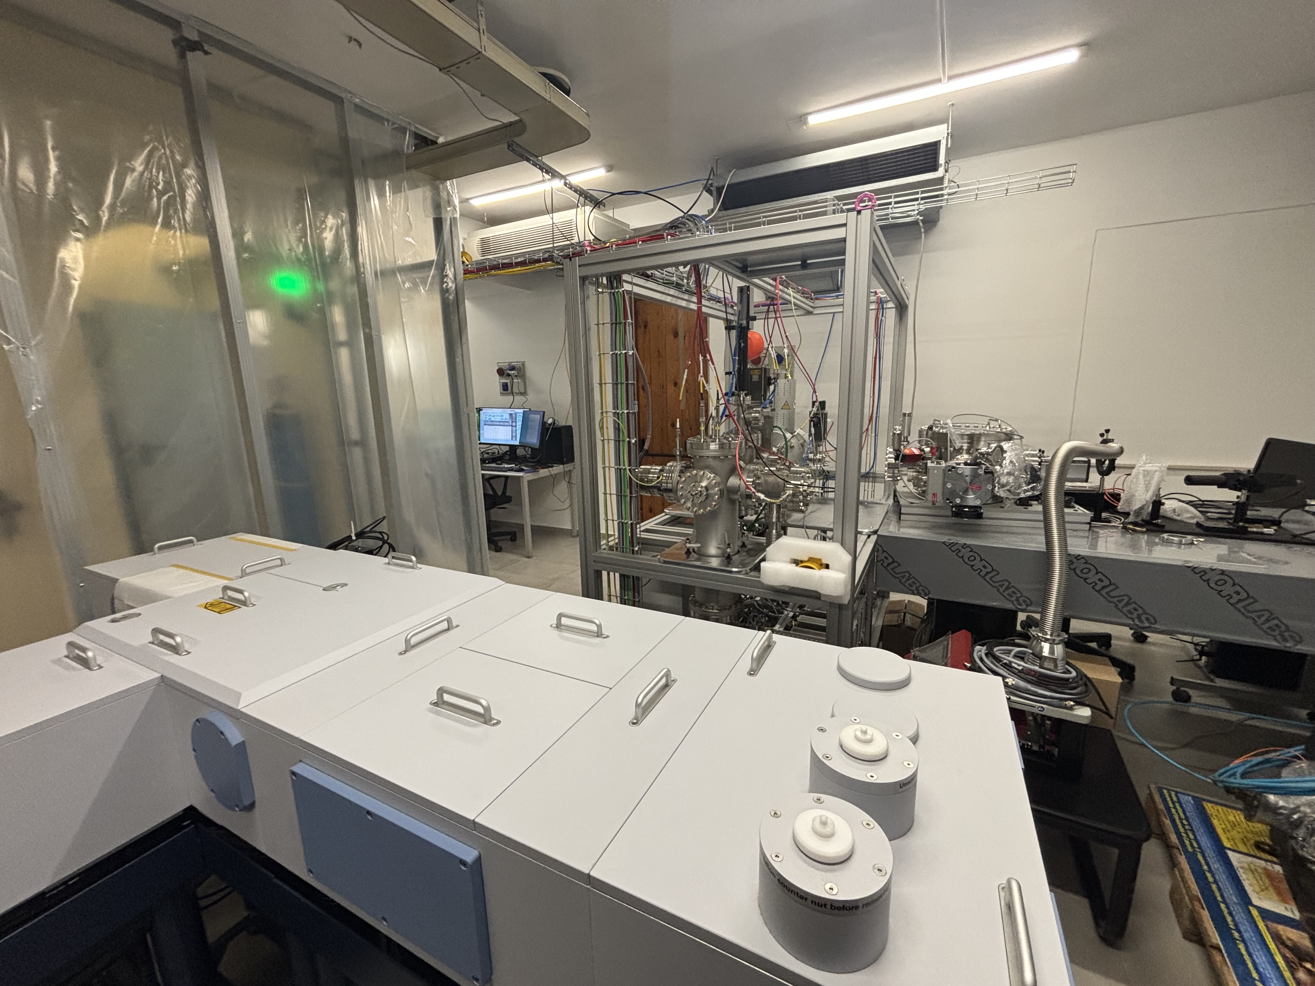
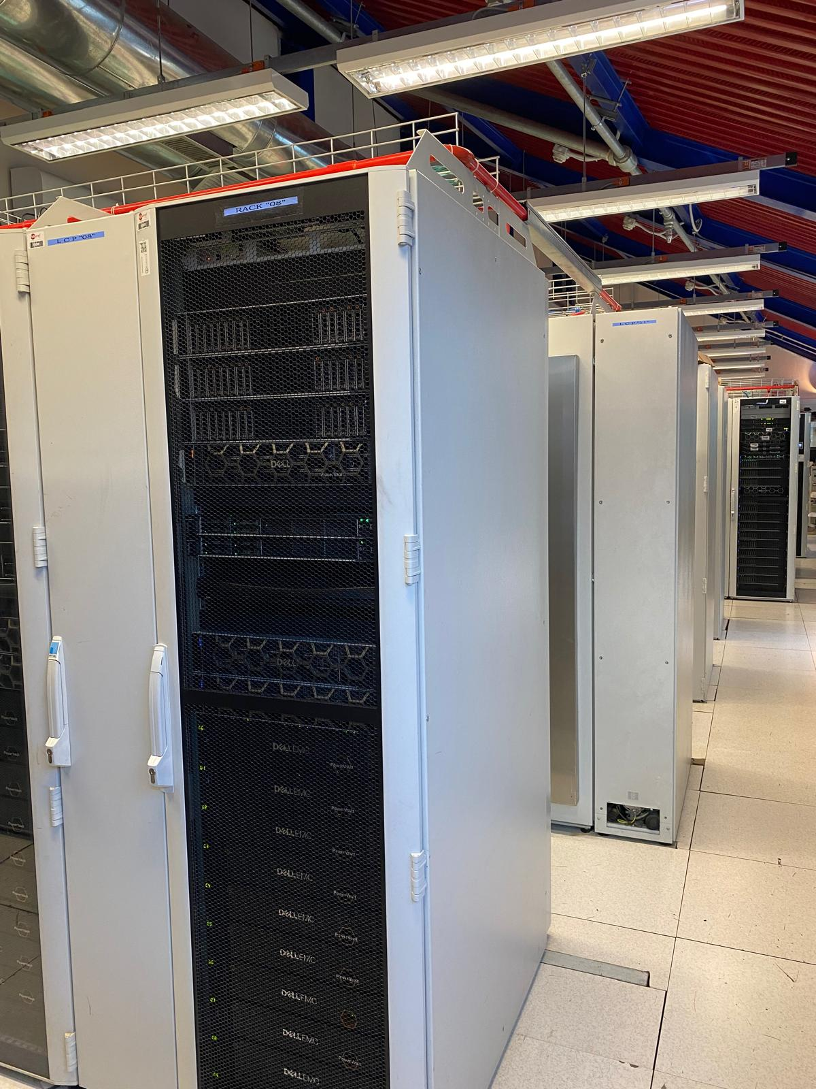
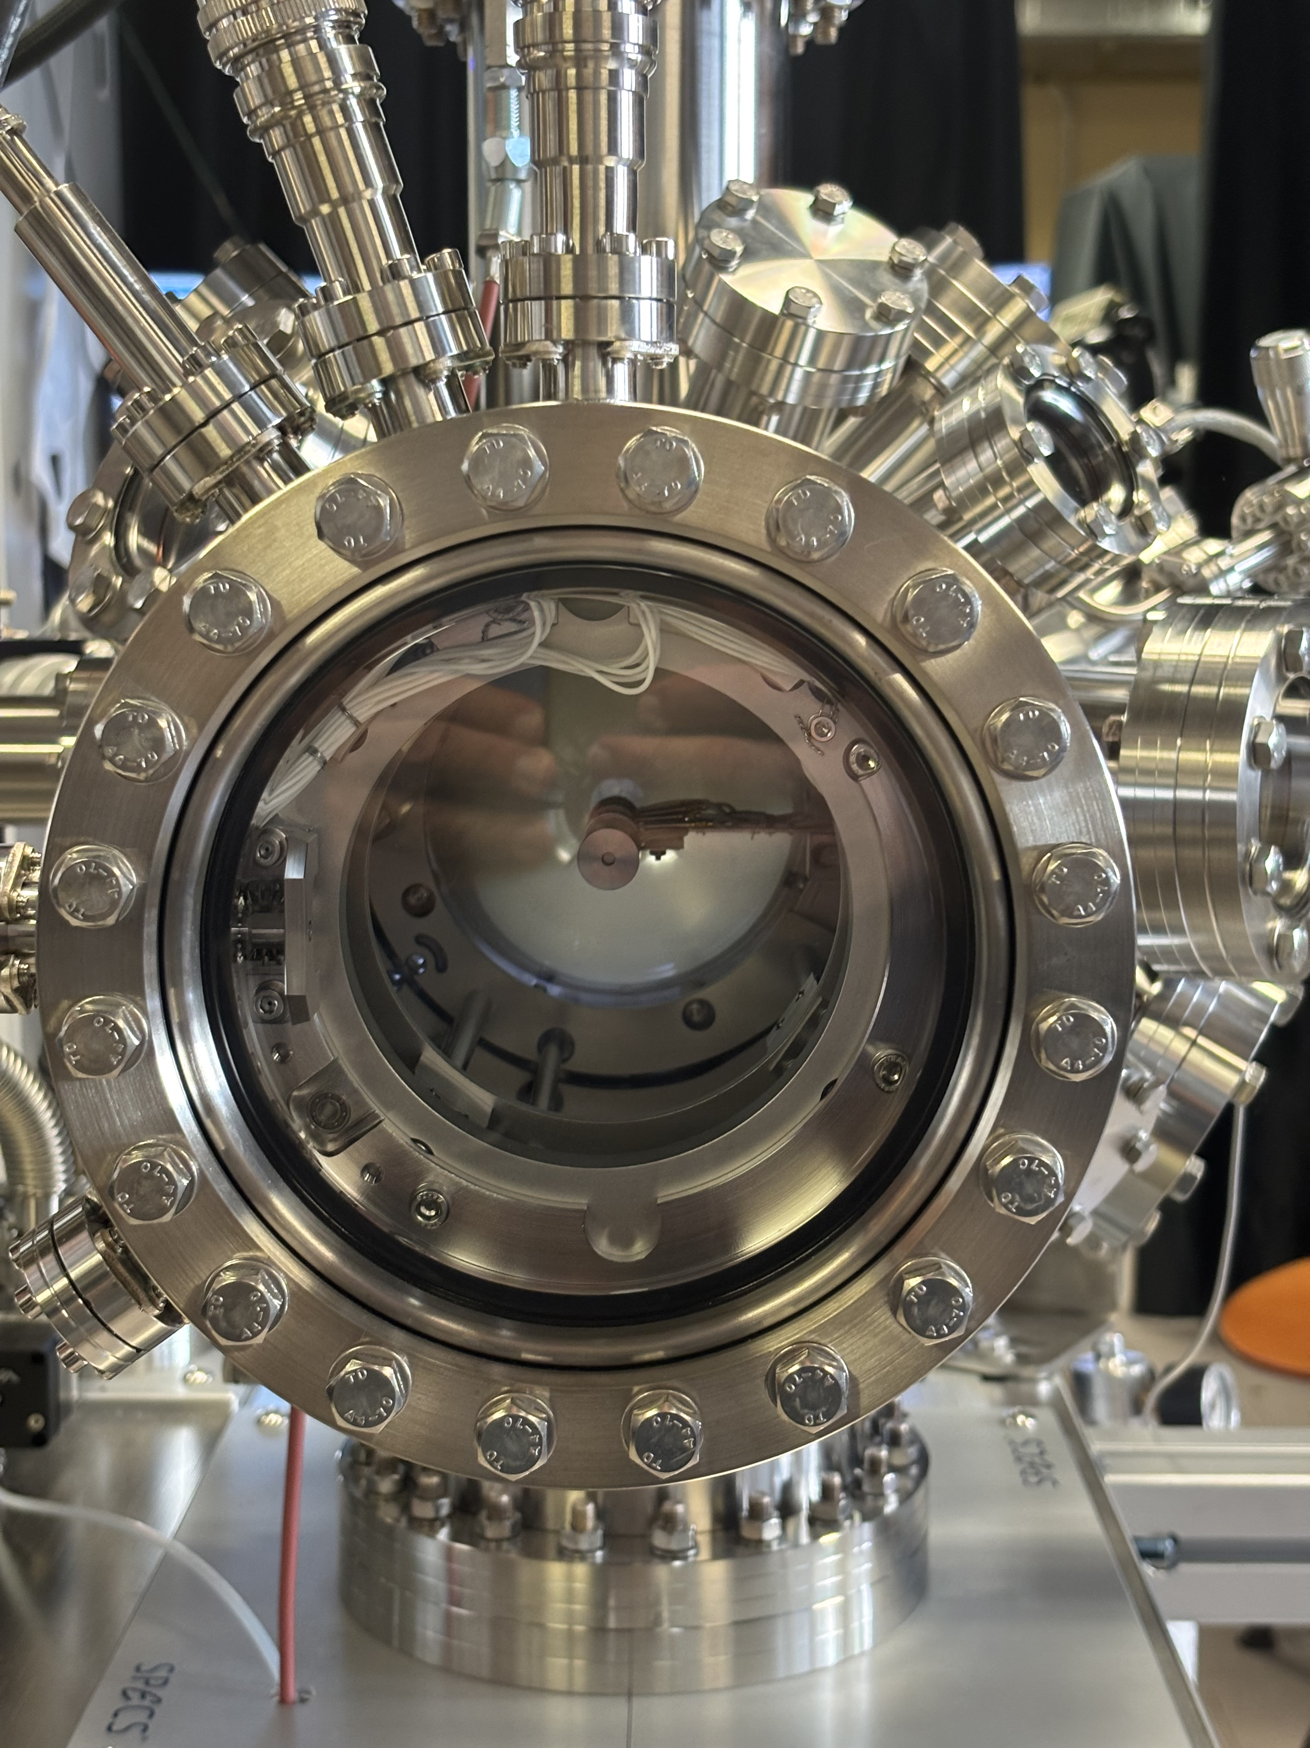
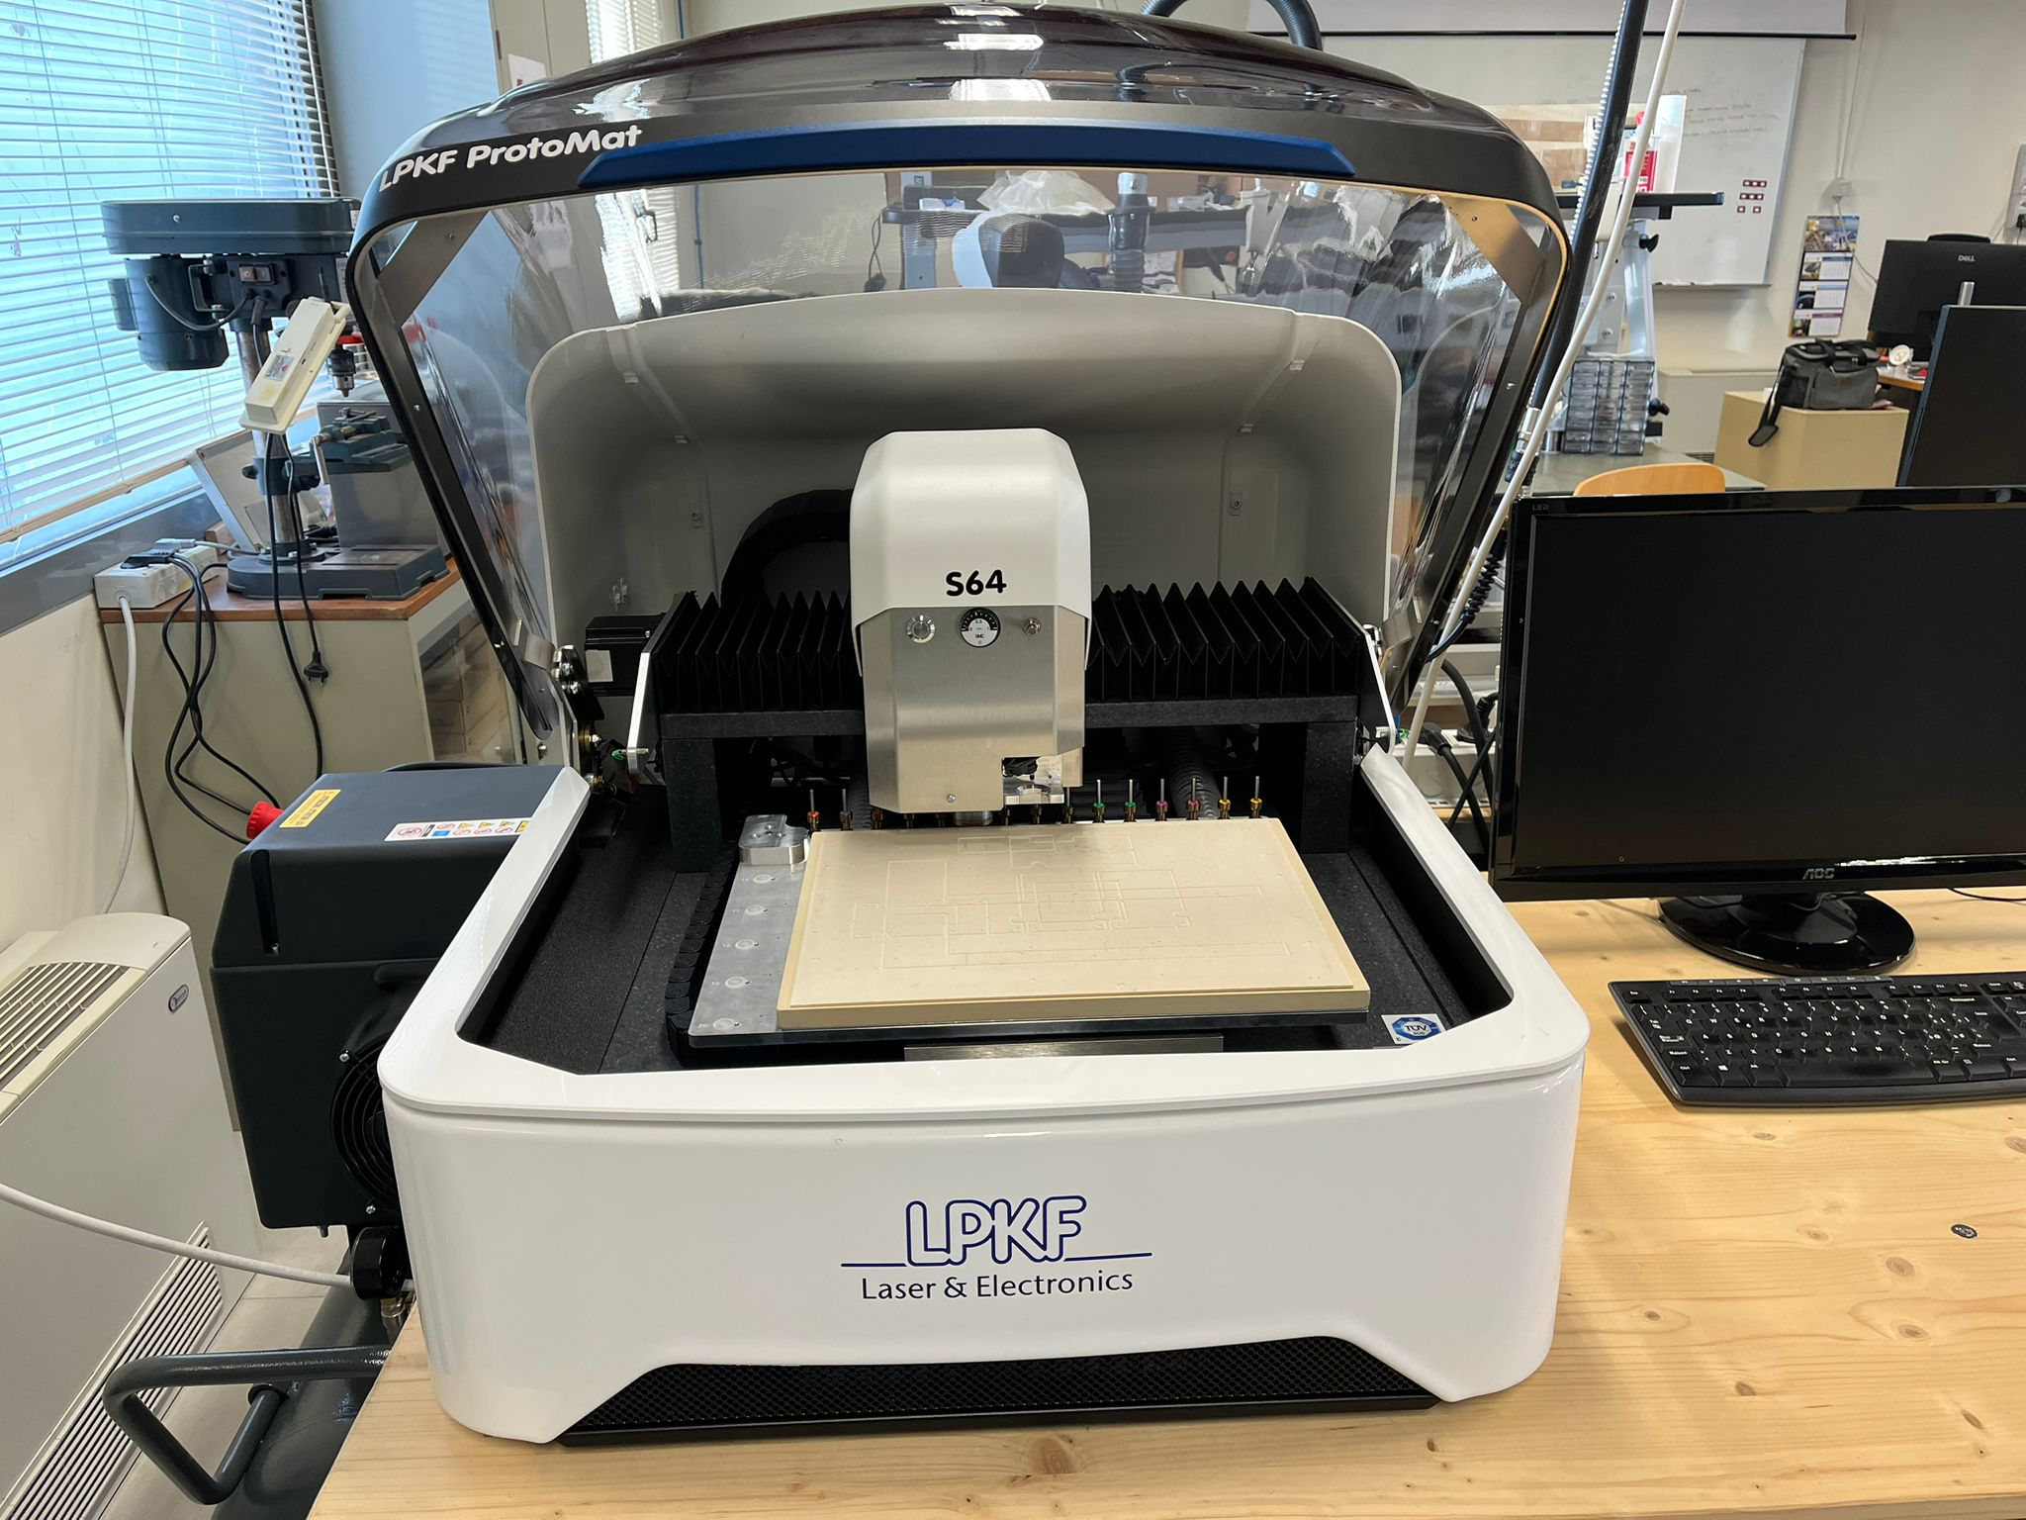
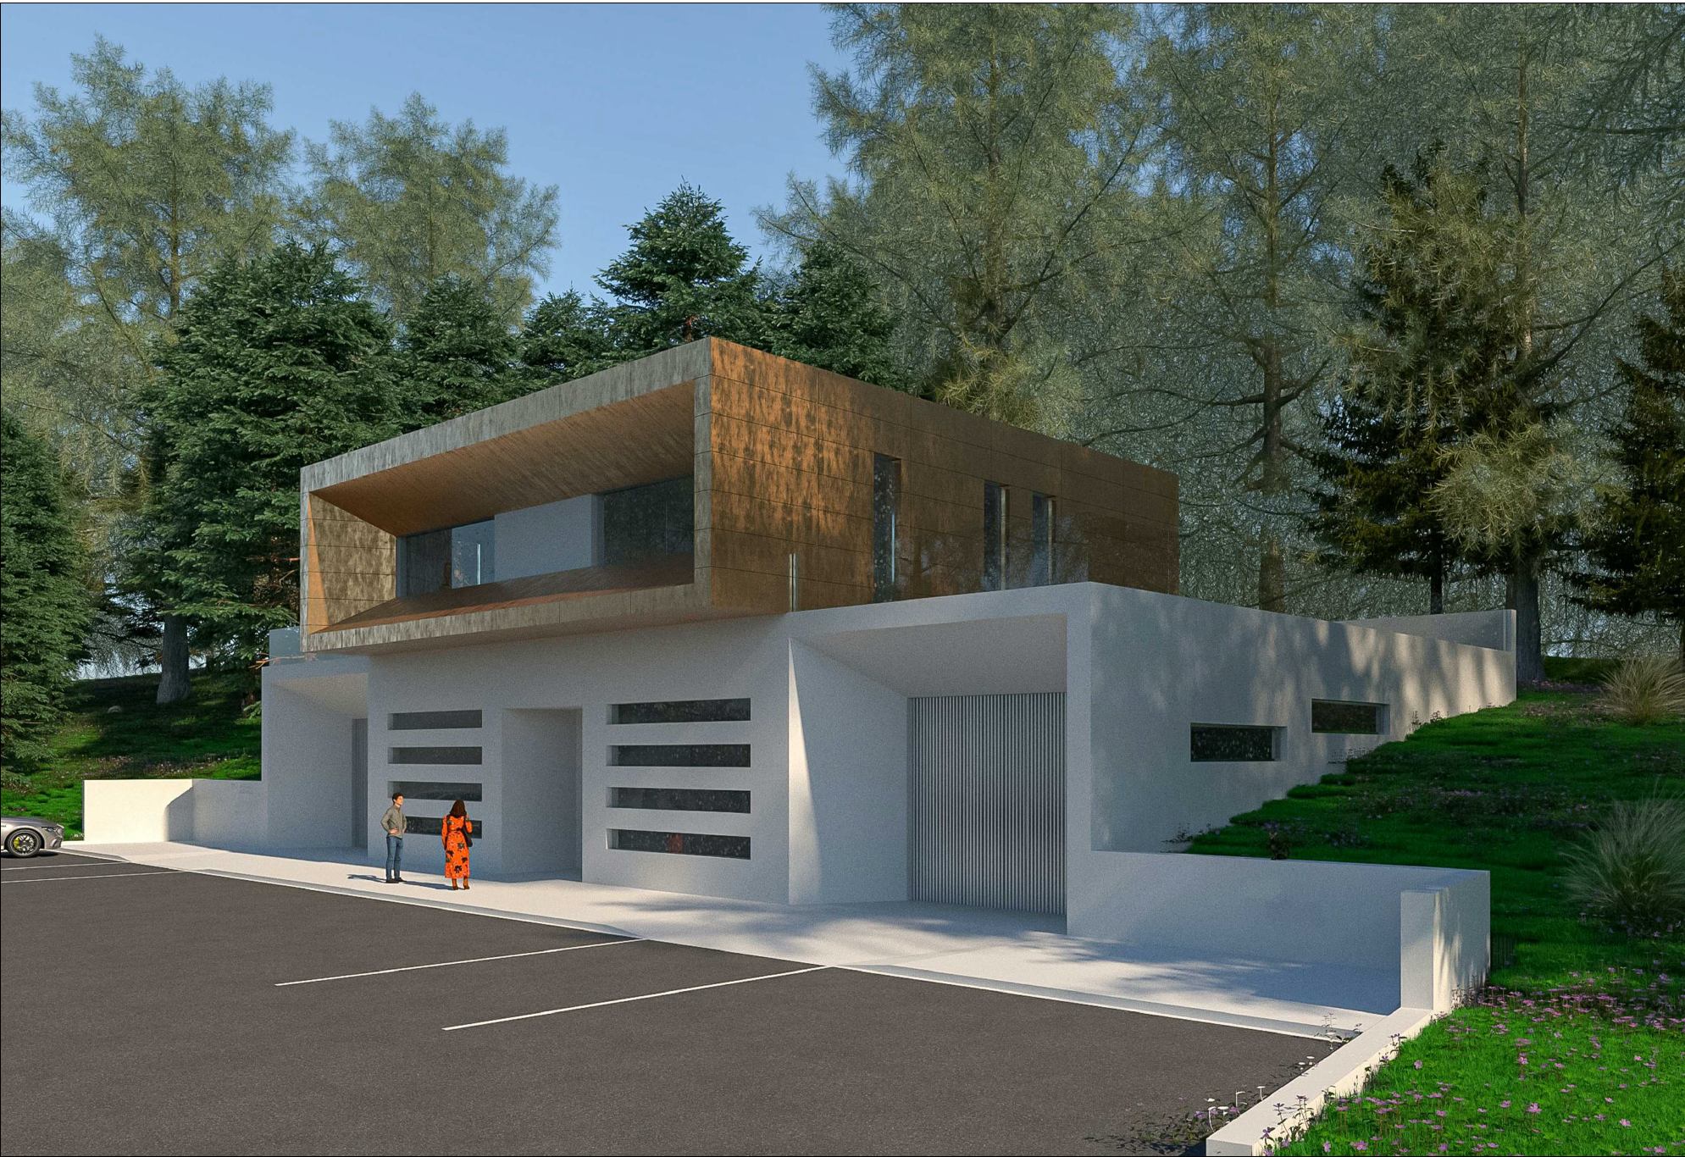
We made it!
All goals (should be) met within the April 30 deadline.

Slide 23

Looking further into the future
STILEMI develops the original concept of STILES in three directions (driven by the call):
Focus on a few high-impact facilities
Extensive co-development and co-use with industries
Technology Transfer and Staff Training

Slide 24
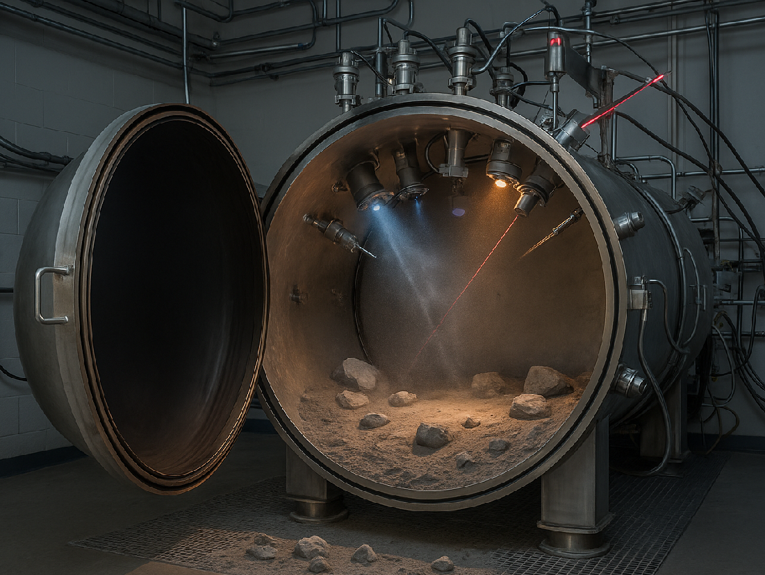
Looking further into the future
STILEMI develops the original concept of STILES in four broad areas:
System Engineering
Facilities for Testing in Extreme Environments
Advanced Radio Frequency Facilities
Optical Test Benches
Funded with 18.5M€. Starting sometines in spring 26…

Slide 25
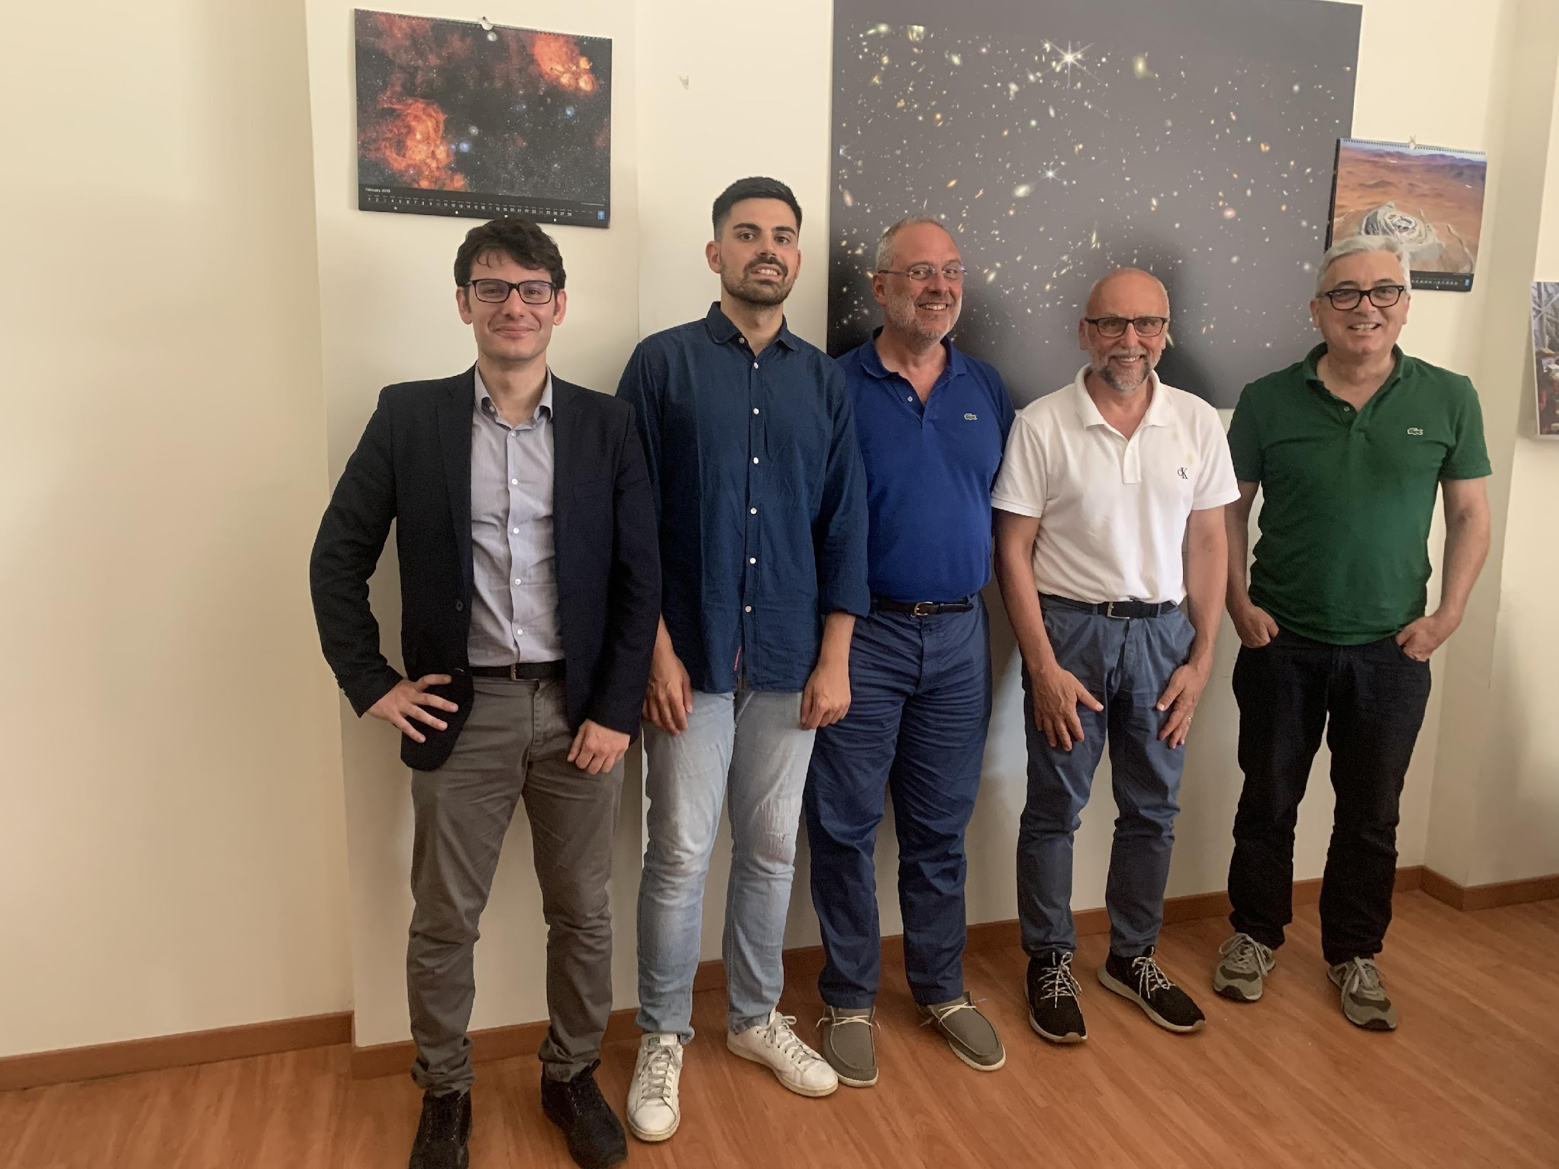
Thanks#1: the STILES Project Office
Francesco Pompa Pacchi Program Manager
Chiara Guccione Responsabile Amministativa
Franco Di Pangrazio Deputy Program Manager
Rendicontazione e Tool informatici
Ugo Di Giammatteo Deputy Program Manager
Supporto Affidamenti Complessi (Morfeo&Meerkat)
Dario Rotondo Junior Project Manager
Affidamenti e Rendicontazione
Nicola Pescatore Junior Project Manager
Supporto Affidamenti e Rendicontazione

Slide 26
Thanks#2: the STILES team
8 Work Package Leader (Bolli, Bonaglia, Brescia, Ciaravella, Ciliegi,
Prandoni, Schillirò, Viotto)
59 Activity Leader
~50+ Scientists and technicians involved in the project

Slide 27
Thanks#3: the INAF/University administrations.
The INAF Program Office (Fierro, Argentati, Bertinelli, Manuli)
The INAF Headquarters (DG: Telesio, Riondino, Schettini, Semola; DS: Zerbi, Pagano, Gualano)
19 Institute/Dept. Directors and their administrations

Slide 28
What have we accomplished?
Nothing
STILES is an enabling project conceived to deliver results in the next decades.
“… a comprehensive and transformational program with the ultimate goal of establishing a firm Italian leadership in the technological developments and scientific exploitation of ELT and SKA”

Slide 30
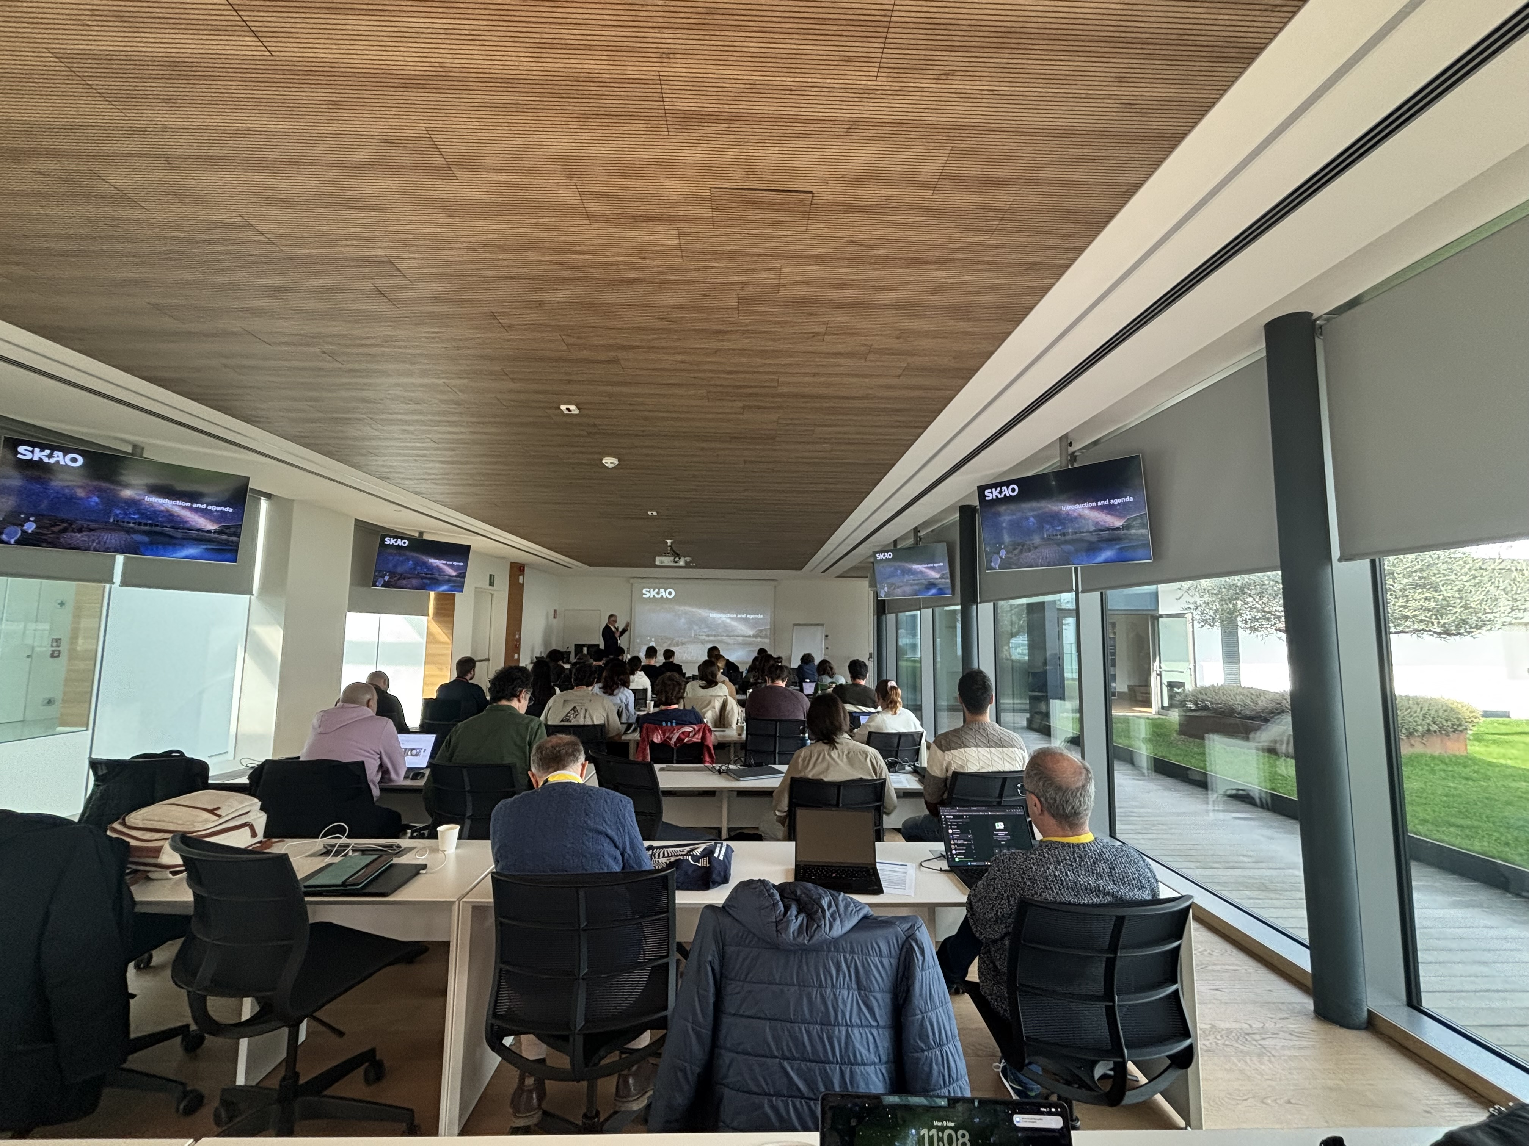
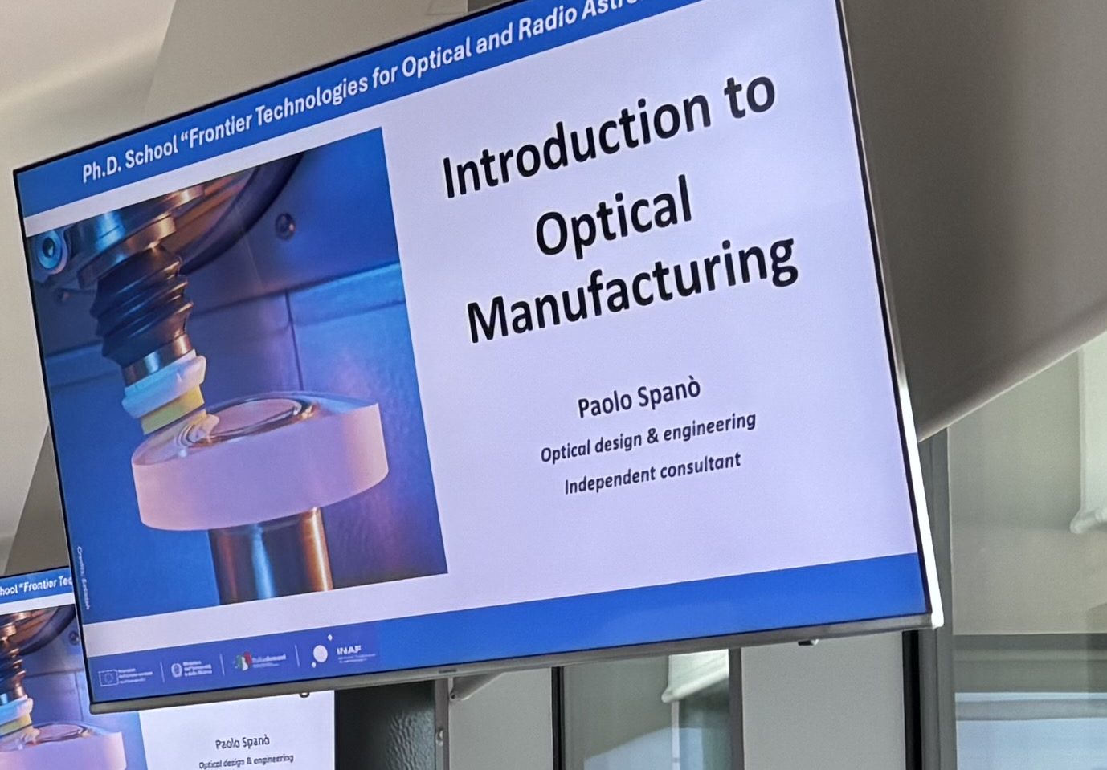
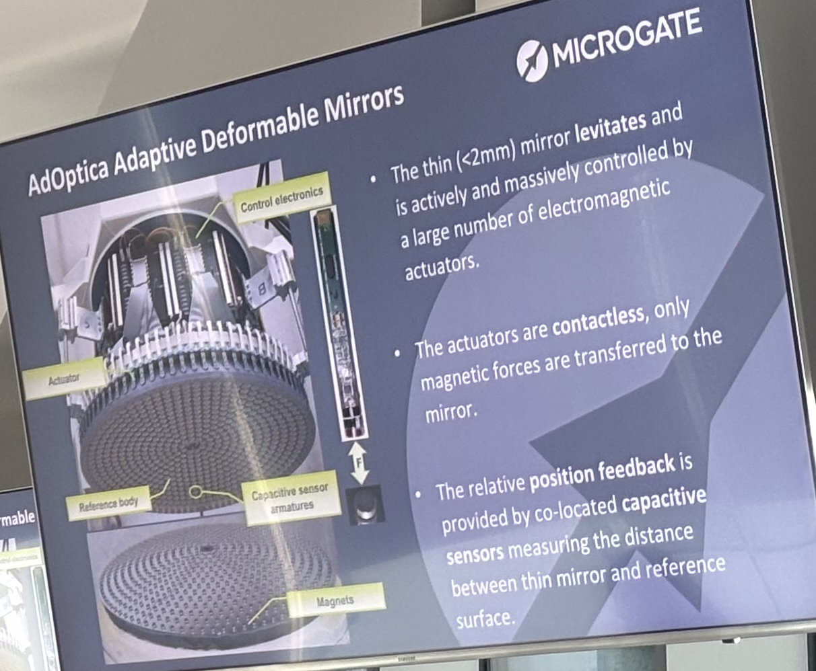
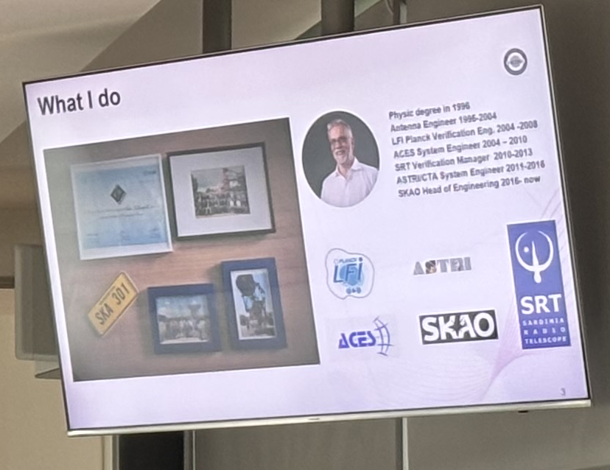

Slide 31
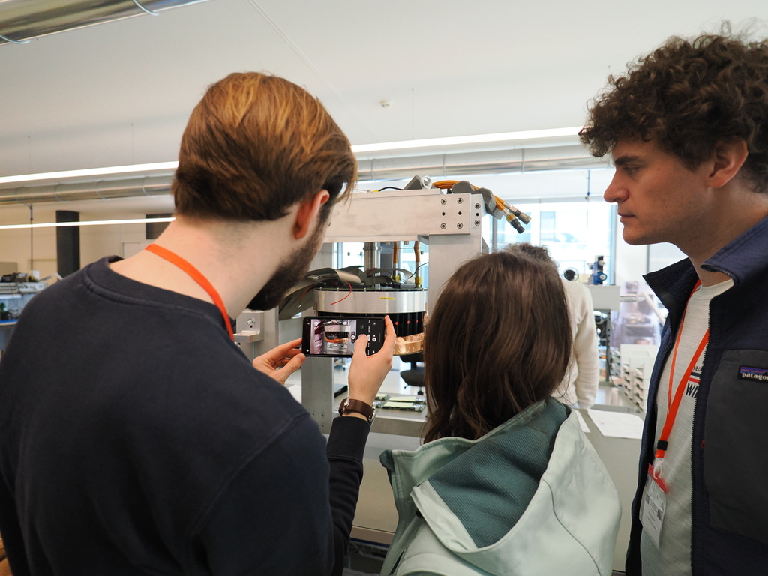
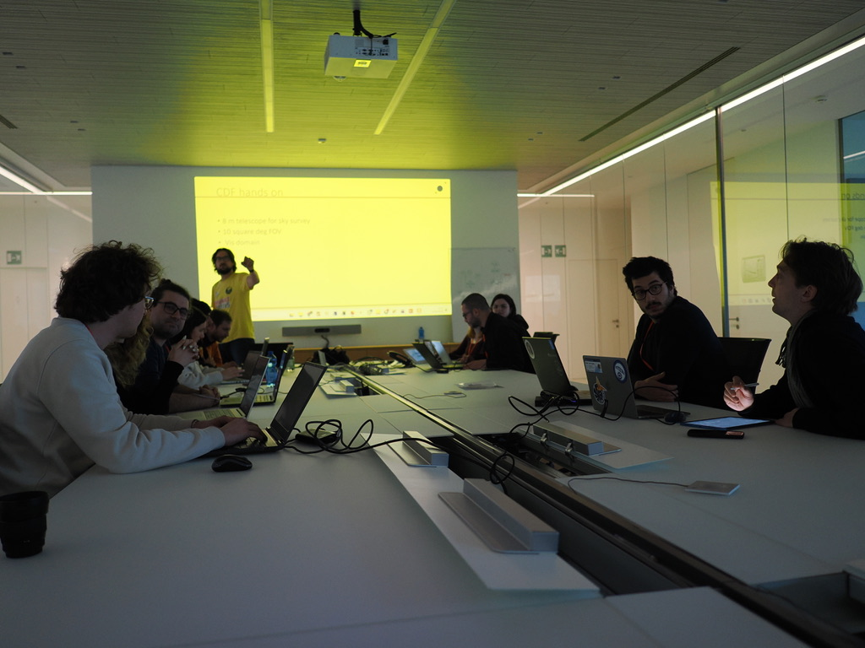
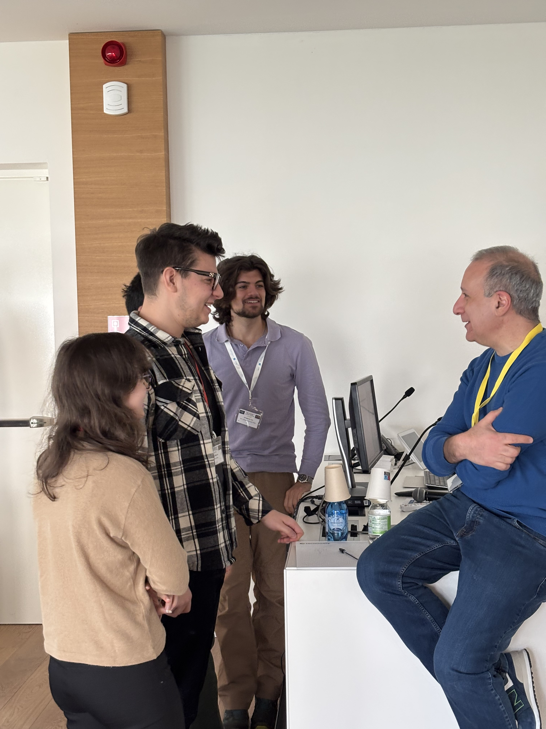

Slide 32
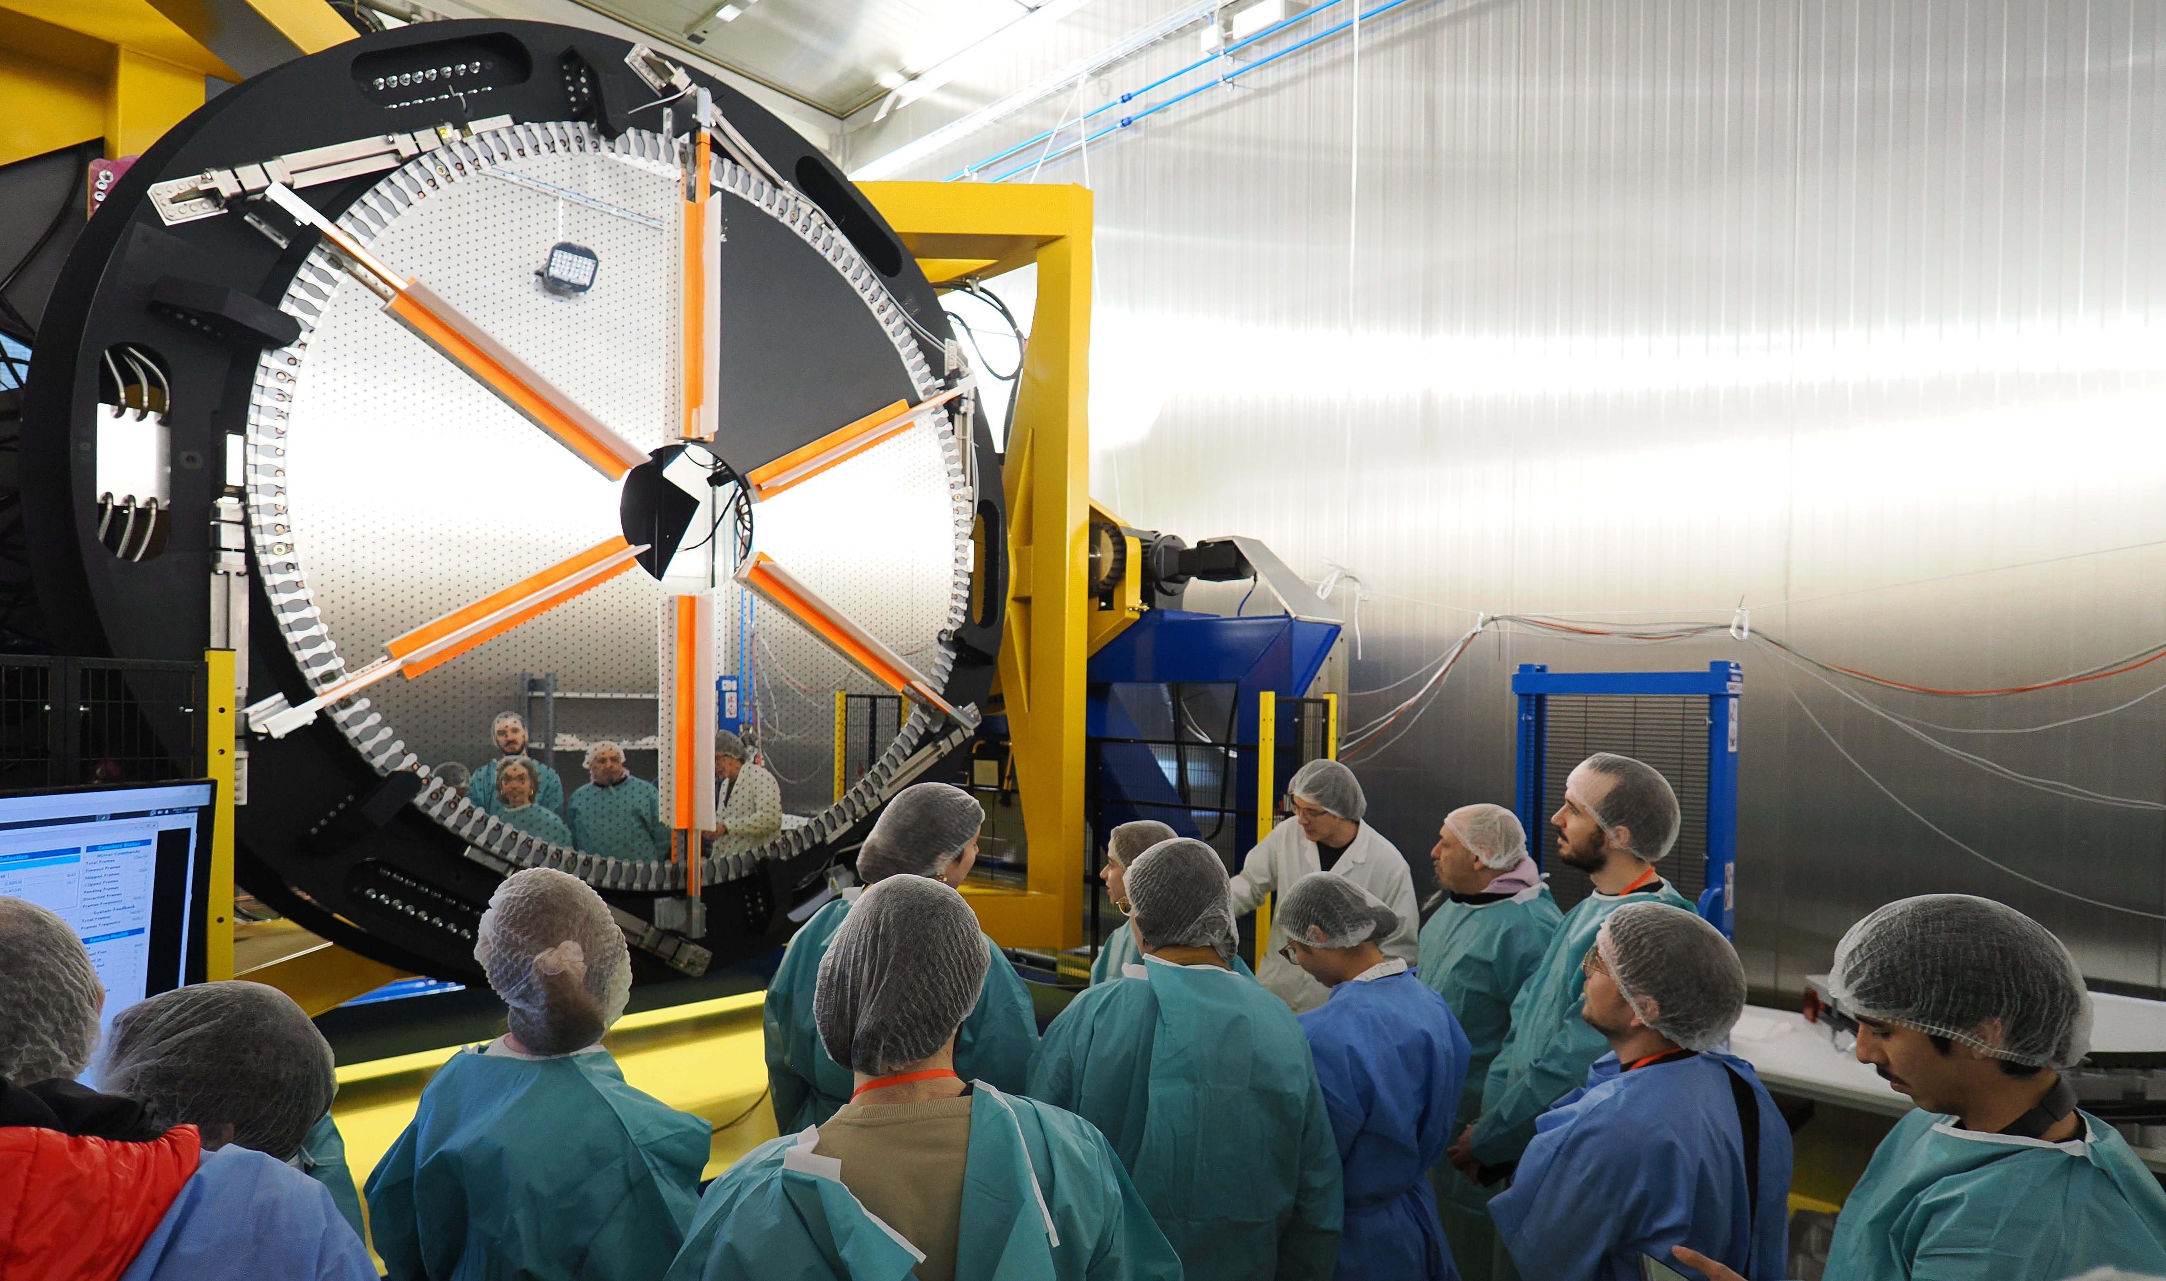

Slide 33
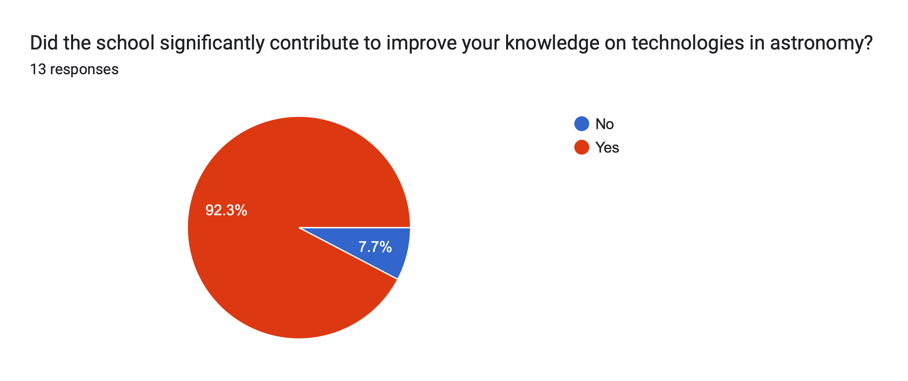
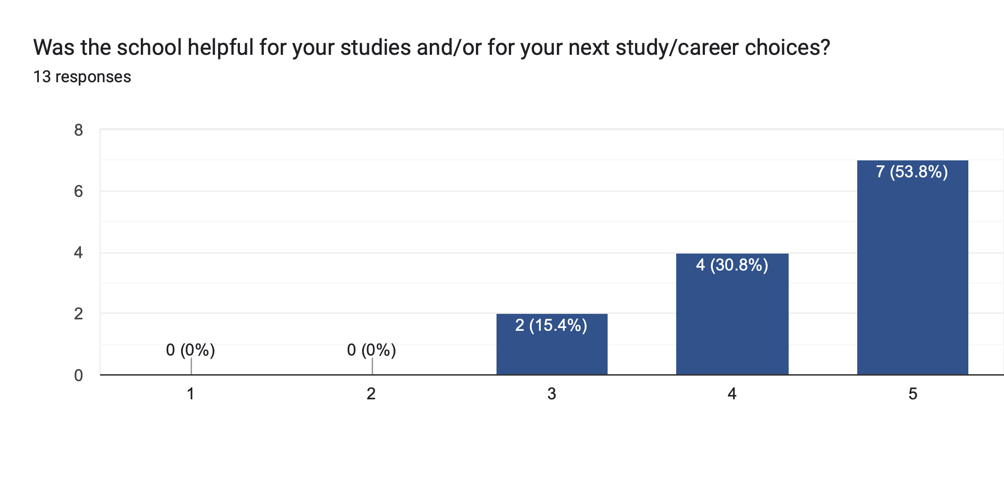

Slide 34
