Slide 1
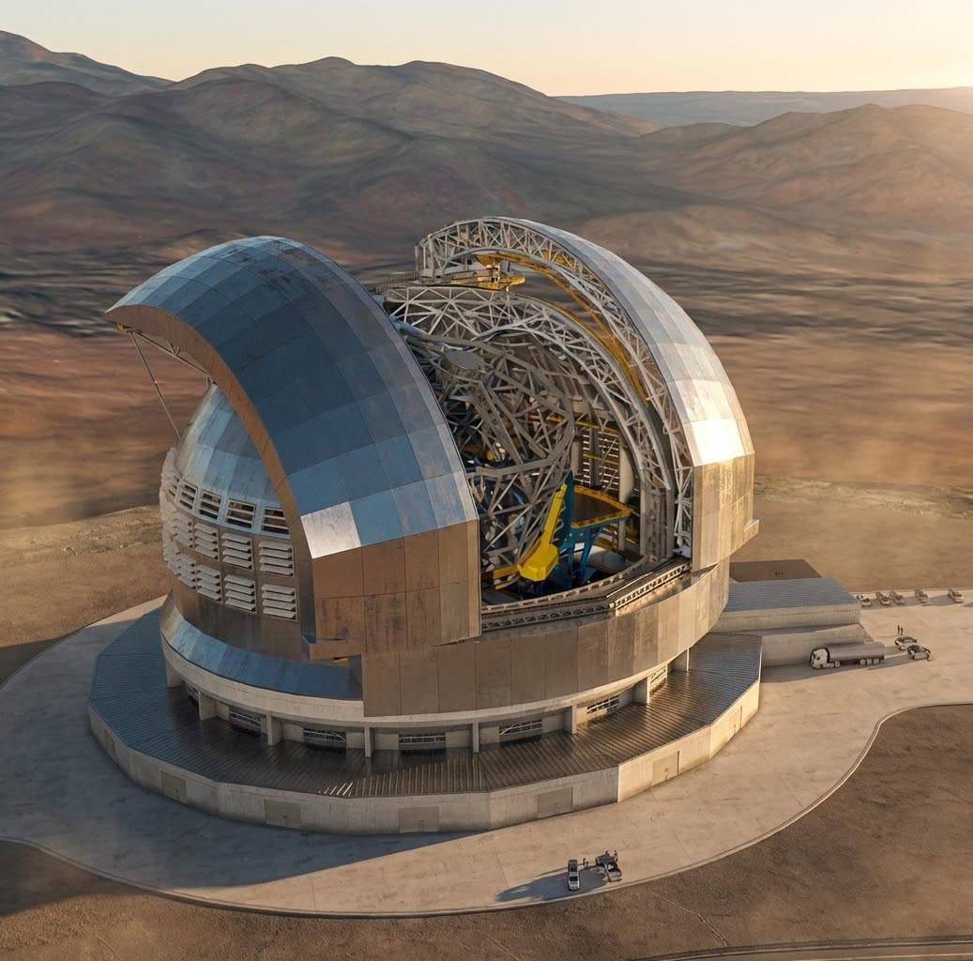
Imaging Exoplanets: status, challenges and future perspectives
Valentina D’Orazi, Gaël Chauvin, Emiliano Diolaiti, Raffaele Gratton, Laura Schreiber
Workshop STILES –Napoli 17th March 2026

Slide 2
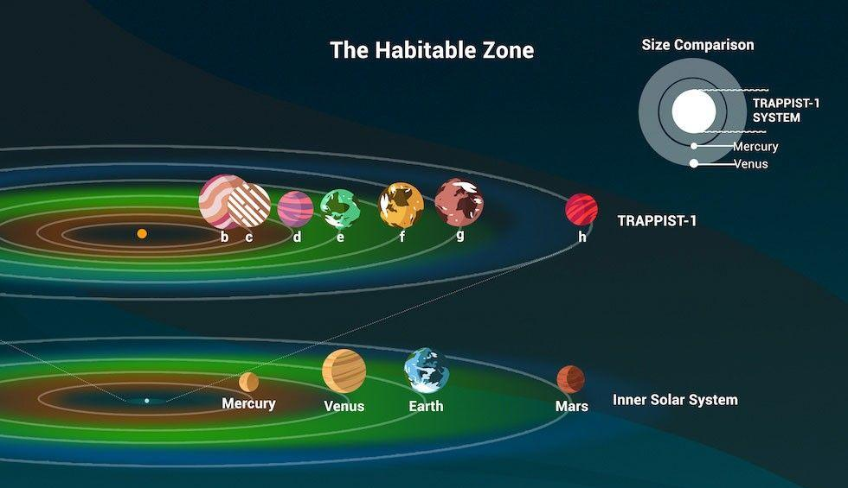
The Ultimate Inquiry
→
Habitability of Rocky Planets and the Possibility of Life
Workshop STILES –Napoli 17th March 2026

Slide 3
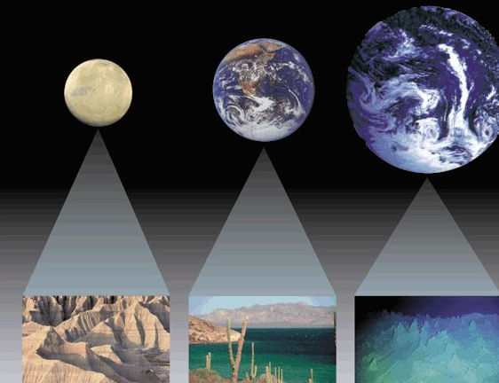
Outstanding questions
How do planets form?
What different types of planets and systems are there?
How does our Solar System compare?
What are planets made of?
→ Can we find signs of conditions that support life?

Slide 4
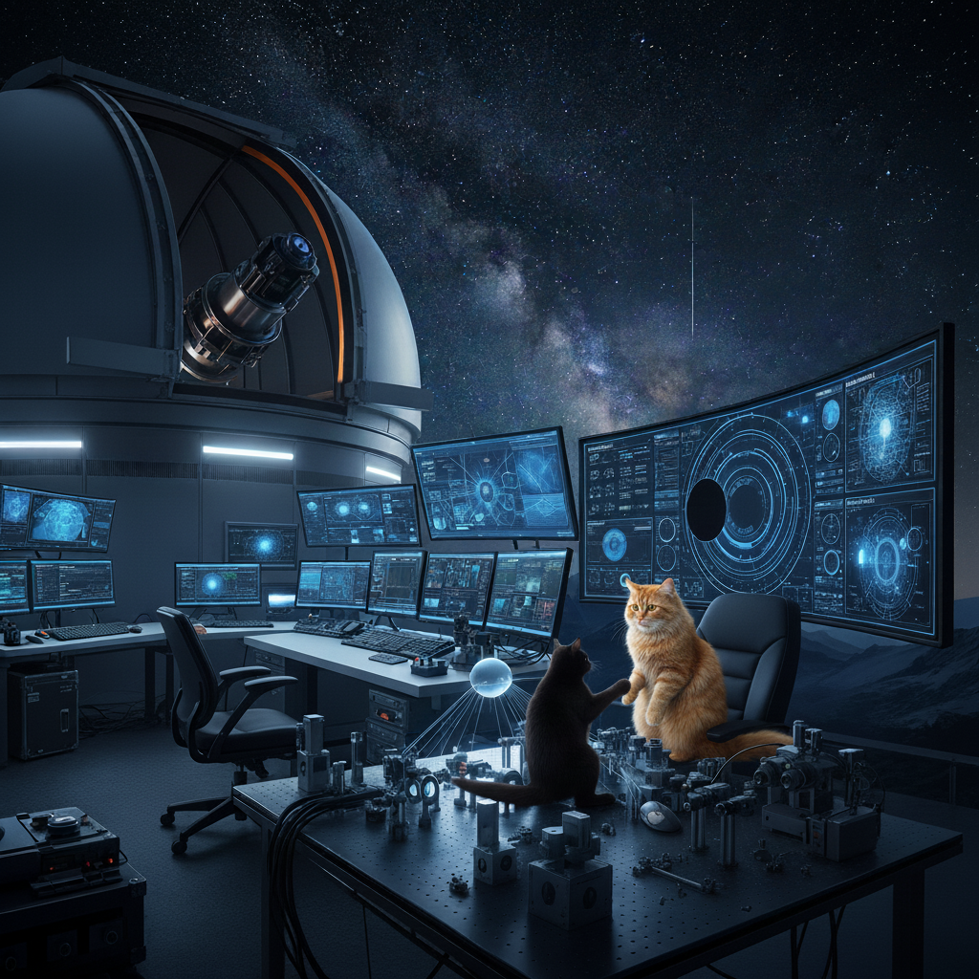
What tools are required to accomplish this goal?

Slide 5
Key Observables
Protoplanetary disks (initial condition of planet formation)
Exoplanets –demographics and architecture
Exoplanetary Atmospheres
Rocky planets – Habitable planets – Life

Slide 6
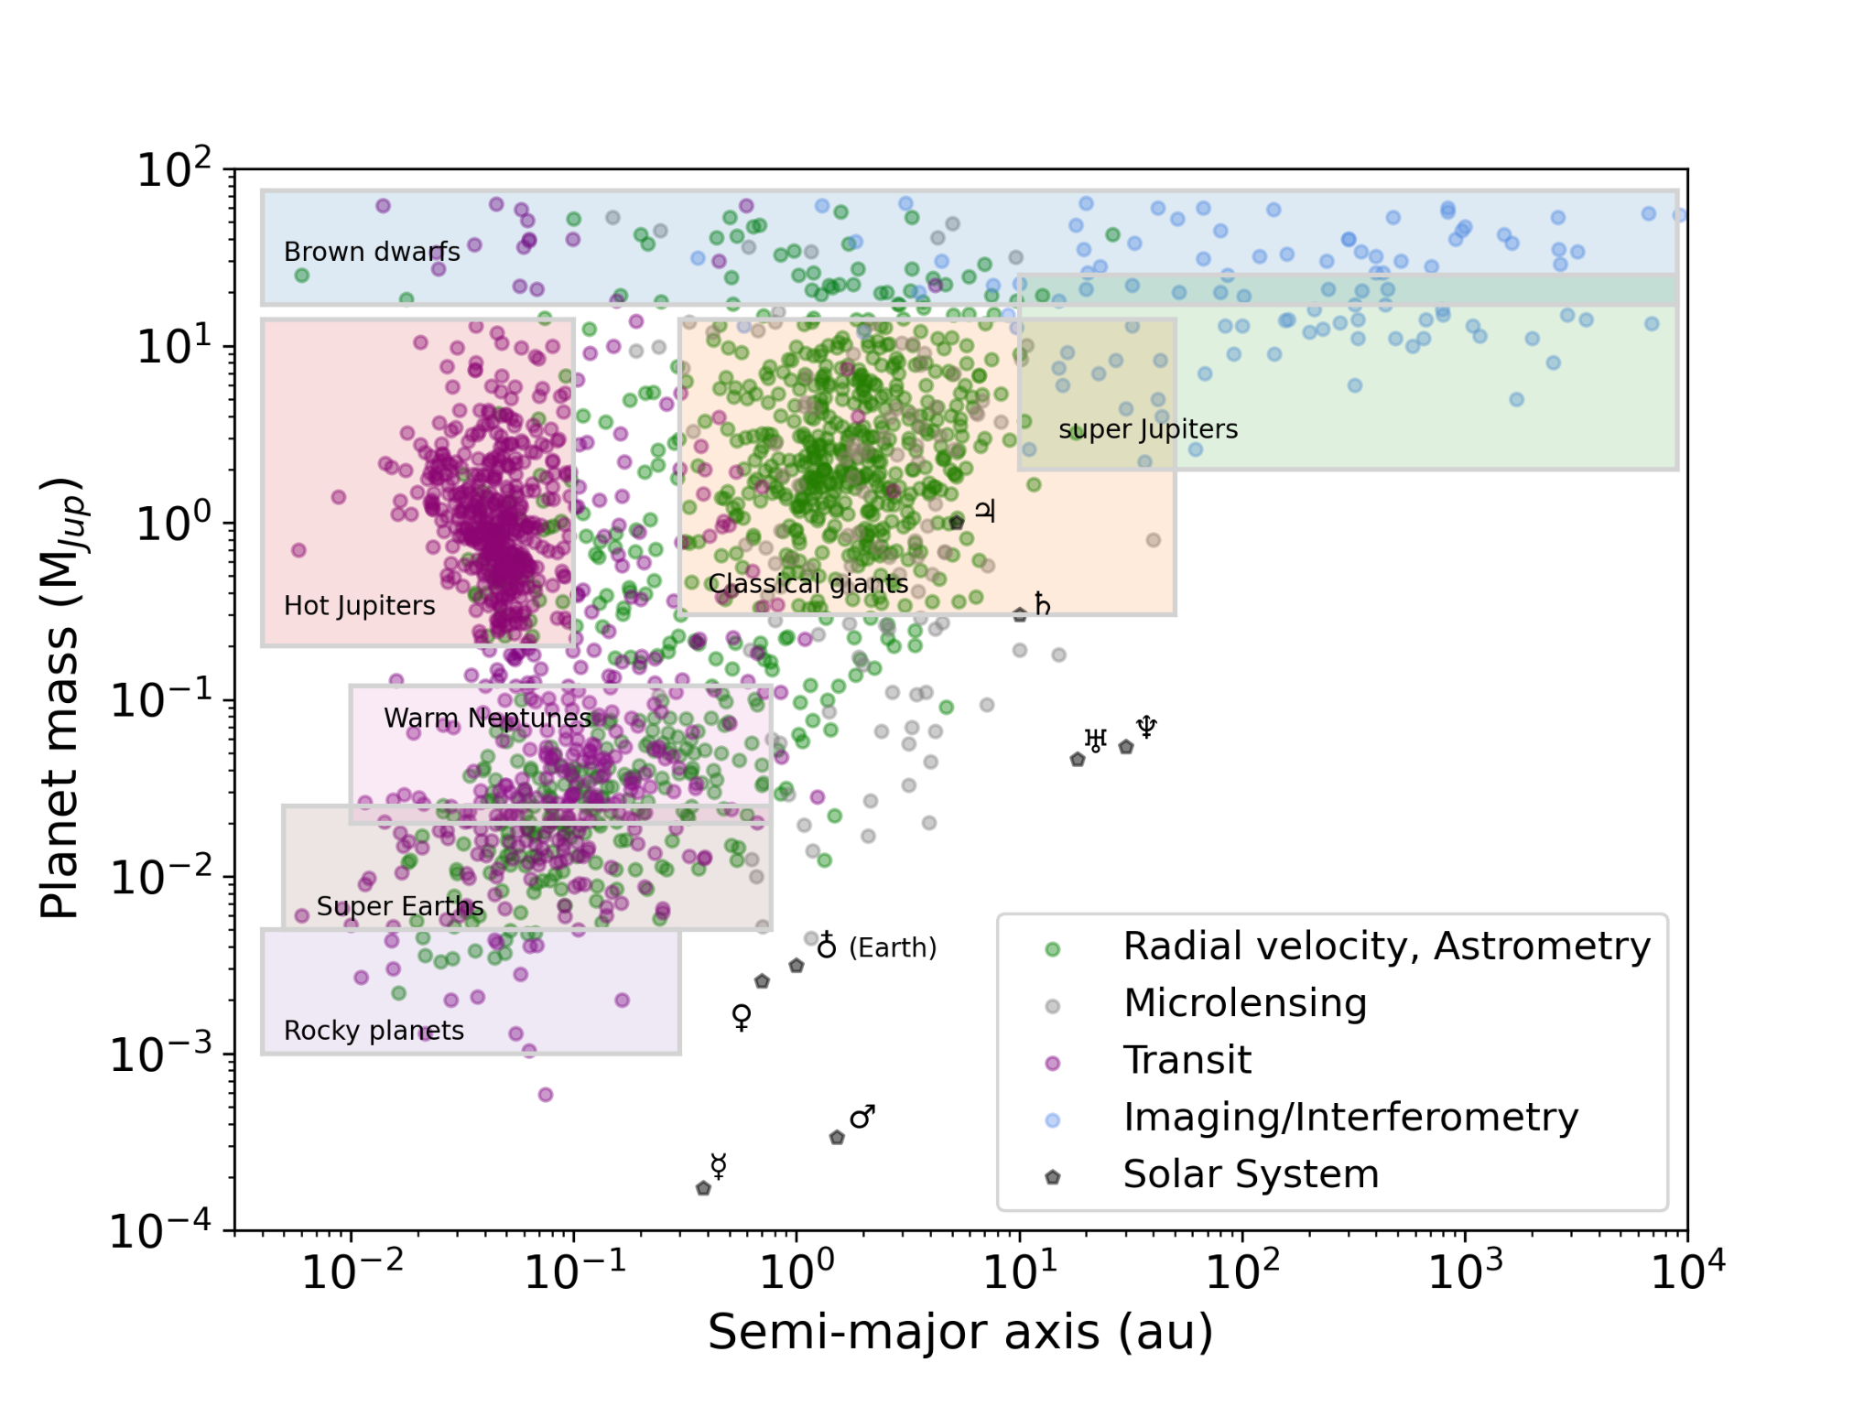
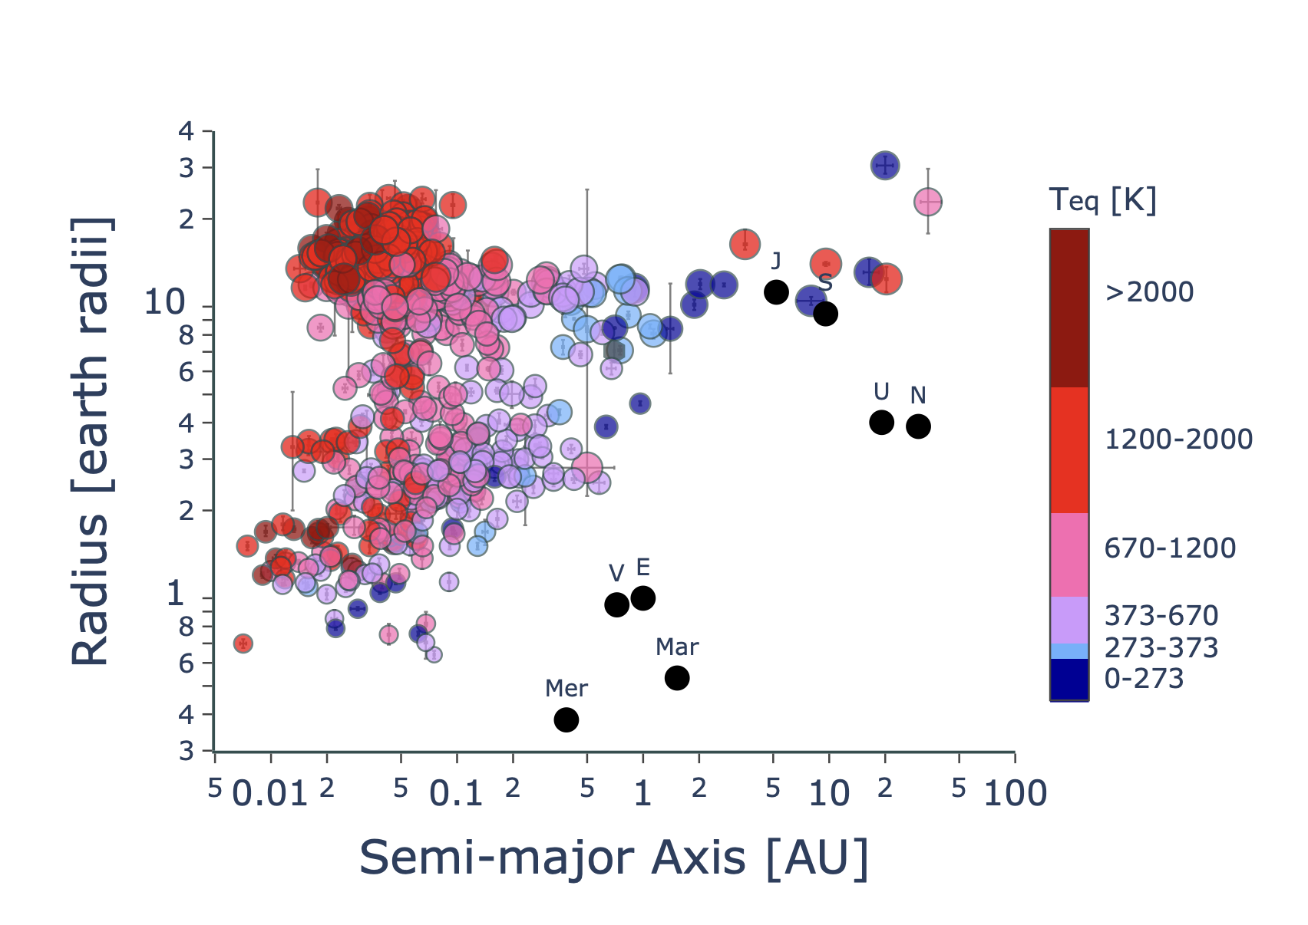
The Diversity of Exoplanets
©Chauvin
Valencia+ 2025
Workshop STILES –Napoli 17th March 2026
Notes:
Exoplanets with masses error and radii error less than 25%. Symbol size is proportional to mass.
Colors correspond to equilibrium temperatures calculated with Bond albedos of 0.3 and redistribution factors
of 4. Colors are loosely binned according to physical processes: planets with icy surfaces should they have
any water (0-273 K), planets that allow for liquid water (273-373 K), planets that are in runaway greenhouse
below the critical point of water (373-670K), hot planets that cannot have water clouds (670-1200K) and
magnetic effects on their atmospheres are negligible, hot planets where magnetic effects like ohmic dissipation
are important, very hot planets where magnetic effects are less important (due to full ionization and freezing
to magnetic field)
. Revealing various categories of planets
HJs from first RV
Mini Neptunes family
Super-Earths (delimited by the radius valley at 1.4-1.8 Rearth
Warm/temperate giant planets
Young Giant planets
. Some complexity/multi-dimensional aspects hidden in that plot: Stellar Mass, Metalicity, Environment, Age

Slide 7
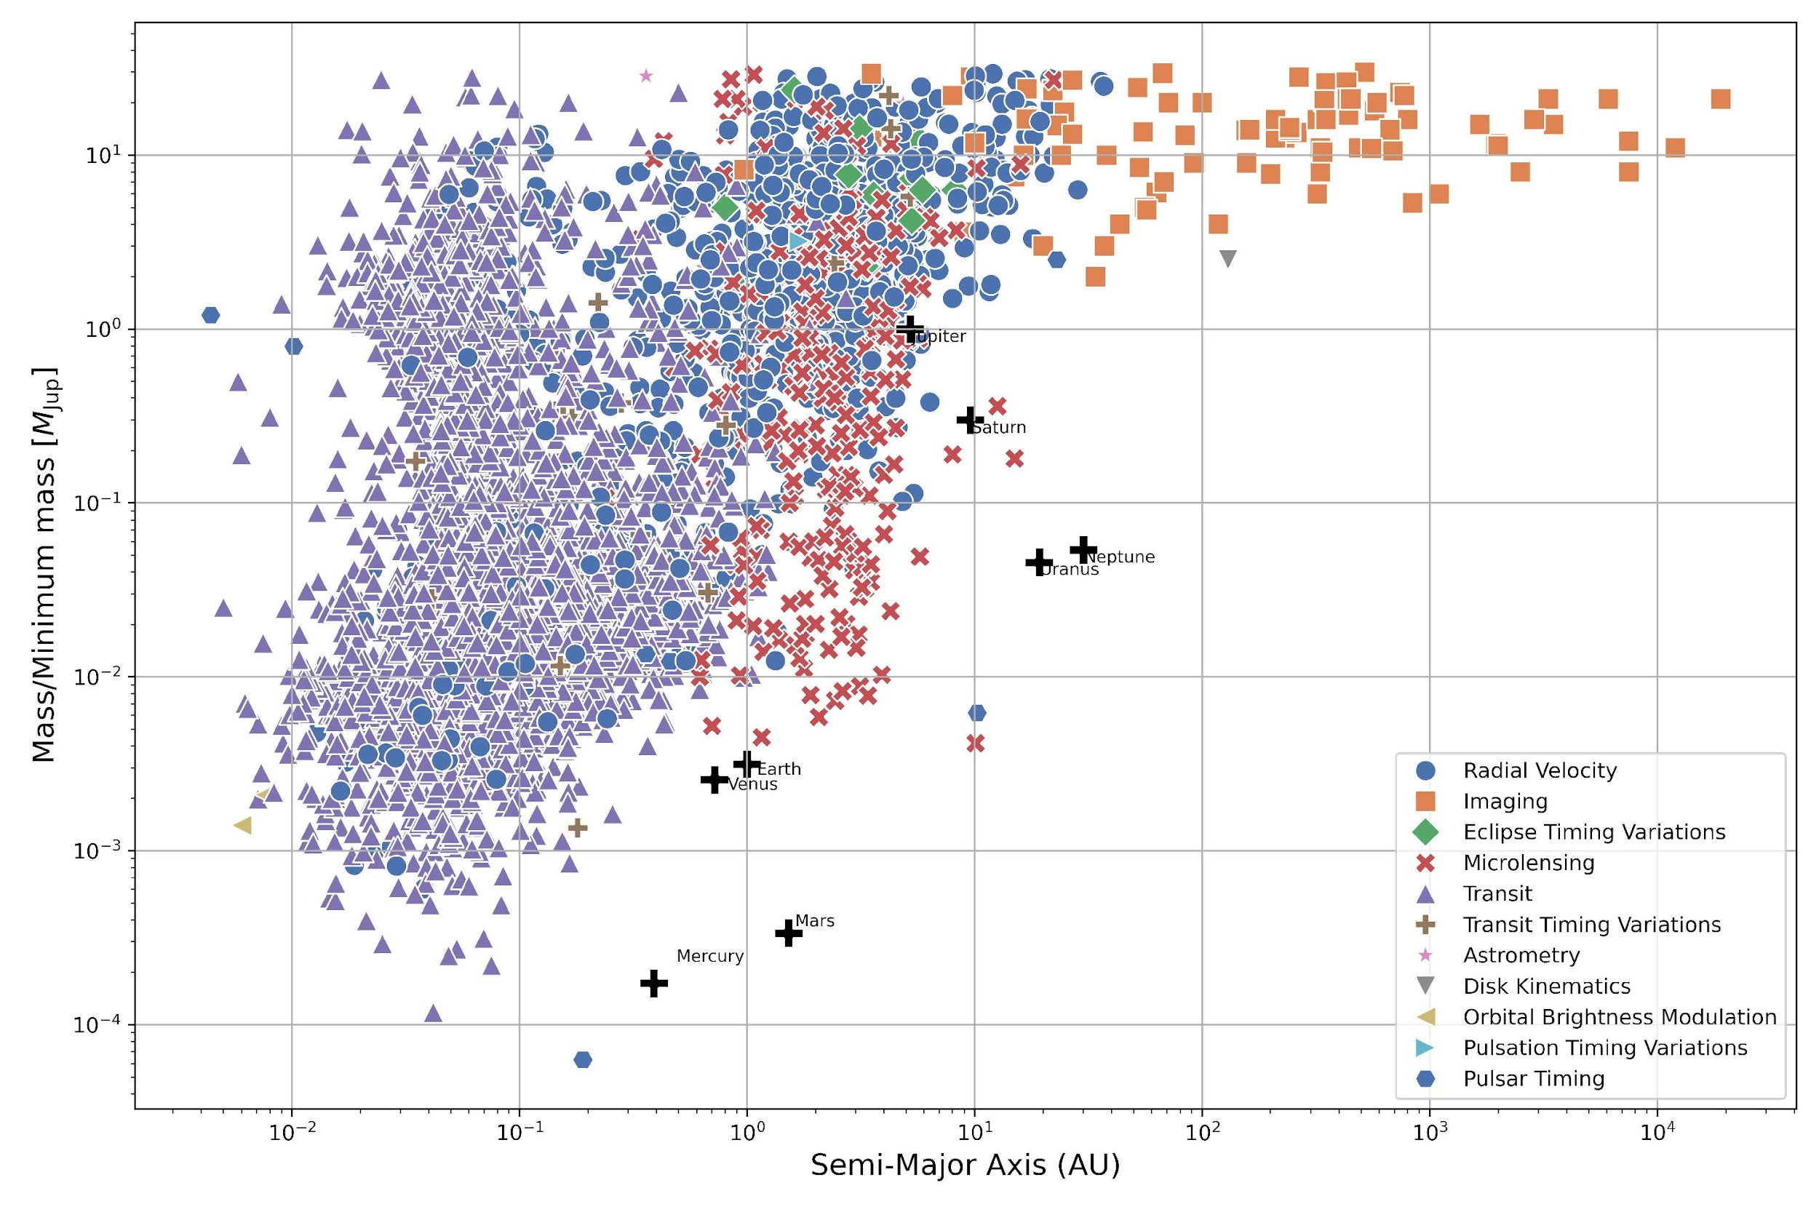

Workshop STILES –Napoli 17th March 2026

Slide 8
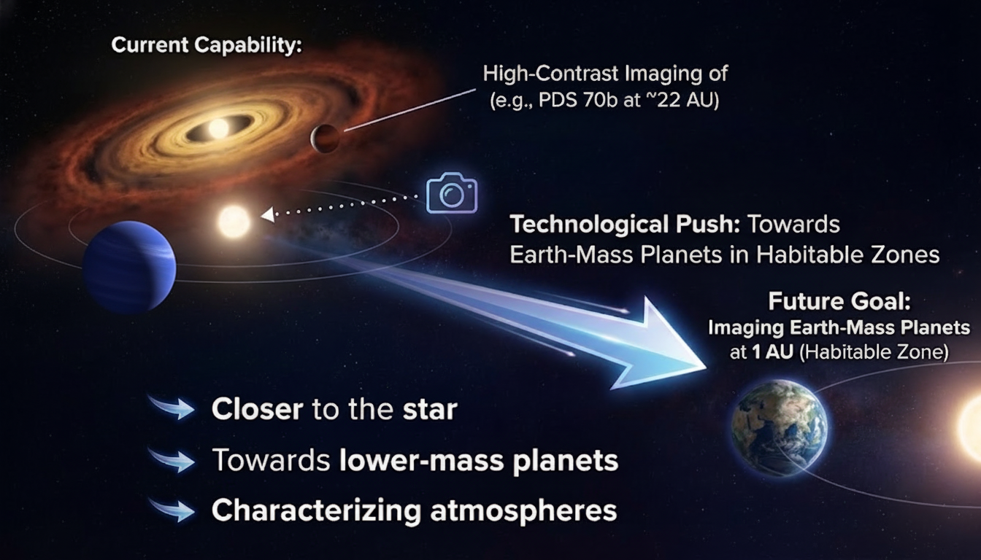

Slide 9
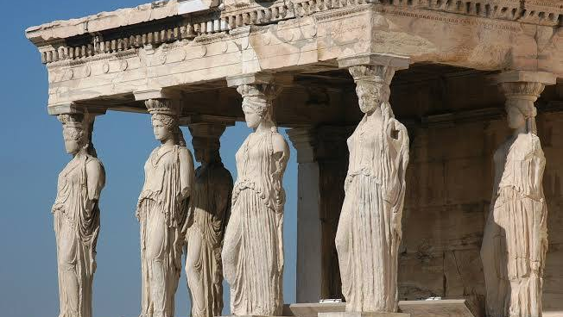
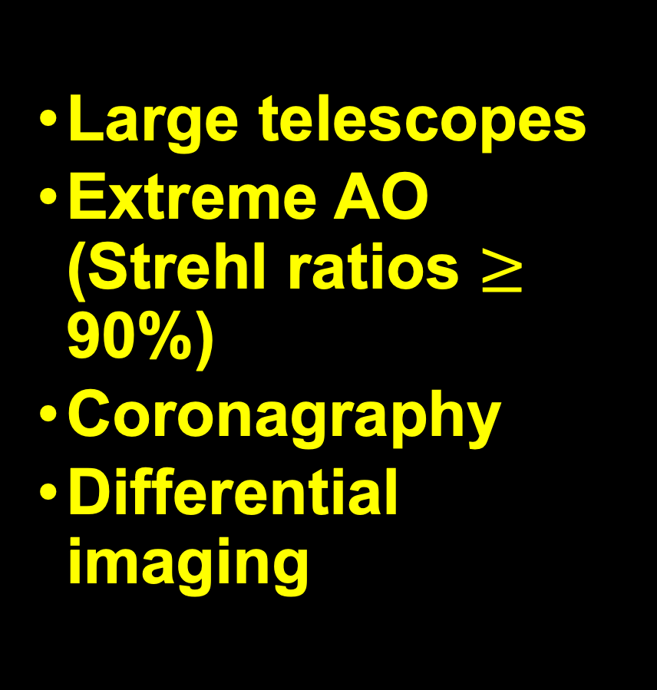
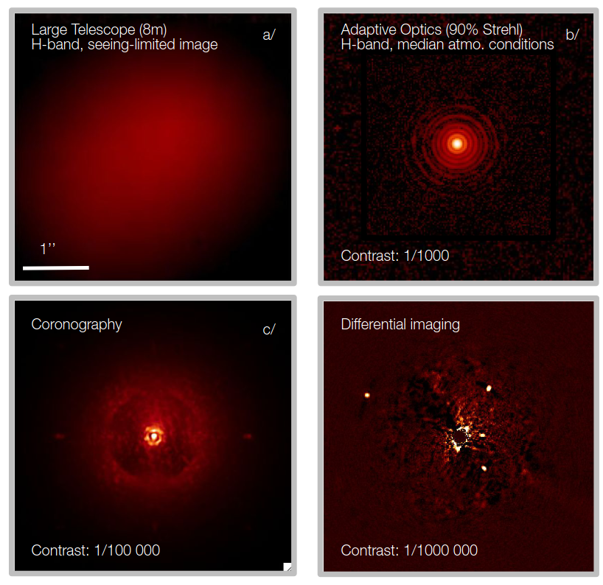
Requirements

Slide 10
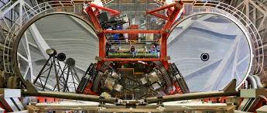
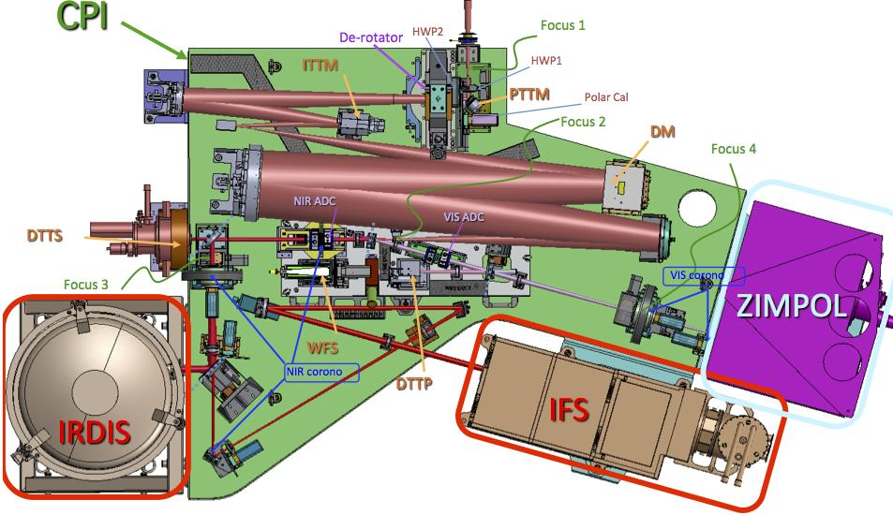
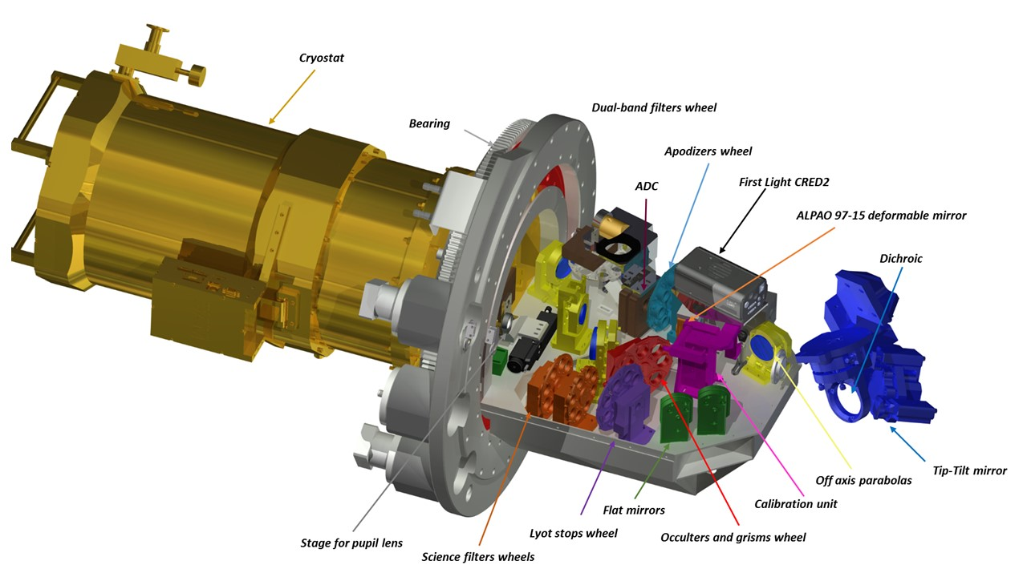
SPHERE at VLT
SHARKs at LBT
Workshop STILES –Napoli 17th March 2026

Slide 11
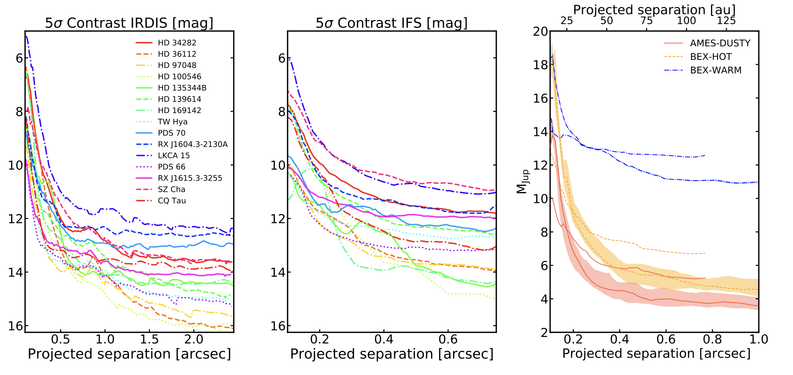
Current facilities on 8-m class telescope:
SPHERE@VLT /SHARKS@LBT/GPI@Gemini/SCExAO@Subaru
→ Contrast ratios of ~10⁻⁴ / 10⁻⁶ between ~0.25-0.5 arcsec
Asensio-Torres+ 2021
Workshop STILES –Napoli 17th March 2026

Slide 12
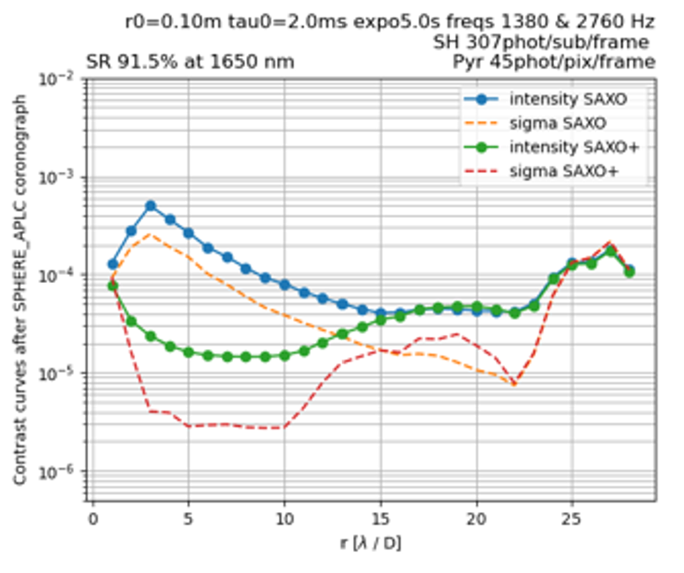
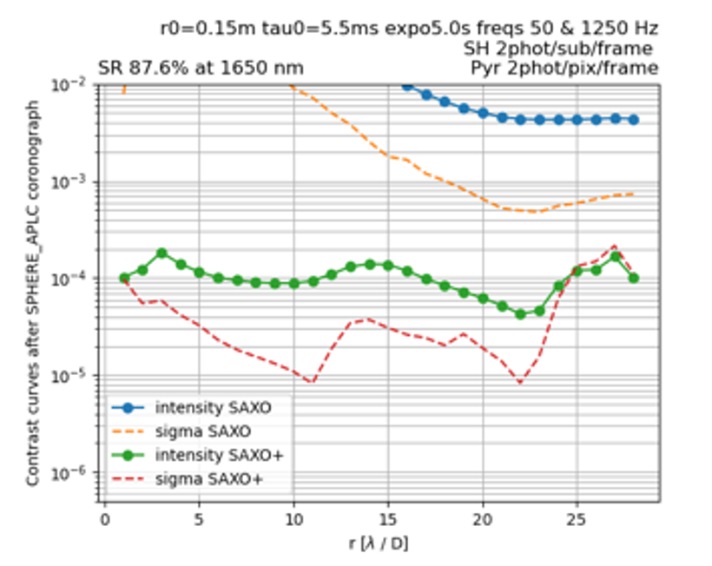
SAXO+
Seeing 0.7’’, mag H 5.1, 9 m/s
2nd stage correction AO
NIR Pyramid Wavefront sensor 50X50 sub-apertures
Up to 2.7 KHz (goal 3KHz) correction frequency
Wavelength range (common path) 0.95 – 2.32 µm
Wavelength range (WFS path) 0.95 – 1.1 µm/ 0.95 – 1.45 µm
DM with 28X28 actuators across the pupil diameter
Guide star up to mag H 11.7+ (mag R 16.8)
Seeing 0.7’’, mag H 9.4, 5.5 m/s
Workshop STILES –Napoli 17th March 2026
Notes:
The boosted adaptive optics performances will be reached by adding a second stage of correction, called SAXO+
It will measure the residual wavefront error coming from SAXO with a pyramid wavefront sensor working in the Near Infrared coupled with a very sensitive camera.
This choice will improve the limiting magnitude up to H 11.7 and more.
A recent modification has been done in the design in order to implement a slightly different deformable mirror. In order to reach the scientific requirements in fact, the yield of the deformable mirror is critical. Broken actuators translates in a contrast degradation. The previously selected mirror, with 28 actuators on the diameter, was not available with a 100% actuators yield.

Slide 13
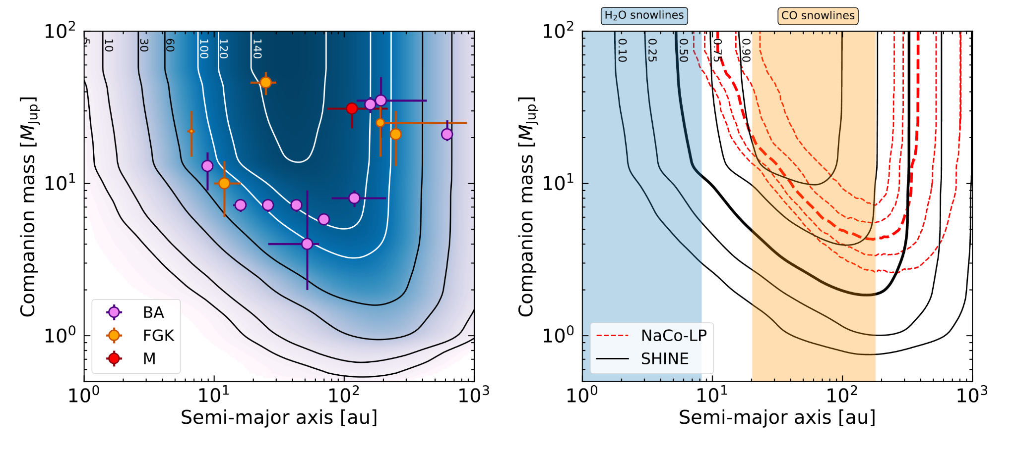
Demographics of young Jupiters down to the snow line
Vigan et al. (2021)
Sample: Young (< 500 Myr), nearby (< 150 pc) stars
Synergies: Gaia (DR4/DR5), RV, expected bulk of RV planet population
Deeper/Closer in contrast (10⁻⁵ at 100mas, 5σ) on bright (R < 9.5) targets at H-band
Notes:
. Bright stars, go faster, therefore potentially closer/deeper in contrast Trade-off-1 (SAXO+): 2nd stage AO (3 kHz) IR path (IR WFS)
. Plot:
. Go down to the snowline
(*) Gaia will observe 450 (and 1200), young (≤ 500 Myr) stars at distances closer than 50 pc (and 150 pc, resp.)

Slide 14
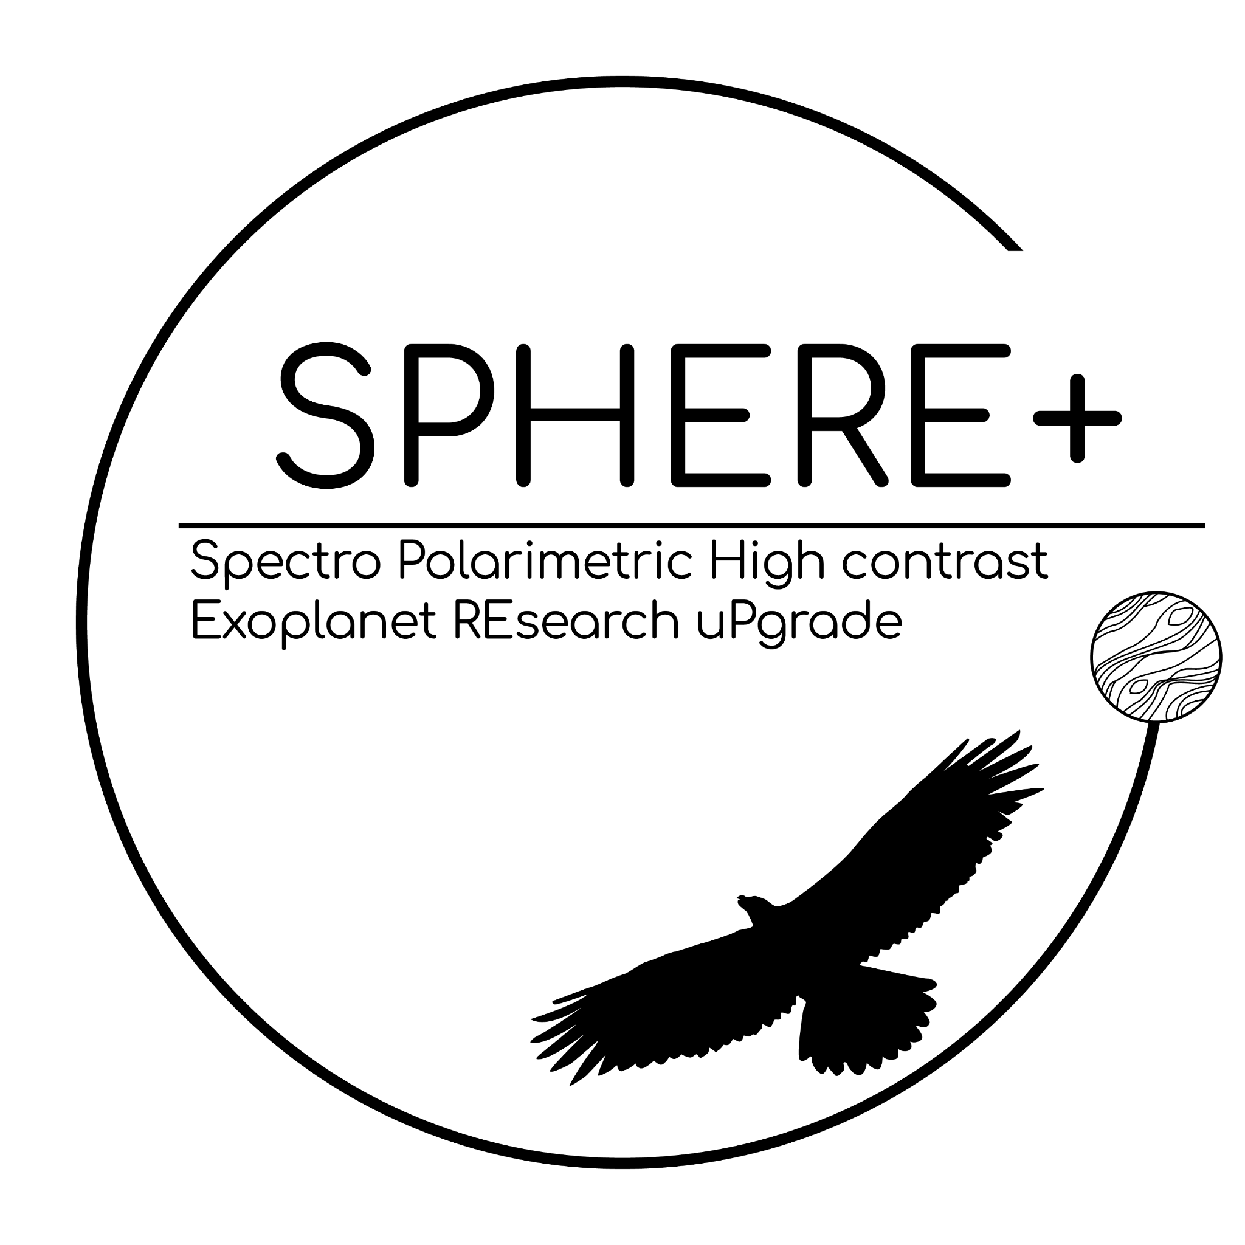
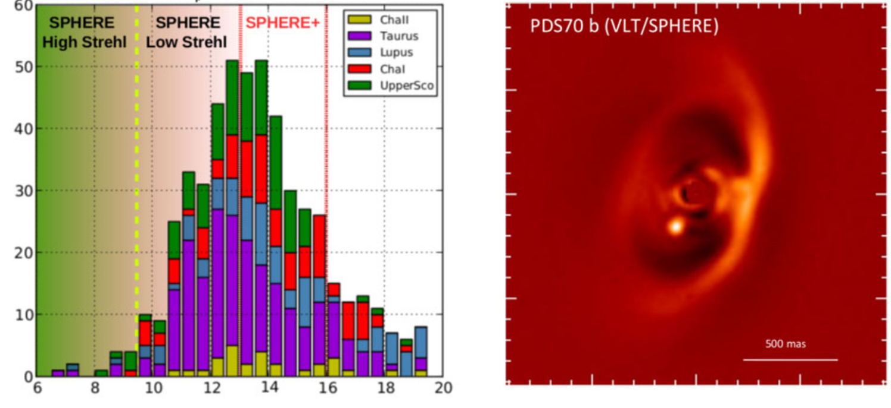
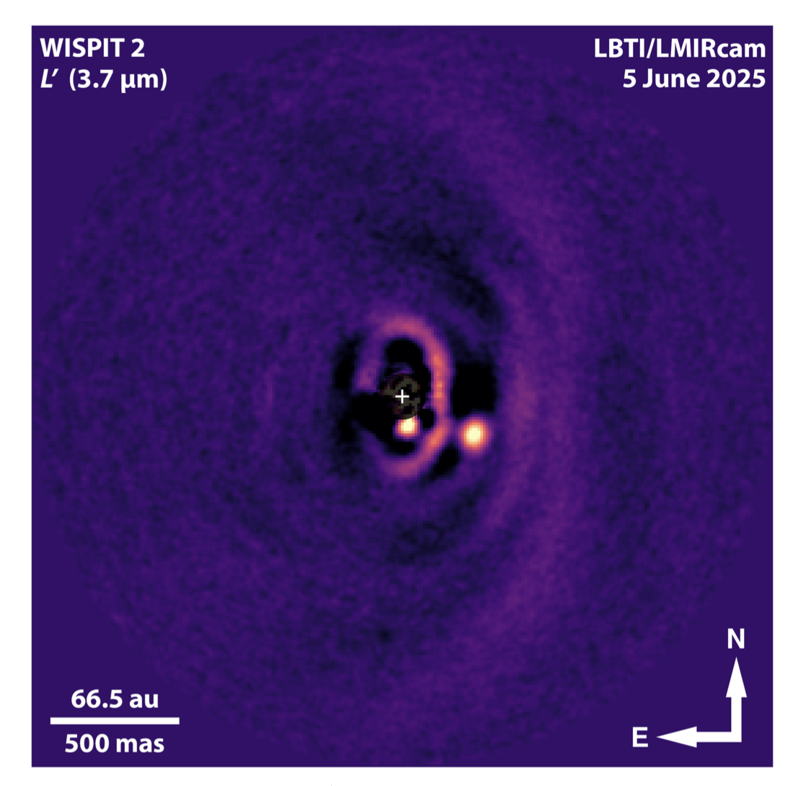
Discovering protoplanets & planet-forming disk diversity
PDS70
Close+ 2025
R (mag)
Keppler et al. (2018),
Haffert et al. (2019)
Sample: Faint members from SFRs (400+)
Synergies: ALMA, Gravity, ERIS(+)
Accessing fainter/redder targets (R < 14 mag, R - J = 2 - 5 mag)
Notes:
We mean carrying out surveys for protoplanets, in emission or in accretion (Paβ)... wispit2 B 57 au with a mass ~ 6 Mjup (mag R~11; H~8.5) also PDS70A G=11.7
fainter/redder
. acces bulk of the members of SFRs (Tauruis, Lupus, ScoCen…)
Trade-off-2 (SAXO+): photons sharing between science and 2nd stage AO, Pyramid-WFS (more sensitive)

Slide 15
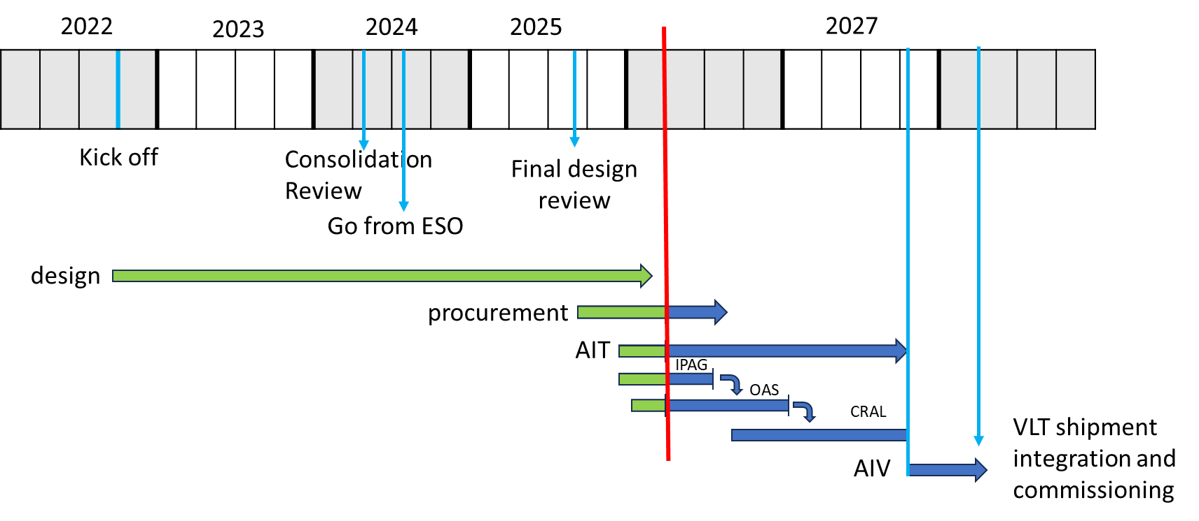
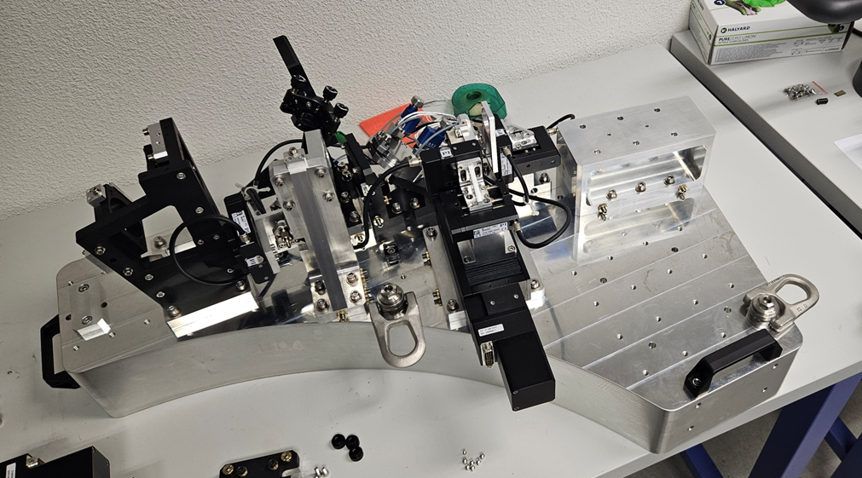
SAXO+ Schedule
Today
Workshop STILES –Napoli 17th March 2026
Notes:
This is the schedule of the project:
the kick off happened about three years ago, in summer 2024 we have obtained the official approval from ESO and summer 2025 we have passed the final design review.
The red line points where we are now:
•We are waiting for the last components to be delivered and
•The integration activity has started
This activity is splitted in three fase:
•the electro-mechanics (mechanics + motors) is integrated at IPAG
•The bench is then sent to Bologna for the integration of the optics and the Camera + deformable mirror
•And the full instrument will be then sent to CRAL, in LYON, for the final integration with the RTC and testing before final delivery to Chile in early 2028

Slide 16
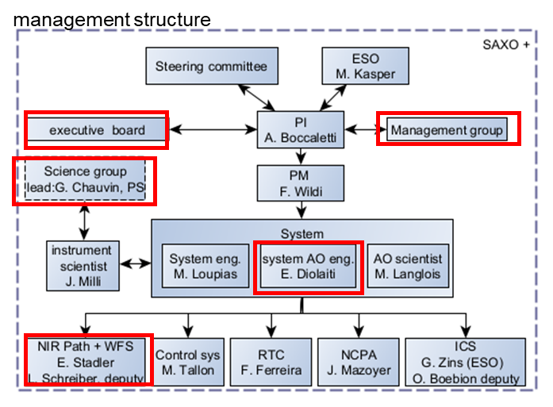
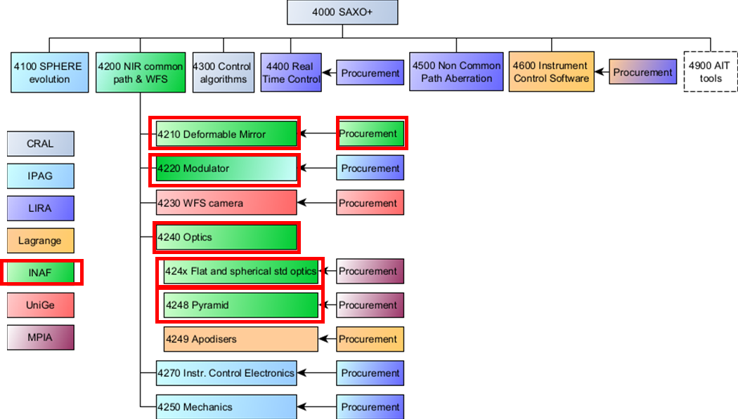
INAF contribution
System AO engineer, WP leader deputy, CO-I, Contribution to many work packages, perform AIT at subsystem level, contributes to the procurement of hardware components (PNRR STILES-2301 e 5101, see presentation E. Pinna)
Funded by STILES 2301
Workshop STILES –Napoli 17th March 2026
Notes:
INAF collaborates in many Work packages and cover roles of responsibility. Raffaele Gratton (OAPD) is one of the CO-Is and Emiliano Diolaiti (OAS) is the AO system engineer.
Laura Schreiber (OAS) is responsible, in collaboration with IPAG, of the SAXO+ sub-system as an opto-mechanical and electrical system.
We have seen that INAF also contributes to the procurement of some hardware key components, in particular the DM, that represents about the 20% of the cost of the instrument.

Slide 17
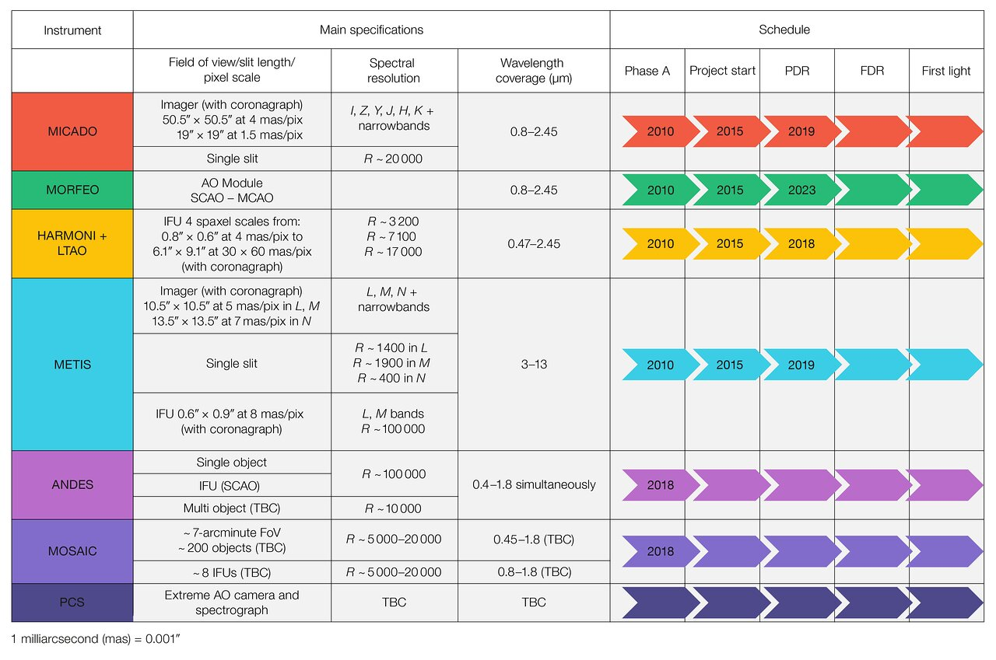
2029
2031
2031
2029
2032
2032
©️ Chauvin
2036
Workshop STILES –Napoli 17th March 2026
Notes:
. in terms of instrumentation roadmap . here all instruments with priority given to planetary formation & exoplanets cases
. MORFEO-MICADO & HARMONI, gral instruments, BUT
. METIS, real first instrument devoted to this science cases
. Then ANDES, PCS

Slide 18

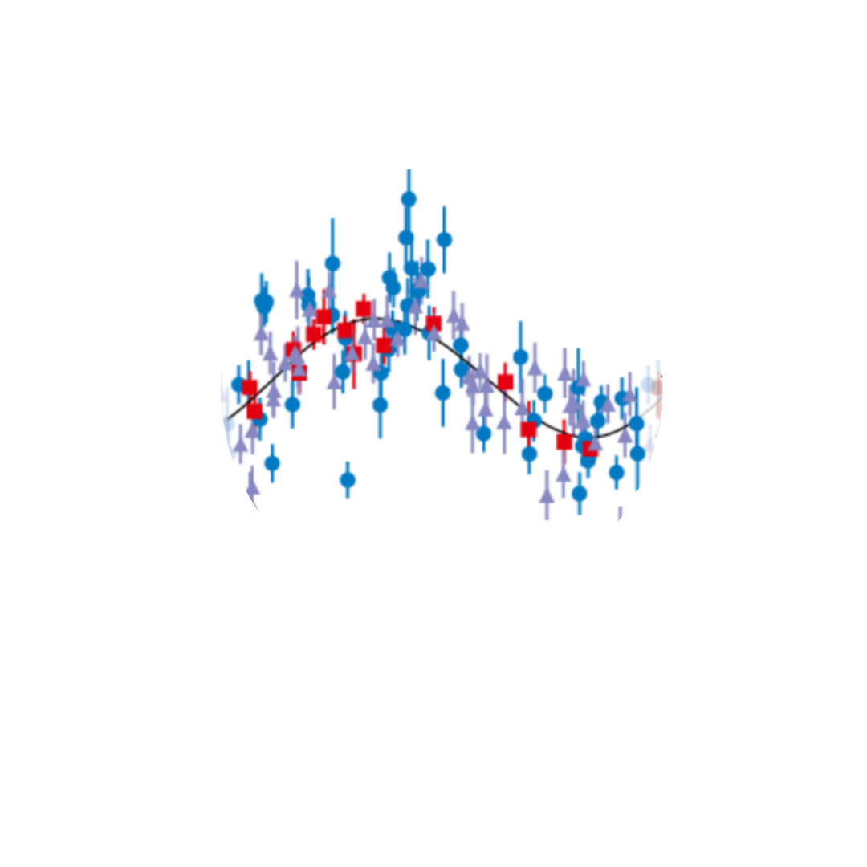
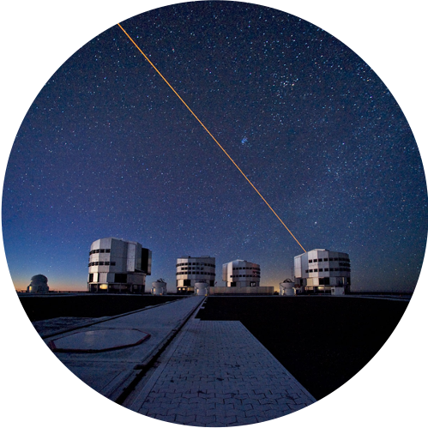

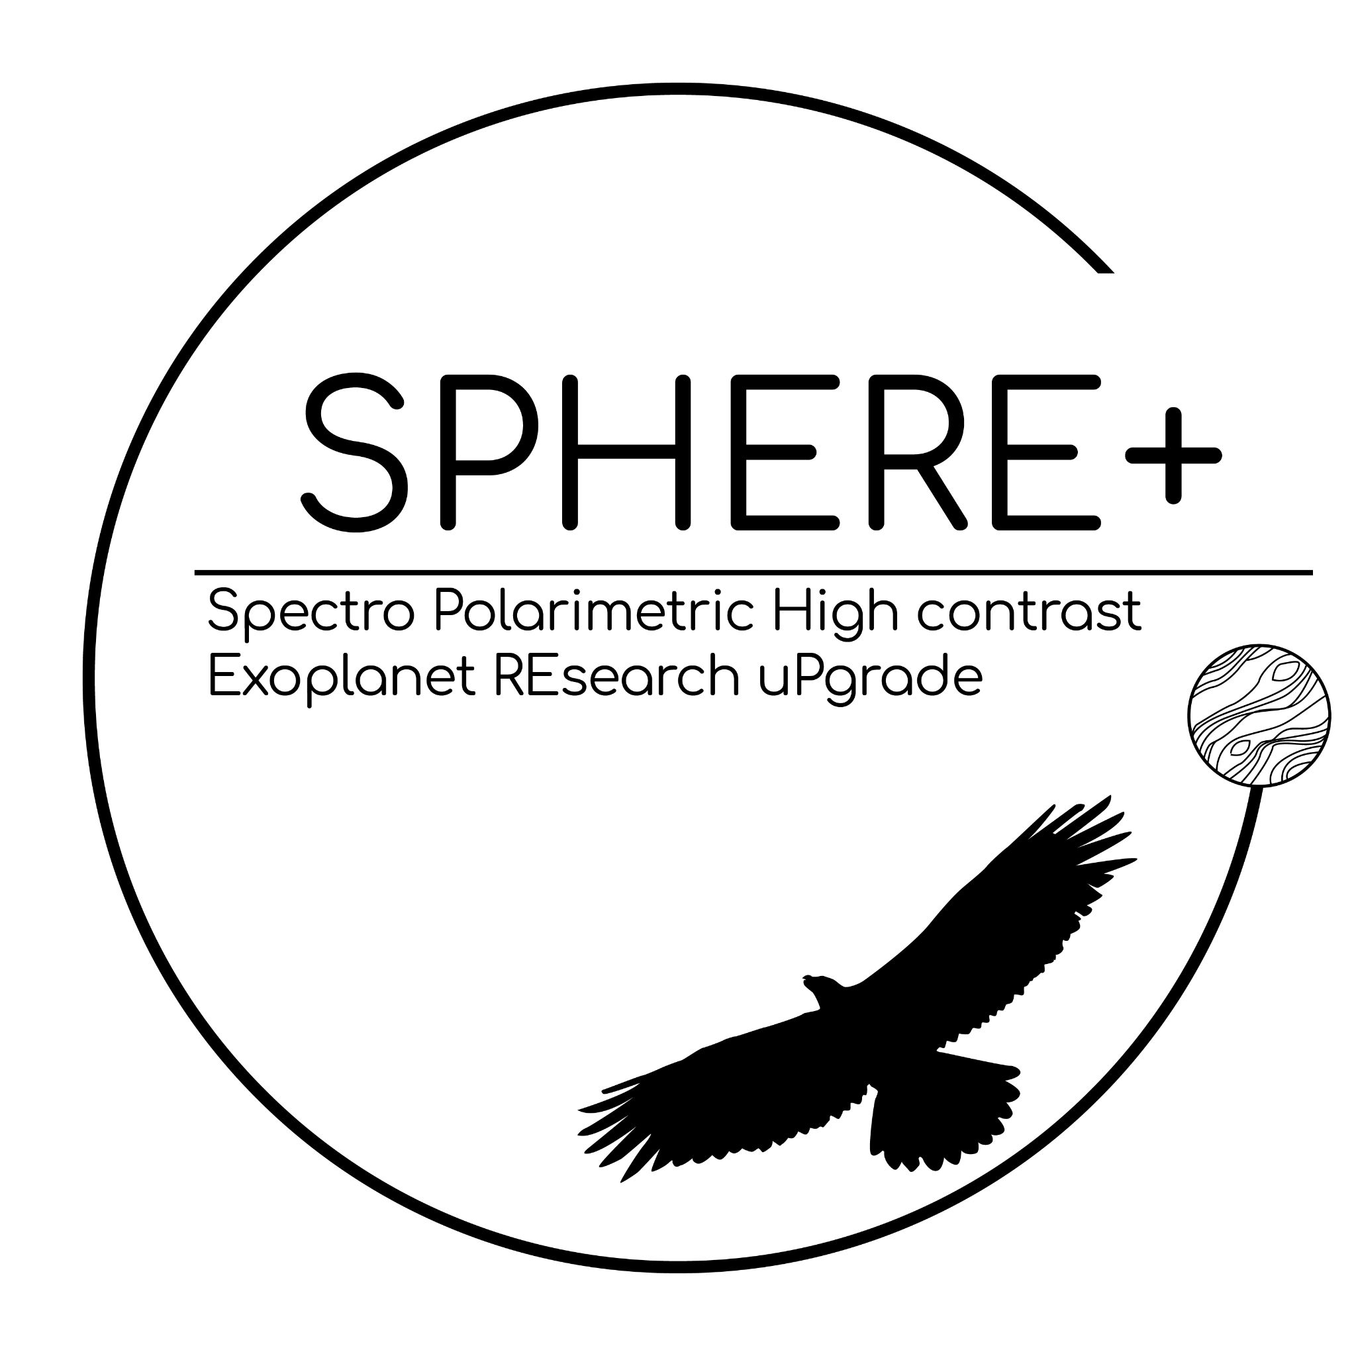

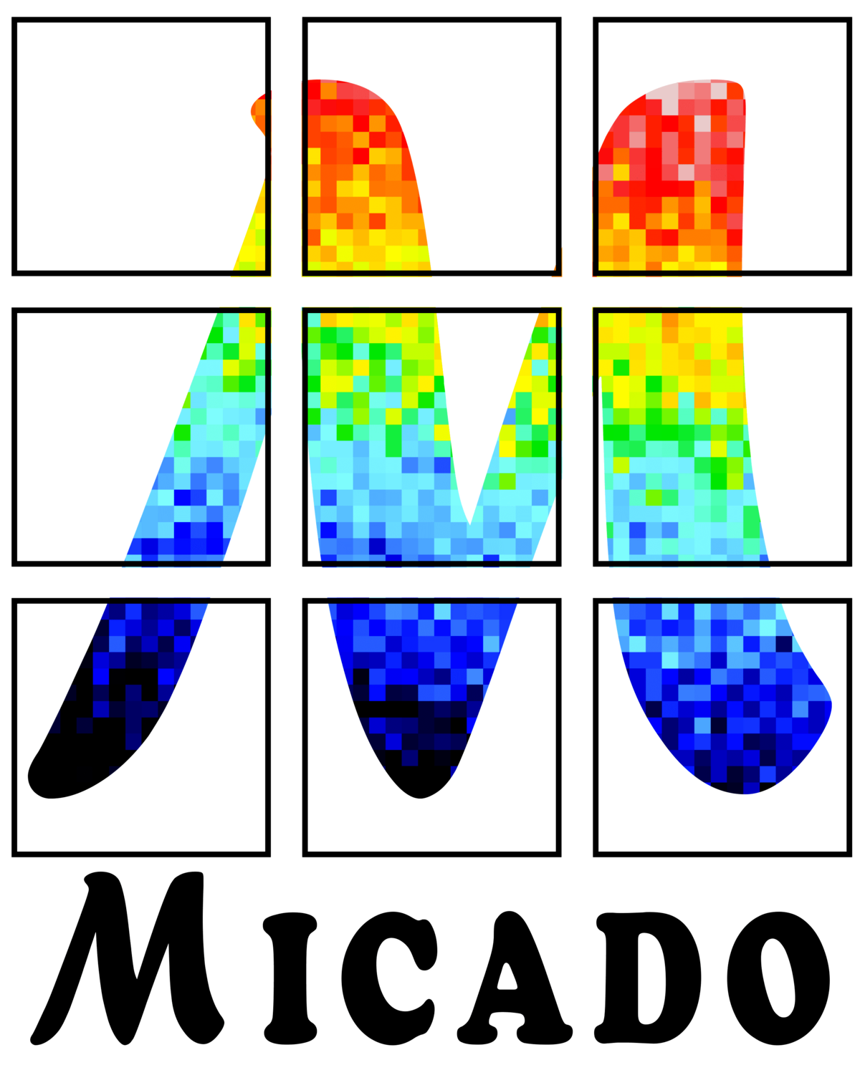
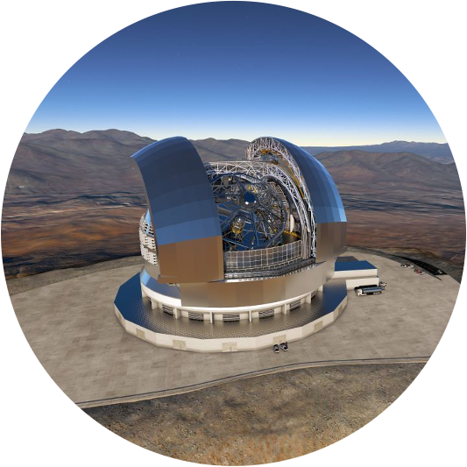




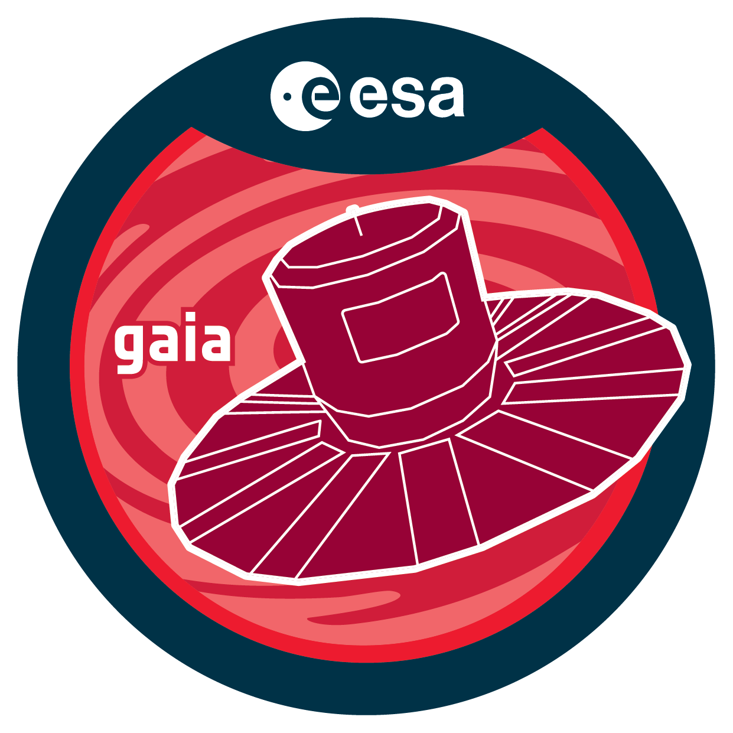

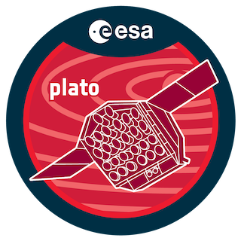
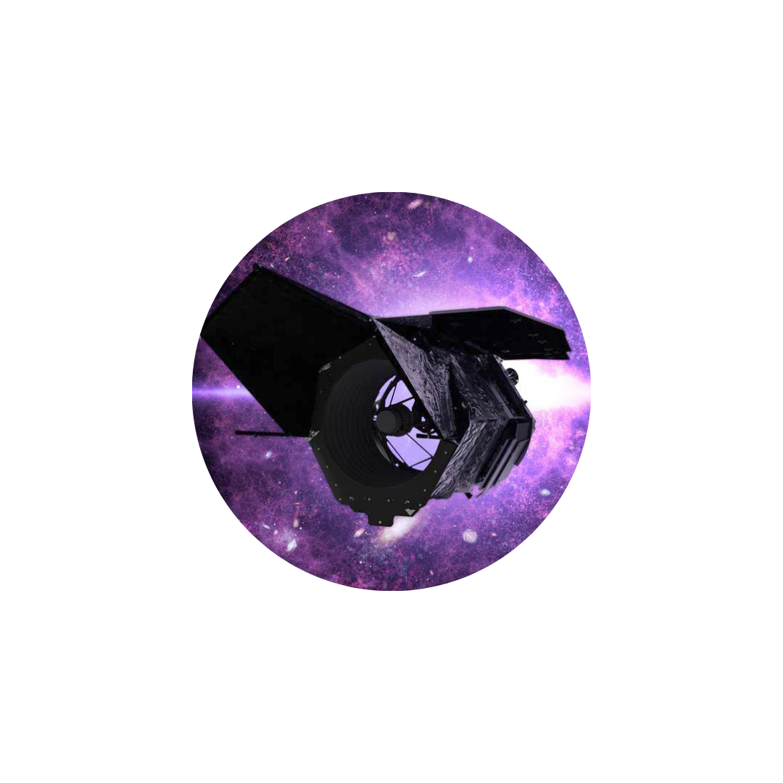
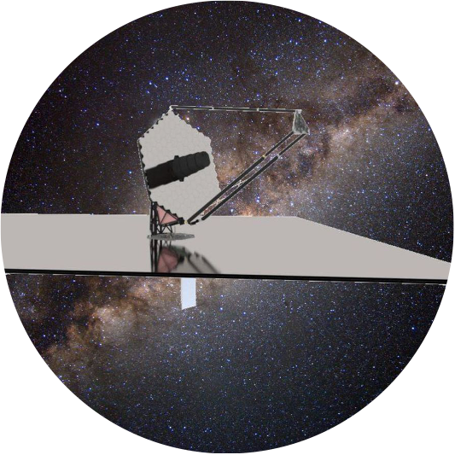


Ground
©️ Chauvin
ALMA
EPRV: HARPS, HARPS-N, HARPS3, CARMENES, SPIROU, NIRPS, GIANO-B, EXPRES…
VLT/VLTI: MUSE, ESPRESSO, SPHERE, ERIS, CRIRES+, HiRISE, X-Shooter, GRAVITY, MATISSE… ASGARD
GRAVITY+
SPHERE+ (PCS Pathfinder)
MORFEO-MICADO
ELT
METIS
HARMONI
First Light
ANDES
PCS
Space
GAIA
JWST
PLATO
Roman
HWO
ARIEL
LIFE
2022 2024 2026 2028 2030 2032 2034 2036 2038 2040
Notes:
1. Important to note that ELT is part of general efforts from Ground/space to to study exoplanets
. space: gaia, jwst, roman plato/ariel
. ground: ALMA, RV, transit, VLT/VLTI
2. Will arrive with a perfect timing to exploit the synergies with these space/ground-based observatoires (ex Gaia DR4/5)

Slide 19
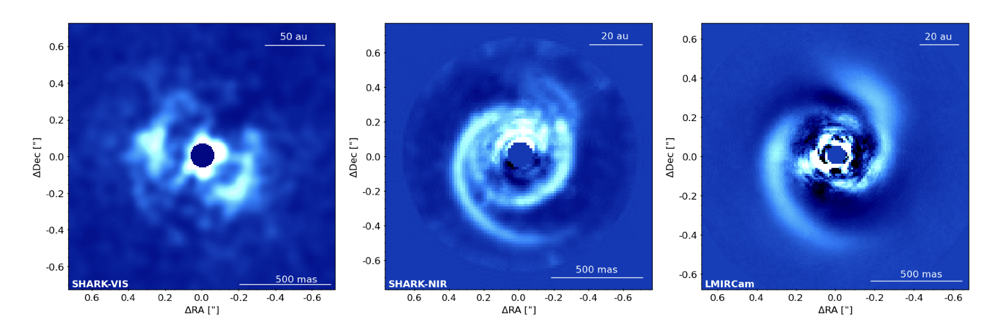
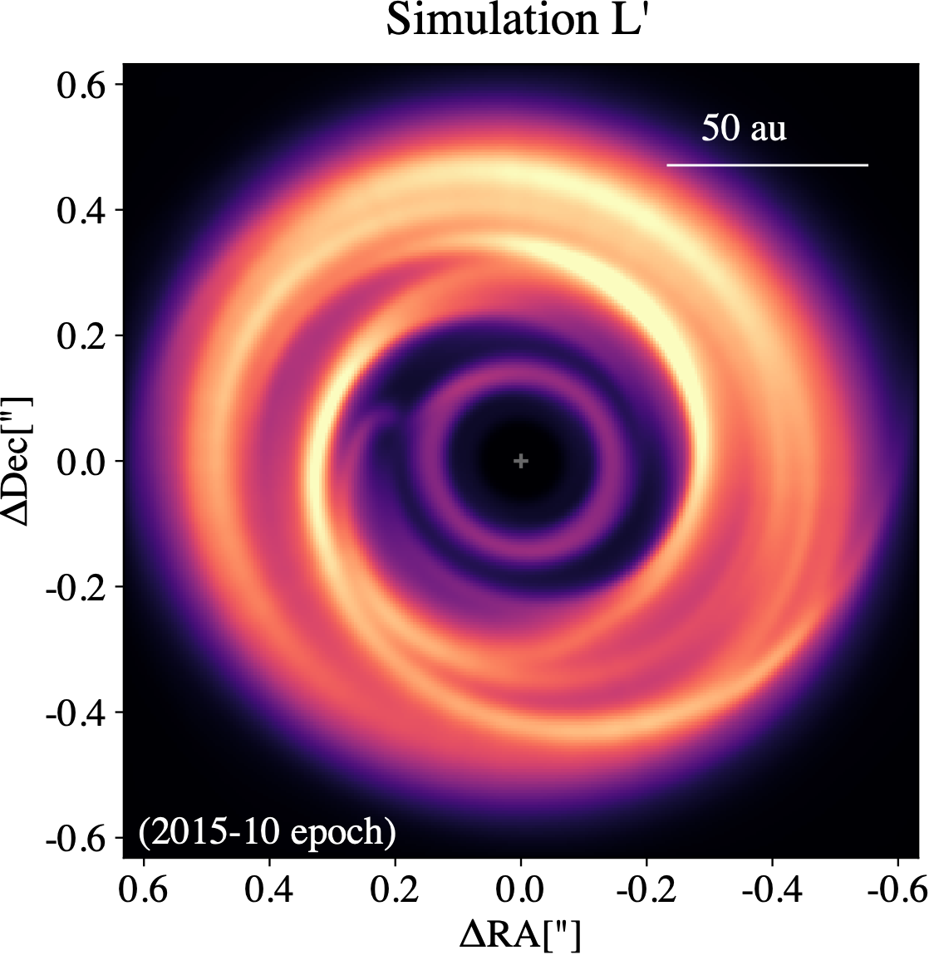
Planet-forming disks
Sub-structures (dust component)
Spirals, Rings, Gaps, Shadows,
vortices (VLT/I, ALMA, SKA synergy)
high-contrast imaging
L-band 3.8 µm, Herbig-star (MWC 758, ~150 pc)
Jupiter footprint at 30 au, very competitive with JWST
Vega Pallauta+, in prep. [LBT]
  METIS simulation. Credits: C. Baruteau & V. Christiaens
Workshop STILES –Napoli 17th March 2026
Notes:
. Explore the dust component.
. METIS simulations of the young disk MWC758 at Lp
. PErspectives to explore dust properties, drift, dust traps and protoplanets > Antoine

Slide 20
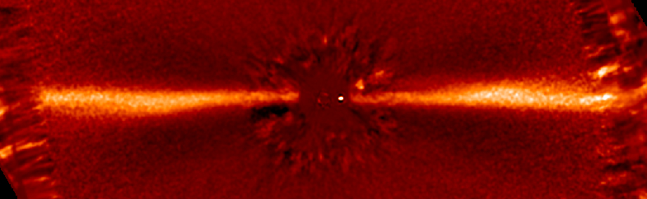
Exoplanetary systems
β Pic (A6V), 23 Myr-old planetary system
β Pic b, 13 M_{Jup} planet at 9au (e = 0.1), Lagrange et al. (2019)
Edge-on debris disk, Smith & Terrile (1984)
SPHERE/GRAVITY monitoring, Nowak et al. (2020)
Second planet c detected by RV/GRAVITY
SPHERE/SHINE - β Pictoris
midplane
b
warp
0.5”
N
10 au
E
Notes:
Beta Pic as become one of the few benchmark
systems for studies of planet formation, in which a debris disk
(Smith & Terrile 1984), extrasolar comets Ferlet et al. (1987);
Beust et al. (1990); Kiefer et al. (2014), and even two extrasolar
giant planets (βPic b Lagrange et al. 2009, 2010 and c Lagrange
et al. 2019; Nowak et al. 2020) have been found. It is a naked-
eye (mV = 3.86) A-type star on the zero-age main sequence.
Case Bpic (inner warp, planet c), simulation MICADO
. role of c for driving exocometray activity in that system, connection to all structures (cat tail)

Slide 21
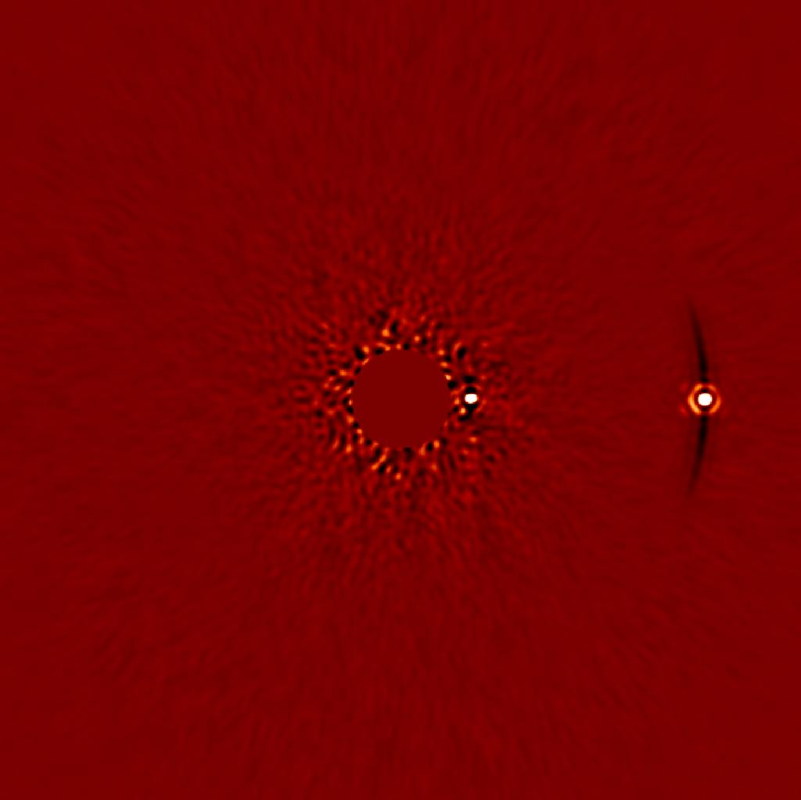
Exoplanetary systems
MICADO - β Pictoris b & c
K-band
Planet(s) & belts
COMPASS/MISTHIC (Baudoz/Huby - MICADO cons.):
β Pic c, 9 M_{Jup} planet at 2.7au (e = 0.24)
MICADO ADI sequence (1hr-meridian),
Telescope, SCAO, NCPA, Corono...
2.7 au
8.9 au
c
b
SPHERE/SHINE - β Pictoris
midplane
b
warp
0.5”
N
10 au
E
Notes:
. Case Bpic (inner warp, planet c), simulation MICADO
. role of c for driving exocometray activity in that system, connection to all structures (cat tail)

Slide 22
Exoplanetary systems
MICADO - β Pictoris b & c
K-band
Connecting Planet(s) physical properties (orbit, mass) & structures of debris disks
Global dynamical stability & evolution
2.7 au
8.9 au
c
b
SPHERE/SHINE - β Pictoris
midplane
b
warp
0.5”
N
10 au
E
Notes:
. Case Bpic (inner warp, planet c), simulation MICADO
. role of c for driving exocometray activity in that system, connection to all structures (cat tail)

Slide 23
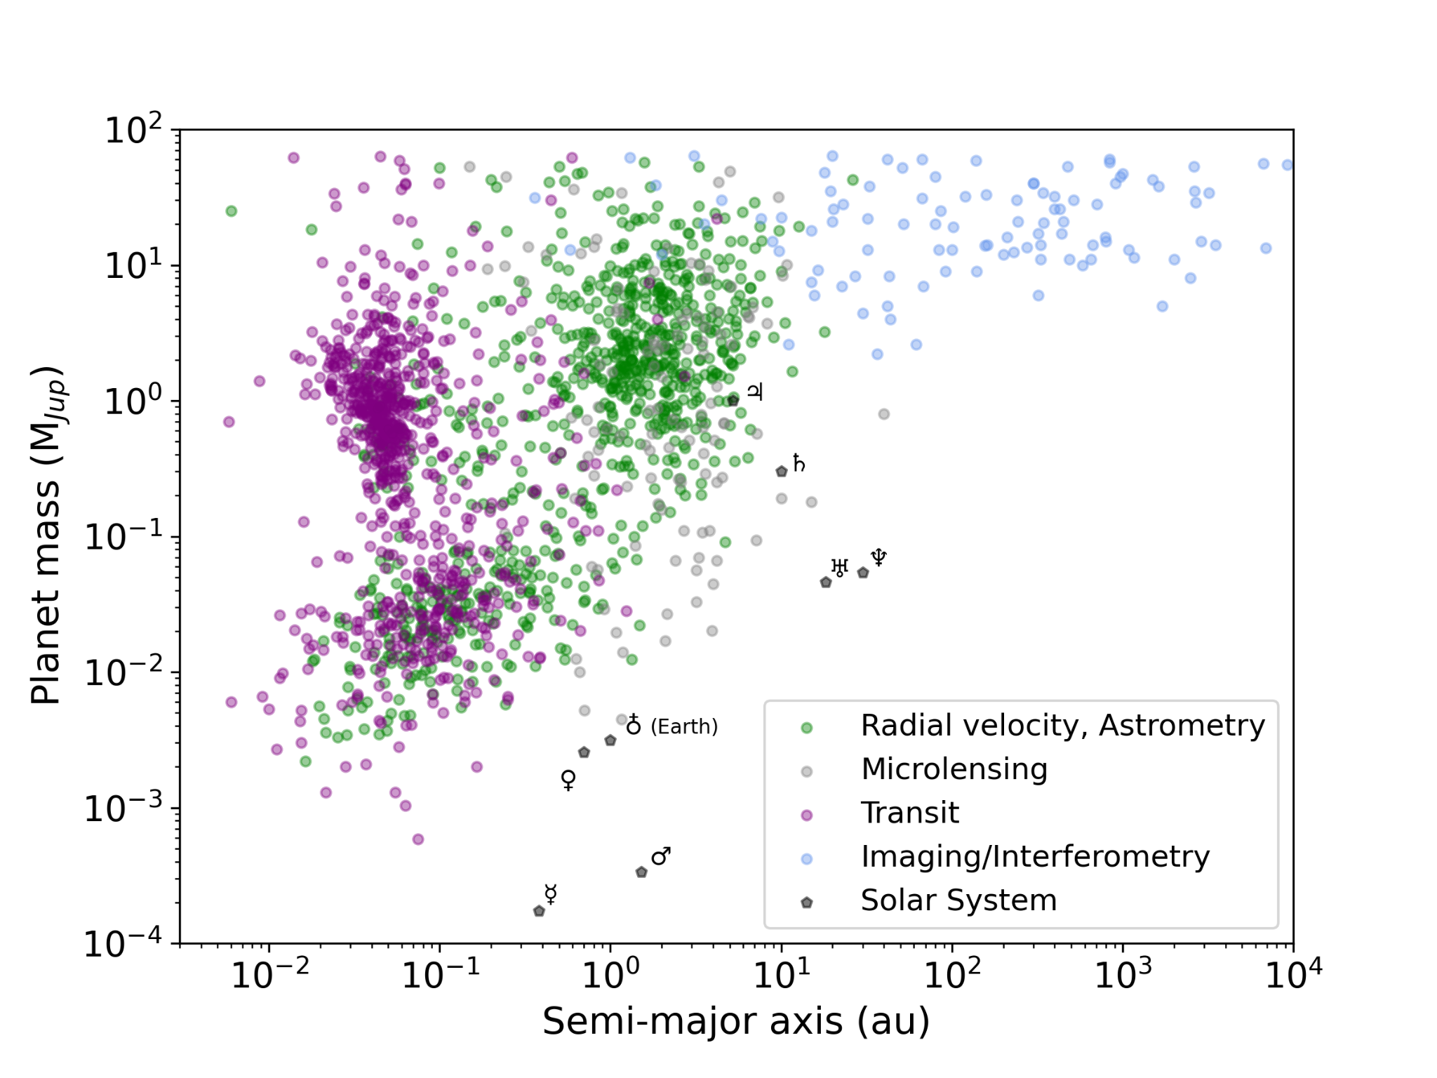
Rocky planets to Habitable Worlds & Life
super-Earths(?), mini-Neptunes, HJs
(Transmitted/emitted Light)
HDS - MICADO/METIS/ANDES
Young Jupiters (Emitted Light)
MICADO/HARMONI/METIS
Notes:
- Rich ground/space instruments, different techniques
- Transition from systematic survey phase to characterization
- Project timeline: SPHERE → SPHERE+ (extreme AO, spectral) → first light ELT → PCS

Slide 24
Rocky planets to Habitable Worlds & Life
super-Earths(?), mini-Neptunes, HJs
(Transmitted/emitted Light)
HDS - MICADO/METIS/ANDES
ELT Reflected light-imaging
Young Jupiters (Emitted Light)
MICADO/HARMONI/METIS
temp. Sup-Earths
METIS/ANDES/PCS
Notes:
- Rich ground/space instruments, different techniques
- Transition from systematic survey phase to characterization
- Project timeline: SPHERE → SPHERE+ (extreme AO, spectral) → first light ELT → PCS
Regarding my research projects:
They fit into a rich ground- and space-based dynamic for the study of exoplanets using different techniques:
- Radial velocities: ESPRESSO, NIRPS, CRIRES+
- Astrometry: Gaia
- Transits: PLATO
- Direct imaging: SPHERE+ (VLT ~2030) and on the ELT
Moving from a phase of systematic surveys to much more targeted characterization (JWST — ~100 hours on one target, ELT).

Slide 25
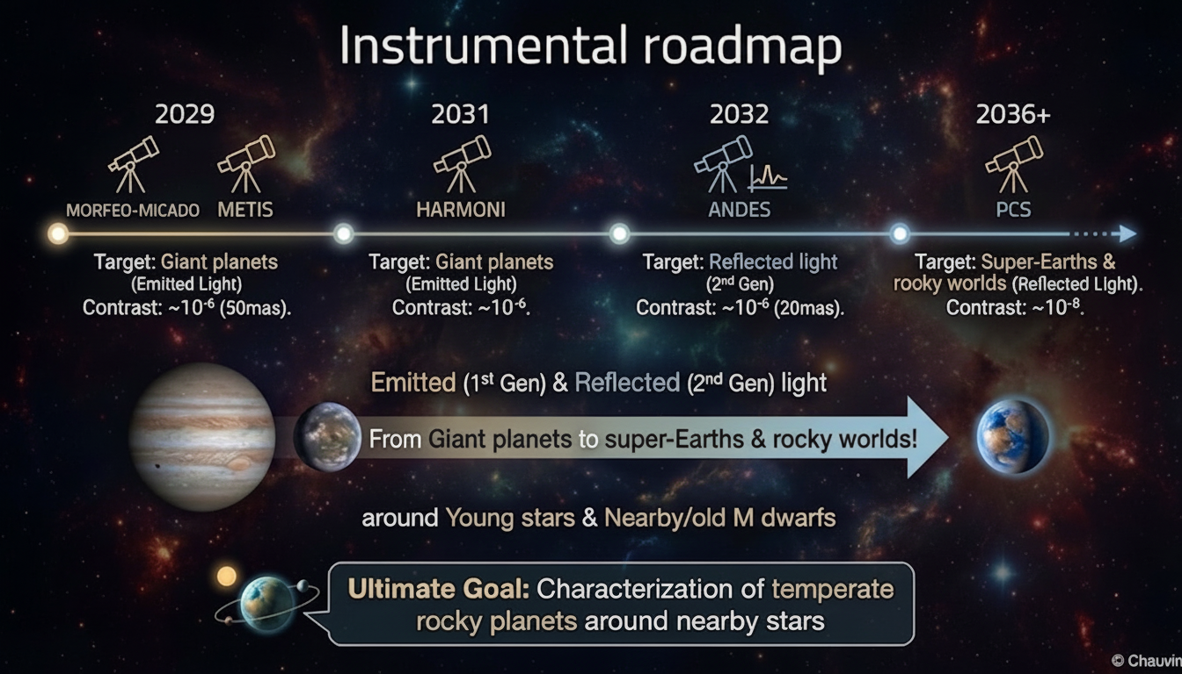

Slide 26
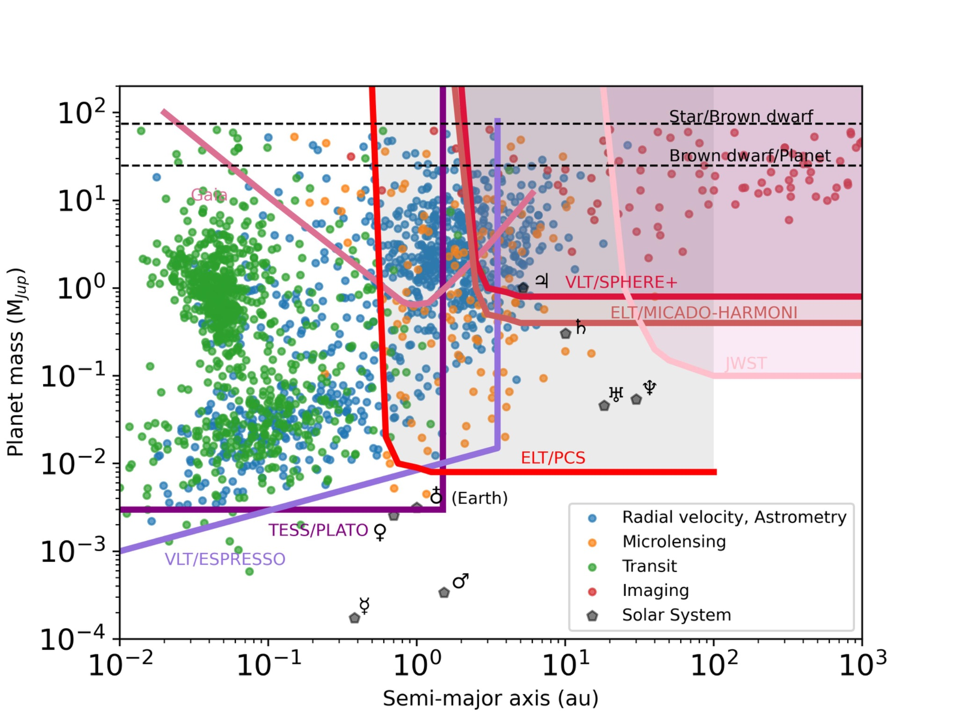
©Chauvin
Notes:
New and old instruments and their high contrast mode. With access to contrasts from 10⁶to 10⁷ for angular resolutions of the order of 50 to 100 mas, direct imaging can: i/ be combined with velocimetry and astrometry techniques to study systematically the same planets and thus constrain mass and luminosity which constrain the formation history of these giant exoplanets, ii/ allow a finer characterization of the physics and atmospheres of the planets giant ice creams of the Saturn and Neptune type with separations greater than a few uas.

Slide 27
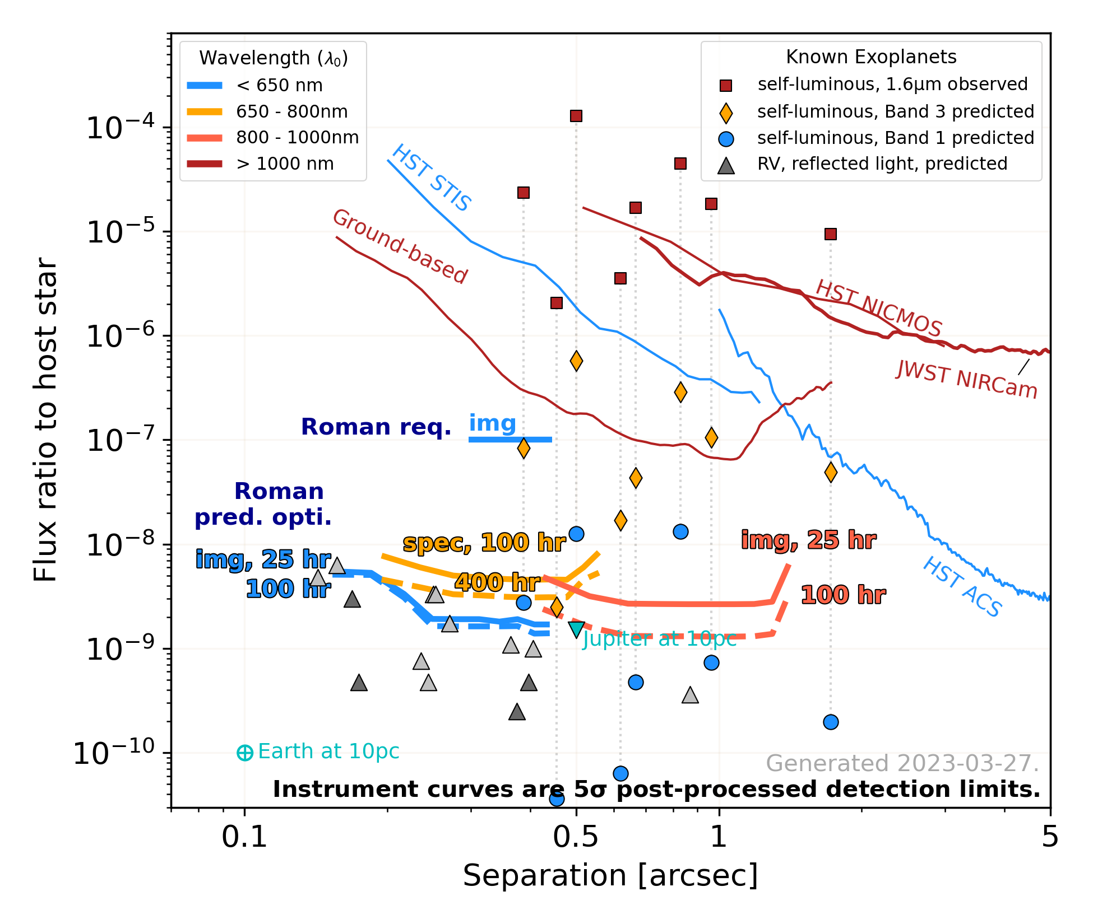

Looking forward to Roman CGI
RV planets (reflected light targets down to Jupiter analogs)
Massive self-luminous giants

Slide 28
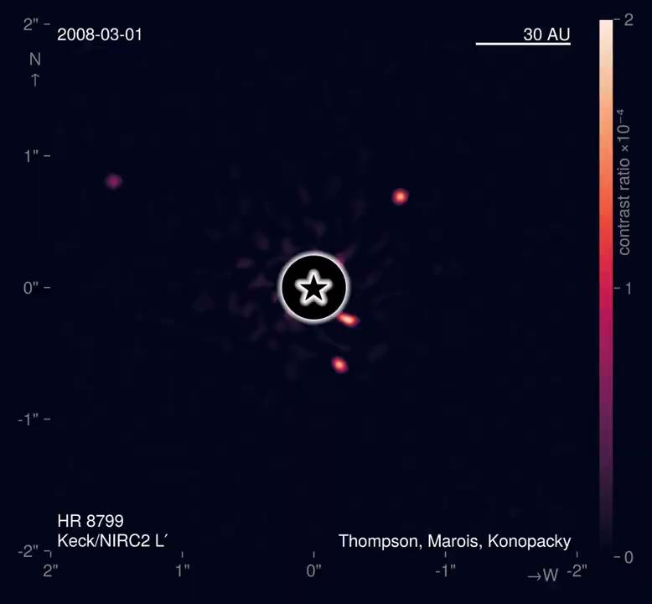
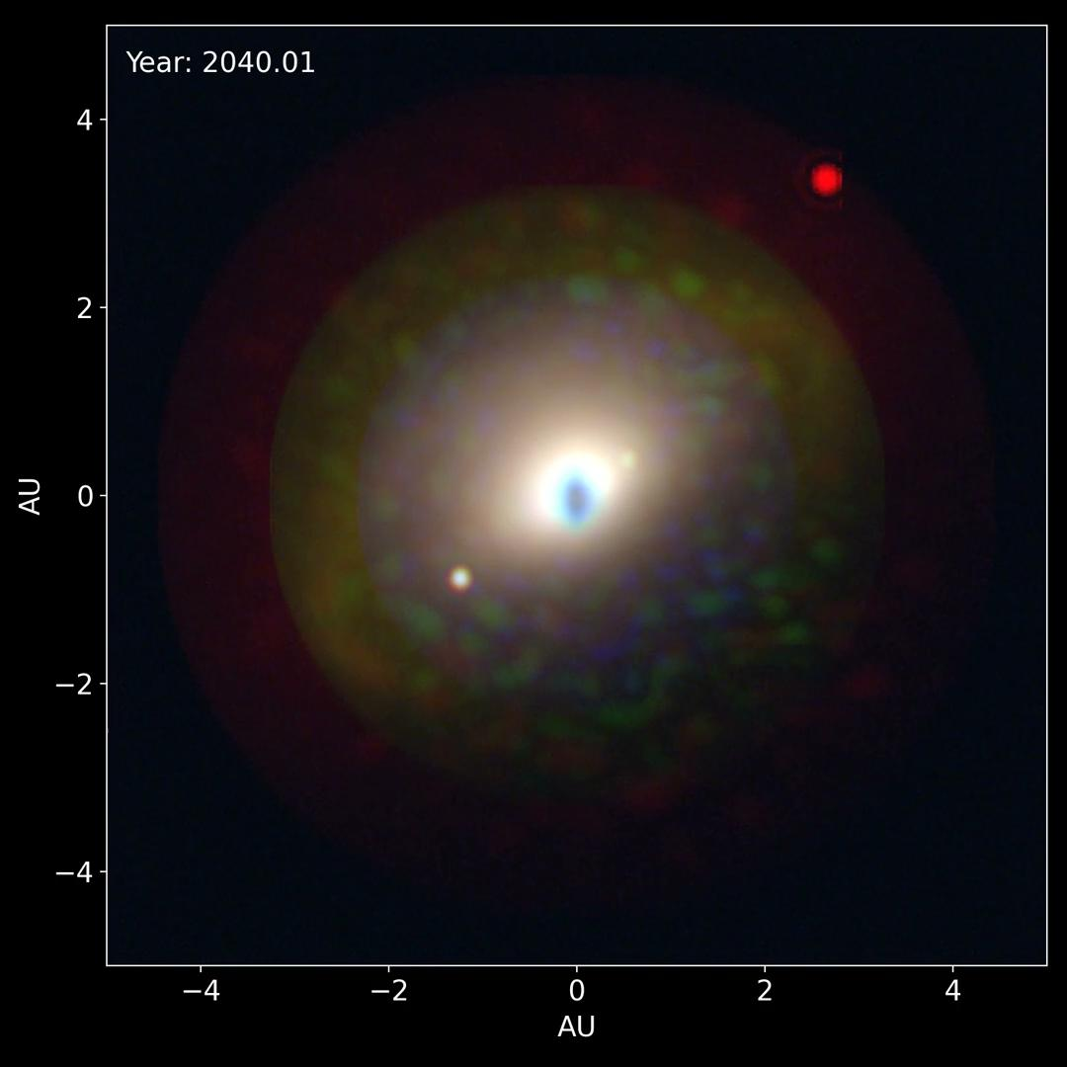
Direct imaging (2008–2040+)
HR 8799 (5-9 M♃)
Exo-Earths and biosignatures
Corey Spohn (NASA Goddard)
Realistic astrophysical fluxes from ExoVista
Coronagraph PSFs from EAC1’s AAVC; CDS pipeline
©J.B.Ruffio

Slide 29
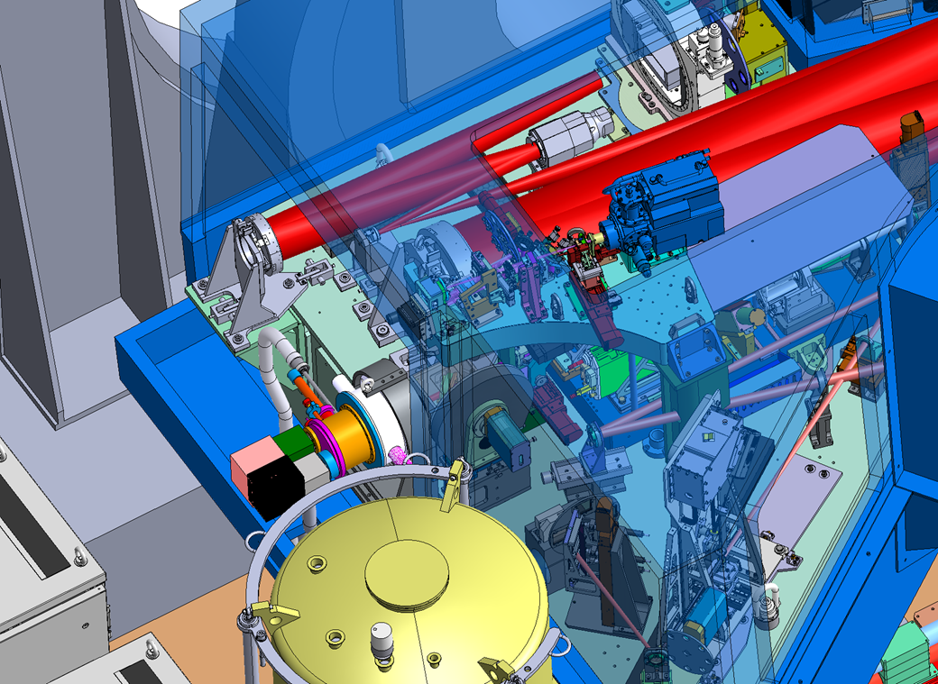
Pushing the limits of the XAO correction
Deeper/closer → contrast improvement
To study young Jupiters close to the star (3-10 au)
Increase the frequency of the xAO system up to almost 3 KHz
Improve the correction of non-common path aberrations and coronagraphic rejection
Fainter → sensitivity improvement
Discovering protoplanets & planet-forming disk diversity
Wavefront sensing in the NIR benefits from first stage correction
Implement a more sensitive wavefront sensor in combination with a very low noise camera
SAXO+
Workshop STILES –Napoli 17th March 2026
Notes:
•MORE CONTRAST, to go closer to the star,
•and MORE SENSITIVITY to go fainter and farer for the observation of planets in formation and disks.
It is possible to dig in the contrast curve by accelerating the xAO system
The temporal error, that is the delay of the correction w.r.t. to the turbulence evolution, is in fact the major contributor to the residual wavefront error after the cure of SAXO.
On the other hand, to improve the sensitivity and overcome the limits of SPHERE (that is around R=13) a possibility is to implement a more sensitive WFS that works in the infrared, in order to benefit from the SAXO correction.

Slide 30
SAXO+ on sky: what the MOU says
The time envelope for integration activities should not exceed 40 days for AIV, 20 nights for commissioning, and 10 nights for initial technical tests. In addition, SAXO+ will be kept as a platform for further technical tests of up to 5 nights per semester (activities to be agreed by ESO) for at least 3 years after installation if the commissioning confirms no detrimental side effects on the science operation of SPHERE (June 2027 – June 2030).
if SAXO+ provides a compelling science benefit compared to the current SPHERE, ESO intends offering the new instrument mode to the scientific community following its standard process and under the condition it can be operated by PAO. Any offering of the instrument mode to the community shall be subject to the signature of an amendment to the current MoU which shall also include granting of Guarantee Observing Time (GTO) with SPHERE upgraded with SAXO+ to compensate for the investments of the SAXO+ Consortium Members in hardware.

