Slide 1
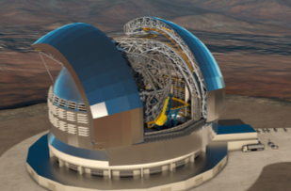
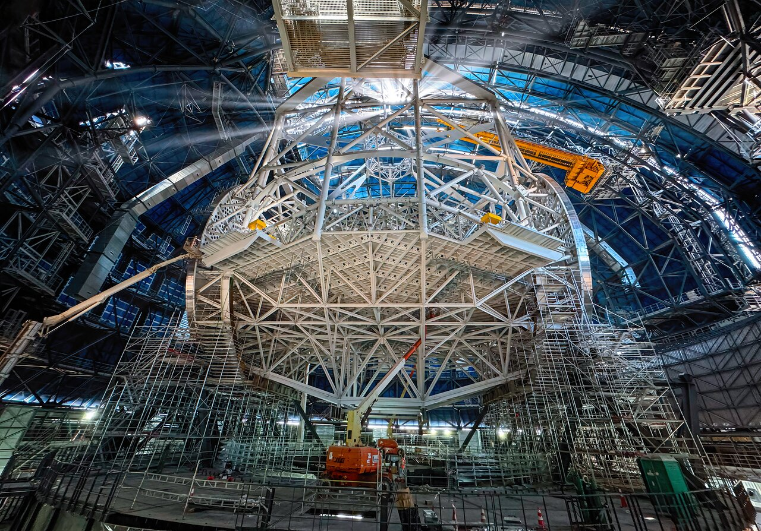
STILES Facilities for Extreme Adaptive Optics
Presented by Enrico Pinna OAA (5103) on behalf of Emiliano Diolaiti - OAS (2301 - 5101) Marco Bonaglia - OAA (5102) Alessandro Barucci - OAA (6101)

Slide 2
OUTLINE
Activity 2301 SPHERE+ SAXO+ lead by E. Diolaiti @OAS
Activity 5101 Optical-IR & AO lab lead by E. Diolaiti @OAS
Activity 5102 AO Cascading testbench lead by M. Bonaglia @OAA
Activity 5103 Petalometer testbench lead by E. Pinna @OAA
Activity 6101 Abetti building renovation lead by A. Barucci @OAA

Slide 3
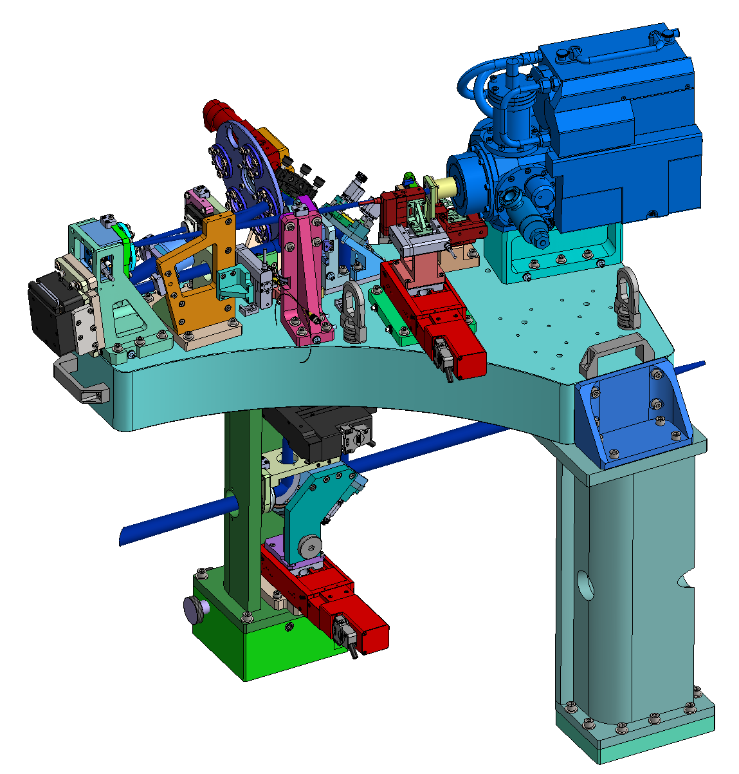
ATT2301 SPHERE+_SAXO+ [lead by E. Diolaiti - INAF OAS]
Objective: support the development of the SAXO+ adaptive optics module
SAXO+
Adaptive Optics module for the SPHERE instrument (Spectro-Polarimetric High contrast imager for Exoplanets Research) already operating on Very Large Telescope
SAXO+ aims to improve the performance of the SPHERE’s adaptive optics system by compensating for high temporal frequency residuals
SAXO+ is a precursor for the ELT’s exoPlanet imaging Camera and Spectrograph (PCS)
Two-stage «cascaded» adaptive optics architecture
Near-infrared pyramid wavefront sensor (0.95-1.1 µm / 0.95-1.45 µm) with tip-tilt modulation
Adaptive optics mirror with 28x28 actuators across the pupil
Adaptive optics loop frequency 2.7 kHz (goal 3 kHz)
Opto-electro-mechanical structure subject to very tight performance and interface requirements
Context and science goals presented by Valentina D’Orazi

Slide 4
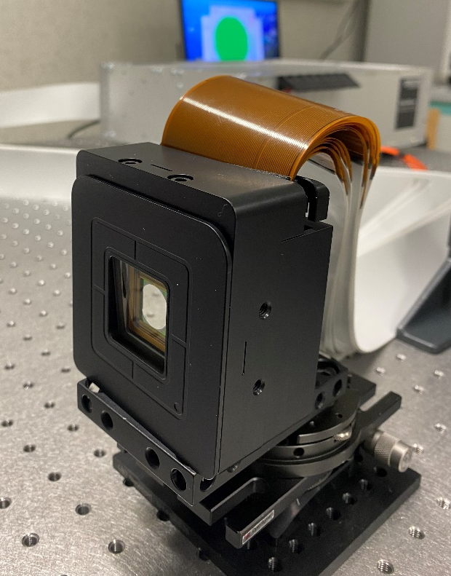
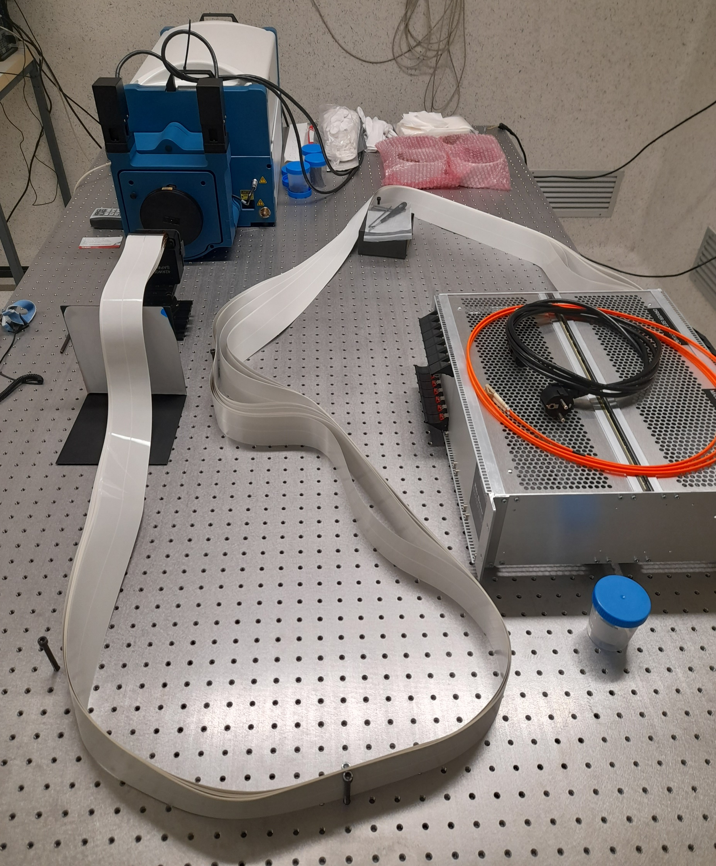
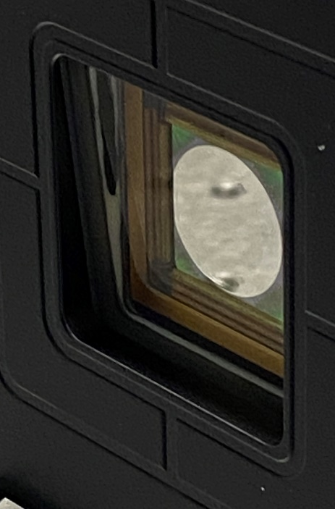
ATT2301 SPHERE+_SAXO+ [lead by E. Diolaiti - INAF OAS]
STILES has funded the purchase of the adaptive mirror for SAXO+
Supply awarded through open procedure
Selected supplier:
Boston Micromachines Corporation (USA)
Delivery:
December 2025 / February 2026

Slide 5
ATT5101 Opt-IR & AO Lab [lead by E. Diolaiti - INAF OAS]
Objective: strengthening INAF OAS laboratories for the development of optical-infrared instrumentation and adaptive optics technologies
First application: integration and verification of SAXO+ (ATT2301)
Purchased equipment:
Coordinate Measuring Machine (FaroArm)
Alignment telescope (Taylor Hobson)
Wavefront sensor (Imagine Optic)
Optical benches and optical lab equipment
Components for the implementation of a cryogenic chamber for the verification of optics in cryogenic conditions

Slide 6
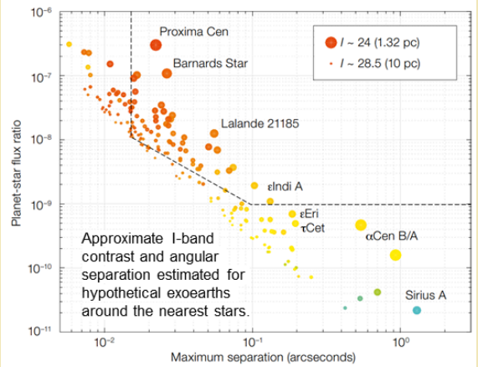
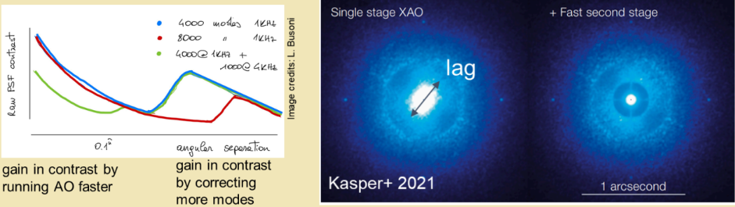
ATT5102 - Cascading testbench [lead by M. Bonaglia - INAF OAA]
Testing XAO techniques for “direct imaging” of exoplanets with ELTs
The detection of exoplanets in “direct imaging” is a complex task for Adaptive Optics:
the intensity contrast bwt the star’s direct light and the one reflected by the planet is typically in the order of 1e-6
the angular separation btw the star and the exoplanet is less than 0.1”
With the hardware purchased within ATT5102 we can integrate in Arcetri a testbench dedicated to bring the research on Extremely Adaptive Optics (ExAO) techniques from numerical simulations to real hardware!

Slide 7
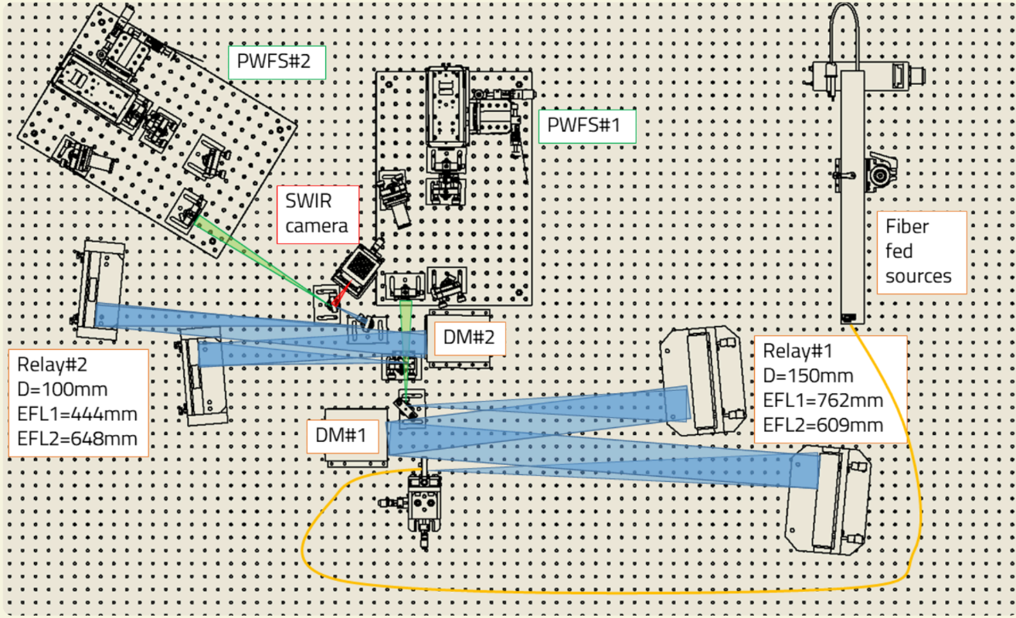
ATT5102 - Cascading testbench [lead by M. Bonaglia - INAF OAA]
Bill of Materials
Key items purchased:
2 deformable mirrors (DM) with voice-coil technology (ALPAO): 820 and 468 actuators
Twymann-Green interferometer to calibrate and debug the optical system
2 high speed visible detectors (FLI C-blue) to be integrated in the pyramid wavefront sensors (PWFS)
Bench design:
2 parabolic mirrors (λ/8 surf. error) provide an achromatic optical system
DMs are placed in pupil-conjugate planes
2 PWFS with tilt modulation (LBT/FLAO-SOUL like) are placed downstream of each DM
Everything is doubled!

Slide 8
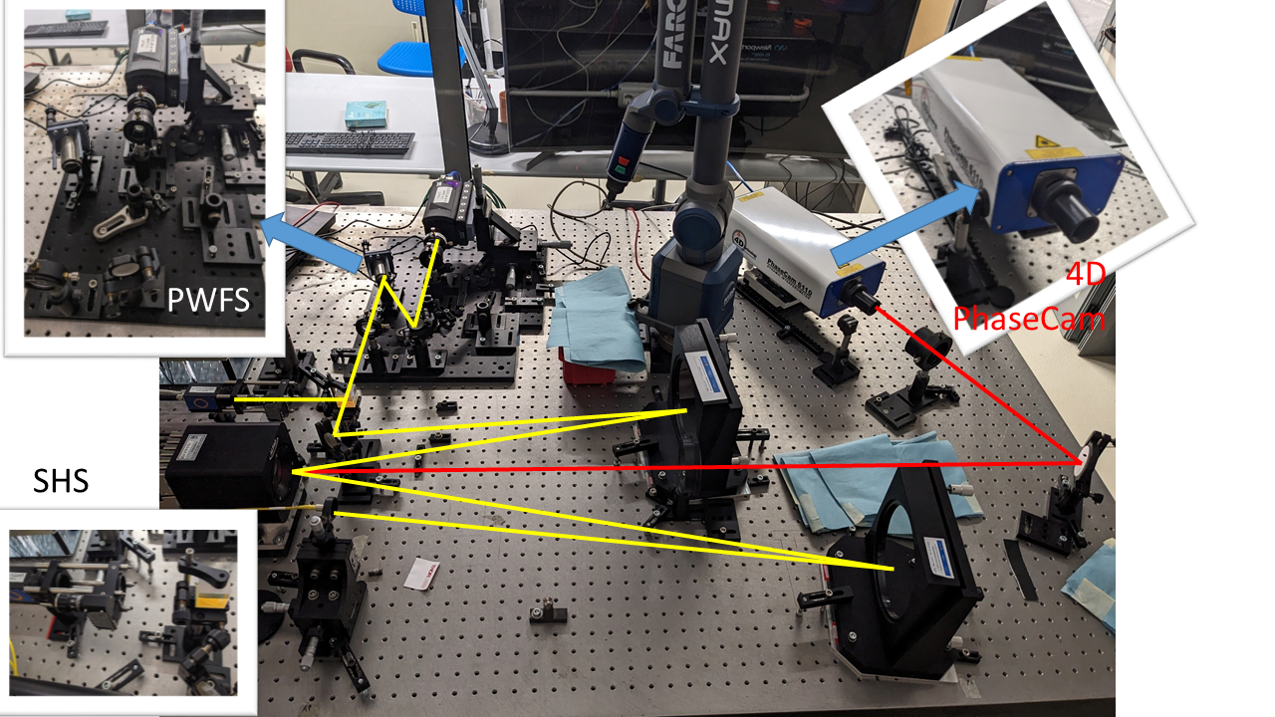

ATT5102 - Cascading testbench [lead by M. Bonaglia - INAF OAA]
State of the art
The bench integration started in a temporary location, waiting for Villino Abetti renovation (see later in this presentation)
The first relay is fully integrated and functional: parabolic mirrors + ALPAO DM820 + Pyramid WFS
Currently we are working for:
integrate the high level functionalities for the AO loop (interaction matrices DM←→PWFS, closed loop)
“join” the bench hardware with the SPECULA simulation software with a dual goal: 1) verify in the lab the performances estimated with numerical simulations (digital twin) 2) control the entire AO loop with SPECULA
As far as today the bench is ready to host students’ research activities (MSc and PhD)!
We are also on Media INAF TV → https://youtu.be/BxGzf_3mon4?si=CK_FlAt7elZiXy_k

Slide 9
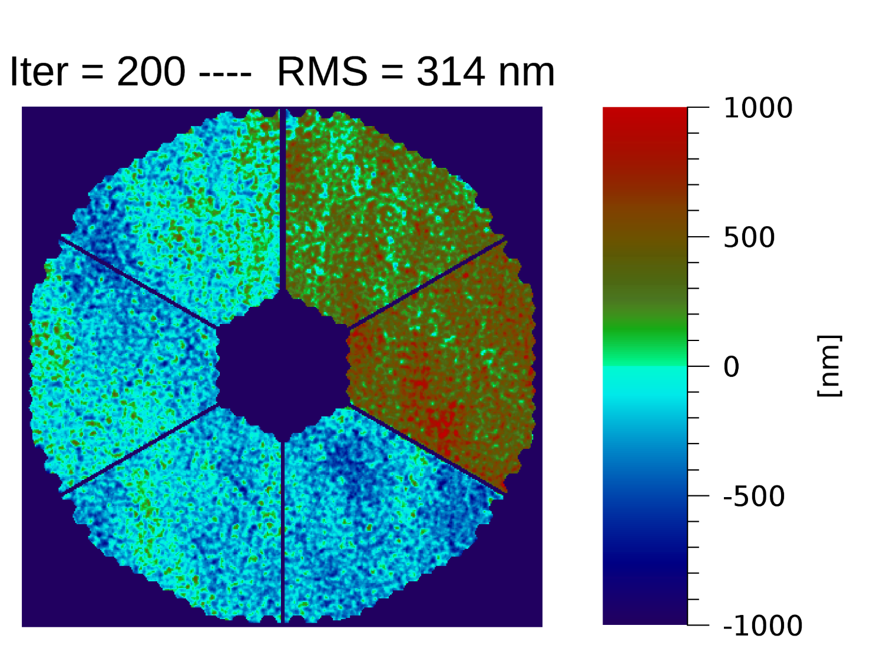
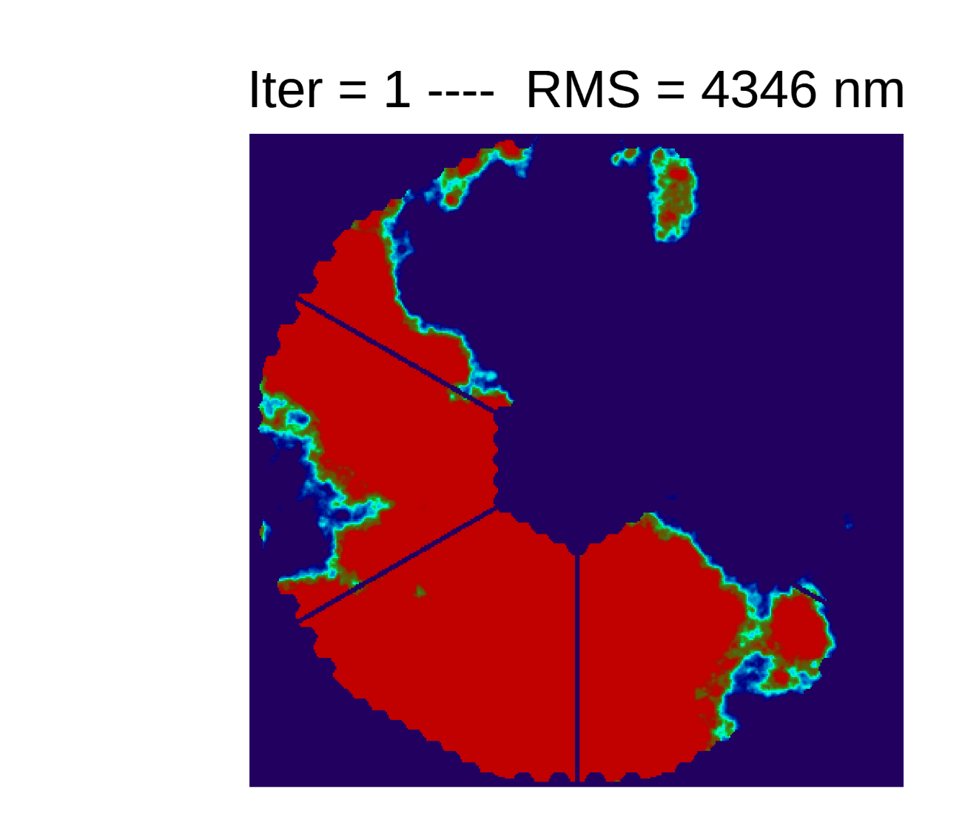
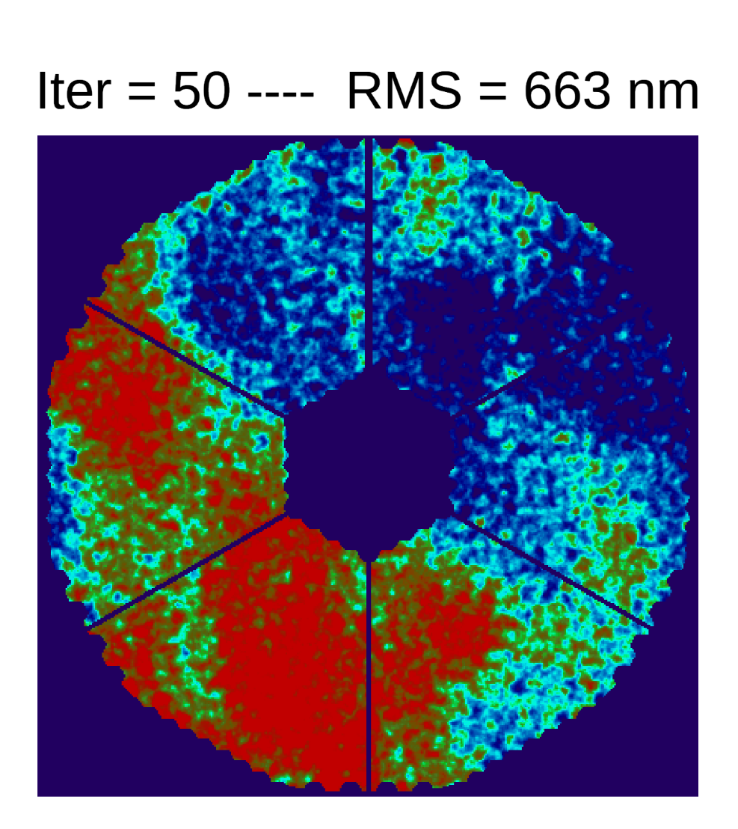
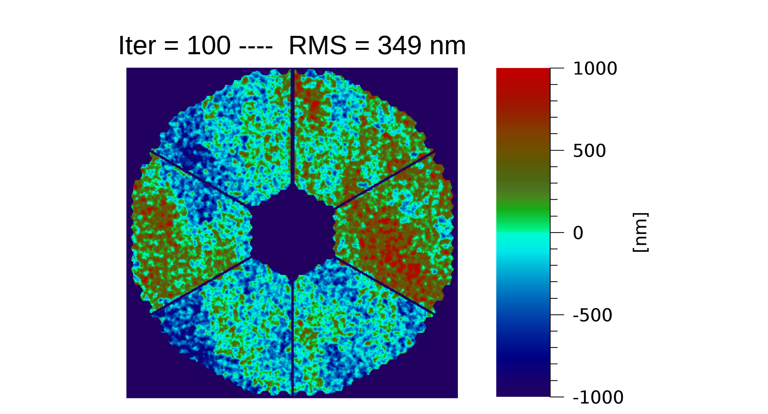
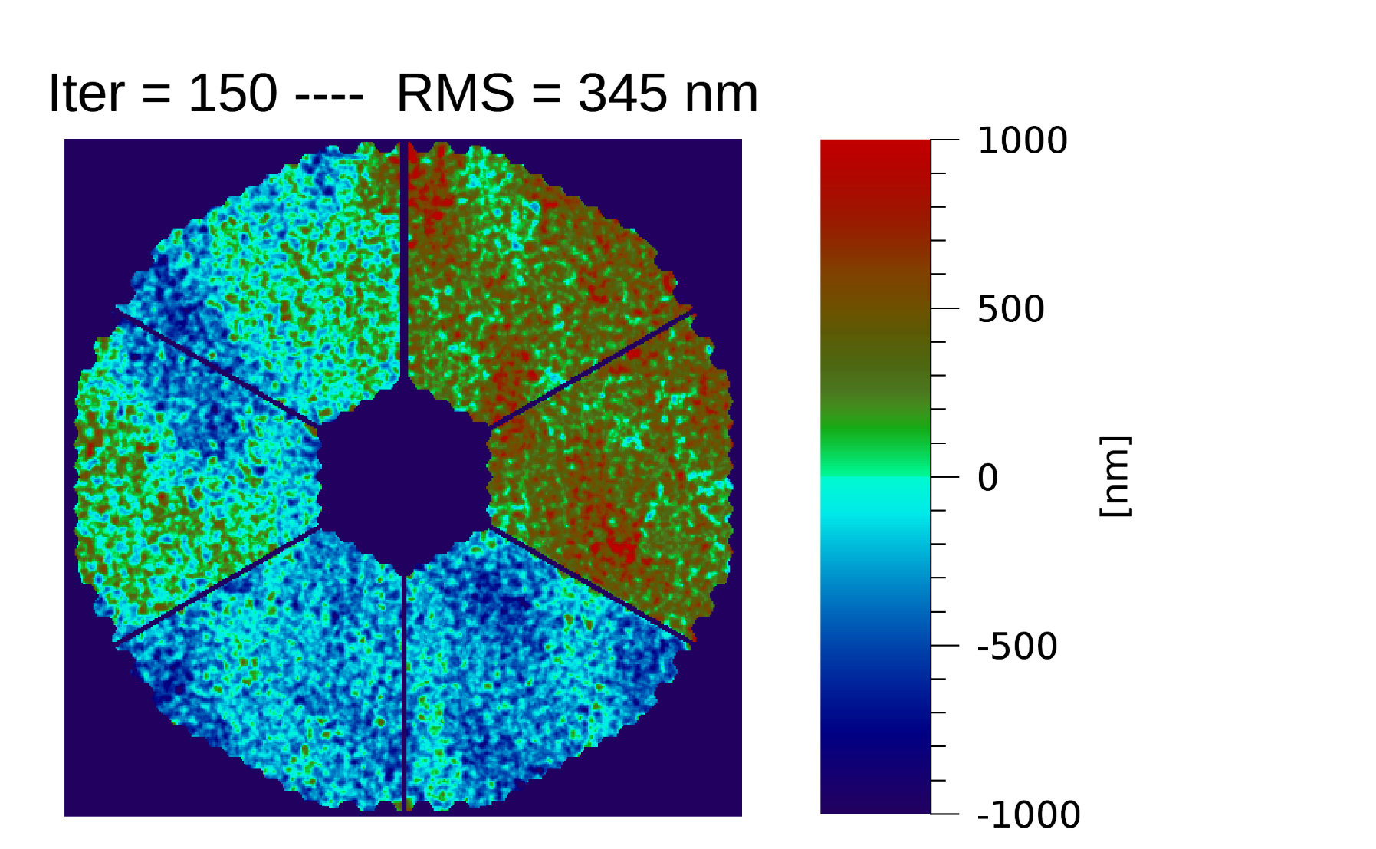
ATT5103 - Petalometer bench [lead by E. Pinna - INAF OAA]
High contrast with large segmented pupil is one of the open challenge for ELT.
A number of sensors and techniques have been proposed by the community to address it.
The Petalometer bench is a facility aimed to their laboratory validation, being this a key step for the success of several ELT instruments.
The challenge: control the differential piston of M4’s petal
ELT pupil

Slide 10
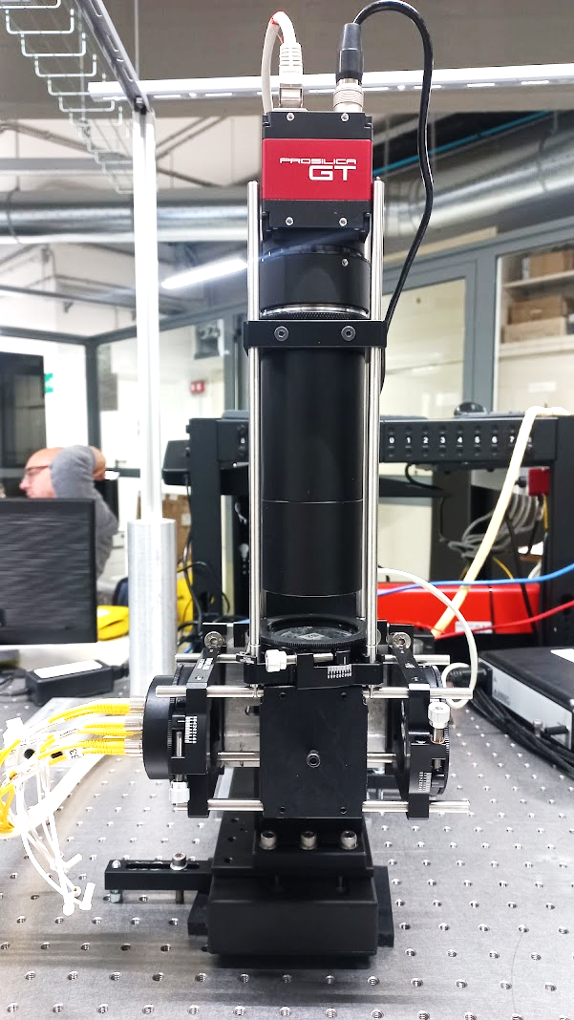
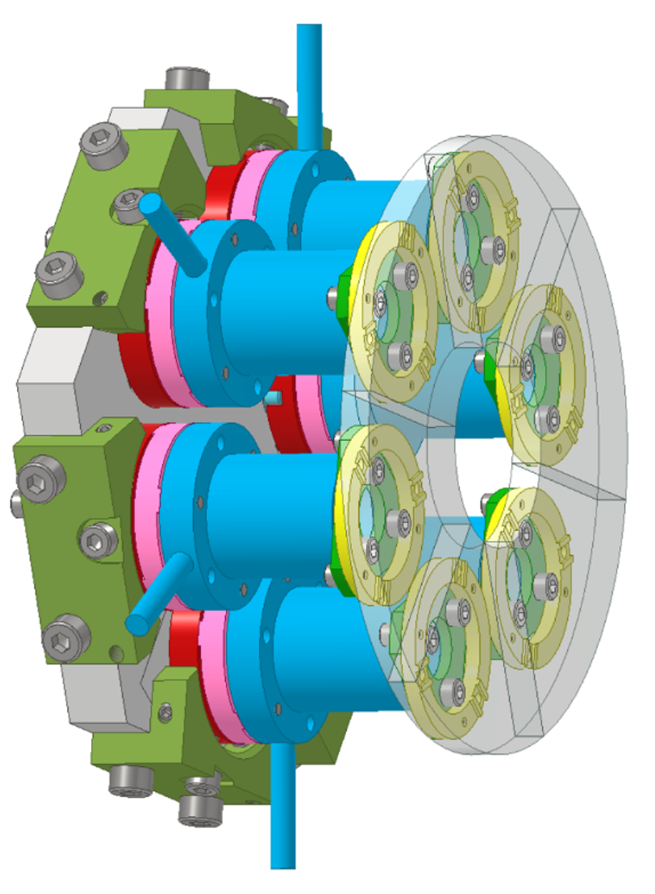
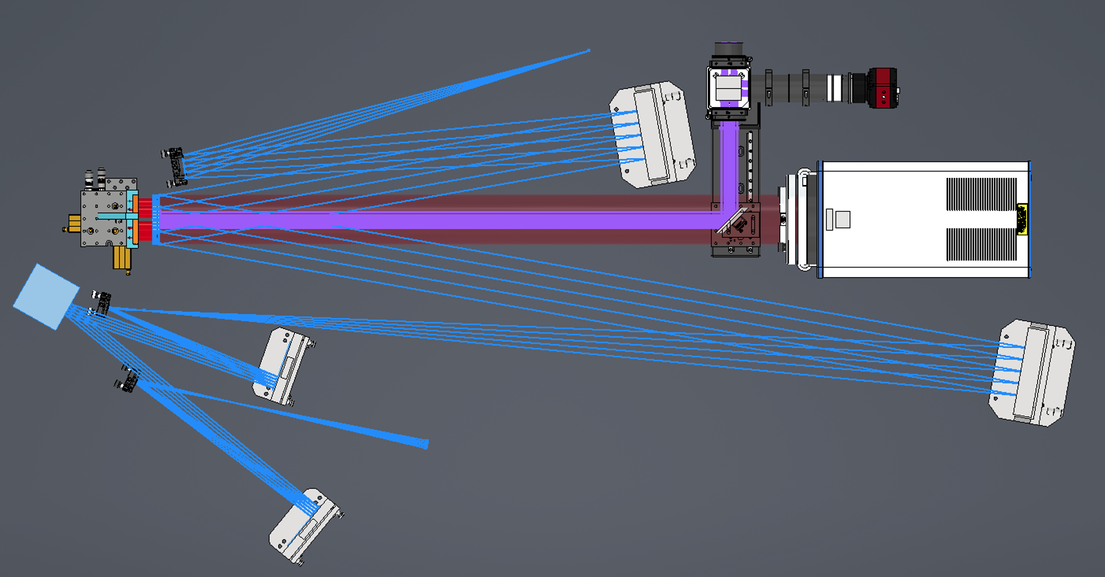
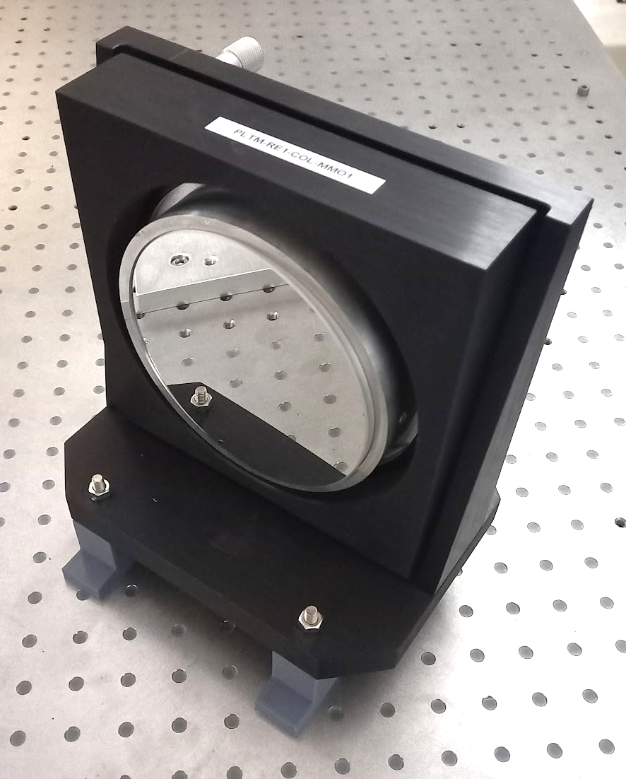
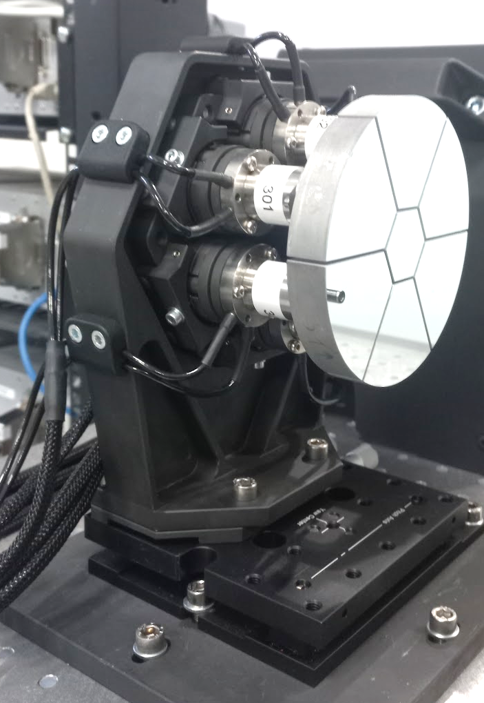
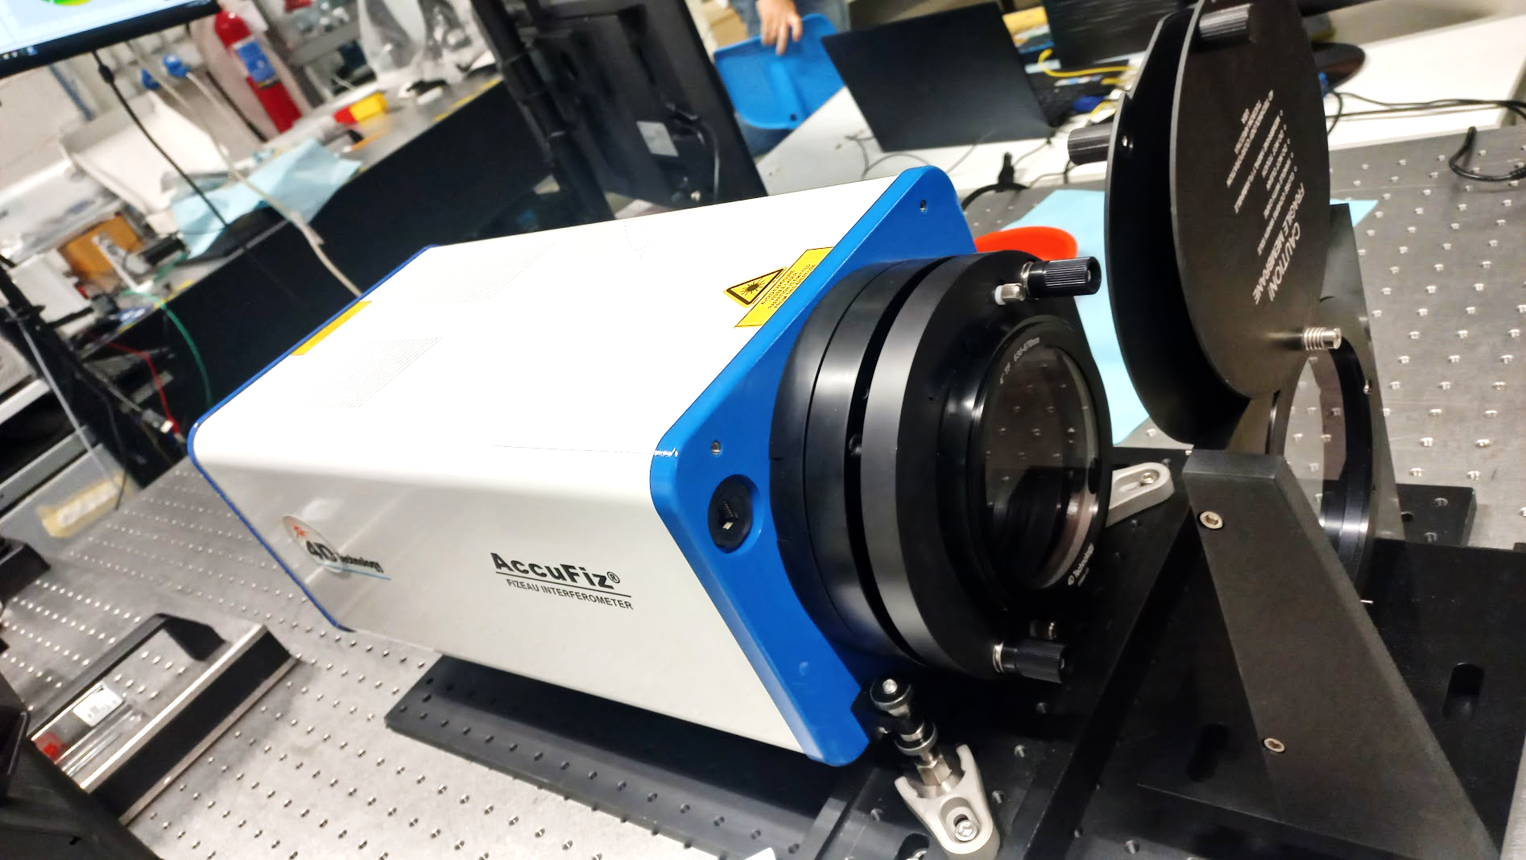
ATT5103 - Petalometer bench [lead by E. Pinna - INAF OAA]
Petalmirror
Procurement and manufacturing completed.
“Revolver”
input light source
100 mm
PTT
internal metrology
OAP
100mm
DM
output beam
OAPs
Petalometer under test
4D AccuFiz
Fast interferometer for tip-tilt and fine phasing (1 lambda range)
custom 6x phasing sensors wide capture range
Custom opto-mechatronics: 6 rigid segments with piezo actutors for tip-tilt-piston

Slide 11
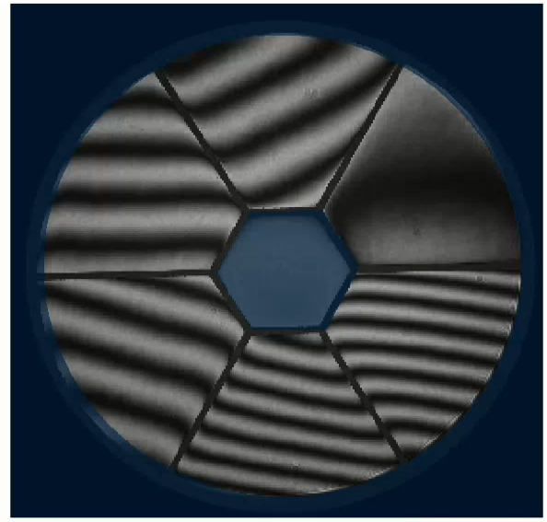
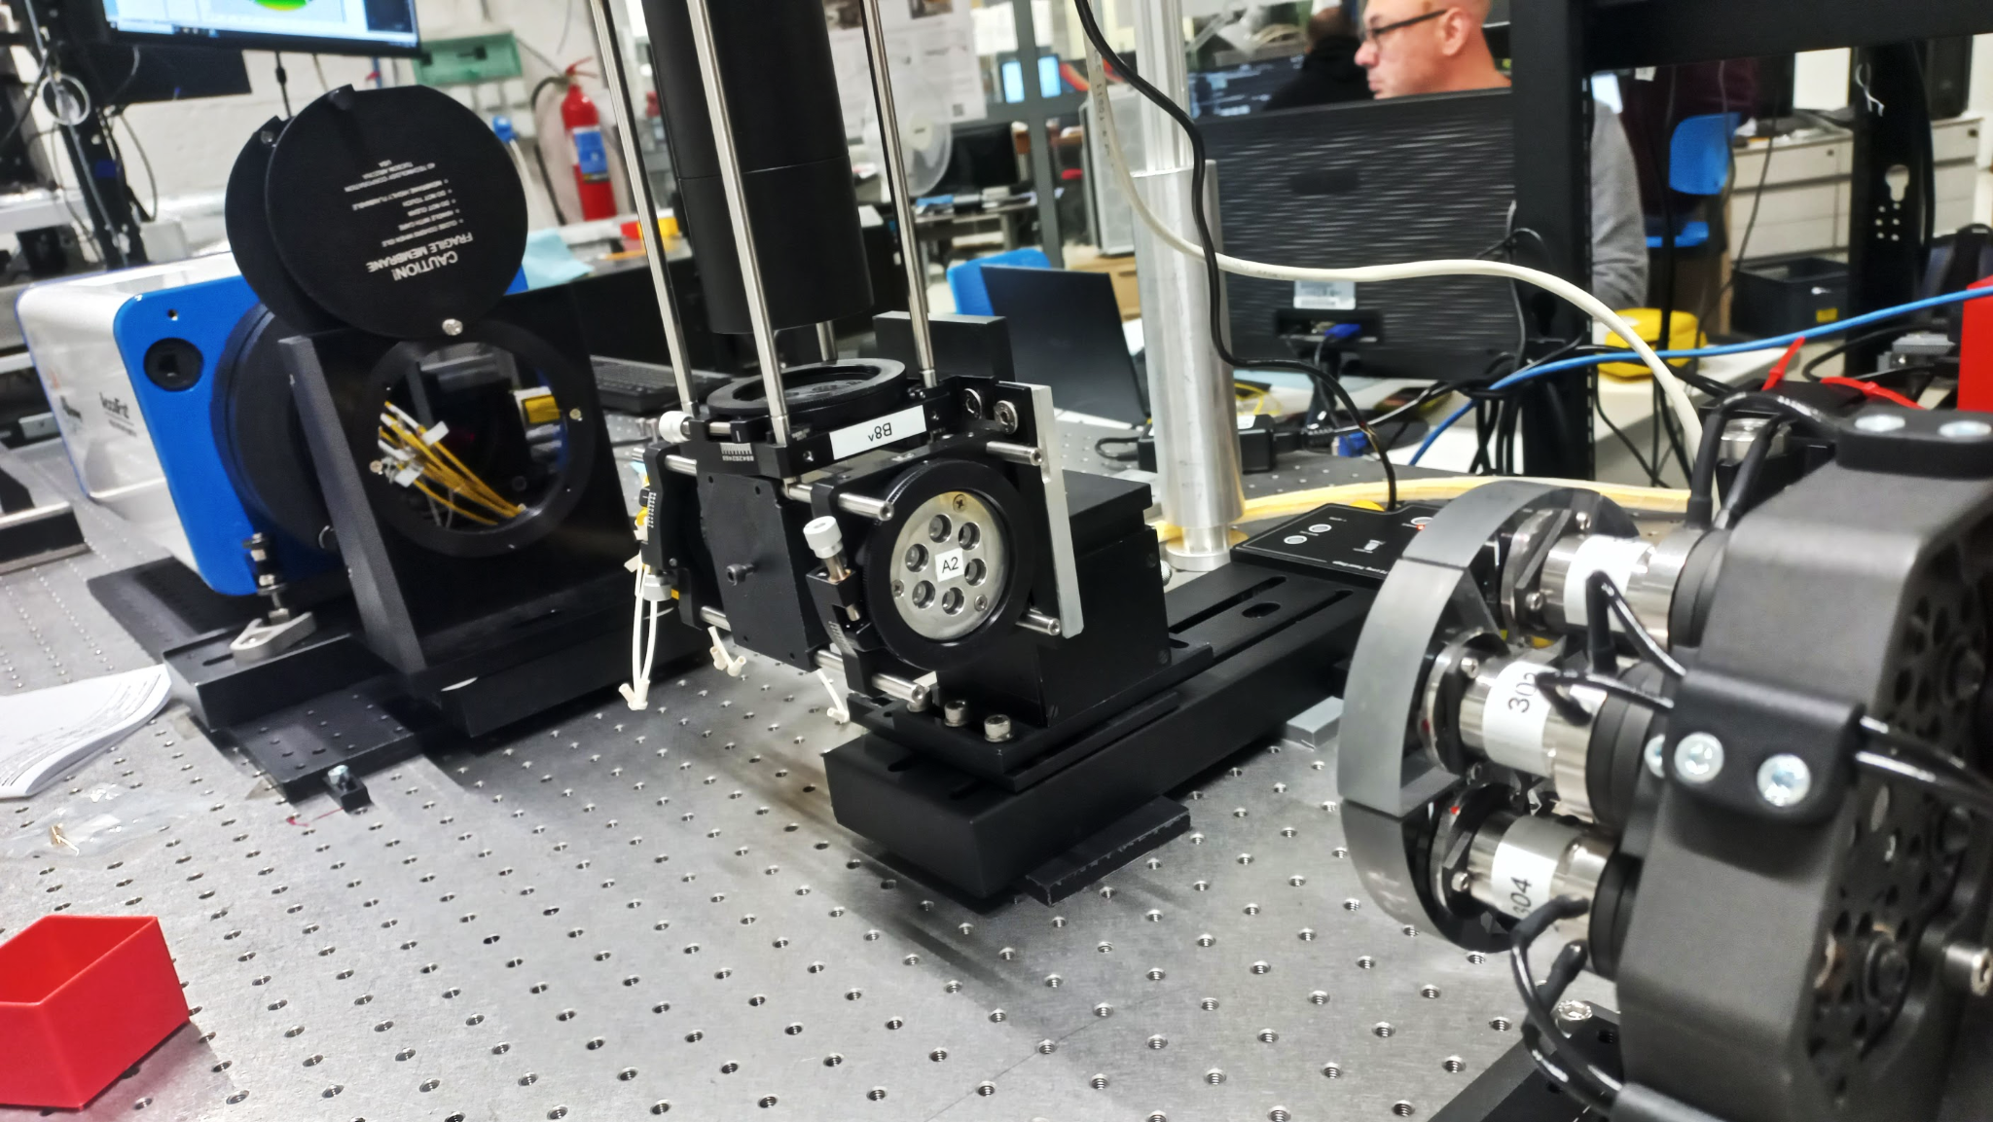
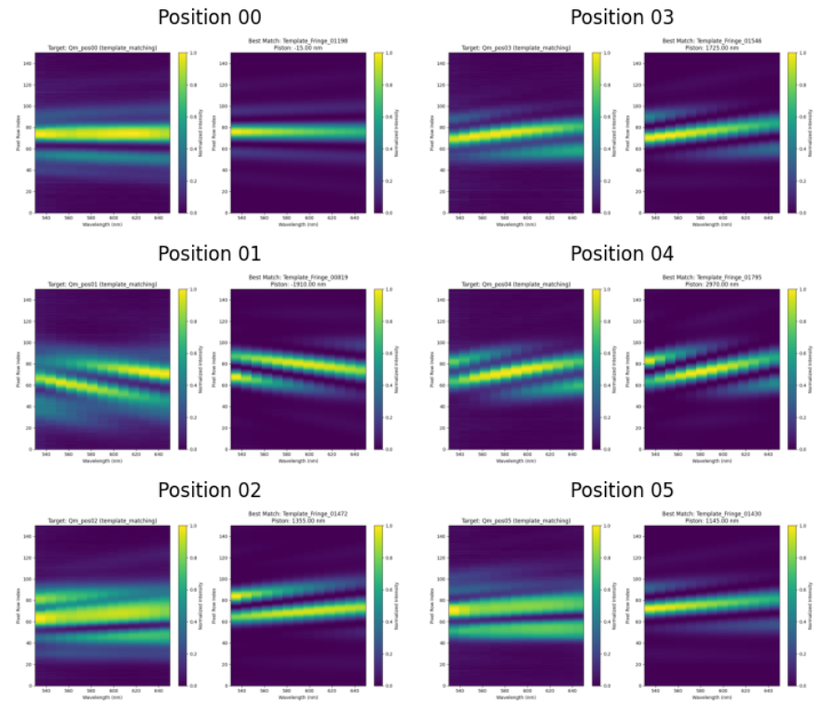
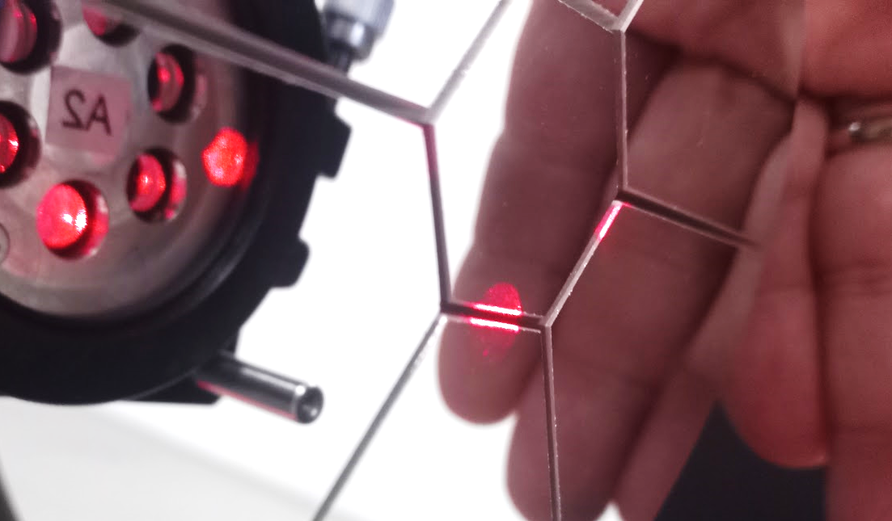
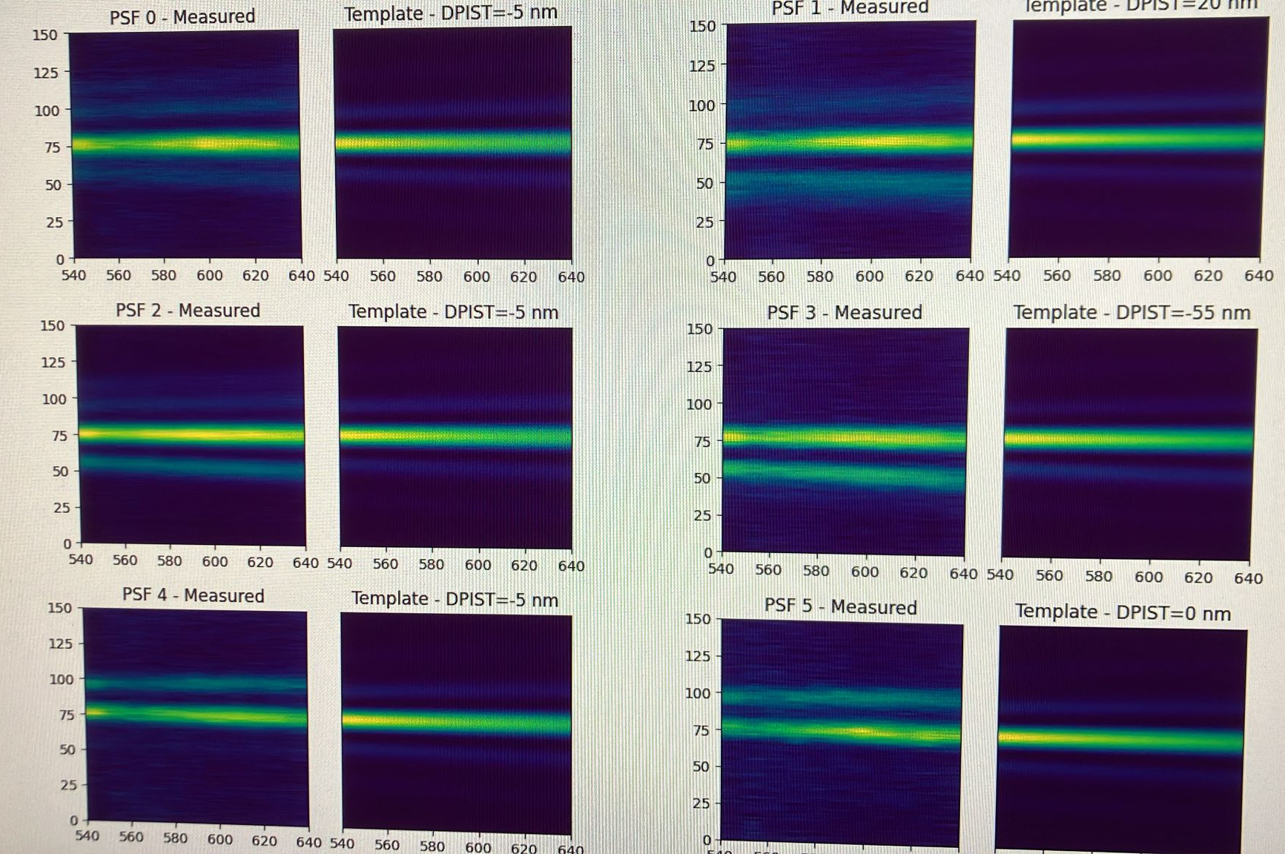
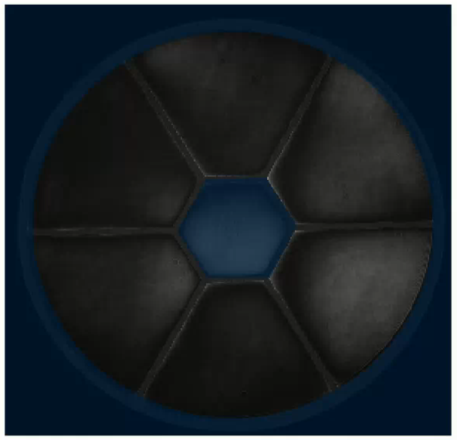
ATT5103 - Petalometer bench [lead by E. Pinna - INAF OAA]
Tilt correction - unphased
Petalmirror and internal metrology system are operative
Revolver
Space
Phased
𝝺
Unphased
4D AccuFiz
Phased
Soon in the lab:
Integration of the off-axis parabolas and the super-continuum laser source
Ready to host the petalometer prototypes (MORFEO, ANDES and more)

Slide 12
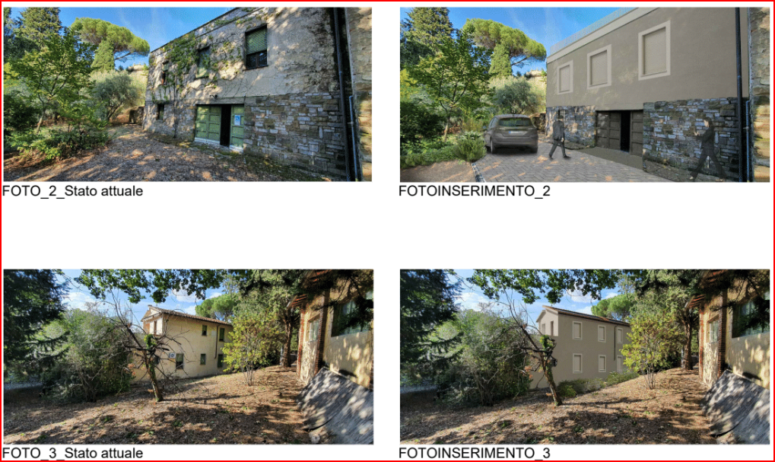
ATT6101 - Abetti Building Renovation [lead by A. Barucci - INAF OAA]
Restoration and renovation of the 'Villino Abetti’ – Civil work project
Project Budget Amount: 1.400 Keuro - Building: 1100 Keuro
Design, other stuff, VAT + taxes etc: 300 Keuro
Condominium building management: INAF and UNIFI (signed agreement for collaboration)
Net surface: 420 m² on 3 floors
Decarbonized building (HVAC all-electric)
Self-generated electricity from photovoltaic panels
Original status
Finalized (rendering)

Slide 13
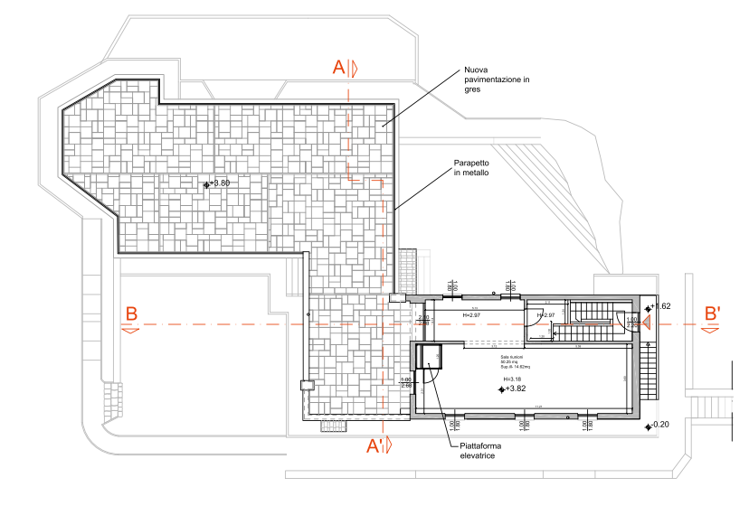
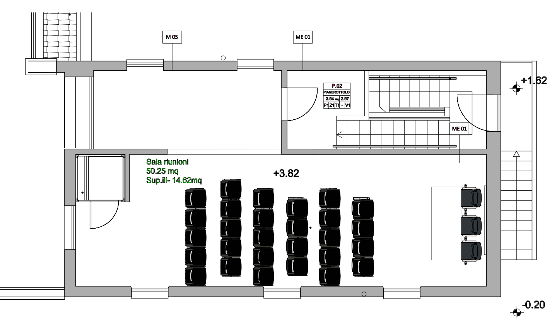
ATT6101 - Abetti Building Renovation [lead by A. Barucci - INAF OAA]
First floor
Huge, panoramic terrace for conferences and social gatherings
Large meeting and conference room

Slide 14
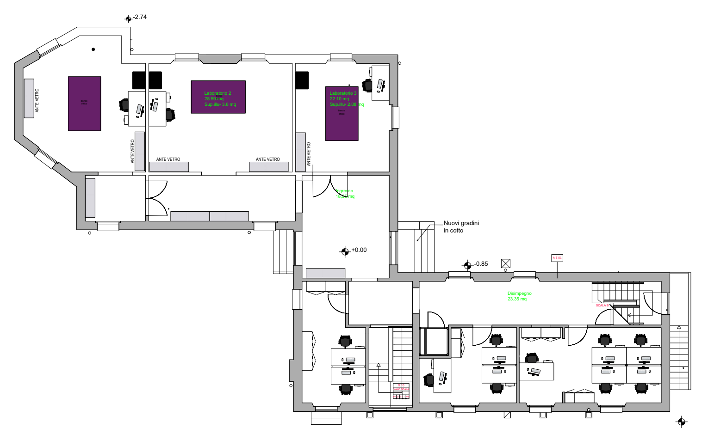
ATT6101 - Abetti Building Renovation [lead by A. Barucci - INAF OAA]
Ground floor
N. 3 optical labs: 2 INAF + 1 UNIFI
N. 10 office workstations

Slide 15
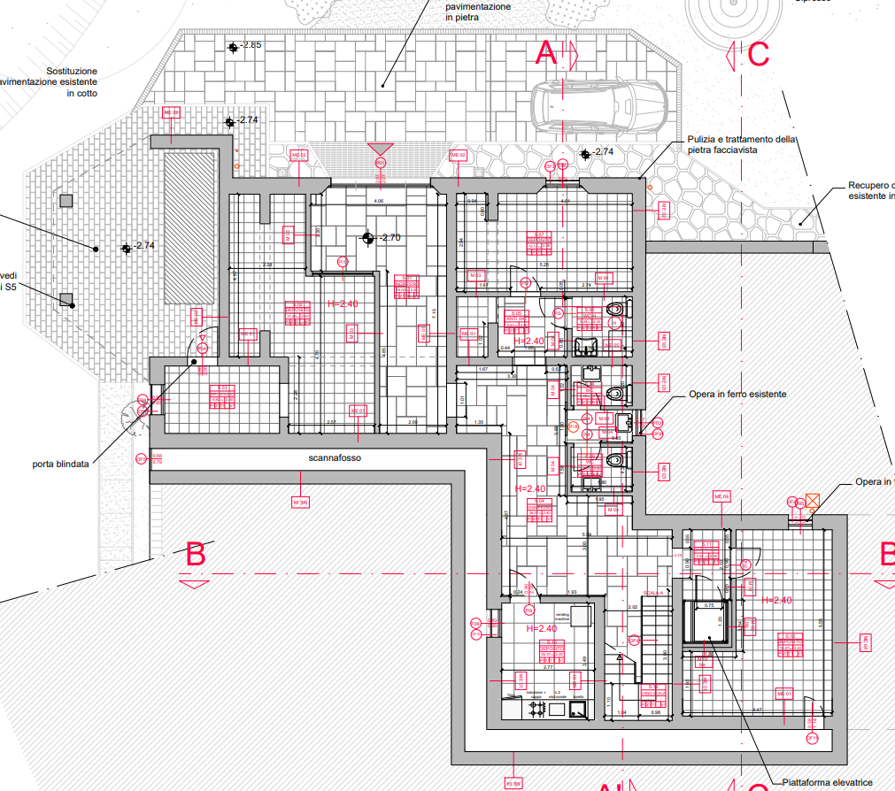
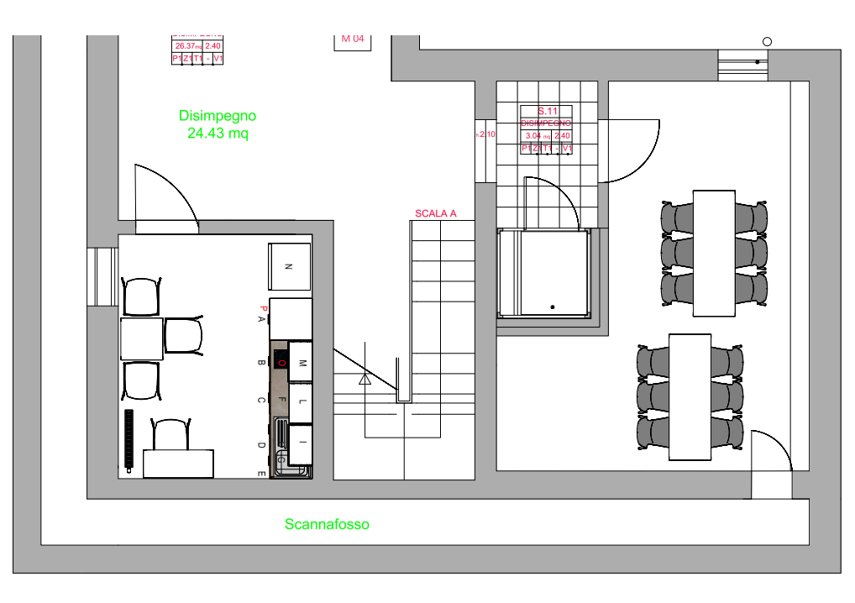
ATT6101 - Abetti Building Renovation [lead by A. Barucci - INAF OAA]
Basement floor
Kitchen and cafeteria
Lifting platform for people with reduced mobility
Restrooms
Service room

Slide 16
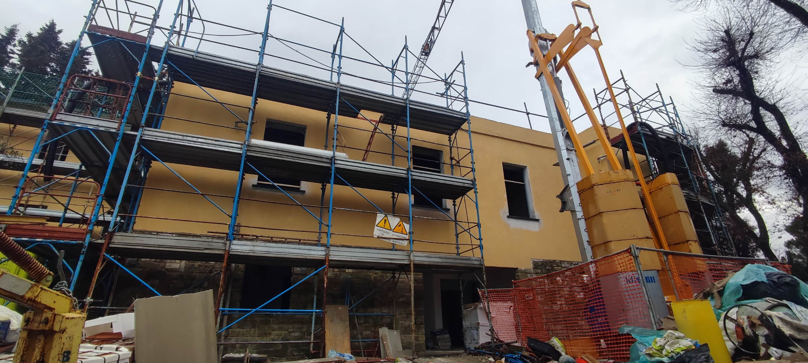
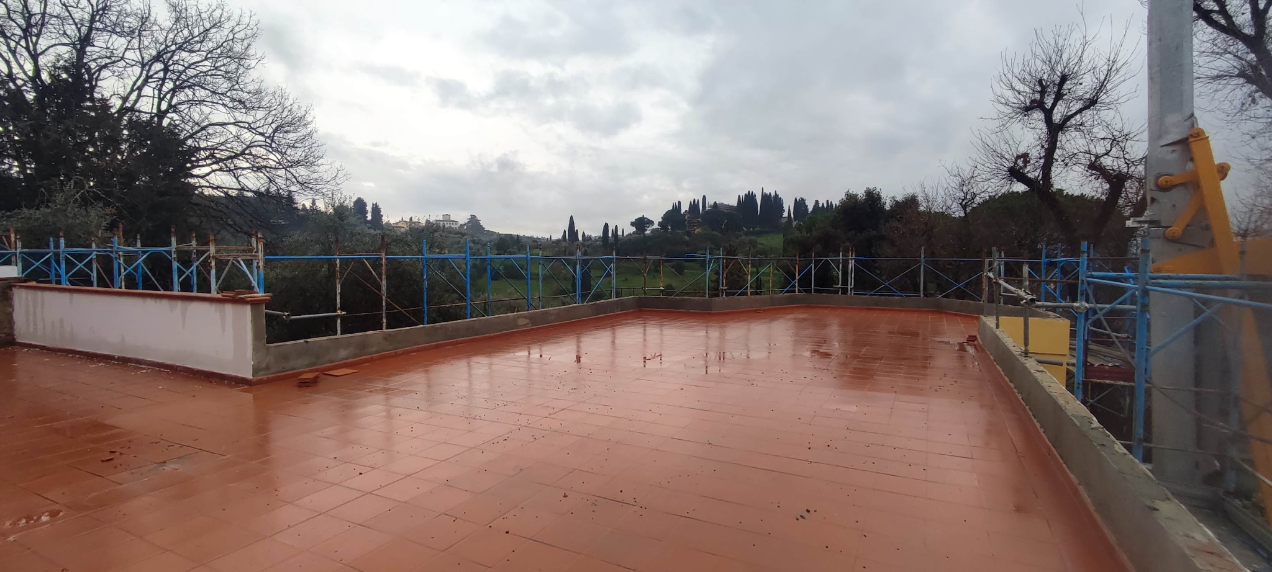
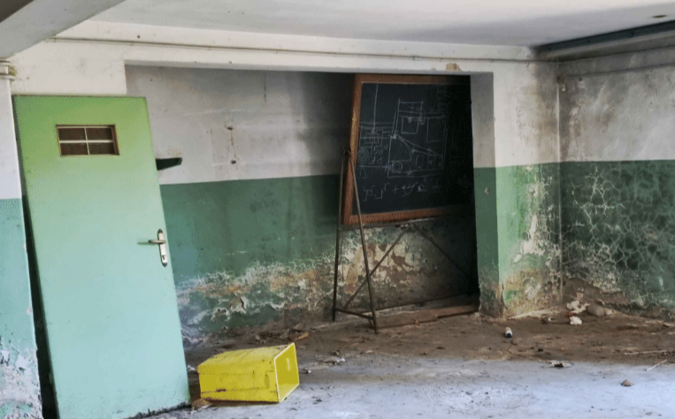
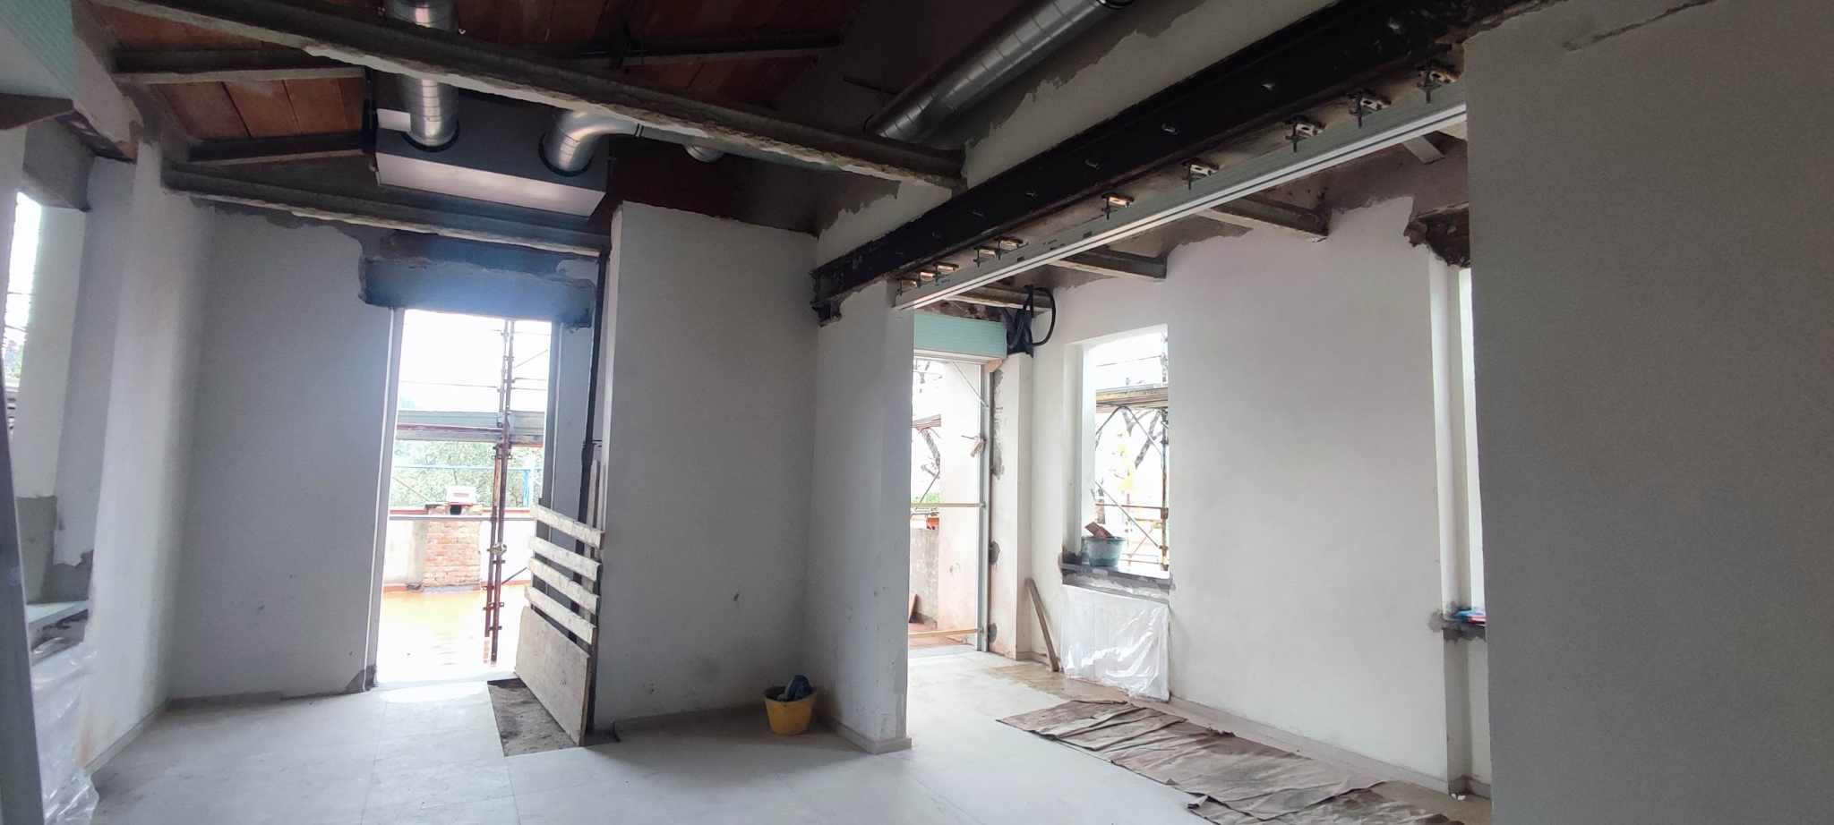
ATT6101 - Abetti Building Renovation [lead by A. Barucci - INAF OAA]
Original status
Today
Expected completion of works: 20/04/26

Slide 17
END
…a new beginning

