Slide 1
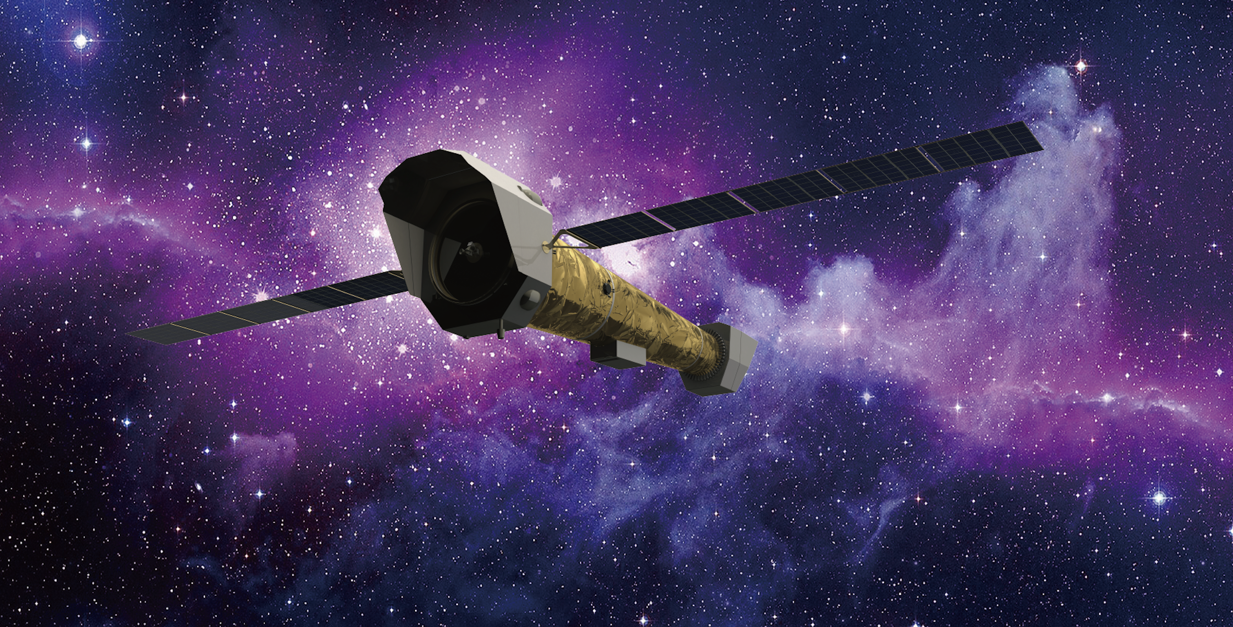
Multimessenger science with New-Athena
Luigi Piro
INAF/IAPS
Notes:
opportunity to
presentation relying on study recently published as a WP

Slide 2
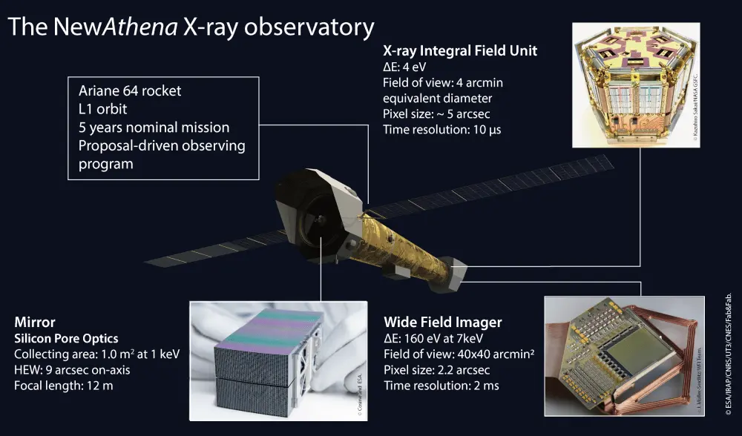

Slide 3
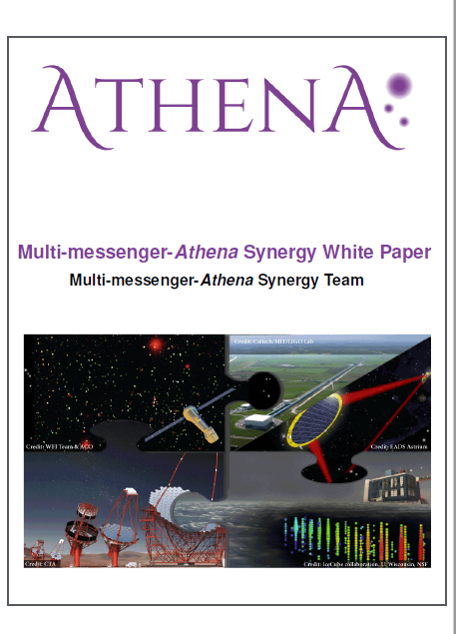
The Athena Multi-messenger Synergy White paper
Scientific synergies between the Athena and Gravitational Waves, neutrinos, high energy and Gamma Ray Burst transient facilities that will be operational contemporary to Athena.
Outline the observing strategy to successfully implement the synergy science goals
Each facility (incl Athena): contact person + experts
  A& ground based GW, AVirgo/Aligo and future facilties (ET, CE,..)
  A& LISA
  A& v’s and HE (ICECUBE, KM3Net, CTA)
  A& Transient Universe experiments a la Theseus
Piro et al 2021: arxiv:2110.15677, Exp.Astron, 2022
Notes:
By Athena ESA Science Study Team and Supported by AHEAD2020
Formal contact with projects/consortia facilities, list of authors

Slide 4
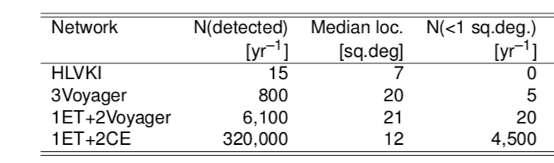
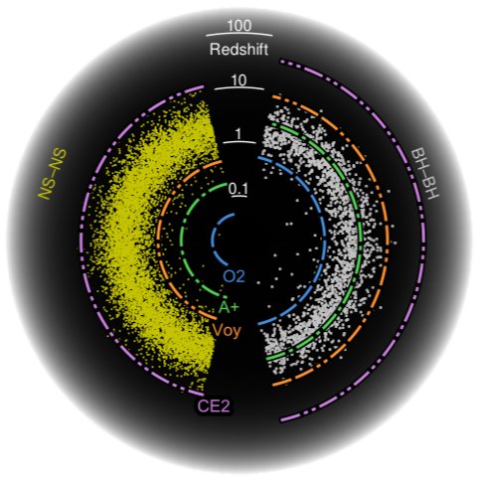
Synergy with et and next generation with GW interferometers
(New) Athena will be able to observe several events (see also Ronchini et al. 2022 )
Main science areas:
Jet structure and connection with central engine
• Cosmology by joint GW (Gianfagna, LP et al 23)
Enrichment of r-process in the Universe by accurate mass of kilonovae
Nature of the remnant compact object through X-ray variability
Athena
ET
Piro et al 2022, ExA,54,23

Slide 5
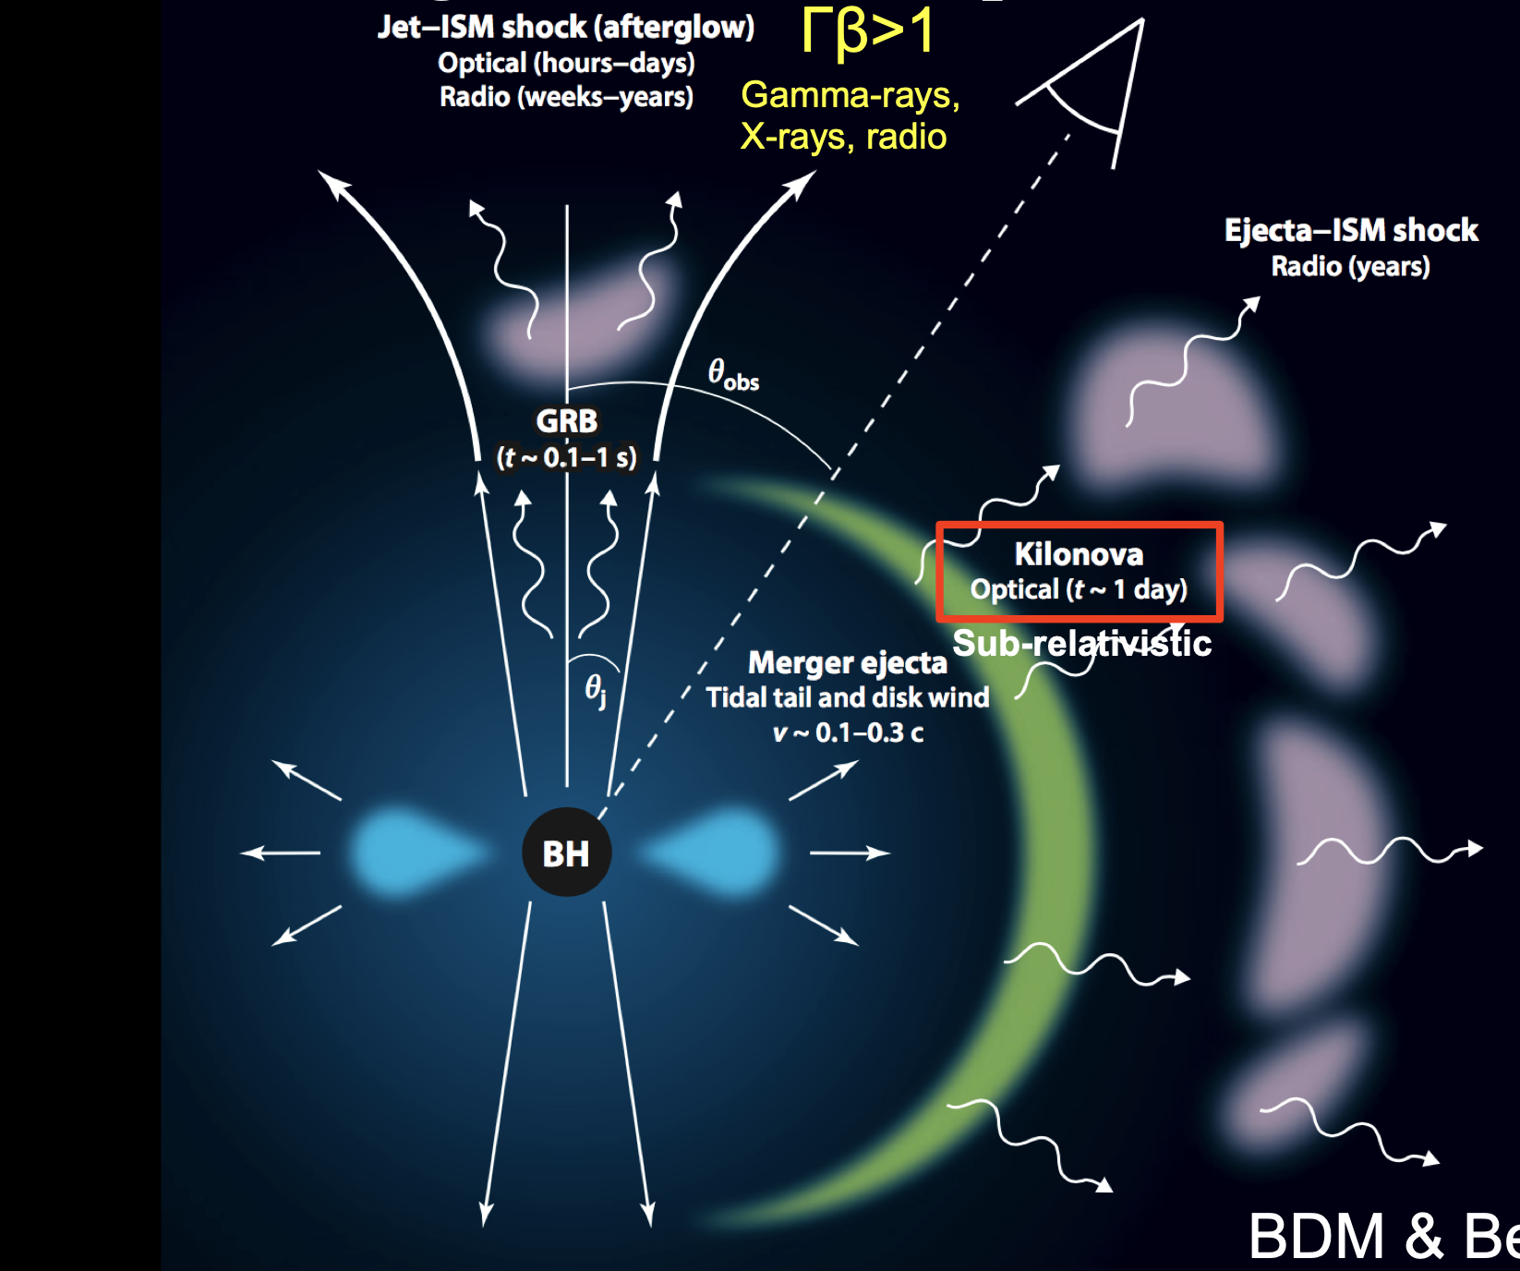
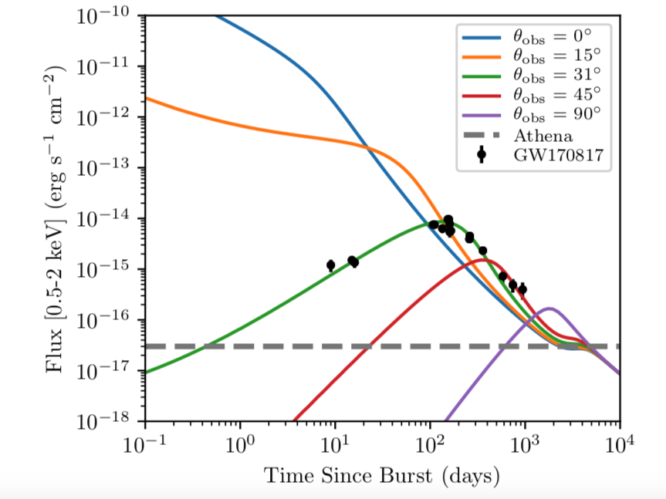
Why new-athena: Multimessenger astronomy
Extending the EM horizon of GW mergers with newAthena
X-rays
Athena
GW170817-like upto z >1
Metzger& Berger 2012
Updated from Piro et al 2022
Notes:
Extending the EM horizon
Strucutured jet modelling of a GW-like event as seen at different viewing angles with parameters as Troja et al 2019)
Specific evolution model dependant but overall behaviout good enough to assess
10 fold improvement in sensitivity => angle, distance, late time

Slide 6
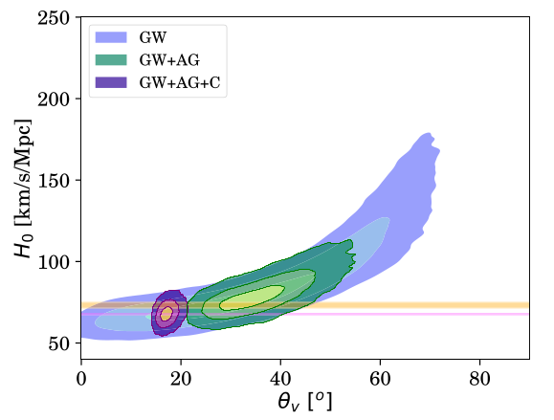




Hubble constant
Gianfagna et al, 2024
Estimate of the Hubble constant, by breaking some of the degeneracy in key parameters inherent to GW data, in particular
dL is degenerate w.r.t. inclination angle
=> EM comes into rescue
By observing with NewAthena 15-20 X-ray afterglows l.c. with z and high-quality jet angle determination would constrain H0 to 2%, needed to solve the Hubble tension
H0 =
H0 =
H0 =

Slide 7
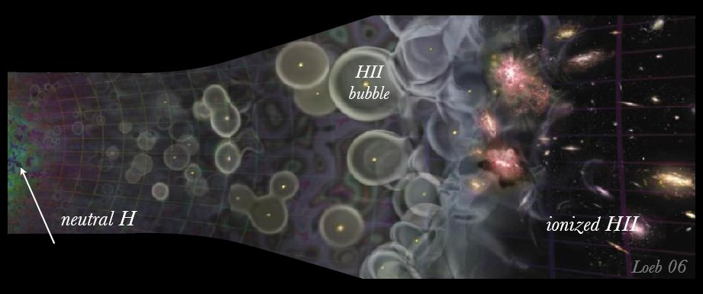
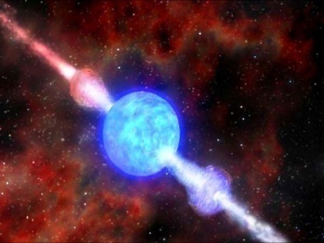
The first stars, the first BH, the first metals
z=1089
Pop III collapsars?
z=12
Pop II GRBs
z=5
z=0
Dark Ages
Reionization
GRB
Notes:
Z= 20 circa 300Myrs
I primi

Slide 8
NewAthena observation of high-z GRB: probing the popii vs popiii metal enrichment
medium bright GRB afterglow @ z=7, T=8hrs, 50 ksec, log(n)=3, N=4 10²²cm⁻²
Time-Variable Photoionzation Code (TEPID: Luminari et al 2023
Piro et al, in prep

Slide 9

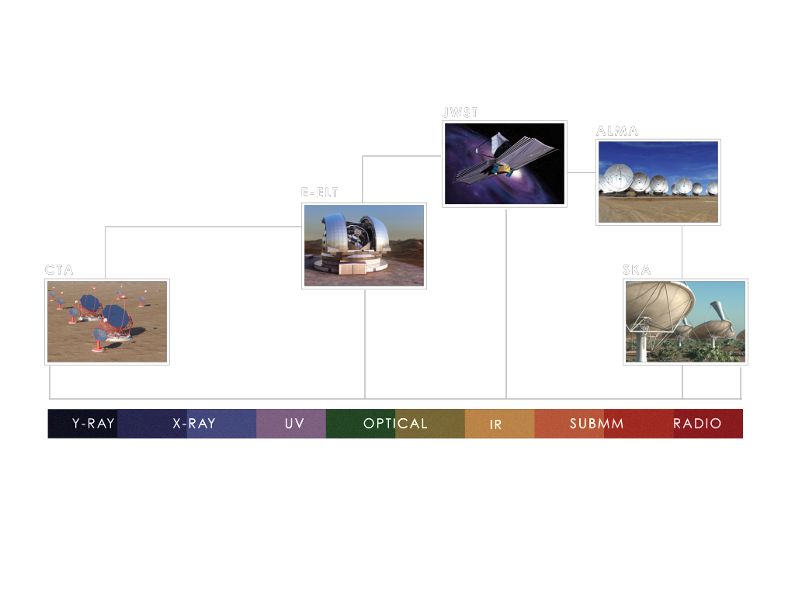
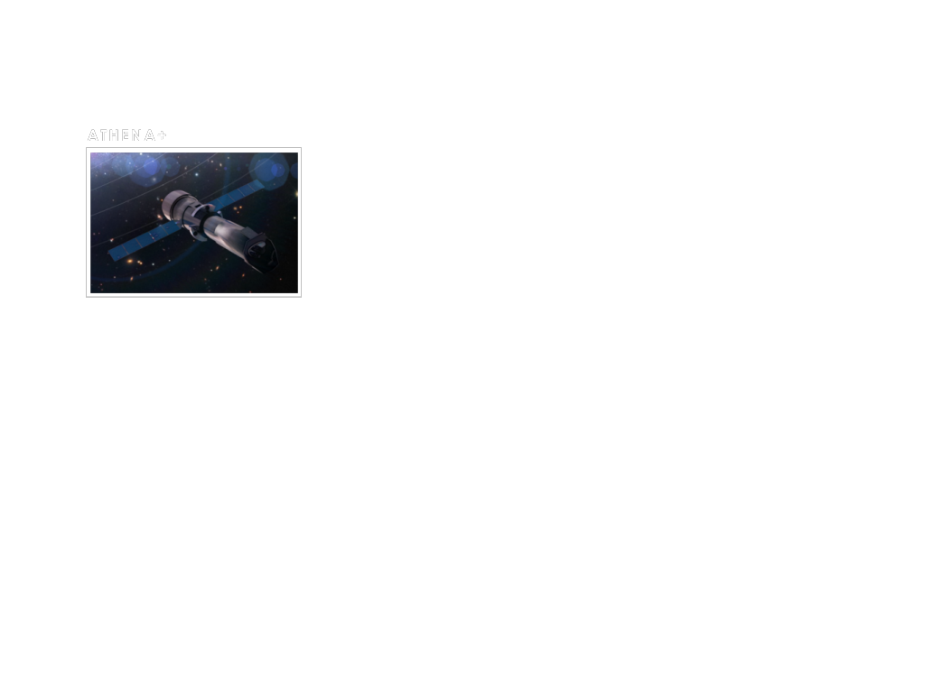
NewAthena in context of large facilties
Multimessenger (v’s and GW): KM3NET, IceCube, ALIGO,AVIRGO, ET, LISA
Athena is a crucial part of the suite of large observatories needed to reach the science objectives of astronomy in the coming decades
Notes:
E’ una facility per tutta l’astronomia, non solo X
Synergy studies with ELT, ALMA and SKA
Science: Hot and energetic universe, here MM

Slide 10

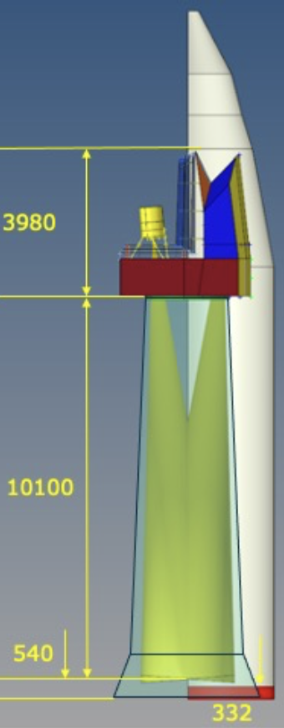
Status and course forward
Athena, originally selected in 2014, underwent a successful re-design in 2022/2023, aiming to achieve compliance with the ESA long-term budget with minimal change on the science case. => NewAthena
    Major simplification in the XIFU with passive cooling+ other cost-saving elements
Schedule
    Now: Phase A/B1
    2027 Q1: Mission Adoption Review
    2027 June: Adoption
    2028 Q1: Prime KO phase B2/C/D
    2034: delivery of XIFU/WFI FM to ESA
    2037: launch
  Strong activities at Instrument and science teams on going: to consolidate the new design, carry out trade-offs, achieve TRL levels 5/6 and support model development of long-lead items (CryoAC, filters)

Slide 11
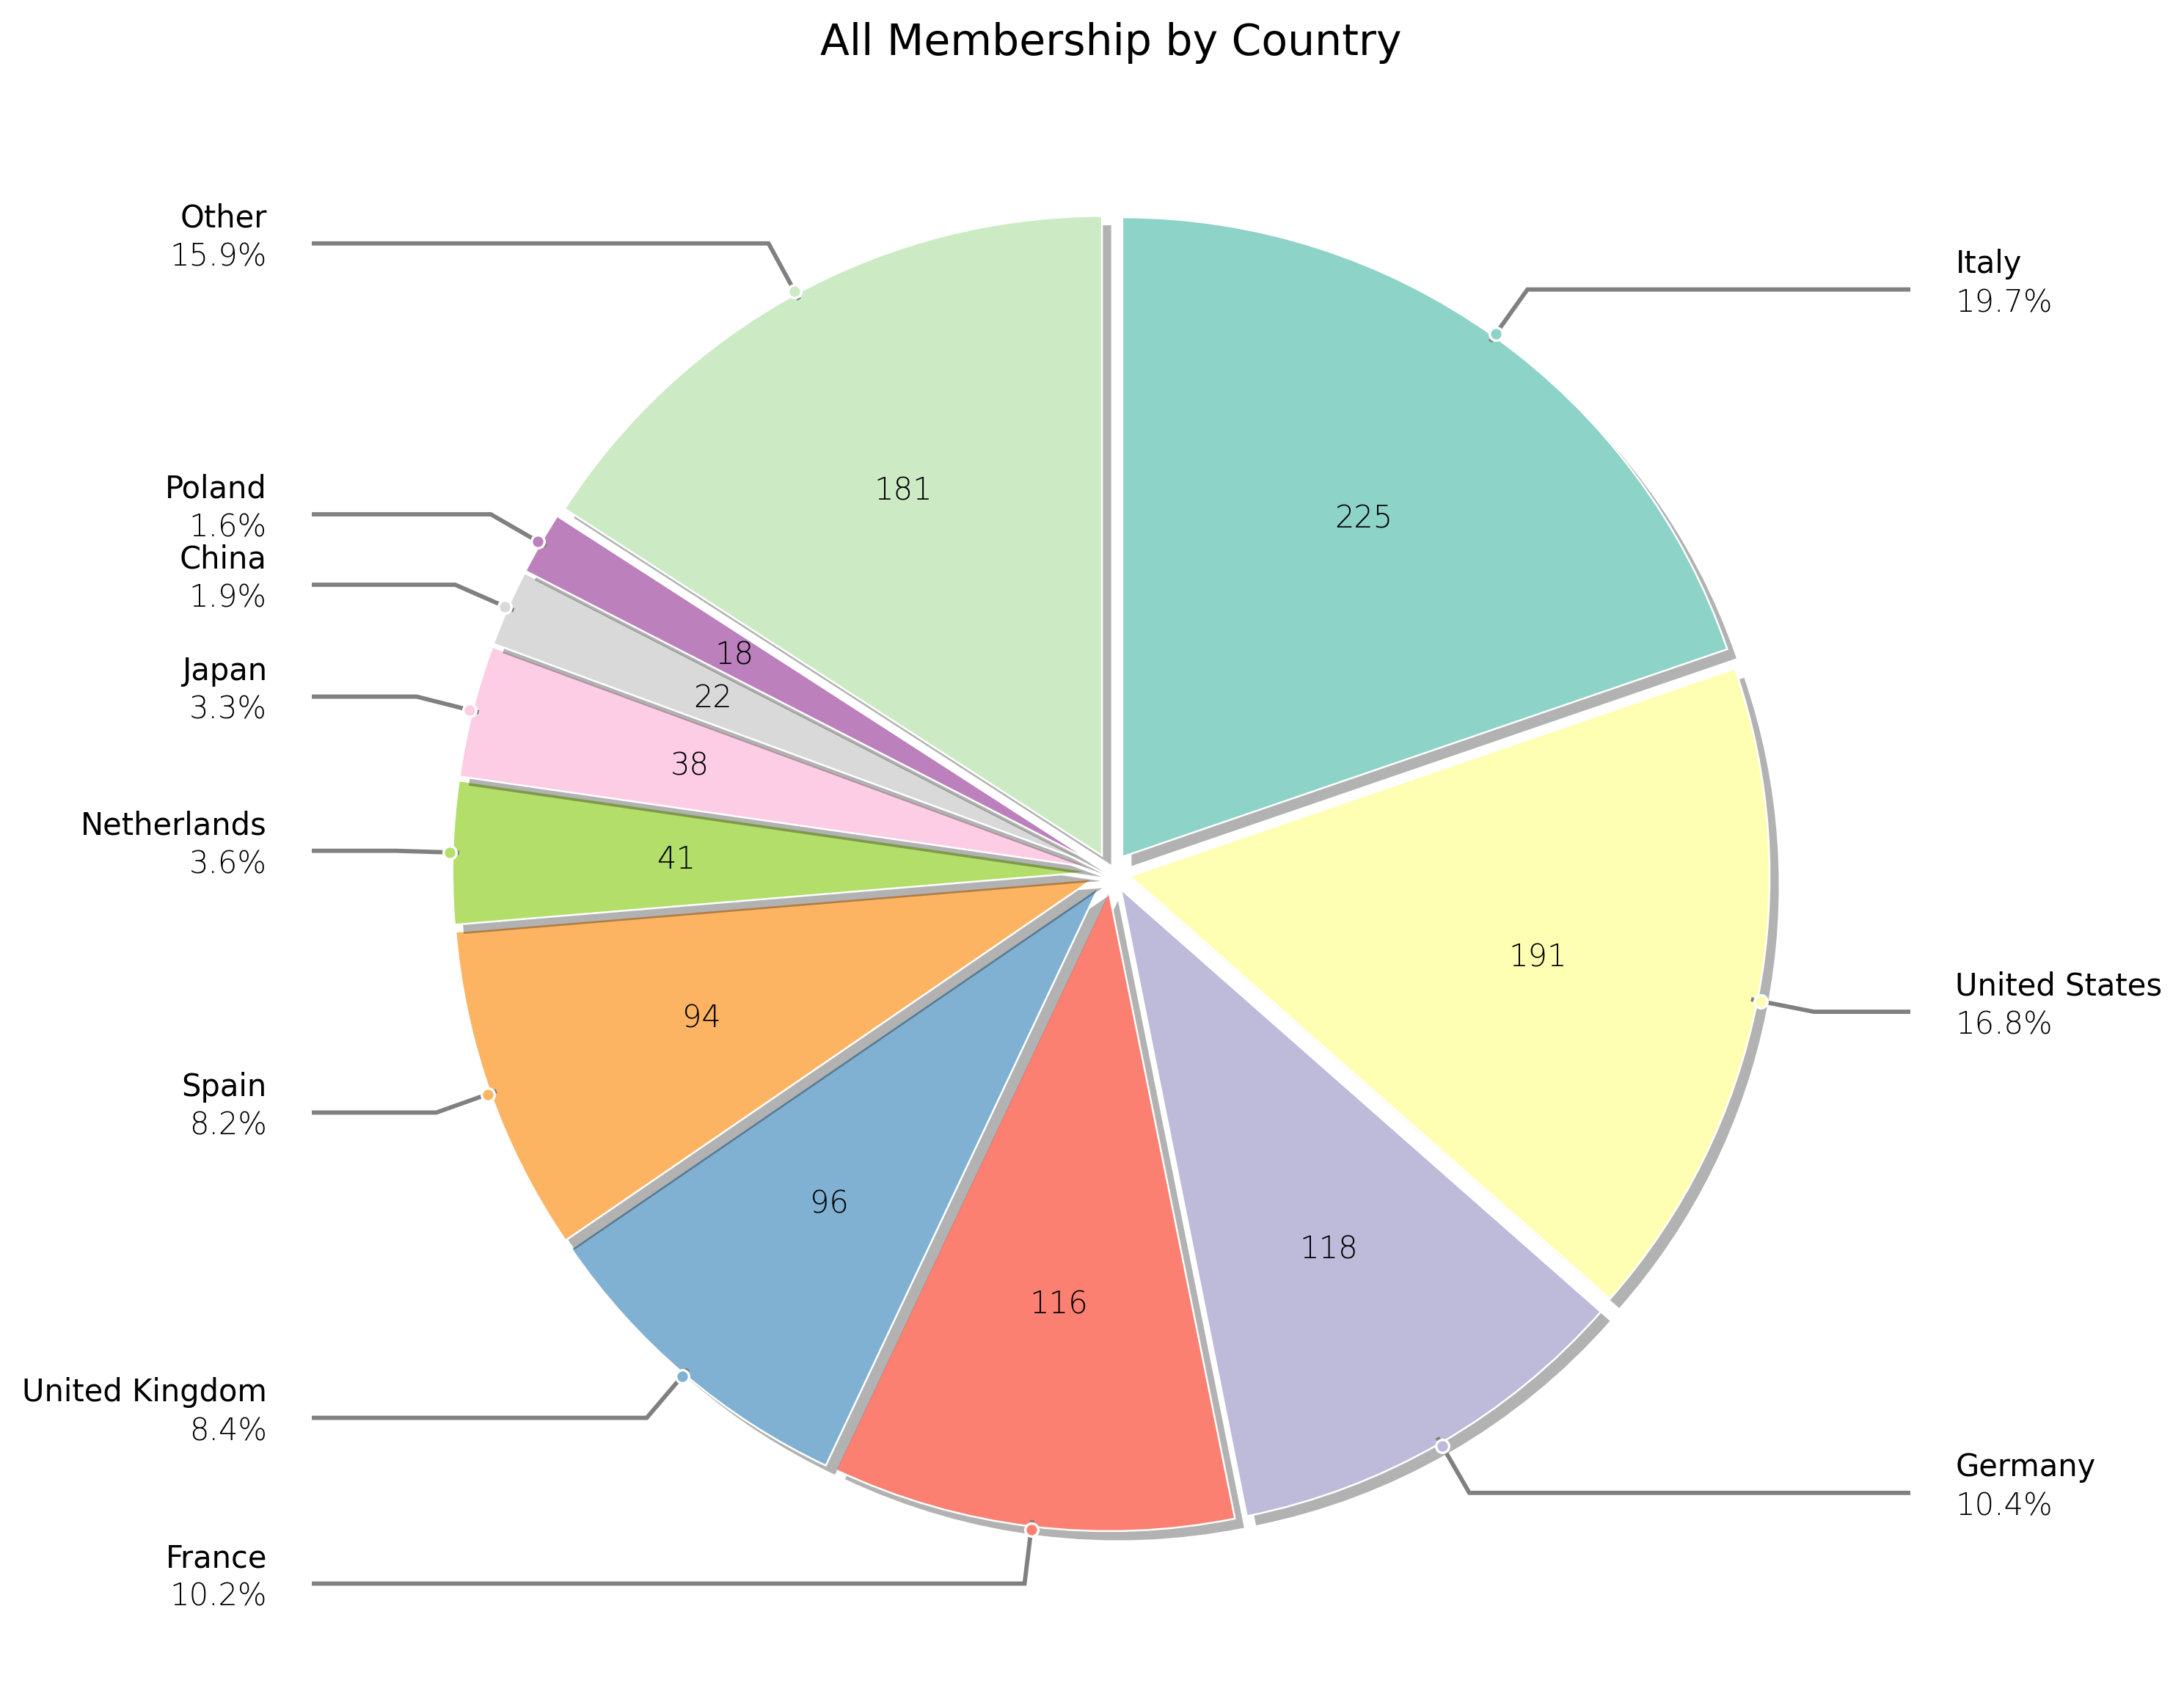
ITALIAN CONTRIBUTIONS TO NEWATHENA
XIFU CoPI-ship (INAF/IAPS, L. Piro)
+ synergical participation to WFI
Italian responsibilities on XIFU:
enabling science, high visibility:
  cryoAC TES microcalorimeter
  background (+ for WFI)
  Filters (+ for WFI)
  ICU
  Innovation Center (L3, adv tools)
  XSAT chairship
System/satellite
  Particle environment: orbit and support to magnetic diverter study
  Mirror calibration and module integration (Vertex, Beatrix)
ESA Science WGs: Italian representatives in ASST, SRDT and now NASST. Science WGs: 225 Italian members (largest contribution vs total 1140
Such a large and complex participation hinges on a well structured organization with 250 researchers and engineers in NewAthena Italian Consortium with more than 207 FTE only for X-IFU from 2016 to 2024 (about 23 FTE/y)
Notes:
Ruolo italiano istituti e industrie: 15 minuti, 10 slides max
- Partecipazione nei vari wg
- Industrial prime-ship: TAS (quella Italia su strumenti e ottiche), sugli strumetni ad alta tech: CGS/FBK, TAS oottiche: Medilario
- Definire senza ambiguita’ i contributi italiani consolidati: Scienza e XMS(CoPI-ship)
- XMS: consorzio istituti, contributi italiani(CoPI-ship: sensore TES ac, simulazioni, elettronica criogenica e digitale, filtri, instrument control unit)
- convolgimento industriale a XMS (integrazione meccanica, termica e elettrica sensore, elettronica analogica e digitale, ICU,)
- Eventuale partecipazione a SOC a livello di nazioni, per trasferimento know-how dello strumento a partecipazione italiano, eventualmente tramite ASDC o istituti (investiamo risorse in gran parte esistenti) ; allargamento ruolo su XMS se back up europeo
- Altre aree potenziali : WFI?, analisi/supporto calibrazioni ottiche ? Attenzione nel non dare pero la impressione che la baseline sia poco solida

Slide 12
conclusions
NewAthena retains nearly all of the Athena science, and can also answer new questions that have emerged over the last decade, such as Multimessenger astronomy
Fundamental, science-enabling contributions from Italy supported by ASI & INAF with a large involvement from the community and our space-industry
It will be THE large X-ray Observatory of the next decade and serve to whole astronomical community, joining other large multiwavelenght and multimessenger facilities in the sky

Slide 13
end

Slide 14
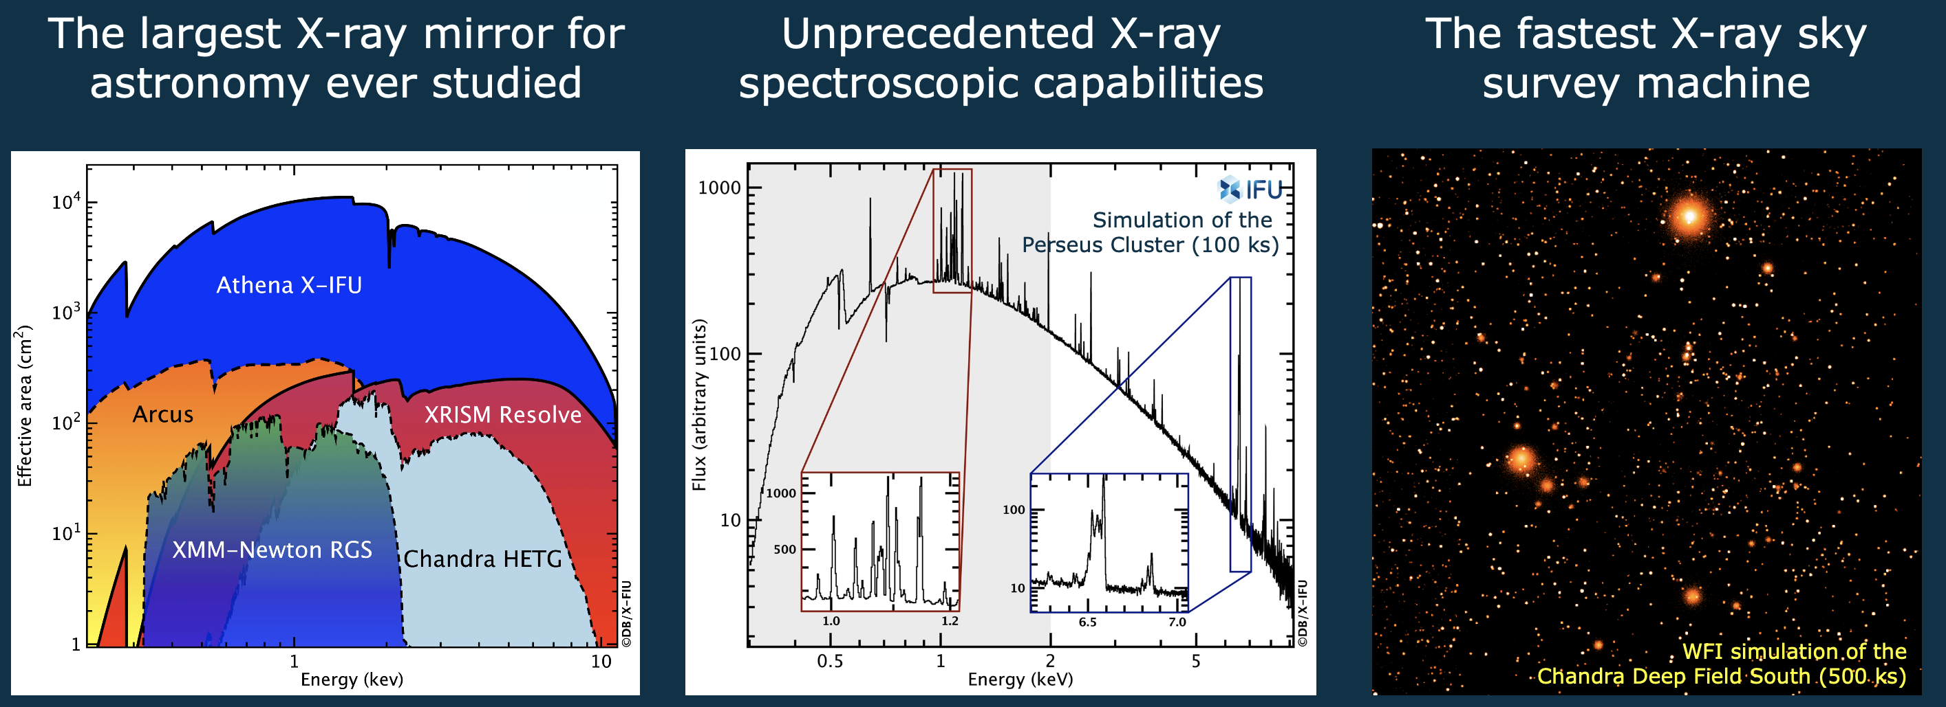
Key innovative elements of new-athena
Notes:
FACTOR OF 10 IN AREA
FACTOR OF 100 IN IMAGING XIFU
WFI: COMBINATION OF LARGE FOV AND AREA

Slide 15
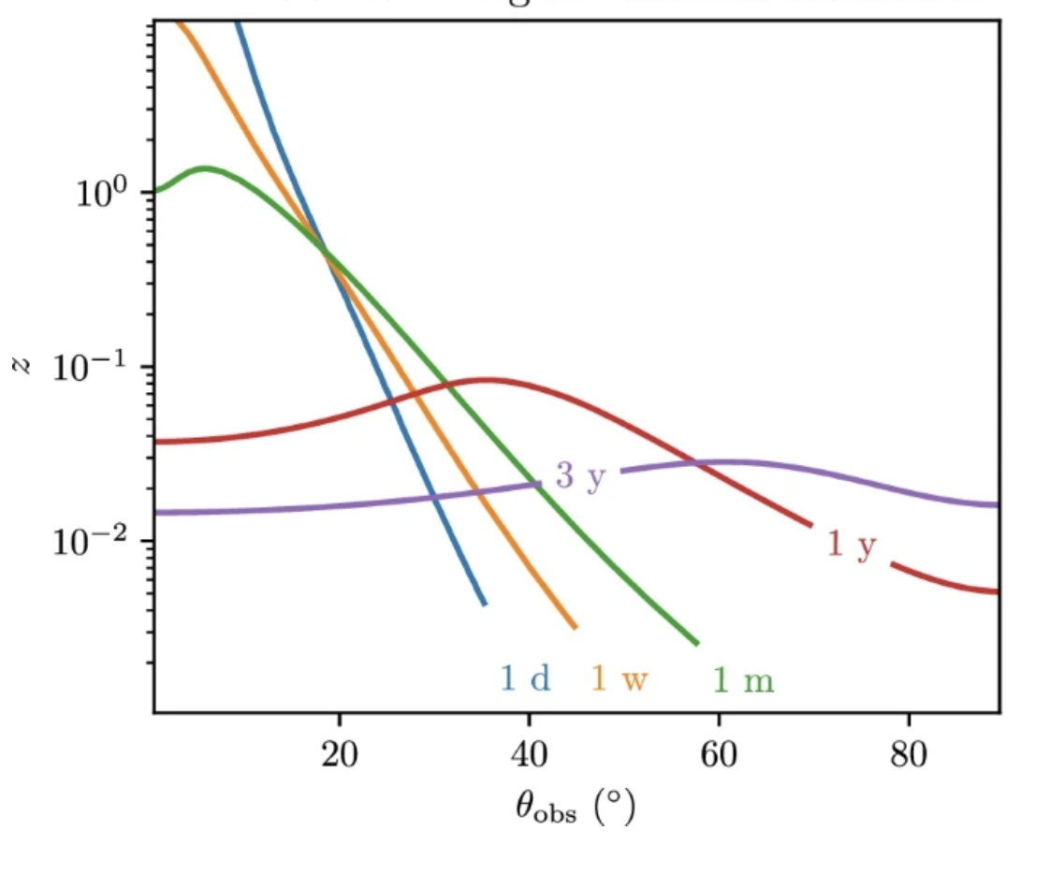
Why new-athena: Multimessenger astronomy
Extending the EM horizon of GW mergers with newAthena
X-rays
Athena
GW170817-like upto z >1
Metzger& Berger 2012
Updated from Piro et al 2022
Notes:
Extending the EM horizon
Strucutured jet modelling of a GW-like event as seen at different viewing angles with parameters as Troja et al 2019)
Specific evolution model dependant but overall behaviout good enough to assess
10 fold improvement in sensitivity => angle, distance, late time

Slide 16
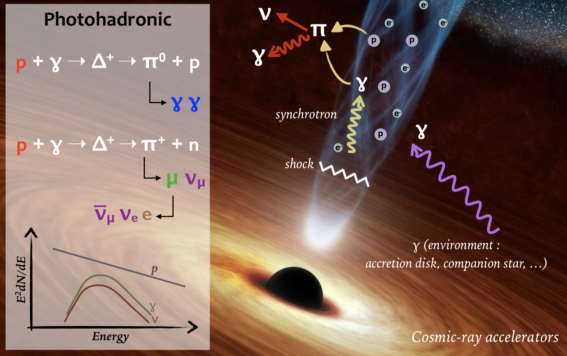
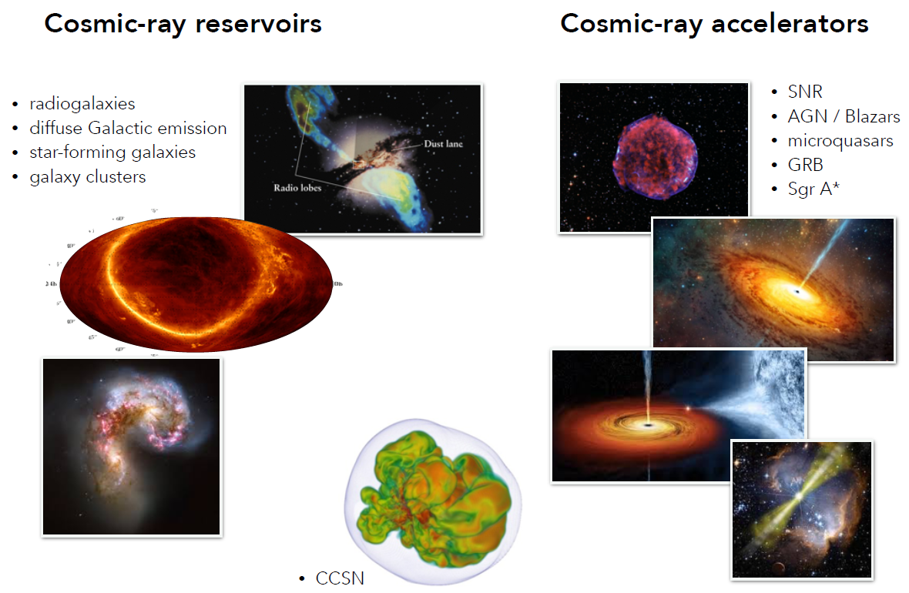
New-Athena, vhe and neutrino observatories
Overaching theme: Cosmic Accelerators and Origin of Cosmic Rays
  Hadronic vs Leptonic
Sources (shock sites):
  - Blazars
  - SNR
  - Sne (v’s from CC)
  - Pulsar/PWN
  - GRBs
  - Starburst galaxies
  - Clusters as CR reservoirs
  -
Notes:
CTA, KM3net and Icecube
Particle acceleration => mostly sources with (relativistic) shocks
Hadron vs lepton: same acceleration, hadron => secondary particles pions -> gamma rays
X-rays: diagnostic of the «target»environment (density, morphology)

Slide 17
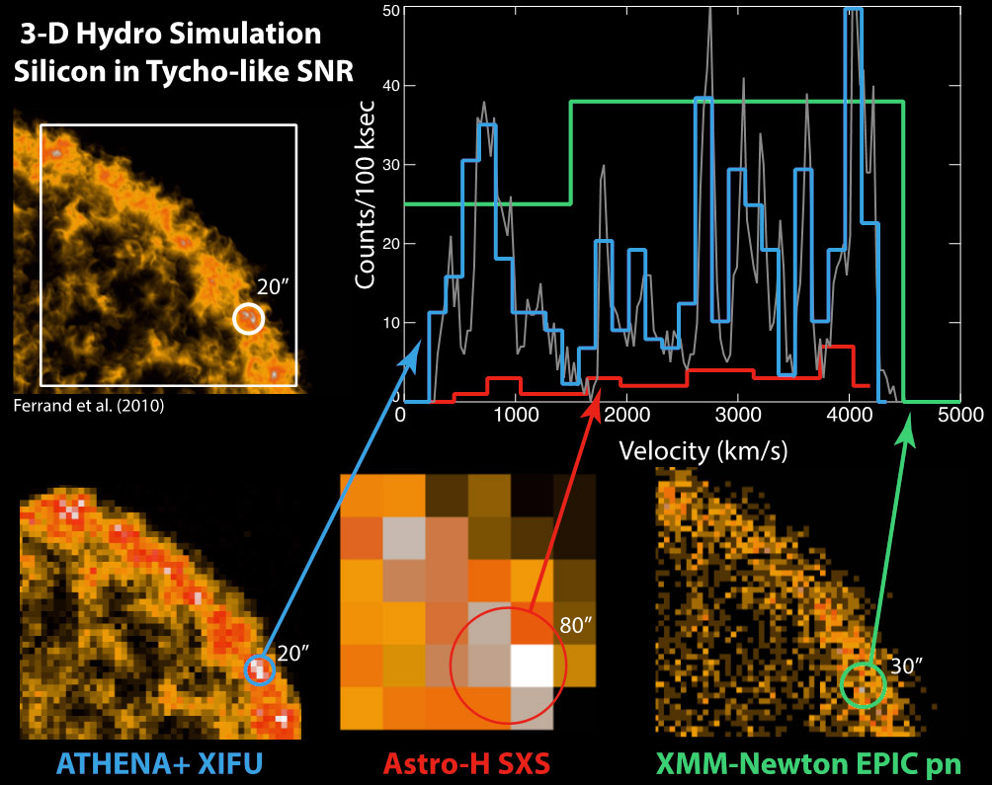
New-athena: high resolution X-ray spectroscopy
Enable conversion of neutrino and/or gamma-ray luminosity into a total energy budget of CR=> X-ray thermal emission => density and composition
Measure the efficiency of CR acceleration in the source=> ion temperature is a proxy => high-resolution spectral of the thermal line broadening (hundreds km/s to separate bulk motions)
X-rays proxy of potentially strong neutrino emission
Notes:
Counterparts tp neutrino sources

Slide 18
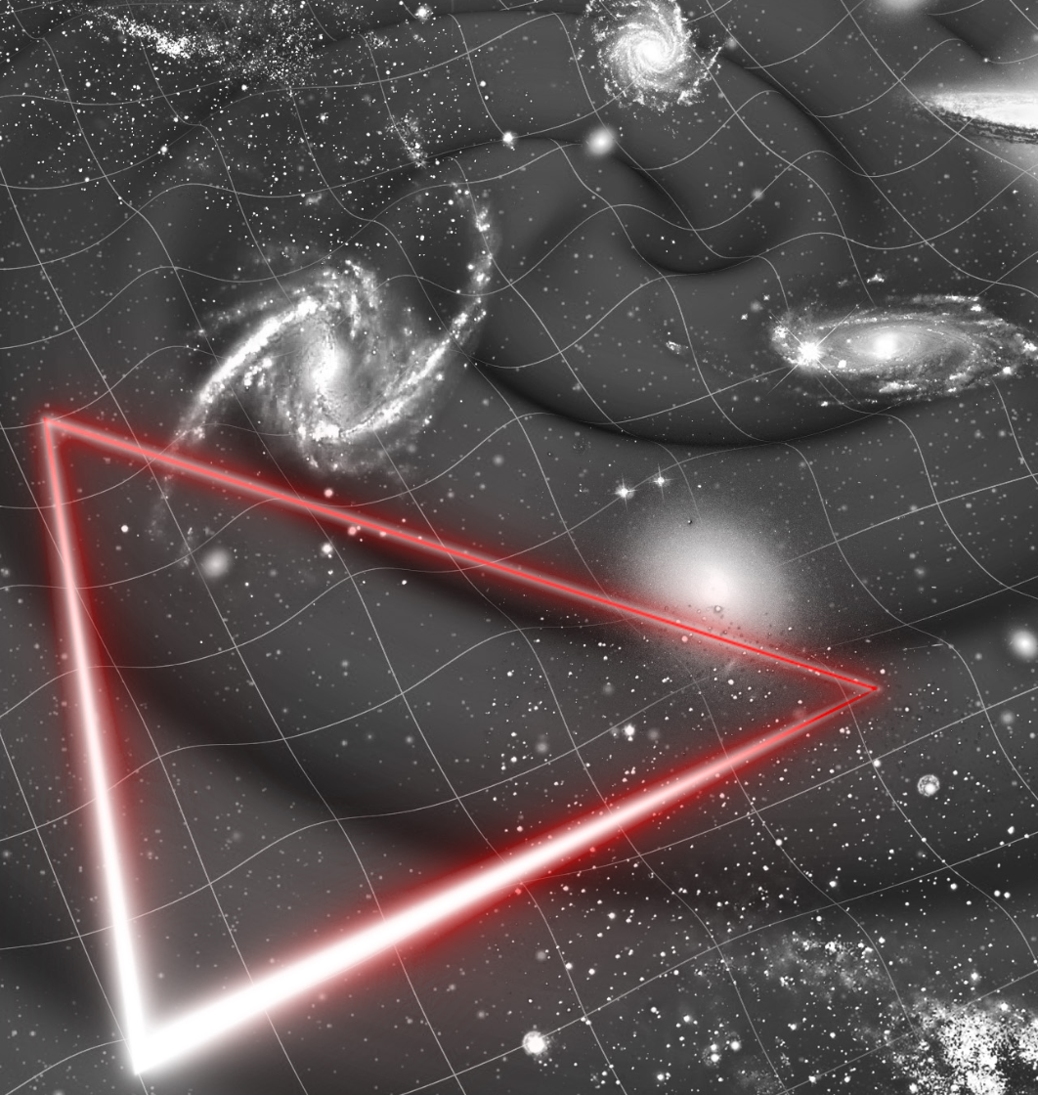
Athena and LISA synergies
Synergy science themes
  Accretion flows, formation of X-ray corona and jet launching around newly formed horizons
  Testing General Relativity as theory of gravity and measuring the speed of GWs and dispersion properties (GW and EM chirp)
  Enhancement of the cosmic distance scale using GW sources as standard sirens
Sources
  Super Massive (binary) BH mergers (SMBHM) in gas-rich environments
  Extreme mass ratio inspirals (EMRIs) where a stellar black hole is skinning the horizon of a large black hole surrounded by an AGN disc
  Coalescence of stellar mass binary BHs
  Interacting double white dwarf and accreting binary systems
Piro et al 2023: MNRAS

