Slide 1
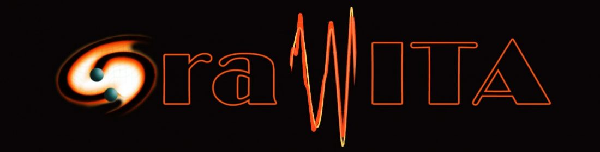
Enrico Cappellaro
INAF – Osservatorio Astronomico di Padova
on behalf of
Enzo Brocato → PI → Maria Grazia Bernardini

Slide 2
2013 -Dec-5
Meeting INAF – LVC Monte Mario
2014 Nature news
After two decades and more than half a billion dollars, LIGO, the world's largest gravitational-wave observatory, is on the verge of a detection.
Maybe.
Started with 50 members (today >135 members)
Know-how: Time Domain Astronomy, Observational Strategy, Image analysis, Accurate Photometry in crowded fields, GRB astronomy, Data Interpretation, Theoretical models
2014 MoU LVC /INAF

Slide 3
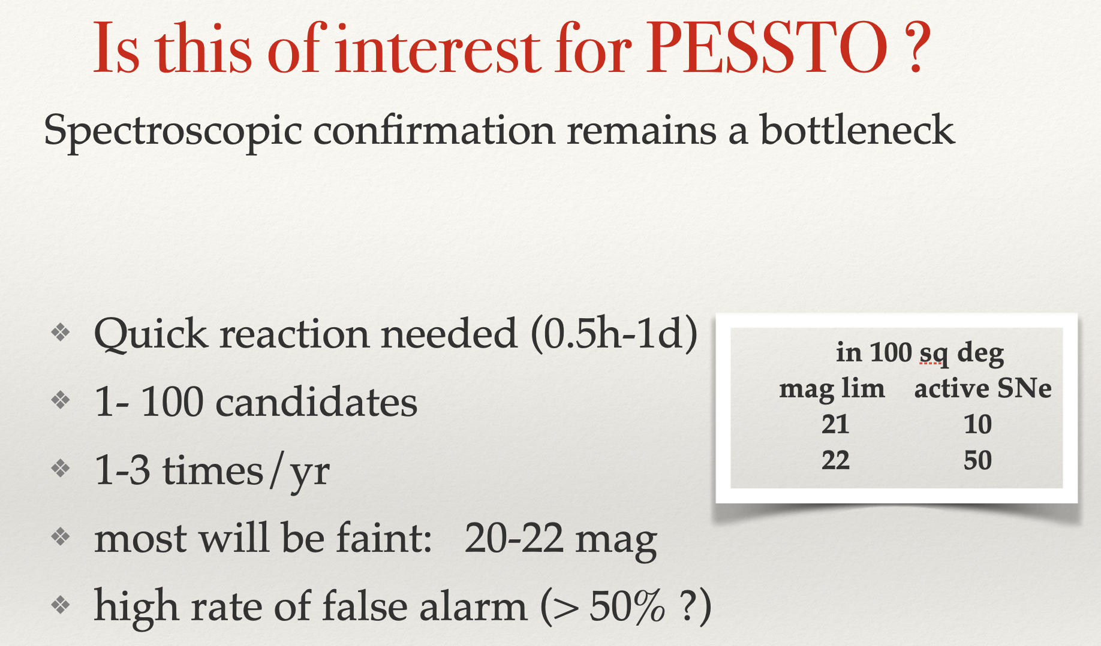
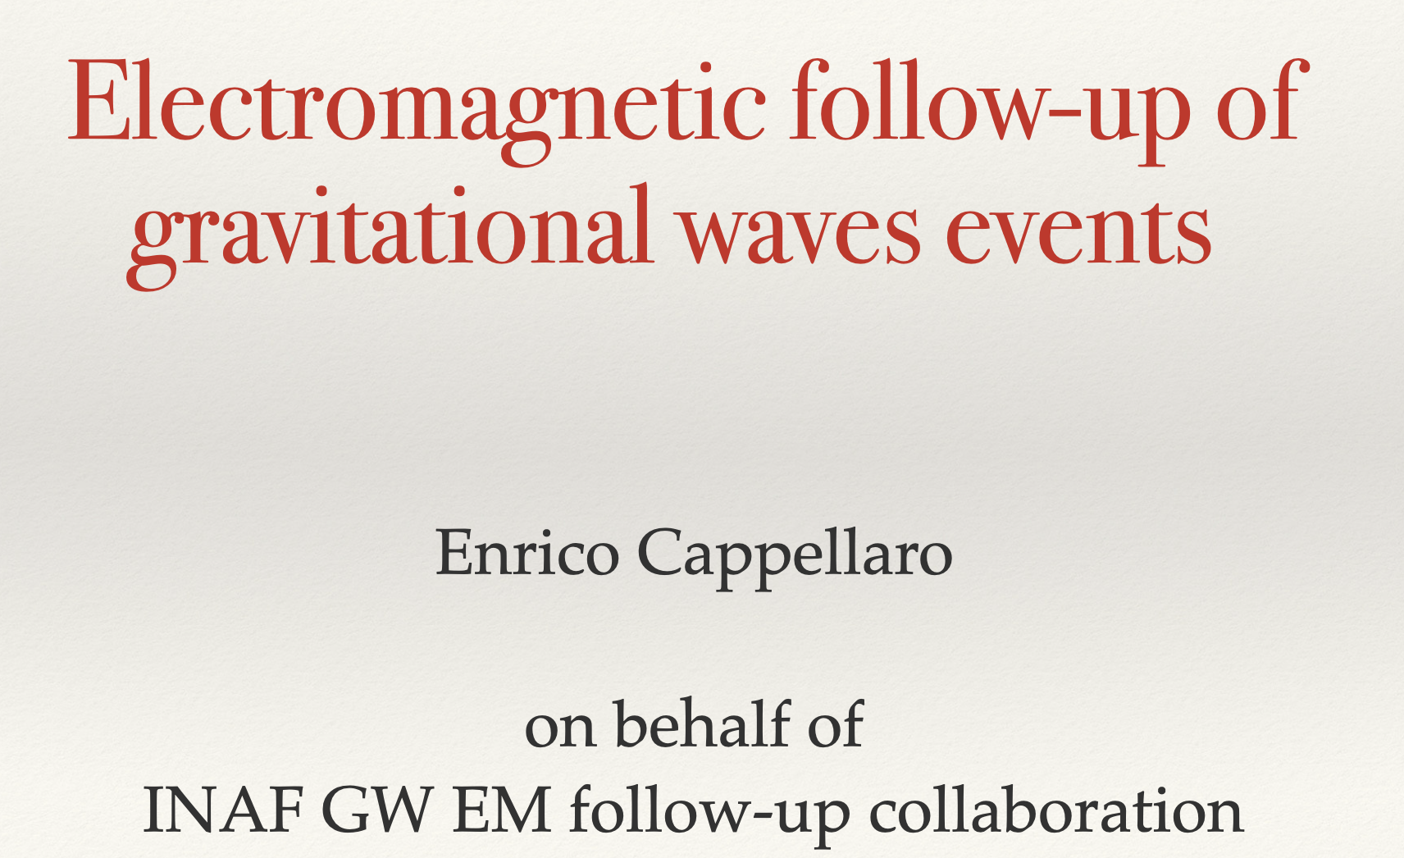
Early activities
Submit observing proposals
Set up communication and data reduction tools
Promote international collaboration
Cambridge PESSTO meeting Feb 2015

Slide 4
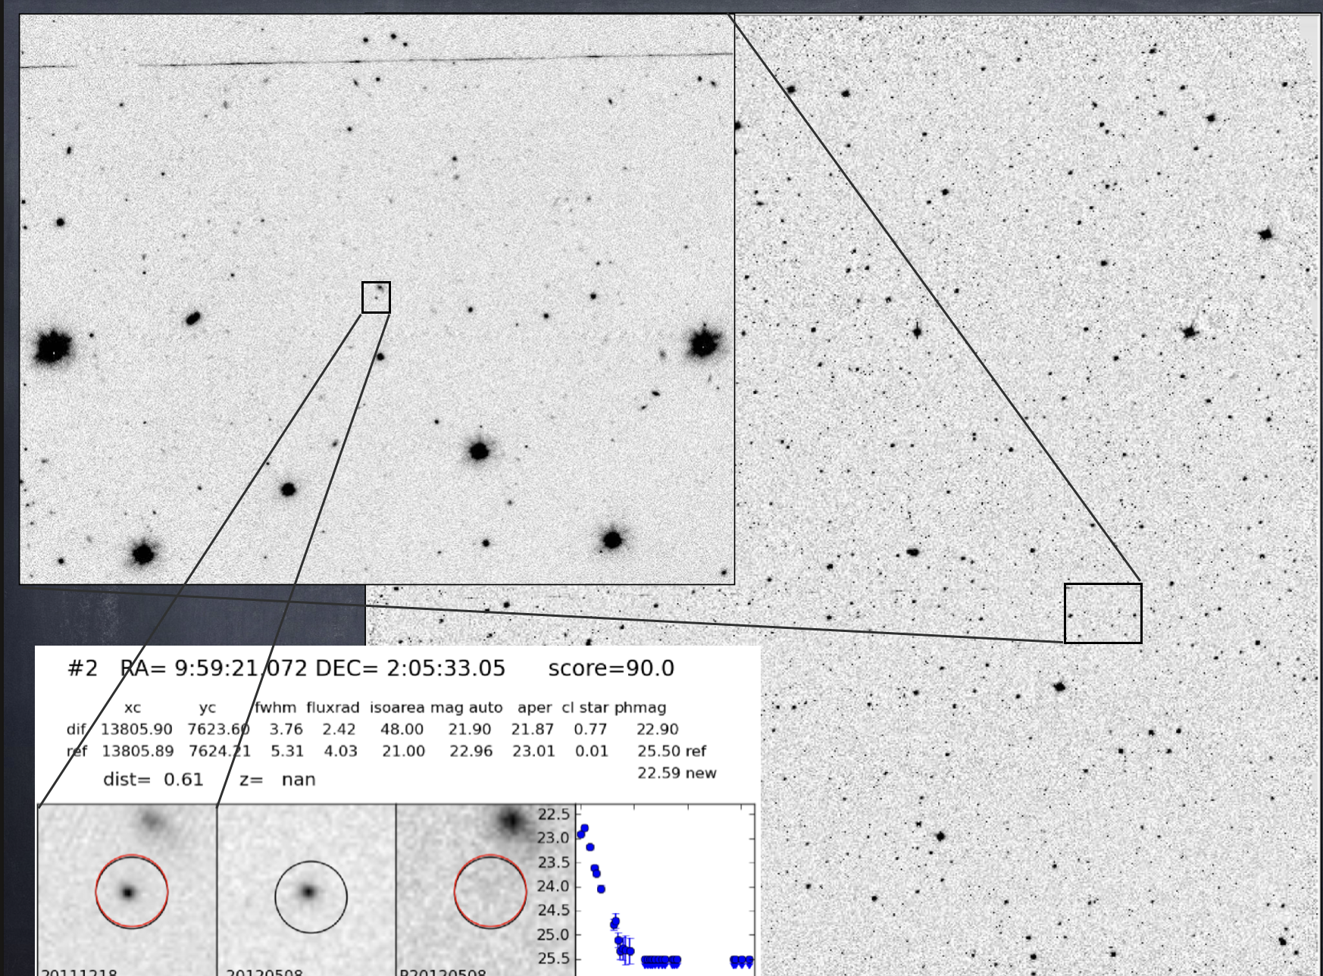
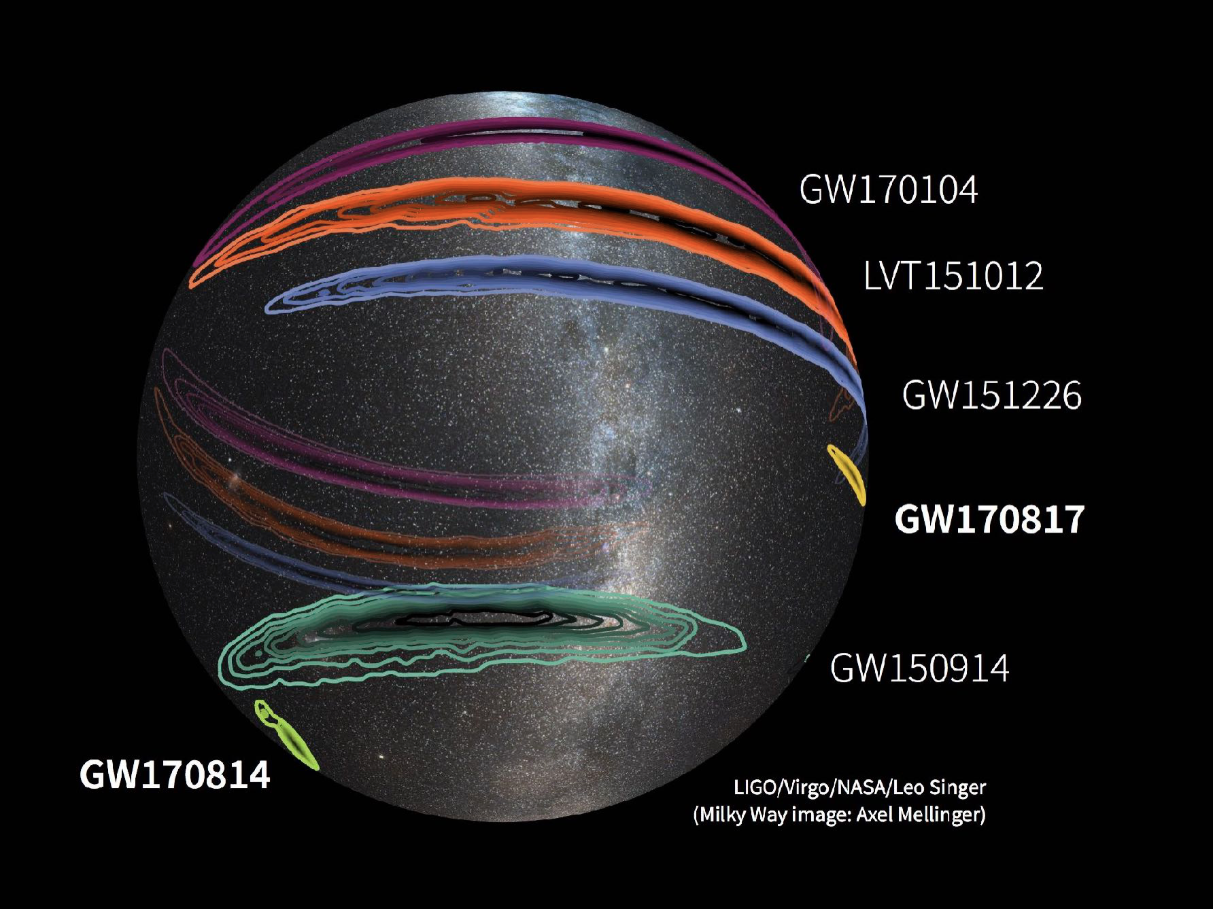
Key features
Large sky error box
EM
counterpart
search
Omegacam @ VST
STEP 1
Search & Detect
1 deg

Slide 5
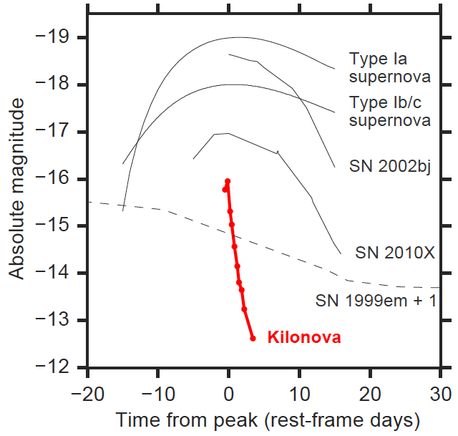
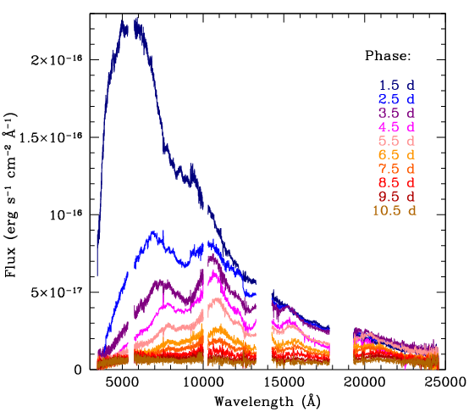
Key features
Large sky error box
Rapid luminosity/color evolution
EM
counterpart
search
STEP 1
Search & Detect
Xshooter @ VLT
STEP 2
Identify & Classify
visible at peak
NIR >3/4 days

Slide 6
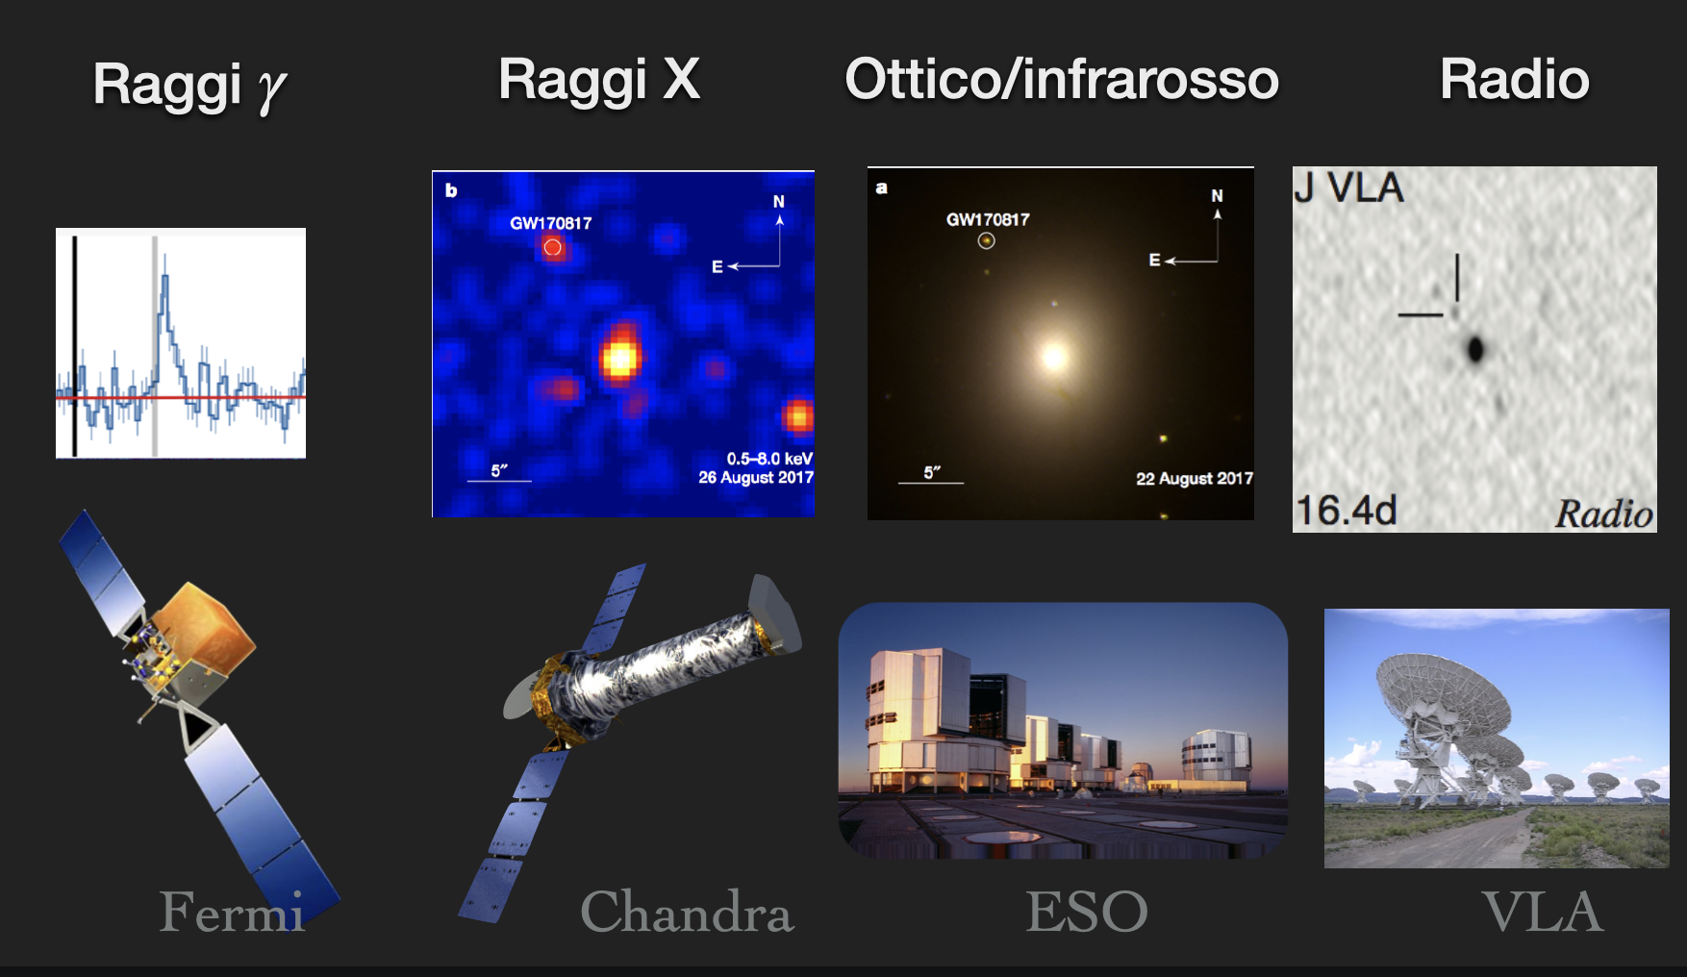
Key features
Large sky error box
Rapid luminosity/color evolution
Truly multi-wavelength
EM
counterpart
search
STEP 1
Search & Detect
gamma X-ray optical/IR radio
STEP 2
Identify & Classify
STEP 3
Follow up

Slide 7
EM
counterpart
search
Jet launching and structure, role of magnetic field, interpretation of polarization, KN nucleosynthesis …….
STEP 1
Search & Detect
Compact radio emission indicates a structured jet was produced by a binary neutron star merger 2019 Ghirlanda et al
On-axis view of GRB 170817A 2019 Salafia at al.
The origin of polarization in kilonovae and the case of the gravitational-wave counterpart AT 2017gfo 2019 Bulla et al.
First 100 ms of a long-lived magnetized neutron star formed in a binary neutron star merger 2019 Ciolfi et al.
Production of Very Light Elements and Strontium in the Early Ejecta of Neutron Star Mergers 2022 Perego et al.
……………………………..
STEP 2
Identify & Classify
STEP 3
Follow up
STEP 4
Modelling

Slide 8
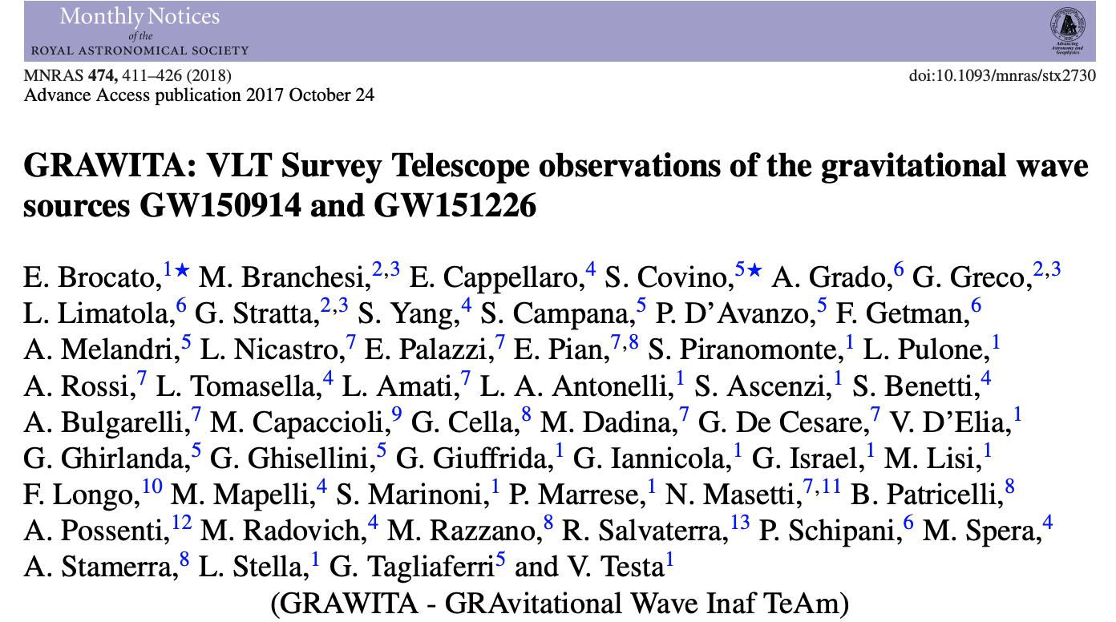
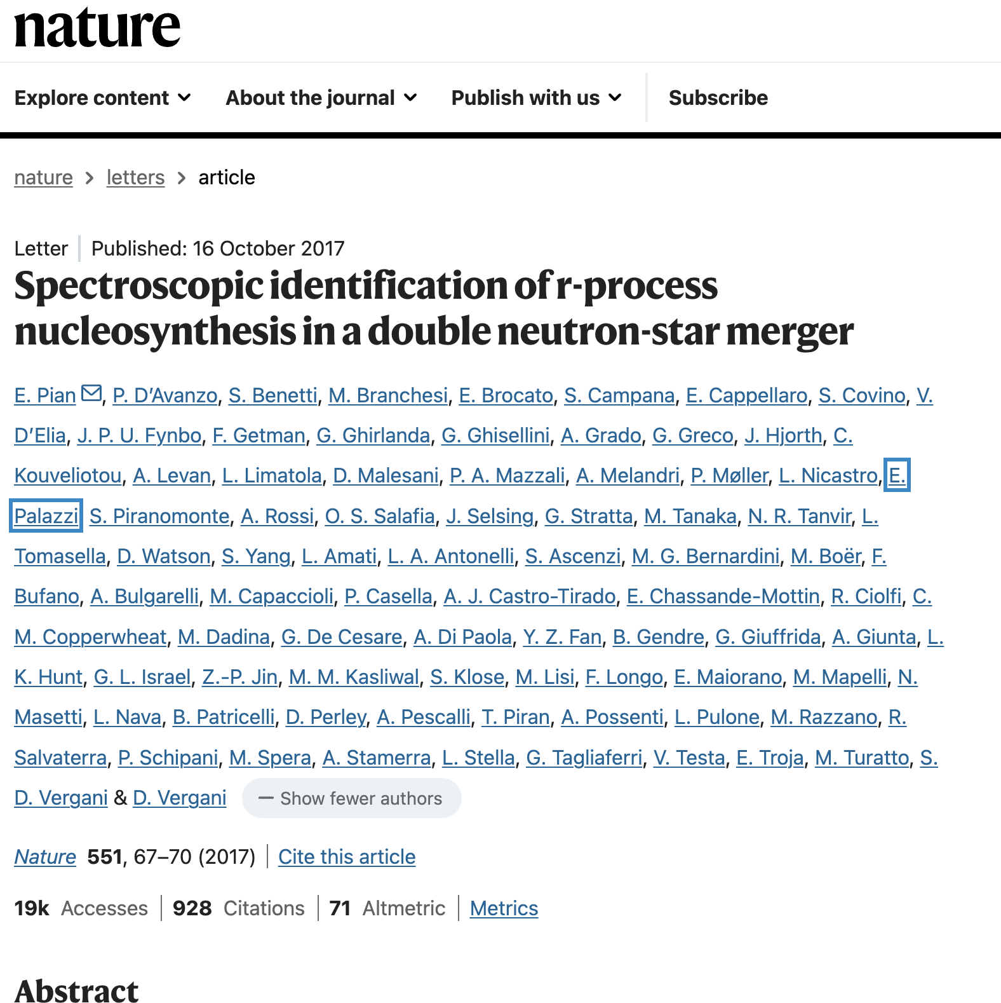
We were ready for the first alerts
… and for the first KN

Slide 9
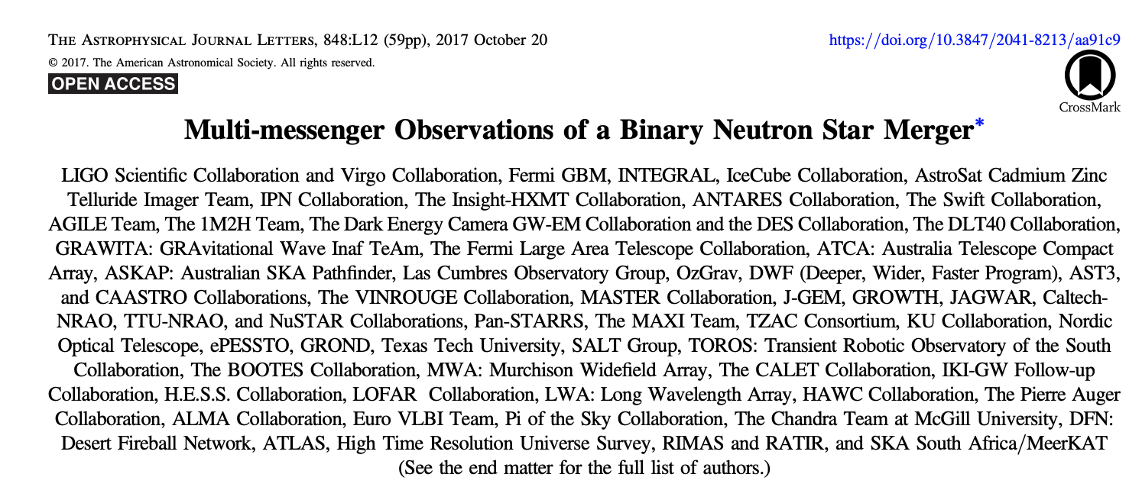
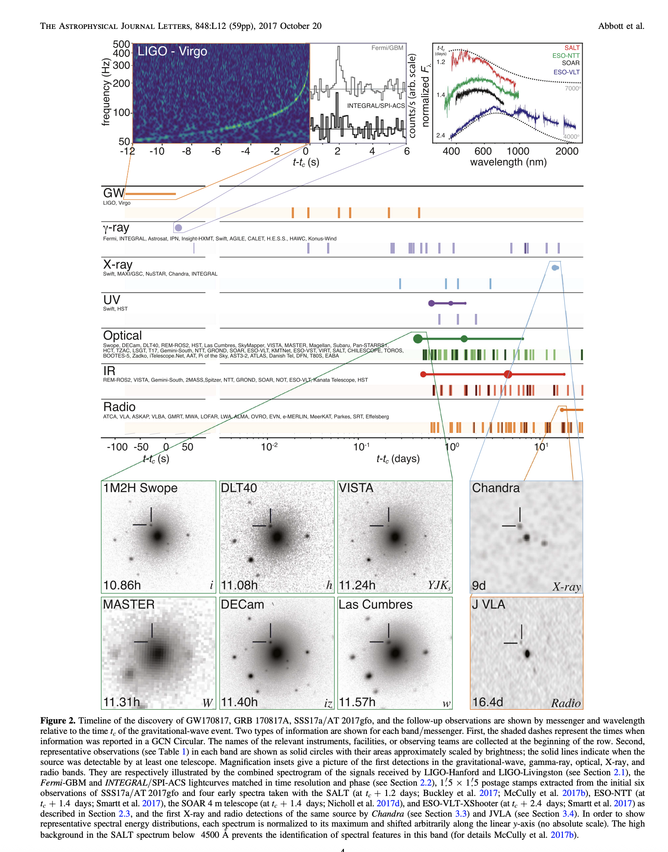

A new paradigm of “collaboration”
3777 co-authors

Slide 10
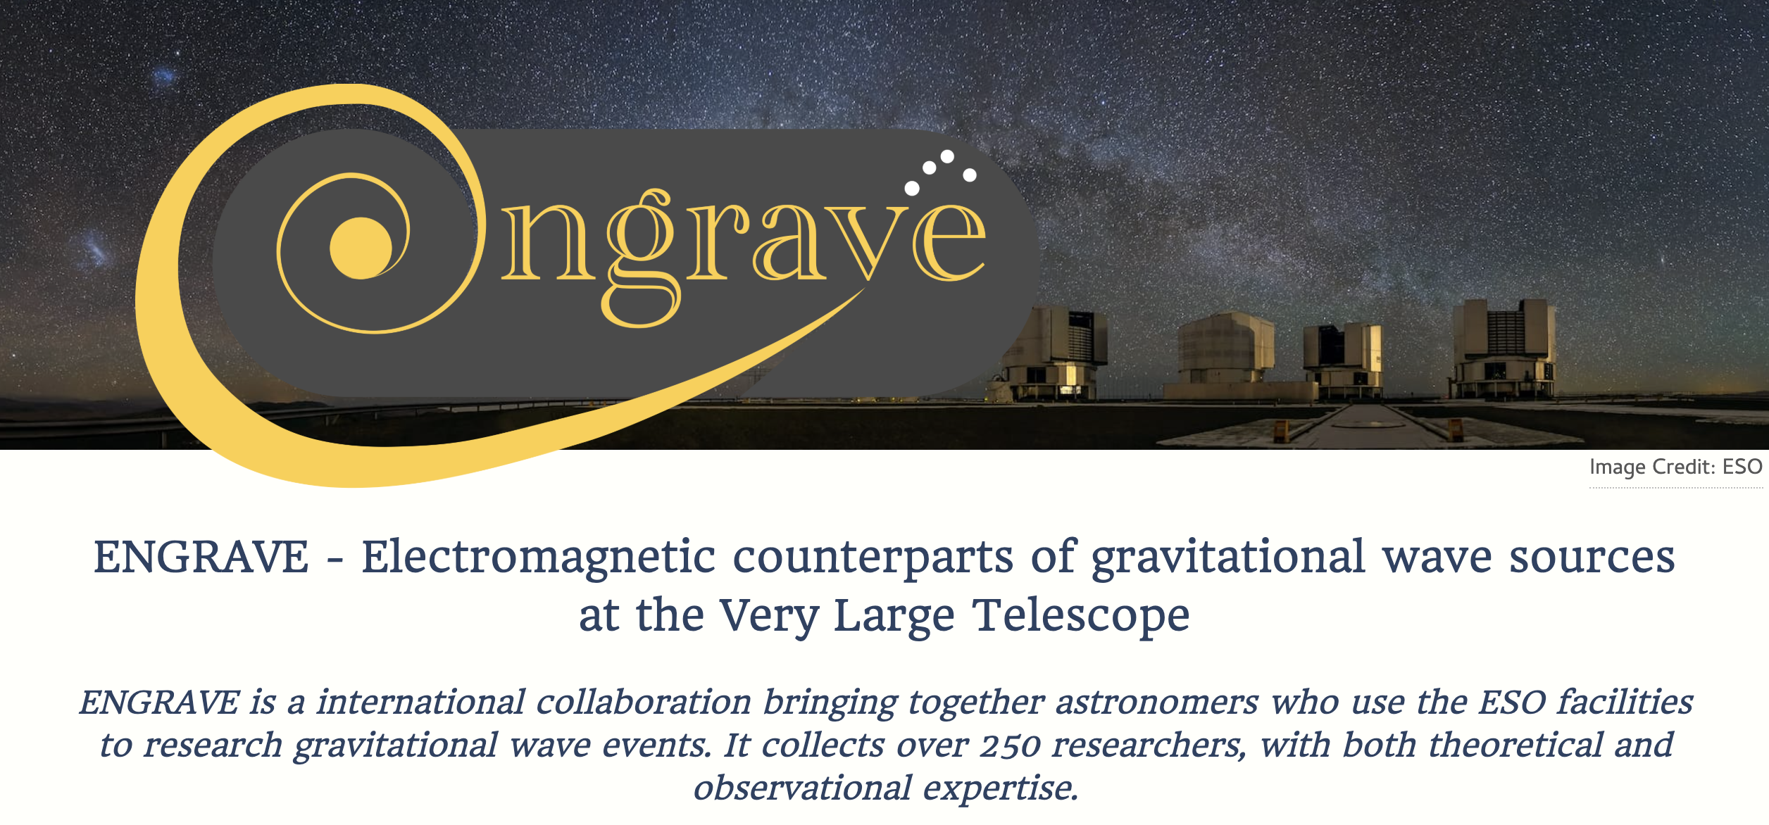
Governing Council (GC): N. Tanvir (Chair), E. Pian, J. Hjorth, D. Steeghs, E. Brocato, P. Jonker, M. Branchesi, J. Sollerman, S. Smartt, P. D'Avanzo

Slide 11



Slide 12
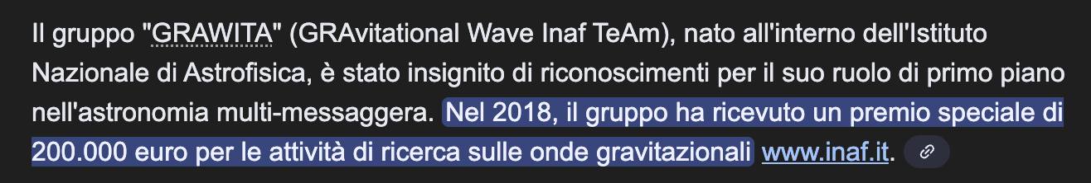
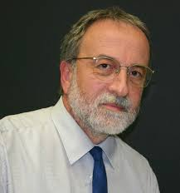
Thanks to the vision of INAF’s President
Nichi D’Amico

Slide 13
Recent/ongoing activities
Ligo/Virgo/Kagra runs: manage/check/update our follow-up strategies/facilities
Contribution to Einstein Telescope (UdR ET-INAF): ET BlueBook. PNRR ETIC (ADONI), initiatives at Sos Enattos (Mezzocielo)
Contribution to EM instrument science cases (Theseus, WST, Mezzocielo…. )
Promoting multimessenger themes in different calls (INAF, ASI, EU, MUR) . PRIN 2020 METE – PI Marica Branchesi contribution to INAF AF2025 LoI
Test other multimessenger science cases: search EM counterpart of high energy neutrinos
Preparation of a next F. Lucchin PhD school

Slide 14
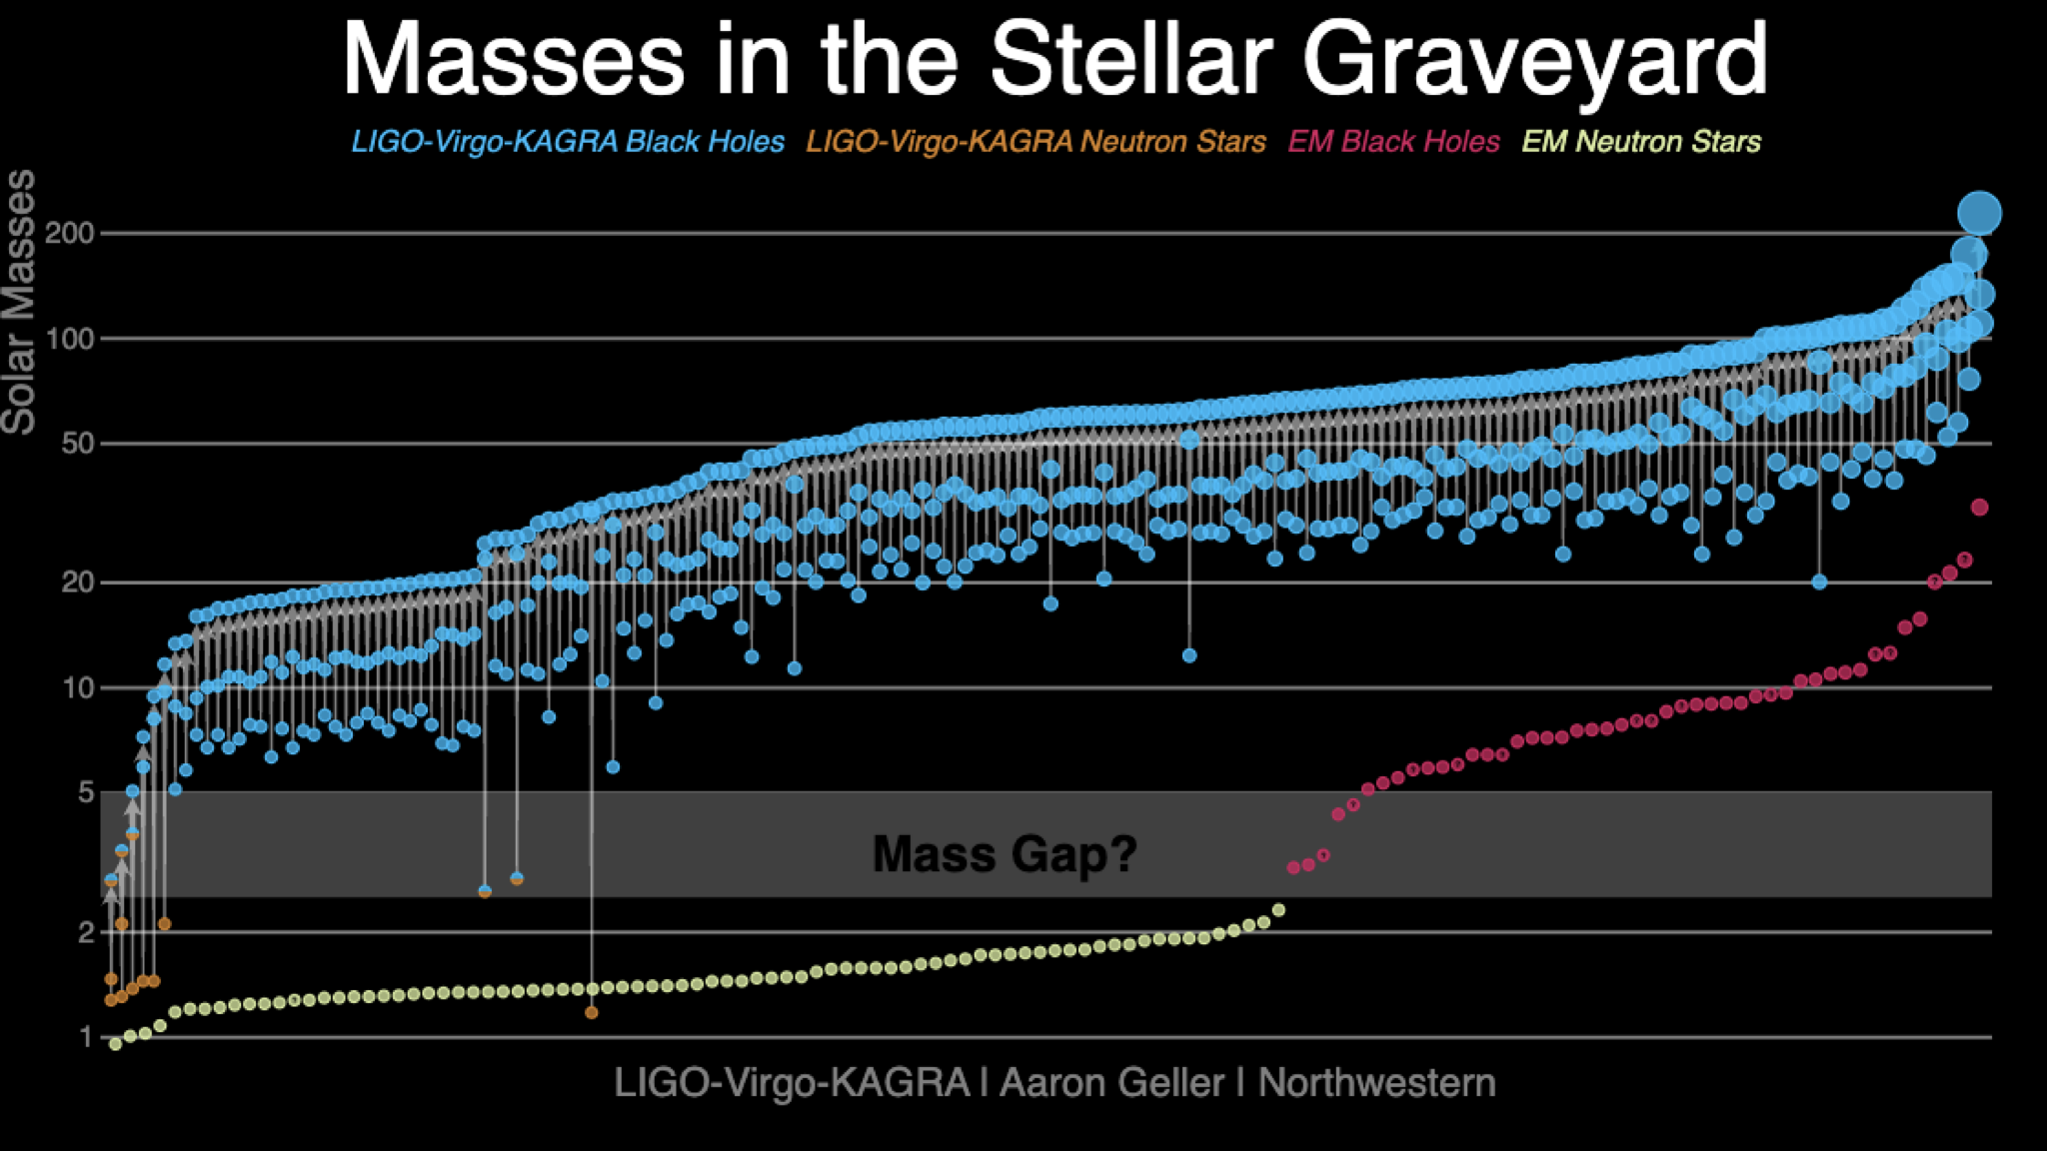
GW170817: a once in a lifetime event ? So what !
https://media.ligo.northwestern.edu/

Slide 15
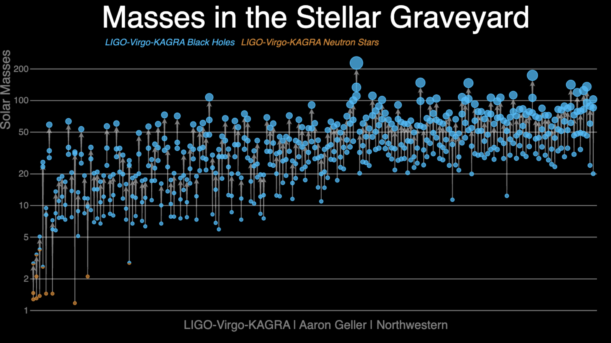
https://media.ligo.northwestern.edu/

Slide 16
GW170817: a once in a lifetime event ?
LVC BNS depending on runs/advancement 0-10 KN/yr
Rubin-LSST 10 million alerts per night,
1 million SNe/yr , 30-70 KNe/yr
10 to 100 KNe per year will be successfully characterized through joint ET and LSST observations.
Einstein Telescope is expected to detect a BNS merger roughly every 5 minutes
Was neutrino source identification (1987A) a once in a lifetime event ?
10-20 high energy (>30 TeV) neutrinos / yr
Notes:
1987A 15 SN/yr / thousands
> 2000 /yr

Slide 17
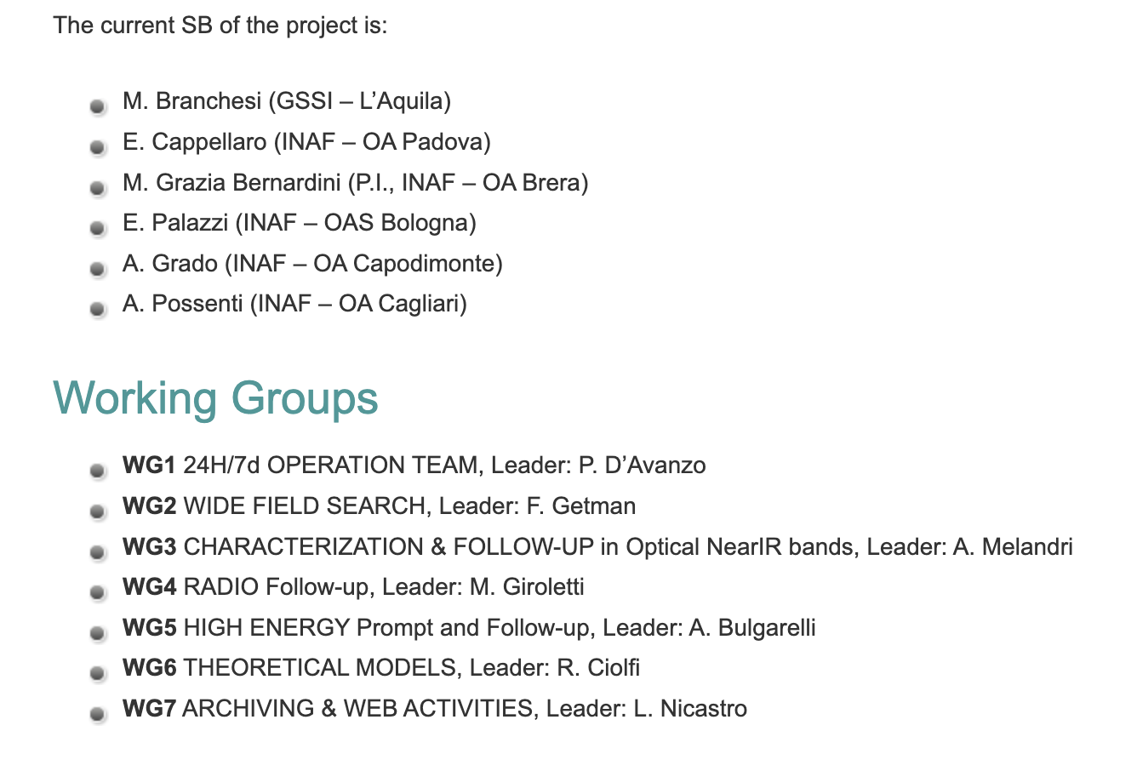
GRAWITA members are called for a revision of scopes and governance of the collaboration
Today >135 members across 8 INAF structures (including associated, PostDoc, PhD students)

