Slide 1





Multi-messenger astrophysics and cosmology with THESEUS Transient High-Energy Sky and Early Universe Surveyor
Lorenzo Amati
(INAF – OAS, on behalf of the THESEUS Consortium)
Multi-messenger astronomy in the Einstein Telescope era (Padova, 10 - 12 February 2026)

Slide 2
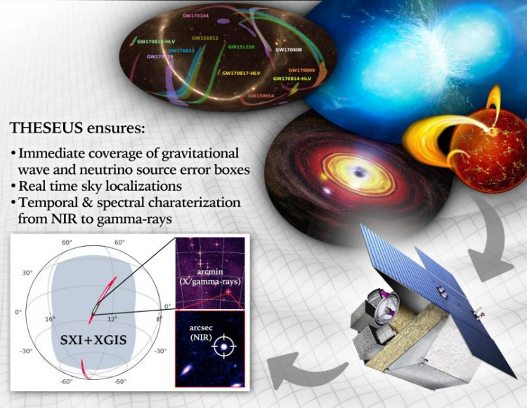
THESEUS core science goals
Probe the early Universe (first stars, first galaxies, cosmic reionization), by unveiling and exploiting the population of extremely distant cosmic Gamma - Ray Bursts (GRB)
Provide a fundamental contribution to multi-messenger and time domain astrophysics through GRB and other X/gamma-ray transient sources
Operate as a flexible multi-purpose and multiwavelength GO facility
Notes:
Presenter’s note:

Slide 3
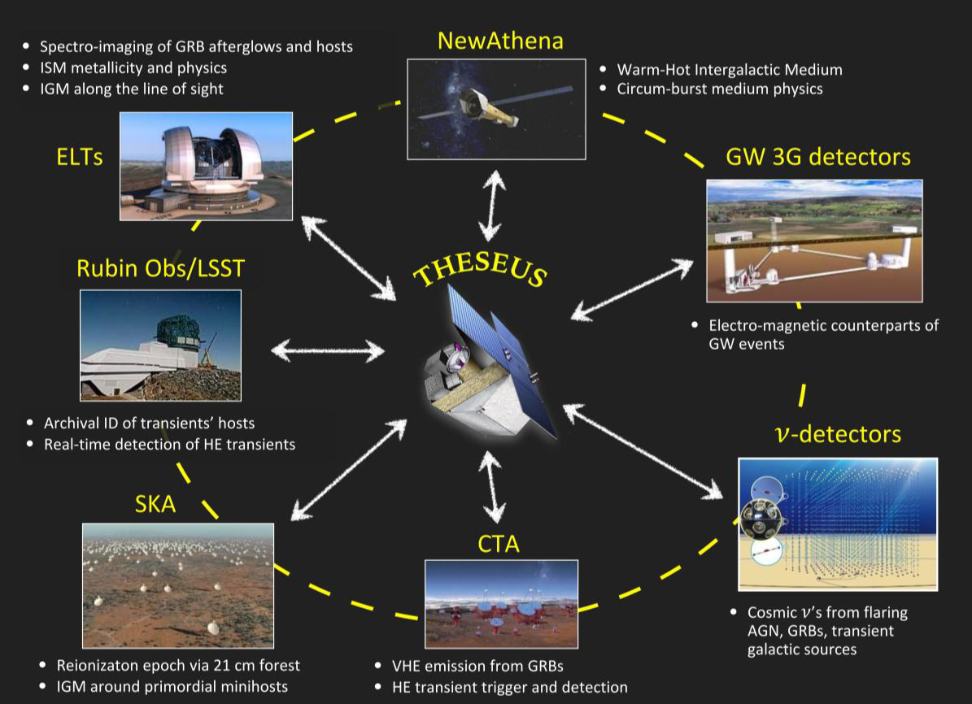
THESEUS: crucial synergies in the late ‘30s
New
The «M7» timeline will allow to widely broaden the mission scientific impact by taking advantage of the perfectly matched synergies with major facilities coming fully operative in the 2030s (e.g., 3G GW detectors)

Slide 4
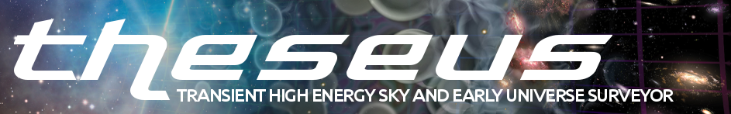
- 2018-2021: ESA Phase-A study (2018-2021) as M5 candidate - 2022: Selected for Phase 0 study (2023) within M7 process
- 2023: Selected for Phase-A study (2024-2026) as M7 candidate - M7 timeline: Phase-A (2024-2026), adoption 2028, launch 2037
Payload consortium: Italy, Germany, UK, France, Switzerland, Spain, Poland, Denmark, Belgium, Hungary, Czech Republic, Norway, Slovenia, Sweden (+The Netherlands, Ireland)
Leads: L. Amati (INAF – OAS Bologna, Italy, lead proposer), A. Santangelo (Un. Tuebingen, D), P. O’Brien (Un. Leicester, UK), D. Gotz (CEA-Paris, France), E. Bozzo (Un. Genève, CH)
Amati et al. 2018 ( Adv.Sp.Res., arXiv:1710.04638 )
Stratta et al. 2018 (Adv.Sp.Res., arXiv:1712.08153)
Articles for SPIE 2020 and Exp..Astr. (all on arXiv)
http://www.isdc.unige.ch/theseus
http://www.isdc.unige.ch/theseus/

Slide 5
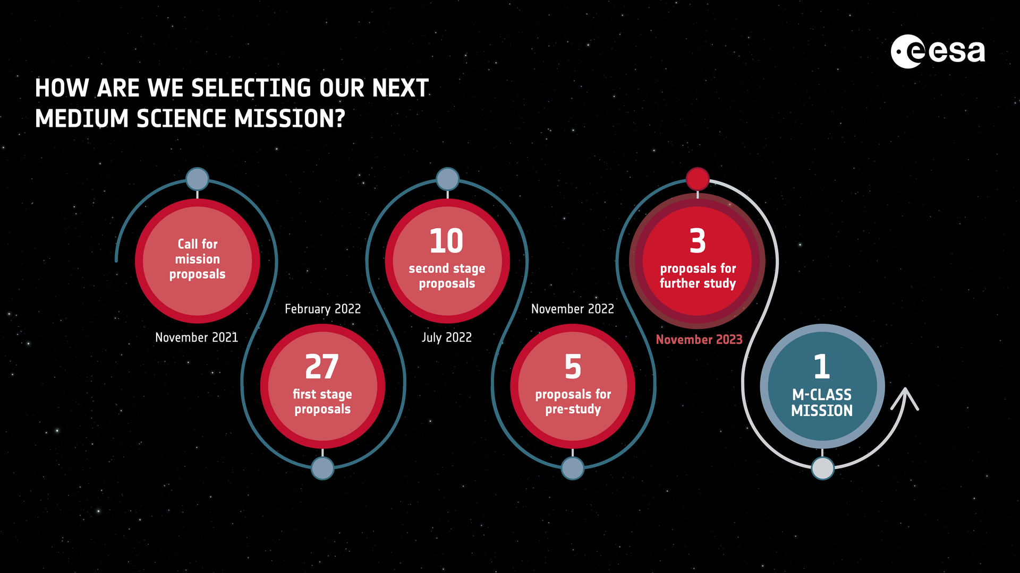
ESA/M7 Selection process
Phase-0 (2023): Calico, Haydn, M-Matisse, Plasma Observatory, THESEUS
Phase-A (2024-2026): M-Matisse, Plasma Observatory, THESEUS

Slide 6
M7 Phase-A timeline
Nov. 8th, 2023: SPC approval and ESA announcement of the three selected candidates (THESEUS, M-Matisse, Plasma Observ.)
Jan. 2024: ESA internal Phase-A KO (17th); ESA KO with Consortium (29th)
May. 2024: KO of industrial Phase-A
Mar. – Apr. 2025: Mission Consolidation Review (MCR)
Feb. – Apr. 2026: Mission Selection Review (MSR)
Apr. - May 2026: Final scientific evaluations (SARP, SSC)
June 2026: Selection of one M7 candidate for Phase-B1

Slide 7
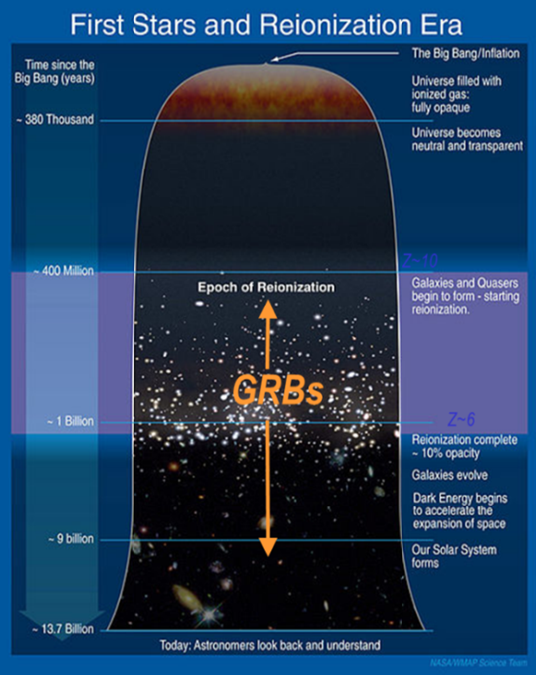
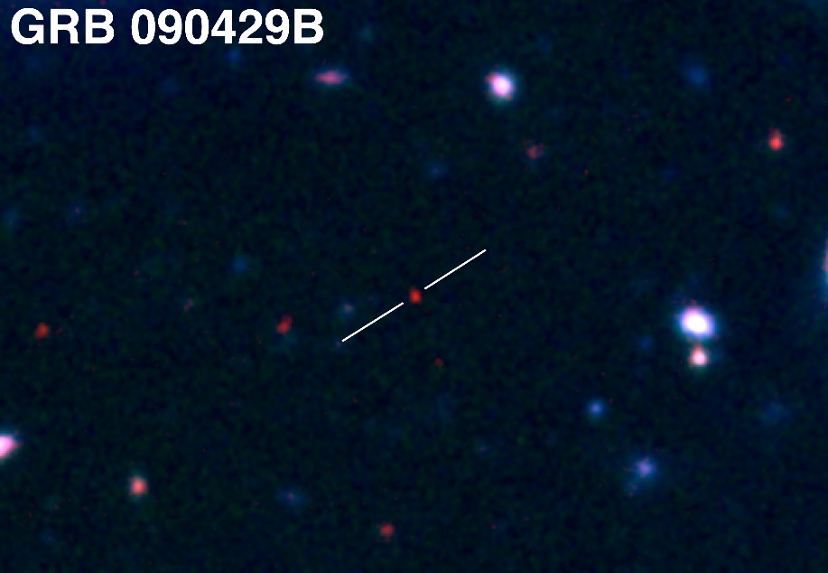
Shedding light on the early Universe with GRBs
Directly (or indirectly) detect the first population of stars (pop III)
Measure independently the cosmic star–formation rate, even beyond the limits of current and future galaxy surveys
Z = 9.4
Copyright: Gemini Observatory / AURA / Levan, Tanvir, Cucchiara

Slide 8
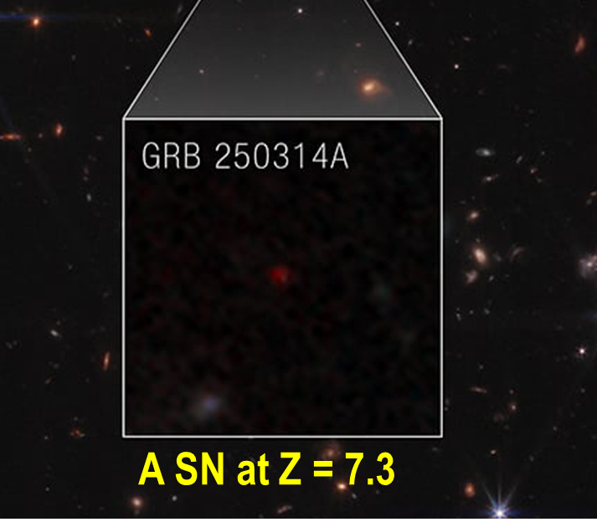
Shedding light on the early Universe with GRBs
Directly (or indirectly) detect the first population of stars (pop III)
Measure independently the cosmic star–formation rate, even beyond the limits of current and future galaxy surveys
Copyright: NASA/JWST Levan et al. 2025

Slide 9
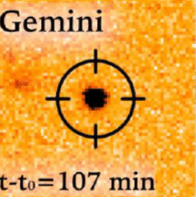
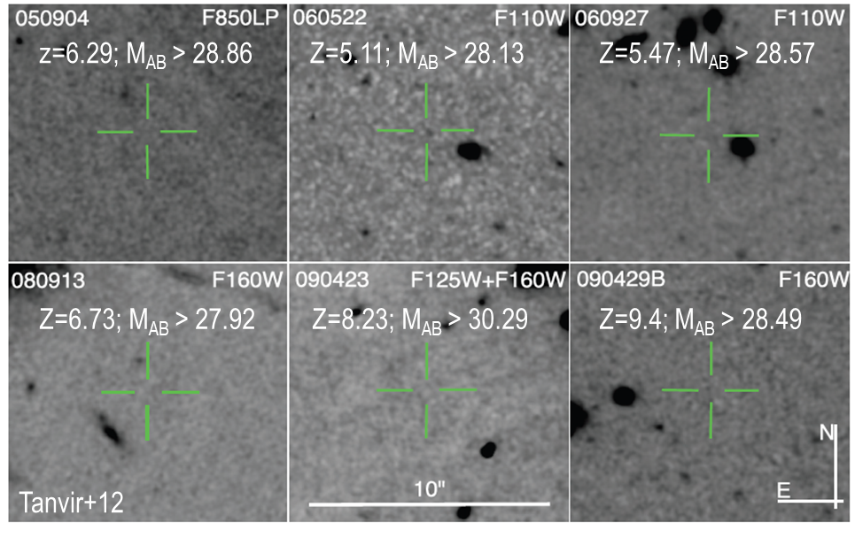
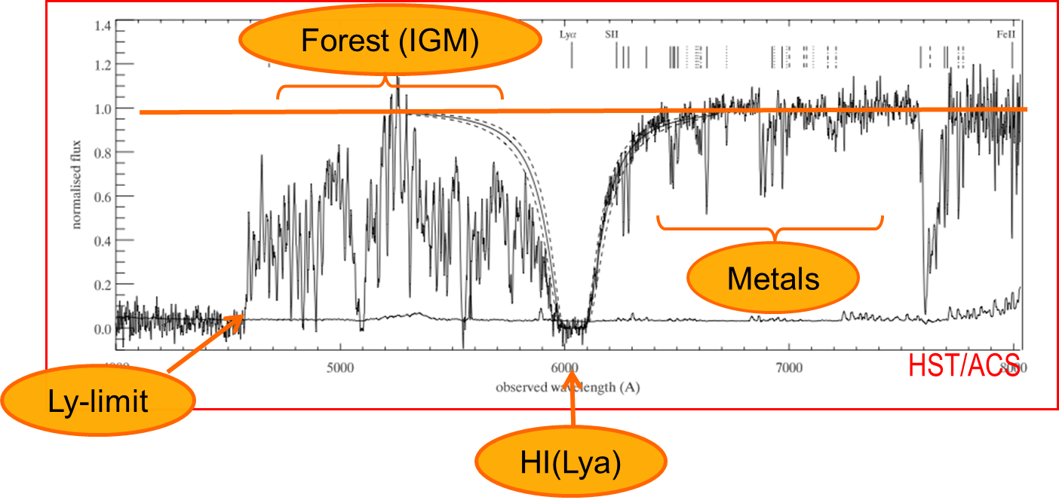
Detecting and studying primordial invisible galaxies
Robertson&Ellis12
Robertson&Ellis12

Slide 10
Detecting and studying primordial invisible galaxies
Beyond even JWST capabilities:
Primordial galaxies detection and characterization Independent on mass and luminosity
Allow absorption spectroscopy (needed because most metals are in neutral gas and and for dust ratio)
Properties of primordial IGM
Targets for JWST
Robertson&Ellis12
Robertson&Ellis12

Slide 11
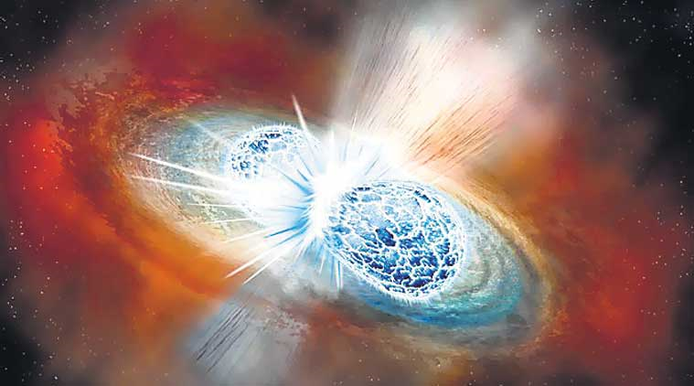
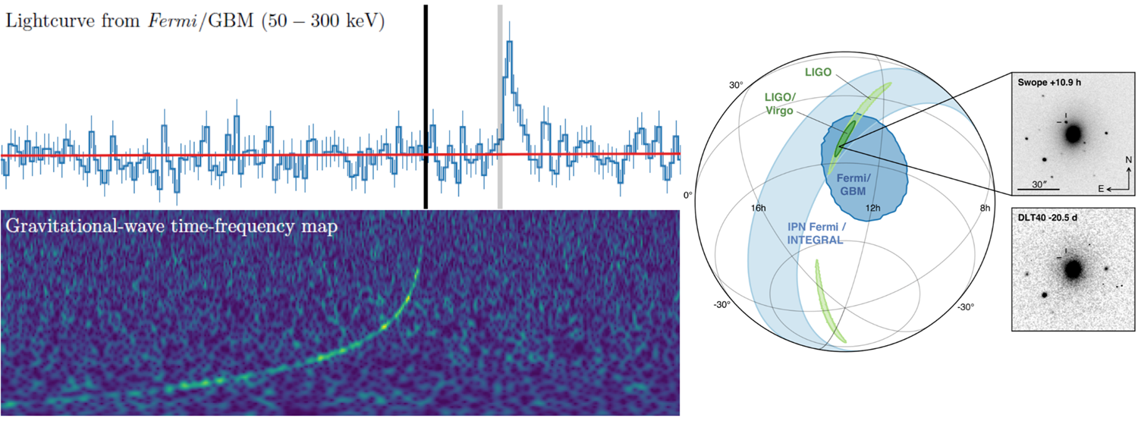
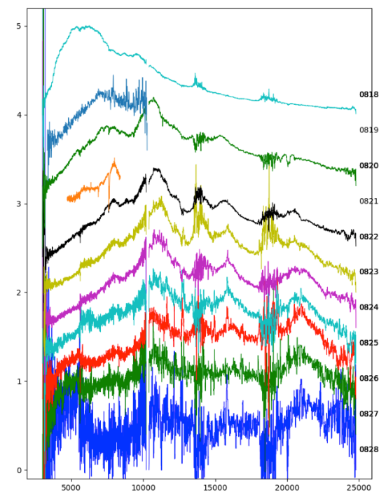
Multi-messenger science with THESEUS
GW170817 + GRB 170817A + KN AT2017GFO (~40 Mpc): the birth of multi-.messenger astrophysics
Notes:
Presenter’s note:

Slide 12
Multi-messenger science with THESEUS
THESEUS & 3G SCIENCE
Main topics | THESEUS role | What will we learn?
Physics of compact binaries | short GRB+GW detection and localization | relativistic jet formation mechanism/efficiency, remnant nature, NS EoS
Relativistic plasma | accurate sky coordinates of GW events associated with misaligned afterglows | Jet propagation, jet structure and its universality, NSBH vs NSNS
Physics of kilonova | accurate sky coordinates of GW events | Role of NS-NS/NSBH in r-process element nucleosynthesis
Fundamental physics | Identify counterparts for events at z>0.3 | Tests of modified gravity theories
Cosmology | accurate sky coordinates of GW events allowing redshift measurement | Independent H0 measure
:
Notes:
Presenter’s note:
With THESEUS & 2G++ we will move from GW+EM studies of single cases to a statistical approach, starting to build the full picture of compact binary coalescences and to answer questions that with 3G will find full confirmation

Slide 13
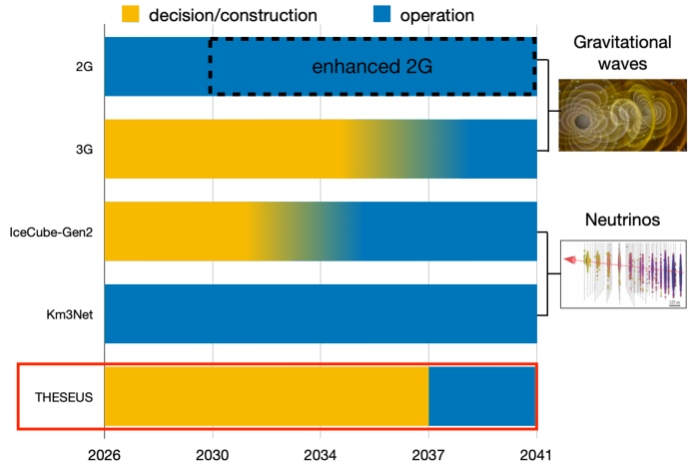
Multi-messenger science with THESEUS
M7 timeline: great synergy with netxt-gen GW and neutrinos detectors
Notes:
Presenter’s note:
Very brief explanation of the red and blue KN (we can take in case another figure). Focus on explain 1) the “standard short GRB”-aligned and “soft short GRB”-misaligned issue 2) the synergy with upgraded 2G to study KN and jet structure with off-axis afterglow 3) the statistical studies possible with synergies with 3G

Slide 14
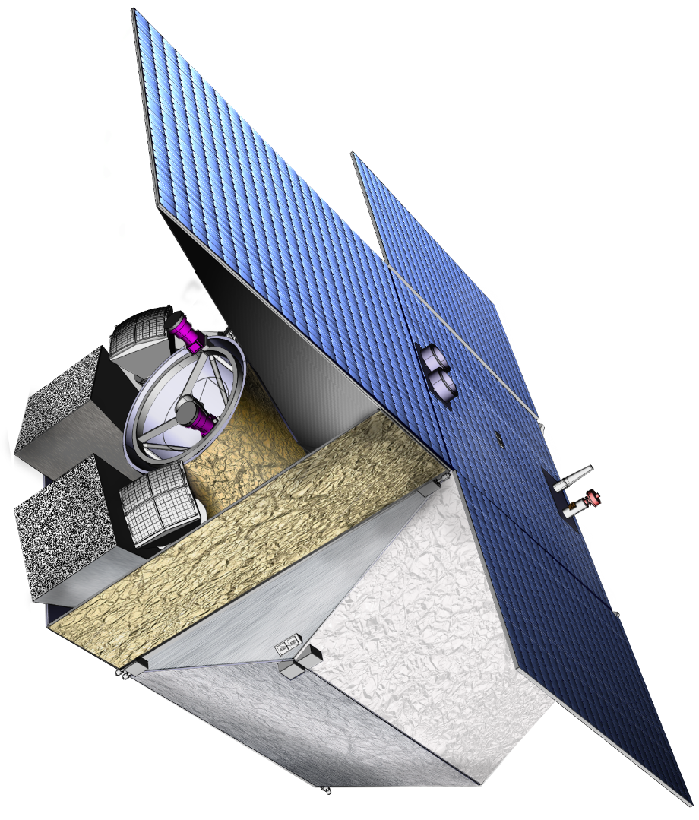
THESEUS Mission Concept
THIS BREAKTHROUGH WILL BE ACHIEVED BY A MISSION CONCEPT OVERCOMING MAIN LIMITATIONS OF CURRENT FACILITIES
Set of innovative wide-field monitors with unprecedented combination of broad energy range from gamma-rays down to soft X-rays, FOV and localization accuracy
Notes:
Presenter’s note:

Slide 15
THESEUS Mission Concept
THIS BREAKTHROUGH WILL BE ACHIEVED BY A MISSION CONCEPT OVERCOMING MAIN LIMITATIONS OF CURRENT FACILITIES
Set of innovative wide-field monitors with unprecedented combination of broad energy range from gamma-rays down to soft X-rays, FOV and localization accuracy
On-board autonomous fast follow-up in optical/NIR, arcsec location and redshift measurement of detected GRB/transients
Notes:
Presenter’s note:

Slide 16
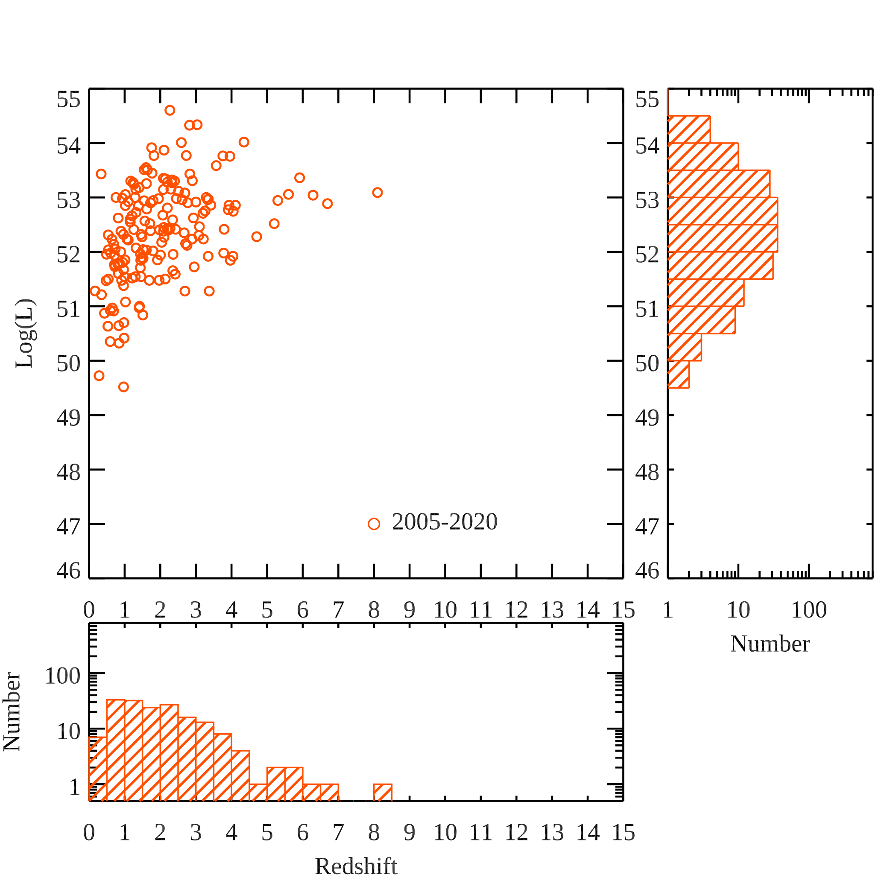
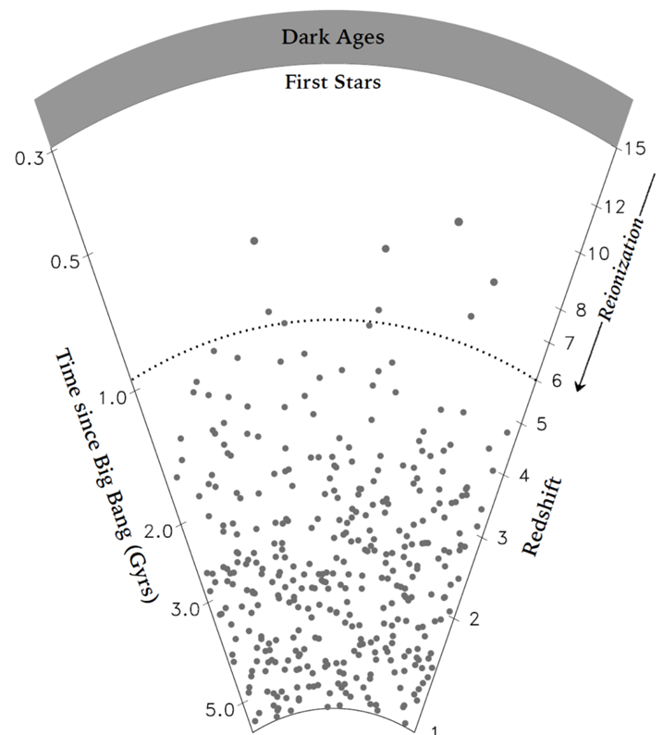
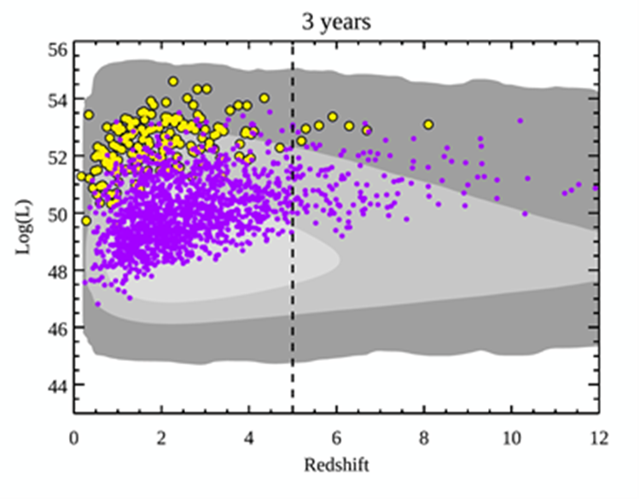
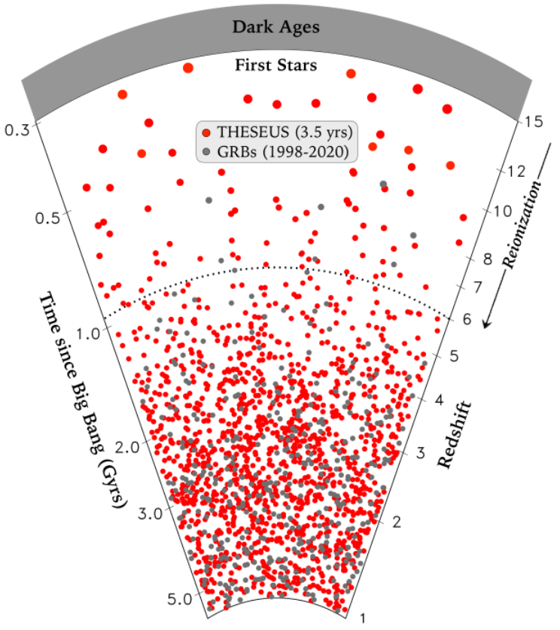
Expected performances: early Universe

Slide 17
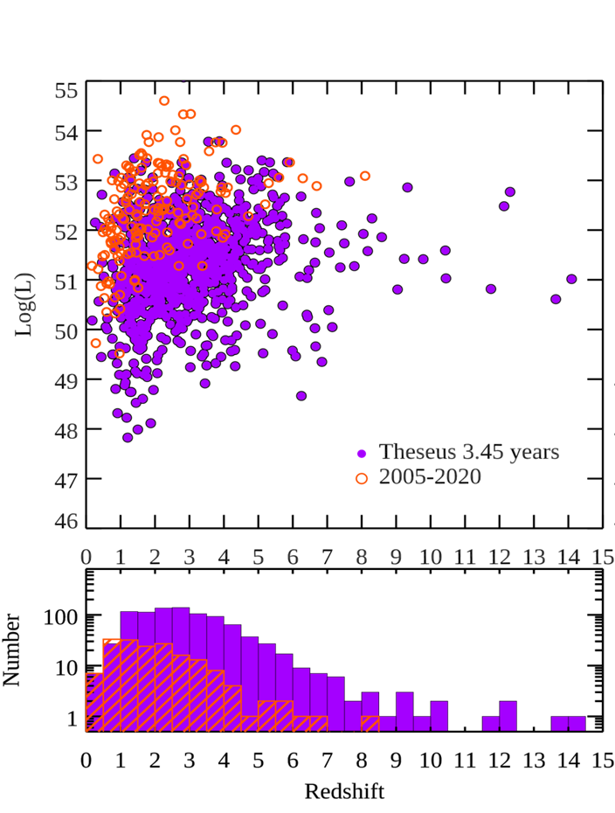
Expected performances: early Universe
Based on sophisticated Mission Observation Simulator by ESA

Slide 18

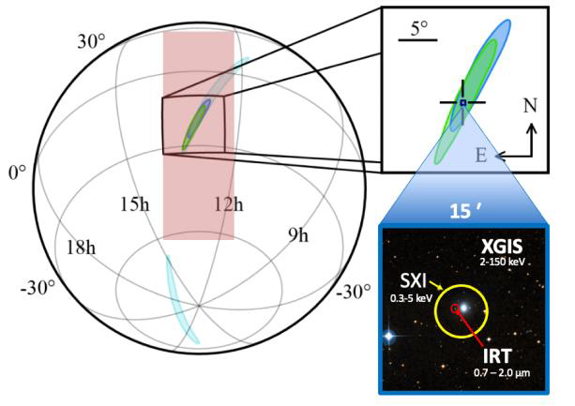
Multi-messenger science with THESEUS
THESEUS:
short GRB detection over large FOV with arcmin localization
Kilonova or IR afterglow detection, arcsec localization characterization
Possible detection of weaker isotropic X-ray emission

Slide 19
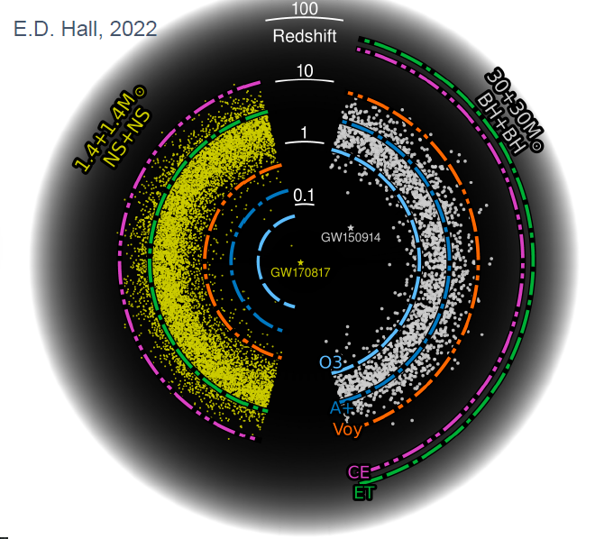
Multi-messenger science with THESEUS
M7 timeline: great synergy with 3G GW detectors (ET, CE)
Notes:
Presenter’s note:
Very brief explanation of the red and blue KN (we can take in case another figure). Focus on explain 1) the “standard short GRB”-aligned and “soft short GRB”-misaligned issue 2) the synergy with upgraded 2G to study KN and jet structure with off-axis afterglow 3) the statistical studies possible with synergies with 3G

Slide 20

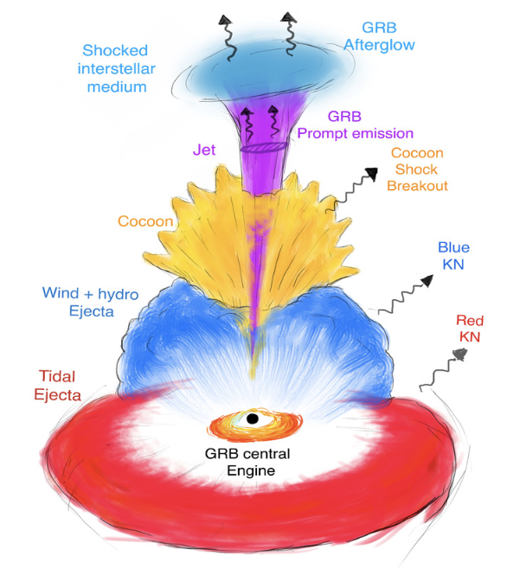
Multi-messenger science with THESEUS
INDEPENDENT DETECTION & CHARACTERISATION OF THE MULTI-MESSENGER SOURCES
Lessons from GRB170817A
Aligned GRBs
Misaligned GRBs
THESEUS + ET in 3 years:
~70 aligned+misaligned short GRB
additional long GRBs from mergers and possible GW-X-ray transients
Higher redshift events – X/𝛾 is likely only route to EM detection: larger statistical studies including source evolution, probe of dark energy and test modified gravity on cosmological scales
Notes:
Presenter’s note:
Very brief explanation of the red and blue KN (we can take in case another figure). Focus on explain 1) the “standard short GRB”-aligned and “soft short GRB”-misaligned issue 2) the synergy with upgraded 2G to study KN and jet structure with off-axis afterglow 3) the statistical studies possible with synergies with 3G

Slide 21
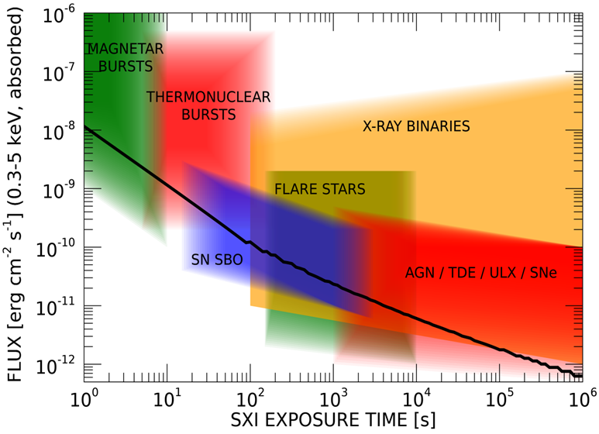
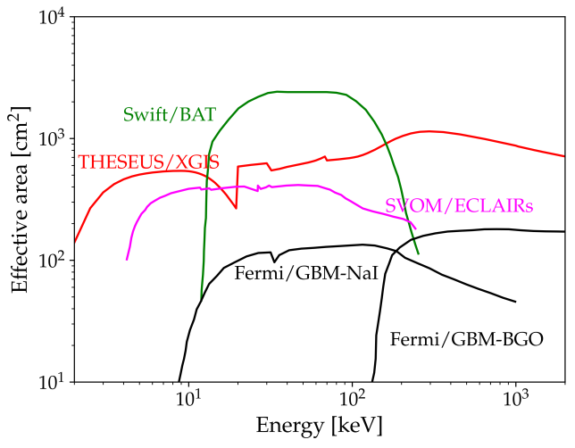
Exploring the transient sky
GRBs extreme emission physics, central engine, sub-classes & progenitors, cosmological parameters & fundamental physics
Study of many classes of X-ray sources by exploiting the simultaneous broad band X-ray and NIR observations
Provide a flexible follow-up observatory for fast transient events with multi-wavelength ToO capabilities and guest-observer programmes

Slide 22






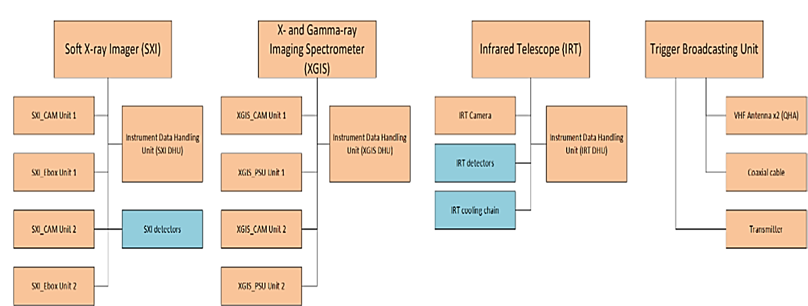









THESEUS responsibilities for M7
IRT Telescope
P/L system Master DHU
Science Data Centre
Main ground station & Fast Alert Broadcasting system
Notes:
Presenter’s note:

Slide 23
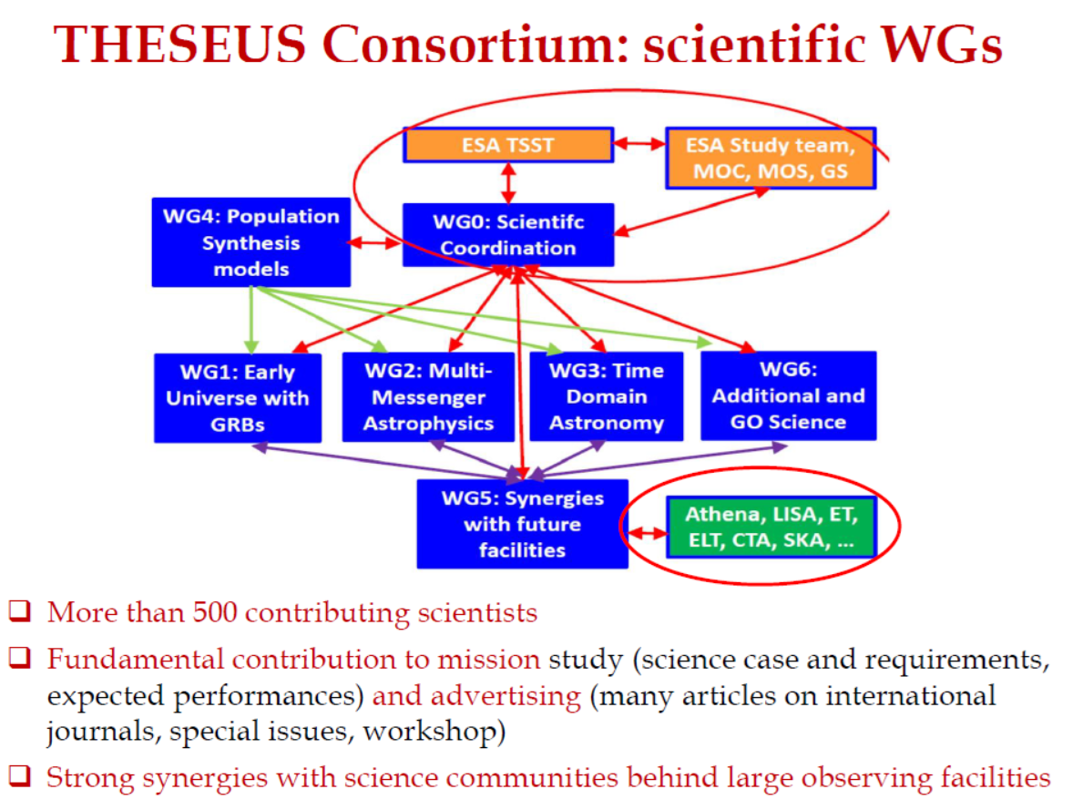

Slide 24
THESEUS: crucial synergies in the late ‘30s
New
THESEUS: perfectly matched synergies with major facilities coming fully operative in the 2030s with relevant INAF contributions: naturally part of GRAWITA and greatly synergic with Einstein Telescope

Slide 25
Back-up slides

Slide 26
THESEUS will have a combination of instrumentation and mission profile allowing the detection of all types of GRBs (long, short/hard, weak/soft, high-redshift) and provide accurate location and redshift measurement for a large fraction of them
Fermi/GBM
GRB170817A/GW170817
High-redshift

Slide 27
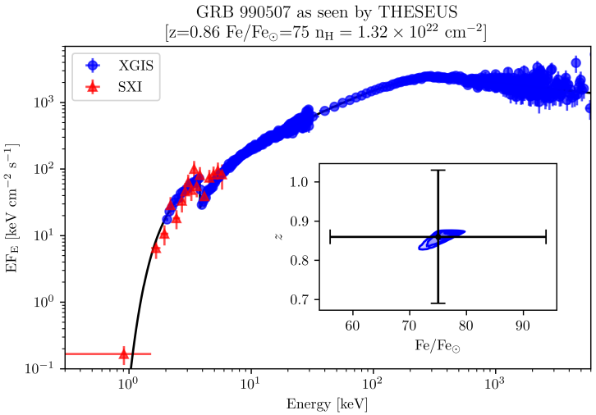
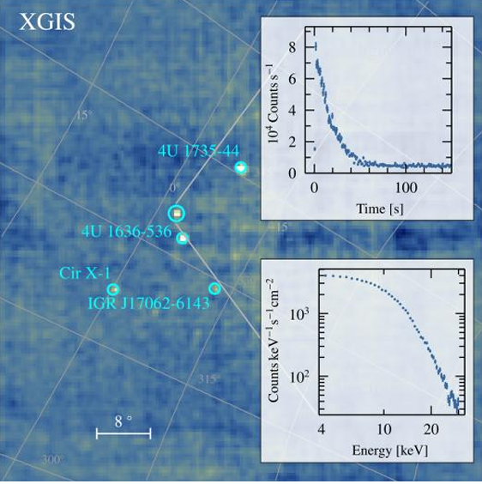
Exploring the transient sky
GRBs extreme emission physics, central engine, sub-classes & progenitors
Study of many classes of X-ray sources by exploiting the simultaneous broad band X-ray and NIR observations
XGIS + SXI wide band spectrum of a GRB with ab absorption feature at 3 keV (progenitor, redshift
XGIS study of galactic hard X-ray sources

Slide 28
GRBs extreme and fundamental physics
THESEUS will measure the prompt and early afterglow emission of thousand GRBs over an unprecedented huge energy band (0.3 keV – 10 MeV) with great sensitivity, timing and spectroscopic capabilities, plus NR afterglow and redshift measurement

Slide 29
Detecting and studying primordial invisible galaxies
Robertson&Ellis12
Even JWST and ELTs surveys will be not able to probe the faint end of the galaxy Luminosity Function at high redshifts (z>6-8)

Slide 30
Expected performances: early Universe
THESEUS detection+identification rate of GRBs at z > 6 will be about 10 – 15 times larger than current scenario including EP and SVOM (about 1 GRB at z>6 per year expected, consistent with observations)
The nominal duration of 3.5 years is just a reference, there are no technical limitations preventing THESEUS to live 10, 20 years or more -> at least 150 GRBs at z > 6

Slide 31
The Leading Italian contribution to THESEUS
Consortium coordination: INAF/ASI (LP, project office
XGIS: INAF (OAS, IASF-MI, IASF-PA, …), Universities (Politecnico Milano, Univ. Pavia, Univ. Ferrara, Univ. Udine), FBK Trento, OHB-I
IRT optical assembly: INAF (Brera, OAS, …), Univerisities: Politecnico di Milano, CISAS – Univ. Padova, Media Lario
Malindi ground station: ASI (in-kind contribution)
Science: INAF (Lead Scientist; OAS, IASF-MI, Oss. Brera, IAPS, IASF-PA, Oss. Napoli, Oss. Roma, …), Universities (e.g., Univ. Ferrara, Pol. Milano, SNS Pisa, Univ. Federico II Napoli, Univ. Urbino, …), INFN (Fe,Ts,Na,…)
Great heritage and leadership in the main scientific fields and key enabling technologies
Notes:
Presenter’s note:
LOFT is being designed to address one of the key science themes of Cosmic Vision: matter under extreme conditions.
Two are the objectives at the core of the LOFT mission:
- First, to probe the state of matter at supra nuclear densities, the ones only reached in the interiors of Neutron Stars.
- Second, to probe the theory of gravity, general relativity, in the very strong environment of Black holes.
LOFT is therefore an observatory designed to probe two key questions of nature, through astrophysics.
But of course LOFT is an observatory and will explore, in addition to its core science, the physics of hundred of
galactic and extragalactic sources.

Slide 32
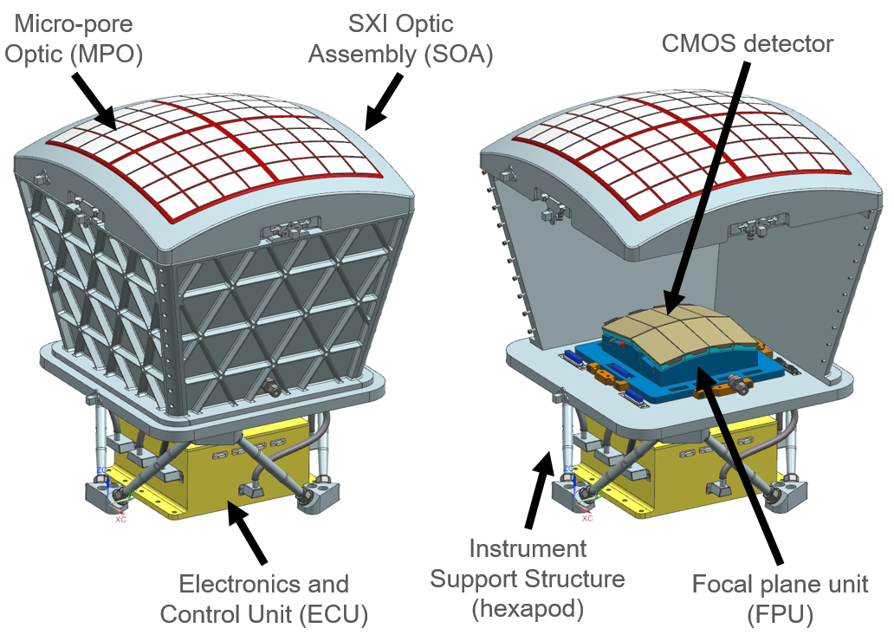
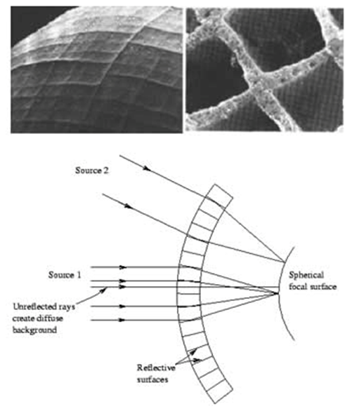
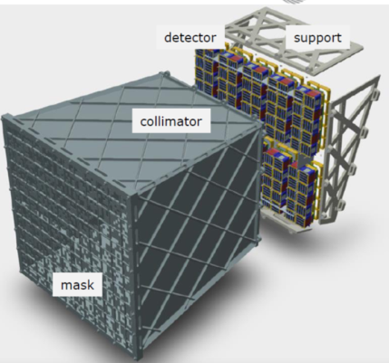
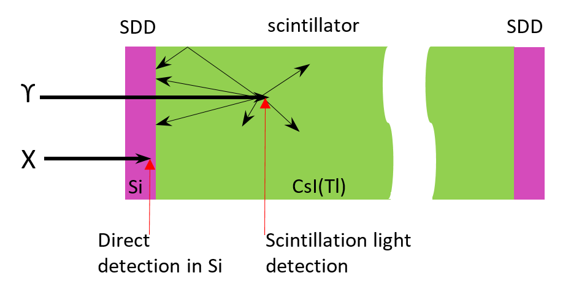
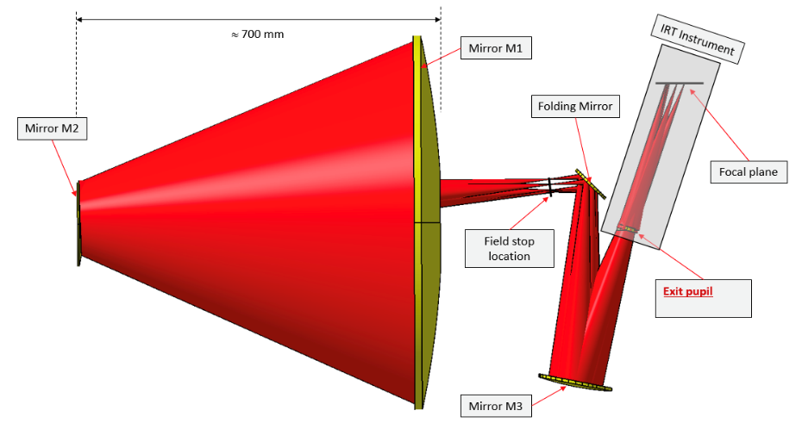
THESEUS Mission Concept
Soft X-ray Imager (SXI): a set of two sensitive lobster-eye telescopes observing in 0.3 - 5 keV band, total FOV of ~0.5sr with source location accuracy <2’
X-Gamma rays Imaging Spectrometer (XGIS): 2 coded-mask X-gamma ray cameras using Silicon drift detectors coupled with CsI crystal scintillator bars observing in 2 keV – 10 MeV band, a FOV of >2 sr, overlapping the SXI, with < 7’ location accuracy for 90% of detected GRBs
InfraRed Telescope (IRT): a 0.7m class IR telescope observing in the 0.7 – 1.8 μm band, providing a 15’x15’ FOV, with both imaging and moderate resolution spectroscopy capabilities
Y_{IRTOR}
Z_{IRTOR}
Notes:
Presenter’s note:

Slide 33
The X-Gamma Ray Imaging Spectrometer (XGIS)
Soft X-ray Imager (SXI): a set of two sensitive lobster-eye telescopes observing in 0.3 - 5 keV band, total FOV of ~0.5sr with source location accuracy <2’
X-Gamma rays Imaging Spectrometer (XGIS): 2 coded-mask X-gamma ray cameras using Silicon drift detectors coupled with CsI crystal scintillator bars observing in 2 keV – 10 MeV band, a FOV of >2 sr, overlapping the SXI, with < 7’ location accuracy for 90% of detected GRBs
InfraRed Telescope (IRT): a 0.7m class IR telescope observing in the 0.7 – 1.8 μm band, providing a 15’x15’ FOV, with both imaging and moderate resolution spectroscopy capabilities
Y_{IRTOR}
Z_{IRTOR}
Notes:
Presenter’s note:

Slide 34
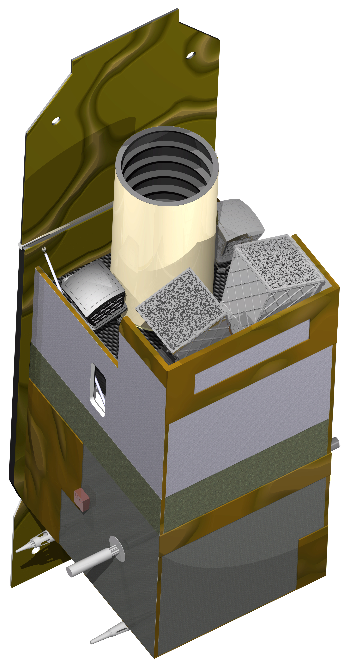
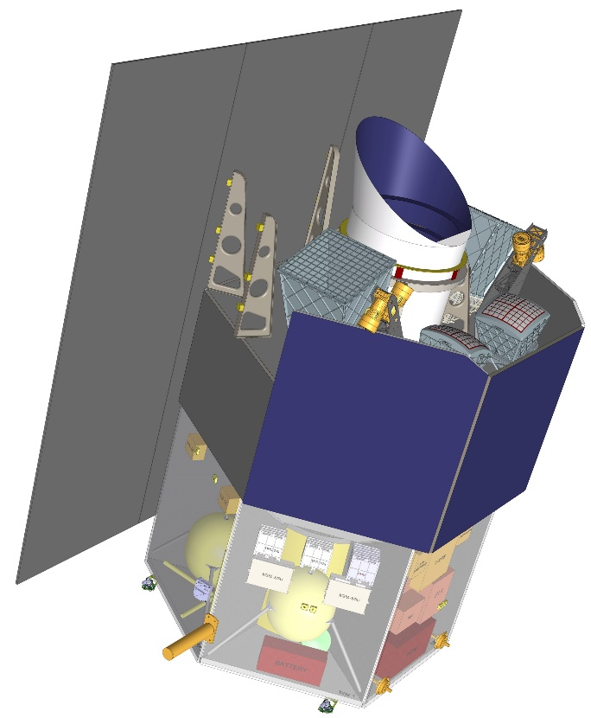
THESEUS Mission Concept
Fast slewing capability (>10°/min), granting prompt NIR follow-up of GRBs and transients
Low-Earth Orbit (LEO), with about 5.4° inclination and 600 km altitude, granting low and stable BKG for the monitors
The weight (about 2 tons dry mass) and dimensions are suitable for launch with VEGA-E (or even VEGA-C)
(ADS)
(THALES)
Notes:
Presenter’s note:

Slide 35
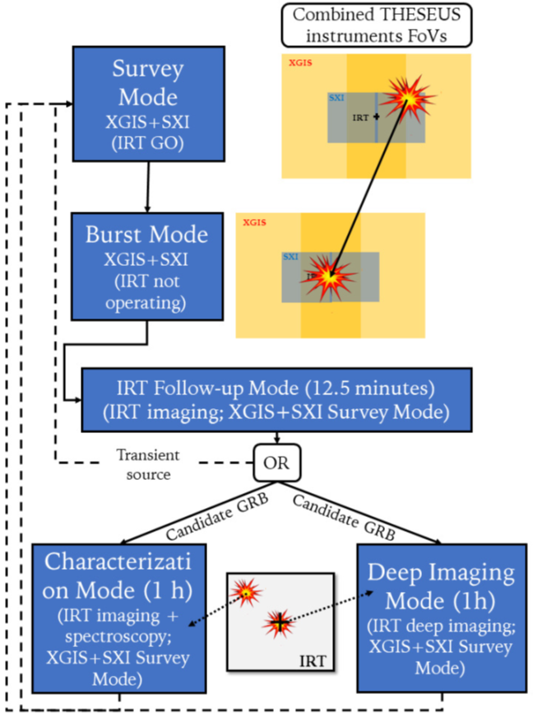
Mission Operation Concept

Slide 36

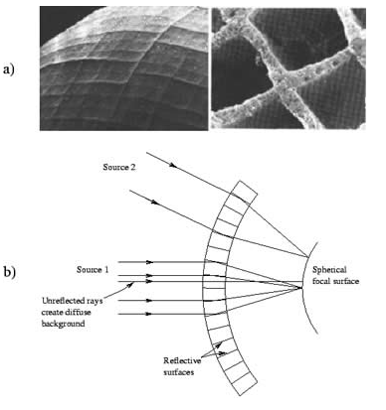

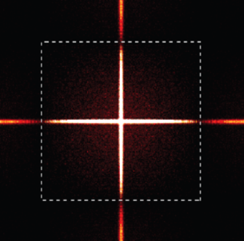

The Soft X-Ray Imager (SXI)
Two sensitive “lobster-eye” X-ray telescopes (0.3 - 5 keV); total FOV of 0.5sr (>1000 $×$ conventional X-ray telescopes); 100ms photon timing; source location accuracy <2’
Mimic a lobster-eye using curved, square-pore MPOs
No single optical axis: get a wide field of view plus focusing with constant effective area
Spot (double reflection) Lines (single reflections)
Notes:
Presenter’s note:
LOFT is being designed to address one of the key science themes of Cosmic Vision: matter under extreme conditions.
Two are the objectives at the core of the LOFT mission:
- First, to probe the state of matter at supra nuclear densities, the ones only reached in the interiors of Neutron Stars.
- Second, to probe the theory of gravity, general relativity, in the very strong environment of Black holes.
LOFT is therefore an observatory designed to probe two key questions of nature, through astrophysics.
But of course LOFT is an observatory and will explore, in addition to its core science, the physics of hundred of
galactic and extragalactic sources.

Slide 37
The Soft X-Ray Imager (SXI)
2 identical SXI modules:
Focal length: 300mm
Optic: 8x8 array of plates
Focal plane: 8 CMOS detectors
0.5sr total field of view
SXI will show a unique combination of FOV and effective area (GRASP), enabling simulatneous detection and localization of many transients in parallel.
Notes:
Presenter’s note:
LOFT is being designed to address one of the key science themes of Cosmic Vision: matter under extreme conditions.
Two are the objectives at the core of the LOFT mission:
- First, to probe the state of matter at supra nuclear densities, the ones only reached in the interiors of Neutron Stars.
- Second, to probe the theory of gravity, general relativity, in the very strong environment of Black holes.
LOFT is therefore an observatory designed to probe two key questions of nature, through astrophysics.
But of course LOFT is an observatory and will explore, in addition to its core science, the physics of hundred of
galactic and extragalactic sources.

Slide 39

The X-Gamma Ray Imaging Spectrometer (XGIS)
Two coded-mask X-gamma ray cameras using innovative coupling between Silicon drift detectors (2-30 keV) and CsI crystal scintillator bars (20 keV–10 MeV)
Notes:
Presenter’s note:
LOFT is being designed to address one of the key science themes of Cosmic Vision: matter under extreme conditions.
Two are the objectives at the core of the LOFT mission:
- First, to probe the state of matter at supra nuclear densities, the ones only reached in the interiors of Neutron Stars.
- Second, to probe the theory of gravity, general relativity, in the very strong environment of Black holes.
LOFT is therefore an observatory designed to probe two key questions of nature, through astrophysics.
But of course LOFT is an observatory and will explore, in addition to its core science, the physics of hundred of
galactic and extragalactic sources.

Slide 40
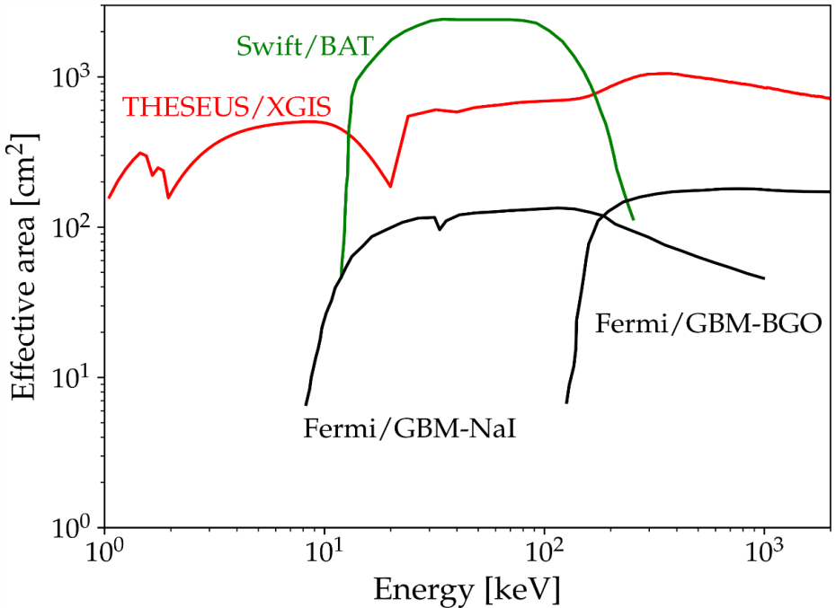
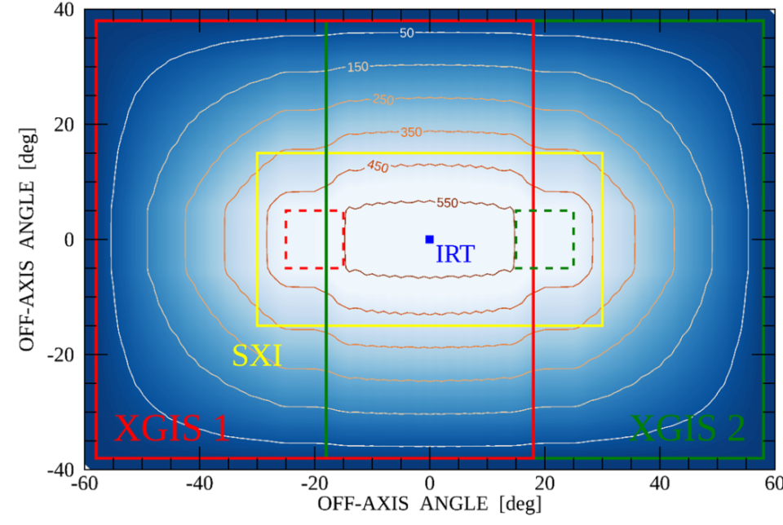
The X-Gamma Ray Imaging Spectrometer (XGIS)
Unprecedented energy band (2 keV – 10 MeV)
Large effective area down to 2 keV
FOV >2 sr overlapping the SXI one
GRB location accuracy <15’ in 2-150 keV
Excellent timing (< a few μs)
Notes:
Presenter’s note:
LOFT is being designed to address one of the key science themes of Cosmic Vision: matter under extreme conditions.
Two are the objectives at the core of the LOFT mission:
- First, to probe the state of matter at supra nuclear densities, the ones only reached in the interiors of Neutron Stars.
- Second, to probe the theory of gravity, general relativity, in the very strong environment of Black holes.
LOFT is therefore an observatory designed to probe two key questions of nature, through astrophysics.
But of course LOFT is an observatory and will explore, in addition to its core science, the physics of hundred of
galactic and extragalactic sources.

Slide 41
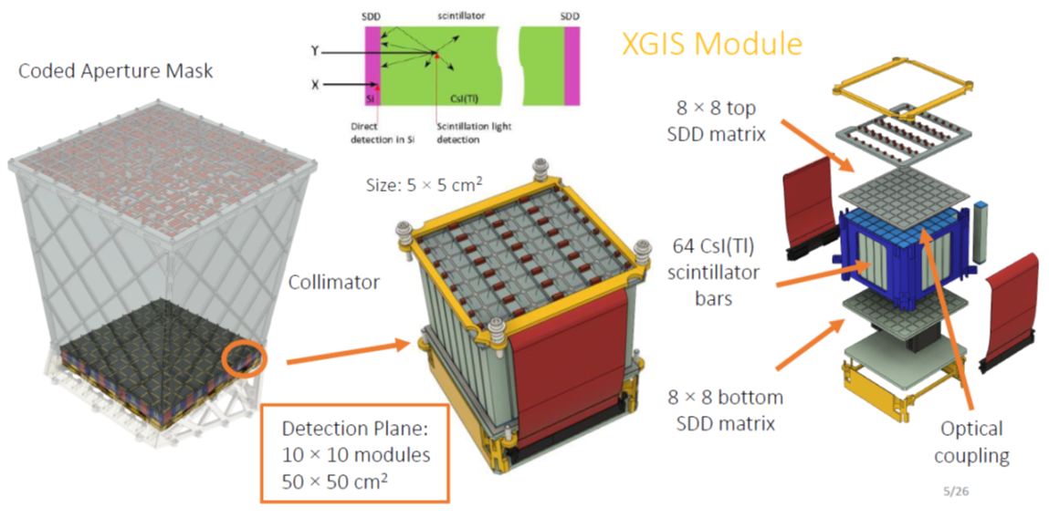
Modularity and high-TRL

Slide 42
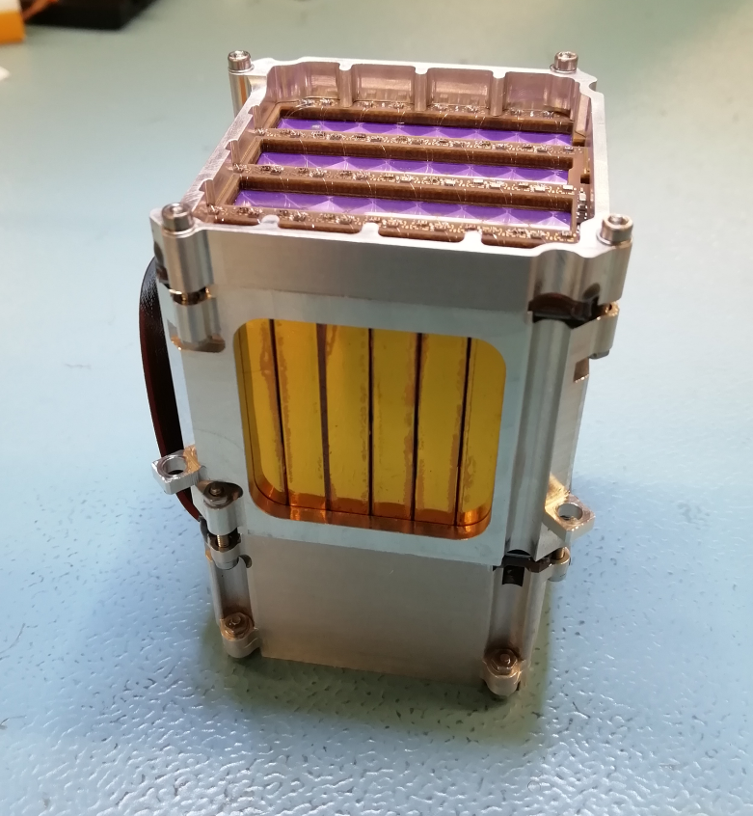
Modularity and high-TRL

Slide 43
The Infra-Red Telescope (IRT)
A 0.7 m class telescope with an off-axis Korsch optical design allowing for a large field of view (15’x15’) with imaging and moderate (R~400) spectroscopic capabilities
Mimic a lobster-eye using curved, square-pore MPOs
Teledyne H2RG sensitive in 0.7-1.8 microns
Expected sensitivity per filter (over 150 s): 20.9 (I), 20.7 (Z), 20.4 (Y), 21.1 (J), 21.1(H). Spectral sensitivity limit (over 1800 s), about 17.5 (H) over the 0.8-1.6 microns
Y_{IRTOR}
Z_{IRTOR}
Notes:
Presenter’s note:
LOFT is being designed to address one of the key science themes of Cosmic Vision: matter under extreme conditions.
Two are the objectives at the core of the LOFT mission:
- First, to probe the state of matter at supra nuclear densities, the ones only reached in the interiors of Neutron Stars.
- Second, to probe the theory of gravity, general relativity, in the very strong environment of Black holes.
LOFT is therefore an observatory designed to probe two key questions of nature, through astrophysics.
But of course LOFT is an observatory and will explore, in addition to its core science, the physics of hundred of
galactic and extragalactic sources.

Slide 44
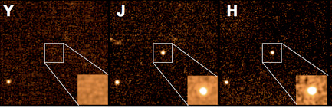
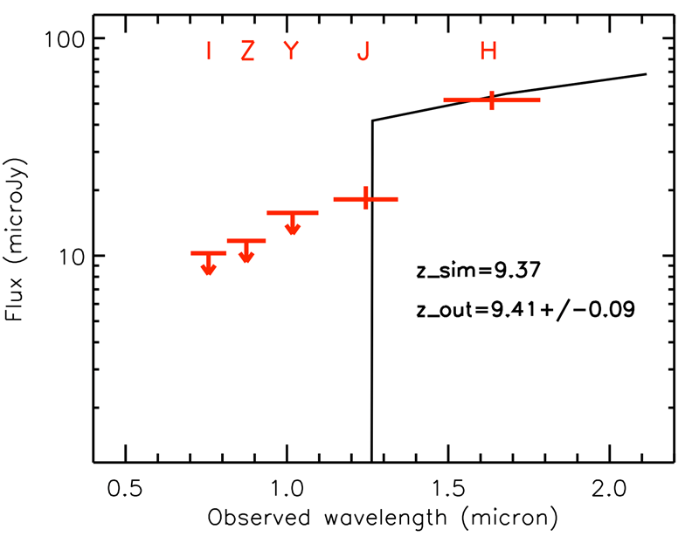
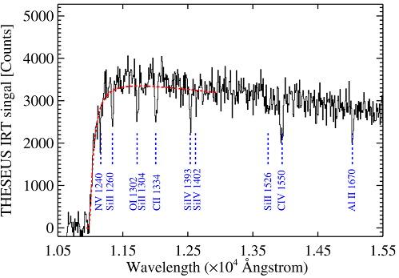
The Infra-Red Telescope (IRT)
On-board photometric redshift for >90% detected GRB afterglows
On-board sensitive absorption spectrosocpy for medium-bright events
Notes:
Presenter’s note:
LOFT is being designed to address one of the key science themes of Cosmic Vision: matter under extreme conditions.
Two are the objectives at the core of the LOFT mission:
- First, to probe the state of matter at supra nuclear densities, the ones only reached in the interiors of Neutron Stars.
- Second, to probe the theory of gravity, general relativity, in the very strong environment of Black holes.
LOFT is therefore an observatory designed to probe two key questions of nature, through astrophysics.
But of course LOFT is an observatory and will explore, in addition to its core science, the physics of hundred of
galactic and extragalactic sources.

Slide 45
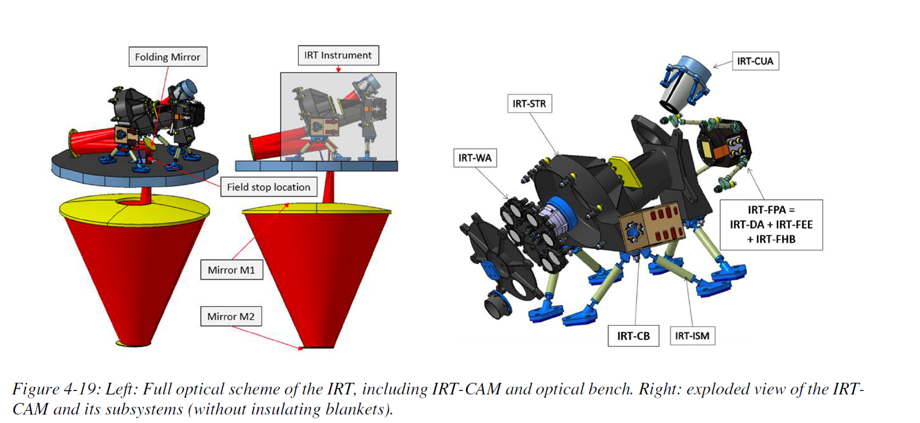
The Infra-Red Telescope (IRT)
Notes:
Presenter’s note:
LOFT is being designed to address one of the key science themes of Cosmic Vision: matter under extreme conditions.
Two are the objectives at the core of the LOFT mission:
- First, to probe the state of matter at supra nuclear densities, the ones only reached in the interiors of Neutron Stars.
- Second, to probe the theory of gravity, general relativity, in the very strong environment of Black holes.
LOFT is therefore an observatory designed to probe two key questions of nature, through astrophysics.
But of course LOFT is an observatory and will explore, in addition to its core science, the physics of hundred of
galactic and extragalactic sources.

Slide 46
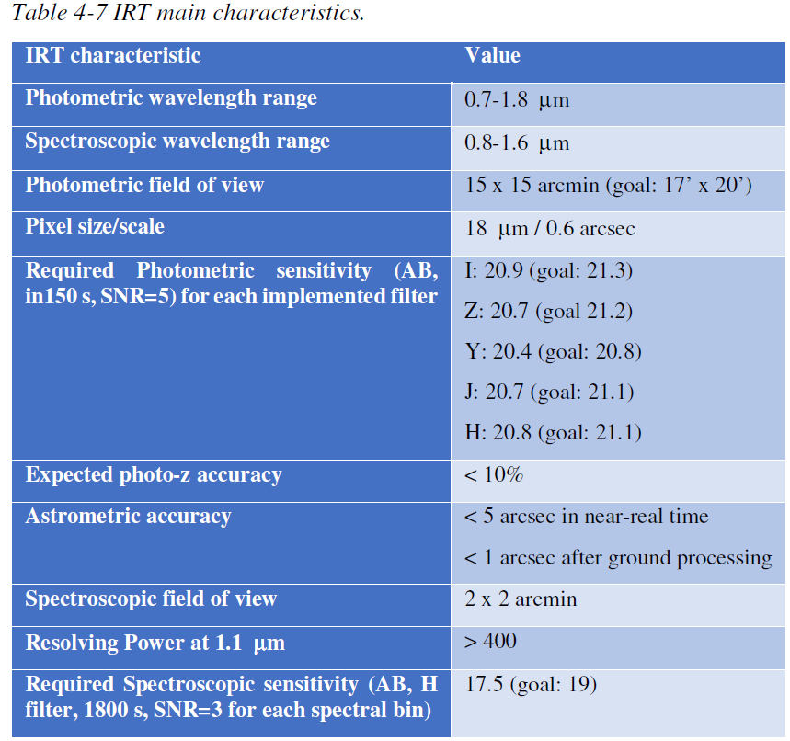

Slide 47
