Slide 1




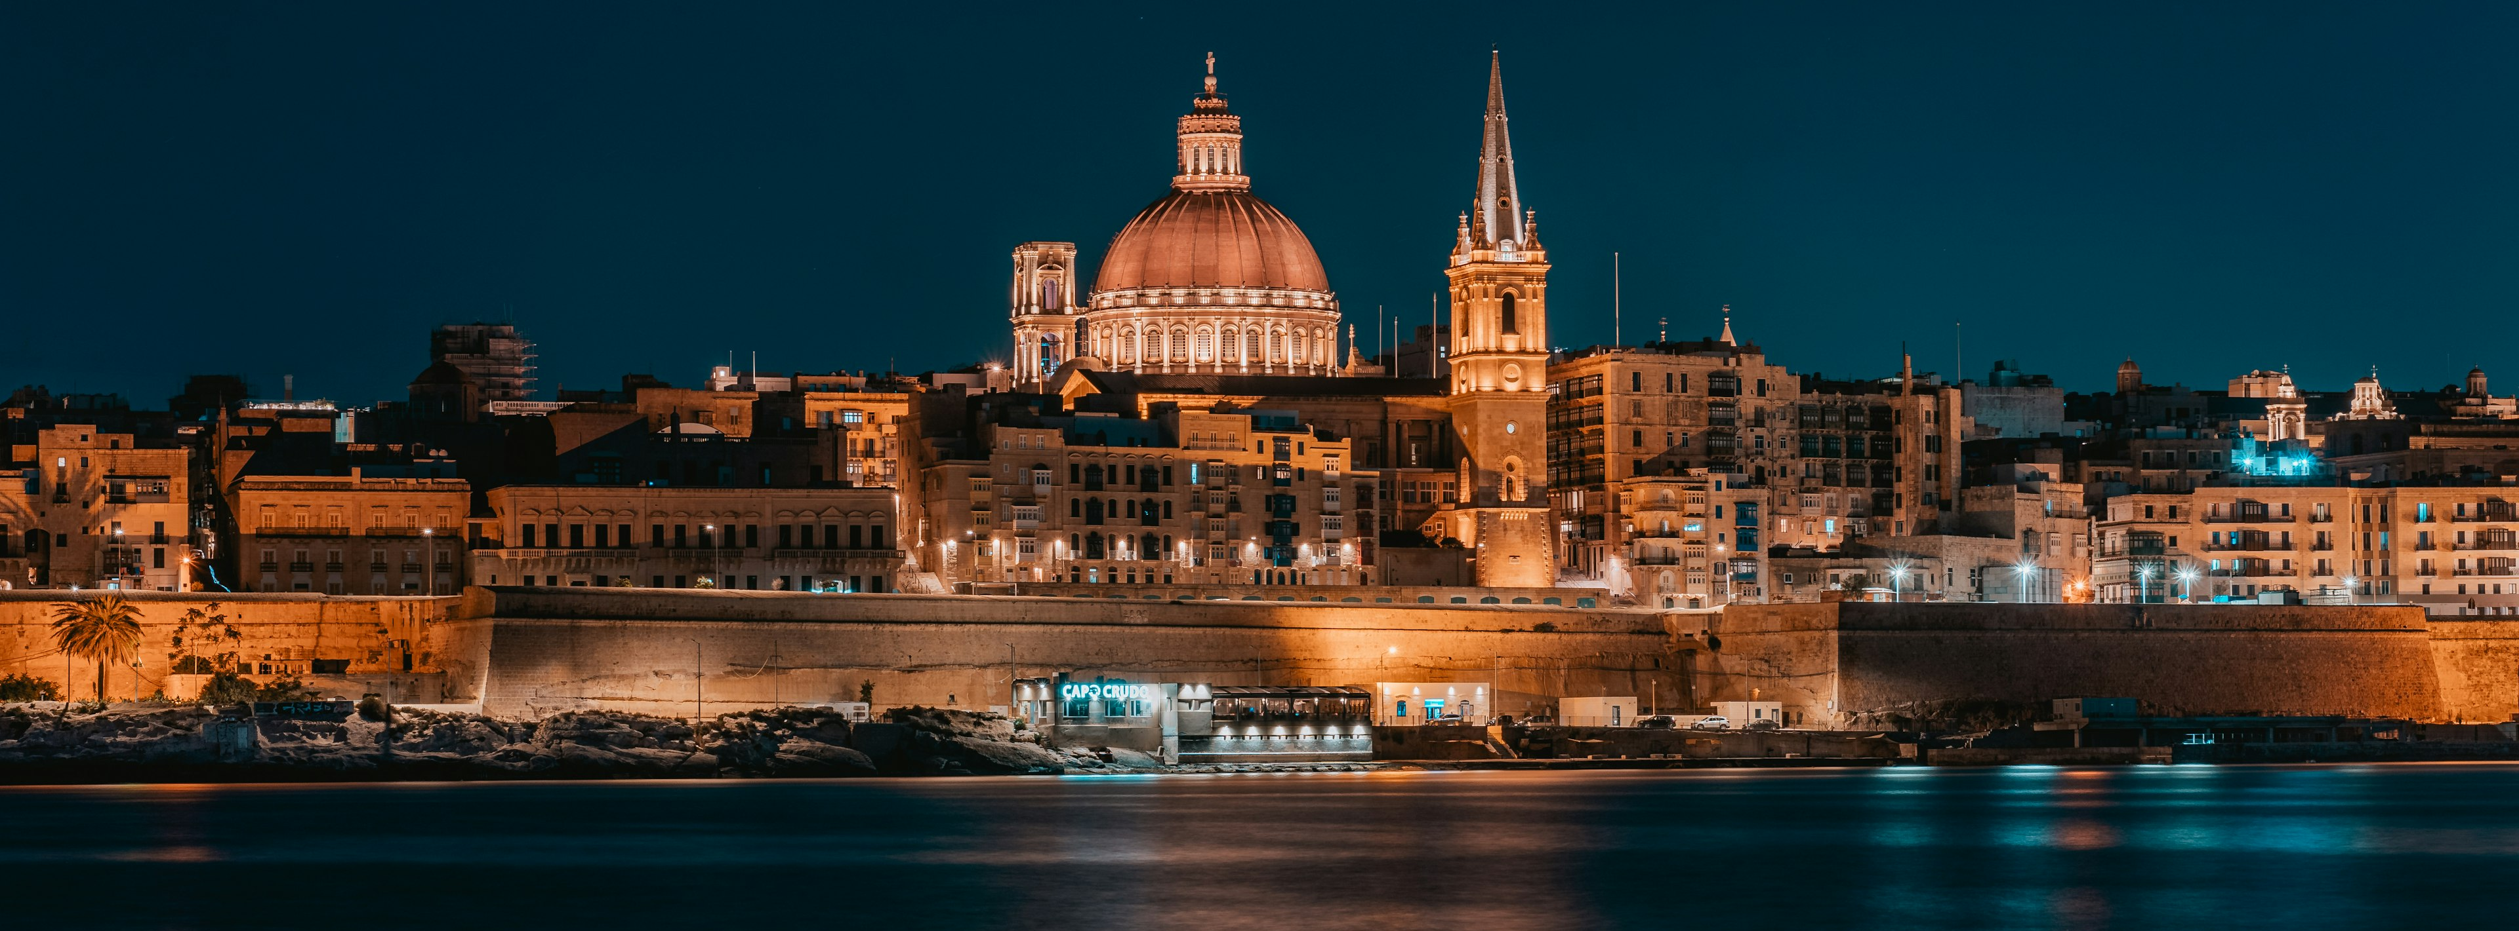
The 3rd International Conference on Machine Learning for Astrophysics
Alessio Magro, SOC & LOC

Slide 2
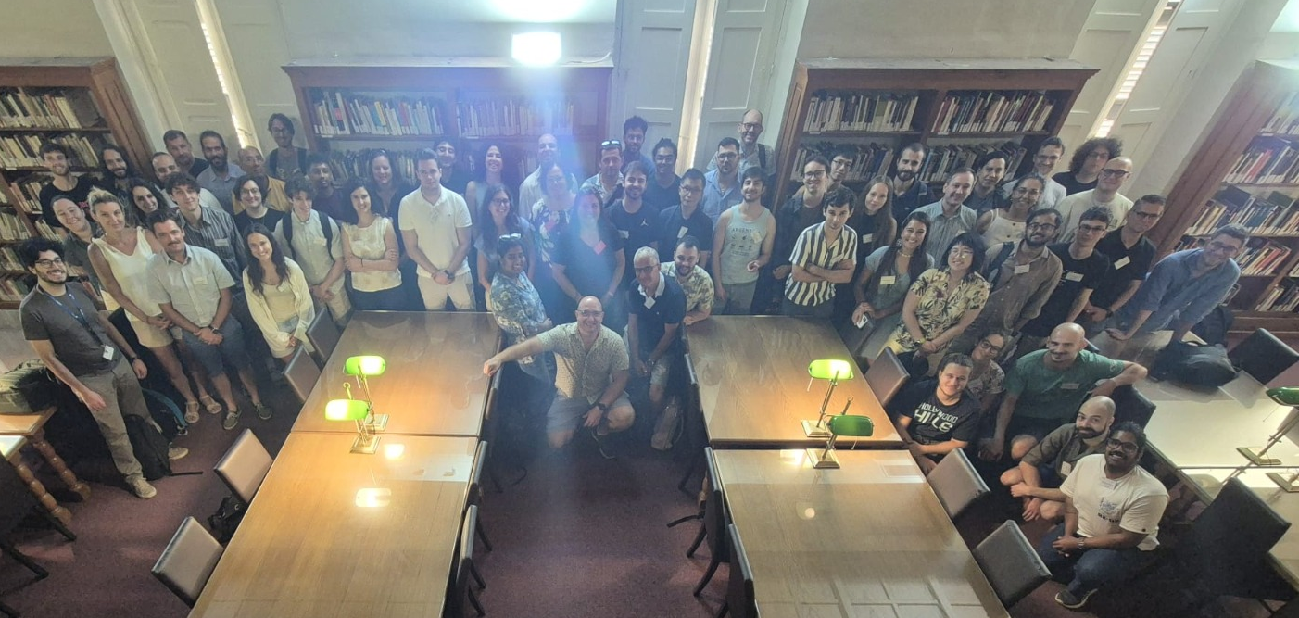
1st Group Photo Attempt

Slide 3
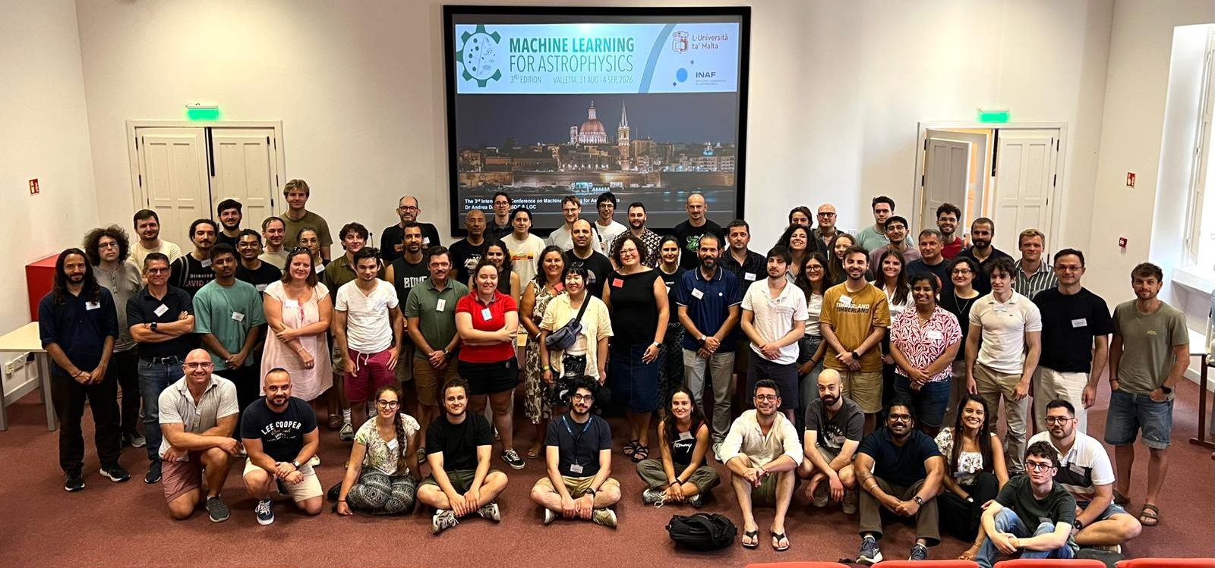
Agenda
2nd Group Photo Attempt

Slide 4
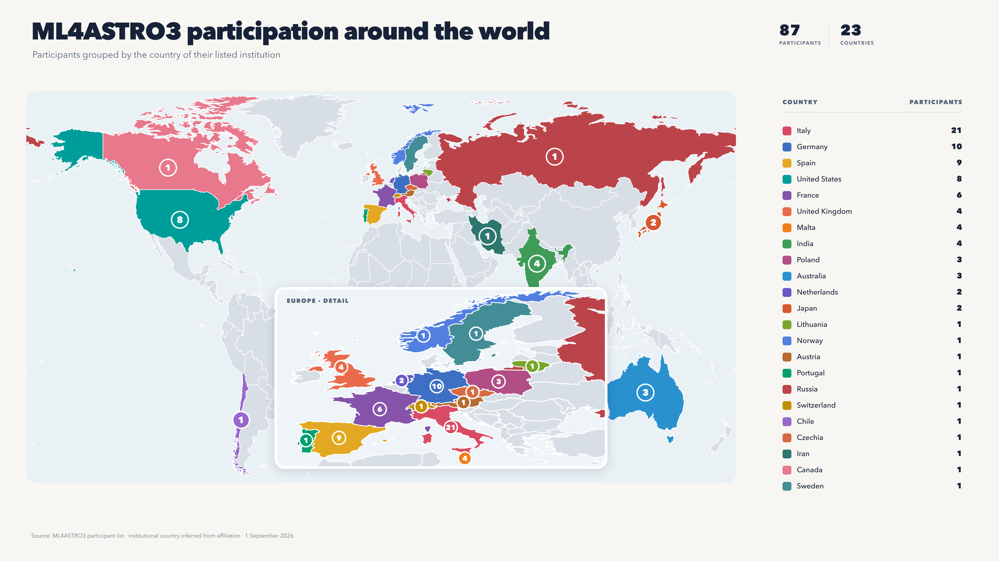
Agenda

Slide 5
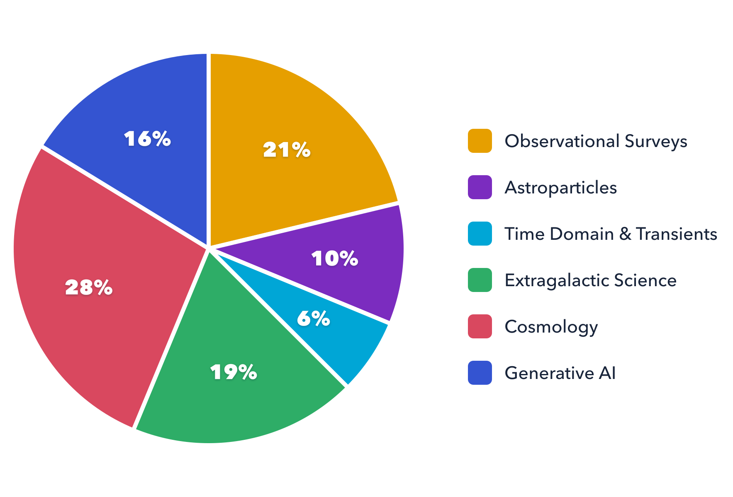
Agenda
Scientific Highlights

Slide 6
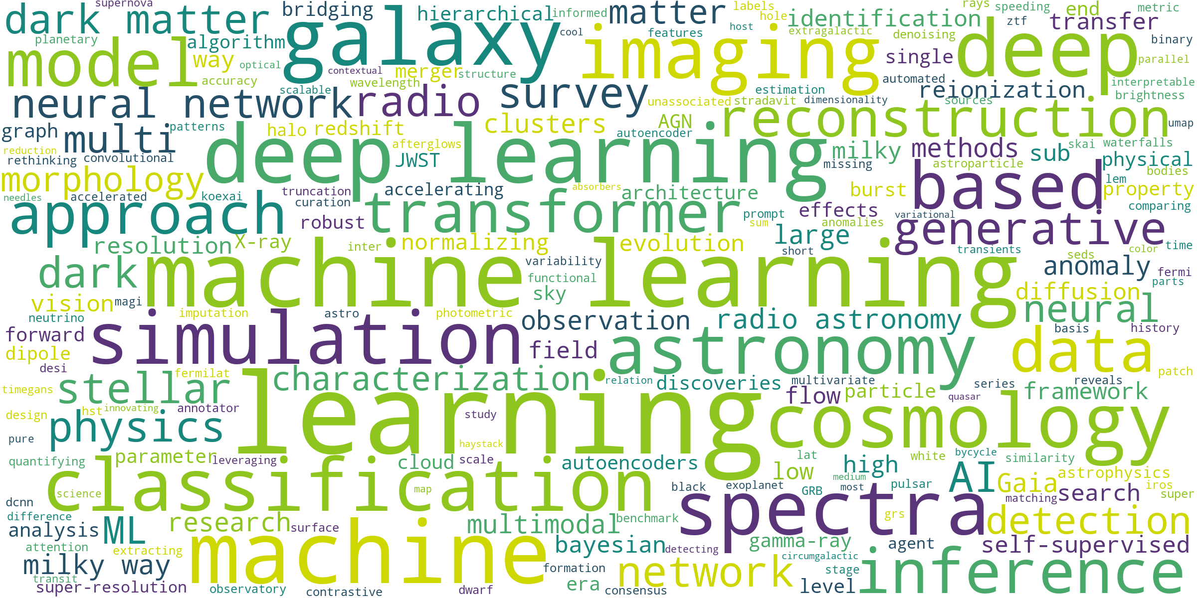
Talk Titles

Slide 7
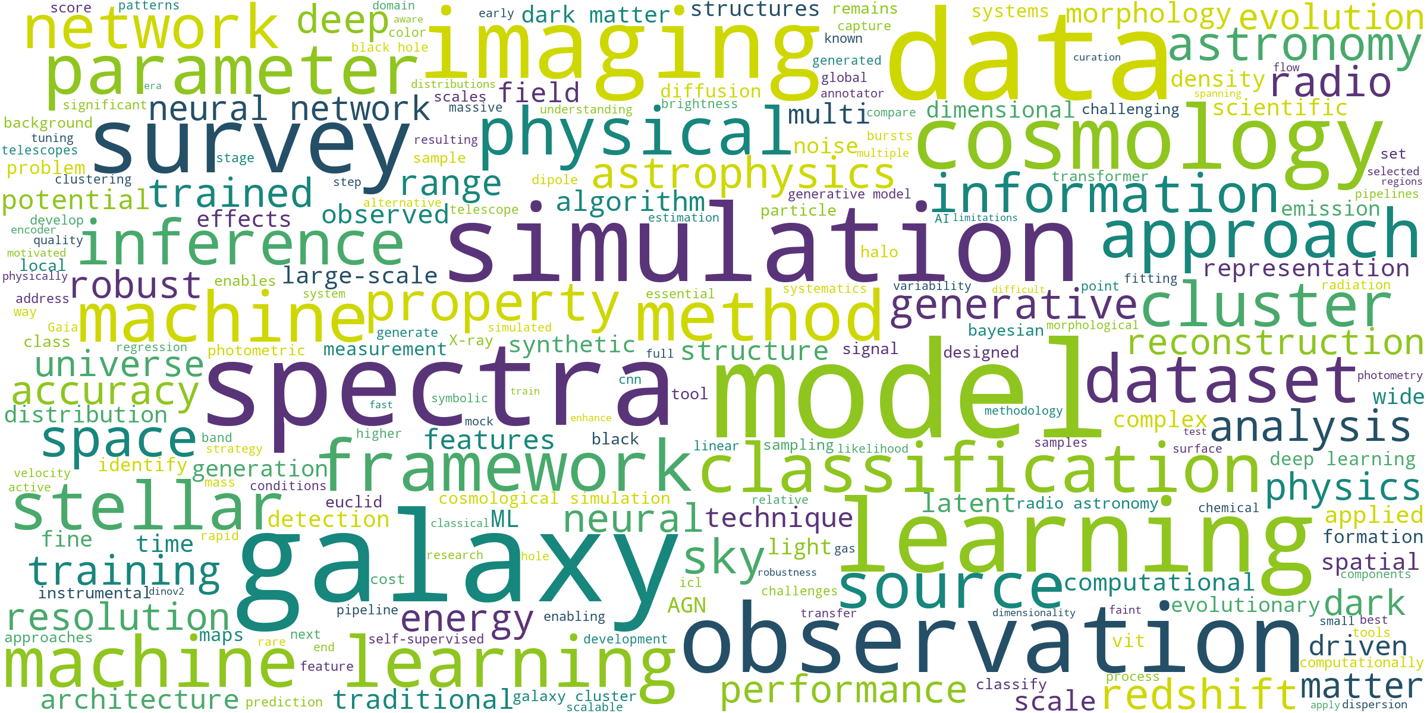
Talk Abstracts
Abstract

Slide 8
We Looked At
        Cosmology, large-scale structure, dark matter and dark energy
        Observational surveys and catalogue science
        Galaxy evolution, morphology and structure
        Radio astronomy and interferometric imaging
        Time-domain astronomy, transients and supernovae
        High-energy and astroparticle astrophysics
        AGN, quasars and black-hole physics
        Stellar astrophysics, asteroseismology and variability

Slide 9
Missing Links
Despite the breadth of this year’s programme, some scientific and methodological areas received little or no dedicated attention:
        Gravitational-wave astronomy
        Solar physics and space weather
        Exoplanet atmospheres and habitability
        Astrobiology and SETI
        Star and planet formation
        Causal machine learning
        Quantum ML in astronomy

Slide 10
The Numbers That Really Matter
Number of pastizzi consumed
Total calories collectively gained
Number of times “it’s hot” was uttered
Number of AI prompts used to create all the slides

Slide 11
After the Conference
All presentations and recorded talks will be uploaded to the Indico page (unless you want to opt out)
If you need an attendance certificate, inform us on ml4astro3@inaf.it
Further information on proceedings will be provided in due time

Slide 12
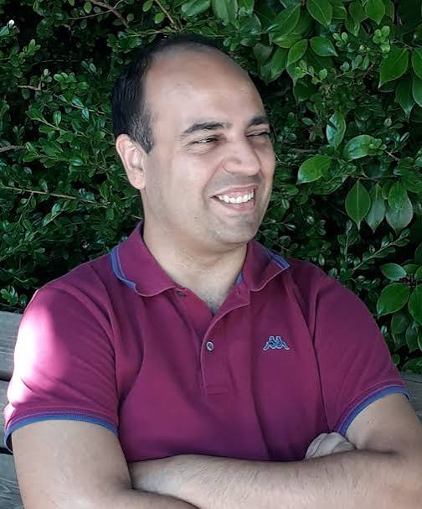
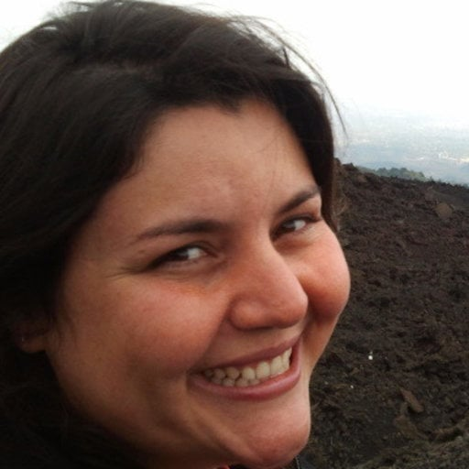

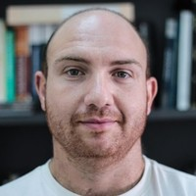

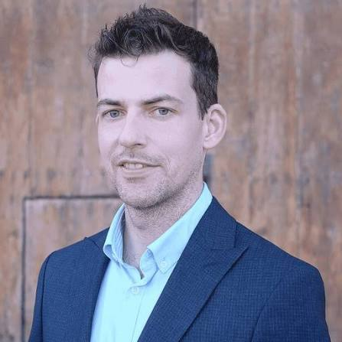
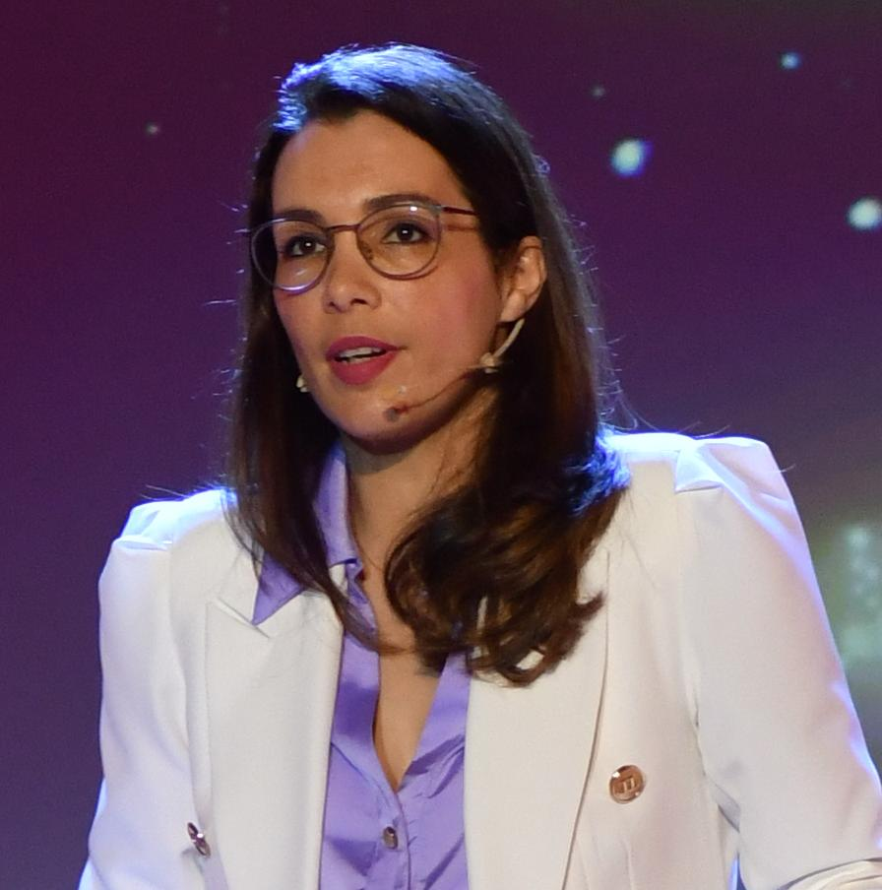
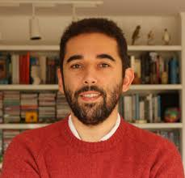
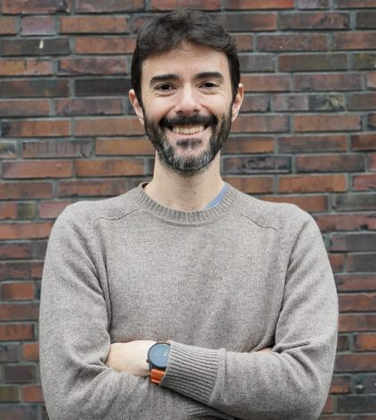
ML4Astro3 SOC

Slide 13
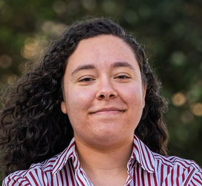
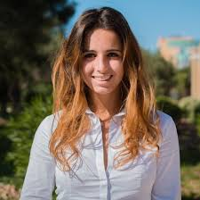
ML4Astro3 LOC

Slide 14
Conference Unit Staff
Lucienne
Sarah
Angele
Maria
Andrew
Clive
Nicholas
Shaoor
Doris
Lilian

Slide 15
Hope you enjoyed
ML4Astro3

Slide 16
ML4Astro4 will be in ……….

Slide 17
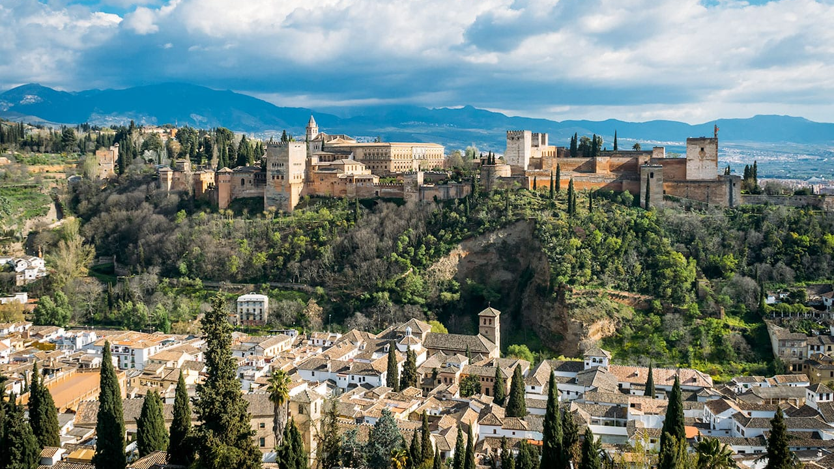
Granada - Spain

