Slide 1

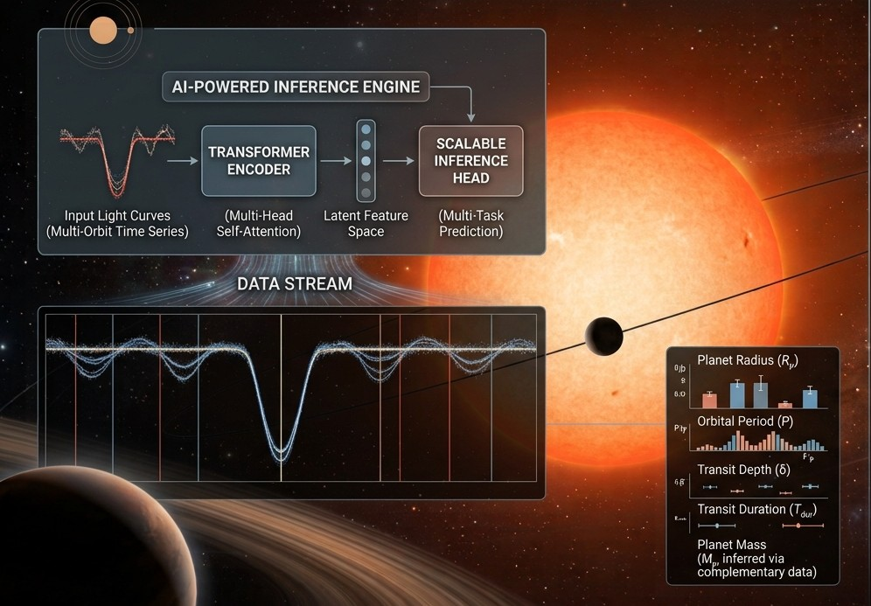

Leveraging Transformer Architectures for Scalable Exoplanet Transit Inference
Vikash Singh
INAF - Catania Astrophysical Observatory

Slide 2
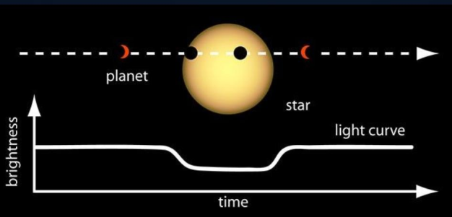
Introduction
Modern Survey telescopes (TESS, PLATO, Roman) continuously record photometry for hundreds of thousands of target stars.
Planetary transits manifest as periodic fractional flux dips typically obscured by stellar variability and instrument noise.
Sub-percent dip amplitudes require extremely sensitive, non-linear detection algorithms.
Legacy CPU pipelines cannot keep pace with exponential data volumes.
Classical techniques like BLS with MCMC perform grid search and iterative likelihood calculations per star. Their complexity create bottleneck for fast candidate vetting.

Slide 3
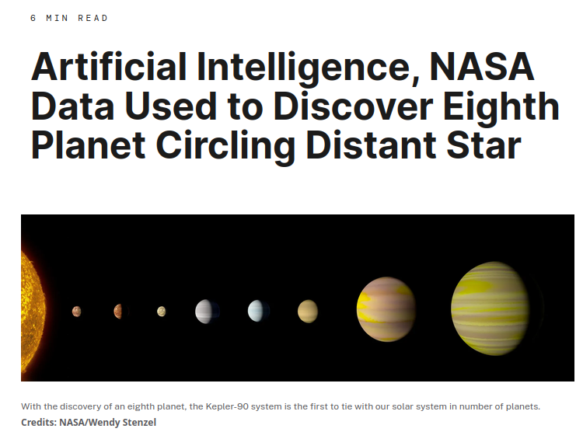
Pioneers
In December 2017, Google AI and NASA used machine learning on Kepler data to discover exoplanet Kepler-90i.
Researchers Christopher Shallue (Google) and Andrew Vanderberg (UT Austin) trained an artificial neural network using 15,000 previously catalogued Kepler signals.
The trained algorithm scanned multi-planet systems, uncovering the faint signals of Kepler-90i and Kepler-80g that human analysts had missed.

Slide 4
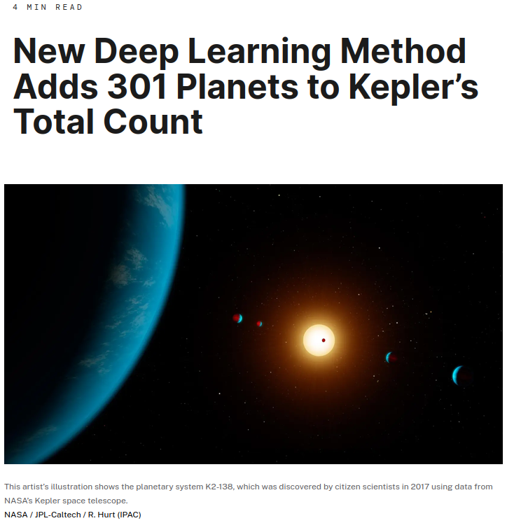
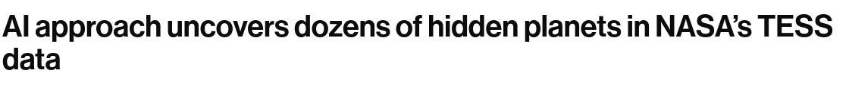
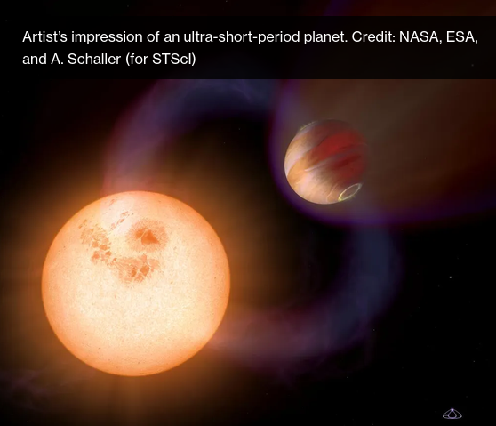
Breakthroughs since 2017
ExoMiner and ExoMiner++ by NASA Ames Research Center
  ExoMiner analyzed archival Kepler data and confirmed 301 new exoplanets all at once. (2021)
  Upgraded ExoMiner++ trained on both Kepler and TESS data. (2026)
  Cross-mission data ingestion.
RAVEN Project @ University of Warwick (2026)
  Successfully validated over 100 exoplanets, over 31 brand-new worlds that has completely escaped human detection.
  Full statistical validation (autonomous confirmation)
  Detecting rare, extreme worlds lurking in the “Neptunian Desert”

Slide 5
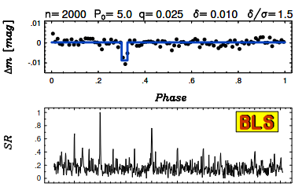
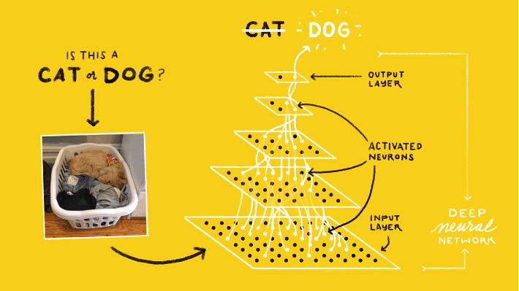
Limitation of Legacy Pipelines
Kovács et. al. 2002
Box-Fitting Least Squares (BLS)
  Brute-force grid searches across assumed Period, transit duration and epochs.
  Suffers exponential computational complexities over long baseline time-series datasets.
Convolutional Neural Nets (CNNs)
  Inability to capture long-range temporal dependencies.
  High vulnerability to false-positives generated by non-stationary stellar activity and eclipsing binaries.
  Extreme sensitivity to skewed datasets: High accuracy but low in precision.
  Poor performance for small Earth-sized planets.
Credits. Google

Slide 6
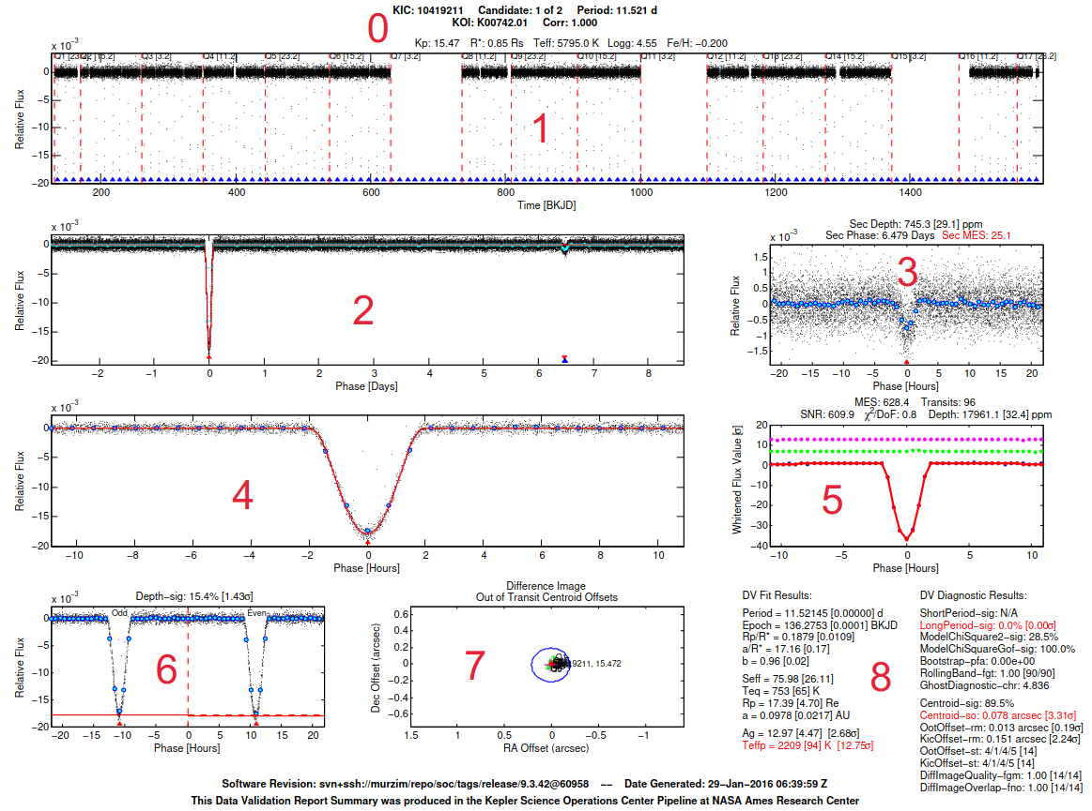
Transit Morphology
Period
Duration
Depth (Rp/R*)²
Impact Parameter
Limb Darkening
ExoMiner (2021)

Slide 7
Attention to Time Series
Sequential Analogy: Photometric time series framed as “textual” tokens, where flux variations represents sequential contextual patterns.
Pattern Recognition: Learned attention kernels detect characteristic U-shaped and V-shaped transit ingress/eggress profiles.
Global Context over Local Isolation: Self attention evaluates long observation windows holistically rather than analyzing individual data points in isolation.
Fine Tuning: Filter out stellar noise, flares and instrumentations artifacts while focusing on meaningful patterns.
Dynamic Correlation: The attention matrix calculates temporal relationships dynamically across distant time patches. (Connecting two transit dips)
Automated feature detections: Capturing the orbital period directly through attention weights.

Slide 8
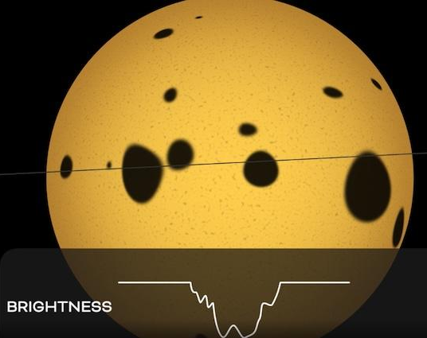
Transformer Architecture
Tokenization
1D Convolutional projection transforms photometric time series into rich spatial-temporal embedding tokens with learned positional encodings
2. Global Self-Attention
Encoder stacks capture long-range temporal dependencies across entire survey sectors, modelling global stellar background context simultaneously.
3. Multi-Task heads
Dual task heads provide concurrent transit detection classification (e.g. softmax) and continuous orbital parameter regression (R_{p}/R* , Period)
Disentangling Signals: Global context vs Stellar Noise
Traditional sliding window algorithms struggle with non-stationary stellar noise, such as starspots, flares and sensor systematics that mimic transit dips.
By leveraging self-attention, transformers evaluate the global light curve context. The model learns stellar activity patterns, isolating localised transit anomalies with high precision and lower false positive rates.
Earthsky.org

Slide 9
Benefits
Scalability and Speed
  Replaces computational grid searches with single matrix evaluation per target.
  Inference executes at ~1000 times speedup per light curve on standard GPU hardware
  Enabling real-time screening across petabyte-scale archives like TESS or upcoming PLATO.
Architecture & Targets
Target Parameter | Legacy Pipeline | Transformer Output Head | Expected Precision
Transit detection | BLS power threshold | Softmax Classifier | High sensitivity / Low FP
Radius Ratio | MCMC Posterior Fit | Dense regression layer | ~ 2-5 % error prior
Period | Periodogram Peak Search | Attention-based frequency head | High-resolution prior
Duration | Geometric Parameter Fit | Multi-token bounding box | Instant initial bounding

Slide 10
Hybrid Inference Engine
2. Survey Screening
Single forward-pass across survey archives to identify transit candidates.
4. Targeted MCMC
High-precision Bayesian physical fitting initialized near global minimum.
Pre-Training
Self-supervised training on the synthetic light curves with stellar variability models.
3. Prior Generation
Regress approximate parameter values R_{p}/R* , Period etc. to seed physical models.

Slide 11
False Positive Probability (FPP) problem
A model receiving only a light curve cannot cannot output a true astrophysical FPP.
True FPP measures the probability of a dip being caused by a real planet vs scenarios like:
  Background eclipsing binaries
  Hierarchical eclipsing binaries
Multi-modal spatial inputs for full statistical validation:
  Pixel level images (TPFs to check centroid motion shifts)
  External Star catalogues (GAIA to check nearby unresolved blend stars)
Solution:
A multi-modal foundation model architecture that includes:
Transformer Encoder for LCs
Vision Transformer for TPFs
Multi level perceptron embedding for stellar catalogues
Followed by a Cross-Attention Fusion Layer to create the Multi-task heads.

Slide 12

Challenges
Out-of-distribution Stars: Robustness against extreme stellar flares and unmodeled instrumental anomalies requires further domain augmentation\
Attention Map Analysis: Visualizing multi-head self-attention weights ensures model decisions align with physical ingress/eggress transit shapes.
Single Transit Inference: Scaling attention mechanisms to reliably detect long-period planets presenting only a single transit event per sector.
Edge Deployment: Model quantization for real time candidate detection onboard future space telescopes like PLATO.

