Slide 1



Optimizing Photometric Redshift Training Sets with UMAP
Finian Ashmead
University of Pittsburgh
finianashmead@pitt.edu
International Conference on Machine Learning for Astrophysics, 3rd Ed.
September 2, 2026
supervisors Jeff Newman and Brett Andrews
this work supported by WFS grant (PI: Newman)
arxiv: 2512.09032

Slide 2

Optimizing Photometric Redshift Training Sets with UMAP
Finian Ashmead
University of Pittsburgh
finianashmead@pitt.edu
International Conference on Machine Learning for Astrophysics, 3rd Ed.
September 2, 2026
supervisors Jeff Newman and Brett Andrews
this work supported by WFS grant (PI: Newman)
arxiv: 2512.09032

Slide 3
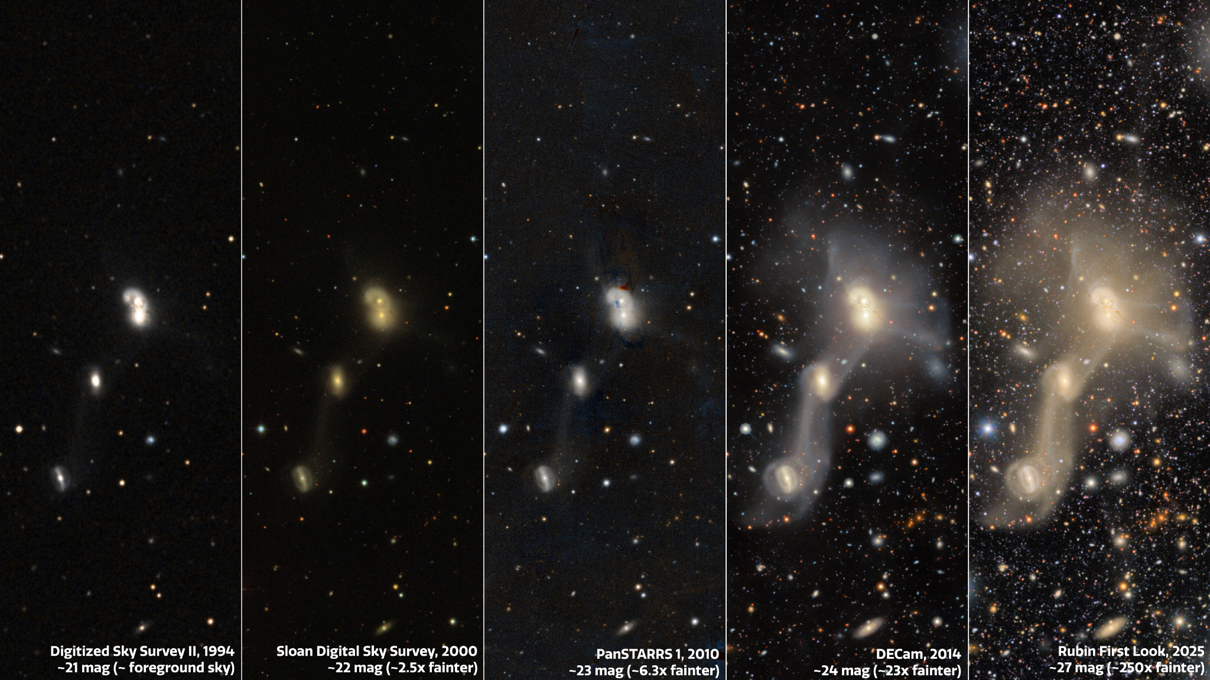
Why photometric redshifts (photo-z’s)?
with large imaging surveys we have a massive amount of photometric data, including very faint objects

Slide 4
Why photometric redshifts (photo-z’s)?
with large imaging surveys we have a massive amount of photometric data, including very faint objects
need redshifts for cosmology + galaxy evolution

Slide 5
Why photometric redshifts (photo-z’s)?
with large imaging surveys we have a massive amount of photometric data, including very faint objects
need redshifts for cosmology + galaxy evolution
spectroscopic redshifts (spec-z’s) are completely infeasible
→ we need to get redshifts from photometry

Slide 6
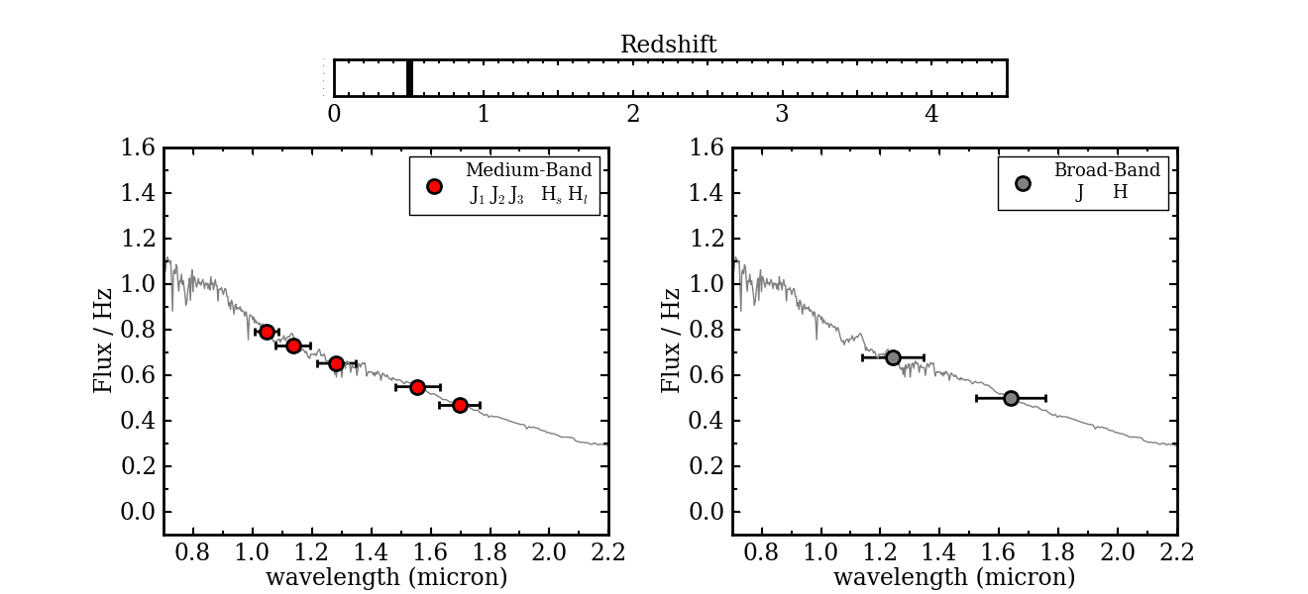
Why do photo-z’s work?
using the galaxies we have spectra for as training data, learn to estimate redshifts from the photometry
A. Tomczak gif

Slide 7
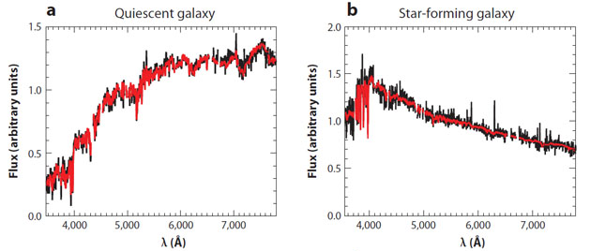
Why do photo-z’s work?
observed galaxy colors are highly correlated and mainly determined by two physical parameters: redshift and specific star formation rate (sSFR)
using the galaxies we have spectra for as training data, learn to estimate redshifts from the photometry
Tojeiro et al. 2009
A. Tomczak gif

Slide 8
Why do photo-z’s work?
observed galaxy colors are highly correlated and mainly determined by two physical parameters: redshift and specific star formation rate (sSFR)
→ use dimensionality reduction to recover the low-dimensional manifold underlying observed galaxy colors
using the galaxies we have spectra for as training data, learn to estimate redshifts from the photometry
Tojeiro et al. 2009
A. Tomczak gif

Slide 9
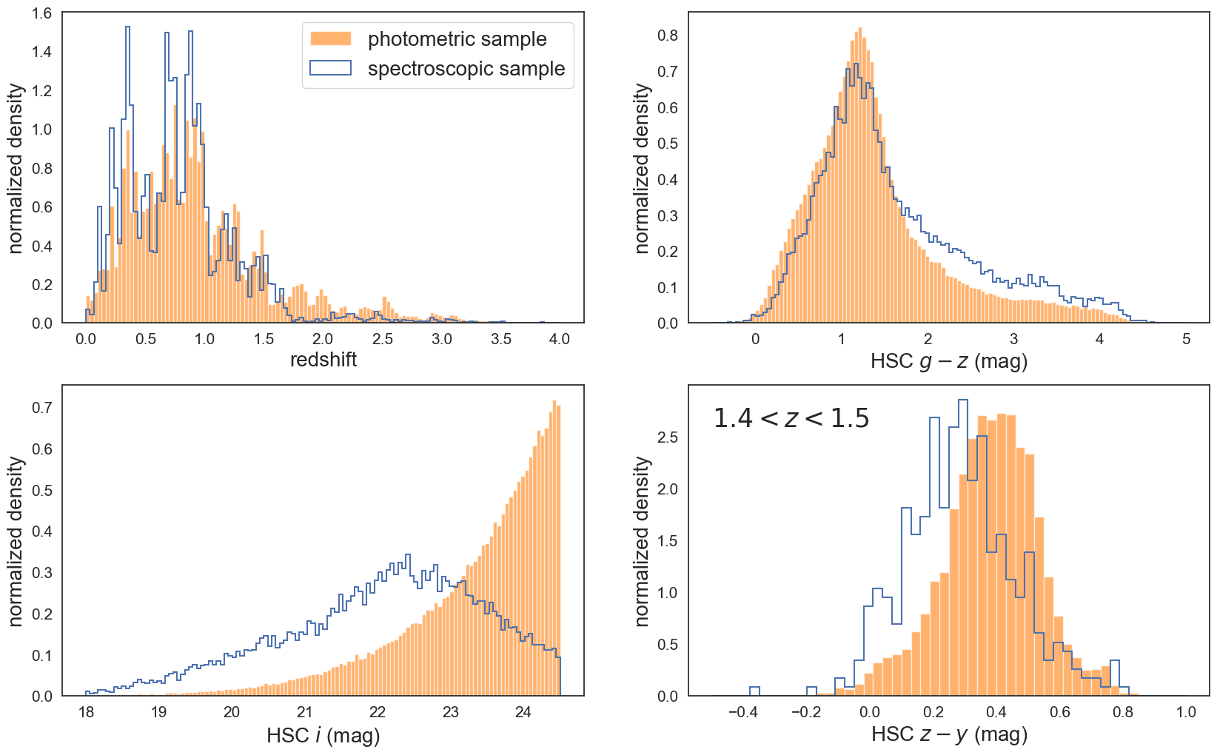
Data
~110k galaxies in COSMOS2020 with ugrizyJH colors, and LePHARE photo-z’s and sSFR’s
~14k with spec-z’s
  spec-z’s have biased coverage of the redshift distribution and color space

Slide 10
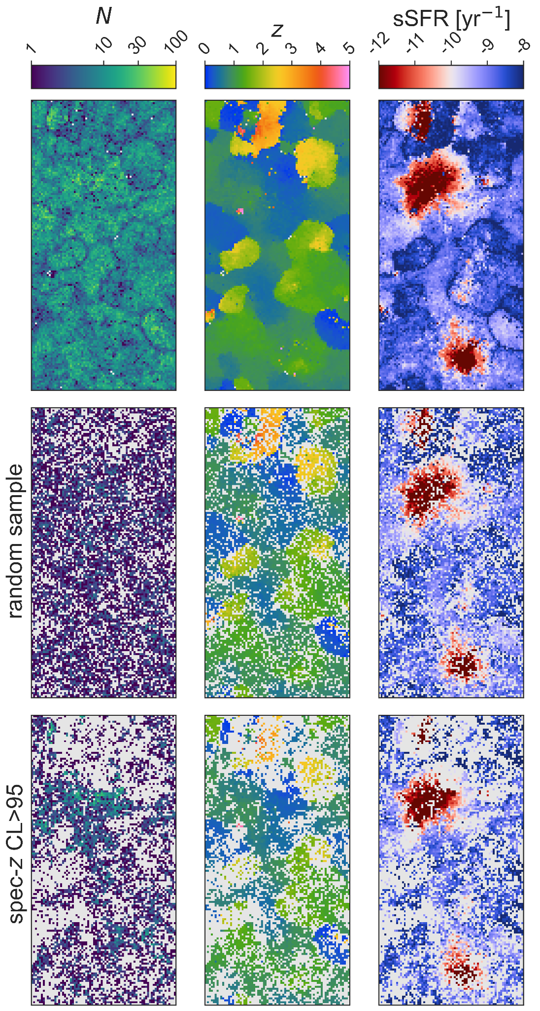
SOM: full imaging sample w/ photo-z’s

Slide 11
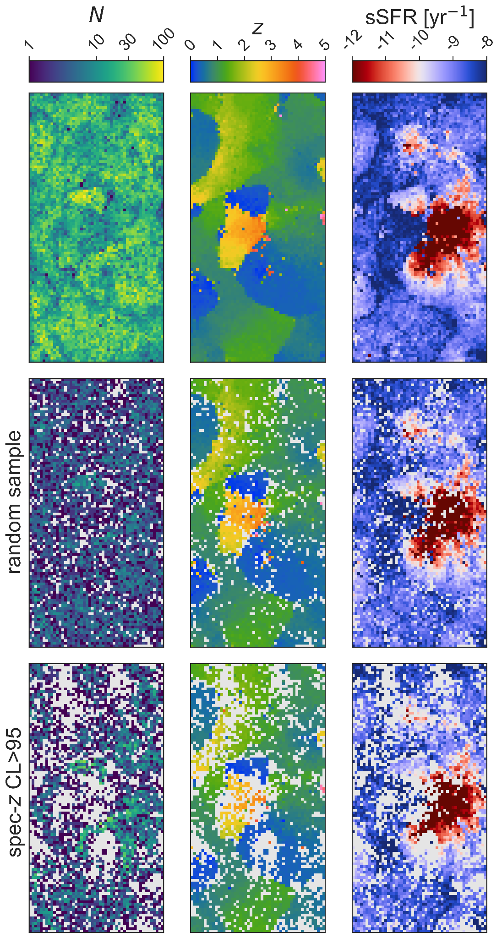
SOM: spectroscopic sample of ~14k

Slide 12
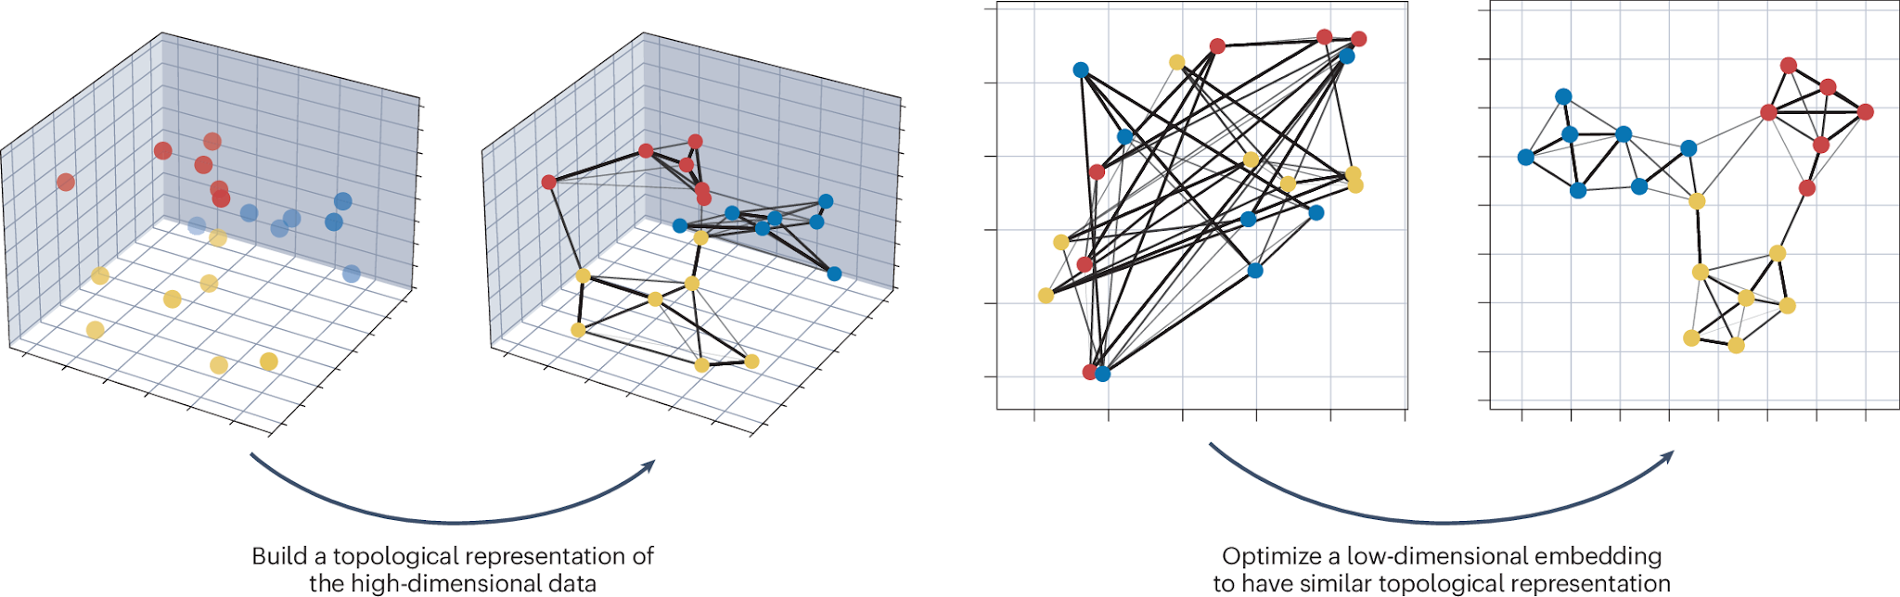
UMAP learning
source

Slide 13
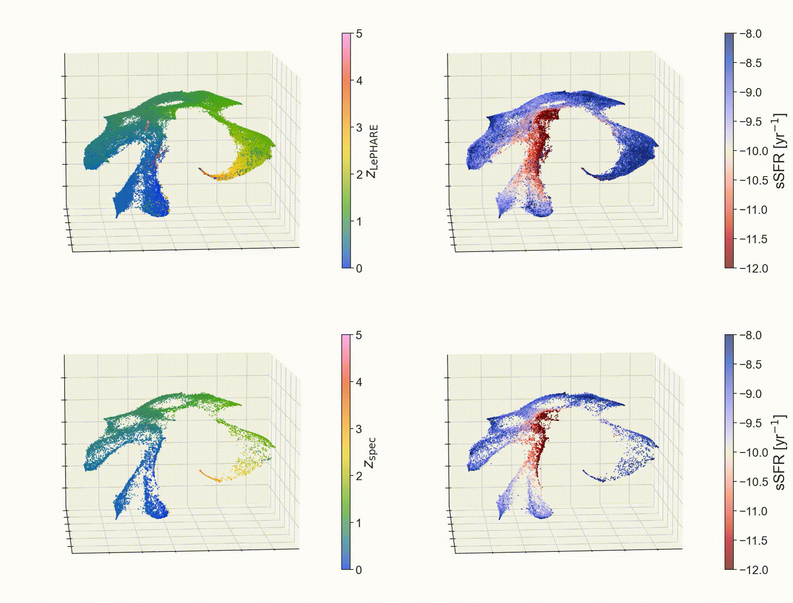
*mp4 animation and interactive versions are available here on my website finianashmead.github.io

Slide 14
*mp4 animation and interactive versions are available here on my website finianashmead.github.io

Slide 15
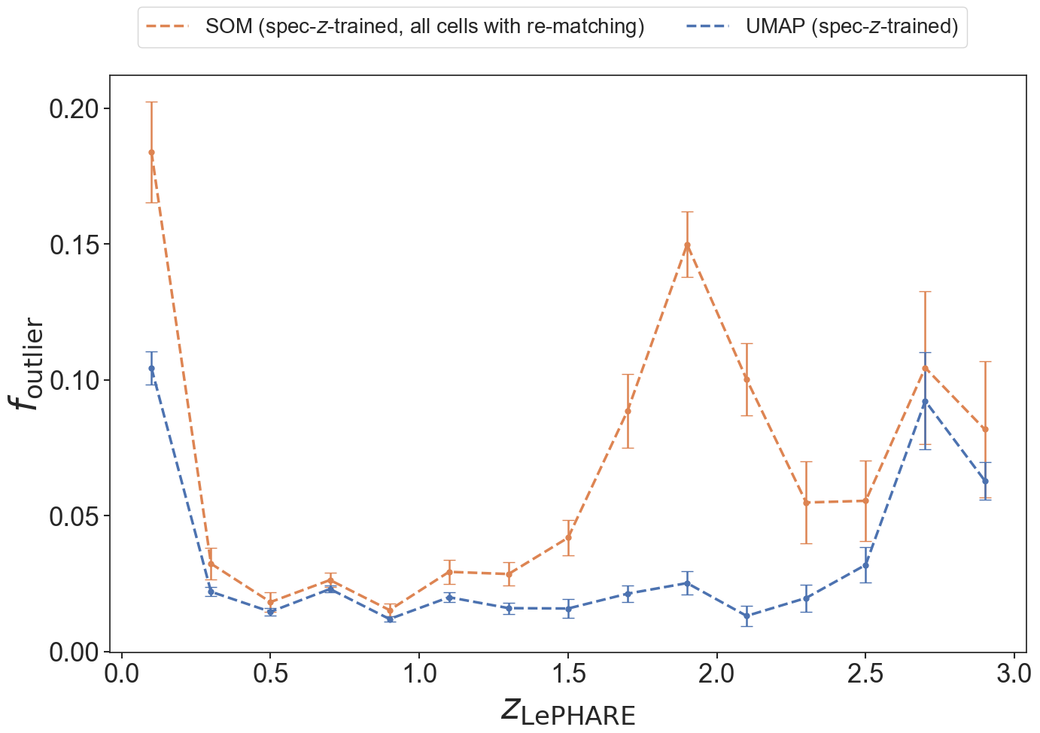
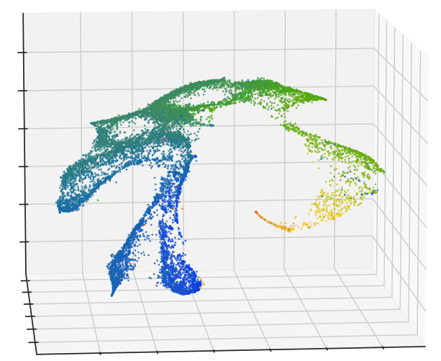
Quantitative Test: Results
fewer outliers with UMAP! especially in difficult regimes

Slide 16
Quantitative Test: Results
fewer outliers with UMAP! especially in difficult regimes
SOM outlier rate spikes where training data is sparse
o

Slide 17
Quantitative Test: Results
fewer outliers with UMAP! especially in difficult regimes
SOM outlier rate spikes where training data is sparse
  we largely rely on ground based instruments, OII leaves optical at z~>1.5
o

Slide 18
Ok great, but how does this help optimize photo-z training sets in general?

Slide 19
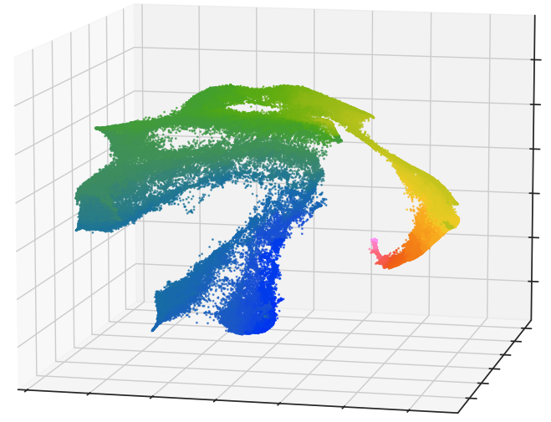
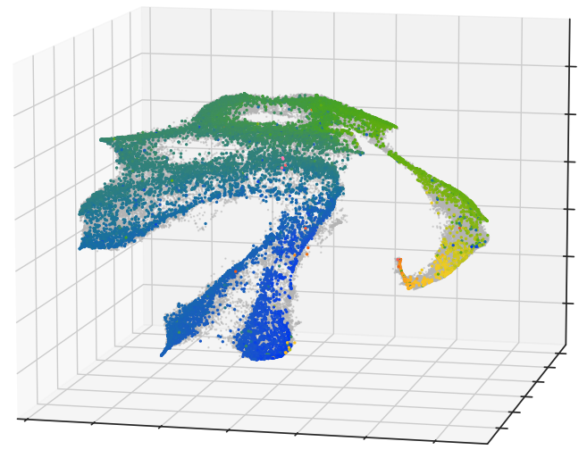
Simple Example: Easy Adoption in SOM-based Frameworks
(3) using UMAP-z’s to fill in the SOM, this approach can easily be adopted as a preprocessing step in SOM-based frameworks
(1) spec-z sources sample only a subset of the color space occupied by galaxies
(2) leverage the UMAP’s coherent mapping to z to fill in the missing redshifts

Slide 20
Next Steps: GPR

Slide 21
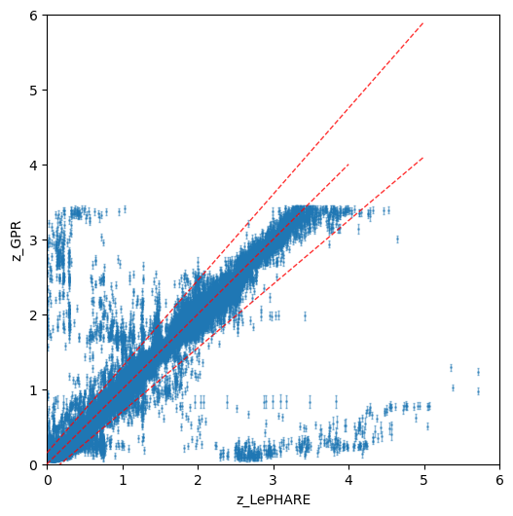
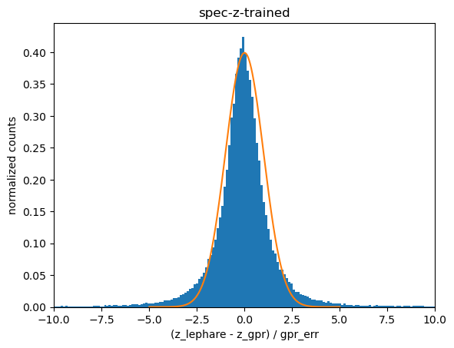
Next Steps: GPR
spec-z-trained
f_out ~= 0.025
NMAD ~= 0.024
bias ~= 0.004
PRE-PRELIMINARY
PRE-PRELIMINARY

Slide 22
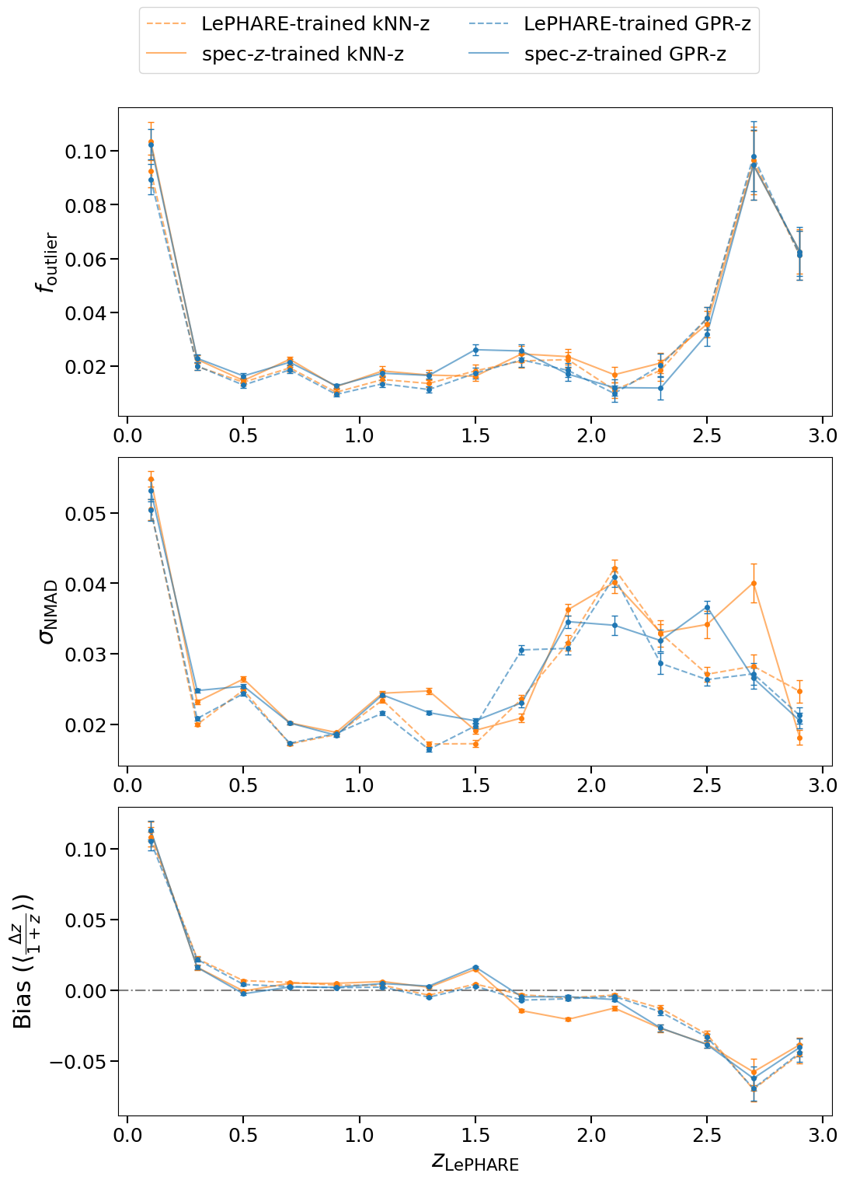
Next Steps: GPR
PRE-PRELIMINARY

Slide 23
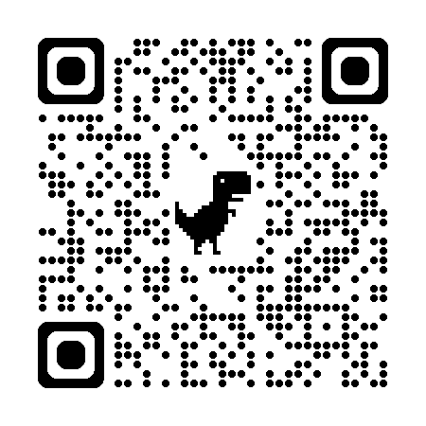
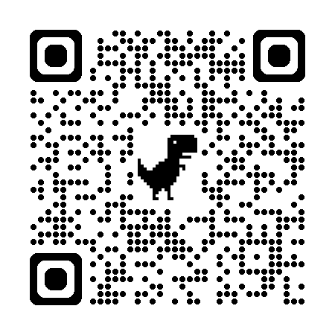
Summary:
*animated/interactive plots, github repo @ finianashmead.github.io
arxiv paper : 2512.09032
UMAP→ work in a space densely sampled by the data that maps simply and reliably to redshift
we can make balanced spec-z training sets as input for existing frameworks
going forward:
  regression and p(z) estimation with techniques like GPR

Slide 24
BONUS SLIDES!

Slide 25
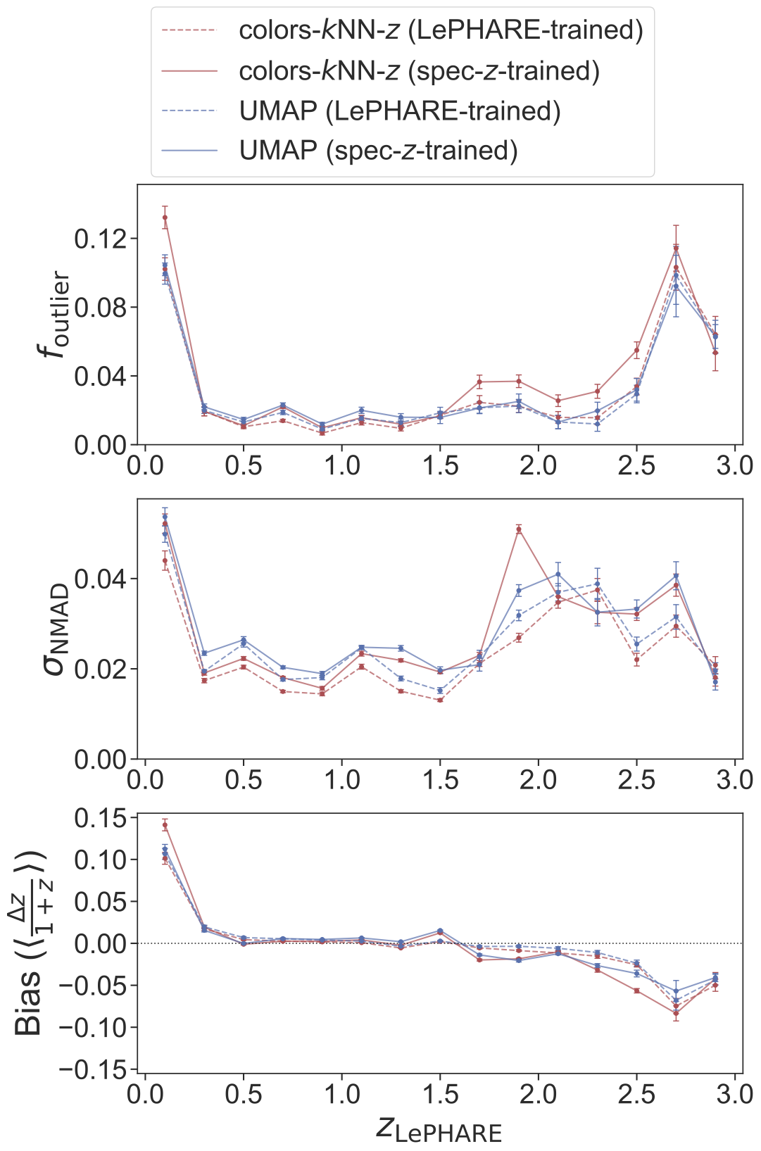
Quantitative Test: Comparison to ugrizyJH color space

Slide 26
Quantitative Test: Training Samples
14.5k/110k have high-confidence spec-z’s (CSRC, Khostovan et al. 2026)
random 14.5k with LePHARE-z’s

Slide 27
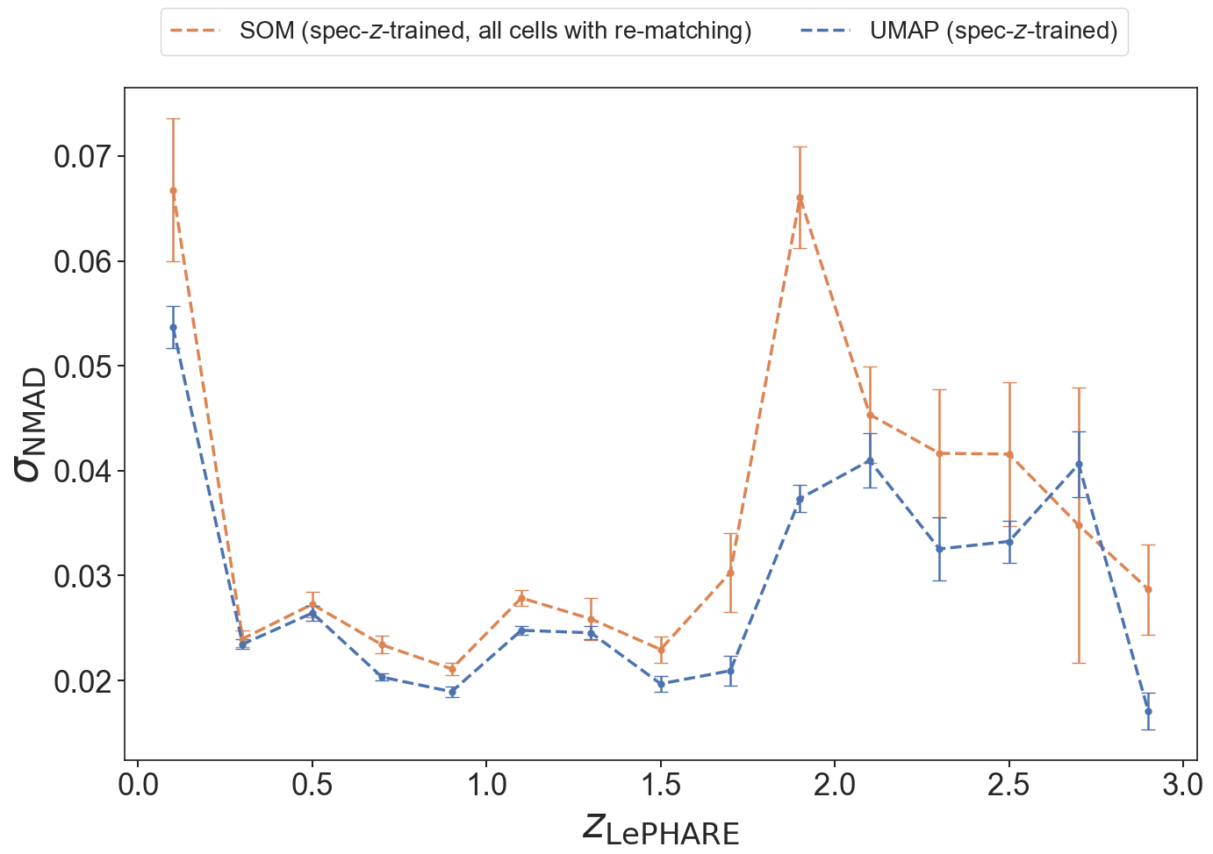
Quantitative Test: Results

Slide 28
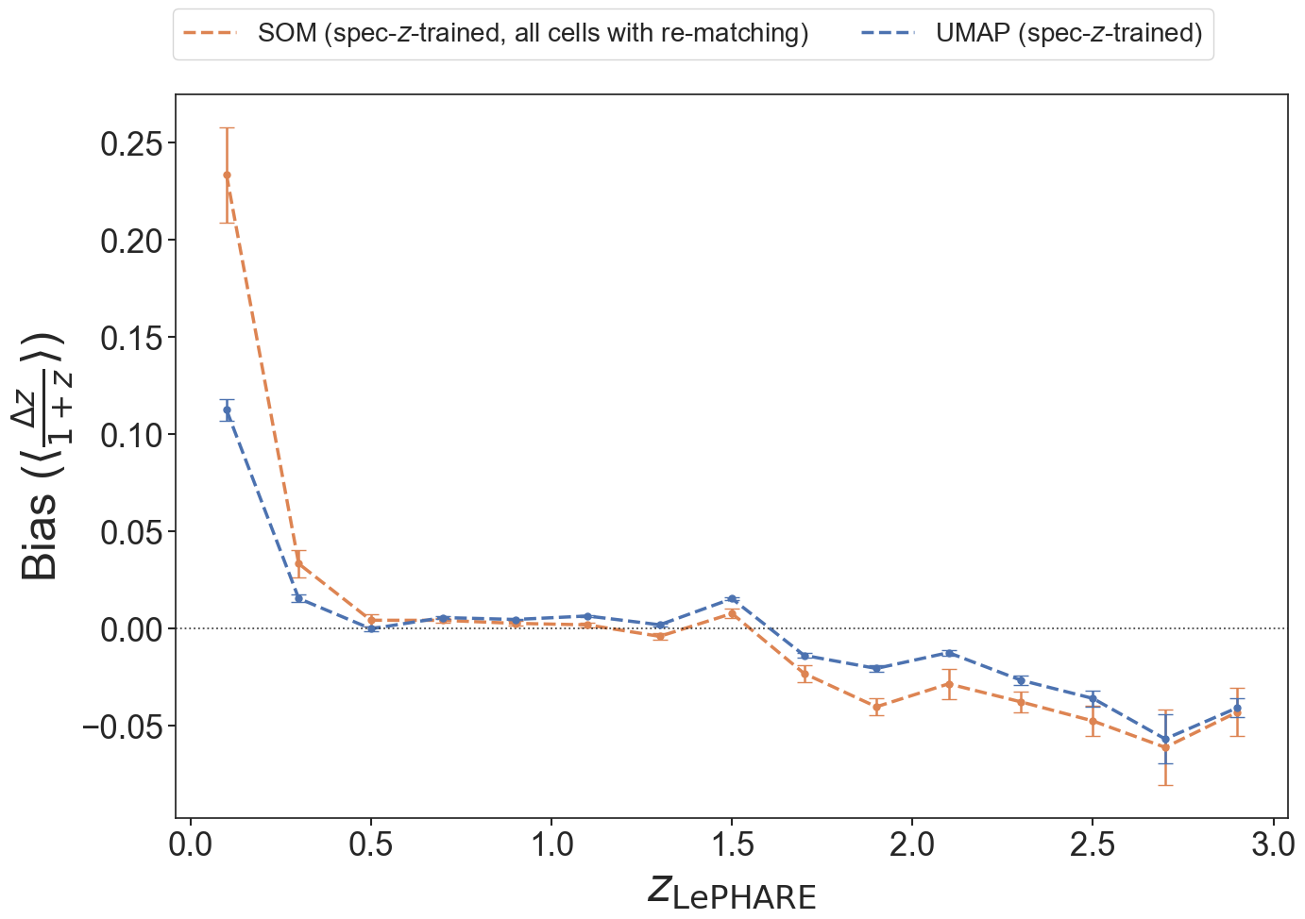
Quantitative Test: Results

Slide 29
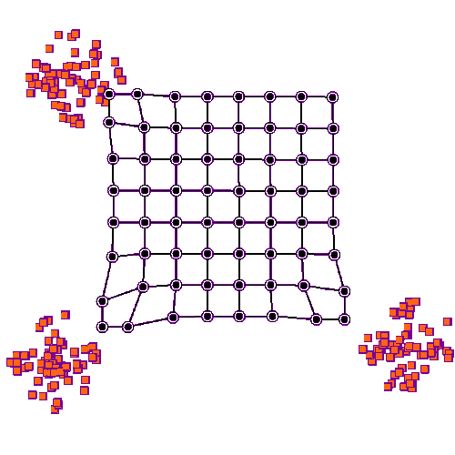
SOM learning
source

Slide 30
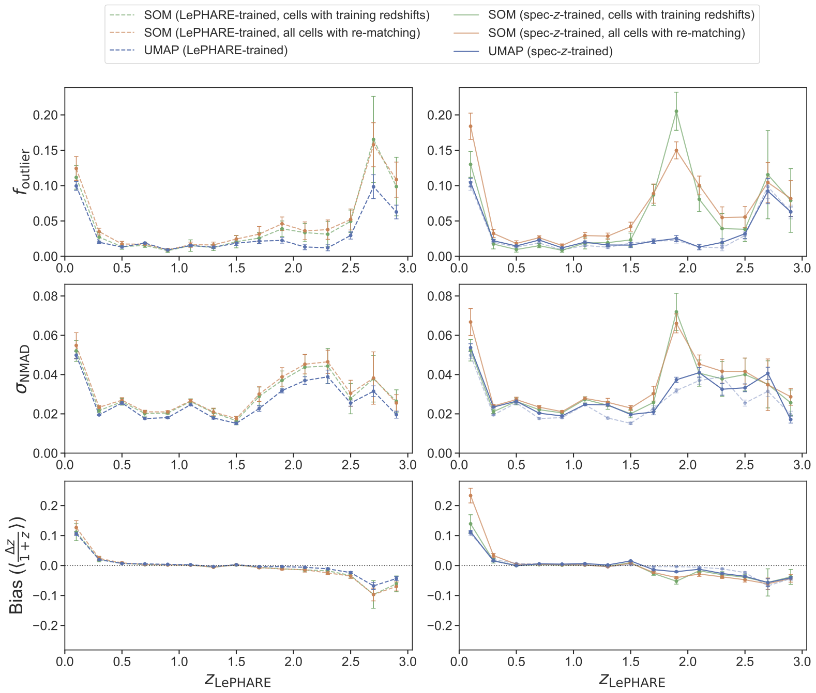
Quantitative Test: Results

Slide 31
Quantitative Test: Results

Slide 32
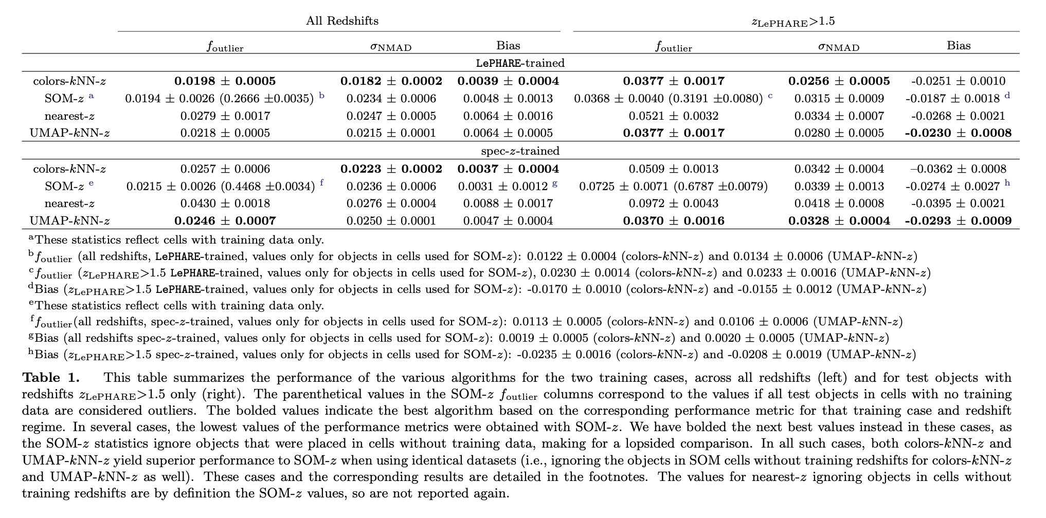

Slide 33
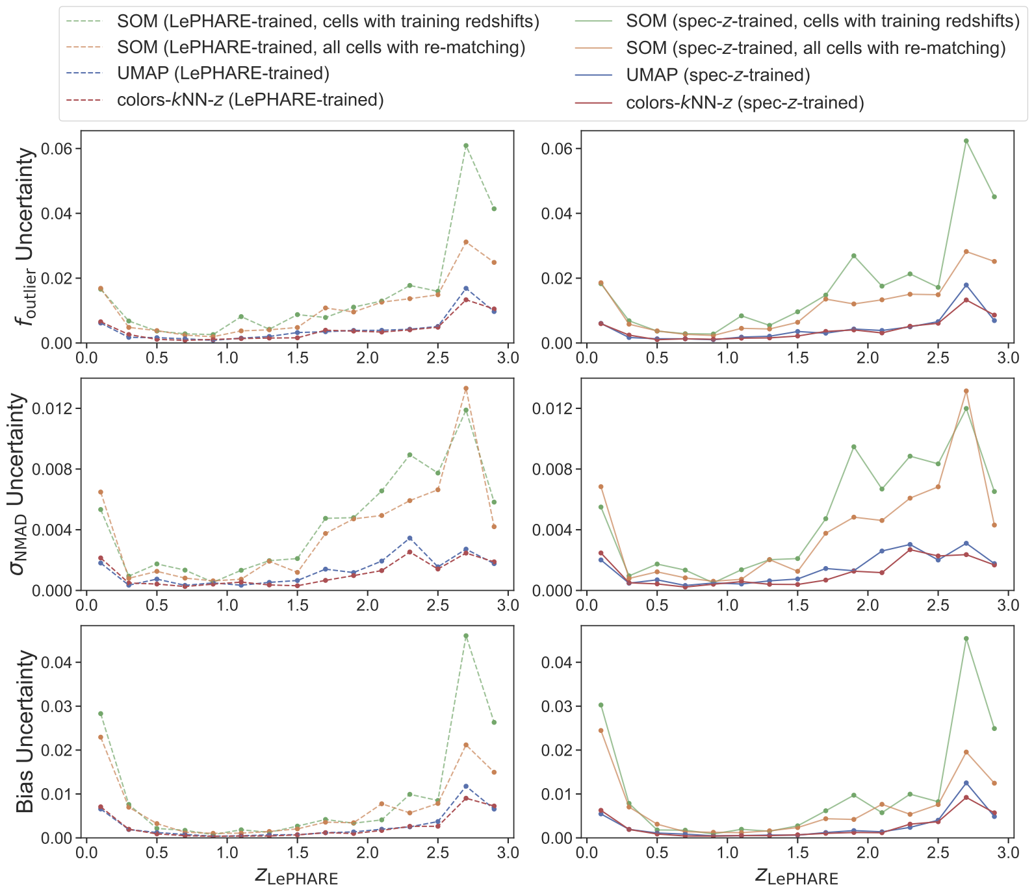

Slide 34
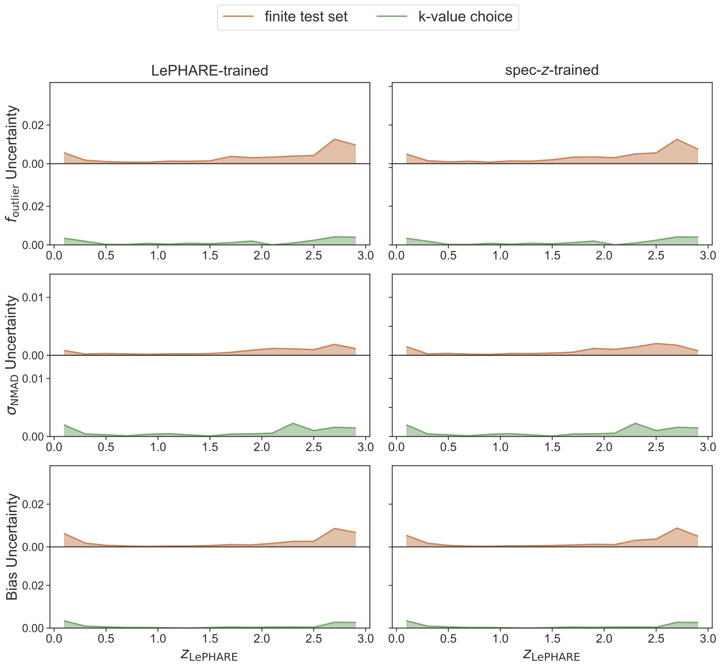
colors-kNN-z uncertainties

Slide 35
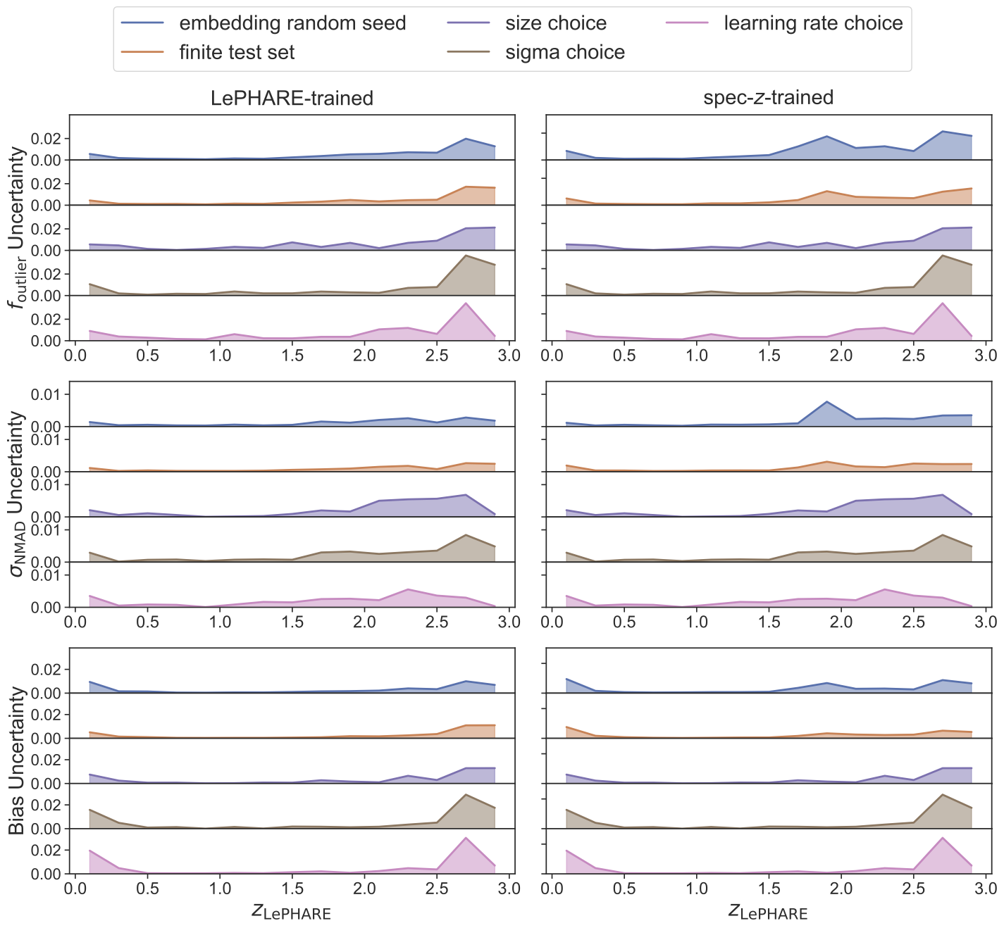
SOM-z uncertainties

Slide 36
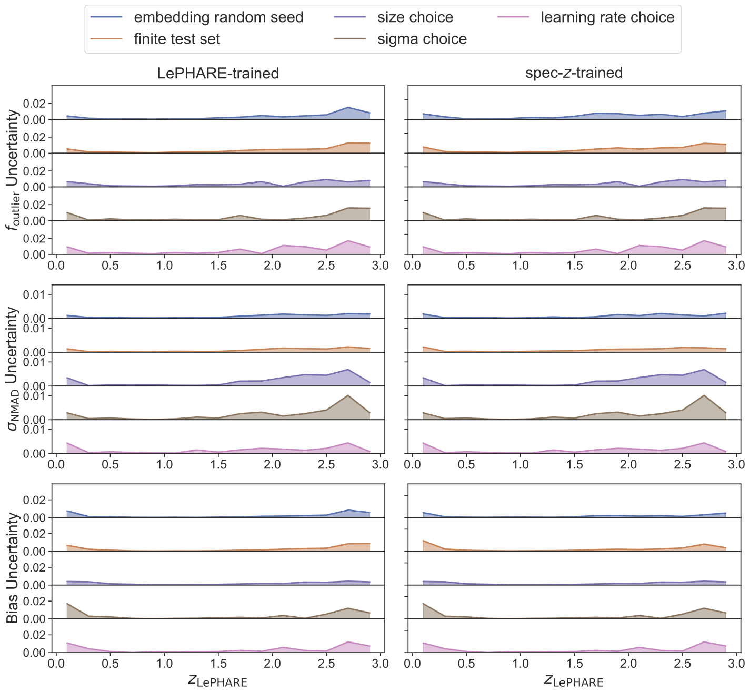
nearest-z uncertainties

Slide 37
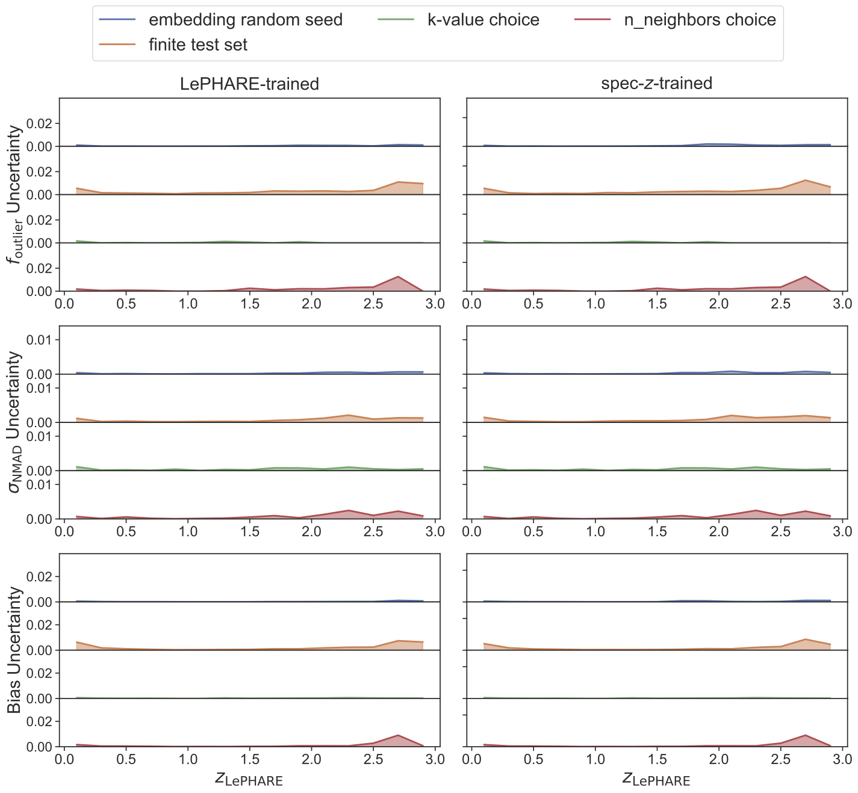
UMAP-kNN-z uncertainties

Slide 38
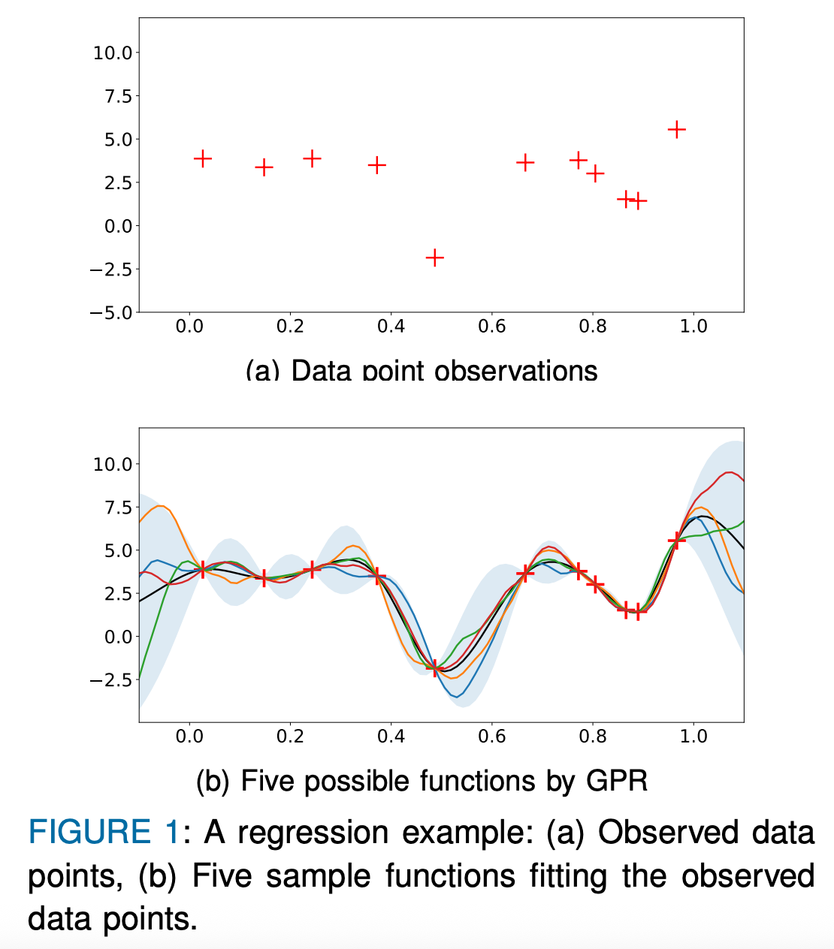
Currently: extending this research
the first paper used kNN interpolation in the UMAP space → this is far from the most sophisticated approach!
robust GPR will allow us to get better predictions + redshift PDFs throughout the UMAP manifold!

Slide 39
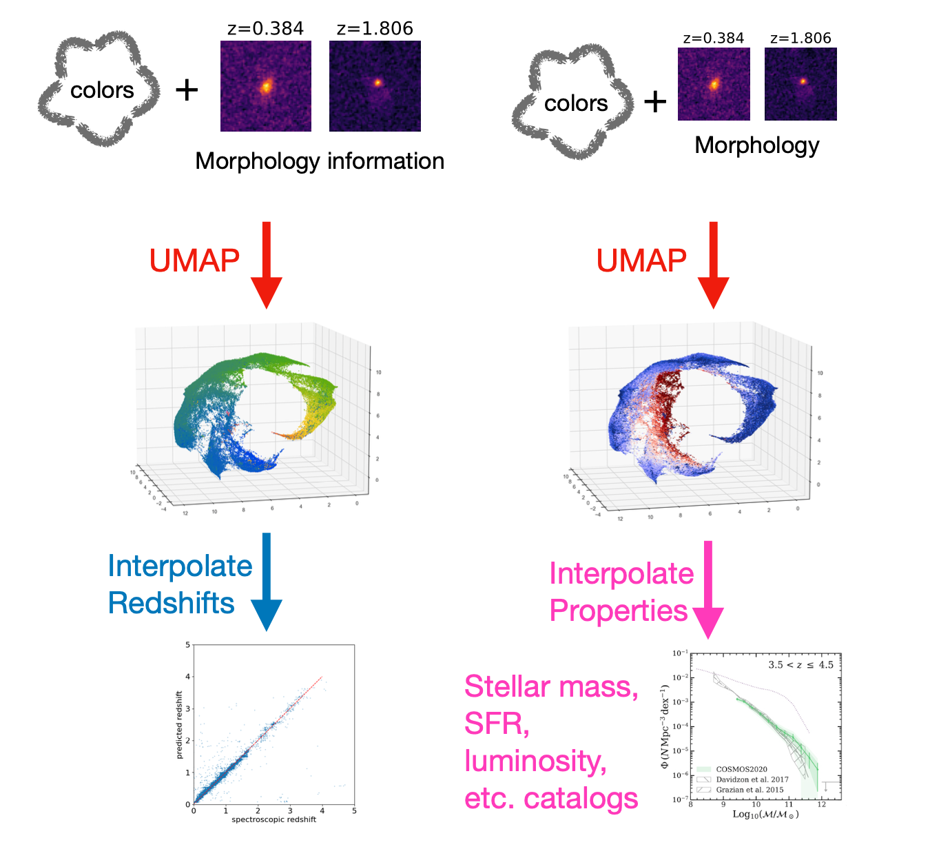
Third Paper and Beyond
catalog-level morphology information (axis ratio, Sersic index, surface brightness, etc.) can be useful for redshift prediction
  potentially break degeneracies in optical color spaces this way, reduce reliance on infrared photometry → big for LSST!
leverage the nice mapping to sSFR shown in this work to predict properties other than redshift using similar UMAP-based techniques

Slide 41
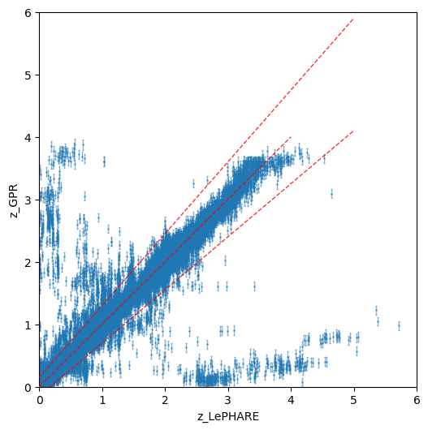
Next Steps: GPR
LePHARE-trained
spec-z-trained
f_out ~= 0.021
NMAD ~= 0.022
bias ~= 0.005
f_out ~= 0.025
NMAD ~= 0.024
bias ~= 0.004
PRE-PRELIMINARY
PRE-PRELIMINARY

Slide 42
Next Steps: GPR
PRE-PRELIMINARY
PRE-PRELIMINARY

Slide 43
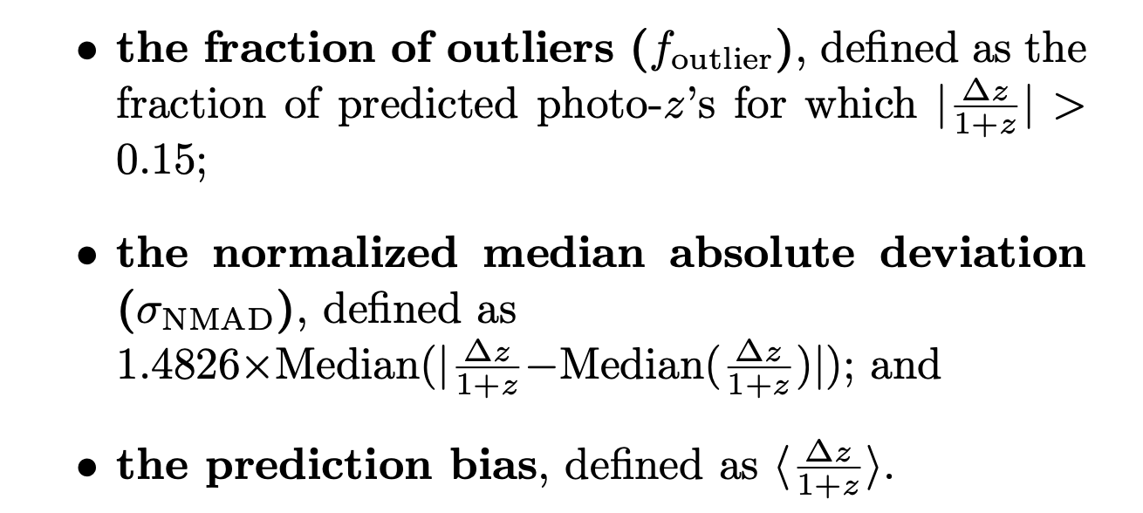
Metrics:

