Slide 1
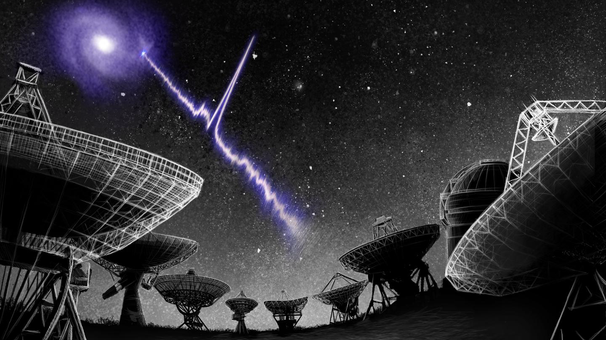


Using Flow Matching to study the sub-burst structure of short astronomical transients
Anja Schmit
a.schmit@uva.nl
01/09/2026
Collaborators:
N. van der Meulen, T. Hadži Veljković, D. Huppenkothen, J. Hessels
Image credit: Danielle Futselaar/artsource.nl
Notes:
comments:
add here different dynamical spectra –slide 3 to show morphology – don’t mention sctteriong as is also wrong haha
slide5:
talk about Sbi – amortisation – only later quickly mention profile function
with sbi we havea amortise inference - highlight trans dimentionality – change the focus of the slide – more automated pipeline
how different
add here different dynamical spectra
already introduce CI already here -
rmv cat
already introduce CI already here -
slide 18 with sigma
conditional and marginal trajoectories - cut that
just talk about conditional paths
highlight multiple timescales, multi dimensional - can put more time to that
talk methodologc=cial transients, transients make it hard that they are TS , irregulta and multiple lengths
talk after the open questions I can tackle with it
current algorithm require handholding - that make it unfeasilble for that many things
profile is intrinsice and extrinsic effects - so we want to use a model like this with different underlying shapes to get evidentce for scattering, separation of peaks, morphologcal differences,..
3 problems my model tries to solve - make a point at the emd what this methods adds to the community
getting a fit requires handholding we want automated
lot of fitting metod give a definitive model, here we get distribution and posteriors
they dont fail gracefully in SNR
talk about sbi - put params, get data - train NN to get parameters distribition
takes a long time to converge

Slide 2
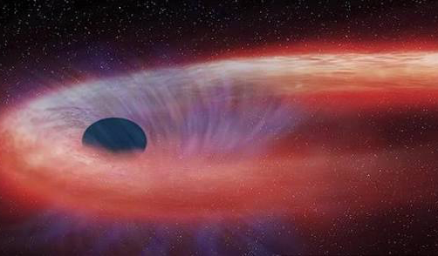
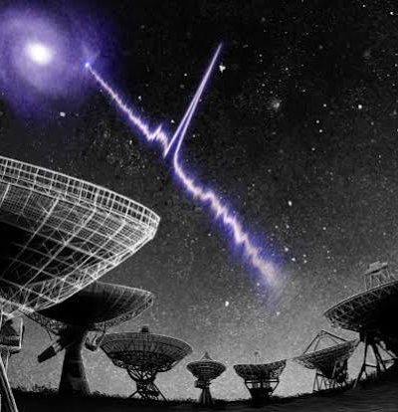
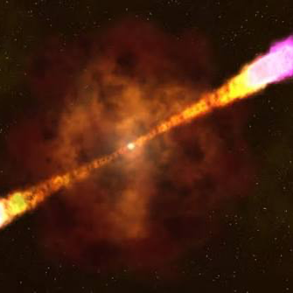
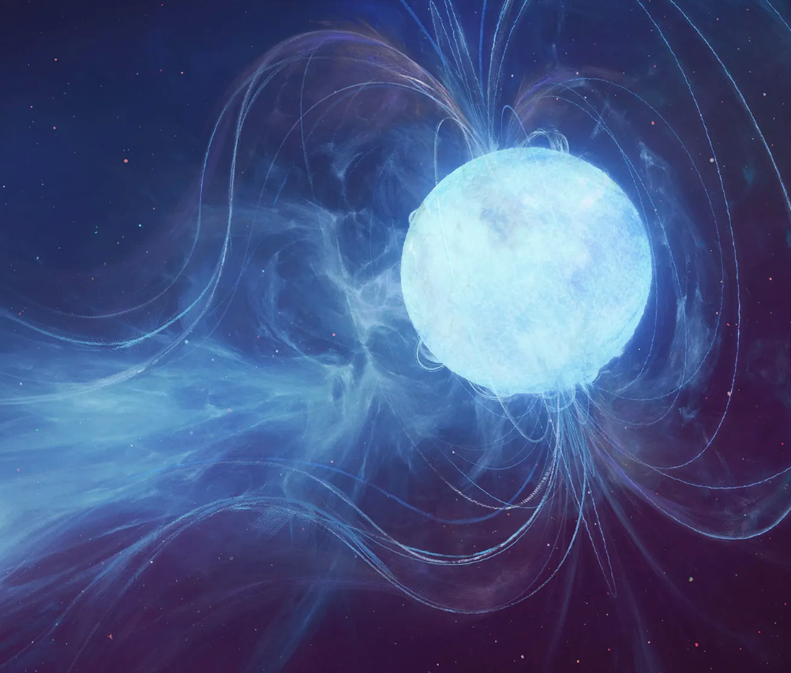
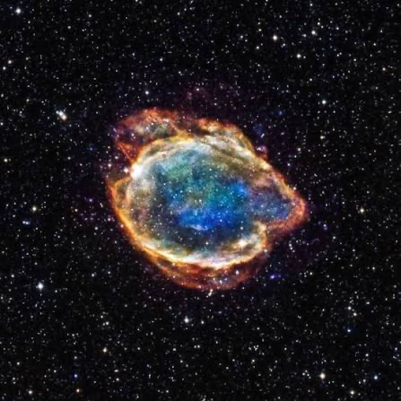
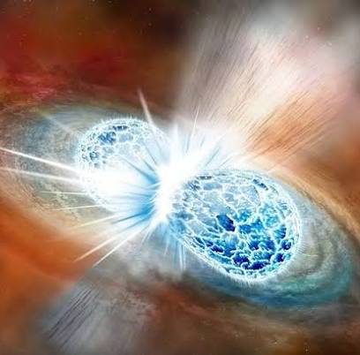
Gamma-ray bursts
Fast Radio Bursts
Tidal disruption events
Magnetar
bursts
Supernovae
Kilonovae
Astronomical transients
Image credits: Danielle Futselaar/artsource.nl (FRB); NASA / CXC / M. Weiss (TDE); NASA's Goddard Space Flight Center (GRB);
Chandra X-ray Observatory Center (SN); Maciej Rebisz for Quanta Magazine (Magnetar); Robin Dienel/Carnegie Institution for Science (KN)

Slide 3
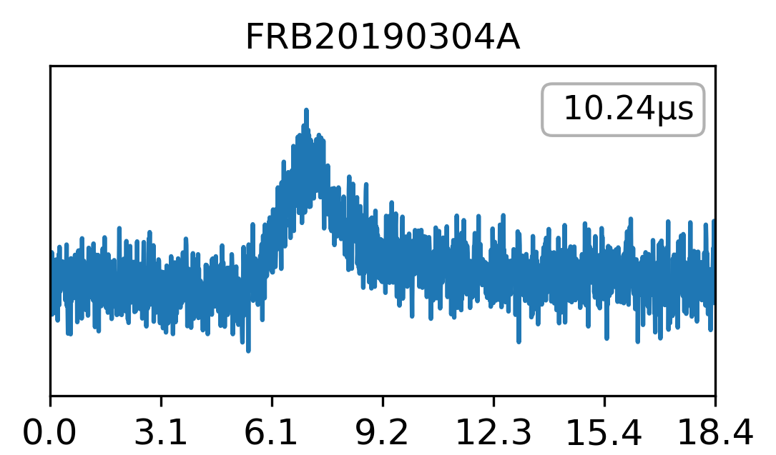
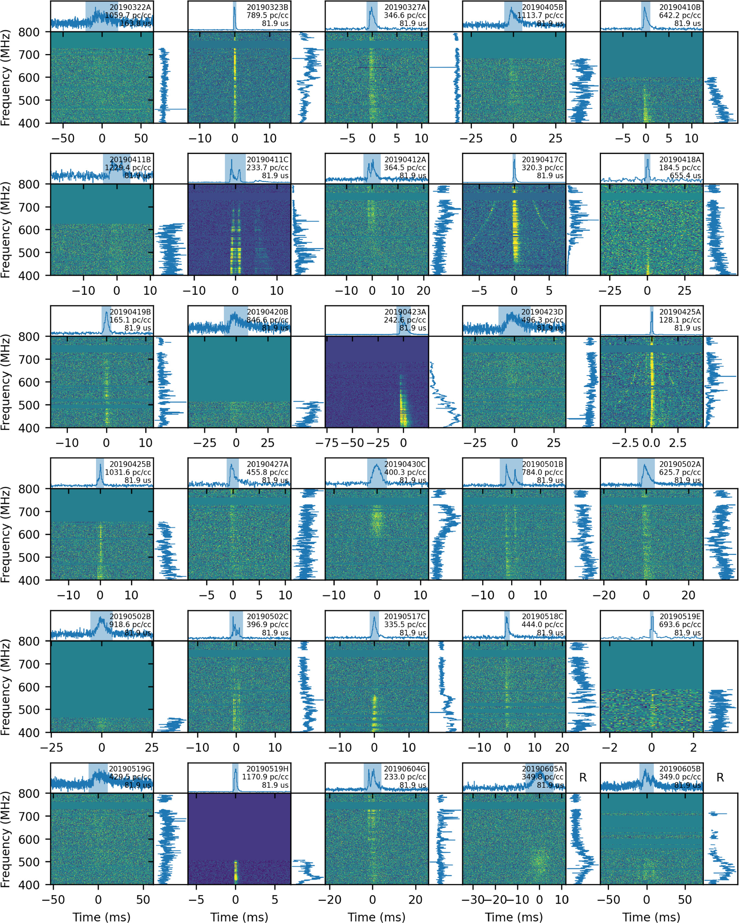
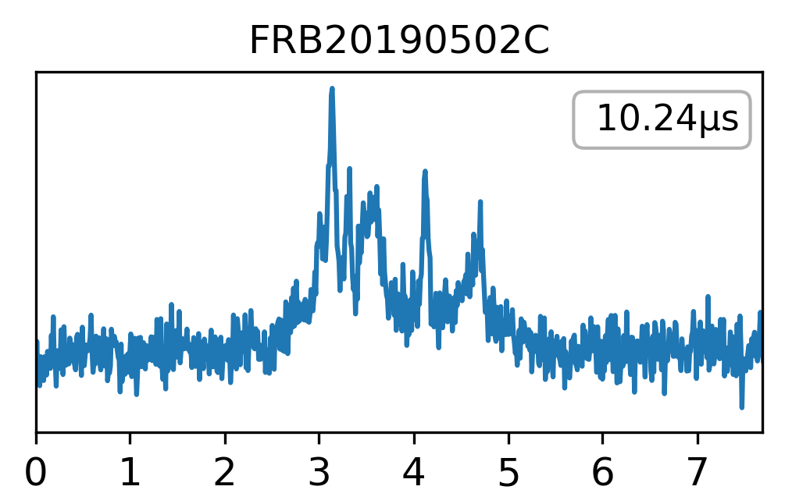
Fast Radio Bursts (FRBs)
Time[ms]
Time[ms]
Amiri, M et al., 2024 (arXiv:2311.00111)
Data adapted from CHIME/FRB

Slide 4
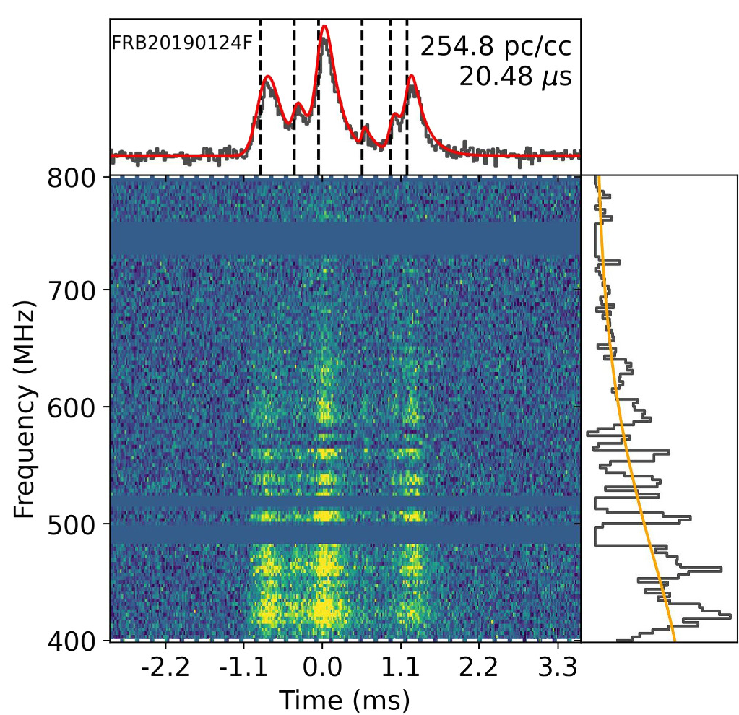
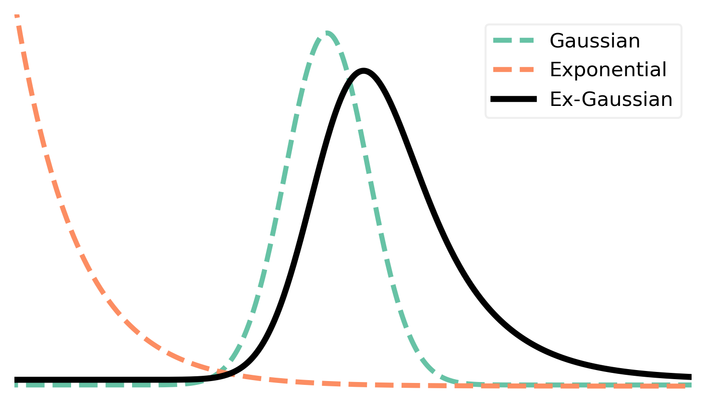
Current modelling + challenges
Multiple component model
Fitburst (Fonseca, E et al., 2024)
  Least squares
  Needs fixed amount of components
  Good first guess often needed
Sand, K et al., 2024 (arXiv:2408.13215)

Slide 5
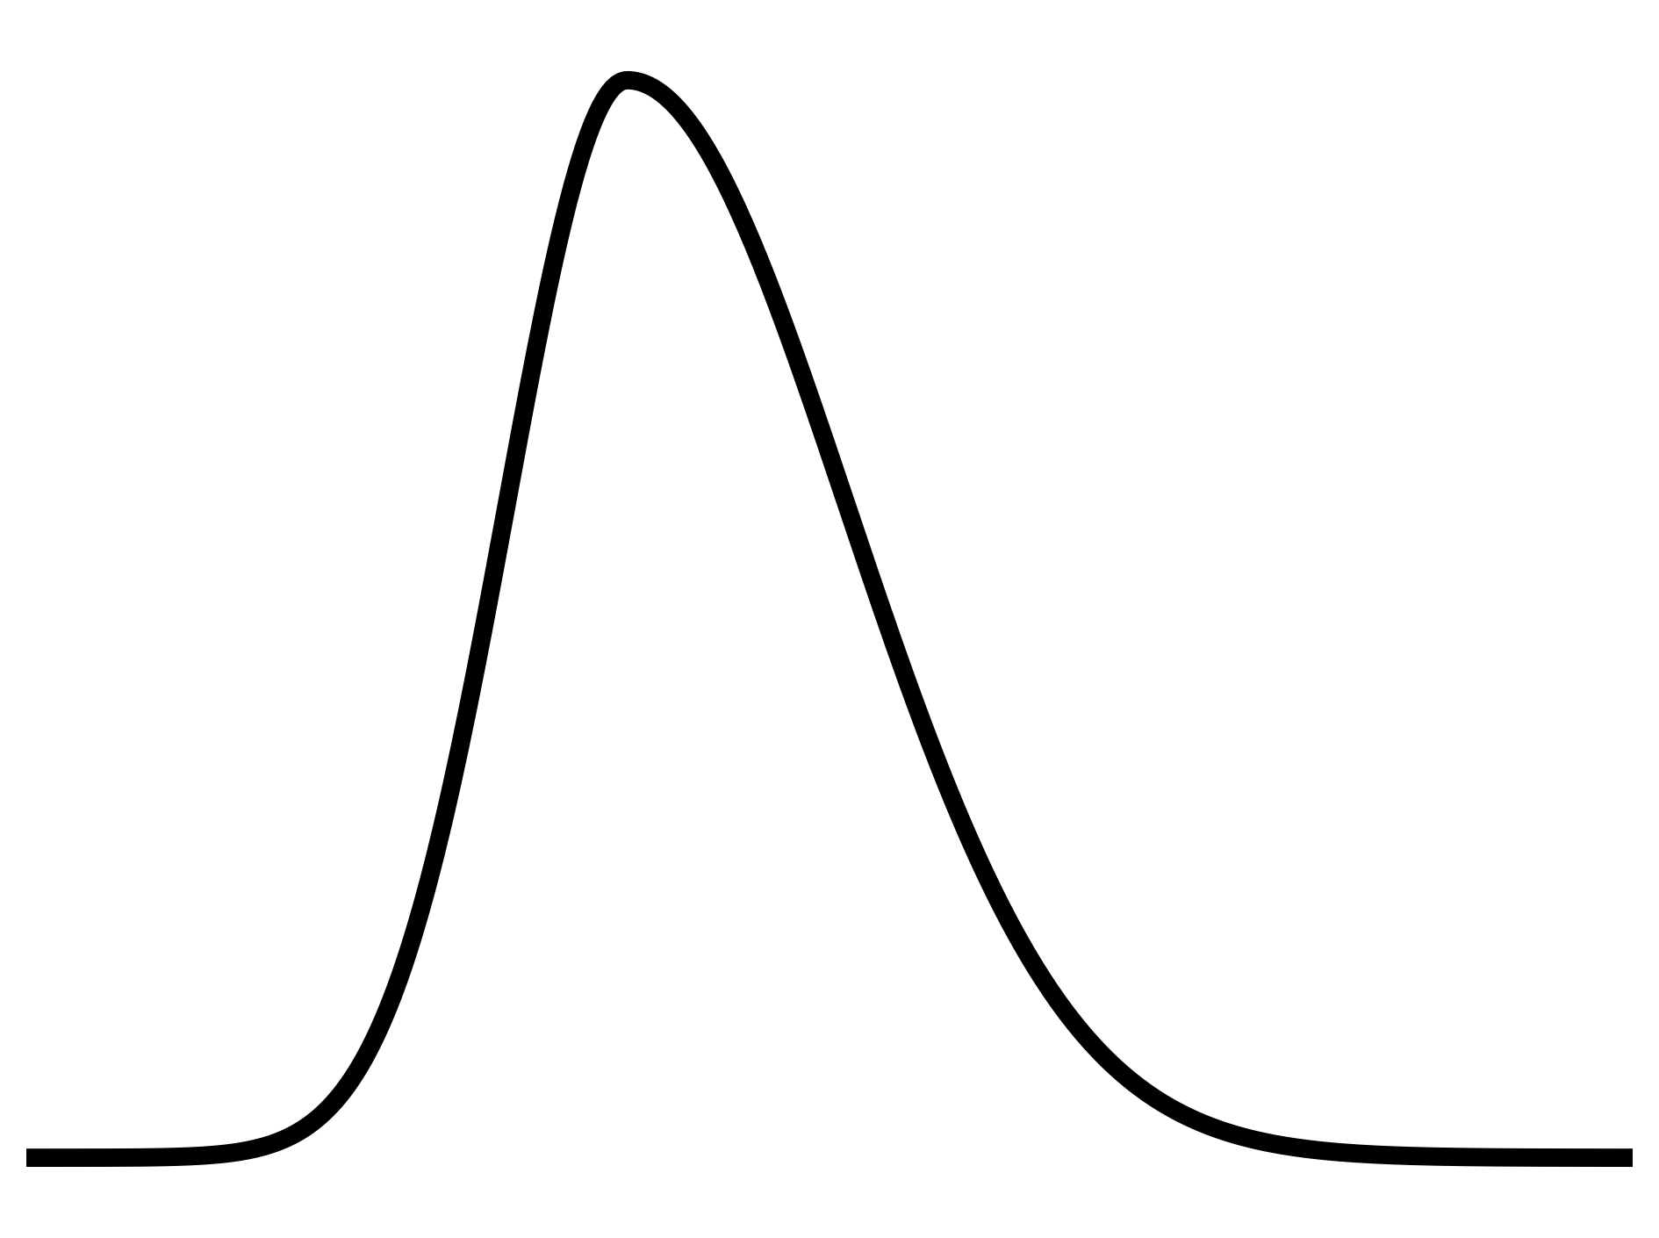
Current modelling + challenges
ML model
  Simulation-based inference
    Very fast amortised inference
  Multi-dimensional
  No manual tuning needed
  Statistical parameter posteriors
  FRBs: large dynamic range of timescales
  Handles low SNR regime gracefully
Skewed
gaussian
Amplitude
Rise
time
Skewness
Sand, K et al., 2024 (arXiv:2408.13215)
Arrival time

Slide 6
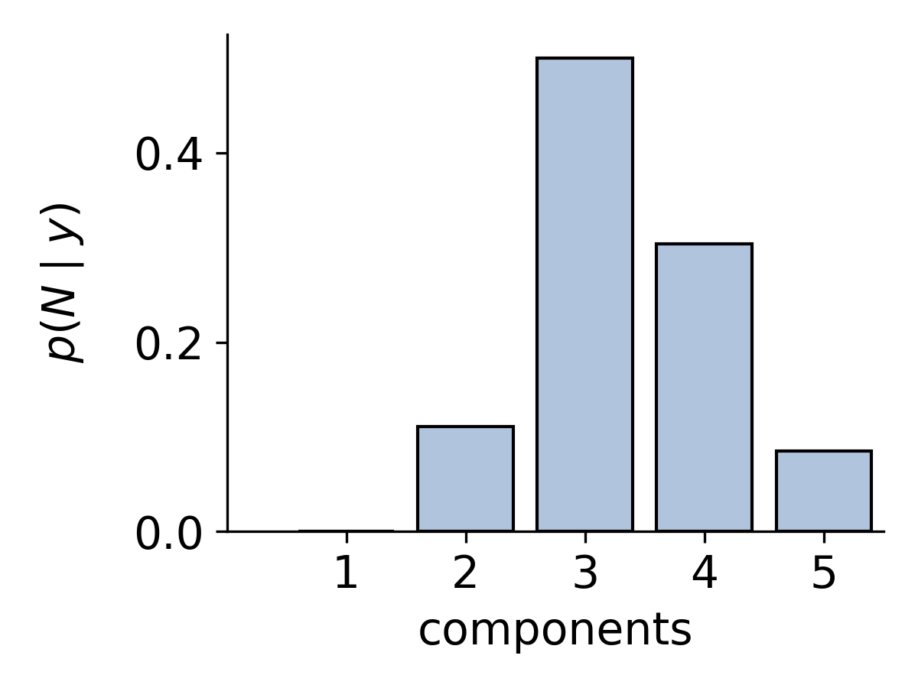
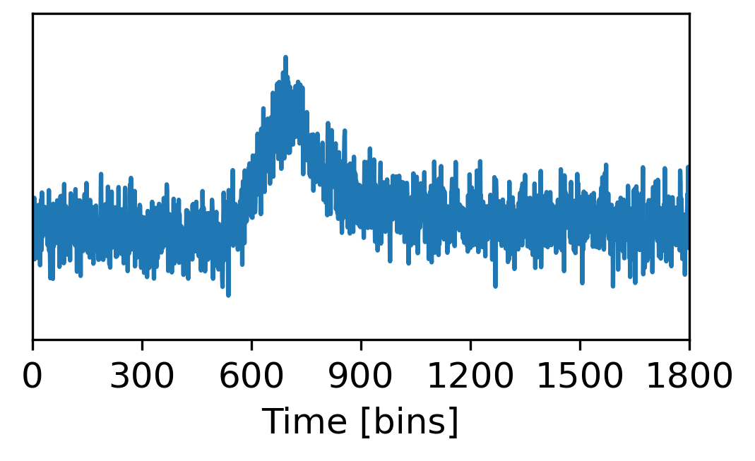
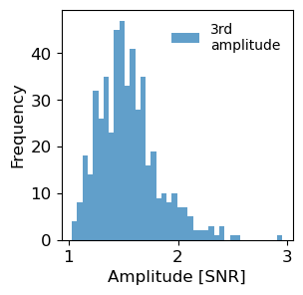
Machine learning pipeline schematic
Probability distribution for the number of sub-bursts
FRB lightcurve (LC)
Part 1
Components
Posteriors of the
sub-burst parameters
Part 2
based on:
van der Meulen et al., 2026 (arXiv:2607.21134)
Data adapted from CHIME/FRB

Slide 7
Classifier:
Infer the amount of components
CNN encoder
Softmax
Probability distribution
for number of components
LC
Encoded LC
MLP

Slide 8
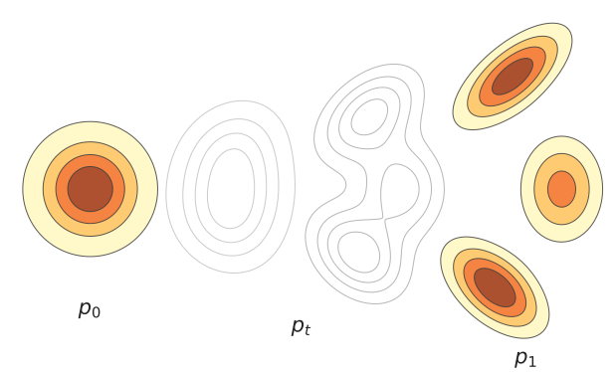
Infer the posteriors: Flow matching posterior estimation
Flow matching (FM)
t=0
0<t<1
t=1
van der Meulen et al., 2026 (arXiv:2607.21134)

Slide 9



Infer the posteriors: Flow matching posterior estimation
Flow matching (FM)
$$θ_{1}$$
$$x_{t}$$
$$θ_{0}$$
t=0
0<t<1
t=1
van der Meulen et al., 2026 (arXiv:2607.21134)

Slide 10
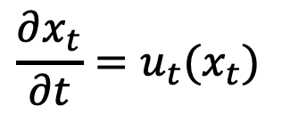

Infer the posteriors: Flow matching posterior estimation
Flow matching (FM)
Trajectory
Vector field
$$θ_{1}$$
ODE:
$$\frac{∂x_{t}}{∂t}=u_{t}(x_{t})$$
$$x_{t}$$
$$θ_{0}$$
t=0
0<t<1
t=1
van der Meulen et al., 2026 (arXiv:2607.21134)

Slide 11

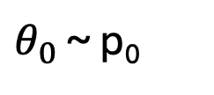
Infer the posteriors: Flow matching posterior estimation
Flow matching (FM)
Trajectory
Vector field
$$θ_{1}$$
ODE:
$$\frac{∂x_{t}}{∂t}=u_{t}(x_{t})$$
$$x_{t}$$
$$θ_{0}$$
solution:
$$x_{t} =ψ_{t}(θ_{0})$$
$θ_{0}$ ~ p₀
Flow
t=0
0<t<1
t=1
van der Meulen et al., 2026 (arXiv:2607.21134)

Slide 12
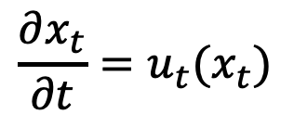
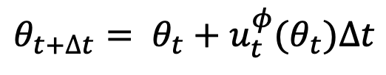


Infer the posteriors: Flow matching posterior estimation
Flow matching (FM)
ODE:
$$\frac{∂x_{t}}{∂t}=u_{t}(x_{t})$$
$$θ_{1}$$
$$x_{t}$$
Solution:
$$x_{t} =ψ_{t}(θ_{0})$$
$$θ_{0}$$
Euler integration:
Old parameter
$$θ_{t+∆t}= θ_{t}+u_{t}^{φ}(θ_{t})∆t$$
Updated
parameter
t=0
0<t<1
t=1
Network parameters $φ$
van der Meulen et al., 2026 (arXiv:2607.21134)

Slide 13
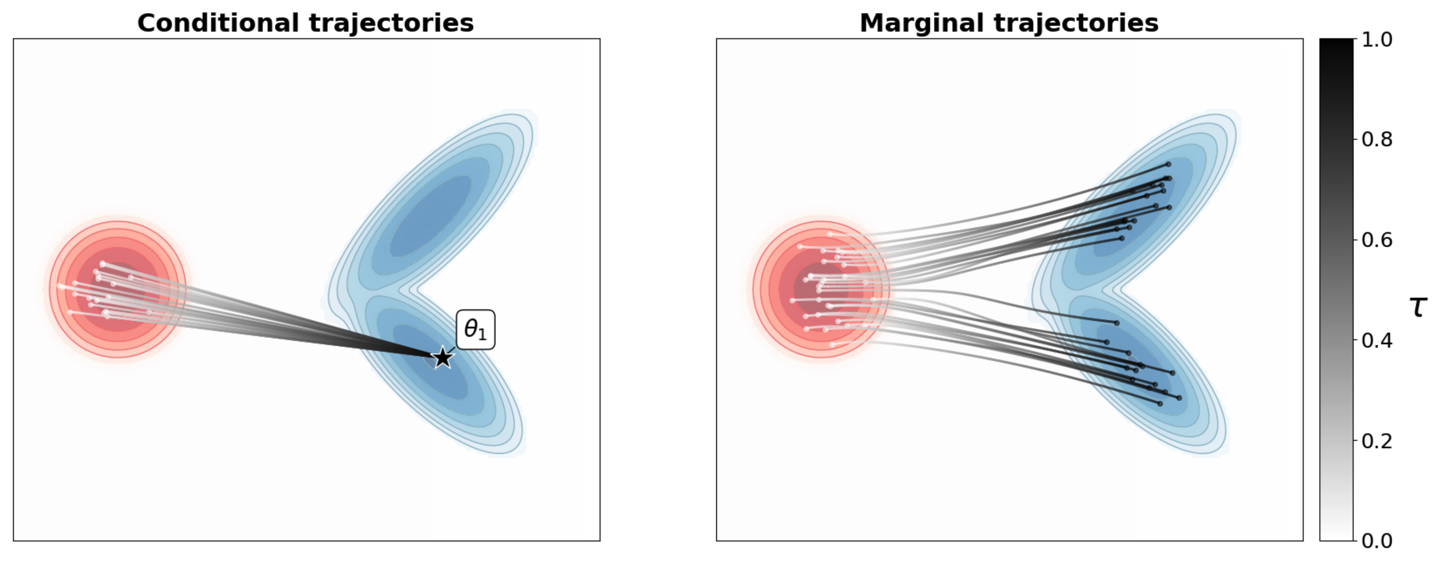
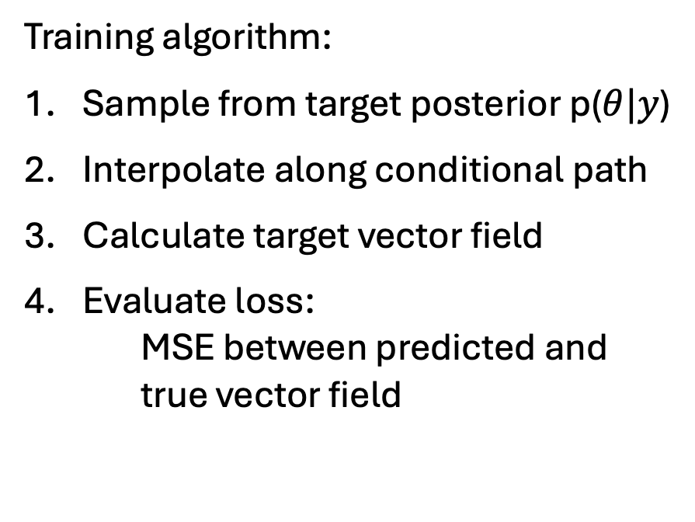
Infer the posteriors: Flow matching posterior estimation
Training algorithm:
Sample from target posterior p($θ|y$)
Interpolate along conditional path
Calculate target vector field
Evaluate loss:
MSE between predicted and
true vector field
t
van der Meulen et al., 2026 (arXiv:2607.21134)

Slide 14
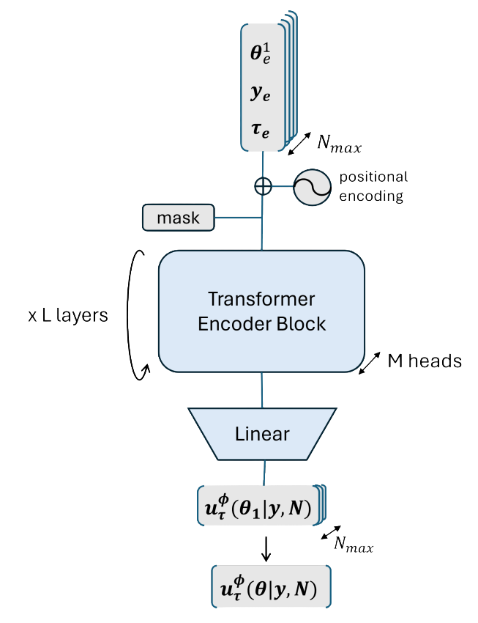
Transformer encoder schematic
Input tokens
van der Meulen et al., 2026 (arXiv:2607.21134)

Slide 15
FM inference
Sample from noise
e.g 1000 samples
Integrate with approximated vector field
1000 posterior samples
Call NN at
every time step

Slide 16
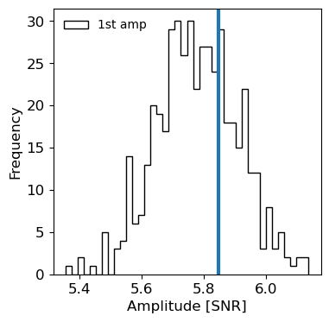
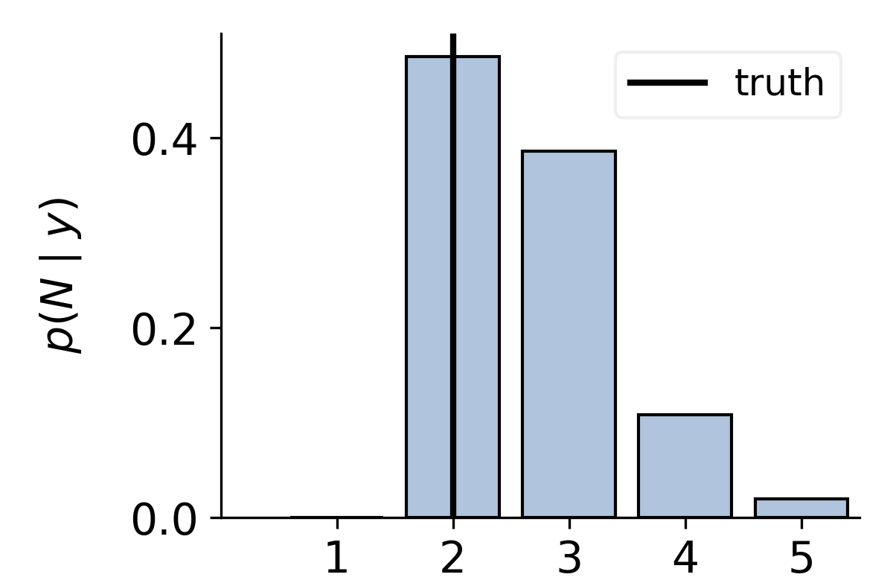
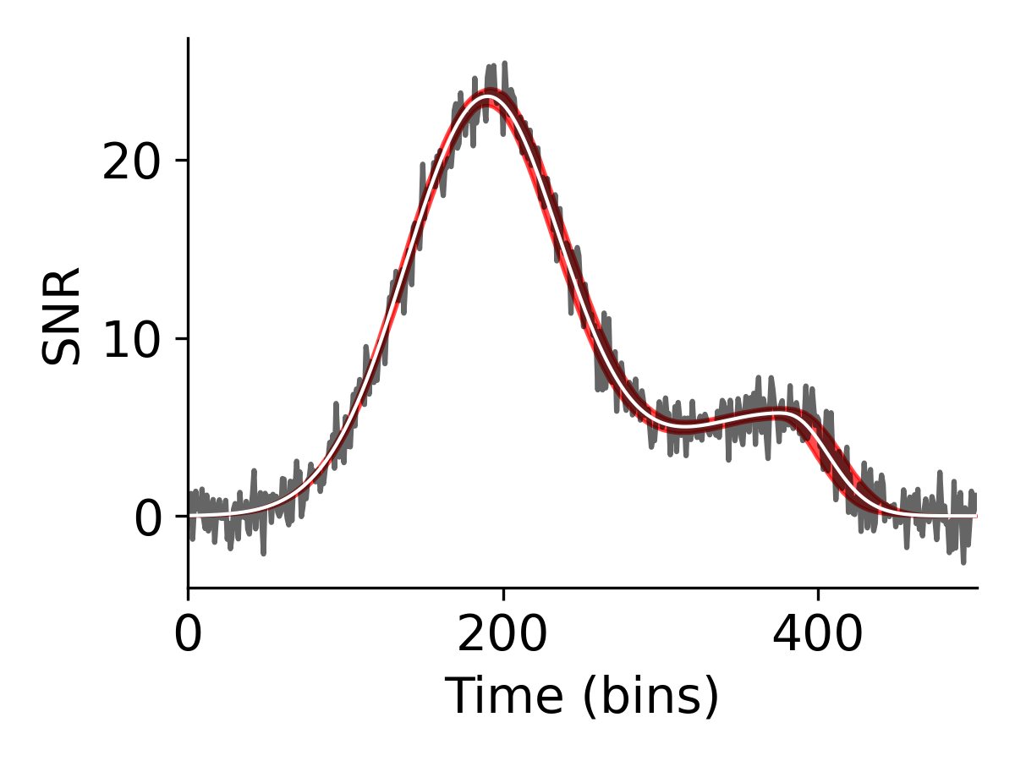
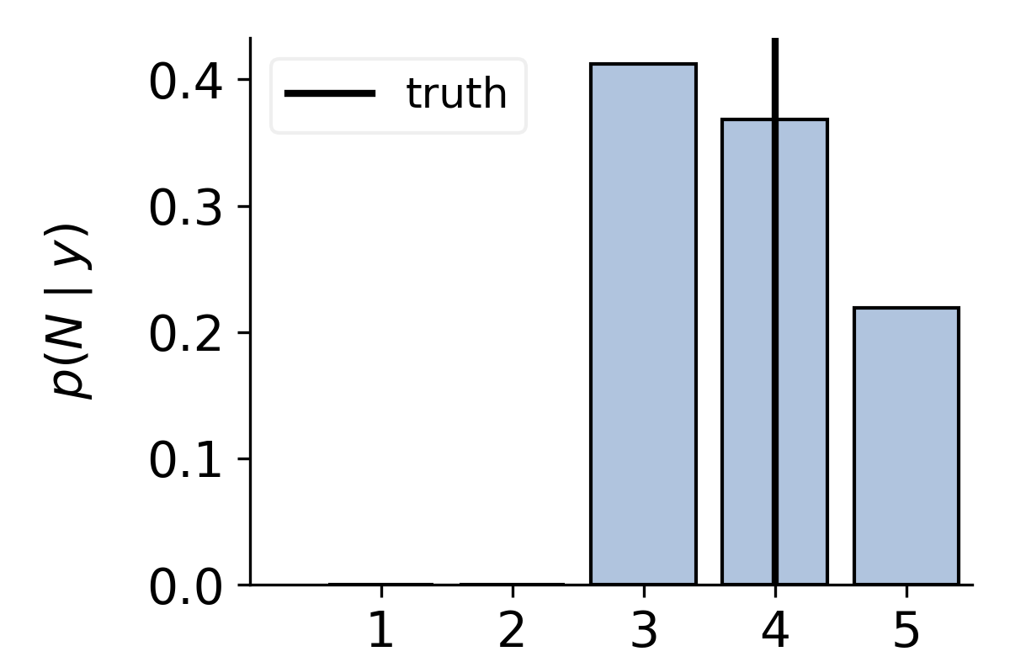
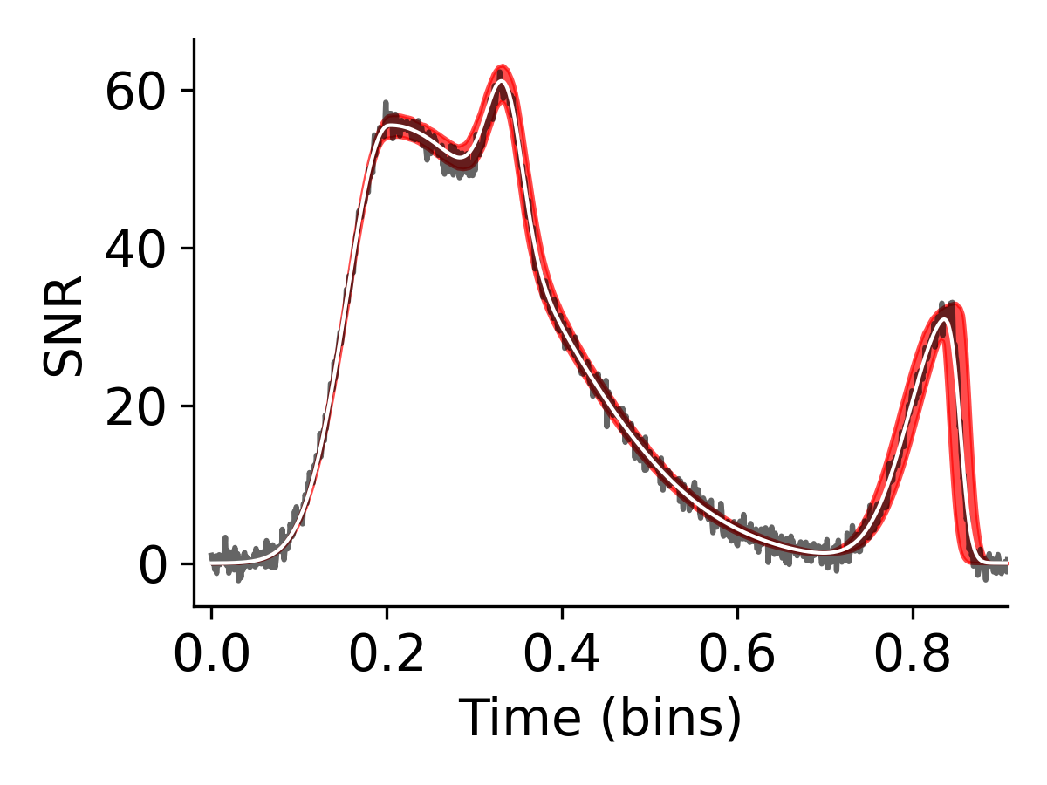
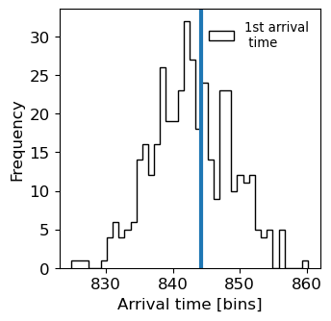
Simulated FRB inference
truth
Components
truth
Components
0 200 400 600 800
Data adapted from CHIME/FRB

Slide 17
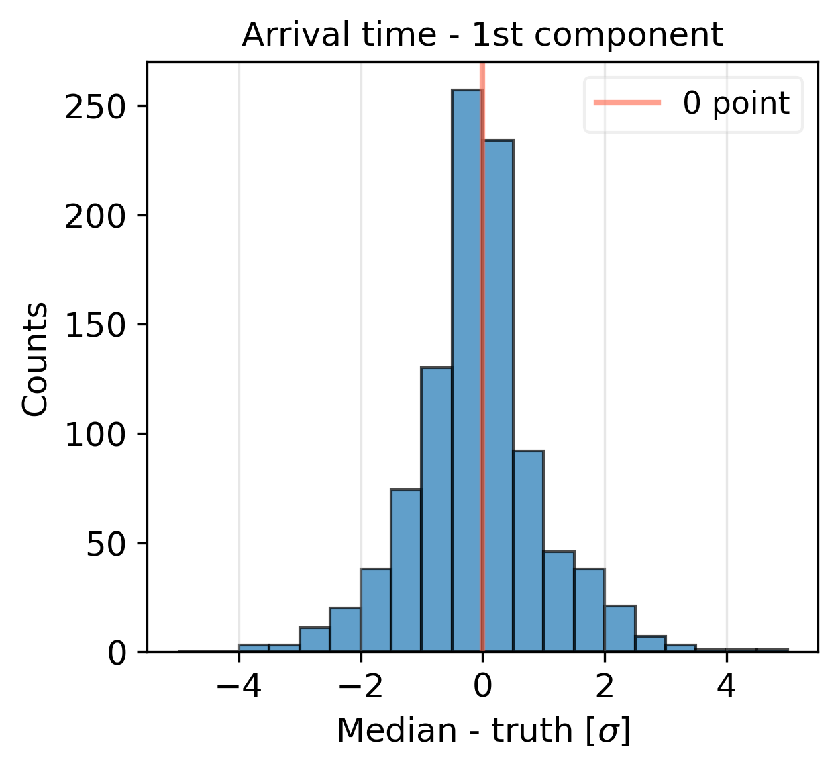
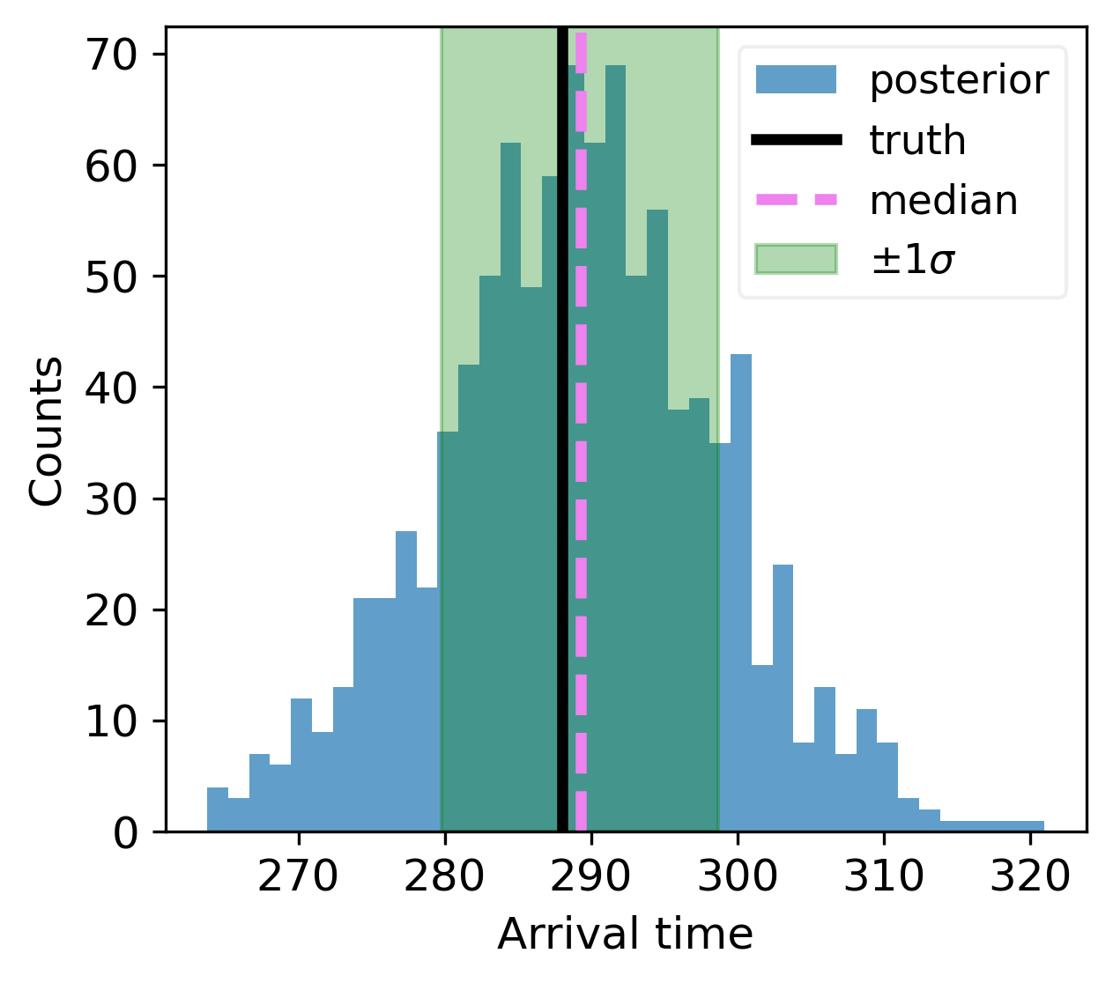
ML evaluation
Arrival time [bins]

Slide 18
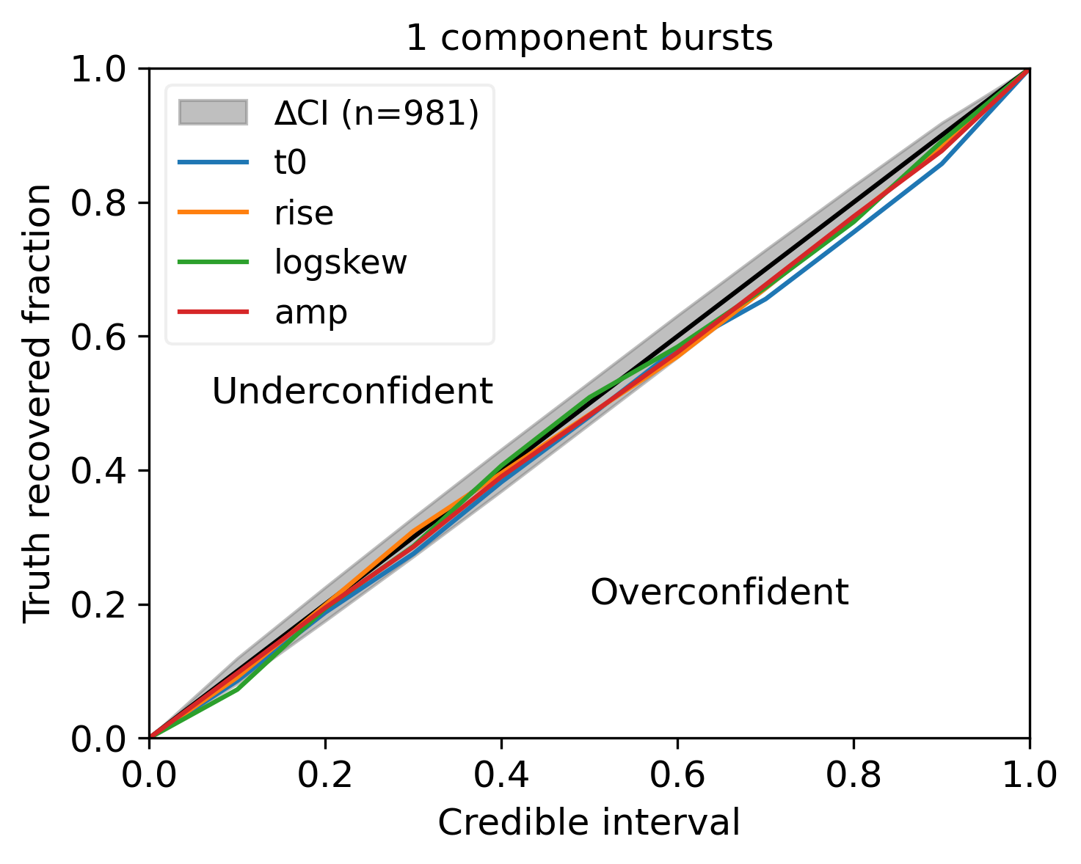
ML evaluation

Slide 19
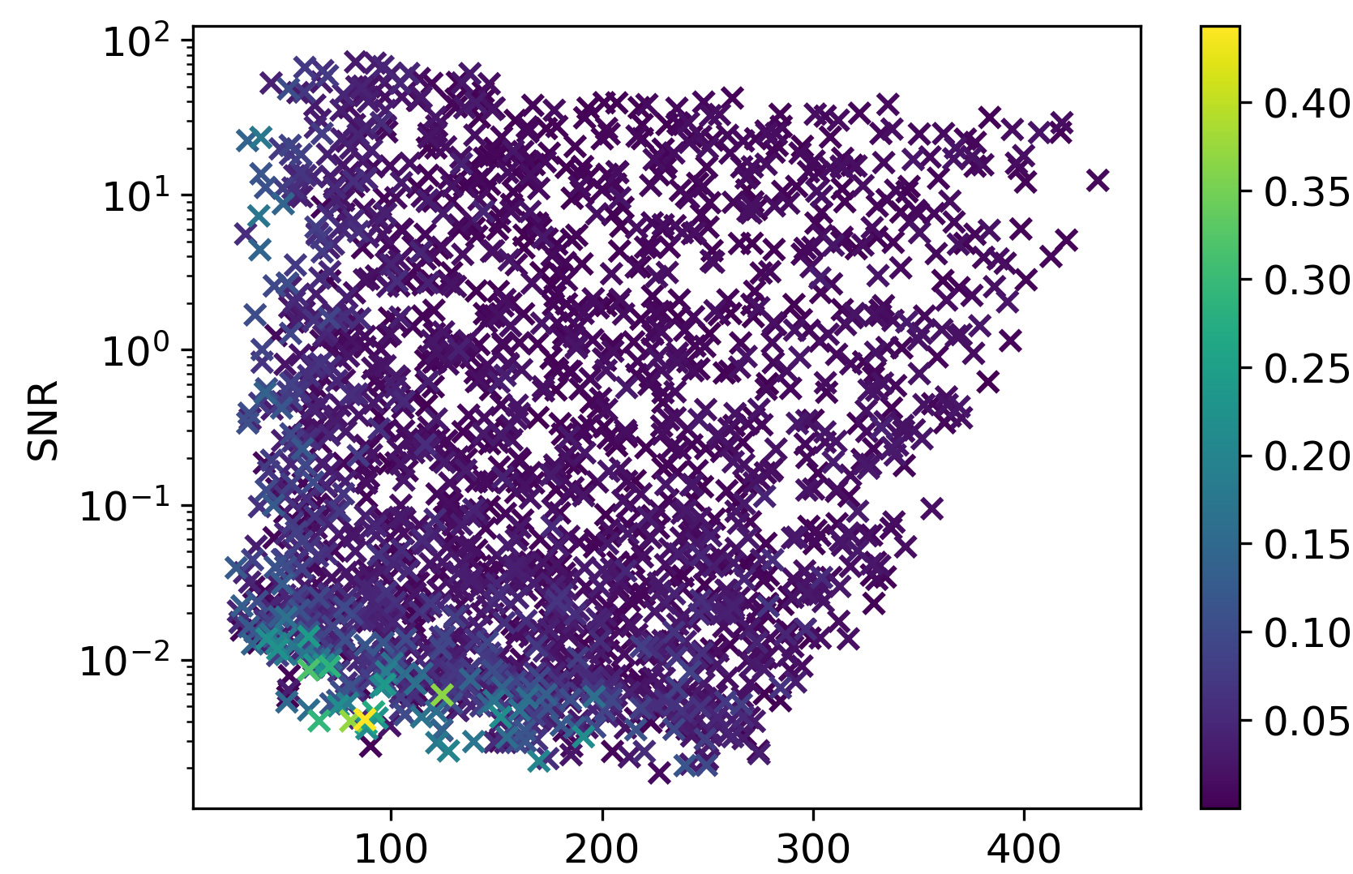
ML evaluation
Mean absolute deviation
Arrival times [bins]

Slide 20
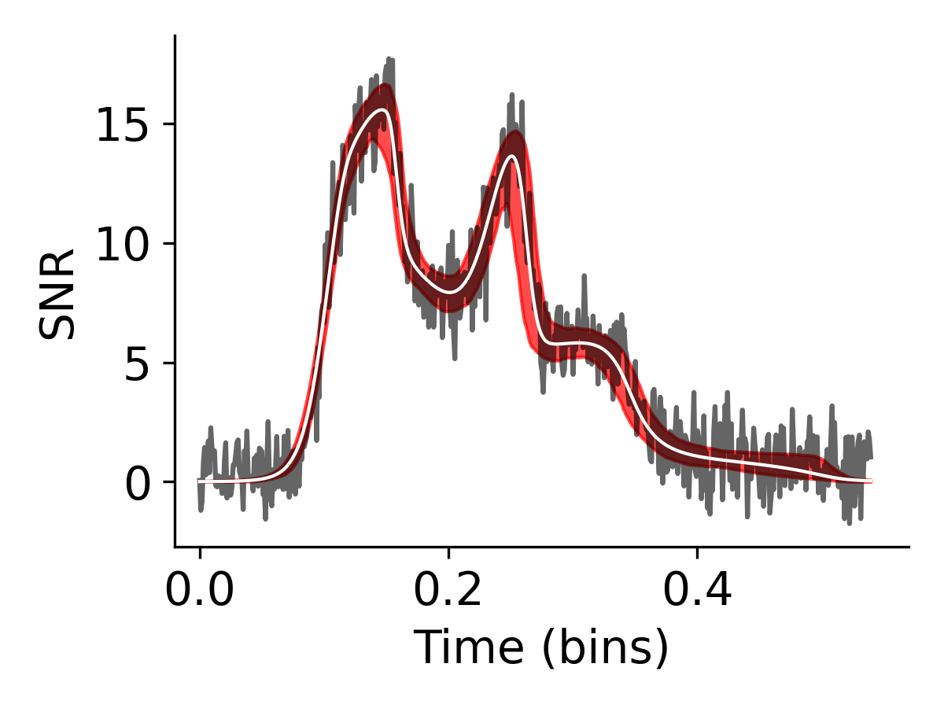
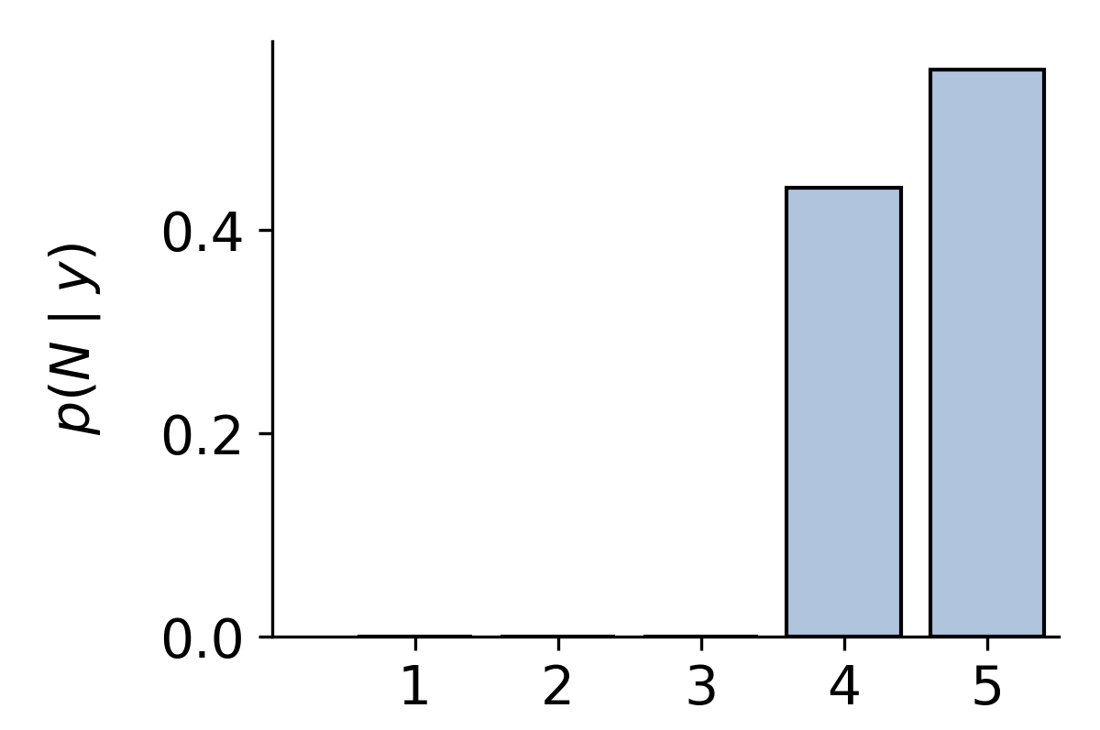
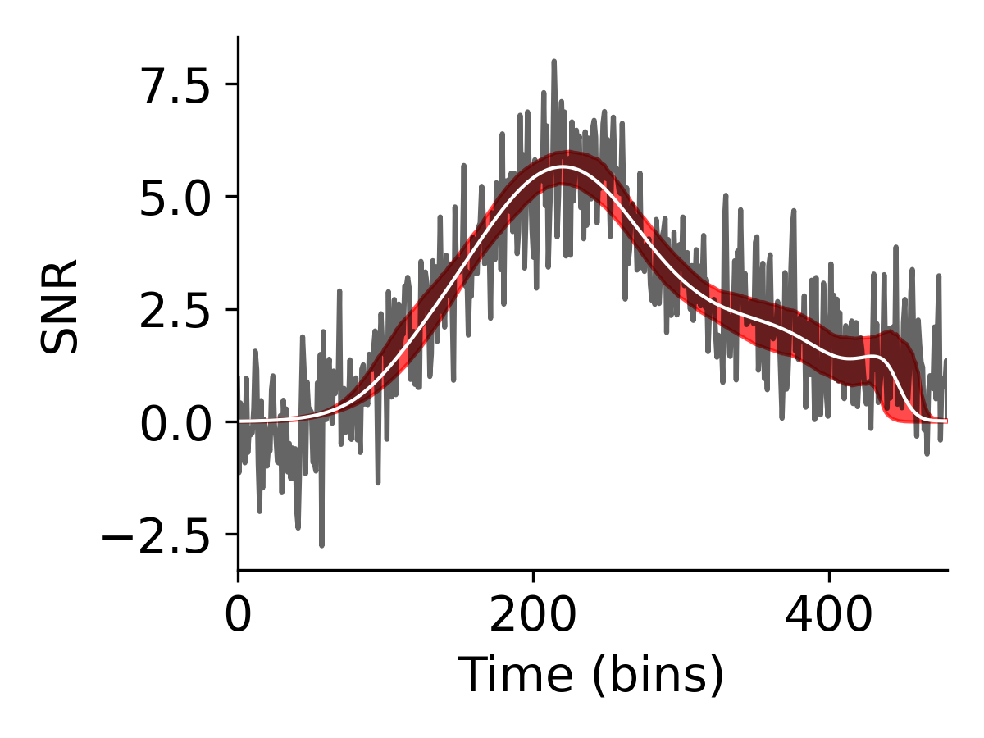
CHIME FRB inference
0 200 400
Components
Components
Data adapted from CHIME/FRB
Notes:
Add what we can get from this – just as words
- pop studies due to fast inference, we can see if there any regroupments of frbs
current main debated repeaters non rpeaters 0- large sample size cna help us narrow down
profile is intrinsice and extrinsic effects - so we want to use a model like this with different underlying shapes to get evidentce for scattering, separation of peaks, morphologcal differences,.. - us we just have empirical shapes no underlying physics
SNR limited – so with trainig data at low SNR – this methods perfoms better than previous ones

Slide 21
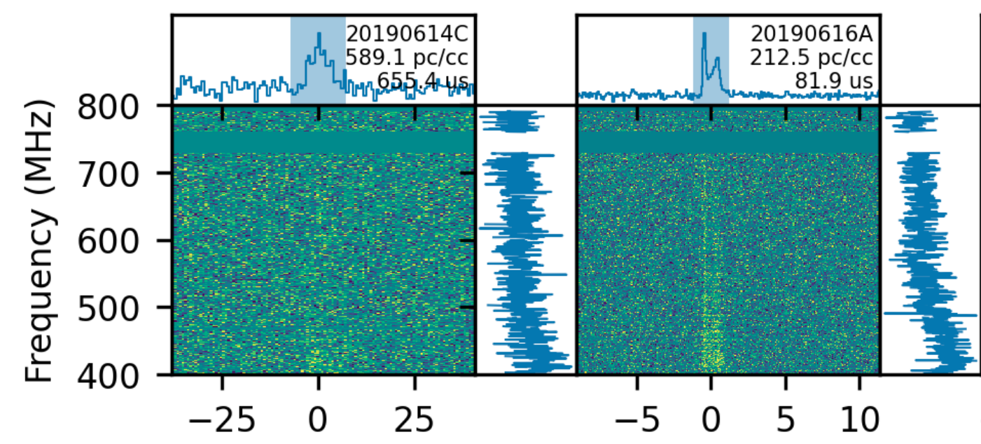
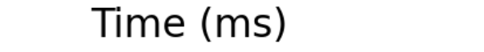
Conclusion & Outlook
a.schmit@uva.nl
Developing an accurate & fast ML pipeline
  Able to deal with thousands of transients
Flexible pipeline
  Applicaple to other transients
  e.g. X-ray bursts, GRB
Extending the pipeline to 2D
  Include time and frequency
Amiri, M et al., 2024 (arXiv:2311.00111)
more on the method:
van der Meulen et al., 2026 (arXiv:2607.21134)

Slide 22
ADDITIONAL SLIDES

Slide 23
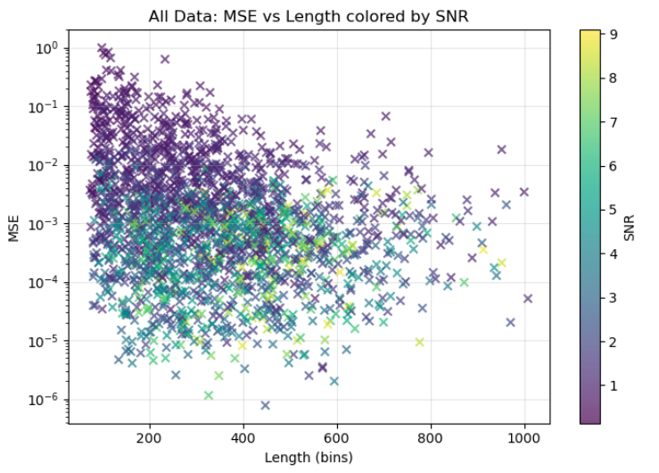
Length dependence

Slide 24
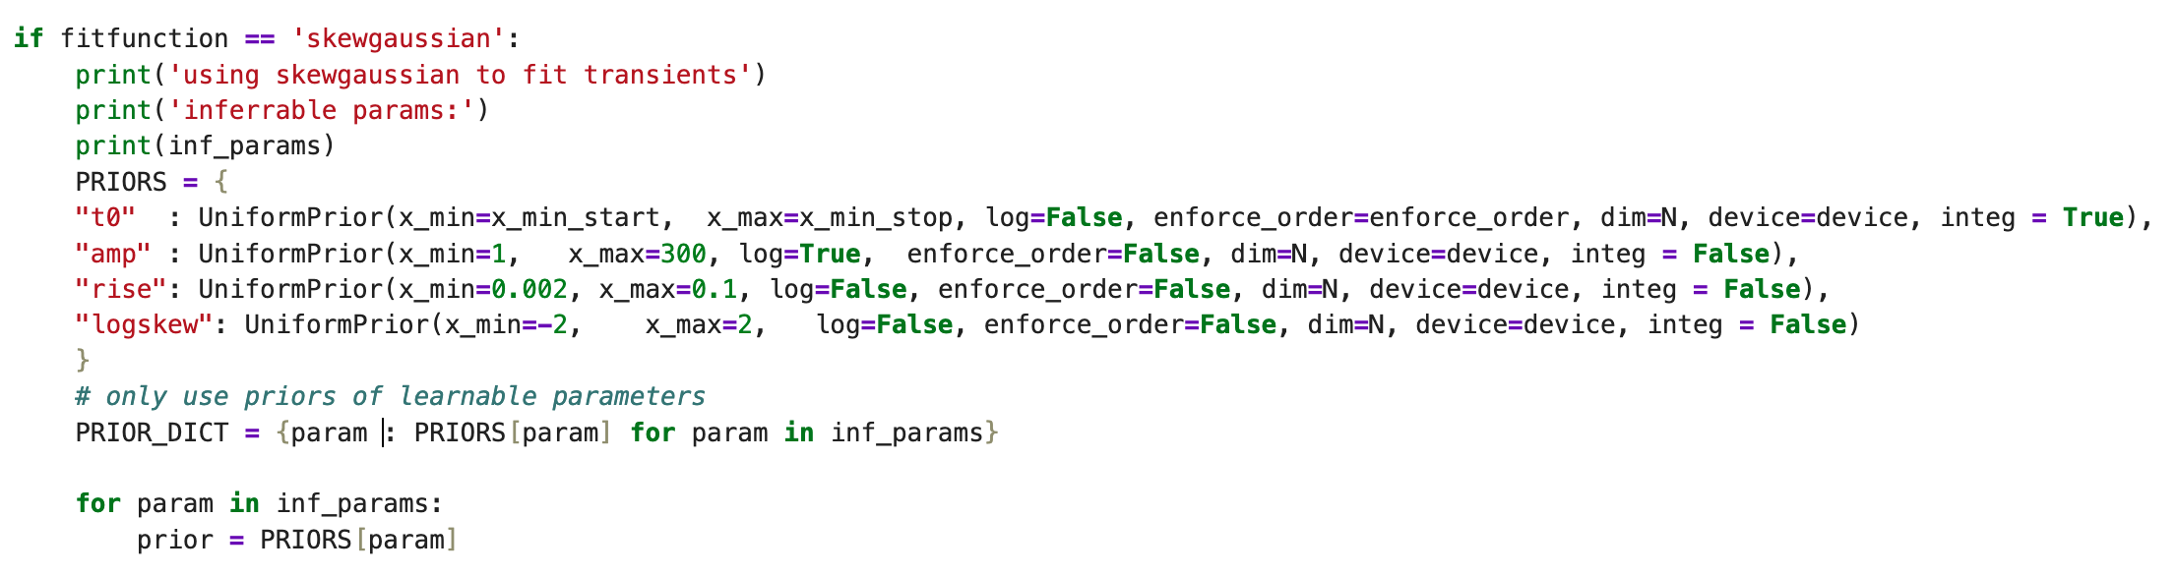
Priors

Slide 25
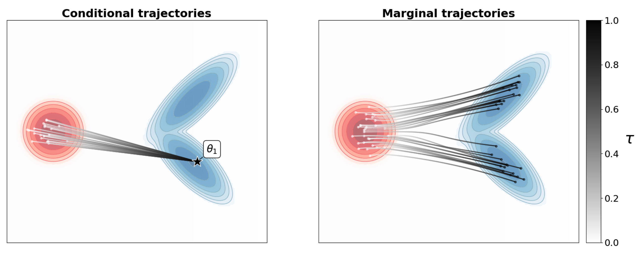
FM info

Slide 26
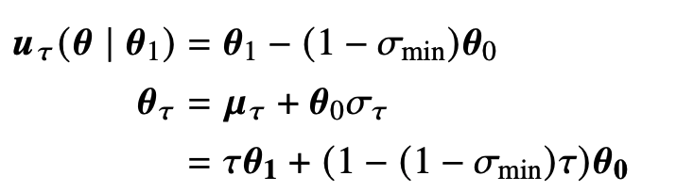
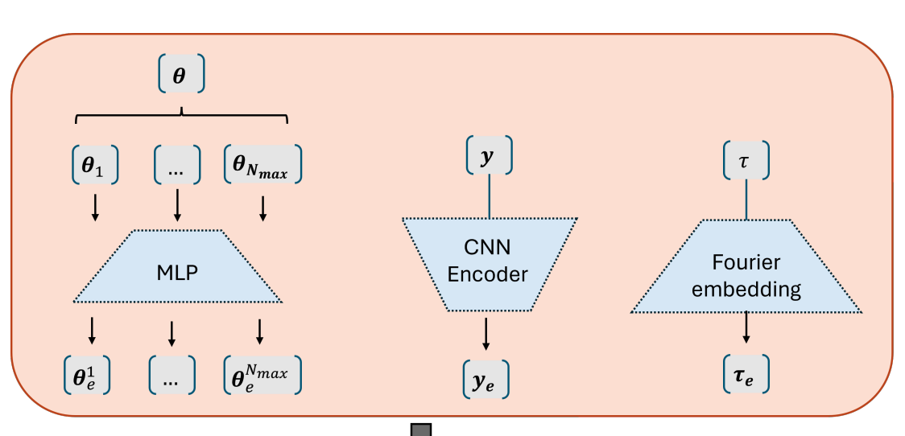
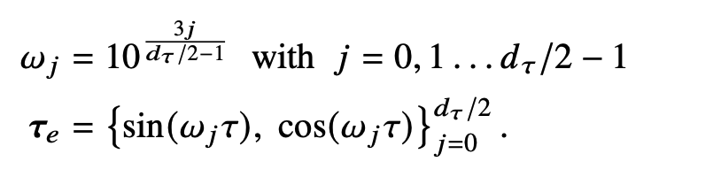

Slide 27
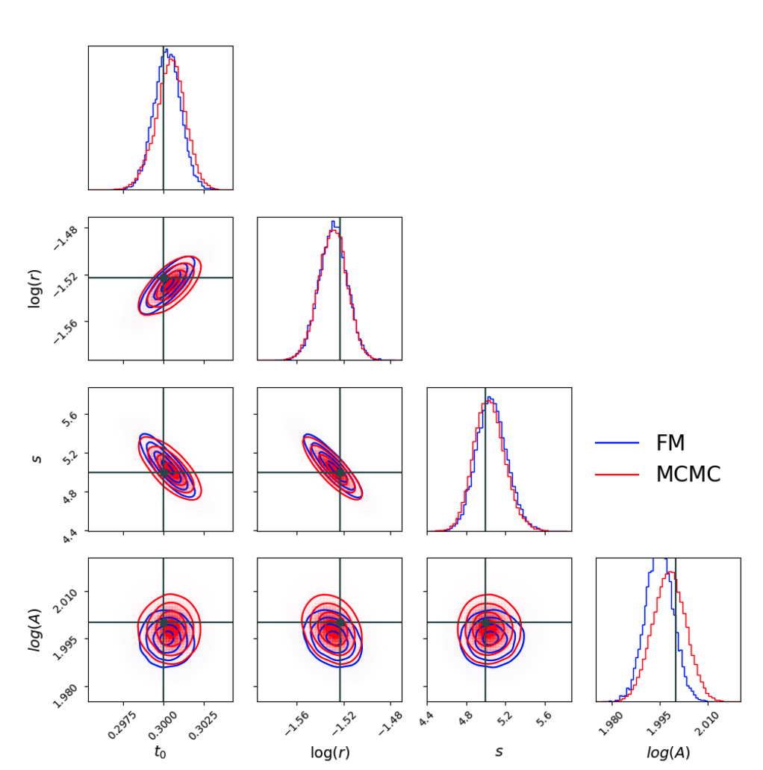

Slide 28
