Slide 1



AI-Assisted Super-Resolution-Simulations: Application to the DEMNUni-Cov N-Body Simulations
Bruno Montaltoª,
(bruno.montalto@inaf.it)
Funded by INAF Ricerca Fondamentale Techno Grant 2023
Eva Sciaccaª, Fabio Vitelloª, Giorgia Vitanzaª, Carmelita Carbone^{b}
ªINAF Astrophysical Observatory of Catania, Via Santa Sofia 78, Catania, Italy
^{b}INAF – Istituto di Astrofisica Spaziale e Fisica cosmica di Milano (IASF-MI) Via Alfonso Corti 12 20133 Milano

Slide 2

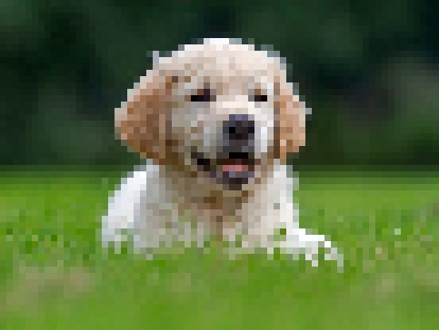


What is super-resolution?
low resolution (LR)
high resolution (HR)

Slide 3
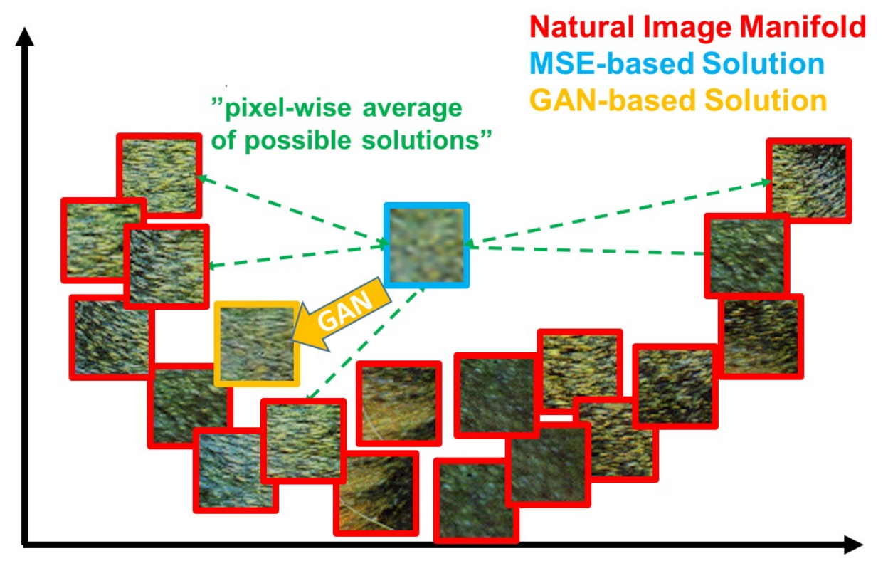
Super-resolution: an ill-posed problem
Ledig, Christian, et al. "Photo-realistic single image super-resolution using a generative adversarial network." 2017 IEEE conference on computer vision and pattern recognition (CVPR). IEEE, 2017.

Slide 4
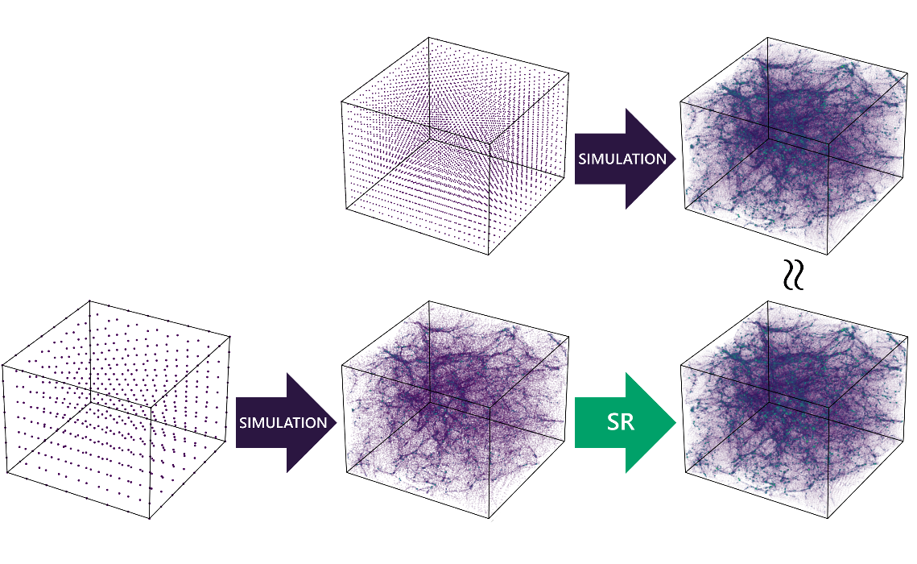
Using ML to overcome mass resolution limits
Computational costs of cosmological simulations increase steeply with mass resolution, often requiring a trade-off between volume and mass resolution.
Deep learning-based super-resolution algorithms learn mappings between low-resolution (LR) and high-resolution (HR) samples from data
Approximate HR simulations (SR) can then be inferred from less expensive LR runs
This procedure can drastically reduce computation costs while maintaining acceptable fidelity
less expensive!

Slide 5
DEMNUni-Cov simulations
The training and test sets used for this work were created from several realizations from the DEMNUni-Cov project (Carbone 2020), used as high-resolution N-body simulations for studying large-scale structure of the Universe and estimating statistical covariances.
Cosmology: standard Planck-2013 LCDM
Mass resolution: ≈8×10¹⁰h⁻¹M⊙
Initial conditions: z_{in}=99, generated with CAMB at z=0 and rescaled to z_{in}=99 with REPS
Evolution: GADGET-3, with 63 snapshots from z=99 to z=0

Slide 6



DEMNUni-Cov HR-LR dataset for super-resolution
15 realizations at z=0
(14 for training + 1 for test)
(1 Gpc/h)³ volume*
x2
1024³ cold dark matter particles (HR)
x2 upsample factor**
*From each training simulation, only a sub-volume of ≈ (500 Mpc/h)³ is considered
**Simulations pairs are generated via a particle downsampling (1024³ → 512³) function

Slide 7
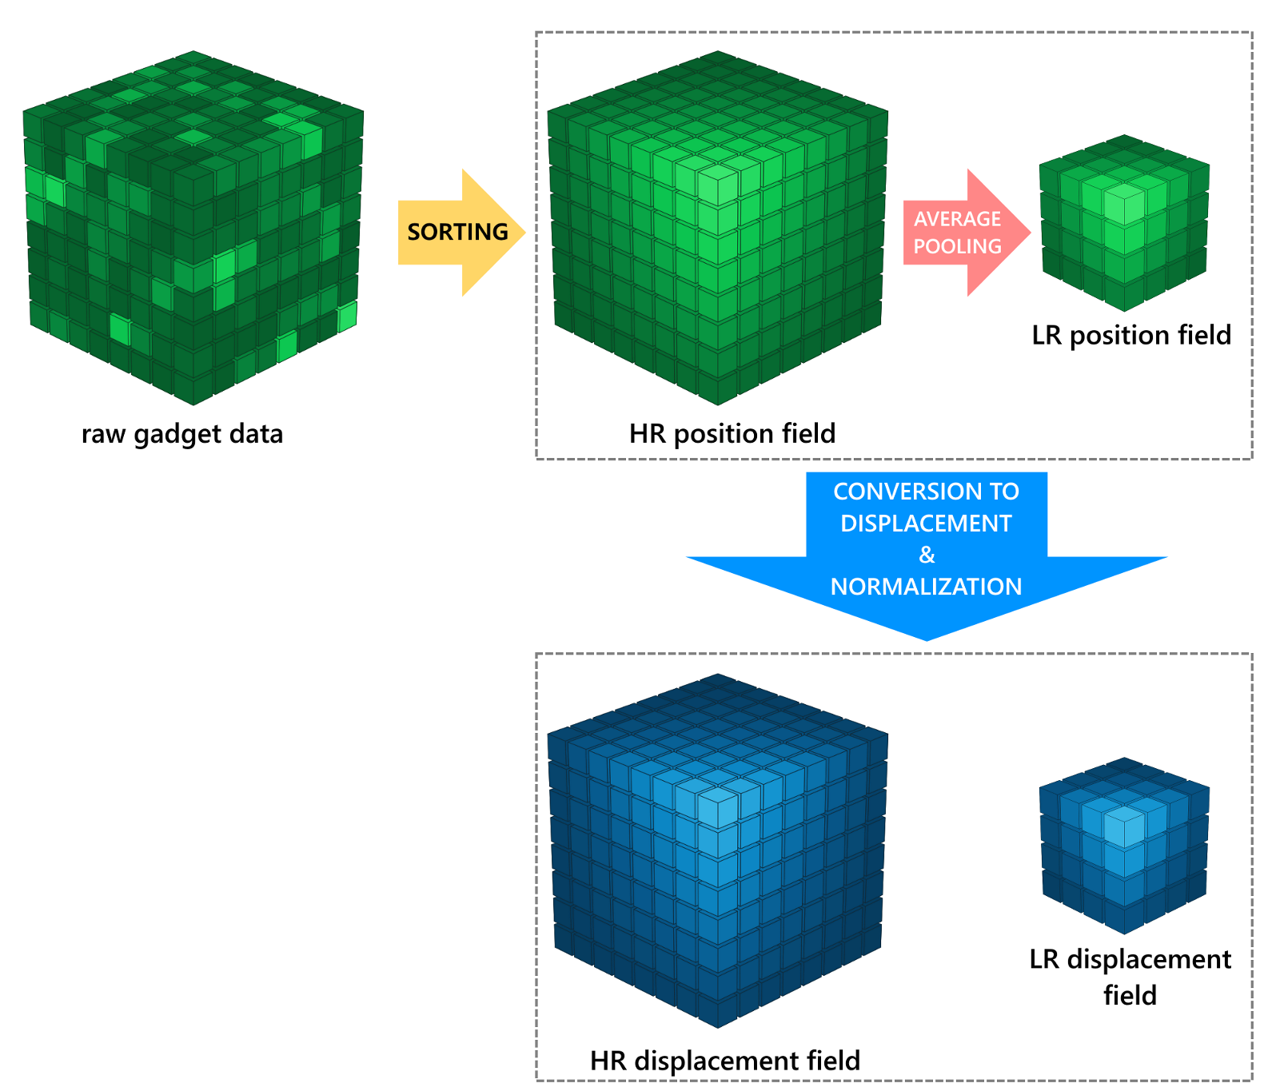
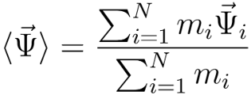

HR-LR pair generation pipeline
sorting enables CNNs to learn meaningful relations

Slide 8
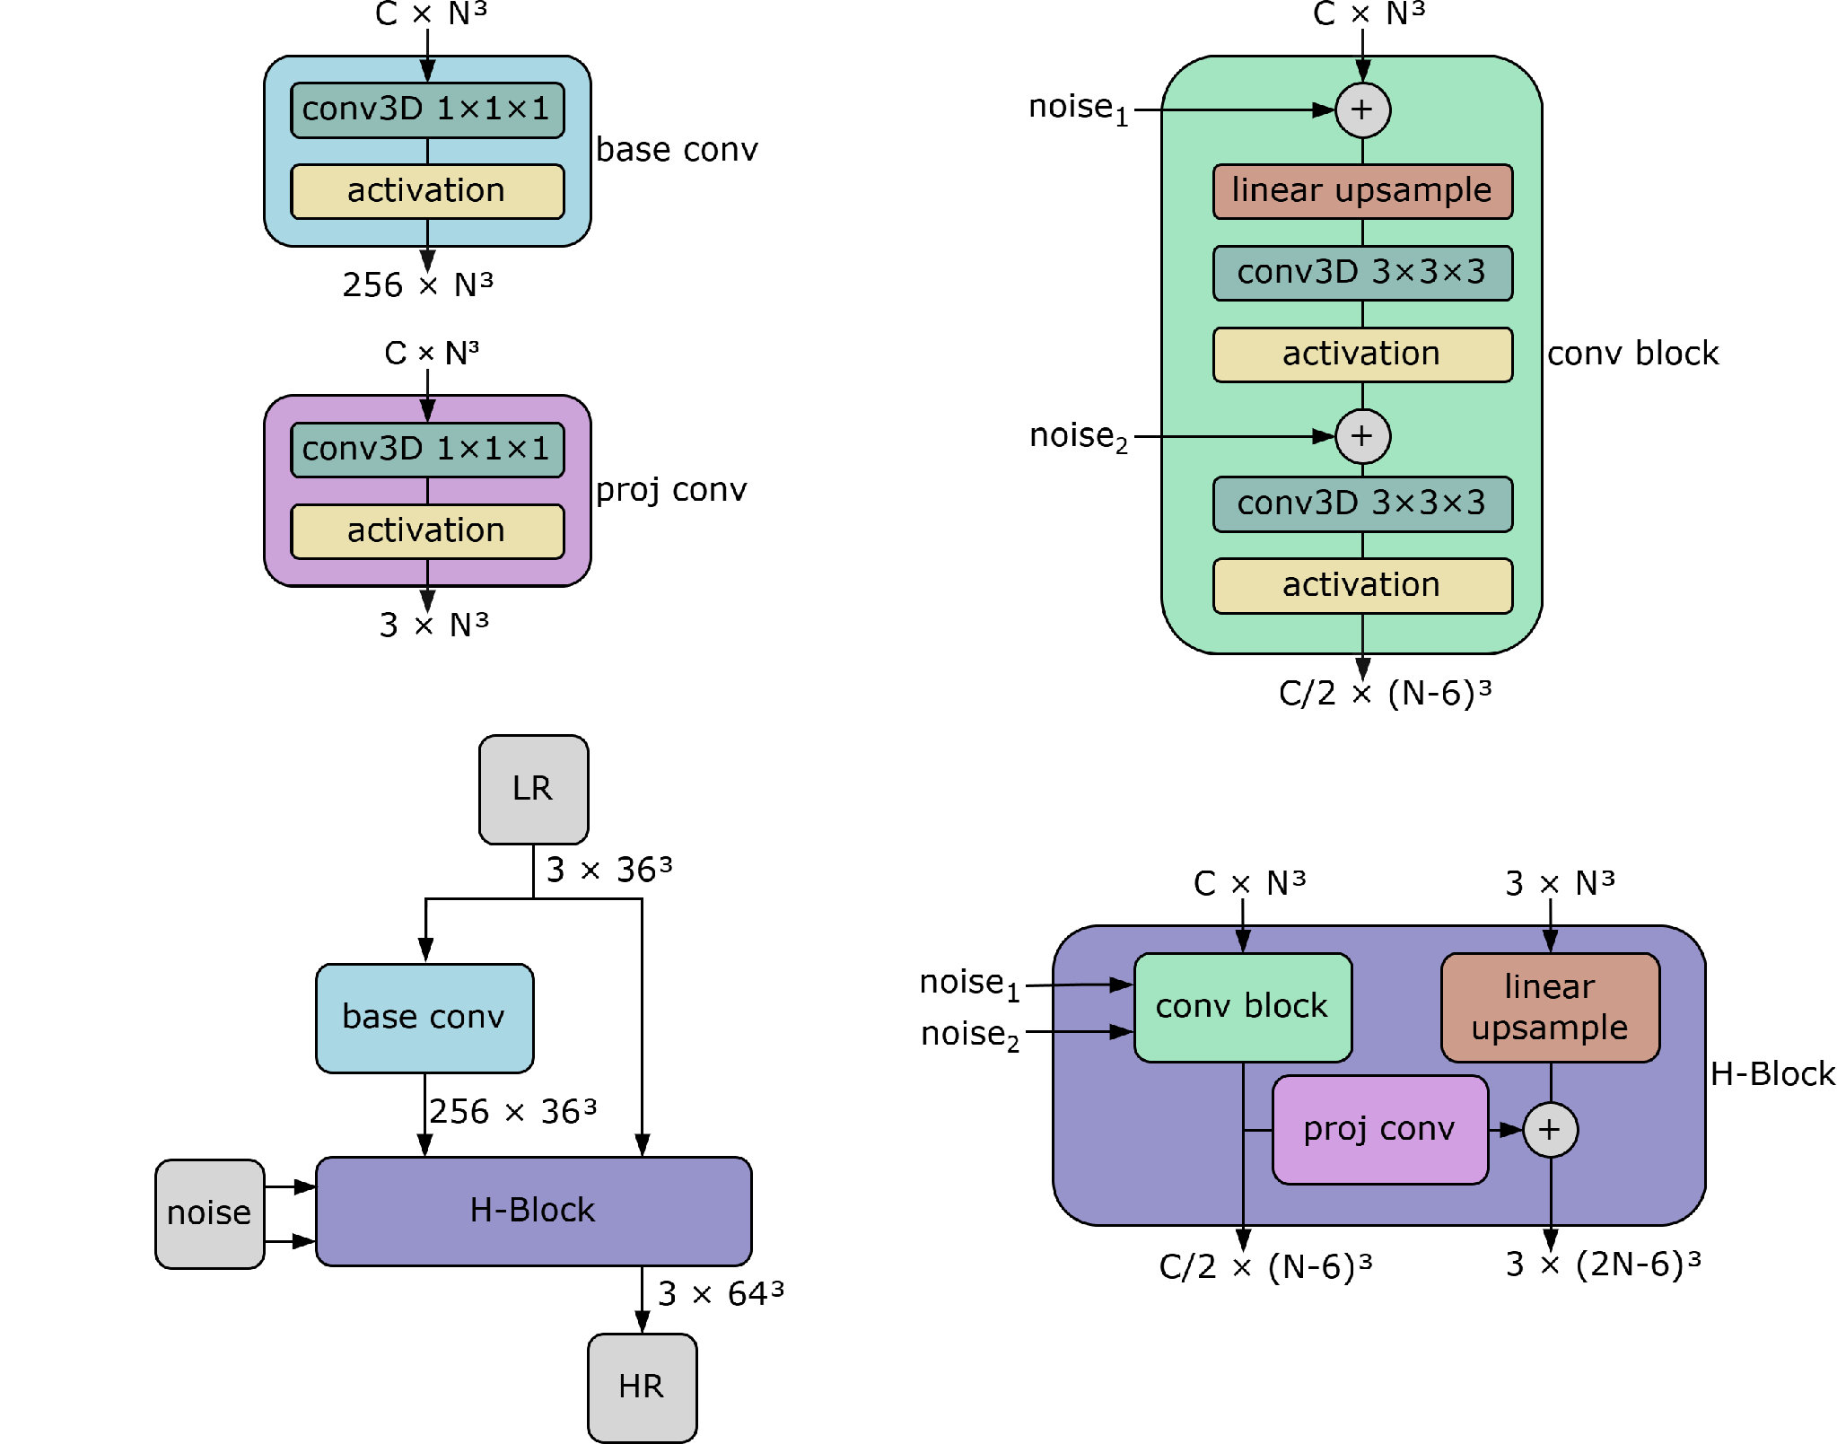
WGAN-SR architecture for x2 upsample (G)
Li, Yin, et al. "AI-assisted superresolution cosmological simulations." Proceedings of the National Academy of Sciences 118.19 (2021): e2022038118.

Slide 9
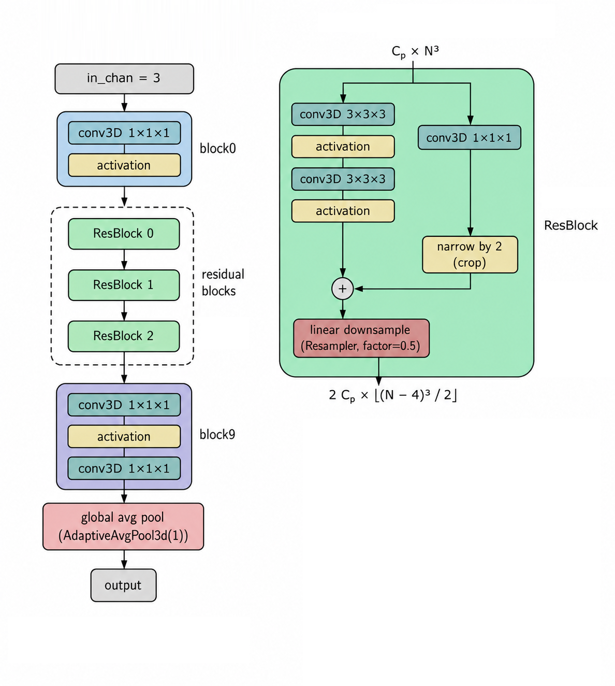
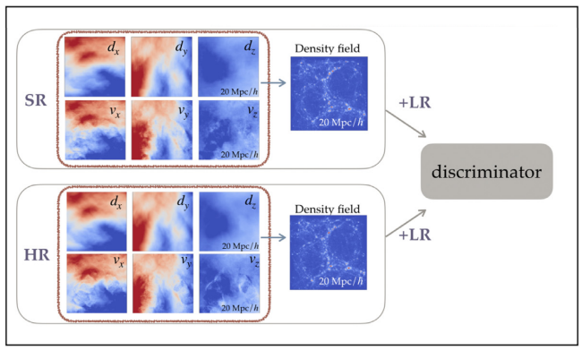

WGAN-SR architecture for x2 upsample (D)
Ni, Yueying, et al. "AI-assisted superresolution cosmological simulations–II. Halo substructures, velocities, and higher order statistics." Monthly Notices of the Royal Astronomical Society 507.1 (2021): 1021-1033.

Slide 10
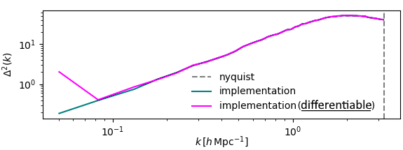
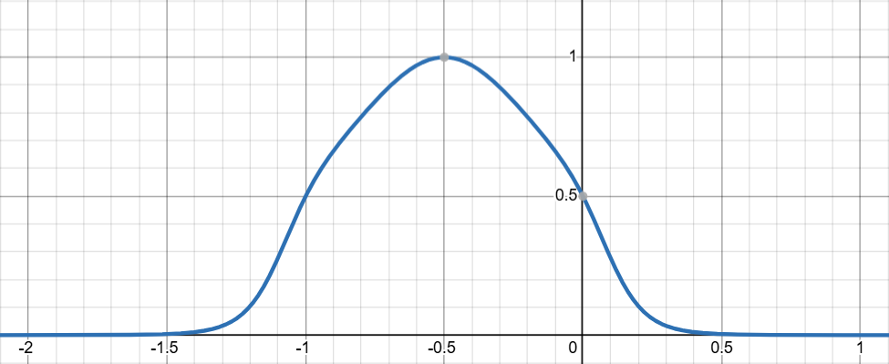
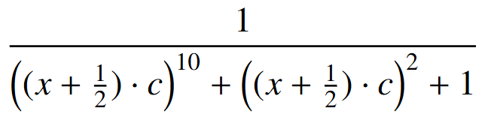

Additional optimization term: differentiable power spectrum
Soft binning response curve
Mean ratio after 3rd bin: 1.0013
«pk method»

Slide 11
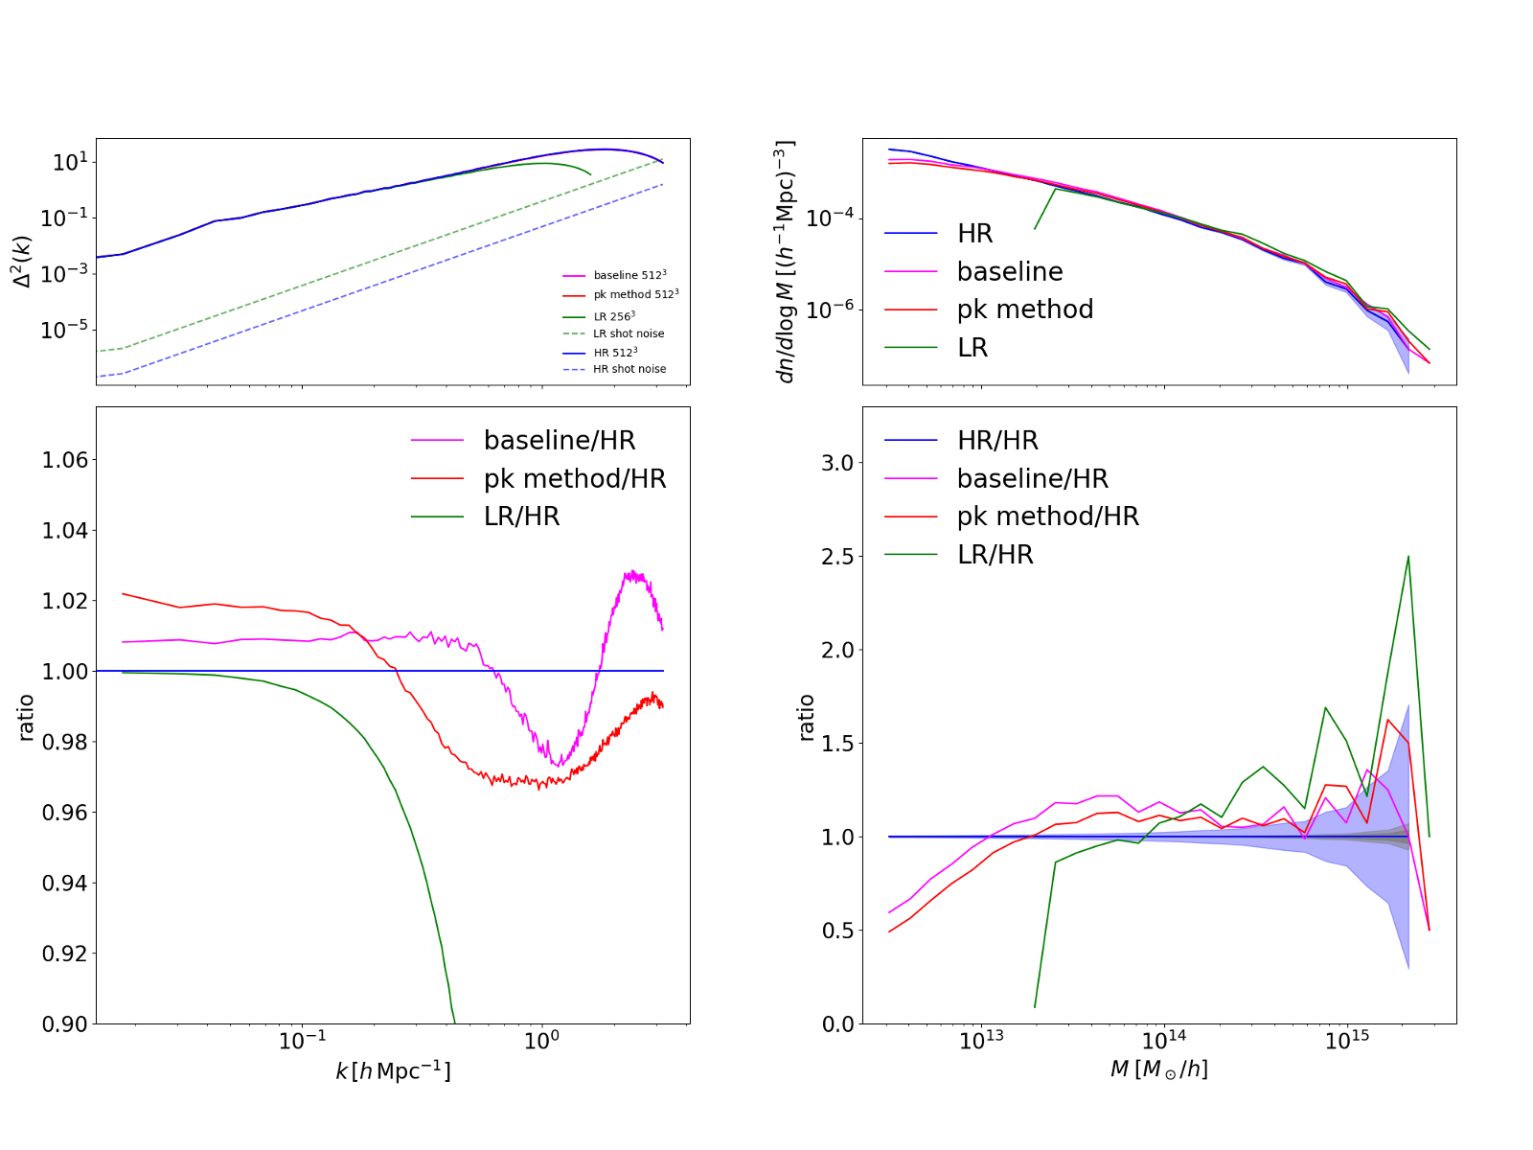
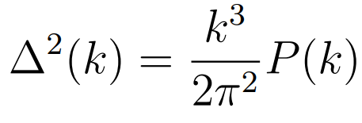
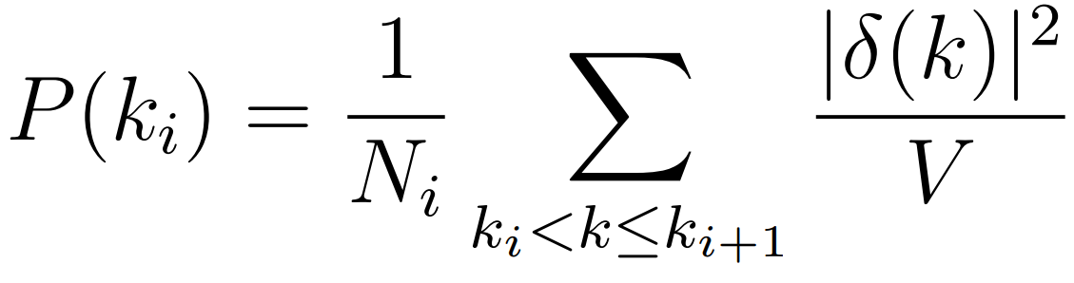
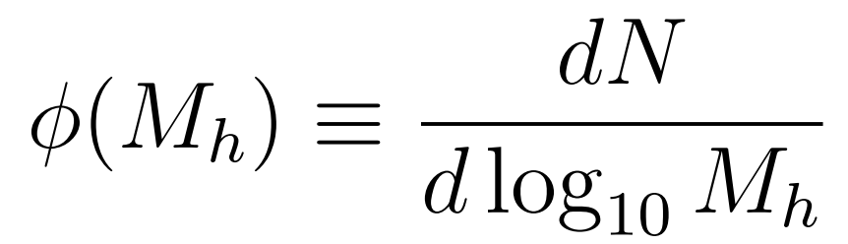
Results on DEMNUni-Cov test set (statistics)

Slide 12
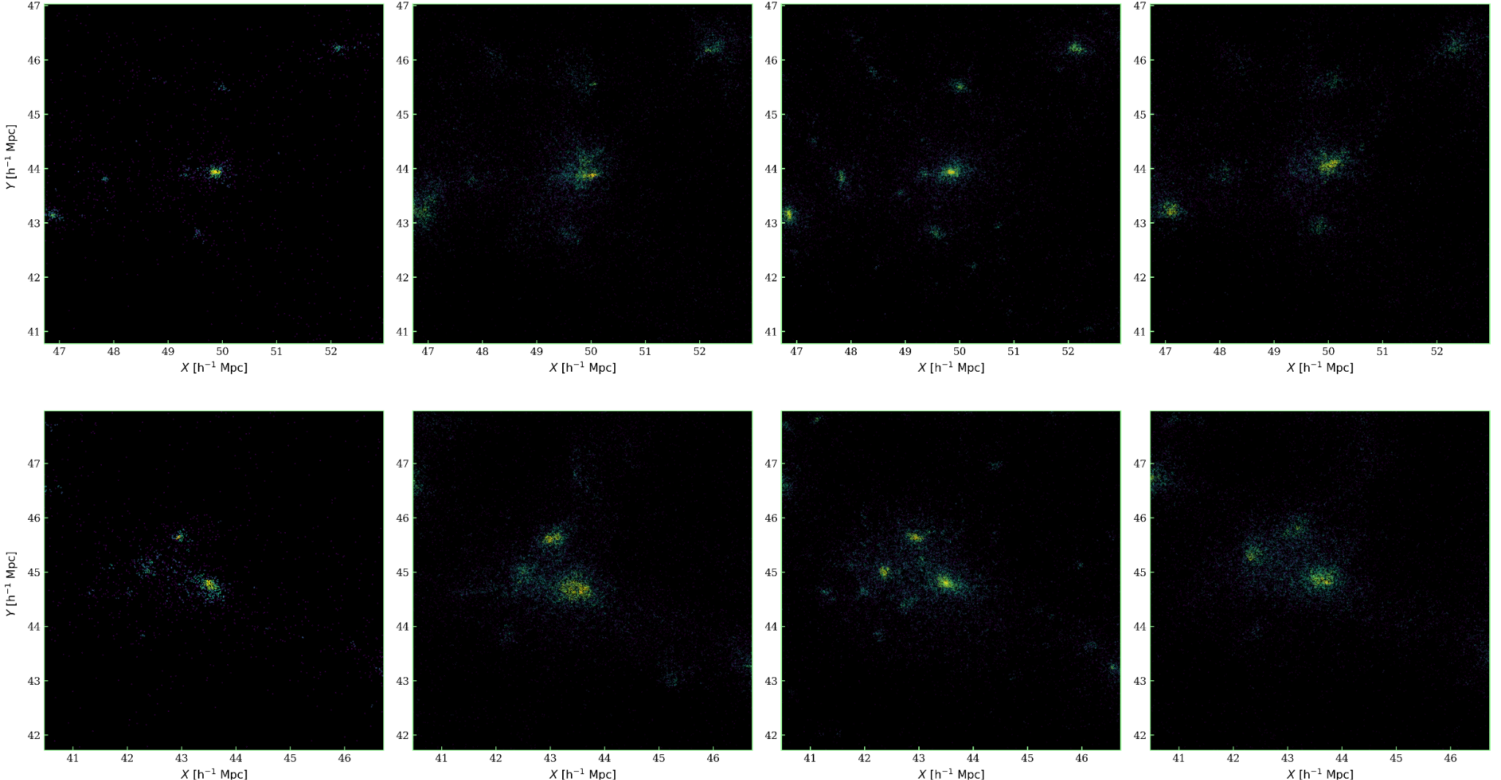
Results on DEMNUni-Cov test set (visualization)
LR
baseline
HR
pk method

Slide 13
Out of domain testing
2 additional DEMNUni (Parimbelli et al. 2022) (with larger volume and different background cosmology) snapshots at z=0 where chosen for out of domain (OOD) testing:
Label | DEMNUni CDM-only with Λ | DEMNUni CDM-only with DE
Cosmological model | LCDM | Dynamical Dark Energy
Σmν | - | 0 eV
𝓌₀ | -1 | -1.1
𝓌ₐ | 0 | -0.3
PlTab | 5 | 5
Box size | (2 Gpc/h)³ | (2 Gpc/h)³
Resolution | 2048³ particles | 2048³ particles

Slide 14
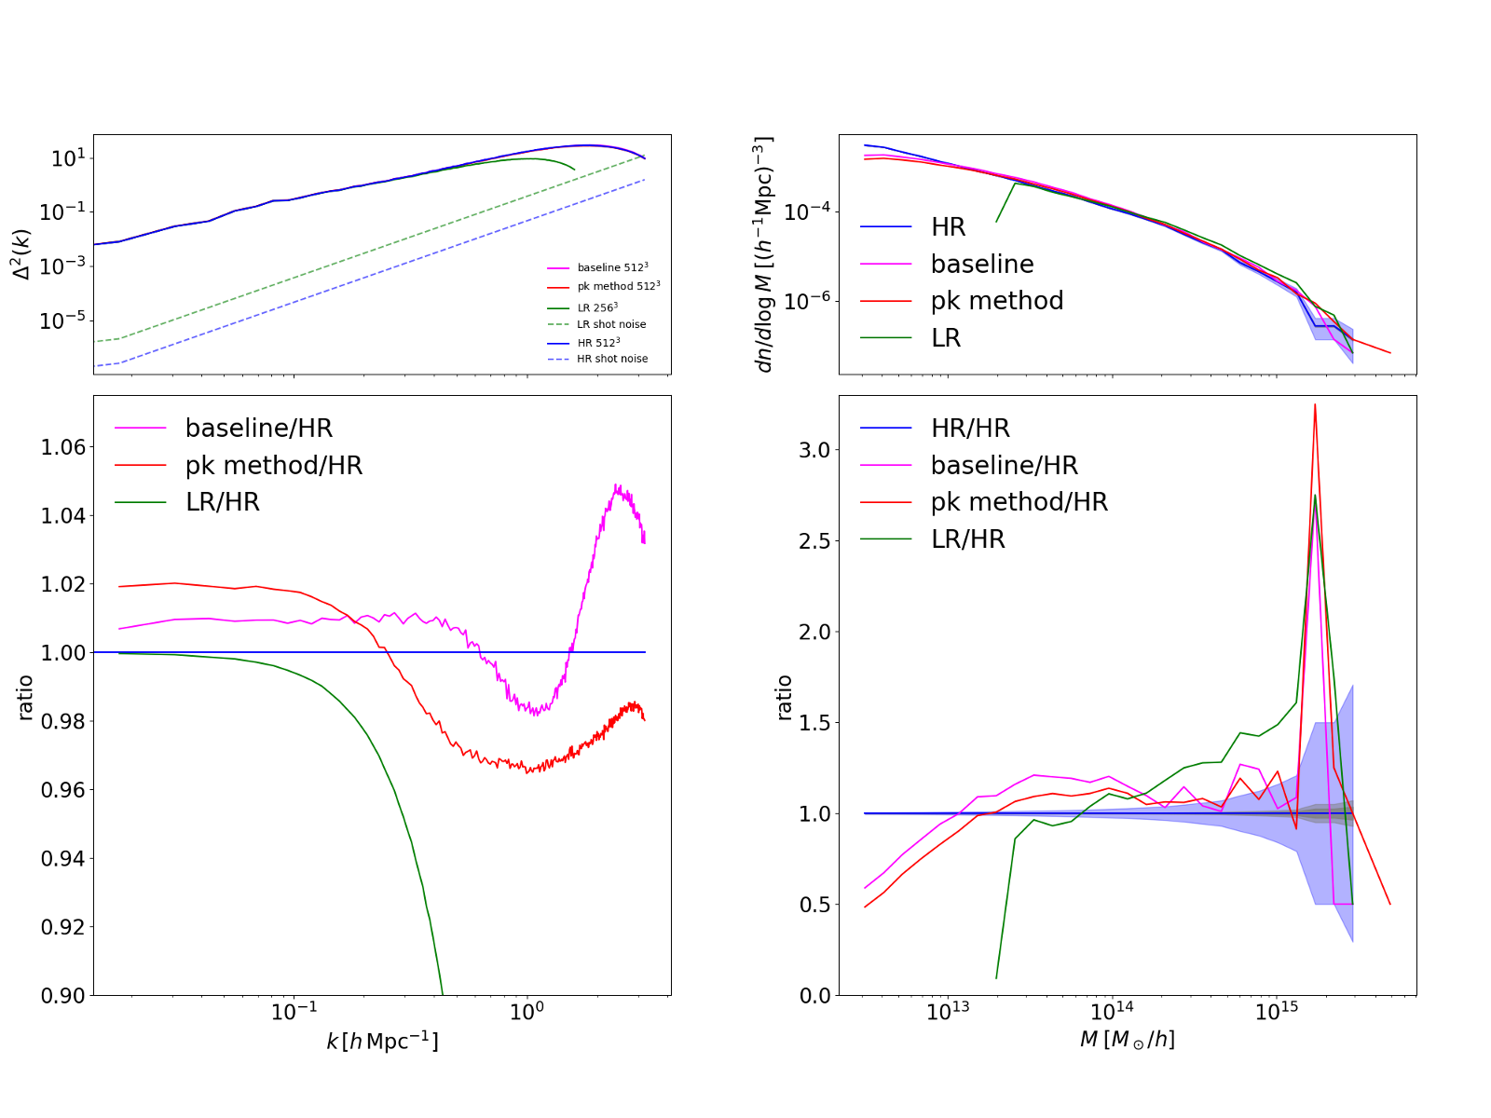
Out of domain testing: DEMNUni CDM-only with 𝚲

Slide 15
DEMNUni-Cov test set results (for comparison)

Slide 16
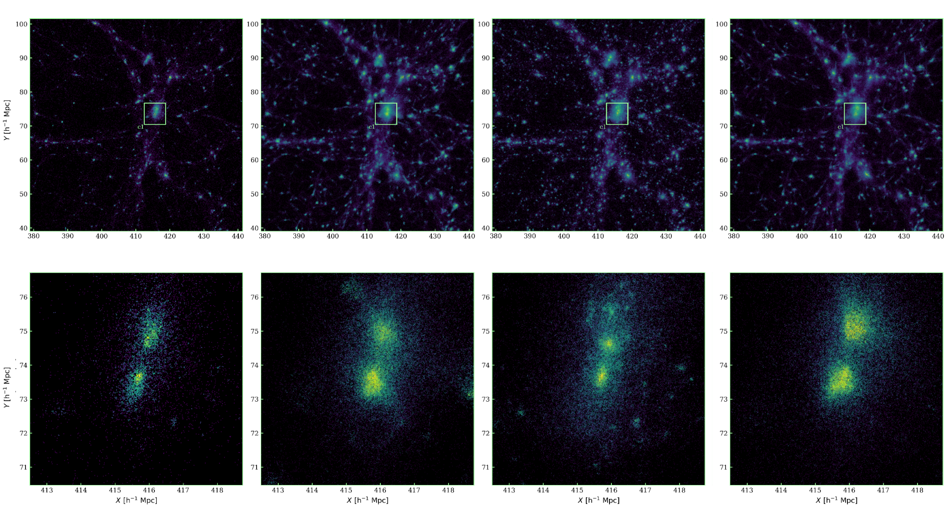
Out of domain testing: DEMNUni CDM-only | Results on rare structure
LR
baseline
HR
pk method
LR zoom
baseline zoom
HR zoom
pk method zoom

Slide 17
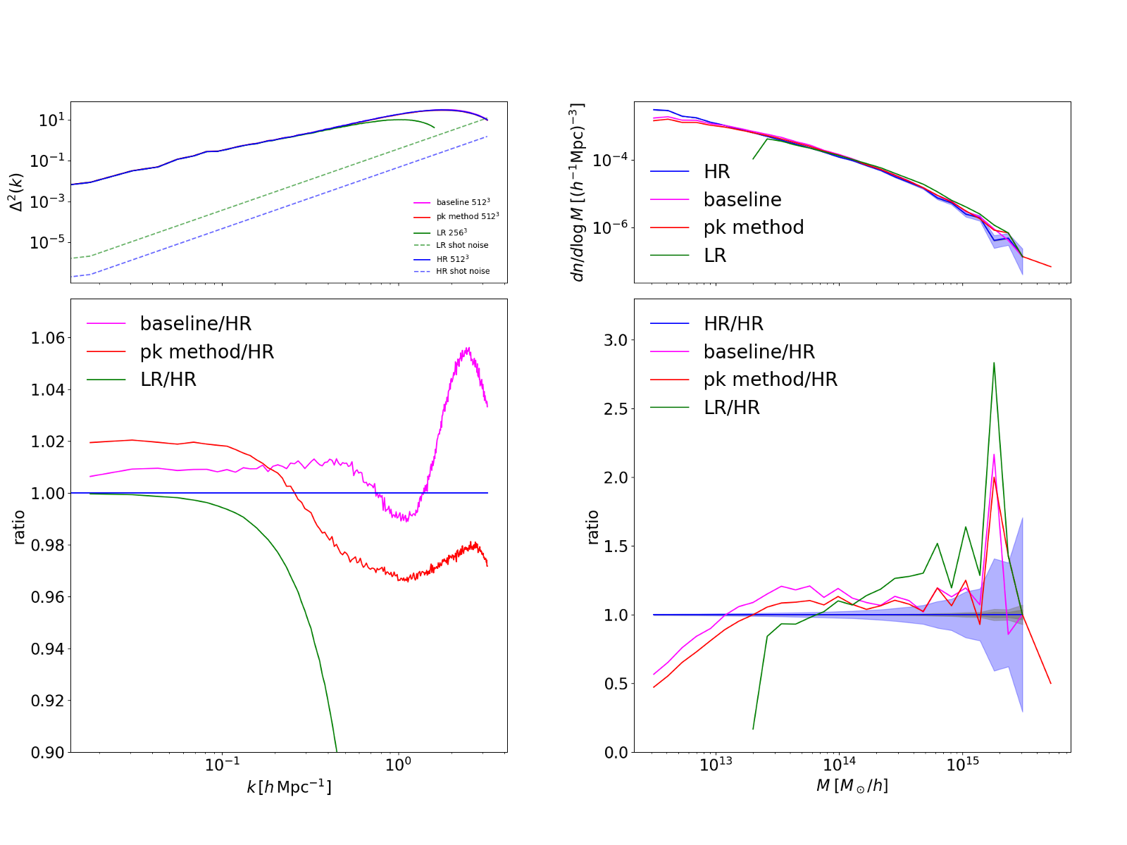
Out of domain testing: DEMNUni CDM-only with DE

Slide 18
DEMNUni-Cov test set results (for comparison)

Slide 19
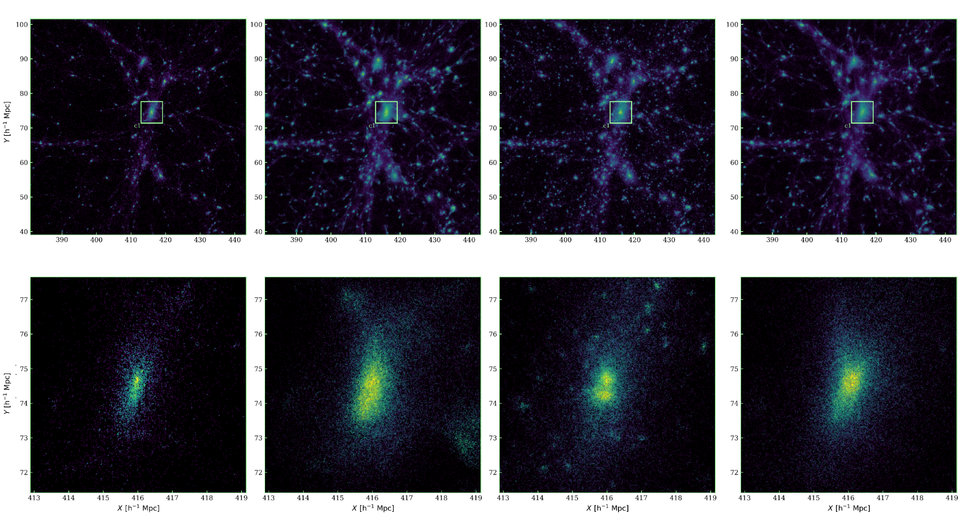
Out of domain testing: DEMNUni CDM-only with DE | Results on rare structure
LR
baseline
HR
pk method
LR zoom
baseline zoom
HR zoom
pk method zoom

Slide 20
Conclusions and future work
A ML pipeline for self-supervised super-resolution of cosmological simulations was deployed
The baseline approach was compared to an alternative one with explicit optimization of a summary statistic (power spectrum), that showed an improvement for smaller scales, at the cost of less fidelity on larger ones
In order to assess generation capabilities, the methods were tested on OOD realizations, showing promising results, in particular on less massive structures
Future developments may include:
Achieve better generalization through conditioning on cosmological parameters
Support scientific visualization with interactive super-resolution (VisIVO)
Experiment explicit optimization of other statistics (what if not differentiable?) as alternatives to perceptual losses or develop one from scratch
Study the trade-offs of a hybrid pipeline for cosmological simulations
Introducing multi-scale density fields representations as inputs to the discriminator network
Expand the work to velocities and time conditioning

Slide 21
Thank you for you attention!
Any questions?
bruno.montalto@inaf.it
CREDITS: This presentation template was created by Slidesgo, and includes icons by Flaticon, and infographics & images by Freepik

