Slide 1
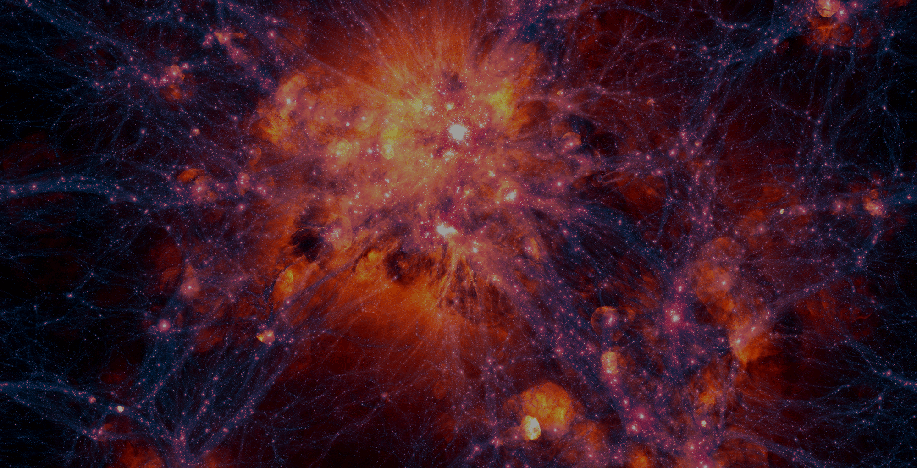



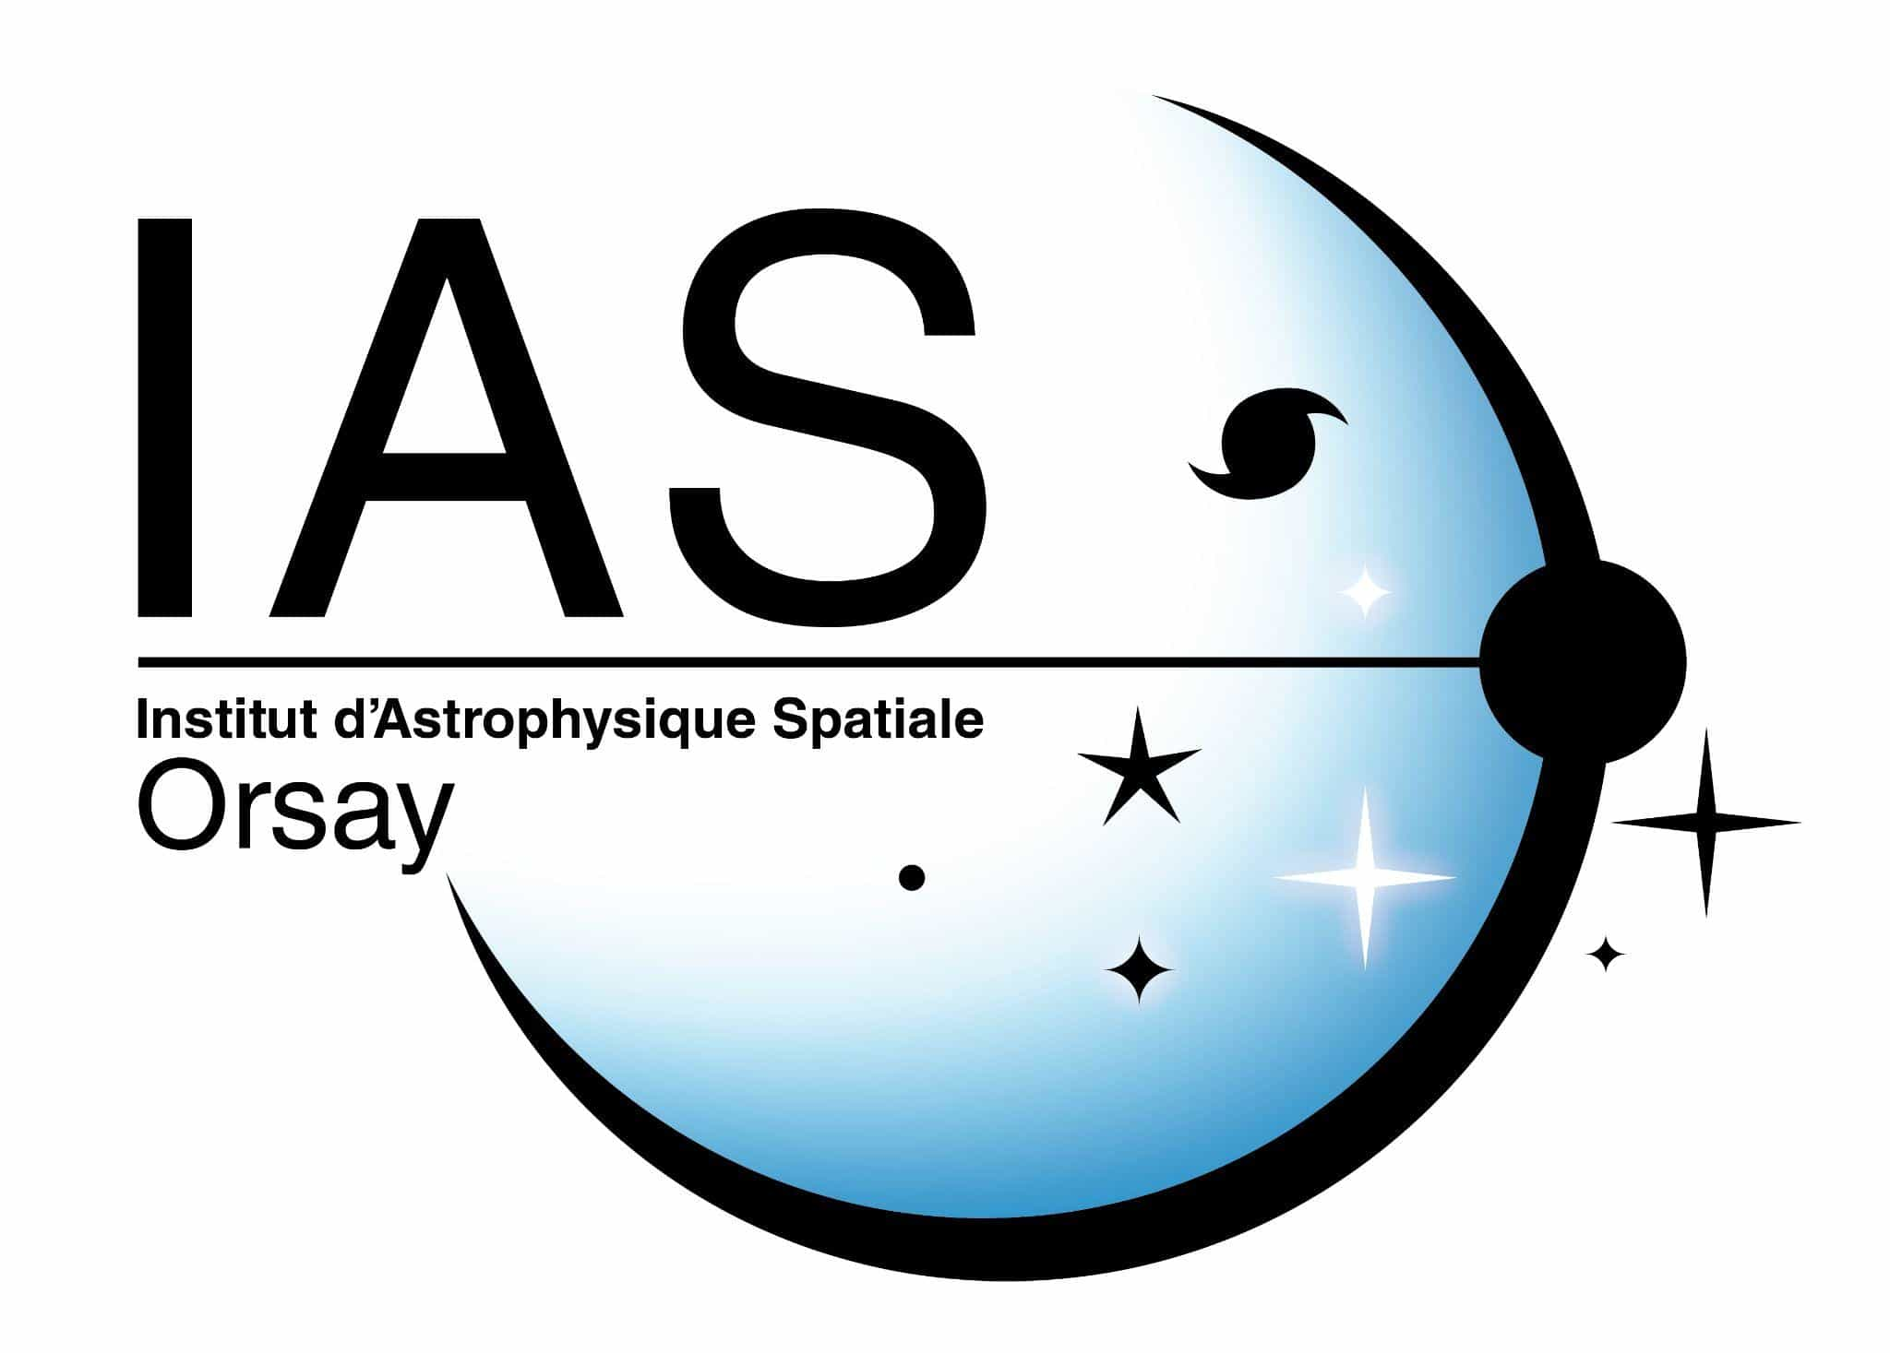

How Do Generative Diffusion Models Learn Cosmic Web Environments?
Mehdi Salman Noor
Supervisors: Dr. Nabila Aghanim, Dr. Aurélien Decelle
Collaborators: Dr. Tony Bonnaire
ML4Astro3 2026
04 September, 2026
CNRS – Institut d’Astrophysique Spatiale – Université Paris-Saclay

Slide 2
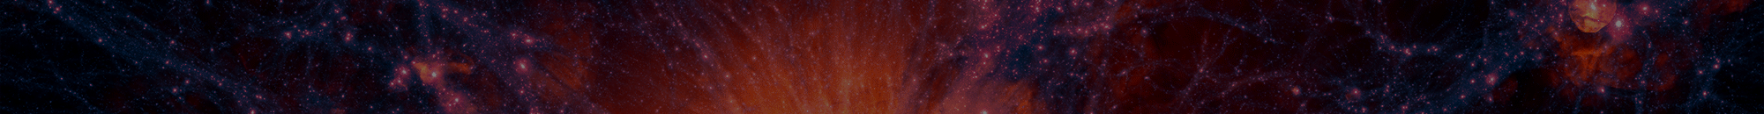
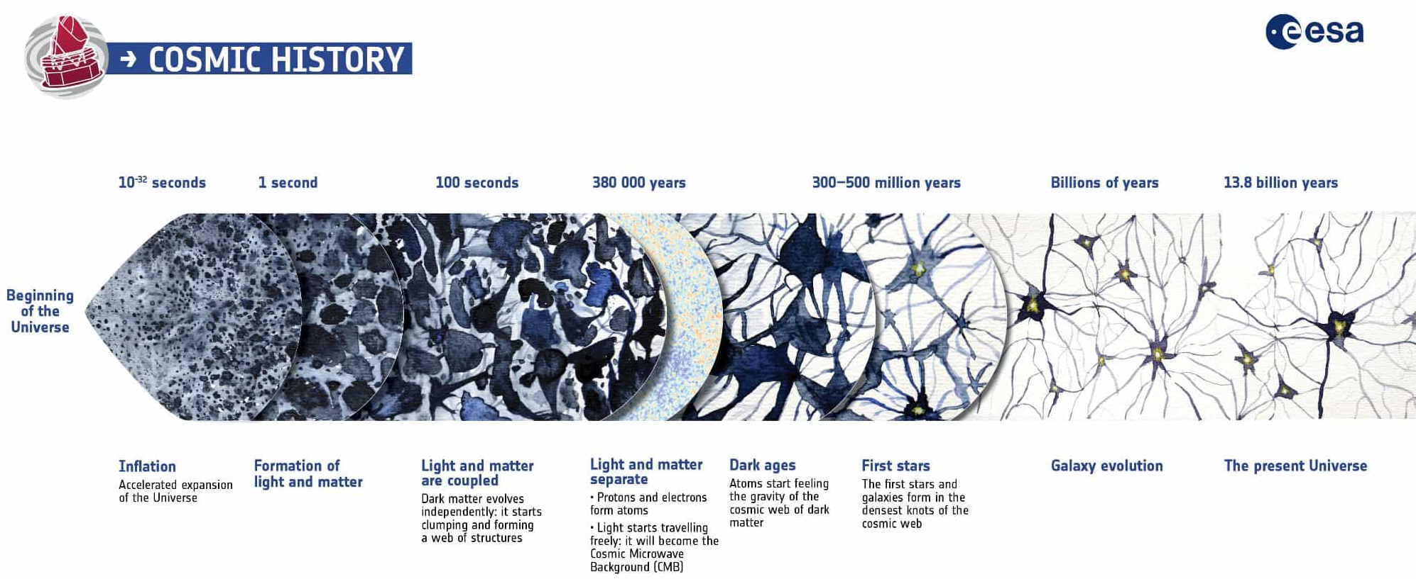
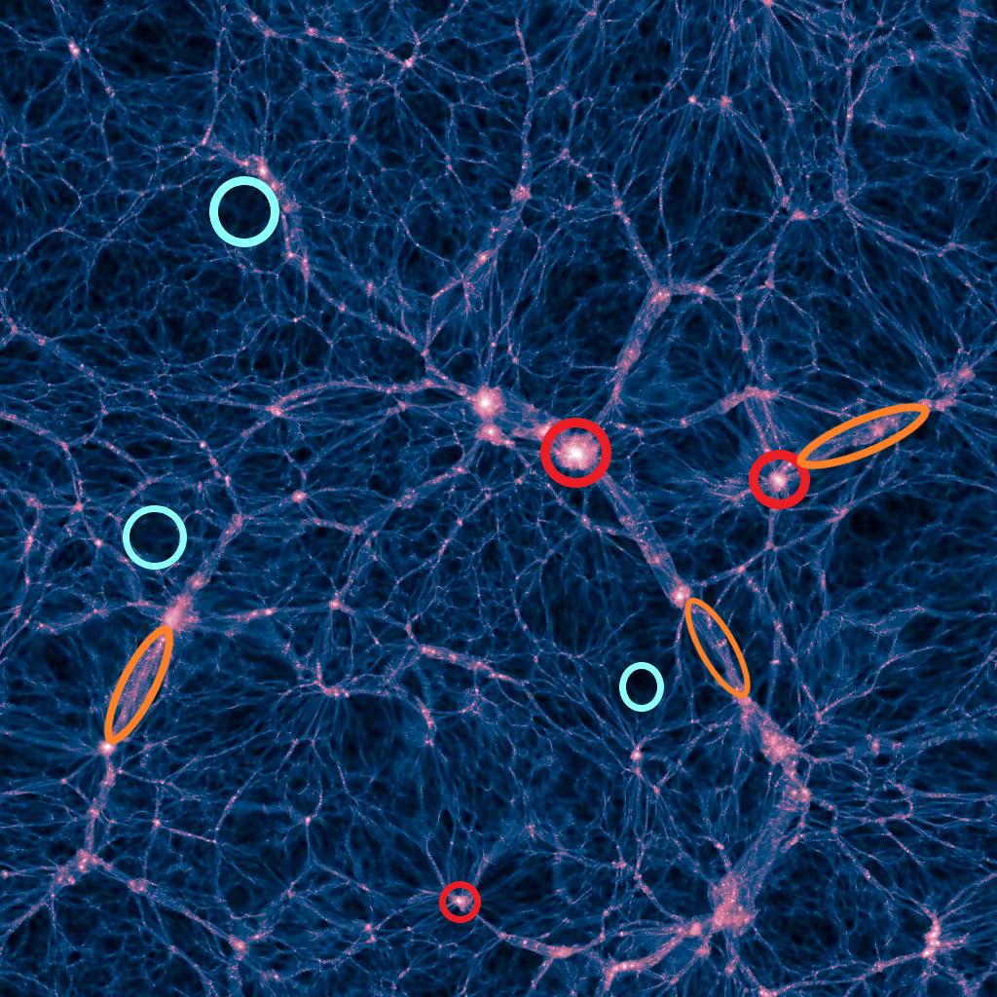
Cosmological Context
The Cosmic Web
Dark matter density distribution, Illustris simulation. Source: Vogelsberger et al. (2014)
The Cosmic Web: the large-scale structure of the Universe shaped by gravitational evolution, forming a vast, interconnected network of nodes, filaments, walls & voids

Slide 3
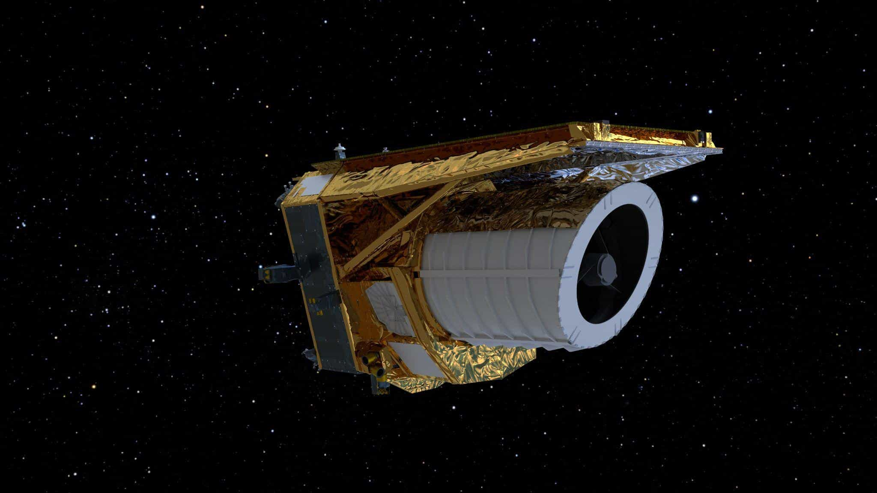
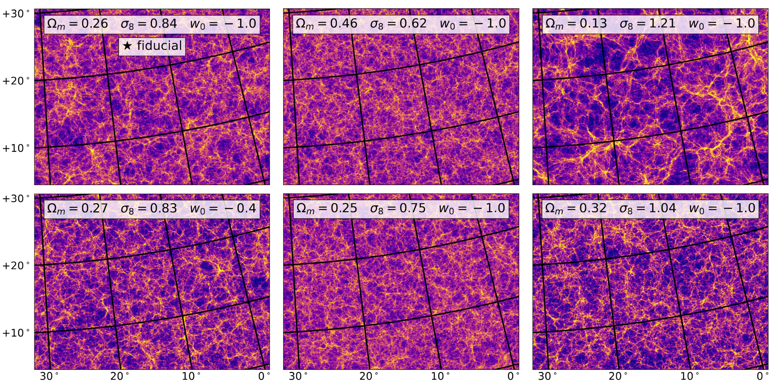
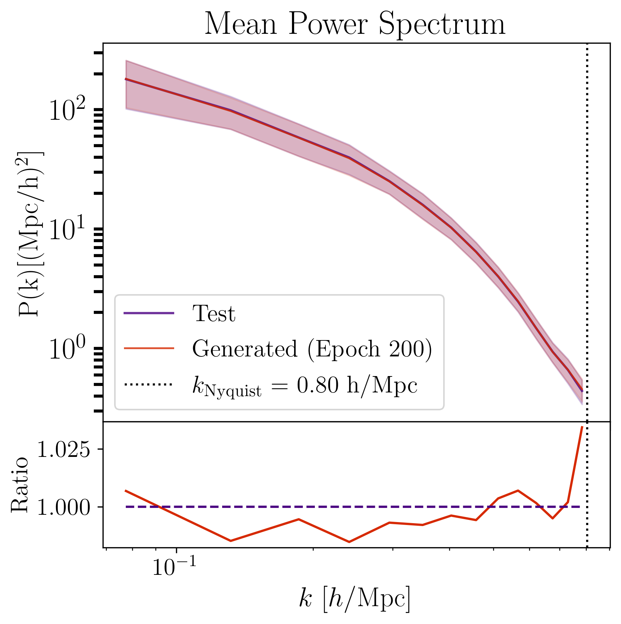
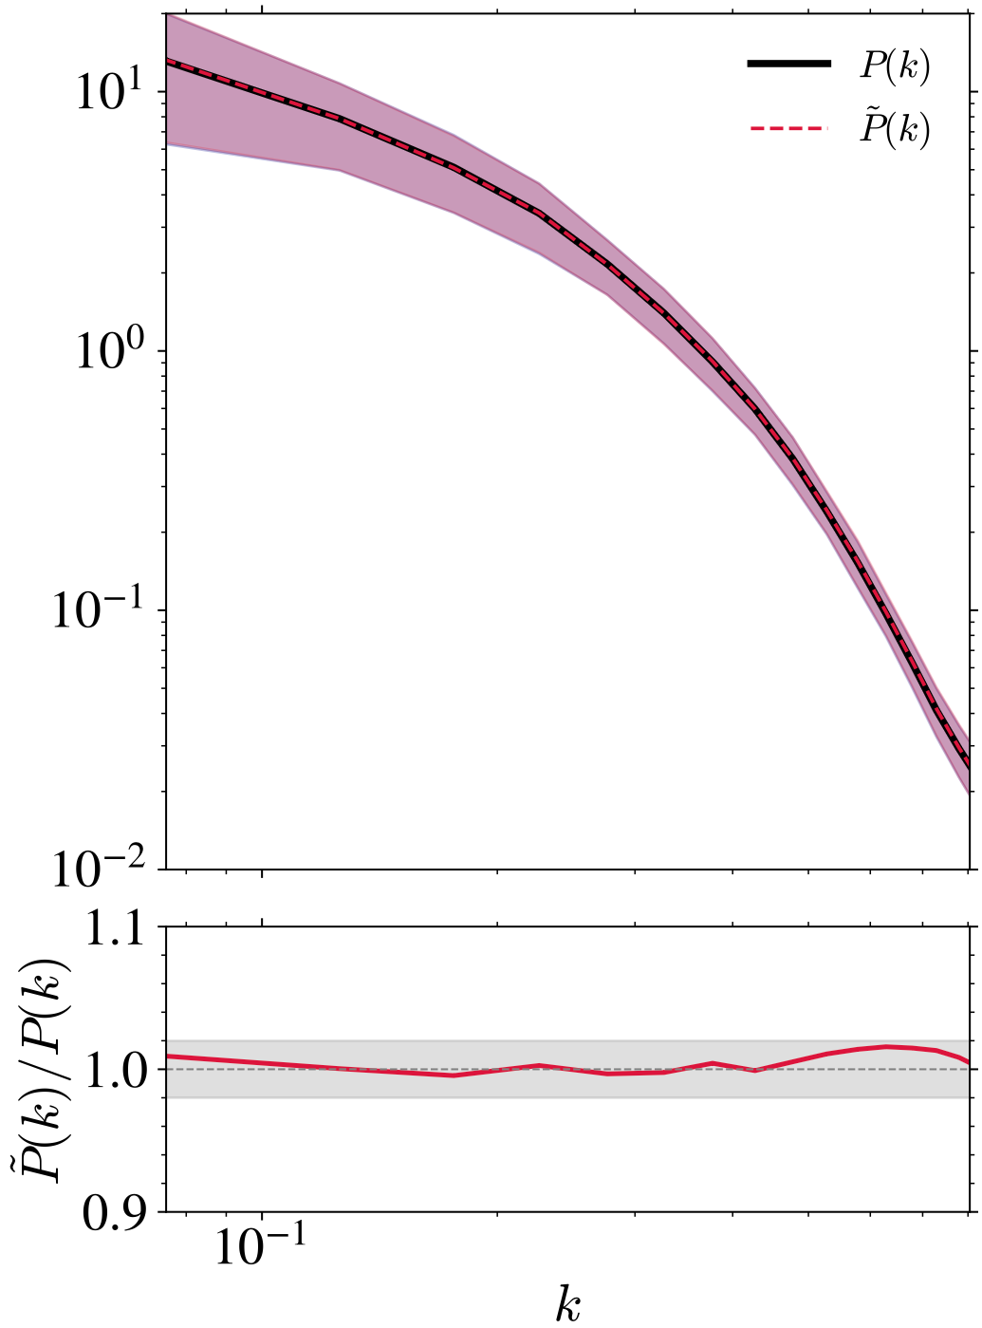
From Galaxy Surveys to Generative Models
Next-generation galaxy surveys:
  Map the 3D distribution of galaxies across the Universe
  Unprecedented high-precision observational data
  Necessary for likelihood analyses and simulation-based inference (SBI)
Challenge:
  Analysis requires large ensembles of cosmic web simulations
  N-body simulations are computationally expensive!
Generative Models:
Learn to emulate cosmological simulations
Bypass computational bottleneck to generate large ensembles
Euclid Space Telescope. Source: European Space Agency (ESA)
SBI: Explore the cosmological parameter space
Accurately reproduce summary statistics (e.g. matter power spectrum)
Evaluate its ability to capture the matter distribution across cosmic web environments
Simulations across cosmological models. Source: Kacprzak et al. (2022)
Thousands of simulations required

Slide 4
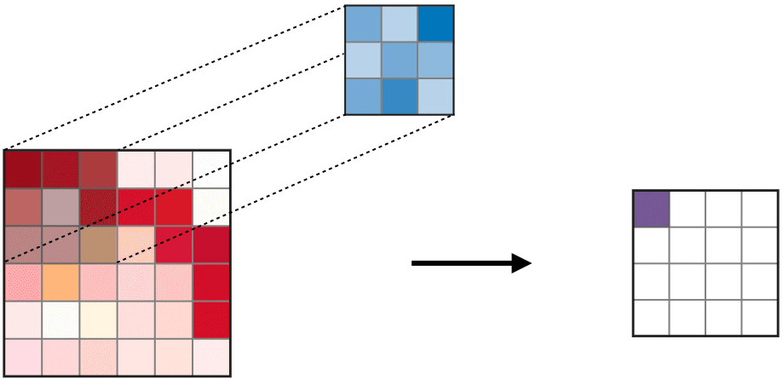
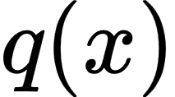
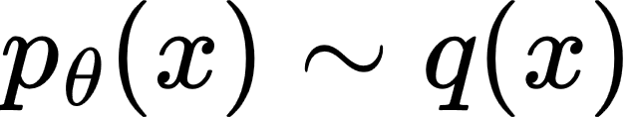
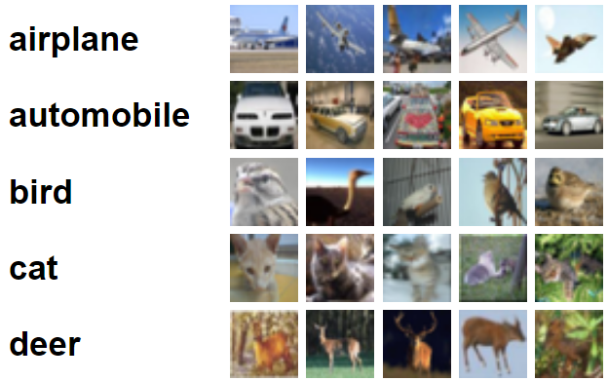
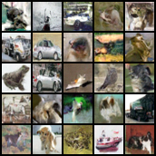
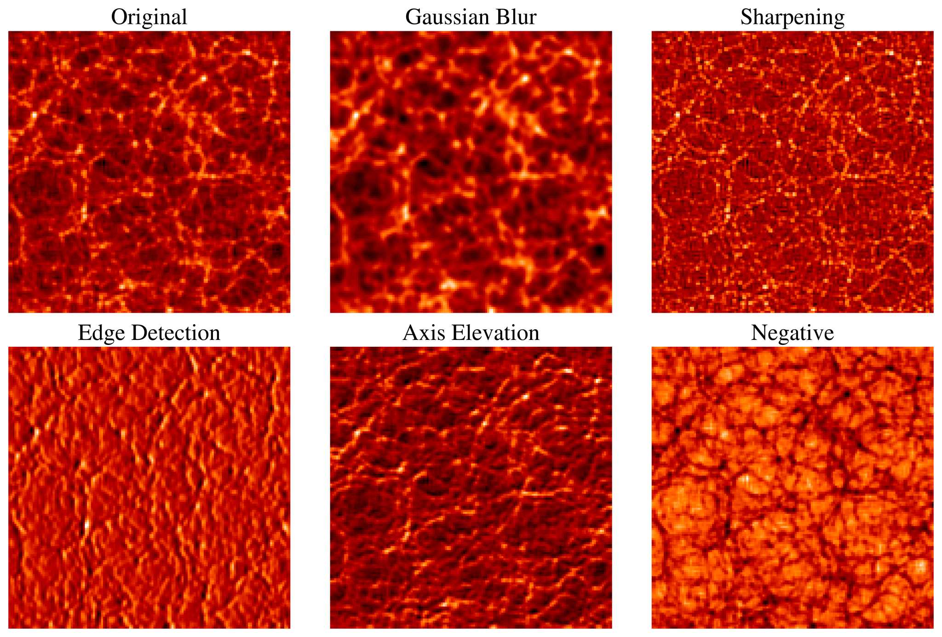
Generative Models
Goal: learn the underlying data distribution of a given dataset through training (e.g. image datasets)
Convolution Layer:
Filter
Generate new, realistic samples by sampling from the learnt distribution using a trained model
Training distribution,
Learnt distribution,
Input
Output
Training
CIFAR-10 Image dataset. Source: Alex Krizhevsky (2009)
Generated samples.
What Happens During Training?
The model learns key features and patterns in the data through convolutional filters
Layers capture various features like blur, edges, sharpness, etc
Examples of simple feature maps that models may learn. Noor et al. (submitted)

Slide 5
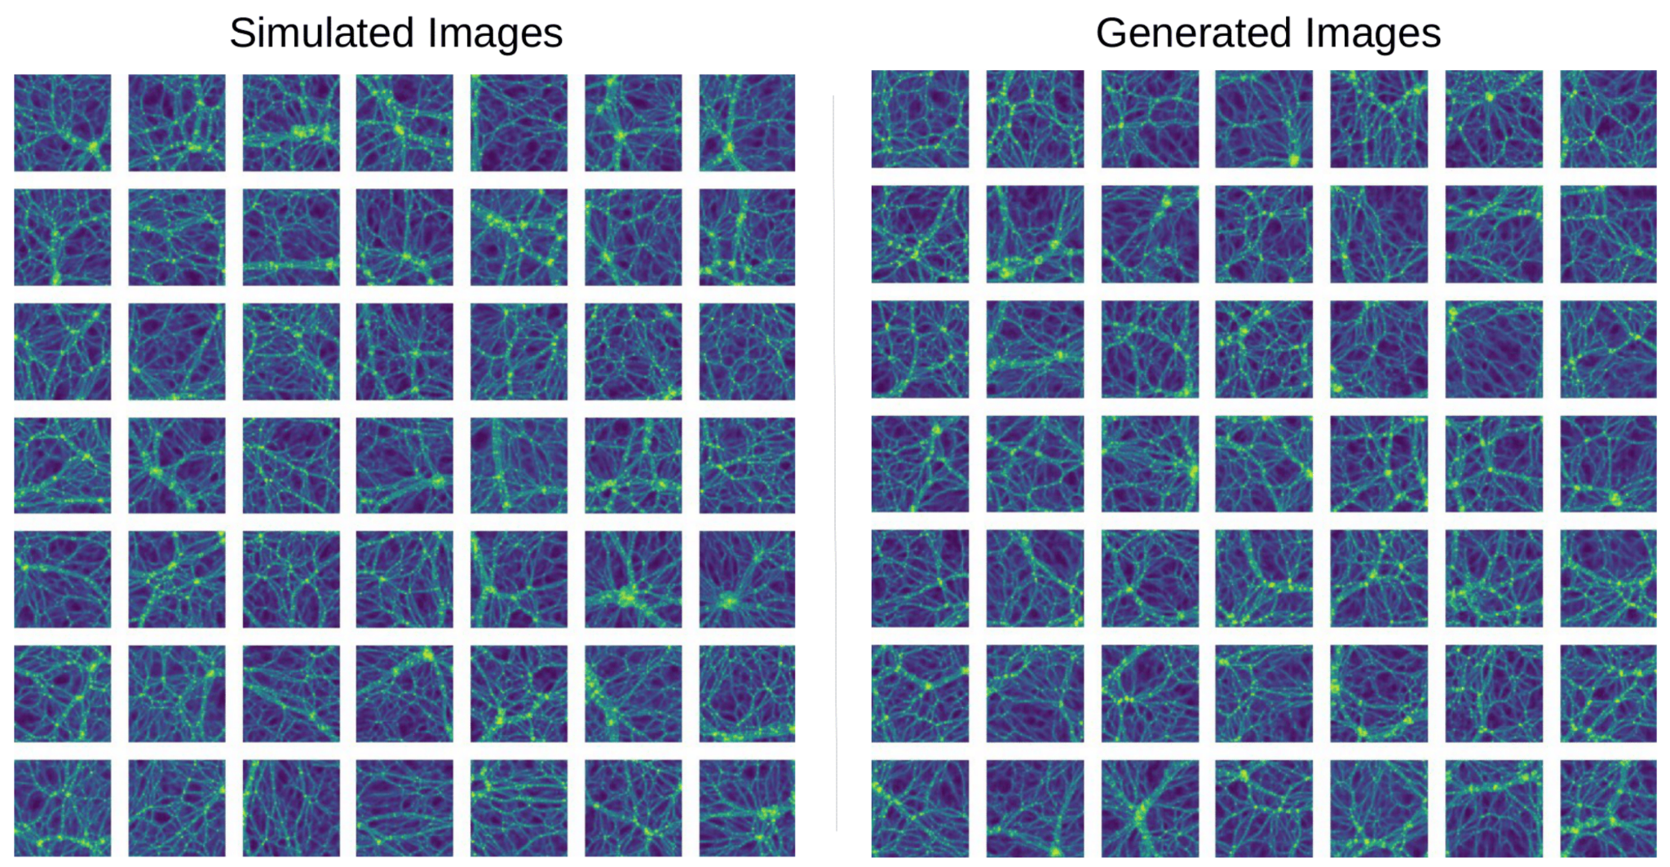
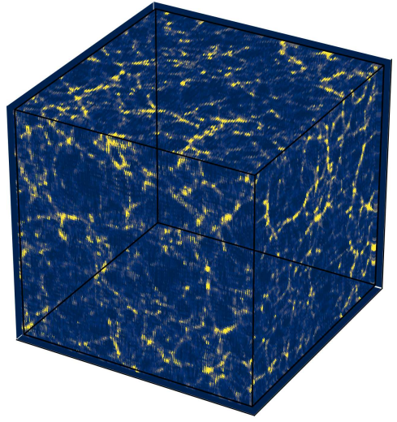
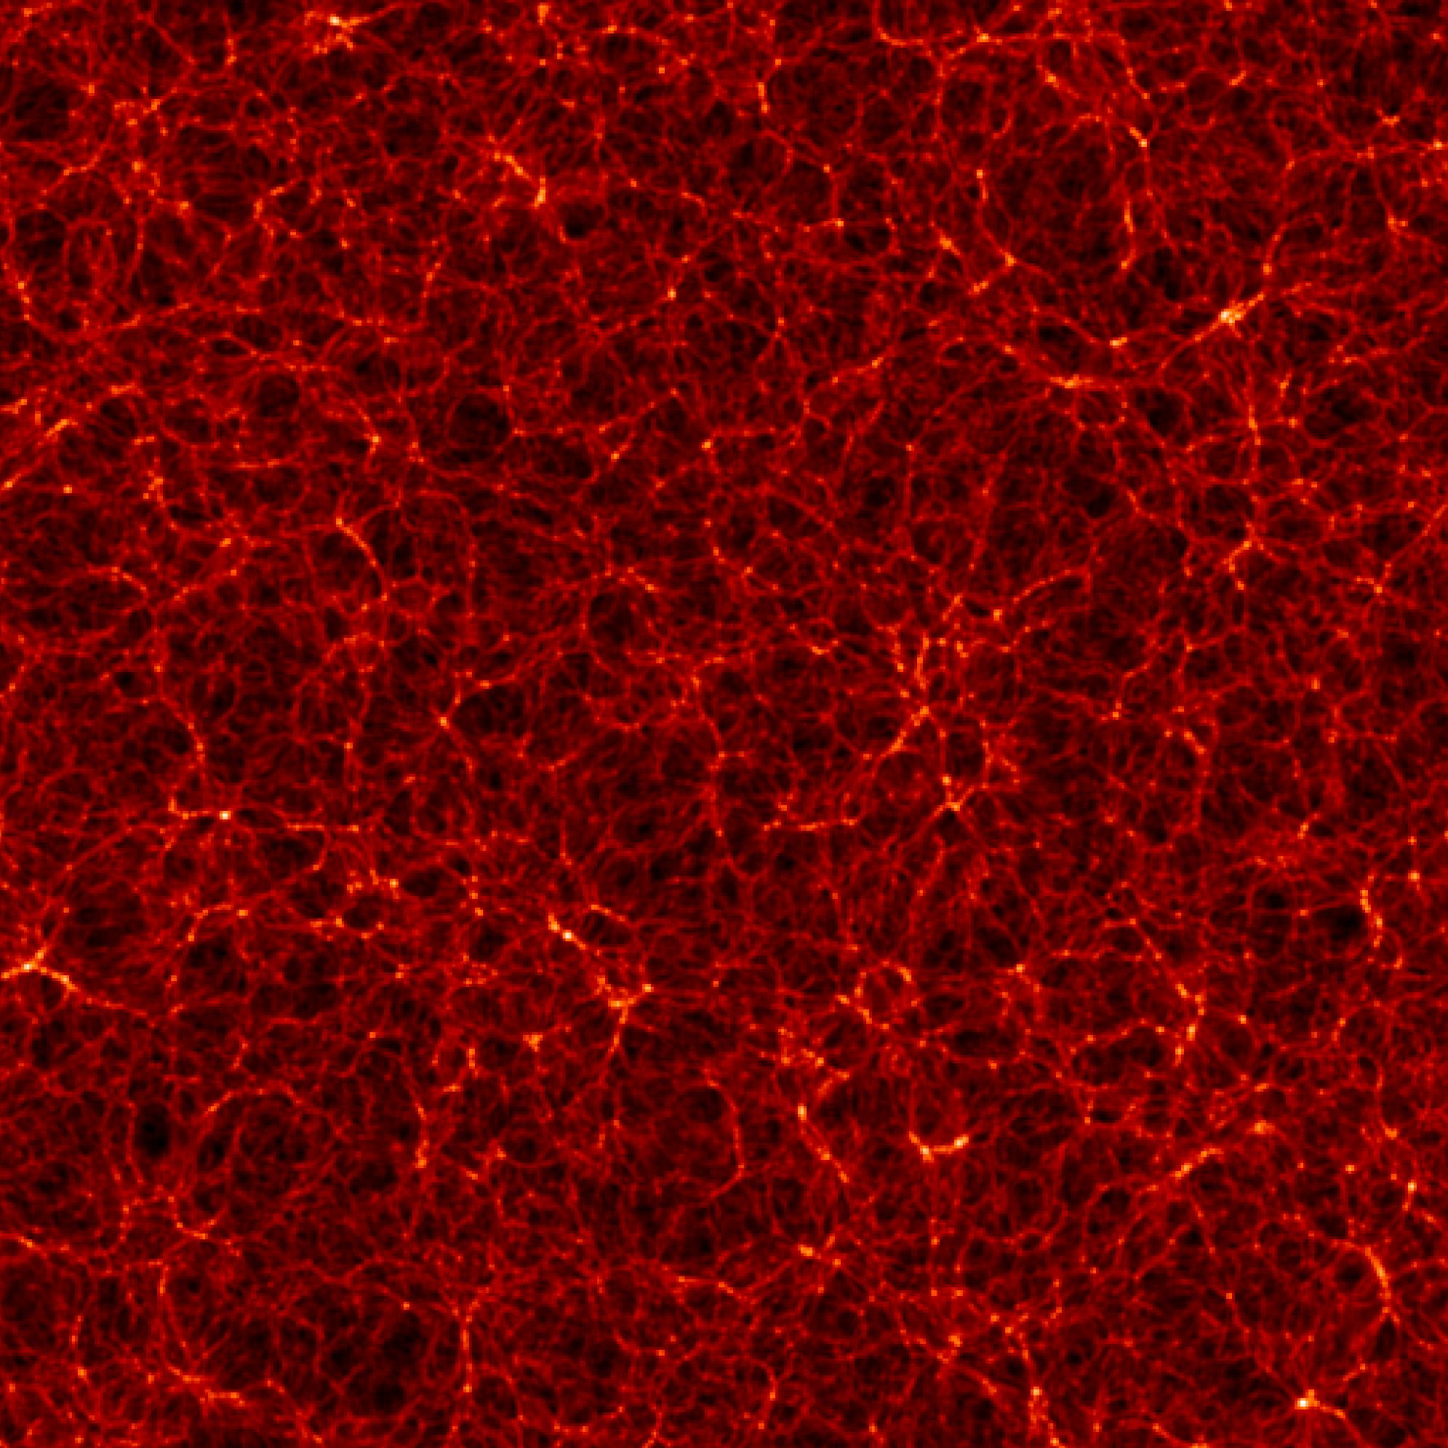
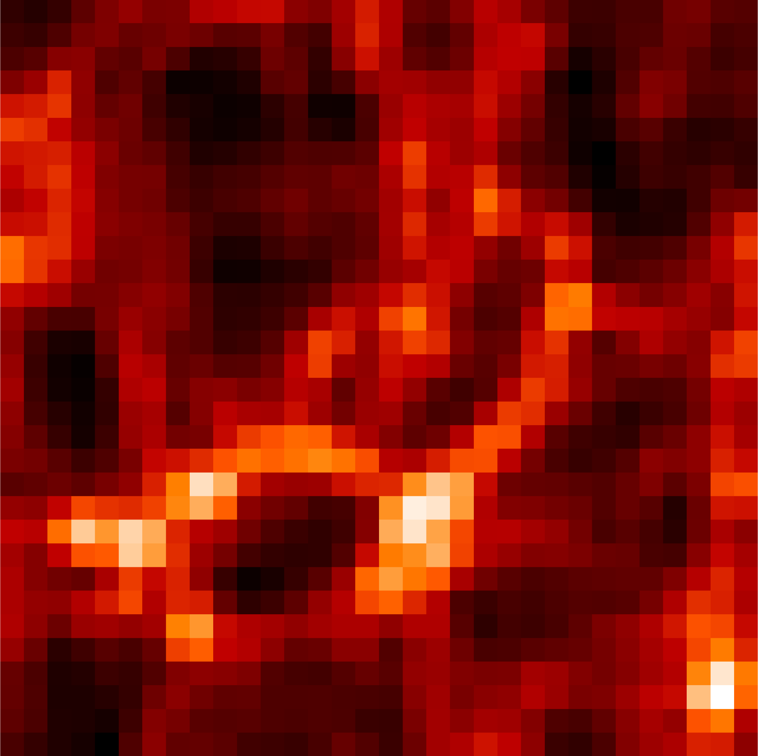
Generative Models
Applications in Cosmology:
Example: Generative Adversarial Networks (GANs) for cosmic web simulations (Ullmo et al. (2020))
First step:
Learn the data distribution of 2D dark matter density fields using generative diffusion models
Training data: Quijote Simulations
  Over 82, 000 dark matter simulations
  Spans beyond 7,000 cosmological models
  Required over 35 million CPU hours
3D Density Field (Quijote)
2D Slice
Training Data
True 2D simulations (left) and GAN-generated simulations (right). Source: Ullmo et al. (2020)
Limitations:
  Mode collapse leads to reduced sample diversity
  Training instability
Diffusion models: stable training & stronger generalisation
32 px
3D dark matter density field, Quijote suite. Source: Villaescusa-Navarro et al. (2020)
256 px

Slide 6
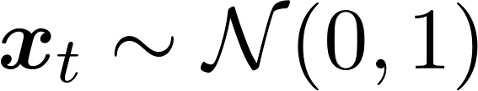


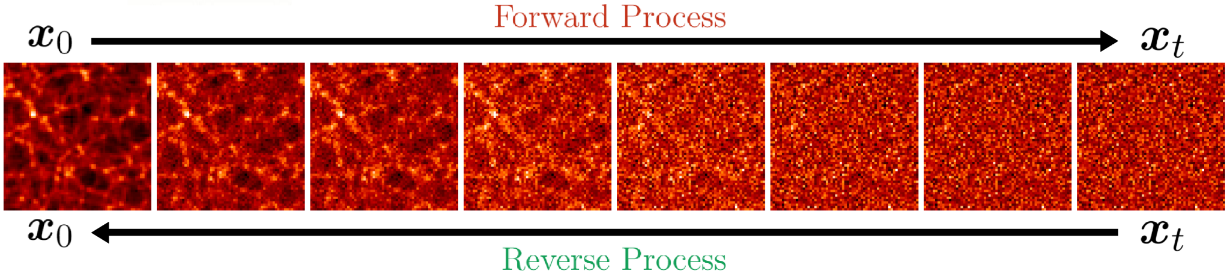
Generative Diffusion Models
Forward process:
Consider a 2D density field slice from Quijote
Gradually add noise over time, transforming it to pure Gaussian noise,
Governed by a stochastic process defined by
Reverse process:
Neural networks are used to reverse the forward process by learning the score function
Generate clean samples matching the original data distribution
Forward process
Reverse process

Slide 7
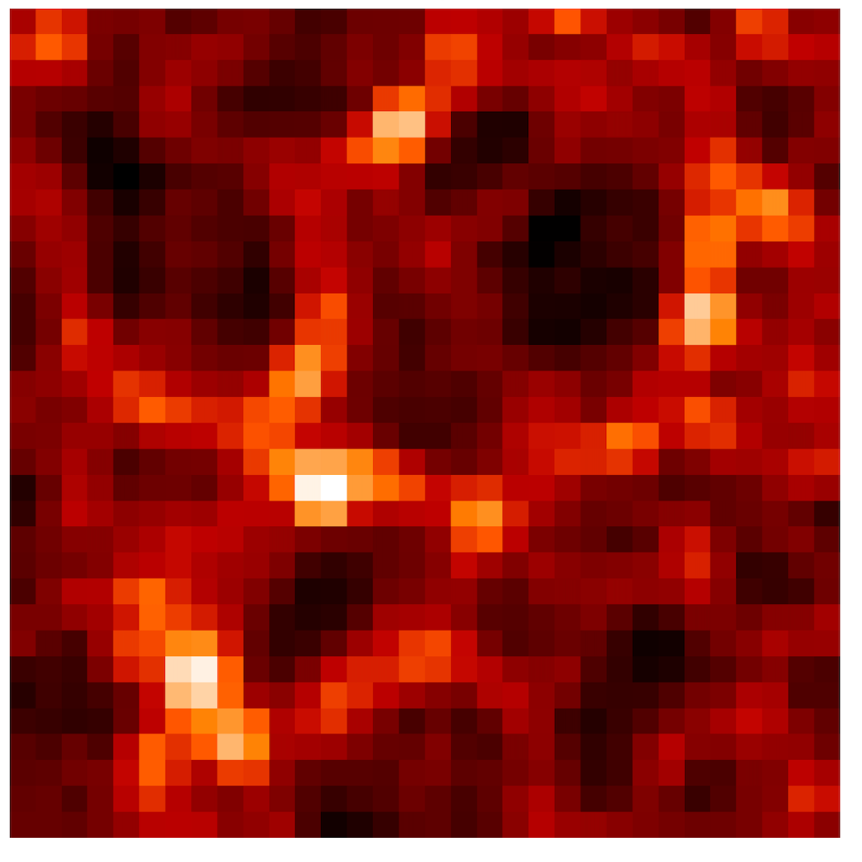
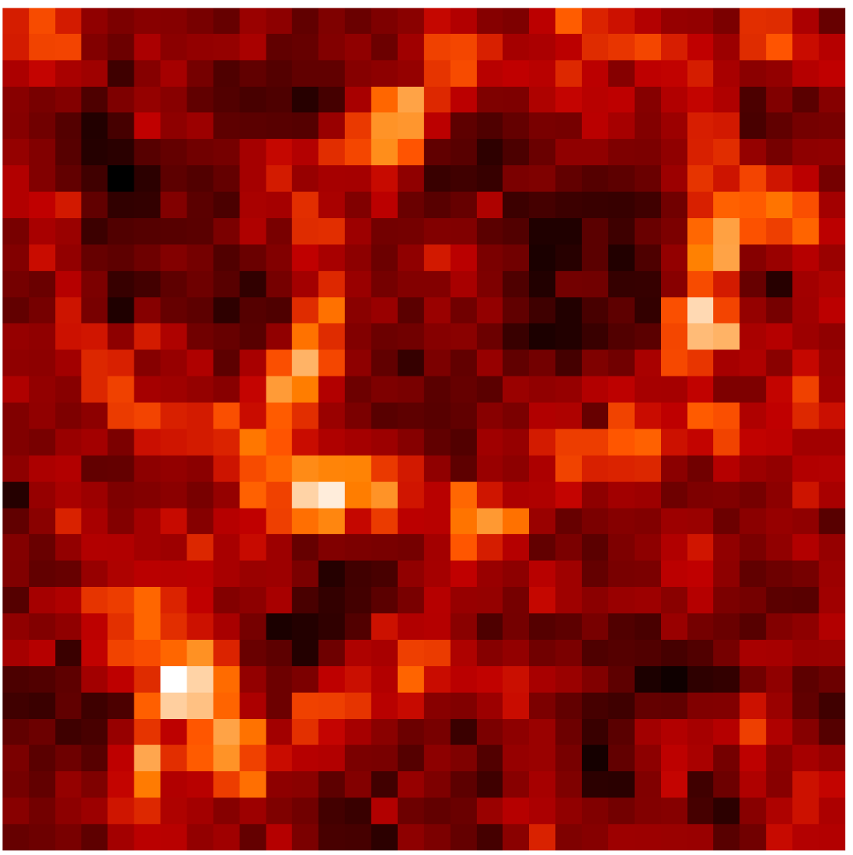
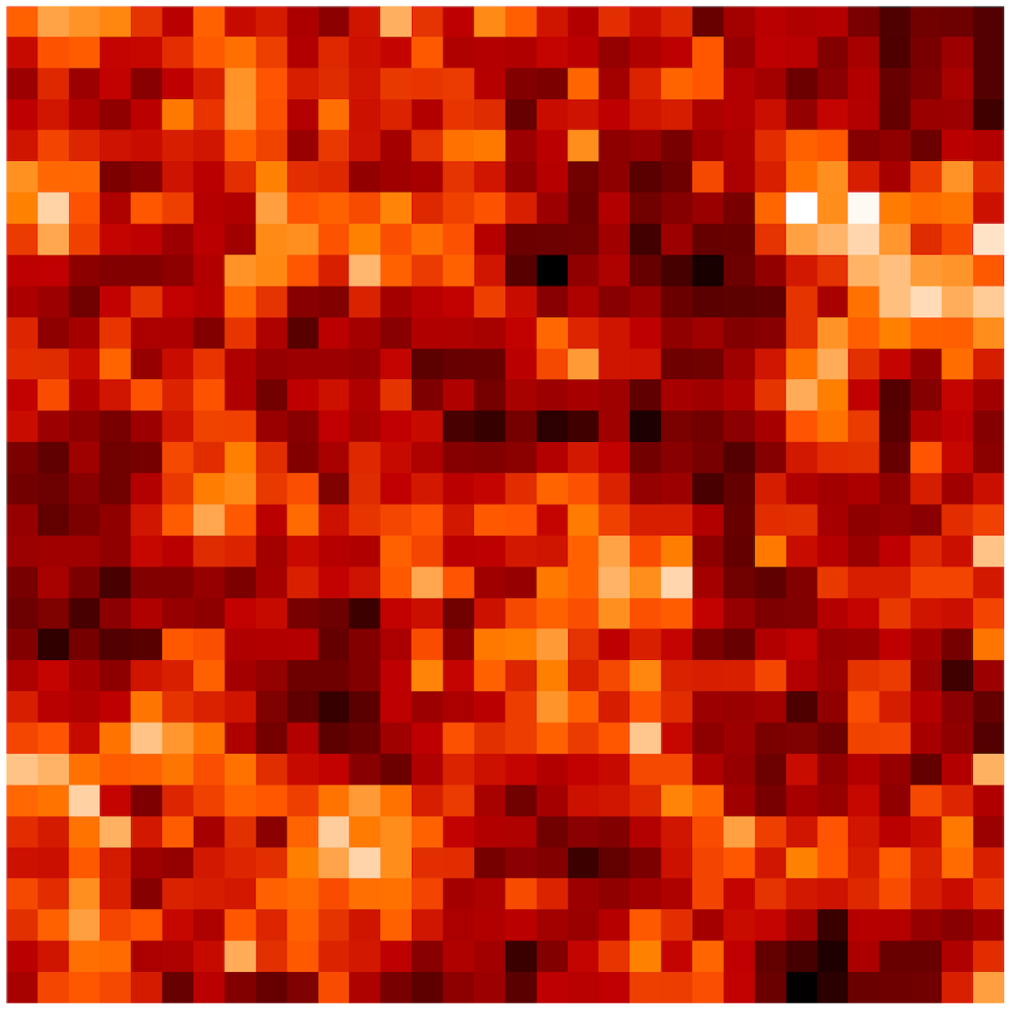
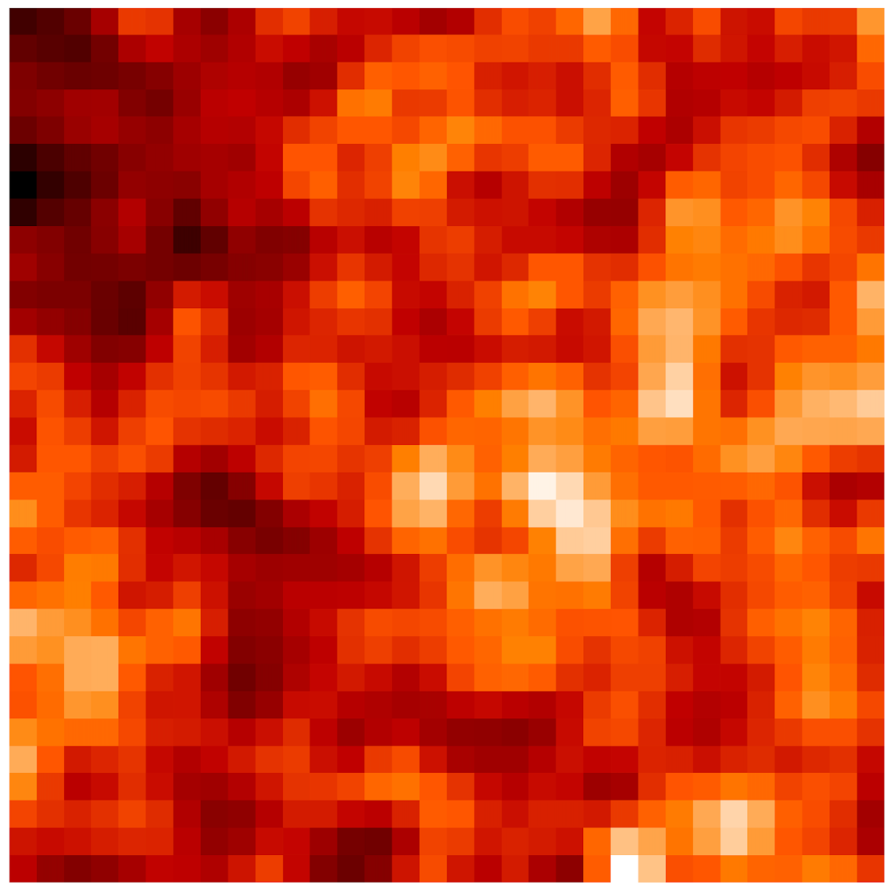
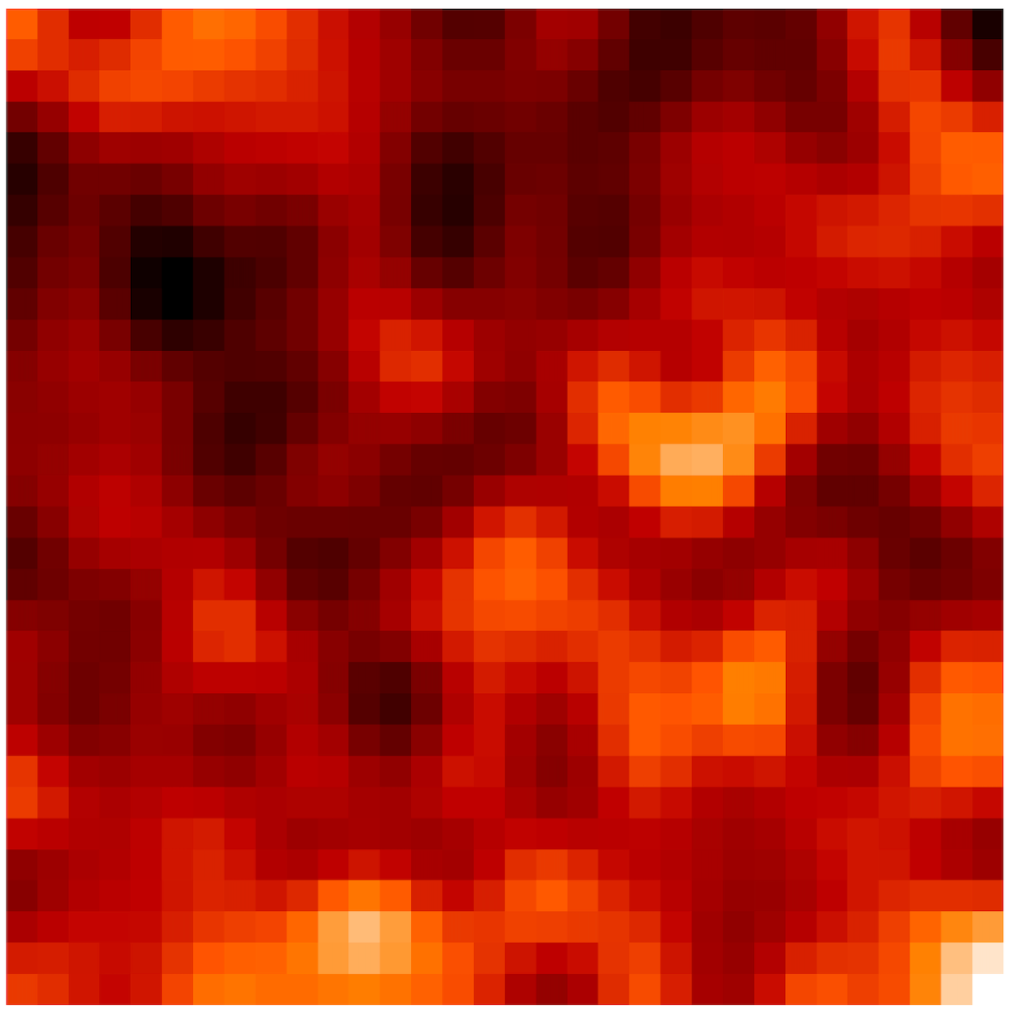
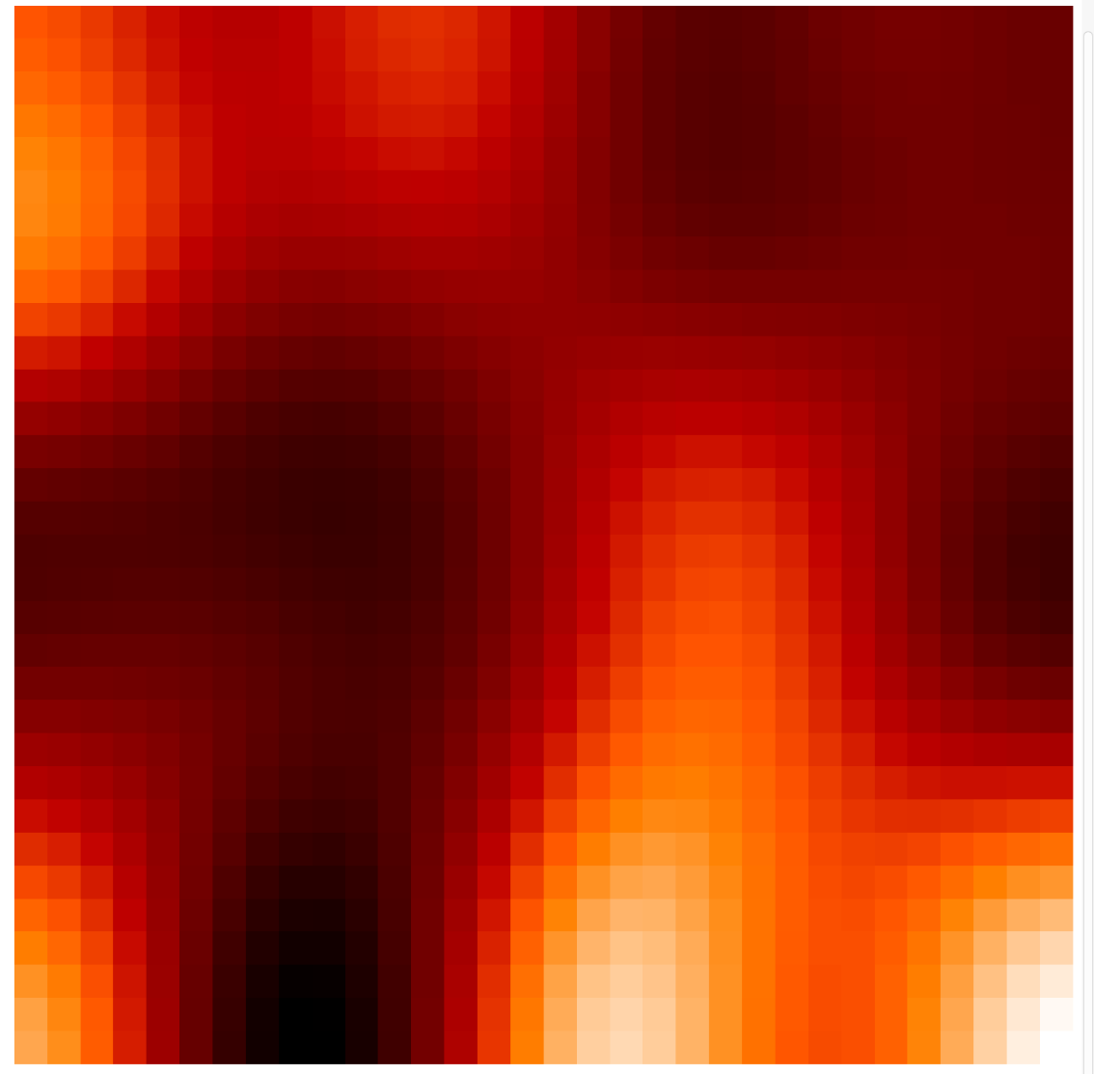
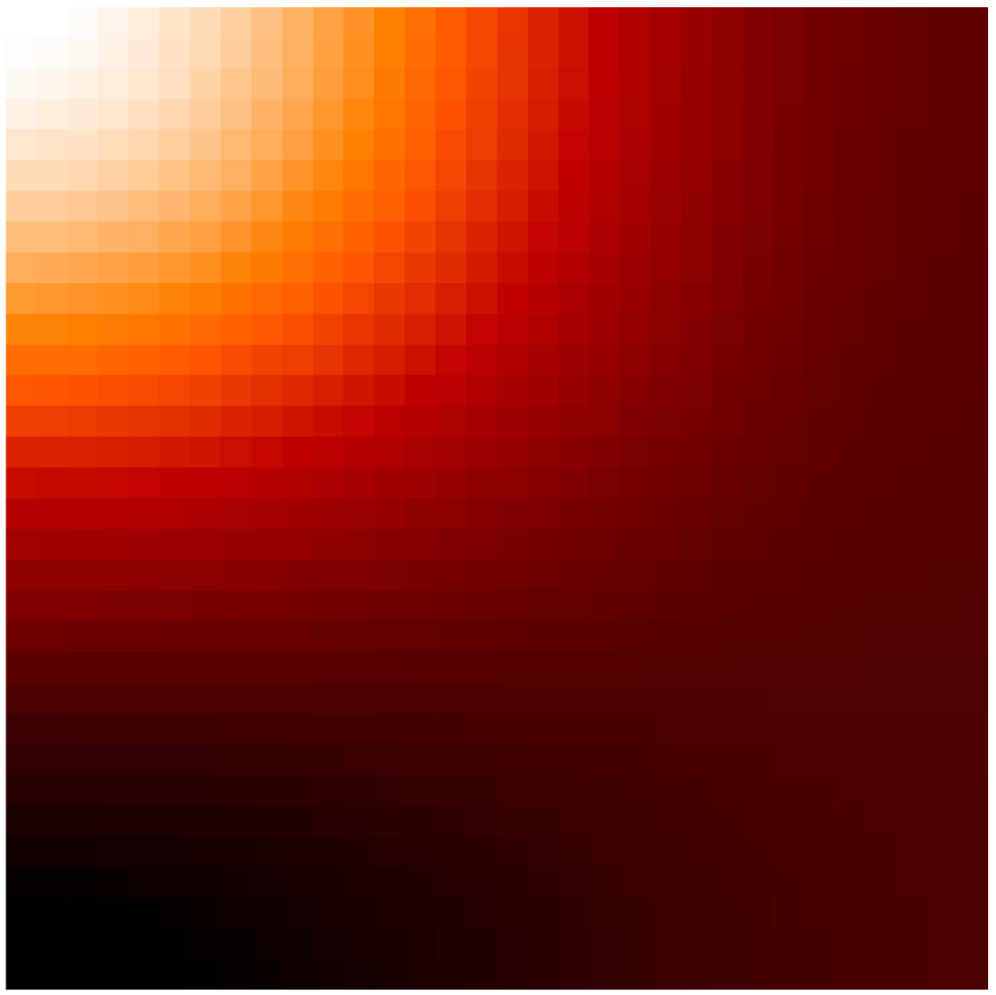
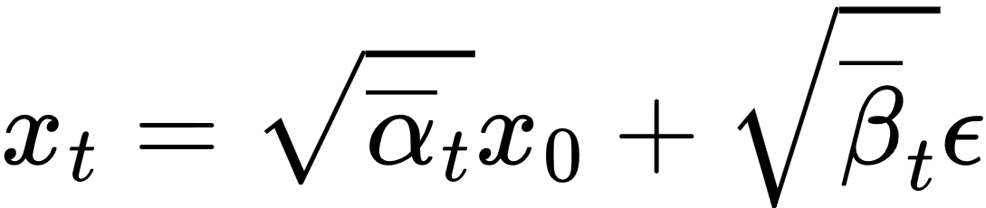
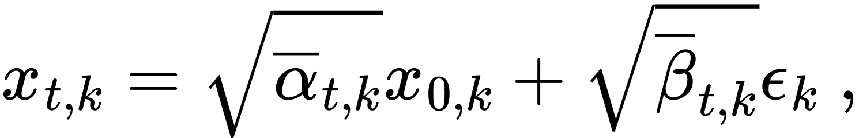
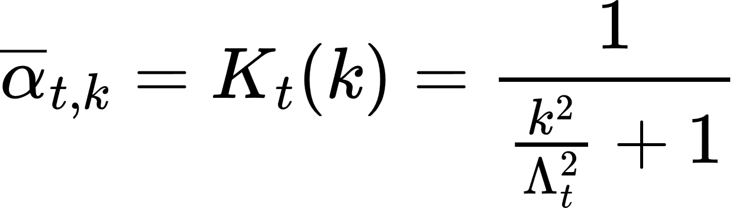
Generative Diffusion Models
Noising procedures
Standard: scale-independent noising in pixel-space
Scale-dependent noising in Fourier-space
Based on: Ho et al. (2020)
Based on: Masuki et al. (2025)
Forward
Forward
Reverse
Reverse
No scale dependence: all scales noised and reconstructed simultaneously in each timestep
Progressively reconstructs structures from coarse, large-scale features to fine, small-scale information over timesteps
Advantage: improved stability and recovery of summary statistics

Slide 8
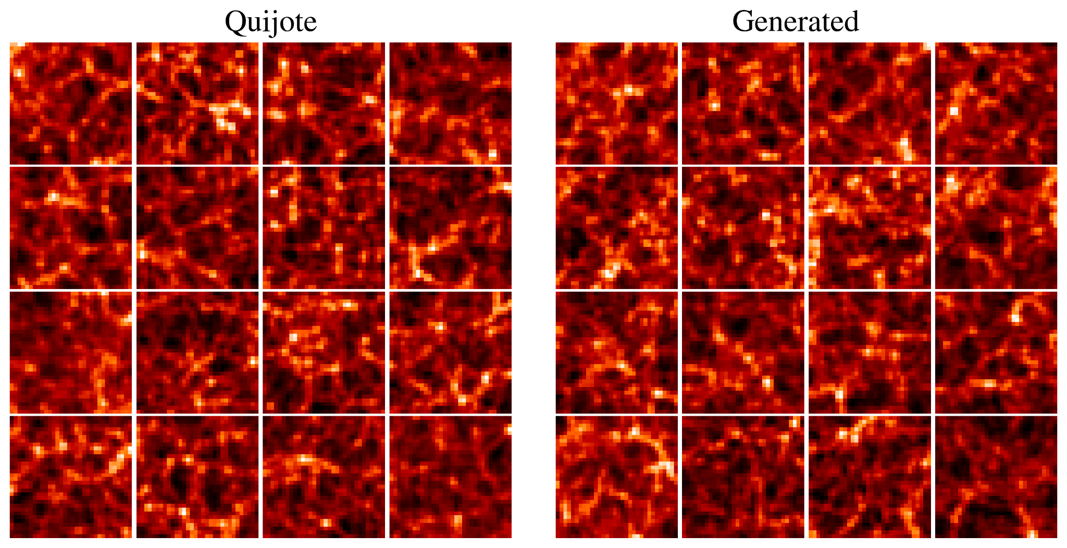
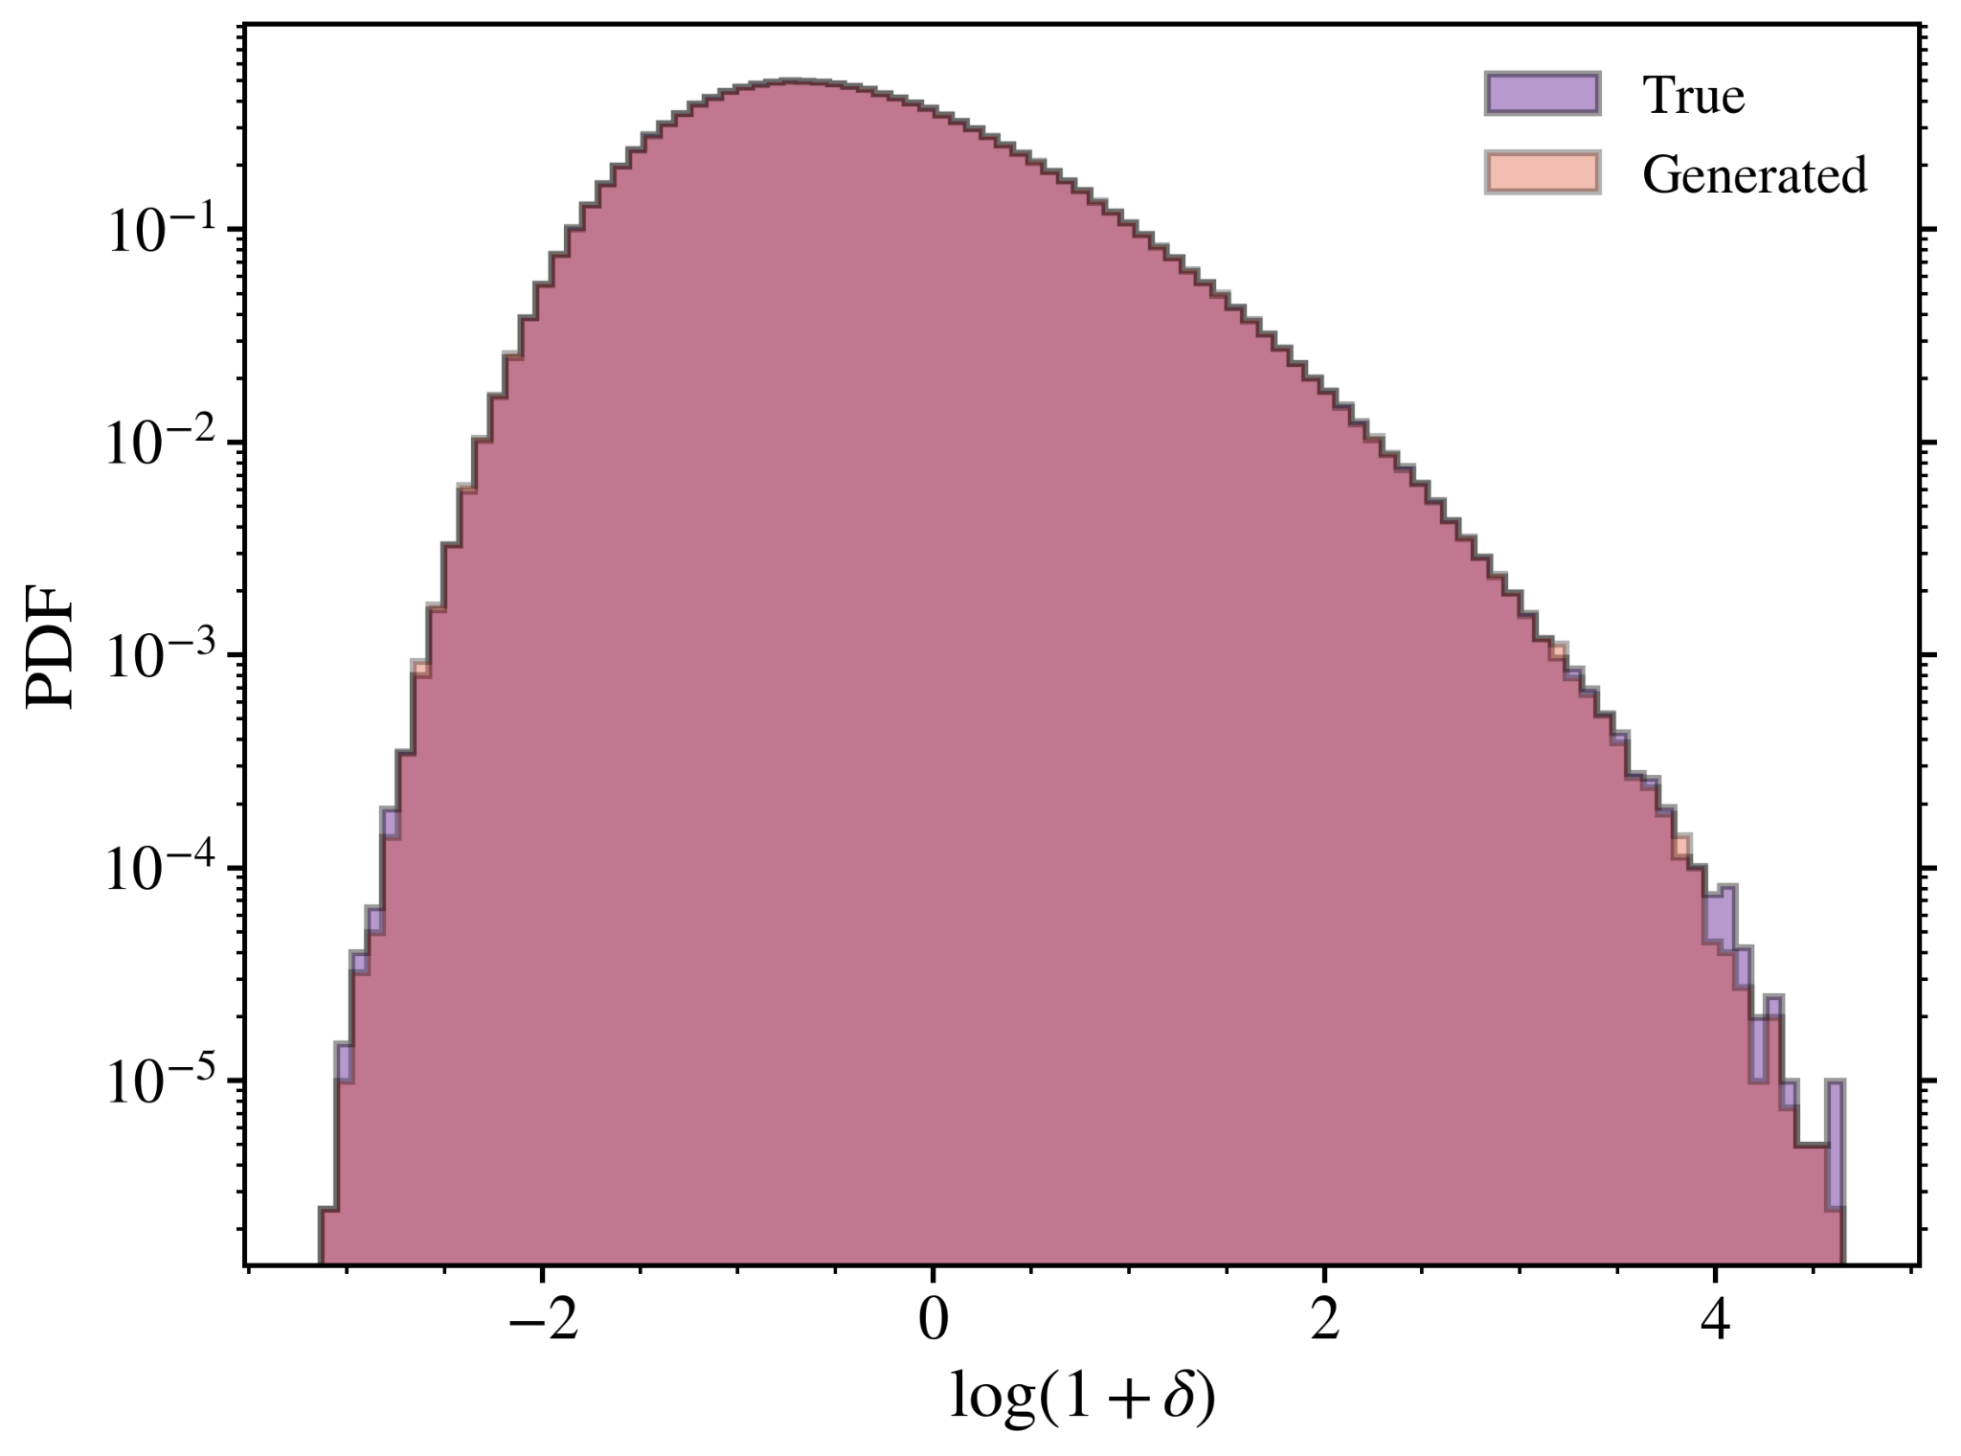
Trained Diffusion Model Analysis
Training Setup:
Training data: 100,000 2D density field slices from 64 Quijote simulation cubes
Trained for 1M iterations, with checkpoints saved periodically
240k checkpoint: best statistical agreement between true and generated data
One-point Statistics:
Pixel-value distributions of true and generated density fields
Excellent agreement across the full distribution
Two-point Statistics:
Mean matter power spectrum of true and generated fields
Accurate to within ~1 - 2% across all scales
240k Iterations
240k Iterations
Noor et al. (submitted)

Slide 9
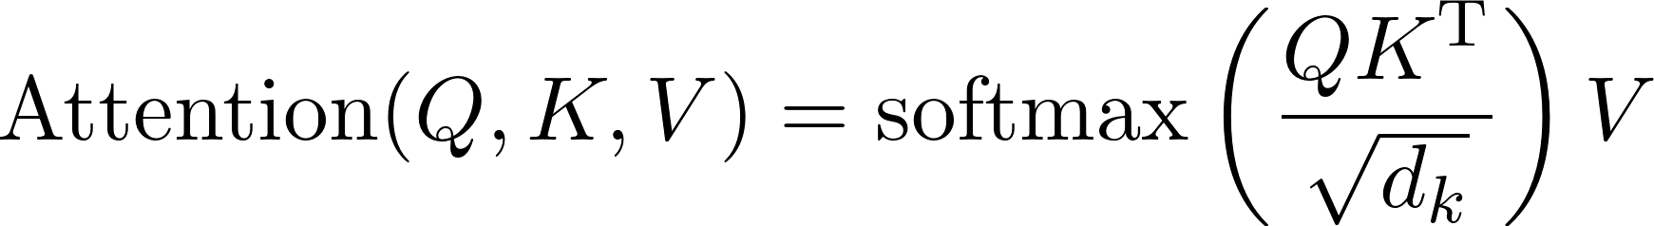
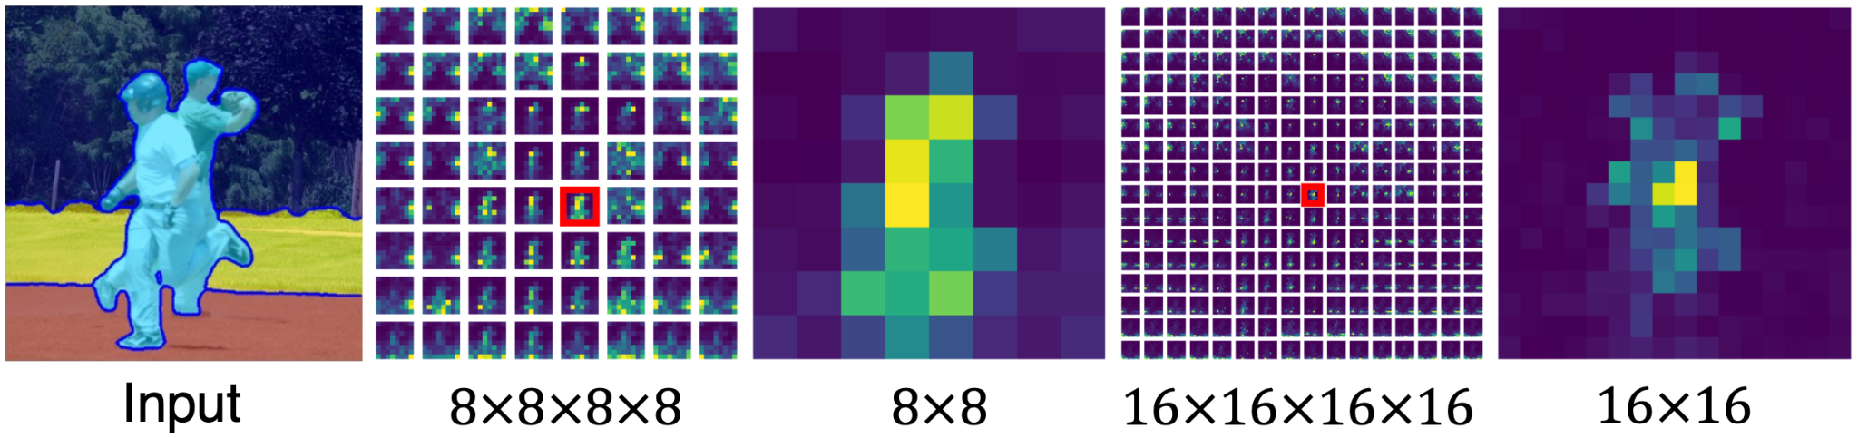
Self-Attention in the Diffusion Model
Second step:
Explore how diffusion models capture distinct cosmic web environments (CWEs) via self-attention maps
Important for capturing non-Gaussian information from the cosmic web
Self-attention Maps:
Quantify how each spatial region correlates to all others in the image
Captures structural patterns across local and global scales (multiple resolution levels)
Spatial region (query)
Attention Layer
Attention Map
Visualisation of self-attention tensors and maps. Source: Tian et al. (2024)

Slide 10
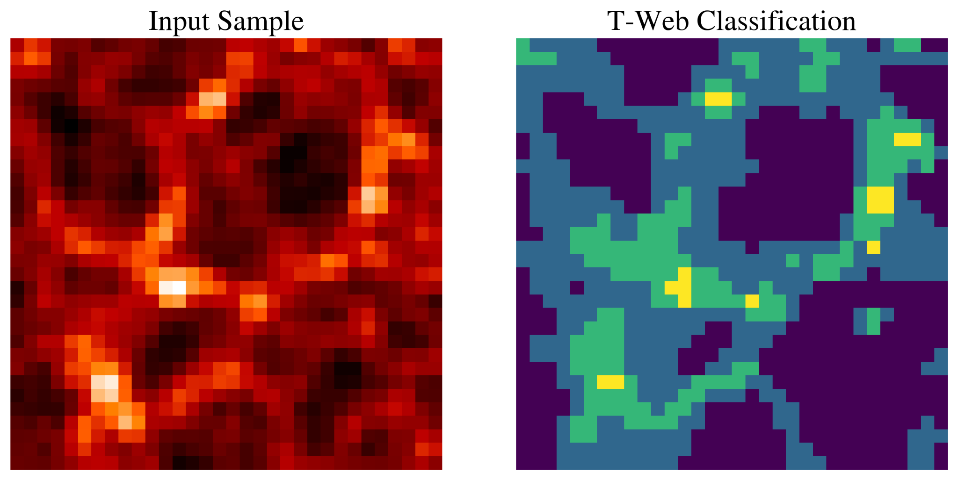
Self-Attention in the Diffusion Model
Method:
Use T-Web (Hahn et al. 2007) to classify density field grid cells under CWEs: voids, walls, filaments and nodes
Self-attention Maps:
Quantify how each spatial region correlates to all others in the image
Captures structural patterns across local and global scales (multiple resolution levels)
Each query position (pixel) is associated to a CWE using T-Web as reference
Use statistical estimators to evaluate how well CWE-associated attention maps capture the overall matter distribution (& also individual CWEs)
Voids
Walls
Filaments
Nodes
Noor et al. (submitted)
Attention map of this query position is associated to nodes

Slide 11
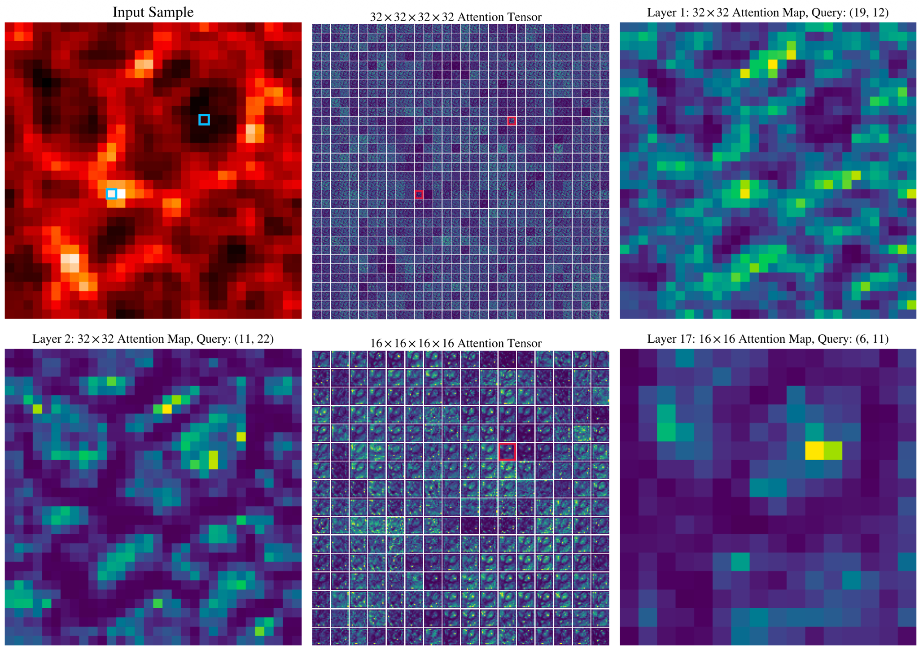
Qualitative Analysis of Self-Attention Maps
Self-attention Analysis Setup:
Attention layers added at 4 resolutions: 32×32, 16×16, 8×8, 4×4
21 attention layers: 8 (encoder), 1 (bottleneck), 12 (decoder)
Layer 1: Node Attention Map
Different attention layers capture distinct CWEs
Lower-resolution maps capture global, large-scale features
Higher-resolution maps capture fine-grained, small-scale structures
Layer 2: Void Attention Map
Noor et al. (submitted)
Lower-resolution Void Map

Slide 12
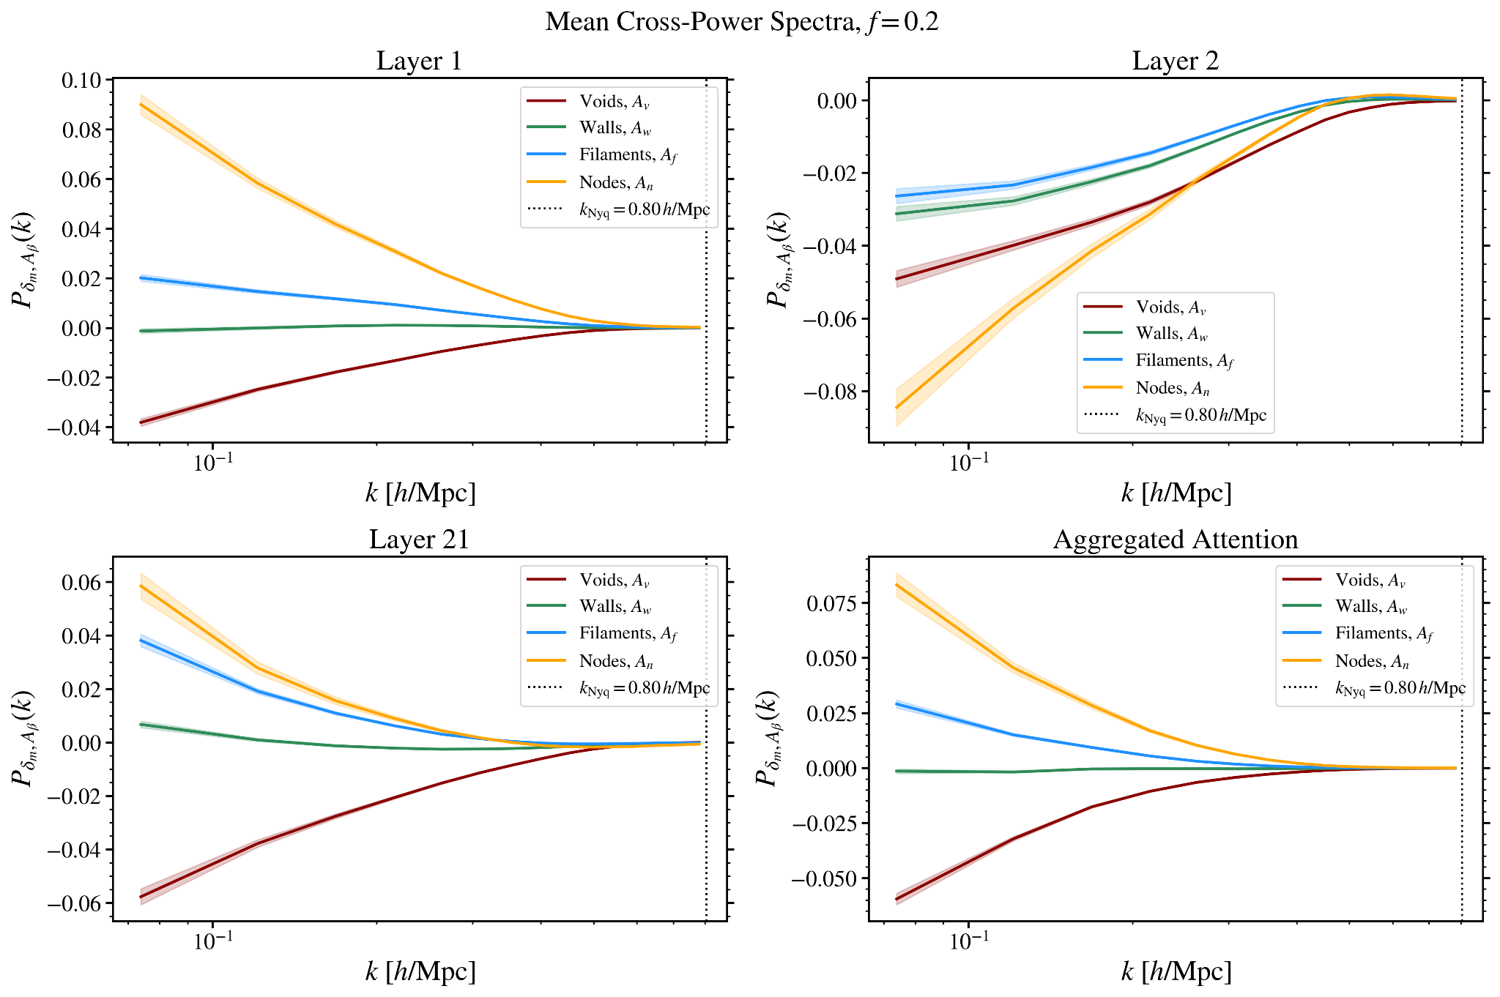
Quantitative Analysis of Self-Attention Maps
Cross-power spectrum computed between:
node map-matter field
Full matter density fields and CWE-associated attention maps
filament map-matter field
Full Matter Field
Void Map
wall map-matter field
void map-matter field
Findings:
Dominant correlations at intermediate-to-large spatial scales
Layer 1: Strong correlations primarily with overdense structures
Layer 2: Strong correlations overall with underdense structures
Noor et al. (submitted)

Slide 13
Summary
Step 1: Training a Generative Diffusion Model:
Generates cosmological simulations that accurately reproduce the summary statistics of the cosmic web
Excellent agreement of one-point statistics & two-point statistics accurate to within ~1 - 2%
Step 2: Evaluation of Self-attention Maps:
Perform both quantitative and qualitative analyses of self-attention maps to assess their ability to capture cosmic web environments
Statistical estimators: Cross-power spectra, cross-component attention distributions & Dice coefficients
Findings:
Different attention layers capture distinct, spatially-coherent cosmic web environments
Dominant correlations occur at intermediate-to-large spatial scales
Attention maps are an important mechanism for capturing non-Gaussian information

Slide 14
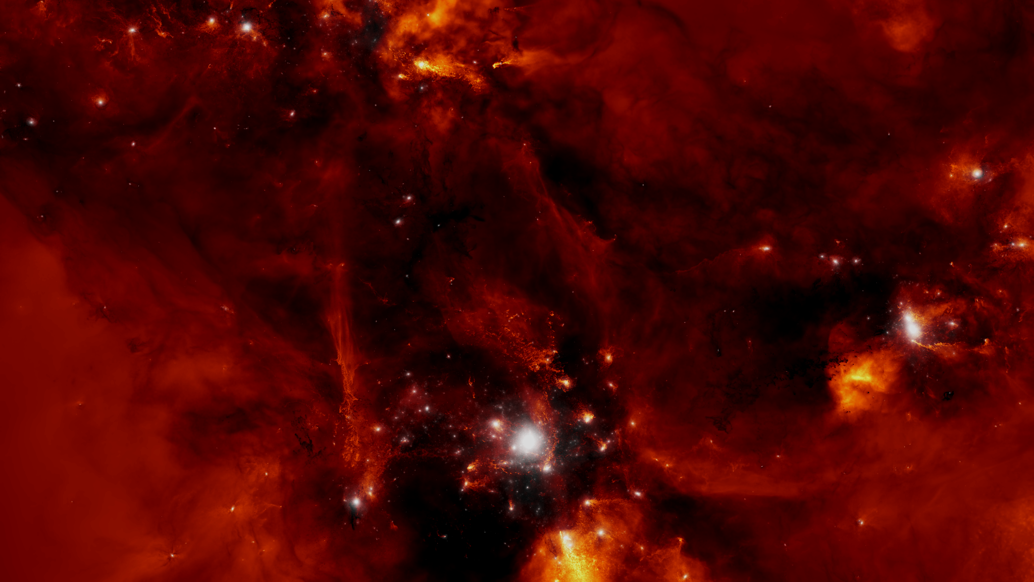
Thank you for your attention!

Slide 15
Back-up Slides

Slide 16
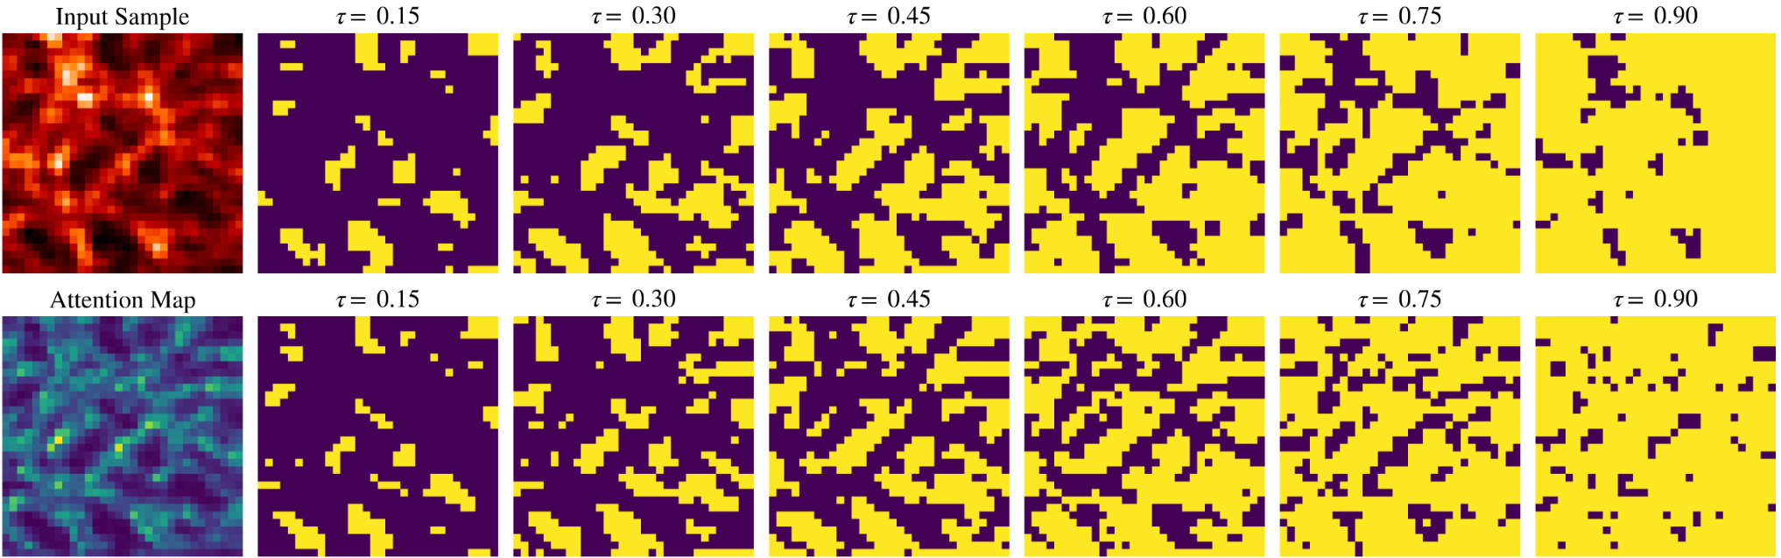
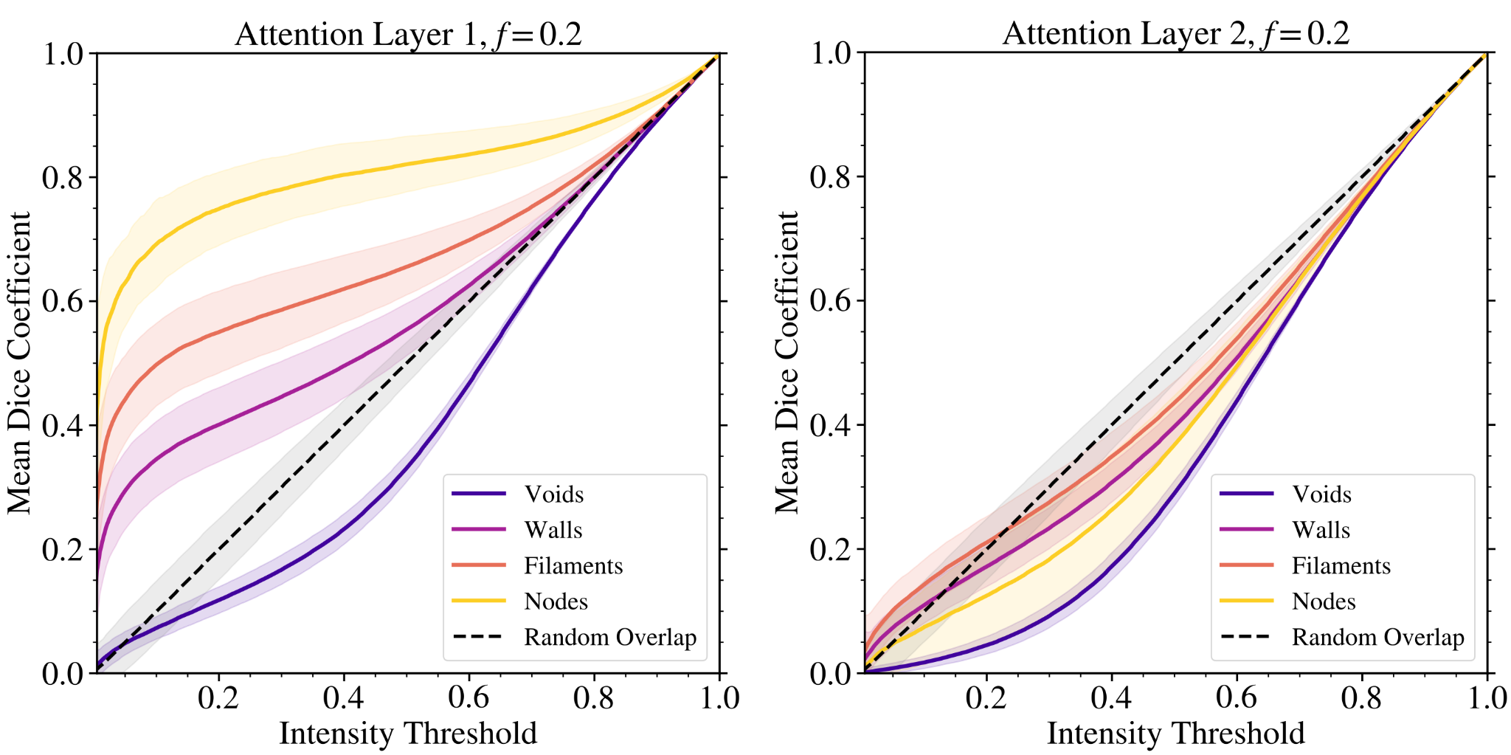
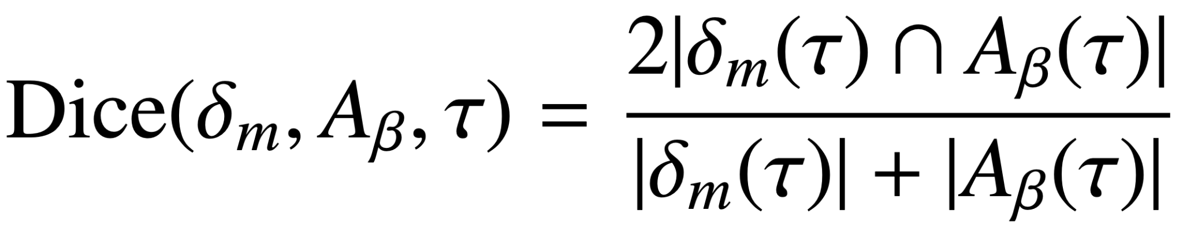
Quantitative Analysis of Self-Attention Maps
Dice Coefficient:
Measure spatial overlap between:
  Environment-associated attention maps & input density fields
  T-Web used as reference for map classification
  Computed over multiple thresholds (e.g., 0.2 retains the lowest 20% of pixel values)
nodes
filaments
Layer 1: strong overlap with overdense environments (nodes and filaments)
walls
Layer 2: strong anti-correlations with underdense environments (voids)
voids
Noor et al. (submitted)

Slide 17
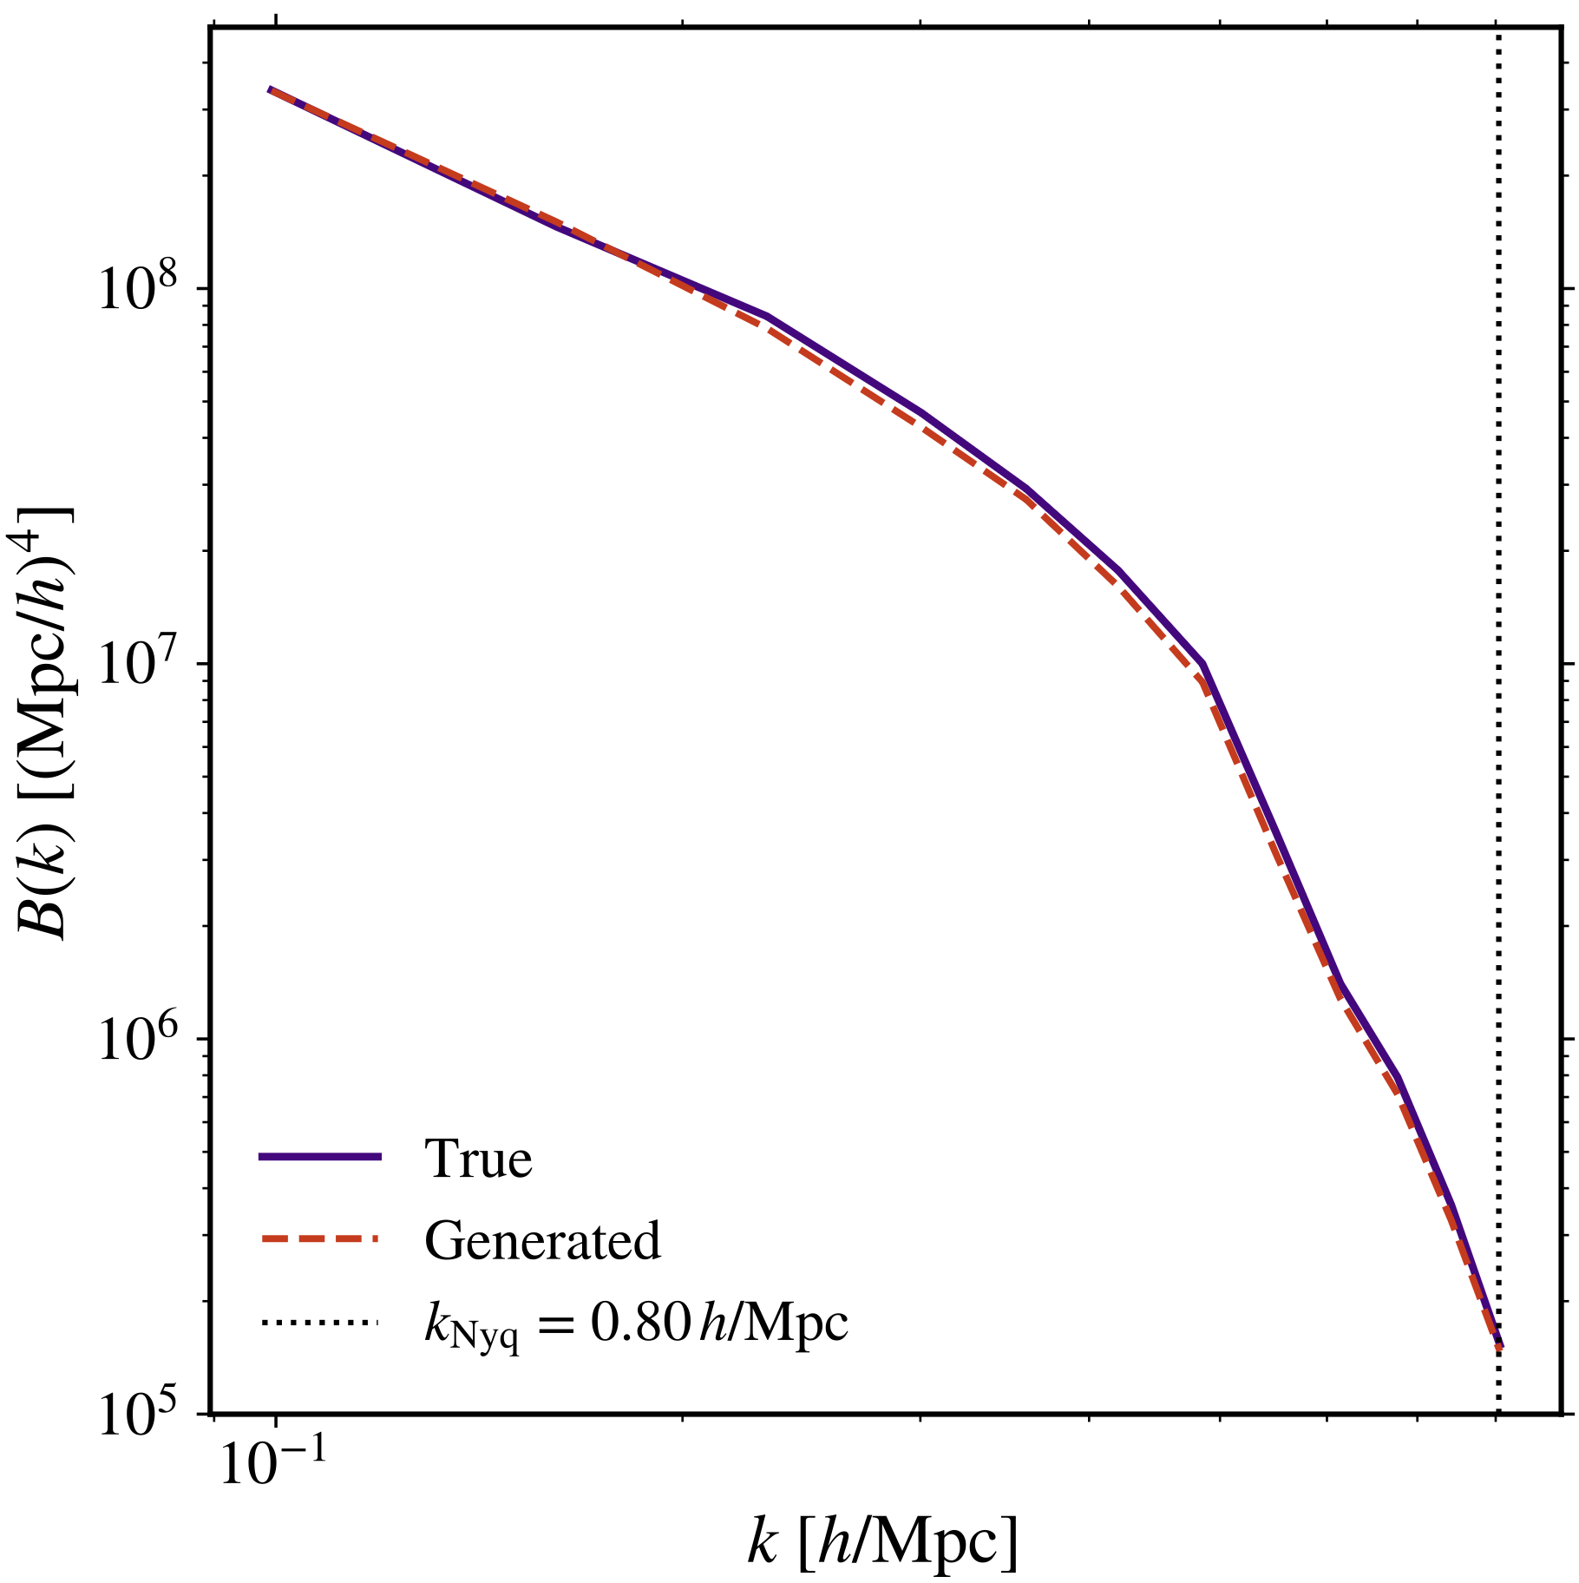
Trained Diffusion Model Analysis
Higher-order Statistics:
Great agreement between the mean equilateral bispectrum of true and generated density fields
240k Iterations
Noor et al. (submitted)

Slide 18
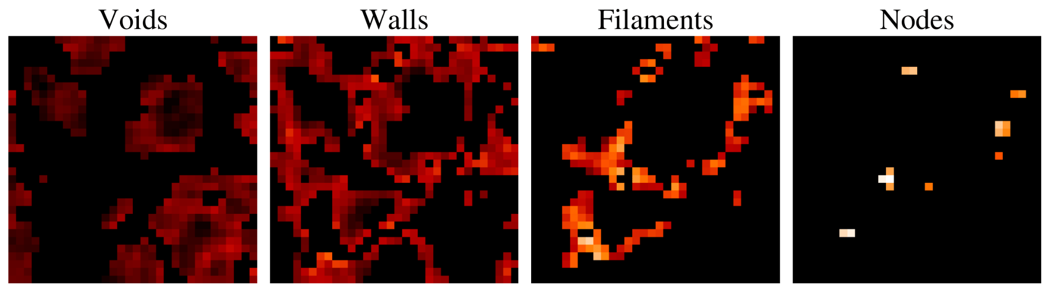
Self-Attention in the Diffusion Model
Method:
Use T-Web (Hahn et al. 2007) to classify density field grid cells under CWEs: voids, walls, filaments and nodes
Self-attention Maps:
Quantify how each spatial region correlates to all others in the image
Captures structural patterns across local and global scales (multiple resolution levels)
Decompose the overall matter density field into component-separated density fields
Each query position (pixel) is associated to a CWE
Use statistical estimators to evaluate how well CWE-associated attention maps capture both the overall matter distribution & individual CWEs
Voids
Walls
Filaments
Nodes
Noor et al. (submitted)
Attention map of this query position is associated to nodes
Noor et al. (submitted)

Slide 19
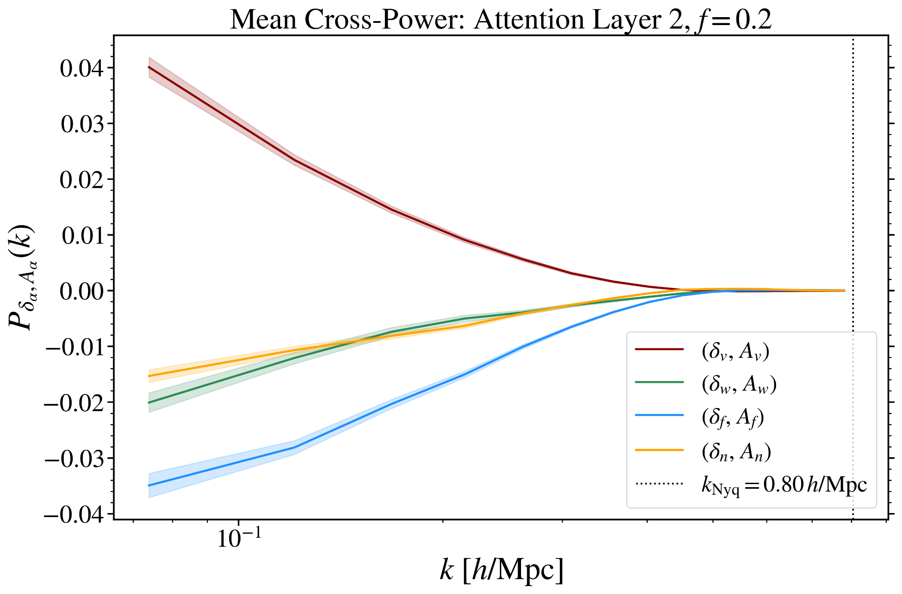
Quantitative Analysis of Self-Attention Maps
Cross-power spectrum computed between:
node map-matter field
Full matter density fields and CWE-associated attention maps
Component-separated density fields and CWE-associated attention maps
filament map-matter field
wall map-matter field
void map-matter field
Full Matter Field
Void Map
Void Density Field
Void Map
void map-void field
Findings:
Dominant correlations at intermediate-to-large spatial scales
Layer 1: Strong correlations primarily with overdense structures
Layer 2: Strong correlations overall with underdense structures
node map-node field
wall map-wall field
filament map-filament field
Noor et al. (submitted)

Slide 20
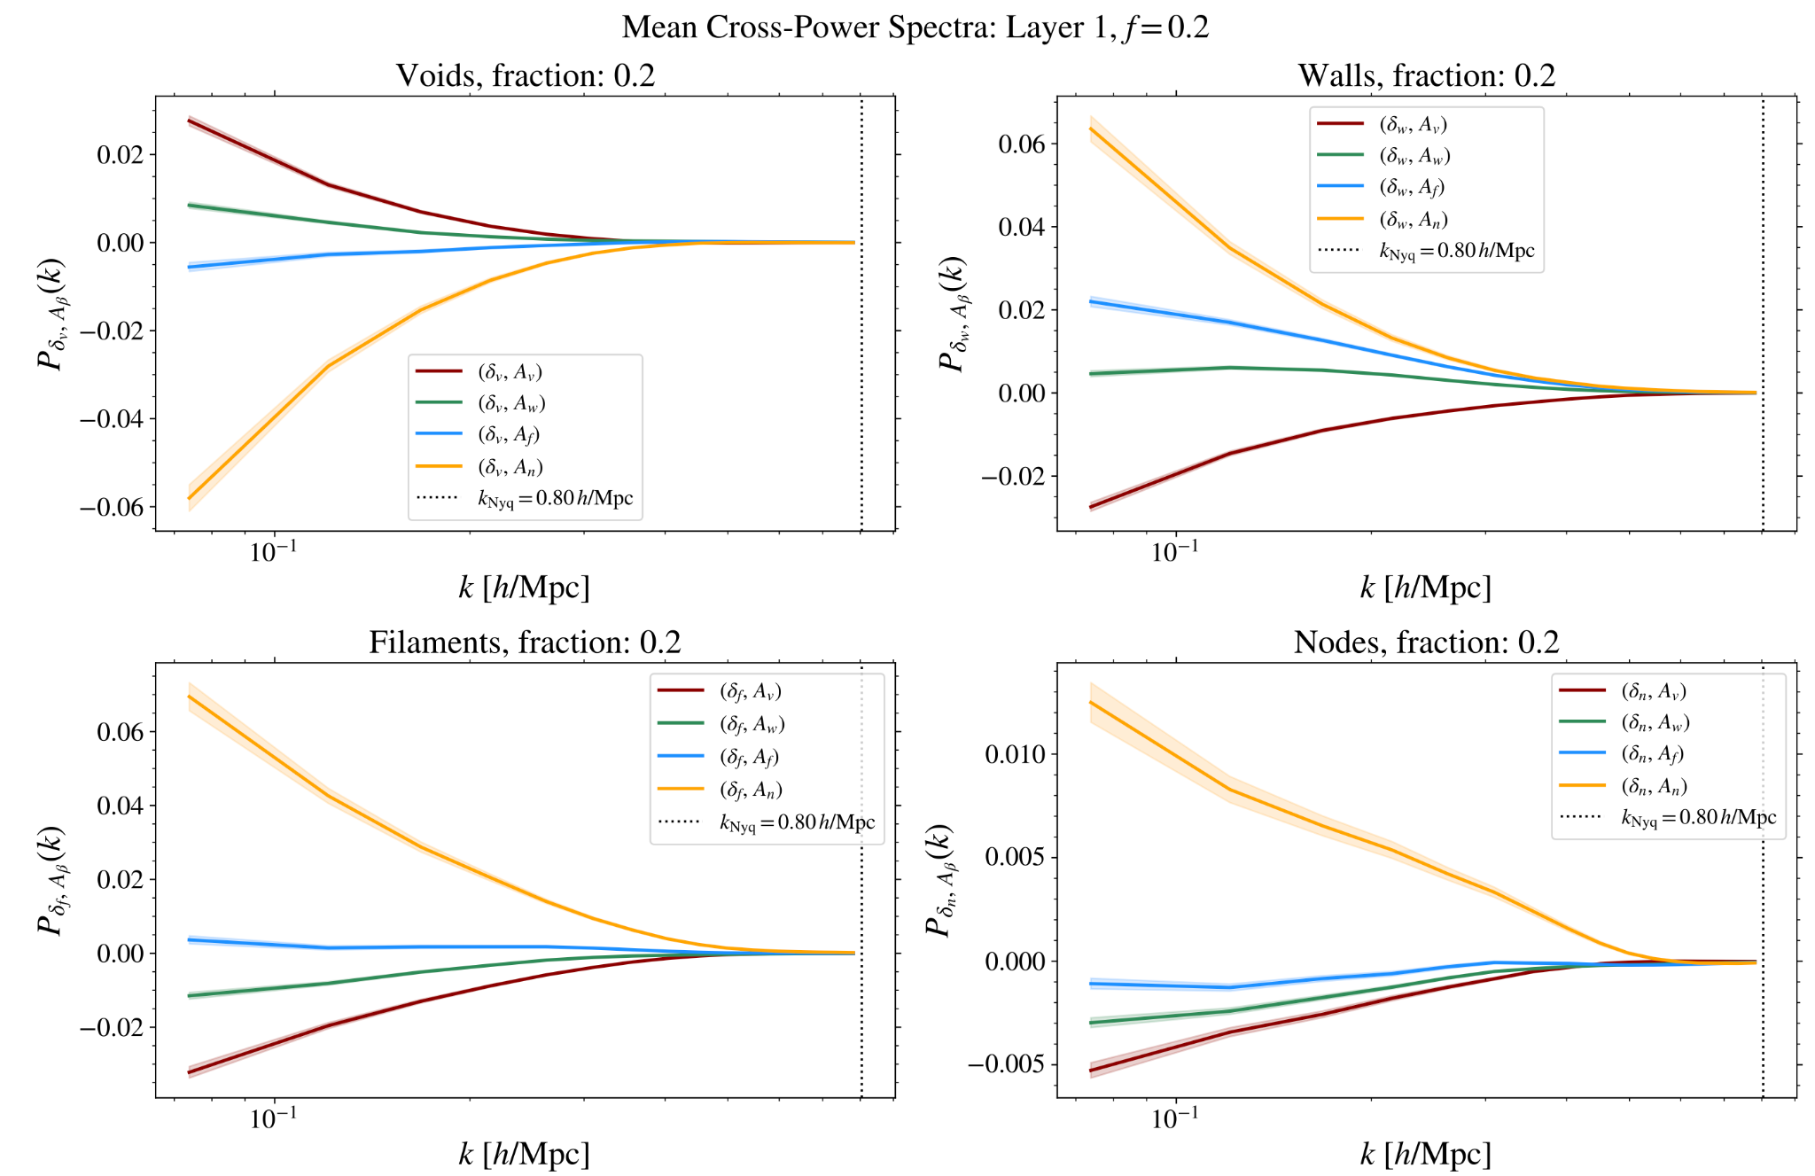
Trained Diffusion Model Analysis

Slide 21
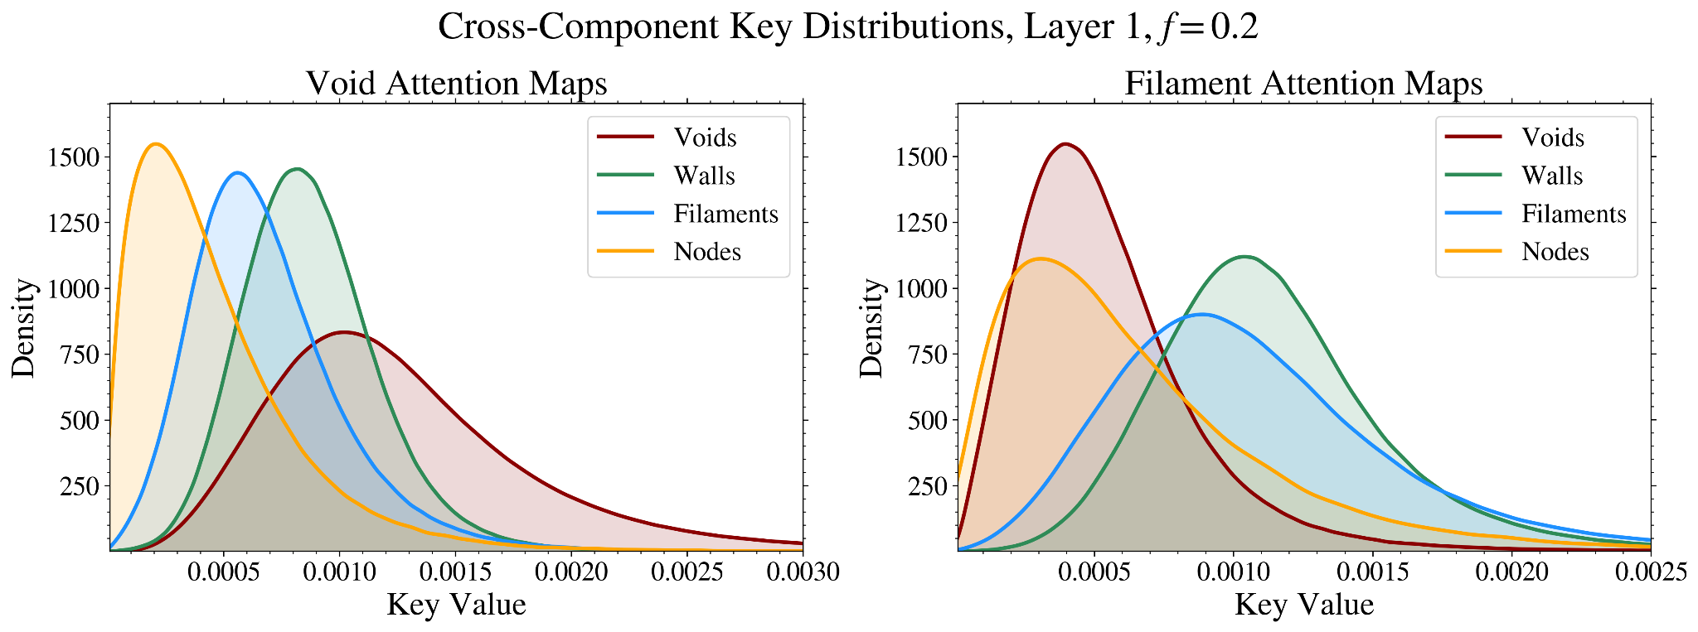
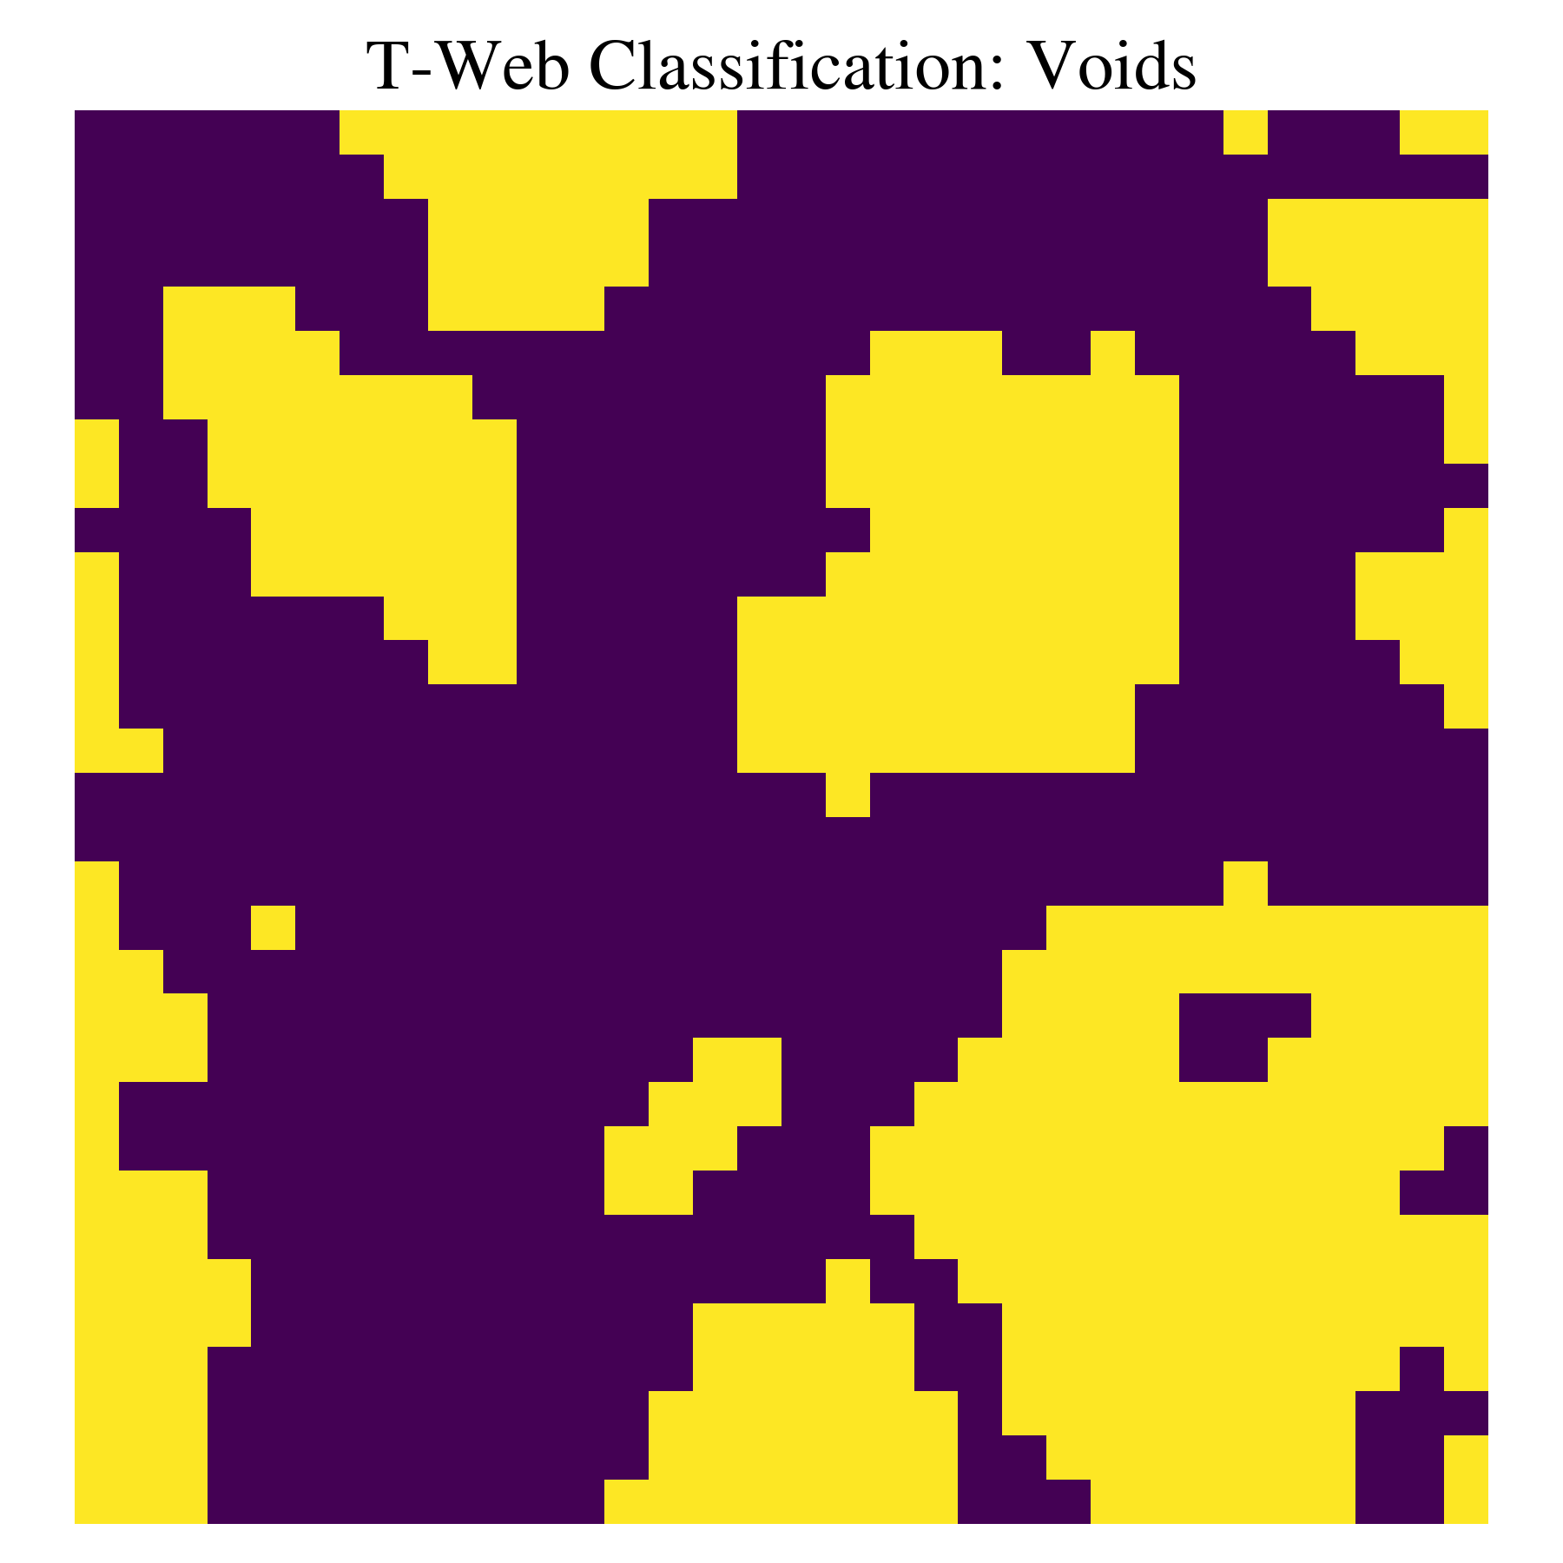
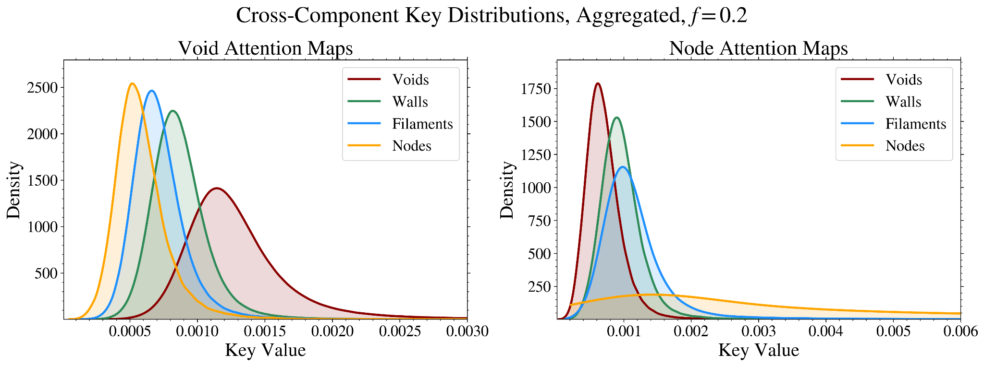
Quantitative Analysis of Self-Attention Maps
Cross-component Attention Distributions:
Use segmented masks of cosmic web environments (CWEs)
Void Attention Map
Void Mask
Select attention map pixels belonging to each CWE
Compare distributions of attention values across CWEs
Select void pixels using the void mask
Source: Noor et al. (in prep.)
Results:
Attention maps respond most strongly to their associated environments
E.g., Void maps are most sensitive to void regions
Aggregated maps enhance separation between environment distributions
Aggregated Attention Maps:
Combine attention maps from multiple resolutions and layers
Captures both small-scale and large-scale structural information

Slide 22
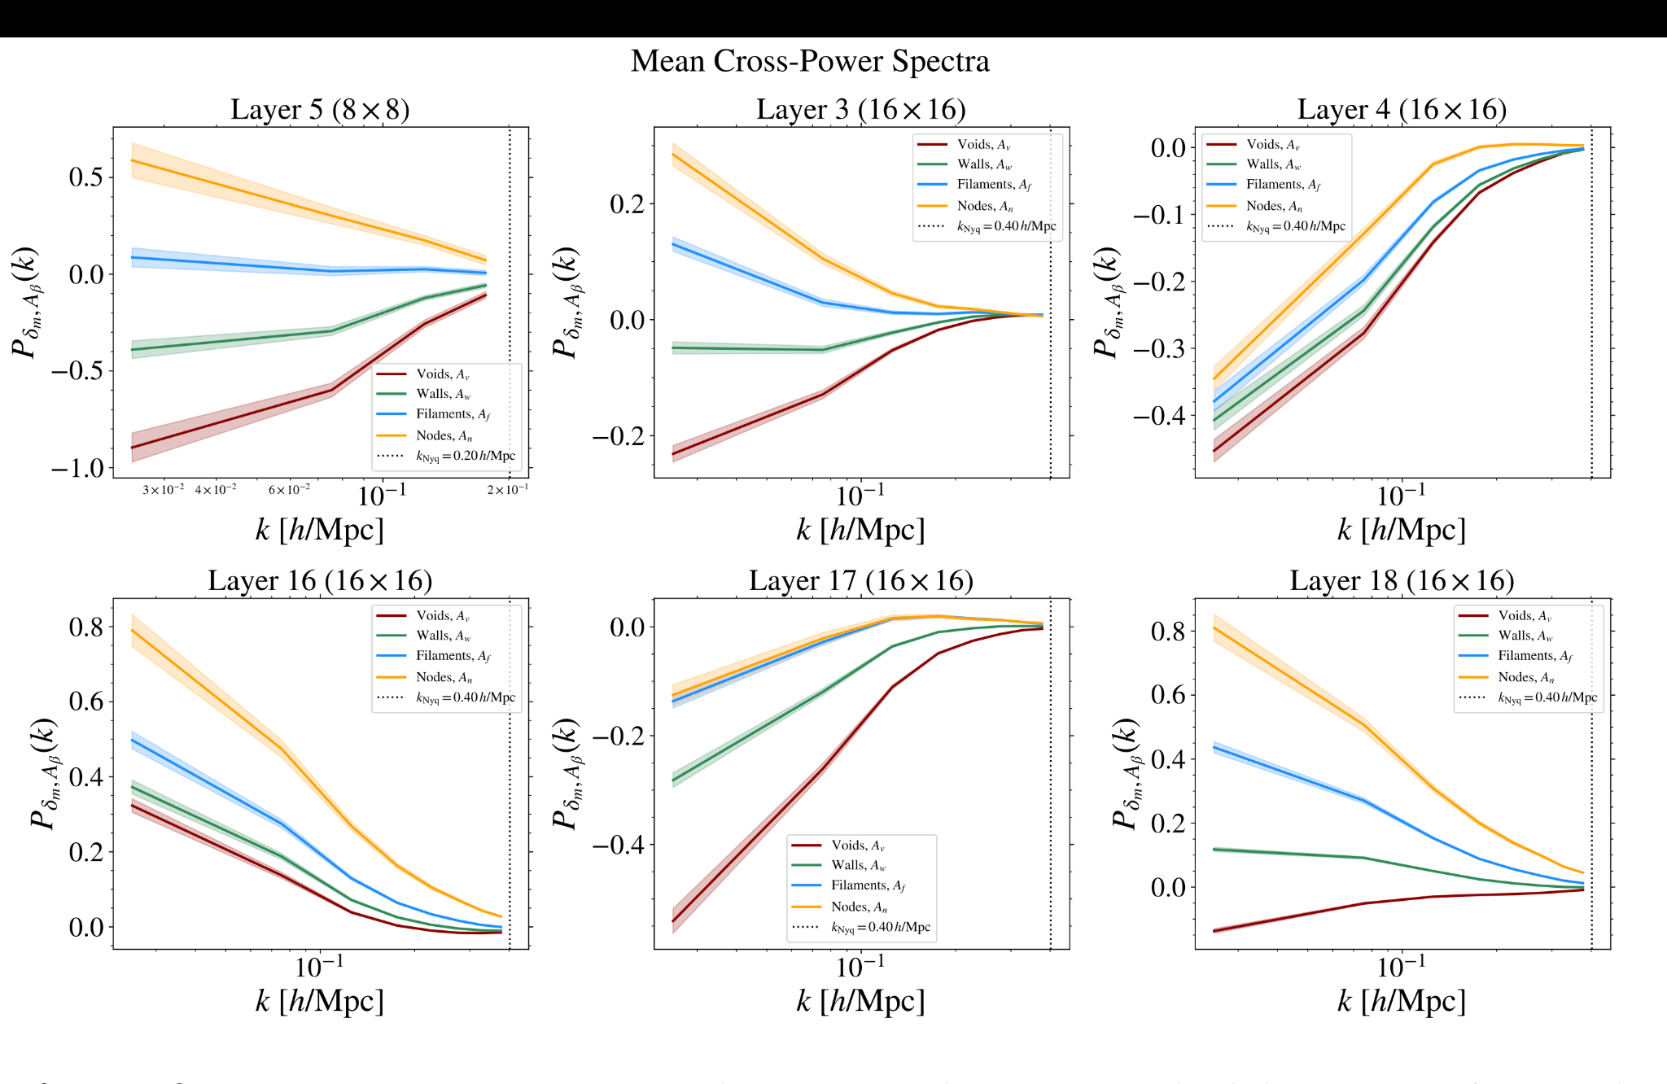
Low-resolution Attention Layers
Cross-power spectra between downsampled log-transformed DM density fields and their matching resolution attention maps associated to different environments. No thresholding is applied to the maps. Shaded bands show ±3SEM of the mean cross-power over 2000 density field samples. Dotted vertical lines indicate the Nyquist frequency. We observe strong sensitivities to both overdense and underdense structures in layers 3 and 5, whereas layers 4 and 17 show strong attention responses to underdense structures overall for all environment cases, and layer 16 showing an overall sensitivity to overdense structures. Layer 18 captures strong correlations to overdense structures, specifically for the filament and wall environments, while also capturing anti-correlations with underdense structures for voids.

Slide 23

Dark Matter Density Field vs Gaussian Random Field
Left: Dark matter density field slice of depth 3.91 Mpc/h from Quijote. Right: Gaussian random field constructed with the same power spectrum as the density field slice. Although both fields share the same two-point statistics, the Gaussian field clearly does not contain the coherent filamentary structures of the density field.

Slide 24


The Cutoff Function
Left: The cutoff function K_{t}(k) as a function of k at t=60. The function decreases monotonically from 1 to 0 with increasing k, with the cutoff scale being defined by the wavenumber at which K₆₀(k) = 0.50. Right: K_{t}(k) at different timesteps.

Slide 25

Cross-Power Across Timesteps
Cross-power spectra of the aggregated attention between environment-associated attention maps and the matter density field for varying diffusion timesteps. Shaded bands indicate ±SEM of the mean cross-power over 500 density field samples. A timestep of T= 60 exhibits the most balanced cross-power amplitudes across cosmic web environments.

Slide 26

Trained Diffusion Model Analysis
Cross-power spectra between log-transformed DM density fields and their corresponding 32 ×32 environment-associated attention maps from the aggregated attention layer. The shaded bands indicate ±3SEM of the mean cross-power spectra over 500 density field samples. The dotted vertical line indicates the Nyquist frequency. Left: Cross-power computed across multiple aggregation weighting exponents α, at a fixed threshold of f= 0.2. For α>0, a stronger weighting to higher- resolution layers is introduced, whereas α < 0 gives a stronger weighting to lower-resolution layers. The overall magnitude of the amplitudes decreases progressively as α is reduced from α = 1 to α =−1, particularly for node and filament maps, supporting the fiducial choice of α= 1 adopted throughout the main analysis. Right: Cross-power computed across multiple density thresholds f , for α= 1. Although there is a decrease in magnitude of the amplitudes with increasing f, the cross-power across different environments remains clearly separated for all threshold values.

Slide 27







Diffusion Models
Mean-squared Error:
Two main processes:
Forward process:
  Start with a sample from the input data (e.g., 2D cosmic web simulation)
  Gradually add Gaussian noise over many time-steps, t
  End with a completely noise-filled image
Reverse process:
  Neural networks are used to predict and remove the noise step-by-step
  Reconstruct a clean image that closely matches the original data

Slide 28



What is Attention?
Spatial region, represented by vector x
Query, Q
Key, K
Attention: Probability maps
Value, V
E.g. Input: 8 x 8, softmax output: 64 x 64 -> 8 x 8 x 8 x 8
Self-Attention Maps:
Captures structural patterns across local and global scales (multiple resolution levels)
Quantify how each spatial region correlates to all others in the image
Attention Layer
Attention Map
Visualisation of self-attention tensors and maps. Source: Tian et al. (2024)

