Slide 1

Hierarchical Simulation Based Inference for Milky Way potential reconstruction
Giuseppe Viterbo, Heidelberg University

Slide 2
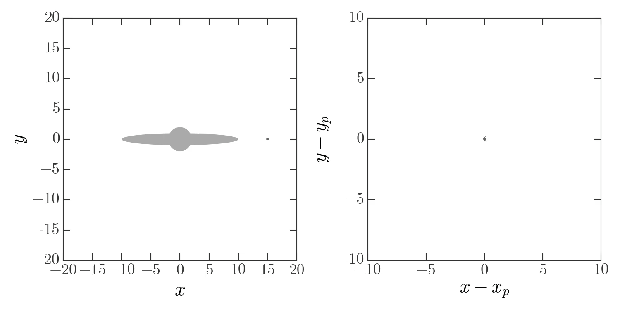
Stellar streams as MW potential tracers
https://adrian.pw/viz/

Slide 3
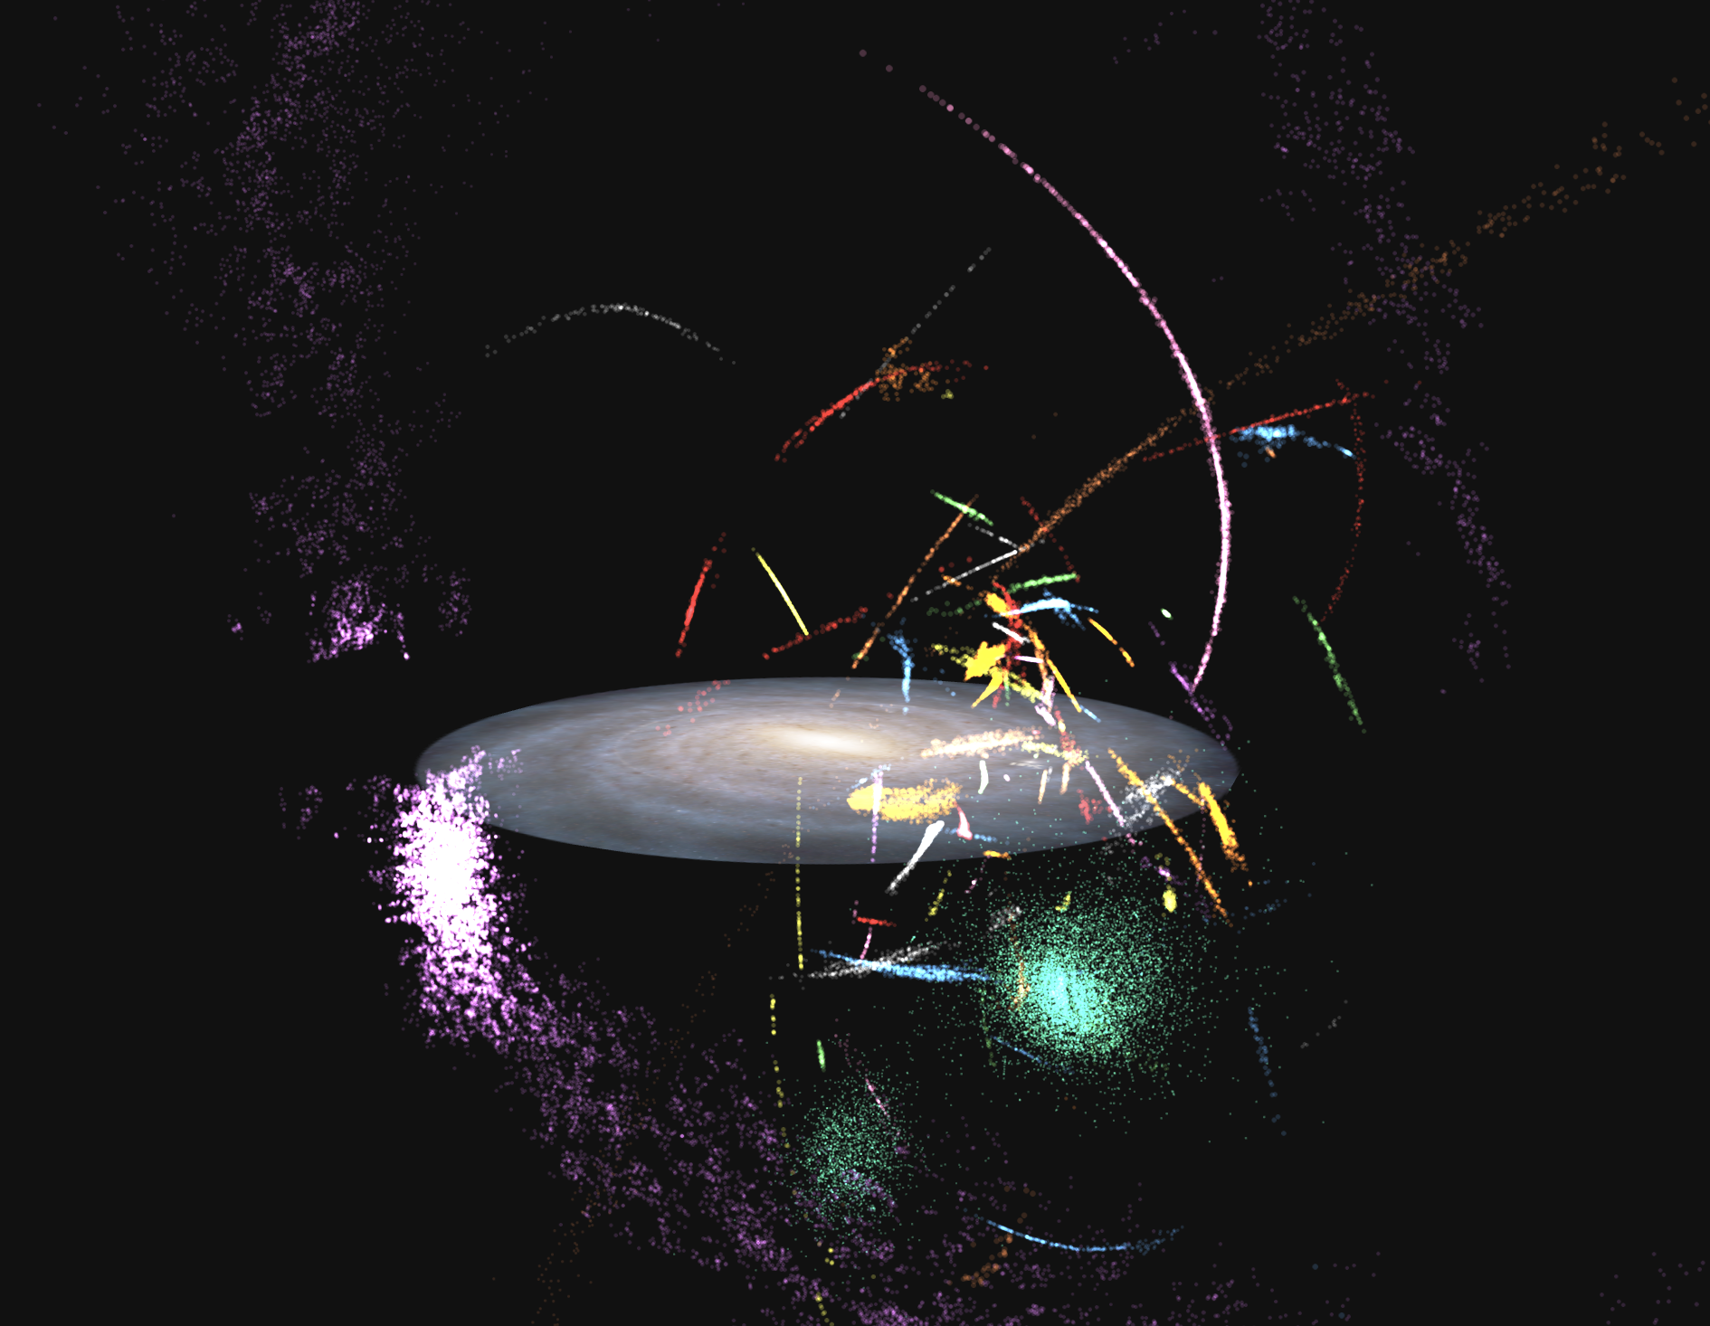
Stellar streams as MW potential tracers
https://adrian.pw/visualizations/mwstreams/

Slide 4
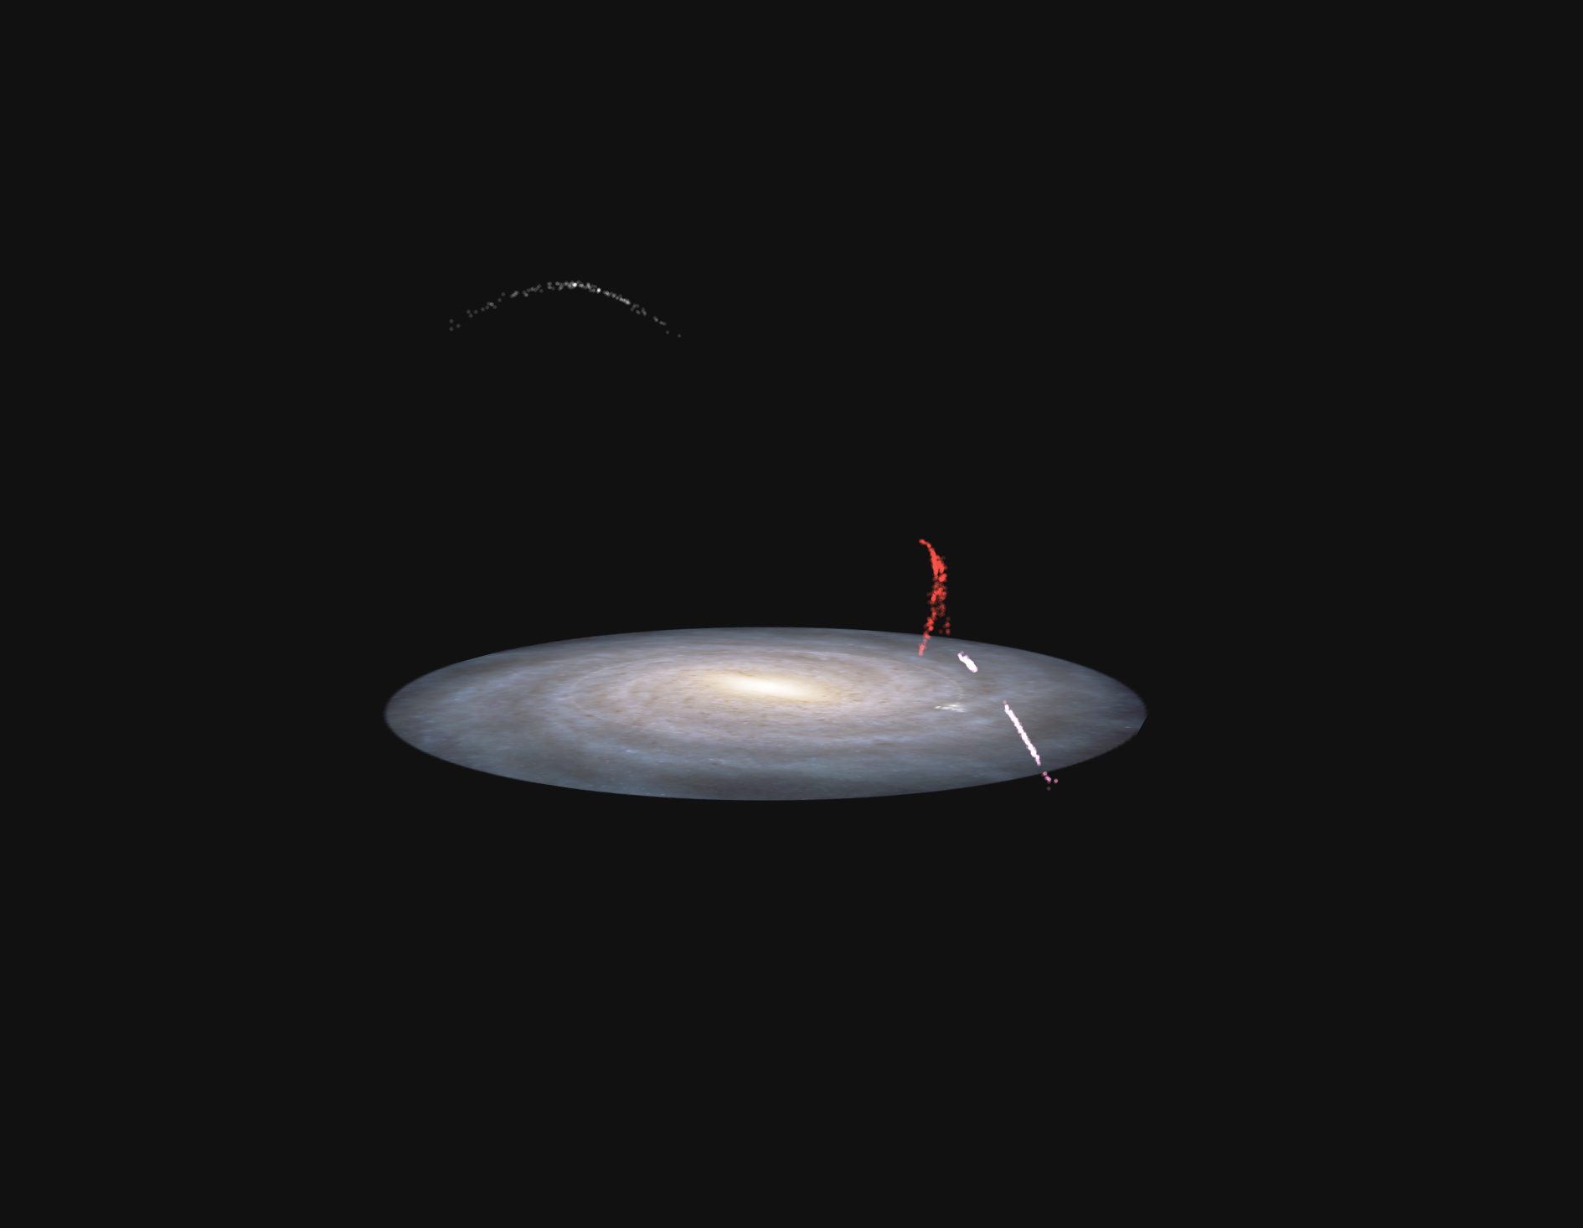
Stellar streams as MW potential tracers
Pal5
M68
NGC3201
https://adrian.pw/visualizations/mwstreams/

Slide 5
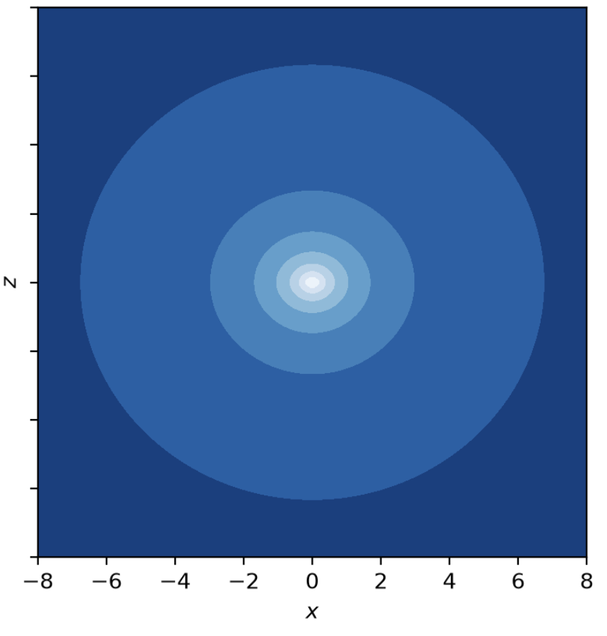
Stellar streams as MW potential tracers
Smooth analytical mass distribution
Halo(θ)+Disk(θ)+Bulge(θ)
https://adrian.pw/visualizations/mwstreams/

Slide 6
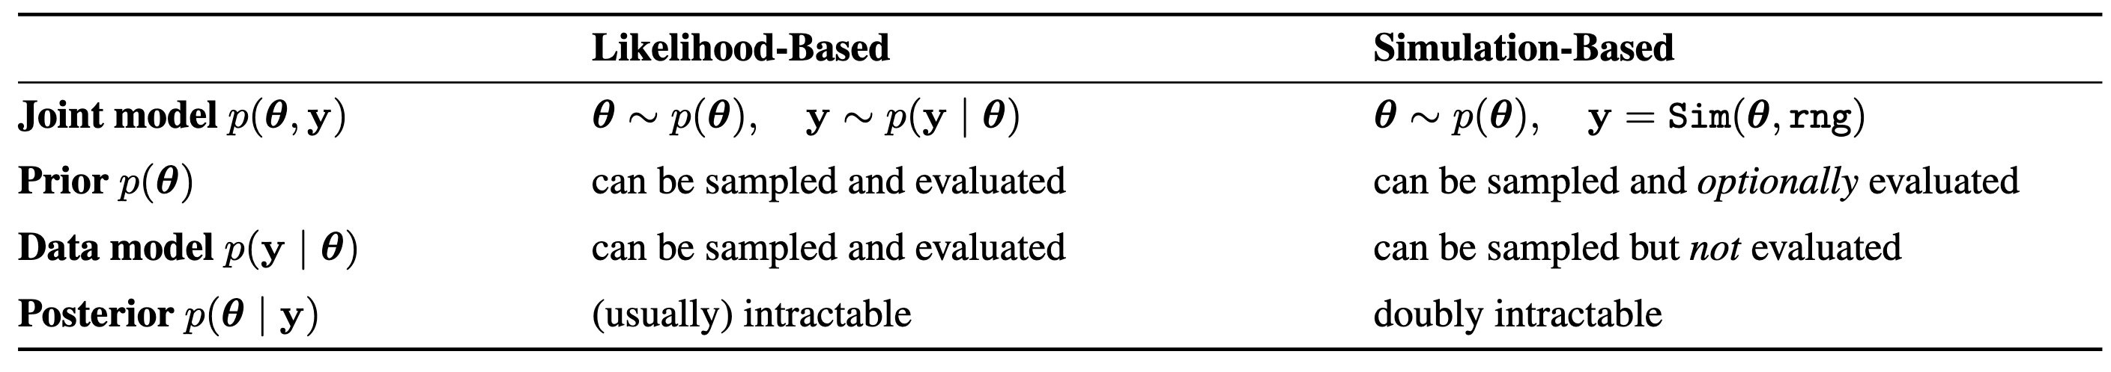
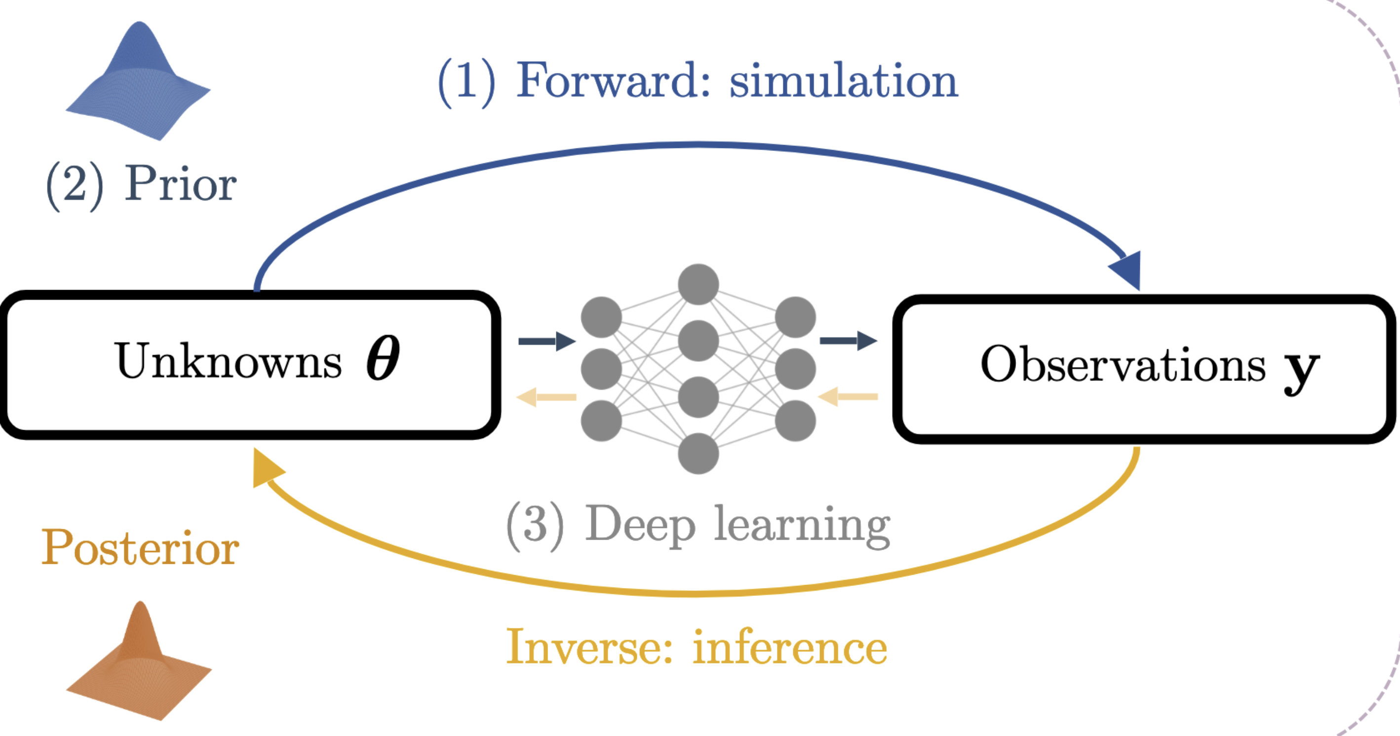
Simulation Based Inference
Arruda et al. 2026

Slide 7
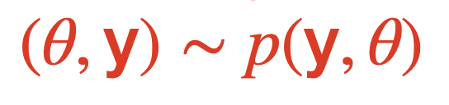
Simulation Based Inference
Training set
Arruda et al. 2026

Slide 8
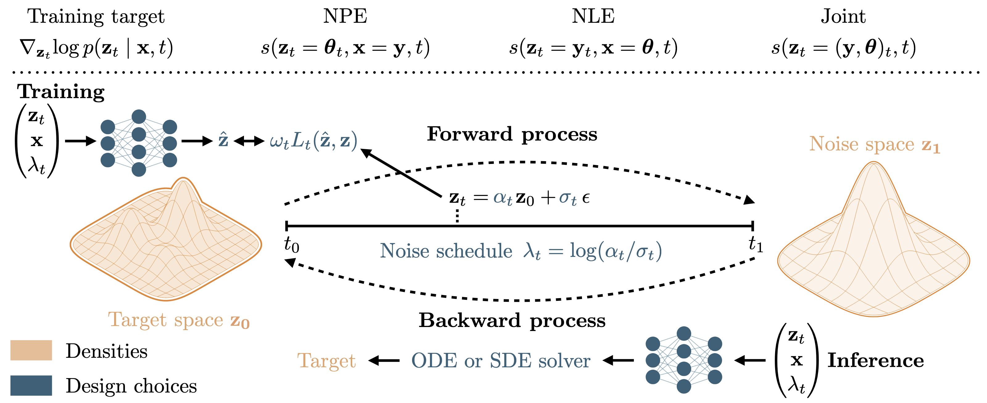
Diffusion models
Arruda et al. 2026

Slide 9
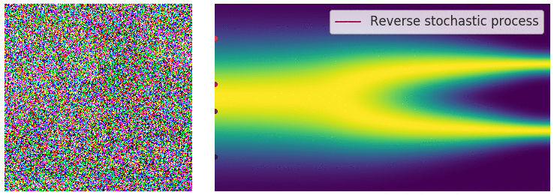
Diffusion models: an image example
TIME
https://aaronlou.com/blog/2023/reflected-diffusion/

Slide 10
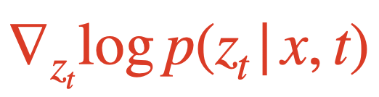
Diffusion models: an image example
We are learning the score
TIME
https://aaronlou.com/blog/2023/reflected-diffusion/

Slide 11
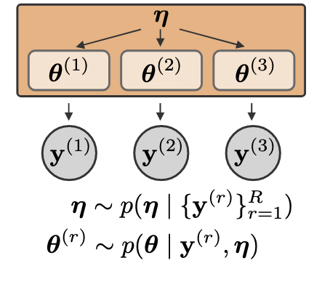
Compositional score modelling
The score is additive: we can leverage hierarchical information
Arruda et al. 2026

Slide 12
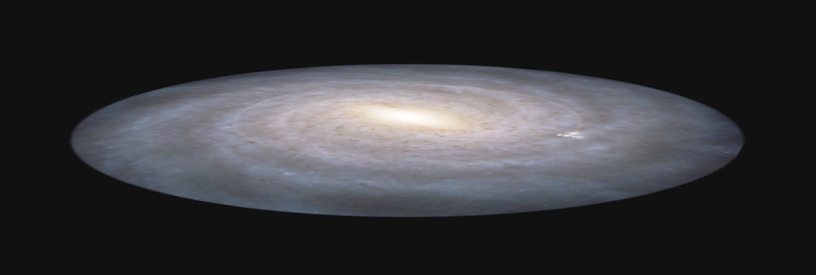

Compositional score modelling
The score is additive: we can leverage hierarchical information
The MW potential is shared

Slide 13
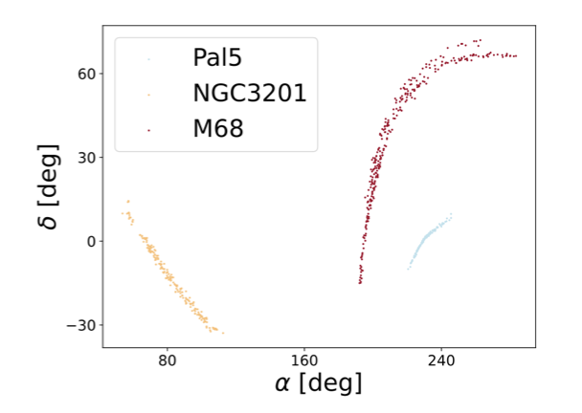

Compositional score modelling
The score is additive: we can leverage hierarchical information
The MW potential is shared
The stellar stream progenitor is not

Slide 14
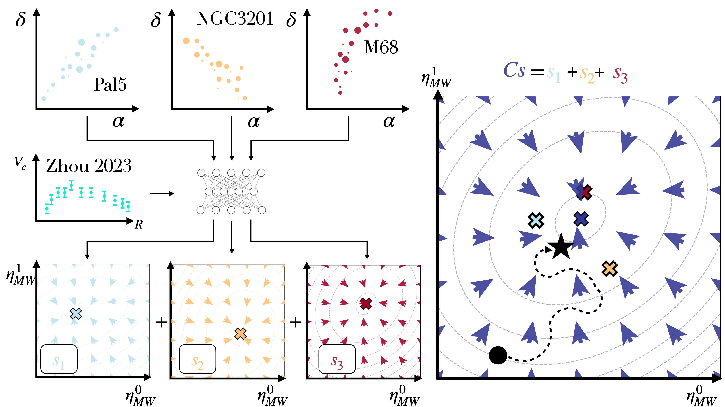
Compositional score modelling
COMBINED SCORE
OBSERVATIONS
Diffusion model
SCORES
https://arxiv.org/pdf/2607.20725

Slide 15
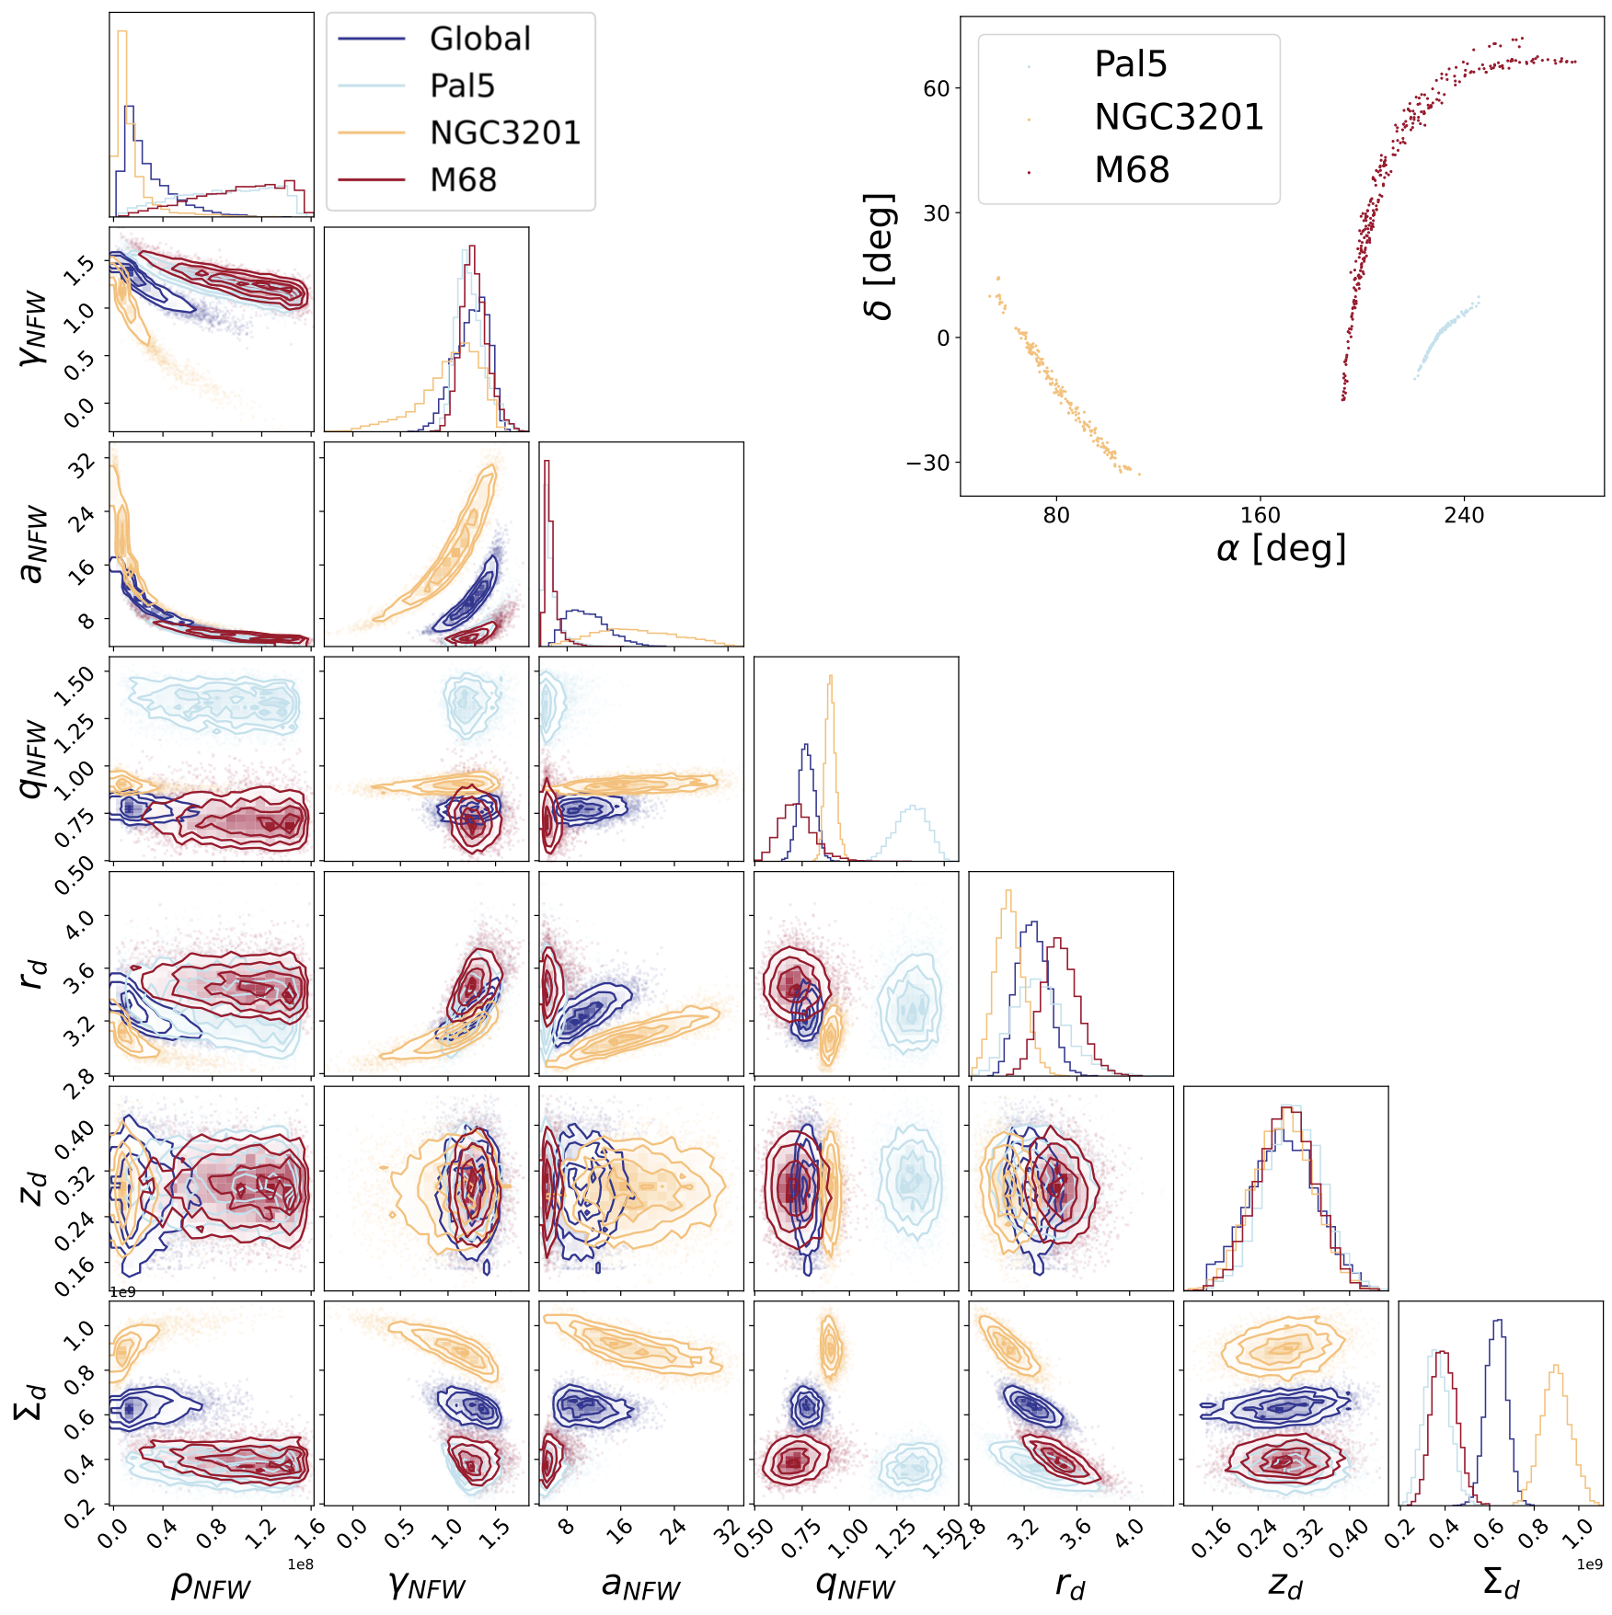
Compositional score modelling
https://arxiv.org/pdf/2607.20725

Slide 16

Compositional score modelling
https://arxiv.org/pdf/2607.20725

Slide 17
Thank you for listening, questions?

