Slide 1
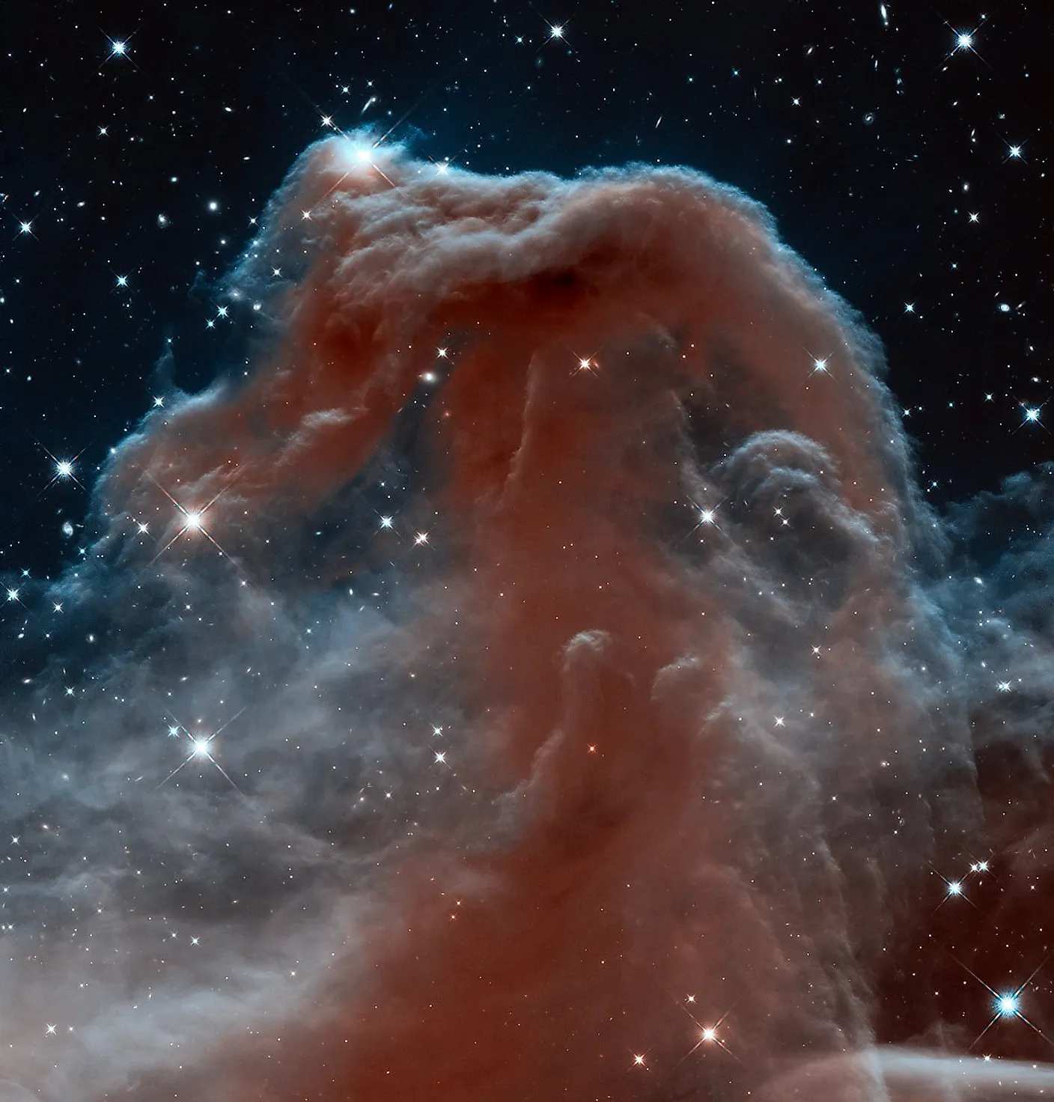



a data-driven approach
DIANE MALINDA SALIM
NASA FINESST & Quad Fellow at Rutgers University
: diane.salim@rutgers.edu
: linkedin.com/in/dmsalim/
for star formation parameterization
ML4Astro 3 Conference
3rd September 2026

Slide 2
WHAT DRIVES STAR FORMATION?
18
STARS FORM FROM
GAS
HOW?
logΣSFR [M☉pc⁻²Myr⁻¹]
KENNICUTT 1998
ΣSFR∝Σgas^{1.4}
logΣgas [M☉pc⁻²]
IMAGE: JWST COLLABORATION

Slide 3
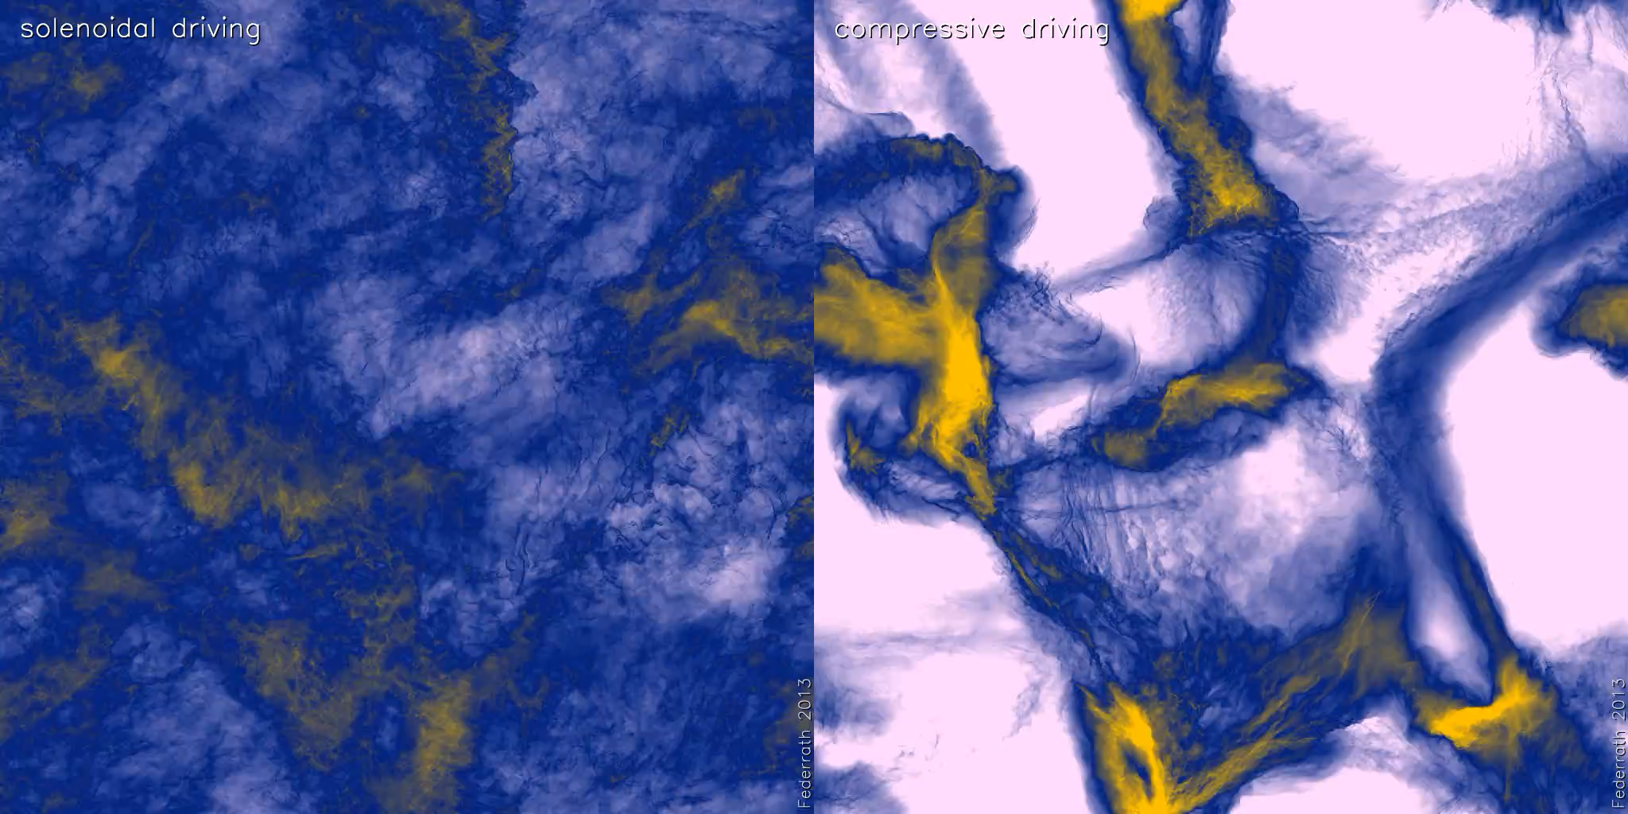
SOLENOIDAL DRIVING
COMPRESSIVE DRIVING
∇・v = 0
∇ ✕ v = 0
Star formation suppressor
Star formation enhancer

Slide 4
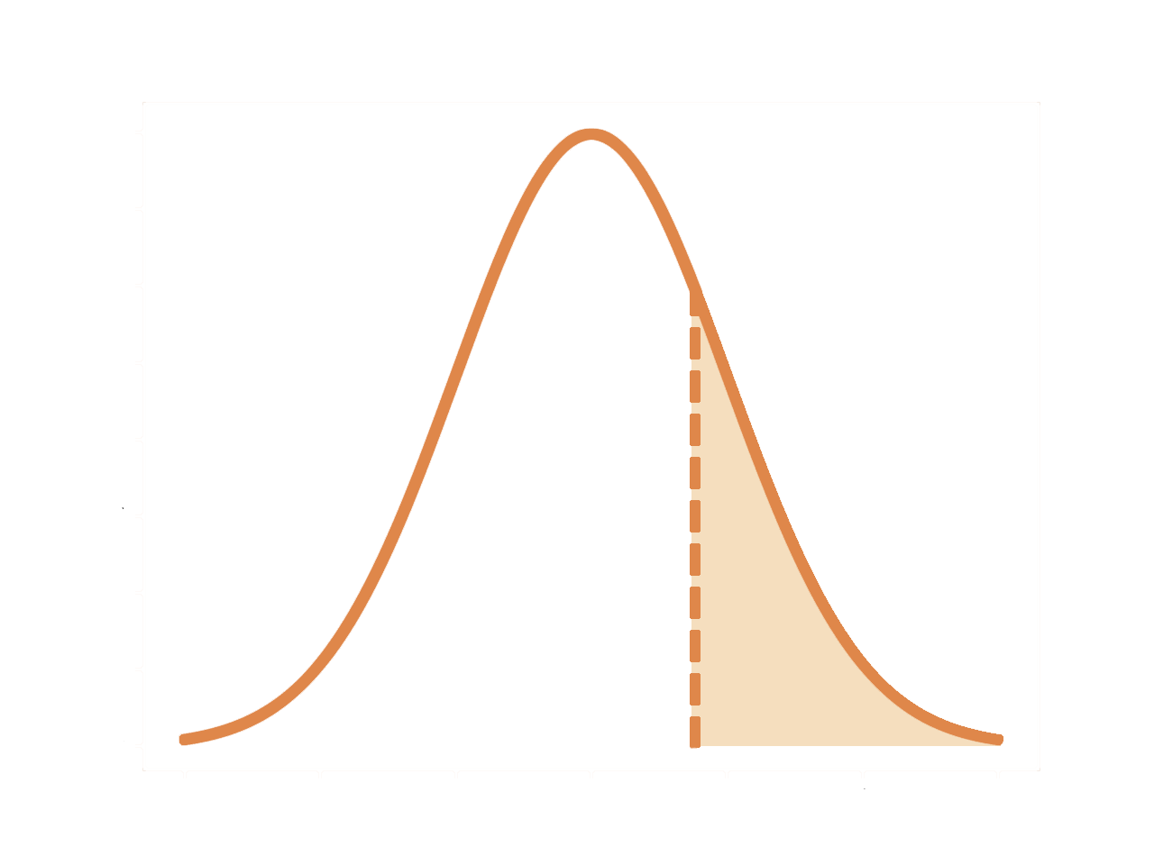
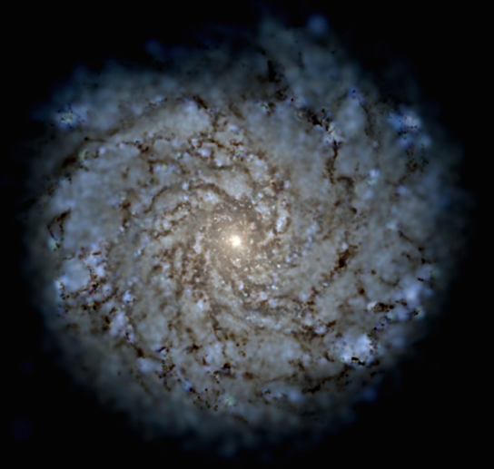
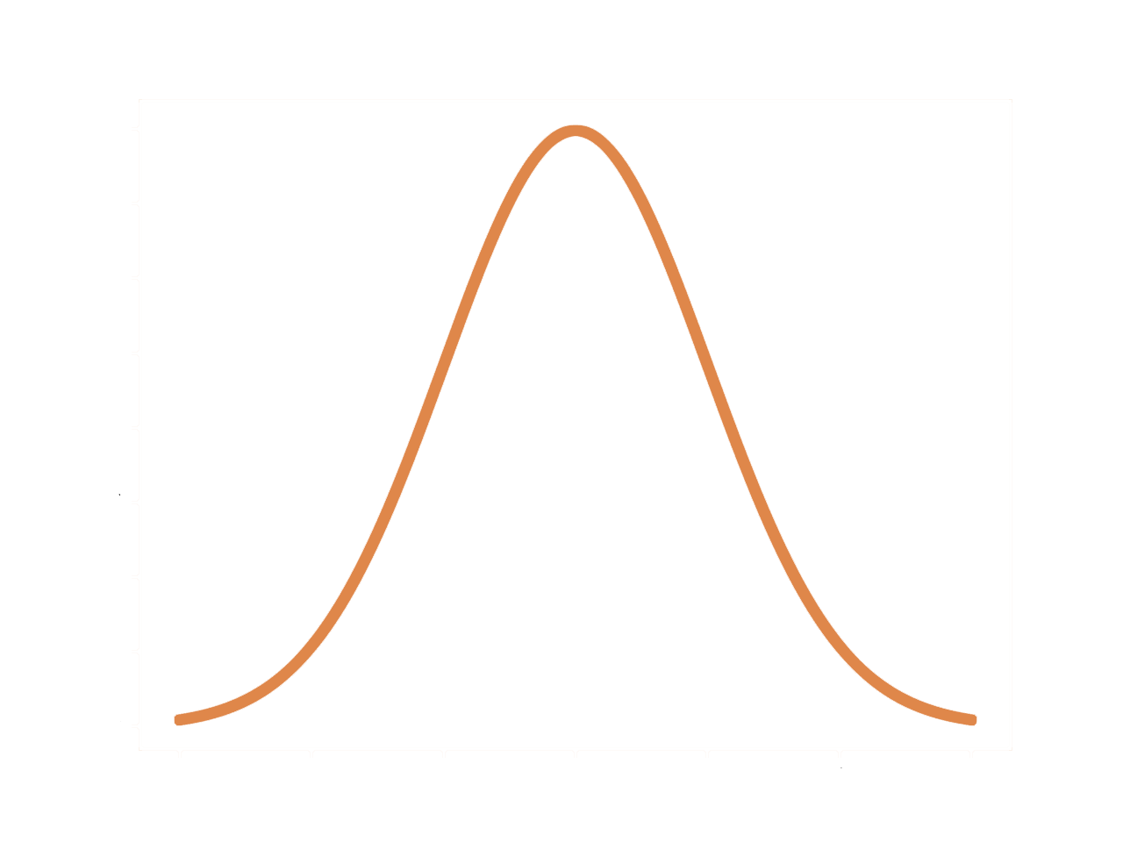
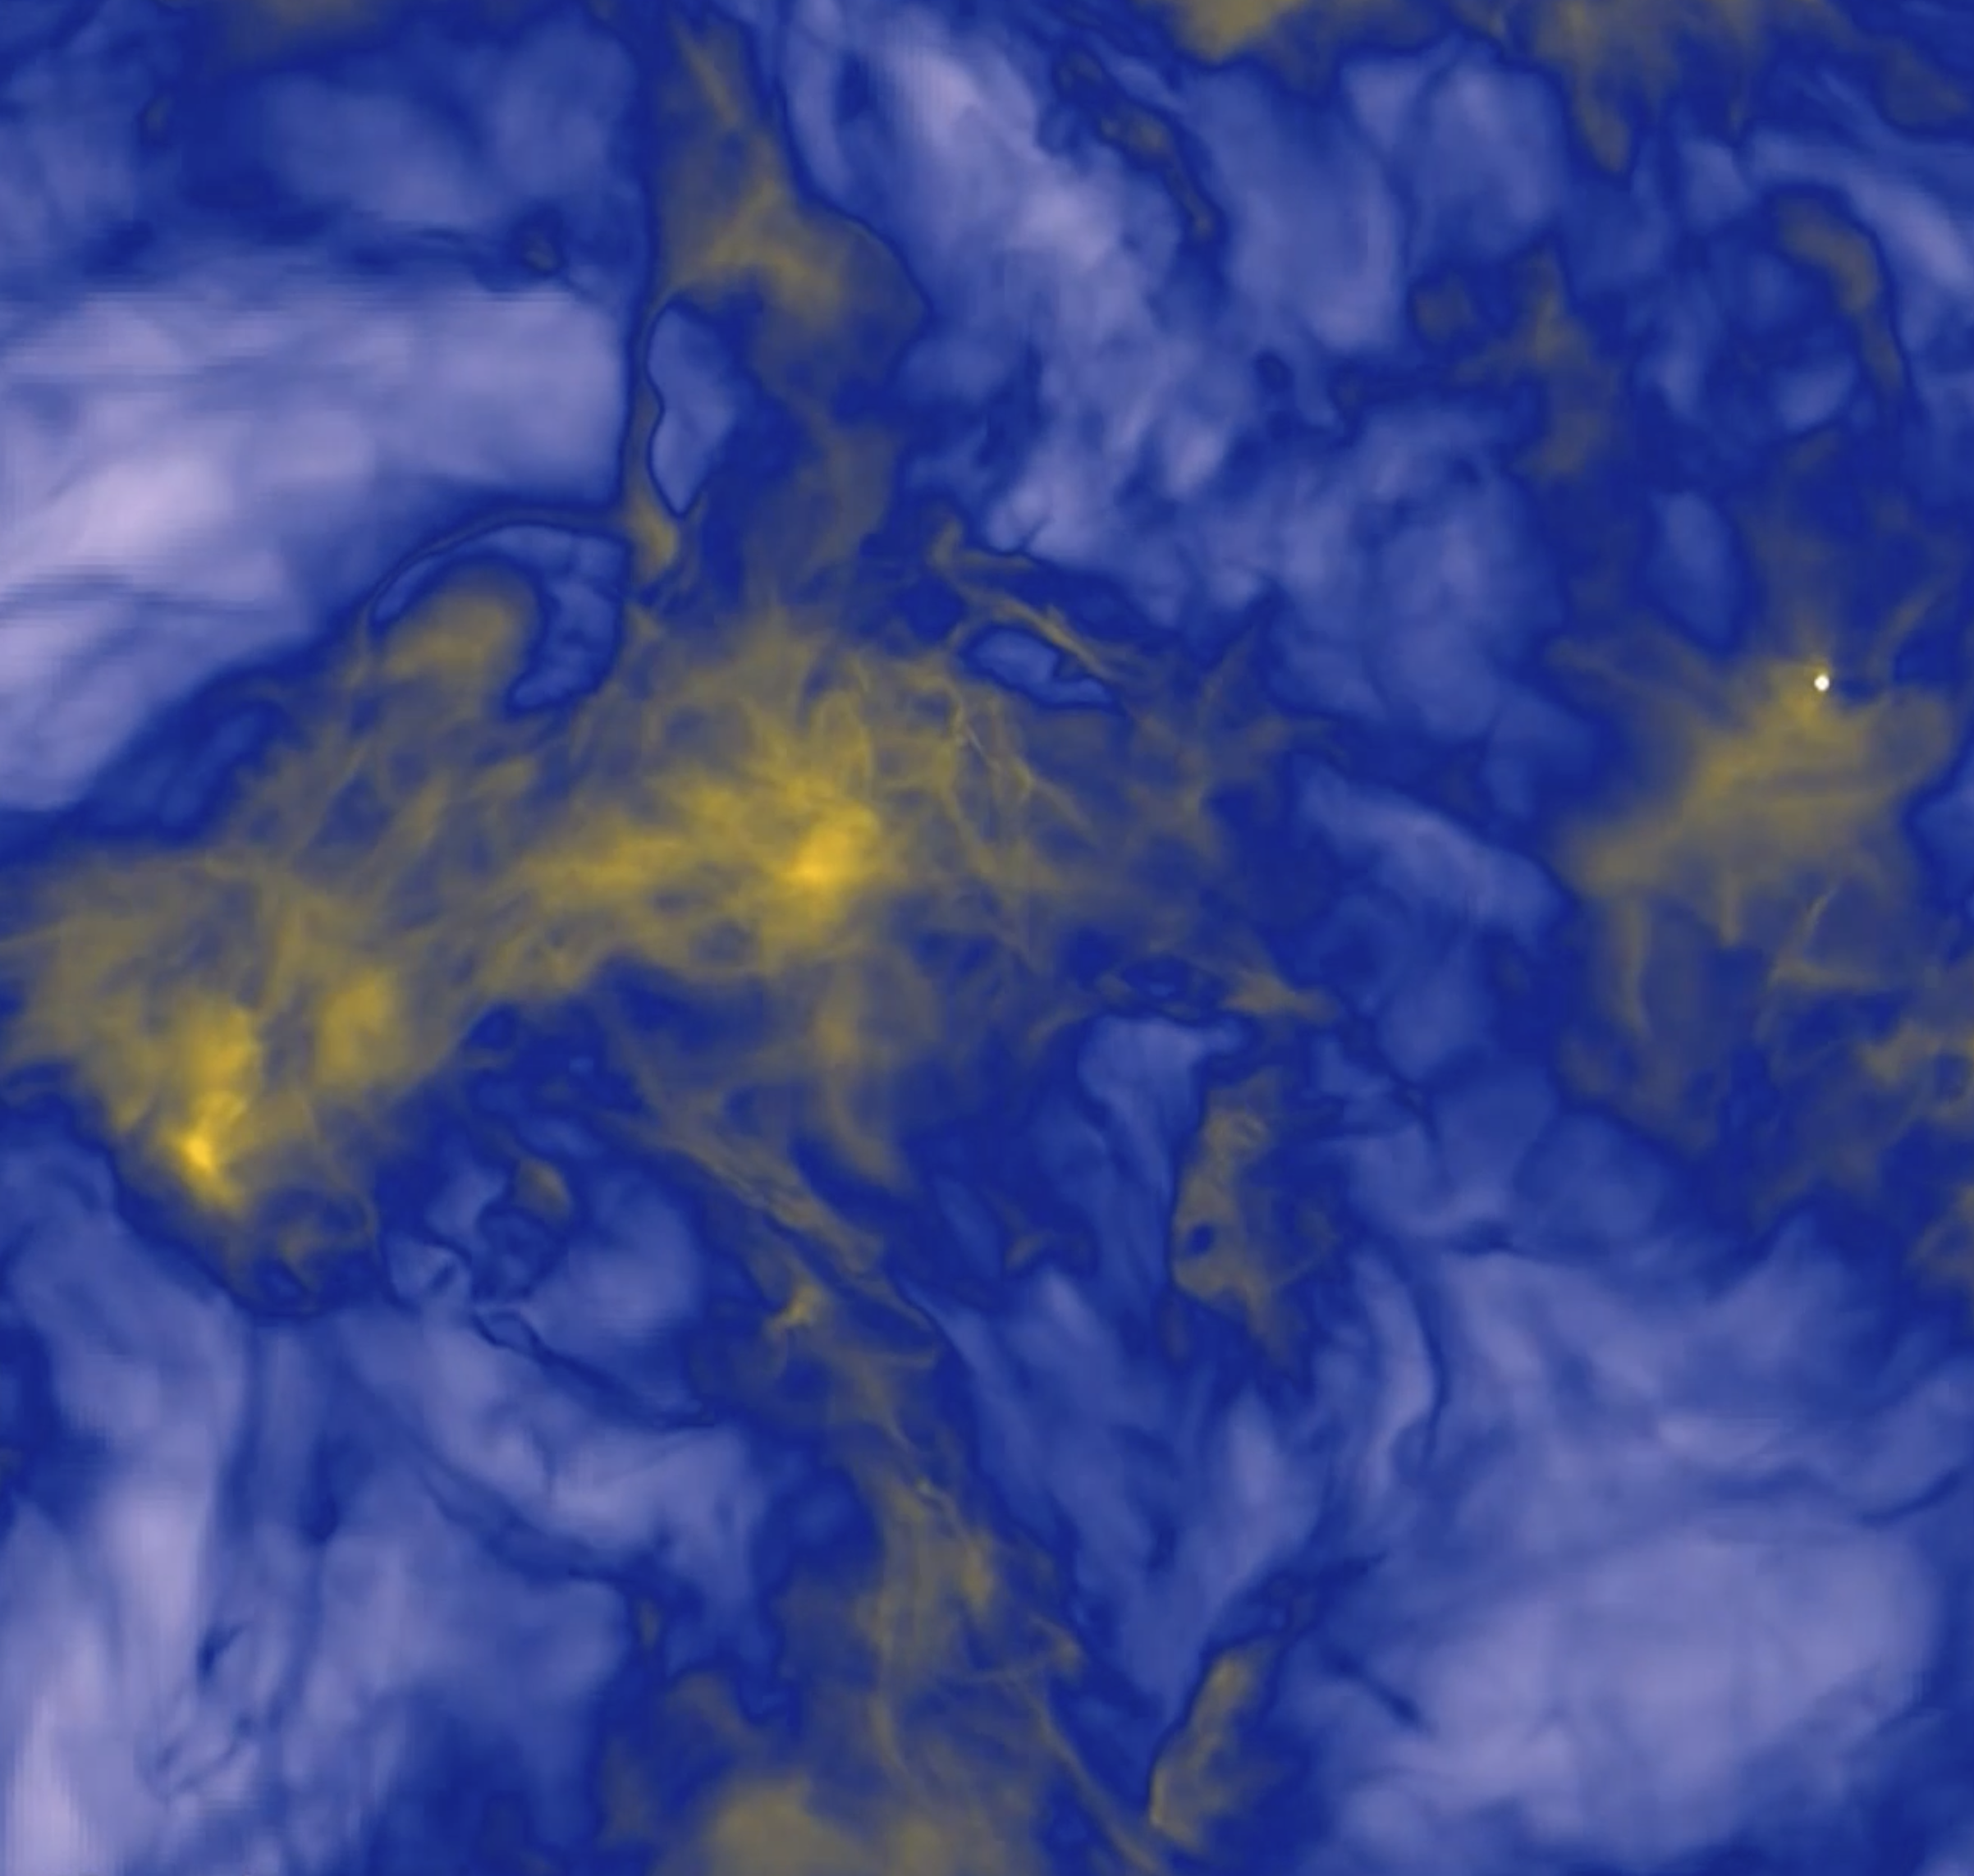



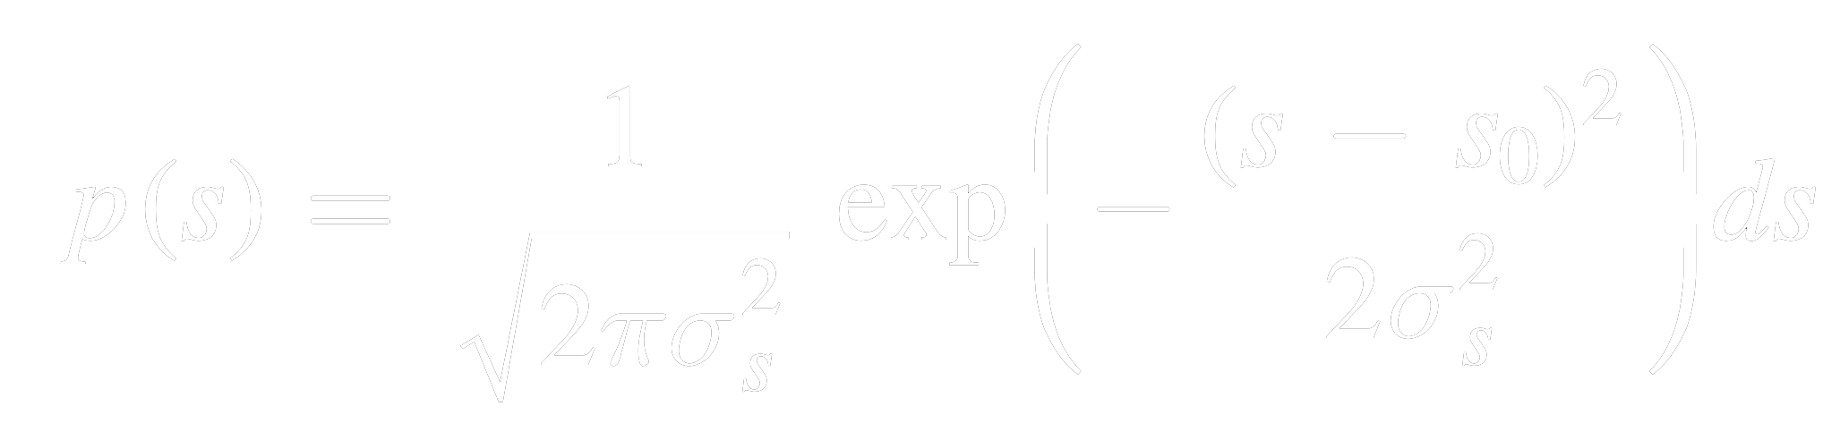
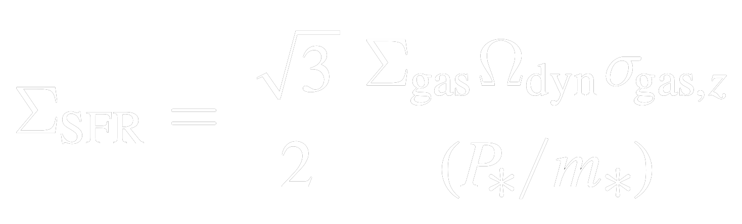
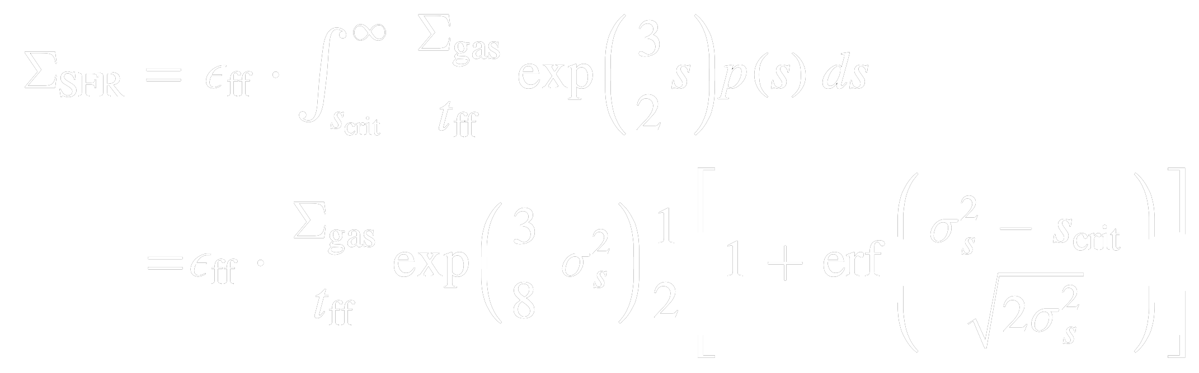
PREDICTIVE EQUATION FOR STAR FORMATION?
19
GALAXY-SCALE MODELS
CLOUD-SCALE MODELS
MODEL: FAUCHER-GIGUÈRE ET AL. 2013
MODEL: SALIM ET AL. 2020
scrit
  → gravity takes over
TURBULENCE
FEEDBACK
TURBULENCE MOMENTUM DECAY
FEEDBACK INJECTION RATE
WIDTH SET BY TURBULENCE
IMAGE: FIRE COLLABORATION
IMAGE: FEDERRATH 2015

Slide 5
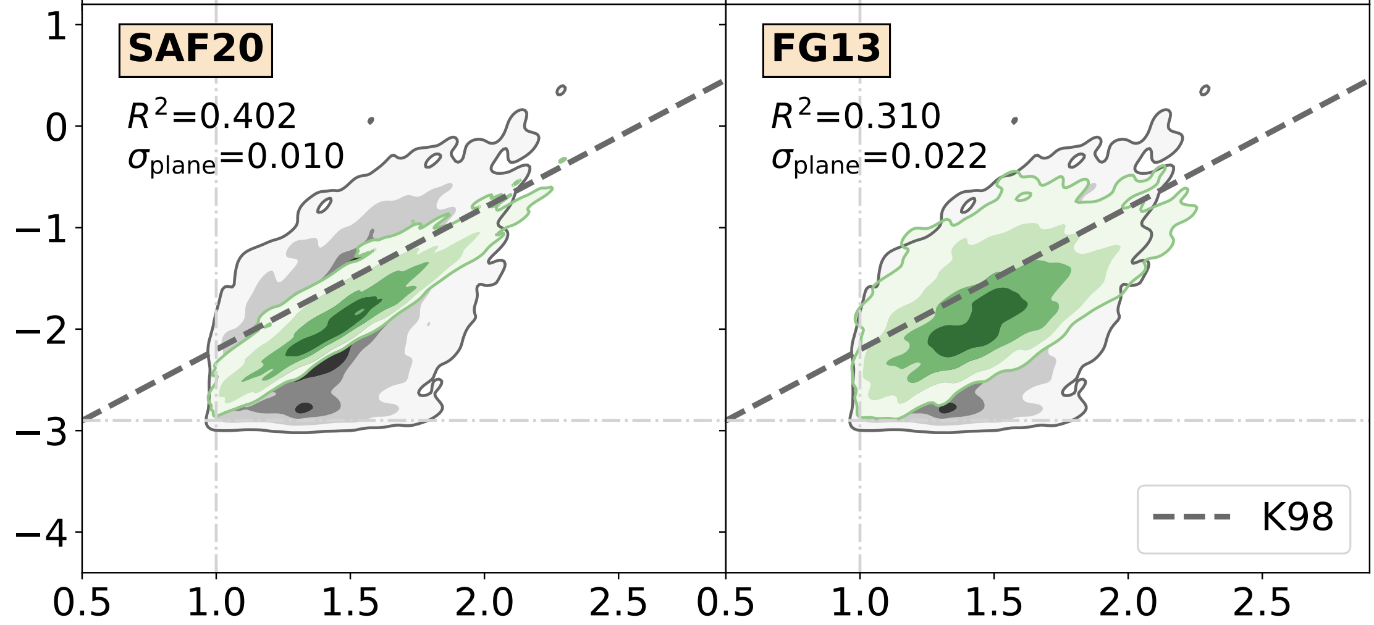
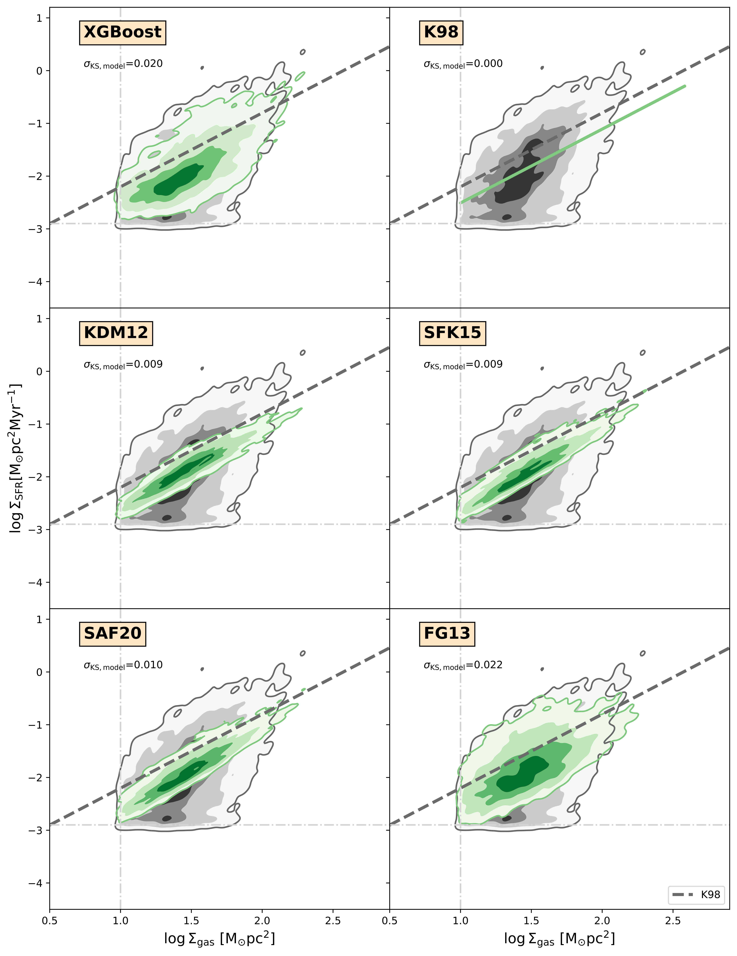
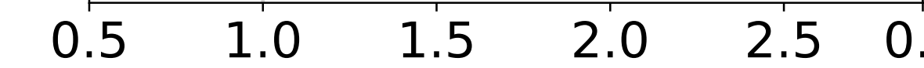
TESTING STAR FORMATION MODELS WITH FIRE-2
20
FIRE-2 LATTE (7 GALAXIES)
ALL SNAPSHOTS,
ALL PIXELS
MW mass galaxies (MHalo ≈ 10¹² M⊙)
z = 2—0
R² = 0.402
(SALIM ET AL. 2020)
CLOUD-SCALE MODEL
logΣSFR [M☉pc⁻²Myr⁻¹]
GREY: FIRE-2
GREEN: MODEL
Minimal free parameters set by hand in star formation (SF) prescription
  optimal for testing SF models on sub-kpc scale
logΣgas [M☉pc⁻²]
IMAGE: FIRE COLLABORATION

Slide 6
TESTING STAR FORMATION MODELS WITH FIRE-2
20
FIRE-2 LATTE (7 GALAXIES)
ALL SNAPSHOTS,
ALL PIXELS
MW mass galaxies (MHalo ≈ 10¹² M⊙)
z = 2—0
R² = 0.402
(SALIM ET AL. 2020)
CLOUD-SCALE MODEL
logΣSFR [M☉pc⁻²Myr⁻¹]
GREY: FIRE-2
GREEN: MODEL
Minimal free parameters set by hand in star formation (SF) prescription
  optimal for testing SF models on sub-kpc scale
R² = 0.310
(FAUCHER-GIGUÈRE
ET AL. 2013)
GALAXY-SCALE MODEL
logΣgas [M☉pc⁻²]
IMAGE: FIRE COLLABORATION

Slide 7
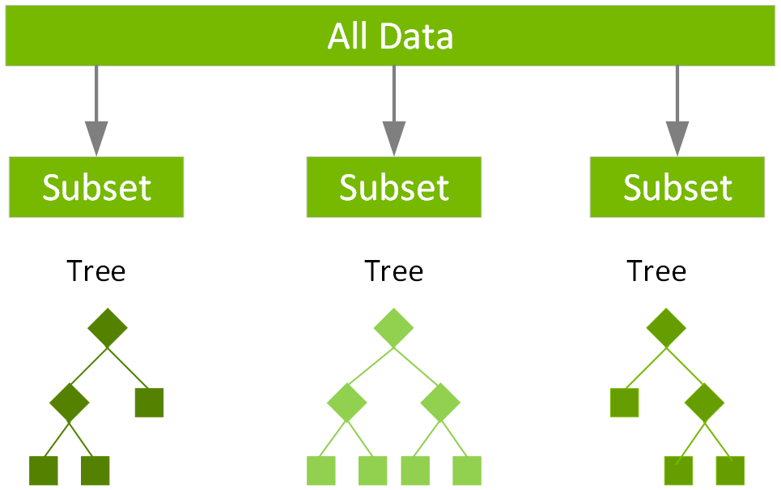
CAN MACHINE LEARNING HELP?
21
REGRESSION MODEL: XGBoost
XGBOOST
GREY: FIRE-2
GREEN: MODEL
INPUT :
pixel-scale
properties
eg. Σgas, σgas,
Ωdyn, Σ★
R² = 0.424
OUTPUT :
pixel-scale values for
ΣSFR
logΣSFR [M☉pc⁻²Myr⁻¹]
= 95%
= 80%
= 50%
= 20%
logΣgas [M☉pc⁻²]
IMAGE: NVIDIA
PROS
CONS
Highly optimised to be accurate on a point-by-point basis
Places limits on how good any equation-based model can be
Not easily interpretable
Not physically meaningful

Slide 8
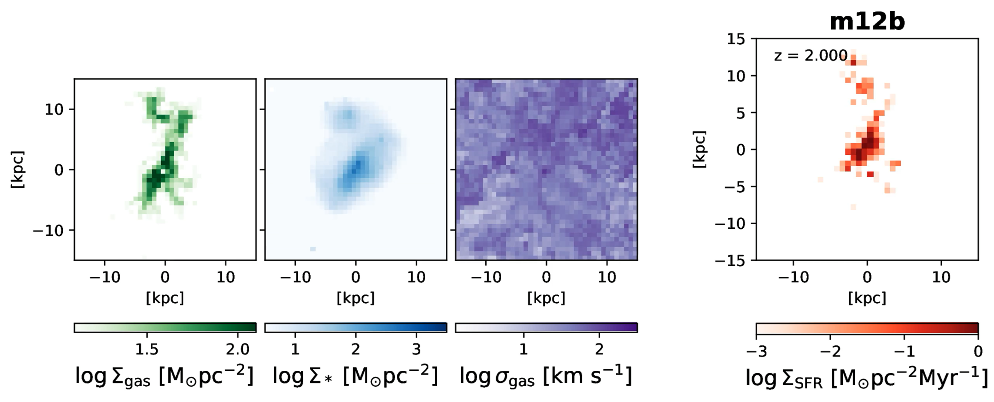
STUDY GOAL: INTERPRETABLE ML PIPELINE
22
8 INPUT VARIABLES
EQUATION FOR TARGET VARIABLE
(ORIGINALLY 76 POTENTIAL INPUT VARIABLES)

Slide 9
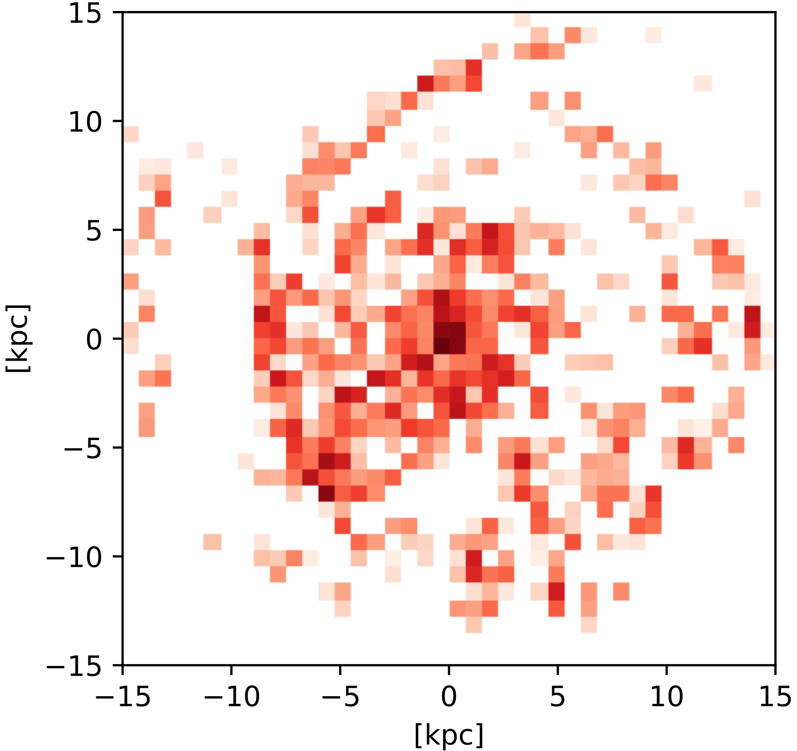
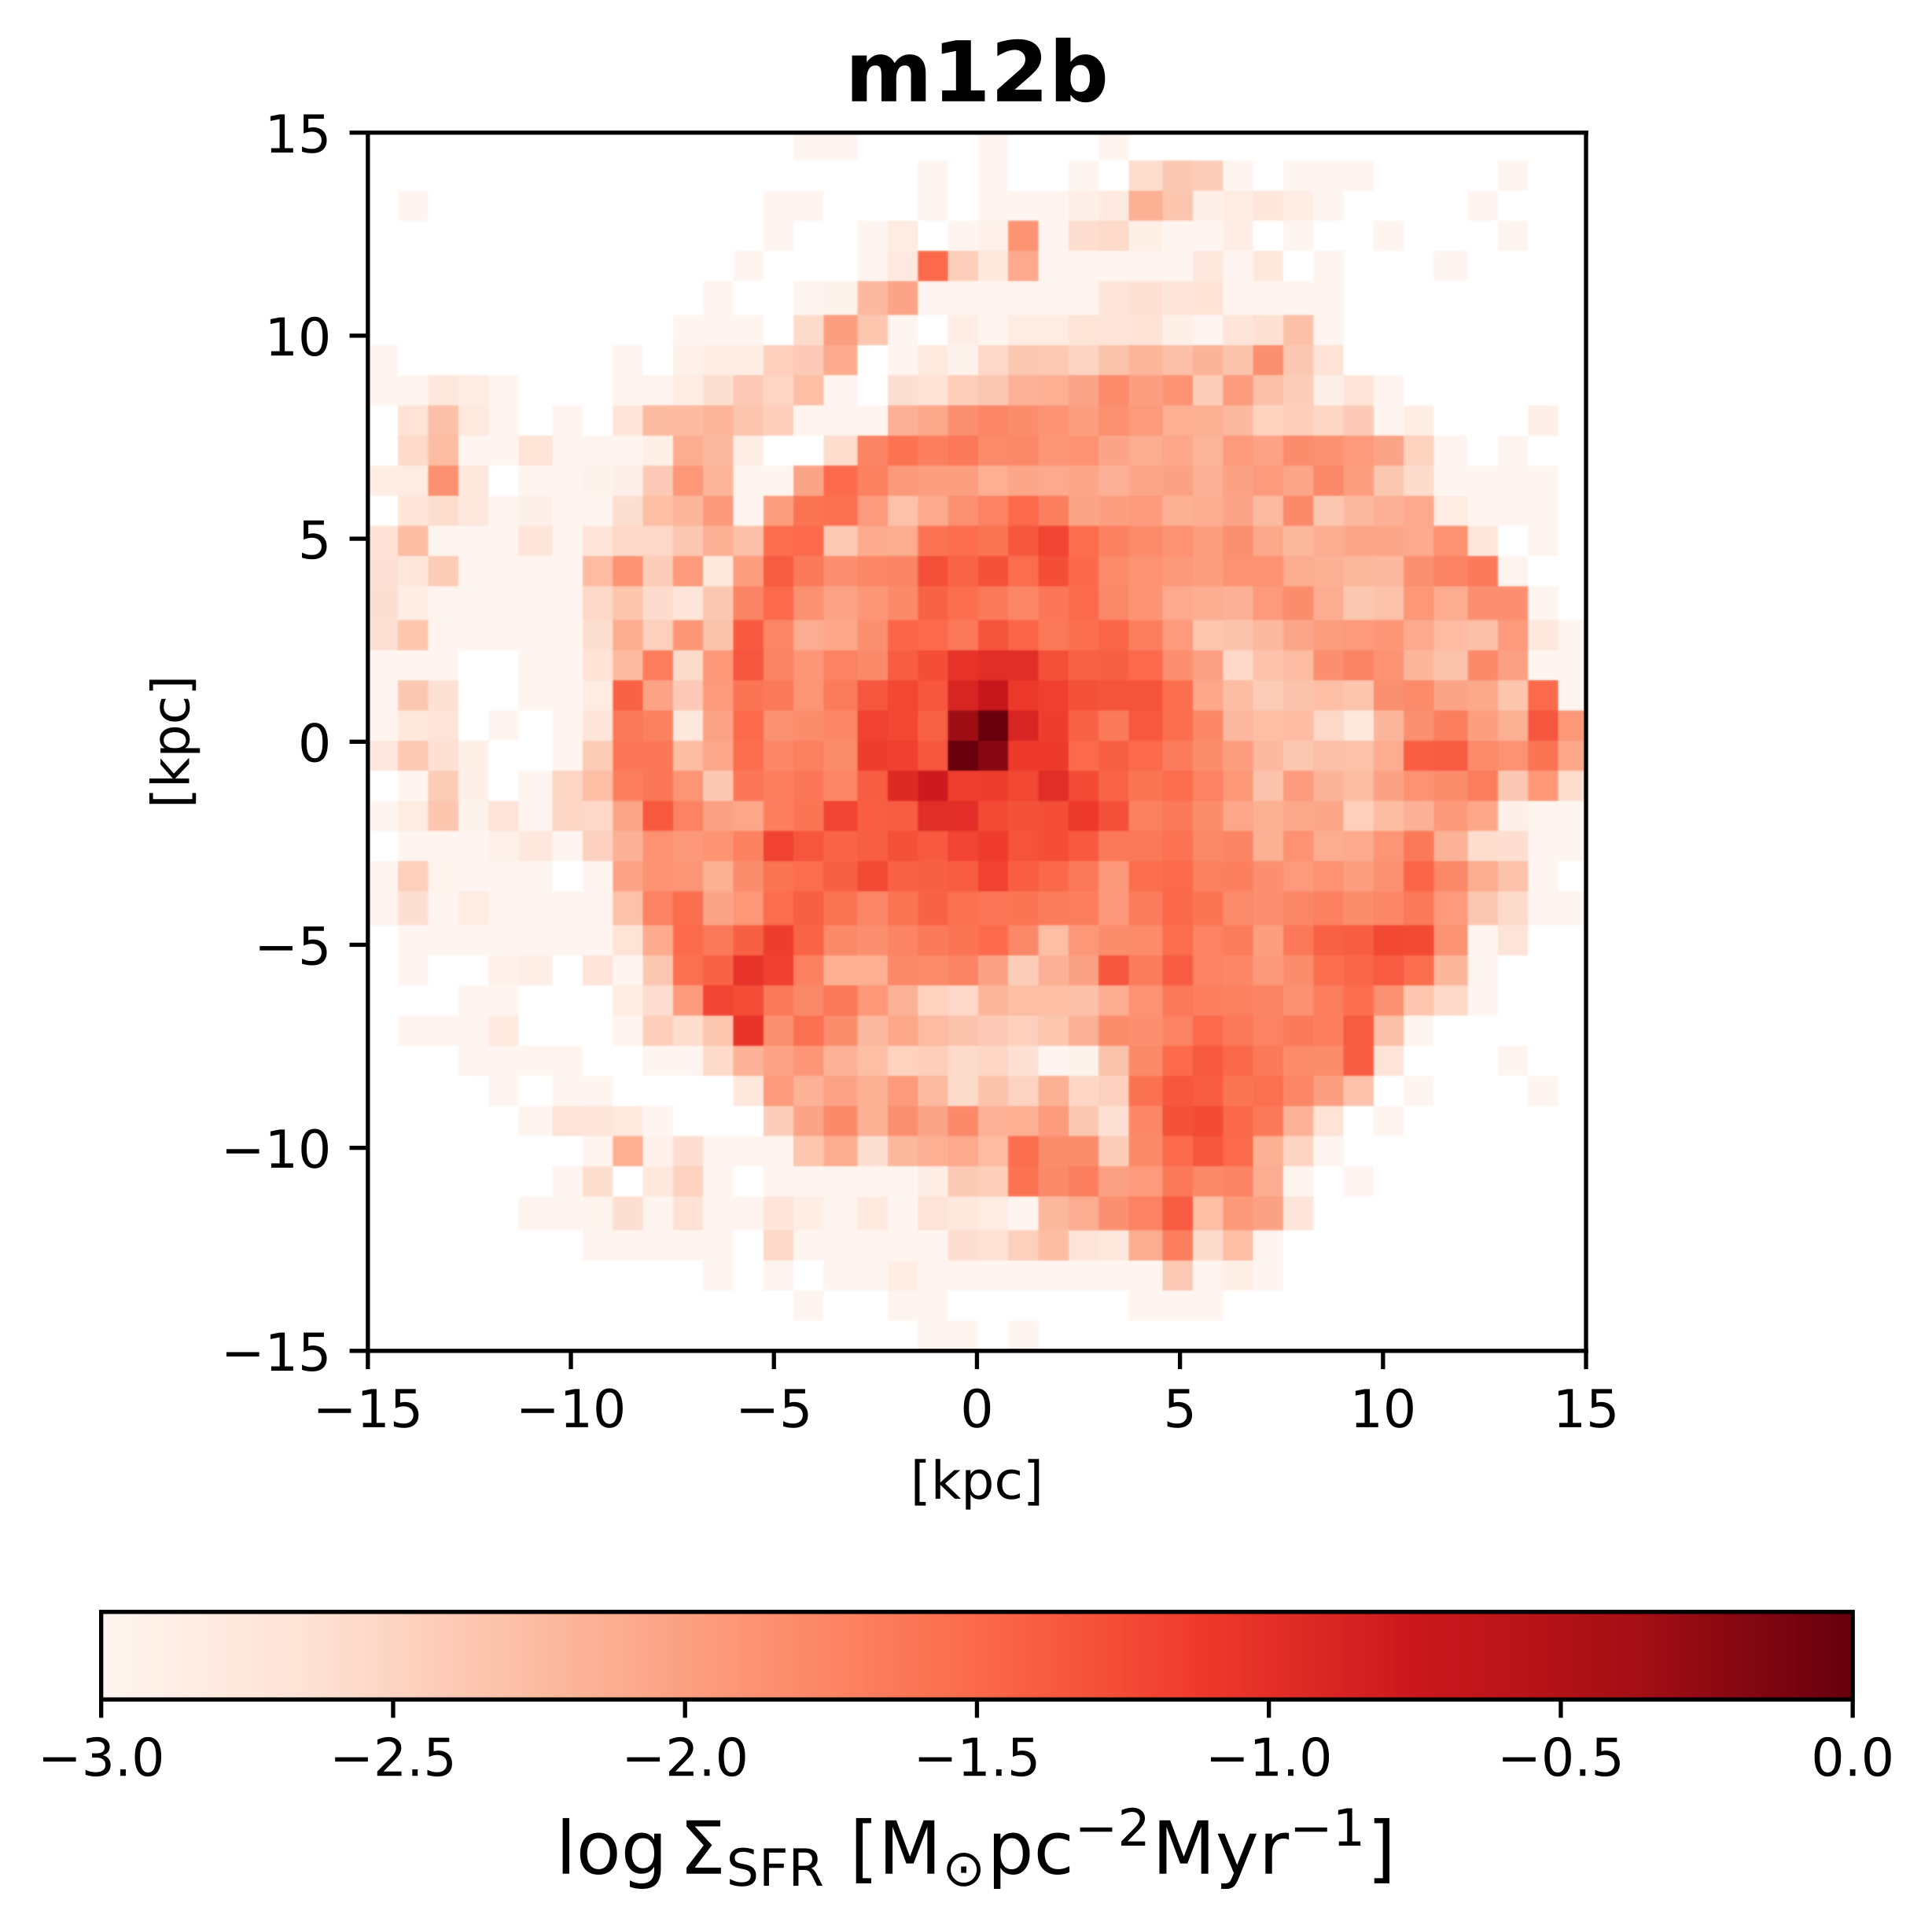
FIRE-2: TWO TIMESCALES, TWO EXPERIMENTS
23
〈tSFR〉= 10 MYR
〈tSFR〉= 100 MYR
←
UV, SED fitting
→
Hα

Slide 10

SYMBOLIC REGRESSION (PySR)
24
Equation complexity = Number of nodes
MOVIE & SOFTWARE: MILES CRANMER 2023

Slide 11
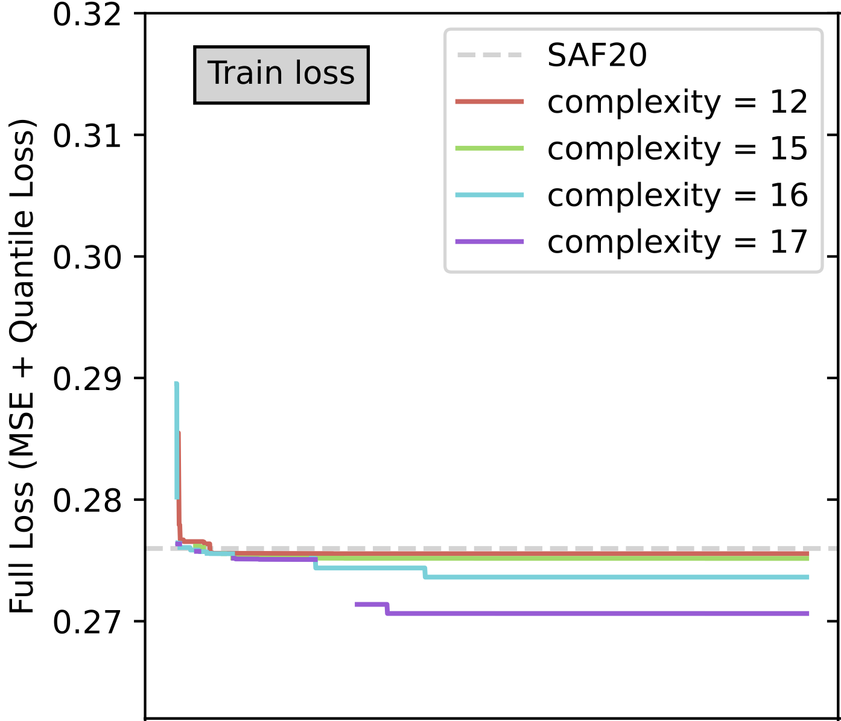
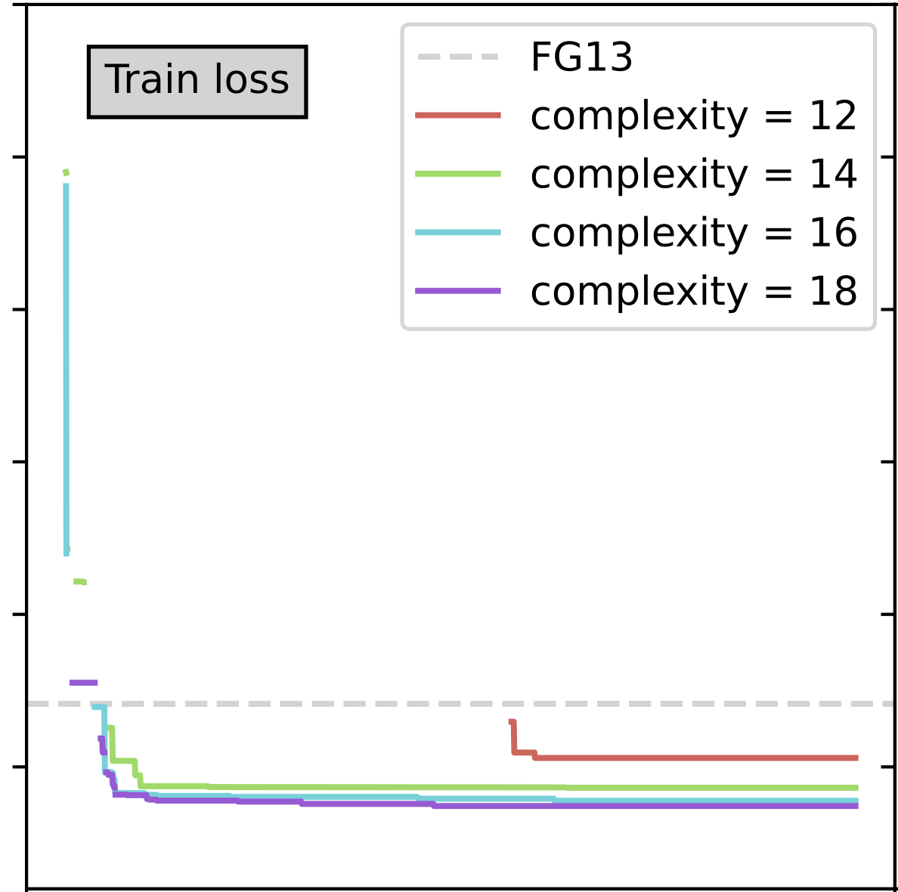
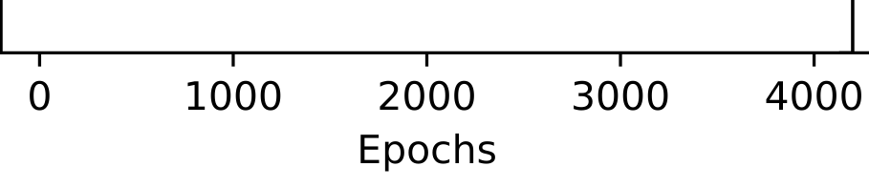
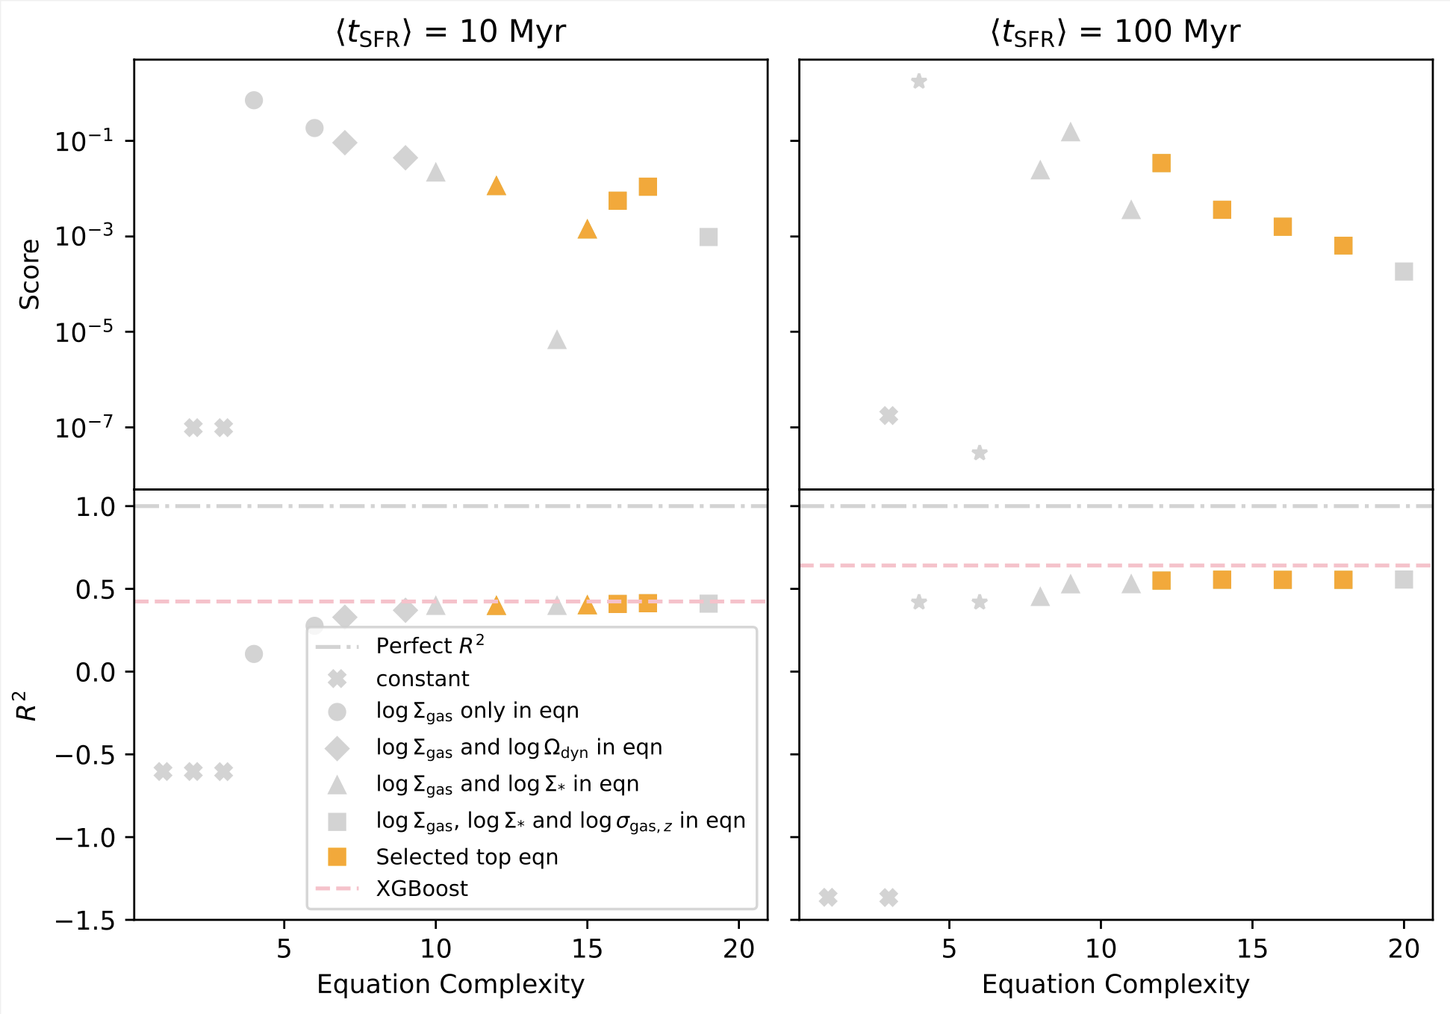

MACHINE LEARNING TRAINING
25
〈tSFR〉= 10 MYR
〈tSFR〉= 100 MYR
LOSS FUNCTION
LTOT = LMSE + LQ
LQ = Quantile Loss
Q = [0.1, 0.25, 0.5, 0.75, 0.9]
where:
Total Loss
Total Loss
CRITERIA FOR CHOSEN TOP EQ^{N}S
TRADITIONALLY: TOP SCORE
Epochs
Epochs
Score = ΔLoss
ΔComplexity
K98 RELATION RECOVERED
Score
Score
Equation Complexity
Equation Complexity

Slide 12
MACHINE LEARNING TRAINING
26
〈tSFR〉= 10 MYR
〈tSFR〉= 100 MYR
LOSS FUNCTION
LTOT = LMSE + LQ
LQ = Quantile Loss
Q = [0.1, 0.25, 0.5, 0.75, 0.9]
where:
Total Loss
Total Loss
CRITERIA FOR CHOSEN TOP EQ^{N}S
TRADITIONALLY: TOP SCORE
Epochs
Epochs
Score = ΔLoss
ΔComplexity
R²
R²
THIS WORK: PHYSICS-BASED
LPYSR < LBEST
MODEL ANALYTIC
MODEL
Equation Complexity
Equation Complexity

Slide 13
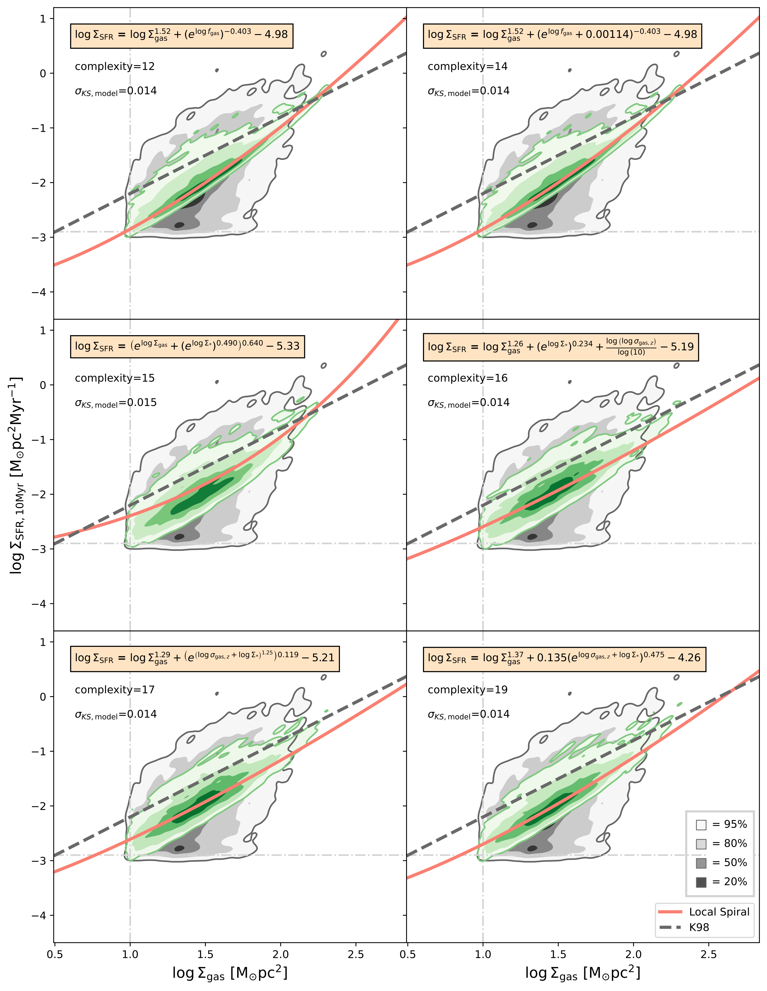
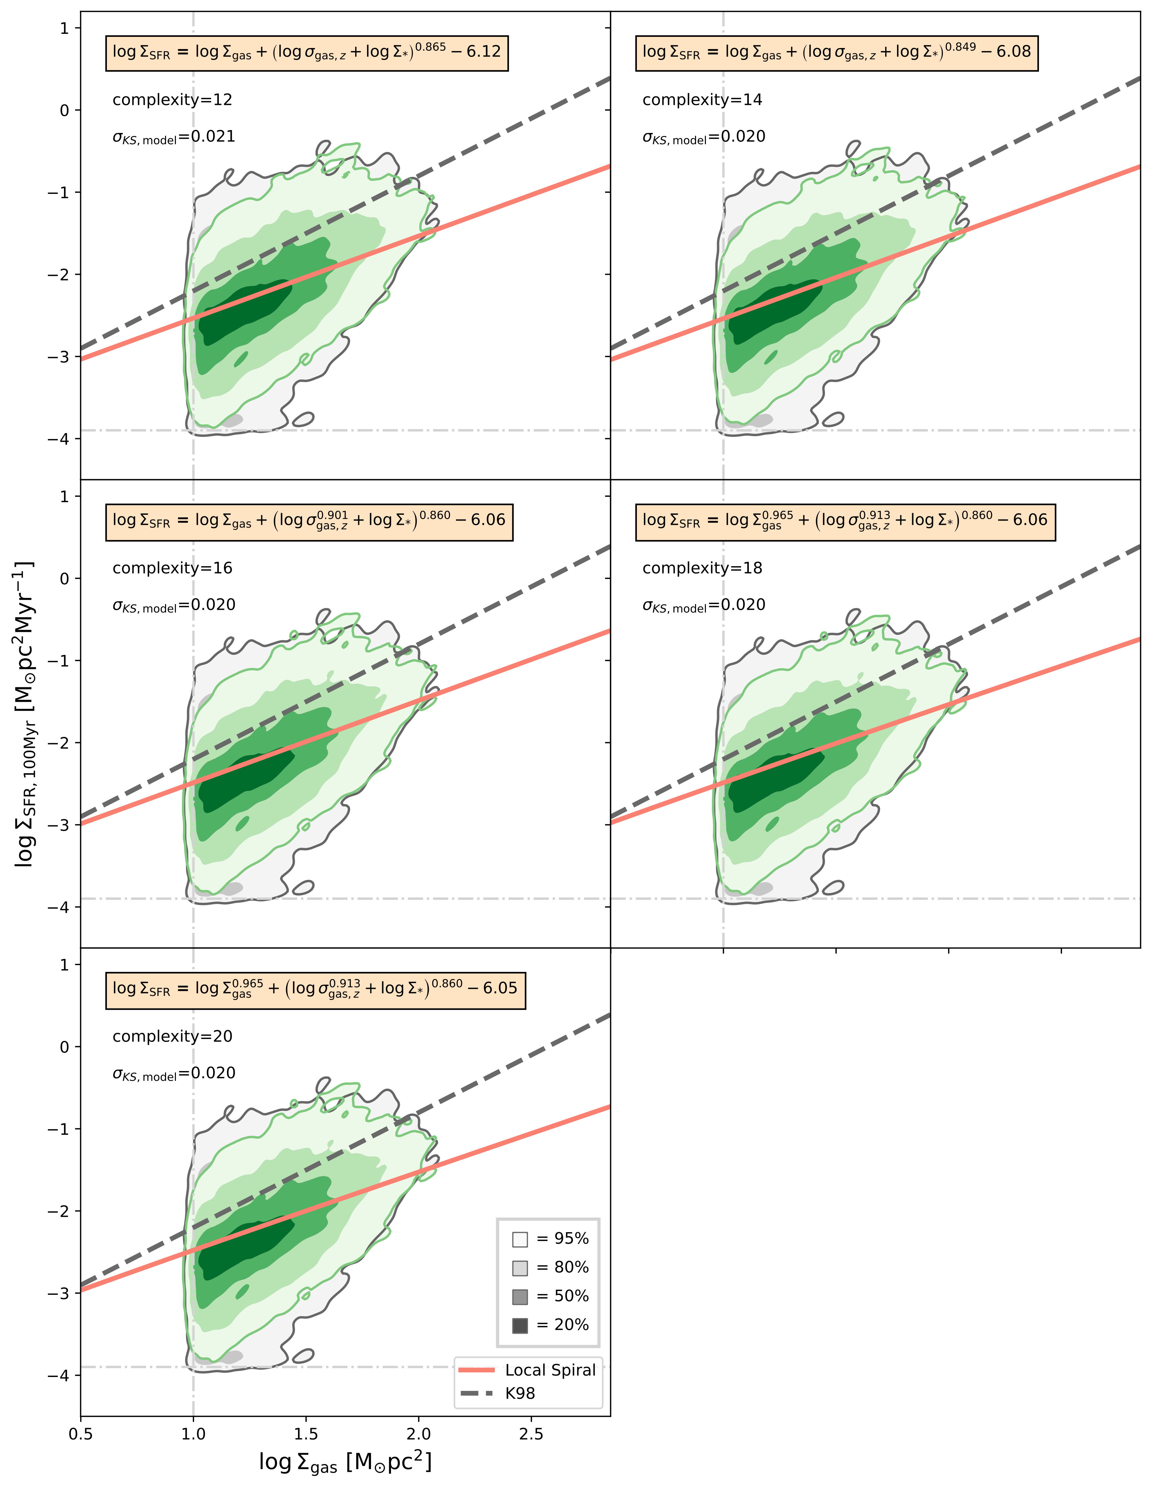
SYM-R FOUND EQUATION EXAMPLES IN FIRE-2
27
〈tSFR〉= 10 MYR
〈tSFR〉= 100 MYR
Complexity = 17
Model R² = 0.413
XGBoost R² = 0.424
Complexity=18
Model R² = 0.556
XGBoost R² = 0.641
logΣSFR [M☉pc⁻²Myr⁻¹]
logΣSFR [M☉pc⁻²Myr⁻¹]
= 95%
= 80%
= 50%
= 20%
GREY: FIRE-2
GREEN: MODEL
logΣgas [M☉pc⁻²]
→ FUNCTIONAL FORM SIMILAR TO GALAXY-SCALE SCALING RELATION
logΣgas [M☉pc⁻²]

Slide 14
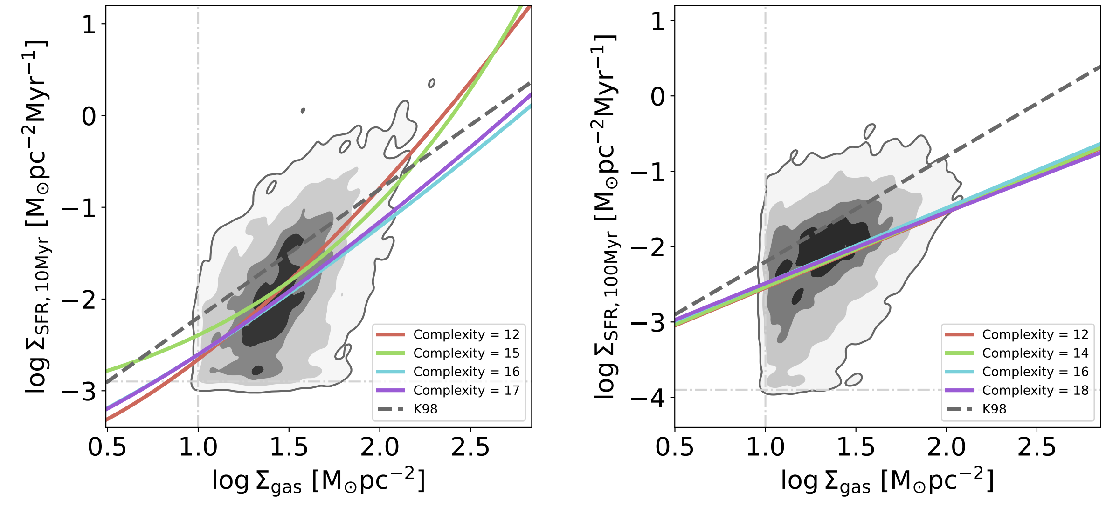
SYM-R FOUND EQUATION EXAMPLES IN FIRE-2
28
〈tSFR〉= 10 MYR
〈tSFR〉= 100 MYR
logΣSFR [M☉pc⁻²Myr⁻¹]
logΣSFR [M☉pc⁻²Myr⁻¹]
logΣgas [M☉pc⁻²]
→ ALL EQUATIONS CONVERGE TO THE SAME LINE
logΣgas [M☉pc⁻²]

Slide 15

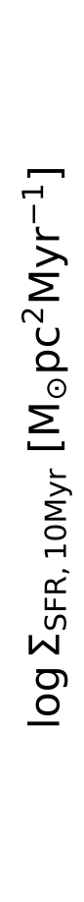
SUMMARY
STUDY ACHIEVEMENTS
CHECK OUT OUR PAPER!
Physics-based SR to understand SF scaling relations
Applied to cosmological zoom-in simulations (FIRE-2)
Found eq^{n}s → Σgas, Σ★ and σgas critical for ΣSFR
→ FIRE-2 SFR best described by galaxy-scale model
〈tSFR〉= 10 MYR
〈tSFR〉= 100 MYR
“A data-driven approach for star formation parameterization using symbolic regression”
DOI: 10.3847/1538-4357/ae13ac
: diane.salim@rutgers.edu
: linkedin.com/in/dmsalim/

