Slide 1
Physics-informed reconstruction using synthetic observations from cosmological simulations
General Assembly
Pablo Martín, Marta Barroso (BSC)

Slide 2
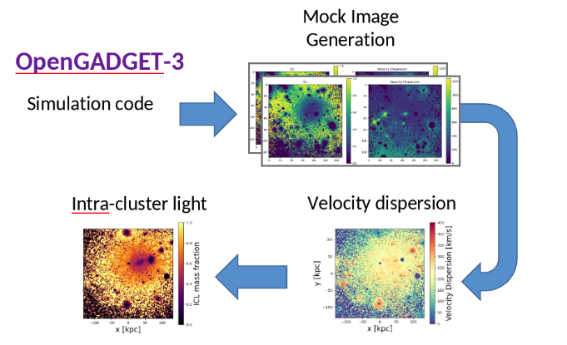
Introduction
Challenge: infer key physical properties of cosmological structures directly from observations.
Solution: use Deep Learning models to predict 2D maps from images by training on cosmological simulations
Recovering intrinsic physical properties of galaxies and clusters to understand how they formed and evolved.
OpenGadget3
Based on the work from I. Marini,A. Saro, S. Borgani and M. Boi2 Intracluster Light: using Deep Learning for Astronomical Analysis

Slide 3
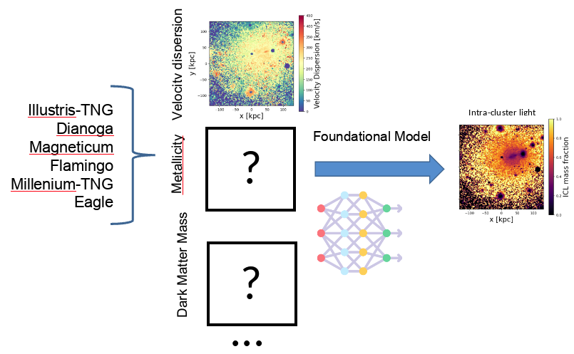

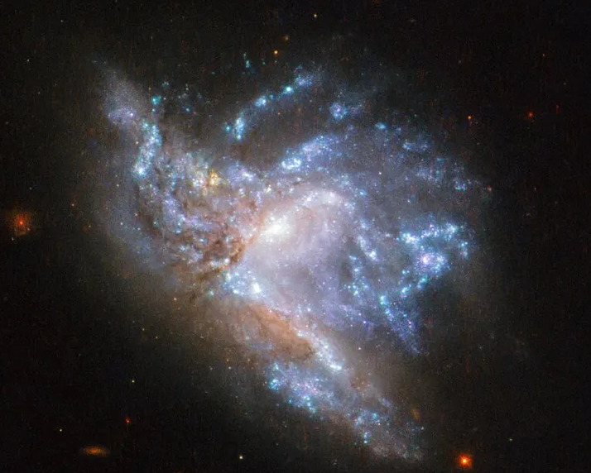
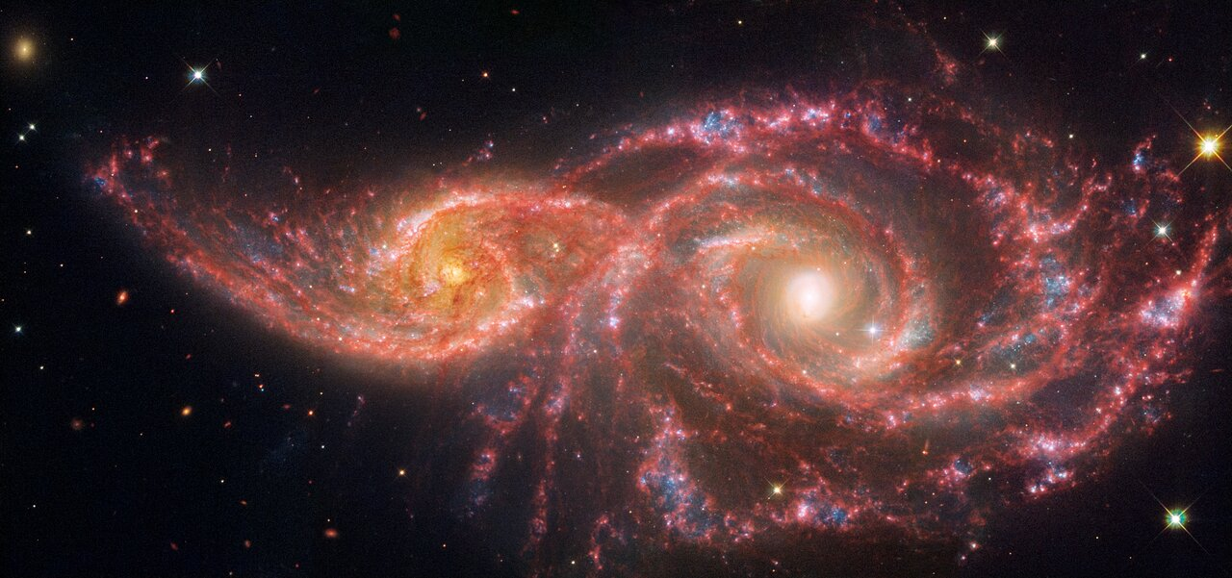
Status - Tool
Key to understanding the history of galaxy interactions and merges in a cluster
Velocity dispersion
Intracluster Light
Illustris-TNG
Dianoga
Eagle
Magneticum
Flamingo
Millenium
Dark Matter Mass
Metallicity
Stellar Mass Density
Foundational model
Galaxies IC 2163 and NGC 2207 Credit: NASA, ESA, CSA, STScI
NGC 6052 is a pair of colliding galaxies in the constellation of Hercules about 230 million light-years away. Credit: ESA/Hubble & NASA, A. Adamo et al.
Notes:
Currently we 're working with the velocity dispersion of the particles and the icl.
The velocity dispersion is a measure that indicates how spread out the speeds of stars/galaxies are in a group, meaning (how different their velocities are).
And the Intracluster Light (ICL) is the diffuse light coming from stars that dont belong to any galaxy.
Although the relationship between these features is complex, it's true that higher velocity dispersion in a galaxy cluster generally means more galaxy collisions and stripping of stars, leading to more ICL.

Slide 4
Status - Tool
Key to understanding the history of galaxy interactions and merges in a cluster
Velocity dispersion
Intracluster Light
Illustris-TNG
Dianoga
Eagle
Magneticum
Flamingo
Millenium
Dark Matter Mass
Metallicity
Stellar Mass Density
Foundational model
Notes:
Currently we 're working with the velocity dispersion of the particles and the icl.
The velocity dispersion is a measure that indicates how spread out the speeds of stars/galaxies are in a group, meaning (how different their velocities are).
And the Intracluster Light (ICL) is the diffuse light coming from stars that dont belong to any galaxy.
Although the relationship between these features is complex, it's true that higher velocity dispersion in a galaxy cluster generally means more galaxy collisions and stripping of stars, leading to more ICL.

Slide 5
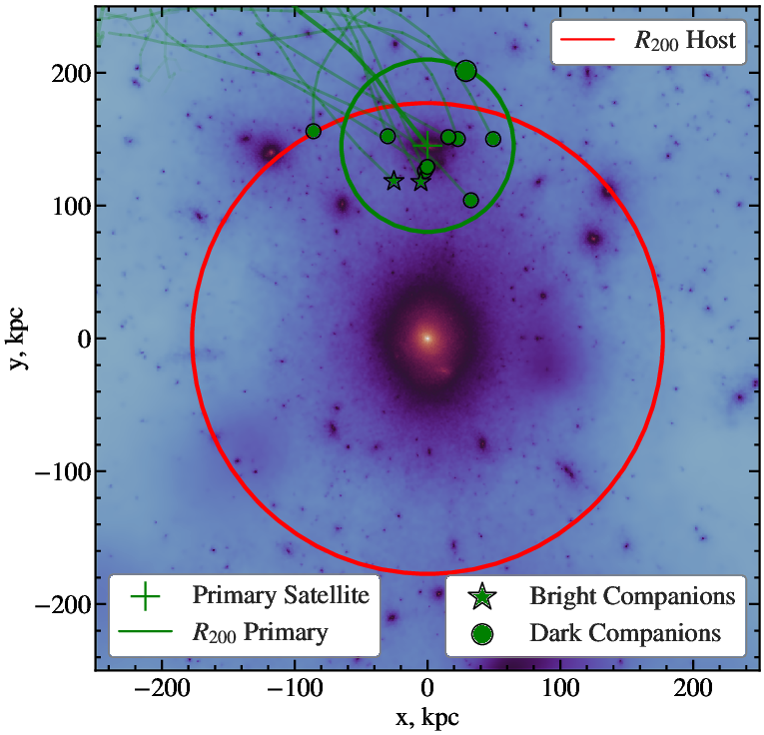
Input features
Halo
Coordinates
M200
R200
Id primary subhalo
Subhalo stellar particles
Mass
Velocity
Coordinates
Subhalo
Halo ID
Stellar mass
Coordinates (center of potential)
Stellar half-mass radius

Slide 6
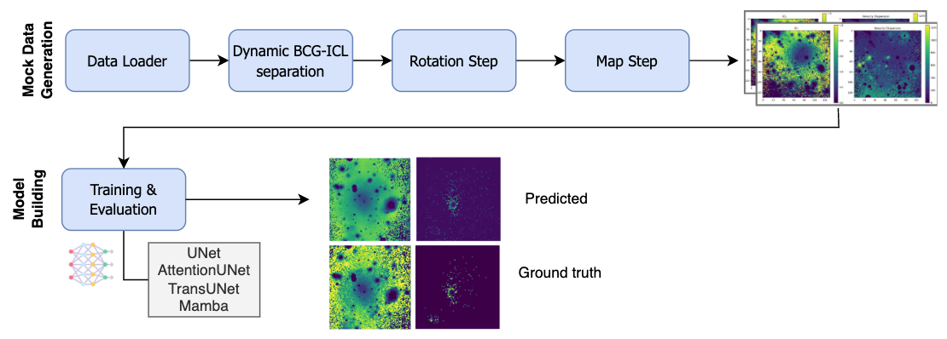
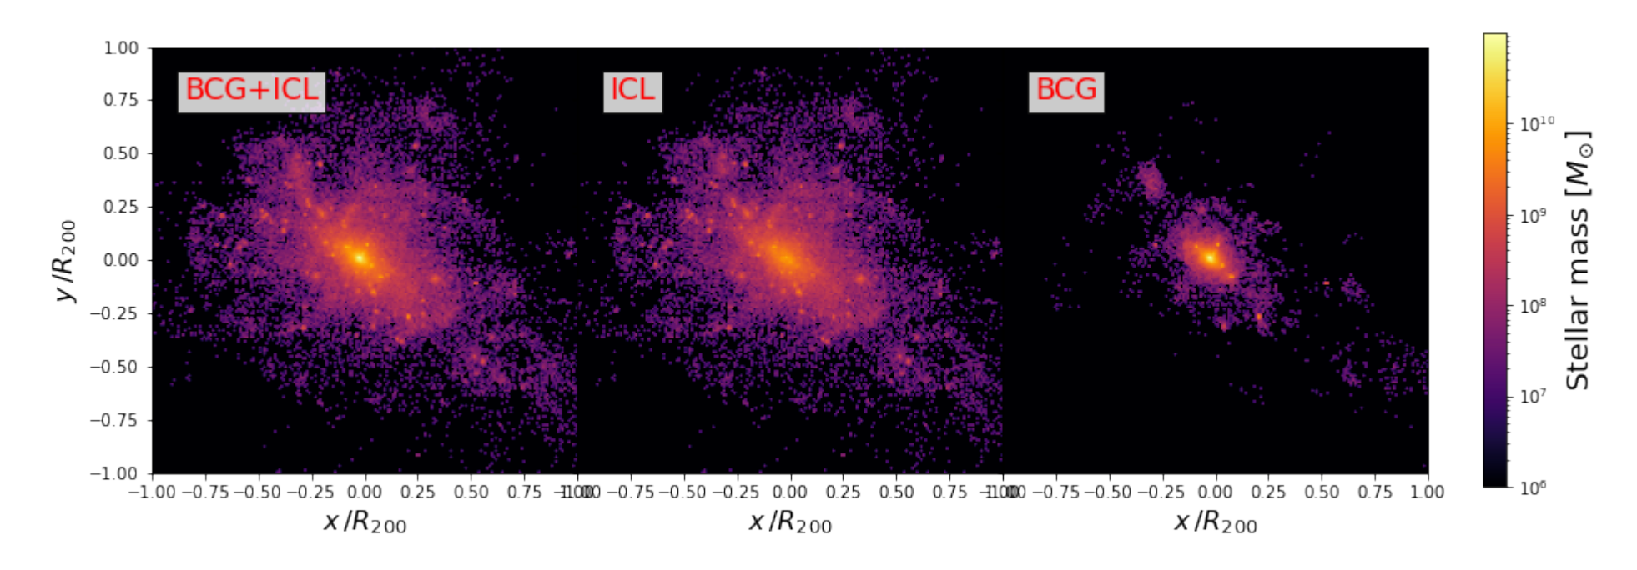
Status - Development
Cross-Simulation Data Generation pipeline
Training/ Evaluation of DL models to predict Feature2 based on Feature1

Slide 7
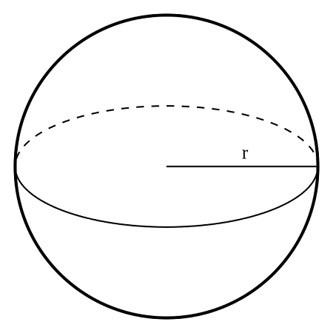
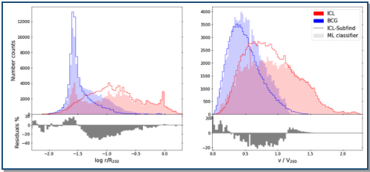
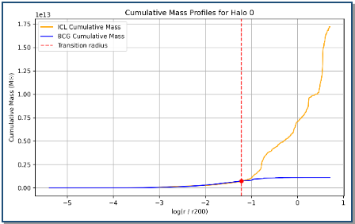
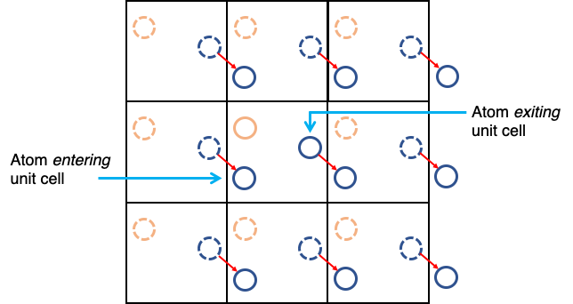
Data Generation
Configuration
Load simulation data
Filter halos and subhalos by mass
Identify overlapping subhalos
For each Halo
Get particle data
Apply periodic boundary conditions
Compute velocity dispersion and BCG-ICL classification using a RF
Estimate transition radius
Merge particle data
BCG-ICL classification Dianoga D2
Transition Radius r/R200 Halo 0, Illustris
Periodic boundary conditions
Notes:
To review

Slide 8
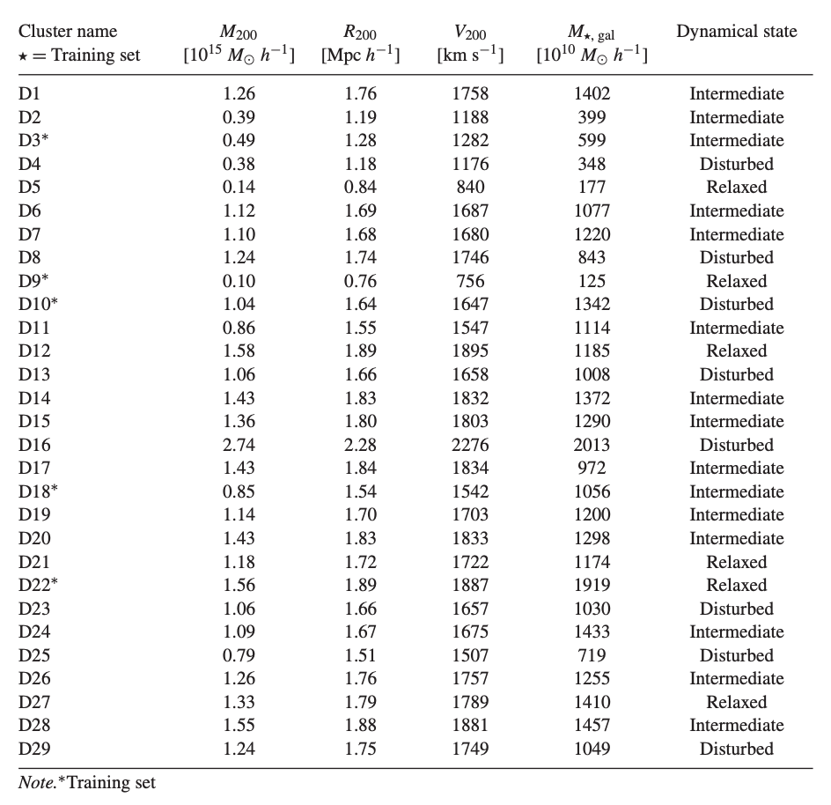
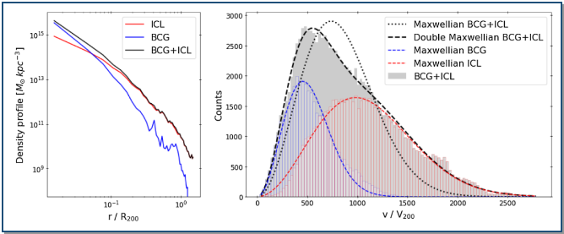
ICL-BCG classification
Generate ground truth using ICL-Subfind
Select clusters and prepare the dataset
Choose and normalize input features
Random Forest training
Marini, S Borgani, A Saro, G Murante, G L Granato, C Ragone-Figueroa, G Taffoni, Machine learning to identify ICL and BCG in simulated galaxy clusters, Monthly Notices of the Royal Astronomical Society, Volume 514, Issue 2, August 2022, Pages 3082–3096,
Notes:
To review

Slide 9
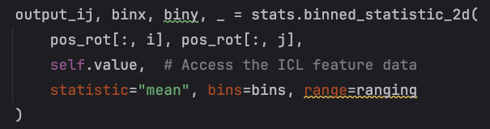
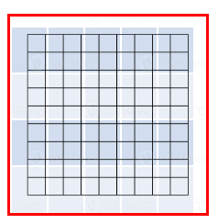
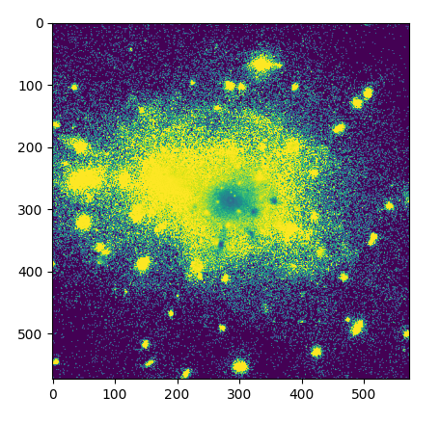
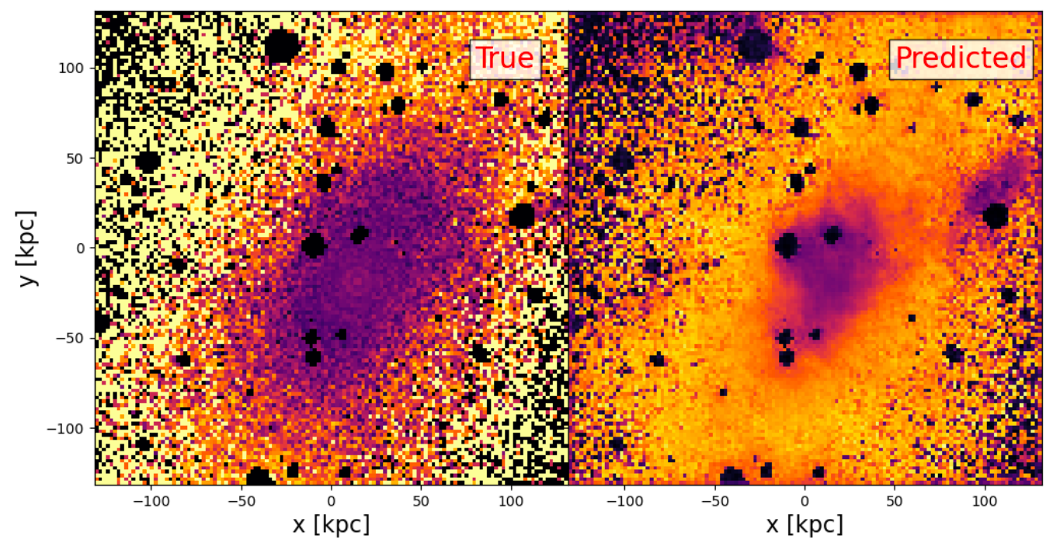
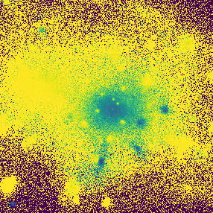

Data Generation
For each Halo
Compute num. bins
Identify interlopers
Generate feature maps
Cropping and zooming (15%)
Storing
Bin
bin_size = (comoving resolution / scale_factor) * 1.5
fov = transition radius * 2
bins = fov / bin_size
Interlopers (dark circles)

Slide 10
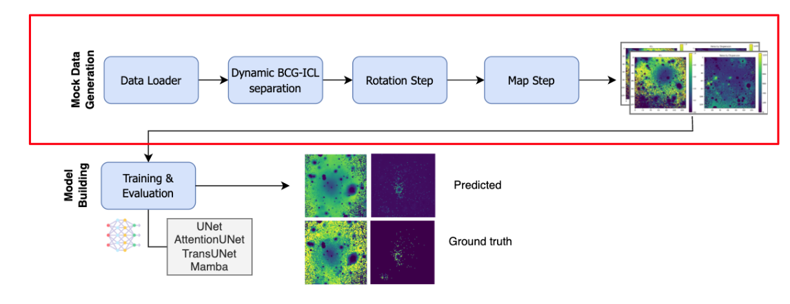

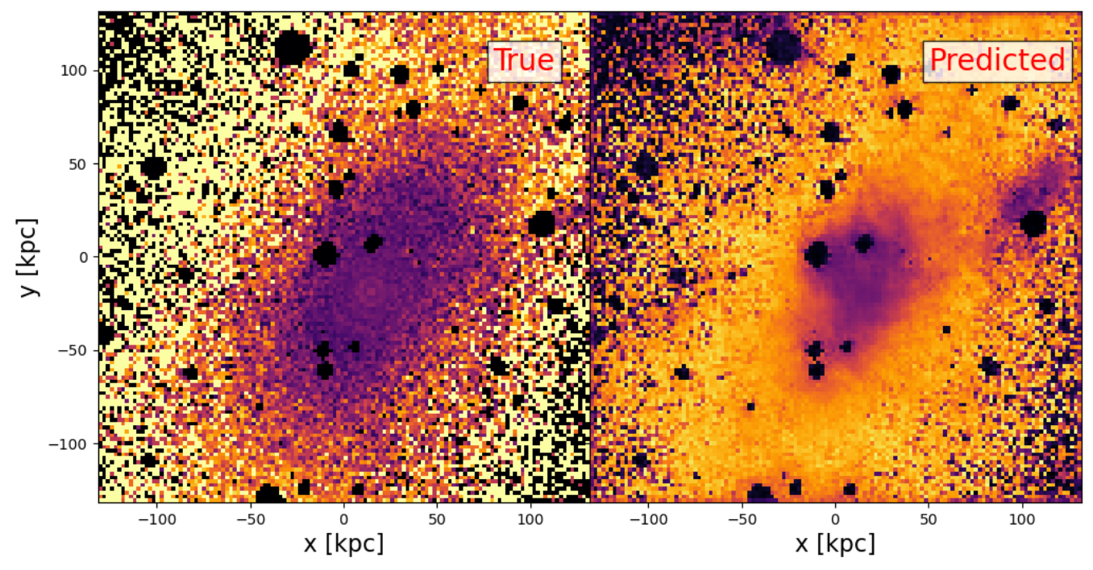
Status - Data Generation
Cross-Simulation Data Generation pipeline
Working cross-simulation data pipeline with 6000 massive halos
Pipeline, highly configurable, modular & scalable compatible with HPC environments
Interlopers

Slide 11
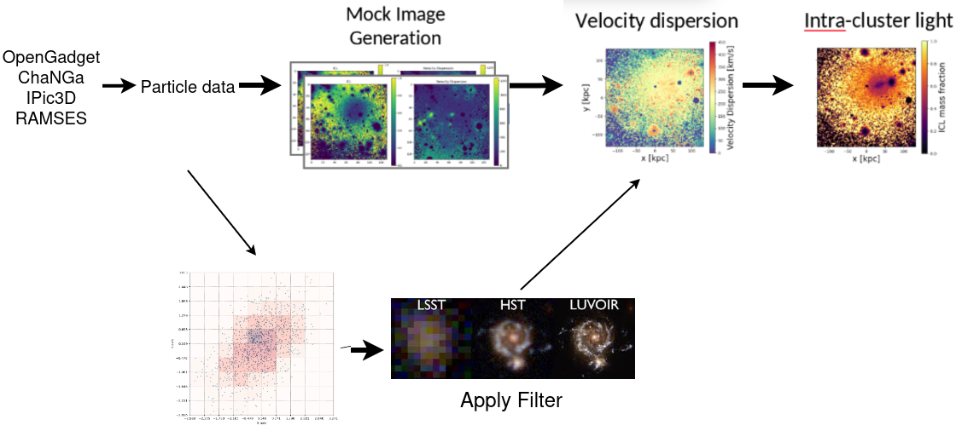
WIP - Generating more accurate mock images
Mock Image
Generation
Velocity Dispersion
Intra-cluster light
OpenGadget
ChaNGa
IPic3D
RAMSES
Particle data
Apply filter

Slide 12
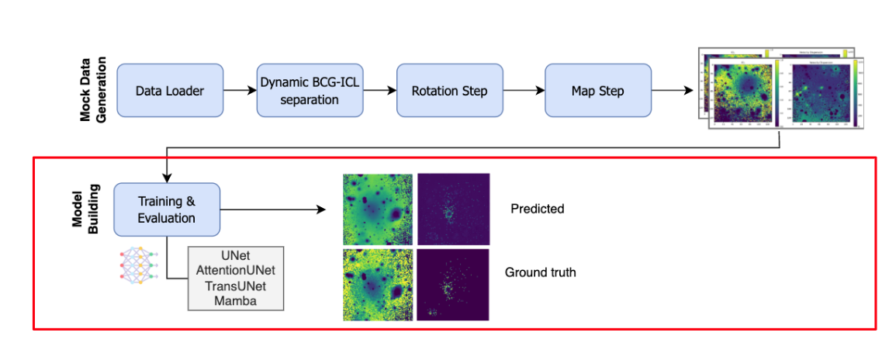
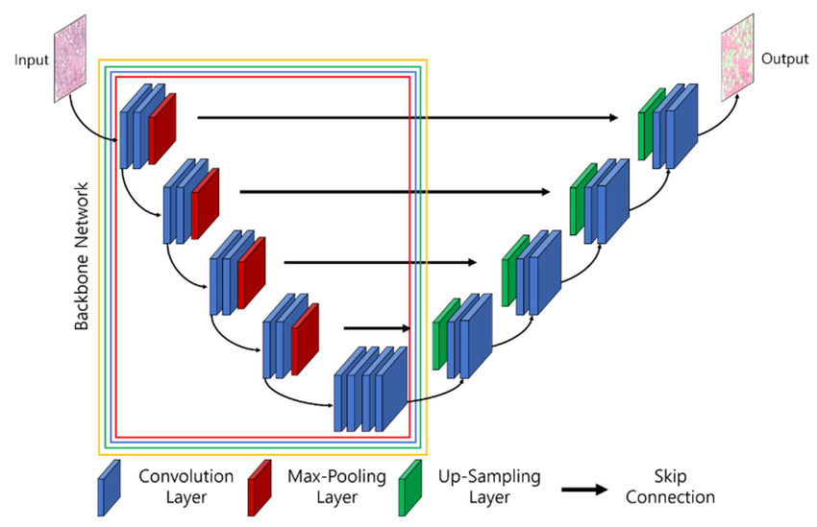
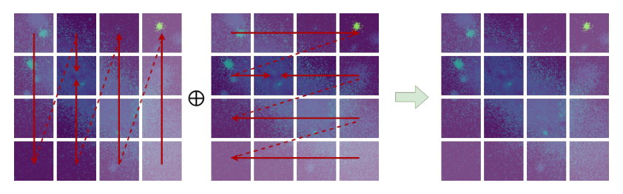
Development - Training ML Models
2. Training/ Evaluation of DL models to predict Feature2 based on Feature1
Trained UNet, AttentionUNet, TransUNet, Mamba, Stochastic Interp.
State-of-the-art results
Experiments measure:
  Model’s ability to reconstruct ICL maps
  Models generalization capabilities
  Trade-off between Accuracy (RASE) vs computational cost (TFLops) trade-off
UNet architecture
Deep State Space Models for ICL prediction

Slide 13
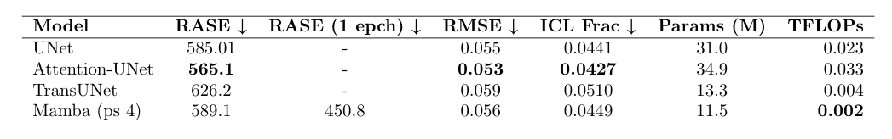
Results
Model Evaluation on Dianoga
Model | RASE | RMSE | 𝚫 ICL | Params (M) | TFLOPs
UNet | 585.01 | 0.055 | 0.0441 | 31.0 | 0.023
Attention-UNet | 565.1 | 0.053 | 0.0427 | 34.9 | 0.033
TransUNet | 626.2 | 0.059 | 0.0510 | 13.3 | 0.004
Mamba (ps 4) | 589.1 | 0.056 | 0.0449 | 11.5 | 0.002
Baseline: 544.47 (RASE)
Notes:
to update

Slide 14
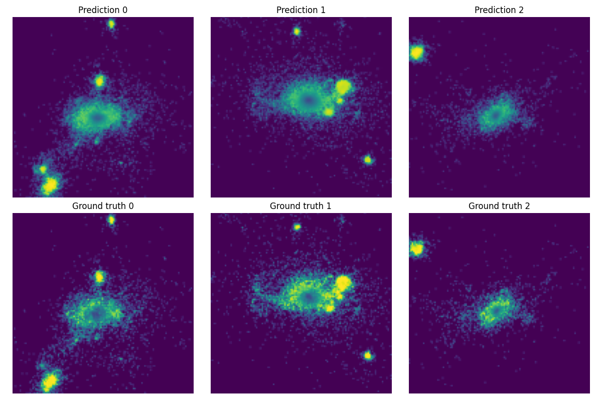
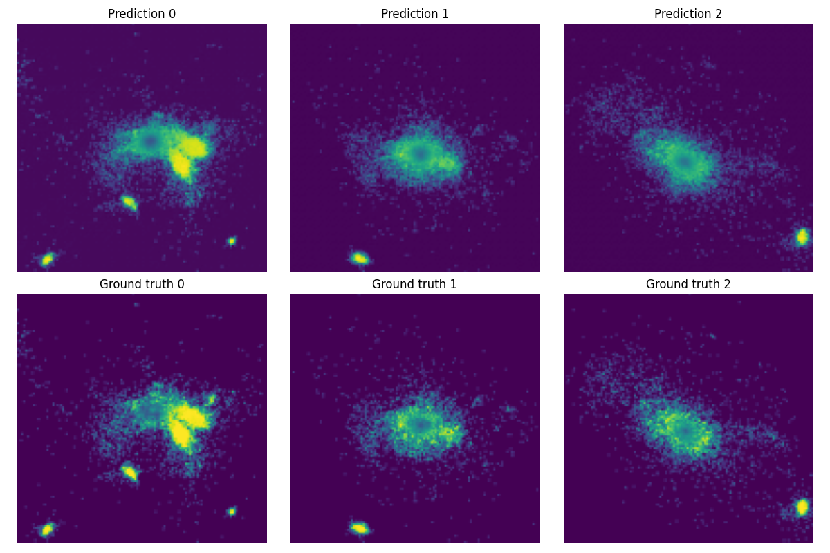
Results
Generated maps vs ground truth - Dianoga
Generated maps
UNet
Mamba
Notes:
Future work ? barplot for the table ?

Slide 15
Results
Generated maps vs ground truth - Dianoga
Generated maps
Ground truth
UNet
Mamba
Notes:
Future work ? barplot for the table ?

Slide 16
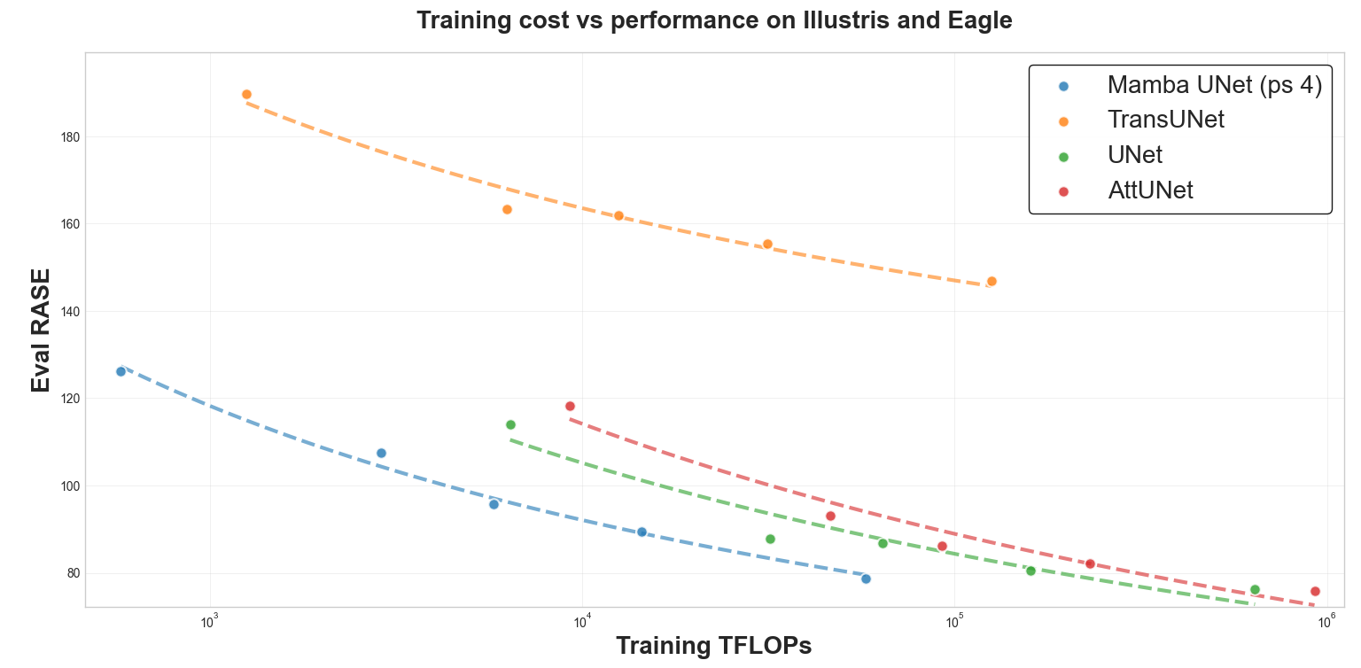
WIP - Results
RASE vs. Computational cost
Current state of the art: error in velocity dispersion to ICL predictions ~4%.
To be done:
Train models using all available datasets.
Train a foundational model using mock images generated from all datasets and release the encoder.
Illustris-TNG, Eagle
Num halos = 3091
Notes:
Mentioned that inference cost is near 0, explain a little bit more the plot -> training teraflops vs rase from evaluation set

Slide 17

Dissemination Activities
Paper in progress in collaboration with Ilaria Marini, Flamingo and Millenium-TNG to be submitted to A&A

Slide 18
Next steps
Train a foundational model with mock images from all the datasets. Release the encoder.
Velocity Dispersion can be used to predict other physical properties, such as Dark Matter distribution (2-3D)
Leverage multi-channel information

Slide 19
Thanks!

Slide 20
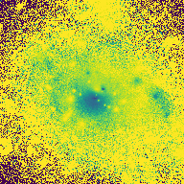
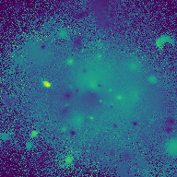
Simulation Coverage
TNG Cluster
Magneticum
TNG-Cluster
  Initial sample size: 8697
    Halos with NO transition radius: 3744
    No transition radius found; ICL never dominates.: 3740
    icl_mask is empty; no masking applied.: 4
  No subhalos found: 116
  Halos with transition radius: 4837
    Halos after 97% cutoff: 4691

Slide 21
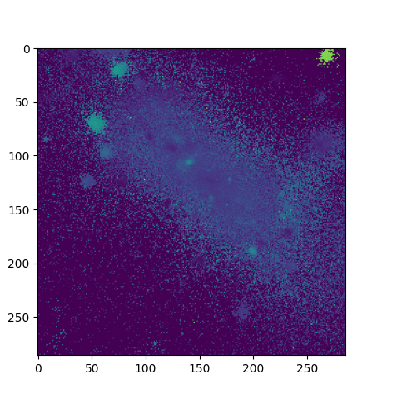
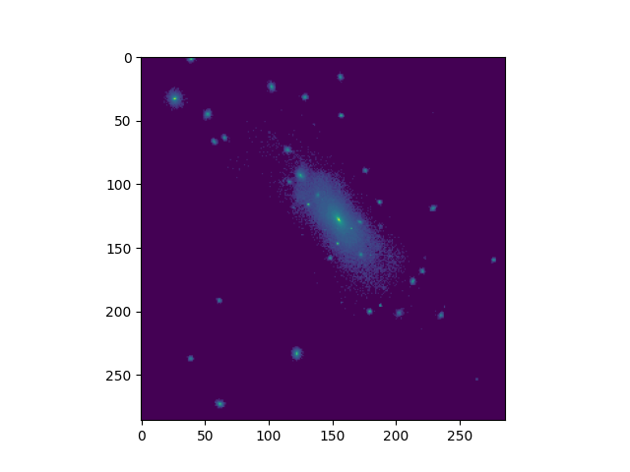
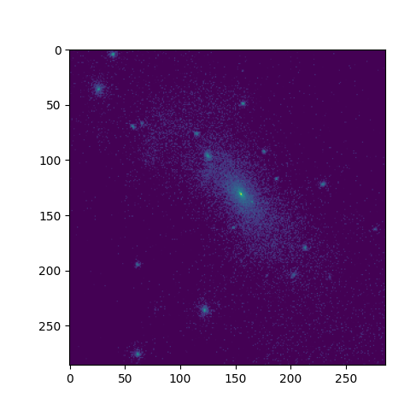
MUSE filter application
Without filter
With filter - mean
With filter - std

Slide 22
Challenges
Cross-Simulation Data Generation pipeline
Identify of overlapping subhalos
Uniform units of measure
Apply periodic boundary conditions
Particle data preprocessing & merging
Previous estimation of transition radius for each simulation suite.
Identify interlopers
Training/ Evaluation of DL models
Model training from scratch
Hyperparameter tuning
Implementation of model architectures
Construction of the combined dataset
…

