Slide 1
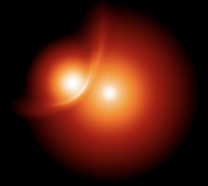
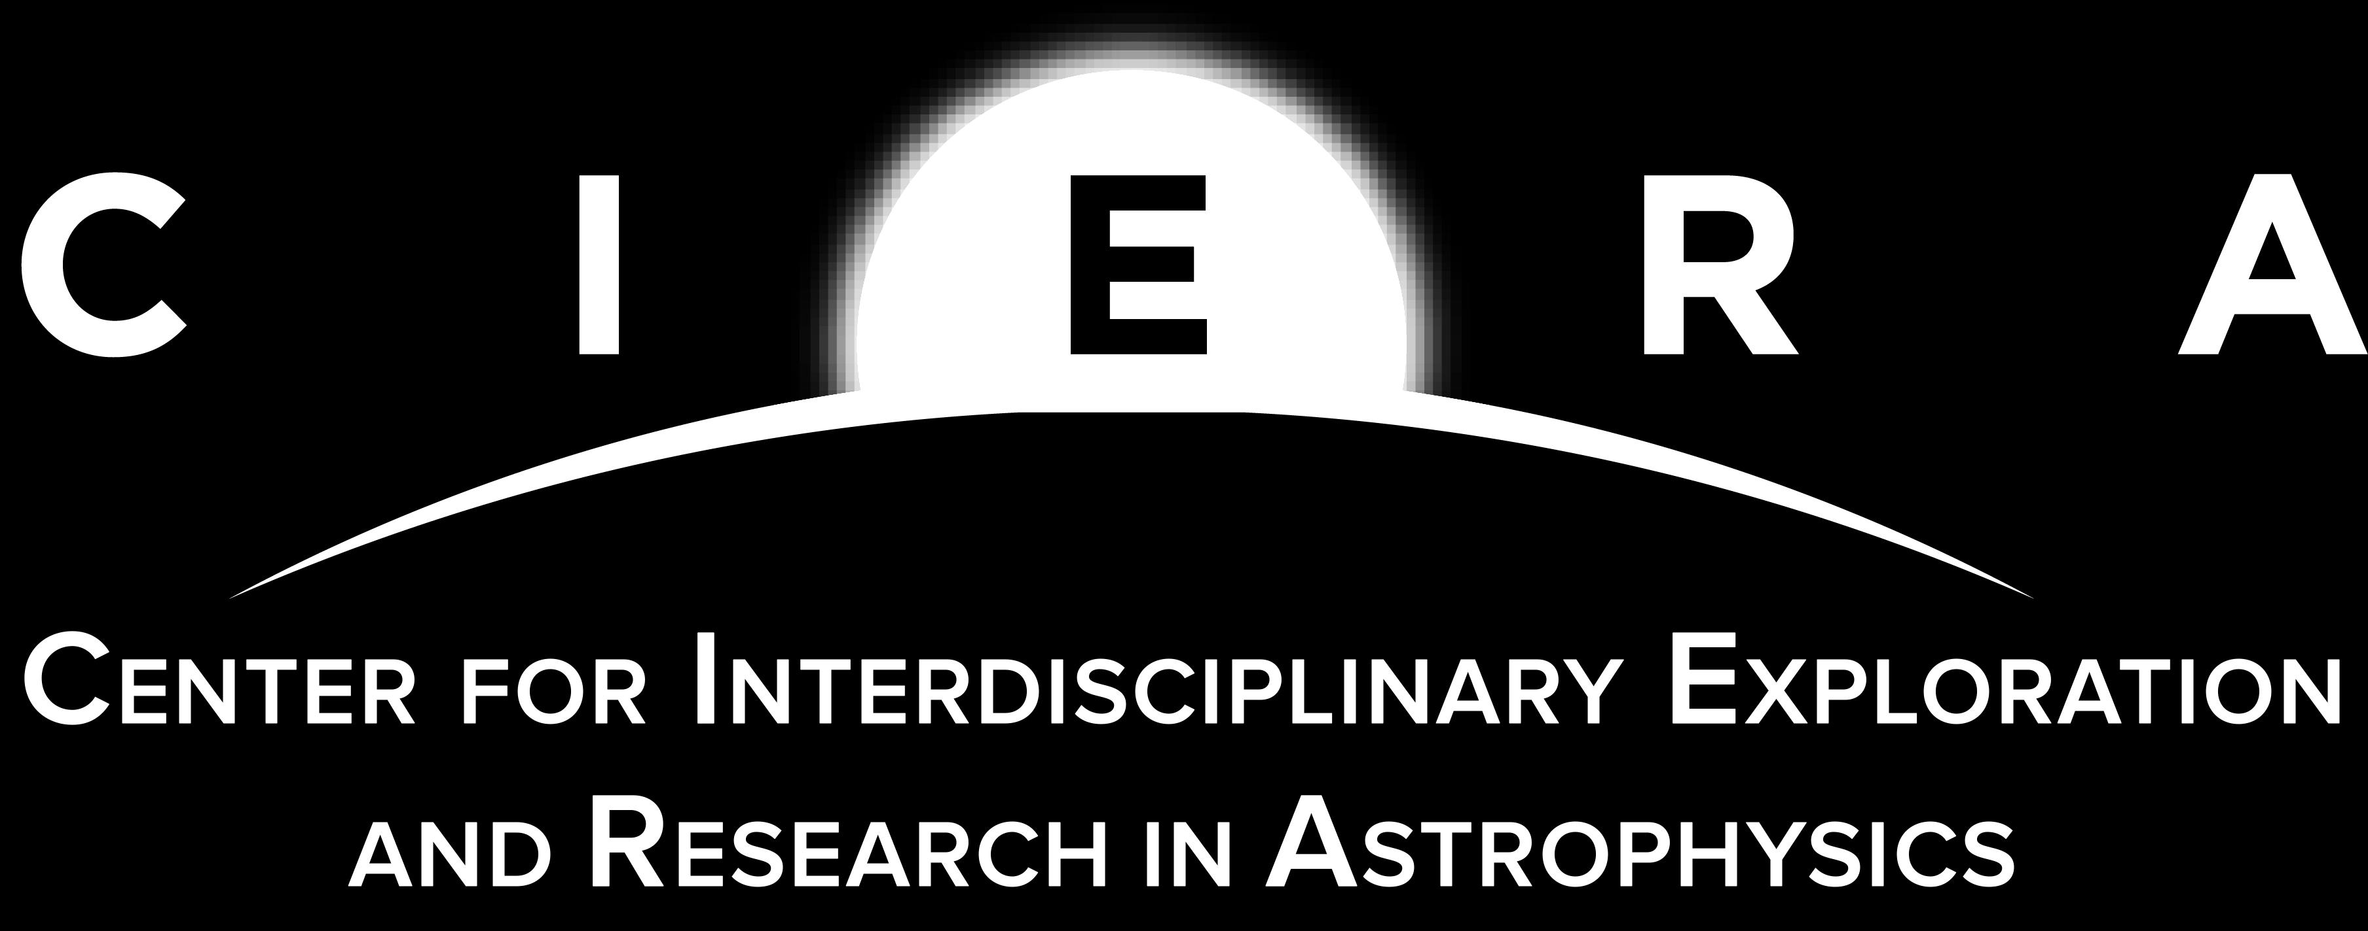


Machine Learning Methods for Stellar Collisions
Elena González Prieto
Northwestern University
In Collaboration With: James C. Lombardi, Sanaea C. Rose, Charles F.A. Gibson, Christopher E. O’Connor, Tjitske Starkenburg, Fulya Kıroğlu, Kyle Kremer, Tristan C. Sand, Frederic A. Rasio

Slide 2
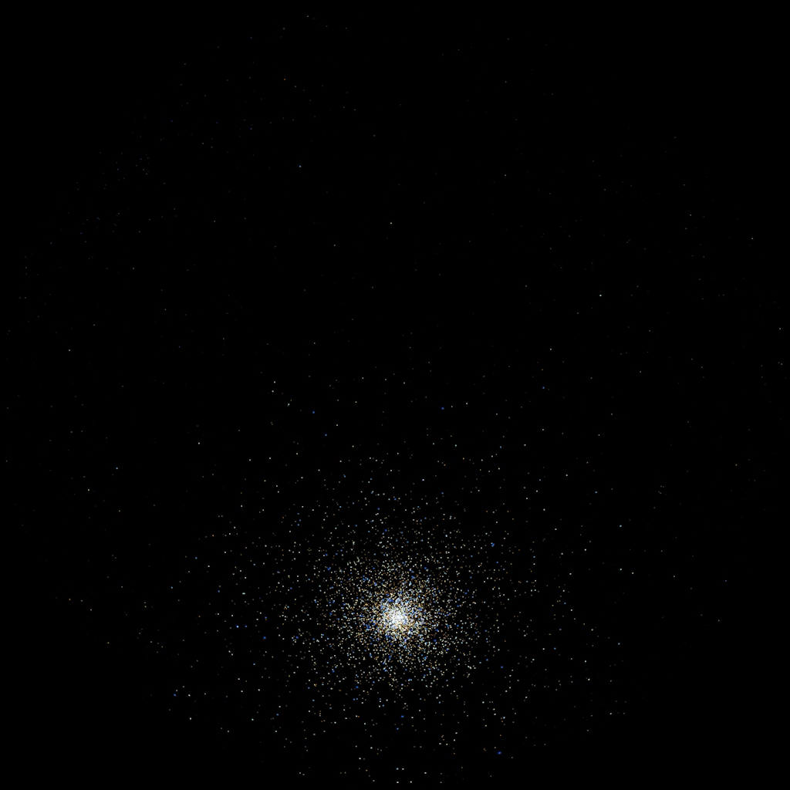
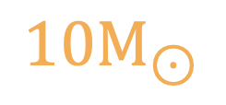




$$+$$
$$=$$
$$10M_{⊙}$$
$$10M_{⊙}$$
$$20M_{⊙}$$
Video Credit: NASA & ESA

Slide 3
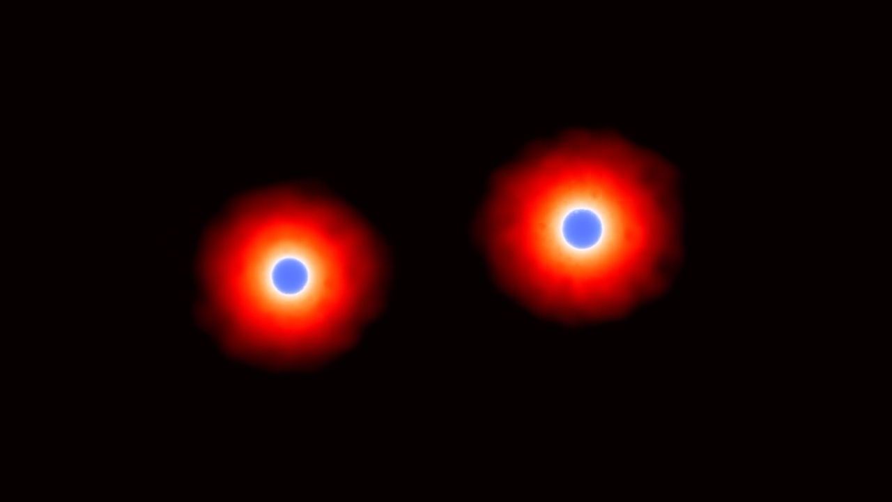
Video Credit: Alexander Brown + Lombardi

Slide 4

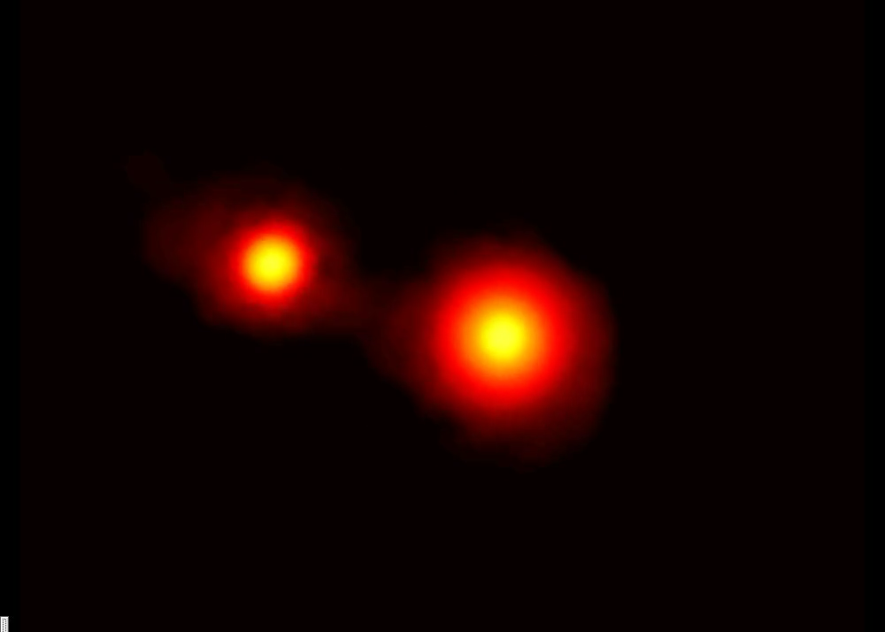
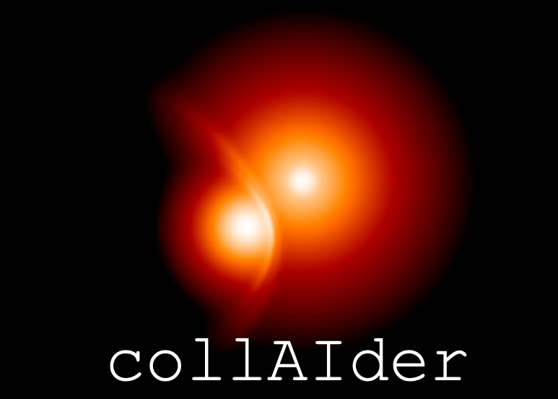


Framework
Machine Learning Model
Realistic Stellar Structure
Hydrodynamics Simulation
+
=
(Paxton et al. 2011-2019, Jermyn et al. 2023)
(Rasio et al. 1991, Gaburov et al. 2010)

Slide 5
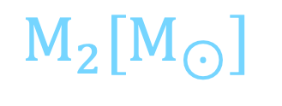



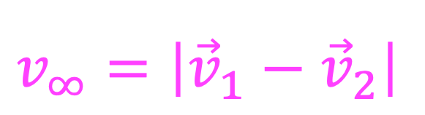
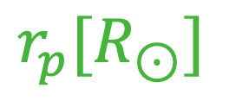

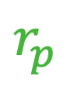

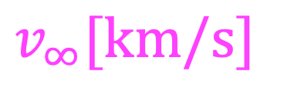
Stellar Collisions
Assume all stars are born at the same time
$$v_{1}$$
Age [Gyr]
$$M_{1}$$
$$M_{1}[M_{⊙}]$$
$$r_{p}$$
Input =
$$M_{2}[M_{⊙}]$$
$$v_{2}$$
$$M_{2}$$
$$v_{∞}[km/s]$$
$$r_{p}[R_{⊙}]$$
$$v_{∞}=\left|{\vec{v}}_{1}−{\vec{v}}_{2}\right|$$

Slide 6
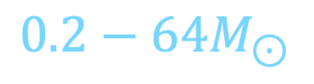
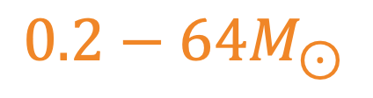
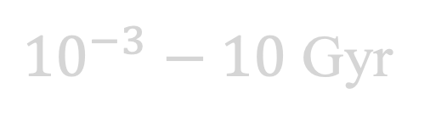
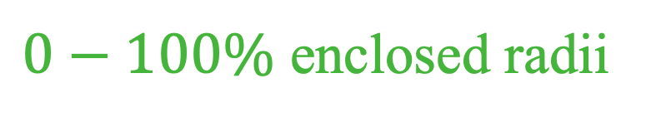
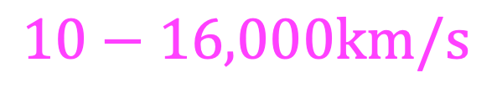
Stellar Collisions
27,720 Simulations
Age [Gyr]
${10}^{−3}−10$ Gyr
$$M_{1}[M_{⊙}]$$
$$0.2−64M_{⊙}$$
Input =
$$M_{2}[M_{⊙}]$$
$$0.2−64M_{⊙}$$
$$v_{∞}[km/s]$$
$$10−16,000km/s$$
$$r_{p}[R_{⊙}]$$
$0−100\%$ enclosed radii

Slide 7
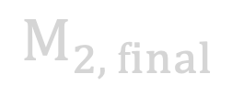
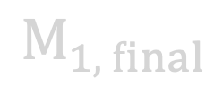
Stellar Collisions
Classification
- Number of surviving stars
Age [Gyr]
0 : Mutual Disruption
1 : Merger
$$M_{1}[M_{⊙}]$$
2 : Fly-by
Input =
$$M_{2}[M_{⊙}]$$
Output =
3 : Stripped Star
$$v_{∞}[km/s]$$
- Masses of surviving stars
$$r_{p}[R_{⊙}]$$
$$M_{1, final}$$
$$M_{2, final}$$
Regression
We compared performance for k-Nearest Neighbors, Support Vector Machines, and Neural Networks

Slide 8
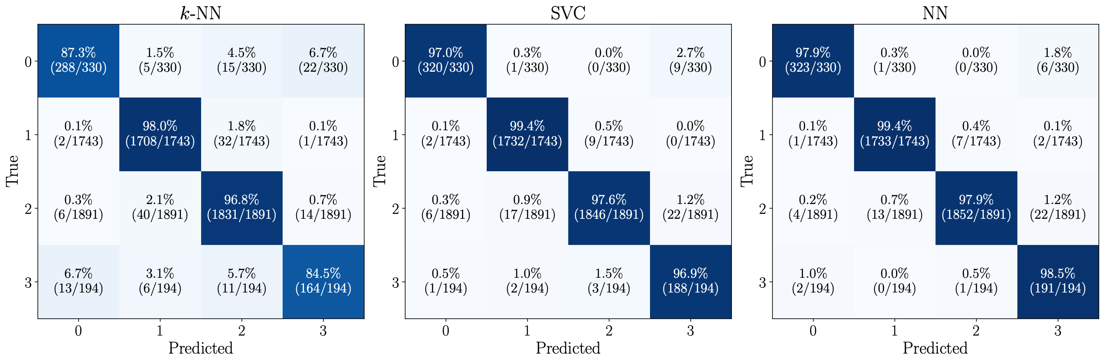
Predicting the final number of stars
Training set is imbalanced, with only 4.8% stripping and 8.1% mutually destructive collisions
Models are scored based on balanced accuracy

Slide 9
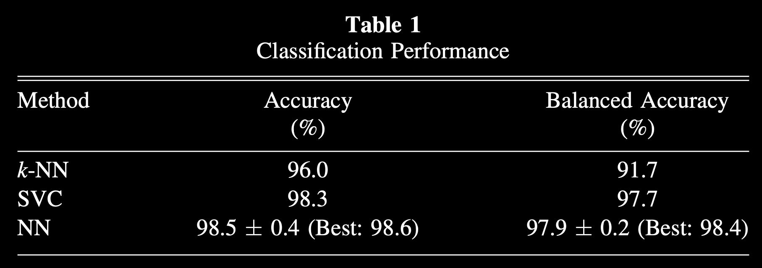
Predicting the final number of stars
We compared performance across k-nearest neighbors, support vector classifier, and a neural network

Slide 10
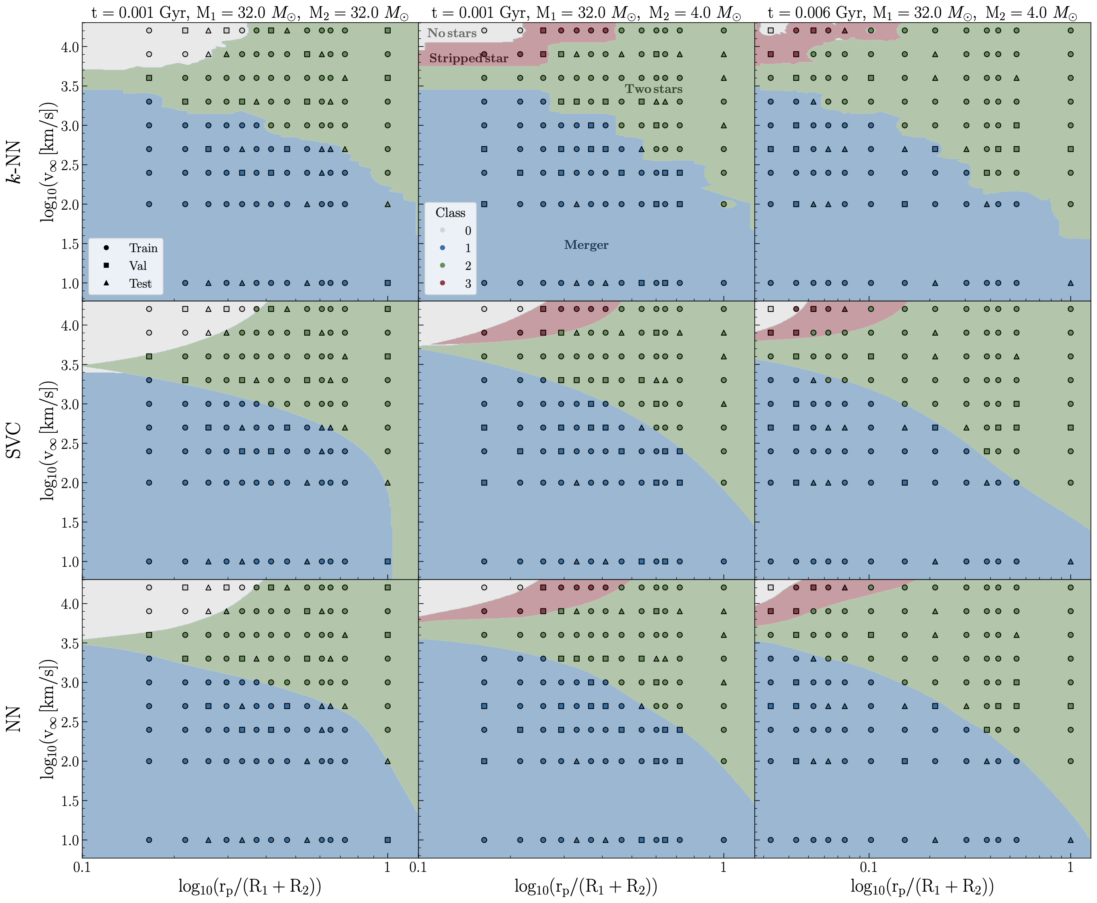
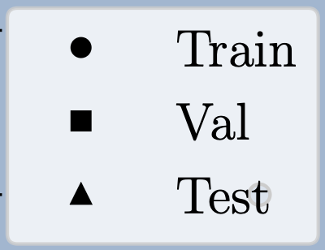
Decision boundaries
Stripped Star (3)
Mutual Disruption (0)
TAMS
Merger (1)
Fly-by (2)
Recovers the symmetries expected for equal-mass collisions
Learns the dependence on the evolution of the stellar structure

Slide 11
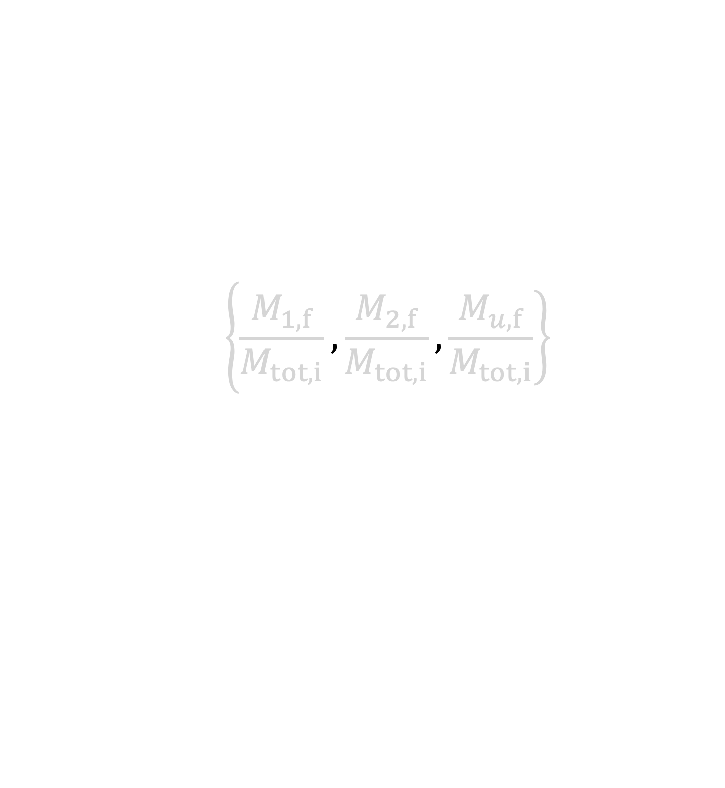
Predicting the final masses
- The NN is trained to predict
$$\left\{\frac{M_{1,f}}{M_{tot,i}}\right.,\frac{M_{2,f}}{M_{tot,i}}, \left.\frac{M_{u,f}}{M_{tot,i}}\right\}$$
which ensures mass conservation.
- The NN outperforms all methods, with relative median errors below 0.15% in the final masses

Slide 12
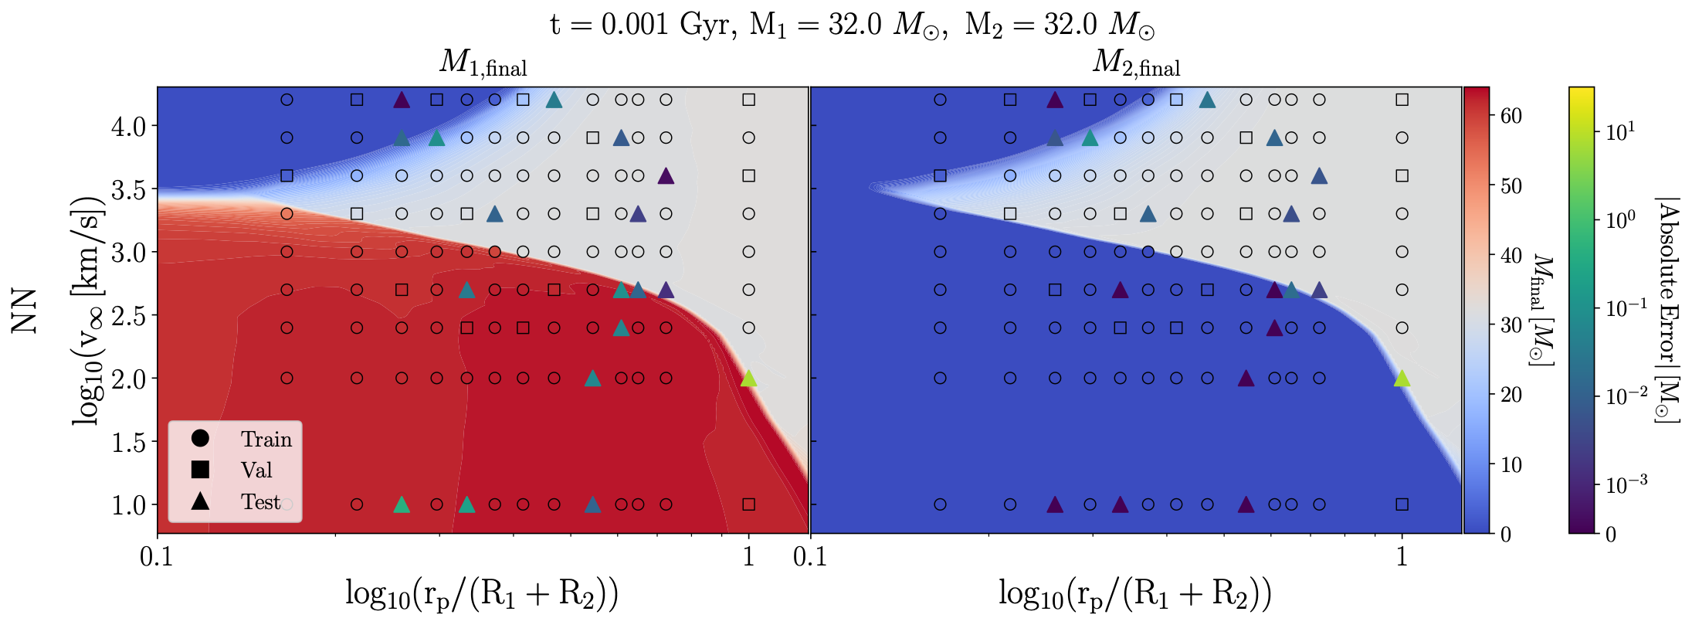
Predicting the final masses
Accurately recovers the symmetry of equal-mass flybys

Slide 13
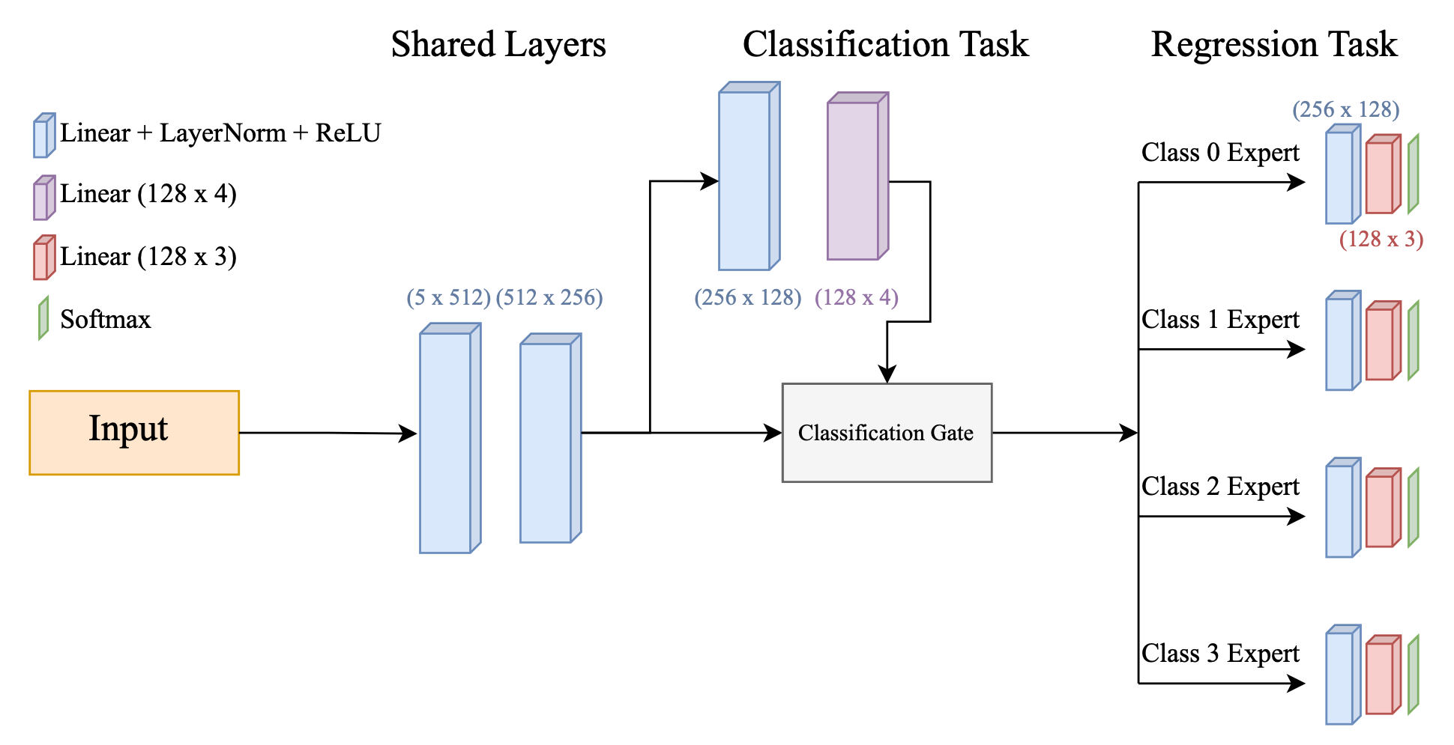
Mixture of Experts Model

Slide 14
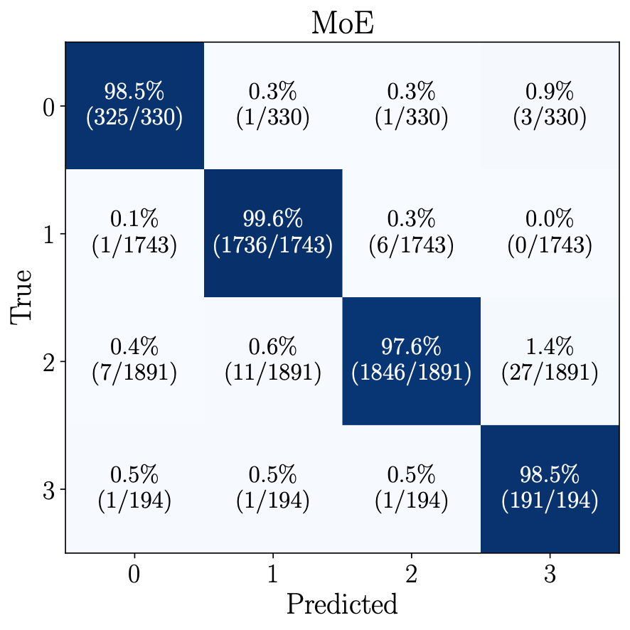
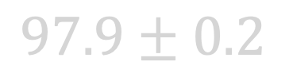
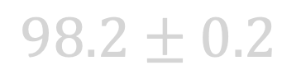
Classification NN vs MoE
Balanced
Accuracy:
$97.9±0.2$
$98.2±0.2$

Slide 15
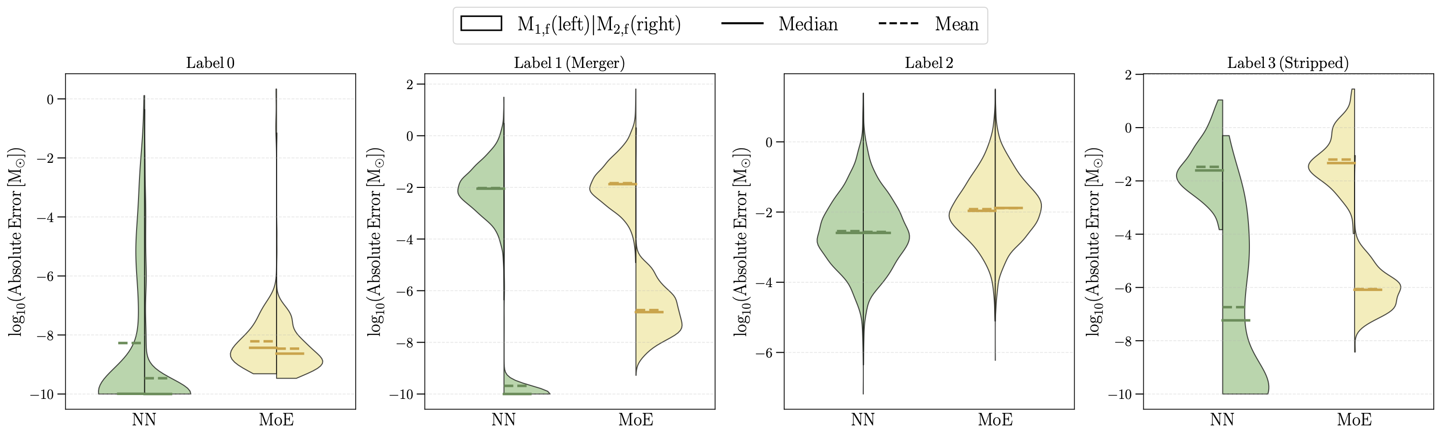
Comparison of Errors
Across all labels, the NN has consistently lower median error

Slide 16
Comparison of Errors

Slide 17
Comparison of Errors

Slide 18




Ongoing and Future Work
Sanaea C. Rose
Lindheimer Postdoctoral Fellow at CIERA
Tristan C. Sand
Incoming Graduate Student at NU
Miguel Orti Vila
Undergraduate at Allegheny College
Joshua Mehler
Undergraduate at Allegheny College
Machine Learning
Uncertainty quantification
Adding kinematic information
Expanding to other metallicities
Collisions beyond the main sequence
N-body Simulations
Modeling stellar collisions in N-body simulations of globular and nuclear star clusters with collAIder
Integrating collAIder into N-body gravitational scattering experiments

Slide 19






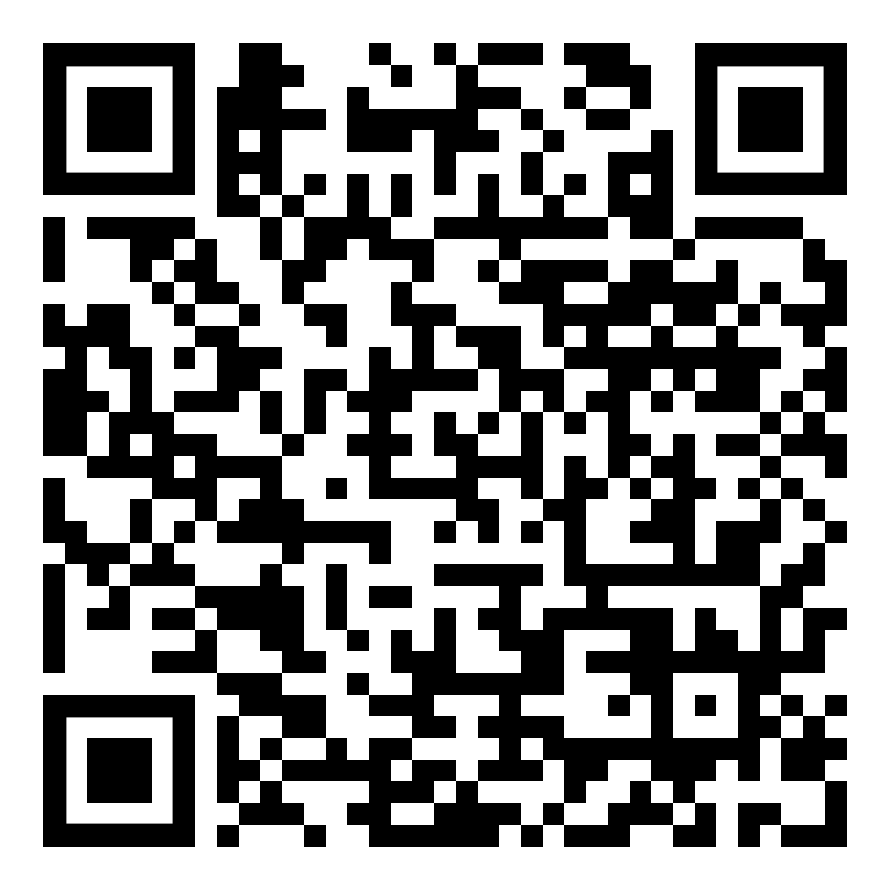



Elena González Prieto
Jamie Lombardi
Fred Rasio
Thank you!
arXiv: 2602.10191
Sanaea C.Rose
Charles F.A. Gibson
Chris O’Connor
Tjitske Starkenburg
Fulya Kiroğlu
Kyle Kremer
Tristan Sand

Slide 20
Extra Slides

Slide 21
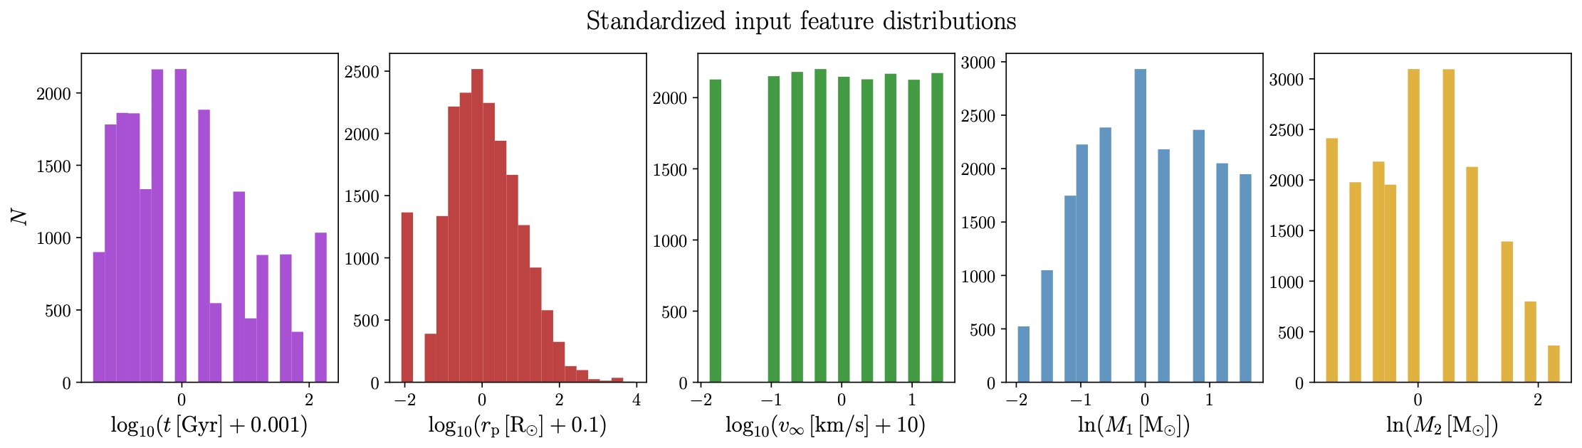
Input Feature Distributions
70% Training (19, 404 samples)
15% Validation / Testing (4,158 samples each)

Slide 22
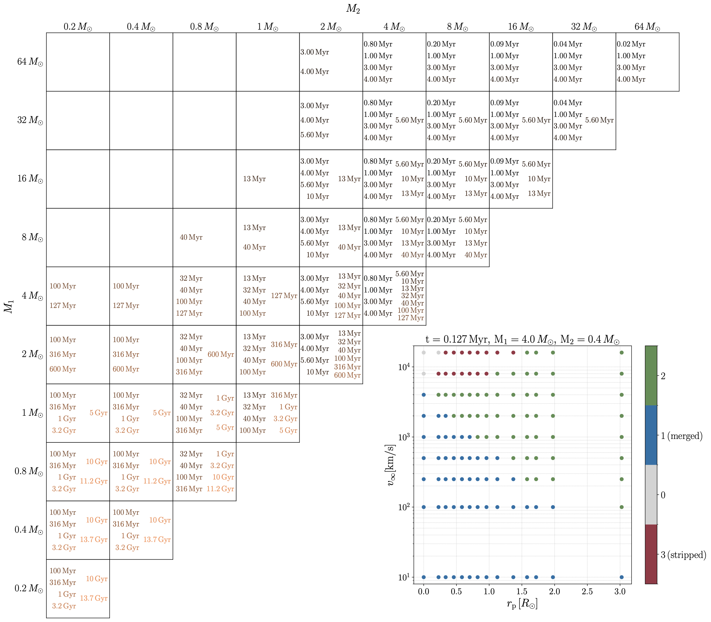
Grid

Slide 23
k-NN/SVC Classification Hyperparameters
kNN
Number of neighbors : 3 - 25 (5)
Distance Metric : Euclidean or Manhattan
Weighting Scheme : uniform or inverse distance
SVC
Kernel : Gaussian radial basis function, polynomial (2 - 3)
C (regularization) : 0.1 - 10,000
Gamma : 0.001 - 1 (0.1)

Slide 24
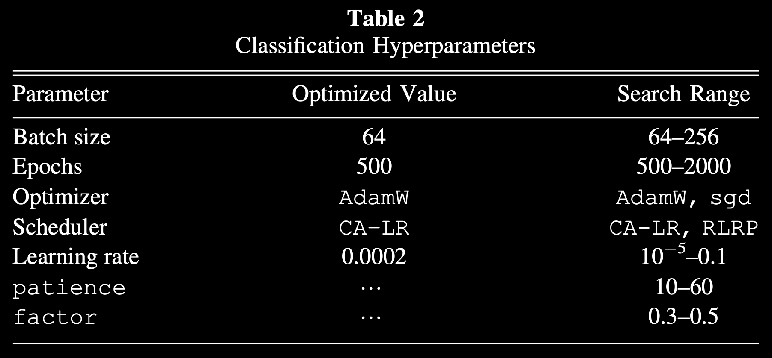
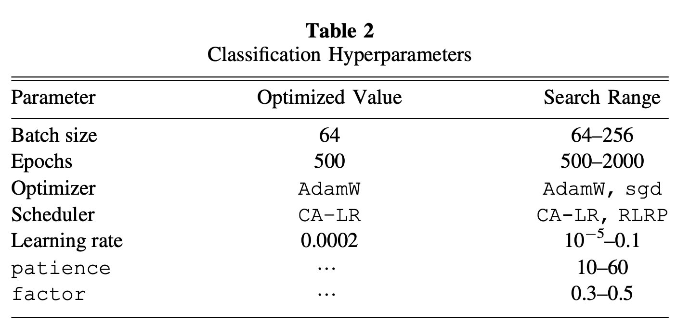
NN Classification Hyperparameters

Slide 25
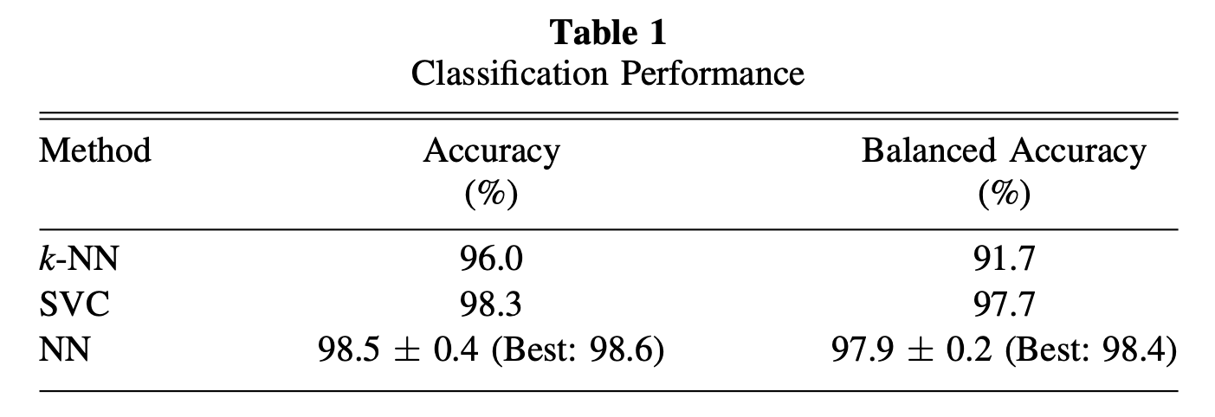
ML Methods Comparison: Classification

Slide 26
Method Comparison: Classification

Slide 27
Method Comparison: Classification

Slide 28
k-NN Regression
- Evaluated on Mean Absolute Error for the predicted mass fractions
Number of neighbors : 3 - 25
Distance Metric : Euclidean or Manhattan
Weighting Scheme : uniform or inverse distance

Slide 29
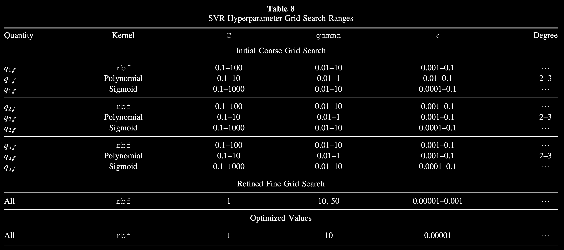
Support Vector Machine: Regression

Slide 30
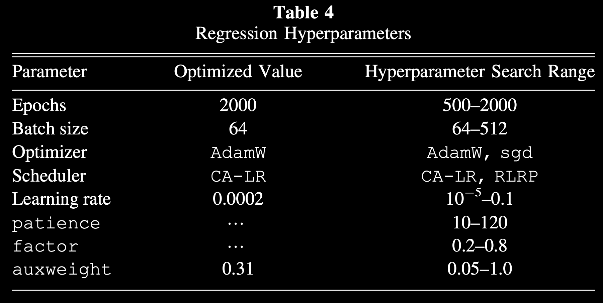
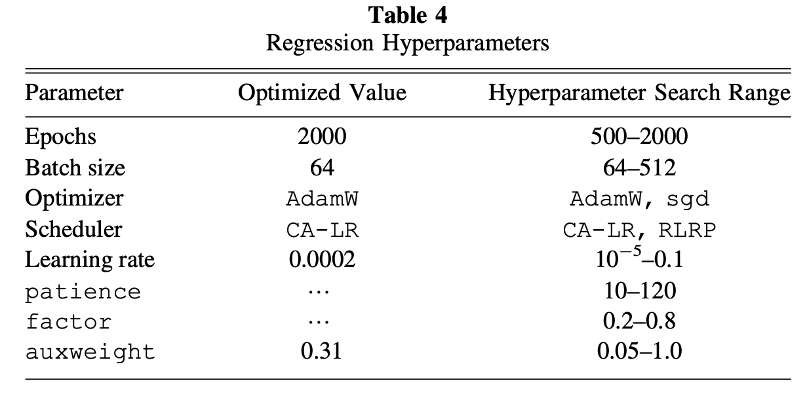
NN Regression Hyperparameters

Slide 31
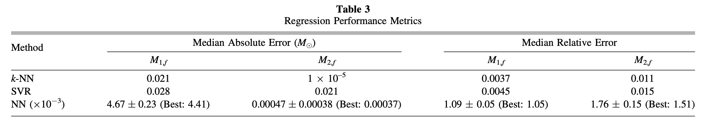
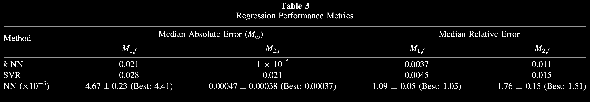
ML Methods Comparison: Regression

Slide 32
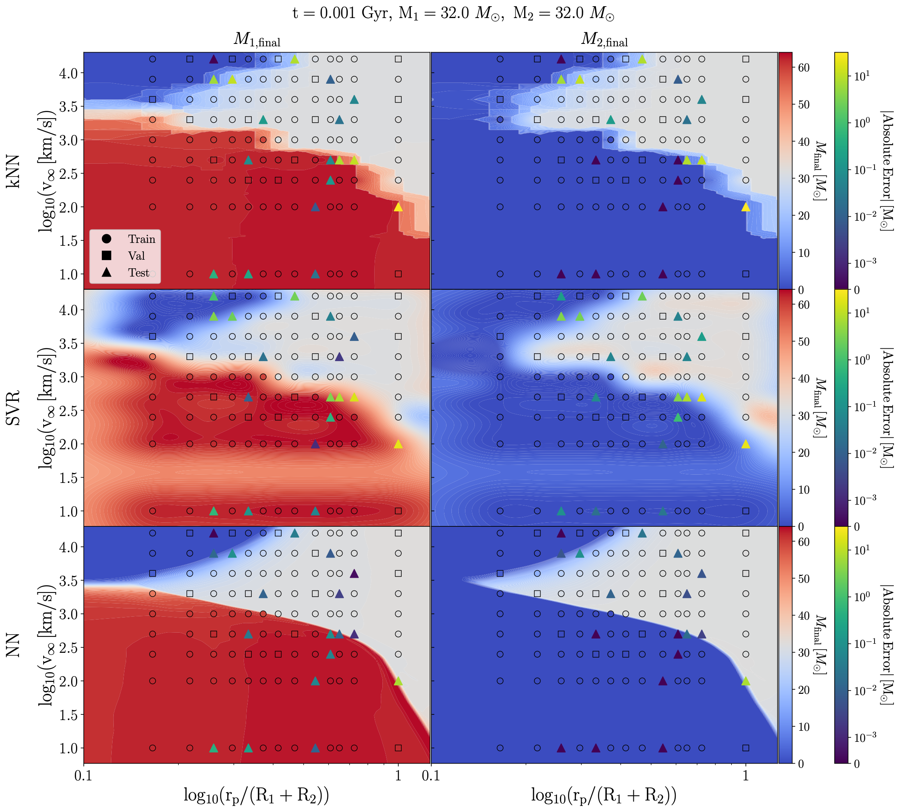
Method Comparison: Regression

Slide 33
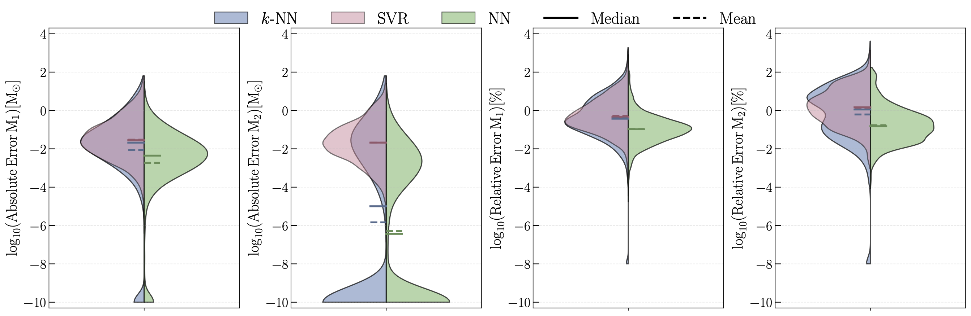
Method Comparison: Regression

Slide 34
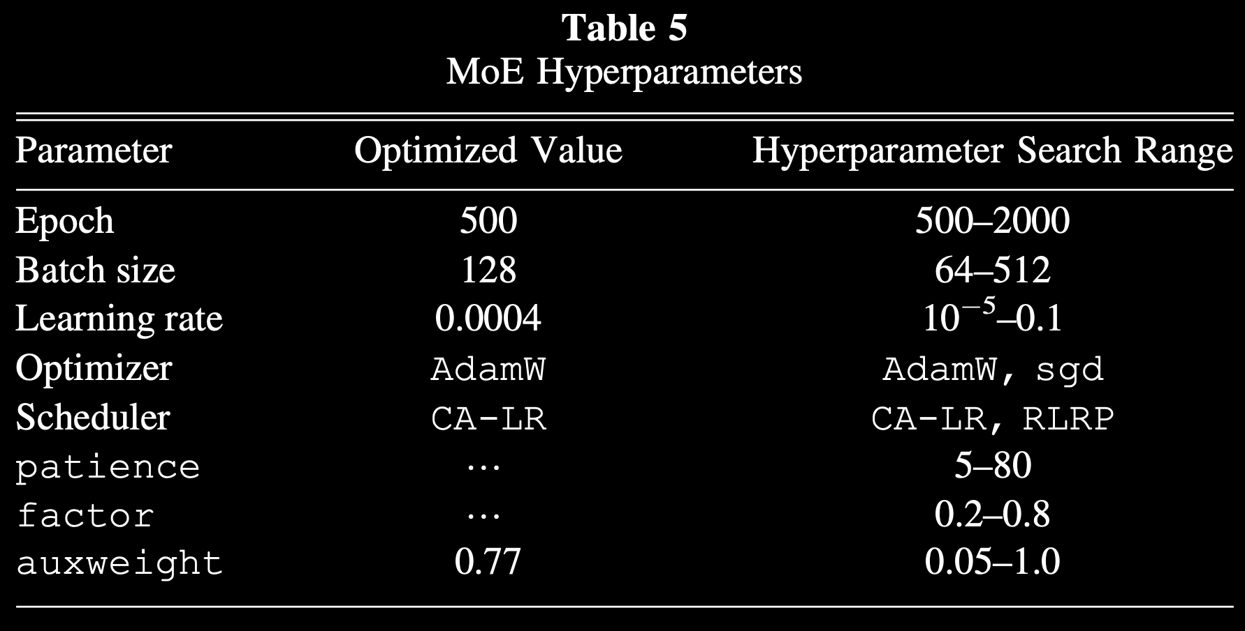
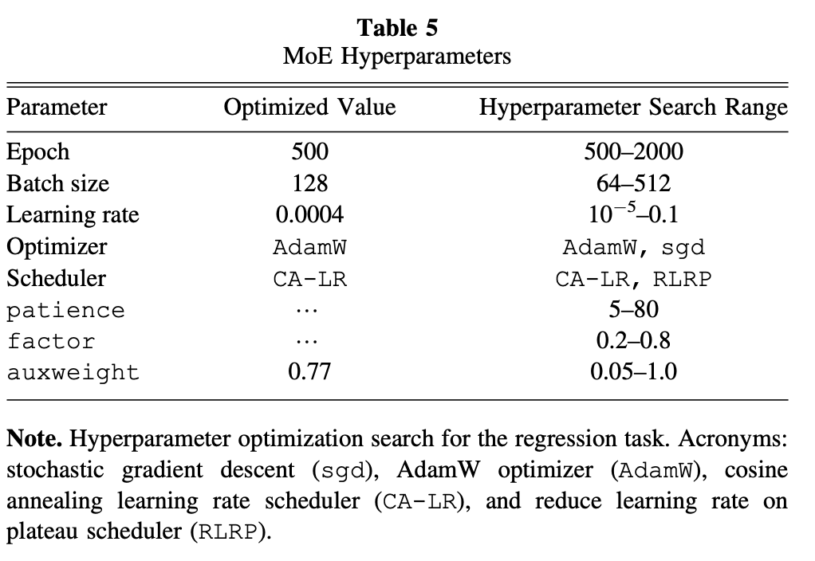
MoE Hyperparameters

Slide 35
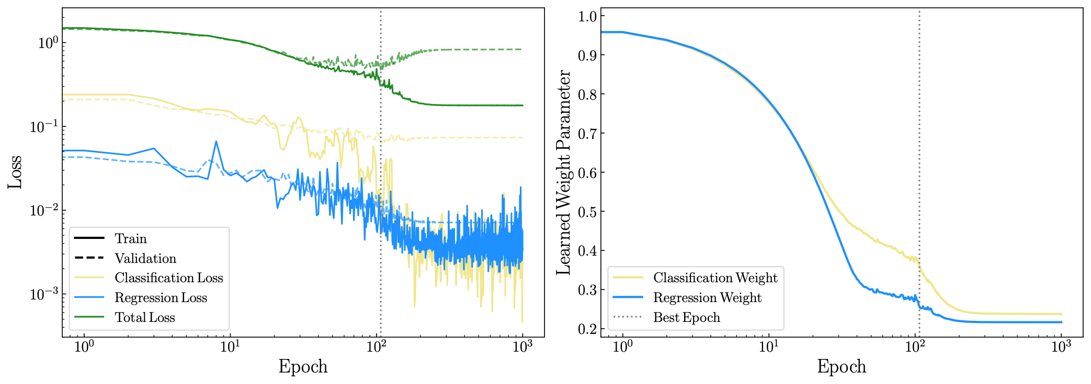
MoE Training

Slide 36

MoE vs NN

Slide 37

CollAIder
Flowchart

Slide 38

CollAIder Performance Metrics
Interpolation: different masses within the original grid
TAMS: near the TAMS of a collision within the grid
Extrapolation: out-of-distribution data (massive stars before/at TAMS)
Across all datasets, collAIder achieves a classification balanced accuracy above 83.8% and median relative errors below 1.2% in the final mass predictions

