Slide 1

Empirical dark matter halo profiles
with Symbolic Regression
Alicia Martín
University of Oxford
w/ Tariq Yasin, Deaglan Bartlett, Harry Desmond, Pedro Ferreira
Notes:
Hey everyone. I'm coming towards the end of my PhD now, and over the last three years a lot of what I've been working on is using a machine-learning technique called symbolic regression
In the modern picture of structure formation, galaxies form at the center of extended, overdense ‘halos’ of dark matter, which originate from small fluctuations in the density of matter in the early Universe

Slide 2
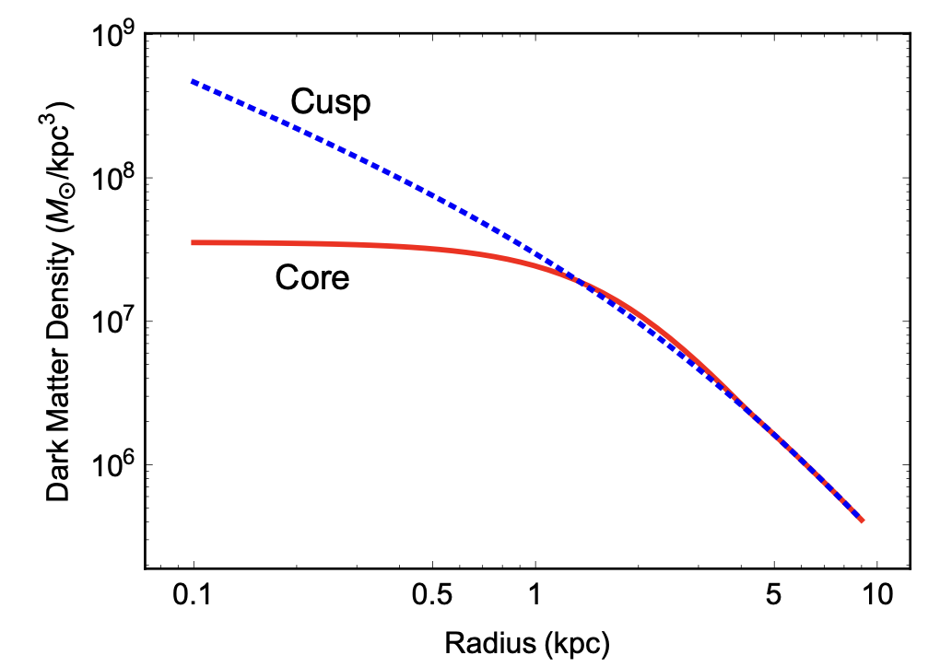
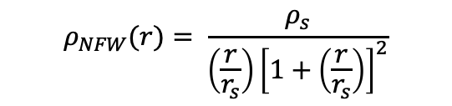
Testing dark matter
Dark matter forms halos ~ spherical clumps
Usual approach: fit simulation profiles to dynamics/lensing data.
Problems:
  Which dark matter model?
  Impact of normal matter
Cores – evidence NFW inadequate
$$ρ_{NFW}(r)= \frac{ρ_{s}}{\left(\frac{r}{r_{s}}\right){\left[1+\left(\frac{r}{r_{s}}\right)\right]}^{2}}$$
Galaxy DD0 154 – Tulin and Yu (2017)
  Aim: DM profiles with maximum empirical accuracy
Notes:
To study the structure and the formation of dark matter haloes , numerical simulations. Early N-body simulations showed that haloes are very self-similar and well described by NFW. Inner slope of r-1
There are a few problems with relying on profiles coming from simulations.
Different dark matter models predict different inner halo structures, so the inferred profile can depend on whether one assumes cold dark matter, self-interacting dark matter, or another scenario.
This makes it difficult to know how robust the resulting density profiles
Uncertain
So one might ask: is there a more systematic, data-driven way to infer halo density profiles directly from observations, without assuming a specific functional form?
such as feedback and cooling.
dwarf galaxies and low-surface-brightness galaxies, observations often favour cored inner density profiles rather than the cuspy behaviour predicted by NFW.

Slide 3
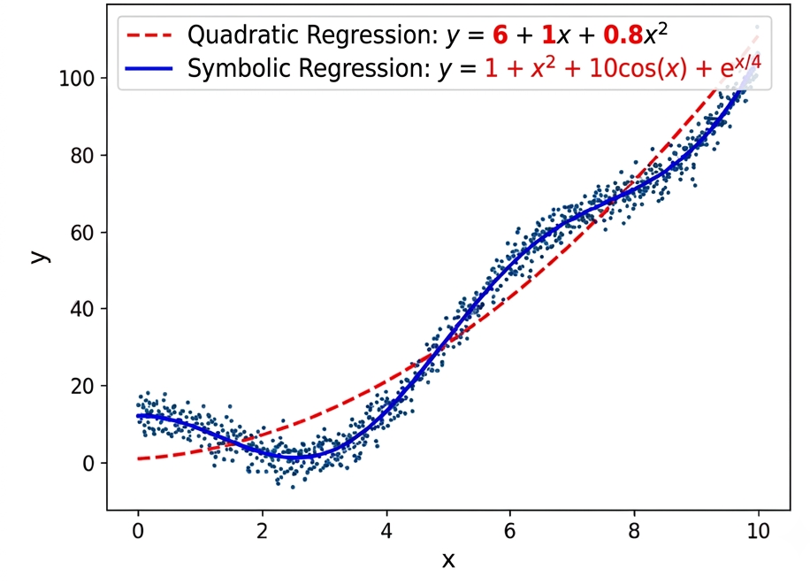


Symbolic Regression
Discover functions describing a dataset
Numerical regression: $y\left(x\right)=a+b x+c x^{2}$
Symbolic regression: $y\left(x\right)= ?$
Notes:
Unlike standard regression, which fits parameters of a chosen function
symbolic regression searches for both the functional form and the parameters that describe the data
This is what makes symbolic regression interesting. Instead of just fitting the data, it tries to discover an analytic expression describing it.
What makes symbolic regression interesting for physics is that physics is rarely just about fitting data. We usually want a model that we can interpret and connect to the underlying physical processes. Unlike many machine learning methods, symbolic regression returns an explicit analytic expression. That gives us something we can understand, compare to theory, and use to derive other physical quantities.

Slide 4

Symbolic Regression
Discover functions describing a dataset
Numerical regression: $y\left(x\right)=a+b x+c x^{2}$
Symbolic regression: $y\left(x\right)=\text{1 + }\text{x}\text{2}\text{ + 10}\text{cos}\text{(}\text{x}\text{) + }\text{ex}\text{/4}$
Why is this useful?
  Find analytic models
  Provide interpretability
  Easy to extrapolate
Notes:
Unlike standard regression, which fits parameters of a chosen function
symbolic regression searches for both the functional form and the parameters that describe the data
This is what makes symbolic regression interesting. Instead of just fitting the data, it tries to discover an analytic expression describing it.
What makes symbolic regression interesting for physics is that physics is rarely just about fitting data. We usually want a model that we can interpret and connect to the underlying physical processes. Unlike many machine learning methods, symbolic regression returns an explicit analytic expression. That gives us something we can understand, compare to theory, and use to derive other physical quantities.

Slide 5
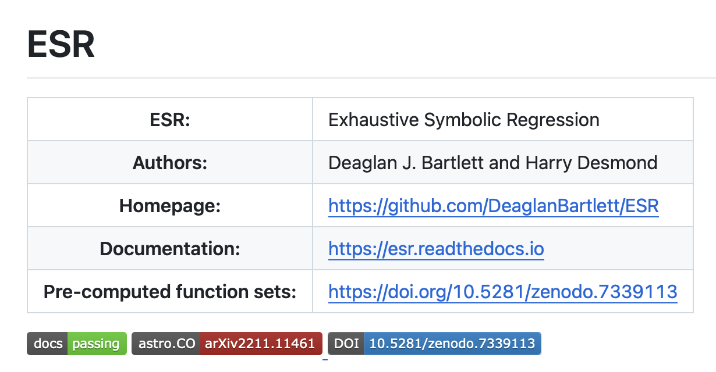
Exhaustive Symbolic Regression (ESR)
Deaglan Bartlett, Harry Desmond, Pedro Ferreira , Exhaustive Symbolic Regression,2023, arXiv:2211.11461, 2022
Two main steps to ESR
Generating functions
Selecting the best functions
Notes:
By searching for simple, analytic descriptions of the data, the advantage of SR algorithms over traditional machine learn- ing methods is their interpretability and clear (although not necessarily accurate) extrapolation behaviour when employed on data outside the range of the training set. A potentially more important, yet more optimistic, goal of SR is to uncover “physical laws” from data, which are necessarily analytic

Slide 6
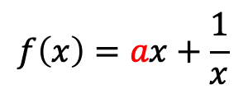

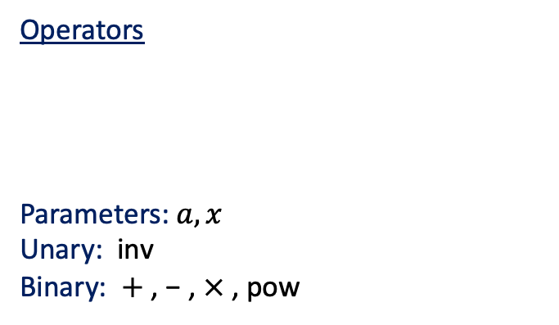
ESR: Generating functions
$$f\left(x\right)=ax+\frac{1}{x}$$
Operators
Parameters: $a, x$
Unary: inv
Binary: $+$, − , $×$, pow
{$x$, a, +, −, ×, ÷, inv, pow}
$$+$$
$$×$$
inv
$$a$$
$$x$$
$$x$$
Comp 6
ESR explicitly considers every possible combination of operators
Comp 10 – 13,4239 unique functions
Notes:
NFW is a comp 9 model
Building blocks that you can mix and match
A convenient way of representing how they're combined is as a tree

Slide 7
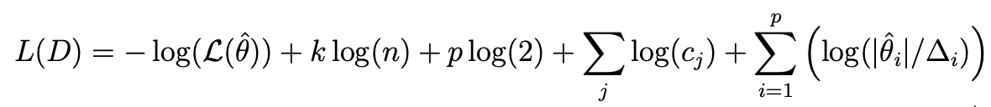
ESR: Selecting the best function
Accuracy
Simplicity
Minimum Description Length
Description length: Units of information (nats) are needed to communicate the data
how well the function fits the data
2. Penalises complex hypotheses
Likelihood
Number of operators and parameters in equation
How fine-tuned parameters are
Notes:
Given a sufficiently flexible function, any finite dataset can be fit arbitrarily well.
And even more in physics we are ofthen interested in simple laws
Even you want to know where this formula comes from you can ask me. Th eimportnat part is that this is a principled way coming from
Imagine I want to communicate the data to you. I first have to tell you what model I'm using, and then I have to give you whatever additional information you need to reconstruct the data given that model.
A complicated model costs more information to specify, while a model that fits the data poorly requires more information to describe the residuals.
Principled way to balance accuracy and complexity

Slide 8
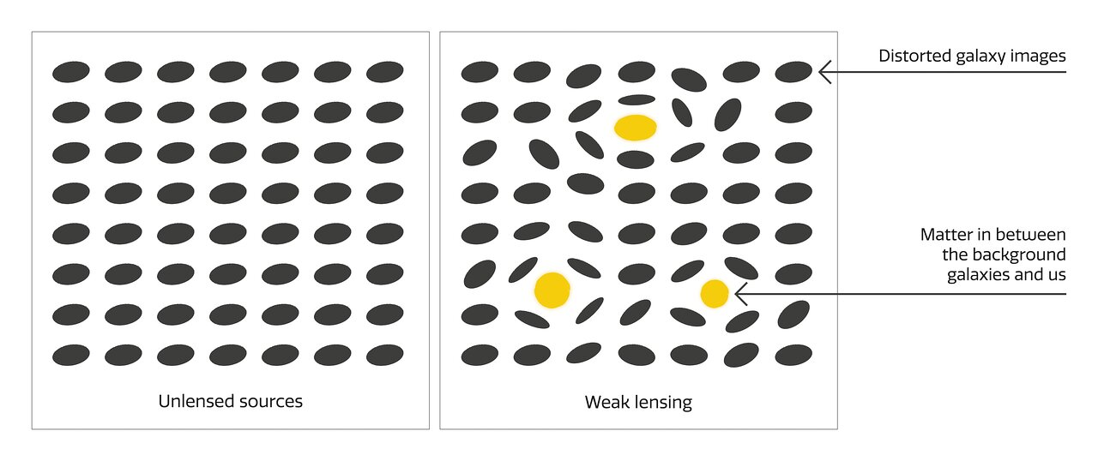
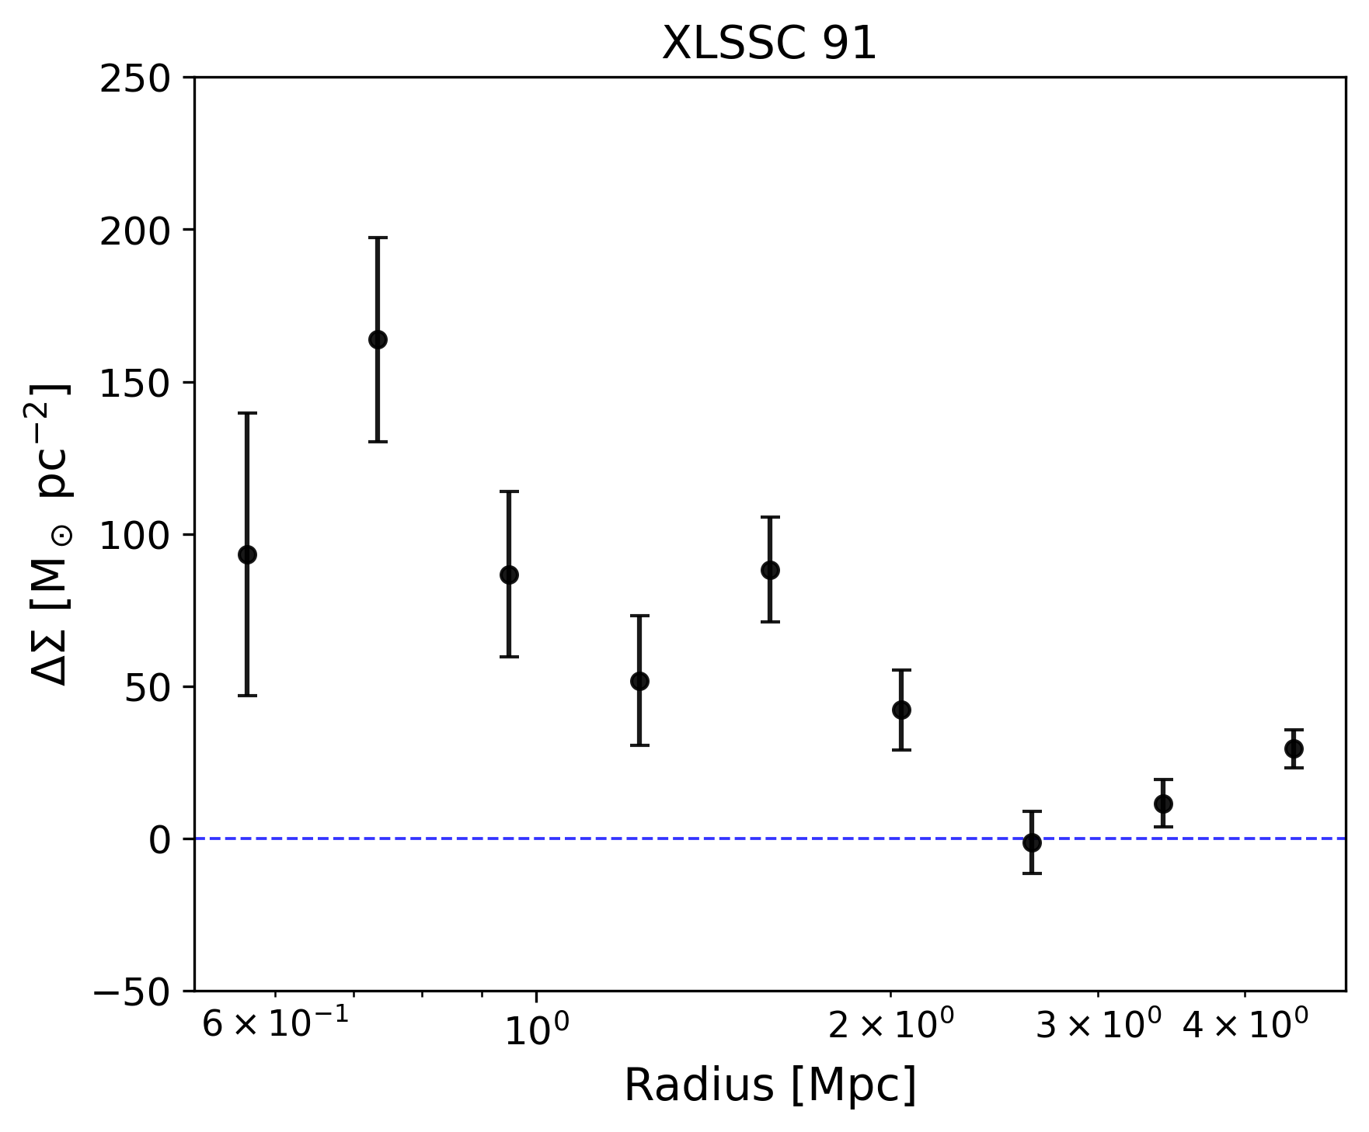

Weak lensing
Background galaxies
Weak gravitational lensing
Direct way to trace the mass distribution of galaxy clusters
Lensing clusters
Observable: Excess surface density (ESD)
ESD
Average
surface density
Surface density
XXL-HSC lensing data around 150 X-ray selected galaxy clusters
Notes:
Weak gravitational lensing is the subtle distortion of background galaxy shapes caused by the gravitational field of intervening mass. Because the effect is sensitive to all matter—regardless of its physical state—it provides a direct way to trace the mass distribution of galaxy clusters, which are dominated by dark matter.
a projected radius compared to the local mass density at that radius, and is directly inferred from the weak-lensing shear.

Slide 9
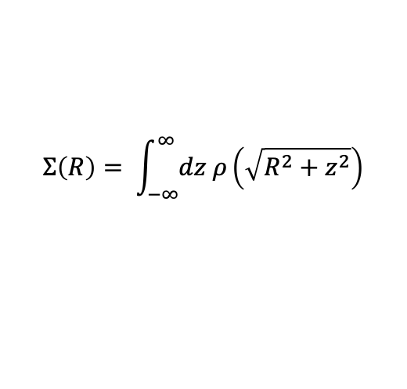

ESR functions
Excess surface density (ESD)
Fit to data
$$ρ_{DM}\left(r\right)=ar+\log{r}$$
$$Σ\left(R\right)= \int_{−∞}^{∞}{dz ρ\left(\sqrt{R^{2}+z^{2}}\right)}$$
Optimise free parameters
Rank functions
Use ESR to find DM profiles that best describe the ESD of HSC galaxy clusters

Slide 10
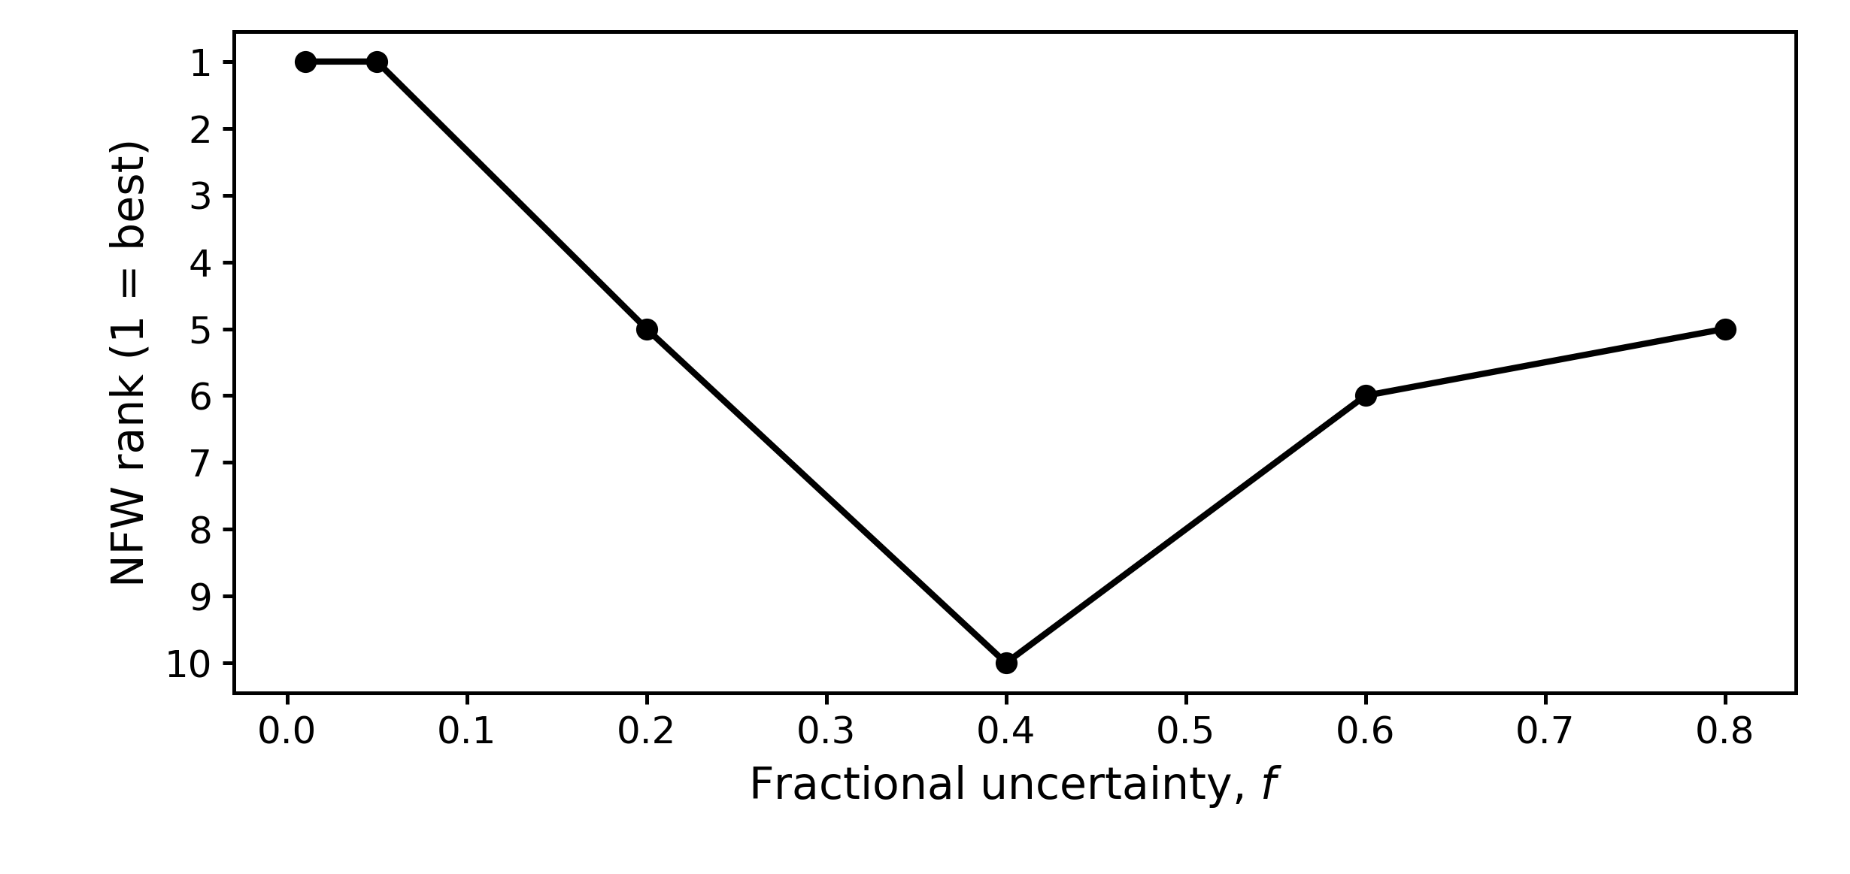
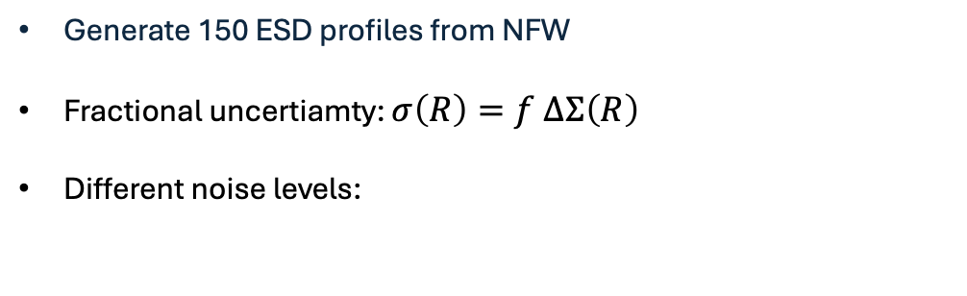
Results: Mock data
Can ESR recover NFW in mocks?
XXL-HSC
Generate 150 ESD profiles from NFW
Fractional uncertiamty: $σ\left(R\right)=f ΔΣ\left(R\right)$
Different noise levels:
ESR consistently ranks the true NFW profile among the best models, even at high noise levels.
A. Martin et al. (2025), arXiv:2511.23073
Notes:
We generated mock ESD profiles from an NFW halo and assigned each point a constant fractional uncertainty.
The mock observations were then obtained by scattering the true profile according to Gaussian noise with that uncertainty.
We start with an NFW profile, and then add different levels of Gaussian noise to mimic observations.

Slide 11
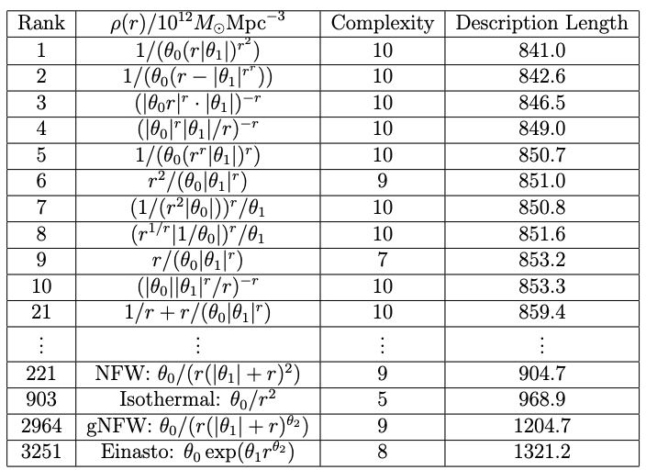
Results: XXL-HSC clusters
And in real data?
Ranking of functions according to DL
A. Martin et al. (2026), arXiv:2601.05203
Notes:
Need to see how much I need to cut this section

Slide 12
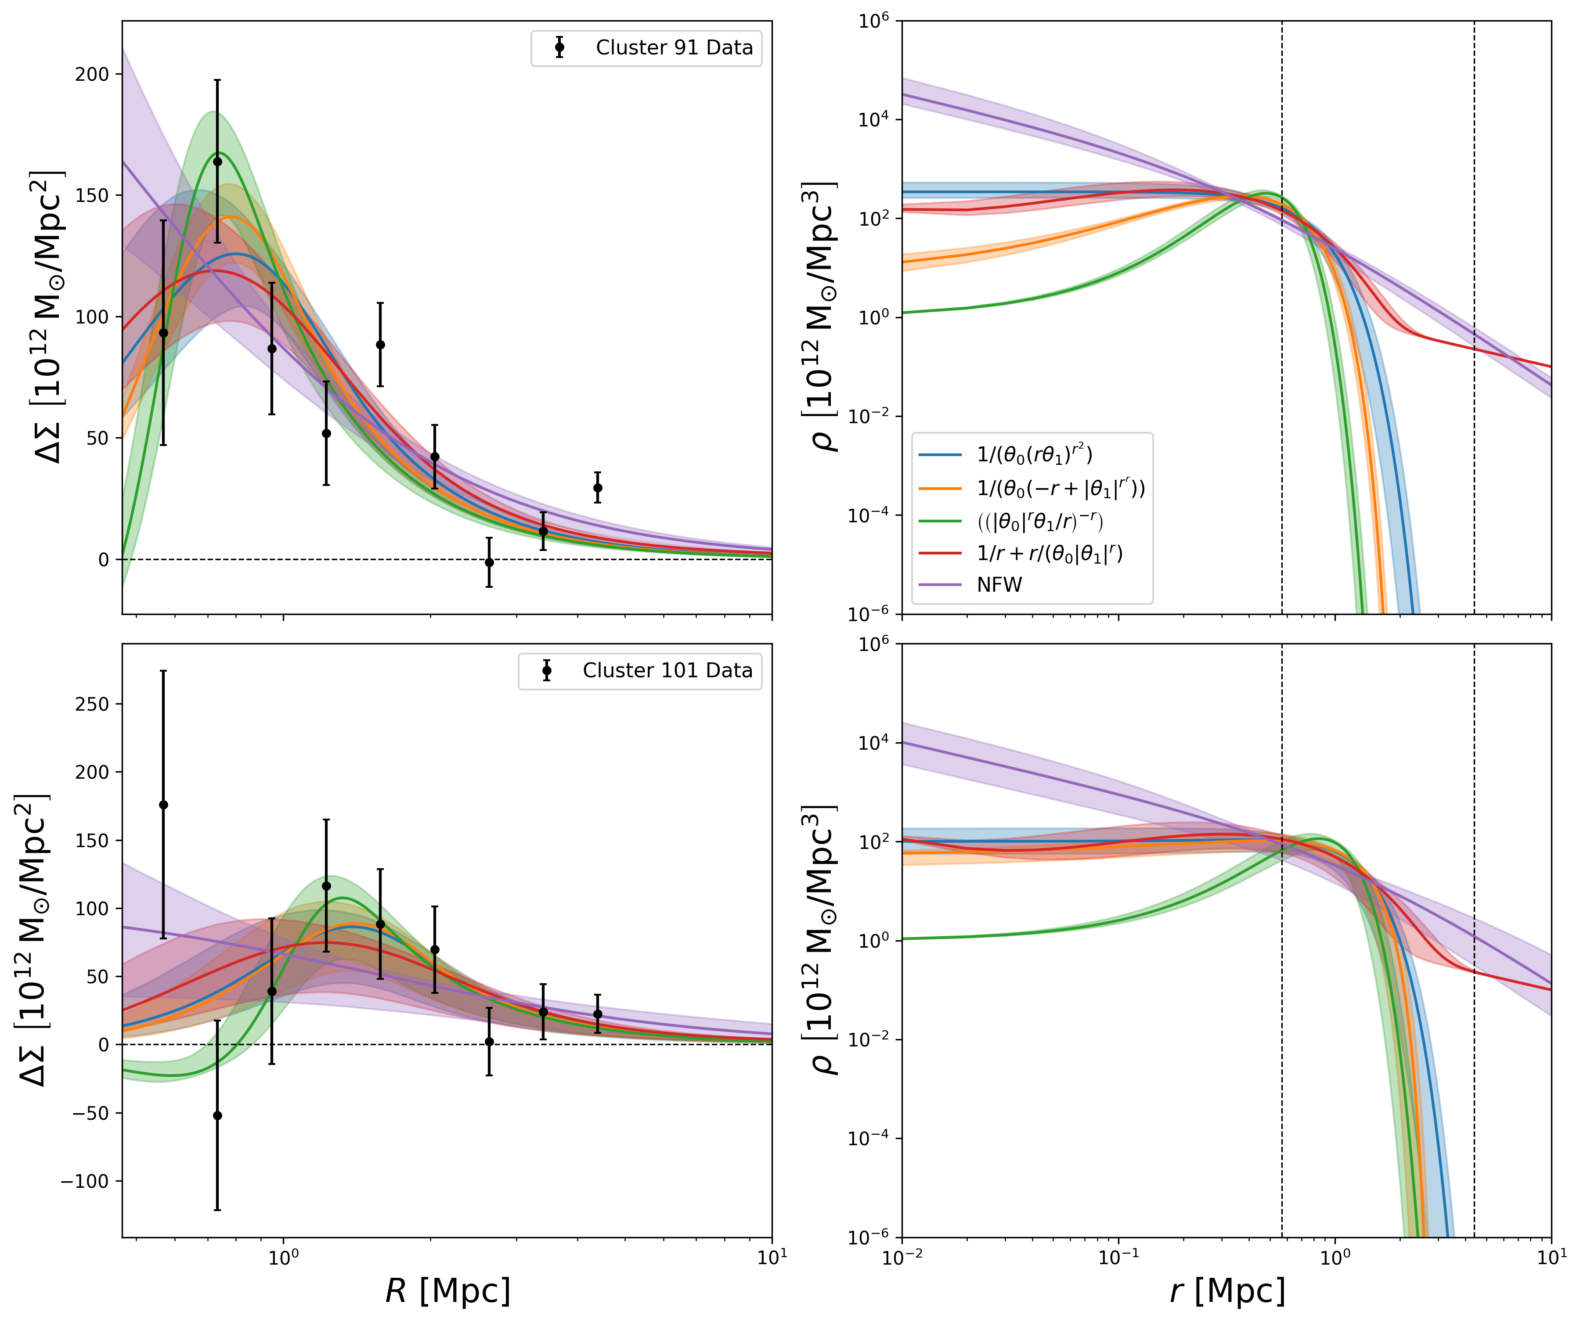
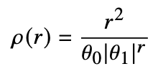
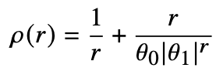
Weak lensing fits
Functions
ESD profile
Density profiles
ΔΣ peaks within the observed radial range
Inner slope remains degenerate
Some good profiles:
Cluster XLSSC 91
Cluster XLSSC 101
Notes:
An important caveat is that weak lensing is not equally sensitive at all radii. The innermost bins have the largest uncertainties, so the data are much more constraining in the outskirts than in the centre. As a result, ESR finds a variety of functions with different inner behaviours that fit the data almost equally well. I therefore interpret this not as strong evidence for a particular inner slope, but rather as evidence that the current data do not strongly constrain the central structure of the halo.

Slide 13
But what else?
New datasets:
Weak lensing
Galaxy dynamics
Others?
CLASH
SPARC
MIGHTEE
Derive physical quantities:
Notes:
But the advantage of this approach is that we are not imposing a fixed functional form like NFW. Instead, we let the data determine which structures are preferred, so the resulting profiles are more directly data-driven.
also account for uncertainty in the functional form itself
So instead of committing to a single model, we marginalise over a set of possible functions
But the method is useful even beyond profile reconstruction. Once we have a set of plausible profiles, we can use them to derive physical quantities such as enclosed masses.

Slide 14
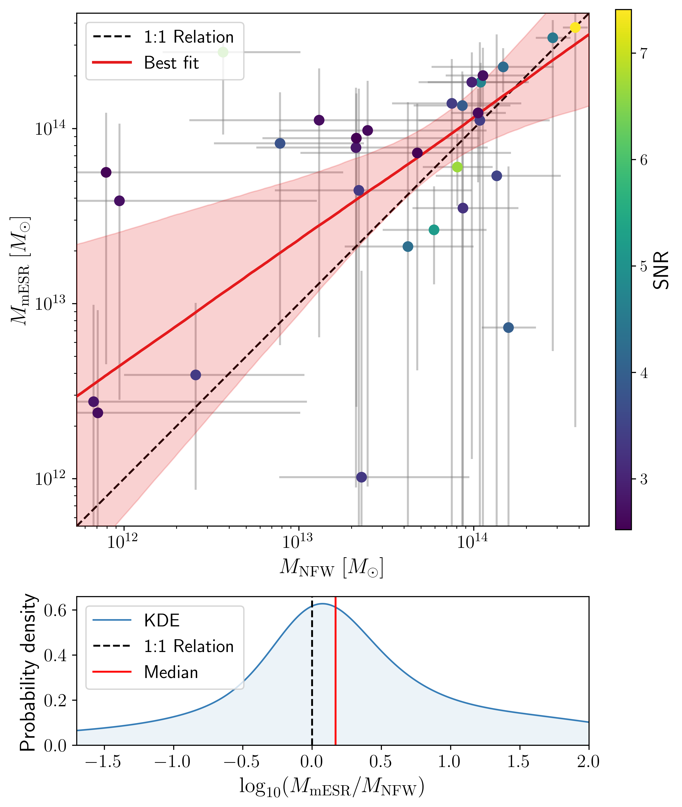

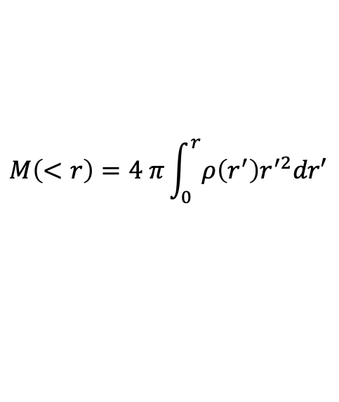

Enclosed mass
$$M\left(<r\right)=4 π\int_{0}^{r}{ρ\left(r^{′}\right)r^{′2}dr′}$$
$$ρ\left(r\right)$$
$$M_{200}$$
Propagate model uncertainty to physical quantities:
Combine plausible profiles using their DL weights
Account for uncertainty in the functional form
A. Martin et al. (2026), arXiv:2601.05203
Notes:
“For each of the highest-ranked ESR profiles, we calculate the corresponding enclosed mass. We then combine those mass distributions, weighting each model according to its probability from the description length.”
Then I'd really emphasise:
“So the final mass uncertainty includes uncertainty in the functional form, not just uncertainty in the parameters of one assumed profile.”
They're broadly consistent, but there is a tendency for the ESR masses to be higher. The important point isn't really the exact offset with this dataset — it's that the inferred mass depends on the assumed functional form.
Here M200M_{200} is the mass enclosed within the radius where the average density is 200 times the critical density of the Universe.

Slide 15
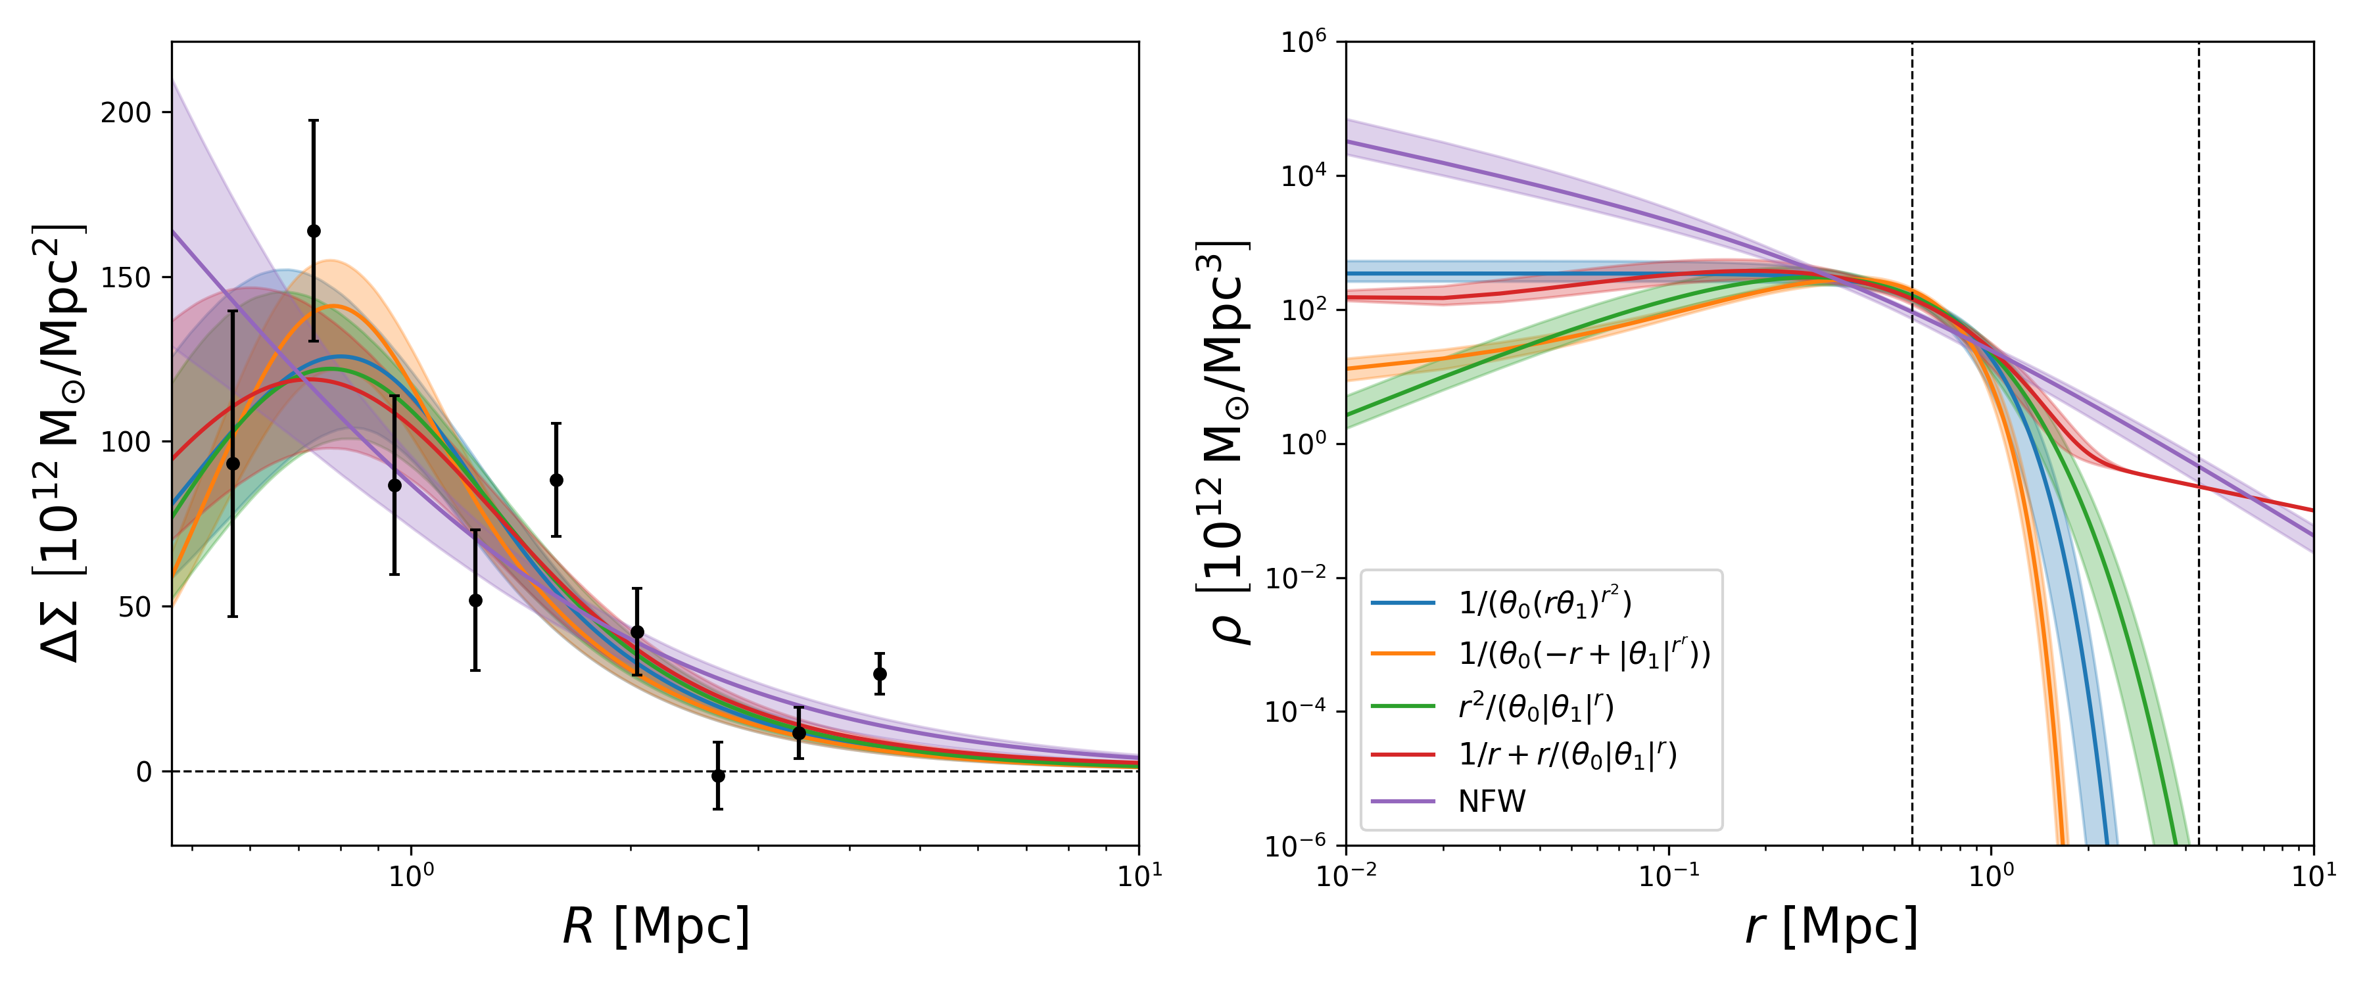
Conclusions
Applied Exhaustive Symbolic Regression algorithm to dark matter profiles
Found superior functions to NFW for HSC clusters, though inner slope can’t be constrained
Now applying to Hubble CLASH WL data + galaxy dynamics (SPARC).
Alicia Martín
alicia.martin@physics.ox.ac.uk
arXiv:2511.23073, arXiv:2511.23073
Notes:
But the advantage of this approach is that we are not imposing a fixed functional form like NFW. Instead, we let the data determine which structures are preferred, so the resulting profiles are more directly data-driven.
The main lesson is that we can infer density profiles directly from observations rather than assuming them a priori.
Rather than starting from NFW and fitting parameters, we allow the data to determine the functional form itself.”
More broadly this shifts the problem from fitting models to inferring them
And I hope I’ve conviced you that this is a pretty exciting thing to do

Slide 17
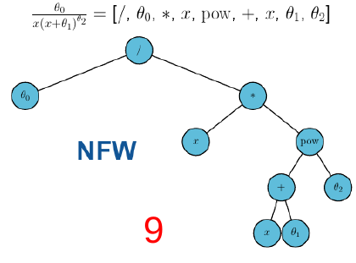
Generating functions: NFW

Slide 18
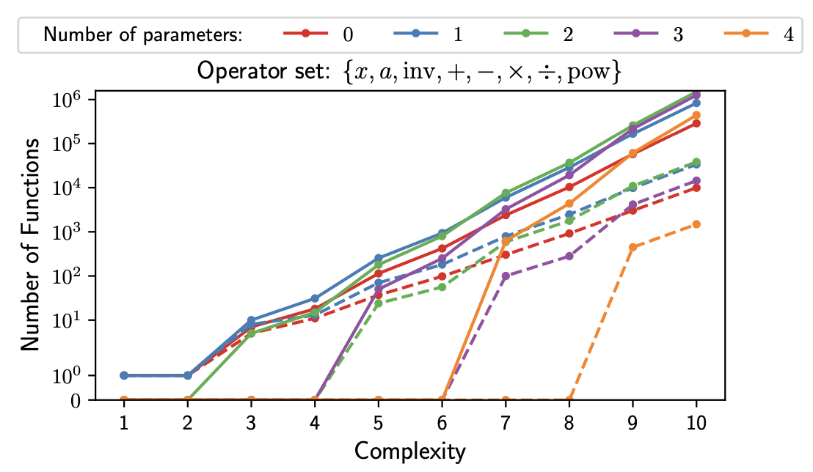
Generating functions:
Highest complexity in ESR is 10 (for now) ---- up to 4 params
D. Bartlett, H. Desmond, P. Ferreira (2023)
Introduction
ESR
Fitting DM haloes
Conclusions

Slide 19
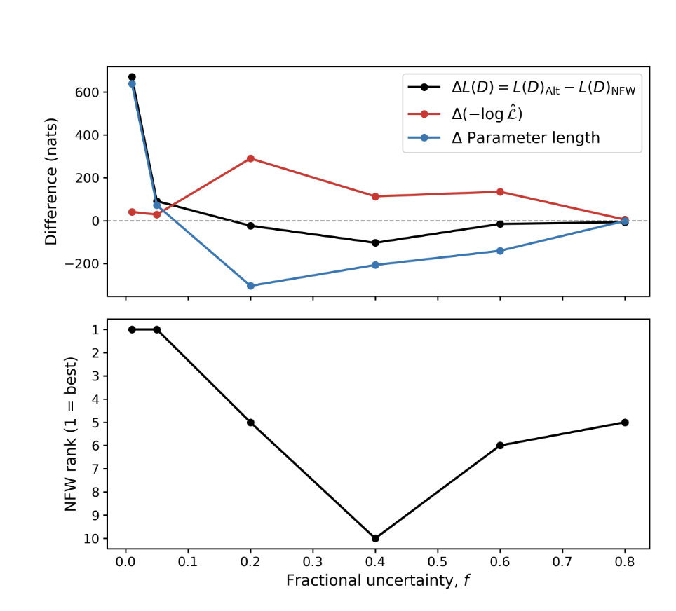

Slide 20



Slide 21



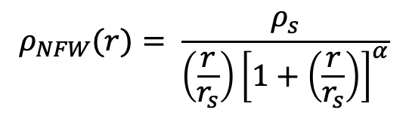






Local and global parameters
2 local parameters
1 local, 1 global parameter
2 global parameters
Cluster 1
$$ρ_{DM1}\left(r\right)=a1 r+b1\log{r}$$
$$ρ_{DM1}\left(r\right)=a r+b1\log{r}$$
$$ρ_{DM}\left(r\right)=a r+b\log{r}$$
Cluster 2
$$ρ_{DM2}\left(r\right)=a2 r+b2\log{r}$$
$$ρ_{DM2}\left(r\right)=a r+b2\log{r}$$
$$ρ_{DM}\left(r\right)=a r+b\log{r}$$
.....
.....
.....
.....
Cluster 150
$$ρ_{DM150}\left(r\right)=a150 r+b150\log{r}$$
$$ρ_{DM150}\left(r\right)=a r+b150\log{r}$$
$$ρ_{DM}\left(r\right)=a r+b\log{r}$$
$$ρ_{NFW}(r)= \frac{ρ_{s}}{\left(\frac{r}{r_{s}}\right){\left[1+\left(\frac{r}{r_{s}}\right)\right]}^{α}}$$
Why have global parameters?
Notes:
Need to see how much I need to cut this section

Slide 22
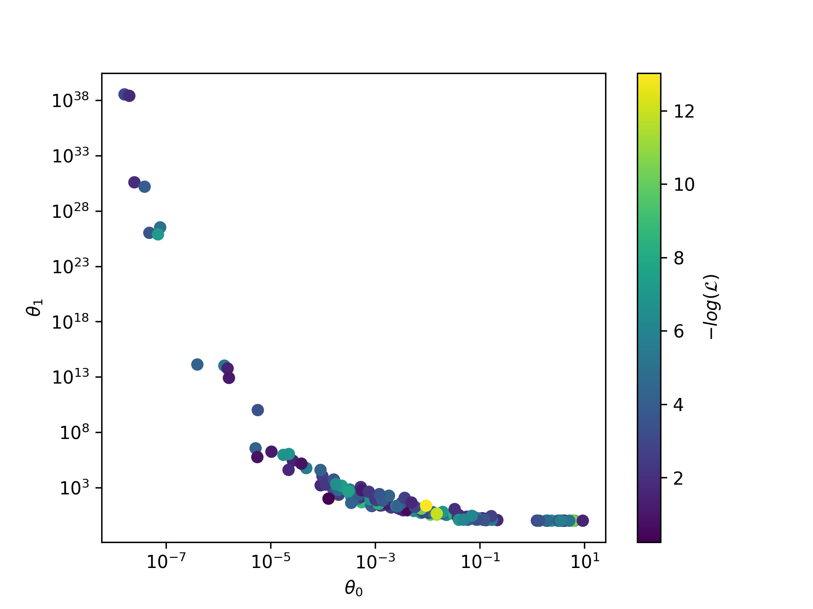
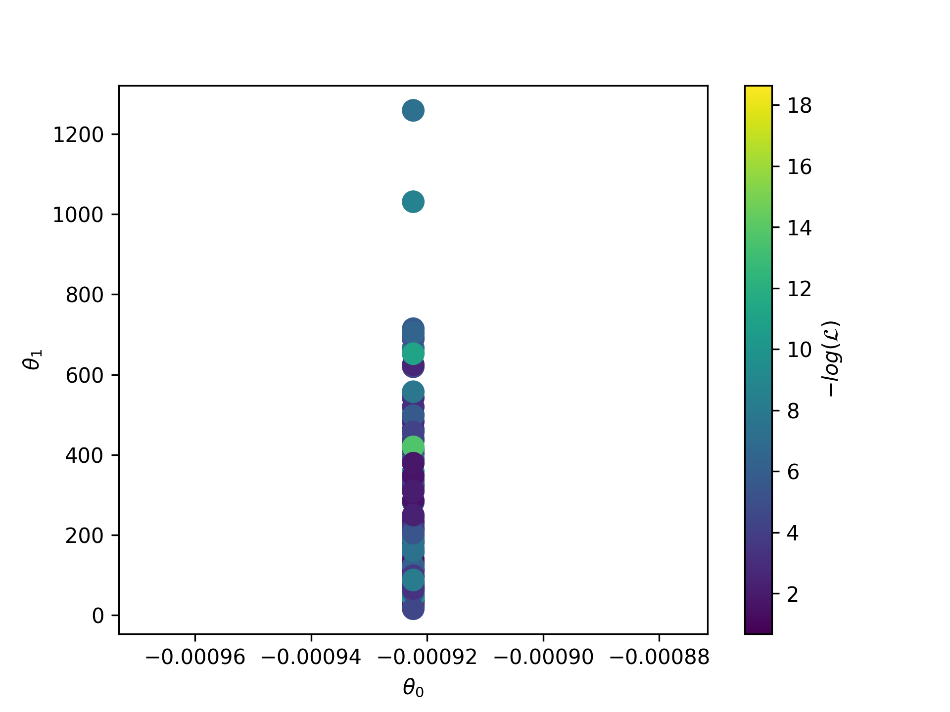



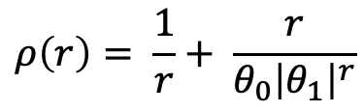

$$ρ\left(r\right)= \frac{1}{r}+ \frac{r}{θ_{0}{\left|θ_{1}\right|}^{r}}$$
Optimised parameters for
2 local parameters
1 local, 1 global parameter
Parameter $θ_{1}$
Parameter $θ_{1}$
Parameter 1
Parameter $θ_{0}$
Parameter $θ_{0}$
DL = 853 nats
DL = 911 nats
Notes:
Put both axis in log?

