Slide 1

Deep learning galaxy morphologies for shear calibration in the era of Euclid
Benjamin Csizi, University of Innsbruck
With Tim Schrabback, Sebastian Grandis, Laila Linke, Henning Jansen, Henk Hoekstra, Nicolas Martinet, + the rest of the Euclid OU-SHE team

Slide 2

Outline
Quick introduction to weak lensing and shear biases
The Euclid mission
A deep generative model for galaxy morphologies
Related shear biases from morphology and colour gradients
Summary & outlook
ML4ASTRO3, Valletta, Malta, 2026 Benjamin Csizi

Slide 3

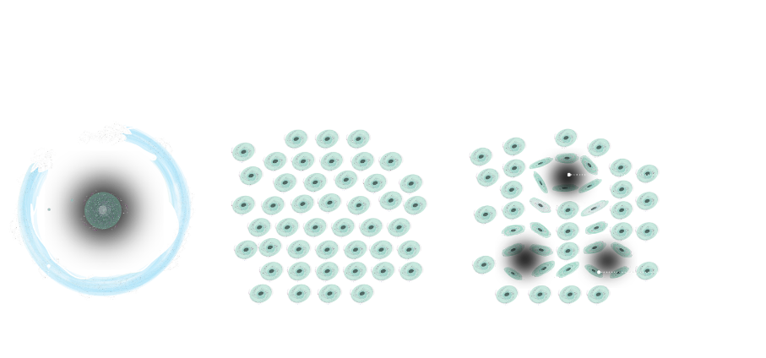
Weak lensing and shear biases
ML4ASTRO3, Valletta, Malta, 2026 Benjamin Csizi
Credit: ESA/ATG
→ Weak lensing: coherent, small distortion of galaxy shapes due to large-scale structure

Slide 4
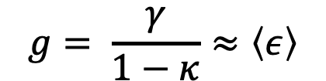
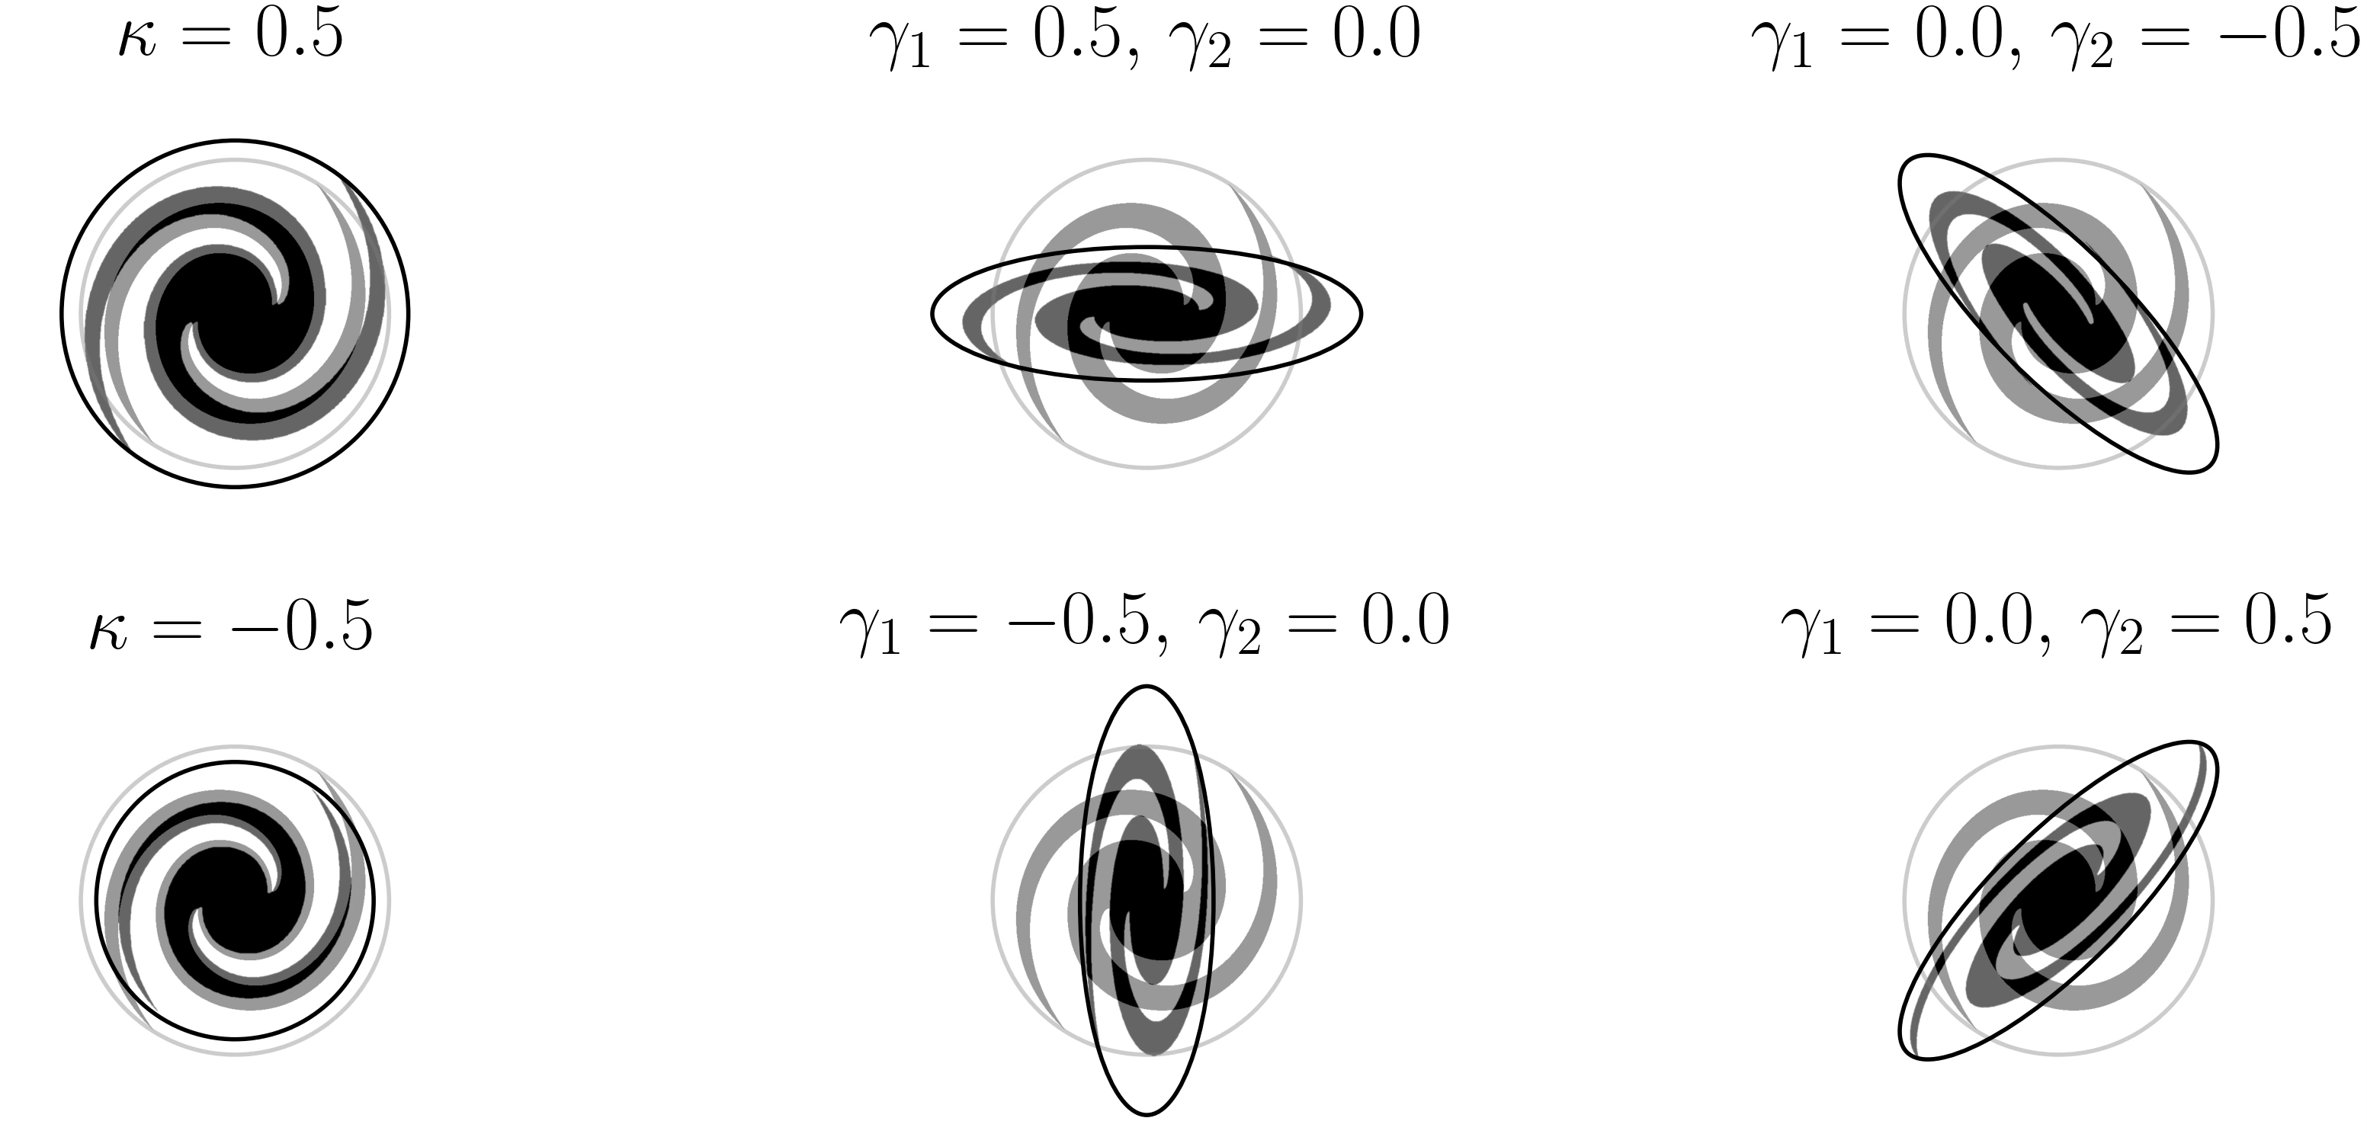
Weak lensing and shear biases
An ensemble average of galaxy ellipticities can be used as an estimator for the reduced shear
  We need image simulations that resemble the real data closely, with an accurate model of galaxy shapes, to calibrate the estimator
ML4ASTRO3, Valletta, Malta, 2026 Benjamin Csizi

Slide 5
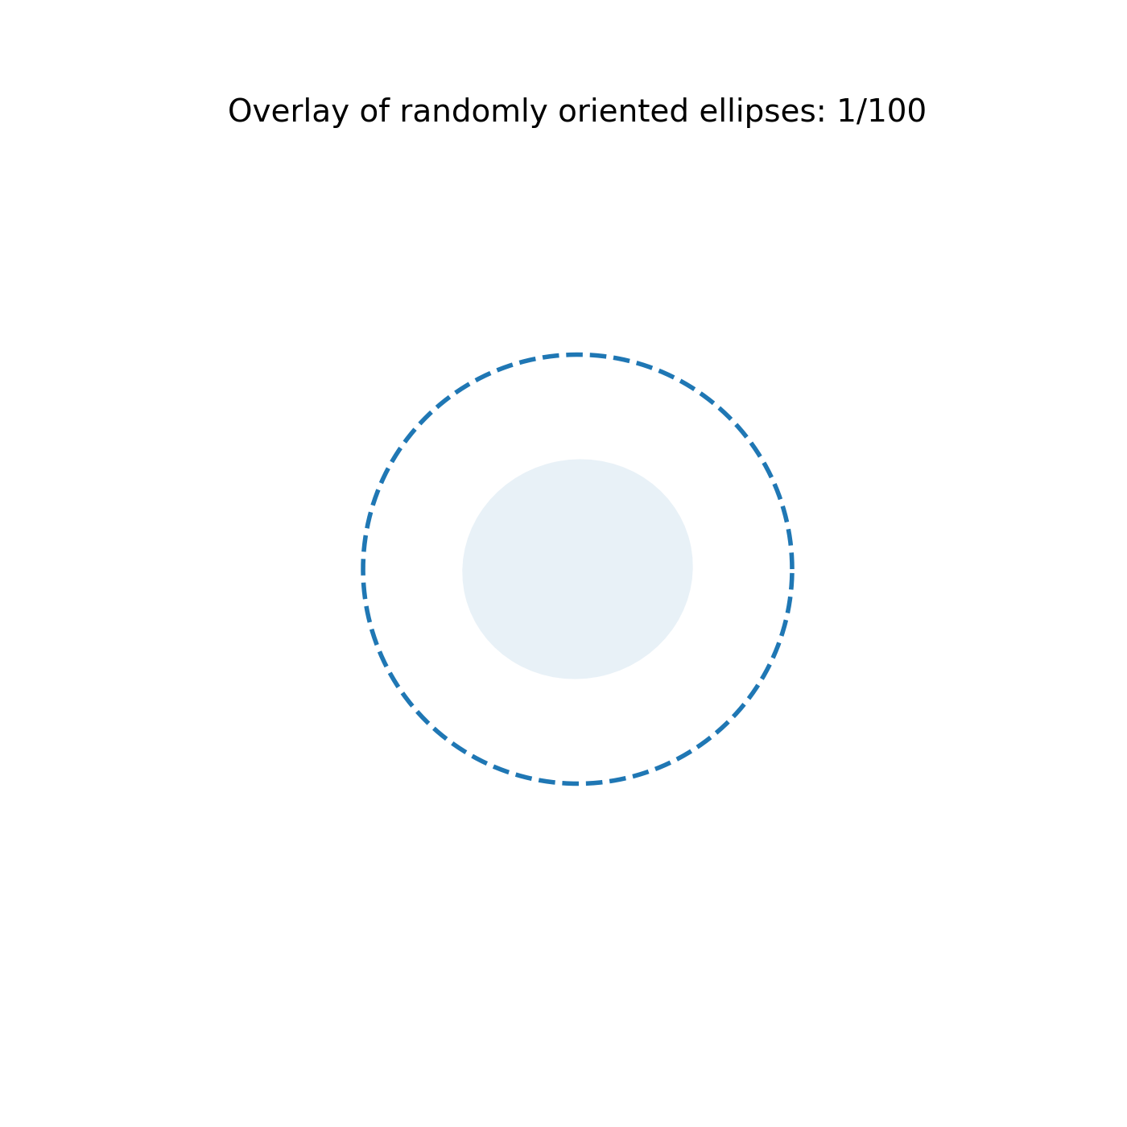
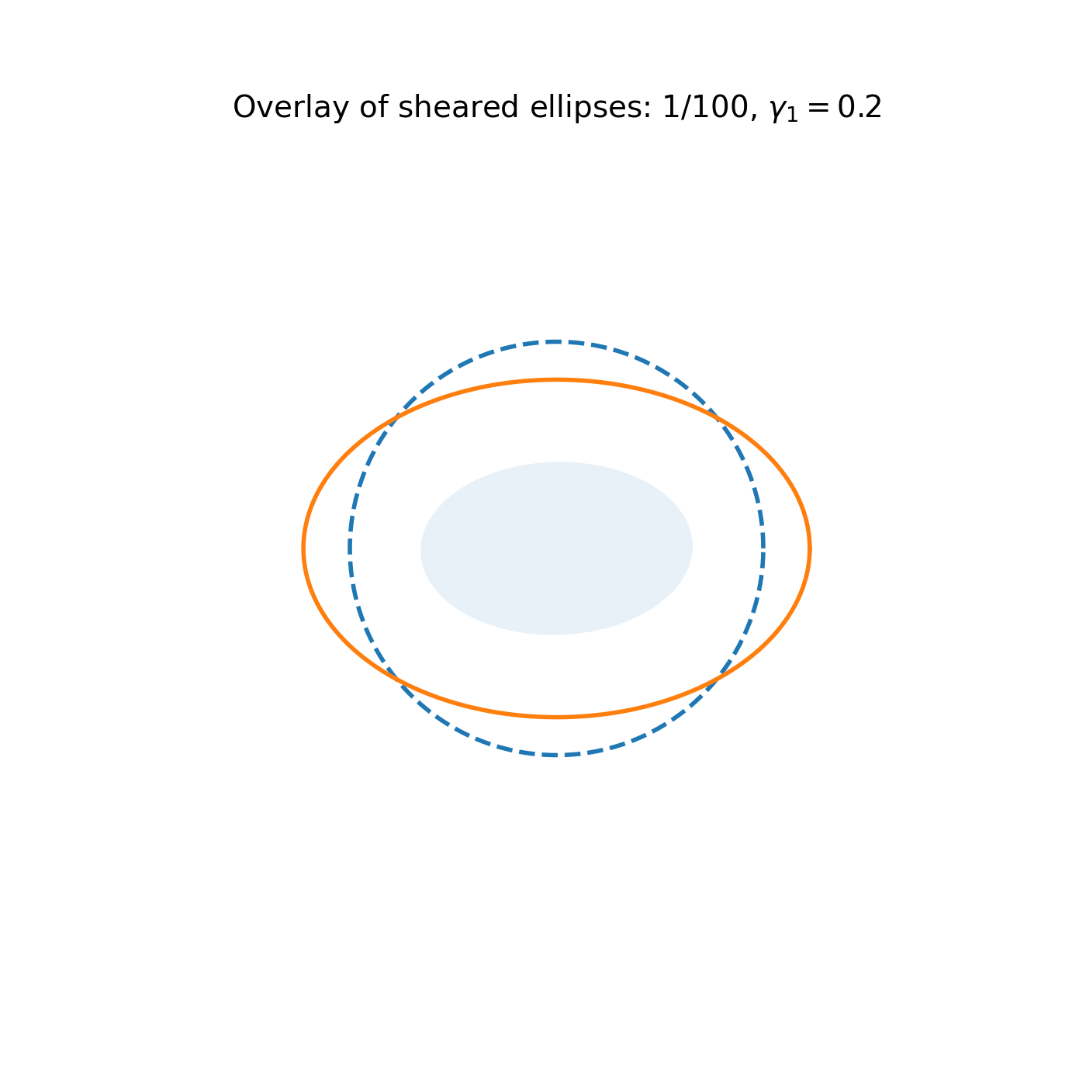
Weak lensing and shear biases
An ensemble average of galaxy ellipticities can be used as an estimator for the reduced shear
  We need image simulations that resemble the real data closely, with an accurate model of galaxy shapes, to calibrate the estimator
ML4ASTRO3, Valletta, Malta, 2026 Benjamin Csizi

Slide 6

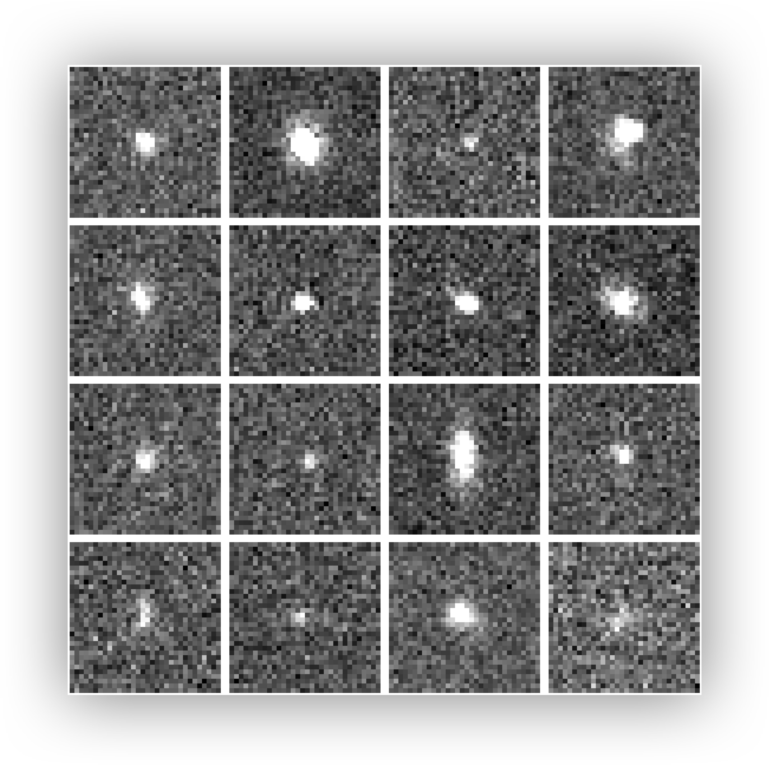
Weak lensing and shear biases
We need to measure galaxy shapes (ellipticities)
→ but: very small and noisy galaxies, plus estimator is biased
ML4ASTRO3, Valletta, Malta, 2026 Benjamin Csizi

Slide 7
Weak lensing and shear biases
We need to measure galaxy shapes (ellipticities)
→ but: very small and noisy galaxies, plus estimator is biased
ML4ASTRO3, Valletta, Malta, 2026 Benjamin Csizi
  We need image simulations that resemble the real data closely, with an accurate model of galaxy shapes, to calibrate the estimator
Deep learning!

Slide 8
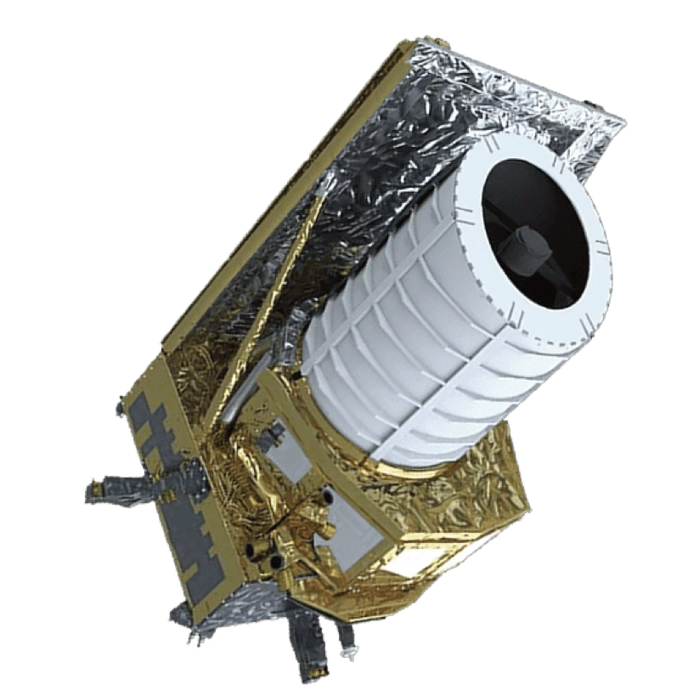
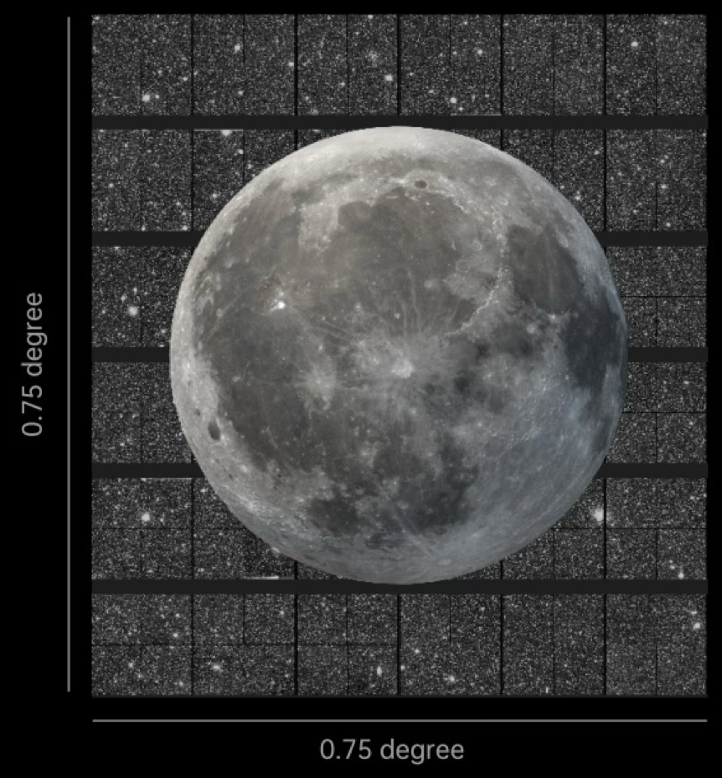
The Euclid mission
ESA M-class mission (EC: Mellier et al. 2025)
- 1.2m telescope at L2
- two instruments: VIS and NISP
- Observing on third of the sky over 6 years
- „Dark Universe Detective“
ML4ASTRO3, Valletta, Malta, 2026 Benjamin Csizi
Credit: ESA/NASAEuclid Consortium

Slide 9
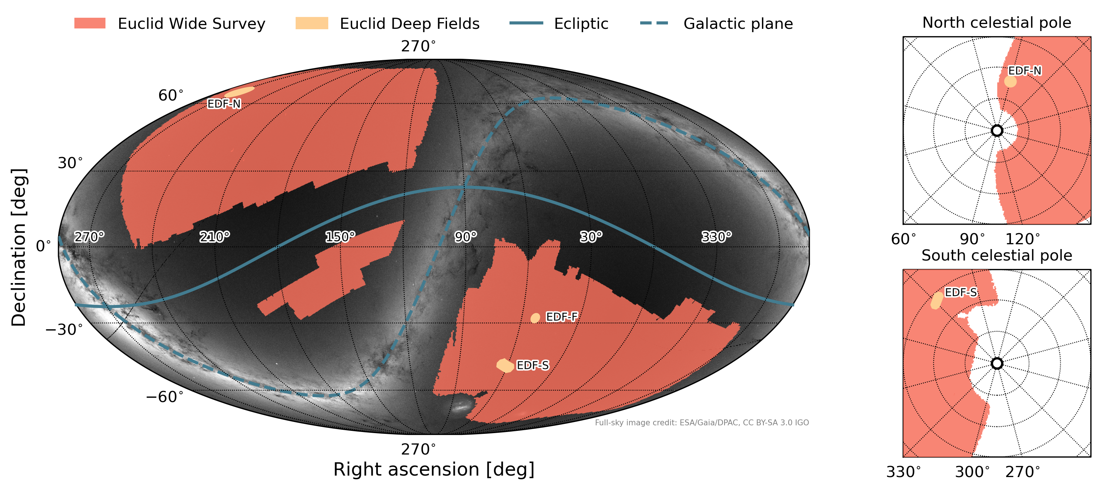
The Euclid mission
ESA M-class mission (EC: Mellier et al. 2025)
- 1.2m telescope at L2
- two instruments: VIS and NISP
- Observing on third of the sky over 6 years
- „Dark Universe Detective“
ML4ASTRO3, Valletta, Malta, 2026 Benjamin Csizi
Unprecedented depth and resolution over large survey area
But: this requires to think about additional systematics that could be ignored so far
Credit: ESA/NASAEuclid Consortium

Slide 10
A deep generative model for galaxy morphologies
Deep generative models for galaxy images have previously been developed by (Lanusse+21, Smith+22, Holzschuh+22)
But: for shear calibration for Euclid, a few criterions must be fulfilled
  Noise- and PSF-independent
  Conditional sampling or distributions matched to Euclid data (e.g. EC: Jansen+26)
  Quick sampling → need to simulated billions of galaxies
  Ideally multi-band morphologies to account for colour gradients etc.
ML4ASTRO3, Valletta, Malta, 2026 Benjamin Csizi

Slide 11
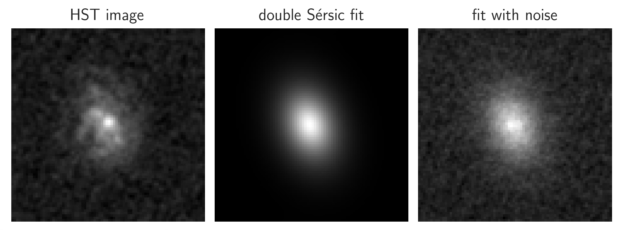
A deep generative model for galaxy morphologies
Deep generative models for galaxy images have previously been developed by (Lanusse+21, Smith+22, Holzschuh+22)
But: for shear calibration for Euclid, a few criterions must be fulfilled
  Noise- and PSF-independent
  Conditional sampling or distributions matched to Euclid data (e.g. EC: Jansen+26)
  Quick sampling → need to simulated billions of galaxies
  Ideally multi-band morphologies to account for colour gradients etc.
High resolution training data: Hubble Space Telescope
COSMOS + CANDELS imaging
ML4ASTRO3, Valletta, Malta, 2026 Benjamin Csizi

Slide 12
A deep generative model for galaxy morphologies
Model architecture
ML4ASTRO3, Valletta, Malta, 2026 Benjamin Csizi
Simple Decoder with manual latent space compression that via wavelet scattering fields + embedding of physical parameters (size, colour, magnitude, redshift, ellipticity)

Slide 13
A deep generative model for galaxy morphologies
Training & validation
After training, we first see qualitatively:
We can reconstruct the training images without noise, preserving complex features and substructure
Significantly improve the accuracy of galaxy shape models (compared to Sérsic fits)
ML4ASTRO3, Valletta, Malta, 2026 Benjamin Csizi
From EC: Csizi et al. (2025)

Slide 14
A deep generative model for galaxy morphologies
Training & validation
After training, we first see qualitatively:
We can reconstruct the training images without noise, preserving complex features and substructure
Significantly improve the accuracy of galaxy shape models (compared to Sérsic fits)
ML4ASTRO3, Valletta, Malta, 2026 Benjamin Csizi
But:
From EC: Csizi et al. (2025)

Slide 15
A deep generative model for galaxy morphologies
Training & validation
→ Quantitative validation: comparison of recovery of input distribution of physical properties
ML4ASTRO3, Valletta, Malta, 2026 Benjamin Csizi

Slide 16
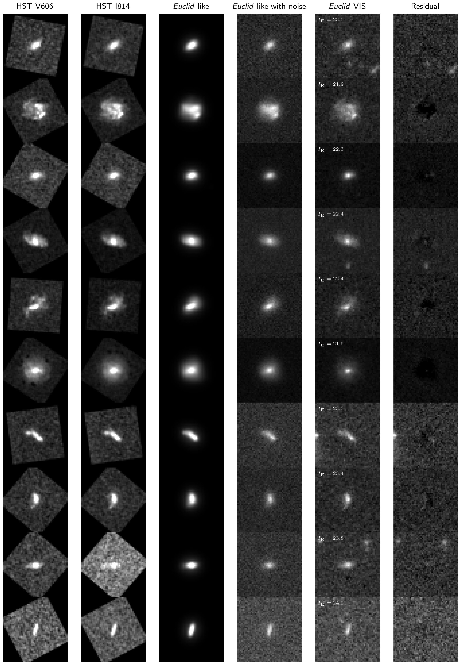
A deep generative model for galaxy morphologies
Training & validation
Comparison of Euclid-like reconstructions to Euclid observed images in the COSMOS field
ML4ASTRO3, Valletta, Malta, 2026 Benjamin Csizi
From EC: Csizi et al. (in prep.)

Slide 17
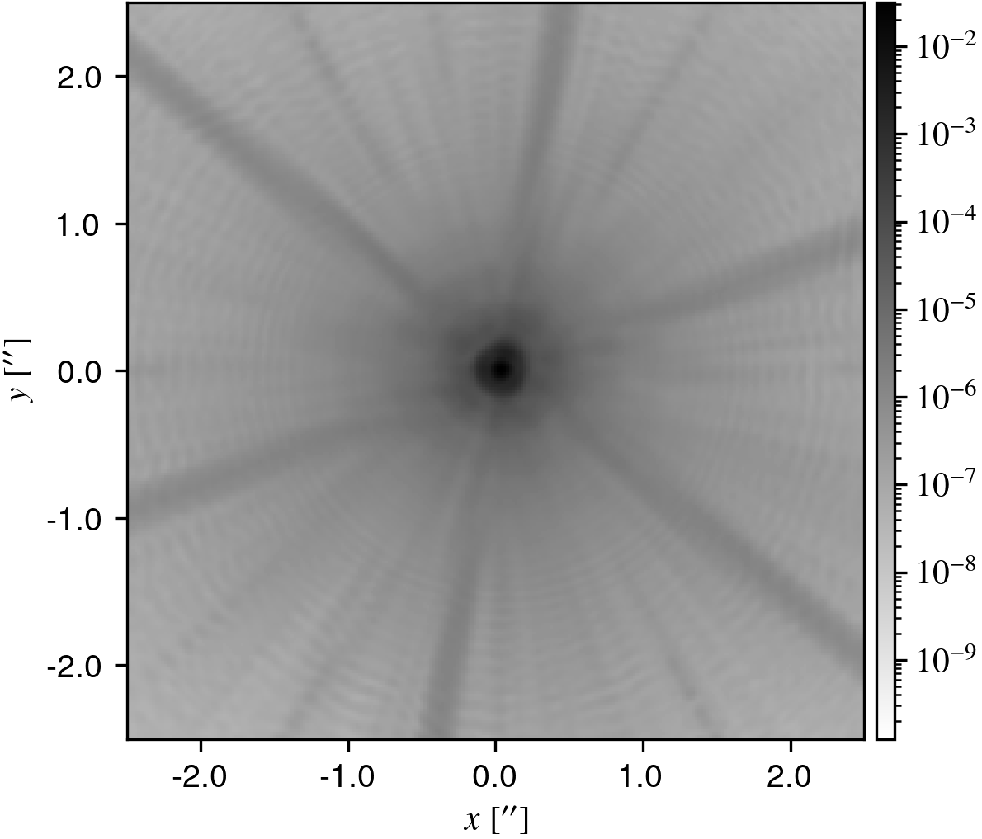
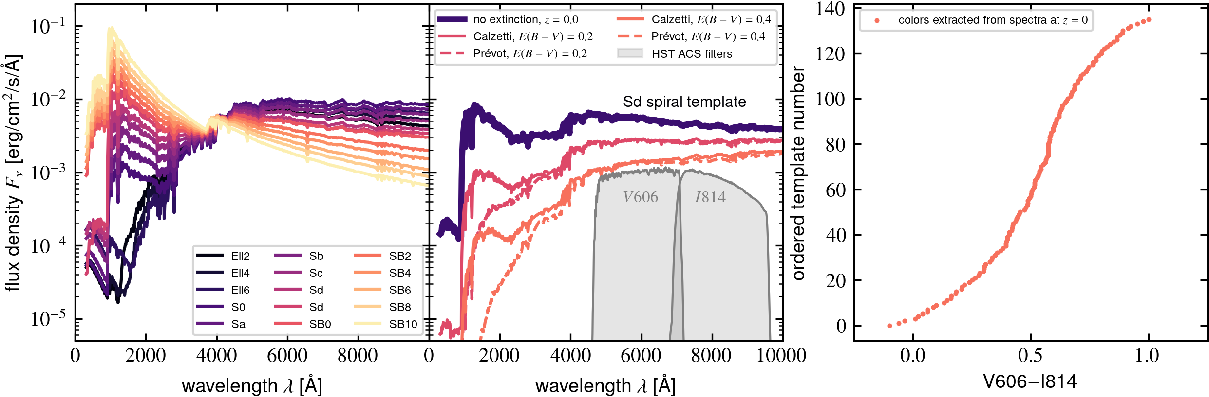
Related shear biases
We can use these galaxies to create realistic simulation of Euclid VIS images using the Flagship N-body simulation as input catalogue (EC:Castander+2025)
Use Euclid PSF, an SED library, and the generative model for galaxy generation
Measure shapes with Euclid’s shape measurement methods
ML4ASTRO3, Valletta, Malta, 2026 Benjamin Csizi

Slide 18
Related shear biases
We are interested in three things:
  How shear biases change when using realistic vs. parametric morphologies
  How detection biases change in that case
  How shear biases change for galaxies with and without colour gradients
ML4ASTRO3, Valletta, Malta, 2026 Benjamin Csizi

Slide 19
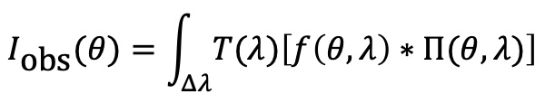
Related shear biases
We are interested in three things:
  How shear biases change when using realistic vs. parametric morphologies
  How detection biases change in that case
  How shear biases change for galaxies with and without colour gradients
Colour gradients: assuming one effective PSF per galaxy, ignoring spatial variation, leads to biases in PSF correction and hence in shape measurement
ML4ASTRO3, Valletta, Malta, 2026 Benjamin Csizi

Slide 20
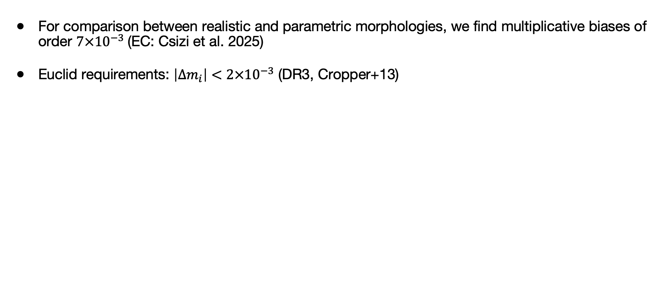
Related shear biases
ML4ASTRO3, Valletta, Malta, 2026 Benjamin Csizi

Slide 21
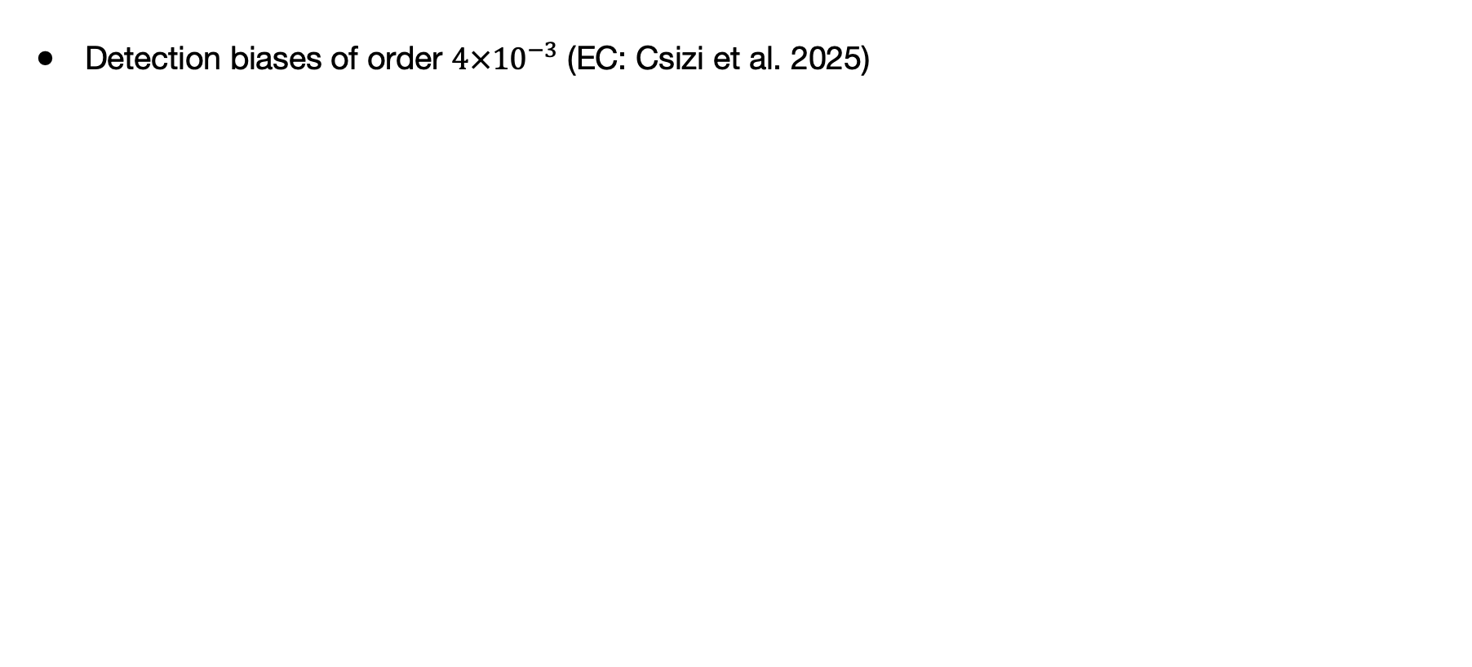
Related shear biases
ML4ASTRO3, Valletta, Malta, 2026 Benjamin Csizi

Slide 22
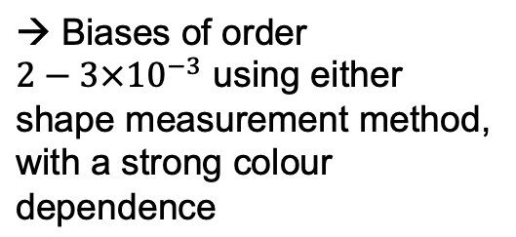
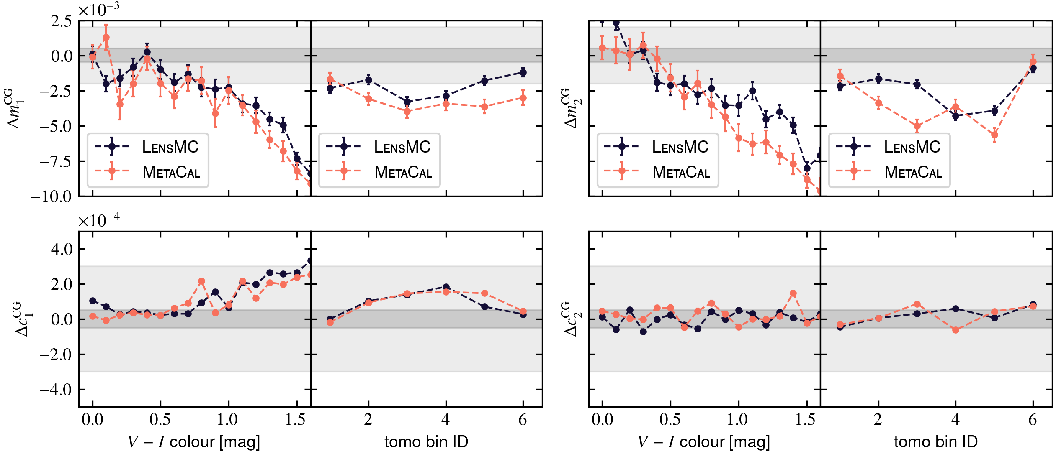
Related shear biases
For colour gradients, we create matching simulations with and without colour gradients using dual-channel HST outputs following Semboloni+13, Er+18 (EC: Csizi et al., in prep.)
ML4ASTRO3, Valletta, Malta, 2026 Benjamin Csizi

Slide 23
Summary & outlook
We have developed and validation a deep generative model trained on HST data to create realistic shapes for Euclid shear calibration image simulations
The model is fast, fully conditioned on multiple parameters, and produces noise- and PSF-free galaxy cutouts
Using it, we find that including of complex morphology and sub-structure into shear calibration is necessary to reach requirements for Euclid calibration and thus cosmological inference (but only beyond DR1)
The model has been fully implemented in the Euclid simulation pipeline, undergoing testing now
In the future: extend to include also infrared morphology, multimodal model that includes also galaxy spectra, …
ML4ASTRO3, Valletta, Malta, 2026 Benjamin Csizi

Slide 24
ML4ASTRO3, Valletta, Malta, 2026 Benjamin Csizi

