Slide 1




Hub-Aware Hybrid Search: Accelerating the Locally Aligned Ant Technique
Simone Vilardi, Reynier Peletier, Felipe Contreras, Kerstin Bunte
ML4ASTRO3 2026
University of Malta, Valletta, 31 August - 4 September 2026

Slide 2


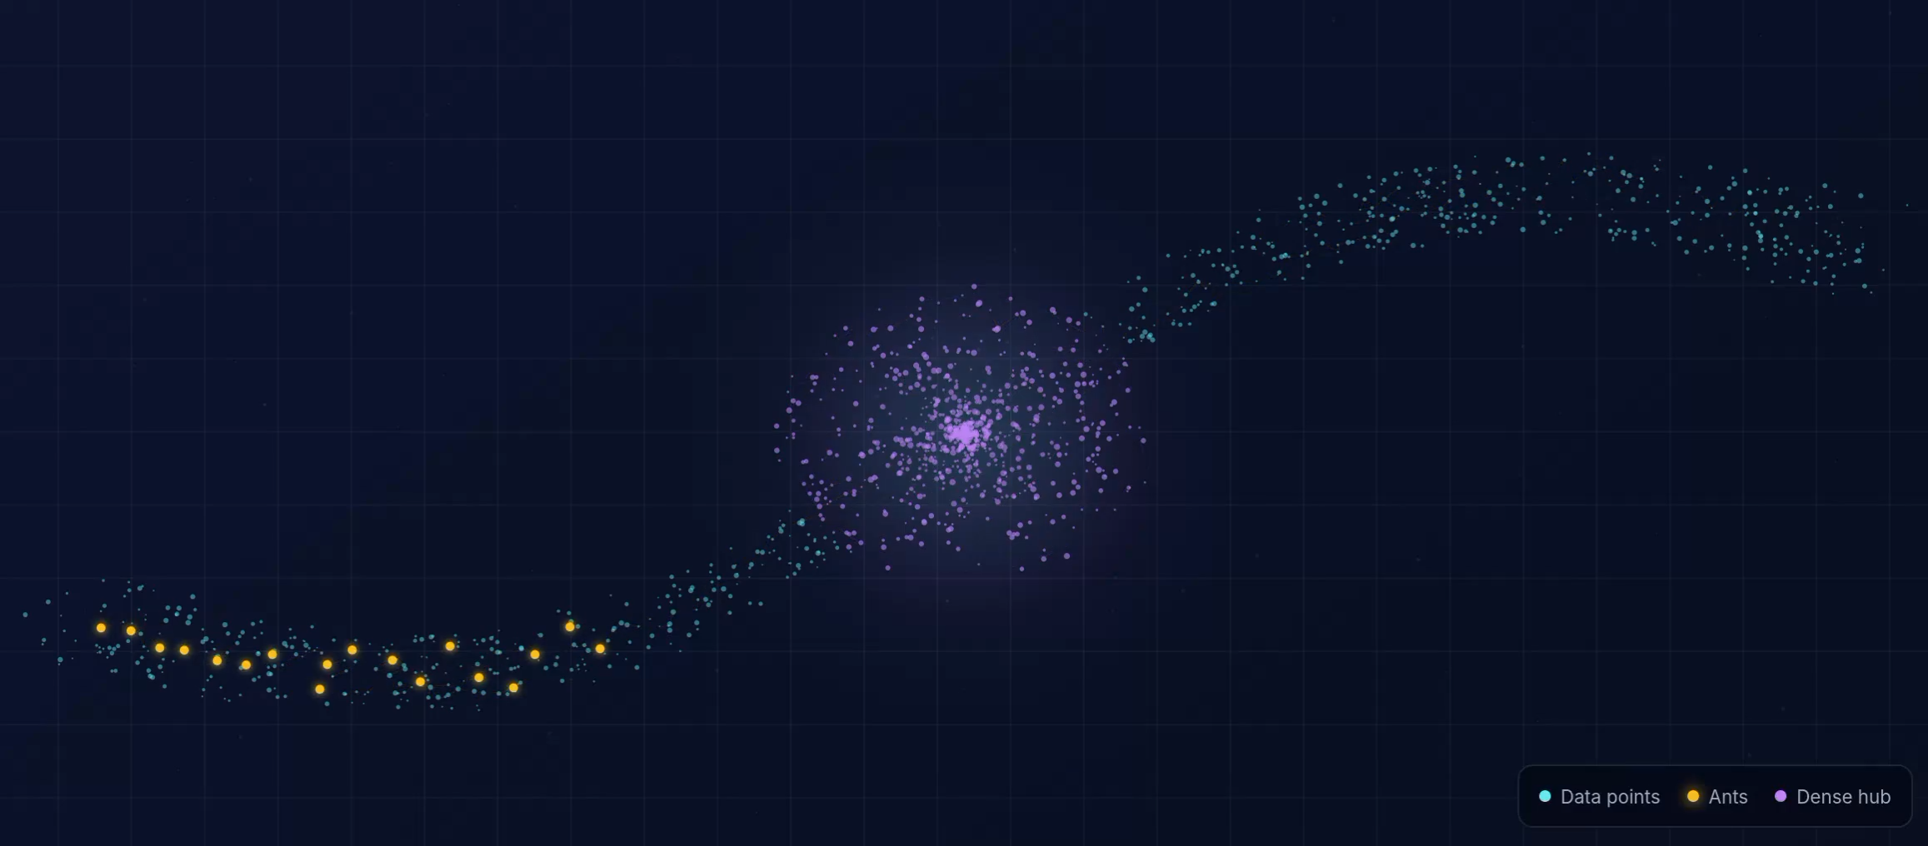
The problem
FUNDING BY THE EUROPEAN UNION (MSCA EDUCADO, GA 101119830).
Dense hubs monopolize Standard LAAT and hide filaments
2

Slide 3
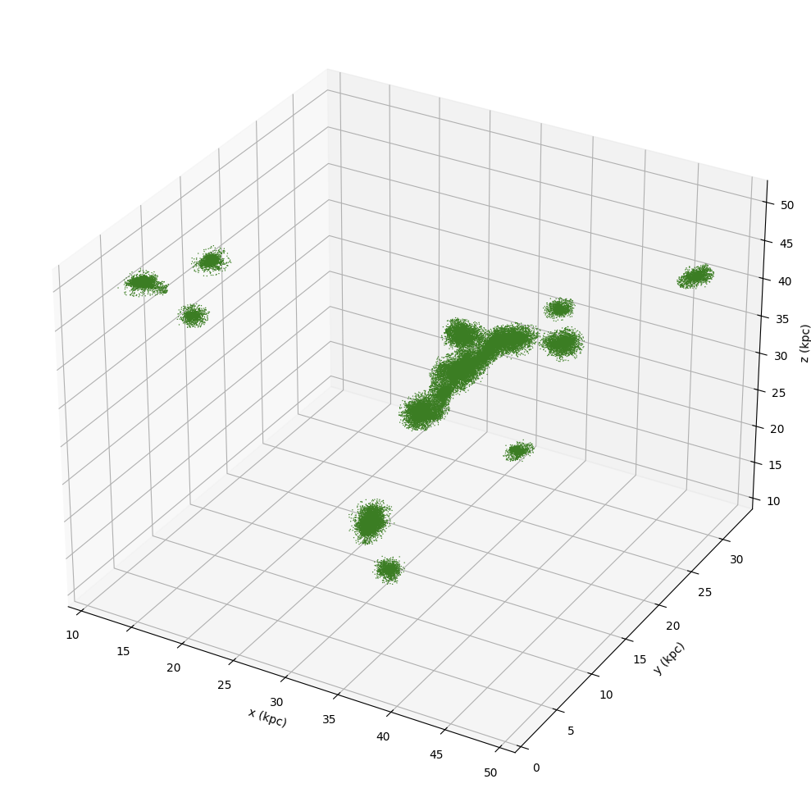
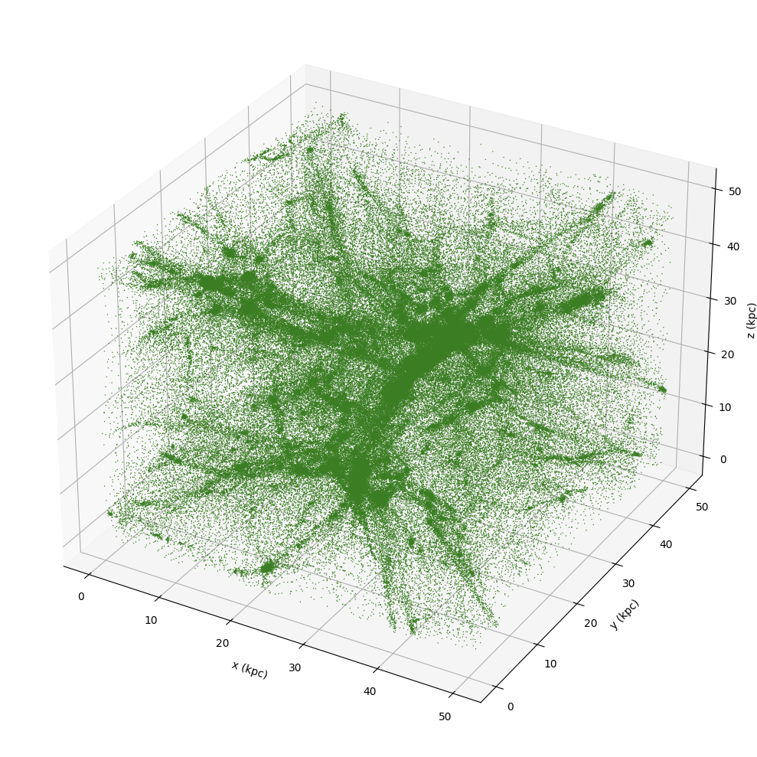
Hub-LAAT
FUNDING BY THE EUROPEAN UNION (MSCA EDUCADO, GA 101119830).
3
Detection and modelling of dense hubs

Slide 4
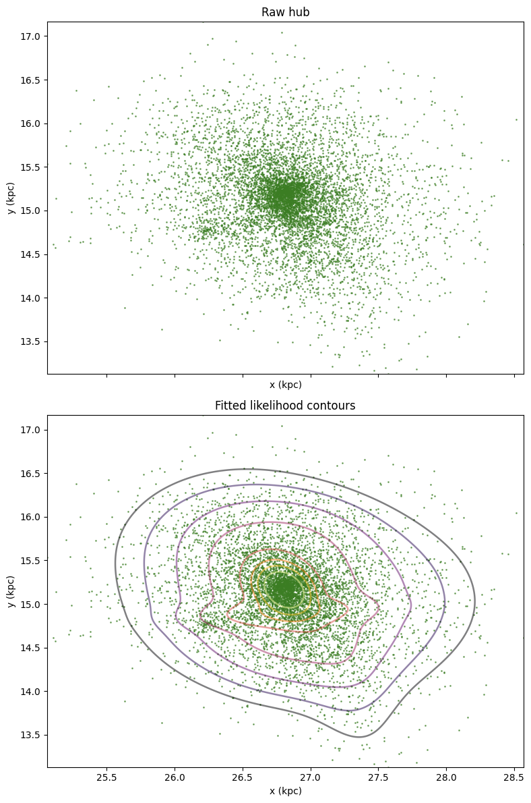
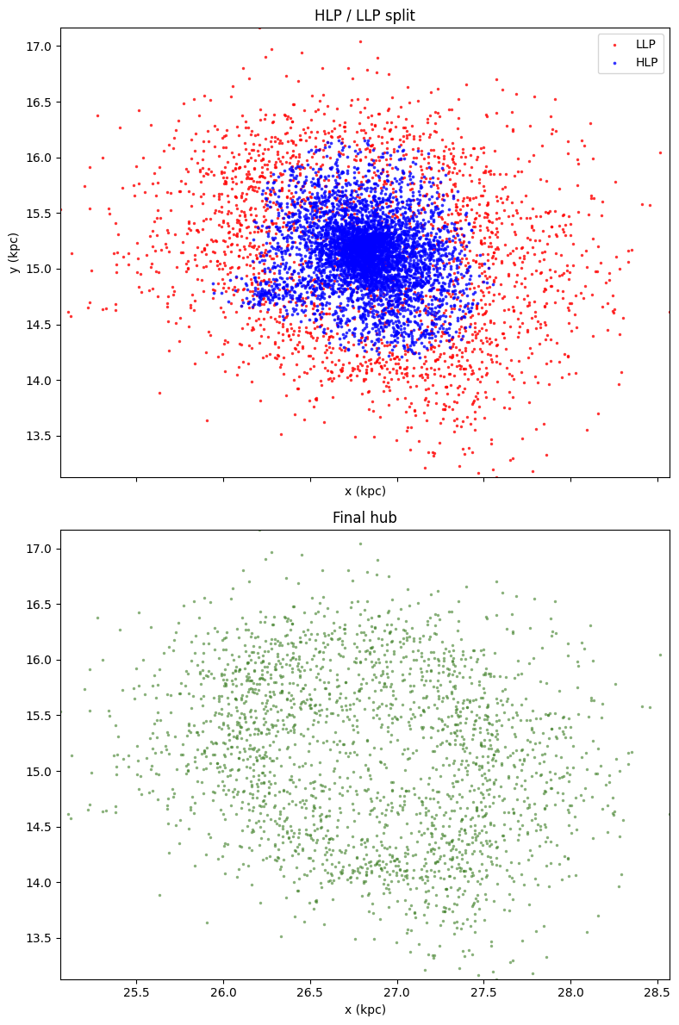
FUNDING BY THE EUROPEAN UNION (MSCA EDUCADO, GA 101119830).
4
Detection and modelling of dense hubs

Slide 5
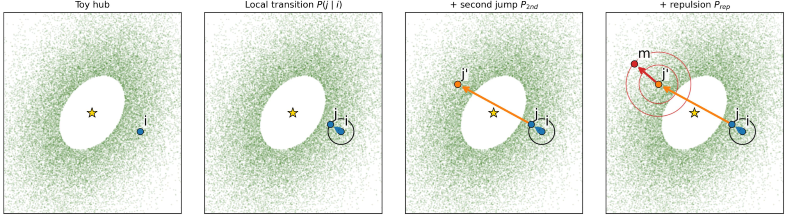
Hub-aware ant movement
FUNDING BY THE EUROPEAN UNION (MSCA EDUCADO, GA 101119830).
HLP core removed
5

Slide 6
Hub-aware ant movement
FUNDING BY THE EUROPEAN UNION (MSCA EDUCADO, GA 101119830).
Likelihood-based local move
5

Slide 7
Hub-aware ant movement
FUNDING BY THE EUROPEAN UNION (MSCA EDUCADO, GA 101119830).
Stochastic crossing
5

Slide 8
Hub-aware ant movement
FUNDING BY THE EUROPEAN UNION (MSCA EDUCADO, GA 101119830).
Repulsive exit
5

Slide 9
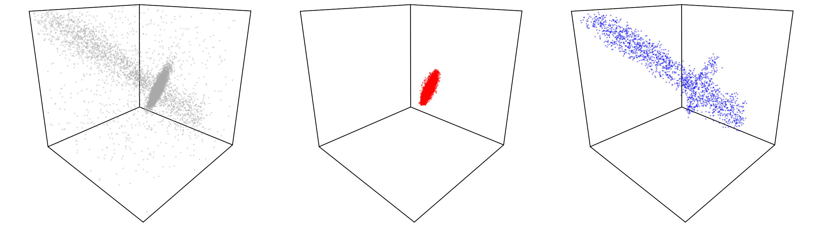

Synthetic experiment
FUNDING BY THE EUROPEAN UNION (MSCA EDUCADO, GA 101119830).
Data
Standard LAAT
Hub-LAAT
Up to 1.53× faster
Hub-LAAT shifts the selected output from the hub to the filament
Filament share of selected output: $1.8±0.4\%→71.9±12.4\%$
Dense hub share: $98.2\%→26.4\%$
Noise remains low: $0.0\%→1.7\%$
6

Slide 10
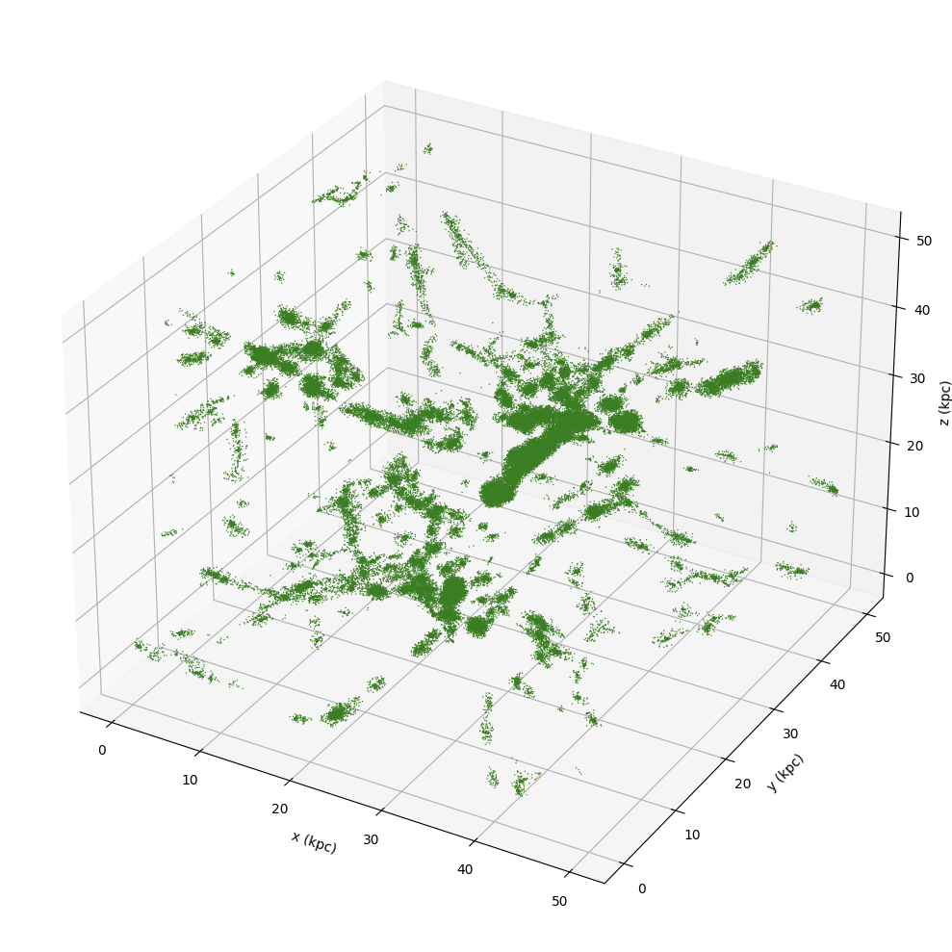
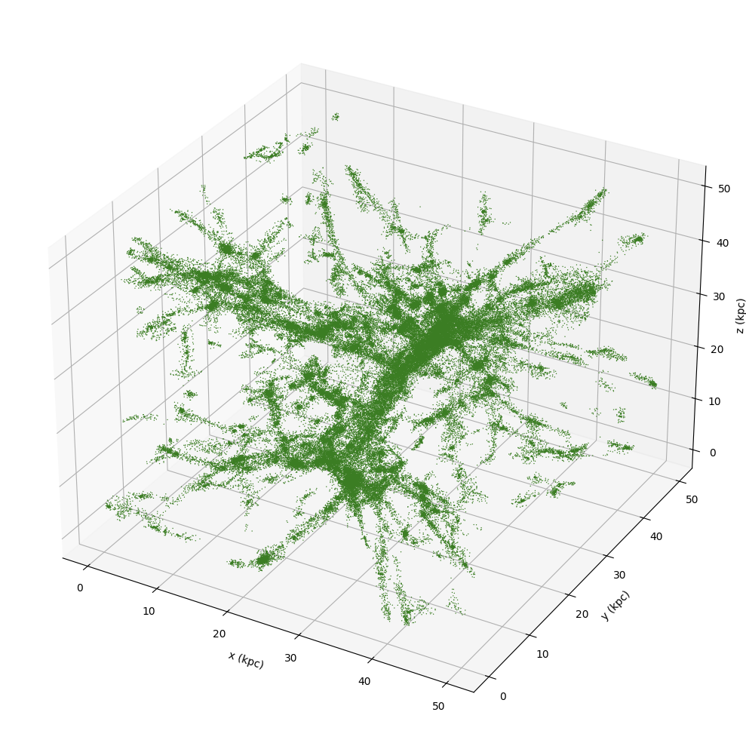
Cosmic web
FUNDING BY THE EUROPEAN UNION (MSCA EDUCADO, GA 101119830).
Standard LAAT
Hub-LAAT
7
Top ${1.2∙10}^{5}$ pheromone-ranked particles under identical LAAT settings.

Slide 11




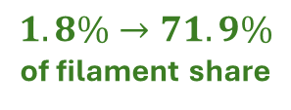
Conclusion
FUNDING BY THE EUROPEAN UNION (MSCA EDUCADO, GA 101119830).
Method
Results
Model the hubs once
Remove their high-likelihood cores
Redirect ants toward connected low-density structures
Improved low density structures recovery
Reduced trapping in dense regions
More efficient exploration of faint structures
$$1.8\%→71.9\%$$
of filament share
$1.53$× faster
Code, paper & demo
Interactive website coming soon!
8
git.lwp.rug.nl/cs.projects/Hub-LAAT
DOI:10.14428/esann/2026.ES2026-110

Slide 12
Appendix
FUNDING BY THE EUROPEAN UNION (MSCA EDUCADO, GA 101119830).

Slide 13
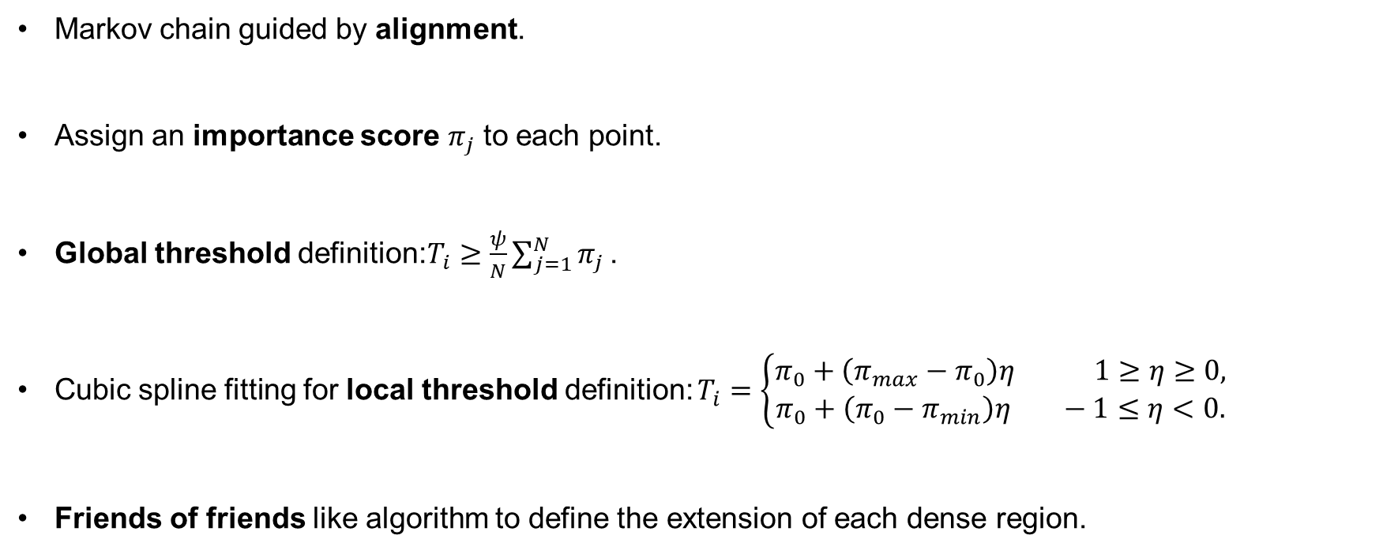
Hub-LAAT: hubs identification
FUNDING BY THE EUROPEAN UNION (MSCA EDUCADO, GA 101119830).
Markov chain guided by alignment.
Assign an importance score $π_{j}$ to each point.
Global threshold definition:$T_{i}≥\frac{ψ}{N}\sum_{j=1}^{N}{π_{j}}$ .
Cubic spline fitting for local threshold definition: $T_{i}=\left\{\begin{aligned}π_{0}+\left(π_{max}−π_{0}\right)η 1≥η≥0, \\ π_{0}+\left(π_{0}−π_{min}\right)η −1≤η<0.\end{aligned}\right.$
Friends of friends like algorithm to define the extension of each dense region.
A

Slide 14
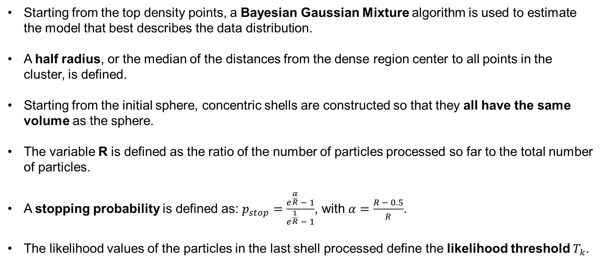
Hub-LAAT: model fitting
FUNDING BY THE EUROPEAN UNION (MSCA EDUCADO, GA 101119830).
Starting from the top density points, a Bayesian Gaussian Mixture algorithm is used to estimate the model that best describes the data distribution.
A half radius, or the median of the distances from the dense region center to all points in the cluster, is defined.
Starting from the initial sphere, concentric shells are constructed so that they all have the same volume as the sphere.
The variable R is defined as the ratio of the number of particles processed so far to the total number of particles.
A stopping probability is defined as: $p_{stop}=\frac{e^{\frac{α}{R}} − 1}{e^{\frac{1}{R}} − 1}$, with $α=\frac{R − 0.5}{R}$.
The likelihood values of the particles in the last shell processed define the likelihood threshold $T_{k}$.
B

Slide 15
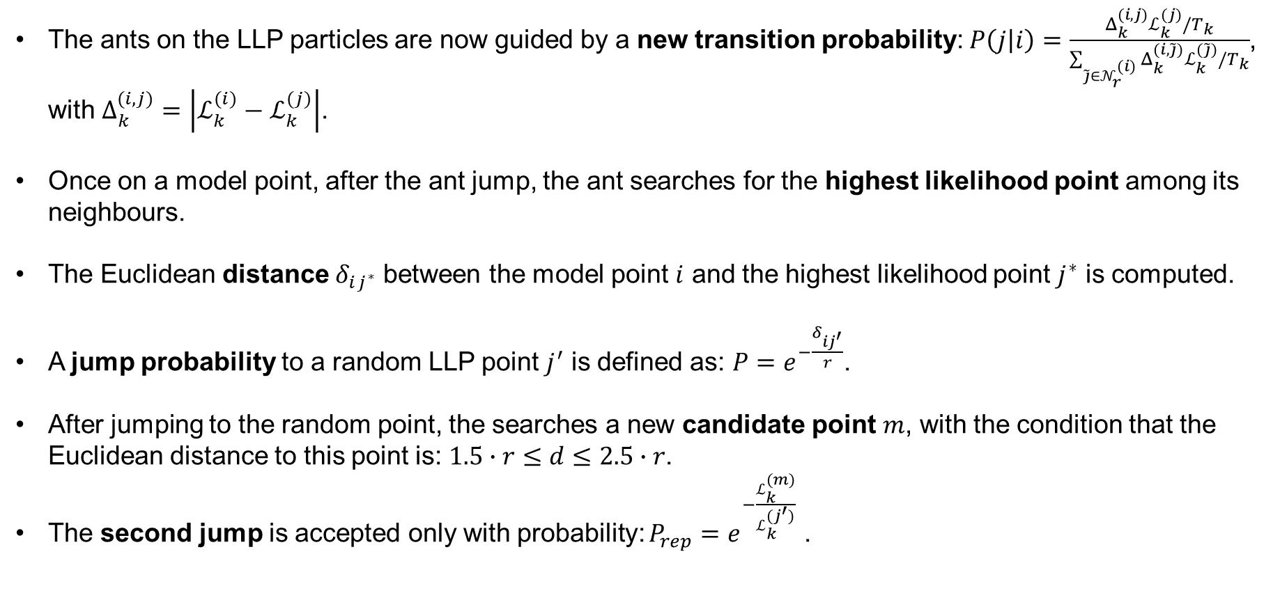
Hub-LAAT: new ant movement
FUNDING BY THE EUROPEAN UNION (MSCA EDUCADO, GA 101119830).
The ants on the LLP particles are now guided by a new transition probability: $P\left(j | i\right)=\frac{Δ_{k}^{(i,j)}ℒ_{k}^{(j)}/T_{k}}{\sum_{\tilde{j}∈𝒩_{r}^{(i)}}{Δ_{k}^{(i,\tilde{j})}ℒ_{k}^{(\tilde{j})}/T_{k}}}$, with $Δ_{k}^{(i,j)}=\left|ℒ_{k}^{(i)}−ℒ_{k}^{(j)}\right|$.
Once on a model point, after the ant jump, the ant searches for the highest likelihood point among its neighbours.
The Euclidean distance $δ_{ij^{∗}}$ between the model point $i$ and the highest likelihood point $j^{∗}$ is computed.
A jump probability to a random LLP point $j^{′}$ is defined as: $P=e^{−\frac{δ_{ij^{′}}}{r}}$.
After jumping to the random point, the searches a new candidate point $m$, with the condition that the Euclidean distance to this point is: $1.5∙r≤d≤2.5∙r$.
The second jump is accepted only with probability: $P_{rep}=e^{−\frac{ℒ_{k}^{(m)}}{ℒ_{k}^{(j^{′})}}}$ .
C

