Slide 1
Cosmological Parameter Inference from Galaxy Properties using Conditional Normalizing Flows
Tirthankar De¹ and Natalí S. M. de Santi²
¹Indian Institute of Technology Roorkee
²Berkeley Center for Cosmological Physics, UC Berkeley

Slide 2
Motivation
Galaxies as cosmological probes: Individual galaxy properties trace their formation environment.
Limitations of standard statistics: Power spectrum/2PCF miss information in the non-linear, non-Gaussian regime.
Intractable likelihoods: Complex baryonic physics makes standard inference impossible.
The solution: Simulation-Based Inference (SBI): Uses conditional normalizing flows for likelihood-free, amortized inference directly from observables.

Slide 3
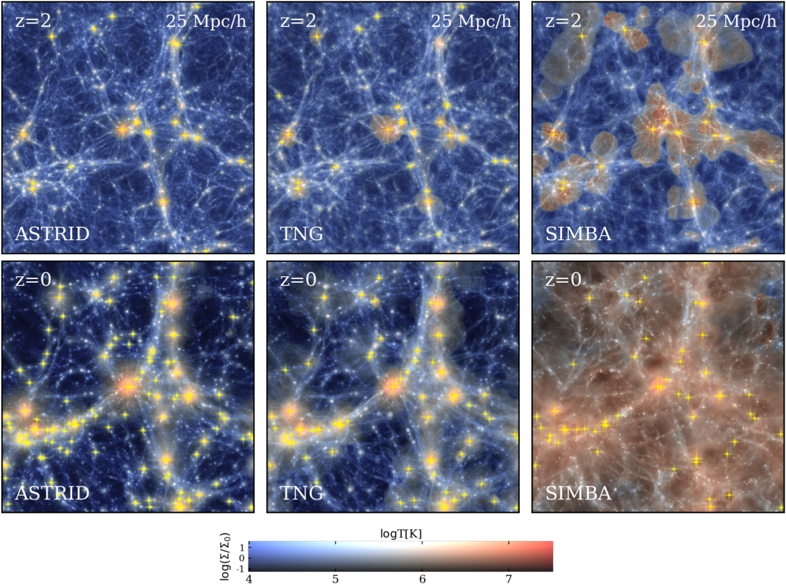
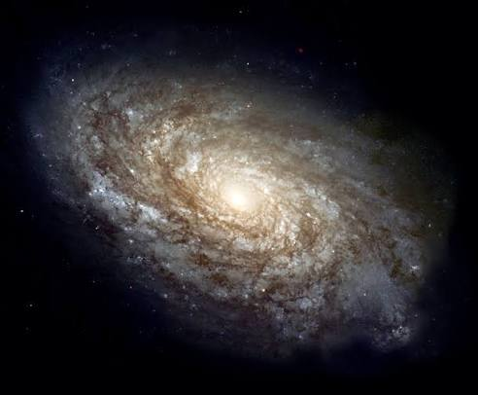
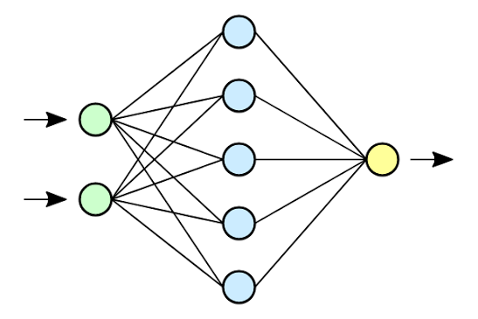
Pipeline
Ω_{m}
Astrid SB7
Halo
M_{g}
Z*
Ω_{b}
M_{BH}
SFR
Ω_{m}/Ω_{b}
M*
J
σ₈
Central galaxy
+
M_{t}
V
S₈
IllustrisTNG SB28
Normalizing Flow
M* > 1.3*10⁸ M☉
V_{max}
R*
A_{AGN1}
σ_{v}
R_{t}
A_{SN2}
Subsampling (Max 60 galaxies per simulation)
Z_{g}
R_{max}
A_{AGN2}
A_{SN1}

Slide 4
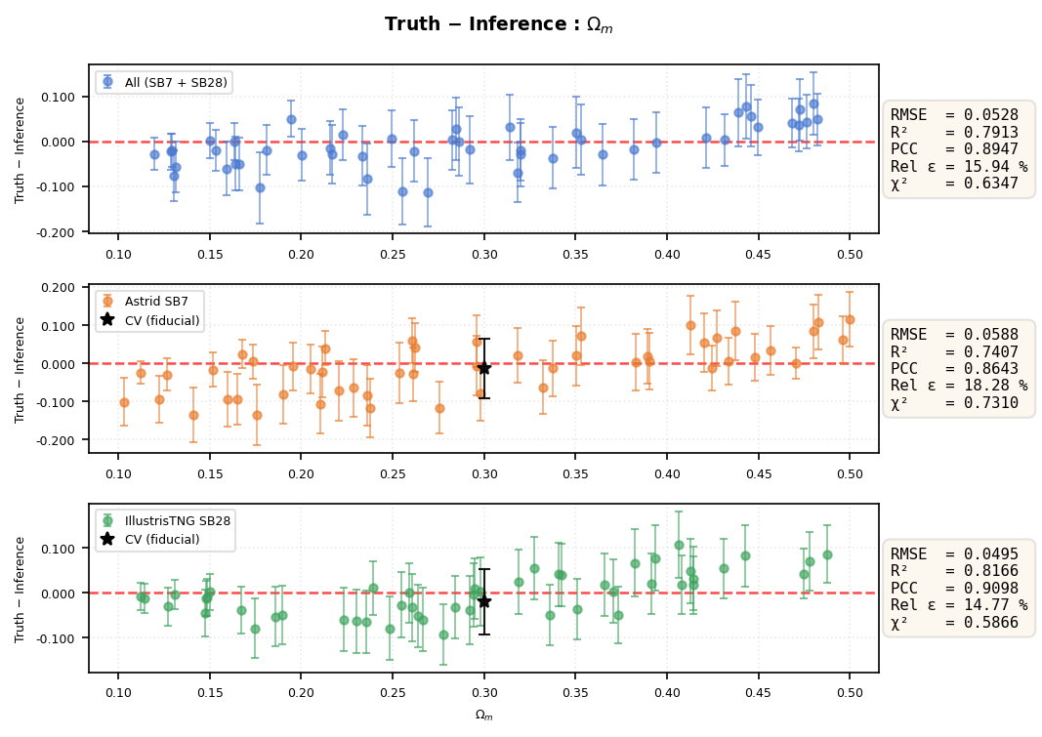
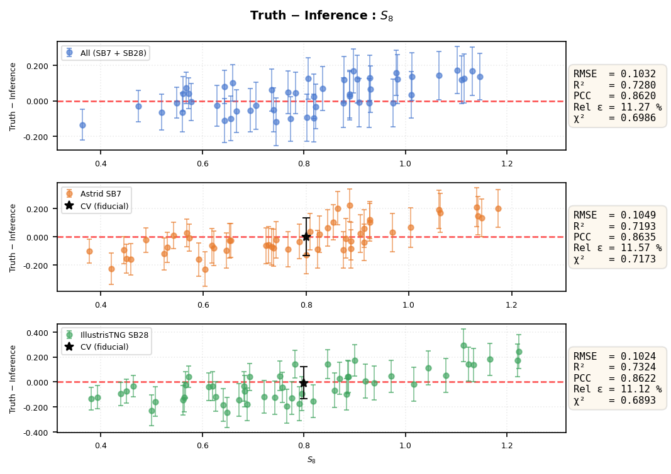
Model performance - Ω_{m} and S₈

Slide 5
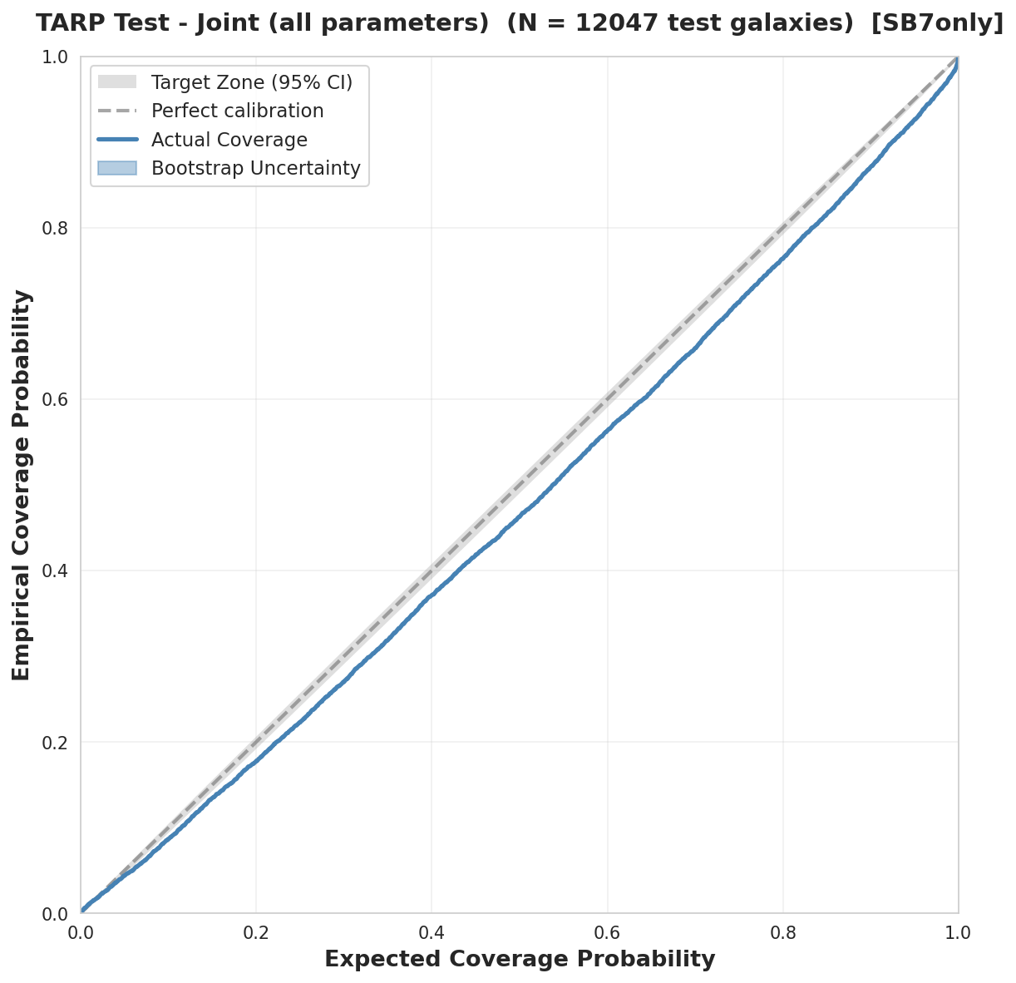
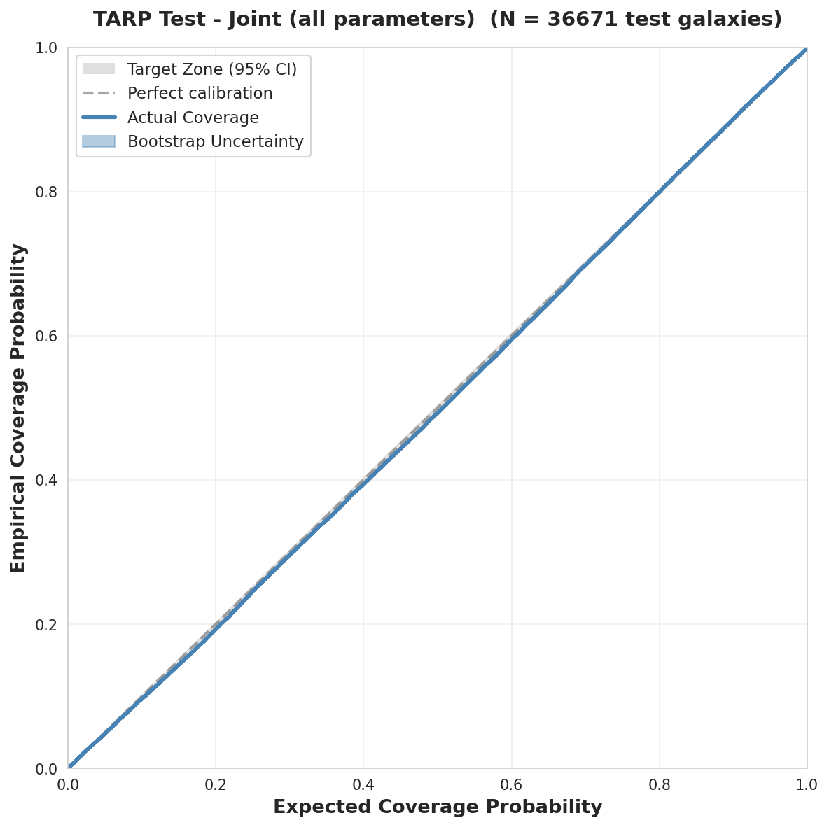
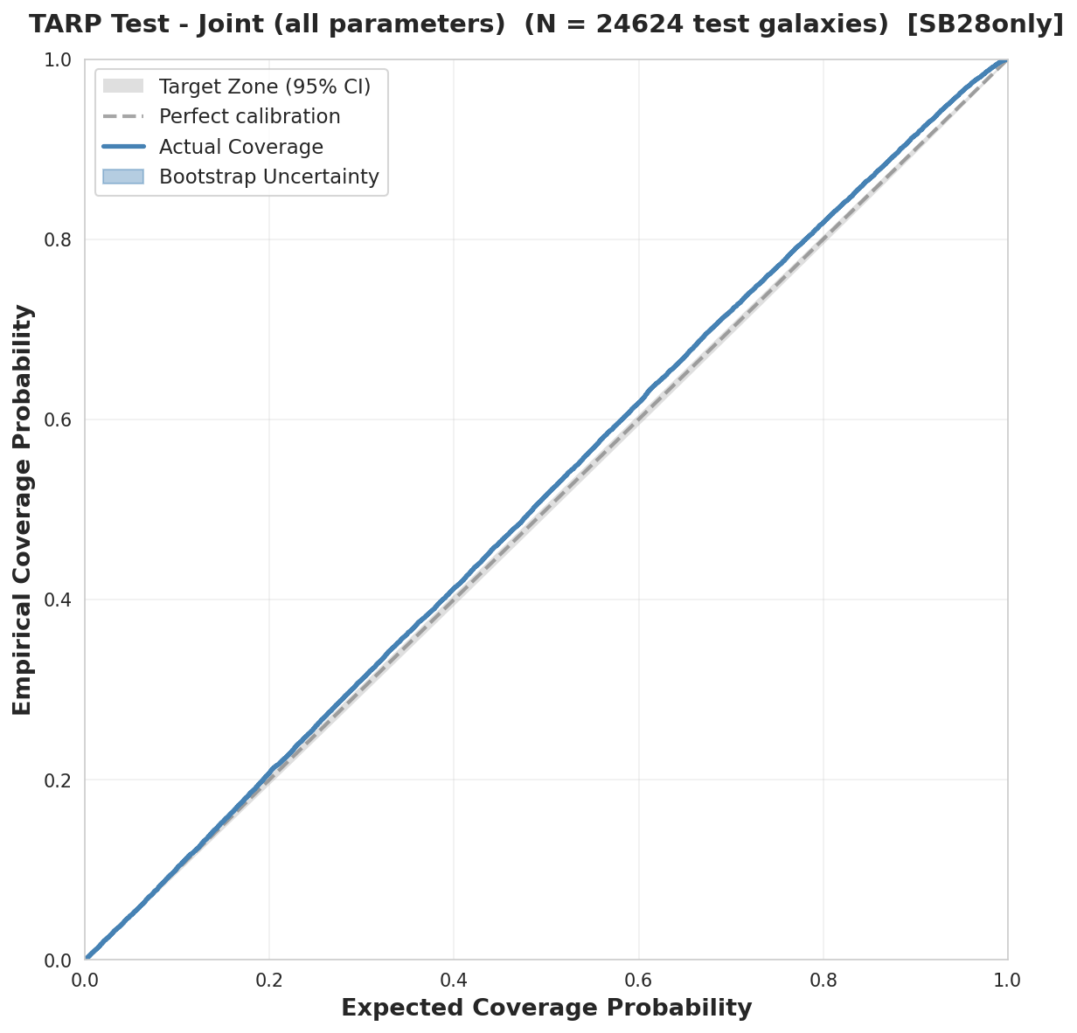
Tests of Accuracy with Random Points (TARP)

Slide 6
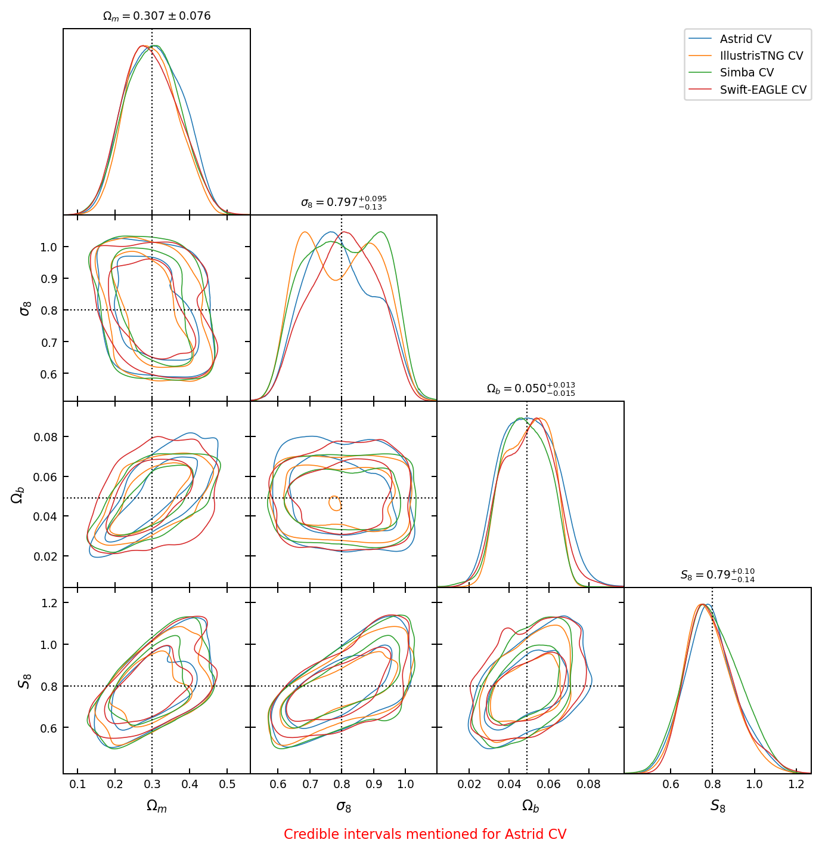
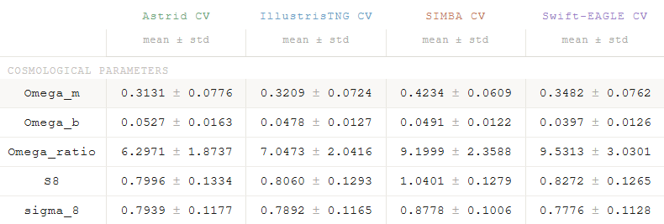
Robustness check - CV set
Averaged over 27 CV sets

Slide 7
Summary
Full posterior from one galaxy: Conditional NF successfully returns calibrated posteriors from 14 galaxy properties.
Best-constrained parameters: Ω_{m} (R²=0.80, σ≈0.067) and S₈ (R²=0.72, σ≈0.129); σ₈ not meaningful (R²=0.14).
Well-calibrated posteriors: TARP coverage tracks the diagonal well on test galaxies, both per suite and jointly.
Cross-suite robustness: Stable on Swift-EAGLE; fails on Simba; Ω_{m}/Ω_{b} fails for all OOD suites; subgrid physics is the bottleneck.

