Slide 1


How to Trust Machines to Learn the Universe from Simulations
Machine Learning for Astrophysics
3/9/2026
How neural network features can identify
unreliable predictions
Ethan Tregidga, David Harvey,
Luca Biggio, Ismail Nejjar, Olga Fink, Felix Vecchi

Slide 2
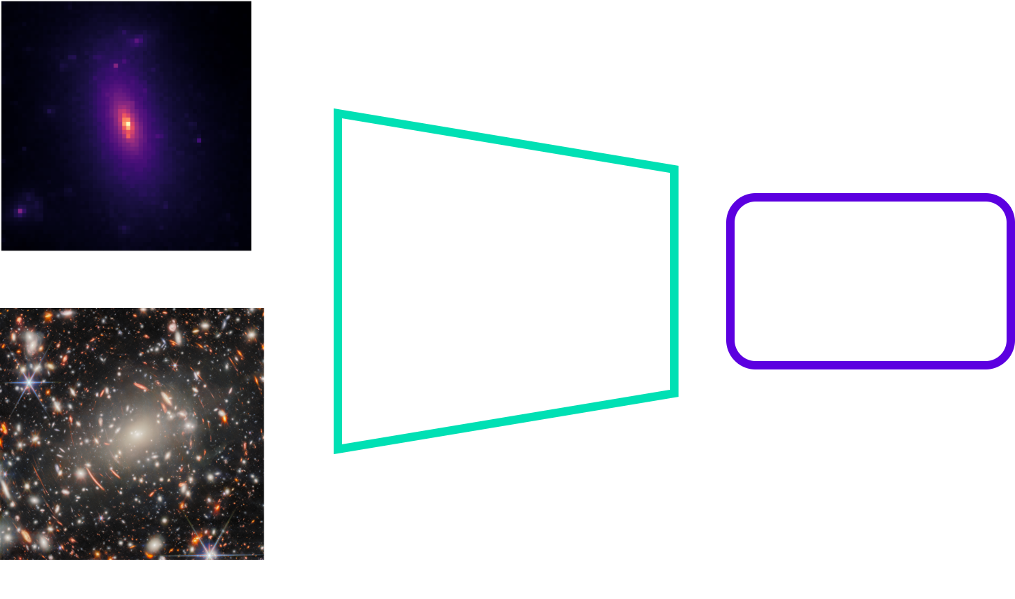
The Promise of Machine Learning
Notes:
Change title, change breaking of black box

Slide 3
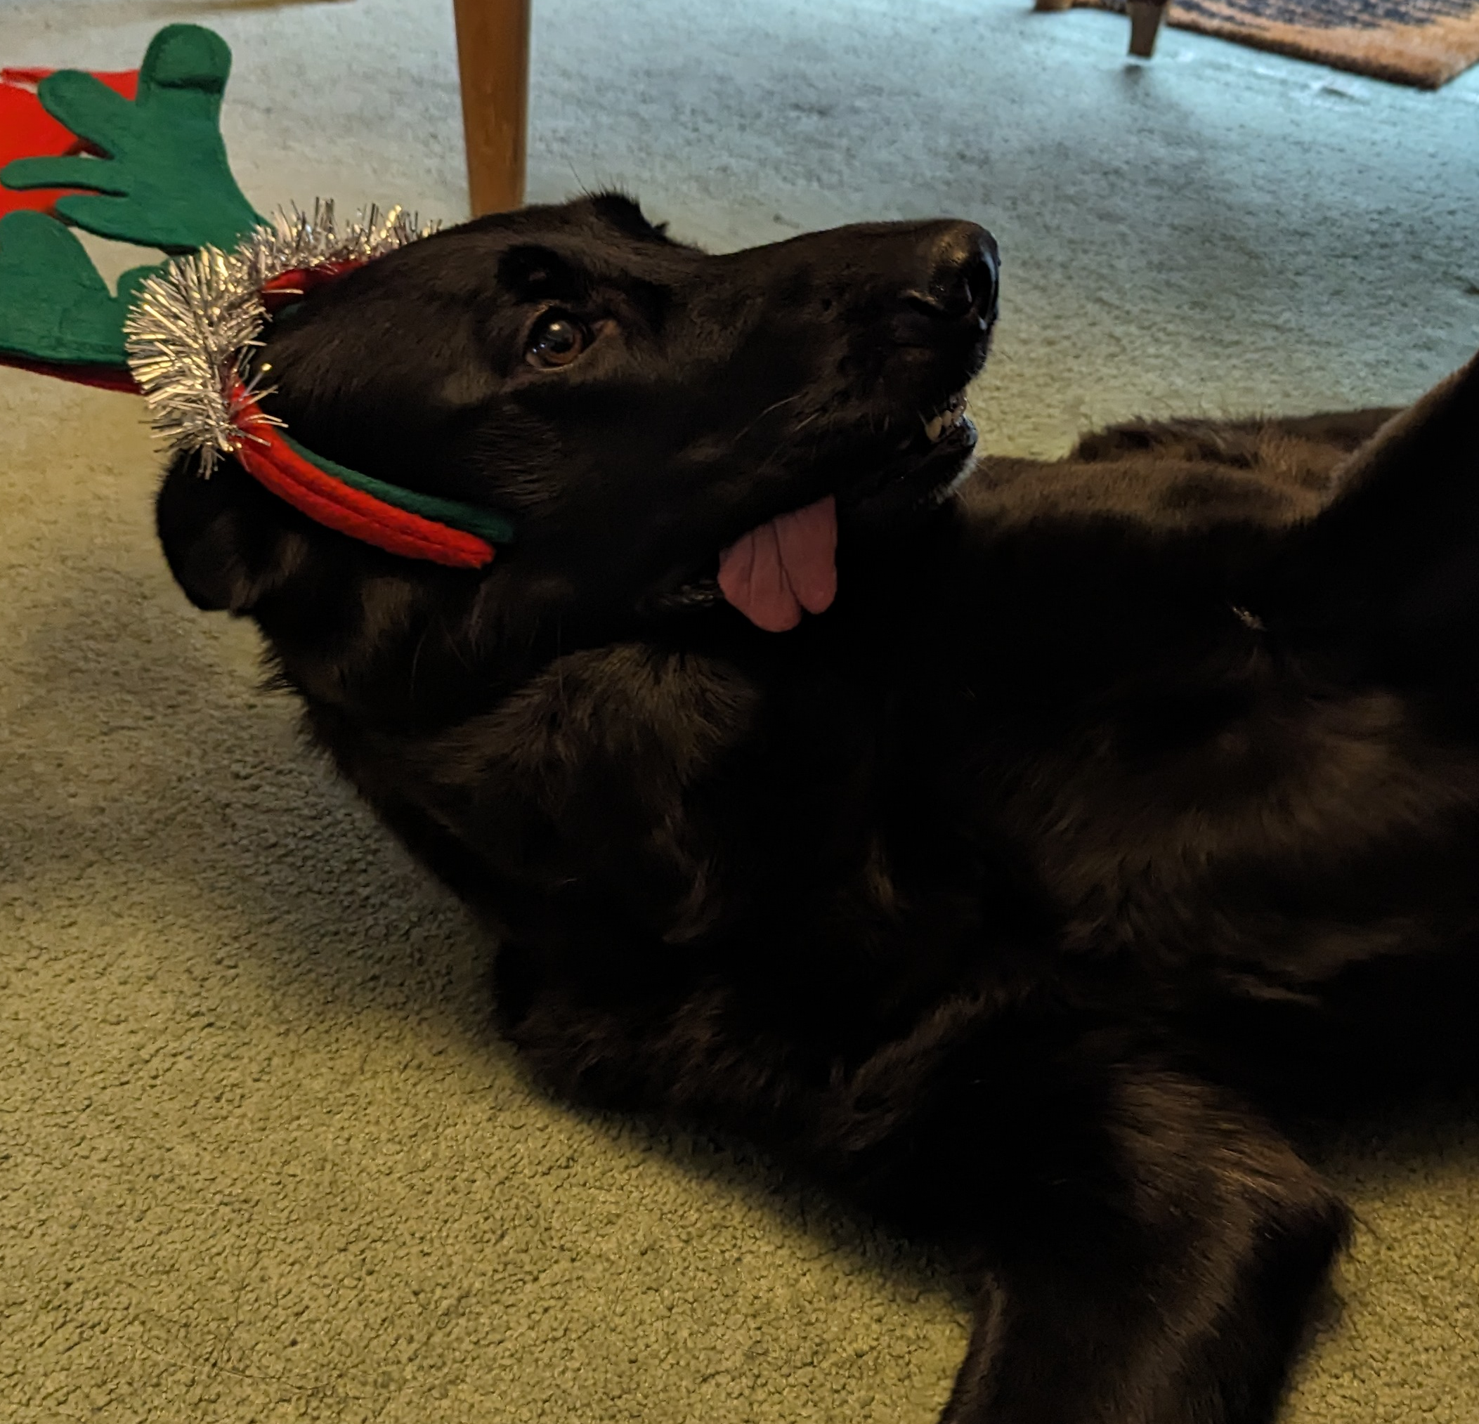
But Can We Trust Machine Learning?
Notes:
Change title, change breaking of black box

Slide 4
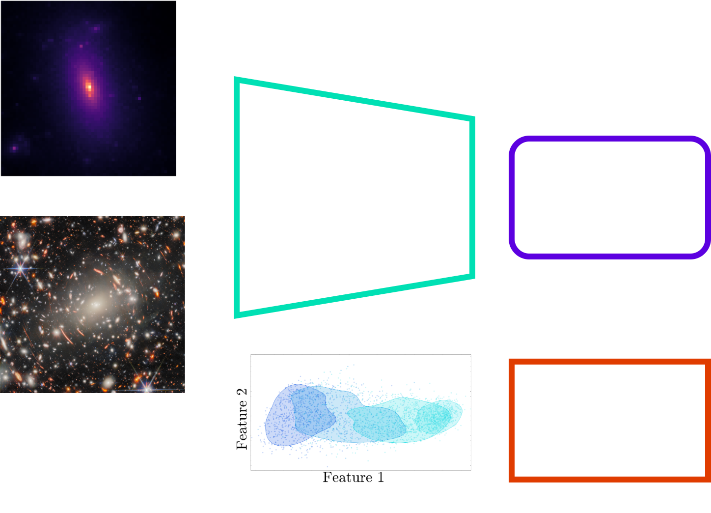
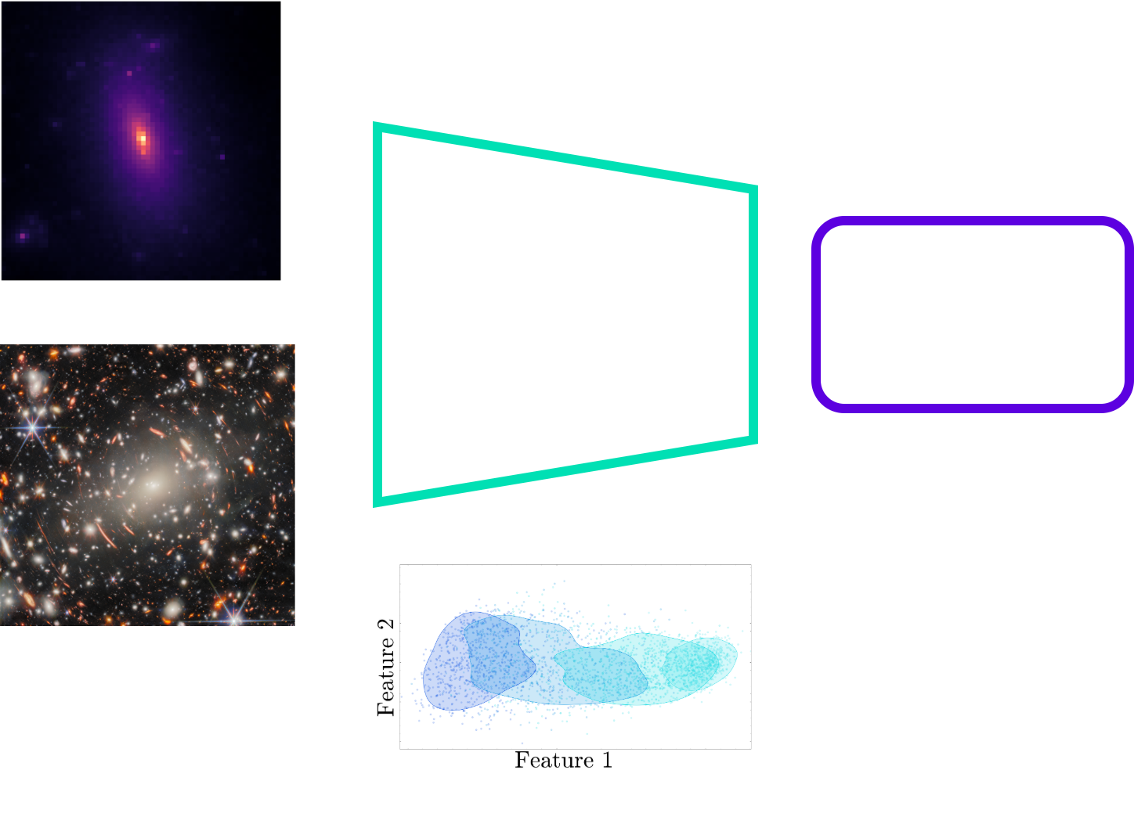
Breaking the Black Box
Notes:
Change title, change breaking of black box

Slide 5
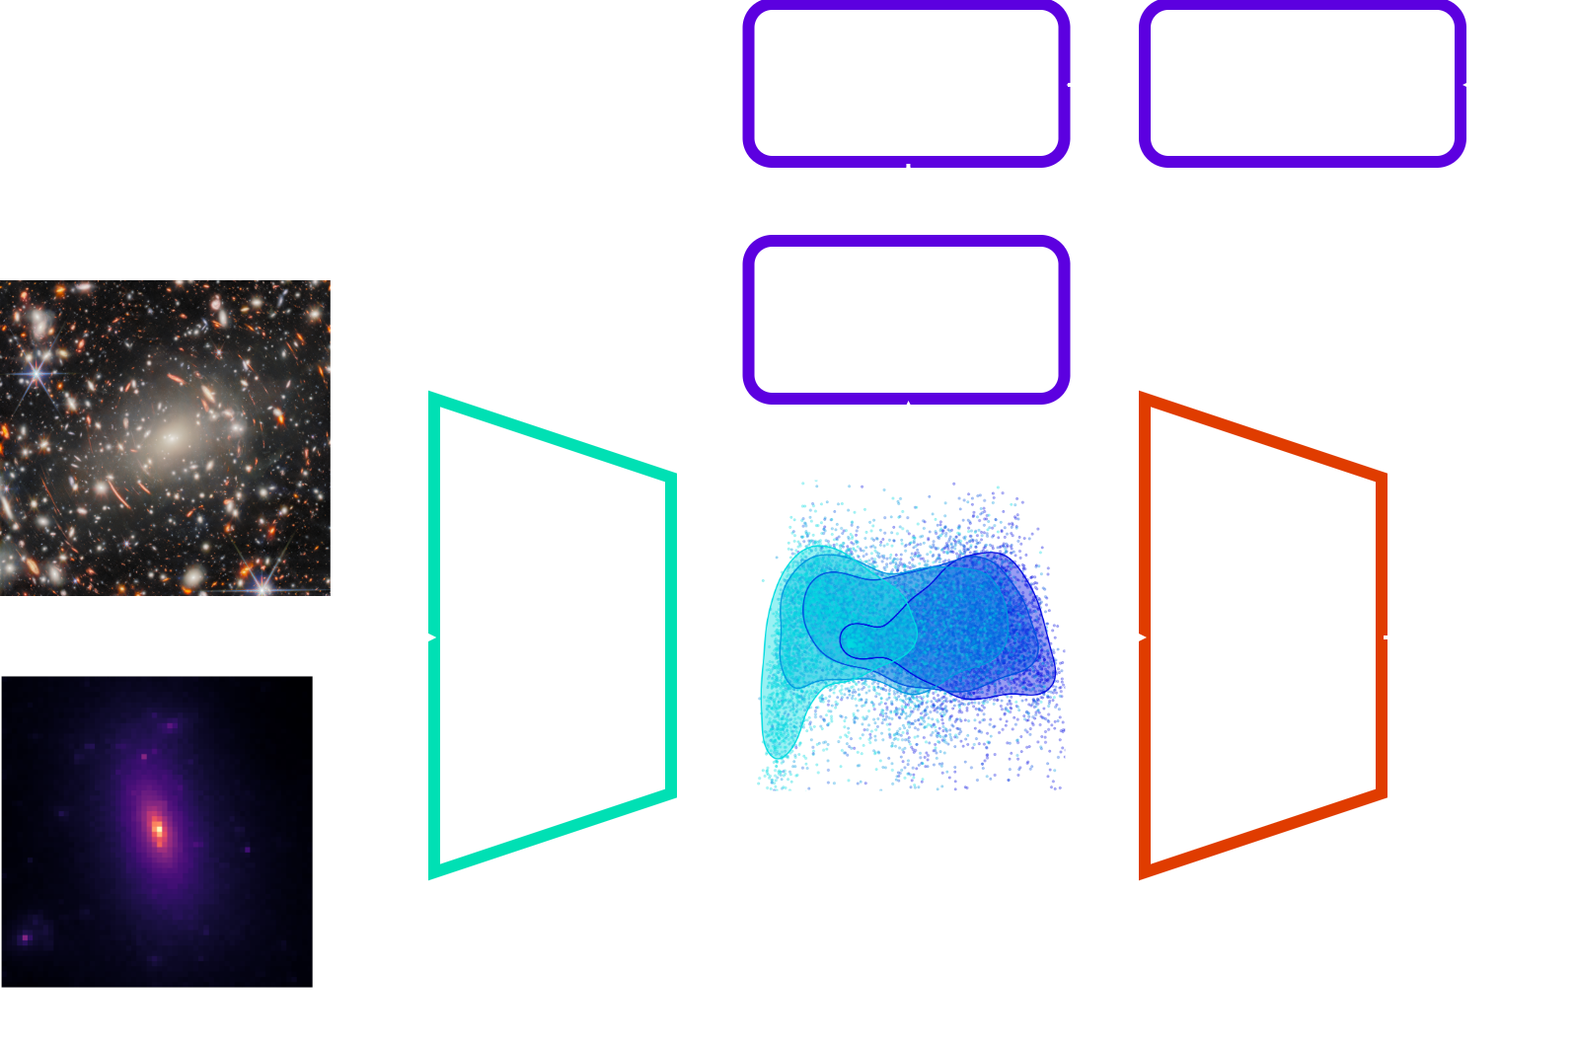
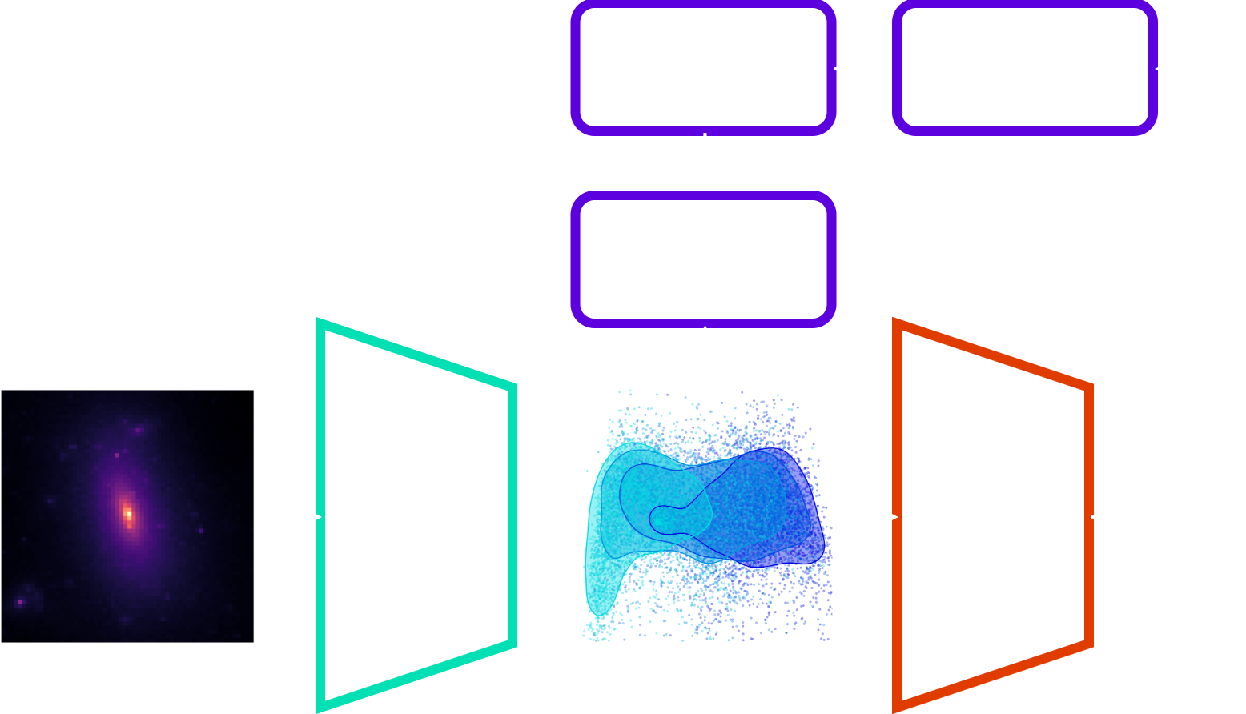
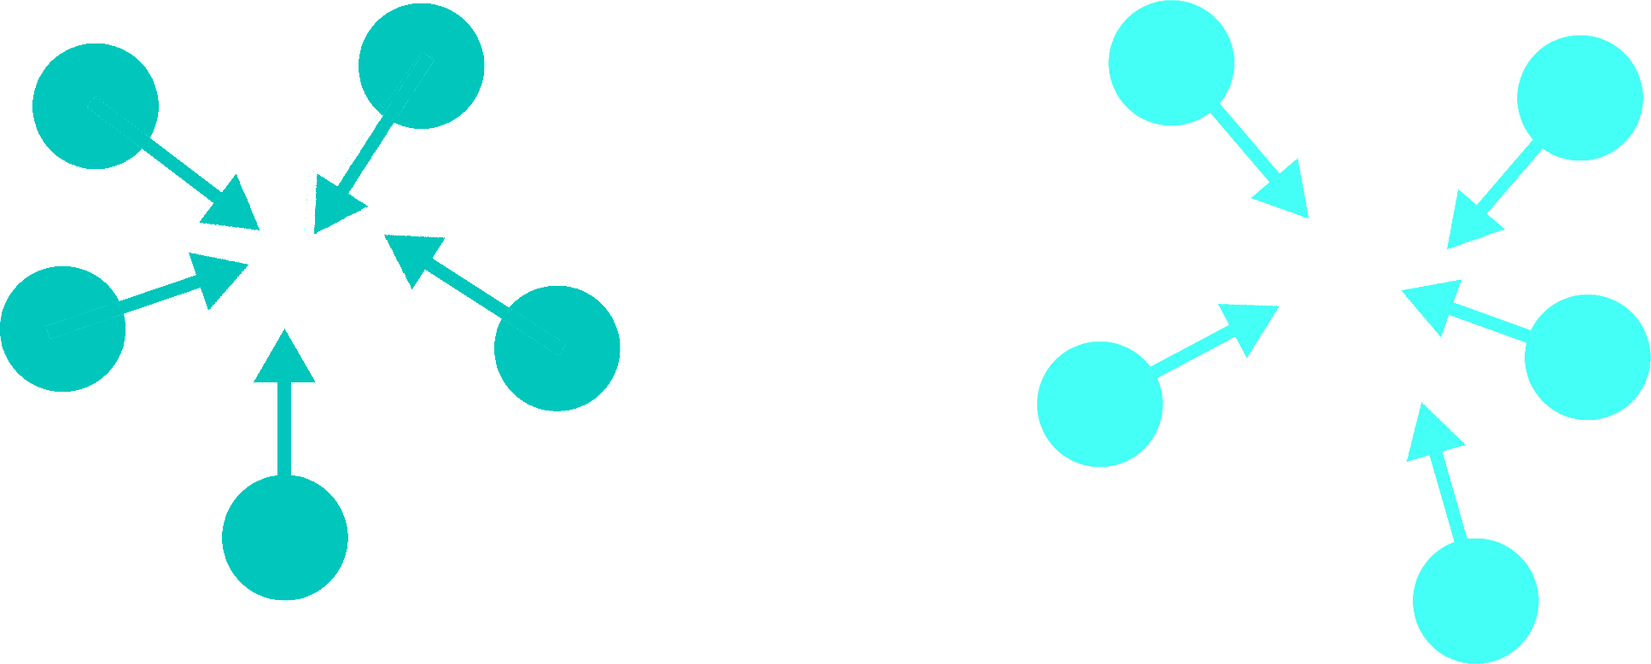
Constructing Informative Feature Spaces
Sim 1
Sim 2
Particle/Not Particle?
Unsupervised!

Slide 6
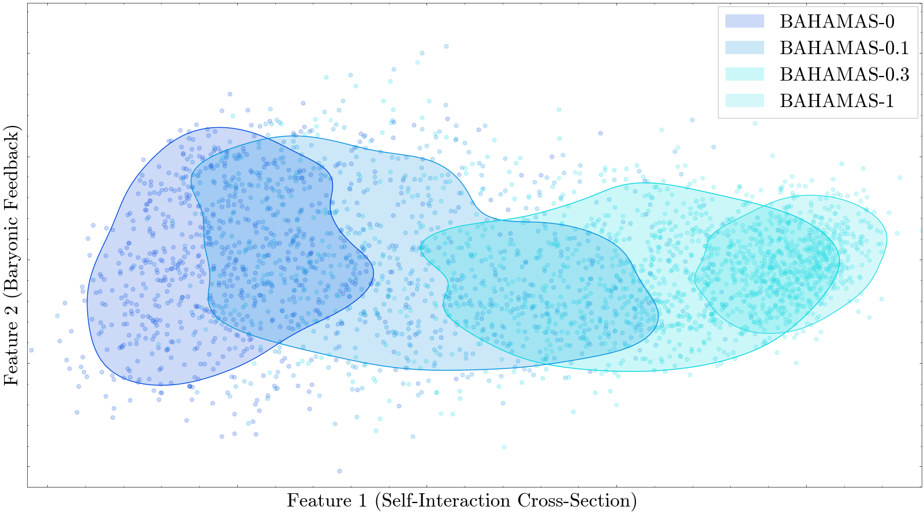
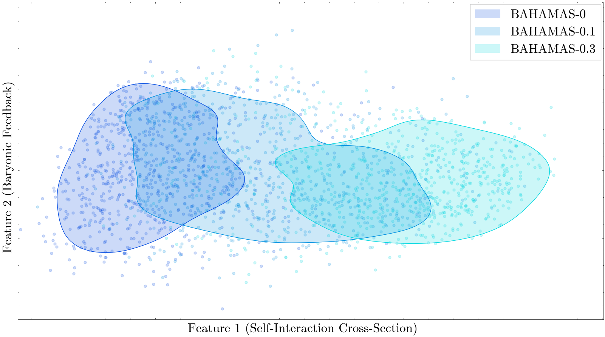
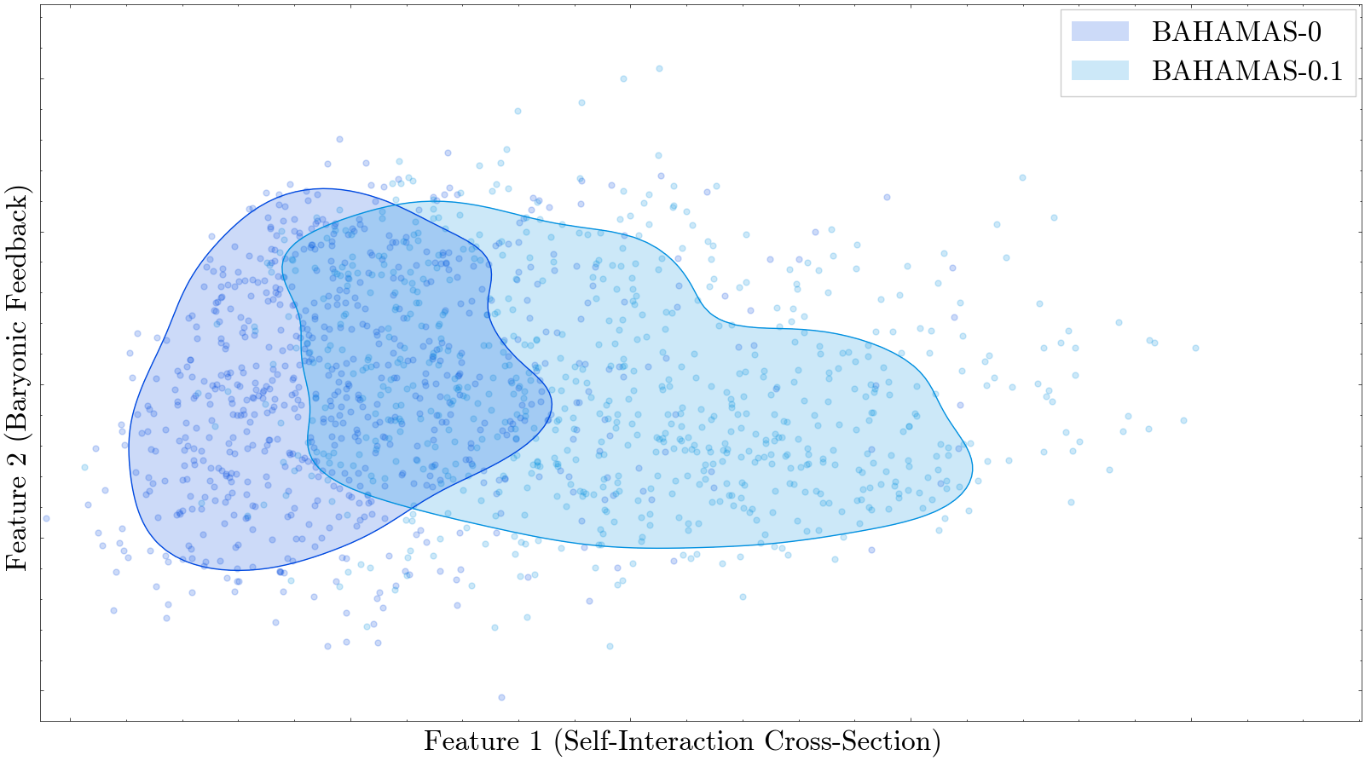
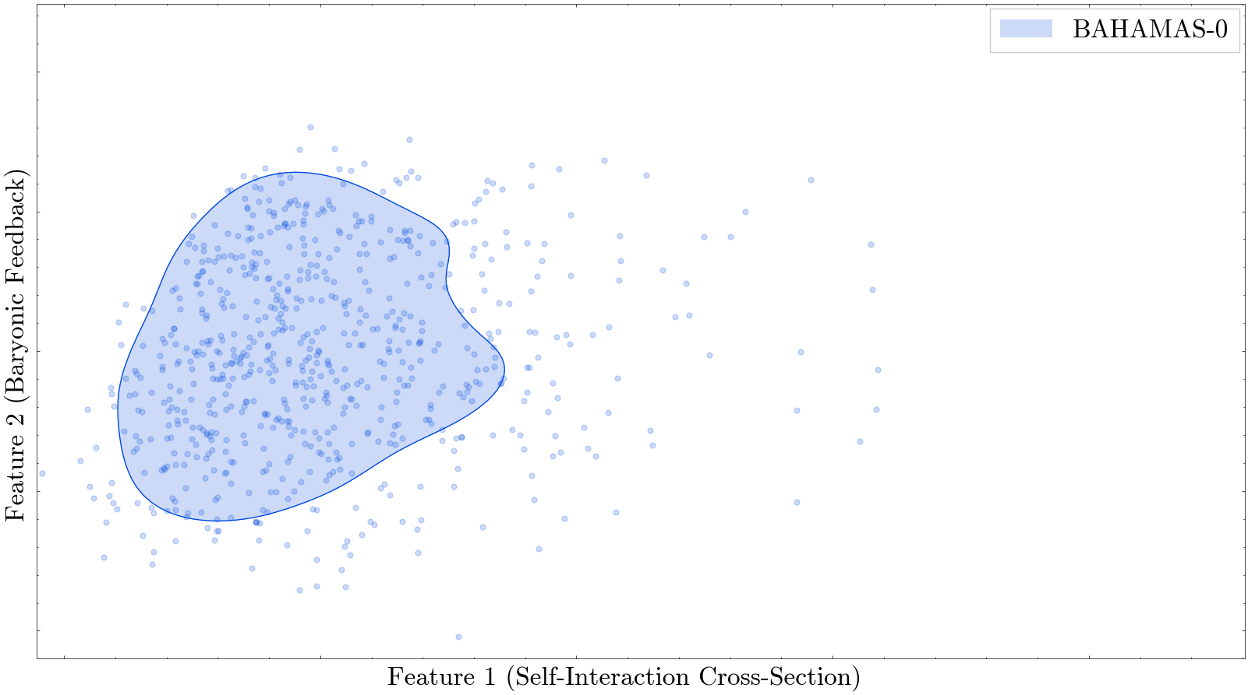
Identifying Features
Feature 2
Feature 1
Dark Matter Parameter

Slide 7
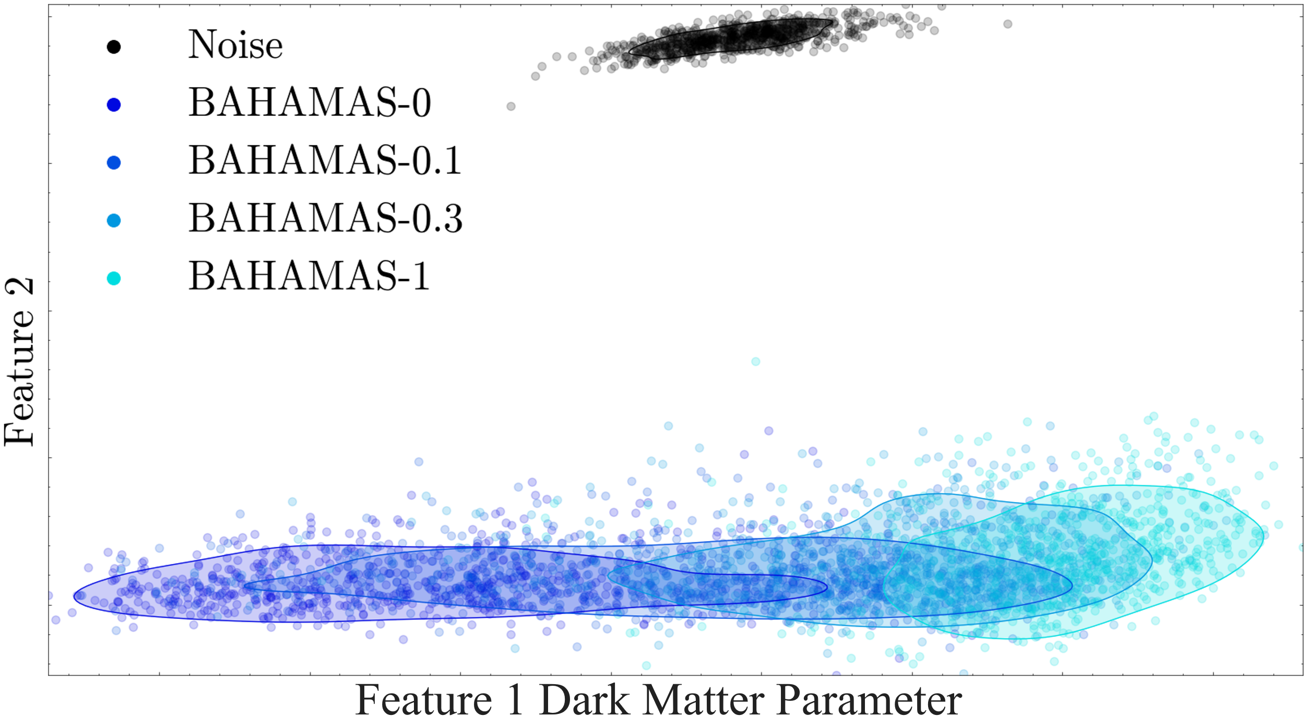
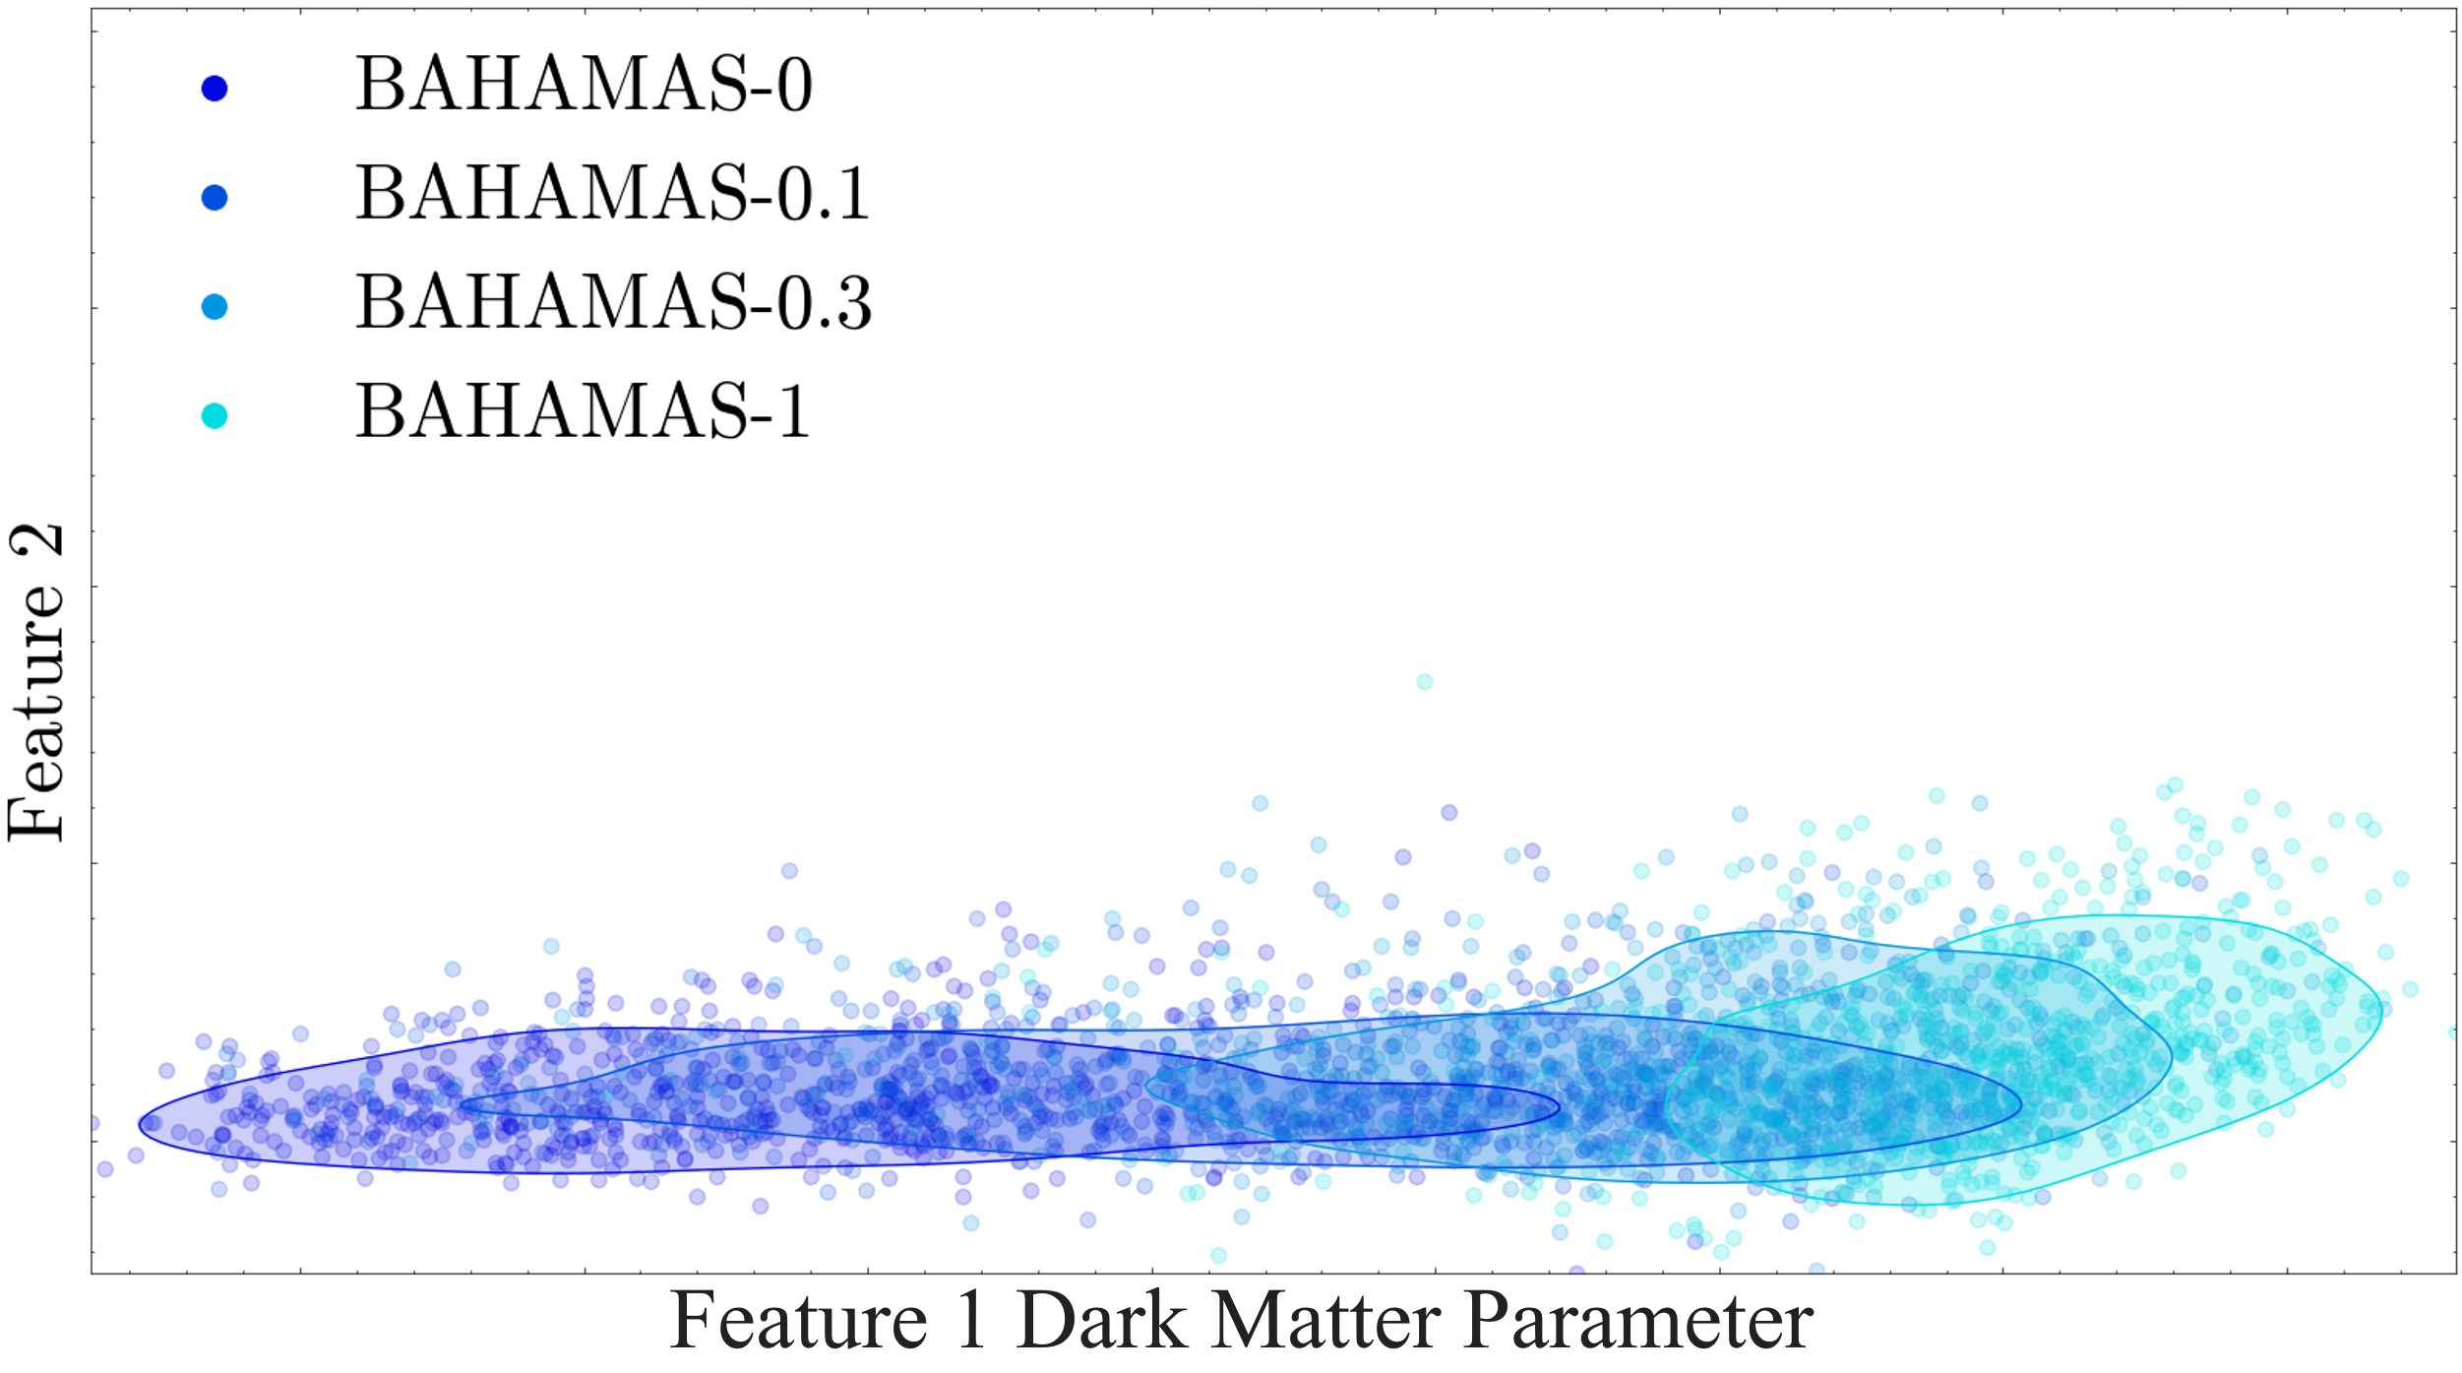
Detecting Anomalies
Foreign!

Slide 8

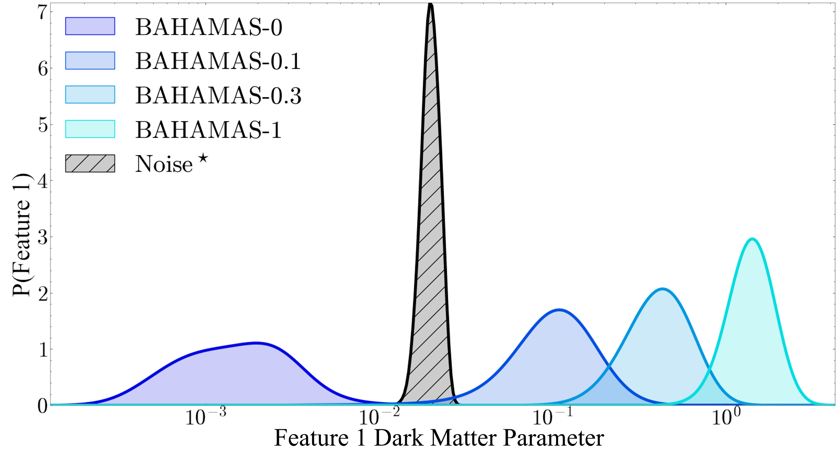
Identifying Unknowns

Slide 9
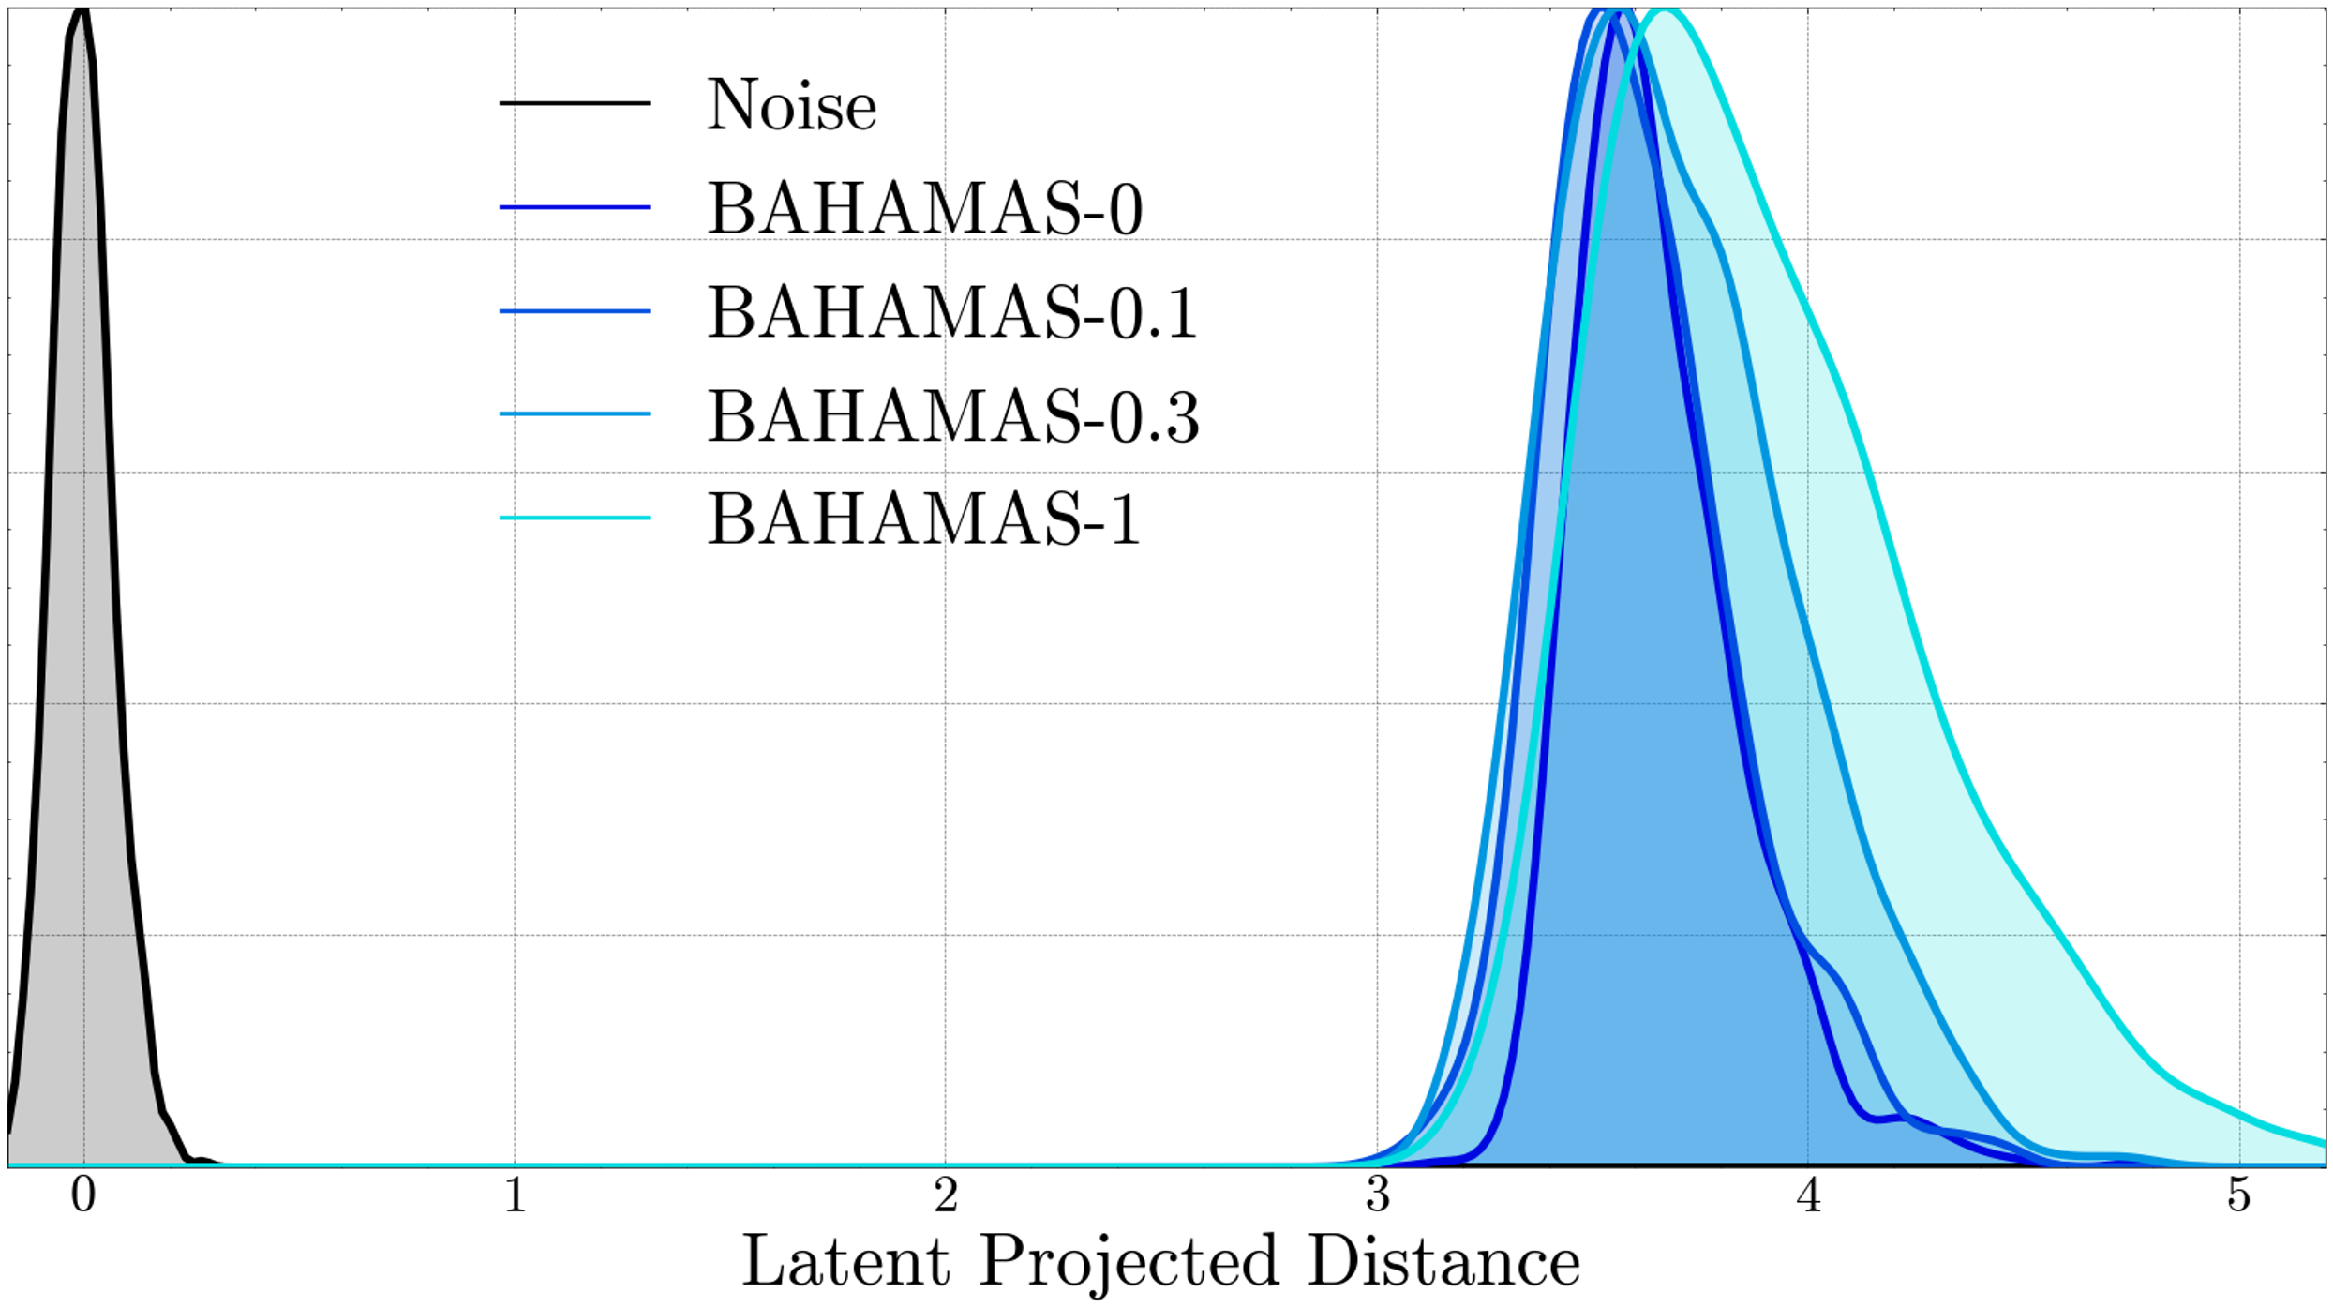
Identifying Unknowns
0% Overlap!

Slide 10
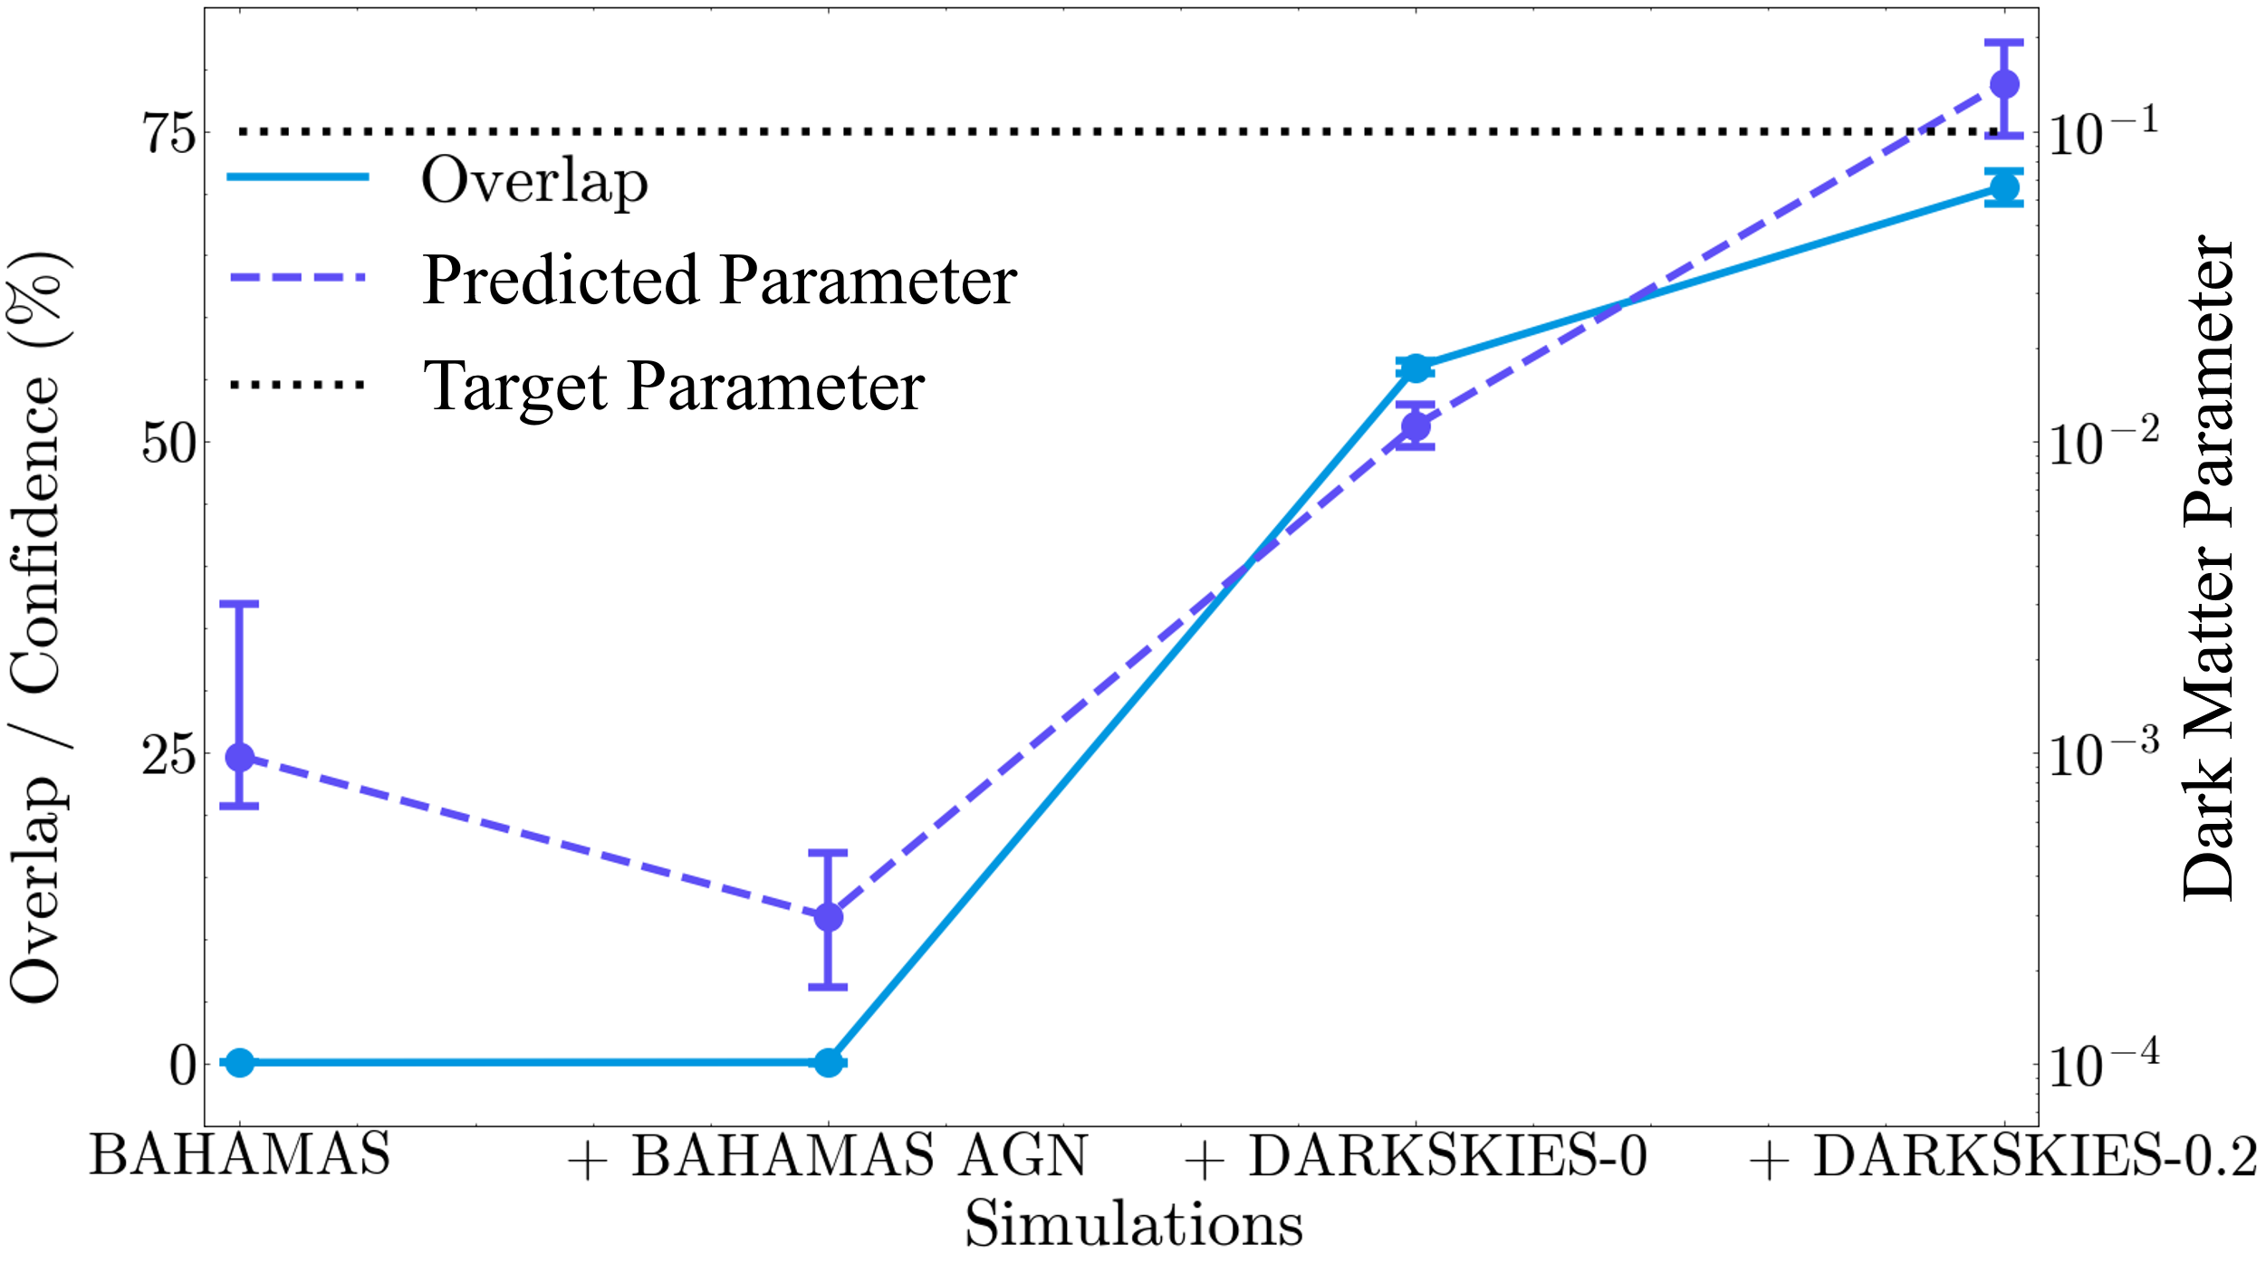
Confidence Statistic for Machine Learning

Slide 11
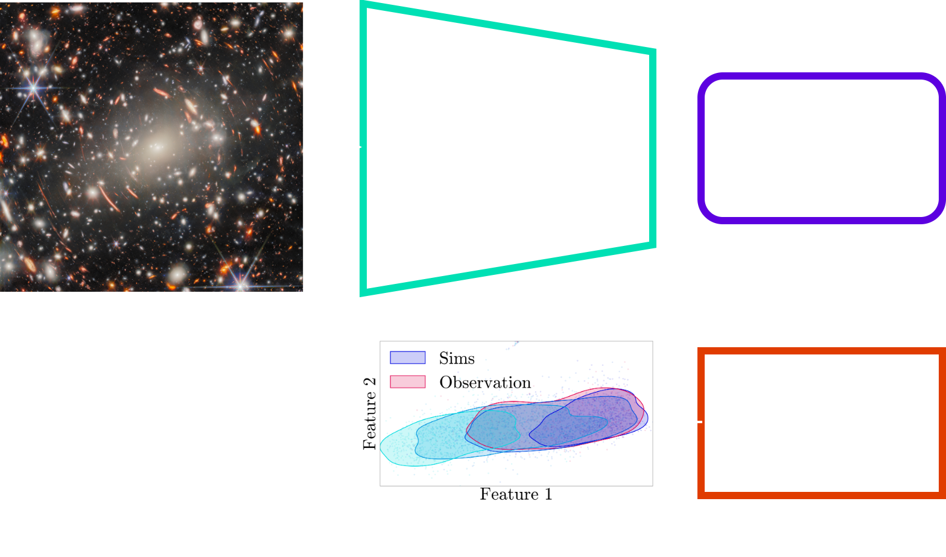
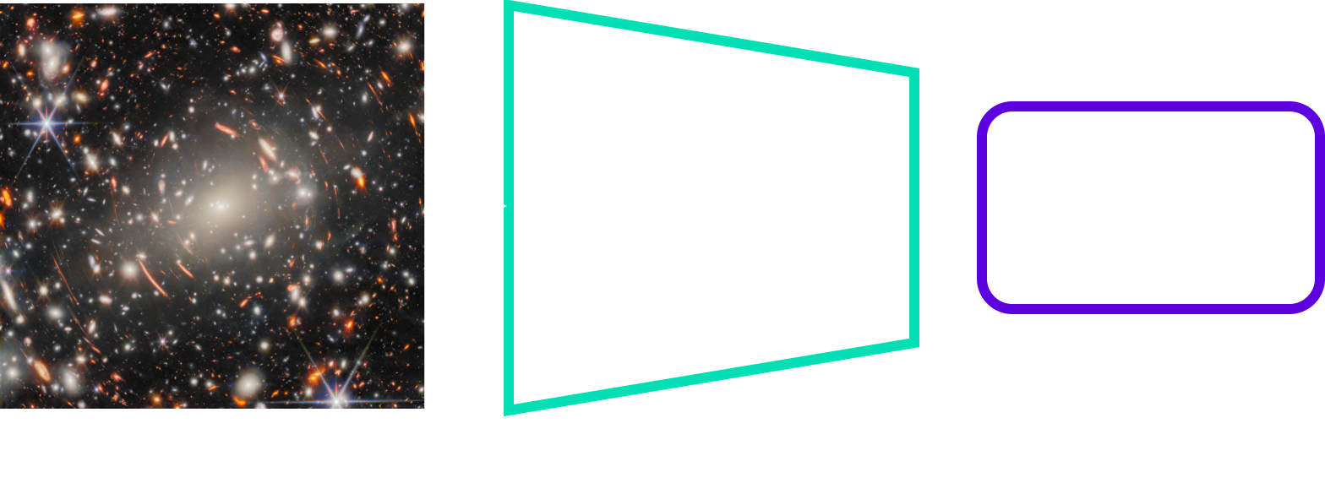

Features Provide Confidence Statistics
Paper

Slide 12
Conclusions
Feature spaces inform how machines learn
Feature spaces provide confidence statistics & can identify anomalous data
Ethan Tregidga, David Harvey,
Luca Biggio, Ismail Nejjar, Olga Fink, Felix Vecchi
ethan.tregidga@epfl.ch

Slide 13
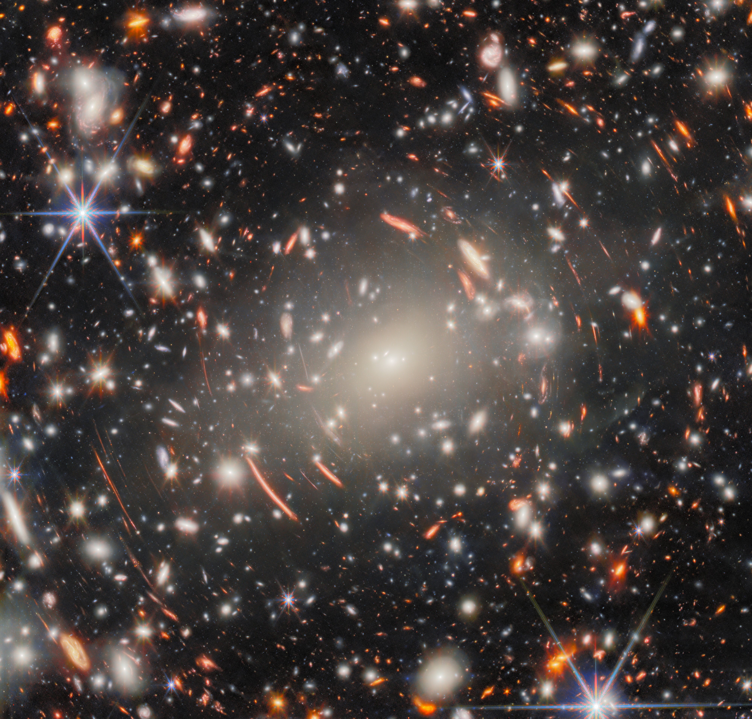
Traditional Methods are Interpretable, but…
What is Dark Matter?
ESA/Webb, NASA & CSA
H. Atek, M. Zamani

Slide 14
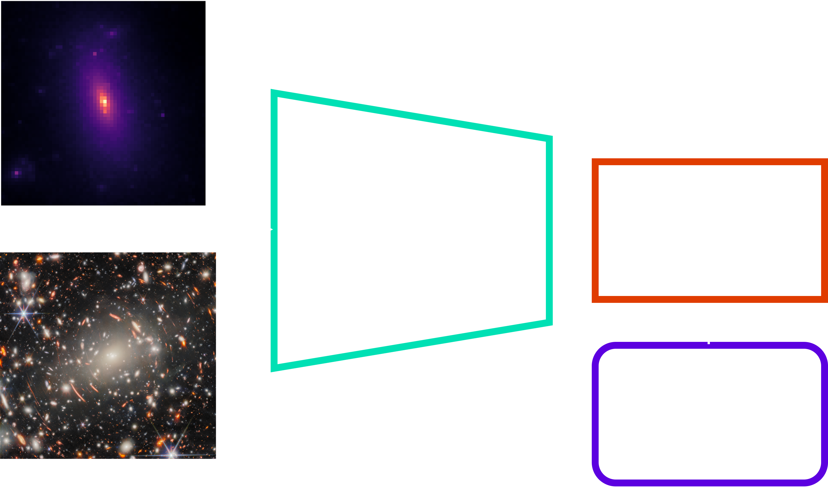
Traditional Methods are Interpretable, but…
What is Dark Matter?
Information Loss/
Slow!

Slide 15
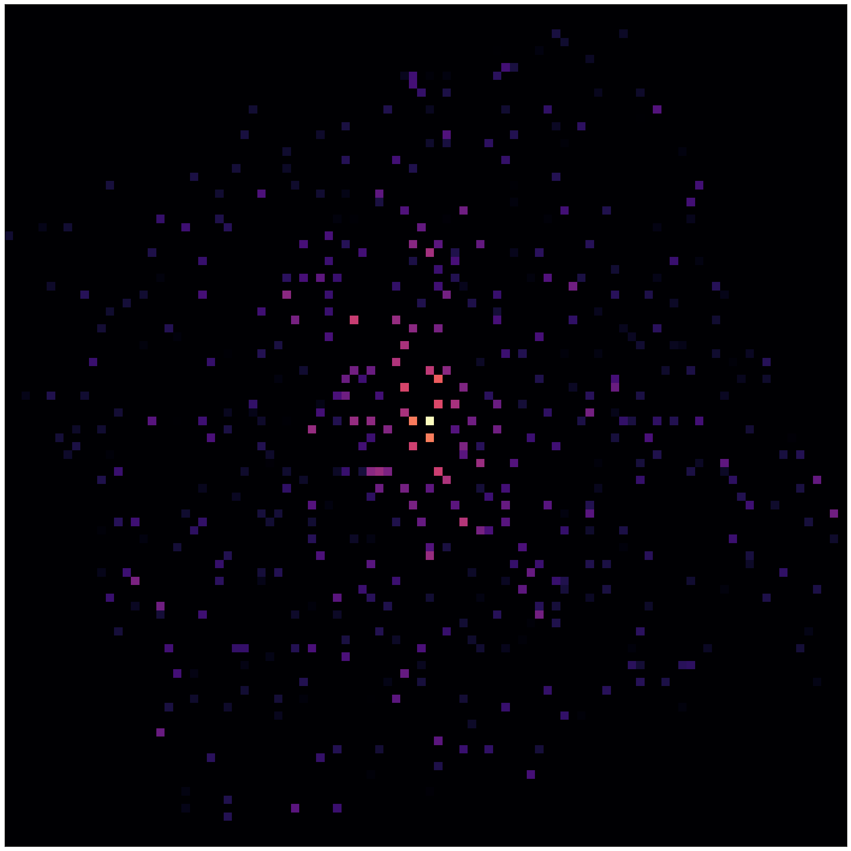
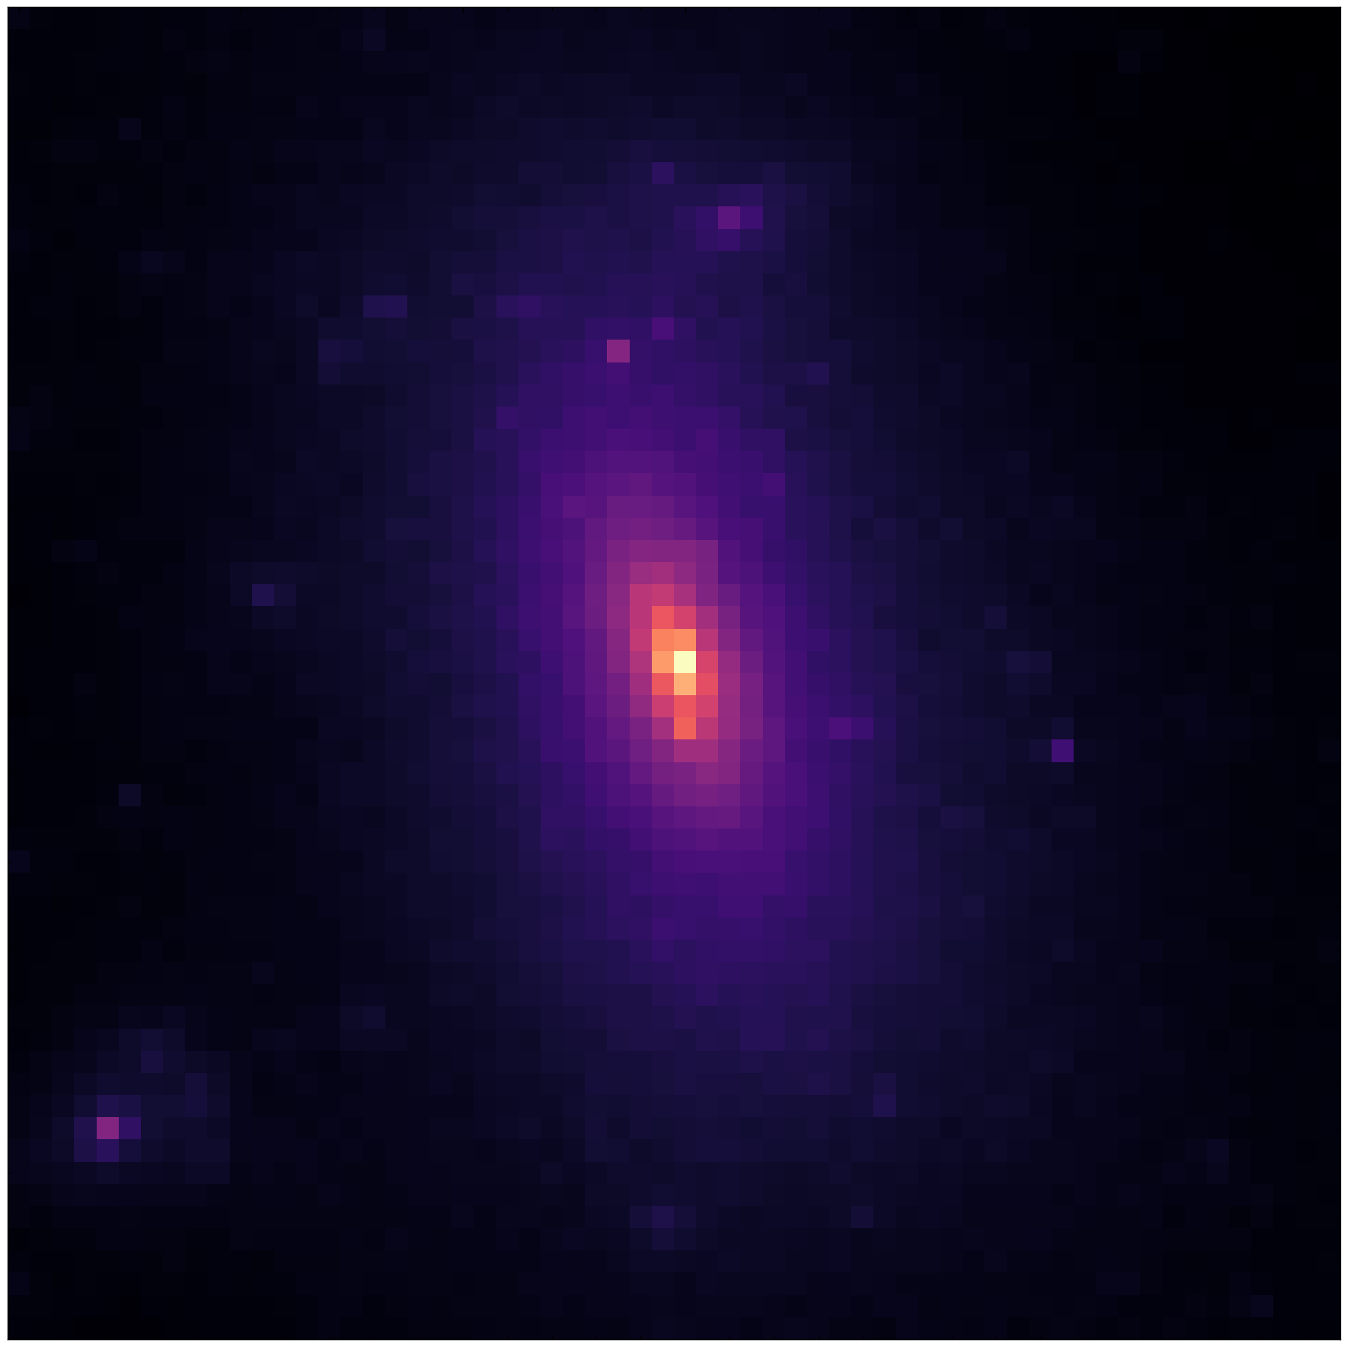
Observing
Dark
Matter
Interesting
Physics

Slide 16
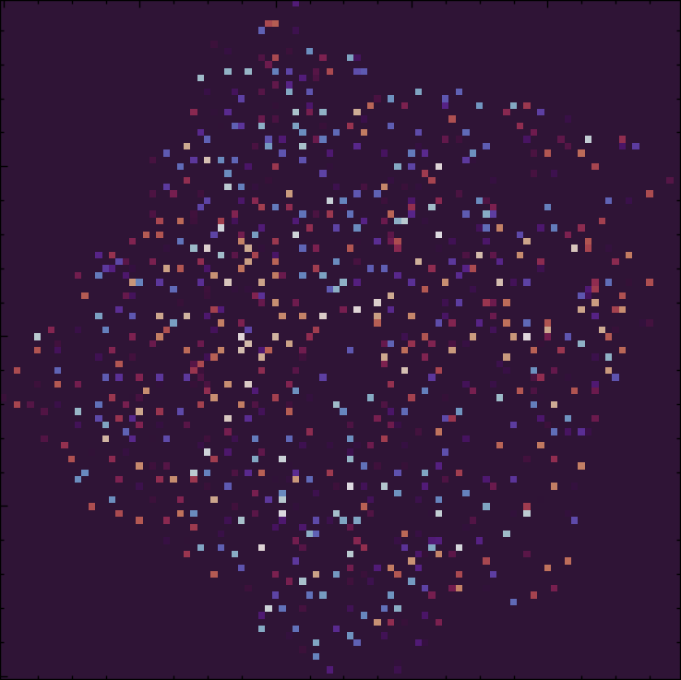
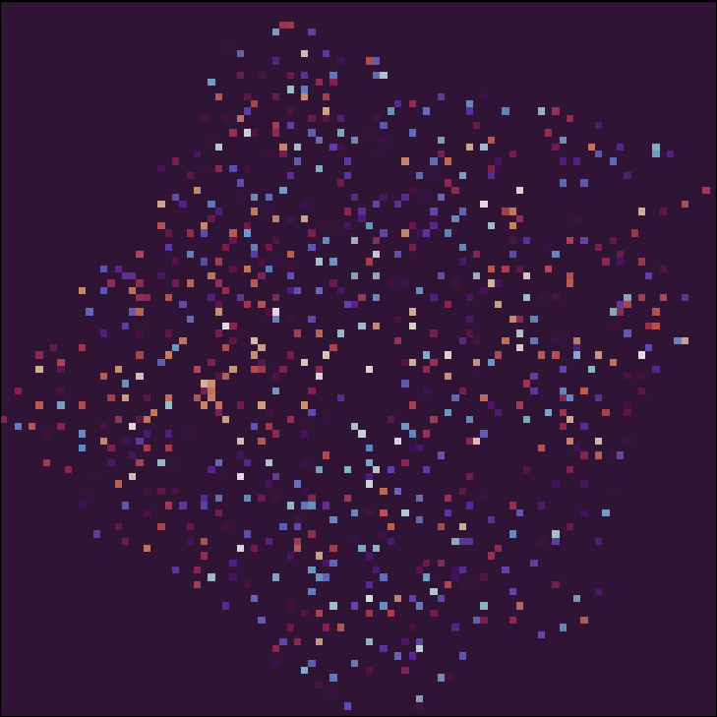
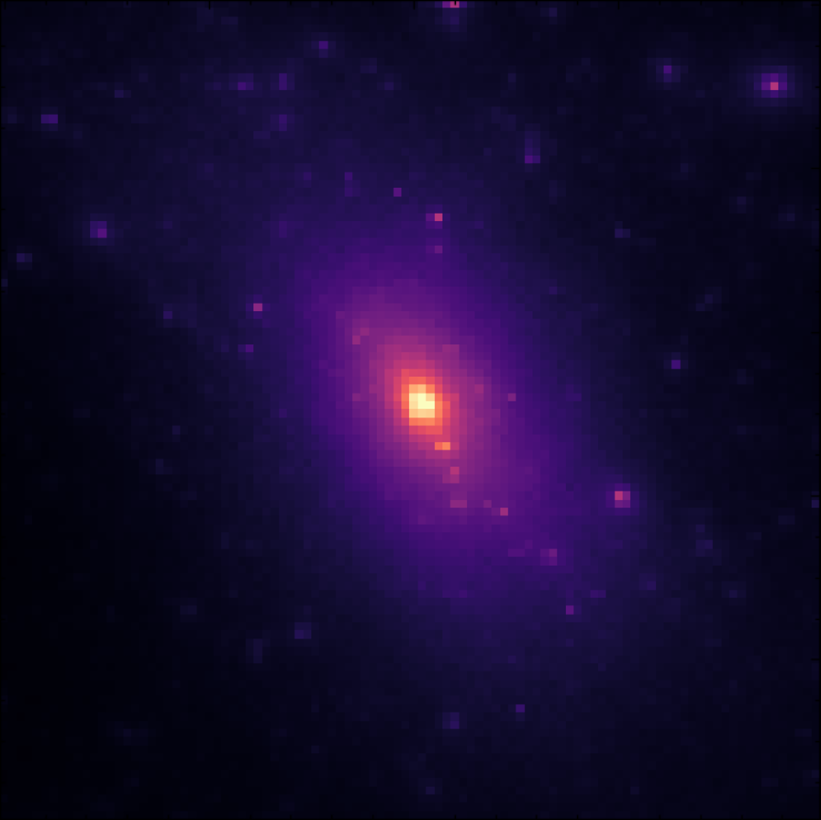
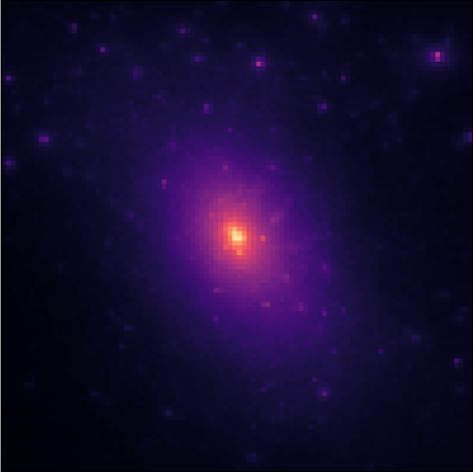
Observing Dark Matter

Slide 17
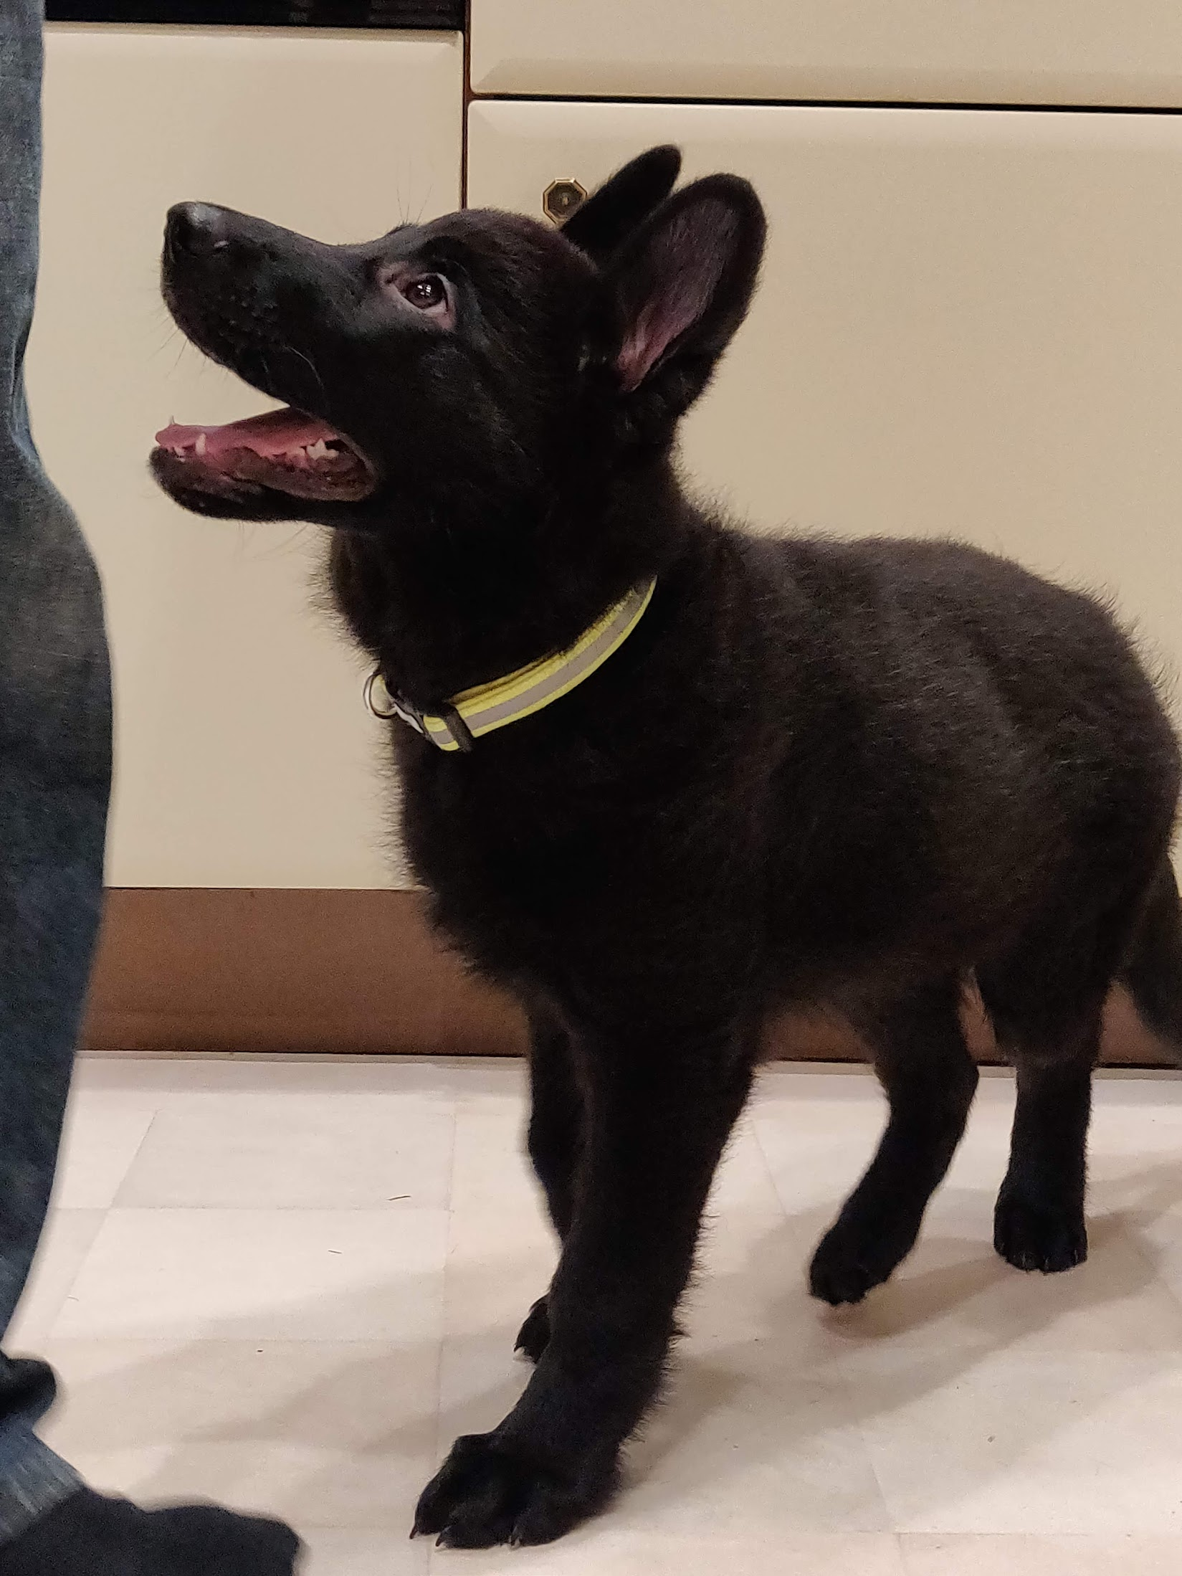
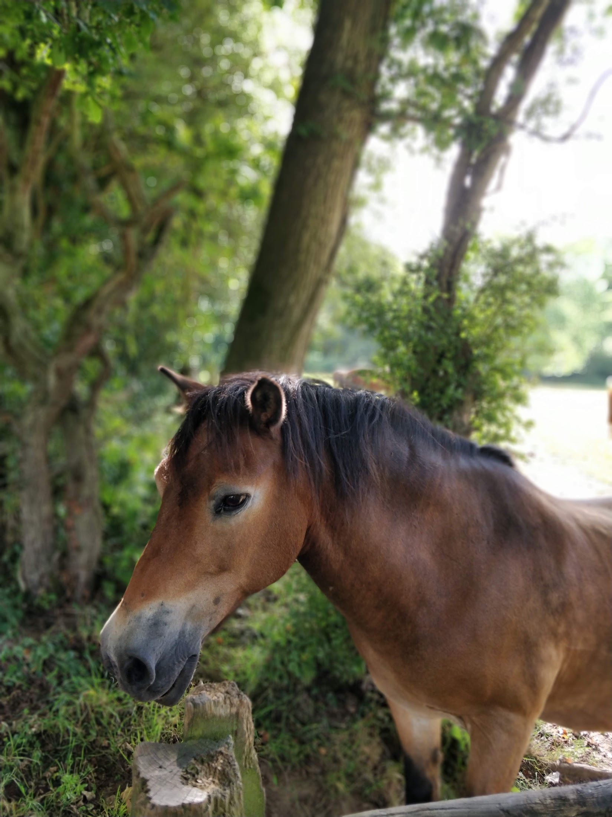
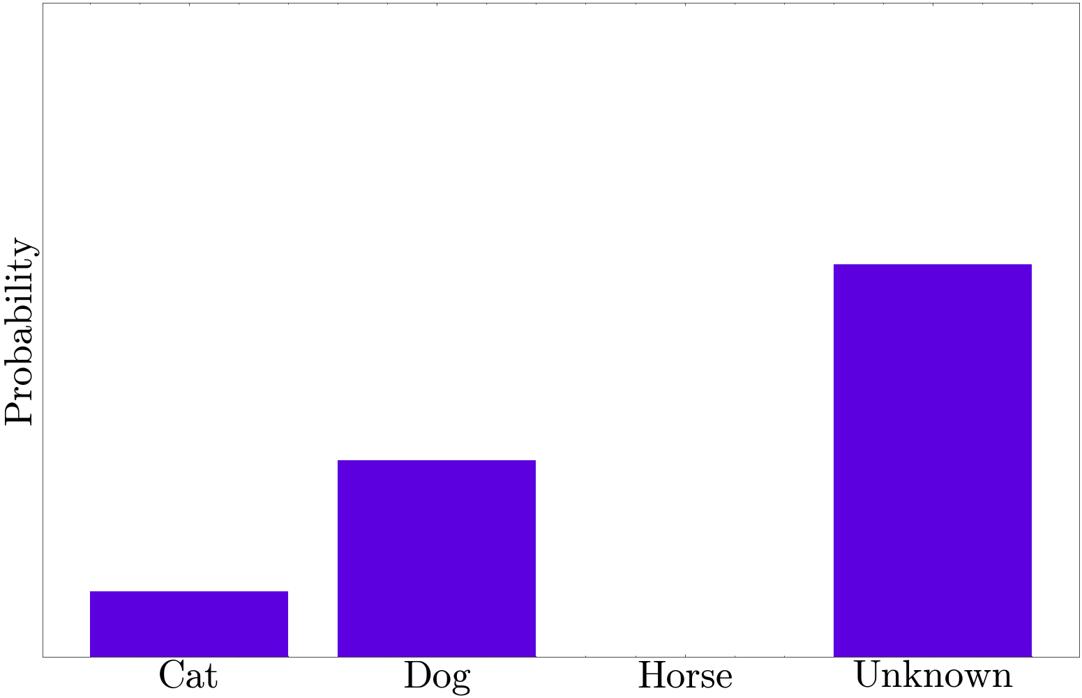
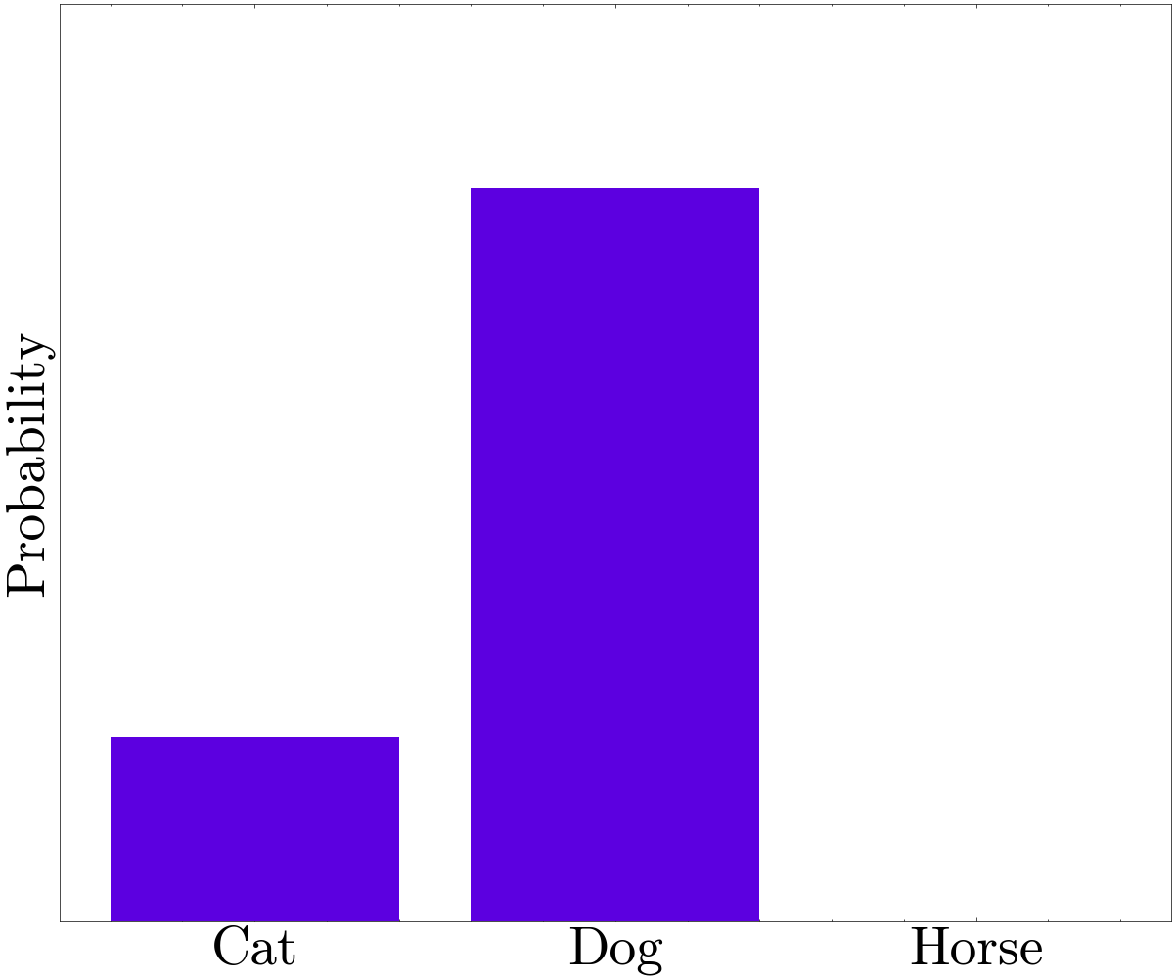
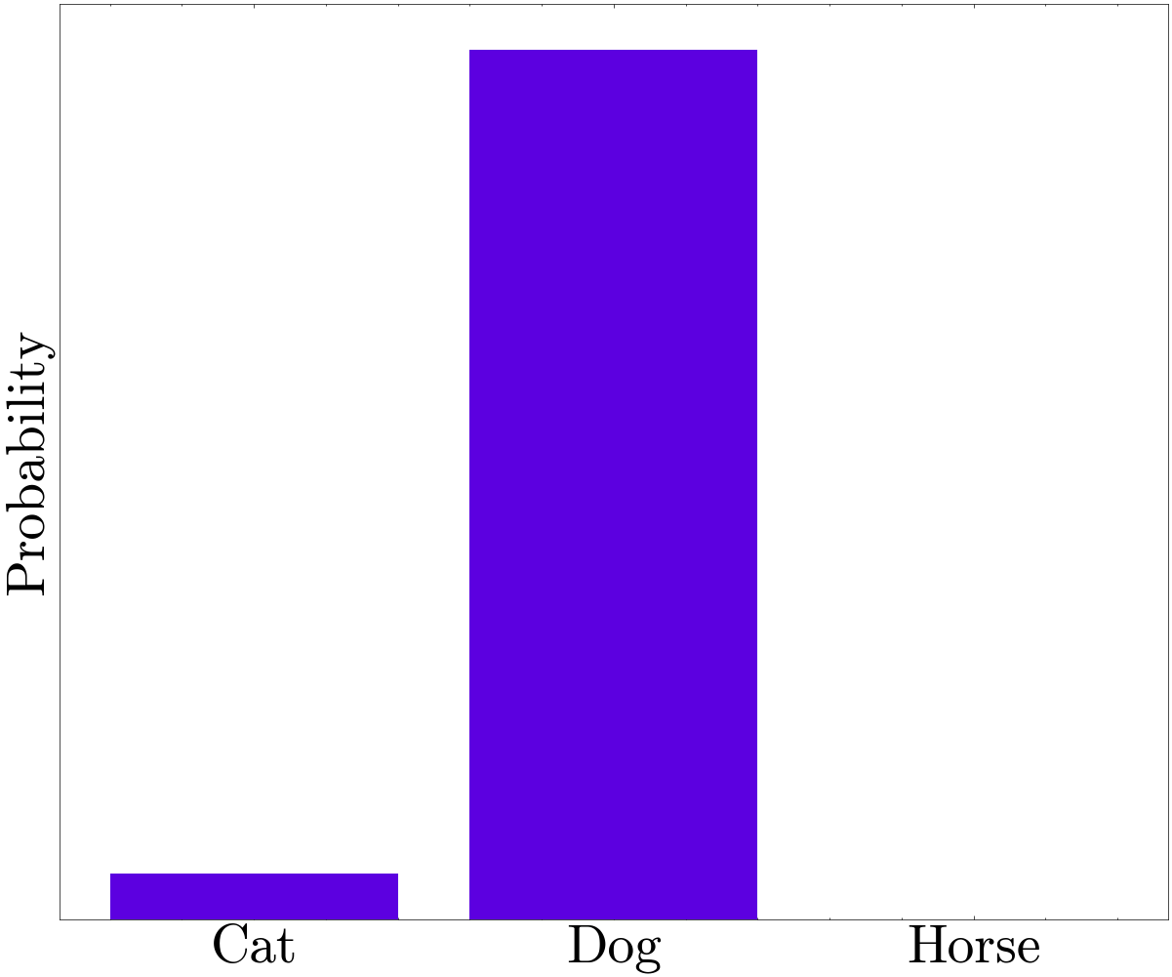
Confidently Wrong
I Don’t Know
Classifier

Slide 18
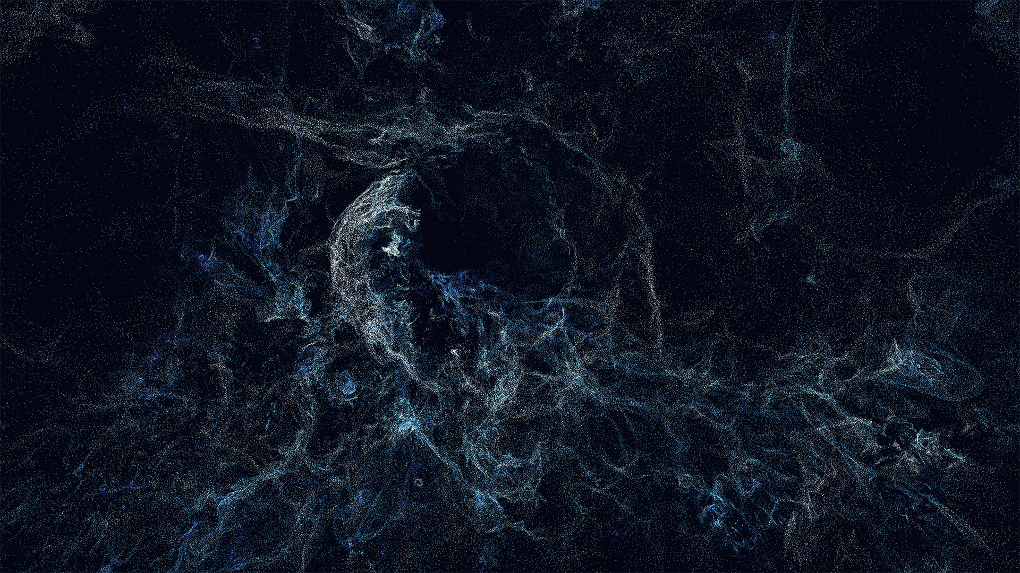
What is Dark Matter?
Nelson, et al. 2024

Slide 19
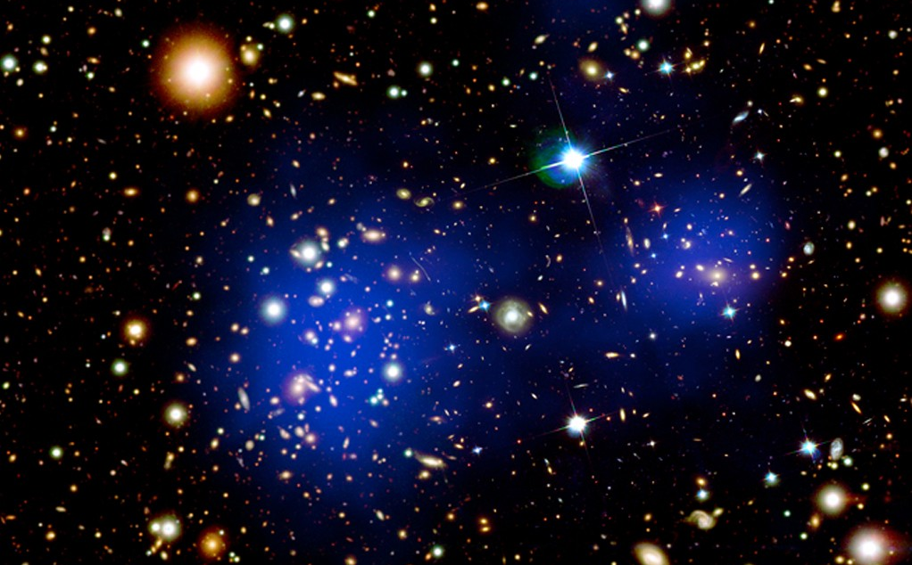
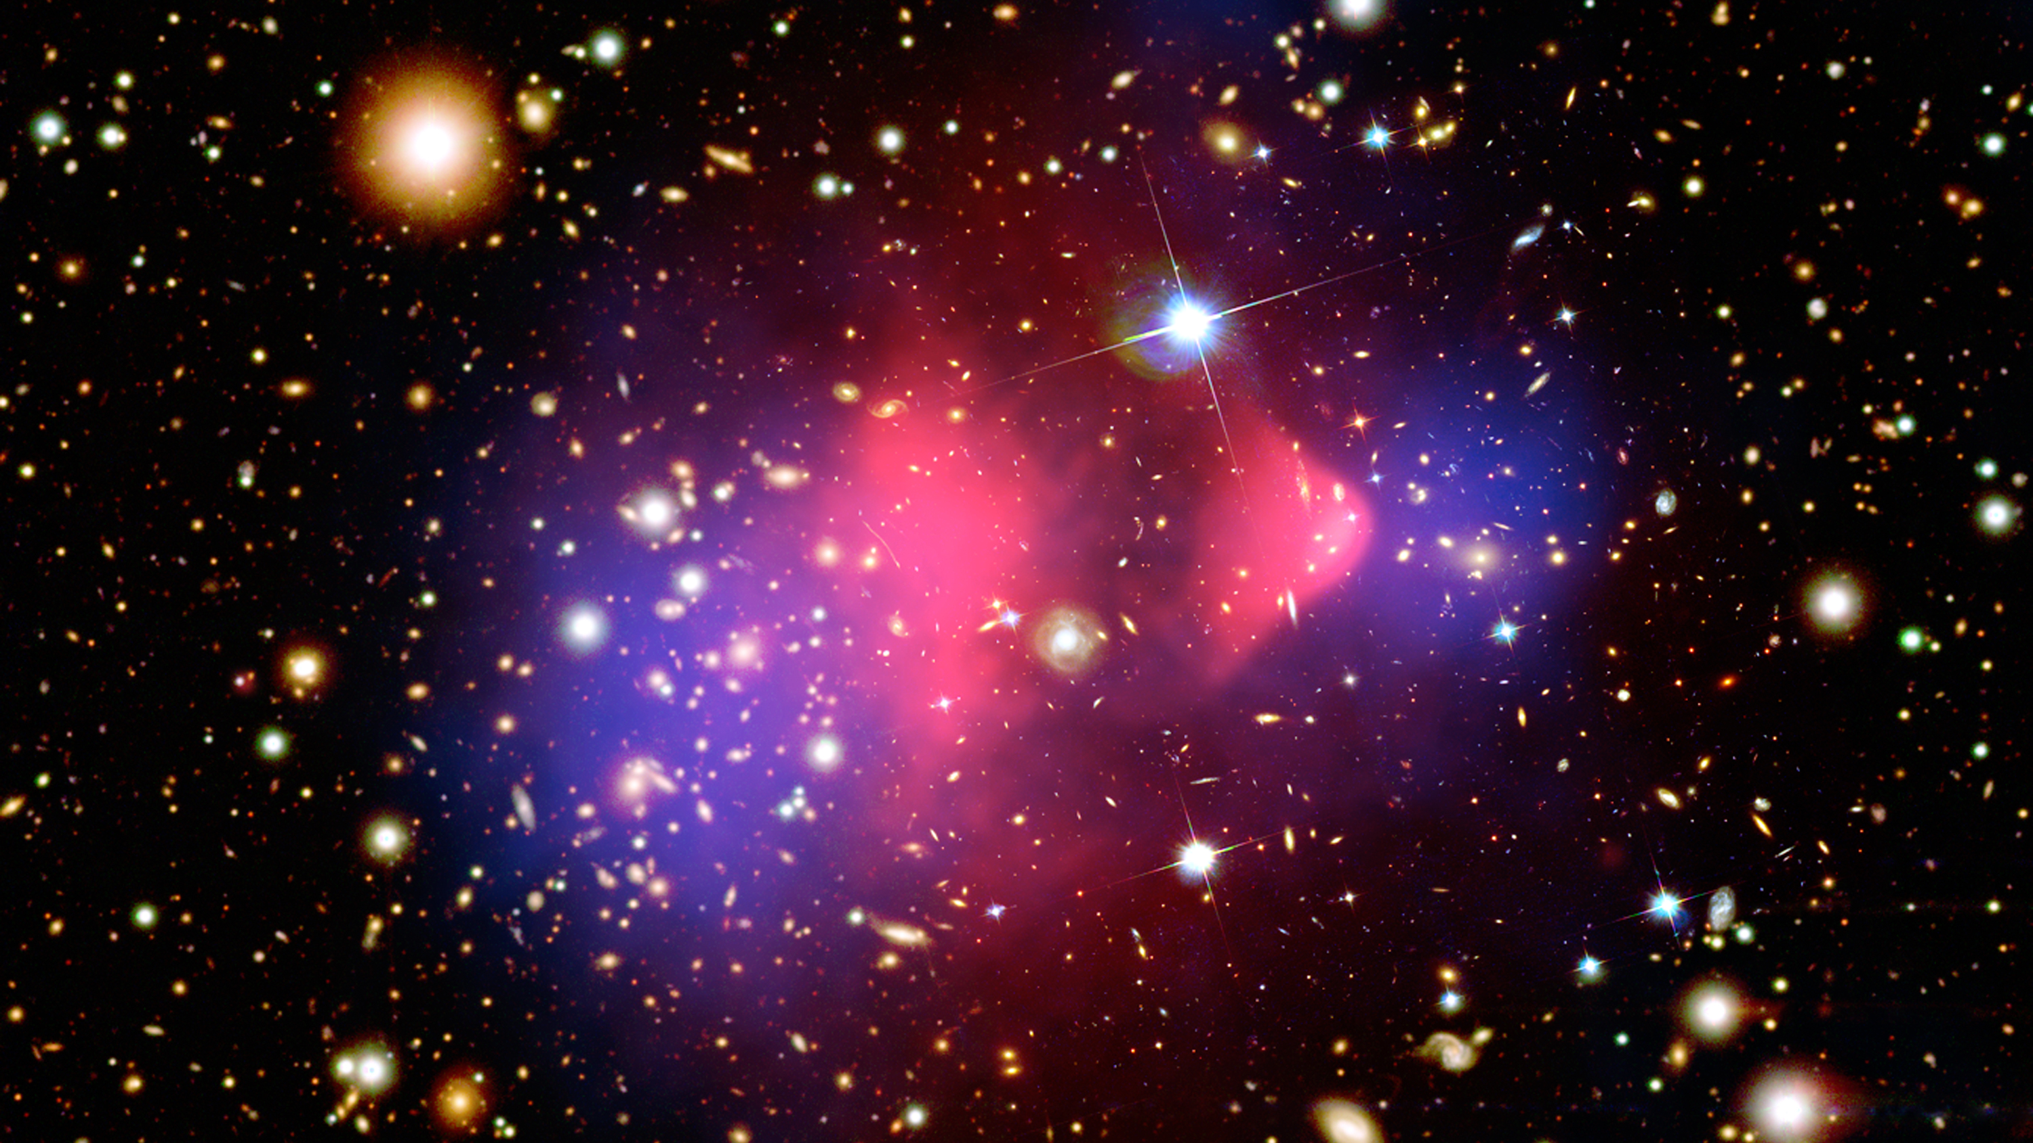
What is Dark Matter?
X-ray: NASA/CXC/M.Markevitch et al.
Optical: NASA/STScI; Magellan/U.Arizona/D.Clowe et al.
Lensing Map: NASA/STScI; ESO WFI; Magellan/U.Arizona/D.Clowe et al.
Notes:
Remove

Slide 20

Galaxy Clusters
Probe Dark Matter
ESA/Webb, NASA & CSA
H. Atek, M. Zamani
Notes:
Remove

Slide 21
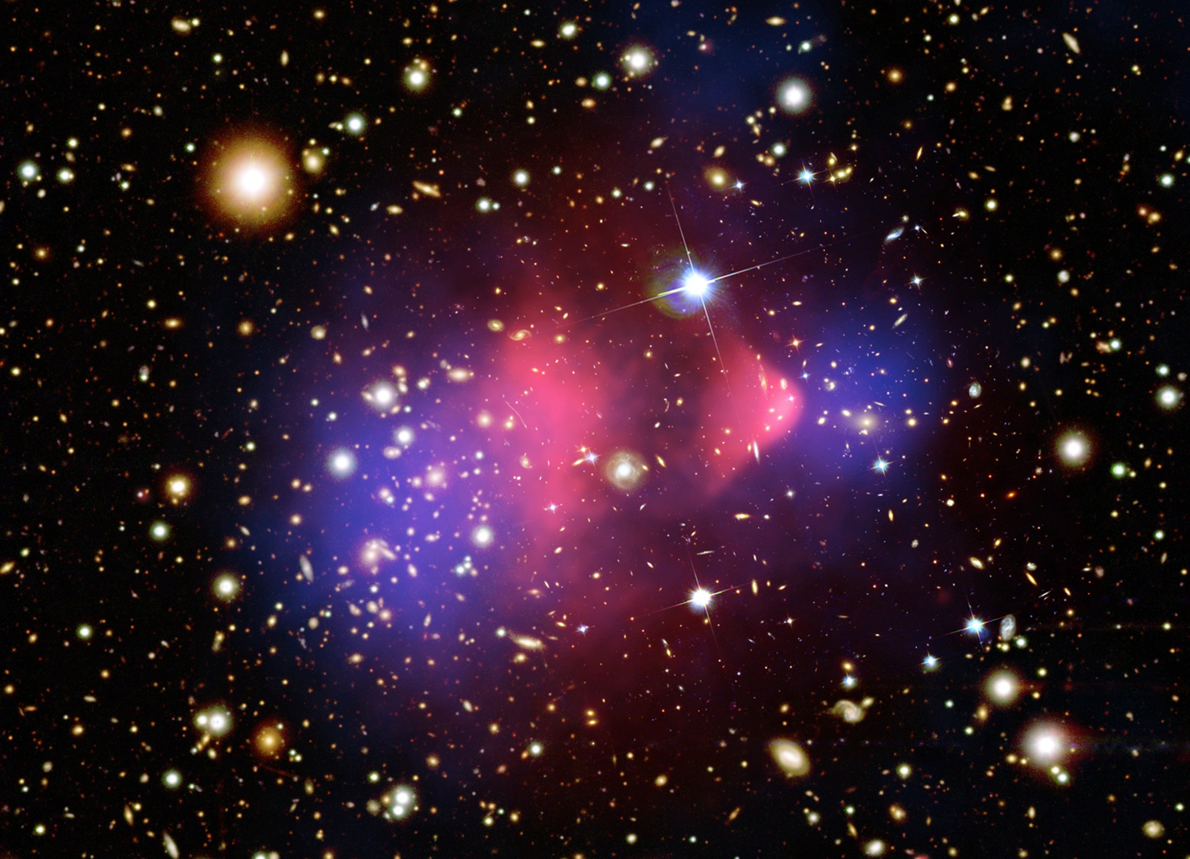
The Mystery of Dark Matter
Total Mass
(Stars + Dark Matter)
Hot Gas
X-ray: NASA/CXC/CfA/M.Markevitch et al.
Optical: NASA/STScI; Magellan/U.Arizona/D.Clowe et al.
Lensing Map: NASA/STScI; ESO WFI; Magellan/U.Arizona/D.Clowe et al.

Slide 22
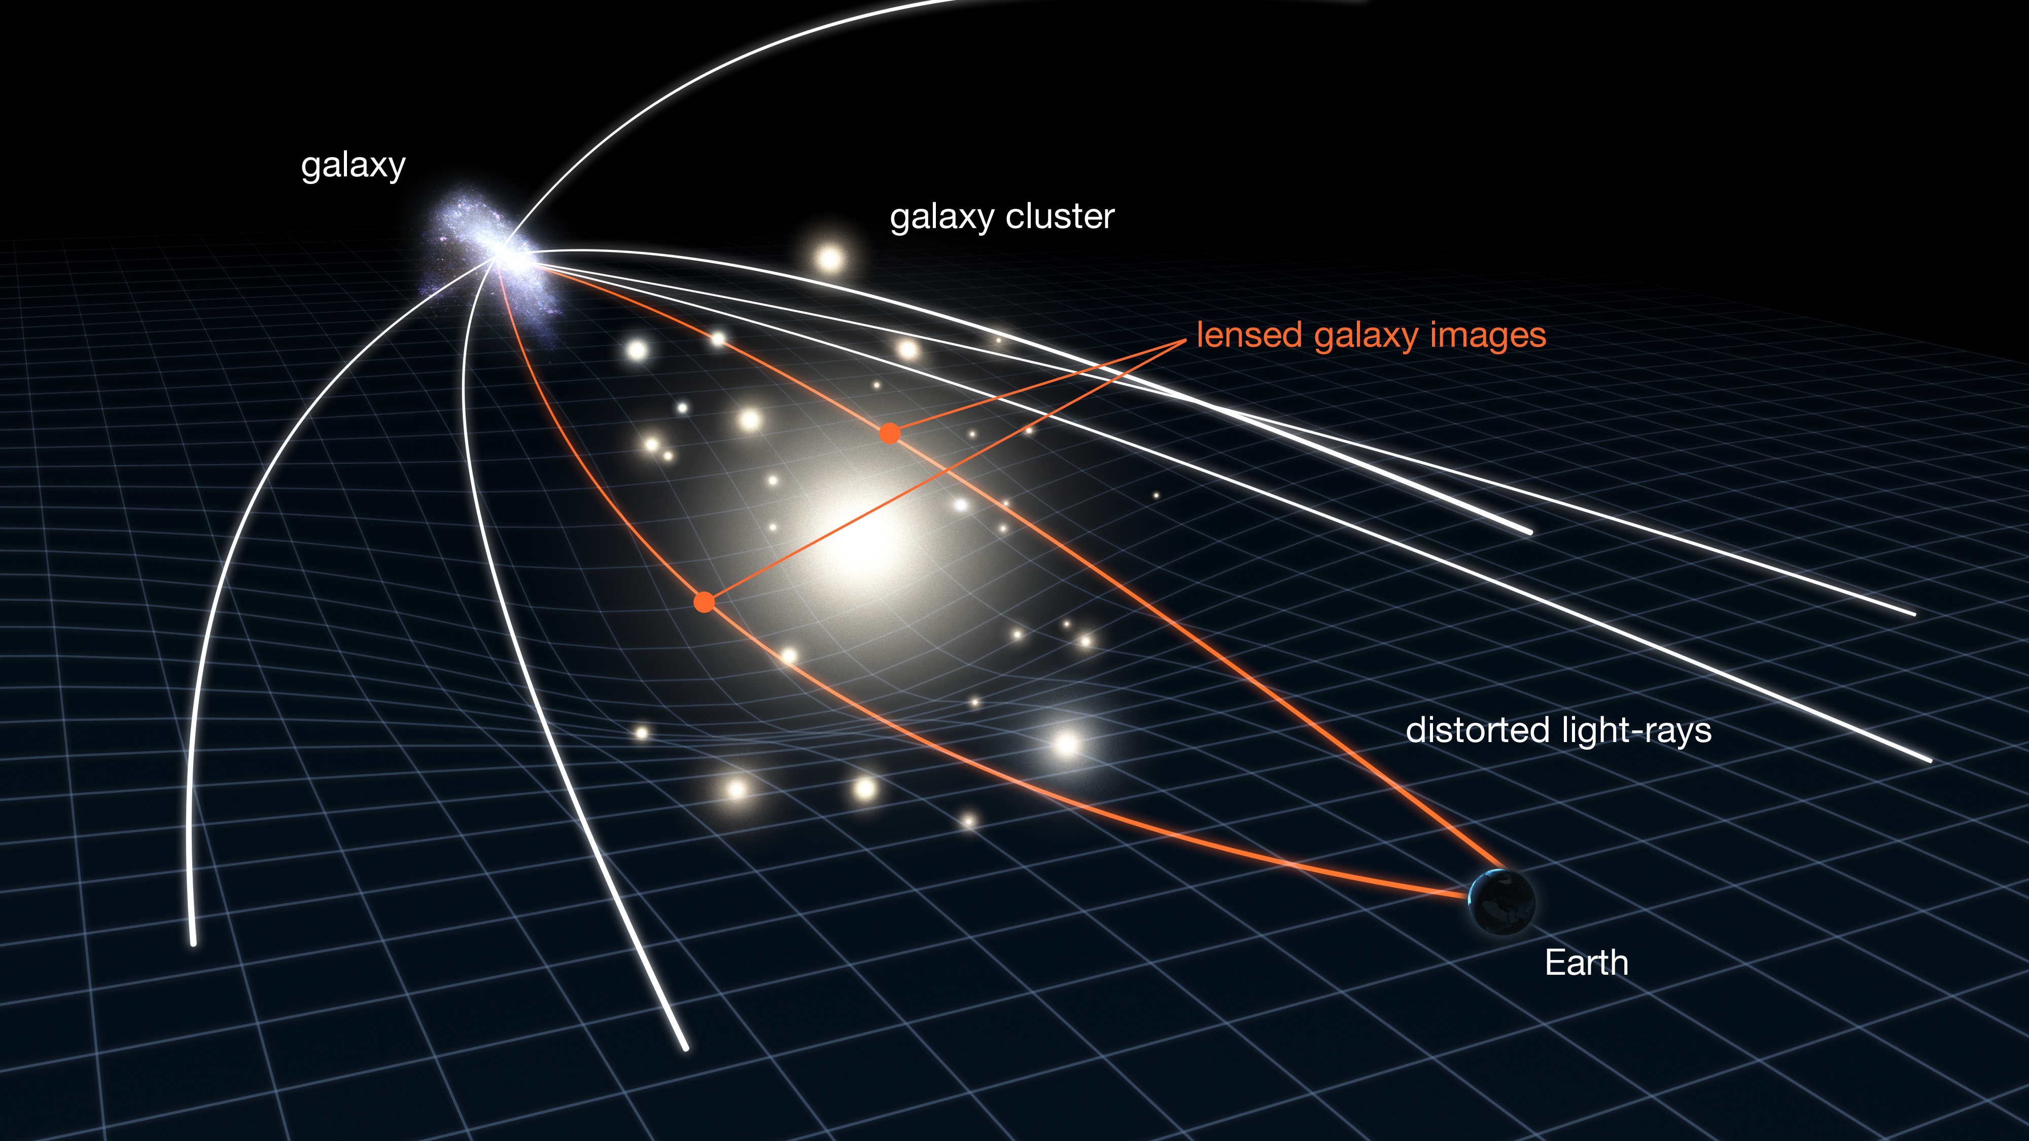
Galaxy Clusters Distort Background Galaxies
NASA, ESA & L. Calçada

Slide 23
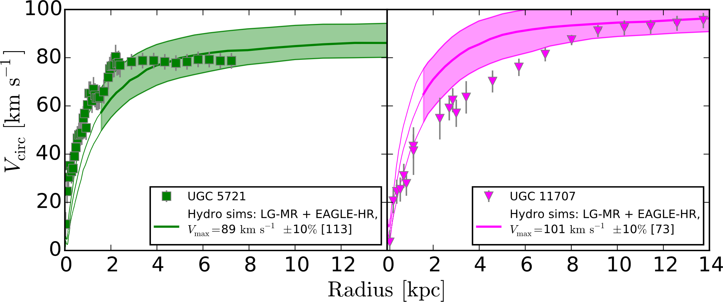
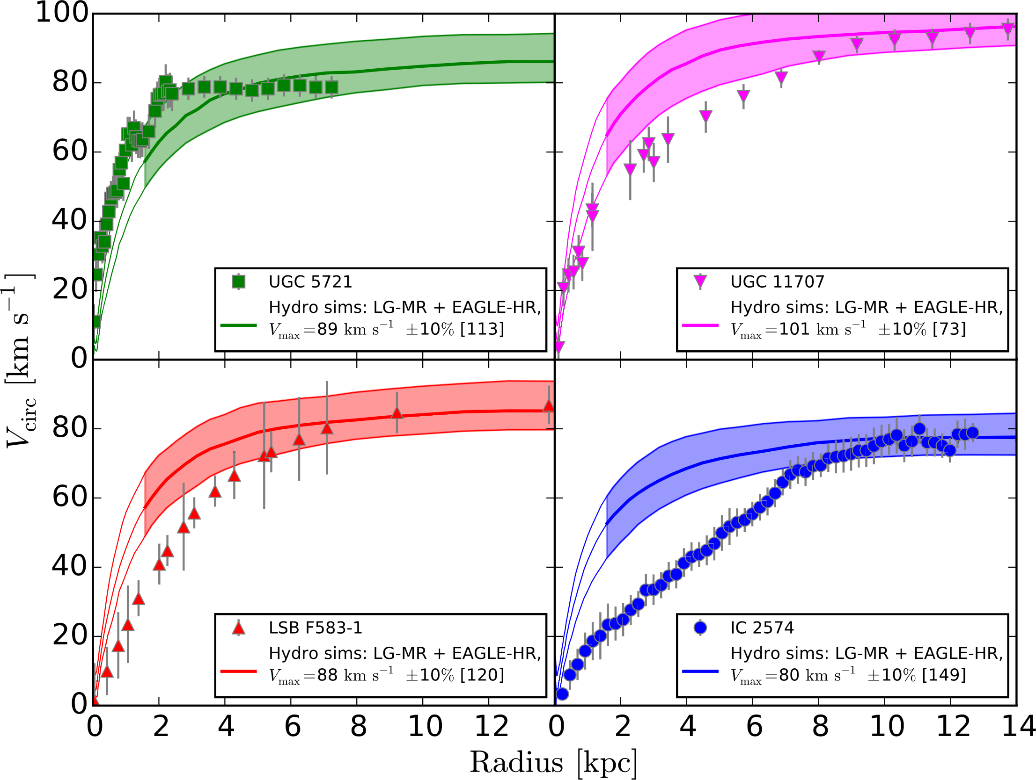
Is Cold Collisionless Dark Matter the Answer?
al
Radius [kpc]
Oman et al. 2015

Slide 24
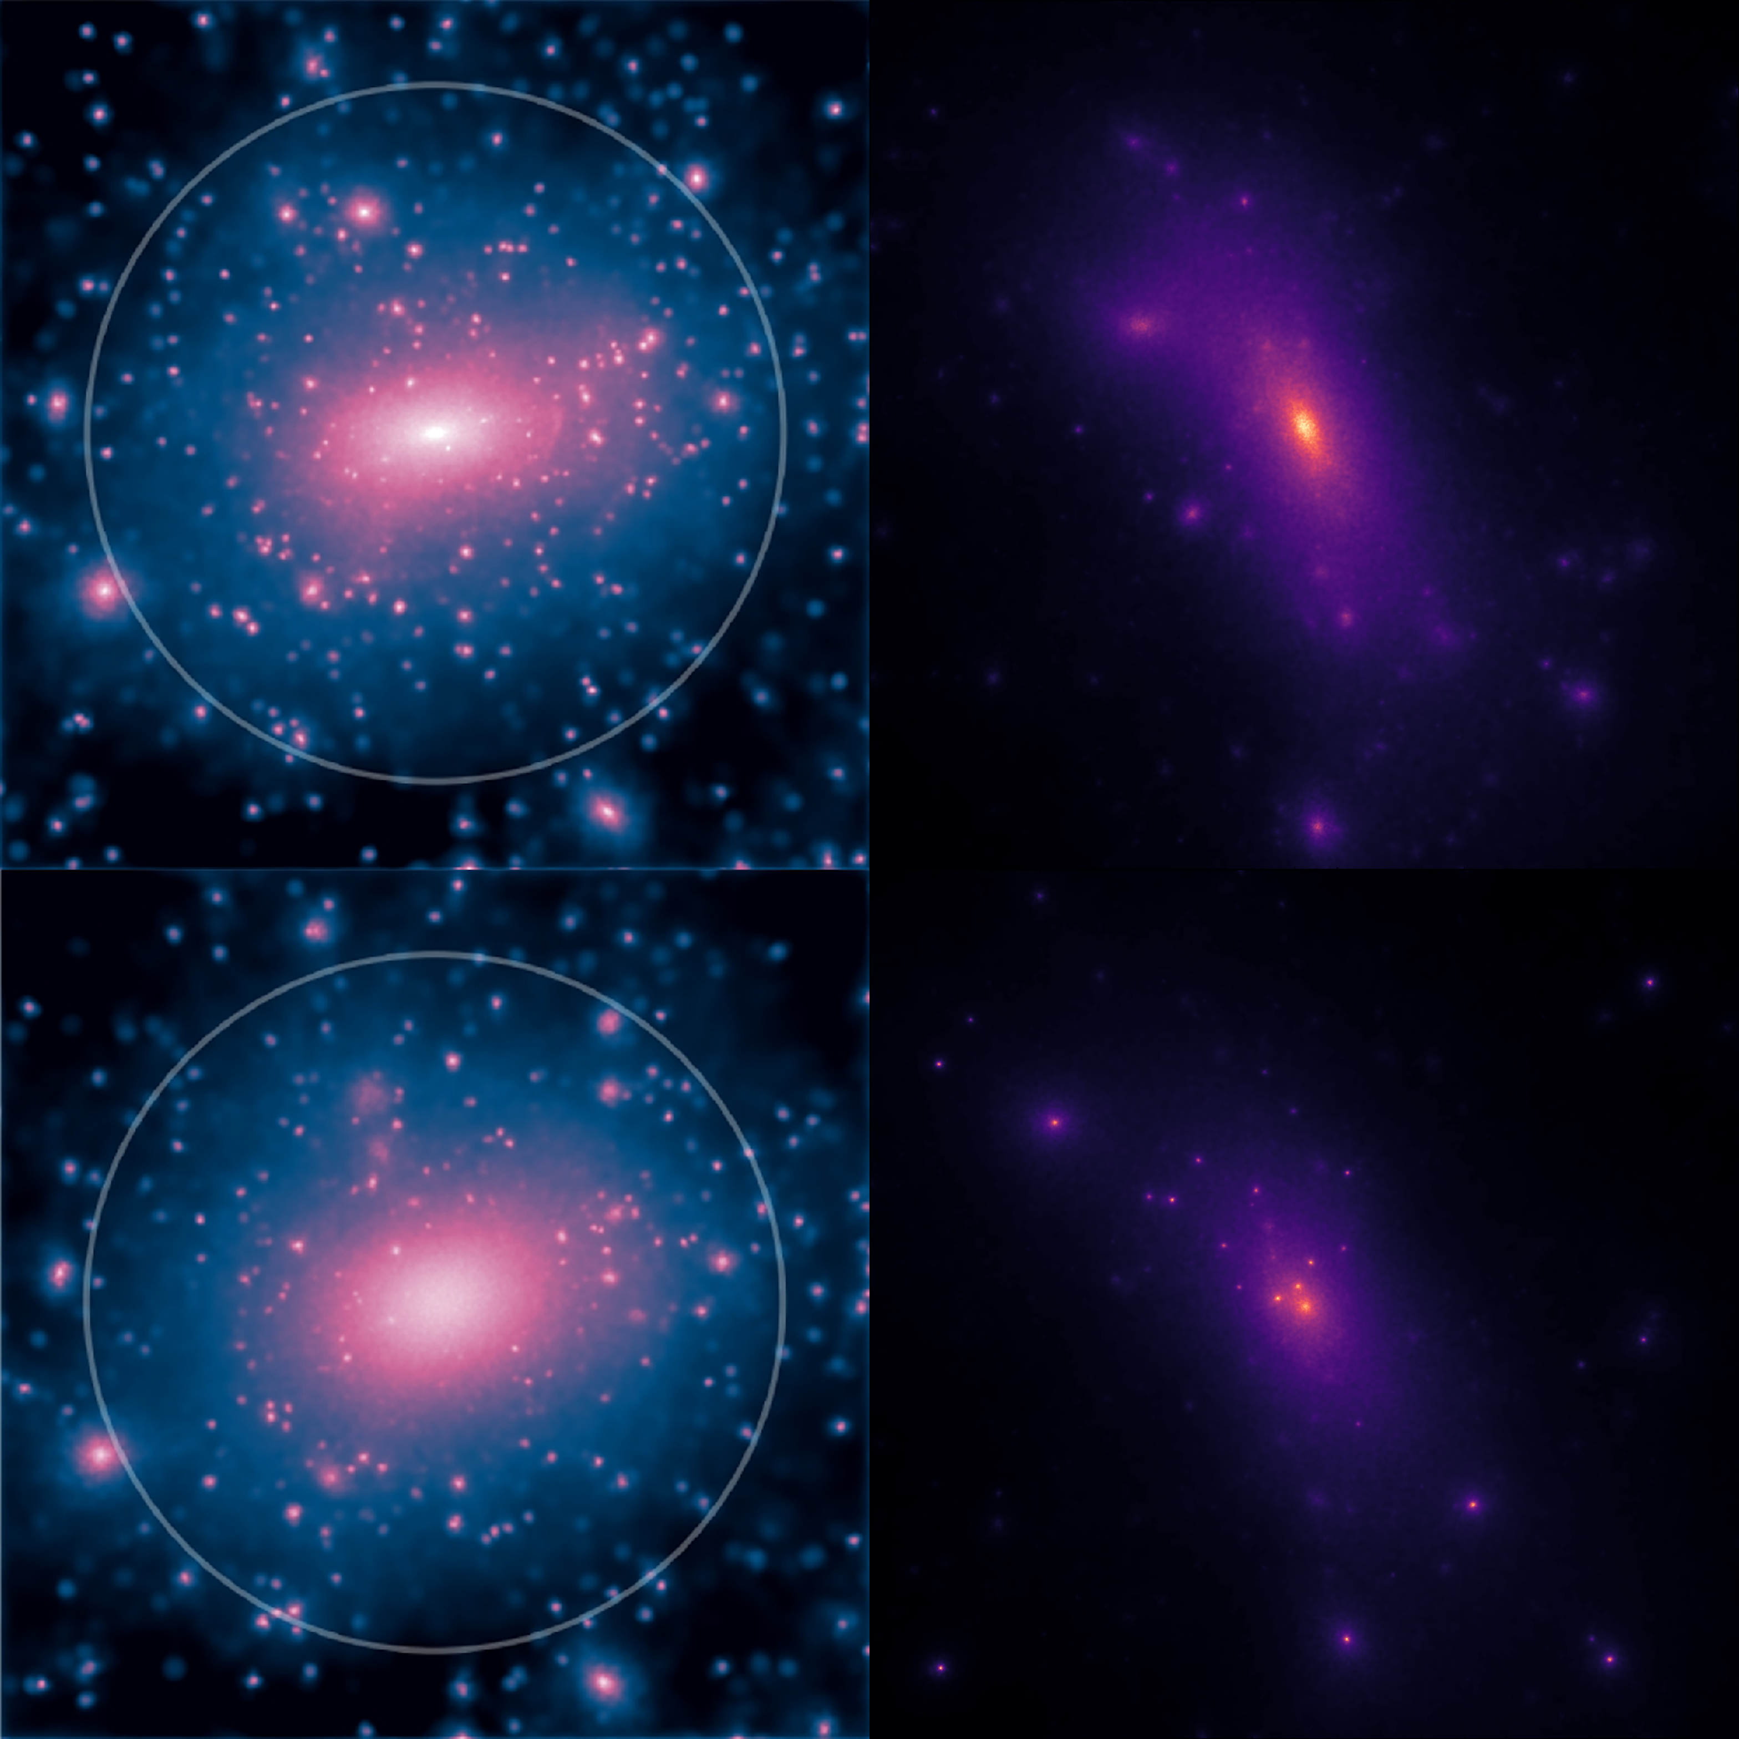
Testing Alternate Dark Matter Theories
Cold Dark Matter
Less dense cores (puffier)
Self-Interacting
Dark Matter
Brinckmann et al. 2017

Slide 25
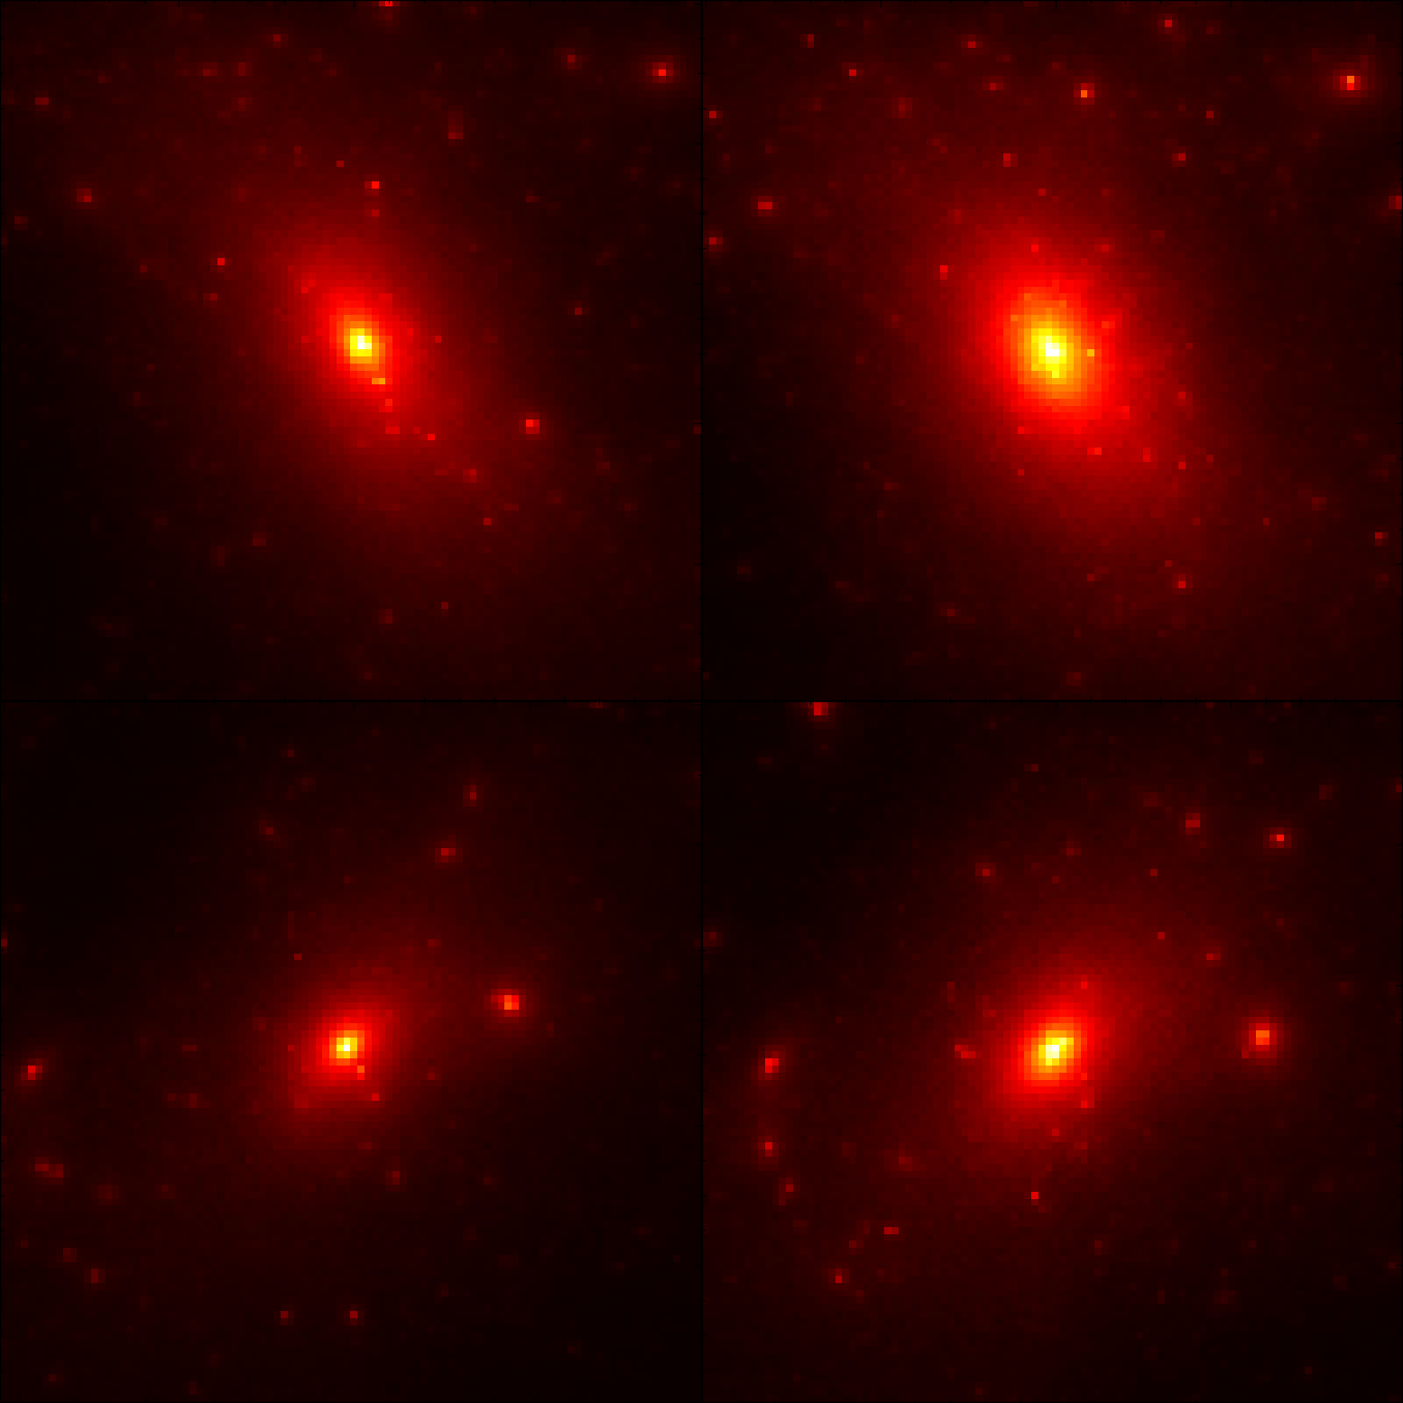
Density Profile Problems
Cold Dark Matter
Less dense cores (puffier)
Over dense cores
Diversity
Self-Interacting
Dark Matter

Slide 26
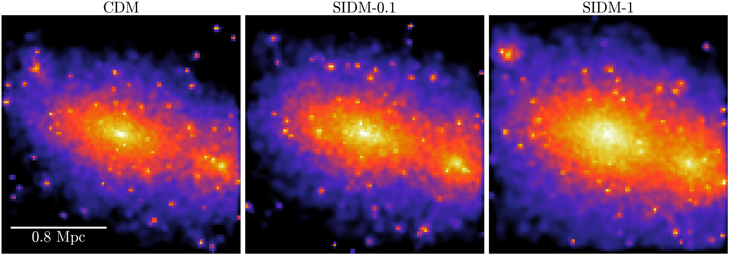
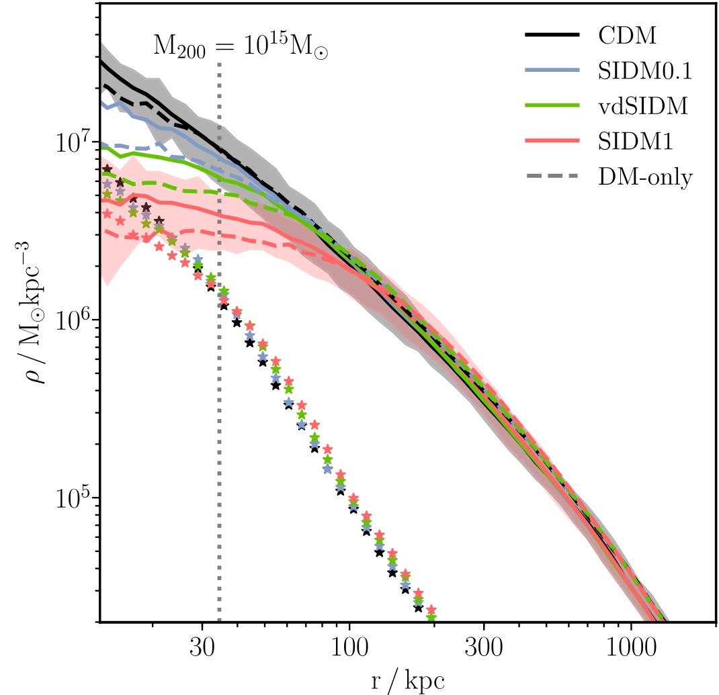
Effect of
Self-Interacting Dark Matter
Robertson, et al 2019

Slide 27

Effect of
Self-Interacting Dark Matter

Slide 28
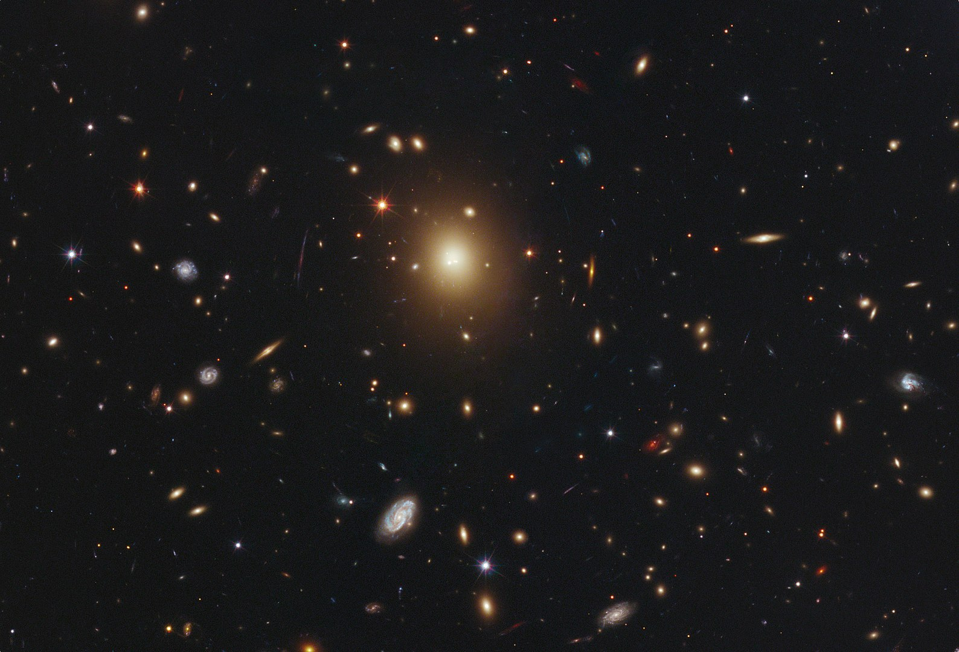
Current Methods are Slow
Brightest Cluster Galaxy (BCG)
Lensed Background Galaxies
NASA, ESA, M. Postman (STScI), T. Lauer (NOAO), and the CLASH Team

Slide 29
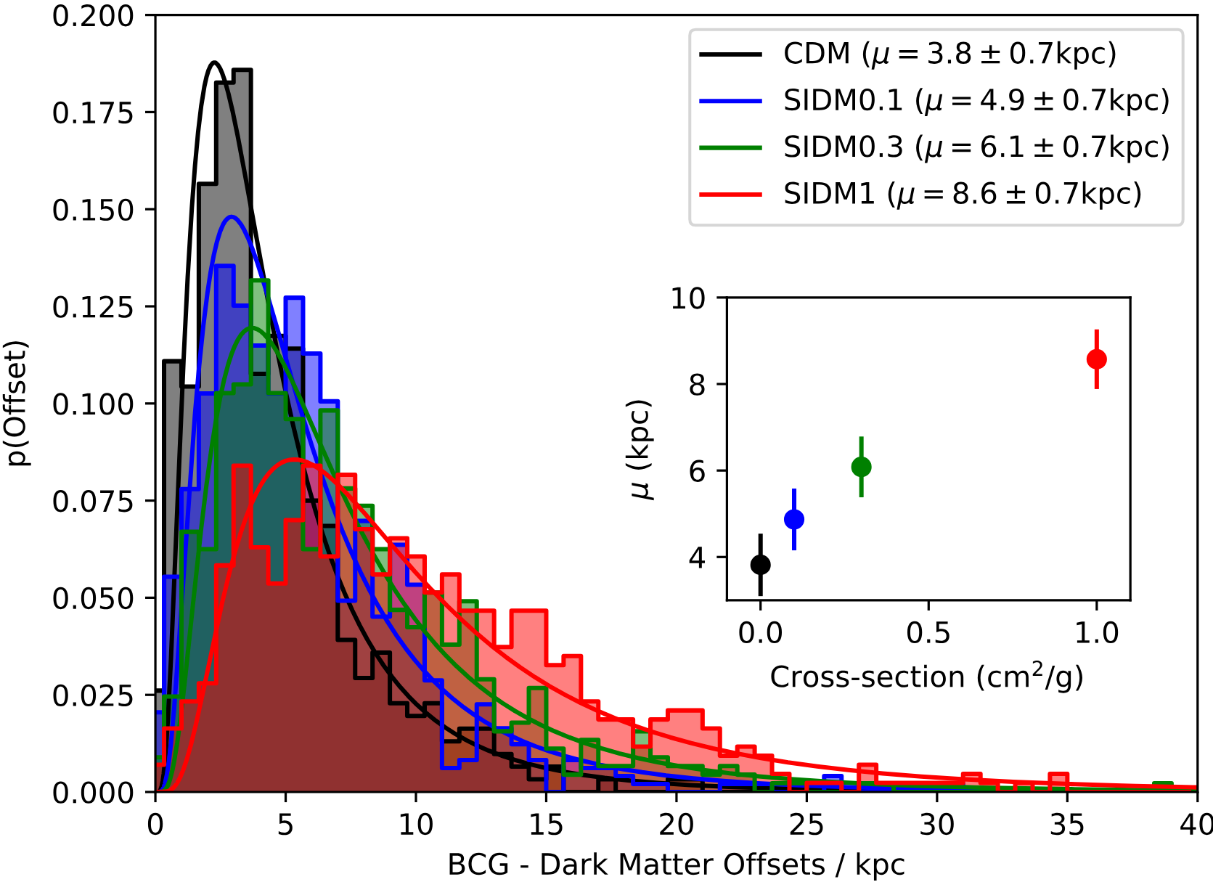
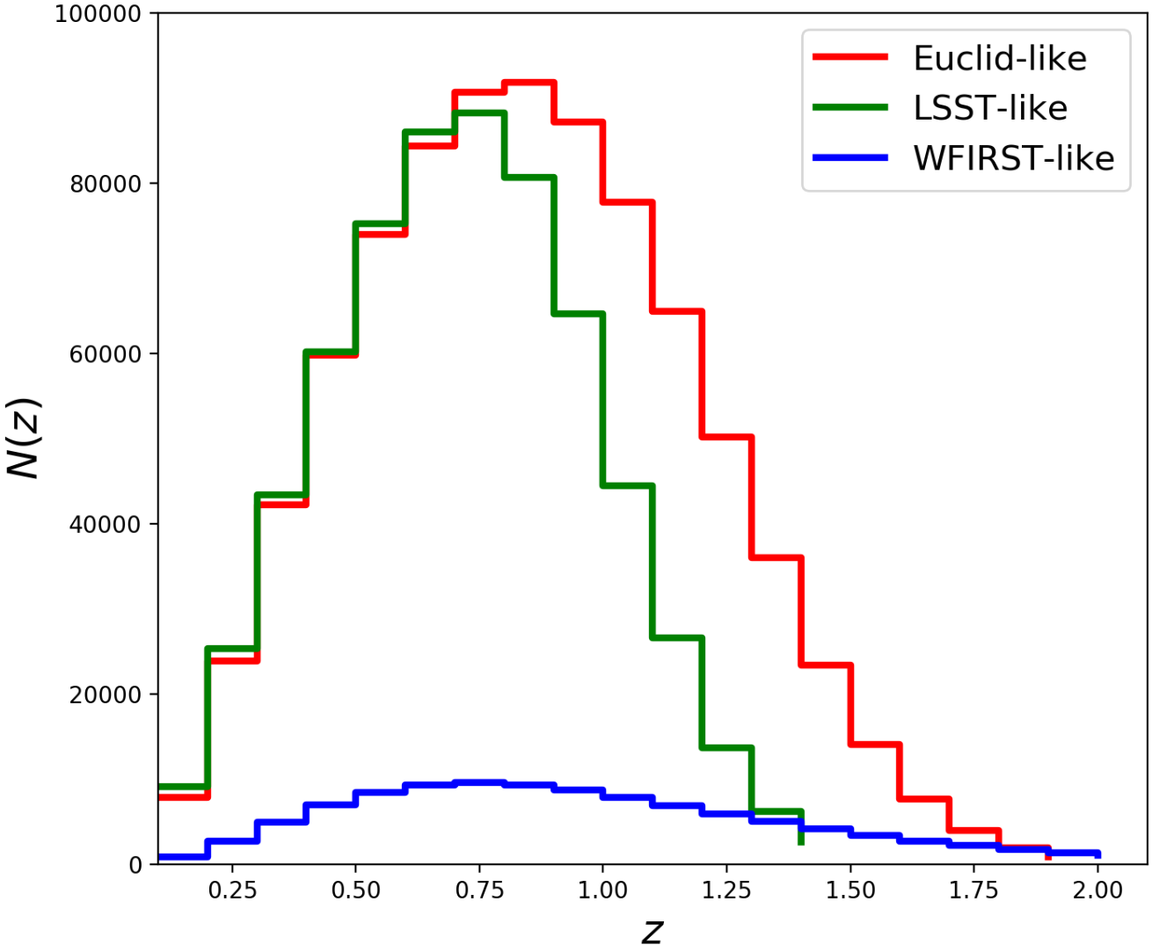
D. Harvey et al. 2019
L. Salvati, M. Douspis, N. Aghanim 2020
Current Methods are Slow

Slide 30
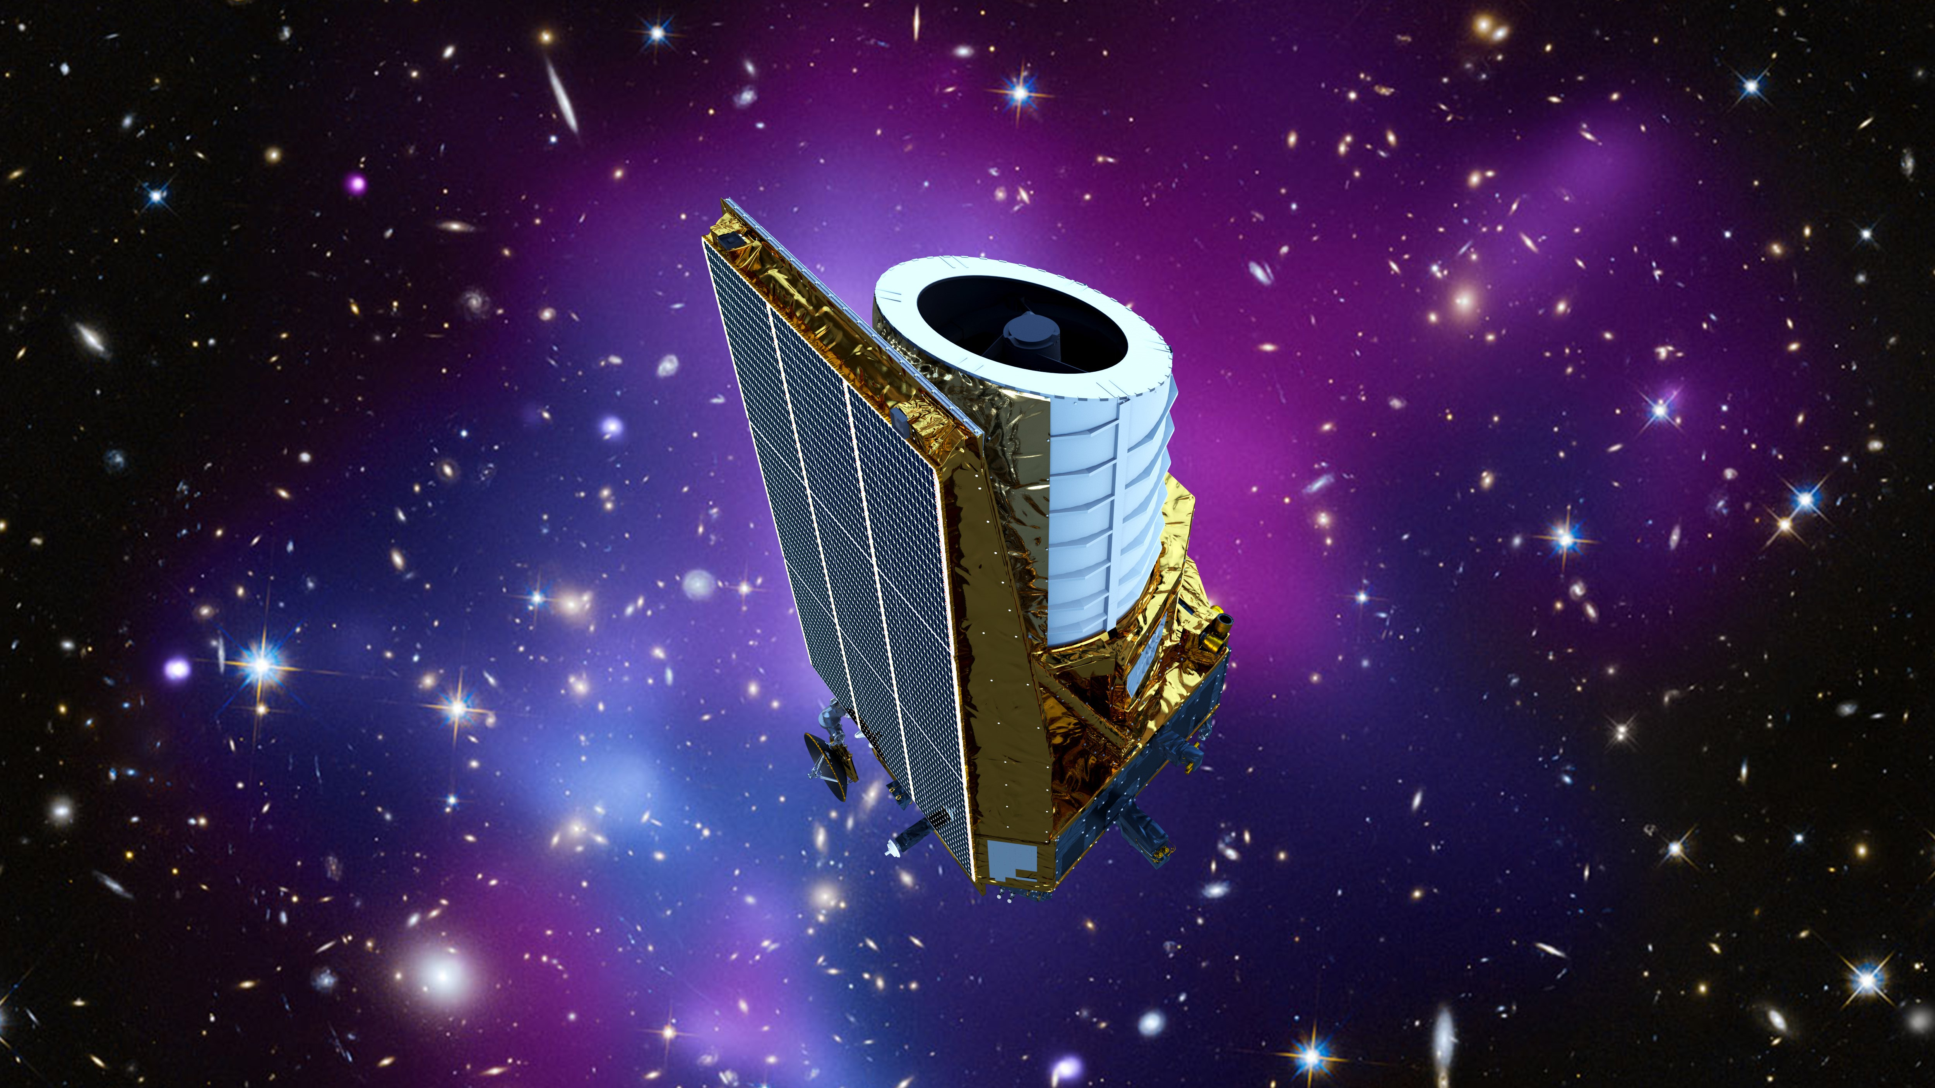
Era of Big Data
c
Keith Cooper, space.com

Slide 31
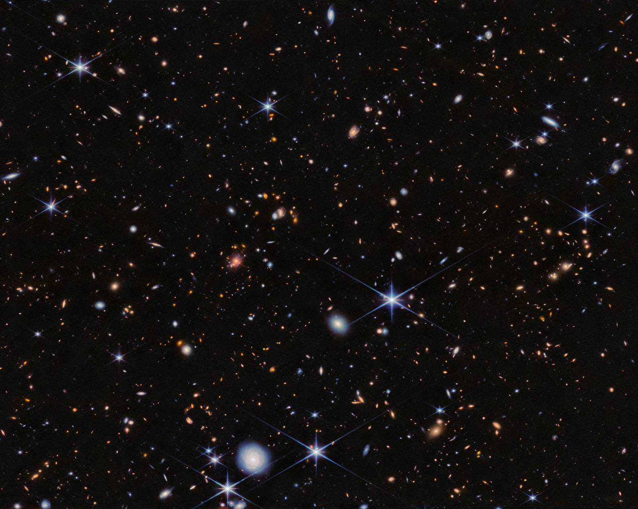
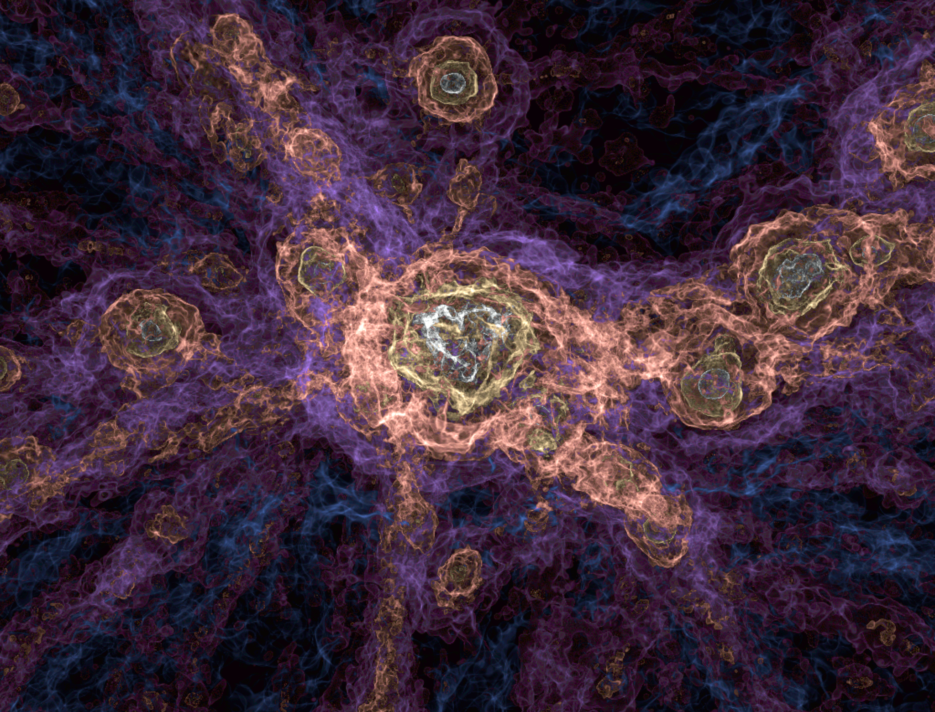
Limitations of Cosmology
ESA/Webb, NASA & CSA, H. Dannerbauer
The FLAMINGO project

Slide 32
Simulating the Universe
Nelson, et al. 2024

Slide 33
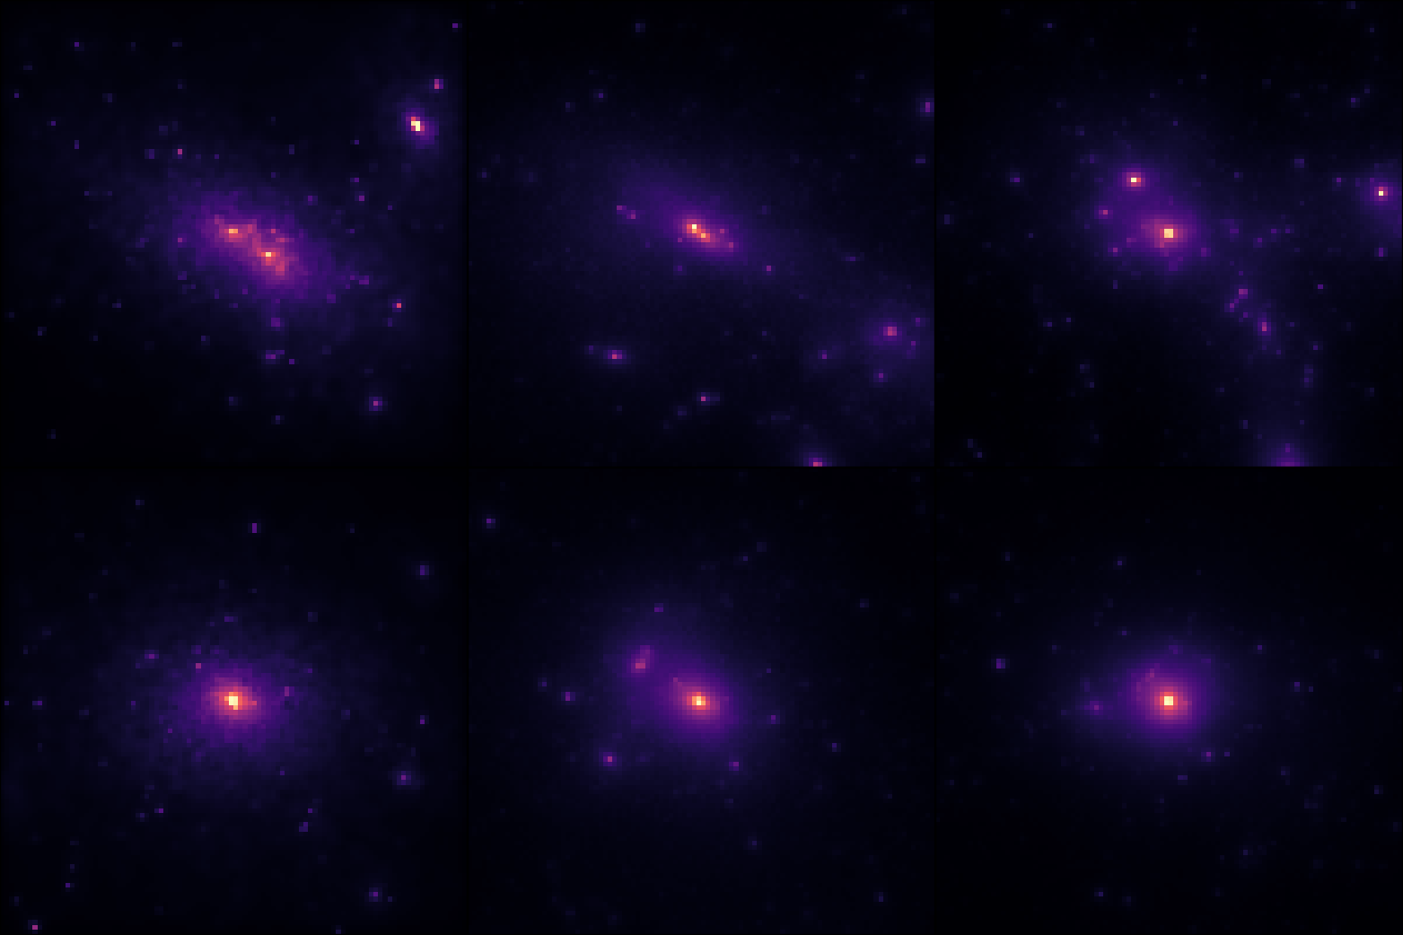
Marginalising Simulations
BAHAMAS
DARKSKIES
TNG
Notes:
Link back to intro

Slide 34
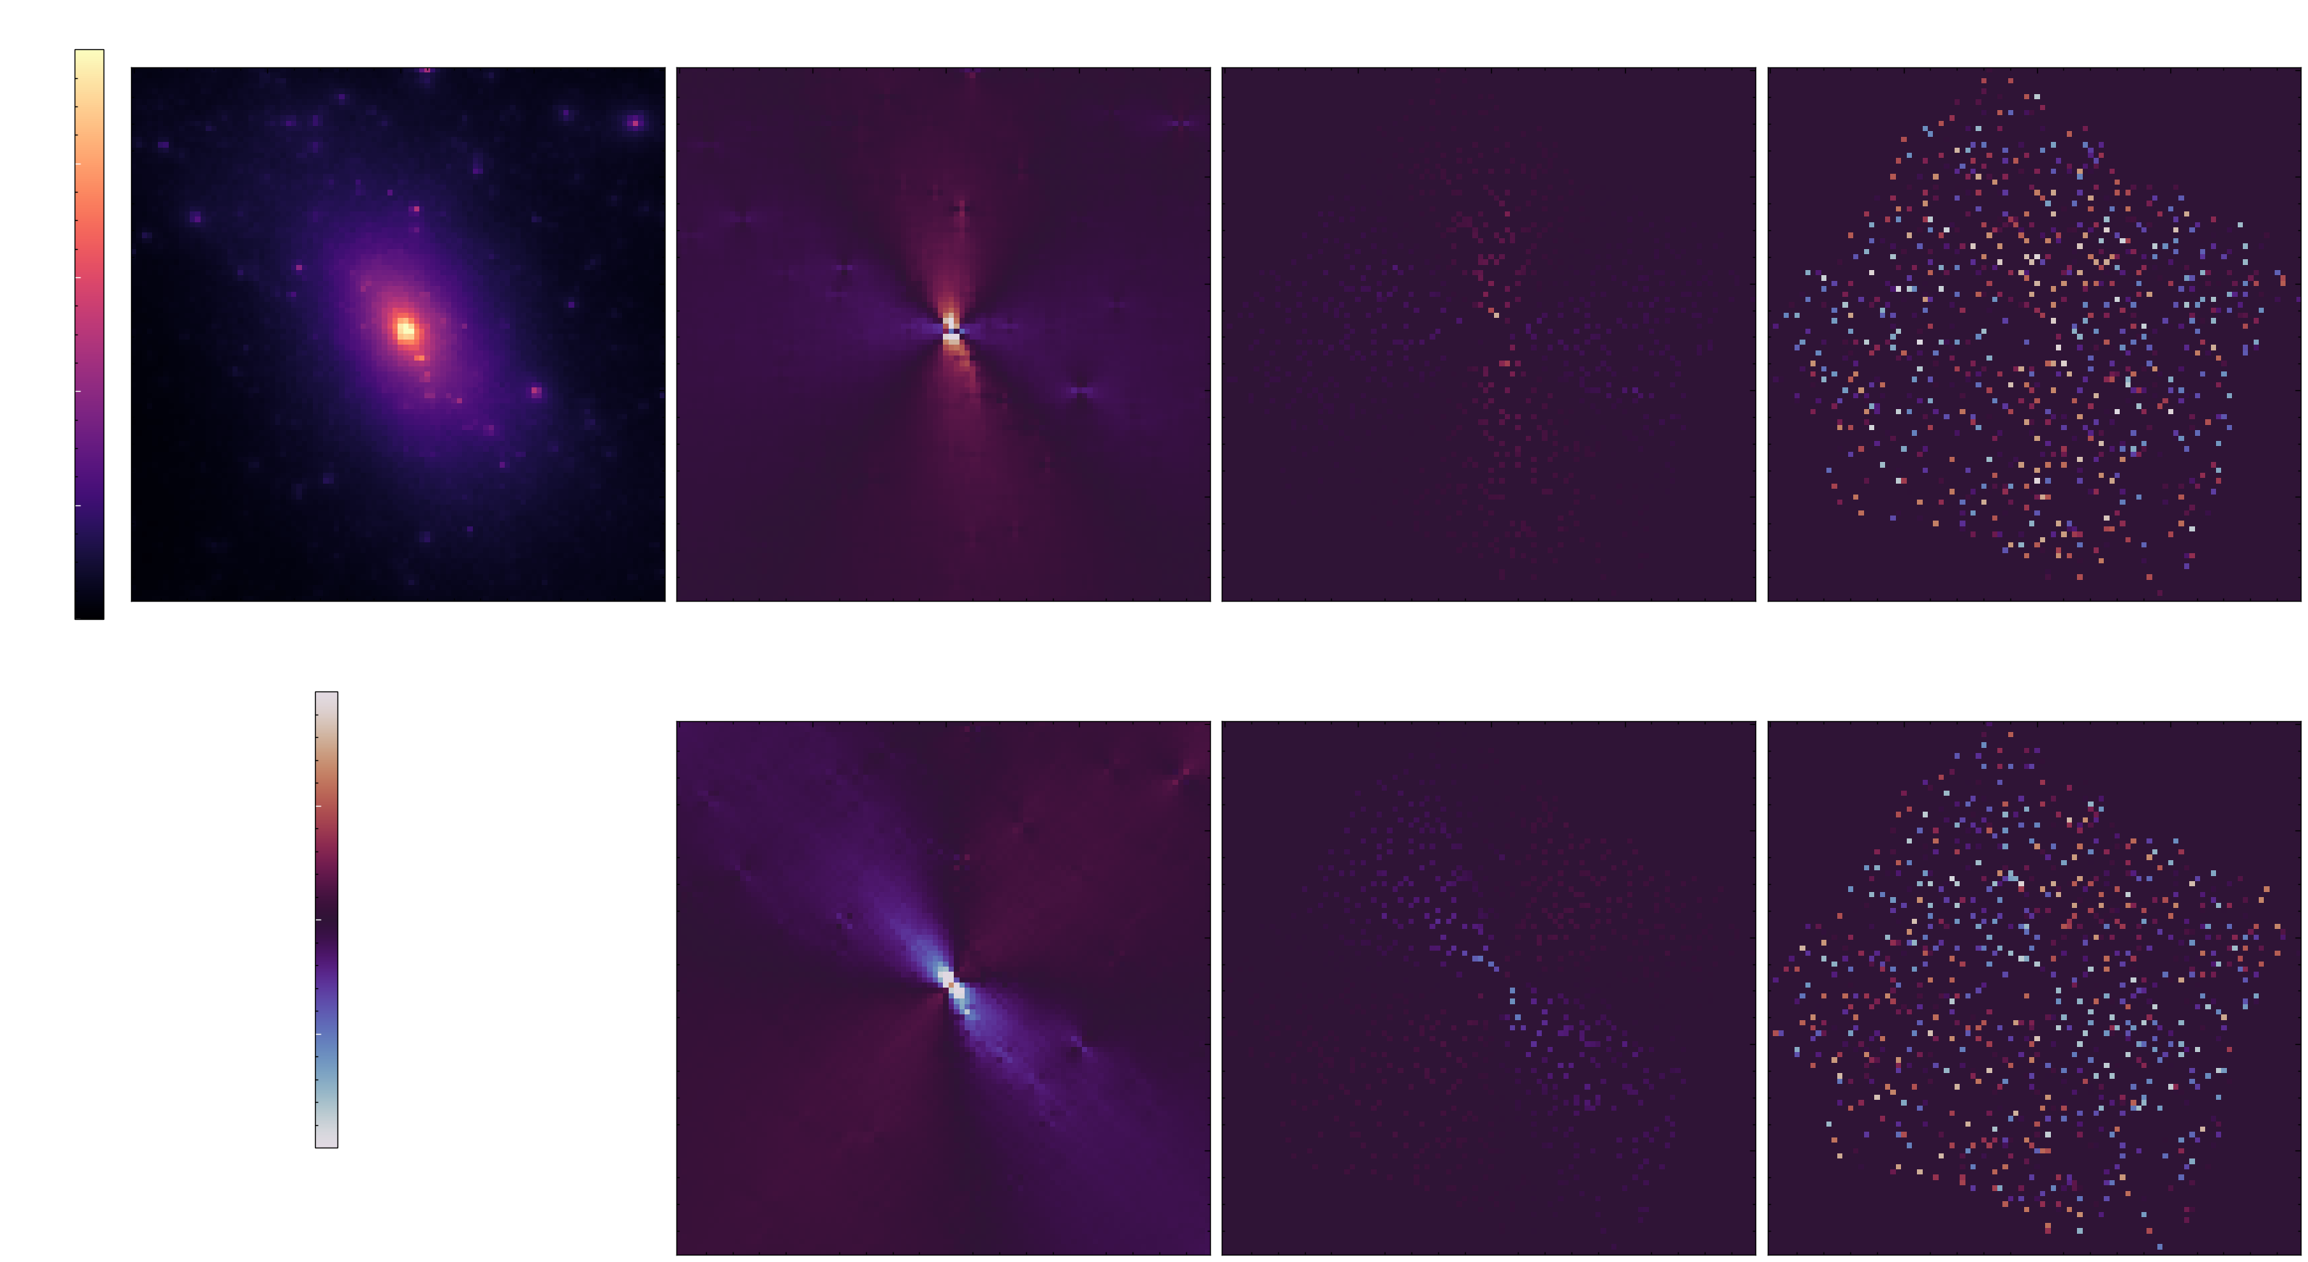
Making Simulations Realistic

Slide 35


Creating an Interpretable Latent Space

Slide 36

But Can We Trust Machine Learning?
1. Theories
2. Neural Network
Notes:
Change title, change breaking of black box

Slide 37






Enforcing Latent Structure

Slide 38

Creating an Interpretable Latent Space

Slide 39


Identifying Features

Slide 40



Improving Accuracy with Additional Data
Foreign!

Slide 41





Improving Accuracy with Additional Data

Slide 42

The Need to Learn Physics
Foreign

Slide 43






Detecting Anomalies & New Domains
Foreign!

Slide 44


Quantifying When the Unknown Becomes Known

Slide 45






Learning Physics
$${10}^{−3}$$
$${10}^{0}$$
$${10}^{−3}$$
$${10}^{0}$$
Feature 1 - Self-Interaction Strength

Slide 46


Marginalising Over Domains

Slide 47



Learning Physics
Preliminary!

