Slide 1
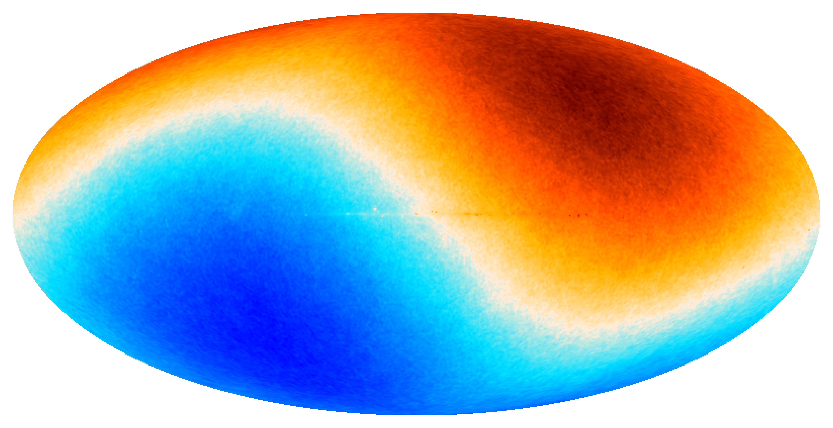




Simulation-based tension quantification of the cosmic dipole anomaly
achine
ML4ASTRO3, University of Malta
M
A
I
L
earning
LAND-STRYKOWSKI^{1,2}
Harry T. J. Bevins^{3,4}, Oliver T. Oayda^{1,2}, Geraint F. Lewis¹, Tara Murphy¹, Emil Lenc², & Stefan W. Duchesne²
¹Sydney Institute for Astronomy, The University of Sydney
²CSIRO Space and Astronomy, Australia
³Astrophysics Group, Cavendish Laboratory, Cambridge
⁴Kavli Institute for Cosmology, Cambridge
rtificial
ntelligence
mlan9395@uni.sydney.edu.au
ML4ASTRO3
0 / 14

Slide 2
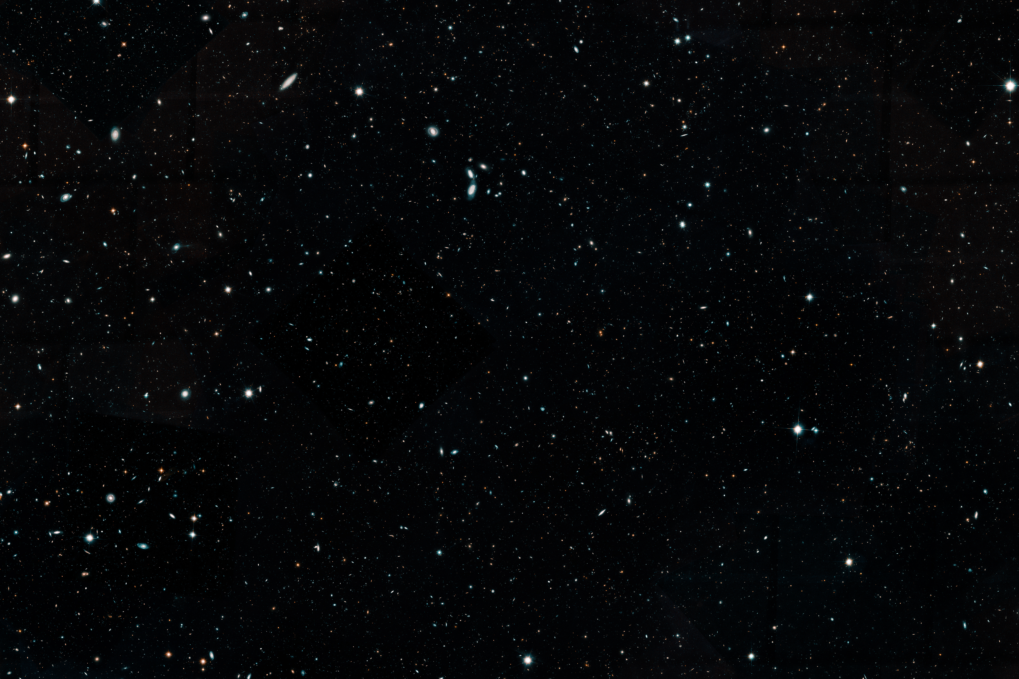
The Cosmological Principle

Slide 3
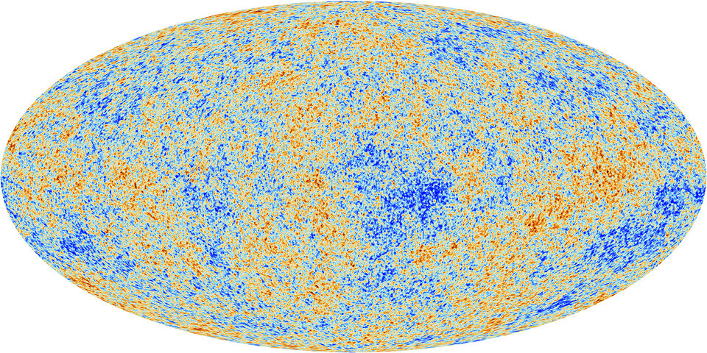

The Cosmic Microwave Background (CMB)
v ≈ 370 km/s
(𝑙, 𝑏) ≈ (264°, 48°)
Image credit: Planck Collaboration
mlan9395@uni.sydney.edu.au
ML4ASTRO3
2 / 14

Slide 4
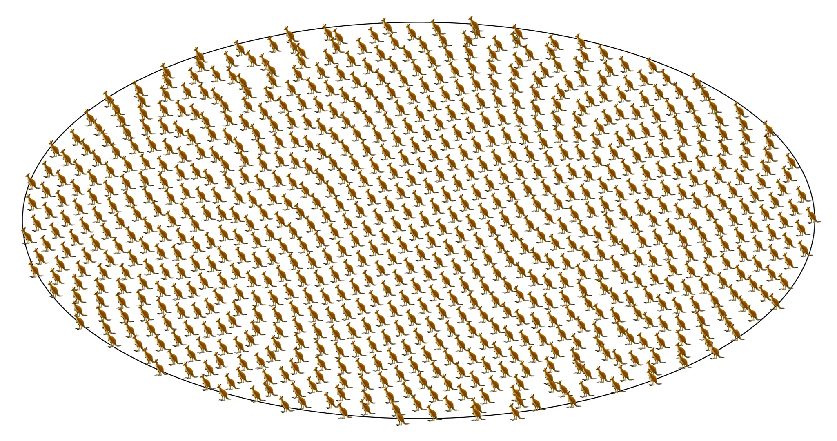
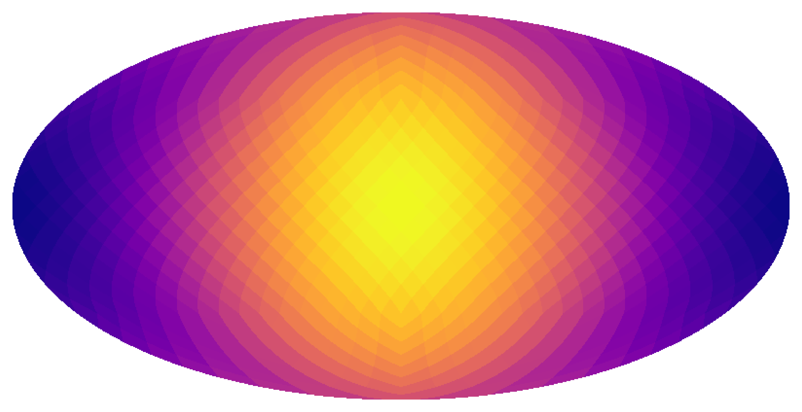
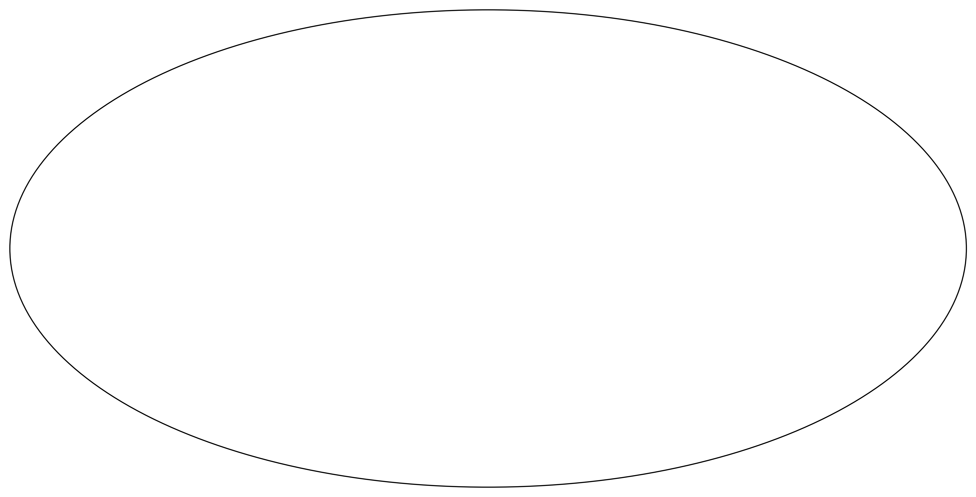
1. Relativistic aberration 2. Doppler boosting
mlan9395@uni.sydney.edu.au
ML4ASTRO3
3 / 14

Slide 5
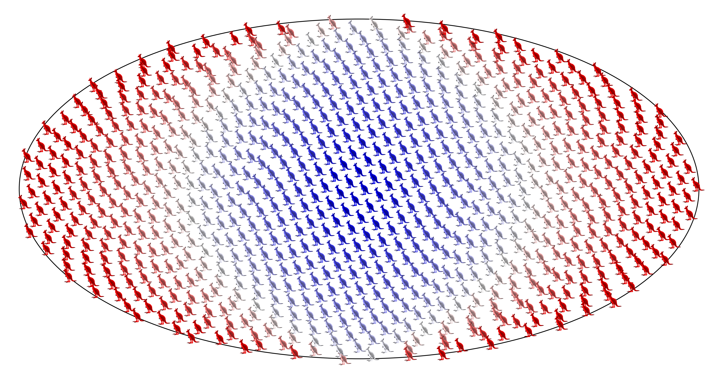
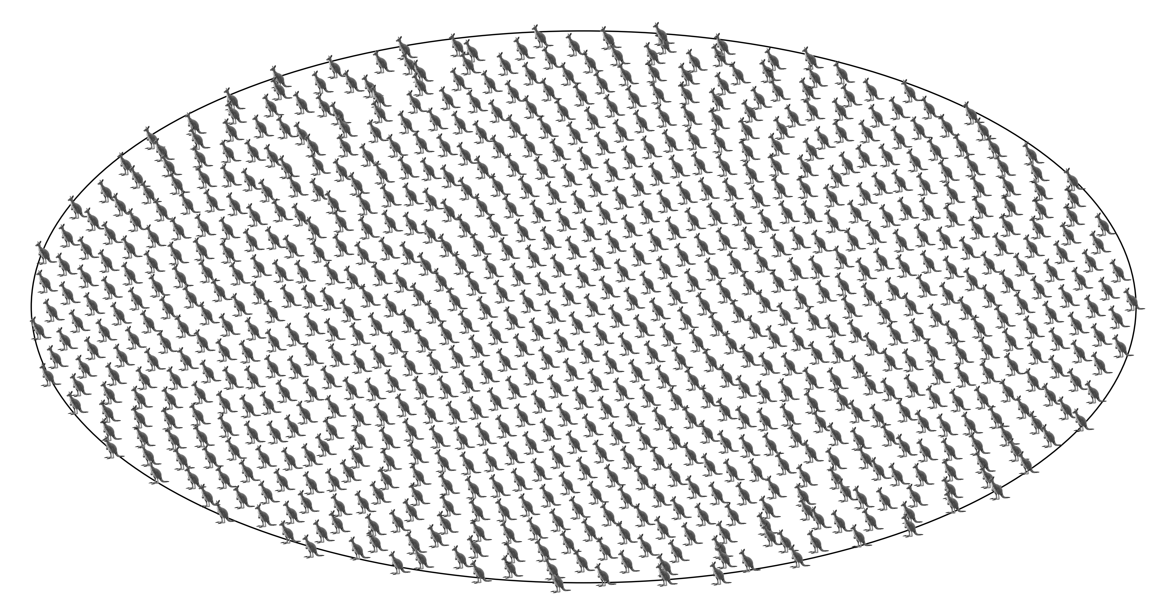
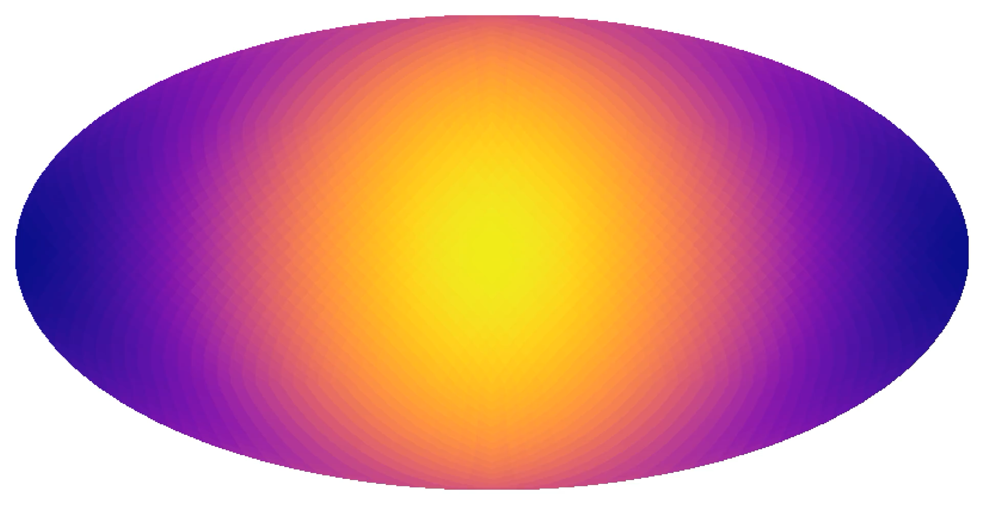
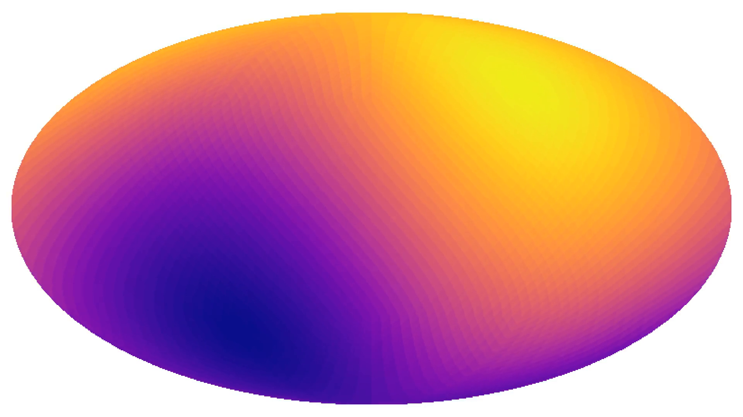
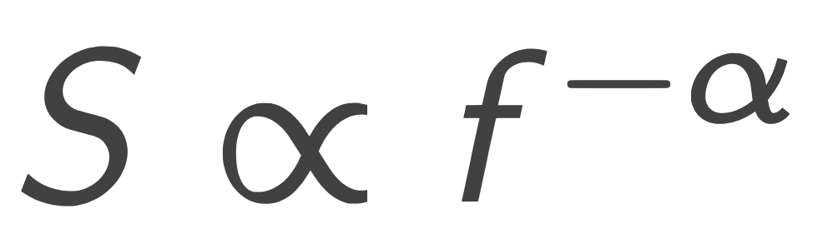
1. Relativistic aberration 2. Doppler boosting
mlan9395@uni.sydney.edu.au
ML4ASTRO3
3 / 14

Slide 6
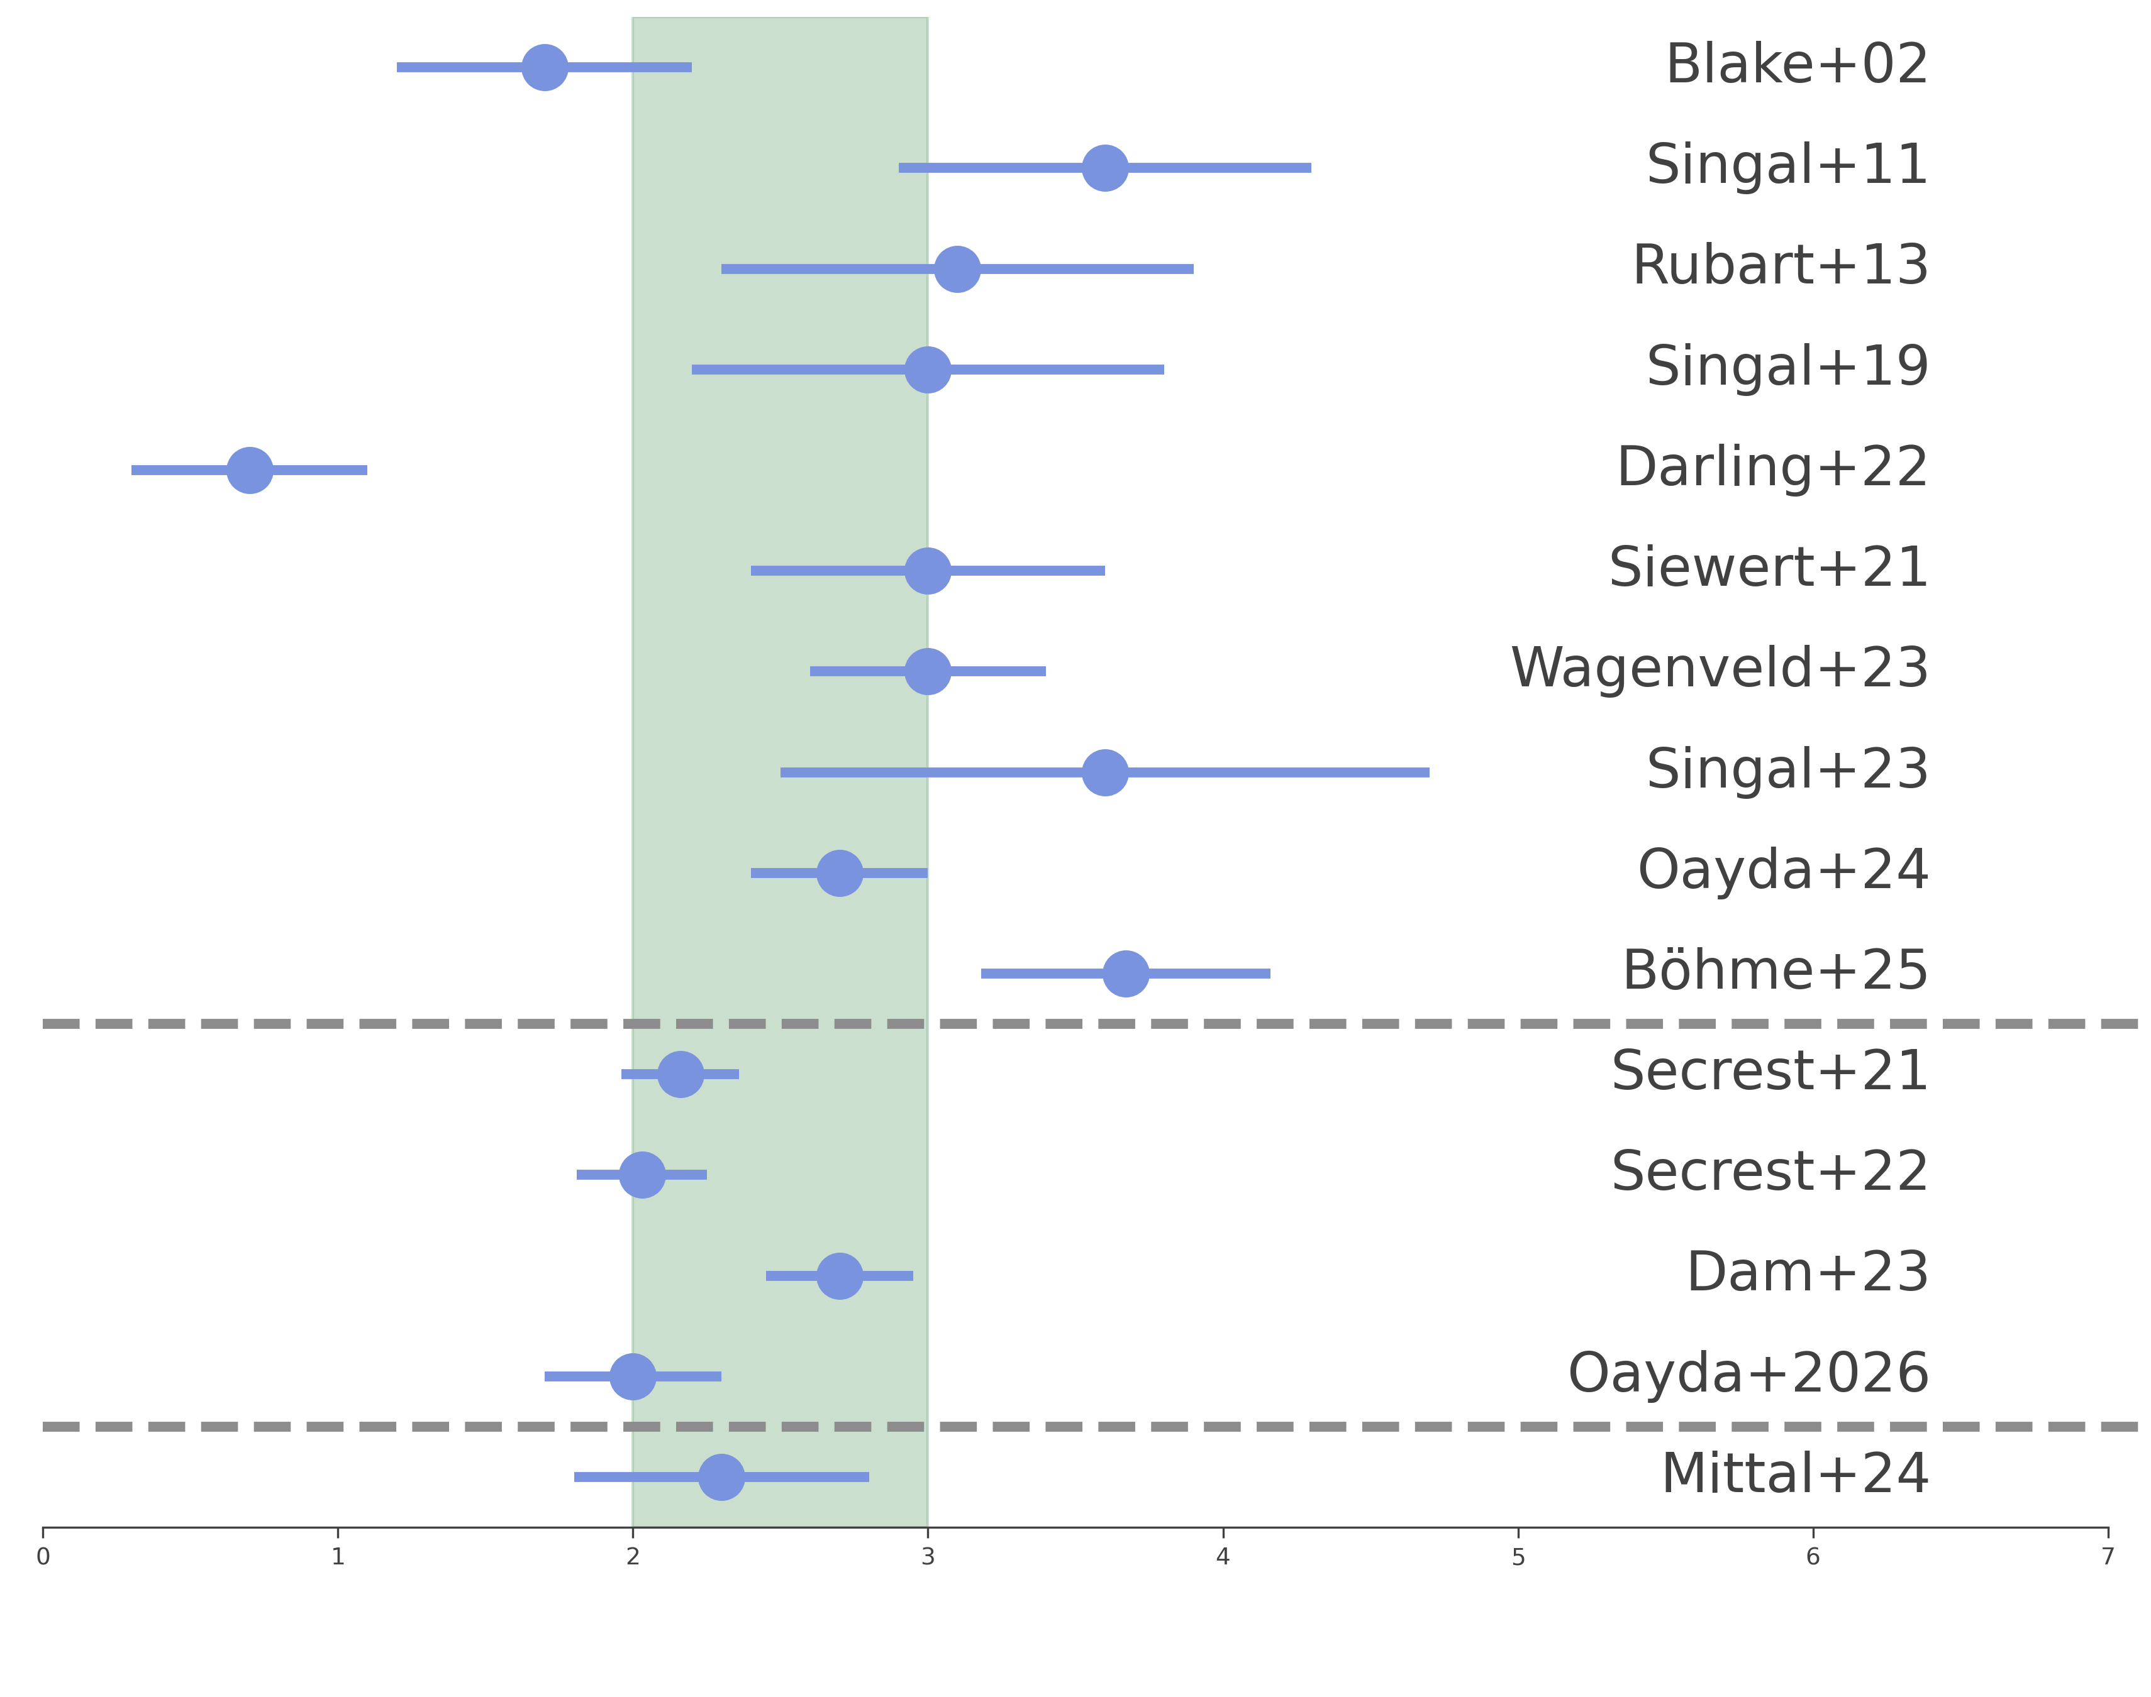
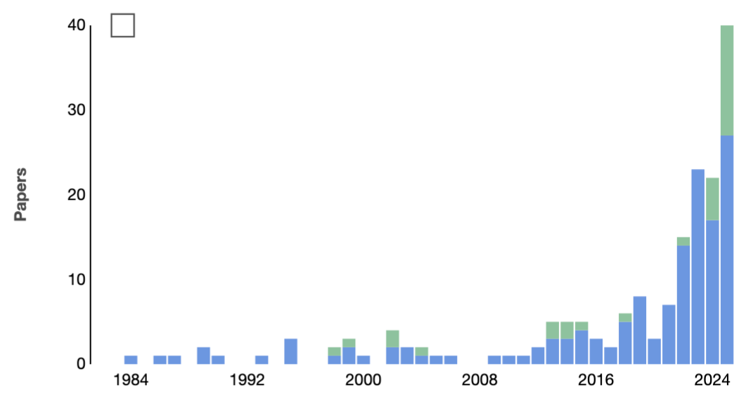

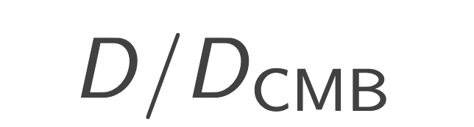
Houston, we have a problem
Popular misquote: Apollo 13, NASA
Dipole amplitudes exceed the expectation
Challenge against the standard model >5σ
Citations to Ellis & Baldwin (1984)
Refereed
Non-refereed
40
Radio
WISE results
30
Papers
20
Later radio analyses
NVSS published
IR
10
Optical
0
1
2
3
4
5
6
1984
1992
2000
2008
2016
2024
Image adapted from NASA ADS & Nathan Secrest
mlan9395@uni.sydney.edu.au
ML4ASTRO3
4
9 / 14

Slide 7
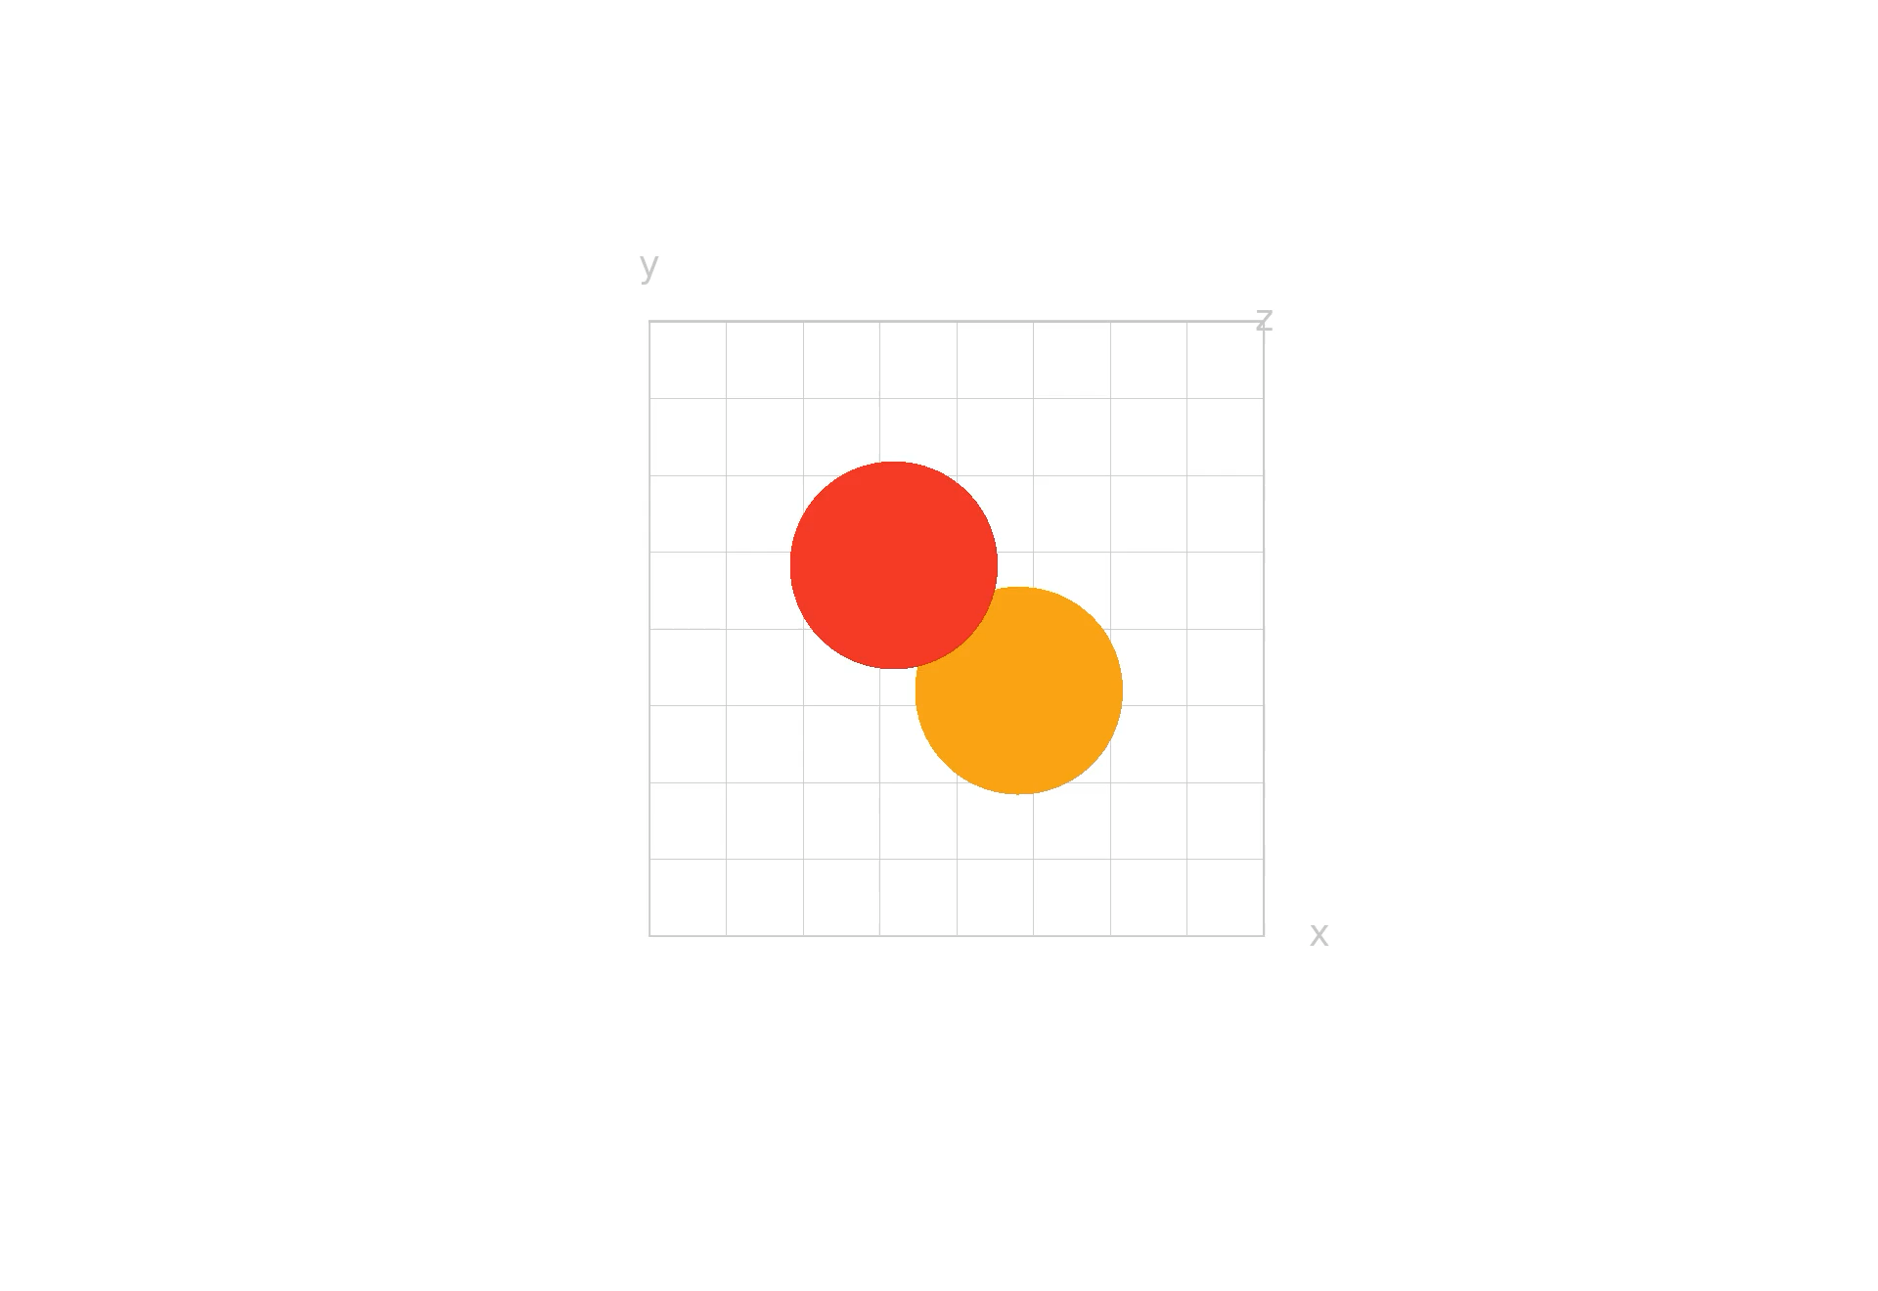
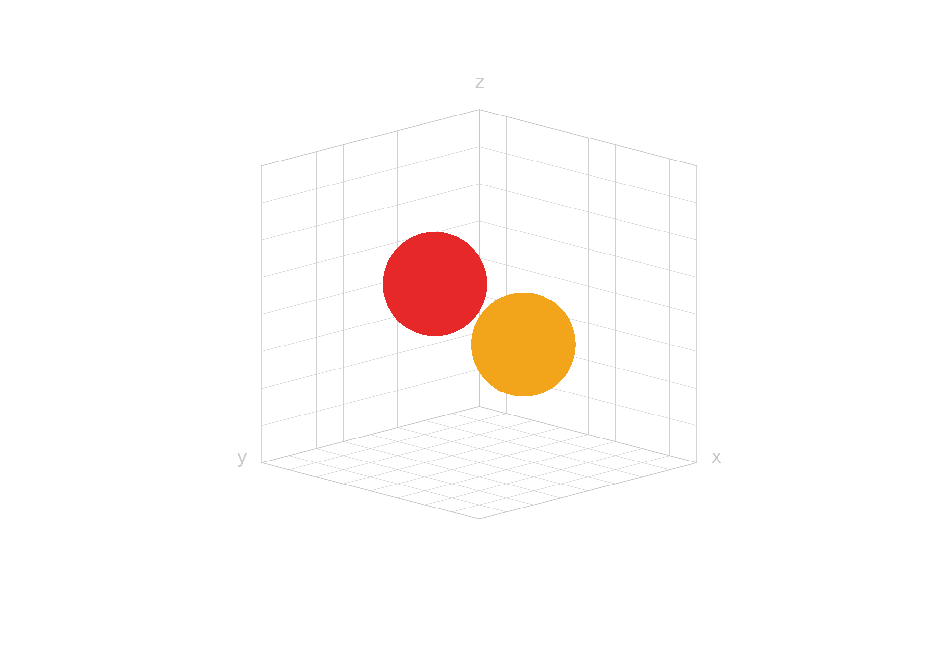
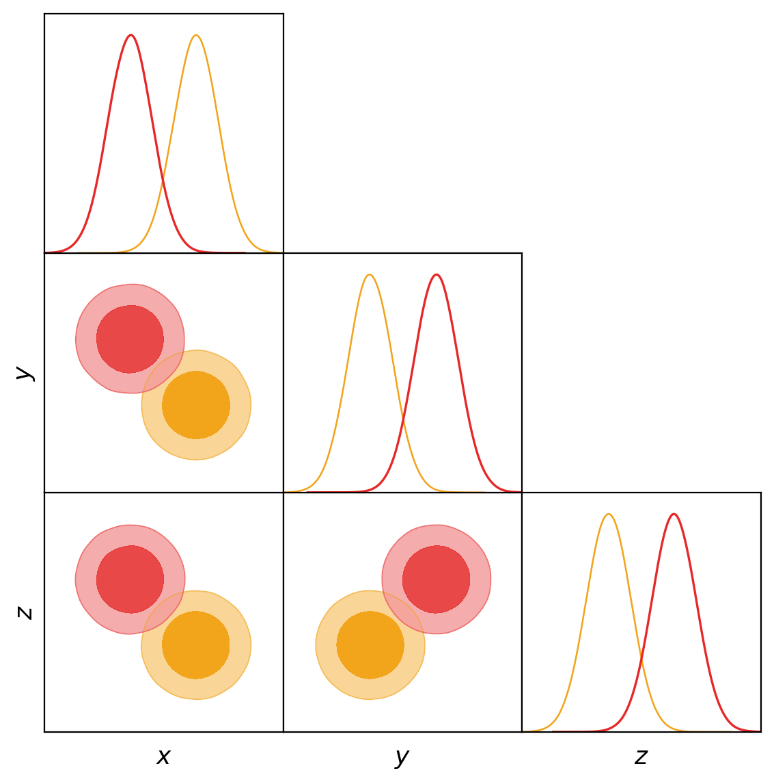
Do these data sets agree within 2σ?
Data set 1
Data set 2
No, they are in tension.
mlan9395@uni.sydney.edu.au
ML4ASTRO3
5
9 / 14

Slide 8
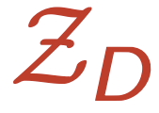
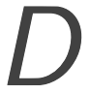

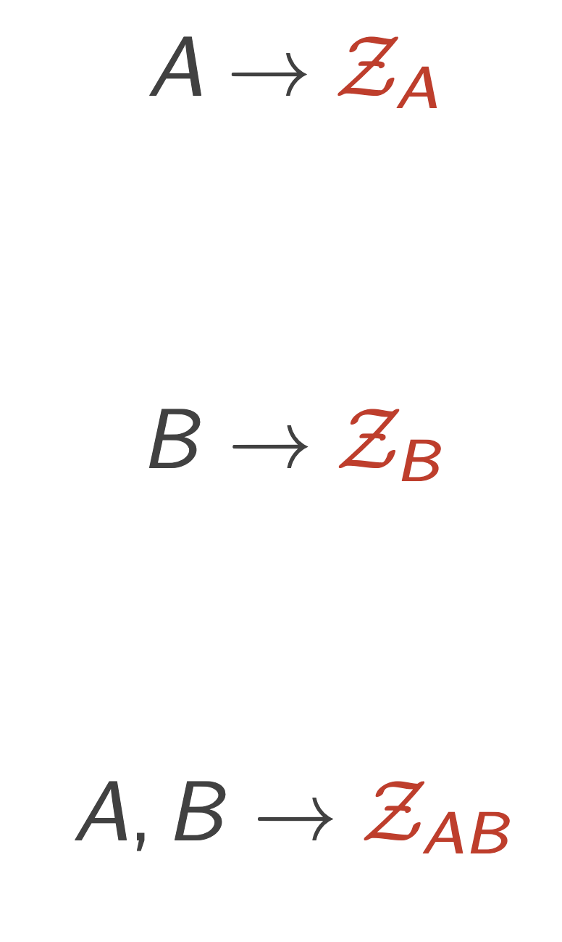
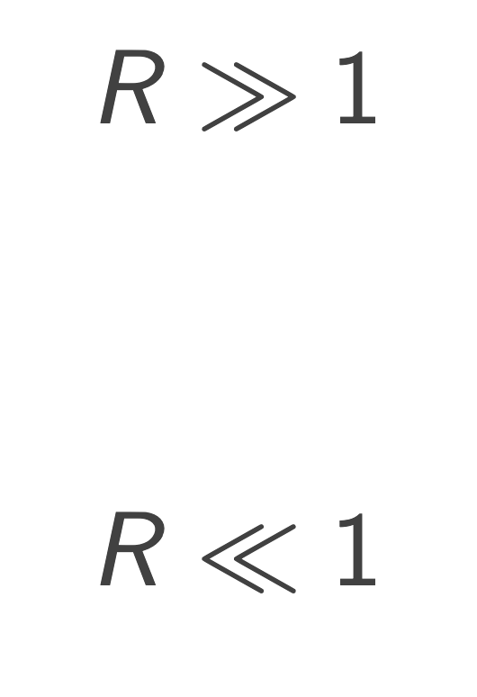
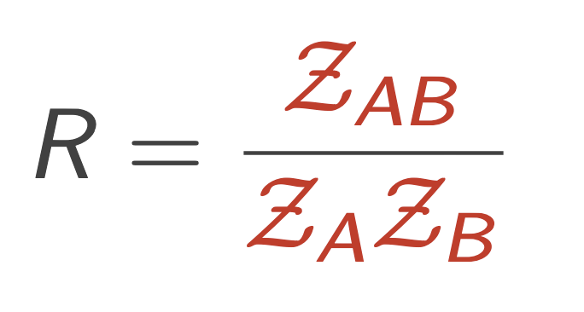
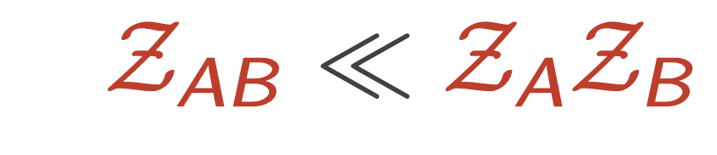
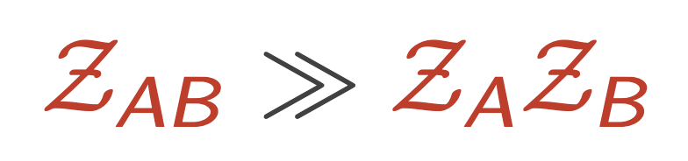
Marshall et al., 2006, Phys. Rev. D, 73, 067302
Handley W., Lemos P., 2019b, Phys. Rev. D, 100, 043504
Tension between data sets
Parameter-invariant — dependent only on the data and model
Bayesian evidence is the probability of observing the data
For data sets and we need , , and (joint)
Tension:
Concordance:
Combining datasets decreases confidence
Combining datasets increases confidence
Convert to Nσ tension via Bayesian ‘suspiciousness’ (from nested sampling)
mlan9395@uni.sydney.edu.au
ML4ASTRO3
6
9 / 14

Slide 9
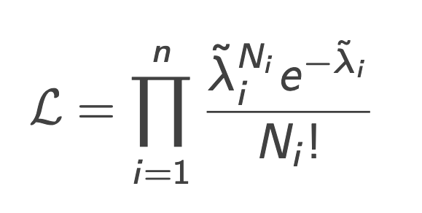
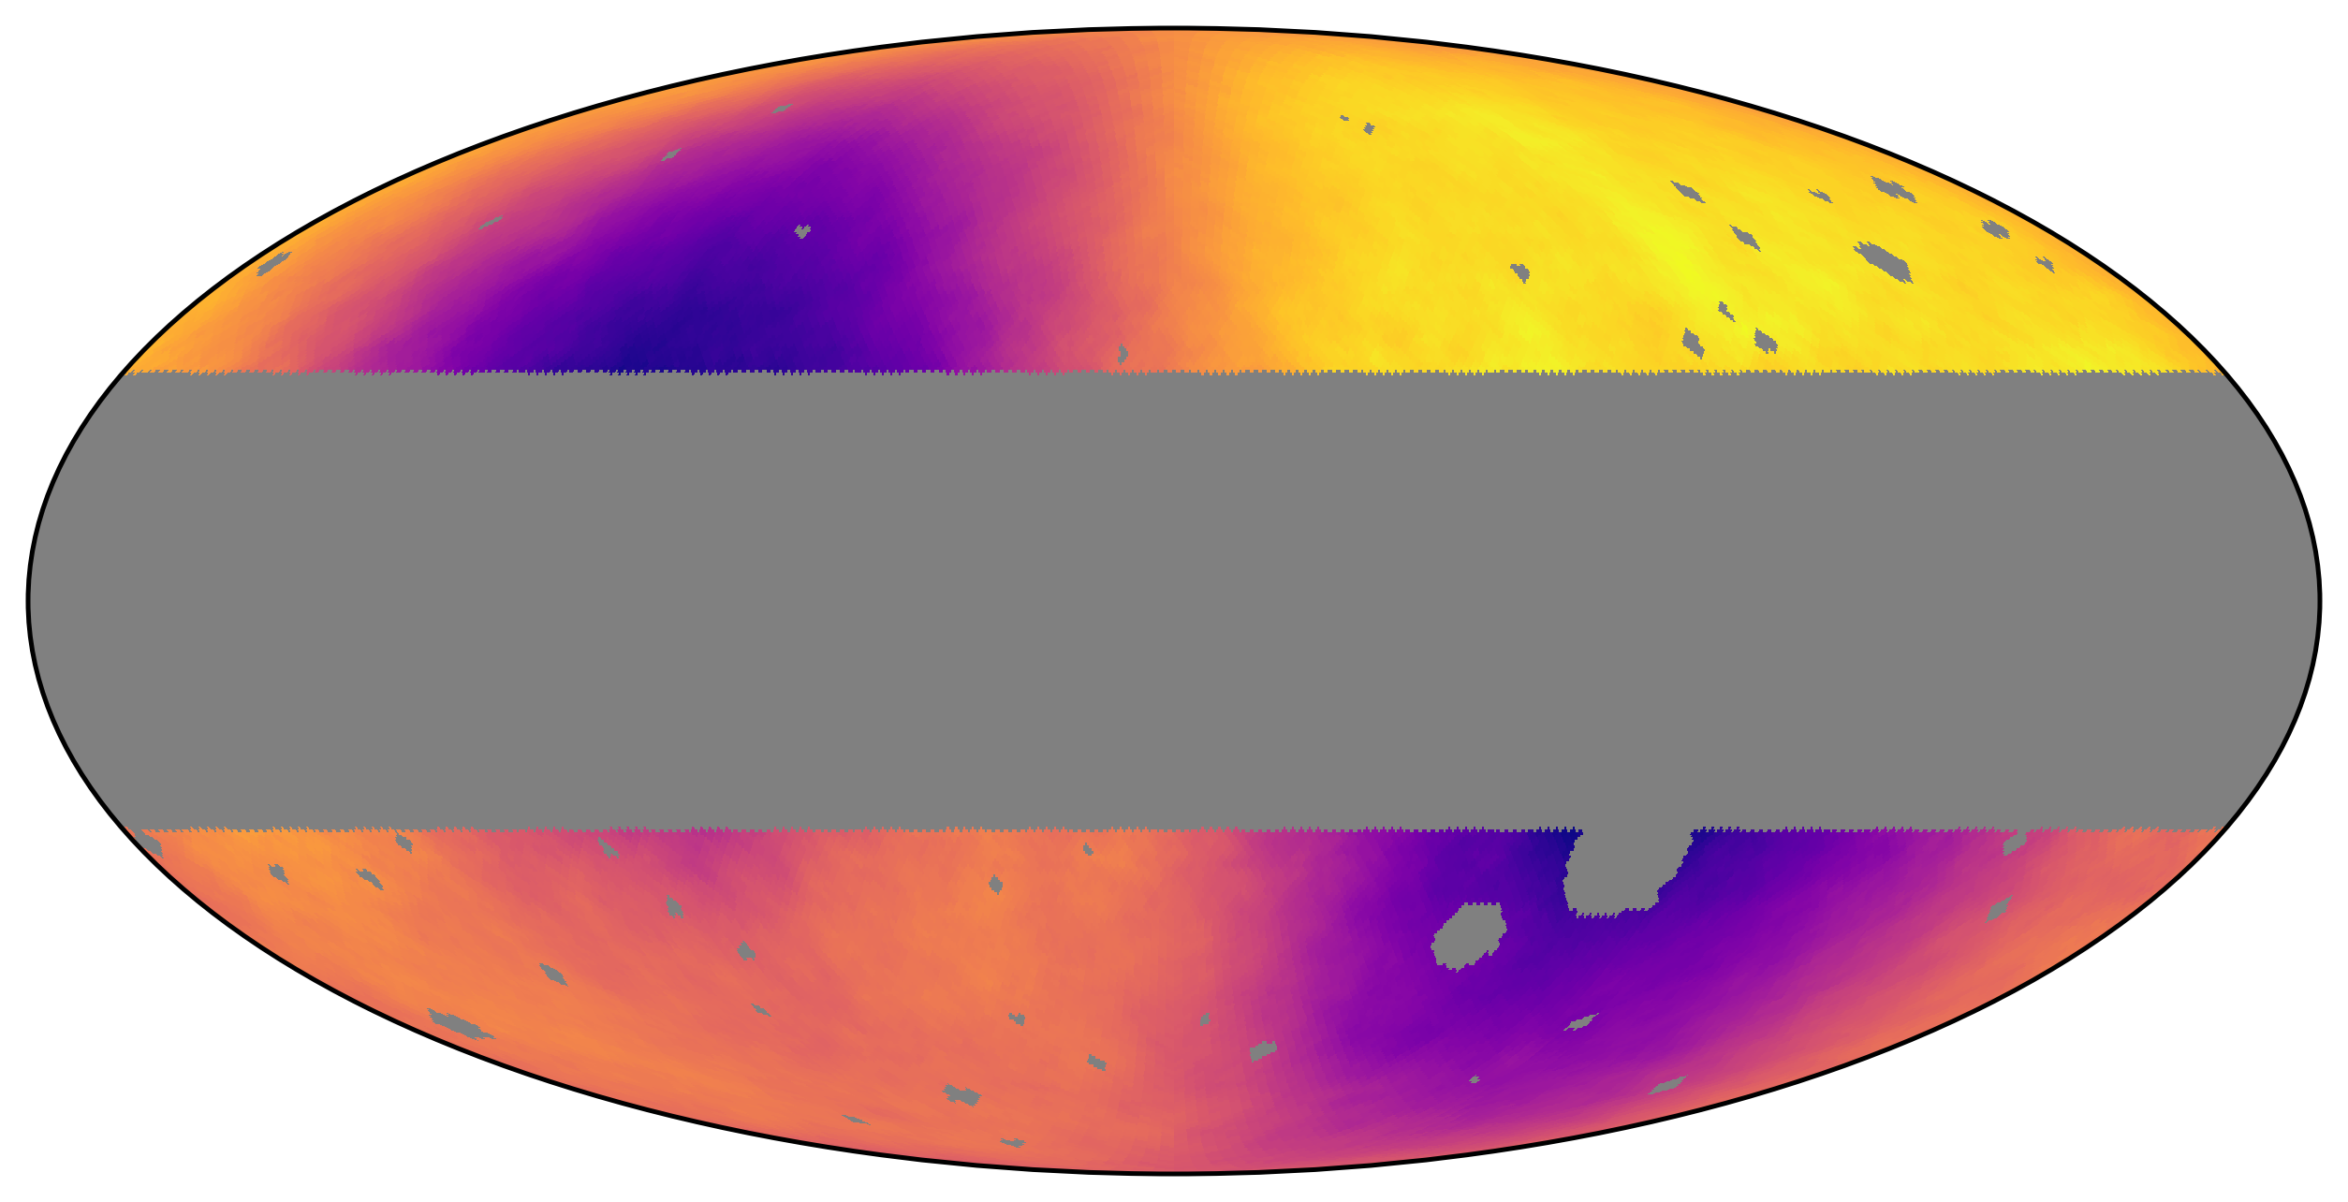
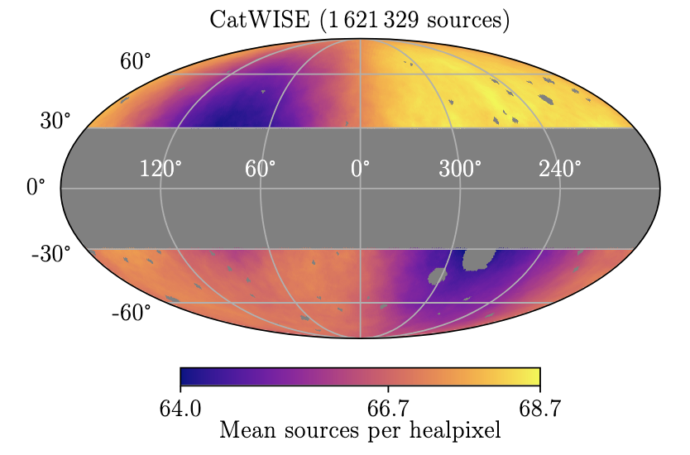
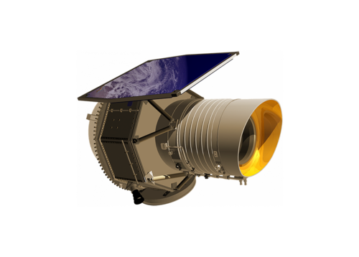
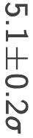
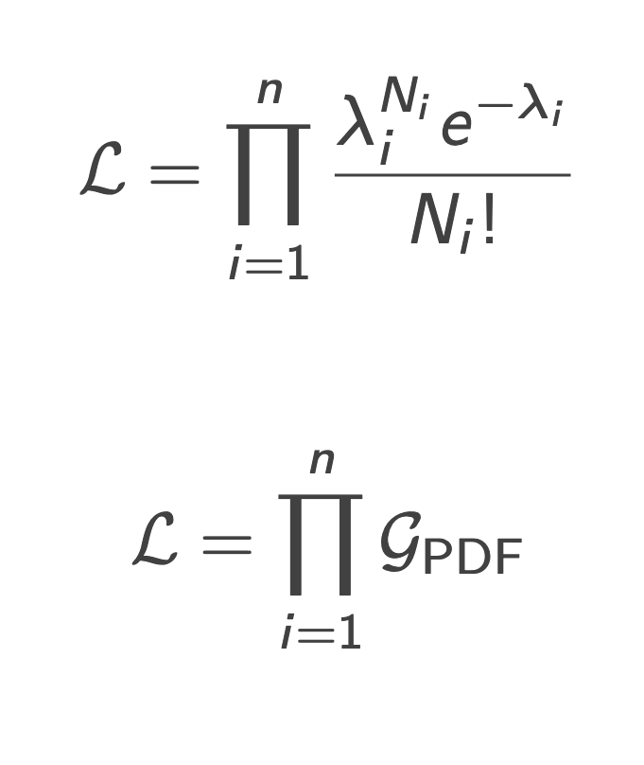
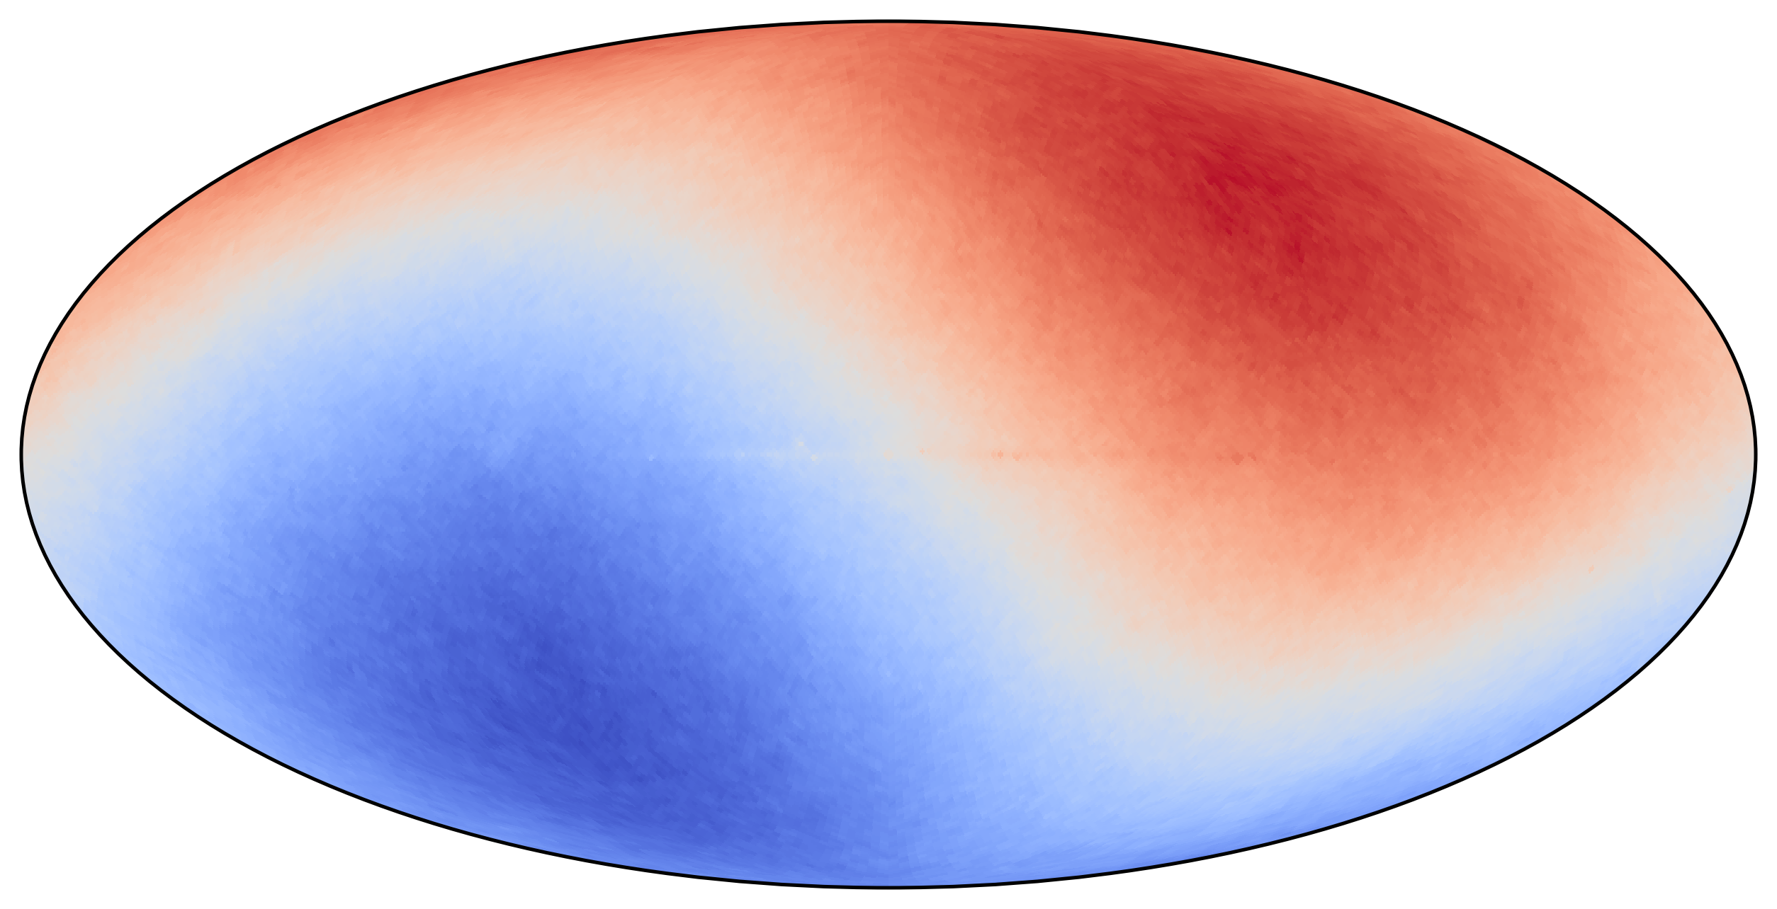
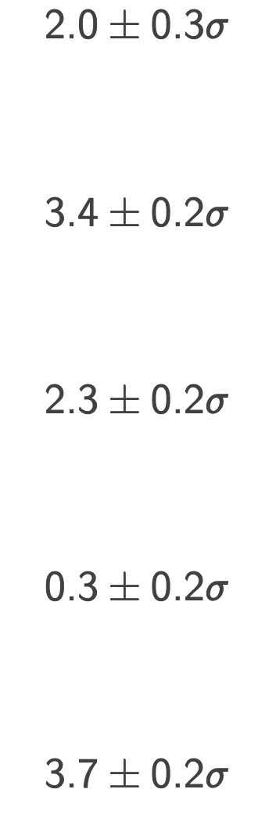
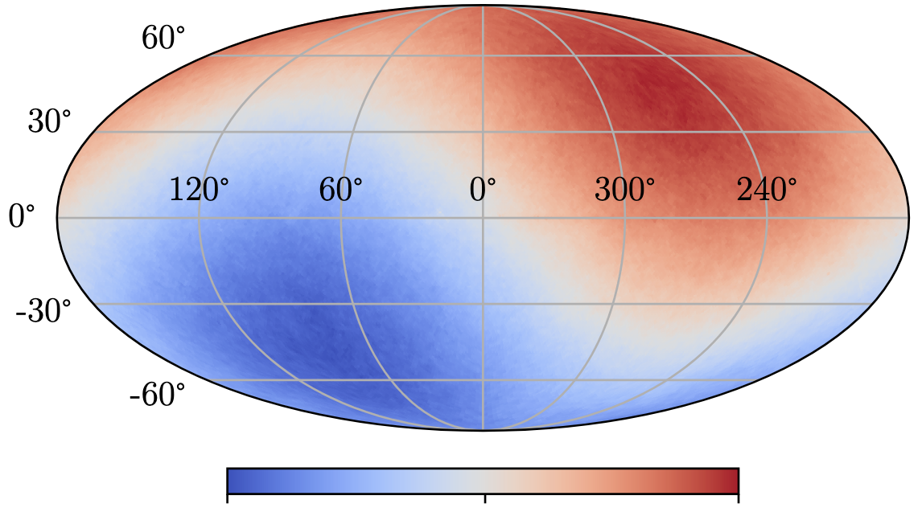
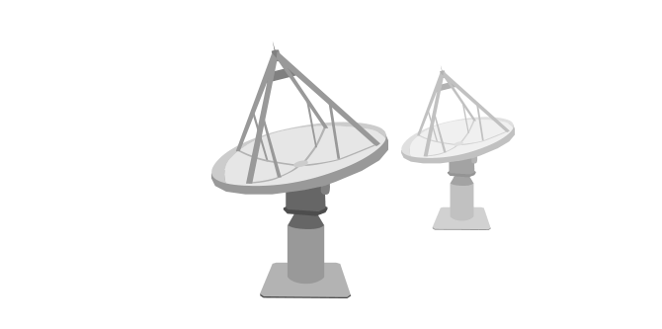
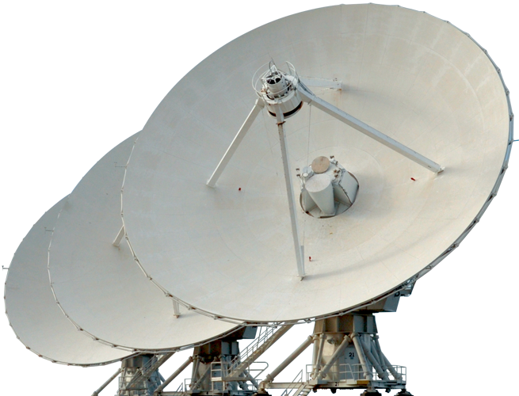
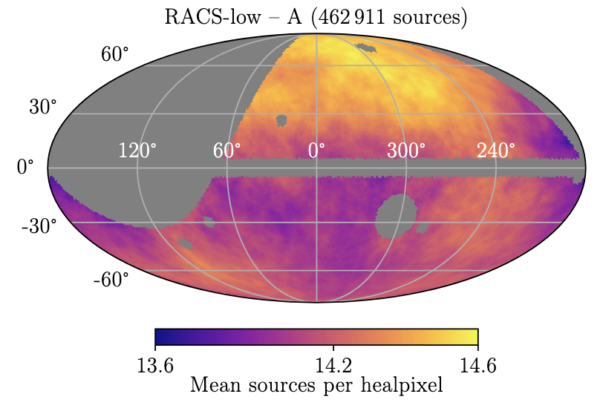
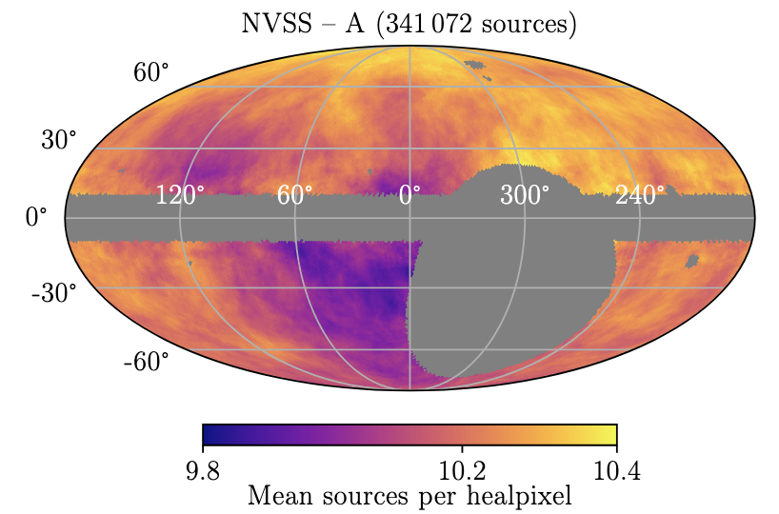
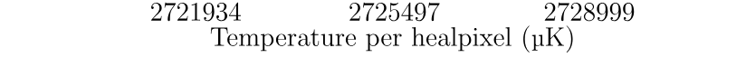
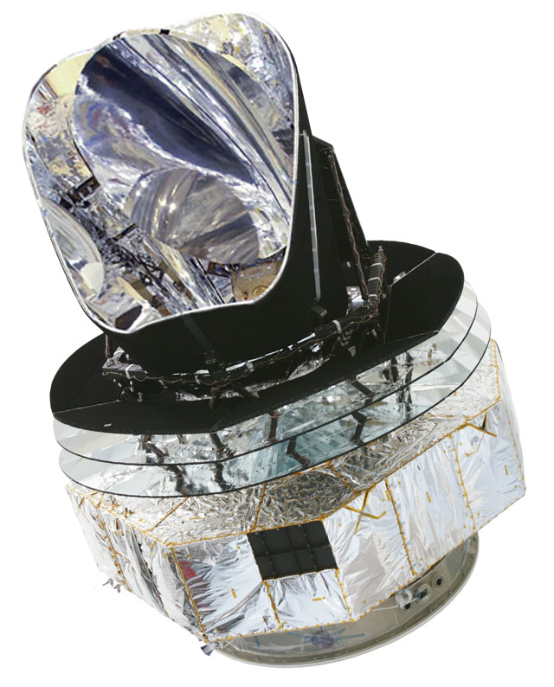
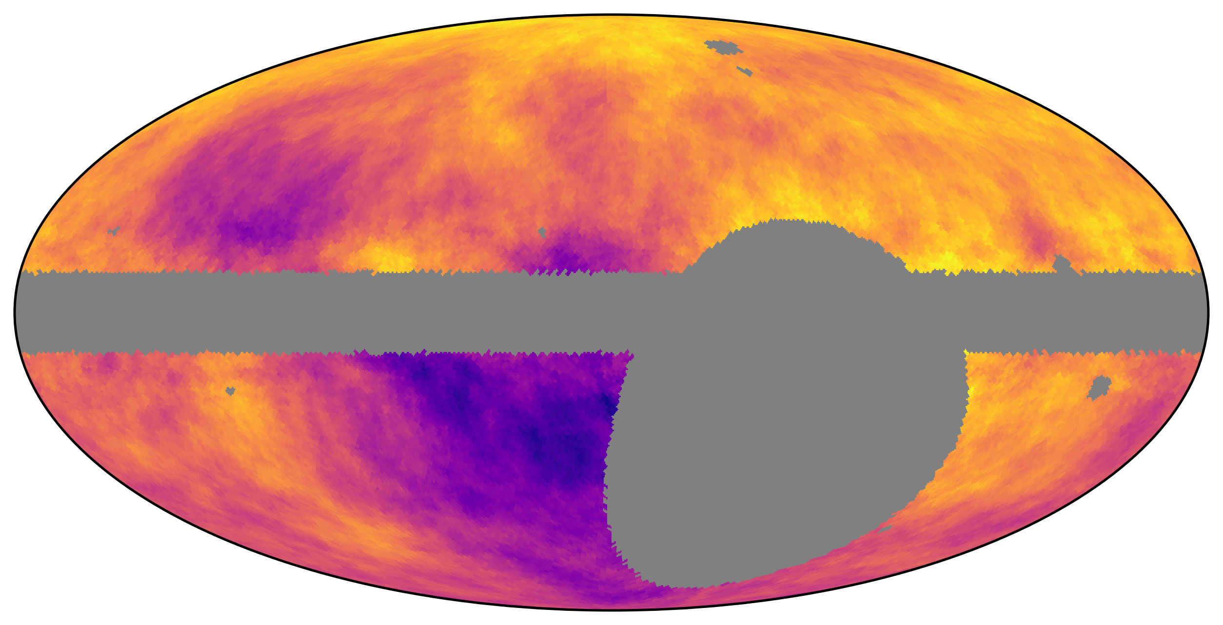
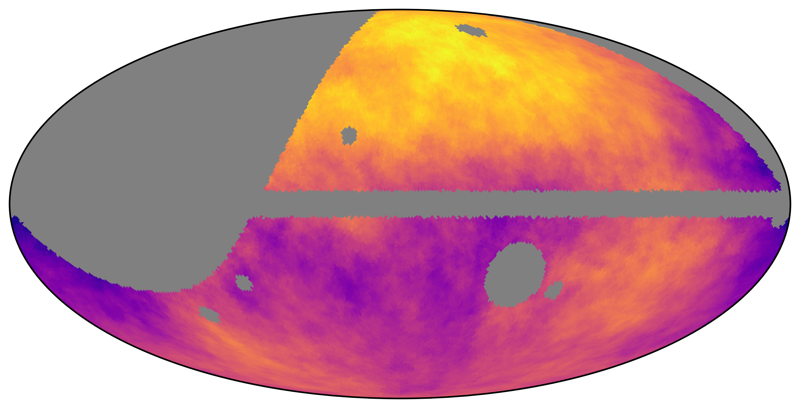
(radio/IR maps smoothed within 1sr)
Land-Strykowski et al., 2025, MNRAS, 543, 3229-3241
Land-Strykowski et al., 2026a, MNRAS, 548, stag483
(radio/IR maps smoothed within 1sr)
Surveys of interest
Tension analysis
Surveys of interest
Tension analysis
CatWISE
W1 and W2
NVSS
RACS-low
1.4 GHz
Planck
887.5 MHz
Planck
30 GHz
NVSS
RACS-low
mlan9395@uni.sydney.edu.au
ML4ASTRO3
7
8 / 14

Slide 10
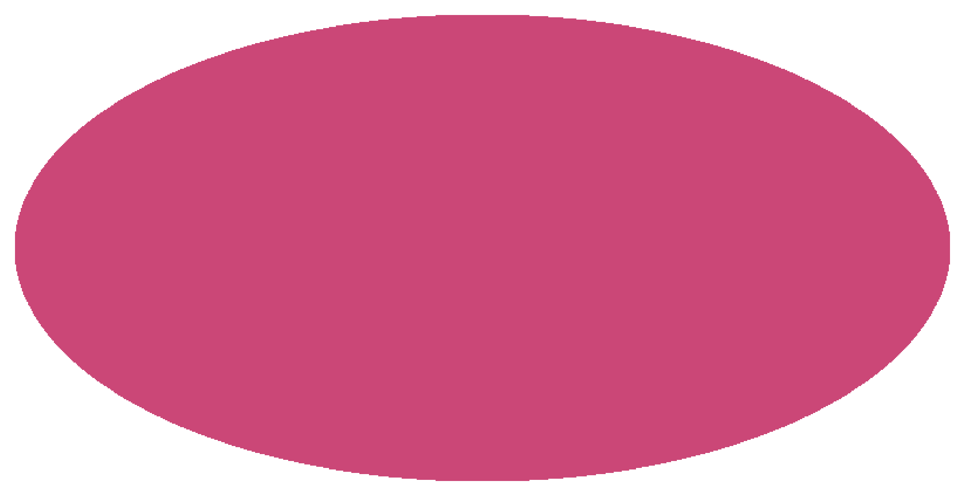
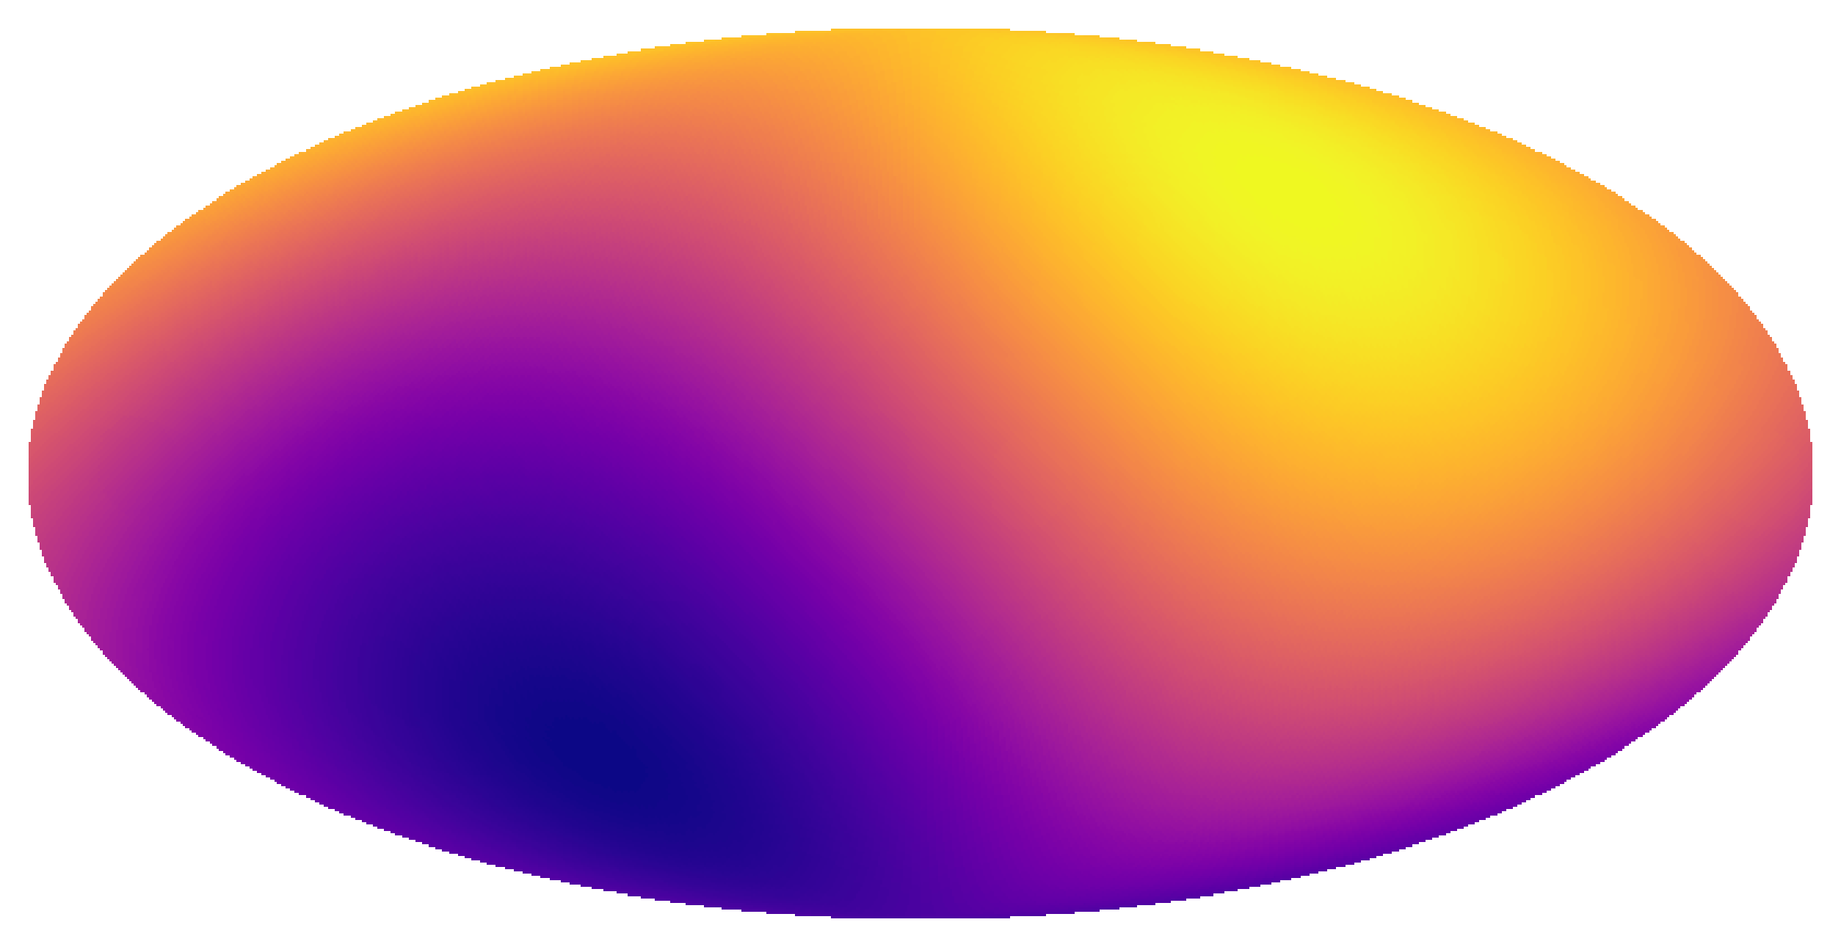
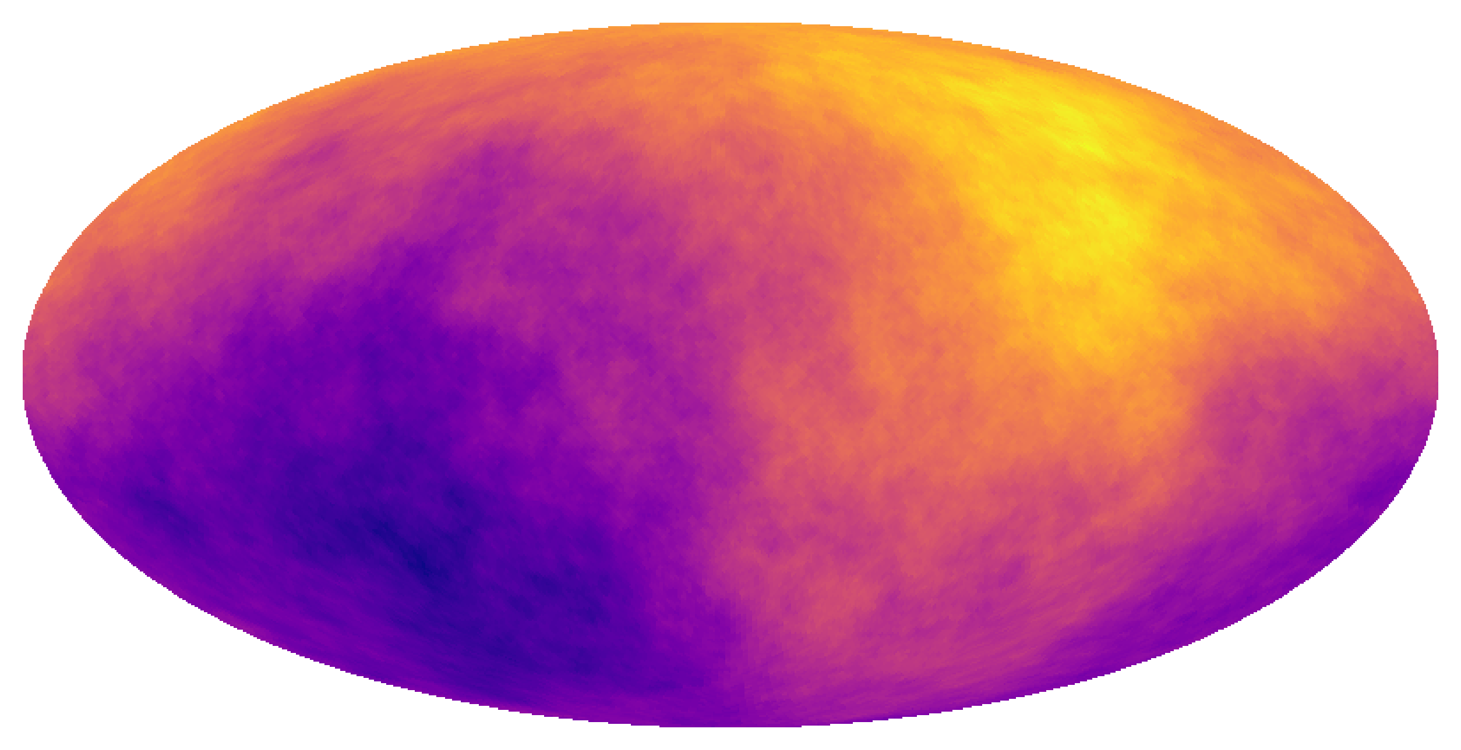
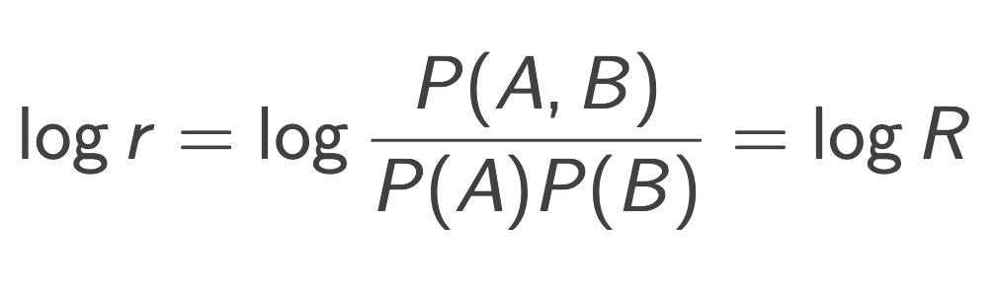
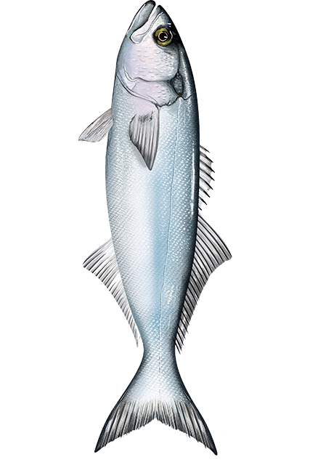
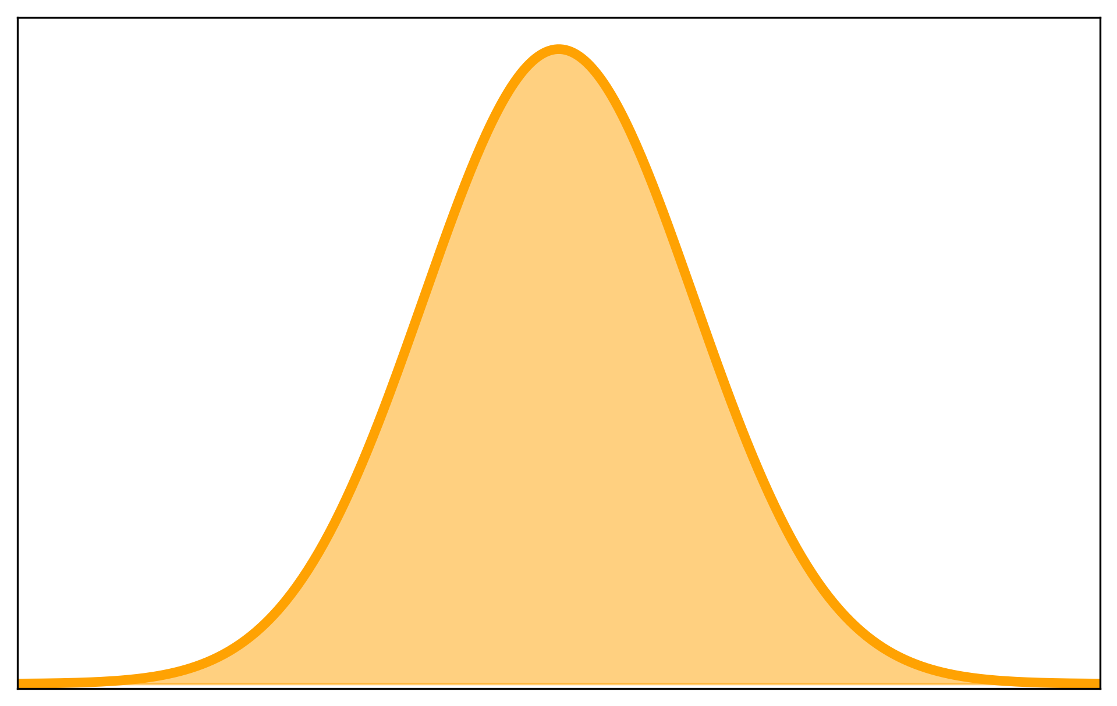
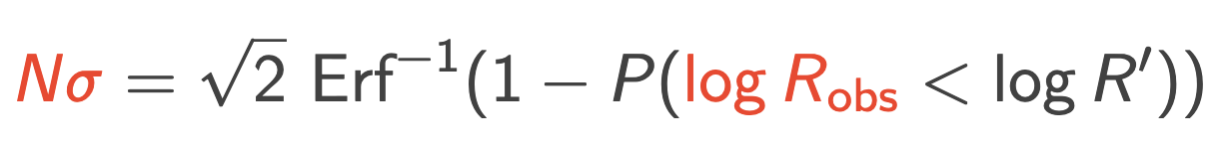
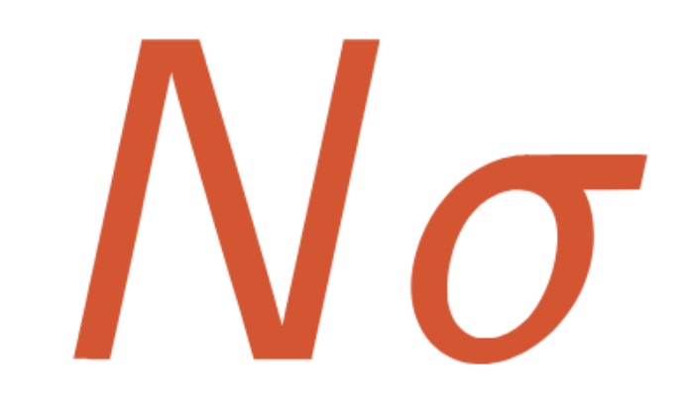
Tension with Neural Ratio Estimators (NREs)
Neural network classifiers trained on simulated data
Quantify tension when models demand intractable likelihoods
Employs the Tensionnet formalism introduced by Bevins+2025
Trained to predict the tension ( log R ) between data set pairs
Predict Robei of simulation pairs
in agreement
Compare
Robse from real observations
Density
tension
Poisson = Fish
Bevins et al., 2025, Phys. Rev. D, 112, 043520
mlan9395@uni.sydney.edu.au
ML4ASTRO3
8
7 / 14

Slide 11
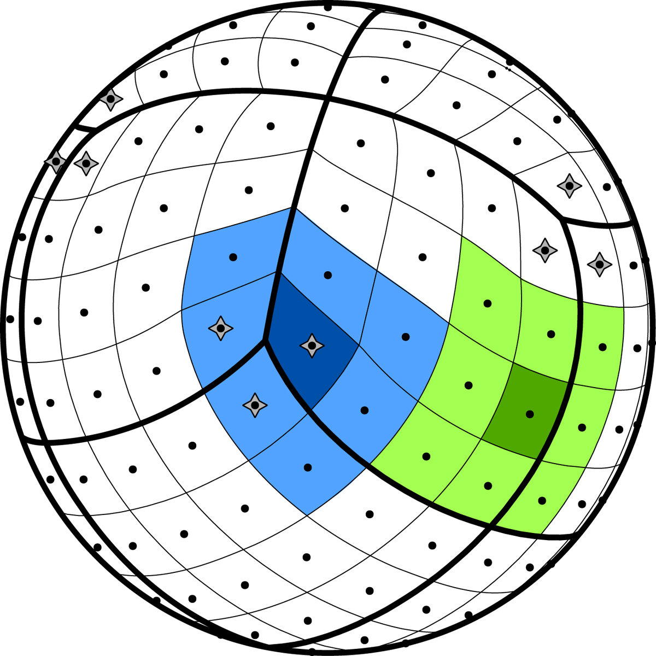

Building the Tensionnet
Krachmalnicoff N., Tomasi M., 2019, A&A, 628, A129
Bevins et al., 2025, Phys. Rev. D, 112, 043520
ADAM optimiser
Learning rate of 10⁻³ decaying by 10% after 1000 epochs
Batch size of 6000, BatchNorm at input
Early stopping with a patience of 50, monitoring val loss
Fully connected layers use ReLU activations and dropout rate of 20%
Binary cross entropy loss function
with
Convolution Tower
Convolution Tower
49152 pix
192 pix
Extract features
Downscale maps
Extract features
Downscale maps
Fully Connected Network
The HEALPix Sphere
(use NNhealpix)
Land-Strykowski et al., 2026b, MNRAS, 551, stag1455
mlan9395@uni.sydney.edu.au
ML4ASTRO3
9
9 / 14

Slide 12

Land-Strykowski et al., 2026b, MNRAS, 551, stag1455
Using the Tensionnet
CatWISE
Planck
NVSS
RACS-low
mlan9395@uni.sydney.edu.au
ML4ASTRO3
10
9 / 14

Slide 13





Extending the Tensionnet to forward-models
WISE ecliptic bias can be modelled as Eddington bias
Likelihood is intractable, requires forward-model (Oayda+2026)
Highlights the utility of our Tensionnet architecture as a diagnostic tool
Framework to test which systematics ease or worsen the cosmic dipole tension
Tensionnet is versatile — takes in simulations, outputs inference
6.7$±$1.1σ tension between CatWISE and Planck
PDF
(5.1σ without Eddington bias)
W1 coverage
Source counts
$−$10
0
10
Land-Strykowski et al., 2026b, MNRAS, 551, stag1455
Image credit:
Oayda & Lewis, 2026, MNRAS, 546, stag248
mlan9395@uni.sydney.edu.au
ML4ASTRO3
11
9 / 14

Slide 14

Change is on the horizon…
Why homogeneity and isotropy?
Inhomogeneous cosmologies…
  Dark matter super-voids (1-3.4 Gpc)
Anisotropic cosmologies…
  Tilted universes (non-Friedmann)
Or, perhaps, something entirely new…
Image credit: xkcd & Geraint F. Lewis
mlan9395@uni.sydney.edu.au
ML4ASTRO3
12
9 / 14

Slide 15










(maps smoothed within 1sr)
(preliminary results)
Current and future work
RACS: catalogue investigation with simulation-based inference
DESI: measuring spectroscopic redshift dipole with Bayesian inference
SKA: forecasting and systematics; cosmic dipole chapter
RACS-low1
887.5 MHz, 25”
RACS-low2
887.5 MHz, 25”
RACS-low2
887.5 MHz, 45”
RACS-low3
943.5 MHz, variable
RACS-mid1
1367.5 MHz, 25”
RACS-mid1
1367.5 MHz, 45”
RACS-mid1
1367.5 MHz, variable
RACS-high
1655.5 MHz, variable
Land-Strykowski et al., 2026c, in prep for MNRAS
Oayda, Land-Strykowski et al., 2026, in prep for MNRAS
mlan9395@uni.sydney.edu.au
ML4ASTRO3
13
9 / 14

Slide 16



Summary and conclusions
CatWISE–NVSS concordance disfavours systematics — RACS-low systematic difference (2509.18689)
Simulated Planck, NVSS, RACS-low, CatWISE — Tensionnet measures accurate tensions (2607.25703)
Tensionnet applied to Eddington bias intractable systematic reveals 6.7$±$1.1σ CatWISE–Planck tension
Is the Kangarooverse homogeneous and isotropic?
​Diagnostic tool to test which systematics ease or worsen cosmic dipole tension (and challenge ΛCDM)
Thank you.
Architecture provides necessary machinery to test complex forward-models in LSST, Euclid, SKA era
astromali.com/
mlan9395@uni.sydney.edu.au
ML4ASTRO3
14
9 / 14

Slide 17







Validating the Tensionnet
Nested Sampling
Nested Sampling
Tensionnet
Tensionnet
10
TN
Suspiciousness
PDF
5
PDF
0
$−$5
$−$5
0
5
10
$−$5
0
5
10
2.8
3.2
3.6
4.0
NS
Tension (σ)
Land-Strykowski et al., 2026b, MNRAS, 551, stag1455
mlan9395@uni.sydney.edu.au
ML4ASTRO3

Slide 18




Marshall et al., 2006, Phys. Rev. D, 73, 067302
Handley W., Lemos P., 2019b, Phys. Rev. D, 100, 043504
Tension with Bayesian suspiciousness
For data sets and we need , , and (joint)
Use or for individual runs, use for joint run
Tension:
Concordance:
Get prior dependance:
Remove prior dependance:
Combining data sets decreases confidence
Combining data sets increases confidence
The quantity
follows a distribution
mlan9395@uni.sydney.edu.au
ML4ASTRO3

