Slide 1



CosmoGen: A genetic algorithm framework for exploring dark energy dynamics
Diogo Castelão
ML4ASTRO3 | Malta

Slide 2
Outline
Part 1: Standard cosmology
Part 2: Cosmological model testing
  Methodology
Part 3: CosmoGen
  Framework overview
  Example application
  Results
Future work

Slide 3
Standard Cosmology
In Cosmology we aim to describe the physical properties of the Universe, following a parametric approach.
The standard model, assumes a Universe that on large scale is homogeneous and isotropic and very well described by the ΛCDM model (6 free parameters).

Slide 4
Observables
Type Ia supernovae - SNe Ia
Baryon Acoustic Oscillations - BAO
Cosmic Microwave Background - CMB
Weak gravitational lensing - WL

Slide 5
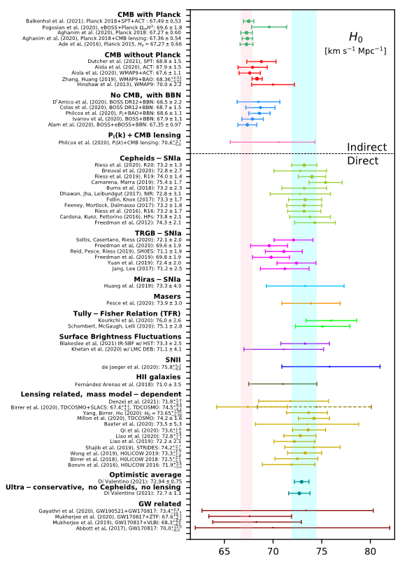
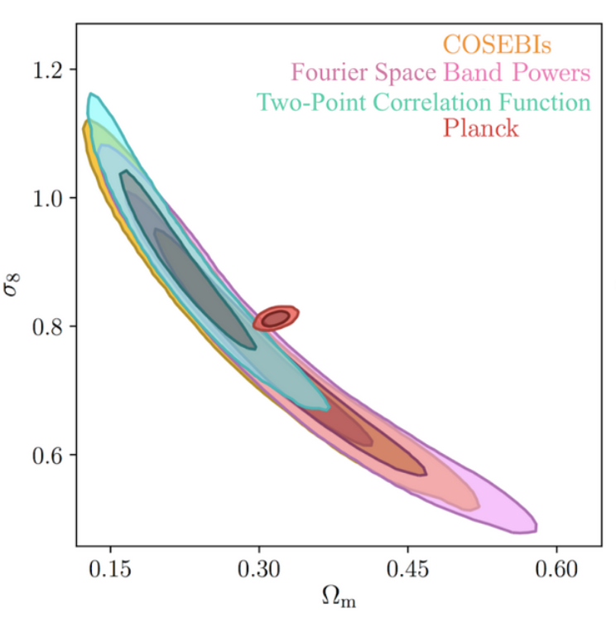
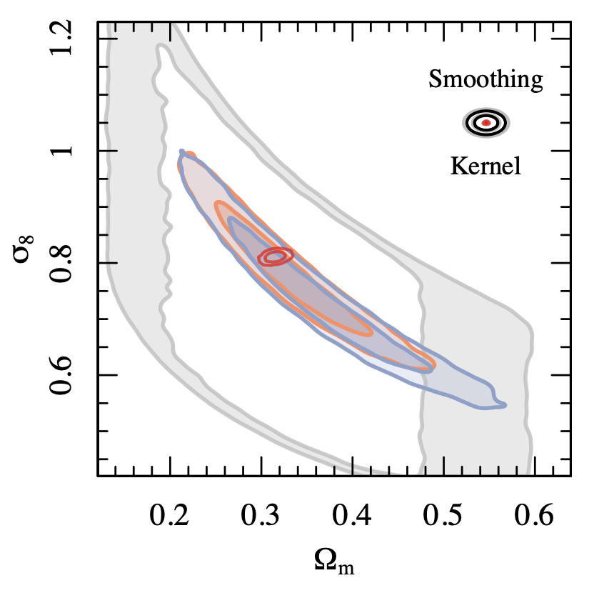
Why look beyond ΛCDM?
2021
Coincidence problem
Fine-tuning problem
Small scale problems
Large scales anomalies
H0 and S8 tensions
2025

Slide 6
Possible alternatives
Quintessence
K-essence
Coupled dark energy and matter
Unified dark energy and matter
f(R), f(Q), f(T) gravity
DGP model
Inhomogeneous LTB model

Slide 7
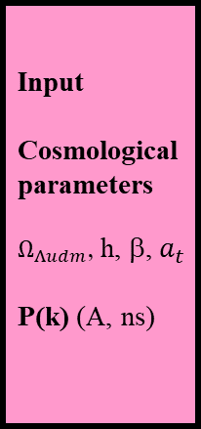
Boltzmann code
Input
Cosmological
parameters
$Ω_{Λudm}$, h, β, $a_{t}$
P(k) (A, ns)
Background:
H(z)
Perturbations:
δ_{mat}(k,z)
SNe code
Weak lensing code
BAO code
CMB code
Nuisance parameters
(E.g.: M, δM, A_planck, A_IA, A_bary, A_SZ)
Liner-nonlinear
mapping:
k_{NL},P_{NL}(k,z)
Parameter
estimation
Likelihood codes
Chains : PDF
MCMC code
Analysing Tools
Observations
Data reduction
Images/maps
Catalogues
Measured data
Data vector
Covariance matrix

Slide 8

MontePython, CosmoMC
Nuisance parameters
(E.g.: M, δM, A_planck, A_IA, A_bary, A_SZ)
Boltzmann code
Input
Cosmological
parameters
$Ω_{Λudm}$, h, β, $a_{t}$
P(k) (A, ns)
Background:
H(z)
Perturbations:
δ_{mat}(k,z)
CLASS, CAMB
SNe code
Weak lensing code
BAO code
CMB code
Liner-nonlinear
mapping:
k_{NL},P_{NL}(k,z)
Parameter
estimation
Likelihood codes
Chains : PDF
MCMC code
Analysing Tools
Observations
Data reduction
Images/maps
Catalogues
Measured data
Data vector
Covariance matrix

Slide 9

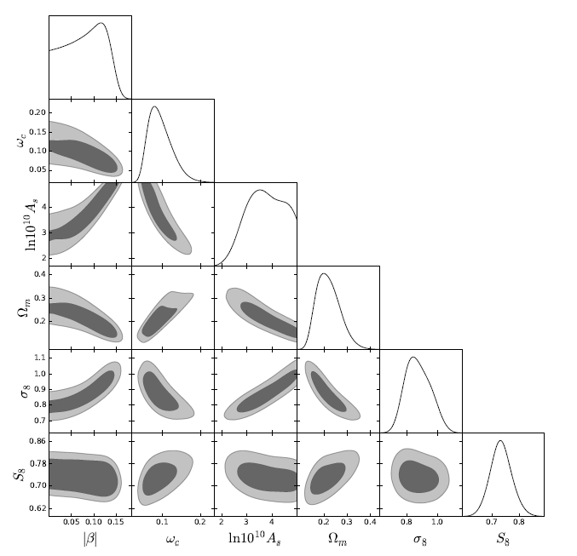
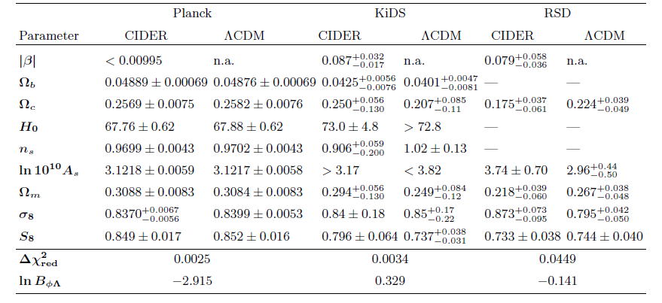
JCAP 01 (2023) 013

Slide 10
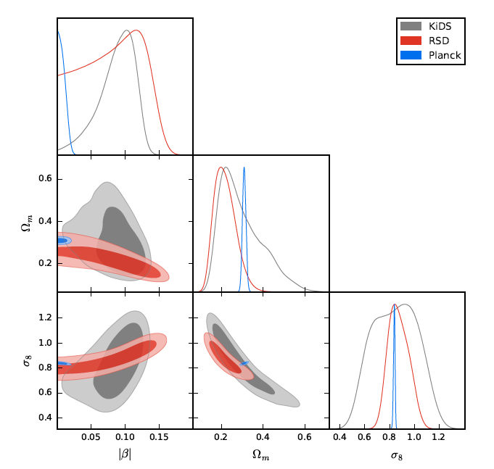
JCAP 01 (2023) 013

Slide 11
What else can we do?
So far, no alternative model is a better representation of the data than ΛCDM.
Models are proposed by hand, implemented in numerical codes, and tested against data. This process is slow and limited to human creativity.
Proposal: Instead of proposing models manually, use ML to generate the best suited models based on data. The role of cosmologists is then to test, interpret, and understand the models generated by the algorithm.

Slide 12

A hybrid approach between traditional sampling methods and evolutionary strategies.
This is done by integrating symbolic regression methods with the cosmological Boltzmann code CLASS and the Bayesian inference tool MontePython.
A&A 709, A159 (2026)

Slide 13
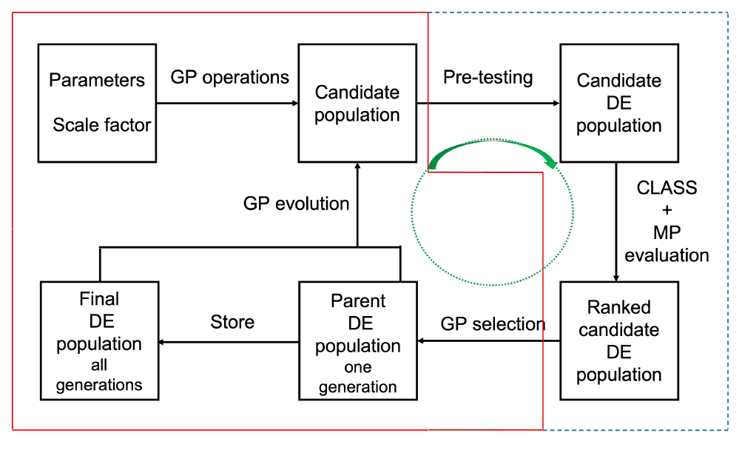
CosmoGen workflow
Contains two main components:
  Machine-learning component:
  generates candidate functional forms using symbolic regression.
  Currently uses a standard tree-based genetic programming approach from DEAP.
  Allows different candidate-generation methods to be implemented.

Slide 14
CosmoGen workflow
Contains two main components:
Cosmology component:
evaluates the cosmological viability of each individual in two stages:
  Pre-testing
  CLASS computations and MontePython sampling methods
The framework allows the user to explore any new cosmological component for which the relevant cosmological equations for background and perturbations can be written in a generalised form.

Slide 15
CosmoGen workflow
Initial population: Generated based on the predefined set of operations, variables and coefficients.

Slide 16
CosmoGen workflow
Pre-testing: Check for potential DE candidates
  Simplification
  Energy density conversion
  Uniqueness check
  Calculation of derivatives
  Infinities and complex-value check
  Free parameter priors

Slide 17
CosmoGen workflow
Evaluation:
Conversion to CLASS conventions
File modification
Compilation
MCMC evaluation and fitness value assignment.

Slide 18
CosmoGen workflow
Selection: Tournament selection.

Slide 19
CosmoGen workflow
Evolutionary strategy: (μ + λ) strategy.

Slide 20





CosmoGen results: testing case
  We asked CosmoGen to generate a population of dark energy models capable of alleviating the $S_{8}$and $H_{0}$tensions.
  We restricted the population to unperturbed dark energy fluids.

Slide 21
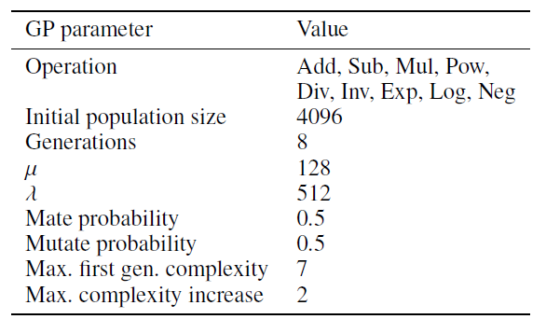
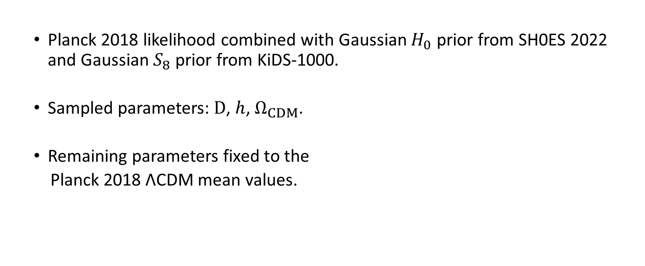
CosmoGen results: Method
  Planck 2018 likelihood combined with Gaussian $H_{0}$ prior from SH0ES 2022 and Gaussian $S_{8}$ prior from KiDS-1000.
  Sampled parameters: $D$, $h$, $Ω_{CDM}$.
  Remaining parameters fixed to the
  Planck 2018 ΛCDM mean values.

Slide 22
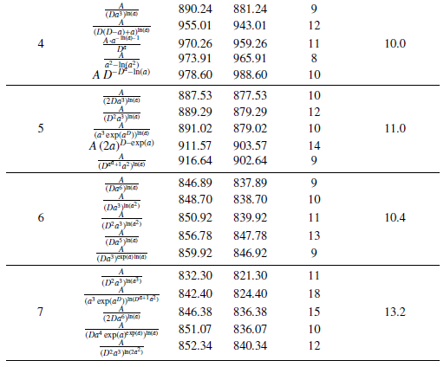
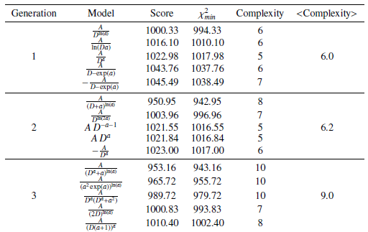
Generated dark energy candidates

Slide 23
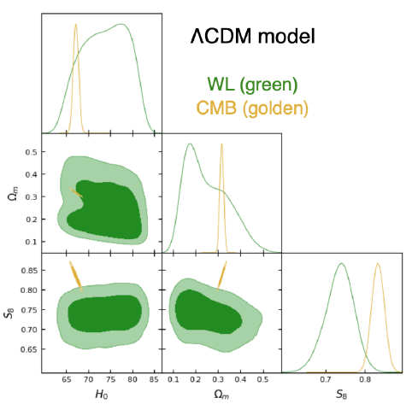

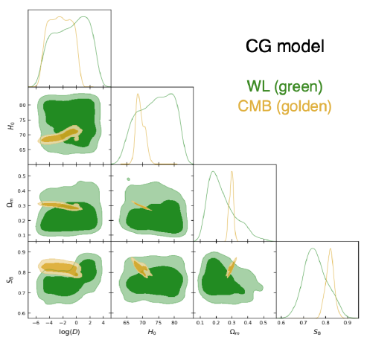
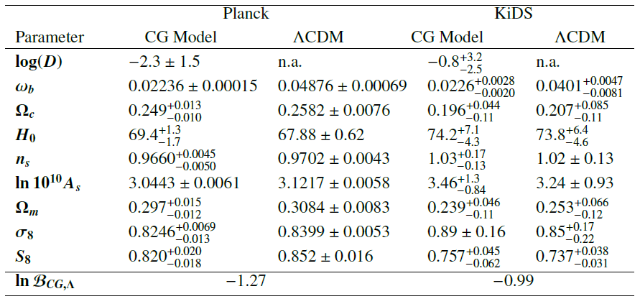
Selected model: parameter constraints

Slide 24
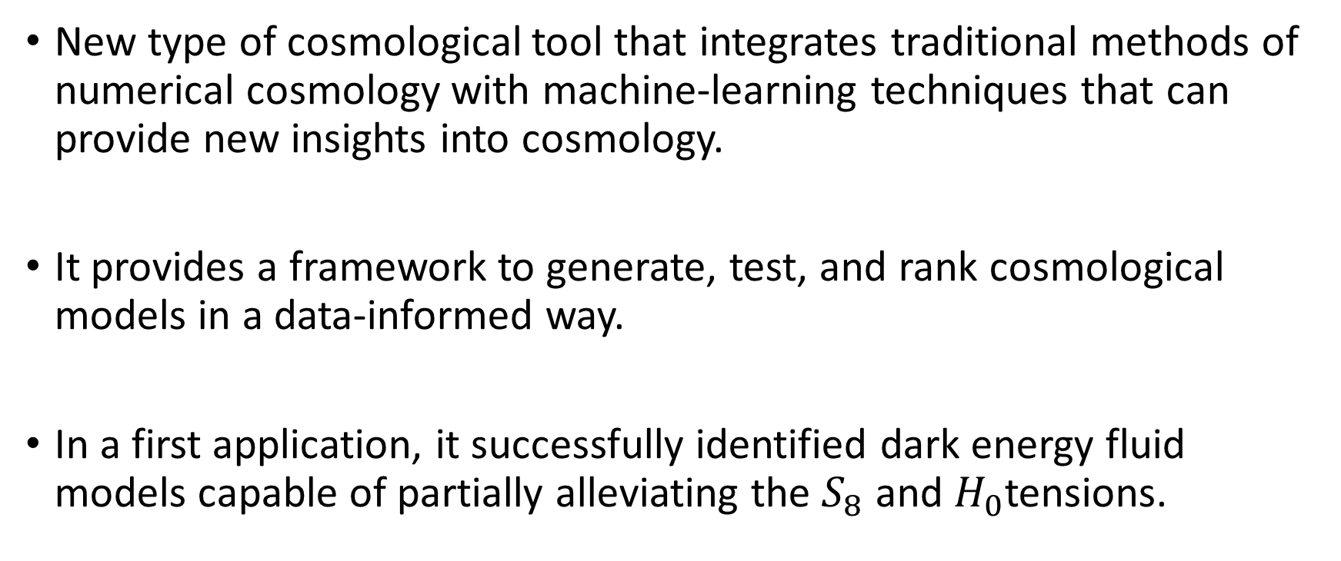
Conclusions
New type of cosmological tool that integrates traditional methods of numerical cosmology with machine-learning techniques that can provide new insights into cosmology.
It provides a framework to generate, test, and rank cosmological models in a data-informed way.
In a first application, it successfully identified dark energy fluid models capable of partially alleviating the $S_{8}$ and $H_{0}$tensions.

Slide 25
Future work
  Extend CosmoGen to other classes of cosmological models, such as coupled species and modified-gravity theories.
  Include better machine learning methods to improve the efficiency of CosmoGen.
  Improve speed of likelihood sampling, e.g. local minimum finder optimisers.
  Include parallelization of the machine learning procedure on top of the MP parallelization procedure, for optimization when using larger clusters.

Slide 26
Thank you

