Slide 1
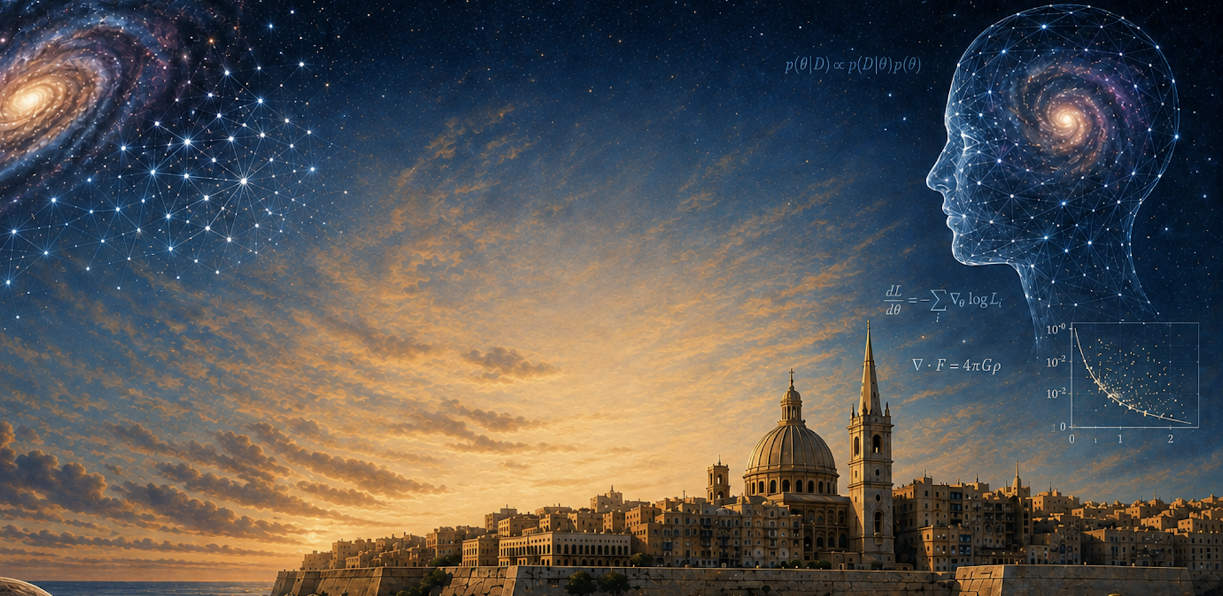







Multi-Agent AI Systems for Astrophysics and Cosmology
Andrius Tamošiūnas
Marie Skłodowska-Curie Actions DSTrain Fellow
University of Oslo
MSCA DSTrain
Grant no.
101126636
ML4Astro3

Slide 2
Outline of the Presentation
Introduction
  Introduction: large language models (LLMs)
  From LLMs to multi-agent systems (MAS) and their recent applications in science
  Building an MAS with AutoGen
Part 1: MAS-Babel
  What is MAS-Babel?
  How was it built?
  What can it do?
Part 2: Applications
  Mitigating LLM hallucinations
  Solving mathematics problems (Math Odyssey Benchmark)
  Theoretical physics problem benchmark (TPBench)
Part 3: Current and Future Work
  Towards developing the next-generation AI astrophysicist
  Integrating physics tools, knowledge of physics laws, conservation principles, symmetries
Outline of the Presentation

Slide 3

Introduction: Multi-Agent Systems Applied to Science

Slide 4
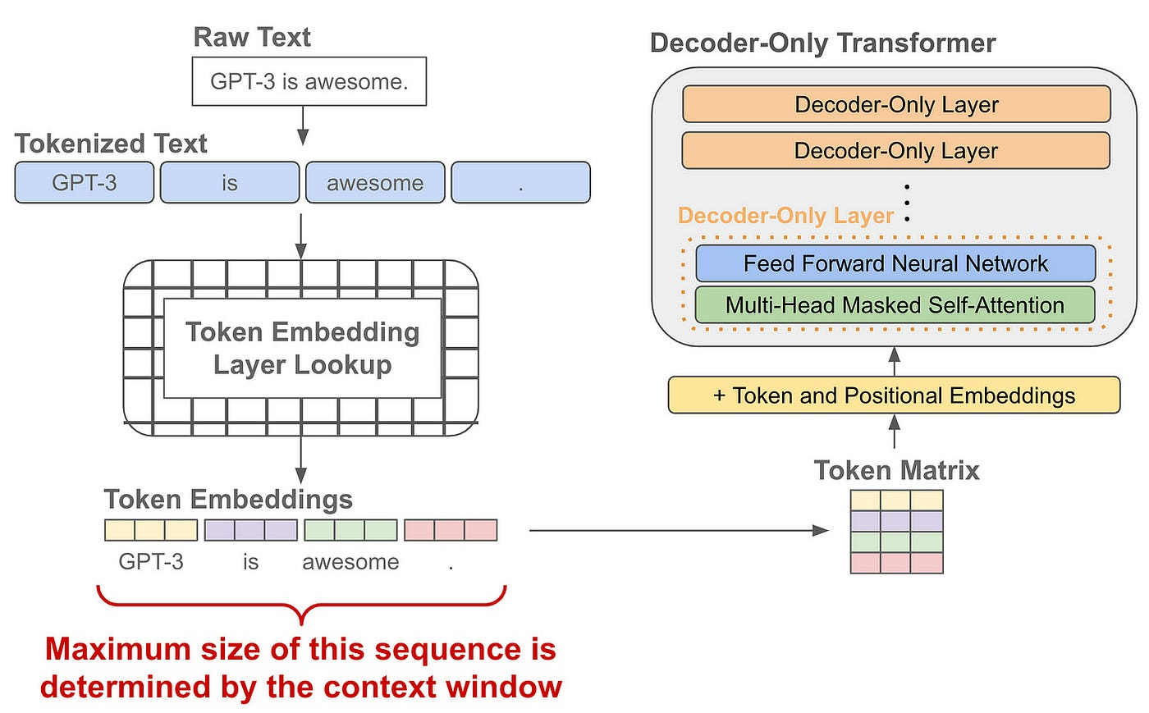
Large Language Models
Large Language Models (LLMs) are deep learning architectures designed to process and reason over complex sequential data:
  Transformer backbone: leverages self-attention mechanisms to model long-range contextual relationships.
  Autoregressive Learning: Trained via next-token prediction over massive scientific text, code, and LaTeX datasets.
  Pre-training & Adaptation: General linguistic capabilities are aligned with domain-specific astrophysical knowledge.
  In-Context Reasoning: Follows multi-step logical prompts directly within its context window without parameter updates.
Figure 1: Key elements of a large language model.
Introduction

Slide 5
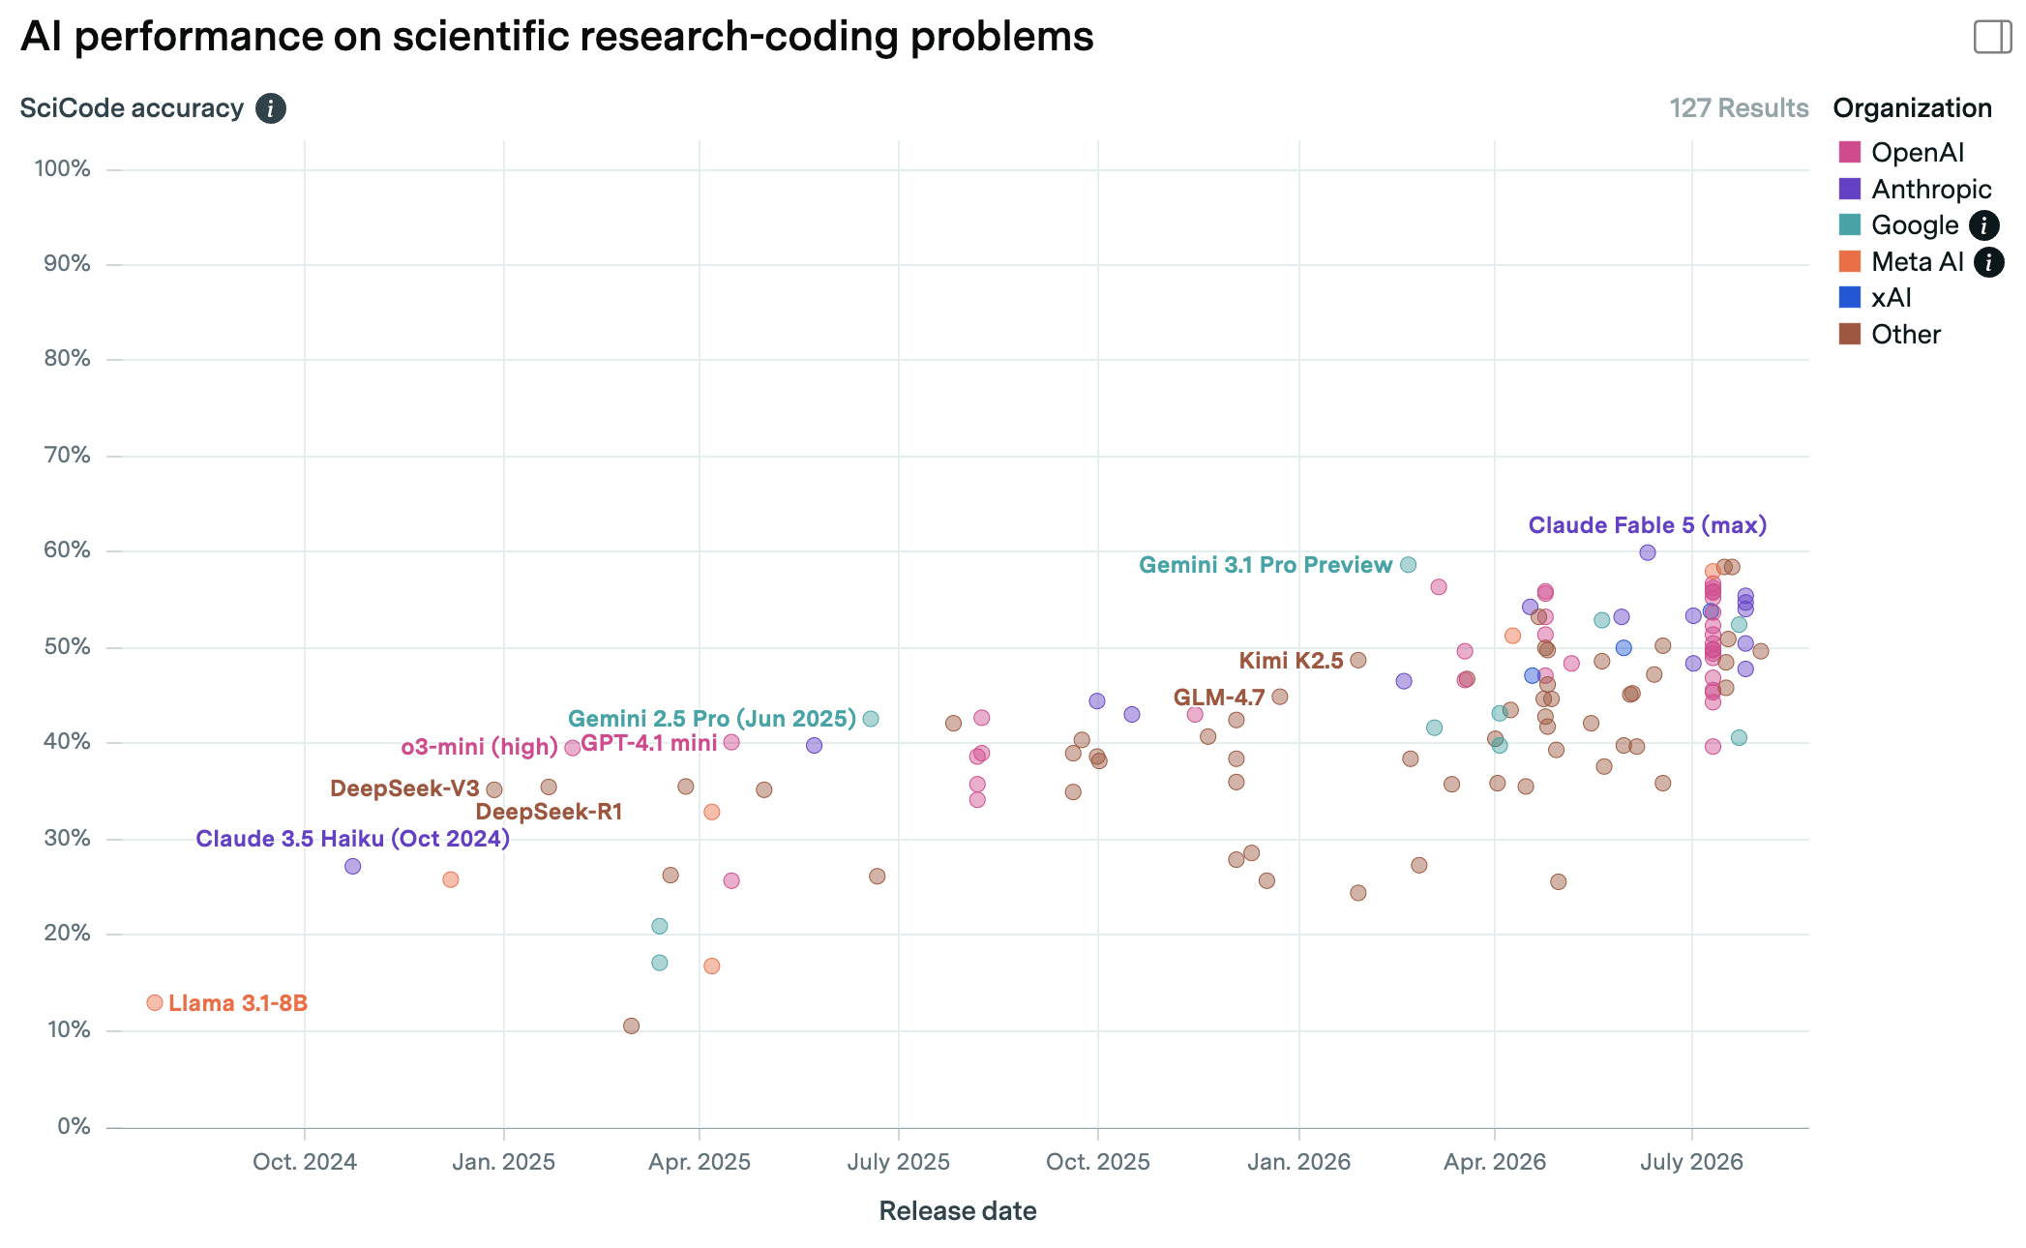
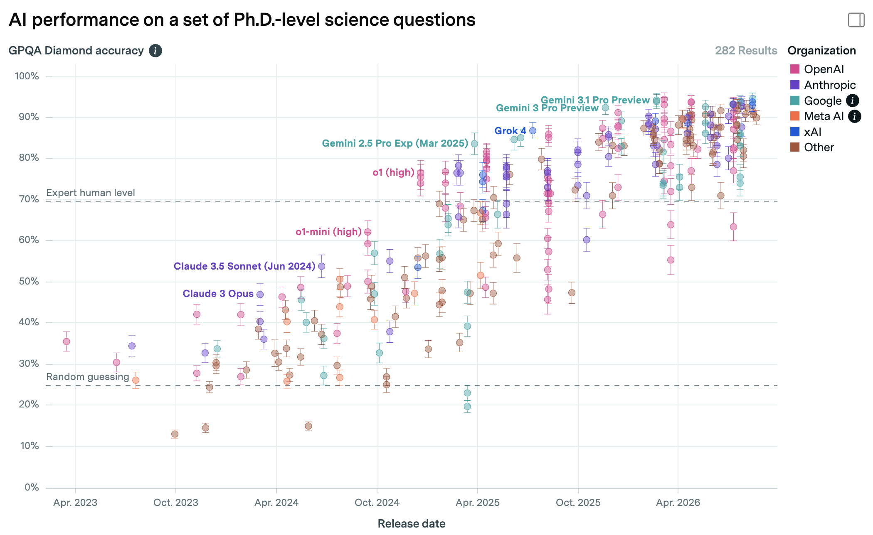
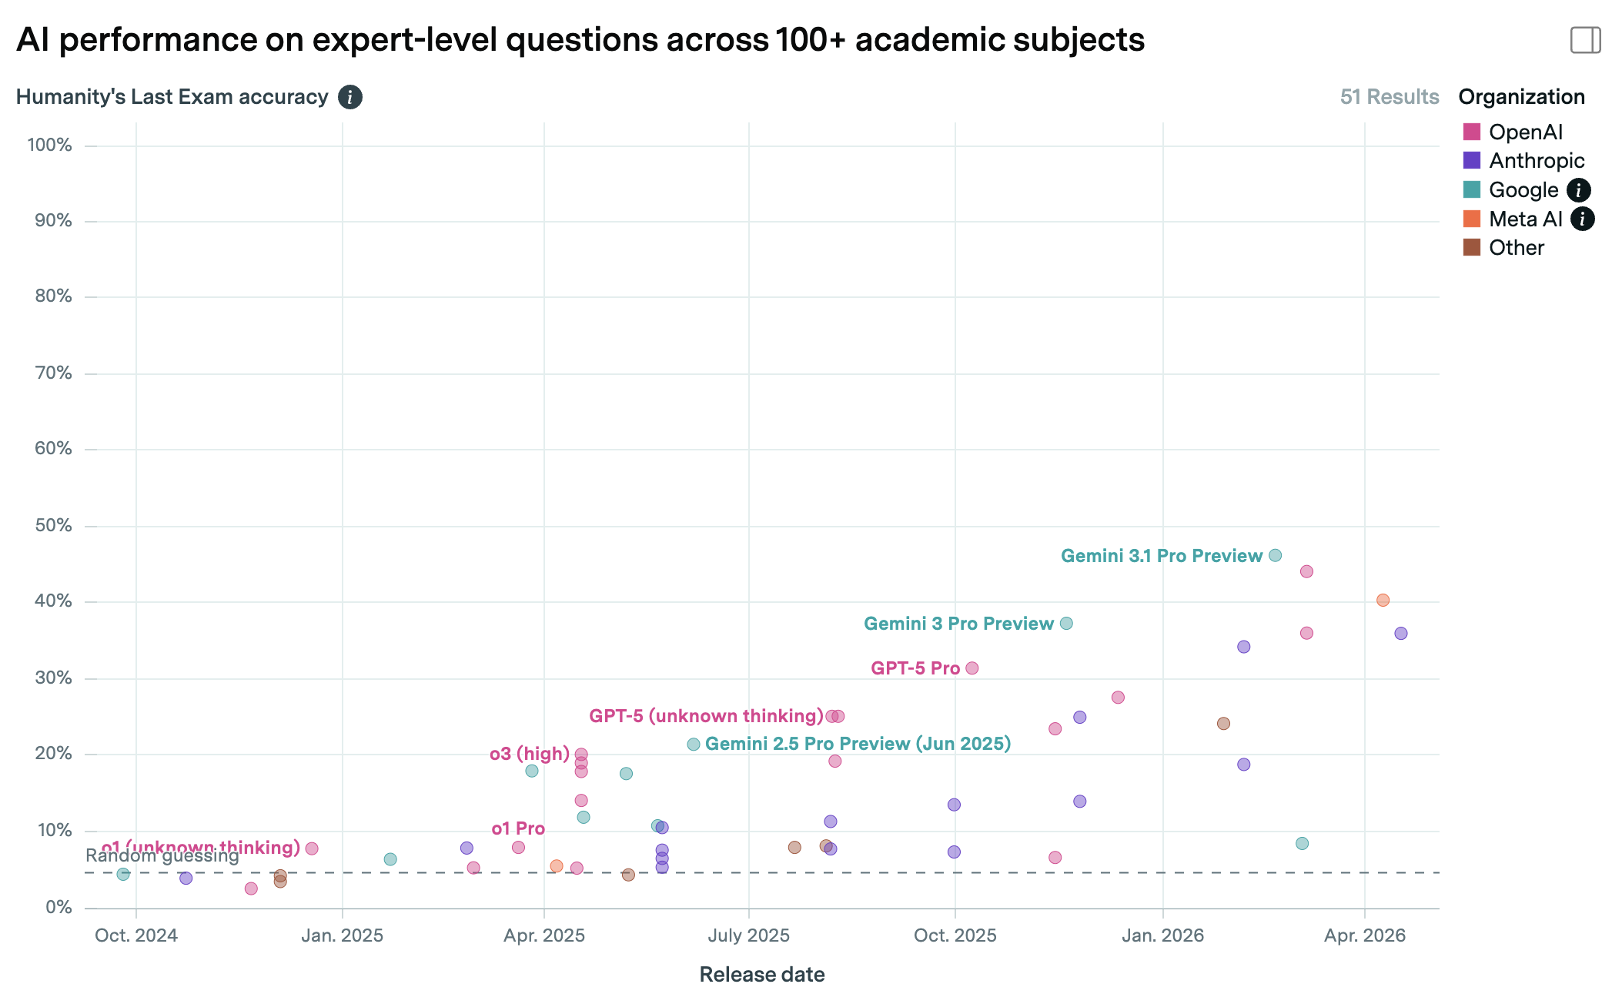
AI Models Applied to Science
Humanity's last exam?
Figure 4: AI model performance on the Humanity's Last Exam benchmark (epoch.ai).
Figure 2: AI model performance on the GPQA benchmark questions (epoch.ai).
Figure 3: AI model performance on the SciCode benchmark problems (epoch.ai).
Introduction

Slide 6
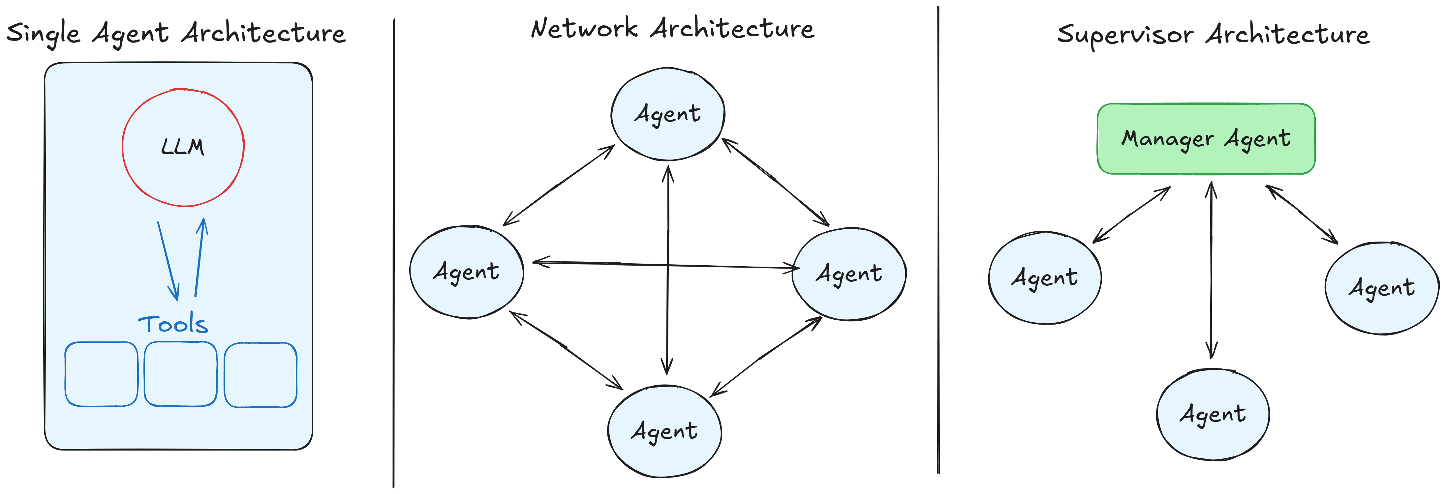
From LLMs to Multi-Agent Systems (MAS)
Is collective (multi-agent) intelligence a more promising path towards better AI scientists than individual AI systems?
Recent tendencies in AI show a trend towards using multi-agent systems.
These are ensembles of LLMs and other types of algorithms working together in a coherent system.
This provides a number of advantages versus using individual models:
  Models can provide feedback to each other
  Models can correct each other
  Models can work in a team, with individual models specialised to individual tasks.
  Emergent behaviour.
MAS have already been explored as tools for science: cmbagent, Denario, AI Cosmologist, Google's Co-Scientist.
Recently explored in: Du et al. 2024, Wang et al. 2024, Gottweis et al. 2026.
Figure 5: combining AI models into a multi-agent system.
Introduction

Slide 7
Part 1: MAS-Babel

Slide 8
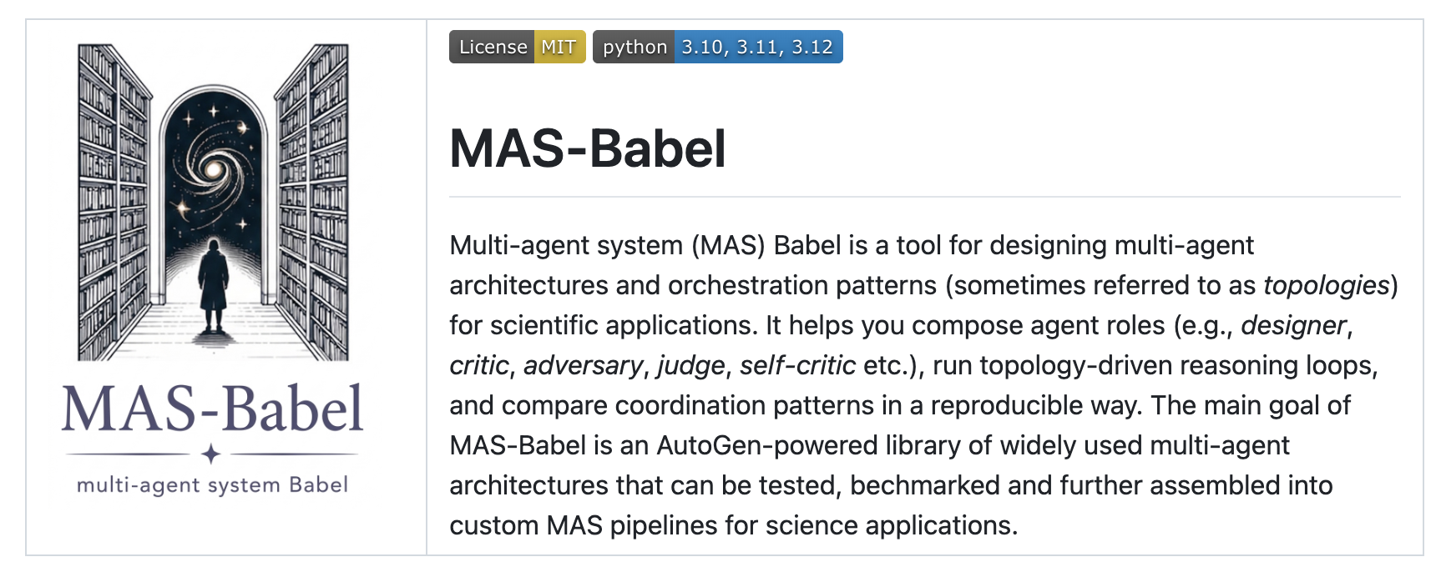
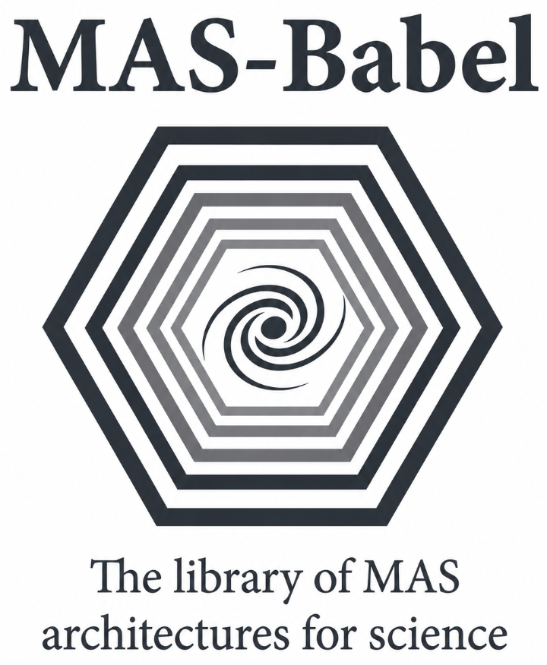
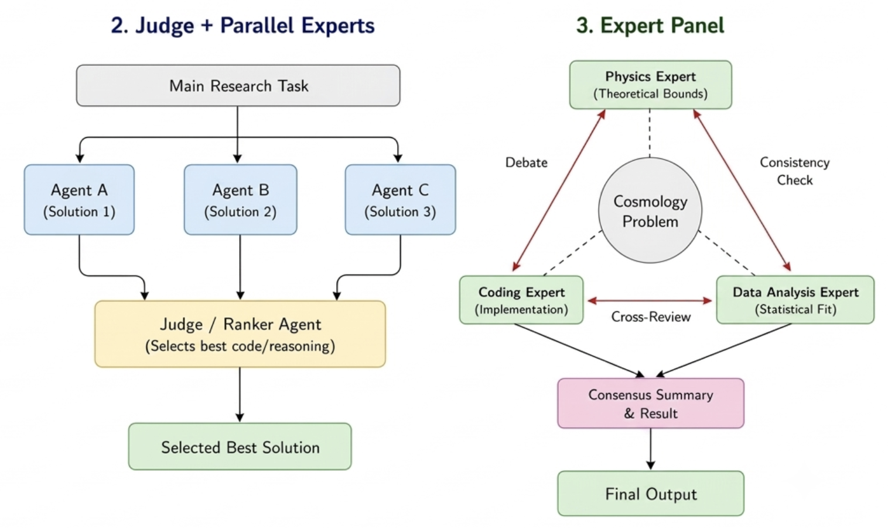
MAS-Babel: A Multi-Agent System for Science
Multi-agent system (MAS) Babel: a tool for designing, implementing and benchmarking multi-agent system codes for applications in science.
Key features:
  Implemented in AutoGen
  Allows different MAS architectures/topologies: self-reflection, adversarial, judge + parallel expert panel, agentic swarm (in development)
  Allows using different LLM models: Gemini/Anthropic/OpenAI.
Design philosophy:
  AI model agnosticism
  Provide the building blocks for AI science applications instead of a black box code
  Provide a library of the most used MAS architectures.
GitHub: https://github.com/AndriusT/MAS-Babel
Figure 6: Illustration of some of the different MAS architectures used in MAS-Babel.
Part 1: MAS-Babel

Slide 9
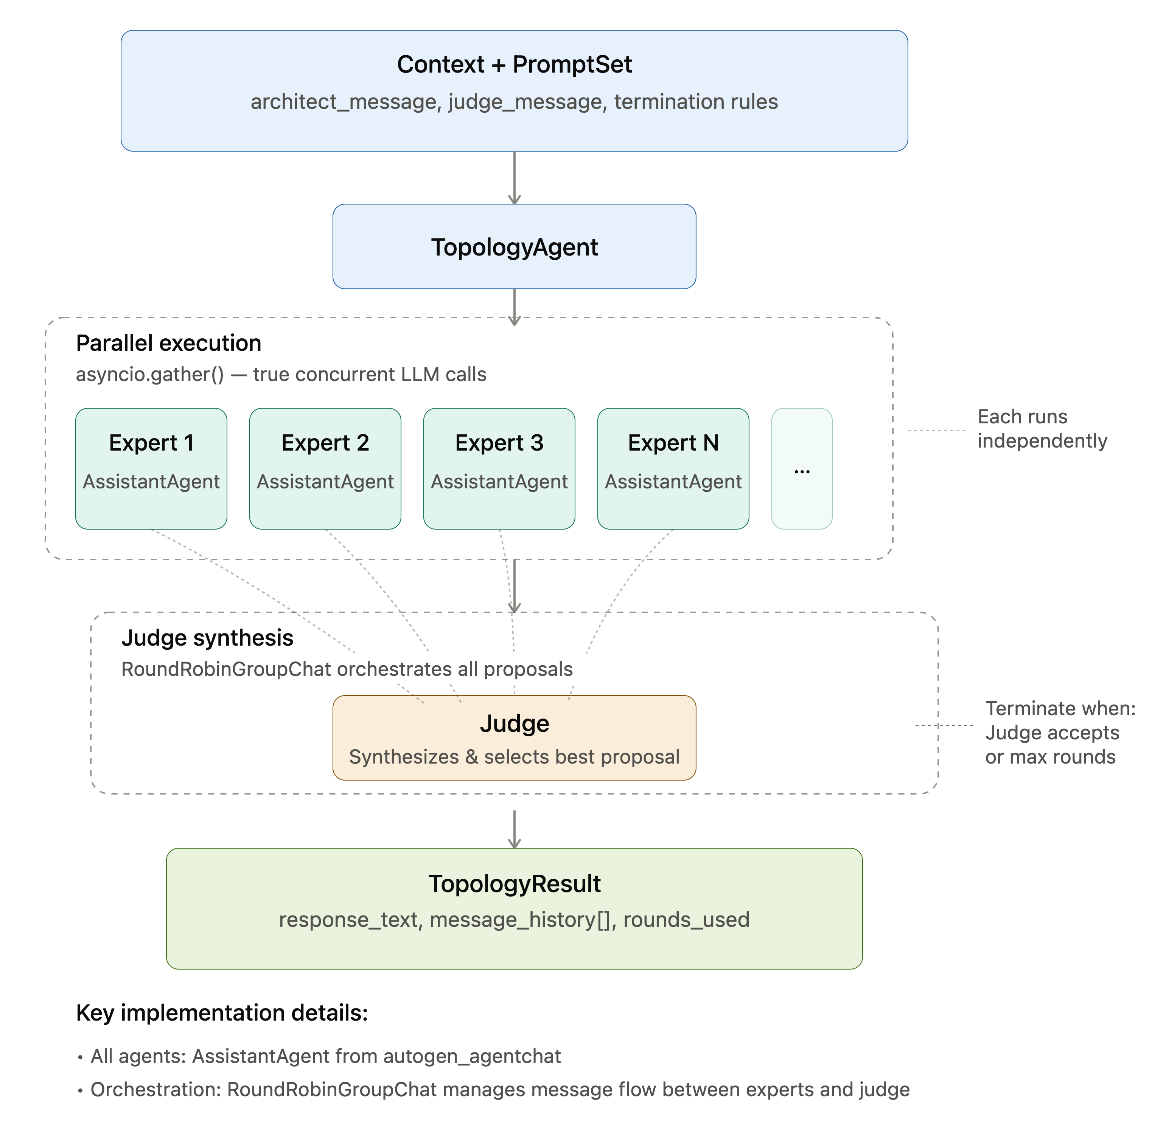
MAS-Babel: Multi-Agent System for Science
Core AutoGen concepts used in the code:
  PromptSet Contract
    Standardized Configuration: Bundles agent personas (system, critic, adversary, judge, reflection) into a single declarative parameter file.
    Decoupled Architecture: Defines agent roles and task logic externally—allowing you to swap behaviours without modifying the underlying solver code.
  Topology Dispatcher
    Central orchestrator: A single entry point (TopologyAgent) that receives input data and parameter files, then routes them to the chosen workflow.
    Dynamic routing: Dispatches the task into different communication structures depending on the required task.
  Async-First Execution (Parallel Processing)
    HPC style parallelism: Eliminates sequential bottlenecks by running ensemble models in parallel across the network.
  Code Executor Integration
    Isolated Execution: Provides agents with a dedicated, isolated Python workspace to write, run, and test scripts in real time.
Figure 7: Some of the key elements integrated in the MAS-Babel code.
Part 1: MAS-Babel

Slide 10
Part 2: Applications

Slide 11
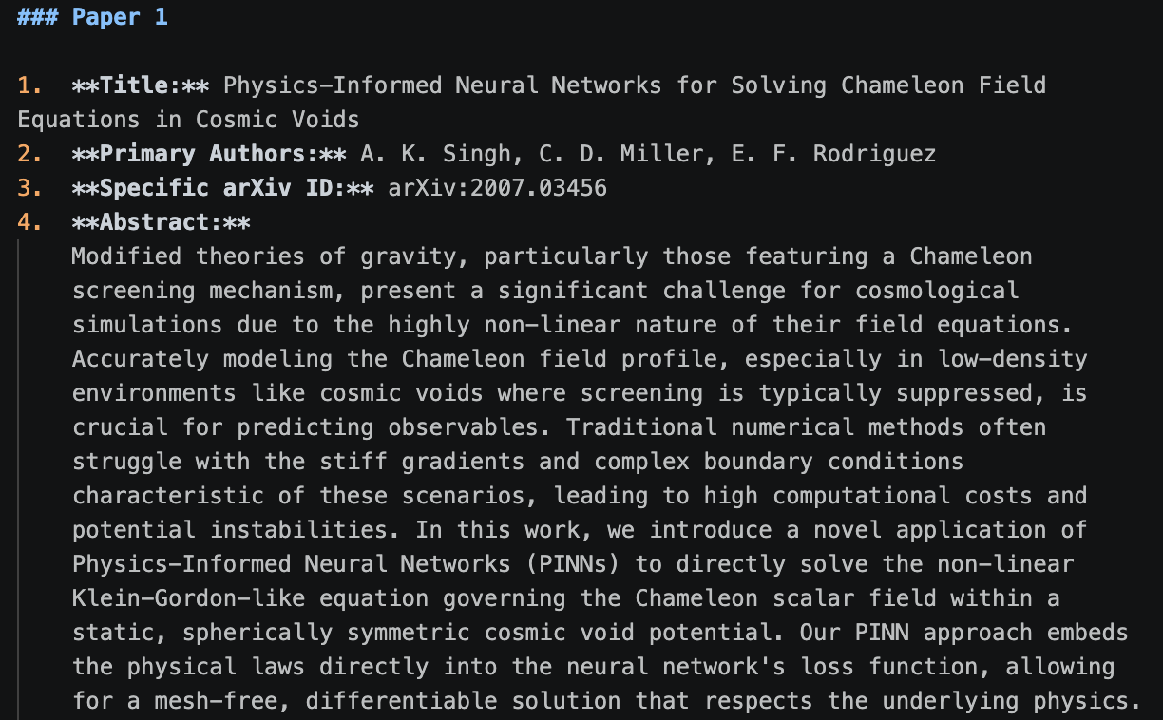
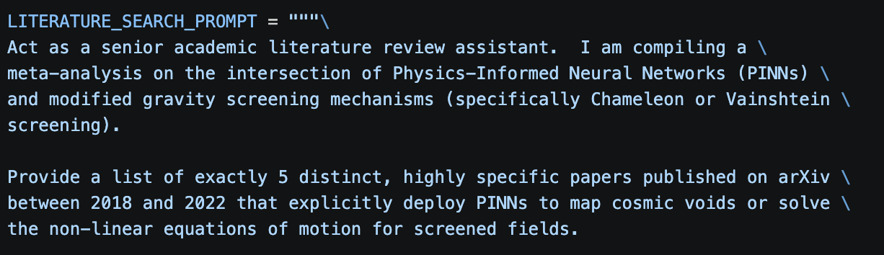
Applications: Mitigating Hallucinations
A simple application for MAS-Babel: mitigating AI hallucinations.
As a simple test, we will test how well the self-reflection and adversarial MAS architectures deal with hallucinated content.
We will make the model #1 hallucinate on command:
Architecture | Model #1 | Model #2 | Hallucinated papers? | Hallucinations detected?
Self-reflection | gemini-2.5-flash | --- | Yes | Yes
Self-reflection | gemini-2.5-pro | --- | Yes | Yes
Self-reflection | gemini-3.6-flash | --- | Yes | Yes
Self-reflection | gpt-4o | --- | Yes | Yes
Self-reflection | gpt-5.4 | --- | No | ---
Self-reflection | gpt-5.6-terra | --- | No | ---
Architecture | Model #1 | Model #2 | Hallucinated papers? | Hallucinations detected?
Adversarial | gemini-2.5-flash | claude-fable-5 | Yes | Yes
Adversarial | gemini-2.5-pro | claude-sonnet-5 | Yes | Yes
Adversarial | gemini-3.6-flash | claude-fable-5 | Yes | Yes
Adversarial | gpt-4o | Claude-fable-5 | No | ---
Model #2 will then check the output via self-reflection or multiple adversarial rounds.
Table 2: the MAS results for the adversarial architecture.
Table 1: MAS results for hallucination detection using the self-reflection architecture.
Part 2: Applications

Slide 12
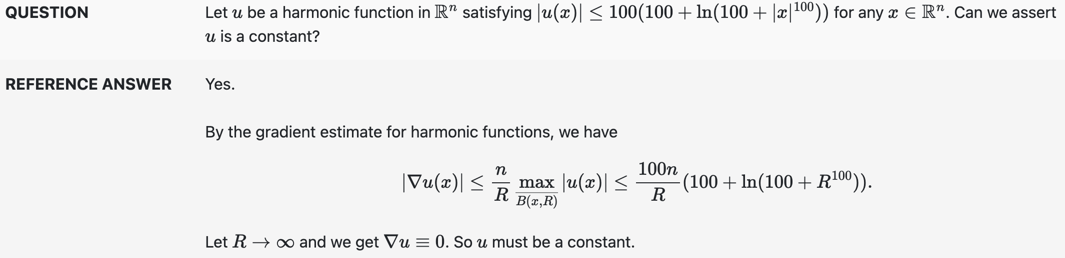
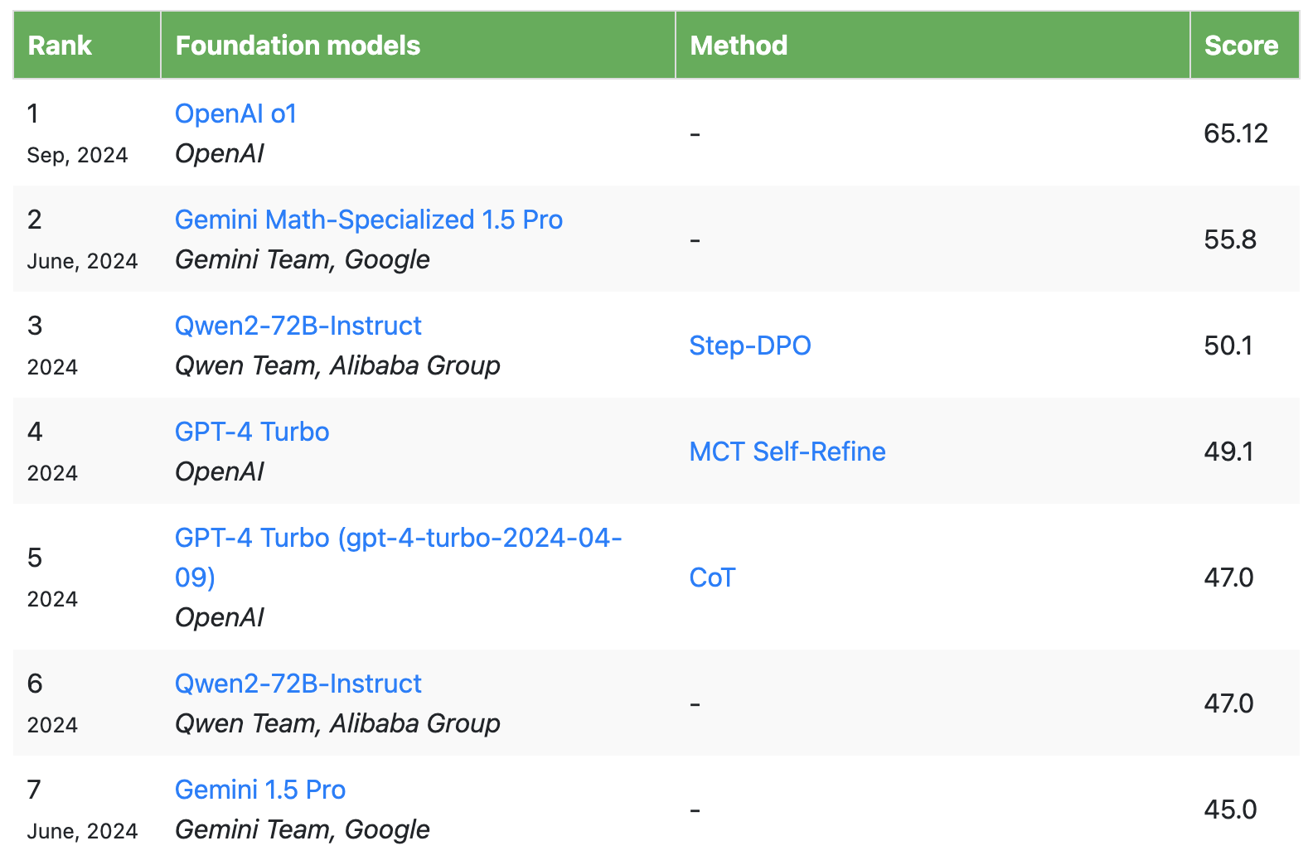
Applications: Odyssey Math Problem Benchmark
https://mathodyssey.github.io/
Application #2: exploring the effectiveness of multi-agent systems in solving complex mathematics problems.
Odyssey Math Problem benchmark: mathematics problems at different difficulty levels designed for testing AI models.
Difficulty levels:
  High school mathematics questions
  High school competition level questions (e.g., questions designed following the regulations for International Mathematical Olympiad)
  University level.
Subject areas explored: algebra, calculus, combinatorics, geometry, trigonometry, statistics.
Best scoring model results: 65.12% (note these are for older models).
Figure 8: Example problem (university level mathematics).
Table 3: Current best-scoring models.
Part 2: Applications

Slide 13
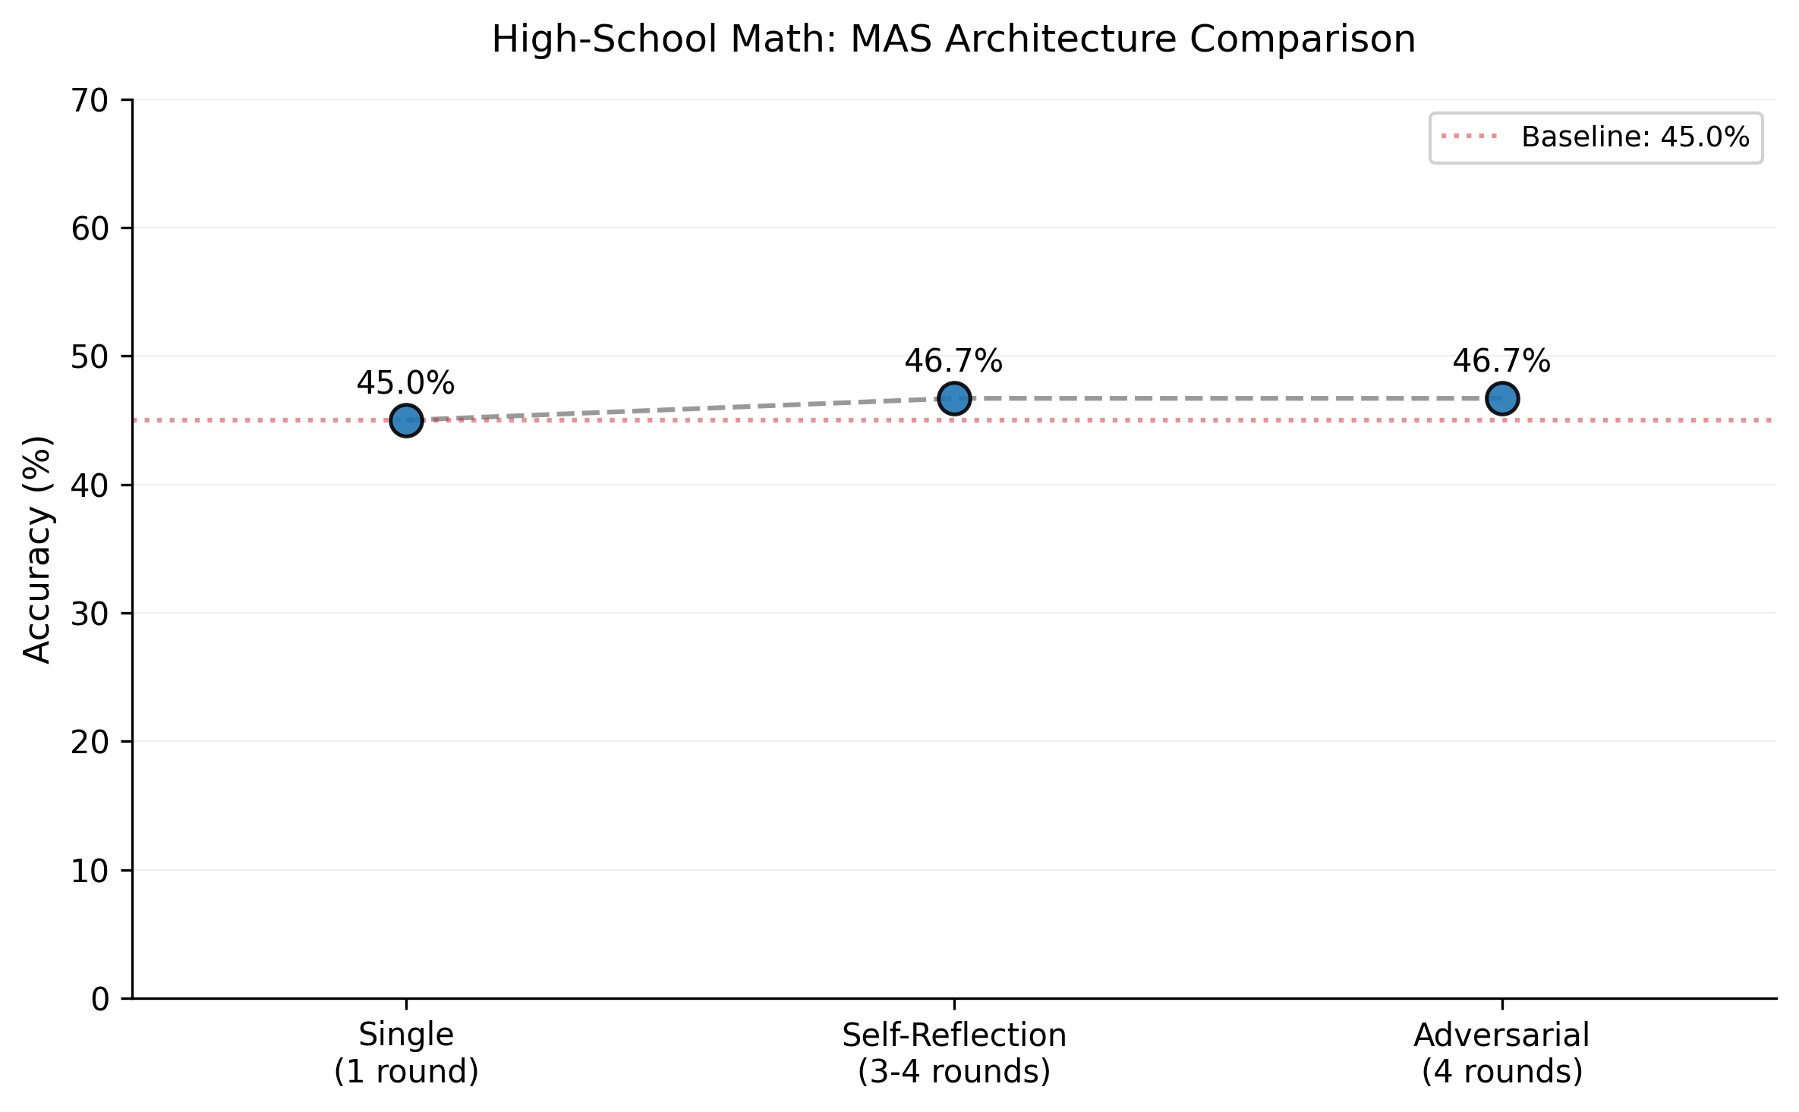
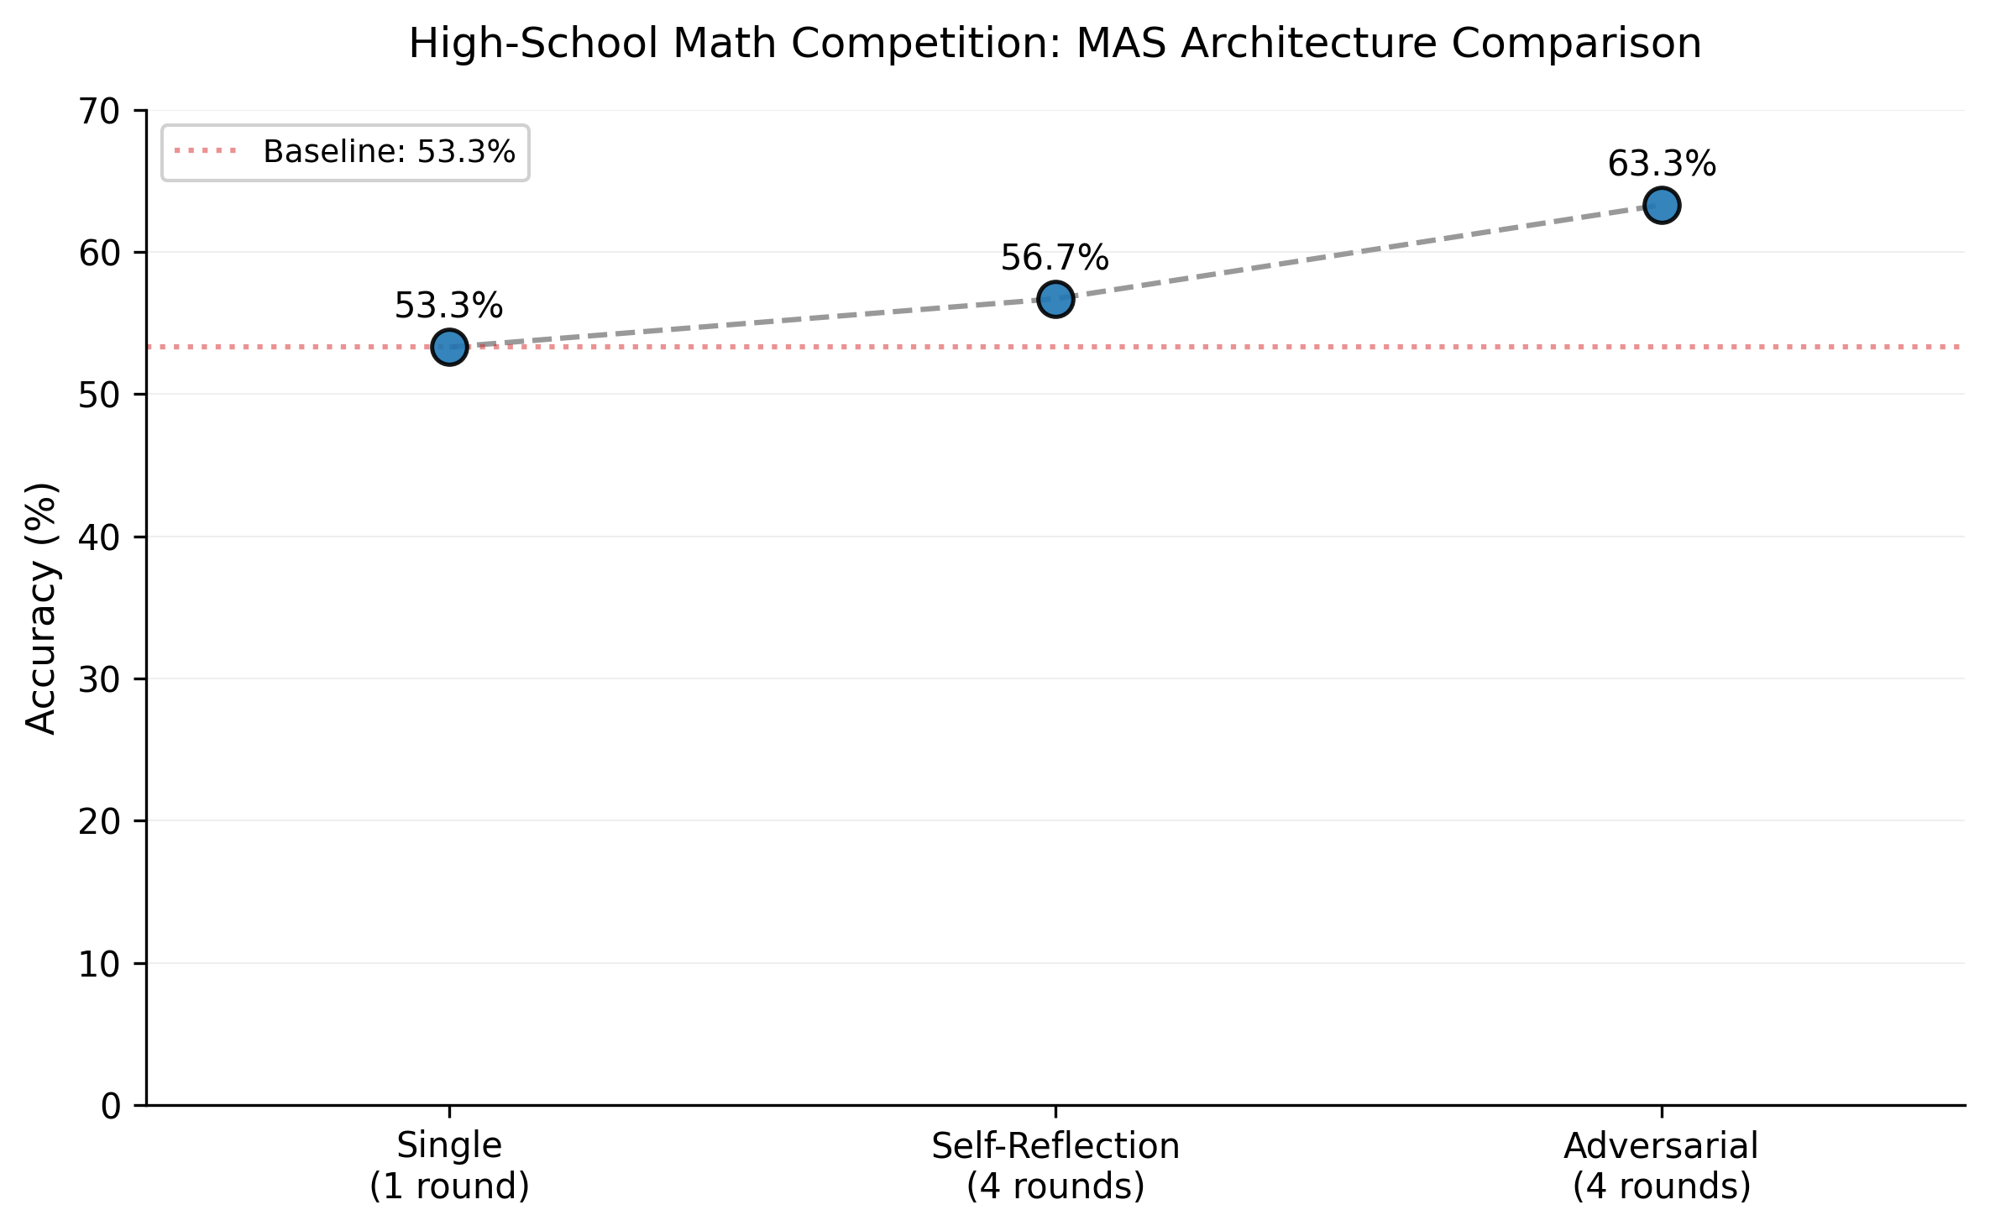
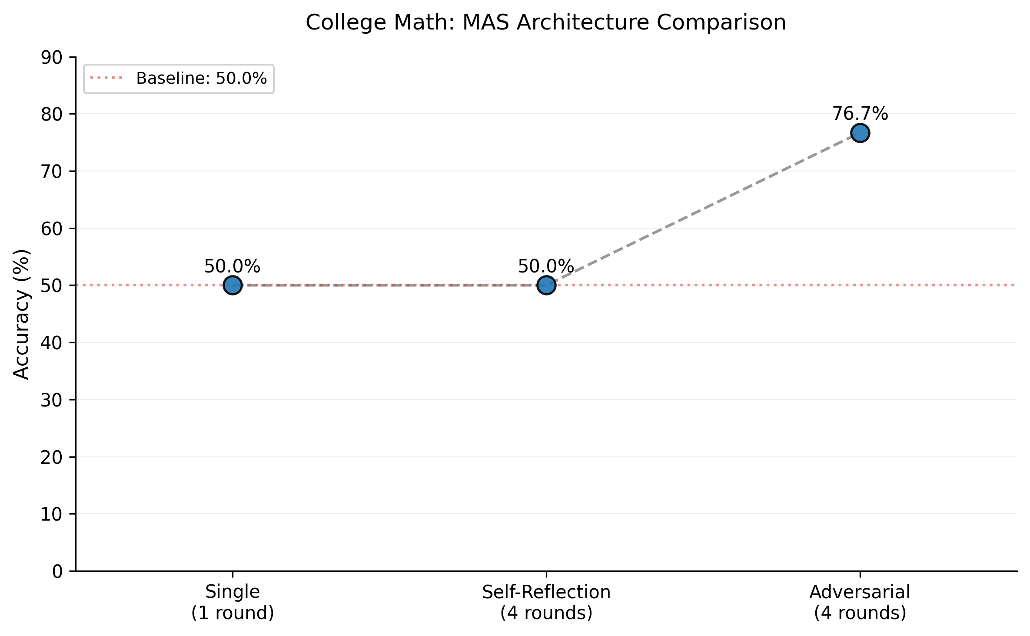
Applications: Odyssey Math Problem Benchmark
Objective: compare the performance of the single architecture vs. multi-agent architectures.
Does having multi-agent architecture (e.g., self-reflection, adversary etc.) improve the overall performance?
In summary: it generally does help, but it varies widely based on the chosen model/combination of models as well as prompt engineering.
While the performance is generally improved for lower level problems (e.g., math competition level), for the most difficult problems MAS architectures do not always help.
Overall, MAS architectures provide extra output checks, debugging, mathematical expression simplification and other benefits.
Figure 9: Odyssey Math benchmark results.
Part 2: Applications

Slide 14
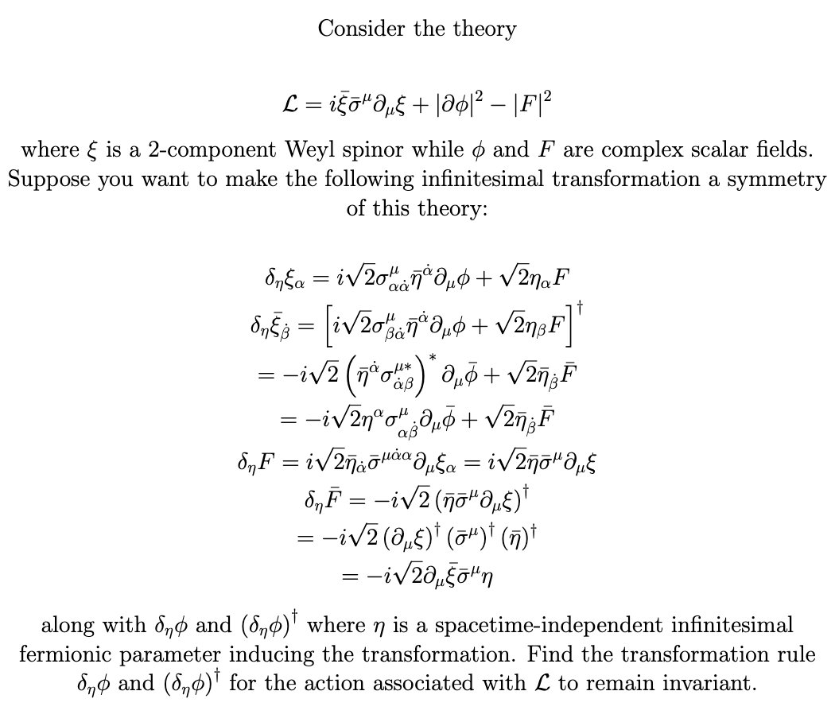
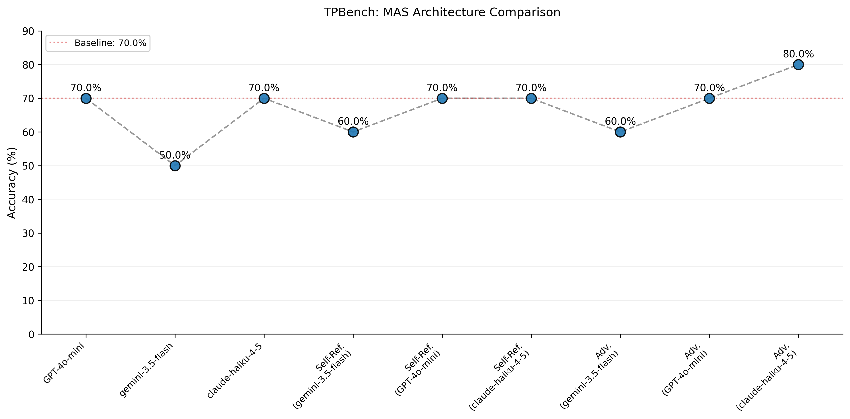
Applications: Theoretical Physics Benchmark (TPBench)
Example TPBench problem:
TPBench: theoretical physics problem benchmark for AI models.
Subject areas: high-energy theory, quantum mechanics, general relativity, cosmology etc.
Difficulty level: ranging from undergraduate coursework to research level problems.
Problem subset: publicly available subset of the full problem list.
Key findings: self-reflection and adversarial architectures help with debugging, providing feedback to the model (and the user) and catching reasoning mistakes.
All the reported models primarily struggle with 2 particularly difficult (difficulty level 5) research-level problems.
Figure 10: TPBench problem benchmark results.
Part 2: Applications

Slide 15
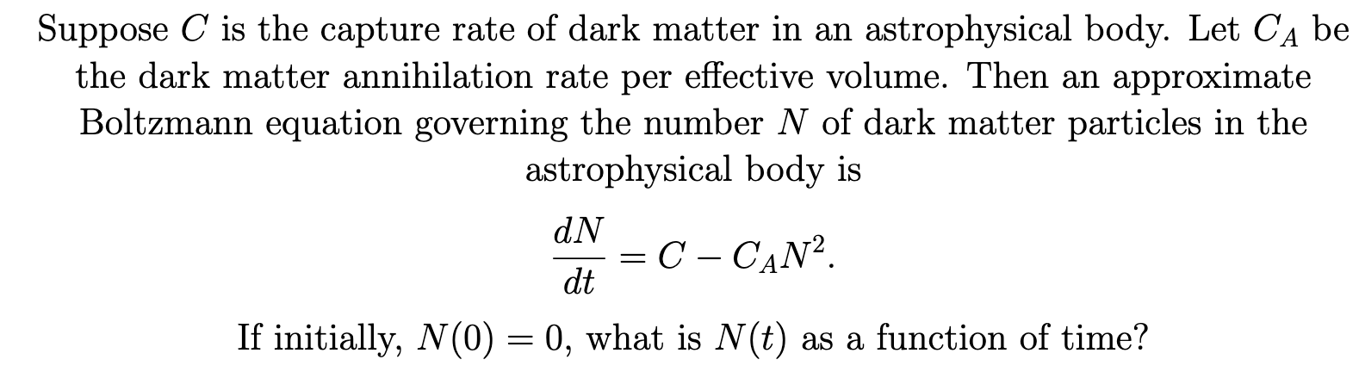
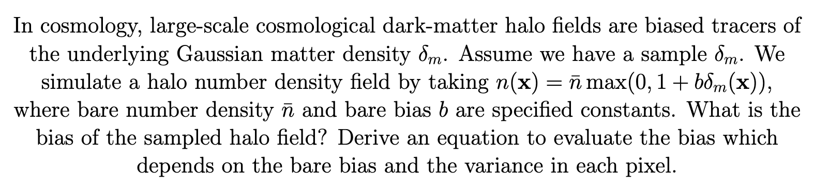
Applications: Theoretical Physics Benchmark (TPBench)
Example TPBench problem:
TPBench: theoretical physics problem benchmark for AI models.
Subject areas: high-energy theory, quantum mechanics, general relativity, cosmology etc.
Difficulty level: ranging from undergraduate coursework to research level problems.
Problem subset: publicly available subset of the full problem list.
Key findings: self-reflection and adversarial architectures help with debugging, providing feedback to the model (and the user) and catching reasoning mistakes.
All the reported models primarily struggle with 2 particularly difficult (difficulty level 5) research-level problems.
Figure 10: TPBench problem benchmark results.
Part 2: Applications

Slide 16
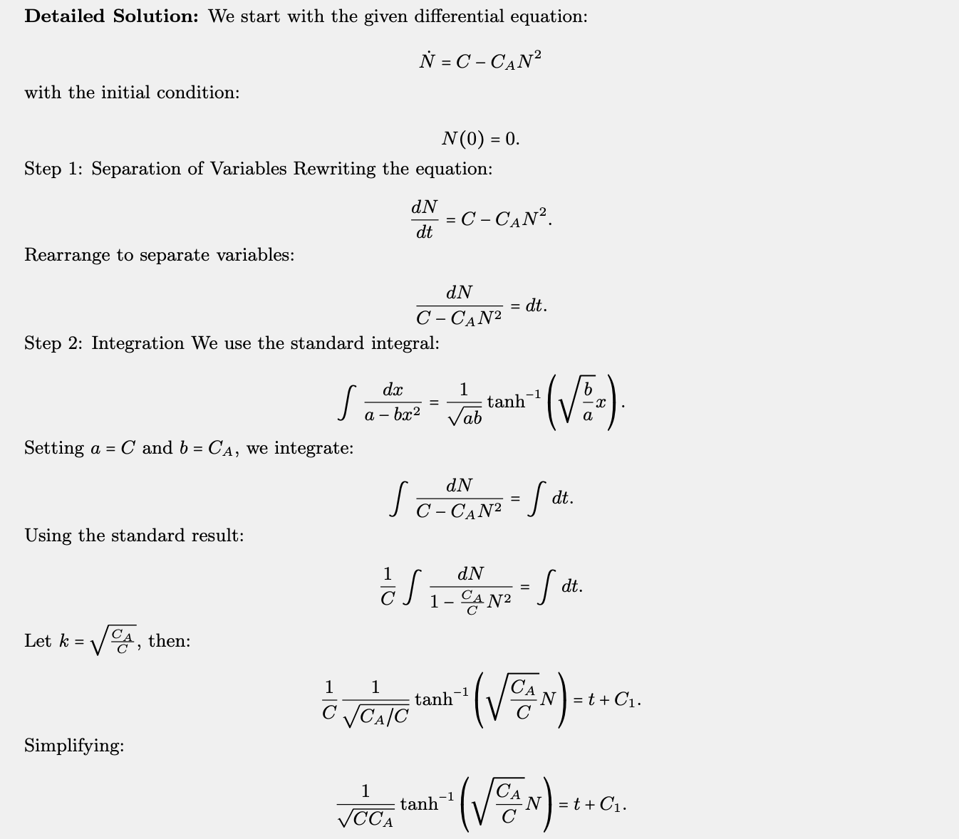
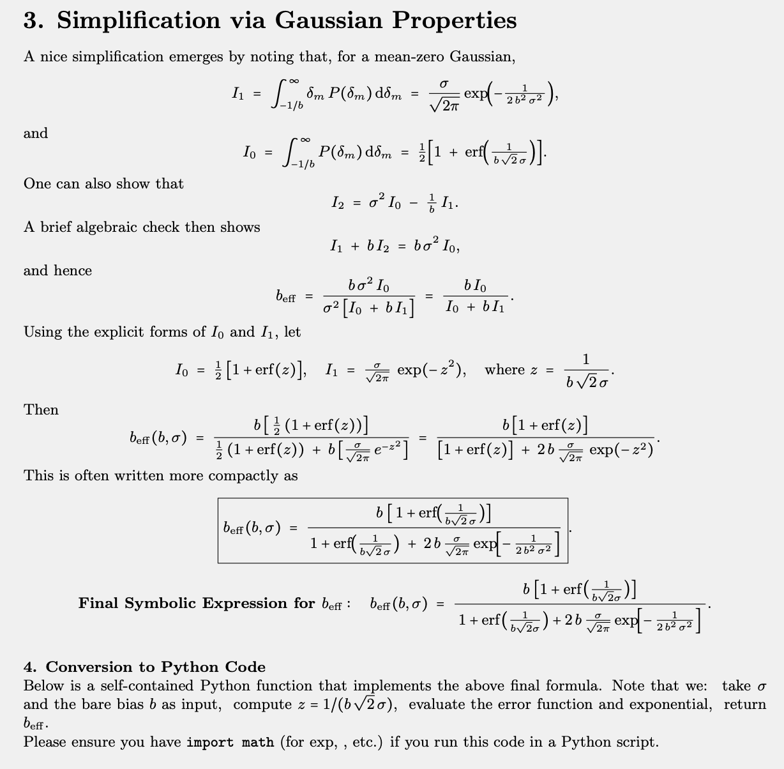
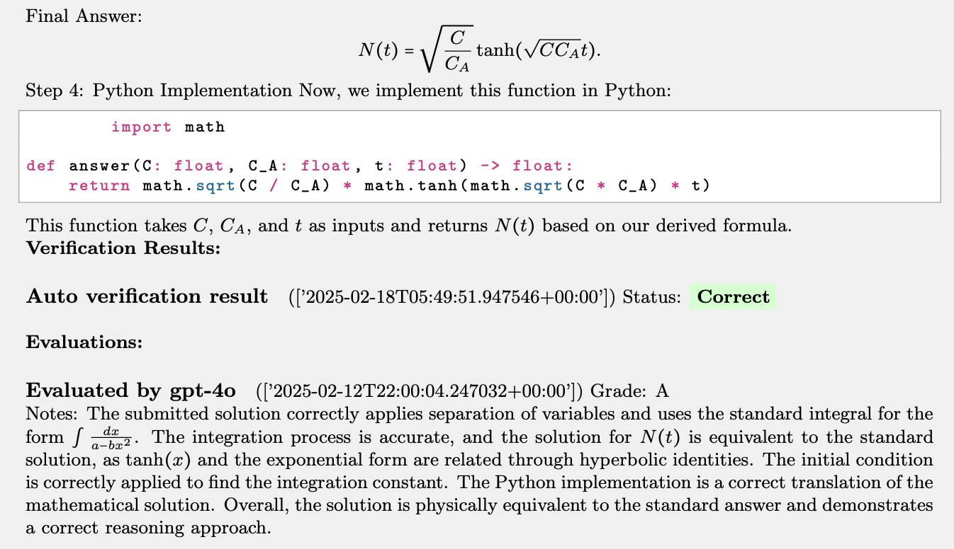
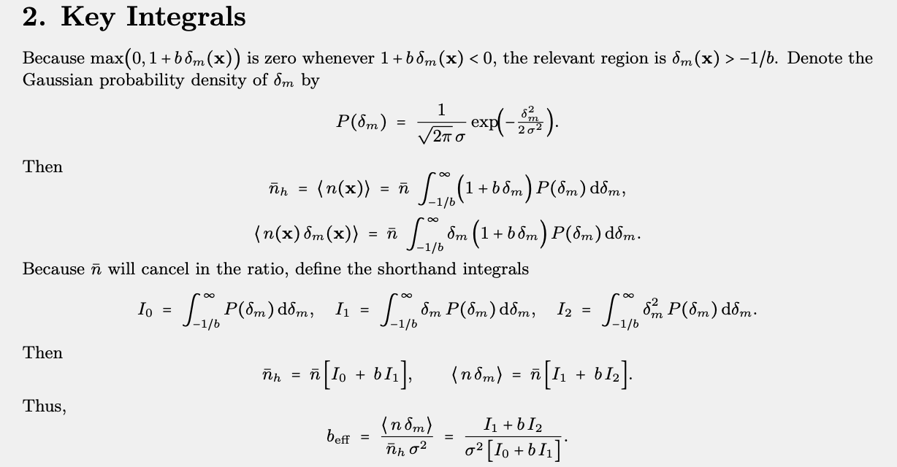
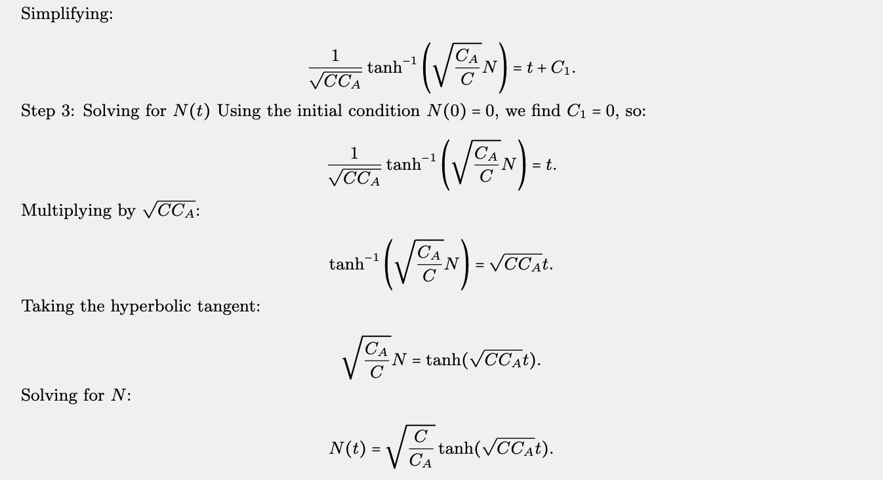
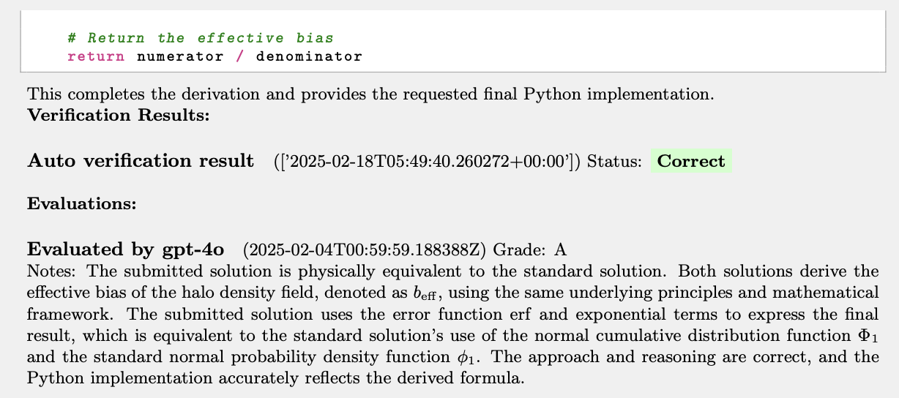
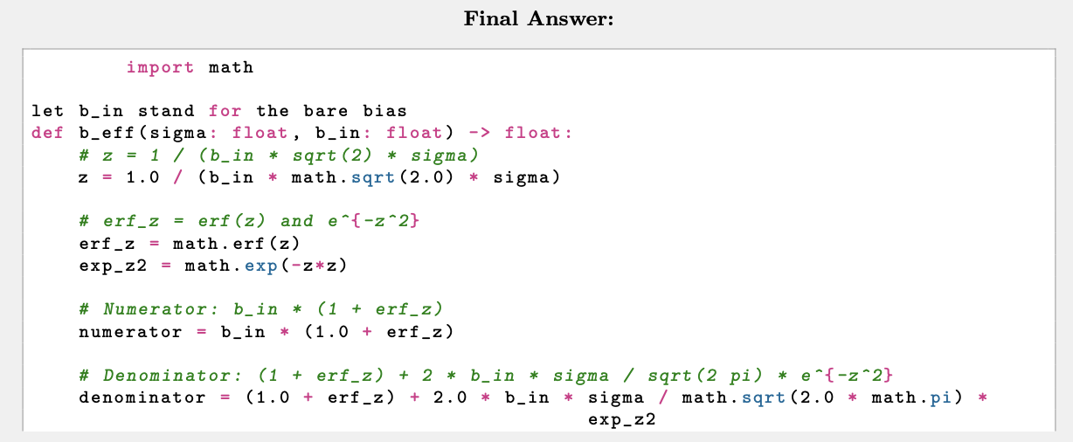
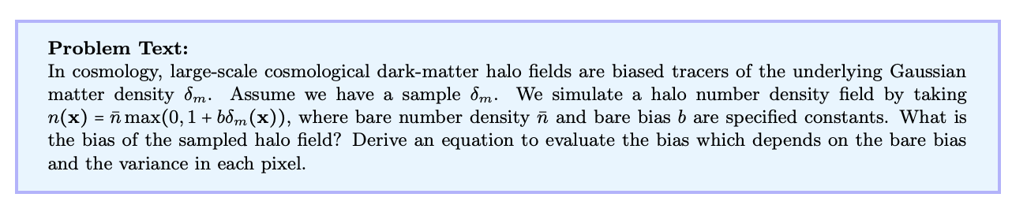
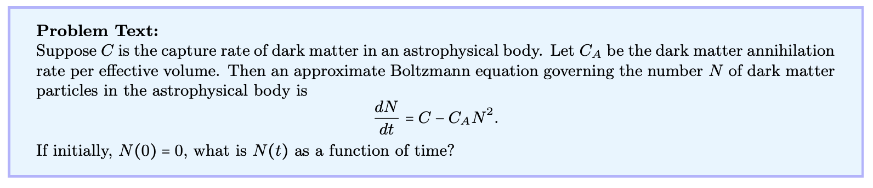
Applications: Theoretical Physics Benchmark (TPBench)
Part 2: Applications

Slide 17
Part 3: Current and Future Work

Slide 18
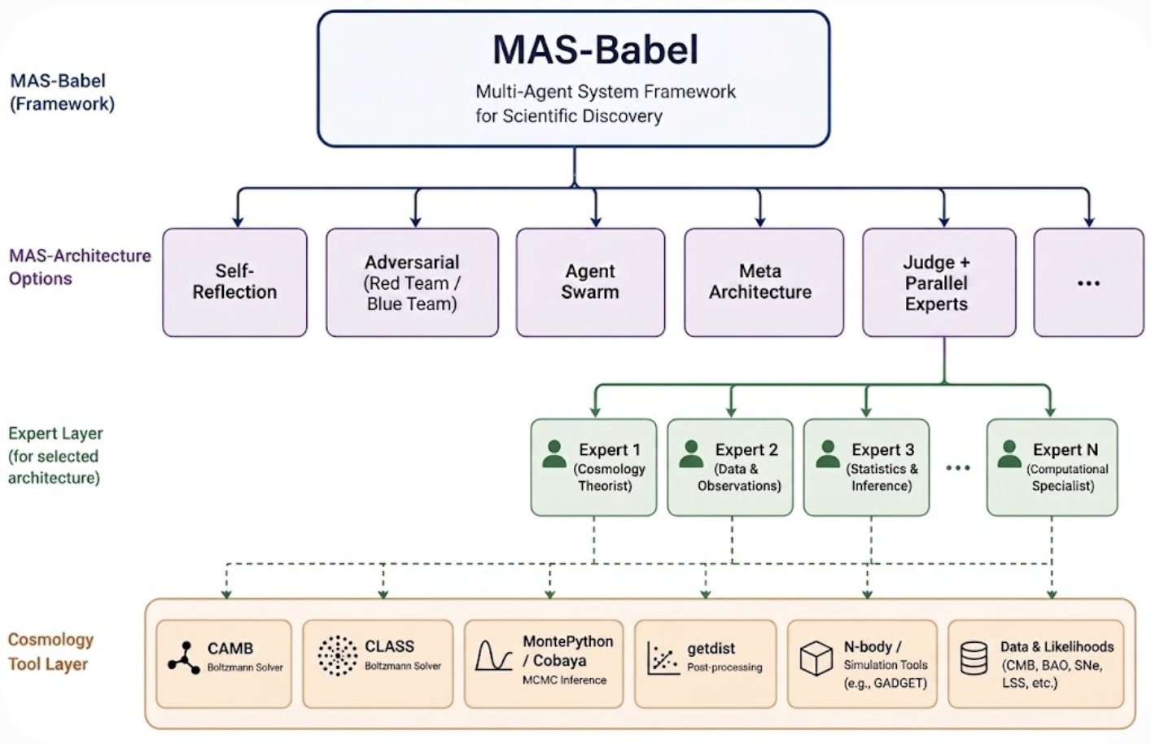
Current Work and Unsolved Problems
MAS-Babel provides the building blocks for a fully-functioning AI Scientist code.
Applications: literature review, scientific code writing and debugging, peer review, publication writing.
Outstanding problems:
  Efficient and secure tool integration (CAMB, CLASS, HEALPix etc.) -- how to make the AI models use the installed cosmology tools?
  Accounting for physics laws, conservation, symmetries. The MAS approach here is naturally helpful (e.g., physics expert agent checks the output of other agents).
  What are other useful architectures for scientific applications?
Current approaches:
  Introducing a cosmology tool layer (CAMB, CLASS, Cobaya, Astropy, emcee etc).
  Writing up new architectures: agentic swarm, meta architecture (planner), peer review architecture.
Figure 11: Extending the MAS-Babel framework.
Part 3: Current Work

Slide 19
Thank you for your attention!

