Slide 1
AI-based Identification of High-redshift Gamma-ray Burst Afterglows in Fermi-LAT observations
International Conference on Machine Learning for Astrophysics - ML4ASTRO3
R. Martinelli (UniTS, INFN TS)
F. Longo (UniTS, INFN TS)
01/09/2026

Slide 2
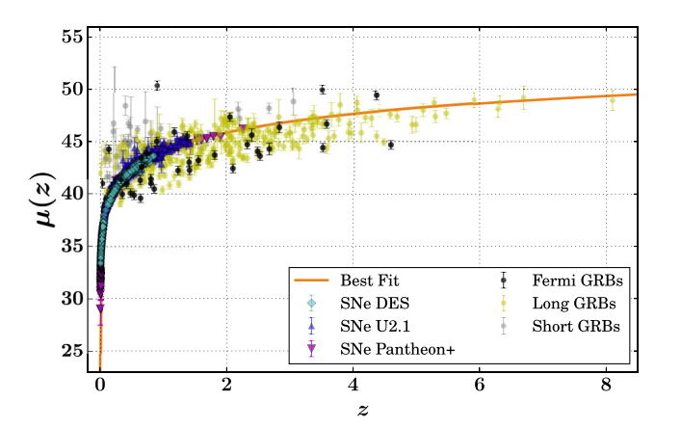
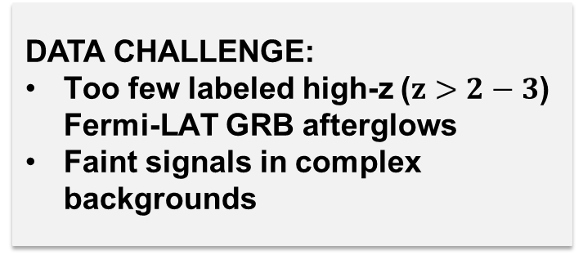
Why searching for high-z GRBs?
SCIENTIFIC OPPORTUNITY:
High-z GRBs probe the early Universe and may constrain cosmological models
DATA CHALLENGE:
Too few labeled high-z ($z>2−3$) Fermi-LAT GRB afterglows
Faint signals in complex backgrounds
ML OPPORTUNITY:
Learning joint spatial, temporal and spectral patterns
T K M Aldowma et al. 2026

Slide 3
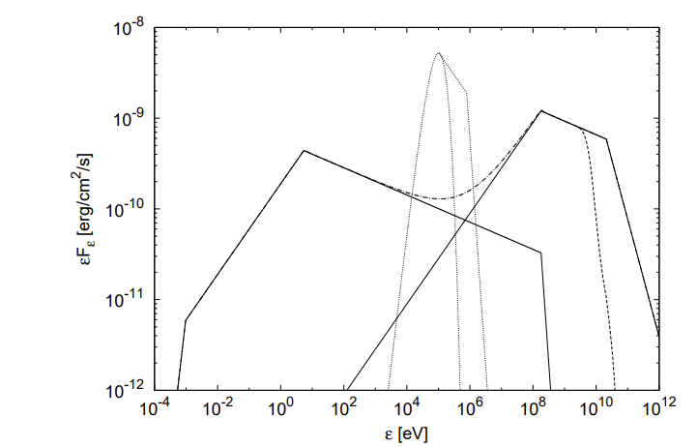
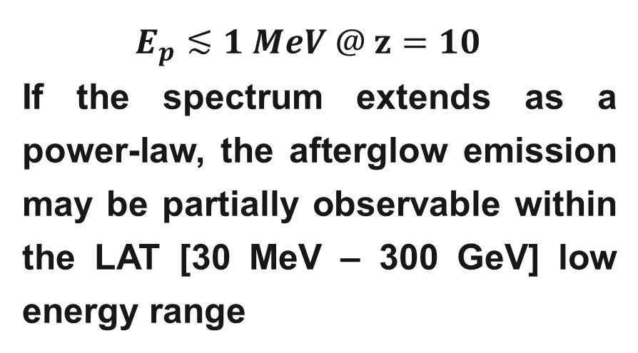
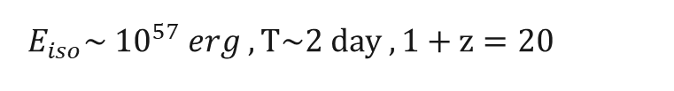
High-z GRB Afterglows Emission
Prompt
Collapsar model:
SSC
Synchrotron
$$E_{p}≲1 MeV @ z=10$$
If the spectrum extends as a power-law, the afterglow emission may be partially observable within the LAT [30 MeV – 300 GeV] low energy range
Toma et al. 2016
$E_{iso}\sim {10}^{57} erg , T\sim 2 day , 1+z=20$

Slide 4
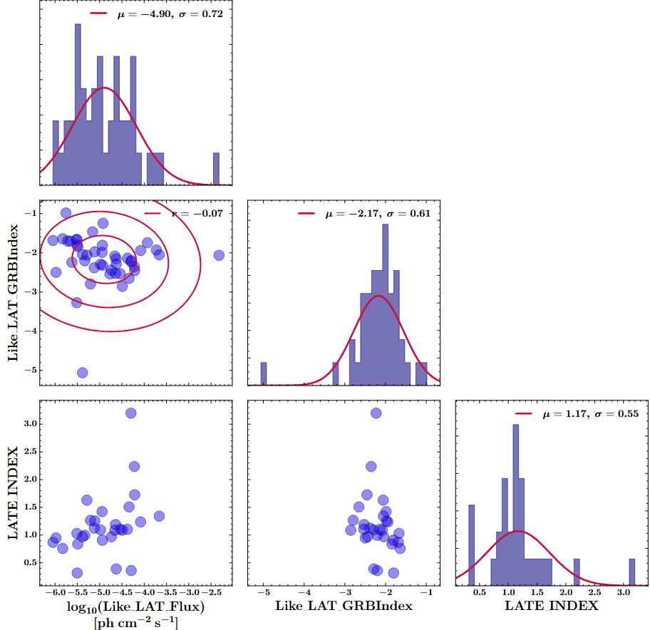
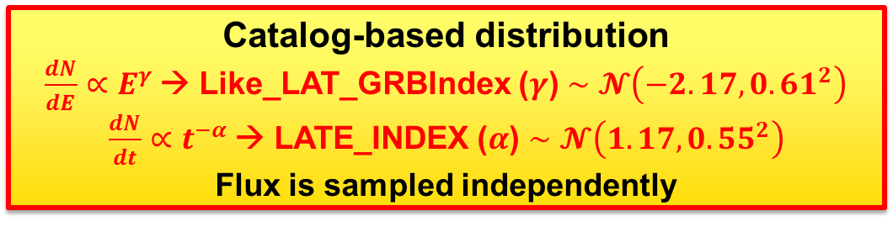
From Observed GRBs to a Synthetic Population
Observed Fermi-LAT GRBs
2nd Fermi-LAT GRBs Catalog
GRBs with known redshift
Catalog-based distribution
$\frac{dN}{dE}∝E^{γ}$→ Like_LAT_GRBIndex ($γ$) $∼𝓝\left(−2.17, 0.61^{2}\right)$
$\frac{dN}{dt}∝t^{−α}$→ LATE_INDEX ($α$) $∼𝓝\left(1.17, 0.55^{2}\right)$
Flux is sampled independently
Synthetic High-z GRB Afterglows (HGA)
Large and diverse sample
Extended low-flux coverage

Slide 5
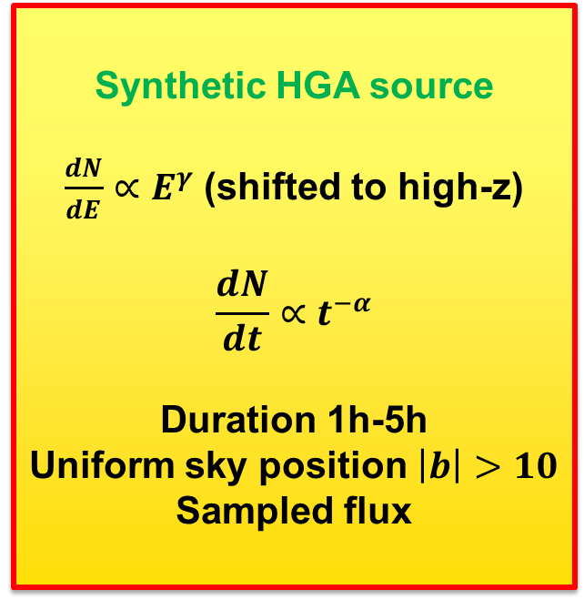
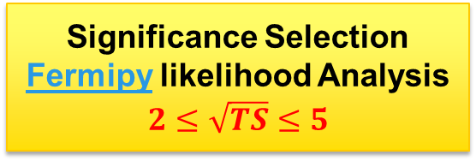
Monte Carlo Simulation of High-z GRB Afterglows
Positive class:
HGA + bkg
Negative class:
Bkg-only
Fermitool for simulating realistic LAT photons
Synthetic HGA source
$\frac{dN}{dE}∝E^{γ}$ (shifted to high-z)
$$\frac{dN}{dt}∝t^{−α}$$
Duration 1h-5h
Uniform sky position $\left|b\right|>10$ Sampled flux
Realistic LAT Background
4FGL-DR1 Catalog sources
Galactic diffuse emission
Isotropic diffuse emission
Gtobssim simulation
P8R3_SOURCE_V3_v1 IRFs
100 MeV – 1 GeV
! Focus on faint afterglows
that are challenging for
standard likelihood searches
Significance Selection
Fermipy likelihood Analysis
$$2≤\sqrt{TS}≤5$$

Slide 6
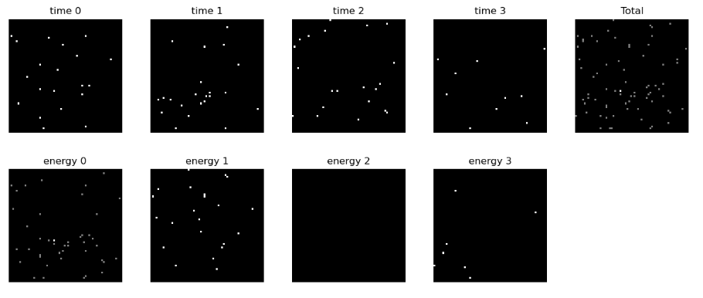
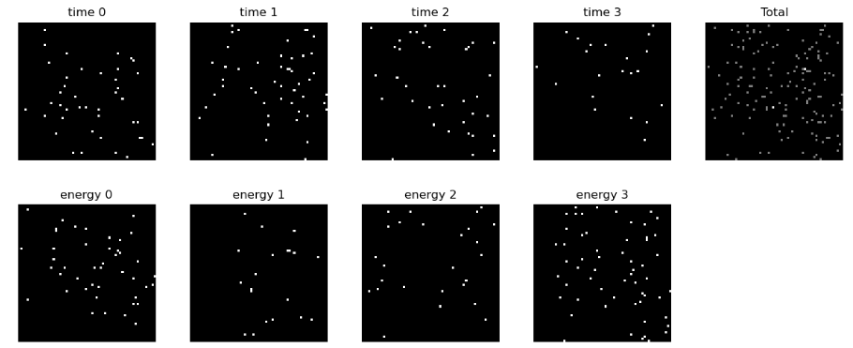
Can You Identify the Afterglow?
Which simulated event contains the HGA?

Slide 7
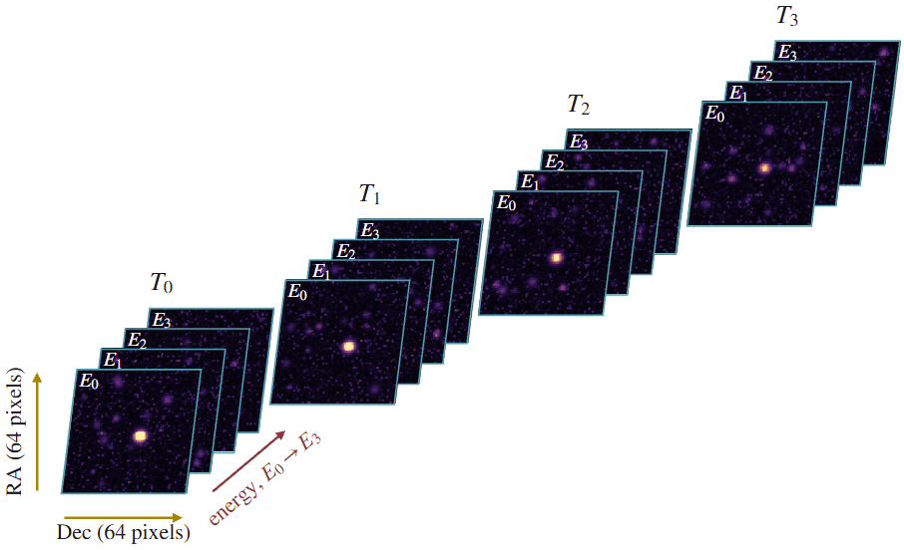
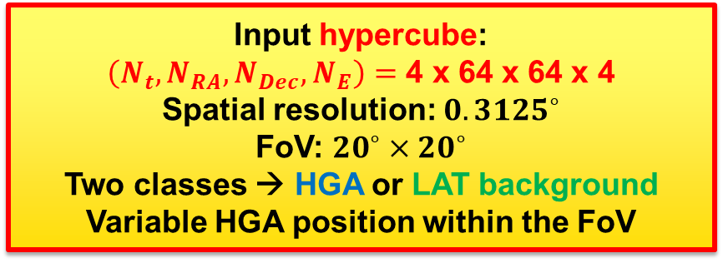
Deep-learning Dataset Construction
Four logarithmic energy bins:
100-178 MeV
178-316 MeV
316-562 MeV
562-1000 MeV
Four logarithmic time bins:
Scaled to each HGA duration
Input hypercube:
$\left(N_{t}, N_{RA}, N_{Dec},N_{E}\right)=$ 4 x 64 x 64 x 4
Spatial resolution: $0.3125^{∘}$
FoV: $20^{∘}×20^{∘}$
Two classes → HGA or LAT background
Variable HGA position within the FoV
TRAINING
408 655
42 874 HGA
365 781 bkg
VALIDATION
102 165
10 718 HGA
91 447 bkg
TEST
127 705
13 398 HGA
127 705 bkg
HGA/bkg = 0.12
Data Augmentation:
↔ FLIPS
↻ 90° ROTATIONS
⇄ ±8 px TRANSLATIONS
[0,1] NORMALIZATION
Augmentation promotes invariance to source position

Slide 8
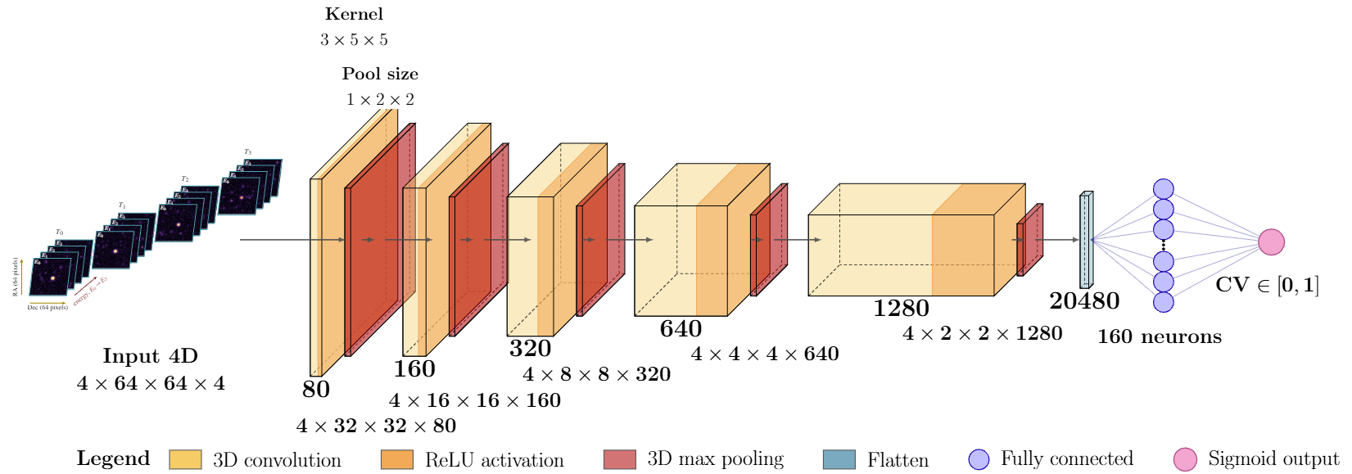
THOR (gamma ray bursT High-z afterglOws Recognizer) Architecture
3D convolutions across time and space
Energy bins treated as input channels
Total params: 84903601 (323.88 MB)
Learning rate: 1.11e-4
Notes:
T

Slide 9
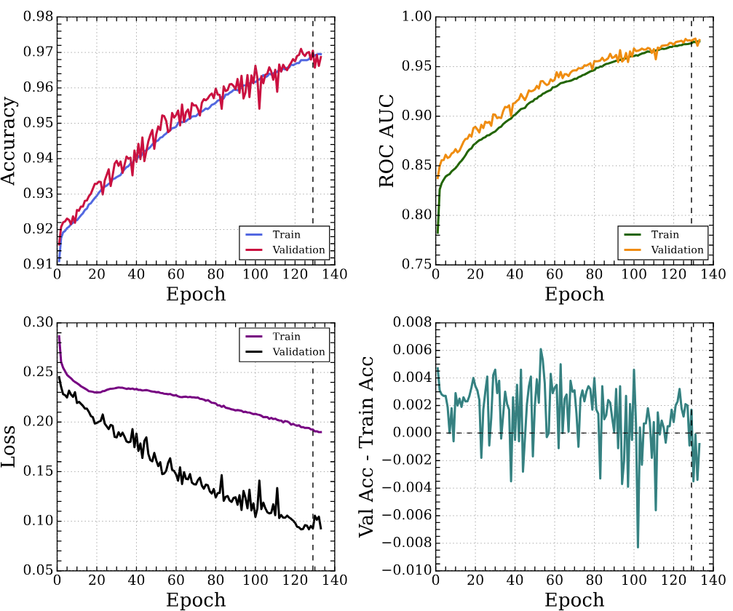
Training and Validation Results
Binary Cross-Entropy loss
Batch size: 128
RMSprop optimizer
Early stopping and overfitting check
TensorFlow MirroredStrategy
4 NVIDIA A100-SXM-64GB GPUs
5 hours training time
PRELIMINARY
Training and validation metrics follow consistent trends, with no sustained evidence of overfitting.

Slide 10
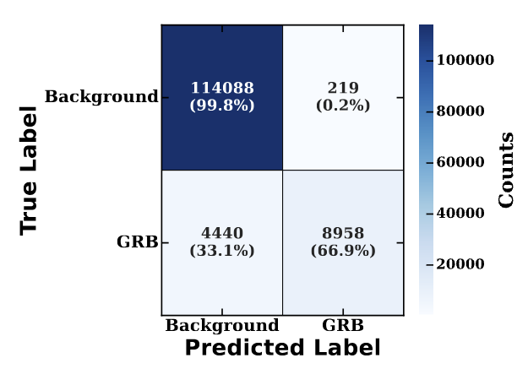
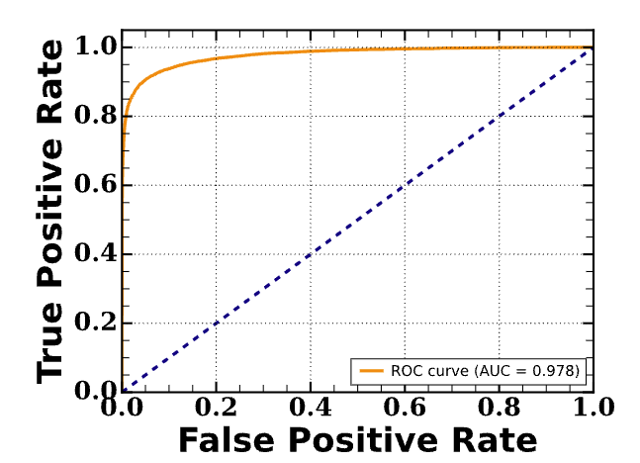
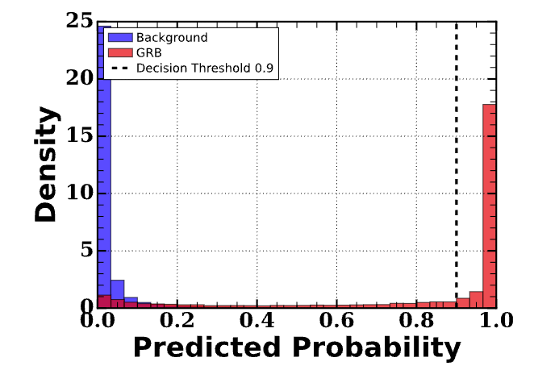

THOR Performance
PRELIMINARY
Threshold 0.9 strongly suppresses false positives while retaining approximately two thirds of the GRB afterglows.
4-fold Cross-validation at threshold 0.9

Slide 11
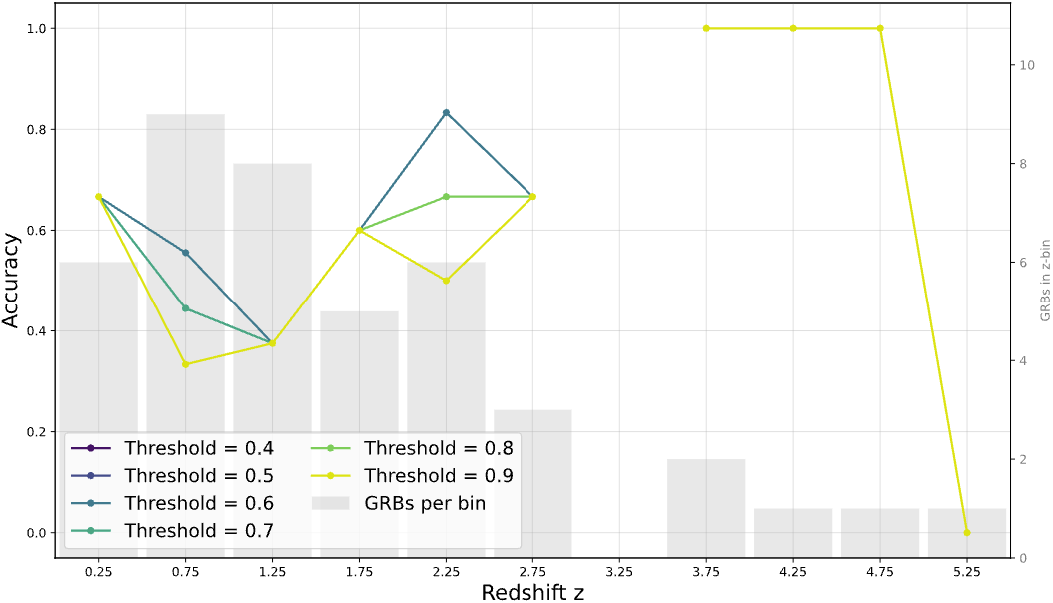
THOR Perfomance on the LAT 2nd GRB Catalog
Create the 4D hypercubes centered in the position of the GRB and with a time interval given by the LAT emission estimated duration.
THOR preferentially recognizes the high-redshift afterglow signatures represented in the simulated training population.
PRELIMINARY
Note: Catalog GRBs are significant LAT detections, whereas THOR training sample focuses on faint simulated afterglows
GRB 250725A

Slide 12
SHAP reveals which input pixels drive THOR’s predictions
The classification results are interpreted using SHAP (SHapley Additive exPlanations), a game theoretic approach that quantifies feature contributions to the model predictions
Reference Input:
Simulated LAT background
SHAP.GradientExplainer:
Compares the model input with the reference input
SHAP values:
Pixel contributions across space, time and energy
Is THOR learning physically meaningful features or simulation artifacts?

Slide 13
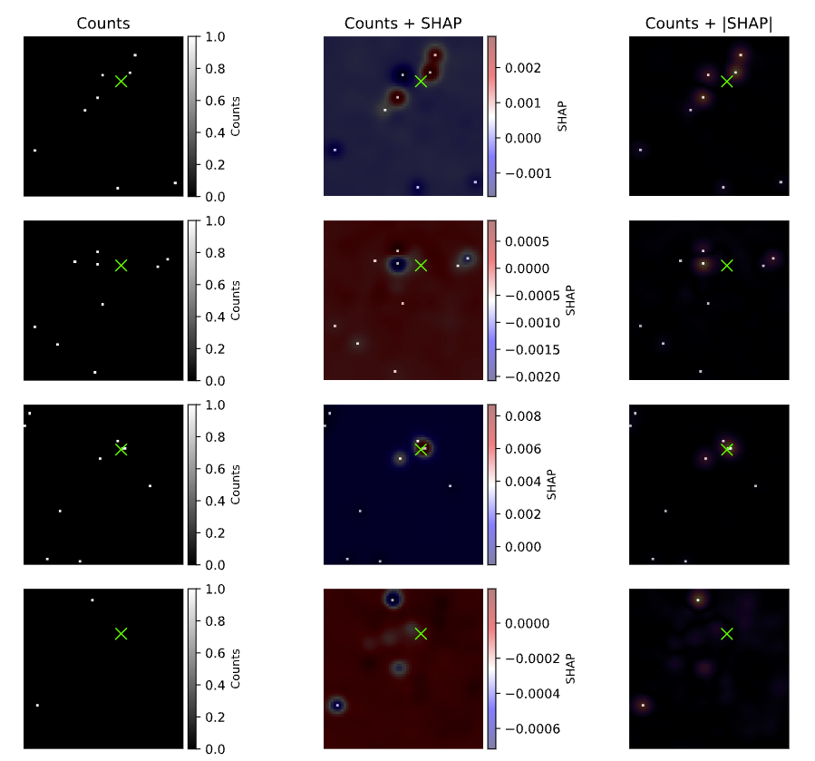
Energy-resolved SHAP Attributions
THOR identifies spatially coherent emission across multiple energy bins
HGA
THOR recognizes an HGA through a spatial consistency in multiple energy bins
Bkg
X : HGA position
SHAP: direction and magnitude of the contribution
|SHAP|: magnitude of the contribution
Increasing energy

Slide 14
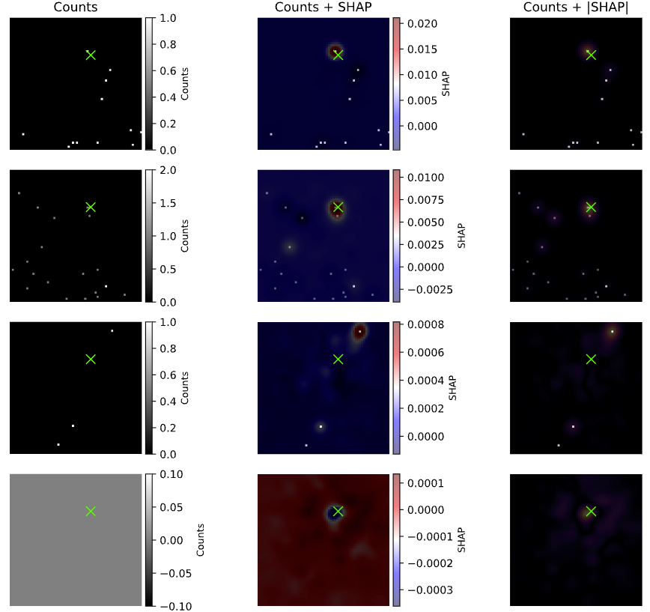
Time-resolved SHAP Attributions
THOR tracks the temporal evolution of spatially localized emission
HGA
THOR recognizes an HGA giving more importance to the photons in the first time bins
Bkg
X : HGA position
SHAP: direction and magnitude of the contribution
|SHAP|: magnitude of the contribution
Increasing time

Slide 15
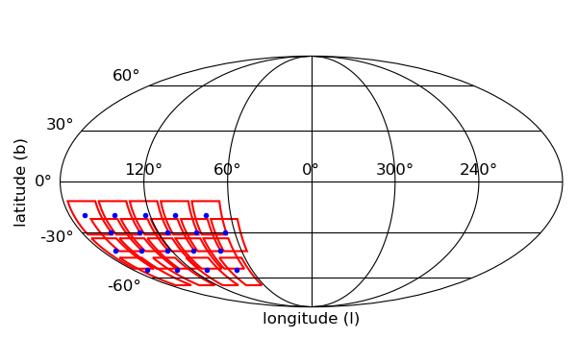
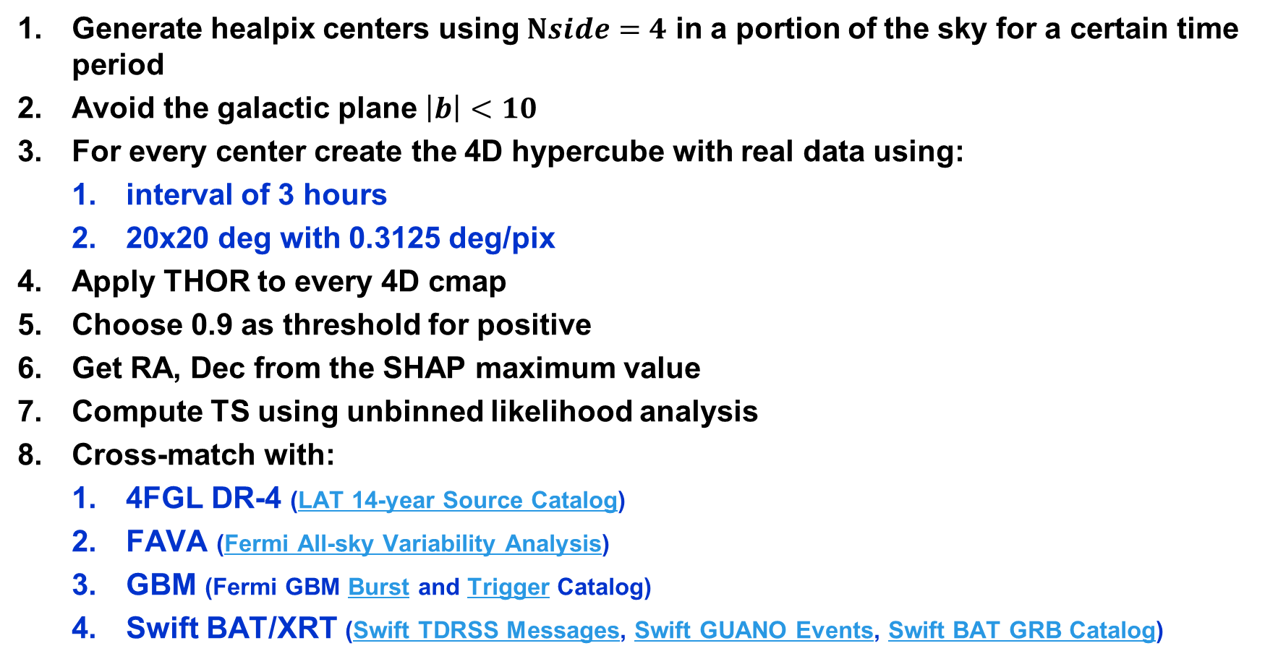
Search Strategy for High-z GRB Candidates
Generate healpix centers using $Nside=4$ in a portion of the sky for a certain time period
Avoid the galactic plane $\left|b\right|<10$
For every center create the 4D hypercube with real data using:
  interval of 3 hours
  20x20 deg with 0.3125 deg/pix
Apply THOR to every 4D cmap
Choose 0.9 as threshold for positive
Get RA, Dec from the SHAP maximum value
Compute TS using unbinned likelihood analysis
Cross-match with:
  4FGL DR-4 (LAT 14-year Source Catalog)
  FAVA (Fermi All-sky Variability Analysis)
  GBM (Fermi GBM Burst and Trigger Catalog)
  Swift BAT/XRT (Swift TDRSS Messages, Swift GUANO Events, Swift BAT GRB Catalog)

Slide 16
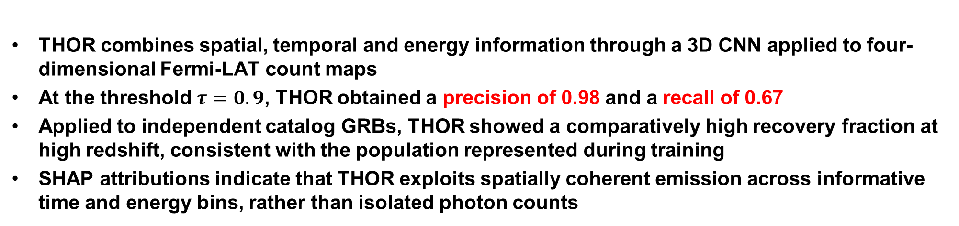
THOR: a new search tool for high-z GRB afterglows
THOR combines spatial, temporal and energy information through a 3D CNN applied to four-dimensional Fermi-LAT count maps
At the threshold $τ=0.9$, THOR obtained a precision of 0.98 and a recall of 0.67
Applied to independent catalog GRBs, THOR showed a comparatively high recovery fraction at high redshift, consistent with the population represented during training
SHAP attributions indicate that THOR exploits spatially coherent emission across informative time and energy bins, rather than isolated photon counts
We have found two promising candidates in 2 months of data!
Next step: extend the search to a larger LAT dataset and investigate the possible origin and nature of the candidates
Beyond gamma-rays:
THOR could be adapted to other wavelengths when realistic observation simulations are available.
Thanks for your attention!

