Slide 1
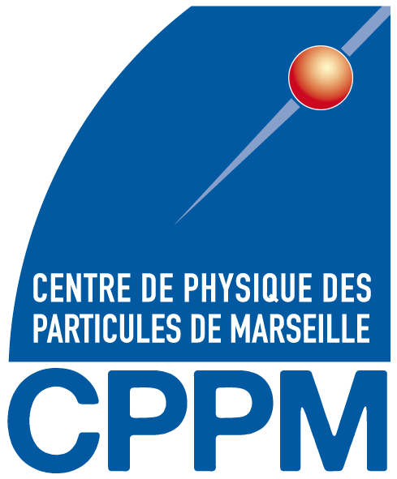



Is Euclid Spectroscopy Science Ready?
Maybe… with some work (AI alert!)
Soorya Narayan
William Gillard, Stephane Ayache, Julien Zoubian
Notes:
Hello everyone,
My name is Soorya Narayan. I will be presenting the work I did in the first half of my PhD.
As you can see in the title, I work with spectroscopic data, but unlike what you see in the title I do not work with Euclid data currently.
My end goal is to prepare something for the Euclid Telescope, especially the NISP instrument.

Slide 2
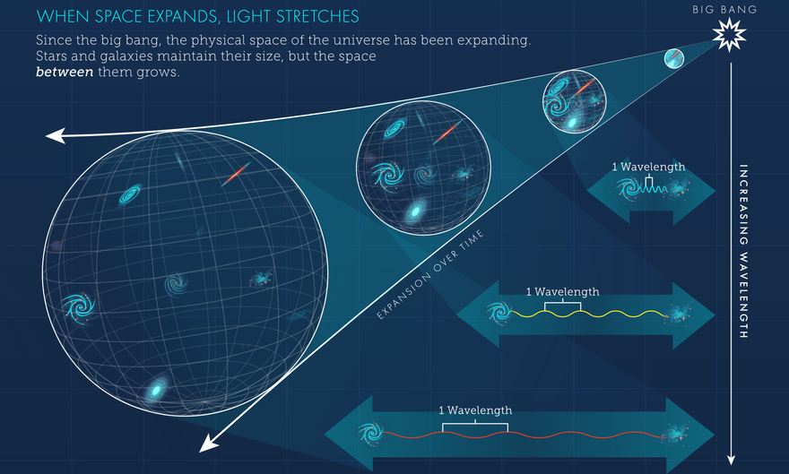
Introduction
Applications of Spectroscopy
Dark matter distribution
Test gravity models
Evolution of the universe
Dark energy EOS and evolution
a
Notes:
Spectroscopy, as we all know, has a wide range of applications ranging from analysing stellar and galactic compositions and dynamics to testings various dark matter models.
Euclid focuses more on the applications shown on the screen. But how exactly does spectroscopy help with these goals?

Slide 3
Introduction
Applications of Spectroscopy
Dark matter distribution
Test gravity models
Evolution of the universe
Dark energy EOS and evolution
a
All of which is possible if we can measure redshift
Notes:
Spectroscopy unlocks the third dimension, by measuring accurate redshifts. Which in turn gives us all the information we need to carry out all the analysis shown on the screen.
Telescopes like the JWST and HST have provided us with some spectra but to have accurate measurements we need more data.

Slide 4
Introduction
Applications of Spectroscopy
Dark matter distribution
Test gravity models
Evolution of the universe
Dark energy EOS and evolution
a
All of which is possible if we can measure redshift
Accurate redshift measurement requires statistics
Notes:
That is where the stage 4 and stage 5 spectroscopic surveys come into play. Euclid and DESI are stage 4 surveys producing around 30-50million samples, while stage 5 surveys like CSST, MUST and Spec-s5 are projected to produce in the hundreds of millions.
With so much data coming our way, we need to be prepared to analyse such large volumes of data. Since we are not used such volumes of data, our traditional analysis techniques are far too slow for the incoming volume. An obvious solution would be to use machine learning.

Slide 5
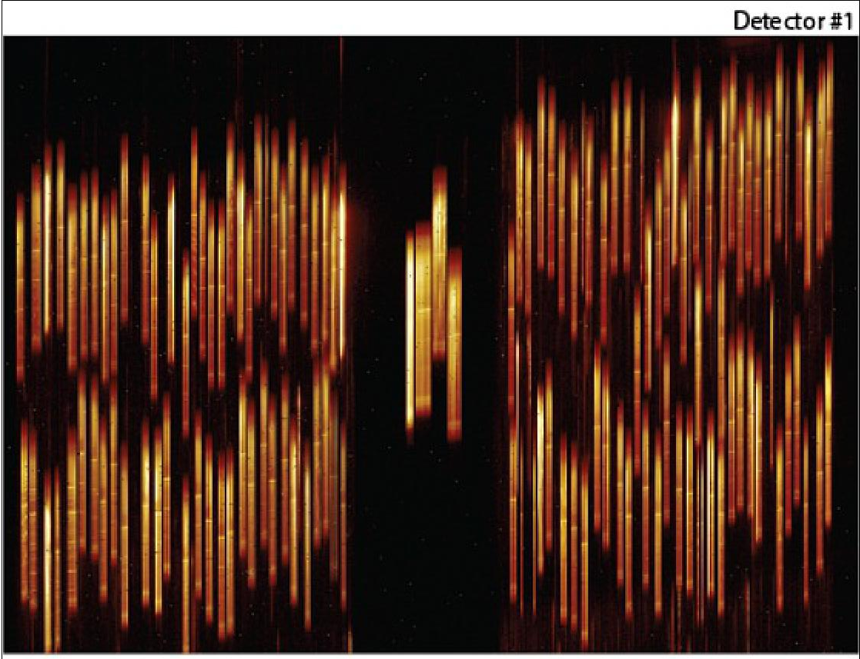
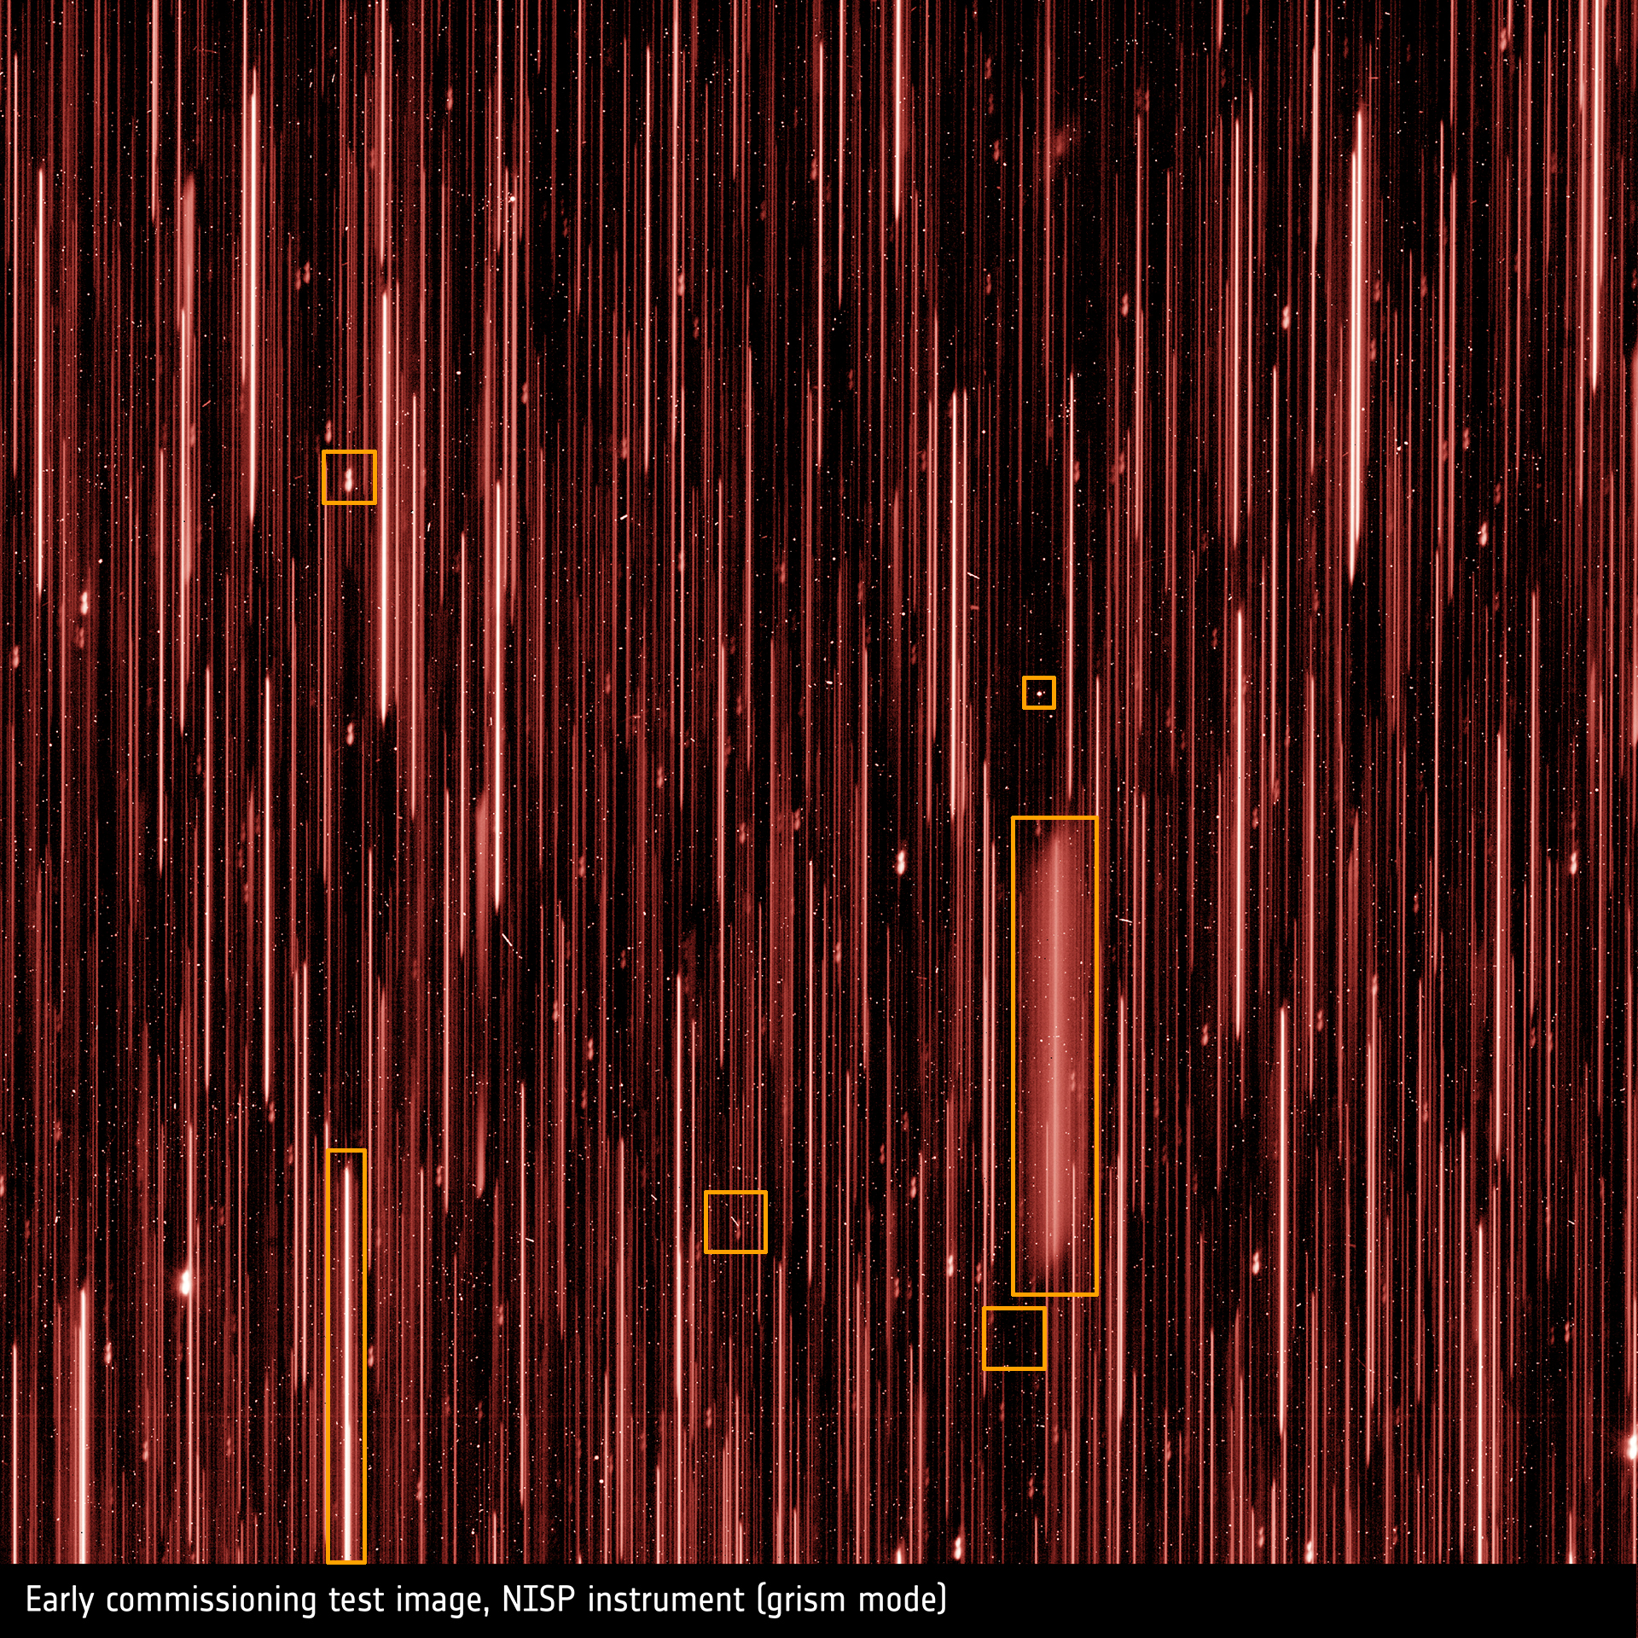
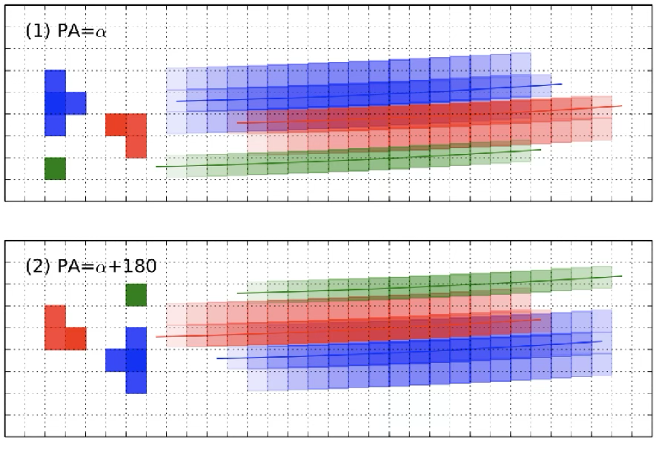
So, what’s the catch?
JWST NIRSpec
Slit Spectroscopy
Euclid NISP
Slitless Spectroscopy
Slitless spectroscopy
  Exponentially increases data acquisition rates
  Rate of contamination increases
Cross contamination and self contamination
Traditional methods take time
Problem Statement
How do we decontaminate Euclid spectrograms and extract 1D spectra? How to we make it fast enough to be feasible for millions of spectrograms? Can we also make a blue print that future surveys can follow for their pipeline?
Notes:
But where exactly is this increase in volume coming from? How are these surveys able to do so much better than the previous ones? Well, different telescopes do it differently, but in the case of Euclid, spectroscopy is performed without a slit. This is called slitless spectroscopy, where all the objects in the field of view of the telescope are dispersed at once.
As you can see in figure, the Euclid image contains many more spectra than the JWST image. But there is a major downside to slitless spectroscopy, which is the contamination of data.
As you can see in the bottom figure, if objects are close by in the field, then their spectra could easily leech into each others'. So while we have a dramatic increase in data volume, we also have a data quality hurdle t overcome.
This brings us to our problem statement - How do we decontaminate Euclid spectrograms and extract 1D spectra? How to we make it fast enough to be feasible for millions of spectrograms? Can we also make a blue print that future surveys can follow for their analysis pipeline?

Slide 6
Problem SOLVED! (maybe)
What we have
  Clean slit spectroscopy data
  Intellect (hopefully)
What we actually have
  JWST data
  Machine Learning
Stage 1
Euclidise
spectrograms
Stage 2
Euclidise
spectrograms
Stage 3
Clean 2D Spectrogram
Spectrogram 2
Spectrogram 1
NISP Data
Cross/Self-Contamination
Model B
Model A
Spectrogram 1
Spectrogram 2
Model B
Model A
Model A
1D Spectra
Spectrogram 2
Spectrogram 1
Spectra 1
Spectra 2
Notes:
Yes, yes we can, maybe. I’m not sure actually, but I have an idea. So what do we have? We have some data from JWST and HST. We also have machine learning.
I propose a solution that can be broken down into 3 stages. In stage 1, we train a model than can produce the 1D spectra, which is what all the scientists need, given a relatively clean 2D spectrogram.
In stage 2, we emulate the contamination seen in Euclid by blending together clean spectrograms from JWST, and teaching a model to undo said blending.
At this points, everything still have some lingering effects from the source, which is JWST, so in stage 3, we will further Euclidise the data and test is on samples we have already processed.

Slide 7
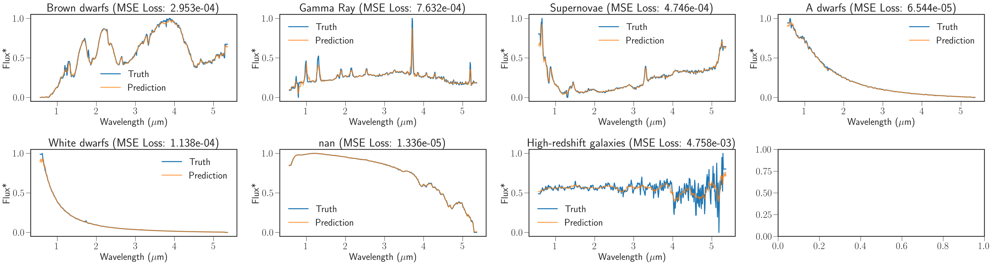
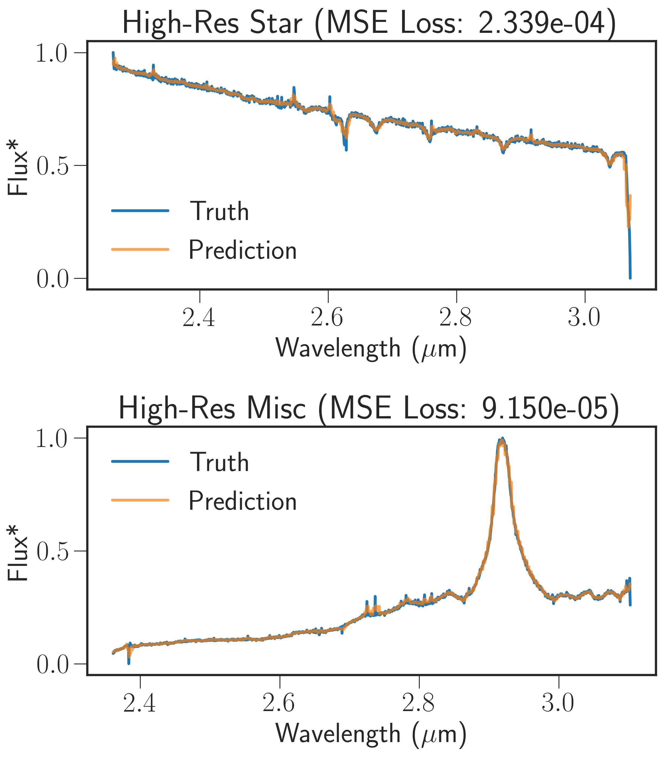
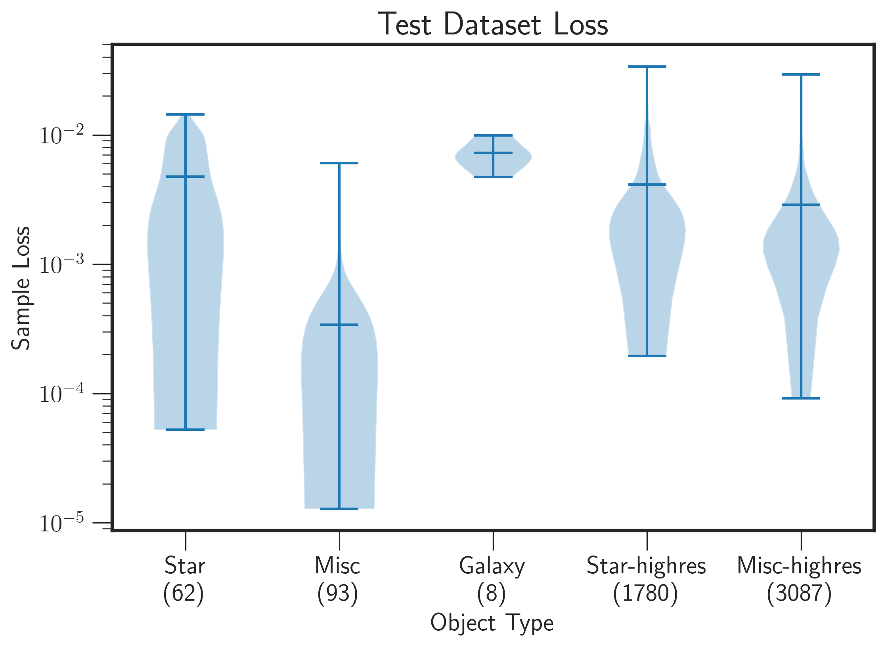
Stage 1 Results
Scan
For
More
Info
Object Distribution in Datasets
 | Stars | Galaxies | Misc
Train | 713 | 97 | 1059
Val | 64 | 10 | 94
Test | 62 | 8 | 93
Notes:
I would like to show you results from all three stages, but sadly I am not Anthropic’s Claude, so here I have the results from stage 1. We have a model that can estimate the 1D spectra from the relatively clean JWST 2D spectrograms.
We also find that,
The model performance is dependent on the training dataset composition. Miscellaneous objects have significantly lower loss values because they dominate the training set. Galaxies have much higher loss for the same reason
The model is very robust to changes in resolution and wavelength range as indicated by the high-res samples (red boxes) having loss values comparable to the test set
The ones in the red box are deep spectroscopic samples. This is a huge deal, because the network was trained on only low resolution spectra.

Slide 8
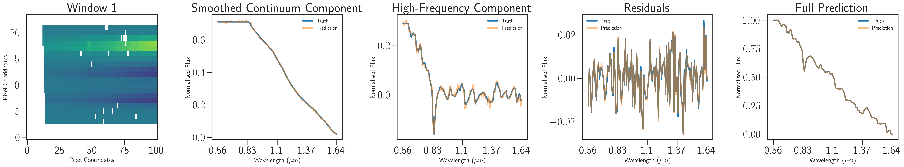
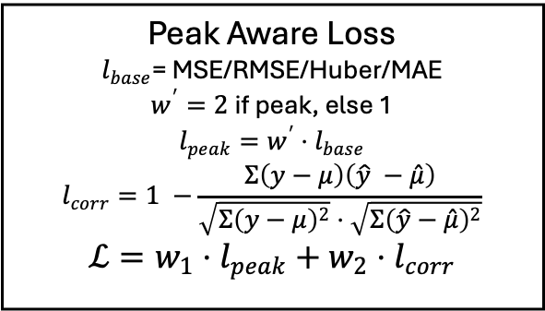


Training Strategy
Scan
For
More
Info
Smooth Loss
Res Loss
Full Loss
2D CBAM-Inception-1D CNN
$$Σ$$
Continuum
High-Freq
$$Σ$$
Continuum
High-Freq
Residual
2D-1DCNN
2D CBAM-Inception-Residual-1D CNN
HF Loss
Peak Aware Loss
$l_{base}$= MSE/RMSE/Huber/MAE
$w^{′}=2$if peak, else 1
$$l_{peak}={w^{′}⋅l}_{base}$$
$$l_{corr}=1 −\frac{Σ\left(y−μ\right)\left(\hat{y} −\hat{μ}\right)}{\sqrt{Σ{\left(y−μ\right)}^{2}}⋅\sqrt{Σ{\left(\hat{y}−\hat{μ}\right)}^{2}}}$$
$$ℒ=w_{1}⋅l_{peak}+w_{2}⋅l_{corr}$$
Model has 3 branches and 2.3M trainable parameters.
Res Loss is a simple MSE and HF Loss a MAE.
Smooth (Huber) and Full (MSE) Losses are Peak Aware Loss
Notes:
So what model did we use? We used a custom 2D to 1D CNN with three branches – each predicting a different part of the spectra. One branch predicts the smooth continuum, one the high frequency residual after removing the continuum, and a third branch that takes in the predictions from the other two branches and predicts the required corrections on the sum of the the other two branches. We also use a custom loss function that weighs peaks and dips more than continuum points while also checking for correlation between the true and predicted values.

Slide 9
Conclusion
Scan
For
More
Info
Stage 1 is complete
  The model works. Model has 2.3M params with 3 branches
  Model performance depends on the training dataset composition
  Model is robust to changes in resolution and measured wavelength
  We are also able to interpret the workings of the CNN (result not shown in this presentation; come find me if you would like to discuss)
Stage 2 is in the works
Personally, data prep for stage 1 is more interesting, but TIME CRUNCH!
Contact info
Name: Soorya Narayan
Lab: Centre de Physique des Particules de Marseille
PIs: William Gillard, Stephane Ayache, Julien Zoubian
Email: soorya_narayan@cppm.in2p3.fr
Notes:
There is a lot more details that I would’ve loved to go into, but because of the time crunch I will leave it at that. Feel free to scan the QR code for more info, or you can come find me around the conference if you’d like a chat.
Thank you for your time.

