Slide 1


A Benchmark of Convolutional Neural Networks and Vision Transformers for Galaxy Morphology Classification
Liam Azzopardi
Supervisor: Dr. Andrea DeMarco
Co-Supervisor : Dr. Dylan Seychell

Slide 2
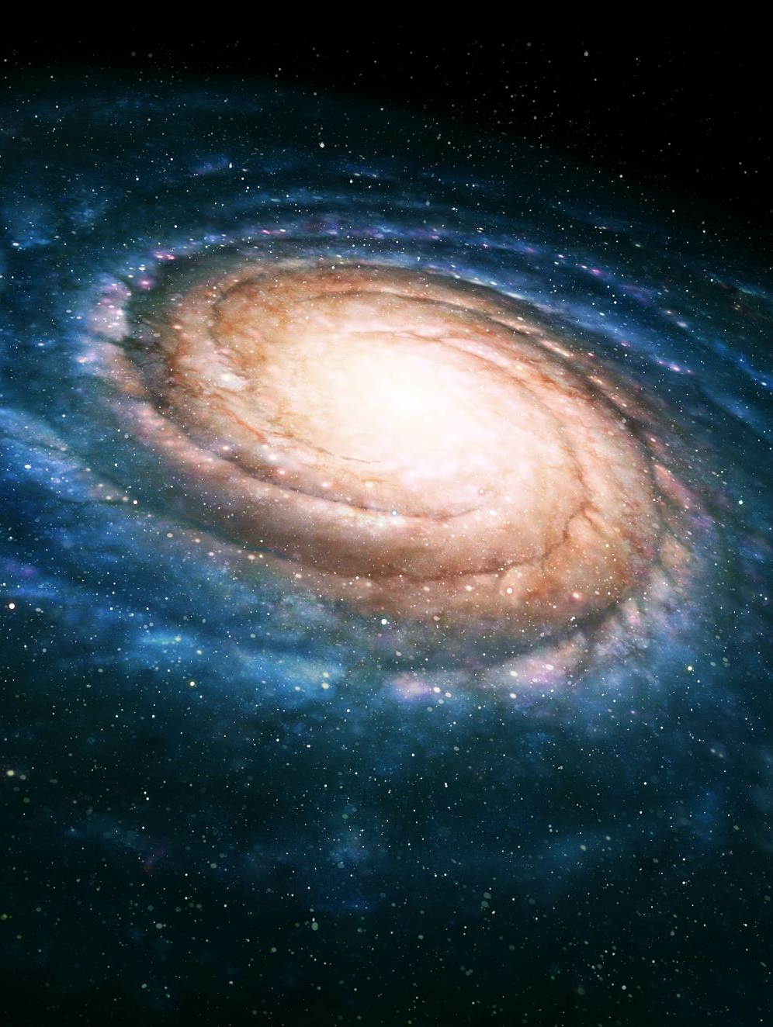
Motivation & Aim
Motivation: Galaxy morphology reveals formation history and star formation, but human classification cannot scale to LSST (~20B galaxies [1]) and is inherently subjective; deep learning can automate this.
Aim: compare Convolutional Neural Networks (CNNs) and Vision Transformers (ViTs) for automated galaxy morphology classification, evaluating how well models pre-trained on natural images can transfer to astronomical data.

Slide 3
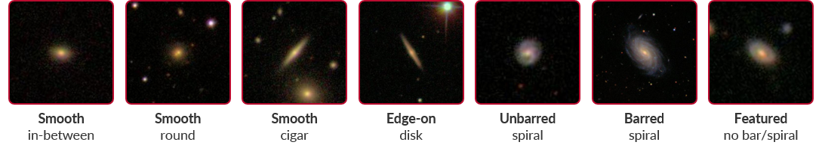
Methodology
Curated Galaxy Zoo 2 [2]; 7 morphological classes, severely imbalanced (~40% down to ~2%).
A hierarchal framework pipeline [3], to handle the imbalance.
Fair comparison in two stages; linear probing (frozen-backbone baselines + model selection), then full fine-tuning of the selected models.
Two follow-up experiments to interrogate the result: a re-run with a new data split (new fold train/test/validation), and an agreement-threshold filtering ablation.
Notes:
Model selection for the next stage - the full-finetuning stage

Slide 4
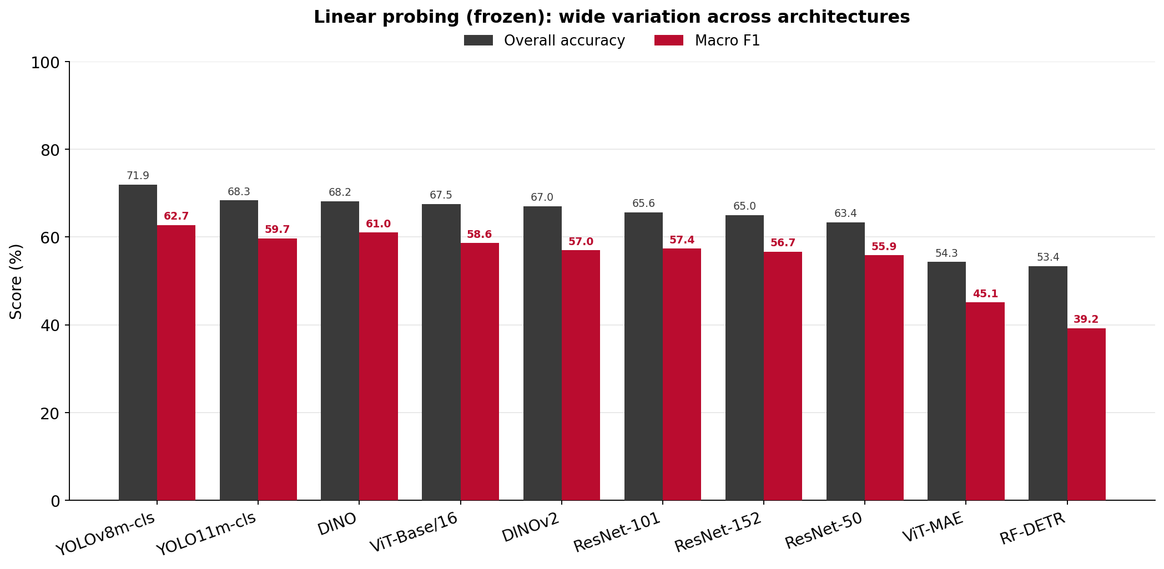
Notes:
5 CNN architectures
5 ViT architectures
Models at this stage are evaluated based on their pre-trained frozen representations from natural images, the models at this stage, do not know what a galaxy is.
the best-performing models are selected for full retraining, plus a few kept for architectural diversity despite weaker baselines.

Slide 5
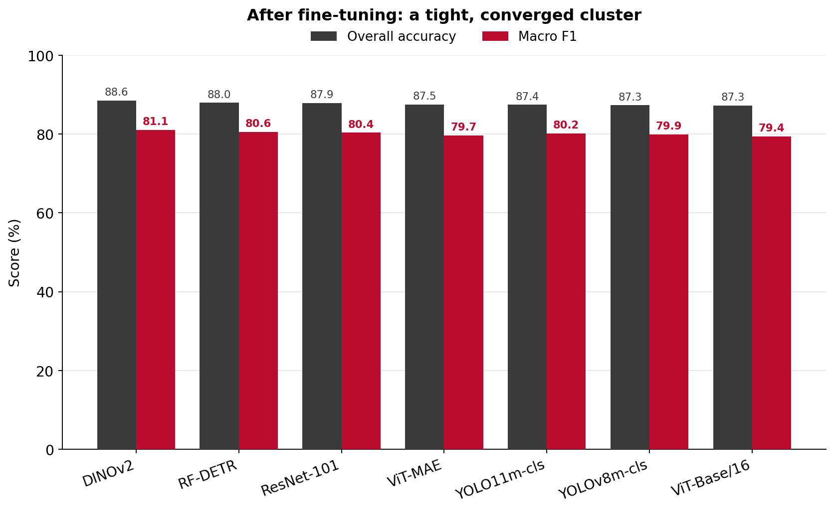

Slide 6
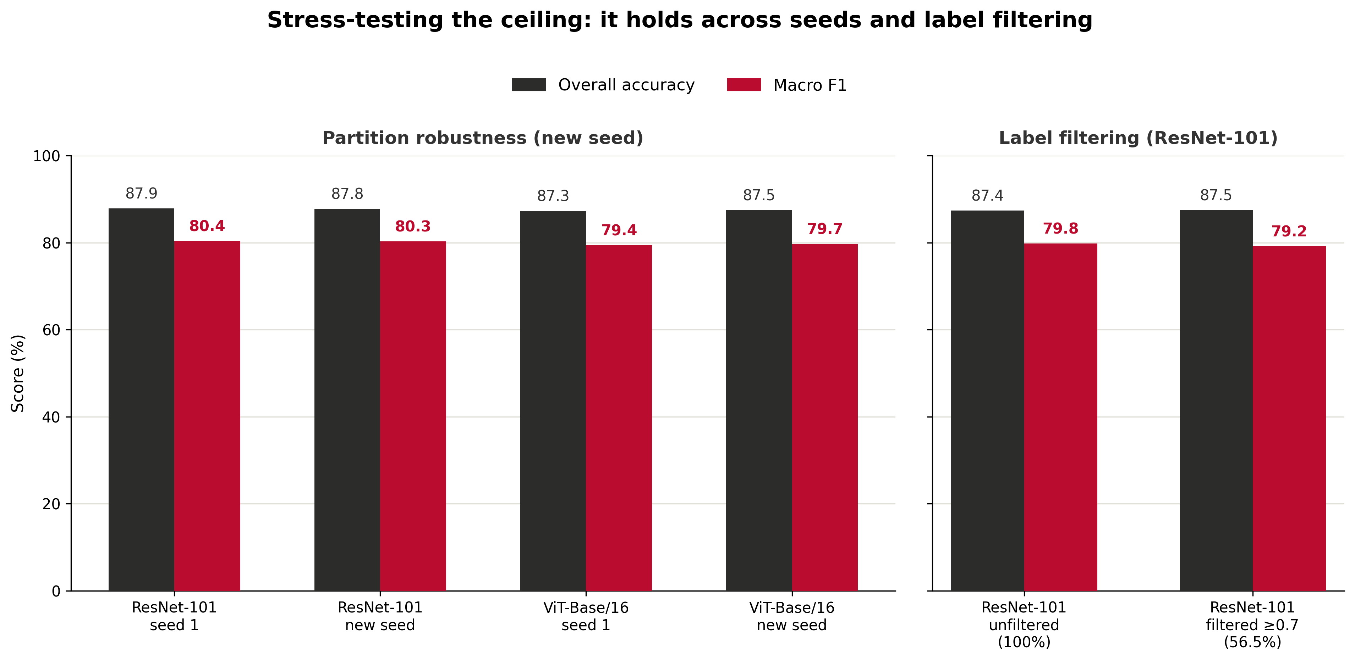
Notes:
Two stress tests, one question: is the 87-88% / ~80% ceiling real, or an artefact of a particular data split, config, or label noise?
Data Partition Robustness: ResNet-101 & ViT-Base/16 stayed in the tight overall accuracy and Macro F1 band, so the ceiling isn’t tied to a particular data split.
Agreement filtering (ResNet-101, t = 0.7): training was filtered to only galaxies with at least 70% agreement from the crowdsourced galaxy zoo 2 dataset, removing the ambiguous ones.
slightly better accuracy 87.38% → 87.55%, but Macro F1 fell 79.83% → 79.25%.
Why filtering backfires: filtering strips ambiguous galaxies from training, but the test set keeps them all; so the model is under-trained on exactly what it's tested on.

Slide 7
Conclusion
CNN and ViT performance comparable after full fine-tuning.
ResNet101 → comparable efficient option when compared to RF-DETR and DINOv2.
The ceiling is consistent, one class (featured no bar/spiral) could be driving this accuracy and Macro F1 ceiling.
Stress-tests: indicates the ceiling is a dataset property, suggesting genuine visual ambiguity, not the architecture, the data split, or noise you can filter away.

Slide 8
References
[1] Ž. Ivezić et al., "LSST: From Science Drivers to Reference Design and Anticipated Data Products," The Astrophysical Journal, vol. 873, no. 2, 2019.
[2] M. Walmsley, "Galaxy-datasets: ML-friendly datasets of galaxy images and labels," GitHub, 2023.
[3] X. Ma, X. Li, A. Luo, J. Zhang, and H. Li, "Galaxy image classification using hierarchical data learning with weighted sampling and label smoothing," MNRAS, vol. 519, no. 3, 2023

Slide 9
Thank you for your time and attention!

