Slide 1

Decoding Saturn’s Moons: A Spectral Signature Approach
Ramapriya Ramamoorthy

Slide 2
Driving Question
Can classification accuracy of an ML model be used to distinguish between celestial bodies, i.e., as a similarity metric?

Slide 3
Data & Methodology
Data | Hyperspectral cubes (.qub format) from Cassini VIMS
Source | NASA OPUS tool via PDS
ML Model Used | Support Vector Machine (SVM)
Input Format | Flattened 2D arrays in pandas dataframe
Moons studied: Titan, Enceladus, Rhea
Raw data in spectral cubes: 6 × 352 × 4 dimensions, 352 spectral channels
Flattened cubes to 2D arrays (24 × 352) & removed NaN values
Pairwise comparison – stored data per pair
Applied binary SVM classifier to each pair and compared results

Slide 4
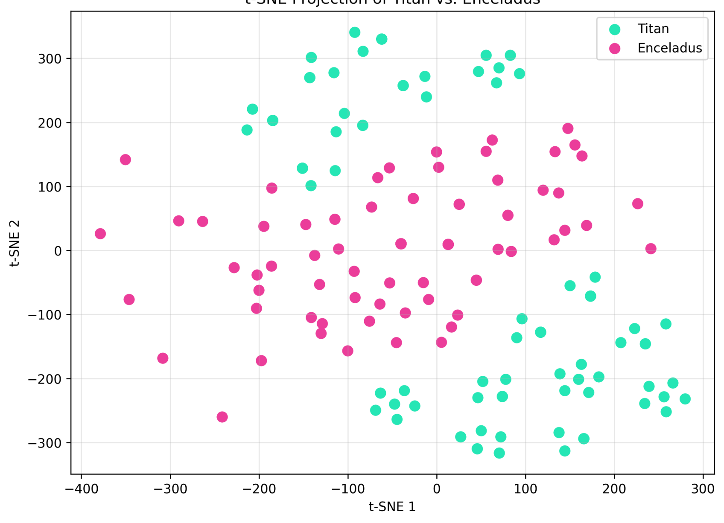
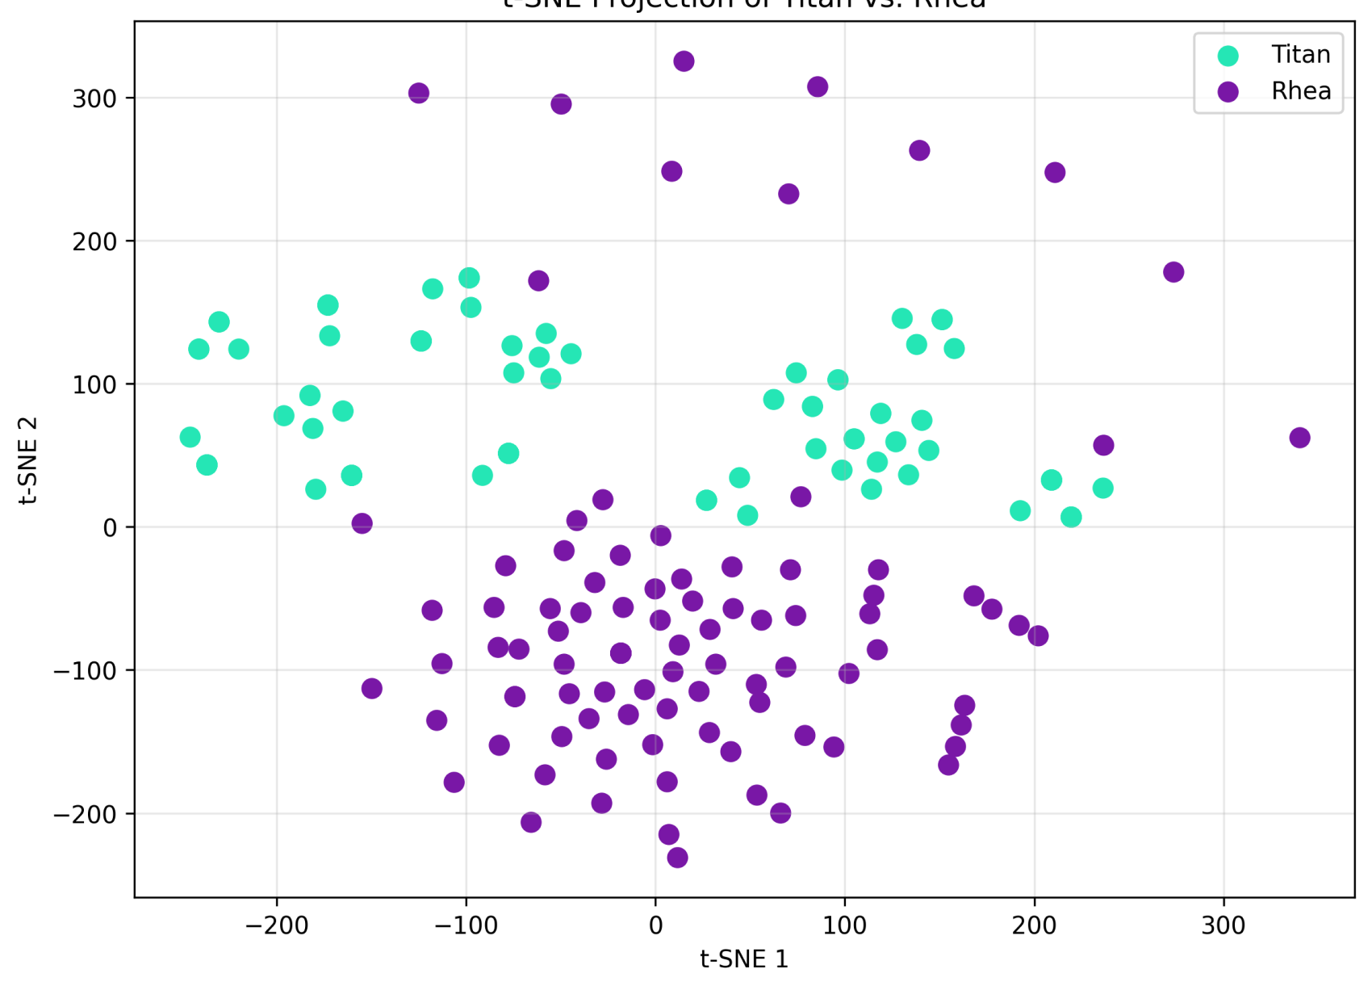
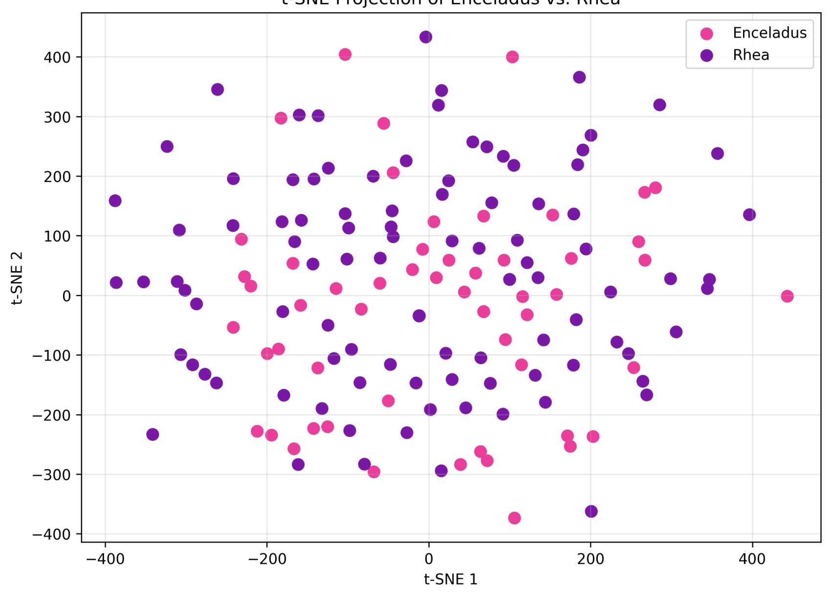
Results
96.9% accuracy — highly distinct
Titan vs. Enceladus
81.6% accuracy — moderately distinct
Titan vs. Rhea
69.4% accuracy — surprisingly similar
Enceladus vs. Rhea ☆
Yes, classification accuracy can be used as a spectral similarity metric.
Key finding: the least similarity between Rhea and Enceladus despite considerable differences in surface activity and composition.

Slide 5
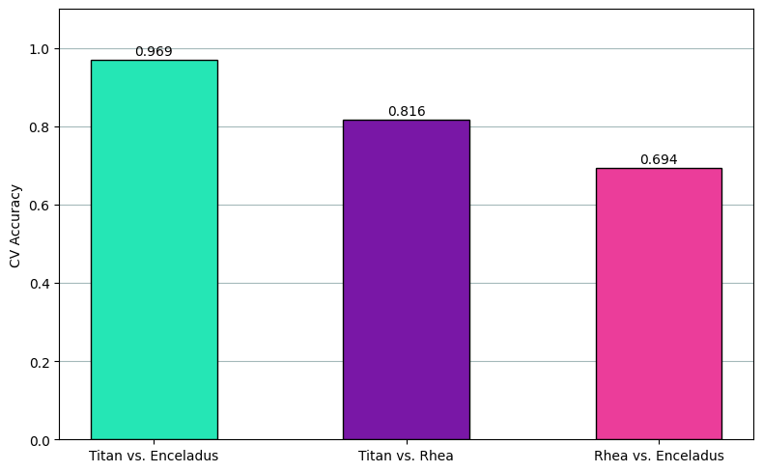
Rhea and Enceladus are not similar – or are they?
Similarity in composition (water-ice-based)
Proximity to Saturn
Surface mineral deposits from Saturn’s rings (micrometeorites)

Slide 6

Thank you!
Open to questions now.

